Slide 1
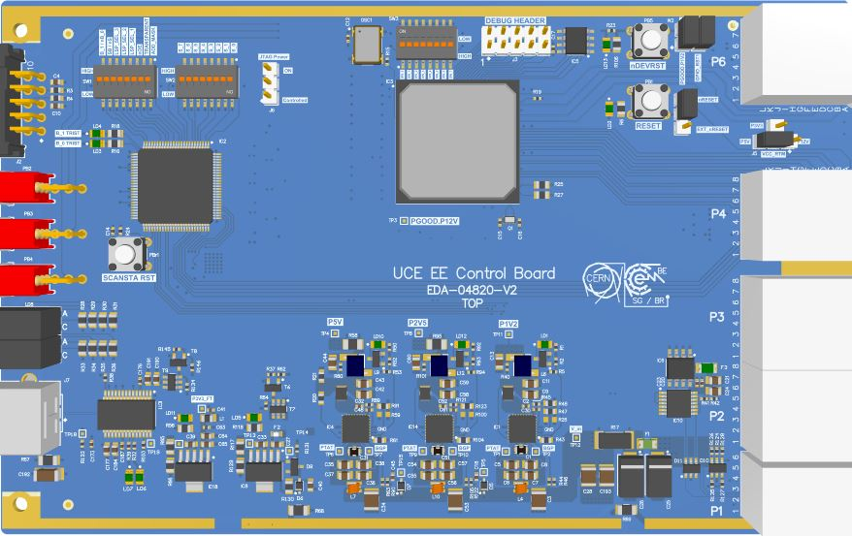
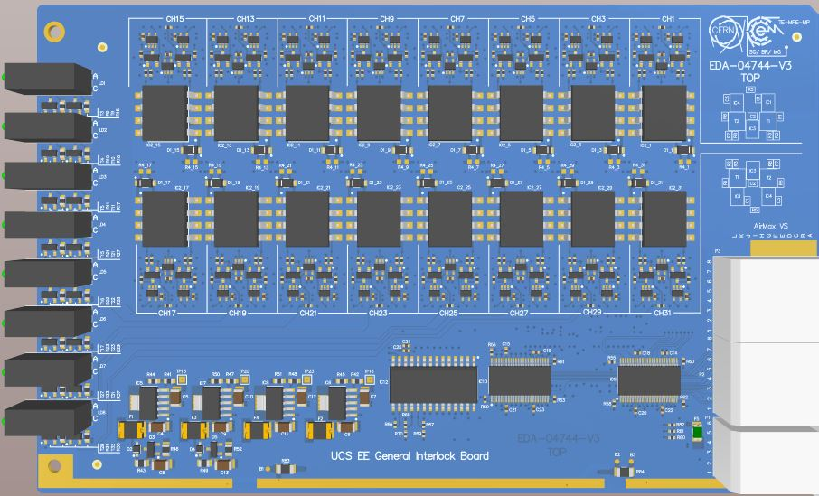
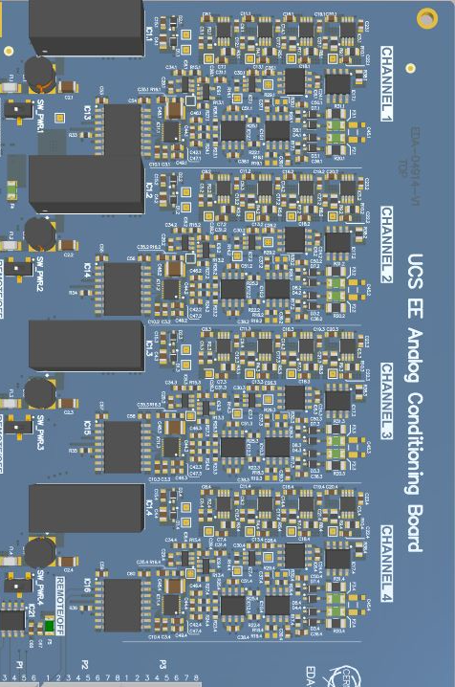

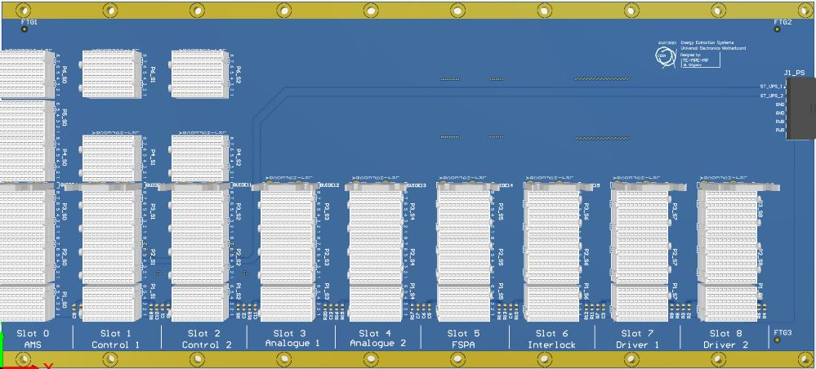
UCE3
Presented by Martin Grigorov
TE-MPE-MP

Slide 2

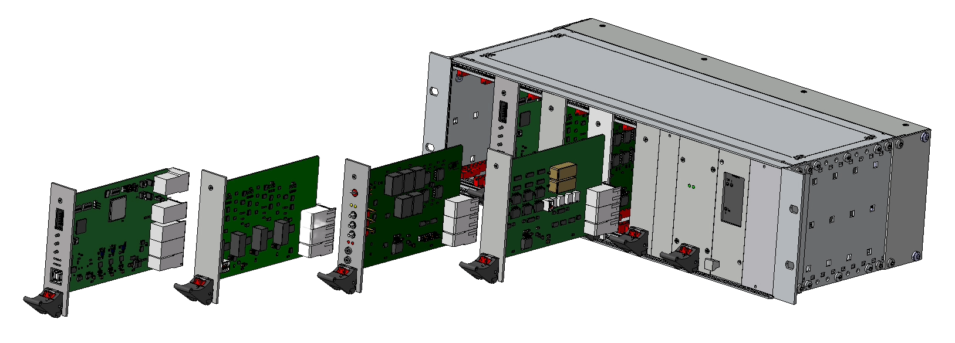

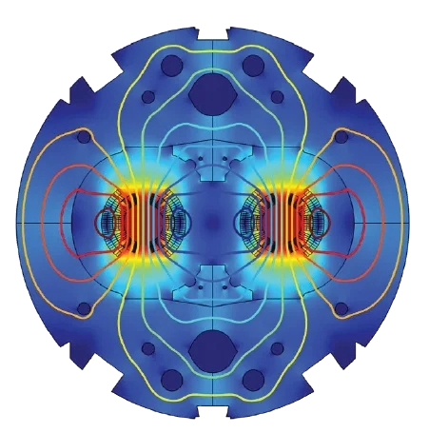

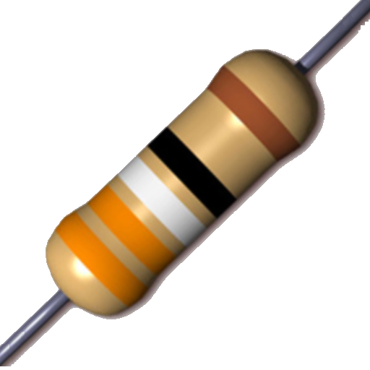

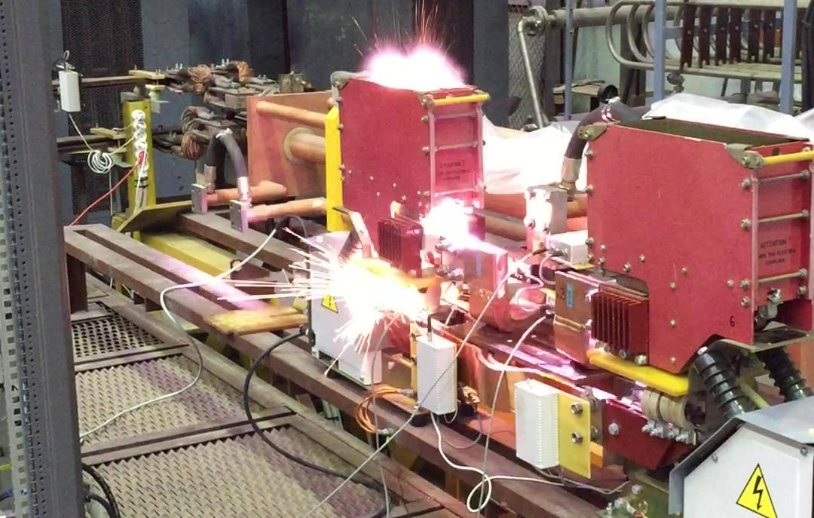
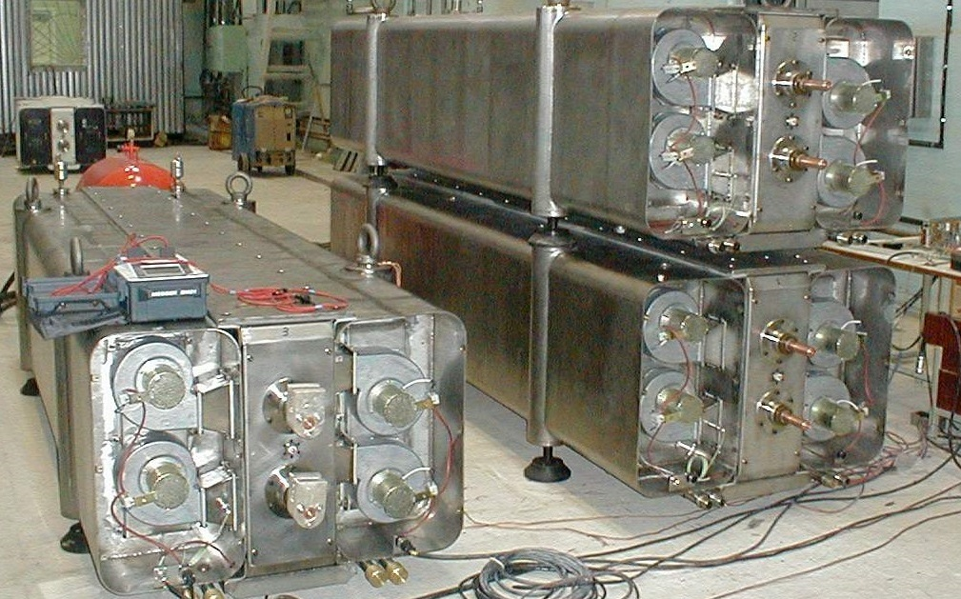
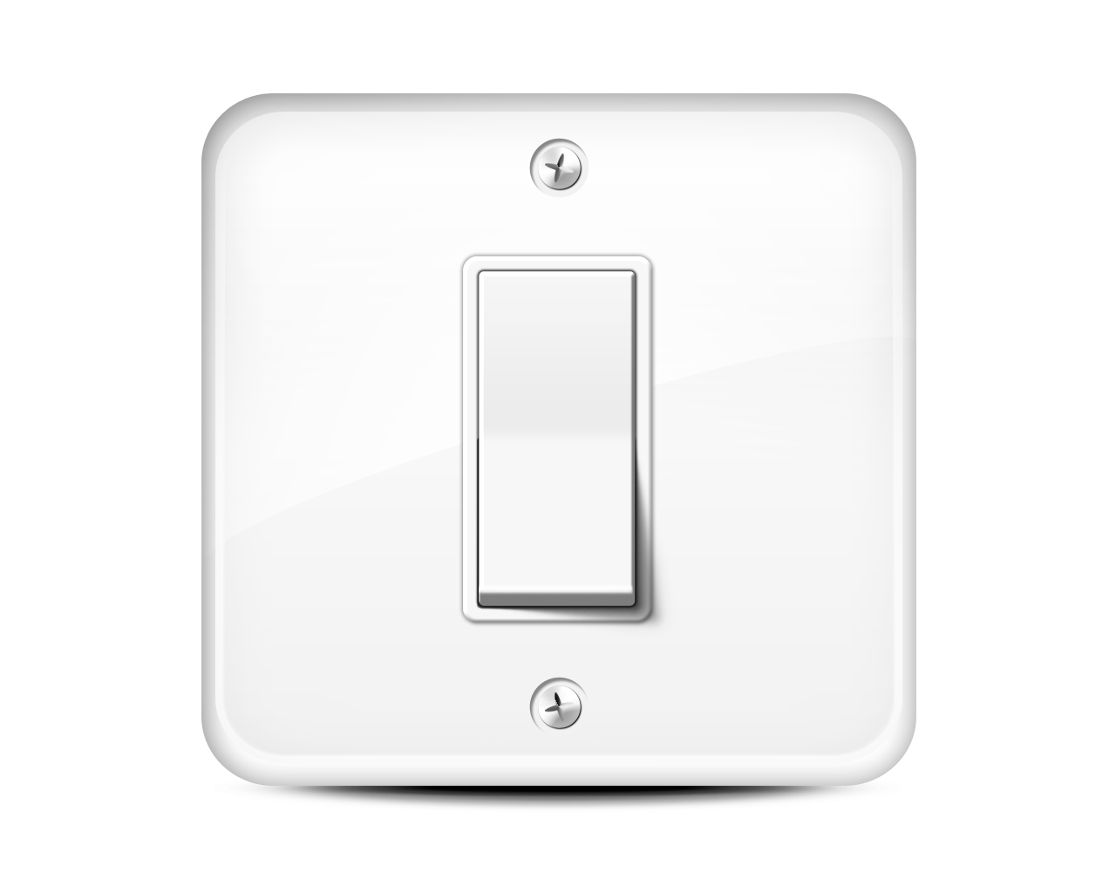
Energy Extraction Basics
Superconducting magnet circuits store energy in their magnetic field
Energy extraction system extracts the energy to dump resistors to protect the magnets
Electronics control the whole energy extraction process

Slide 3
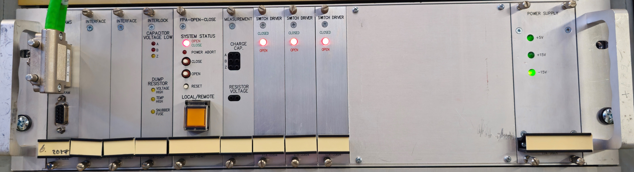
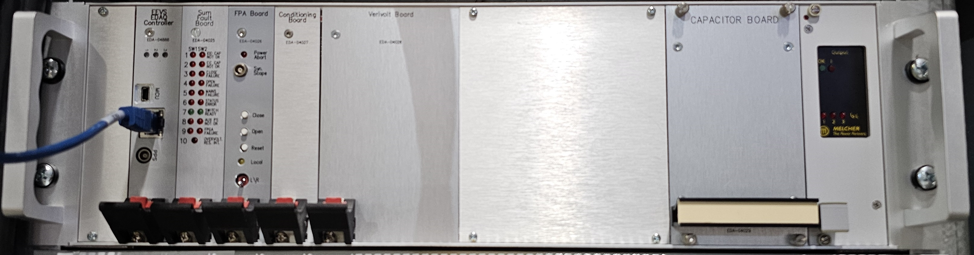

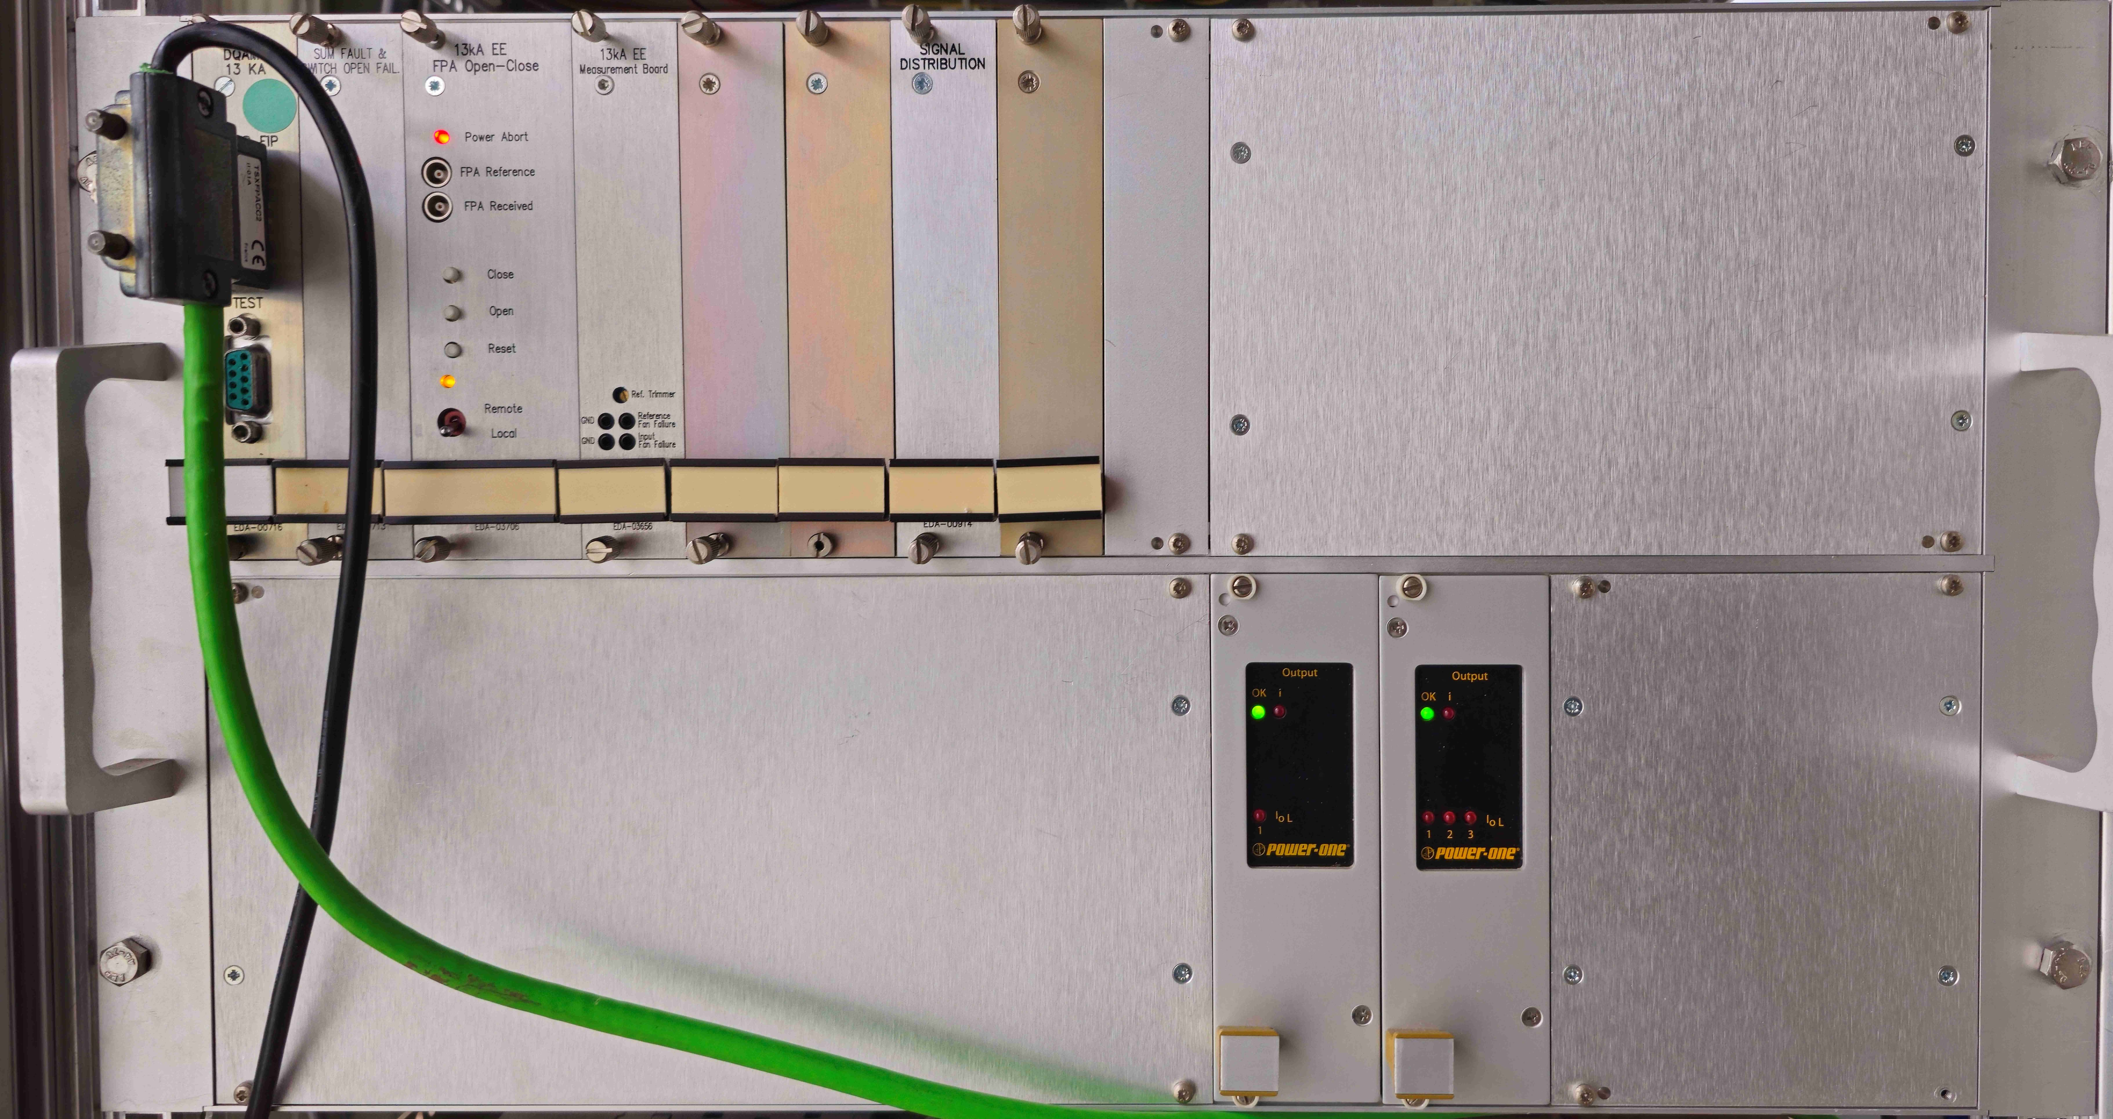
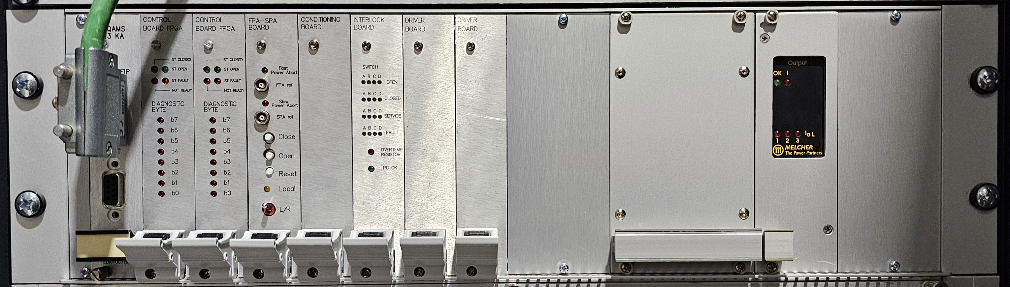
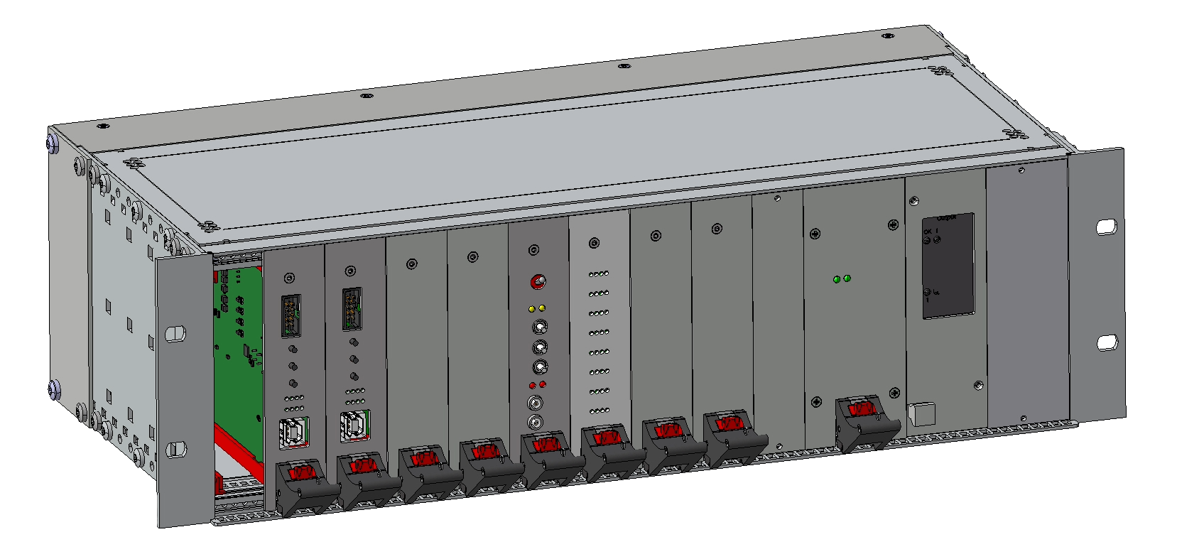
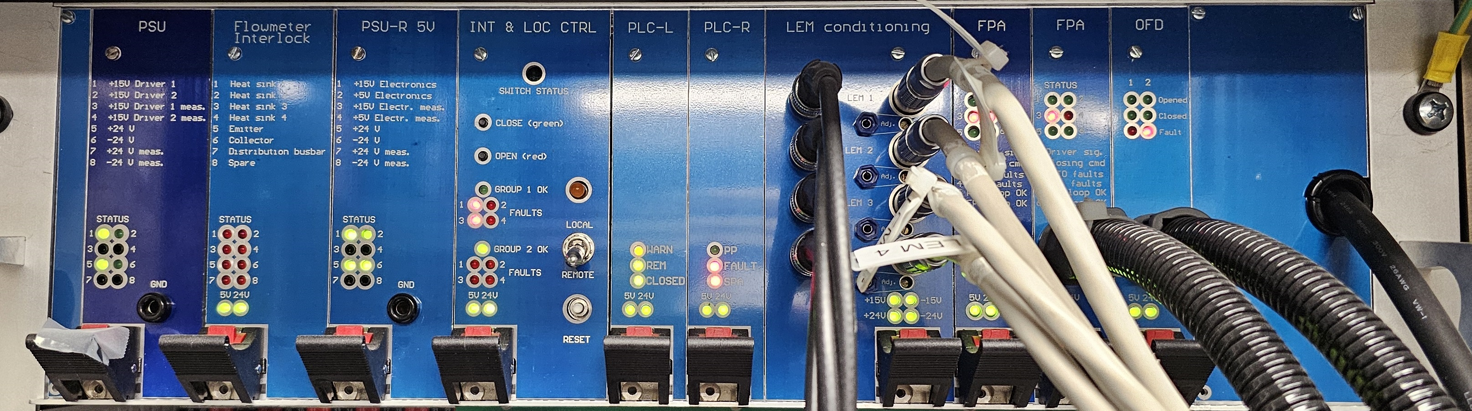
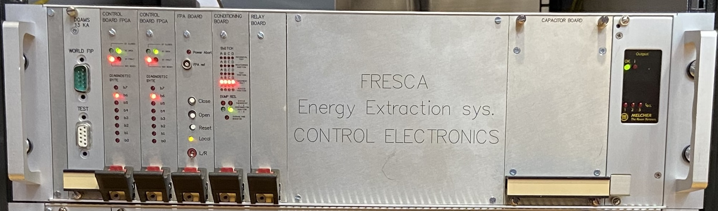
Motivation for Universal Control Electronics
Contactors
Vacuum 2kA/600A
13kA
North Area
UCE3
IGBTs
FRESCA
Versatility and reduced complexity
Radiation tolerance
Improved maintainability

Slide 4
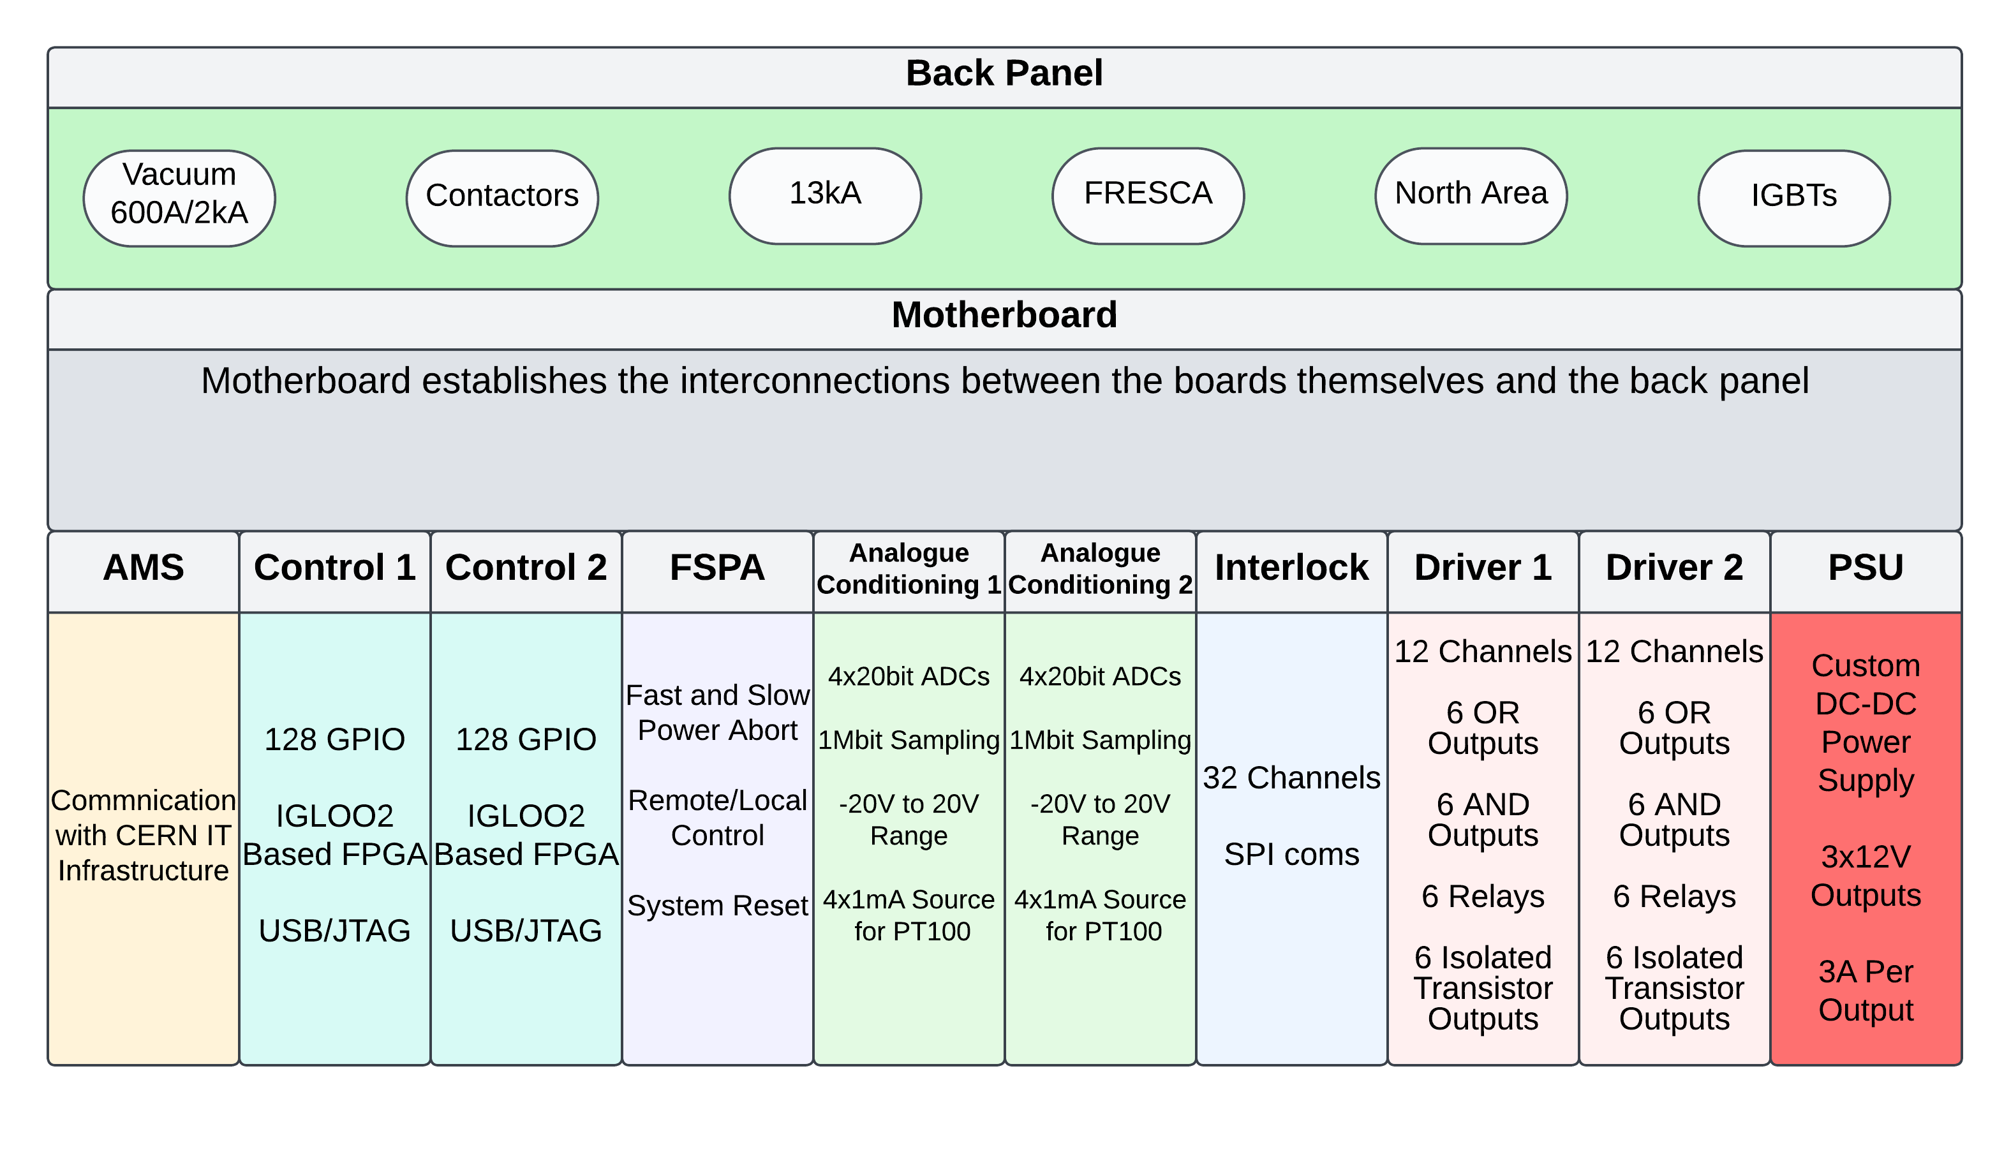
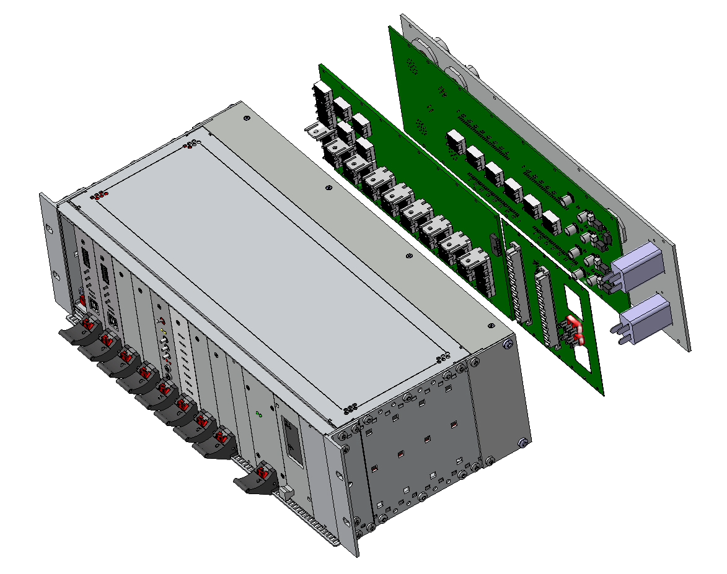
Structure
11 boards shared between all energy extraction systems
Only the back panel varies between systems
Designed with redundancy in mind
All cards have spare outputs for future needs

Slide 5
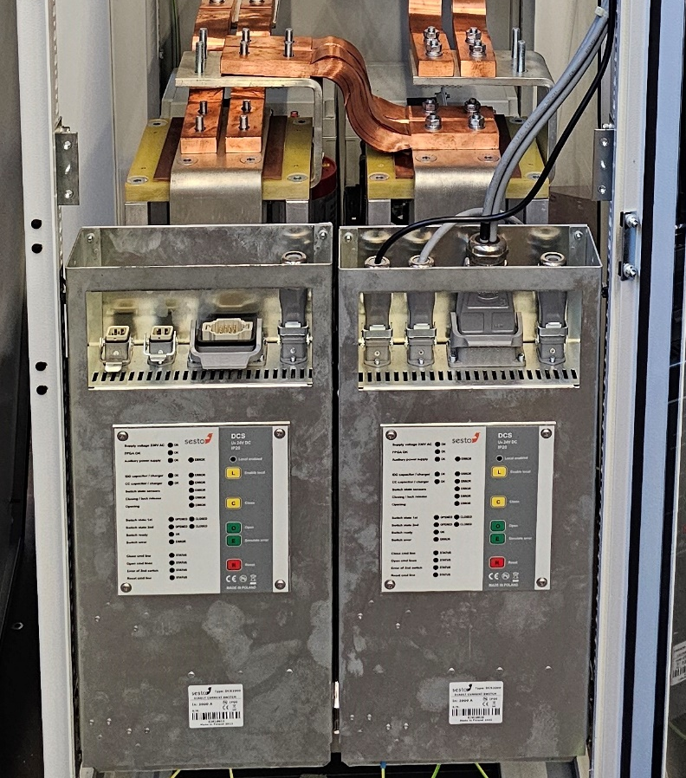
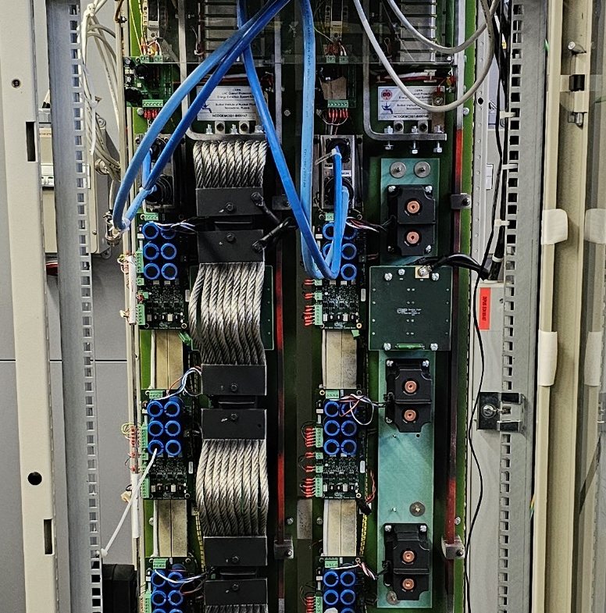
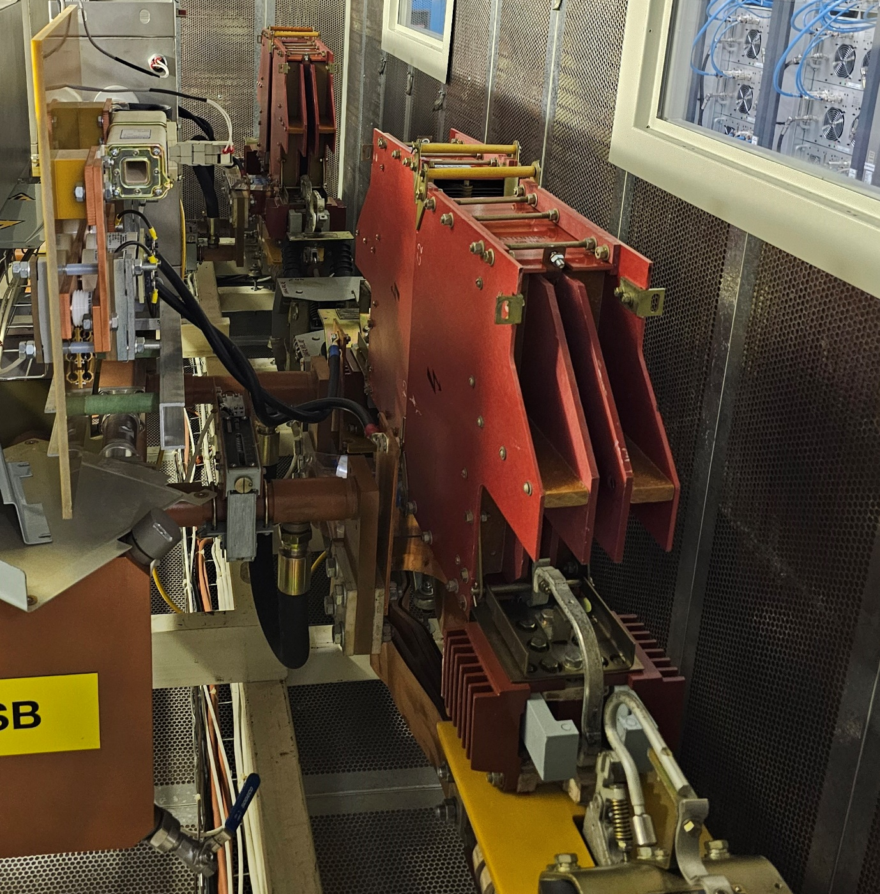
Systems
Three systems are currently actively developed for the UCE upgrade scheduled for LS3:
Vacuum 2kA/600A
Contactors
13kA electro-mechanical CBs.

Slide 6
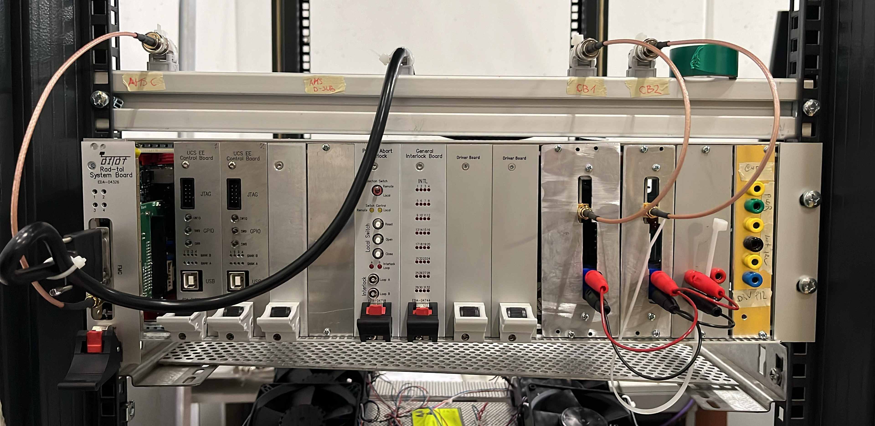
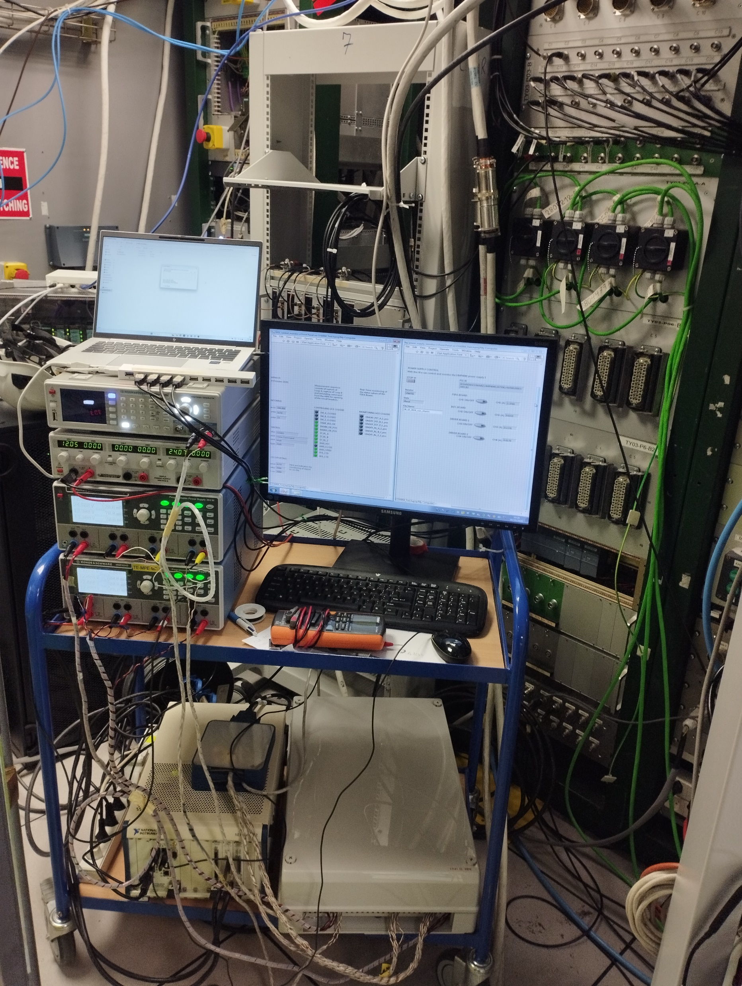
CHARM
Prototype board-level tests
System-level successful past 500Gy
Third test scheduled for Q2 2025.

Slide 7
Project Timeline
The design of the UCE3 started
CHARM Test 1
CHARM Test 2
Design submitted for EDMS, and 10 complete units ordered
CHARM Test 3
Commissioning and installation of the Universal Control Electronics
Q3 2023
Q2 2024
Q4 2024
Q2 2025
Q3 2025
Q3 2022
Q2 2024
Q3 2024
Q1 2025
Q2 2025
LS3
First functional prototype of the electronics
Design reiteration based on CHARM testing results
4 UCE vacuum CB units shipped to SESTO in Poland
Finishing the design of the back panel for the 13kA EES
Purchasing of:
44x Vacuum-based
202x Contactors
32x 13kA
3x NA
1x FRESCA

Slide 8
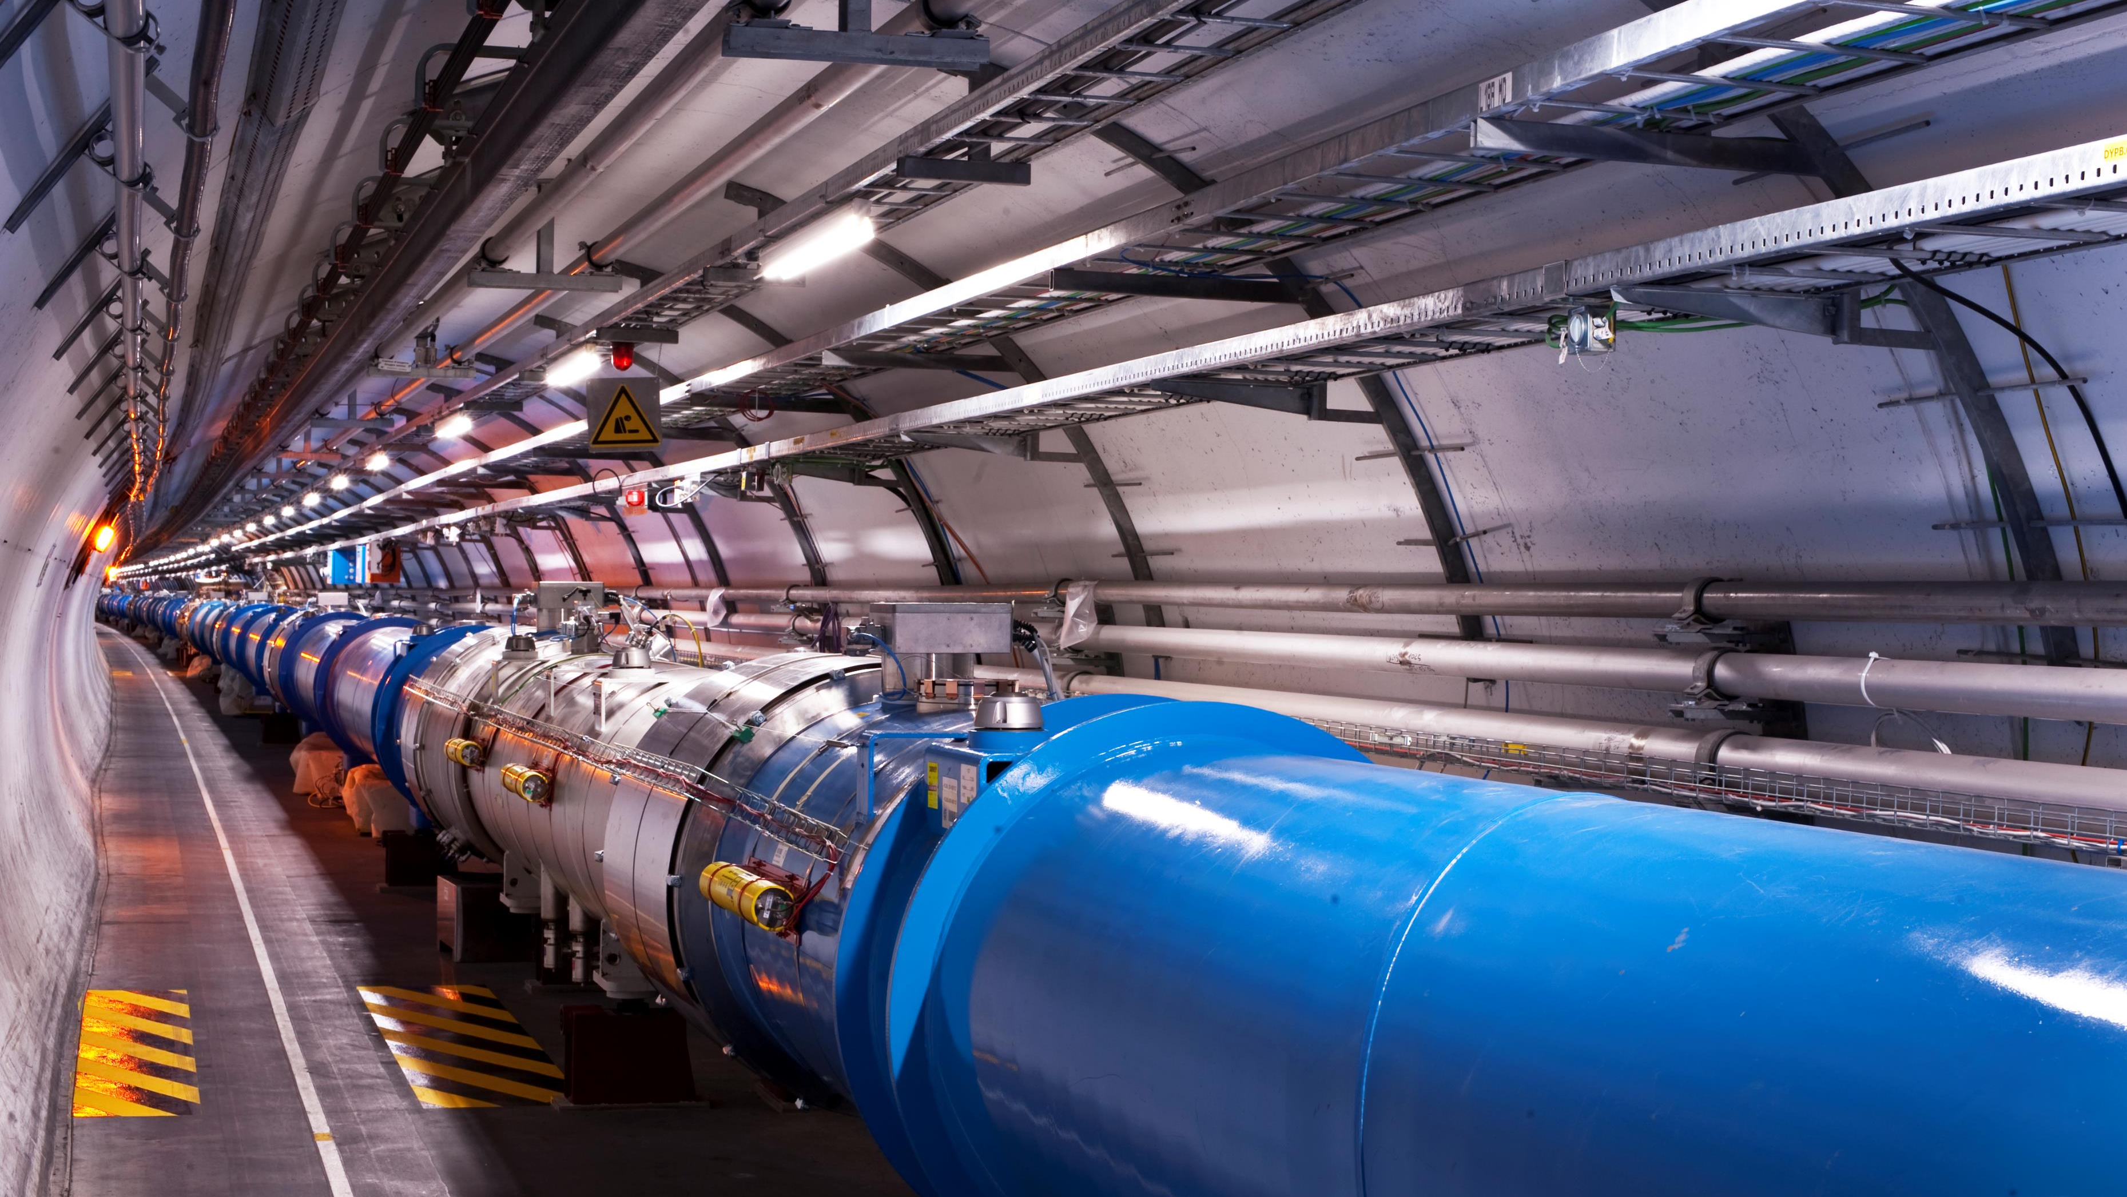
Thank you for your attention!

