Slide 1
A switchboard for valuable signals, the UQDS and PDSU patch panels ...
TE-MPE-EP
Vito Vizziello
21/01/2025

Slide 2
What is the UQDS and PDSU patch panel
For the upgrade of the LHC to HL-LHC, the patch panel represents an element of the Quench Detection System that accomplishes the complex aim of mapping multiple signal sources to multiple destinations.
A switchboard for valuable signals, the UQDS and PDSU patch panels ...
Vito Vizziello TE-MPE-EP

Slide 3
Importance of Patch Panel during Hi-Lumi
ELQA measurements can be done, at any moment, directly from the Patch Panel if radiation level around IFS boxes placed on the magnet cold mass are high.
Conveying all the needed signals from several IFS boxes directly to each specific UQDS.
Patch Panel
Possibility to use a standard hardware configuration for UQDS with fewer risks to make mistakes with the cabling.
ELQA measurements can be provided without the need to disconnect the quench detection system.
Optimizing the time and make it easy during the local interventions.
A switchboard for valuable signals, the UQDS and PDSU patch panels ...
Vito Vizziello TE-MPE-EP

Slide 4
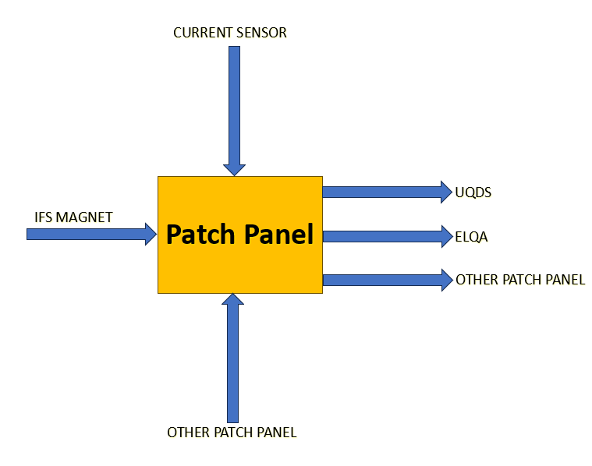
General architecture of the Patch Panel
The Patch Panel collects INPUT signals from:
IFS boxes of the magnets
The current sensor boxes
Another patch panel from a different rack.
Internally the patch panel is routed for driving each single INPUT signal to a specific OUTPUT.
The Patch Panel dispatches OUTPUT signals to:
UQDS → according to the configuration needed for each protection unit.
ELQA → reproducing on a dedicated area the same pin-out/connector configuration as for the IFS boxes for each magnet.
Another patch panel from a different rack.
A switchboard for valuable signals, the UQDS and PDSU patch panels ...
Vito Vizziello TE-MPE-EP

Slide 5
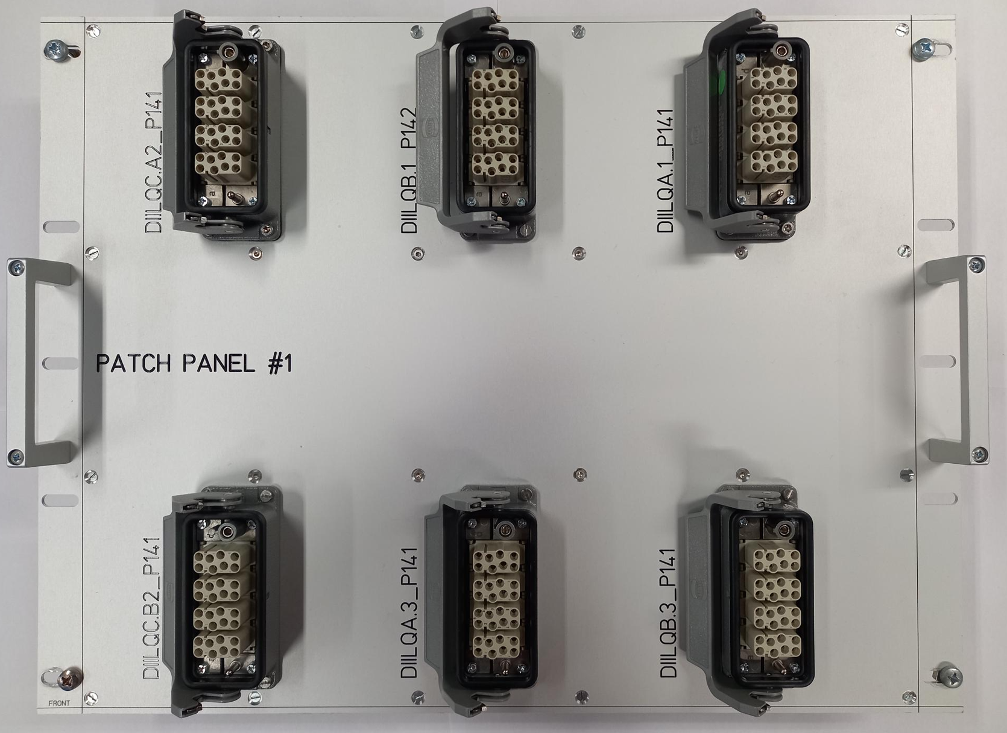
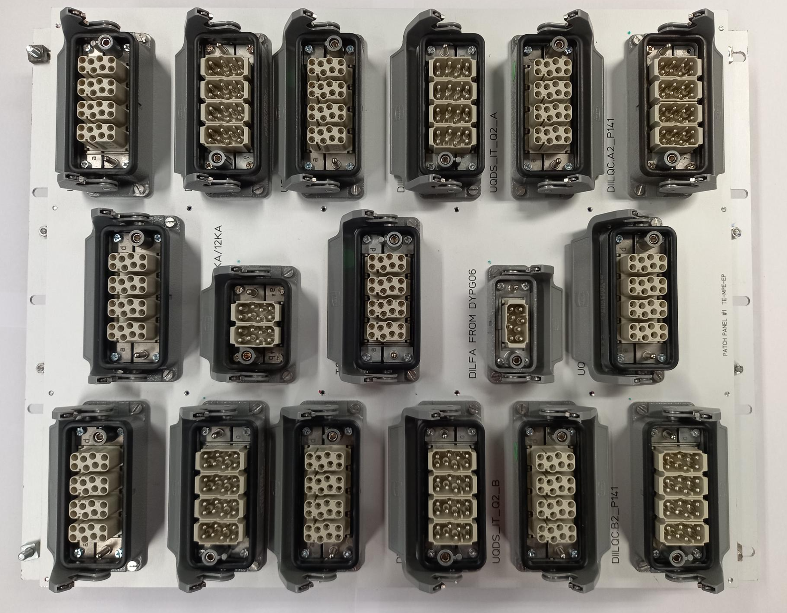
View of the Patch Panel
All the Patch Panels are different between each other; every rack has its own patch panel.
Front side: ELQA measurements
Back side: Input / Output
current sensors / other racks
A switchboard for valuable signals, the UQDS and PDSU patch panels ...
Vito Vizziello TE-MPE-EP

Slide 6
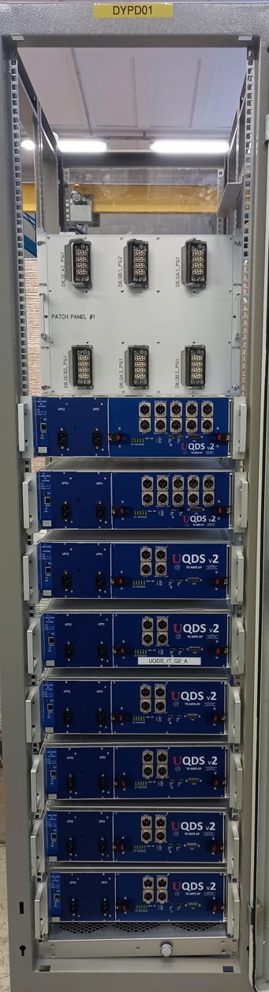
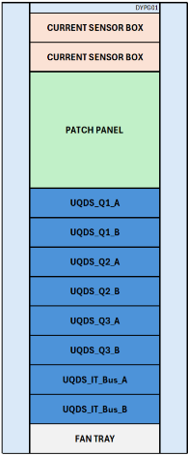
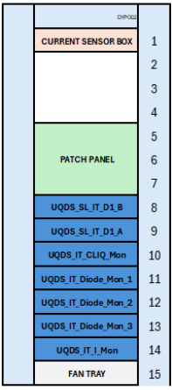
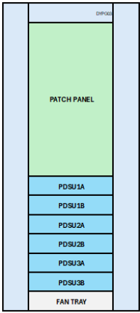
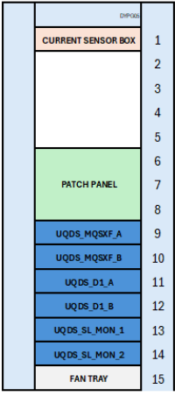
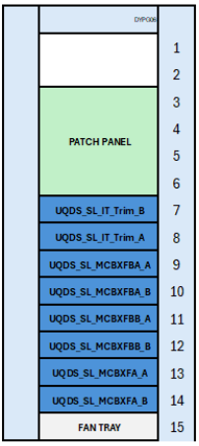
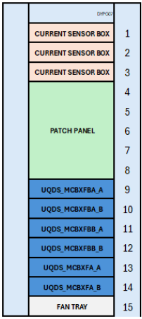
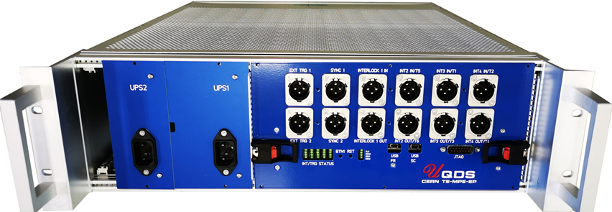
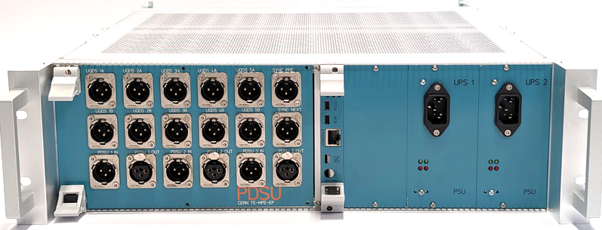
IT-STRING Patch Panel
Universal Quench Detection System
Protection Device Supervision Unit
A switchboard for valuable signals, the UQDS and PDSU patch panels ...
Vito Vizziello TE-MPE-EP

Slide 7
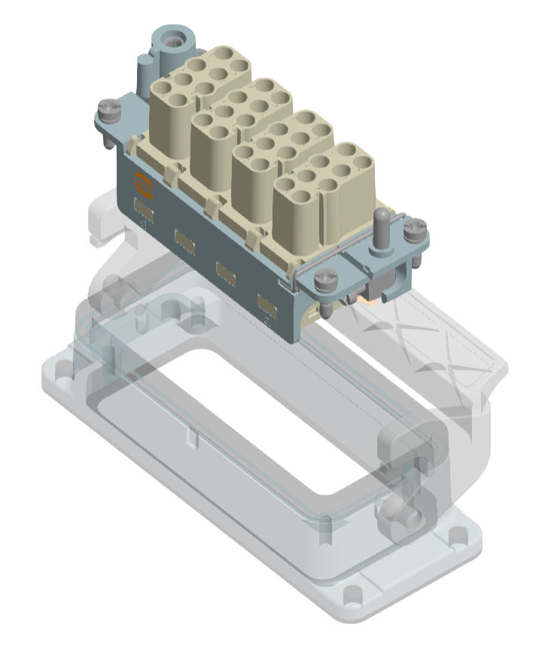
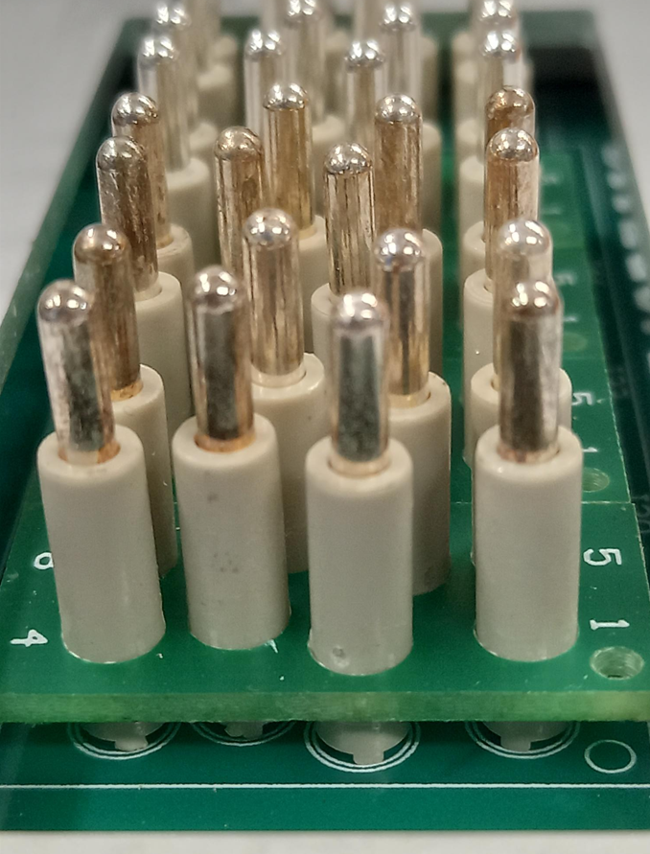
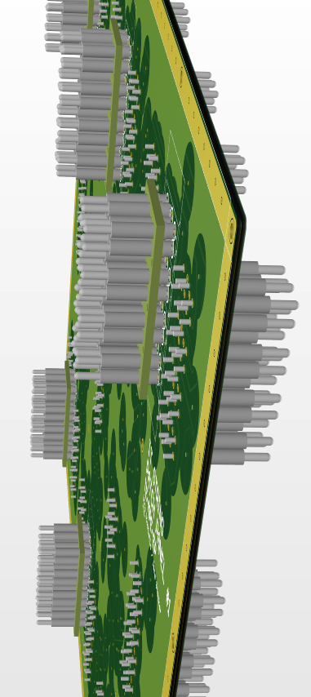
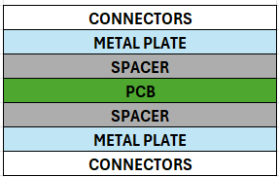
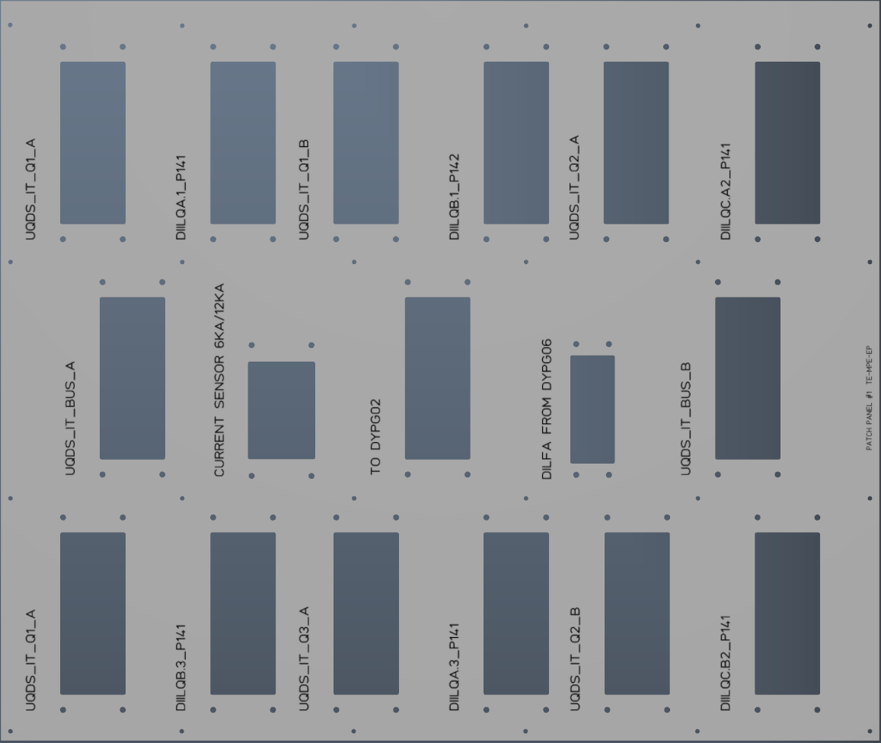
Development of the Patch Panel
All PCB based (no wires).
PCB is housed in a sandwich: Metal plate, spacer, PCB, spacer, Metal plate.
Connector housings are mounted on the metal plate, both sides, and are connected directly to the PCB via the pin-matrix.
A switchboard for valuable signals, the UQDS and PDSU patch panels ...
Vito Vizziello TE-MPE-EP

Slide 8
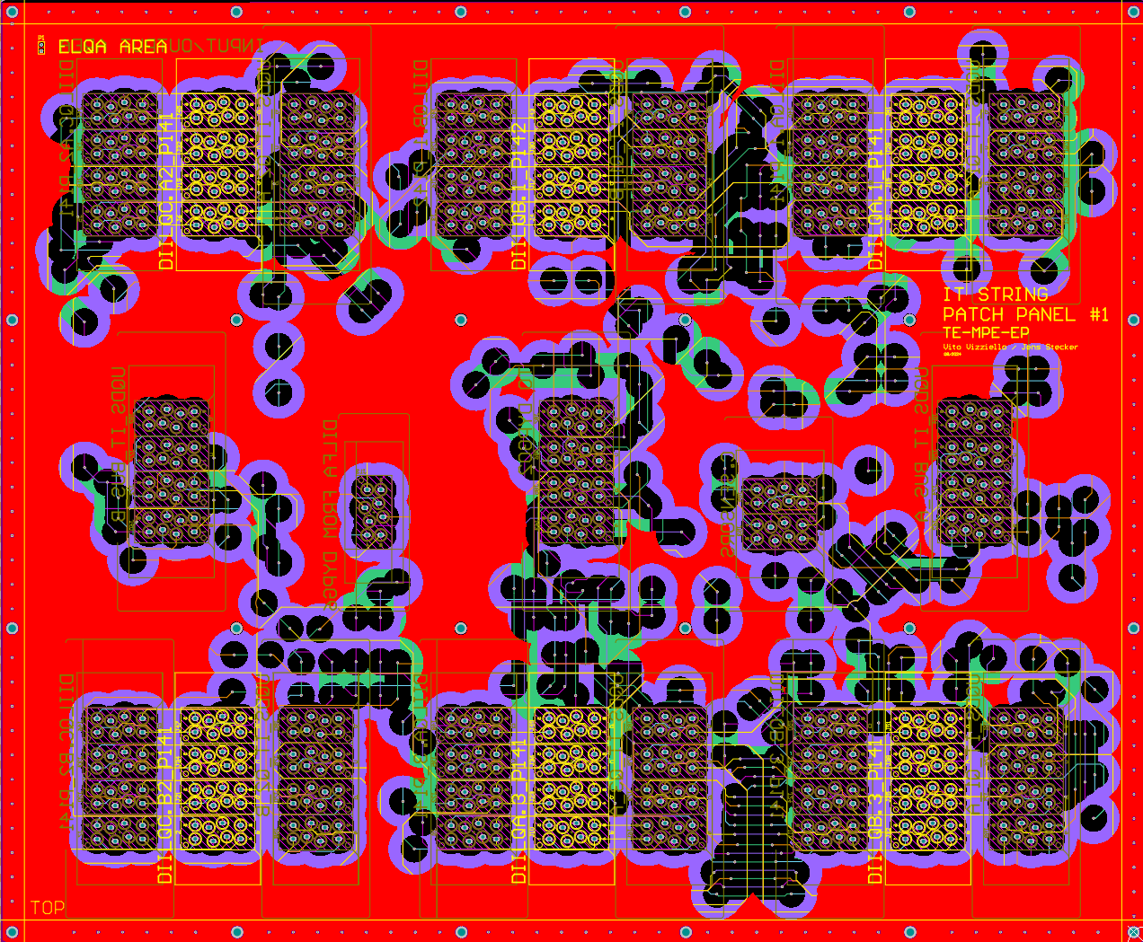
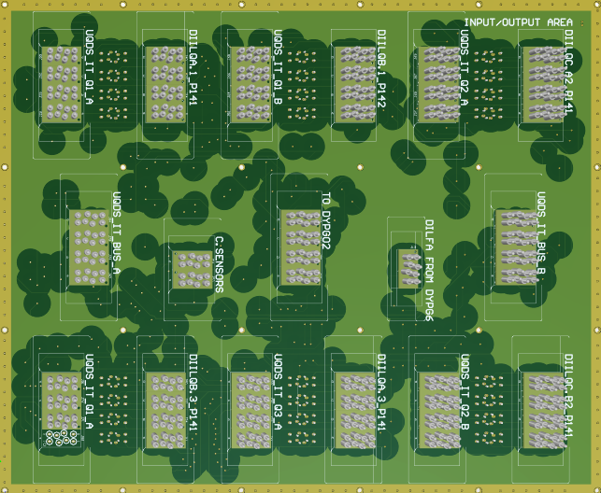
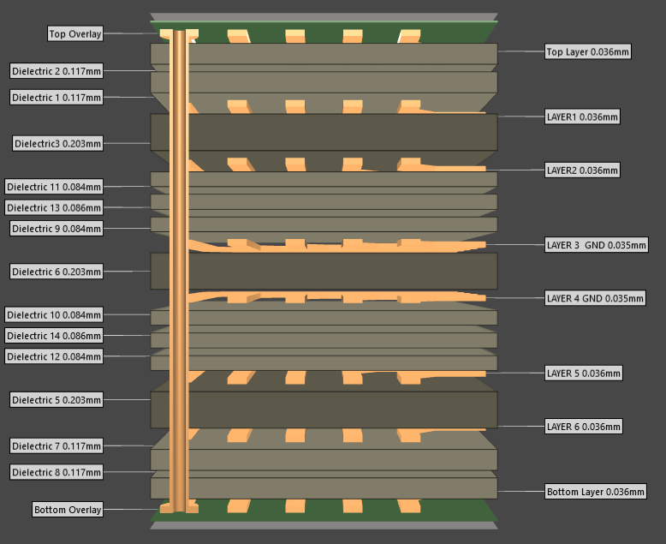
Development of the PCB
PCB size: 3U, 6U, 9U
Number of layers of the PCB: 8
Number of dielectric layers: 13
A switchboard for valuable signals, the UQDS and PDSU patch panels ...
Vito Vizziello TE-MPE-EP

Slide 9
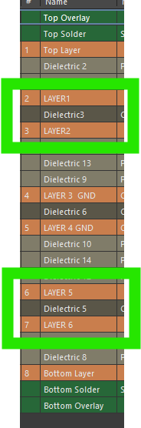
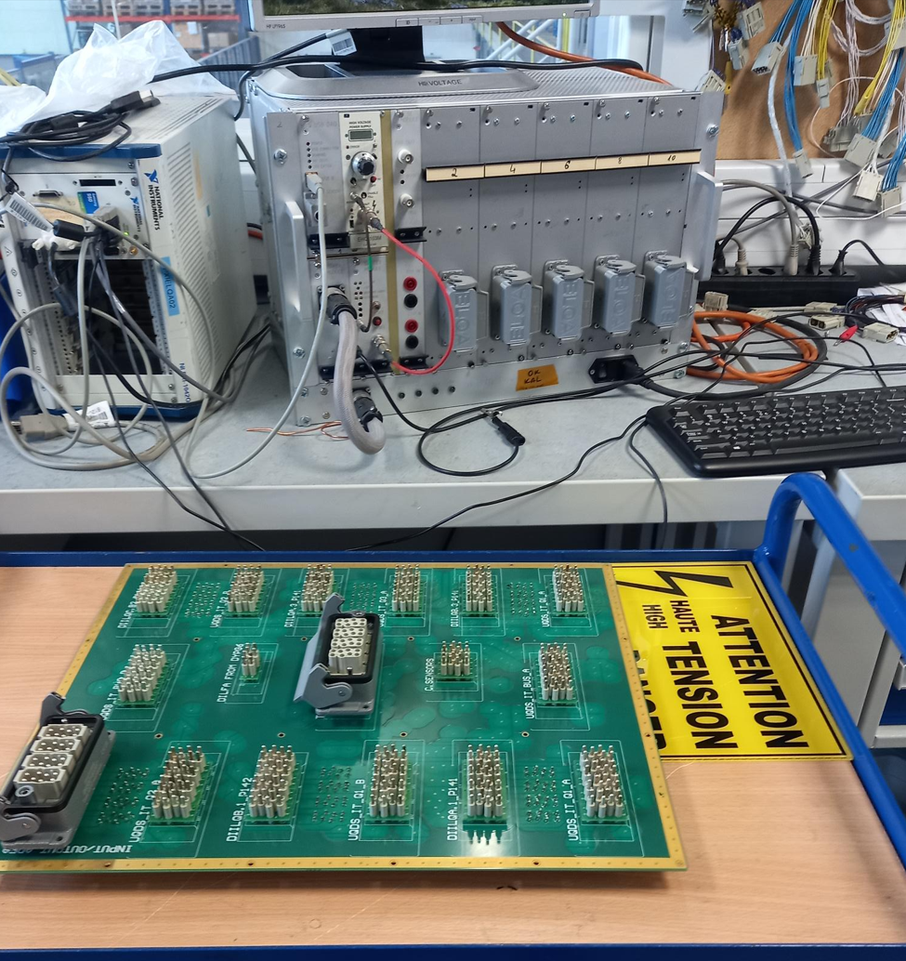
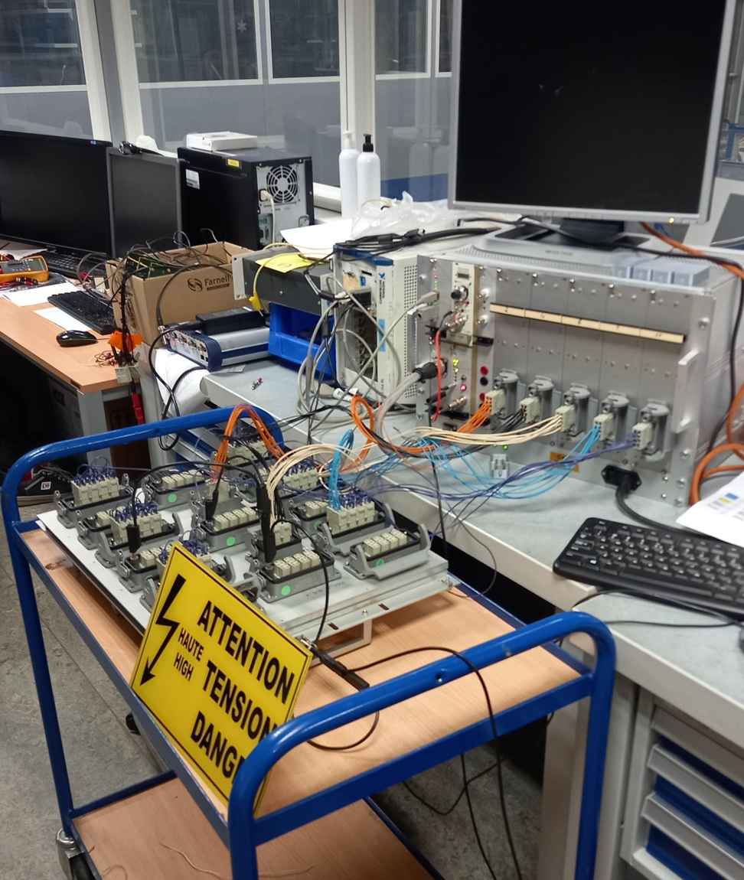
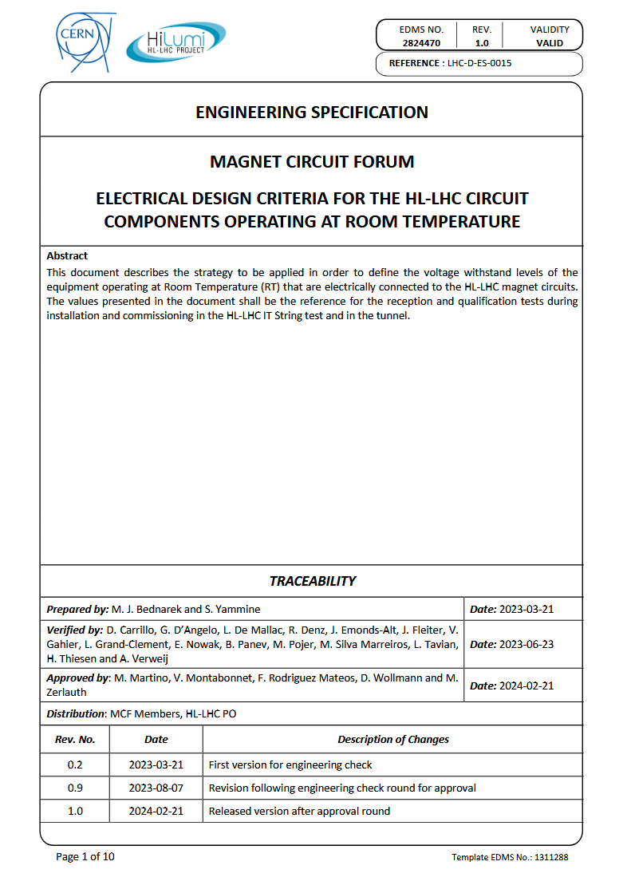
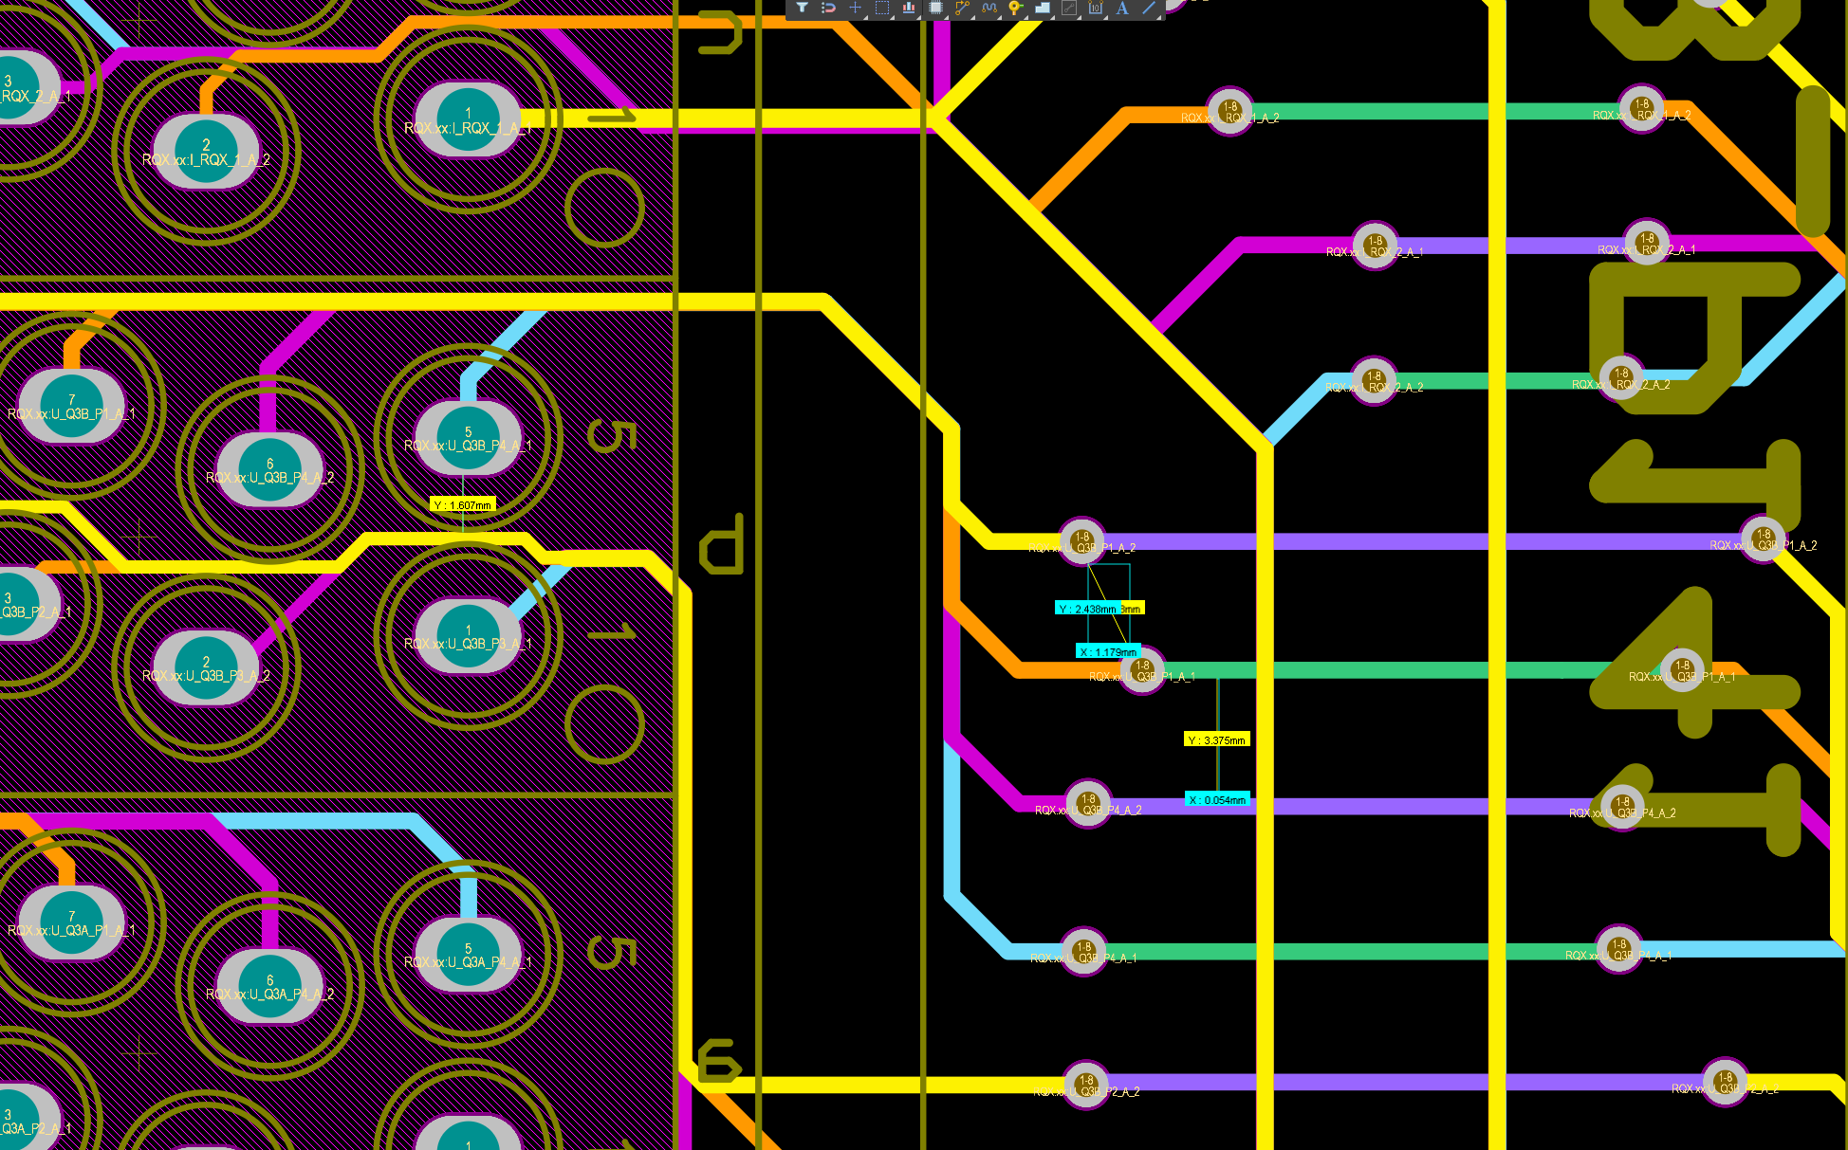
HV test validation
HV test validation by TE-MPE-PE
The QDS Input Patch Panel must withstand a minimum of 2.5 kV for 60 s with no breakdown and a maximum leakage current of 10 µA.
Each connector at 1 kV must have a leakage current of less than 0.1 µA after 60 s.
A switchboard for valuable signals, the UQDS and PDSU patch panels ...
Vito Vizziello TE-MPE-EP

Slide 10
Thank you

