Slide 2
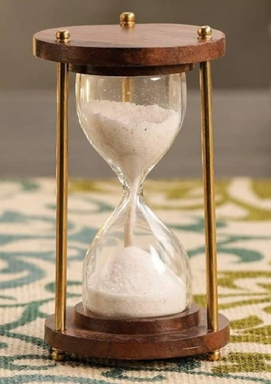
TE-MPE Annual Meeting
21 January 2025
Welcome and General Information
Jan Uythoven
Many thanks to the Section Leaders and group members for their input
Special thanks to Daniel Wollmann, Daniel Calcoen and Claudia Dupraz
15 min

Slide 3
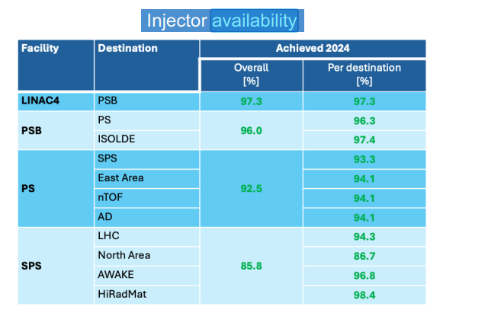
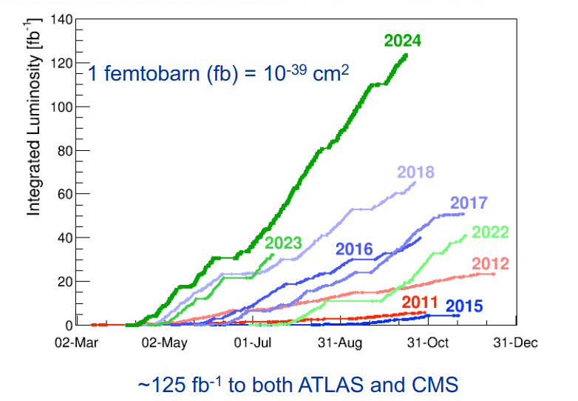
Excellent performance of the accelerator complex
LHC Integrated Lumi
Injector Availability

Slide 4
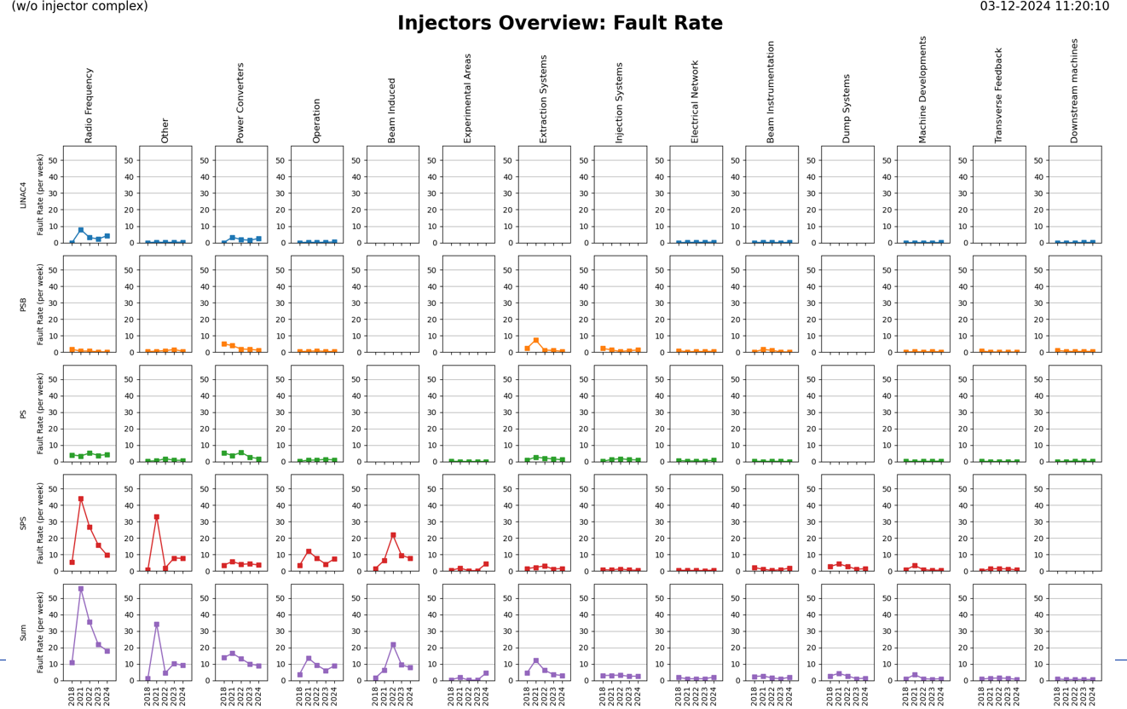

Excellent performance of the accelerator complex
LHC Integrated Lumi
Injector Availability

Slide 5

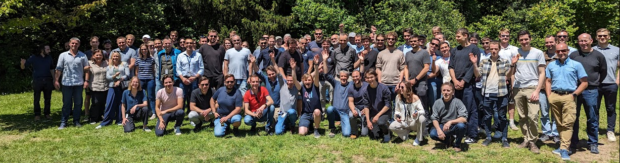

Slide 6
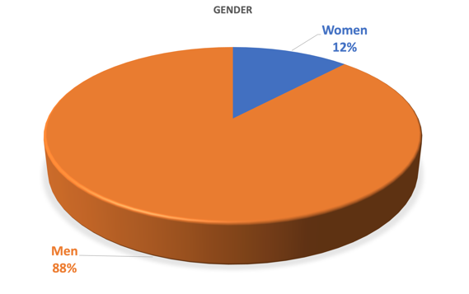
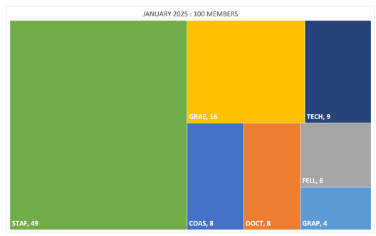
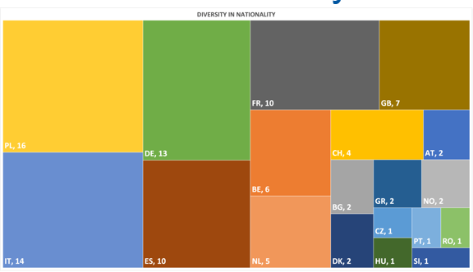
MPE Statistics - 2025
Diversity is a core value underpinning our Code of Conduct.
CERN promotes diversity, inclusion and equality at all levels.
Gender
Status
Nationality
January 2025 : 100 members
December 2023 : 101 members
December 2022 : 92 members
December 2021 : 89 members
19 nationalities

Slide 7

Arrivals in MPE 2024/5
Staff
Fellow, PhD, Quest, Origin
DOMANGE Delphine | CB | HERRERO ALVAREZ Lucia | SF
WESTERMANN David | CB | MURARIU Alexandra | CB
MAYR Daniel | PE | GORNY Karol Stefan | MI
RINALDONI Davide | PE | KOLITSI Foteini | MP
DALLAGLIO Daniele | CB | LOPEZ CORDONCILLO Denisse | MP
SCHNAUBELT Erik Michael | PE | PIRC Vasja | MP
MORRIS Geoffrey Charles | EP
Techs, Students and COAS
BOLTON Samuel Lyndon | MI | PENNOCK Steven Adne | MI
MARCINIAK Karol Tadeusz | PE | GLOCK Alexander | PE
LOEVENDAL Jacob | EP | MEDEIROS PEREIRA Mateus | PE
DOSTMANN Hannah Alida | CB | REYNAUD Valentina | PE
DRYSCH Simone | CB | TEICHROB Leon | PE
HERMUELLER Philipp | CB

Slide 8

Departures 2024
ATALAY Sina | GORENFLO Max Heinrich | MAGNUS Fredrik | SKOCZEN Andrzej Jozef
BAILEY David Heinrich | GUASCH MARTINEZ Josep | MROCZEK Mariusz Piotr | SPASIC Jelena
BARBA Andreas Verdoner | GUZZETTI Riccardo | MULLER Andreas | TSVARKALEVA Mariya Georgieva
CHARIFOULLINE Zinour | HJELLE Ingrid Midtbust | OBERMAIR Christoph | VITRANO Andrea
CHEDAS CASTRO Pablo | HOLLOS Adam Erik | PRIDII Tetiana | WOJAS Damian Lukasz
DE NICOLAS LUMBRERAS Enrique | JANIK Grzegorz Michal | SANTIAGO FERRER Alvaro | ZACHOU Georgia
DIMITROV MENA Ivan | KARAS Krzysztof | SEGERIE Reynalde | ZILINSKAS Antanas

Slide 9
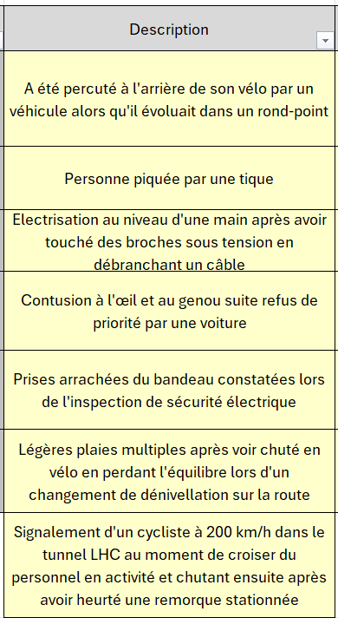
2024 declared accidents
Another good year with no absences related to work-accidents
A total of 7 (minor) incidents
  3 related to bikes on the road
  1 to bike in the tunnel (GET OFF YOUR BIKE when passing by other people working !)
  1 to animals
  2 to electrical installations
Keep on taking care of your and other people’s safety
Drive a bit more slowly on your bike
  Keep on riding and be visible!

Slide 10
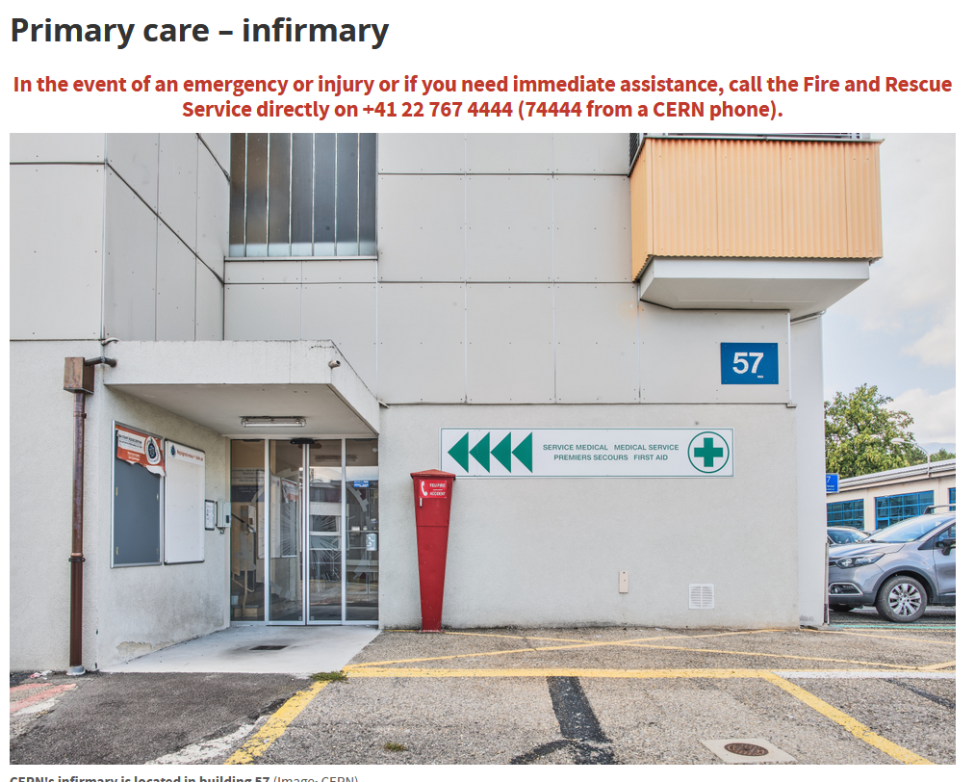
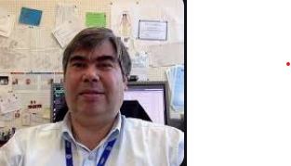
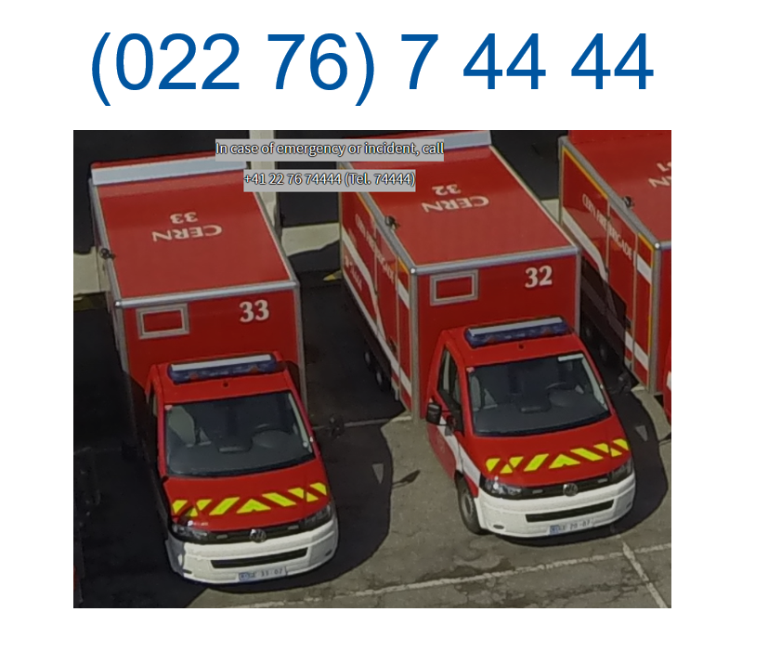
Safety is a top priority and key responsibility of everyone working in TE-MPE
Delphine Letant-Delrieux
TE DSO
Daniel Calcoen
MPE Safety Link Person

Slide 11
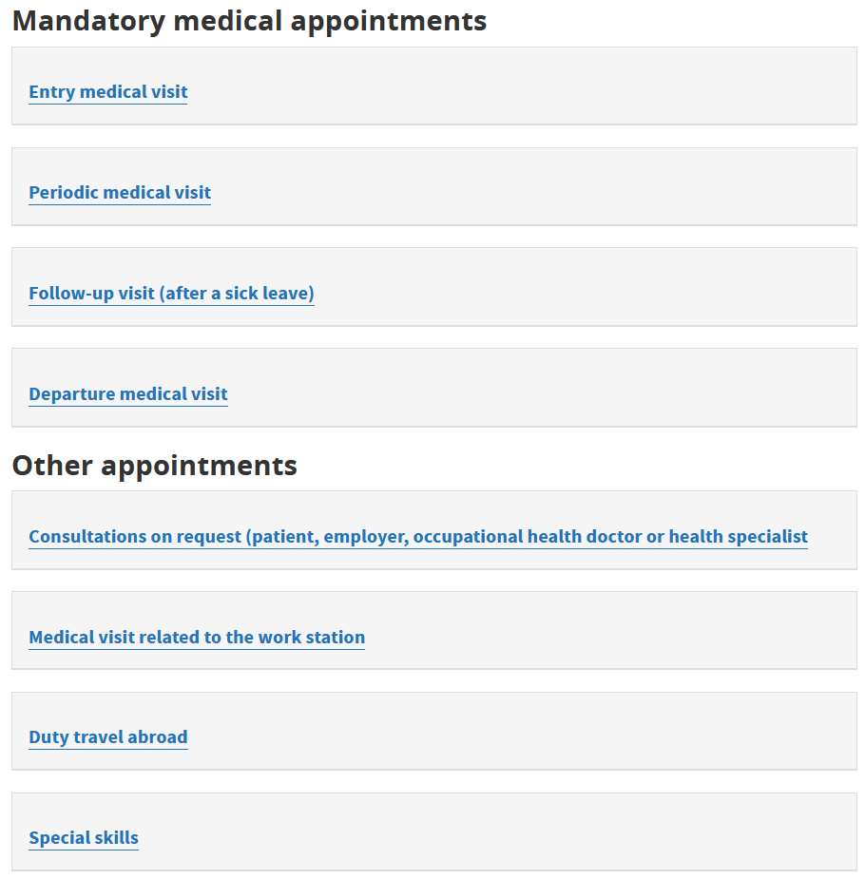
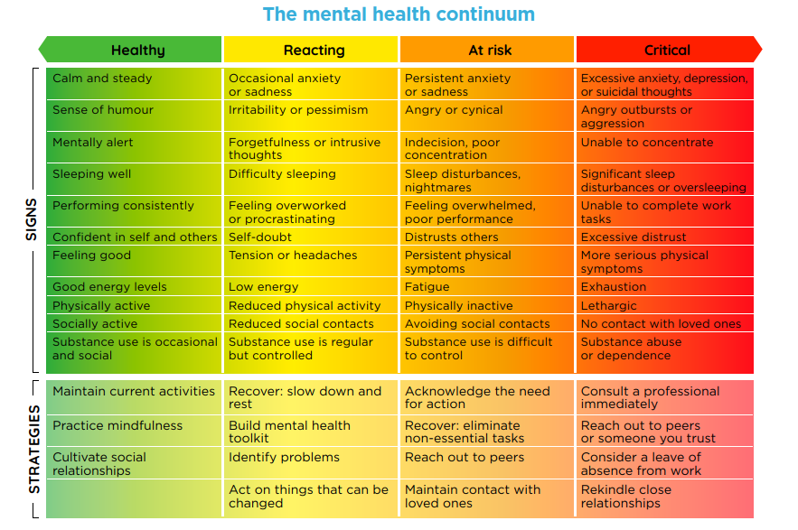
Occupational Health & Mental Health
Talk to your supervisor, or you can make an appointment with a CERN psychologist via e-mail at psychologist.medical.service@cern.ch.

Slide 12
One quick slide per Section
Not covering the work done by the section or claiming to be complete in any sense
The aim is to give newcomers a taste of what else we are doing in the group
More complete information at the MPE Technical Meetings

Slide 13
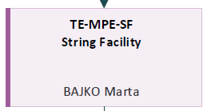
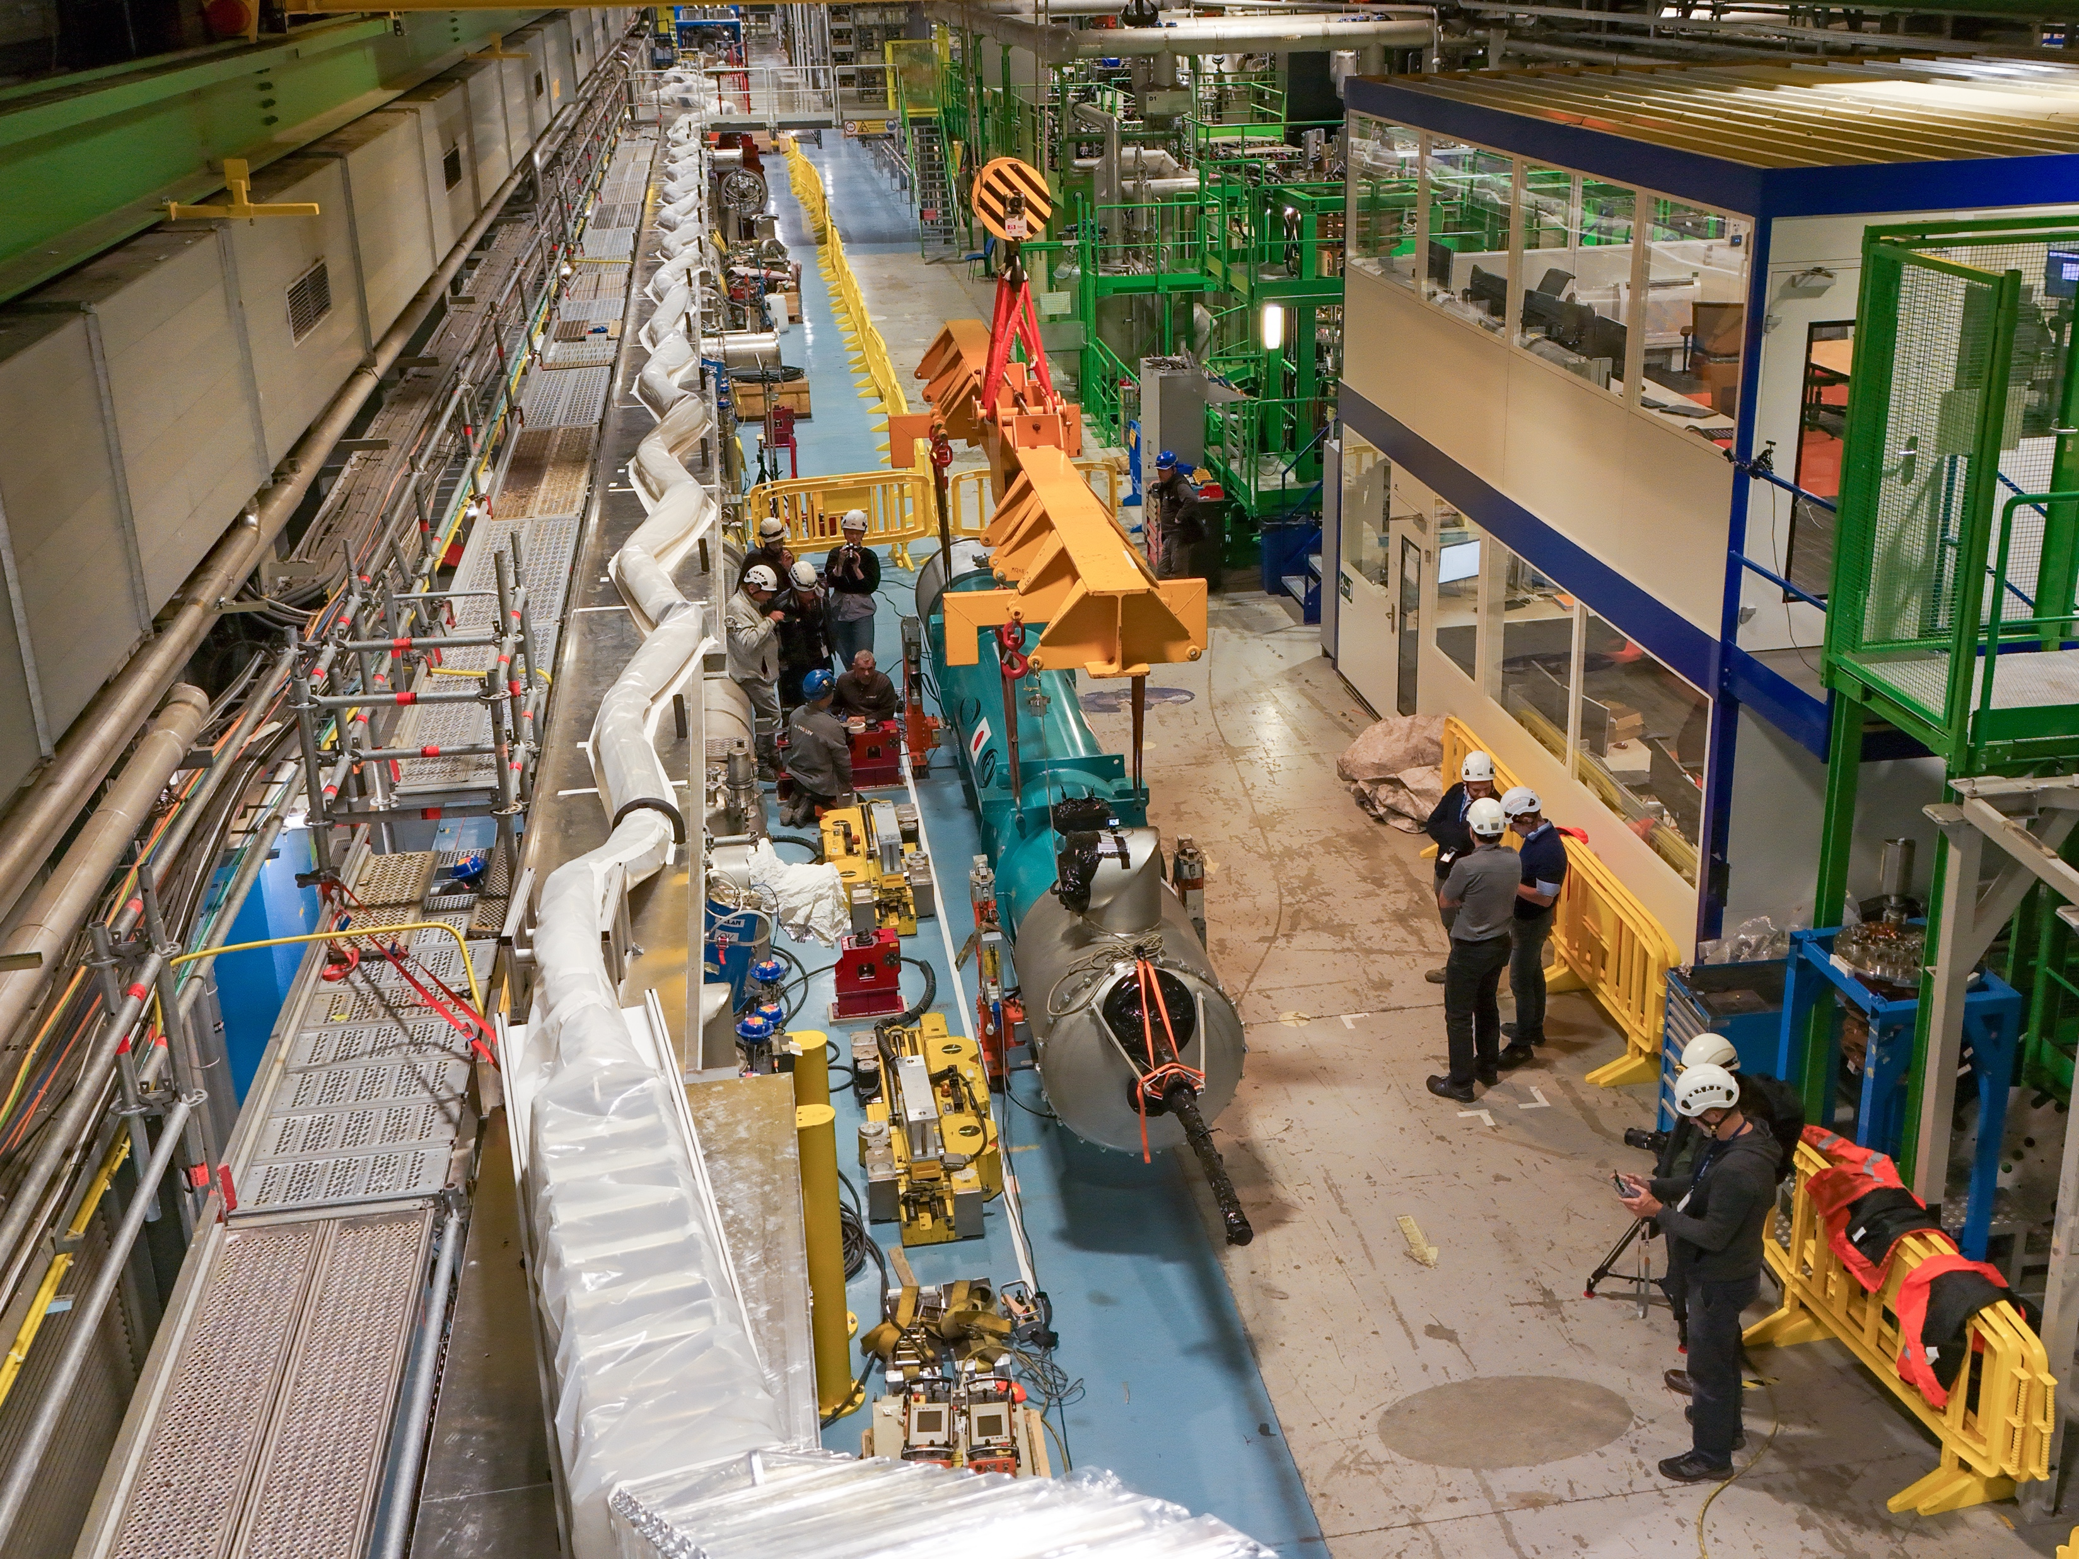
High Luminosity LHC
Inner Triplet String Facility
Installation, Hardware Commissioning
Operation of String
D1 installation and sc link

Slide 14
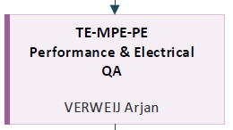
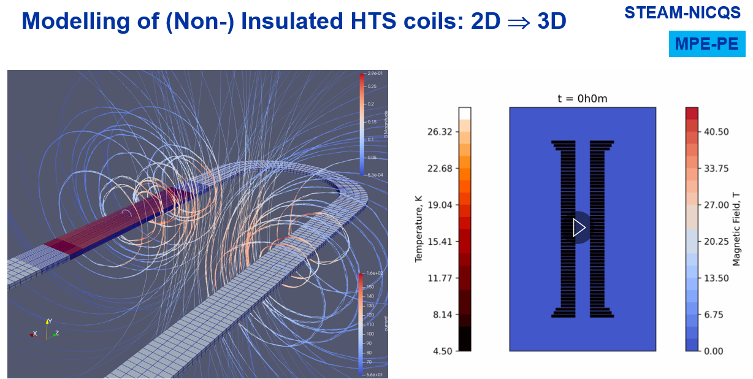

Superconducting Magnets Hardware Commissioning
Operation sc magnets, MP3, SigMon, cold diodes, …
Electrical Quality Assurance
STEAM framework:
Simulation of Transient Effects in Accelerator Magnets
Simulation and protection of sc magnets for future applications

Slide 15
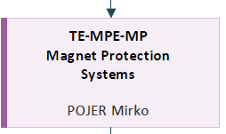
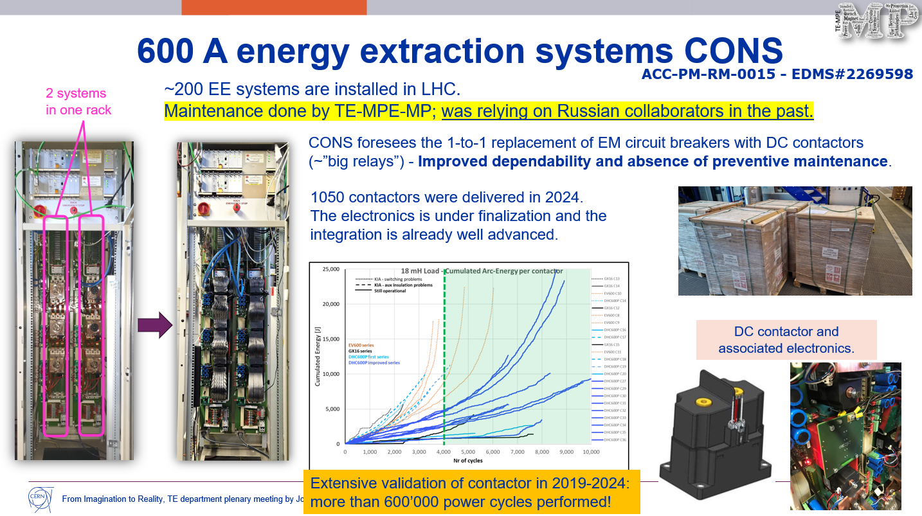

Quench Protection Energy Extraction Systems
Circuit breakers / switches / DC contactors
CLIQ
Quench Heater Power Supplies
Universal Control Electronics for EE systems

Slide 16
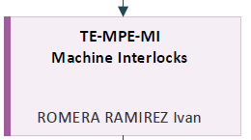
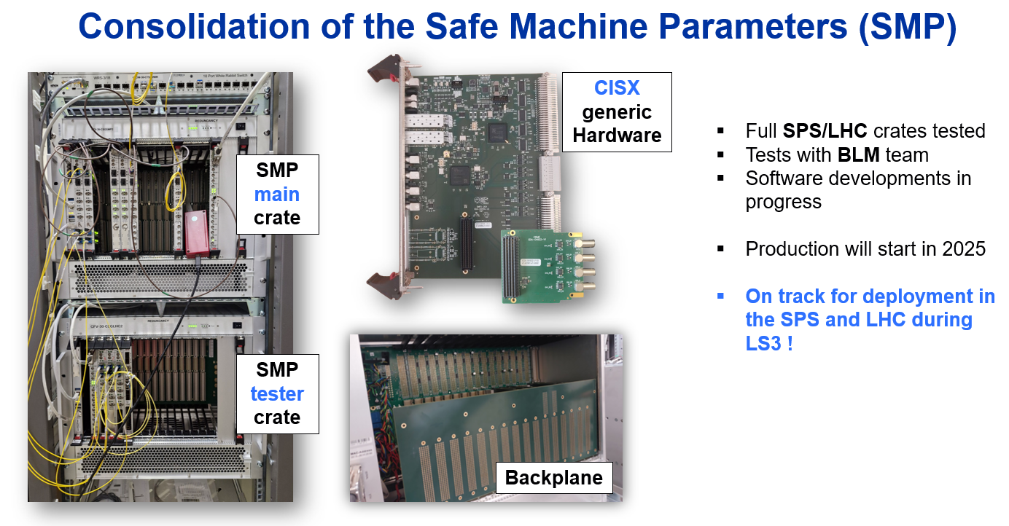

Beam Interlock System BIS
Safe Machine Parameters SMP
Warm magnet Interlock Controller WIC
Power Interlock Controller PIC
Fast Magnet Current change Monitor FMCM

Slide 17
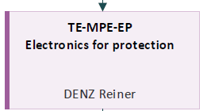
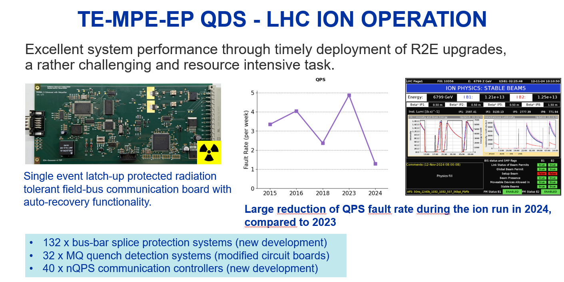

Quench Detection System (QDS)
UQDS, PDSU, EDAQ
DAQs for test benches (SM18, IT String)
Research and Development

Slide 18
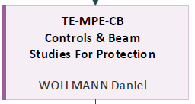
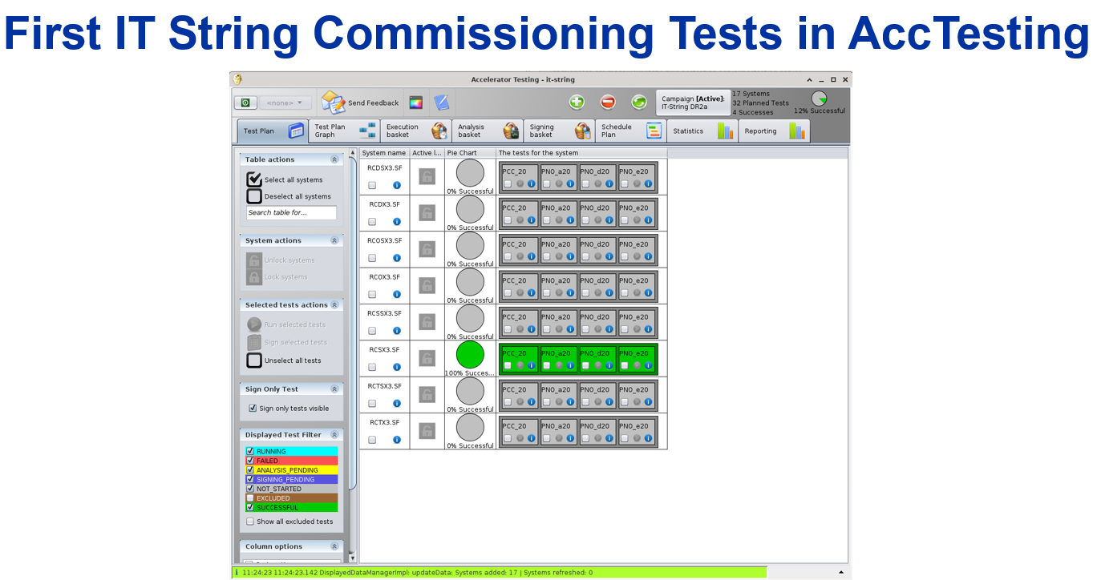

Controls and software systems
Post Mortem, SigMon, AccTesting
Dependability studies for protection systems and accelerators
Failure case and beam induced damage studies
UFOs
Machine Protection Panel

Slide 19
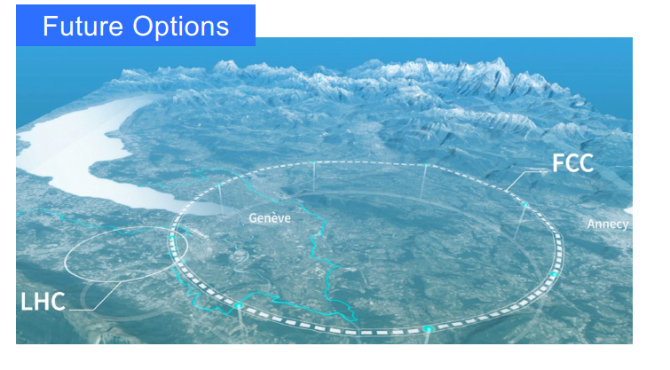
MPE is also working on the (far) future !
This is no. 3

Slide 20
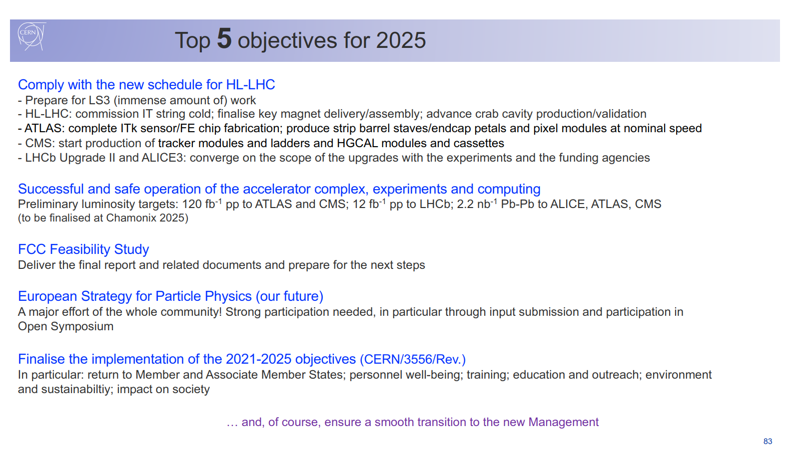
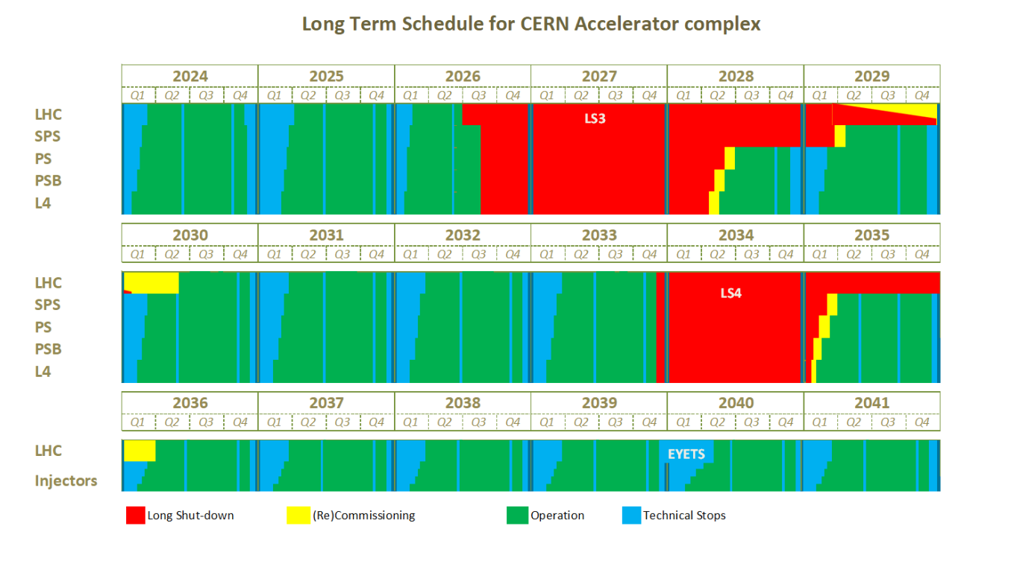
Fabiola, one week ago:

Slide 21

Next:
7 min
They are not:
  The highlights of the section
  Covering the most important topic of the section
They are aimed to be:
  Speed (7 minutes)
  Interesting

