Slide 1



Cooling Cell Integration Issues
Lucio Rossi – Marco Statera – Giuseppe Scarantino – Mattia Castoldi WP8 & WP7
Dario Giove WP8 & WP6
Univ. of Milan & INFN-Milan-LASA
Roberto Losito – Siara Fabbri & Luca Bottura CERN WP7 – WP8

Slide 2
Content
  Recap Fermilab Workshop outcome
  New magnetic configuration studies
  Cryostat integration choice
  Memory shape alloys solution
  Integration RF cavities
  Selected Magnetic configuration
  Cell Integration and assembly status

Slide 3
Lattice operation of a cell and stand alone operation
LATTICE OPERATION
SINGLE CELL
ONE CELL
absober
RF cavity
Solenoid and dipole
FORCE
FORCE

Slide 4
Operating mode
Lattice mode
Stand alone
Normal one during beam operation
Designing for this solution only is simpler
Test of each cell at full field is mandatory.
→ Can this be challenged?
→ We think no…
A magnet can always fail with faster discharge than the adjacent one. → we ask to support 10% of the nominal force on half cell coil
The first cell and the last one of a stage have different “weaker or stronger” neighbors. Or even none.

Slide 5
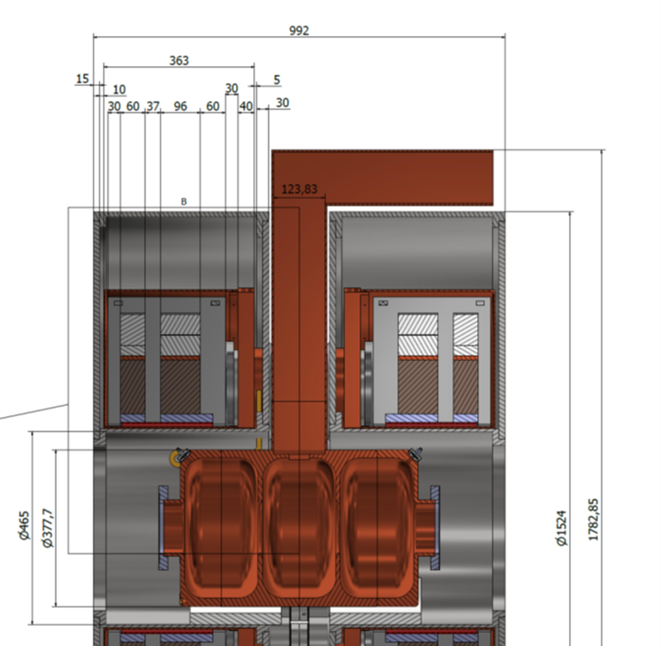
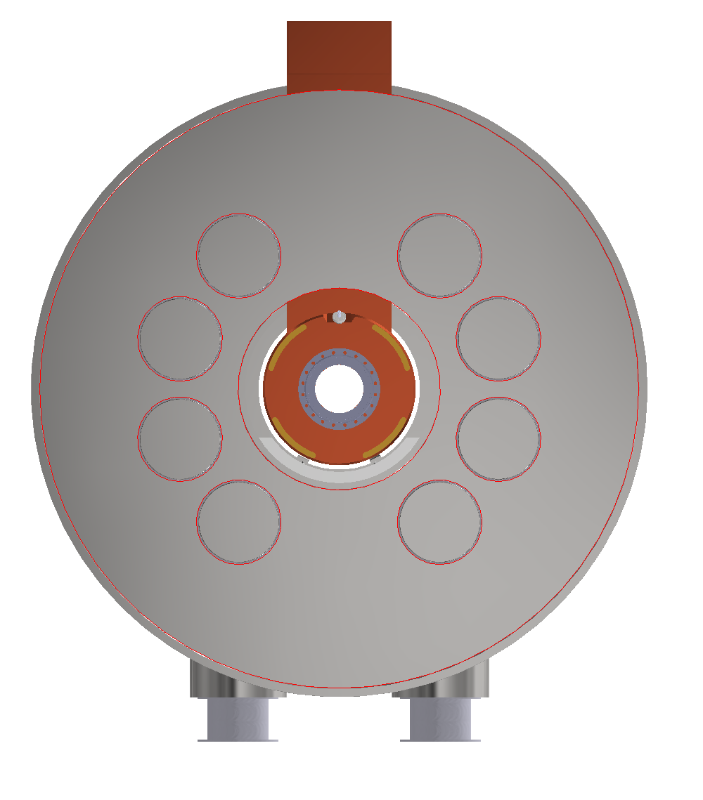
S5-like demo cell
Integration V0.1
992 mm
Where to gain more: space removed with an intercell cryostat
Solution 2 : single cell cryostat → no good for thermal
And huge forces between intracell coils
Traces of the 8 support rods

Slide 6
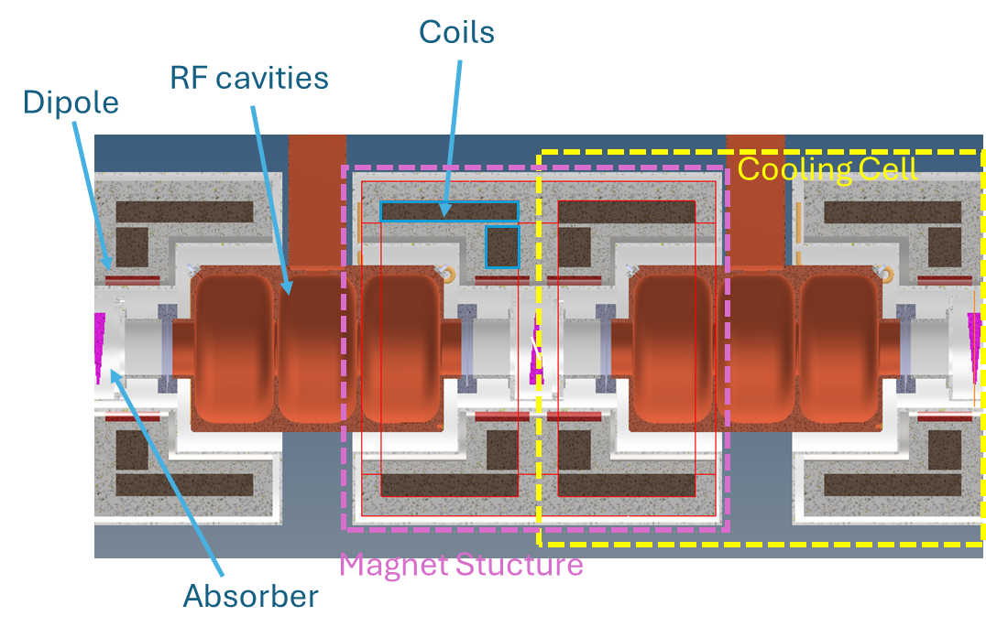
The magnet crystat would be simply slided over the RF structure from both sides of RF coupler
Solution pursued for lattice operation
Intercell cryostat
Plus
RF structure fully assembled independently on the rest
Makes easy assembly and access to RF for maintenance
The coils of a cell can be pushed as near the cell border as wanted
Minus
The forces between coils of the same cell needs to be reacted though RT gap
This generates enormous heat load at 20 K since gap is short and forces enormous (>> than the RFMFTF)
A single cell is not representative of the whole. For a single cell one needs to build also adjacent magnets (and forces are not balanced on aside coils)

Slide 7
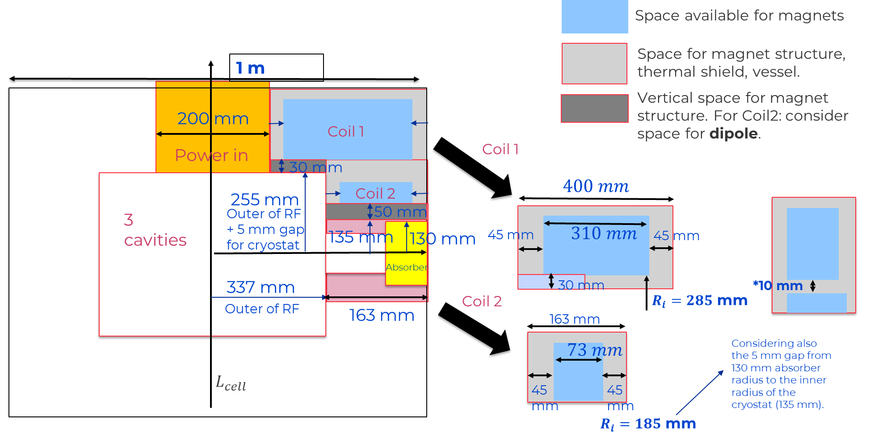
New Magnet Optimization: parameter space

Slide 8
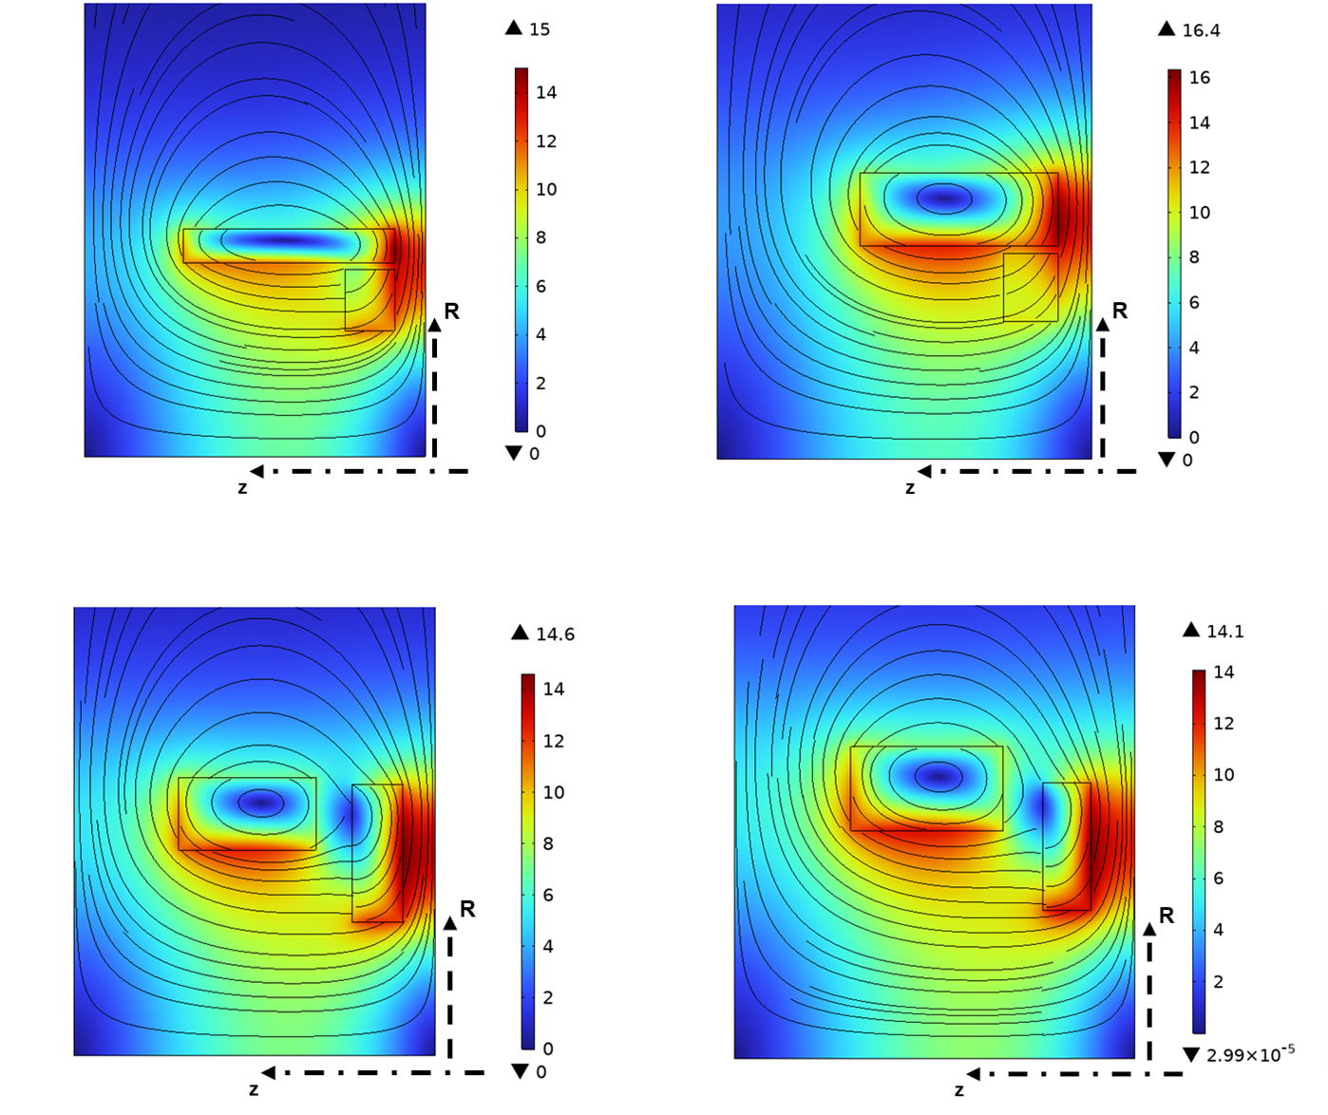
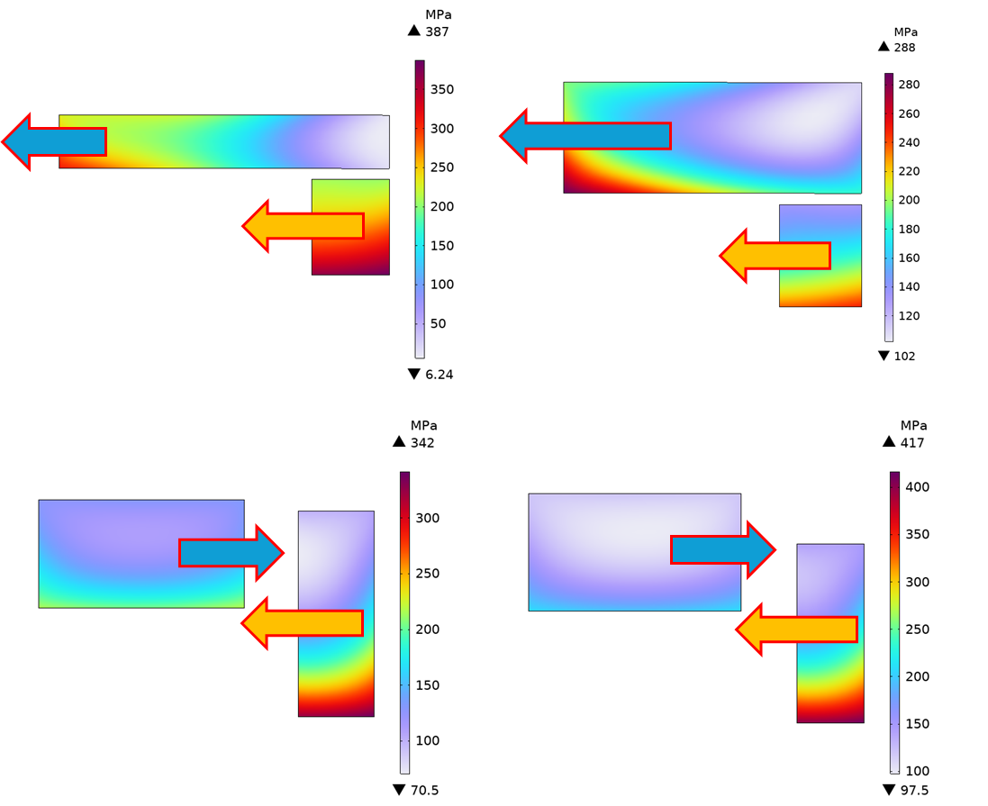
(Recap) Results Presented @ FNAL Workshop
Option 17MN – 10mm gap
“Min Net Axial Force”
Option 27MN – 10mm gap
“Min Axial Force on Coil2”
Option 17MN – 10mm gap
“Min Net Axial Force”
Option 27MN – 10mm gap
“Min Axial Force on Coil2”
Option 21MN – Optim. Tool “Min hoop stress on Coil2”
Option 15MN – Optim. Tool
“Min Coil Volume”
Option 21MN – Optim. Tool “Min hoop stress on Coil2”
Option 15MN – Optim. Tool
“Min Coil Volume”
Lattice operation

Slide 9
(Recap) Results Presented @ FNAL Workshop (II)
Configuration | B2/B1 (%) | Focusing Strength per cell length (T^2 m) | Max Hoop Stress (MPa) | Max Tensile Radial Stress (MPa) | Axial Force on Coil#1/Coil#2 (MN) | Net Axial Force (MN) | Total Torque (MN m) | Total Magnetic Energy Density in cell (MJ/m^3) | Coil Volume (half cell) (dm^3) | Coil Current Coil#1/Coil#2
Option 17MN -10mm gap | 14.4 | 24.42 | 387 | 15.3 | +7 +10 | +17 | 0.14 | 152.4 | 39.7 | 1035 575
Option 27MN -10mm gap | 14.2 | 24.39 | 288 | 11.9 | +20.5 +6.5 | +27 | 0.51 | 135.6 | 63.8 | 768 334
Option 21MN - Optim. Tool | 13.6 | 26.39 | 342 | 7.65 | -12.3 +33.1 | +20.8 | 1.25 | 138.0 | 63.4 | 686 720
Option 15MN - Optim. Tool | 13.5 | 26.37 | 417 | 6.08 | -10.6 +25.1 | 14.5 | 1.29 | 125.0 | 58 | 674 847
“S5test_demo_28Tpeak_1” 25% current reduction | 5.03 | 38.88 | 672 (422 with prestress) | 0.14 | -27 +67 | 50 | -- | 292.1 | 43.31 | 1253
Minimum coil volume (cost) option: selected for more detailed EM and mechanical analyses
Lattice operation

Slide 10
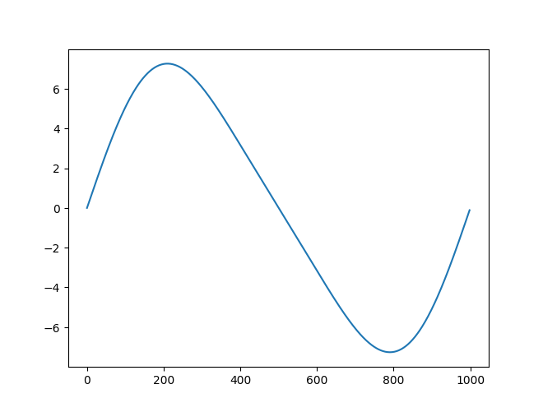
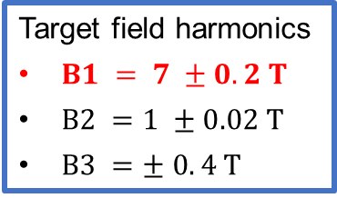
Coil Search Scheme for Cell Demonstrator
Two approaches were considered for the search of the optimal coil configuration:
  Optimization tool (S. Fabbri presentation),
  Coil parameters scan in operating conditions.
In this presentation I will focus on the coil configuration scan approach.
MATLAB + FEMM script solving the magnetostatic problem in lattice conditions.
Scan the coil geometrical parameters and current densities: 10 parameters.
Results compared to the target field harmonics required by the cooling lattice.
Select the optimal configuration based on your design parameters.
Cons: computational cost. Choose the initial set of parameters and use discrete steps!
Target field on axis for a 1 m cell
Target field harmonics
$B1 = 7 ±0.2 T$
$B2 =1 ±0.02 T$
$B3 =± 0. 4 T$
Target design parameters:
Minimize axial force (feasibility).
Minimize conductor volume (cost).
Minimize stored magnetic energy (protection).

Slide 11
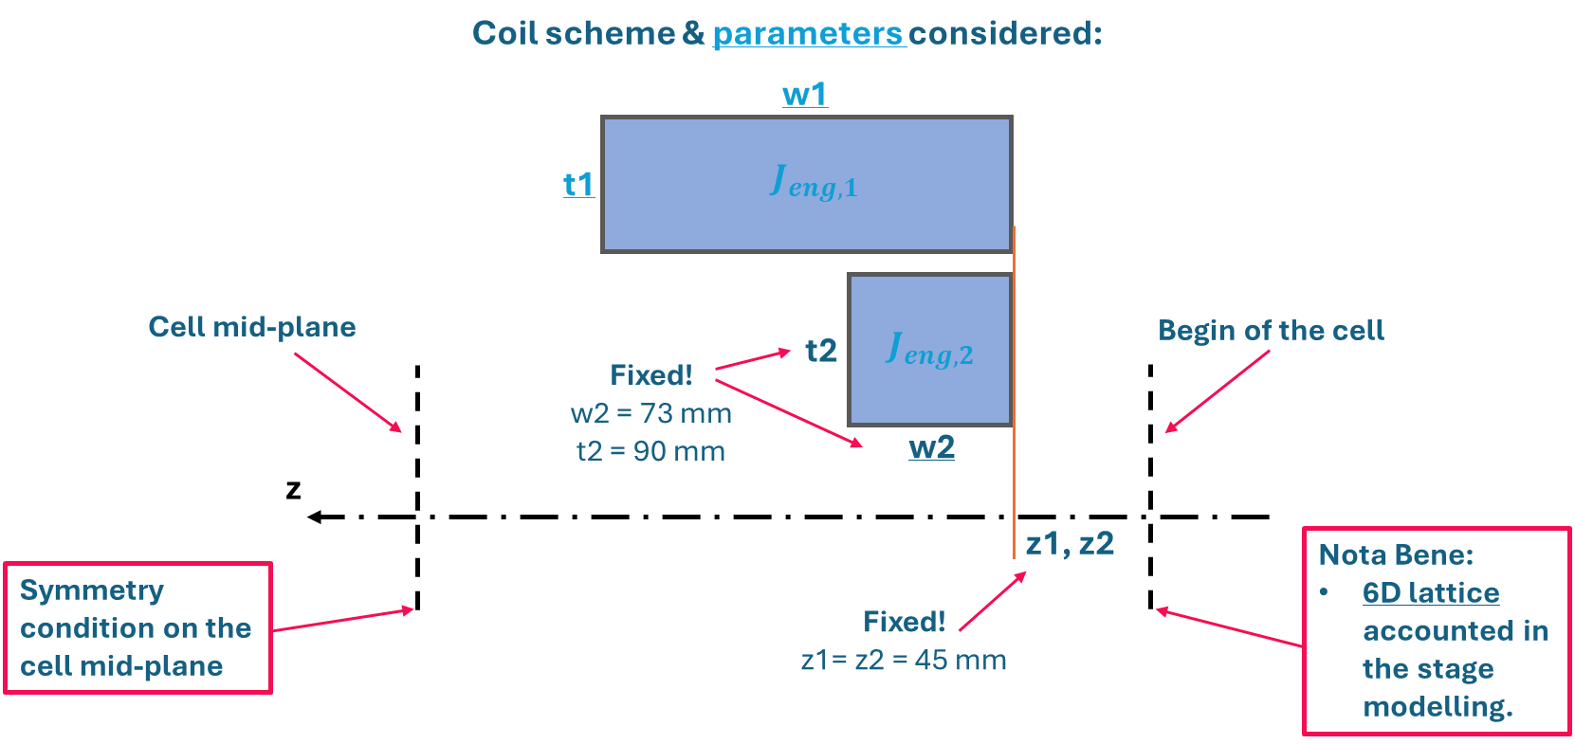
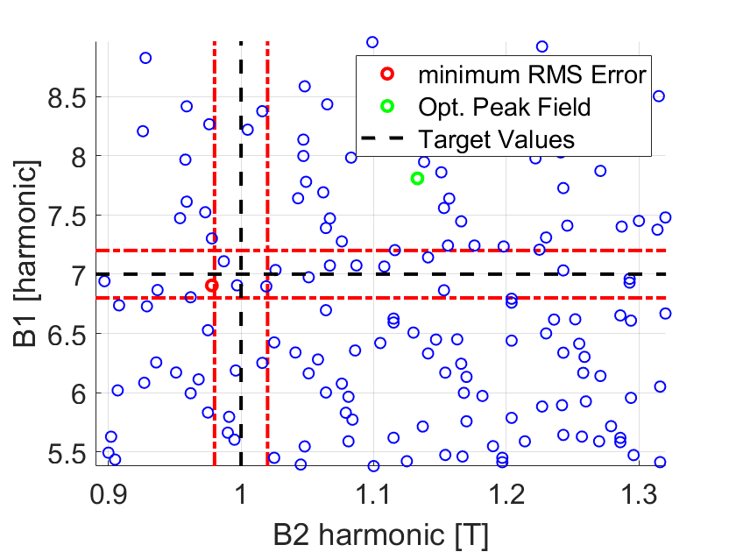
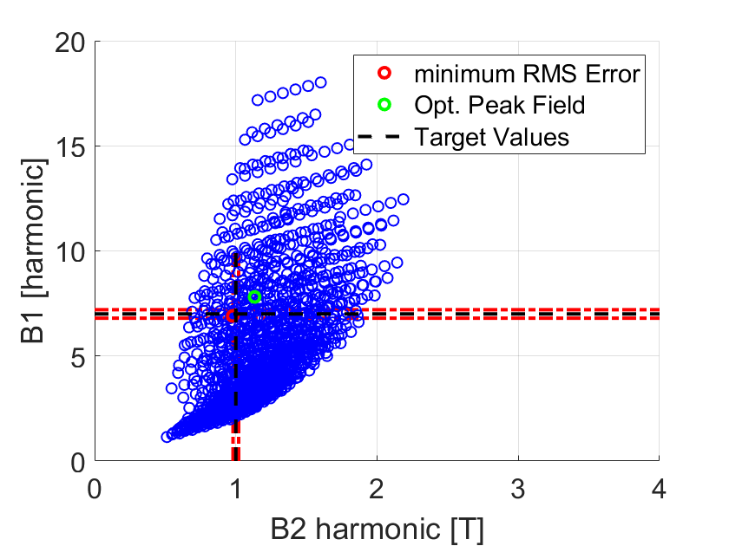
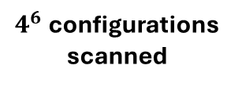

Coil Search Scheme – Setup#1
Geometry of coil#2 is fixed. Four free parameters considered: $J_{eng,1}$, $J_{eng,2}$, coil#1 axial and radial length.
Parameters scan within the reported geometrical constraints.
Five configurations within the target field harmonic tolerances have been identified.
Configuration selected: minimum net axial force and minimum coil volume
«17MN-10mm gap Option», minimum axial force on Coil#2 «27MN-10mm gap Option».
$4^{6}$ configurations scanned
Coil 1
Coil 1
Coil 2
Coil 2

Slide 12

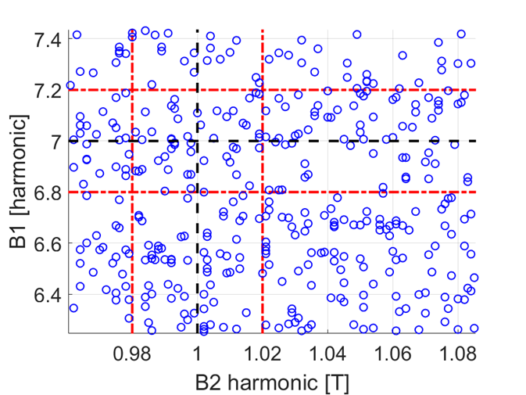
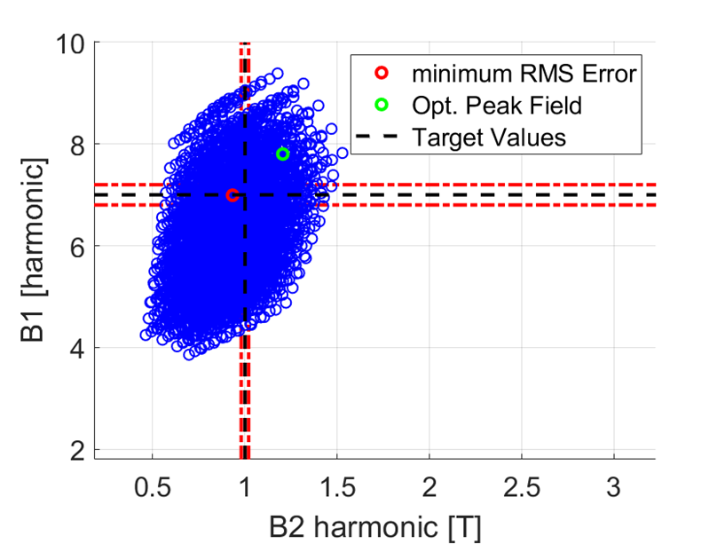

Coil Search Scheme – Setup#2
(with step between coil start)
From the analysis of the “17MN-10mm gap” configuration, the coil search scheme has been refined to scan a finer parameters space, relaxing previously constrained parameters.
Seven free parameters considered: $J_{eng,1}$, $J_{eng,2}$, coil#1 radius, axial position and axial/radial length, coil#2 radial length.
O(100) configurations within the target field harmonic tolerances have been identified.
Two optimal configurations selected: «11MN-20mm gap – min volume», «11MN-20mm gap».
around 5000 configurations scanned
Coil 1
Coil 2

Slide 13
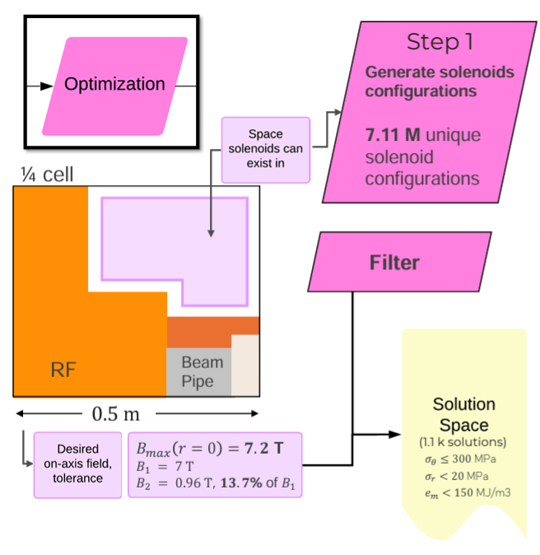
Optimization Tool: Analytical Framework (S. Fabbri)
Configurations found:
Option 21MN – Optim. Tool “Min hoop stress on Coil2”.
Option 15MN – Optim. Tool “Min Coil Volume”.
Credits S. Fabbri

Slide 14
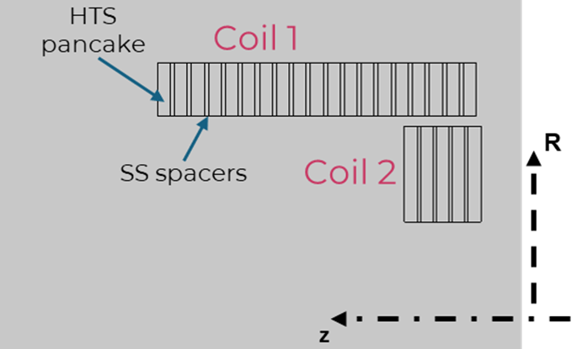

Winding Discretization
Winding scheme: 2x HTS tapes + SS tape co-wound (ESMA-derived).
Dimensions: HTS(12mm X 0.0656mm), SS(12mm X 0.026mm).
Divide the homogenized coil section in pancakes separated by SS spacers.
Inter-pancake spacers dimensions?
  Find the best compromise in terms of field (B1, B2, focusing strength), margins (Ic) and mechanics.
SS tape: $26 μm$
HTS
HTS
Selected spacer dimensions:
Coil1: 4mm spacer
Coil2: 3mm spacer
This configuration maximize the number of pancakes in the stacks, given the total coil dimensions for «Option1»

Slide 15
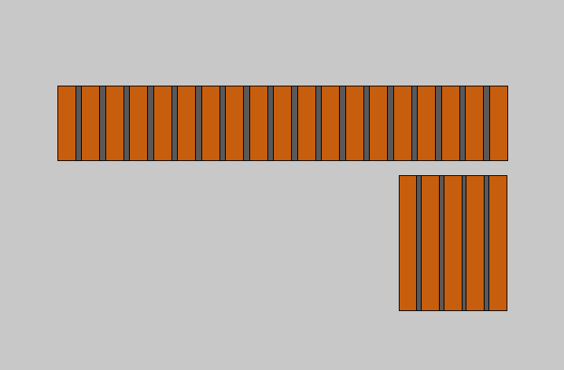
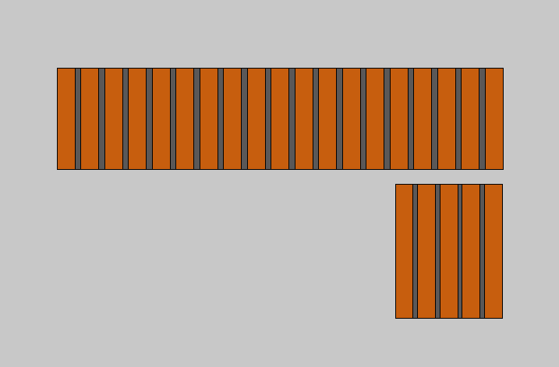
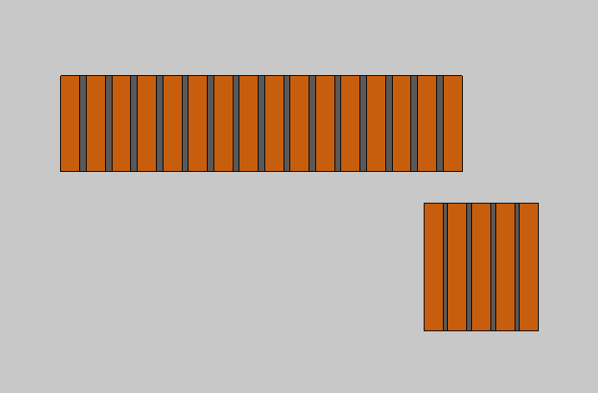
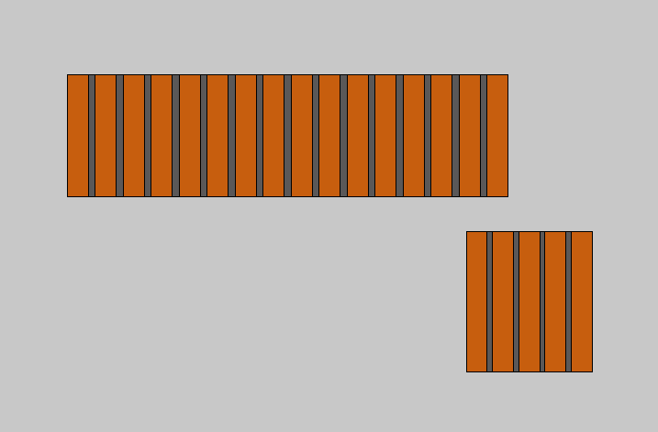
Configurations studied
Configuration derived from “Option 17MN-10mm gap” for Ampere-turns conservation and increased margins
Option 17MN – 10mm gap
Option 18MN – 10mm gap
Setup#1
Optimized versions of “Option 17MN-10mm gap”
Option 11MN – 20mm gap
“minimum volume”
Option 11MN – 20mm gap
Setup#2

Slide 16
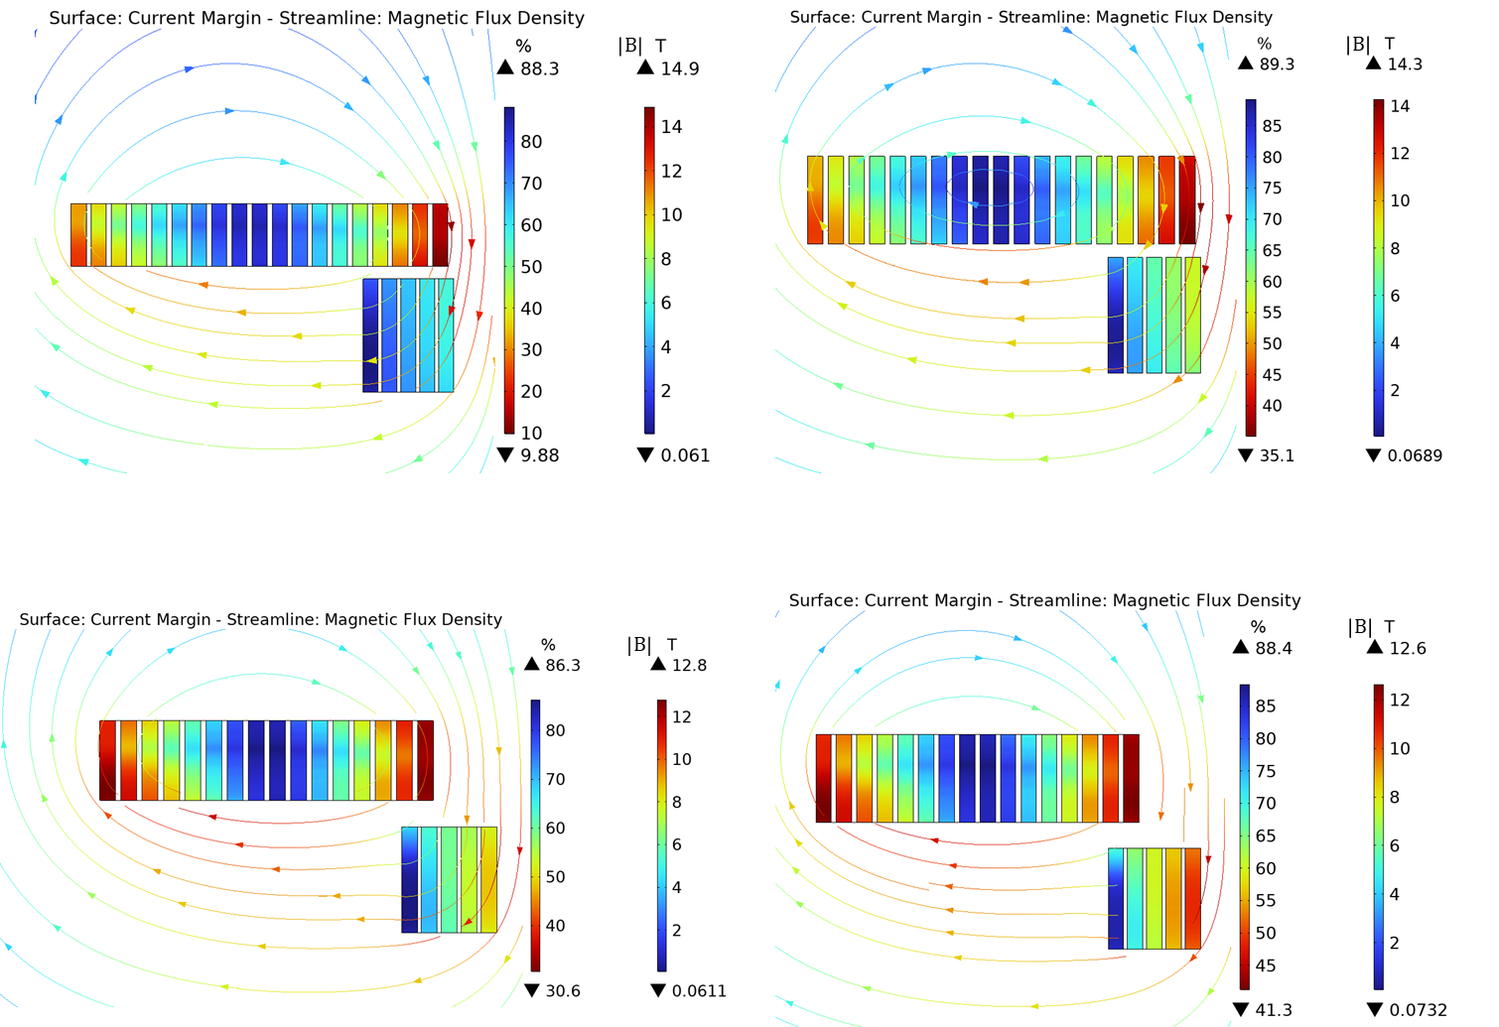
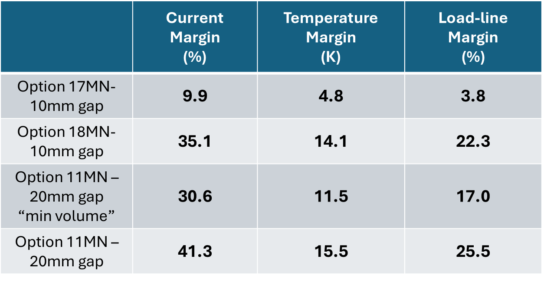
EM Analysis Results: Coil Margins
Option 17MN – 10mm gap
Option 18MN – 10mm gap
Option 11MN – 20mm gap
“minimum volume”
Option 11MN – 20mm gap
Lattice operation

Slide 17
Summary Table
Configuration considered to study the mechanics of the coil assembly
“11MN-20mm gap” configuration provides highest margins, low magnetic energy density and forces, with 9 km increase of the total HTS length .
Lattice operation
 | J_eng Coil1/Coil2 (A/mm^2) | B2/B1 (%) | Focus. Strength per cell length (T^2*m/m) | Axial Force on Coil1/Coil2 (MN) | Net Axial Force (MN) | Net Torque applied on centroid of forces (MN*m) | Peak Hoop Stress on Coil1/Coil2 (MPa) | Peak Positive Radial Stress on Coil1/Coil2 (MPa) | Peak Von Mises Stress on SS spacers (MPa) | Total Magnetic Energy Density in cell (MJ/m^3) | Total HTS length (full cell) (km) | Coil Current Coil1/2 (A)
Option 17MN-10mm gap | 421.5 209.1 | 14.7 | 24.7 | +6.7 +10.4 | +17.1 | -0.597 | +294 +397 | +1.96 +14.5 | +499 +465 | 159.4 | 66 | 795 394
Option 18MN-10mm gap | 322.9 209.1 | 14.5 | 24.6 | +8.0 +10.3 | +18.3 | -0.652 | +230 +358 | +0.91 +14.1 | +390 +459 | 130.0 | 85.6 | 609 394
Option 11MN – 20mm gap “min. vol.” | 380.3 263.9 | 14.7 | 24.4 | +0.4 +11.0 | +11.4 | -0.540 | +260 +349 | +3.45 +8.97 | +377 +460 | 155.3 | 62.8 | 717.4 497.2
Option 11MN – 20mm gap | 328.3 263.9 | 14.8 | 23.7 | +0.7 +10.8 | +11.5 | -0.562 | +222 +344 | +2.95 +8.84 | +323 +454 | 136.2 | 71.6 | 619.4 497.9

Slide 18
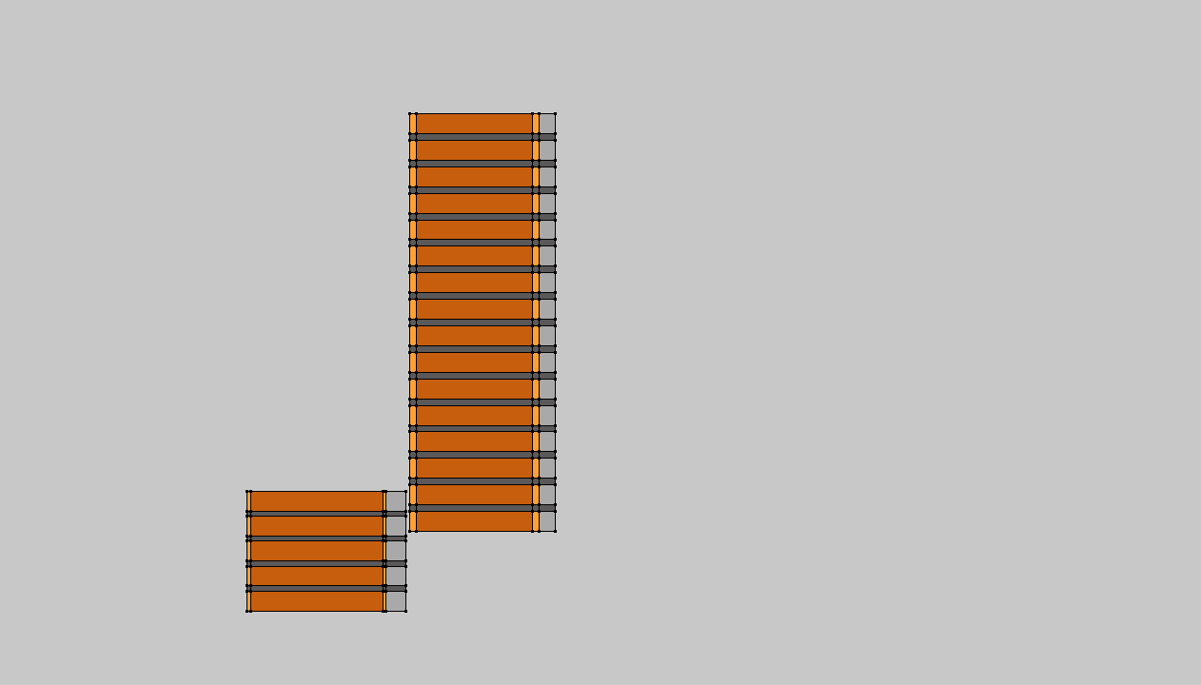
Coil Assembly Study
External SS cylinder
11MN-20mm gap Option
A mechanical analysis of the coil assembly has been performed.
The Cu rings (4mm Coil1, 2mm Coil2) have been dimensioned to limit the Joule losses below 10 mW.
The SS ring thicknesses were limited by the space available for Coil2. 12mm thick rings were considered in Coil2 and 10mm rings in Coil1 (since the highest radial stresses and coil radial thickness are in Coil2).
The SS spacers have been extended to contain the Cu/SS rings.
Cu ring
Coil 1
Coil
Coil 2
Space too tight!
Only 1 mm gap between coils
USED for Integration drawing and studies

Slide 19
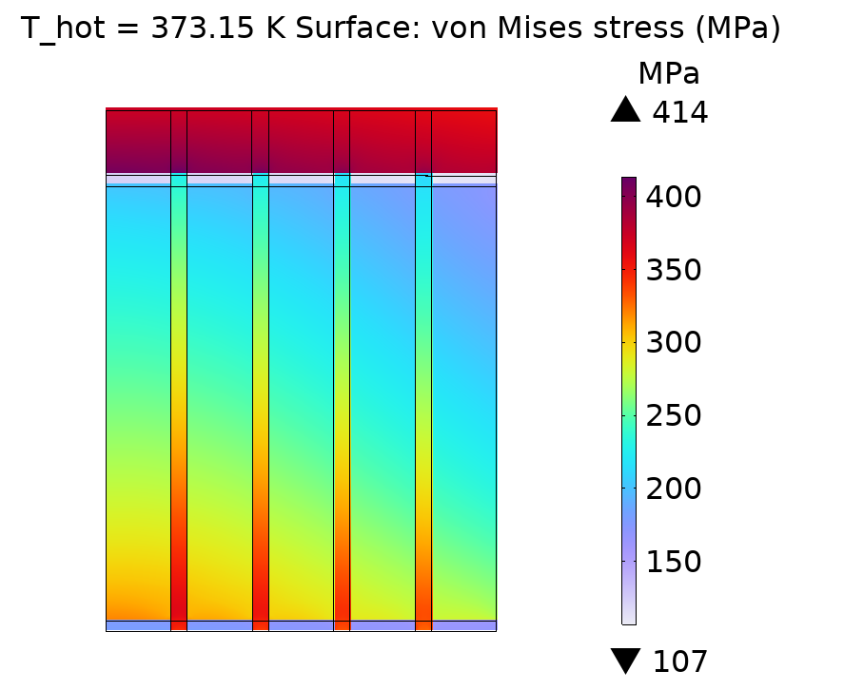
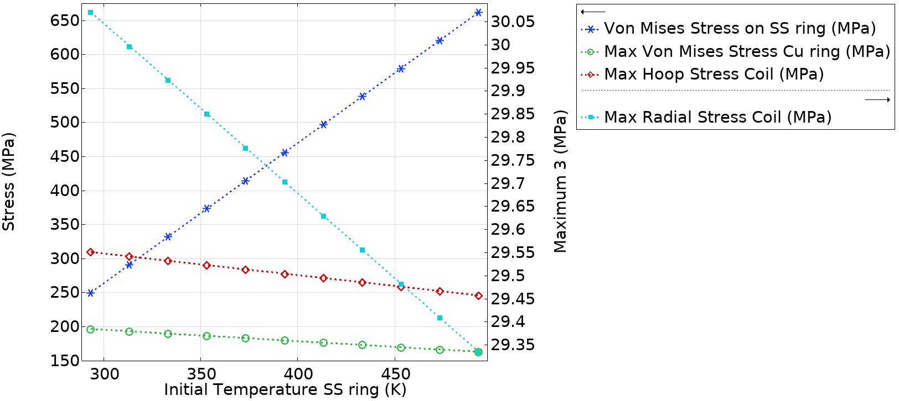
Shrink-fitting Evaluation on Coil2
In the proposed configuration, Coil2 presents the challenge of high radial/hoop stresses to be contained by SS rings of relatively thin radial thickness.
From a simplified analysis, the radial pressure applied on the external coil boundaries in lattice operation must be at least 16MPa on Coil 1, 80MPa on Coil 2.
This study serves to answer the question on the maximum applicable stress via shrink fitting and the associated hot temperature.
Coil 2
Search for coil configurations with increased radial gap between the coil (> 30 mm)
This solution is not feasible:
SS ring thickness too small to provide the required pre-compression on Coil2.
Too small radial gap between coils.

Slide 20
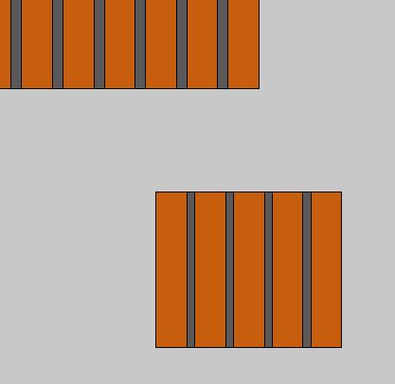
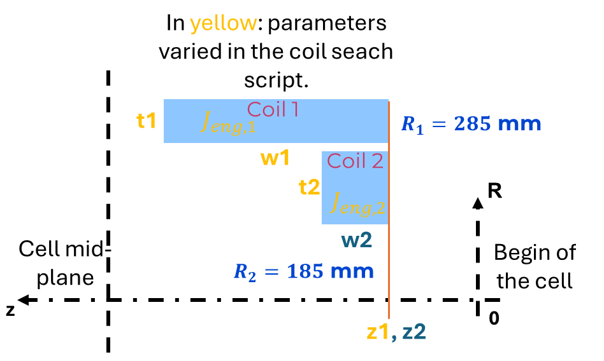
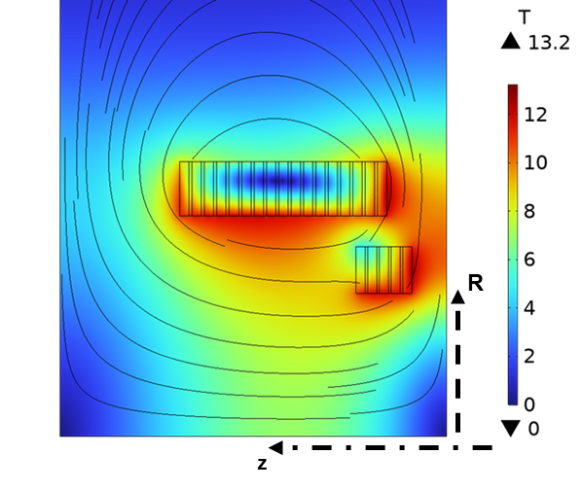
New configuration for integration studies + mechanics: Option 12MN-40mm gap !!!
From a new scan of the coil search scheme, with the new constraint on the minimum radial gap between the two coils, we found the here reported solution: “Option 12MN-40mm gap”.
This solution offers minimum differences with the 12MN-20mm gap option, with the advantage of increased radial gap between coils.
40 mm
Coil 2

Slide 21
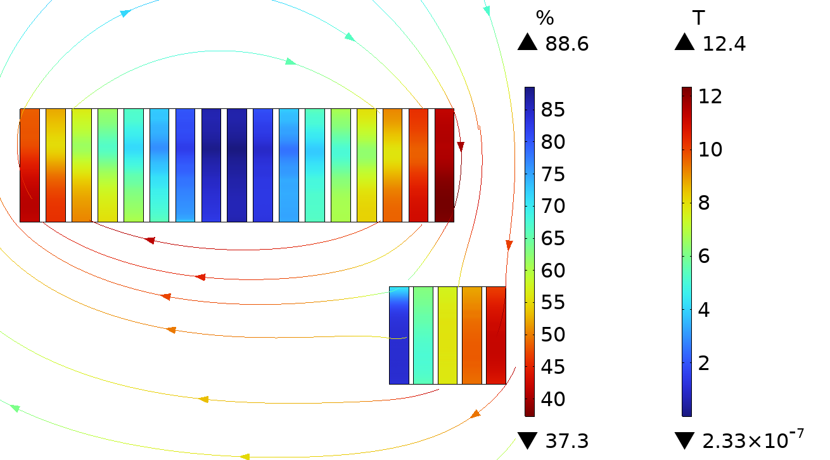
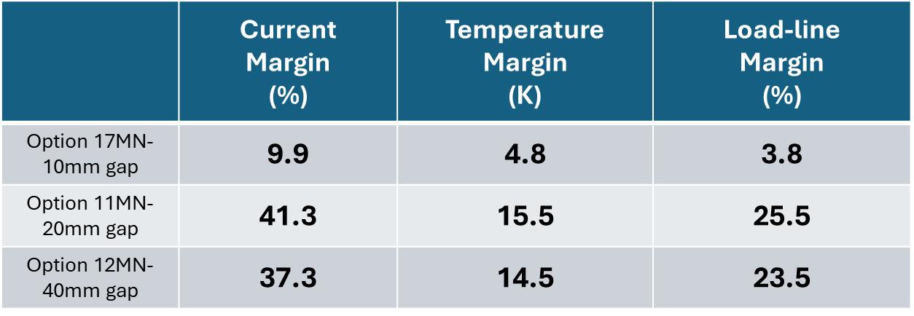
Solutions comparison - Margins
Option 12MN – 40mm gap
Margins are too low
Lattice operation

Slide 22
Summary Table
Lattice operation
 | J_eng Coil1/Coil2 (A/mm^2) | B2/B1 (%) | Focus. Strength per cell length (T^2*m/m) | Axial Force on Coil1/Coil2 (MN) | Net Axial Force (MN) | Net Torque applied on centroid of forces (MN*m) | Peak Hoop Stress on Coil1/Coil2 (MPa) | Peak Positive Radial Stress on Coil1/Coil2 (MPa) | Peak Von Mises Stress on SS spacers (MPa) | Total Magnetic Energy Density in cell (MJ/m^3) | Total HTS length (full cell) (km) | Coil Current Coil1/2 (A)
Option 17MN-10mm gap | 421.5 209.1 | 14.7 | 24.7 | +6.7 +10.4 | +17.1 | -0.597 | +294 +397 | +1.96 +14.5 | +499 +465 | 159.4 | 66 | 795 394
Option 11MN-20mm gap | 328.3 263.9 | 14.8 | 23.7 | +0.7 +10.8 | +11.5 | -0.562 | +222 +344 | +2.95 +8.84 | +323 +454 | 136.2 | 71.6 | 619.4 497.9
Option 12MN-40mm gap | 328.6 299.8 | 14.9 | 24.0 | +4.12 +8.25 | +12.4 | -0.558 | +231 +374 | +1.77 +9.48 | +353 +508 | 140.4 | 71.2 | 620.0 565.4

Slide 23
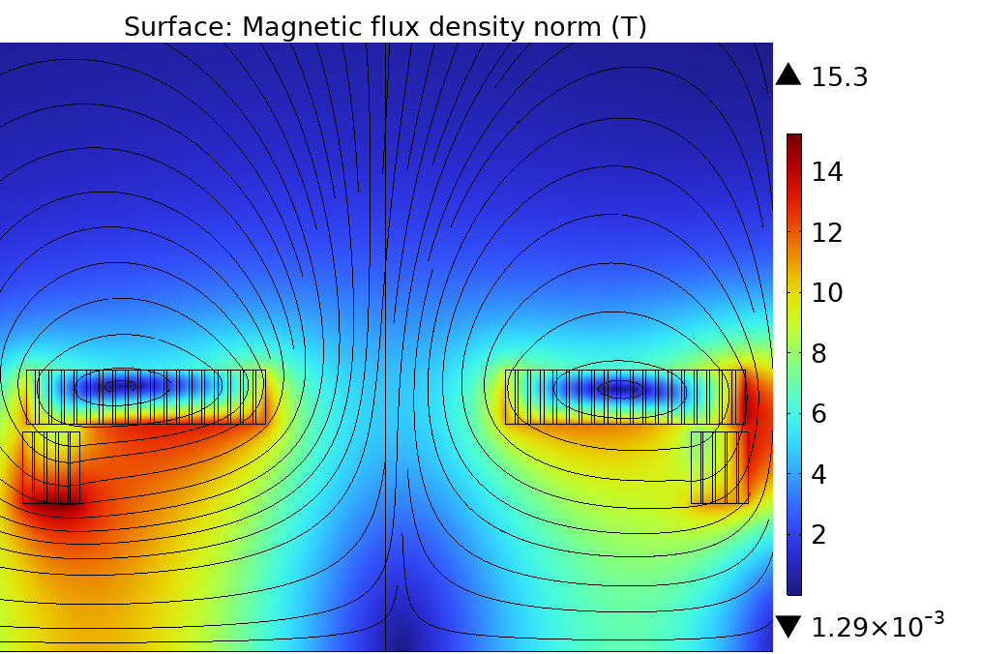
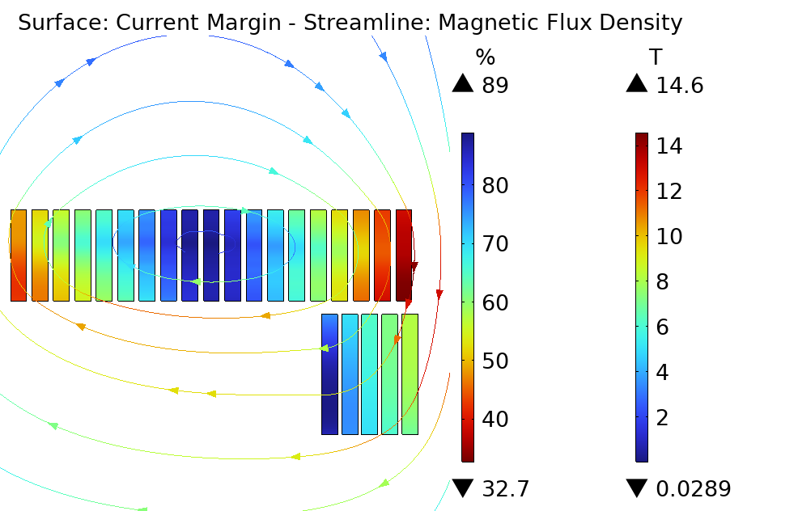
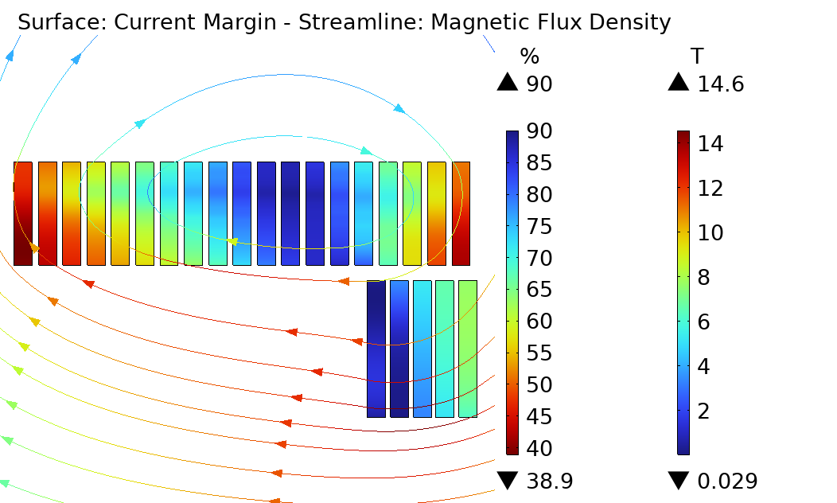
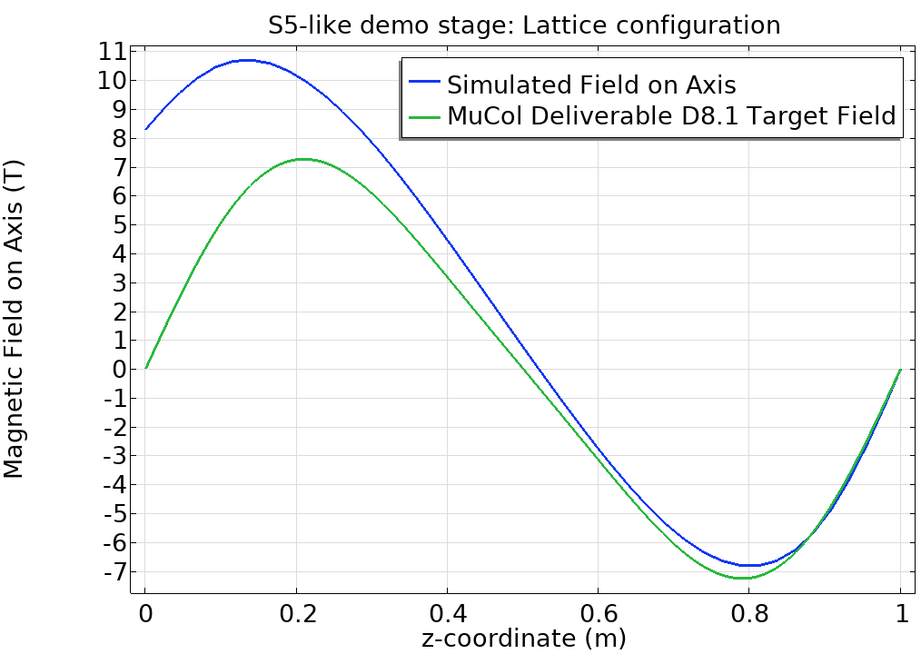
Note: Beg/End Stage Field Analysis
To be validated by Optics!
In lattice operation, the magnets of the first and last cells of the array are subjected to different operating conditions.
The margins are not critical. A slight improve of the current margins is observed.
Instead, attention must be given to the stresses!
Begin of Cell
6D lattice
R
z
Magnet facing the “begin of cell” side.
Magnet facing the lattice side.

Slide 24
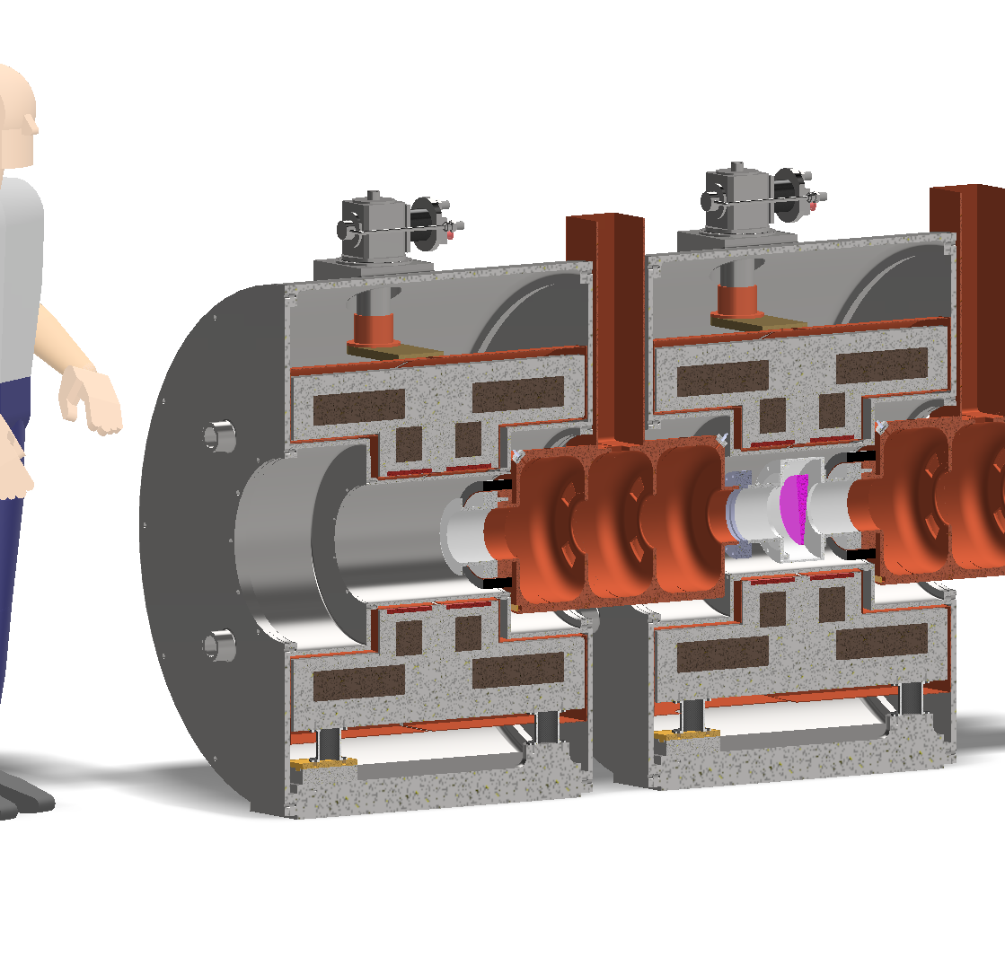

Slide 25
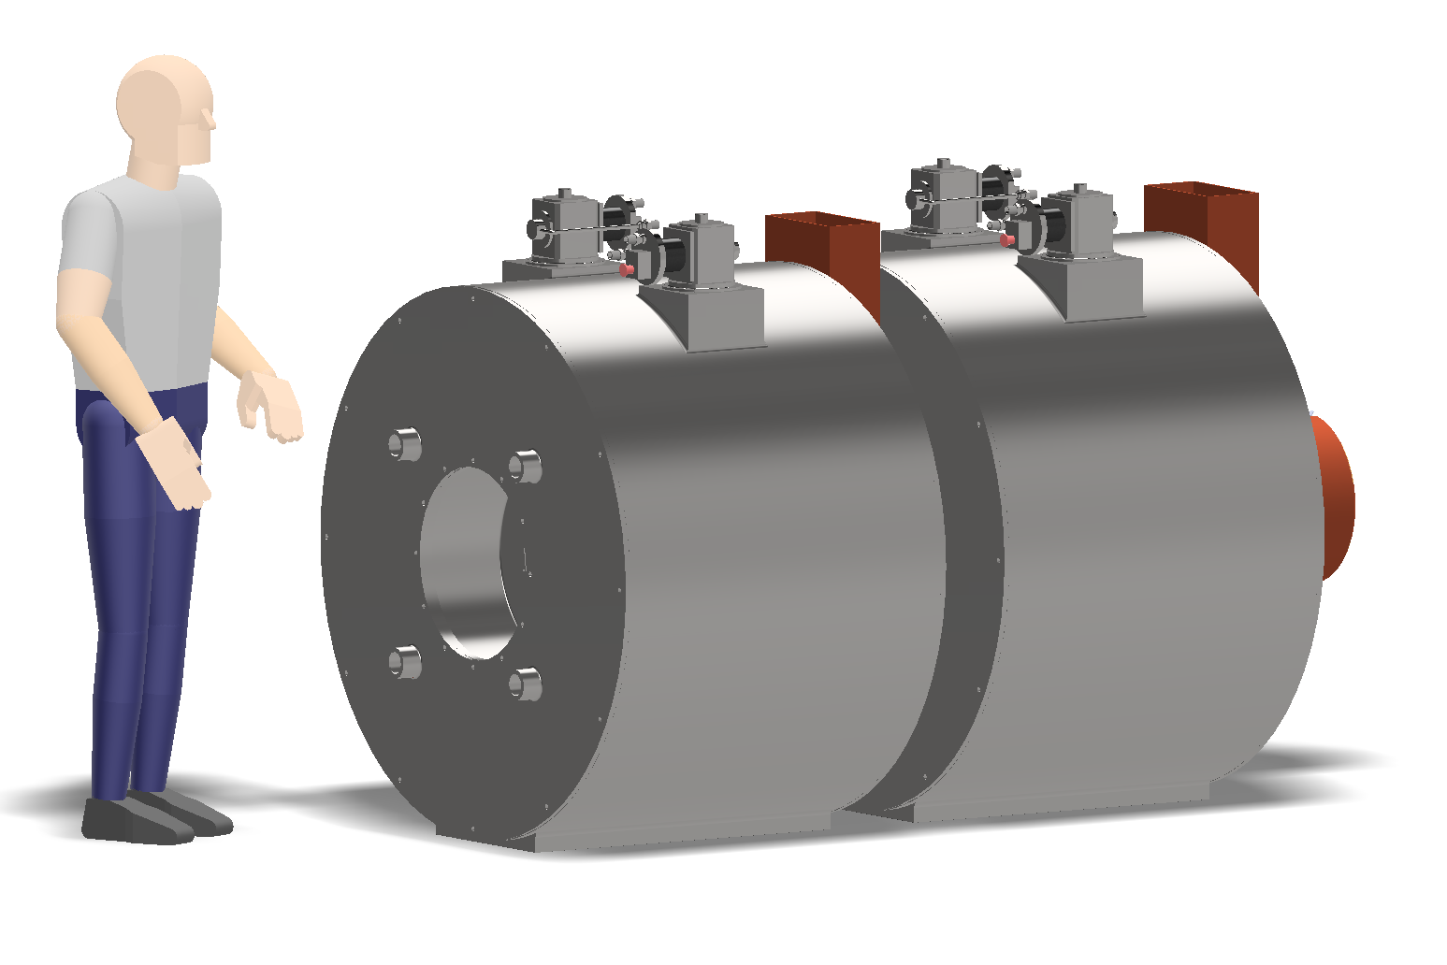

Slide 26
