Slide 1

AGM 2025
Large locale
Aimilianos Koulouris - President
Roberto Fernandez Bautista – Treasurer

Slide 2
News

Slide 3


WiFi!
Mattermost Channel

Slide 4
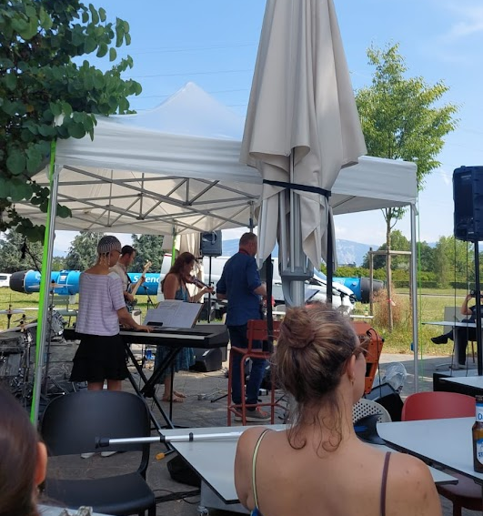
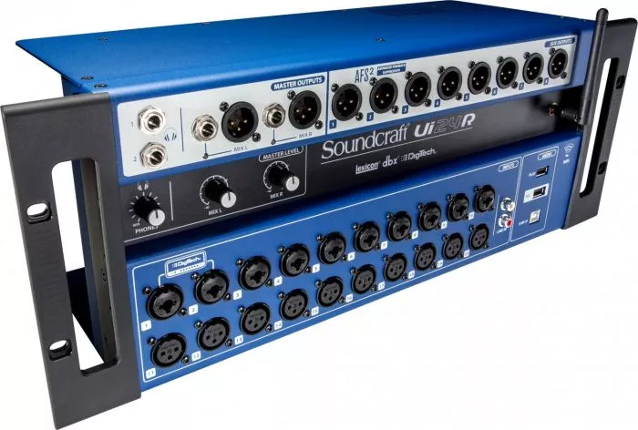
Soundcraft Ui24R
+ Laptop + Router
CHF 1,460
New Tent
CHF 4,149
Available to rent!
(+ side panels not shown)

Slide 5
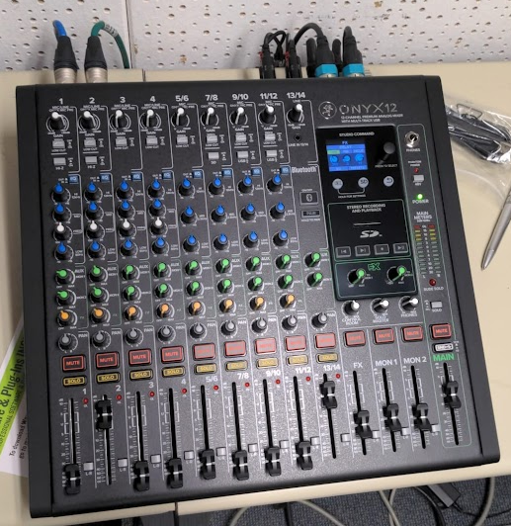
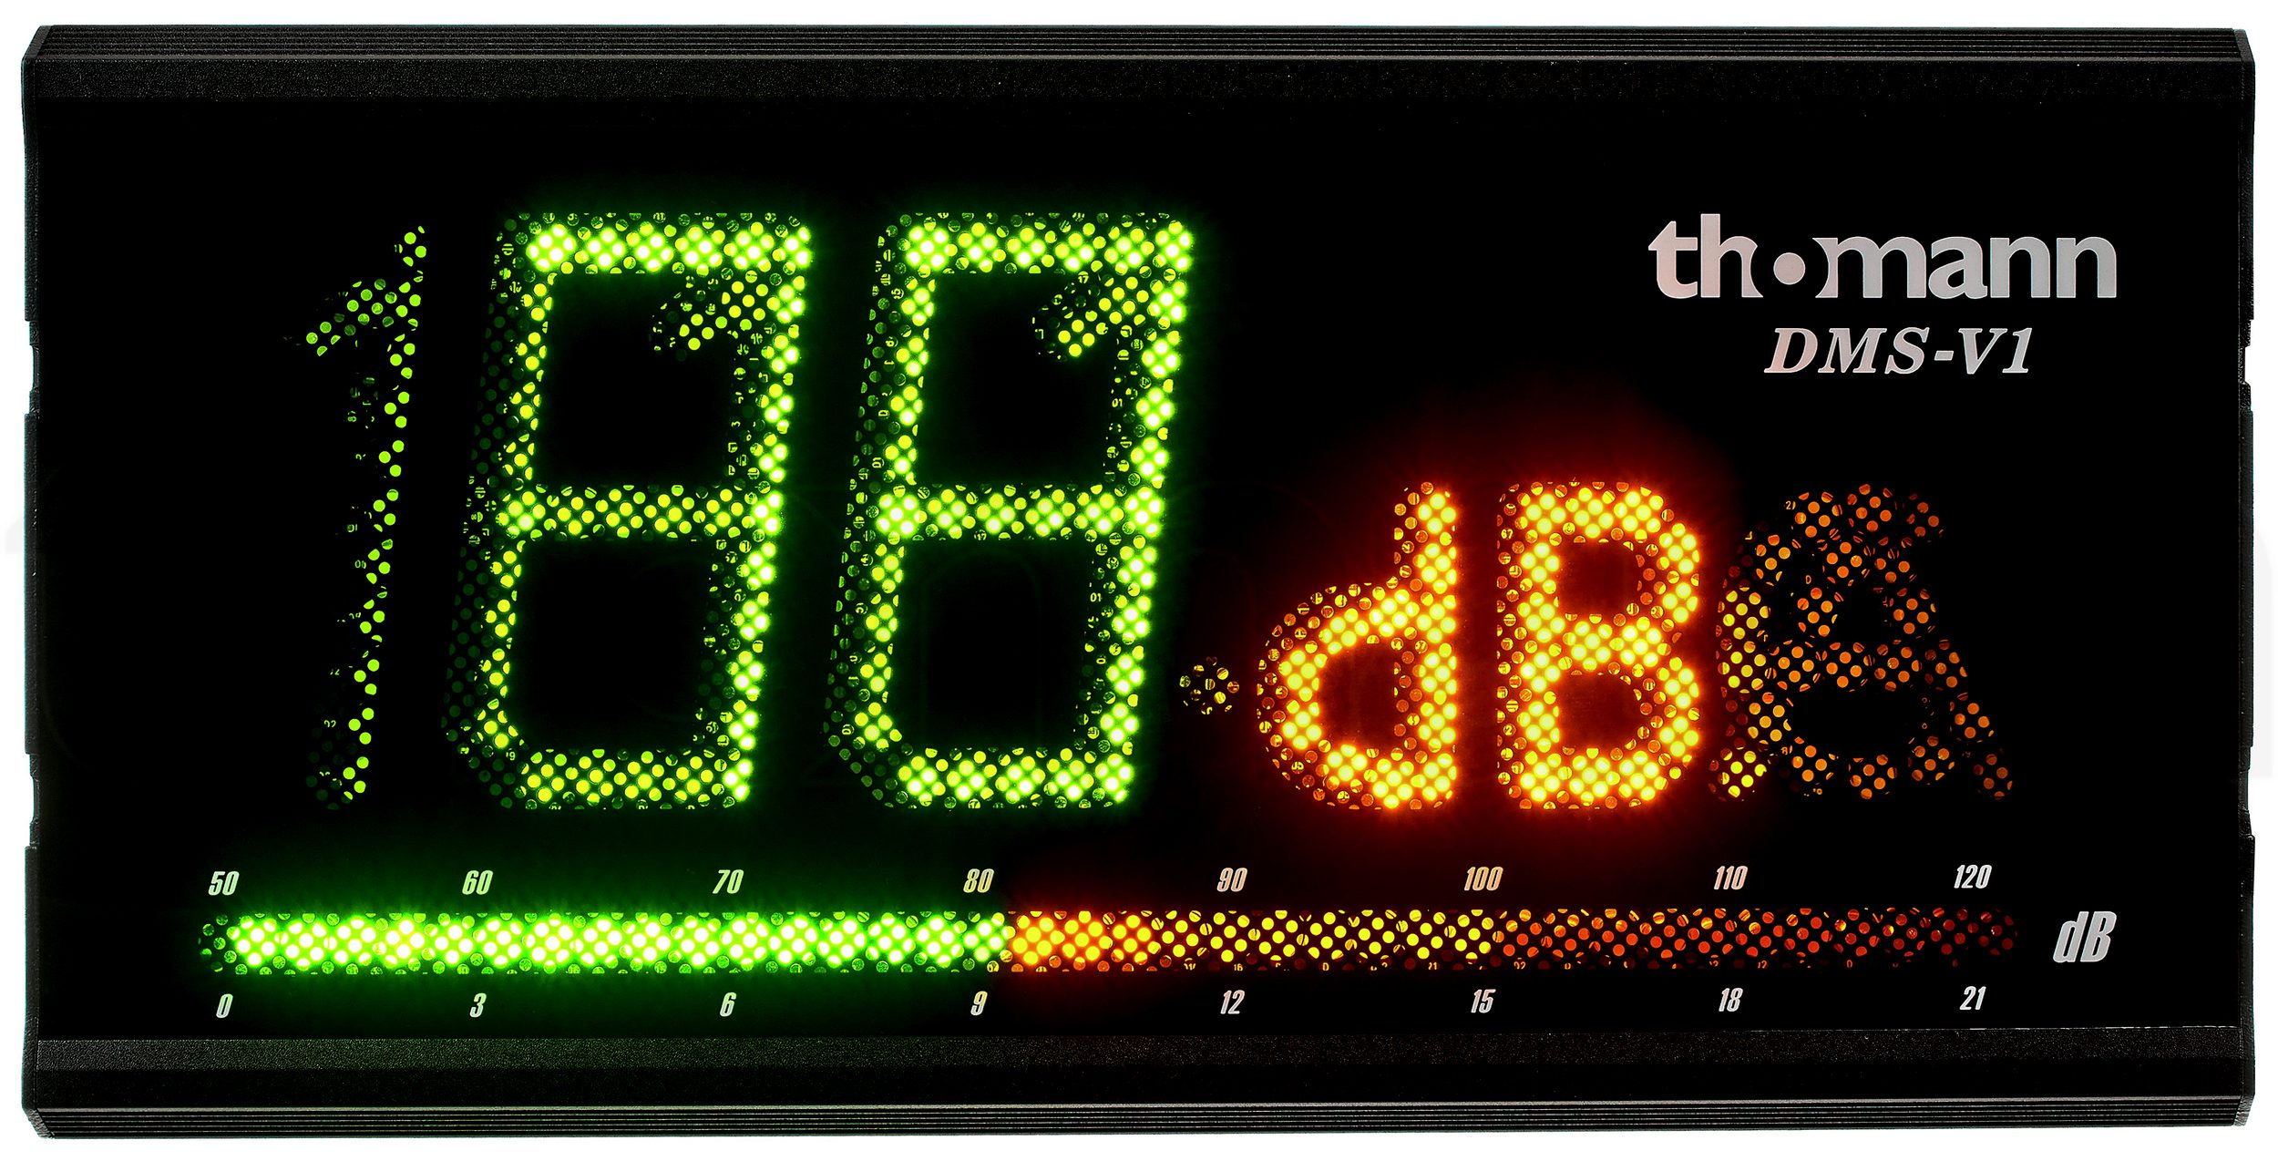
Mixer small locale
Mackie Onyx12
CHF 444
Thomann dB meter
CHF 295

Slide 6
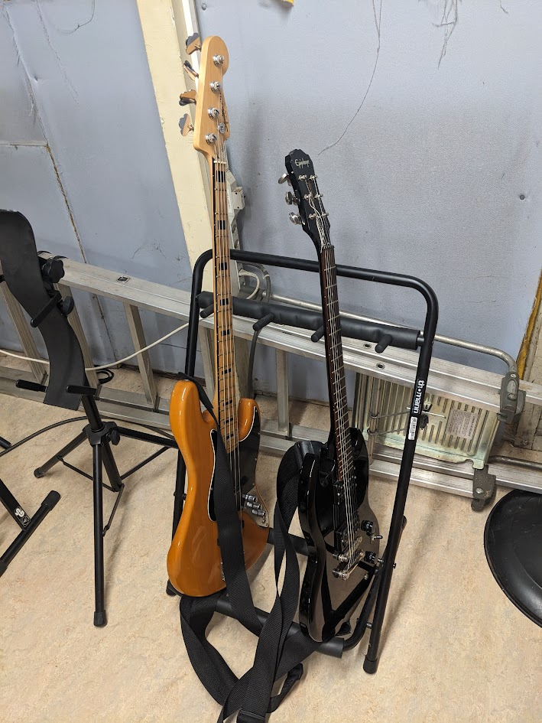
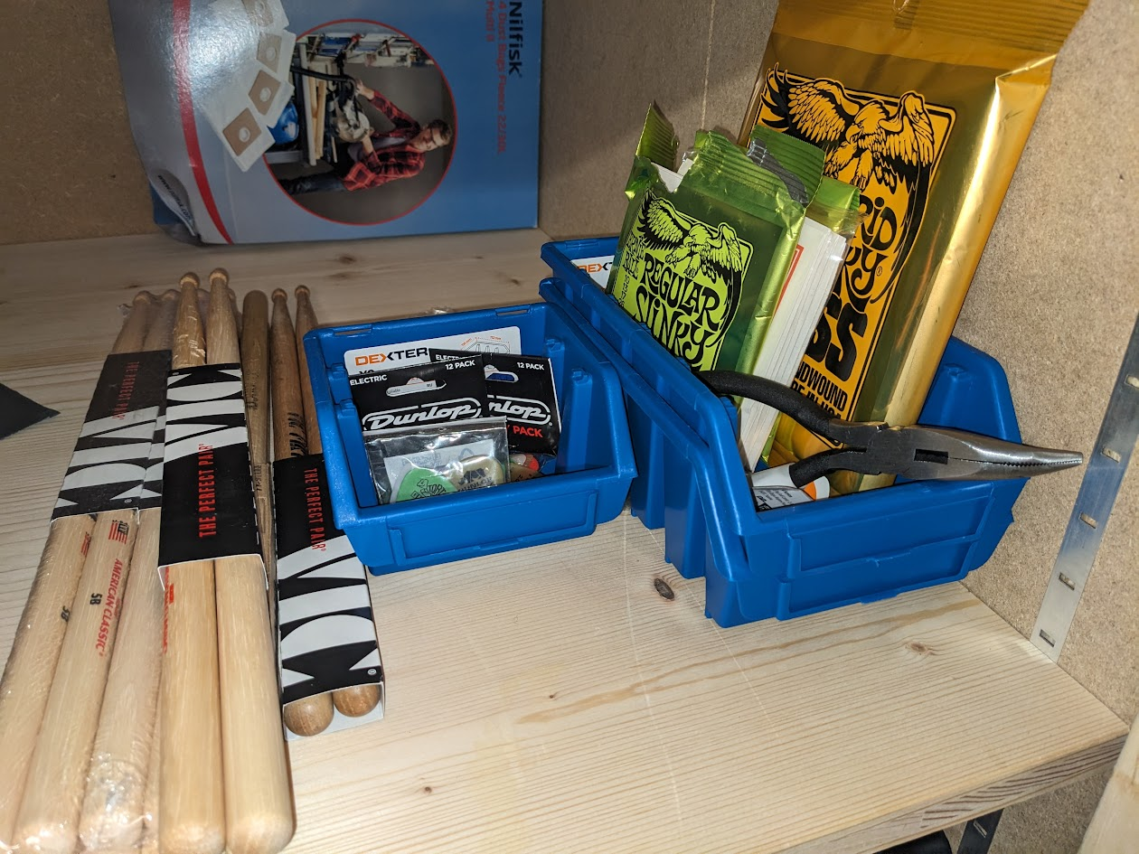
Guitar, bass, stand
CHF 310
Picks, strings, drumsticks
CHF 156
(Expected < 100CHF per year)
ONLY TO BE USED IN LARGE LOCALE
(not for personal instruments)

Slide 7
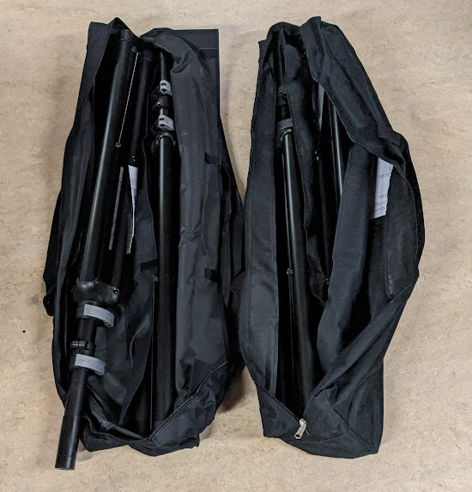
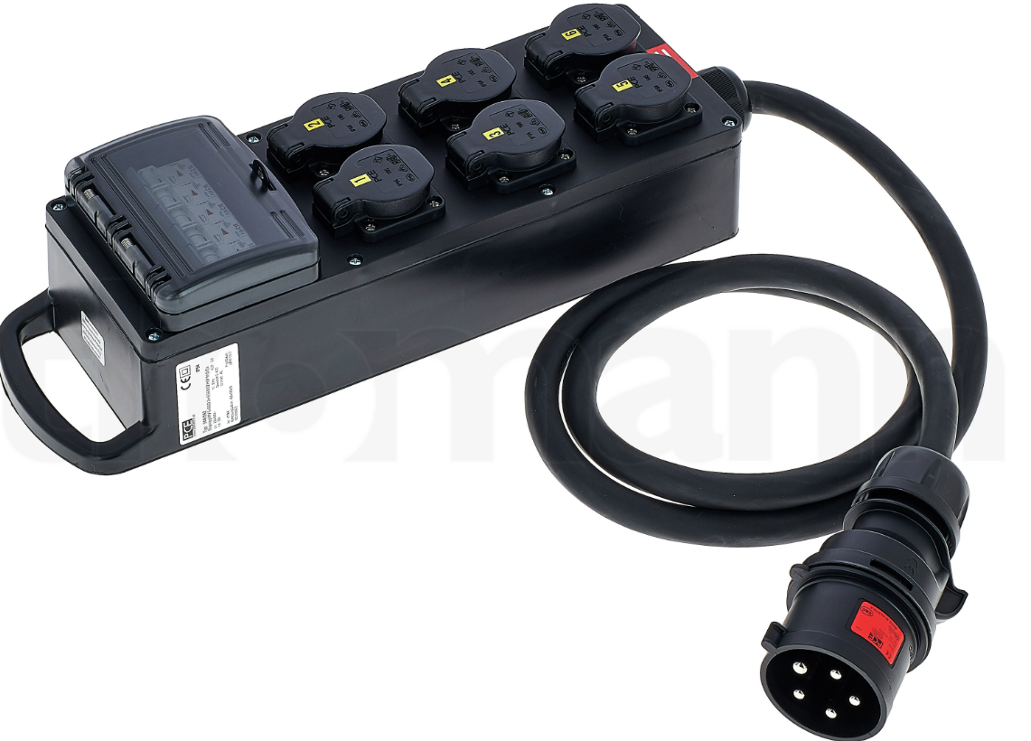
32a to 16a distribution
CHF 211
Replacement speaker poles
CHF 238

Slide 8
Treasurer's report

Slide 9
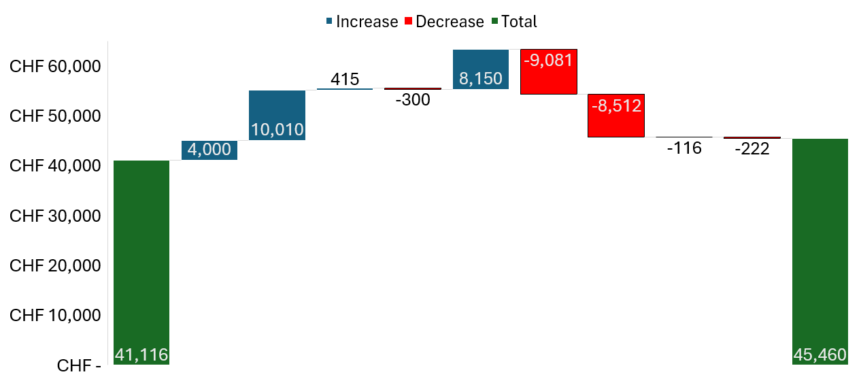
2024 Finances summary
Rentals
Key Returns
Hardronic subsidies
Hardronic expenses
SA Subsidy 2023
Memberships
Equipment purchases
~200 members
Bank Charges
Eurovision 2024 event

Slide 10
Equipment Purchases

Slide 11
Hardronic 2024
Subsidies:
  4000 CHF – Staff Association
  3000 CHF – CERN70 [new for 2024]
  500 CHF – FCC [new for 2024]
  500 CHF – IR [new for 2024]
New costs:
  2440 CHF – Ferney stage rental
  445 CHF – Drinks (previously donated)
Not charged (were in 2023):
  2648 CHF – SCE Electrical installations
Total cost
9081 CHF
Paid by MusiClub
931 CHF
(approx. 5 CHF per member)

Slide 12
Hardronic increasing costs
2019: 6819 CHF
  1969 CHF MusiClub
  ~10 CHF per member
2023: 7892 CHF
  SCE electrical installation ~2000CHF (not in previous years)
  3842 CHF MusiClub
  ~20 CHF per member
2024: 9081 CHF
  3931 CHF MusiClub without CERN70 subsidy
  ~20 CHF per member

Slide 13
General Club matters (voting/discussion)

Slide 14
Hardronic 2025 costs
Maximum per MusiClub member budget contribution
  10CHF per member?
  If more than 150% this budget, cancel? (if can't find new funding)

Slide 15
Cleaning
Small locale
Centralised cleaning service

Slide 16
Inventory update
Double pedal large locale
Piano small room
Speaker stands small locale lost (replacement 238CHF)

Slide 17
Rentals
Mackie speakers to ski club – 2 months
Rental helpers

Slide 18
Large Locale
Andrea M: can someone make a simple tutorial for how to use the mixer? Either a video, or few screenshots, and/or a link to a concise online existing one…
heating point from Andrea M: everyone should take care to setting heating to medium…
imbalance in small/large usage
individuals/duos should really go for the small locale
usage monitor should allow “no cancel shaming” (maybe once and if it works, implement strike system?)

Slide 19
Availability in large locale
suggestion: split low-demand slots from 3h to 1h or 1.5h
suggestion: reduce bulk booking from Emil (probably dropping this in the end)
suggestion by Tom B. including validation system (probably handled simplerly :P by Roberto’s proposal)
proposal:
  Change booking sheet to only allow 1 week booking in advance by members (bulk booking done by Board)
  New bulk booking policy: eligibility is bands with 3 or more members + they must agree to being in the cleaning rota.
  Implement monitoring of room utilisation (using dB meter) over 1 year and make decision at next AGM with data available.
  Allow booking any time slot (we need a volunteer programmer)

Slide 20
Storage
invite people to check around their buildings/offices in case of available storage/locale
move DJ mixer+PA to large locale =? small locale more usable

Slide 21
Shopping list
New edrum kit - budget 3000 CHF. (need specific suggestions)
  got one from G. Moscardi (decent Roland)
New skins/upgrade of large locale kit (need specific suggestions)
  Got one from G.Moscardi (Remo Emperors or Evans G2’s)
Sound proofing small locale - budget 3000CHF (expected to be a lot less):
  Air vent sound proofing (product suggestion Tom Levens)
  Insulating foam for small locale? (product suggestion by Sandra)
New mackie speaker (normally we should have 2)

