Slide 1
1
General Information & highlights from the 28th (Super)KEKB Accelerator Review meeting
Frank Zimmermann
201st FCC-ee Accelerator Design Meeting & 72nd FCCIS WP2.2 Meeting

Slide 2
Status FSR vol 2.
e+e- booster (tapering?), e+e- injector, hh in good shape
e+e- collider:
add orbit feedback, vibrations, tuning with IP signals, etc.
(proposal Xavier & Jack)
updates / addition in design section
(e-cloud & vacuum effects,..)
still empty parts operations section
(injection after abort, machine protection, availability, operation model)

Slide 3
(Super)KEKB review #28 | 14 -16 Jan 2025 | participants
Frank Zimmermann, Chair CERN
Ralph Assmann GSI
Vincent Baglin CERN
Paolo Craievich PSI
John Fox Stanford University
Andrew Hutton JLab (excused)
Heung-Sik Kang POSTECH
Catia Milardi INFN-LNF
Evgeny Perevedentsev BINP (remote)
Qing Qin ESRF
Bob Rimmer JLab
John Seeman SLAC
Michael Sullivan SLAC
Tom Taylor CERN (ret.)
Rogelio Tomas CERN (remote)
Yuan Zhang`` IHEP
Tadashi Koseki KEK, Director of Acc. Lab., Ex Officio Member
Kyo Shibata KEK, Head of Acc. Division III, Ex Officio Member
Makoto Tobiyama KEK, Head of Acc. Division IV, Ex Officio Member
Hiroyasu Ego KEK, Head of Acc. Division V, Ex Officio Member

Slide 4
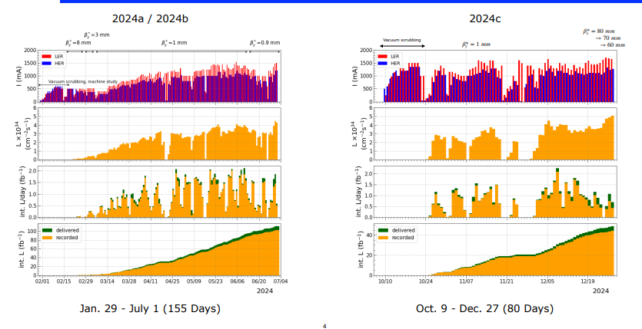
run 2024c

Slide 5
parameters, 2024 progress w.r.t. 2022 and SKB design
parameter | KEKB w Belle |  | SKB 2022b |  | SKB 27 December 2024 |  | SKB design
 | LER | HER | LER | HER | LER | HER | LER | HER
E [GeV] | 3.5 | 8 | 4 | 7 | 4 | 7 | 4 | 7
β_{x}* [mm] | 1200 | 1200 | 80 | 80 | 60 | 60 | 32 | 25
β_{y}* [mm] | 5.9 | 5.9 | 1.0 | 1.0 | 1.0 | 1.0 | 0.27 | 0.30
ε_{x}* [nm] | 18 | 24 | 4.0 | 4.6 | 4.0 | 4.6 | 3.2 | 4.6
ε_{y}* [pm] | 150 | 150 | ~50 | ~50 | ~70 | ~70 | 8.6 | 12.9
I [mA] | 1640 | 1190 | 1321 | 1099 | 1632 | 1259 | 3600 | 2600
n_{b} | 1584 |  | 2249 |  | 2346 |  | 2500
I_{b} [mA] | 1.04 | 0.75 | 0.587 | 0.489 | 0.696 | 0.537 | 1.44 | 1.04
ξ_{y} | 0.098 | 0.059 | 0.0407 | 0.0279 | 0.036 | 0.027 | 0.069 | 0.060
L_{sp} [10³⁰cm⁻²s⁻¹mA⁻²] | 17.1 |  | 71.2 |  | 58 |  | 214
L [10³⁴ cm⁻²s⁻¹] | 2.11 |  | 4.65 |  | 5.1 |  | 80

Slide 6
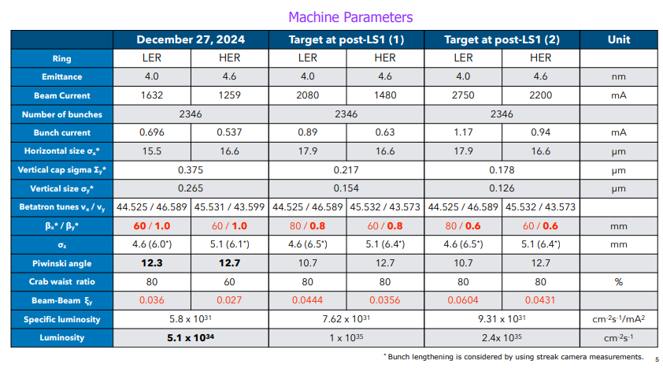
parameters, record dec ‘24 and “near-term” targets

Slide 7
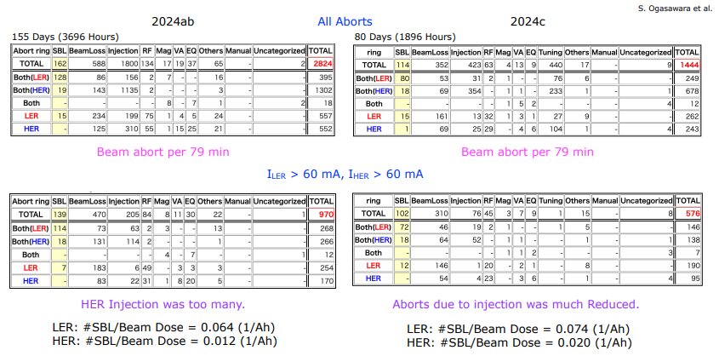
beam aborts

Slide 8
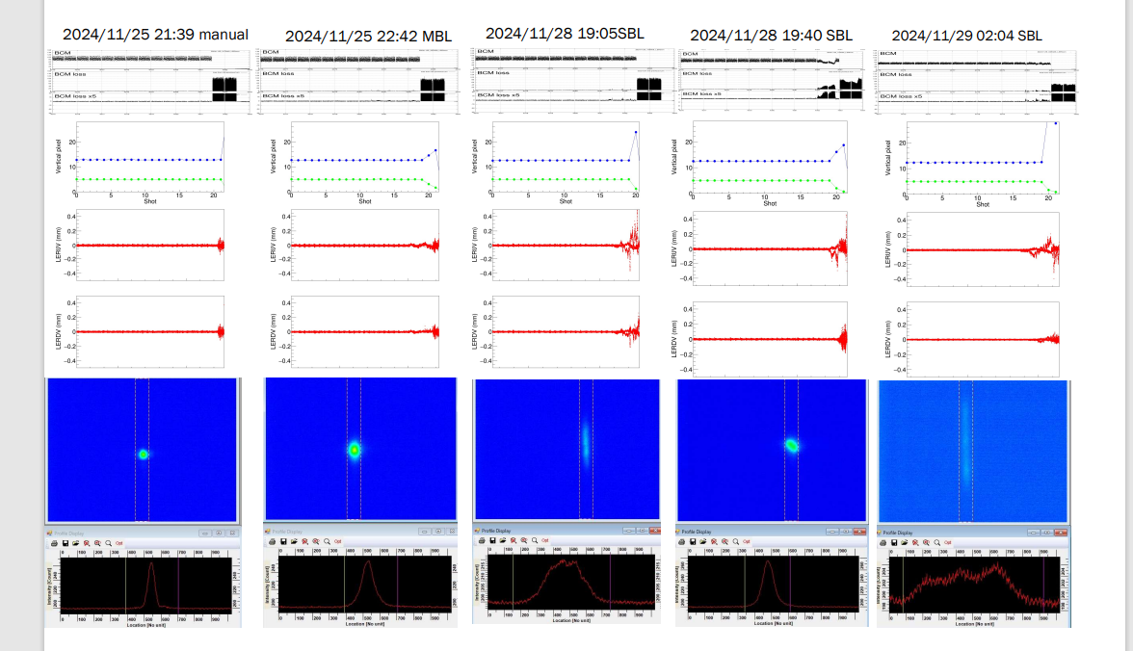
Sudden Beam Loss – vertical blow up seen

Slide 9
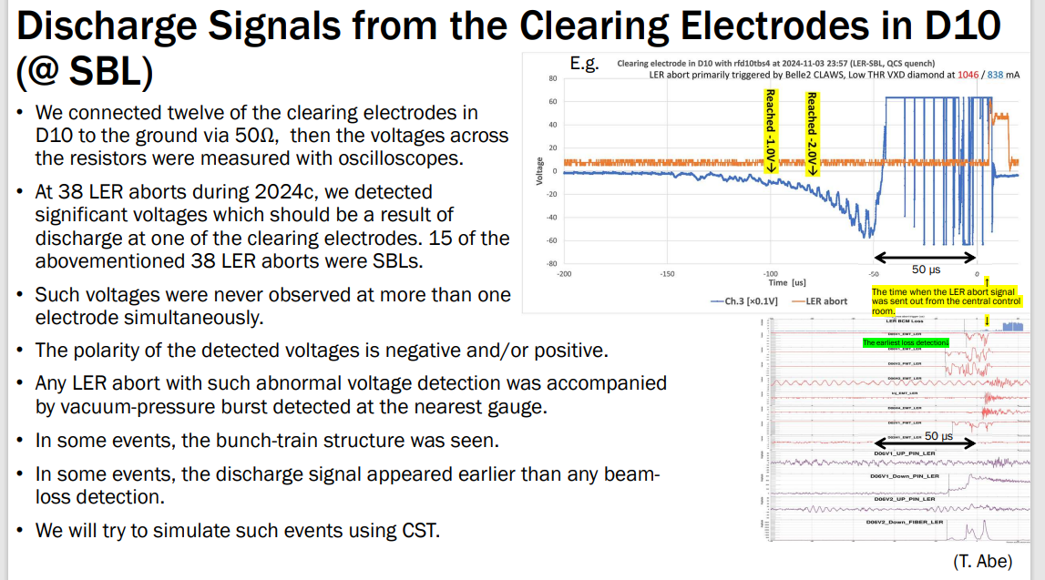
Sudden Beam Loss – signal on clearing electrodes

Slide 10
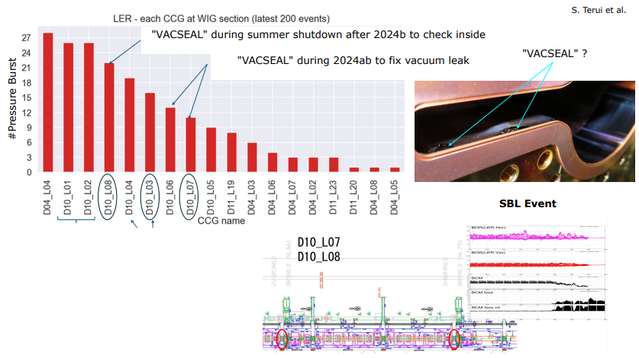
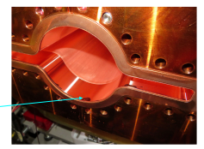
VacSeal in vacuum chamber

Slide 11
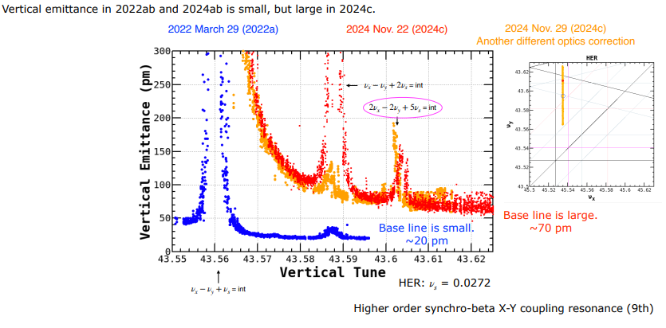
huge vertical emittance and vertical tune in HER
started two weeks into the 2024c run; emittance could not be recovered

Slide 12
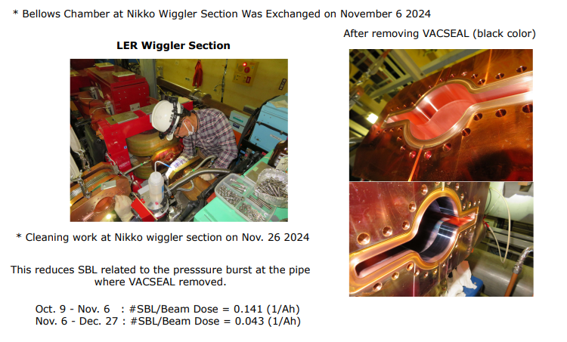
cleaning inside of flanges and vacuum chambers

Slide 13
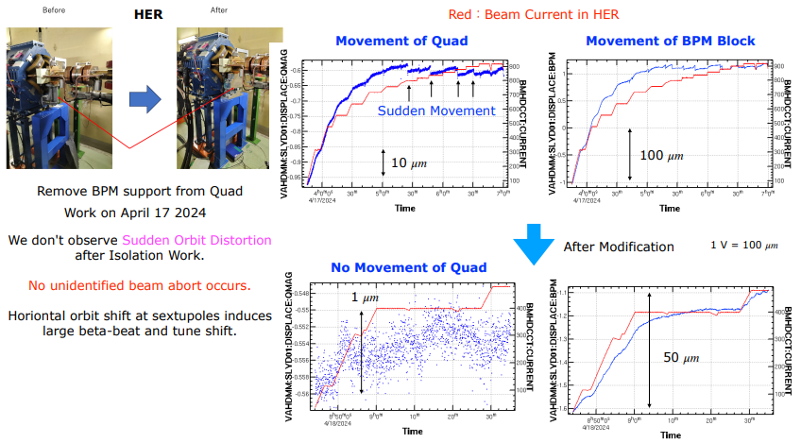
decoupling of BPMs from quadrupole

Slide 14
ordered list of priority items, proposed by ARC review
0. Reconnect the BPMs which were isolated in 2024 to the adjacent quadrupoles, and stabilize the quadrupole position by mechanical means
Acquiring or producing vacuum clamshells to avoid use of VacSeal during the next run
Installing more BORs for SBL diagnostics around the LER, and at least one in the HER, in particular RFSoC with bunch-by-bunch capabilities
Additional laser-based (?) IR survey (misalignment/tilt of Belle-II detector w.r.t accelerator)
Further development of improved IR magnetic model
BT dipole magnet replacements (for LER)
Further realignment of both BT lines (since realignment of ARC1 e+ proved effective in reducing the emittance growth)
Improve and extend turn-by-turn BPM reading capability for both HER and LER
Routine recording of emittances or beam sizes measured by SR monitors
Installing two or more nonlinear magnets, such as octupoles, in each of the two BT lines, once the potential beneficial effect for injection efficiency is confirmed by simulations
Explore and, if deemed possible, implement a local water cooling at the heat source for some power supplies, to save energy and not only to rely on air conditioning

