Slide 1
Updates of the RPO / cavity voltage studies for the FCC-ee booster
Ivan Karpov and Franck Peauger for FCC SRF WP1 with input from:
Hannes Bartosik, Xavier Buffat, Antoine Chance, Yann Dutheil, Giorgia Favia, Jiquan Guo (JLAB),
Mauro Migliorati (INFN), Katsunobu Oide, Jorg Wenninger, Frank Zimmermann, Mikhail Zobov (INFN)
201th Accelerator Design Meeting & 72th FCCIS WP2.2 Meeting, 28.01.2025

Slide 2

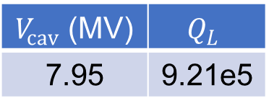
Introduction
A common RF system design for Z, W, and ZH modes of the collider was adopted as a new baseline:
2 RF systems with 50 MW RF power and 1 GV of RF voltage
A low RF voltage for Z is achieved using Reverse phase operation mode (RPO, Y. Morita et al., 2009)
Splitting and combining beams in the RF straight section covers the RF voltage range for W and ZH
 | Energy (GeV) | Current (mA) | RF voltage (GV)
Z | 45.6 | 1283 | 0.088
W | 80 | 135 | 1.05
ZH | 120 | 26.7 | 2.1
RPO at Z
$→$ The Booster RF system requires similar flexibility to achieve a smooth switch between operational modes
$V_{cav}$ (MV) | $$Q_{L}$$
7.95 | 9.21e5

Slide 3
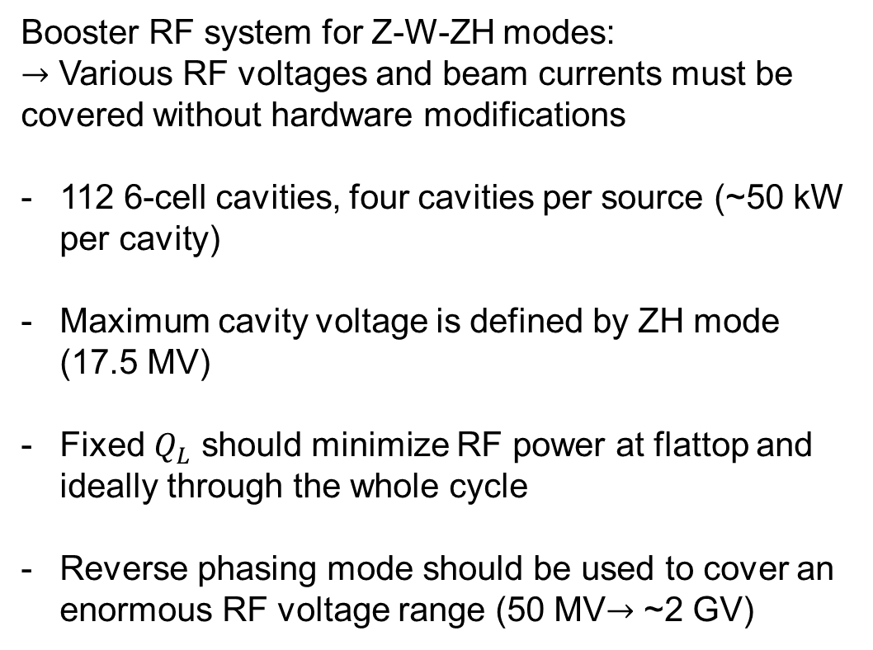
Design constraints
Booster RF system for Z-W-ZH modes:
$→$ Various RF voltages and beam currents must be covered without hardware modifications
112 6-cell cavities, four cavities per source (~50 kW per cavity)
Maximum cavity voltage is defined by ZH mode (17.5 MV)
Fixed $Q_{L}$ should minimize RF power at flattop and ideally through the whole cycle
Reverse phasing mode should be used to cover an enormous RF voltage range (50 MV$→$ ~2 GV)
Main RF-related parameters
 | Unit | Z | W | ZH
Beam current | mA | 16 | 13 | 2
RF voltage (FB) | MV | 50
RF voltage (FT) | MV | 57 | 402 | 1960
Max SR power | MW | 1.05 | 4.51 | 3.44

Slide 4
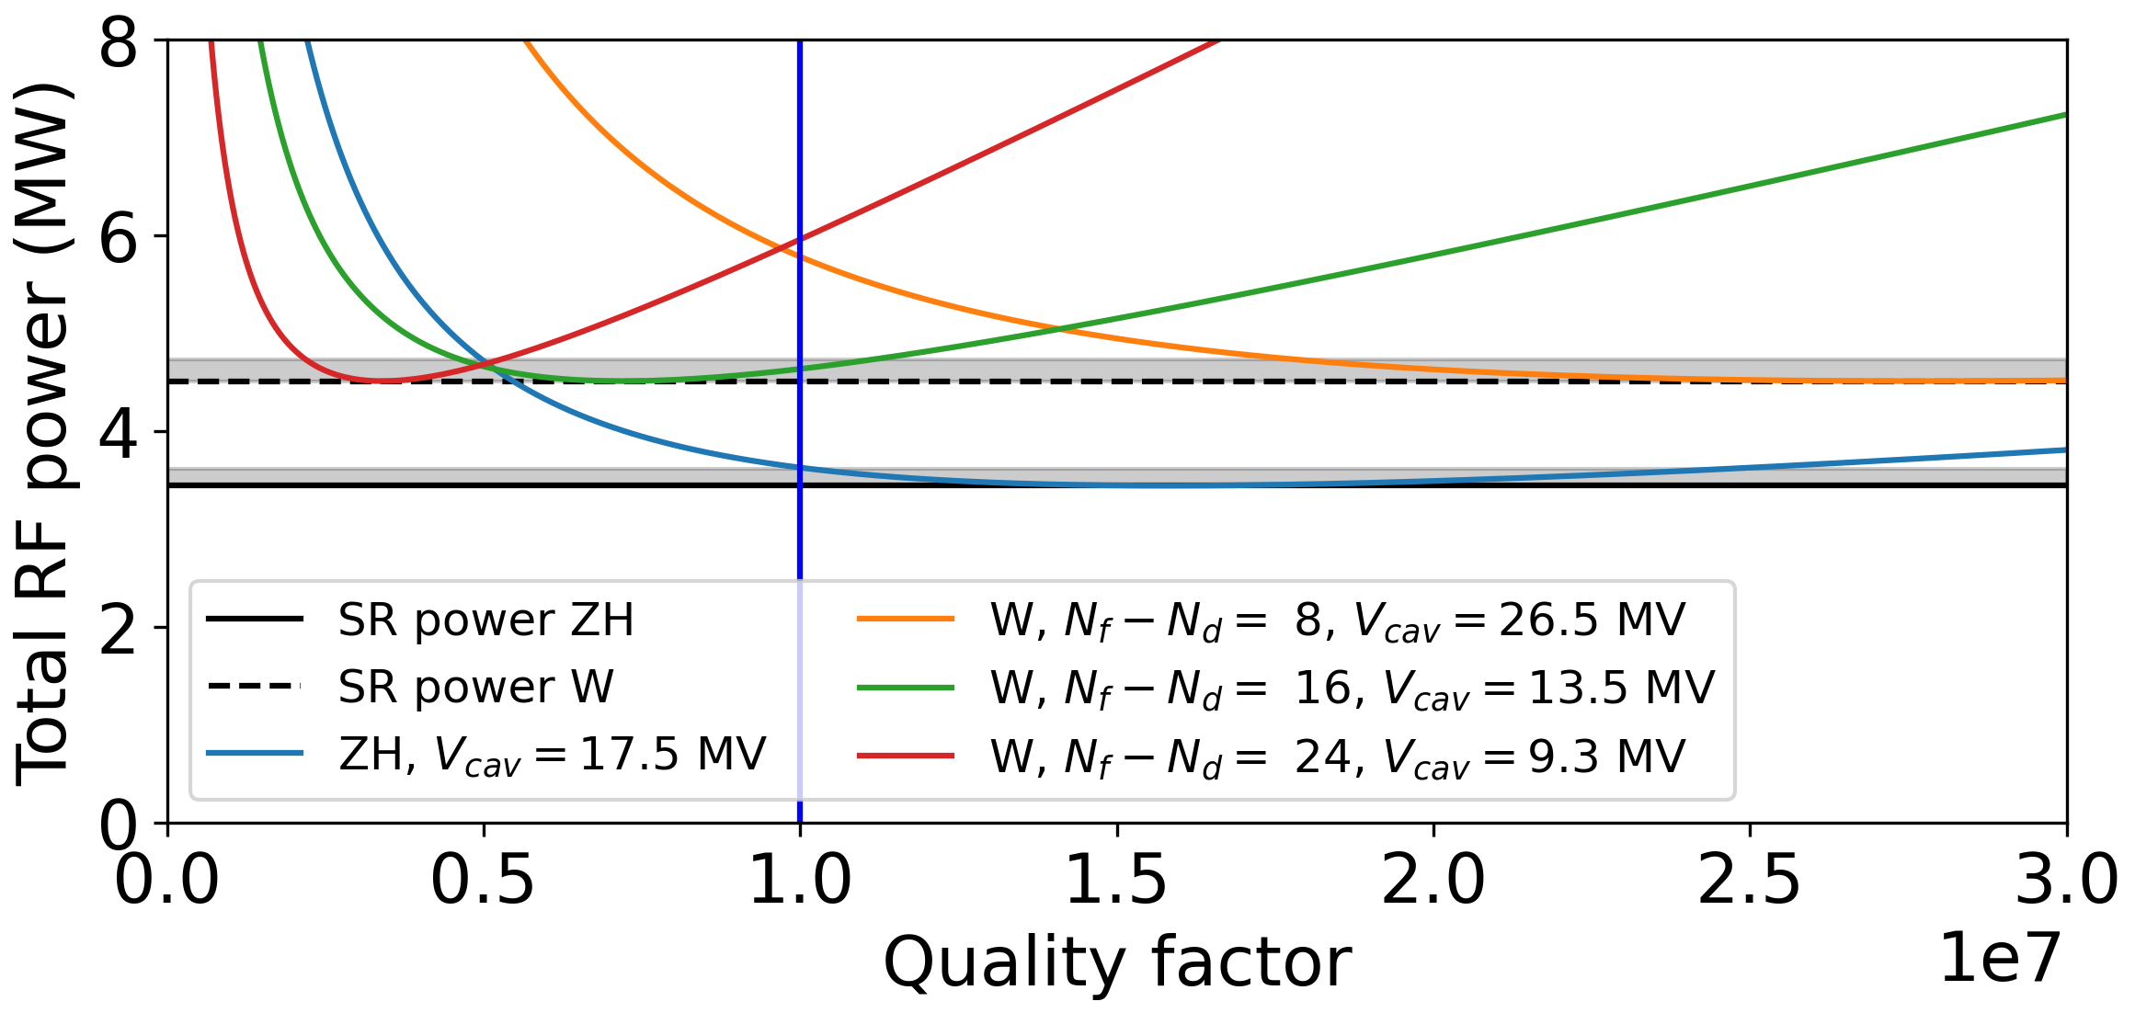
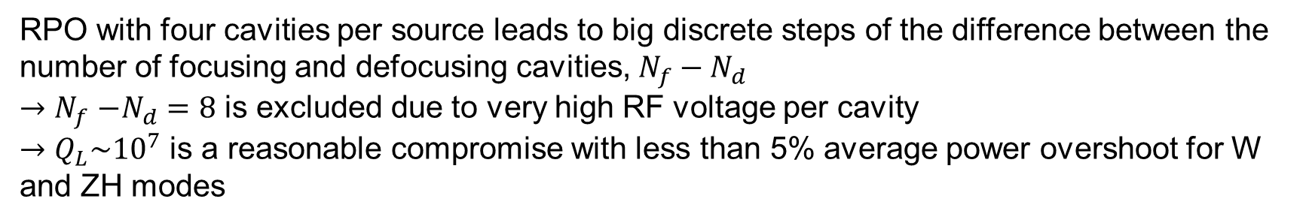
Optimal coupling: flattop considerations
RF power requirements at the extraction energy
RPO with four cavities per source leads to big discrete steps of the difference between the number of focusing and defocusing cavities, $N_{f}−N_{d}$
${→N}_{f}−N_{d}=8$ is excluded due to very high RF voltage per cavity
$→Q_{L}\sim {10}^{7}$ is a reasonable compromise with less than 5% average power overshoot for W and ZH modes

Slide 5
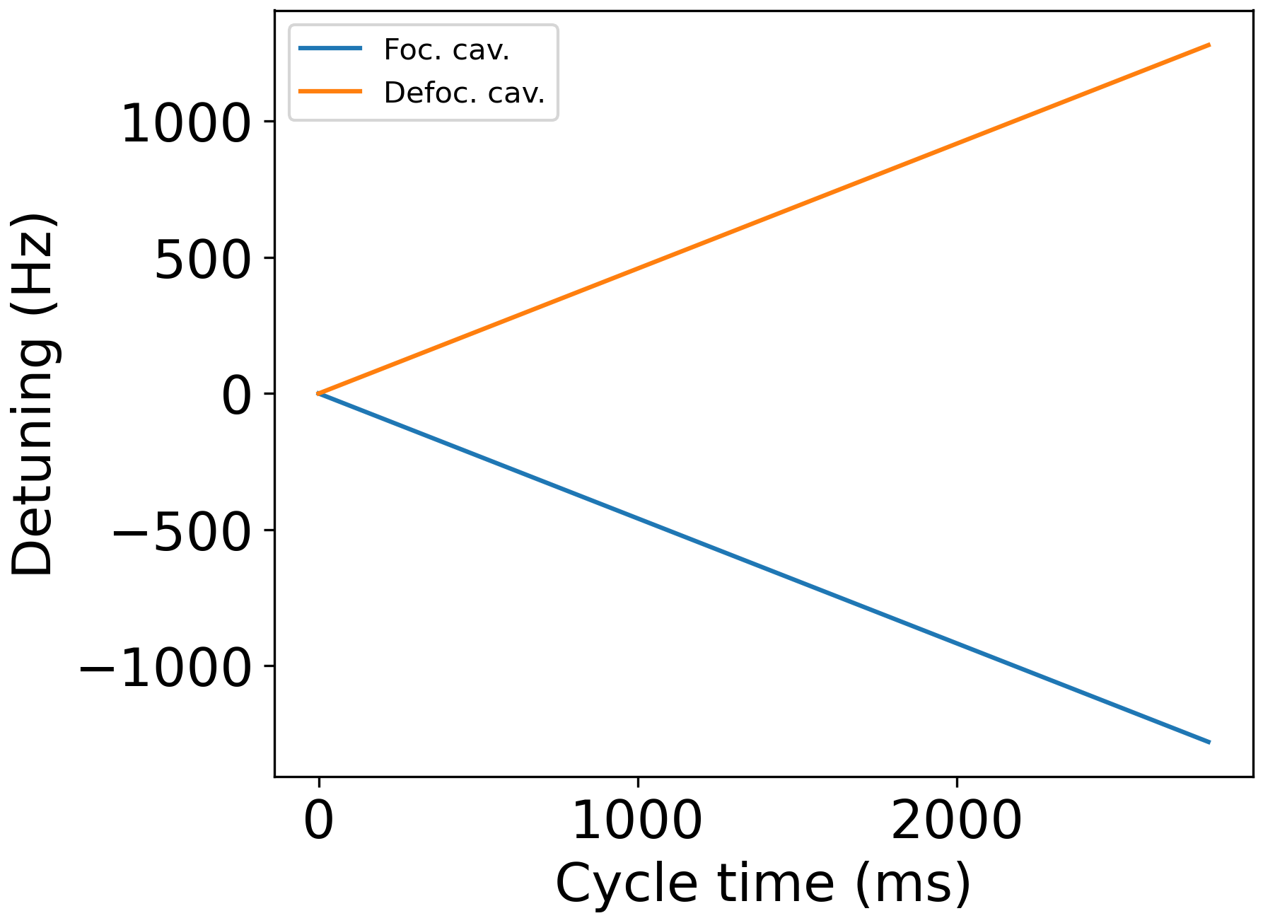
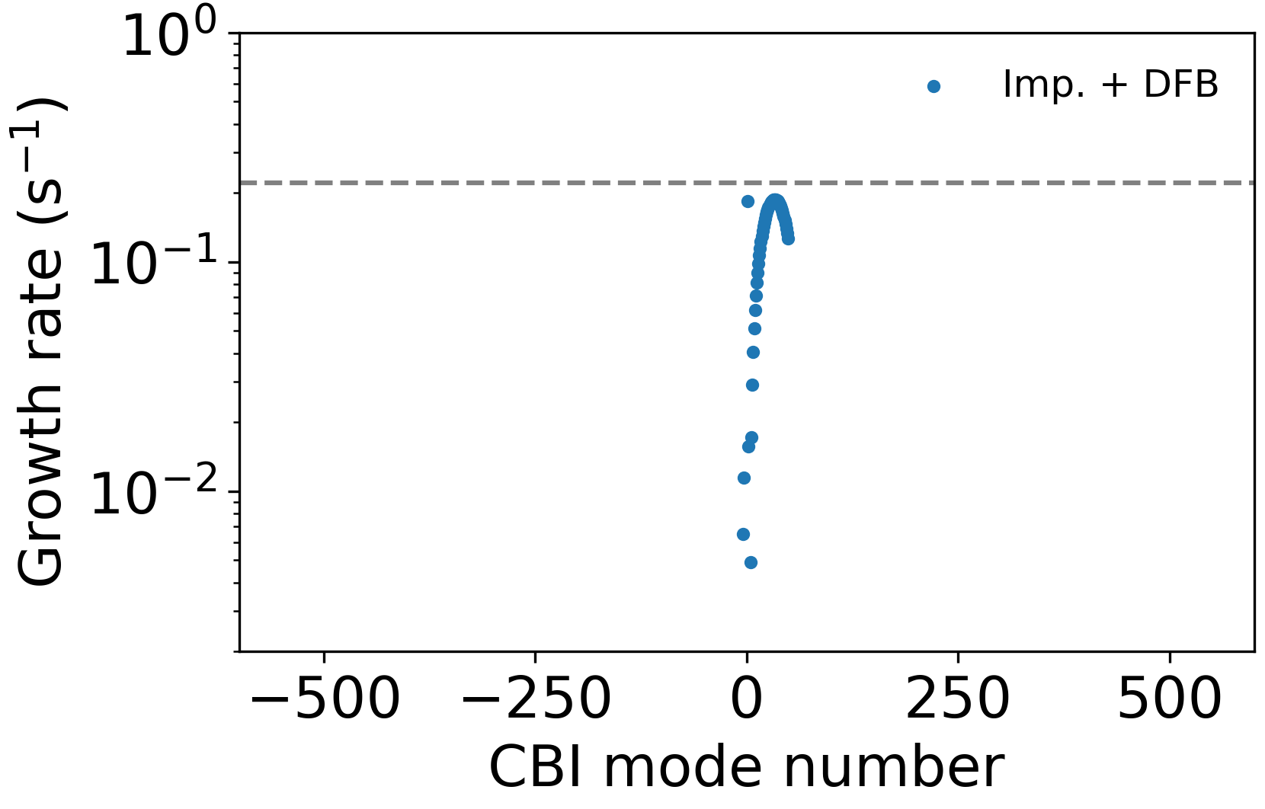
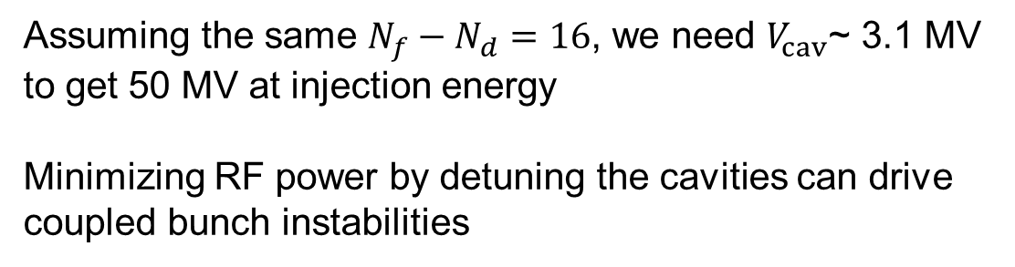
Coupled-bunch instabilities at 20 GeV
Assuming the same $N_{f}−N_{d}=16$, we need $V_{cav}$~ 3.1 MV to get 50 MV at injection energy
Minimizing RF power by detuning the cavities can drive coupled bunch instabilities
Optimal detuning during injection for Z
Main RF-related parameters
$→$ No margin for beam stability with direct RF feedback activated
We could profit from installing wigglers (1 wiggler $→$ gain of 4)

Slide 6
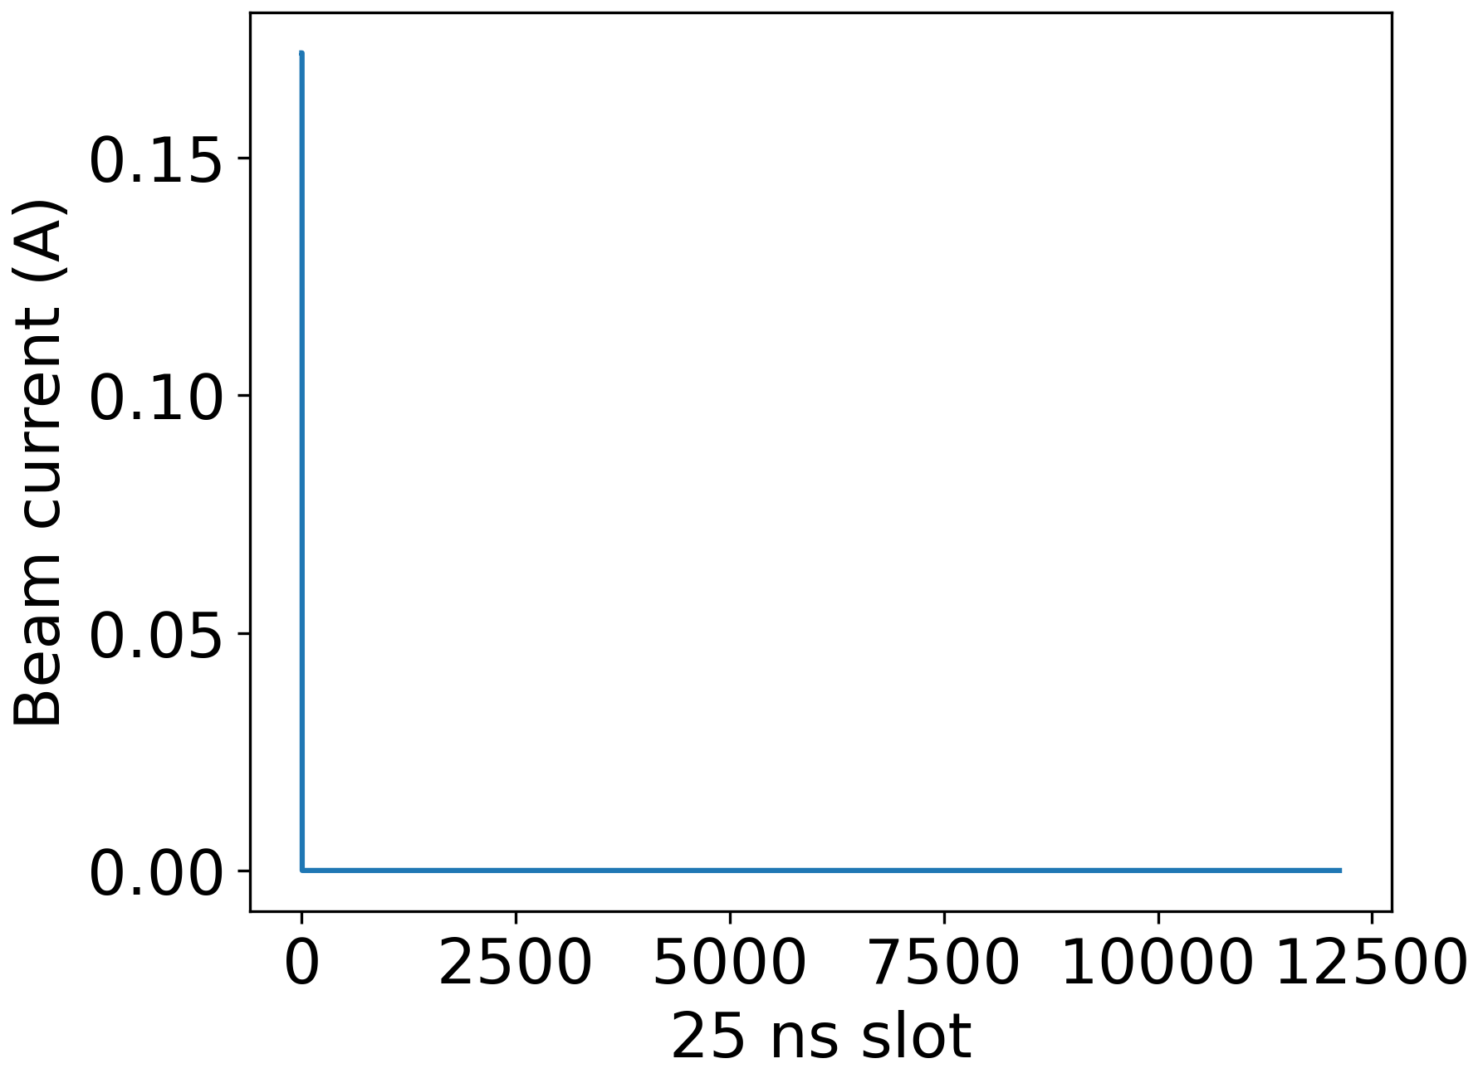
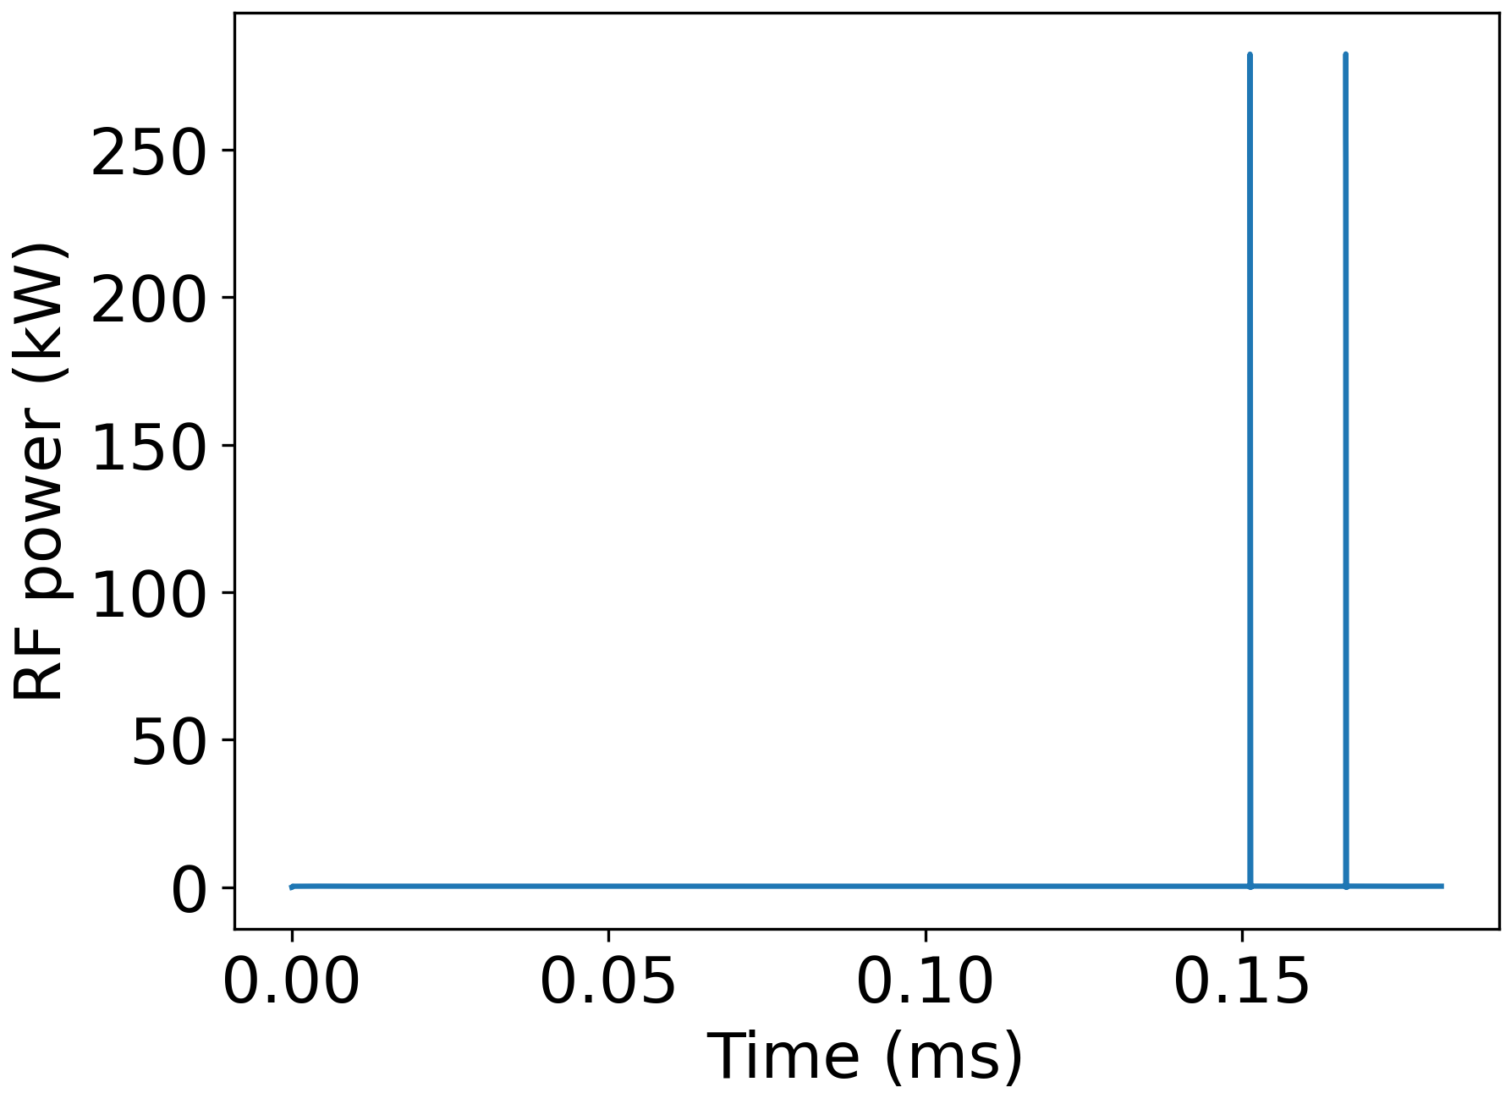
RF power at injection
Large transients with the full feedback gain due to high peak beam current

Slide 7
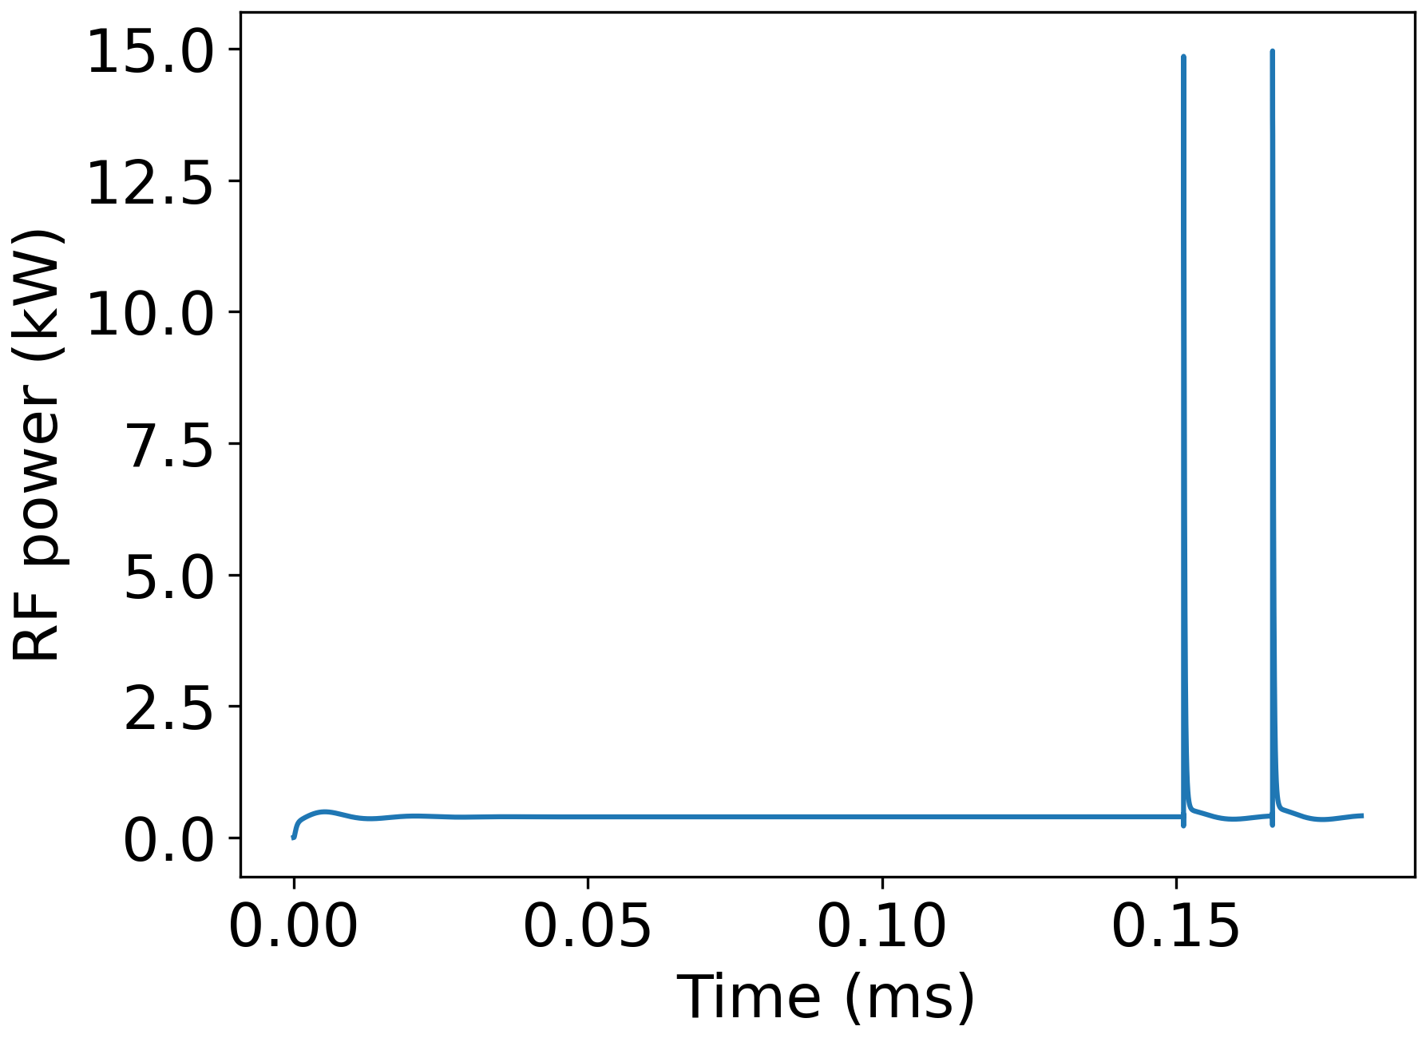
RF power at injection
Reduction of gain by a factor of 5 significantly suppresses power transients
Feedback gain can be ramped up together with beam intensity
Additional margin with wigglers would be beneficial
Filling should be as uniform as possible

Slide 8
Conclusions
Reverse phase operation seems feasible for the high-energy booster to avoid hardware modifications for Z, W, and ZH modes
Beam instabilities due to fundamental mode require strong feedback
RF feedback leads to large power transient at injection, which can be cured if additional stability margin is available (wigglers)
Thank you for your attention!

Slide 9
Backup slides

Slide 10
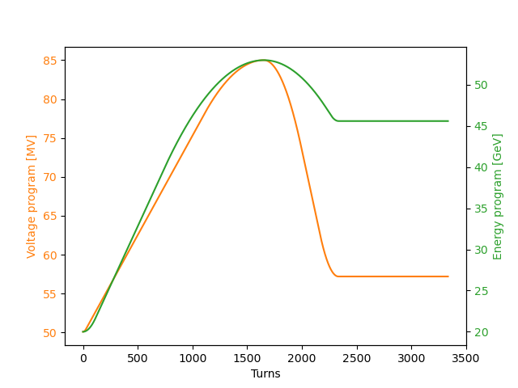
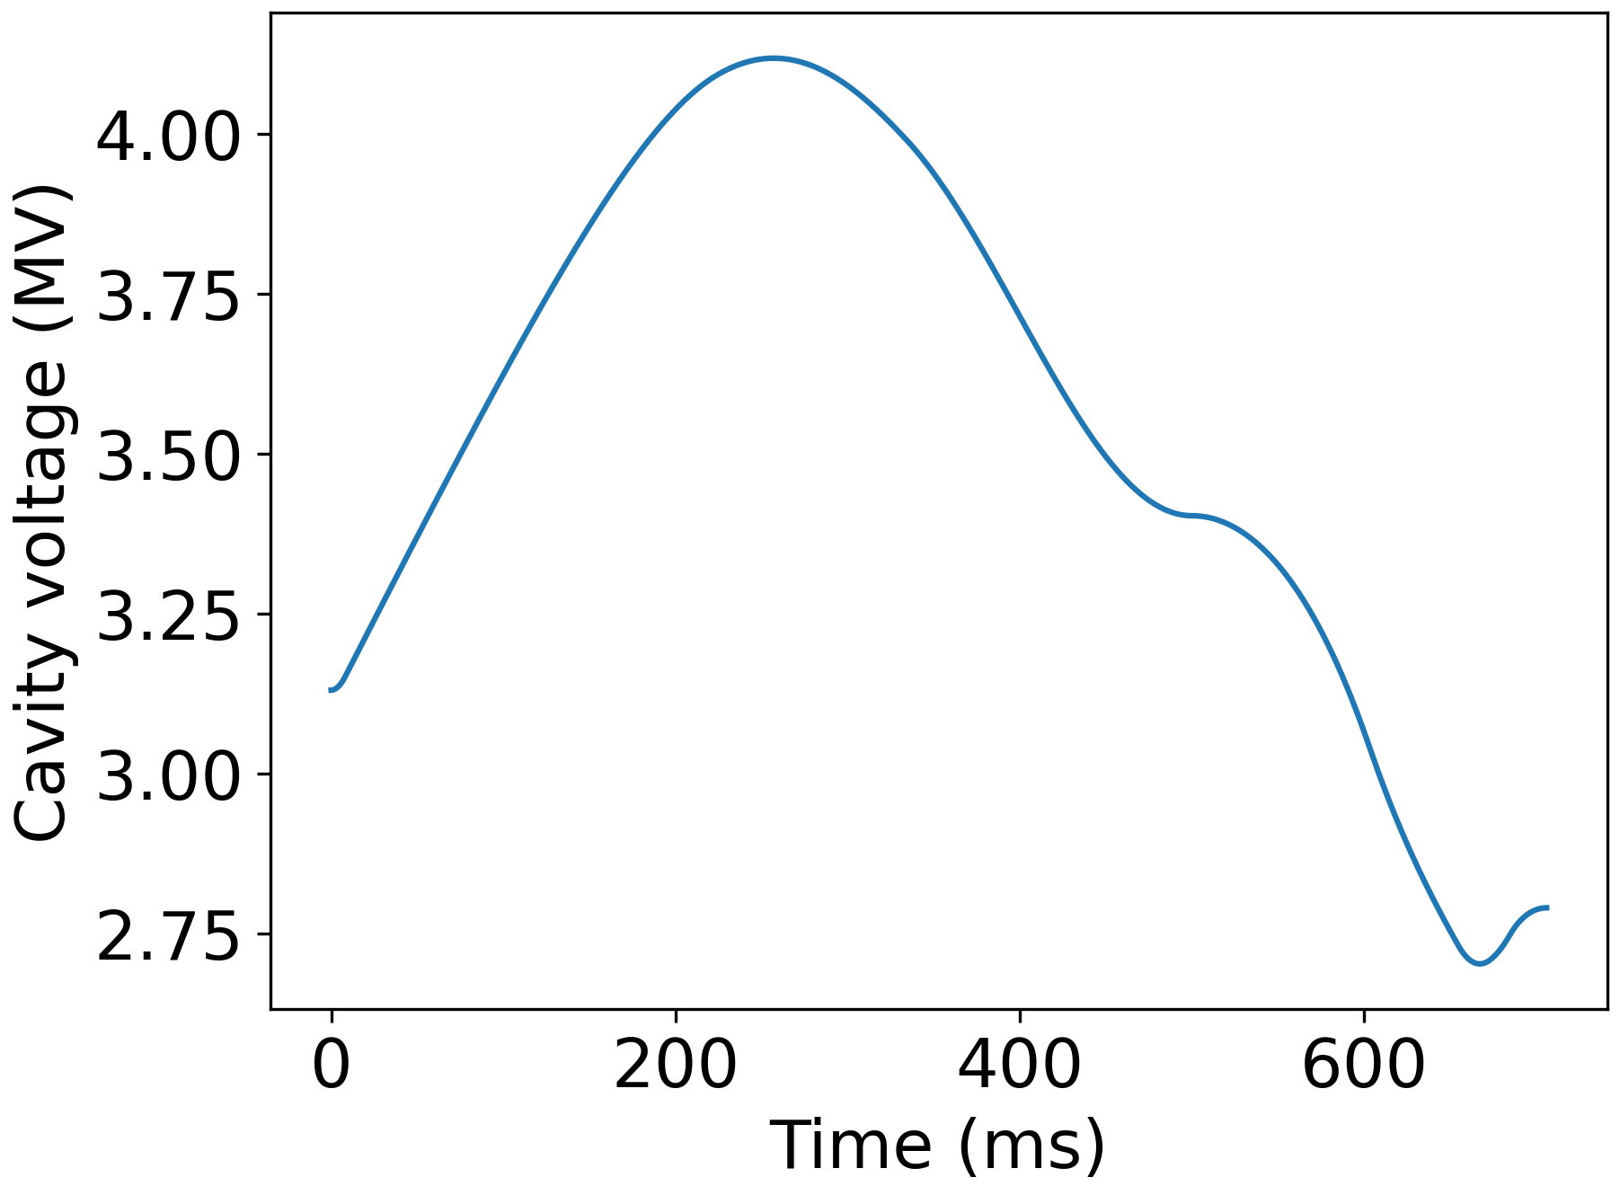
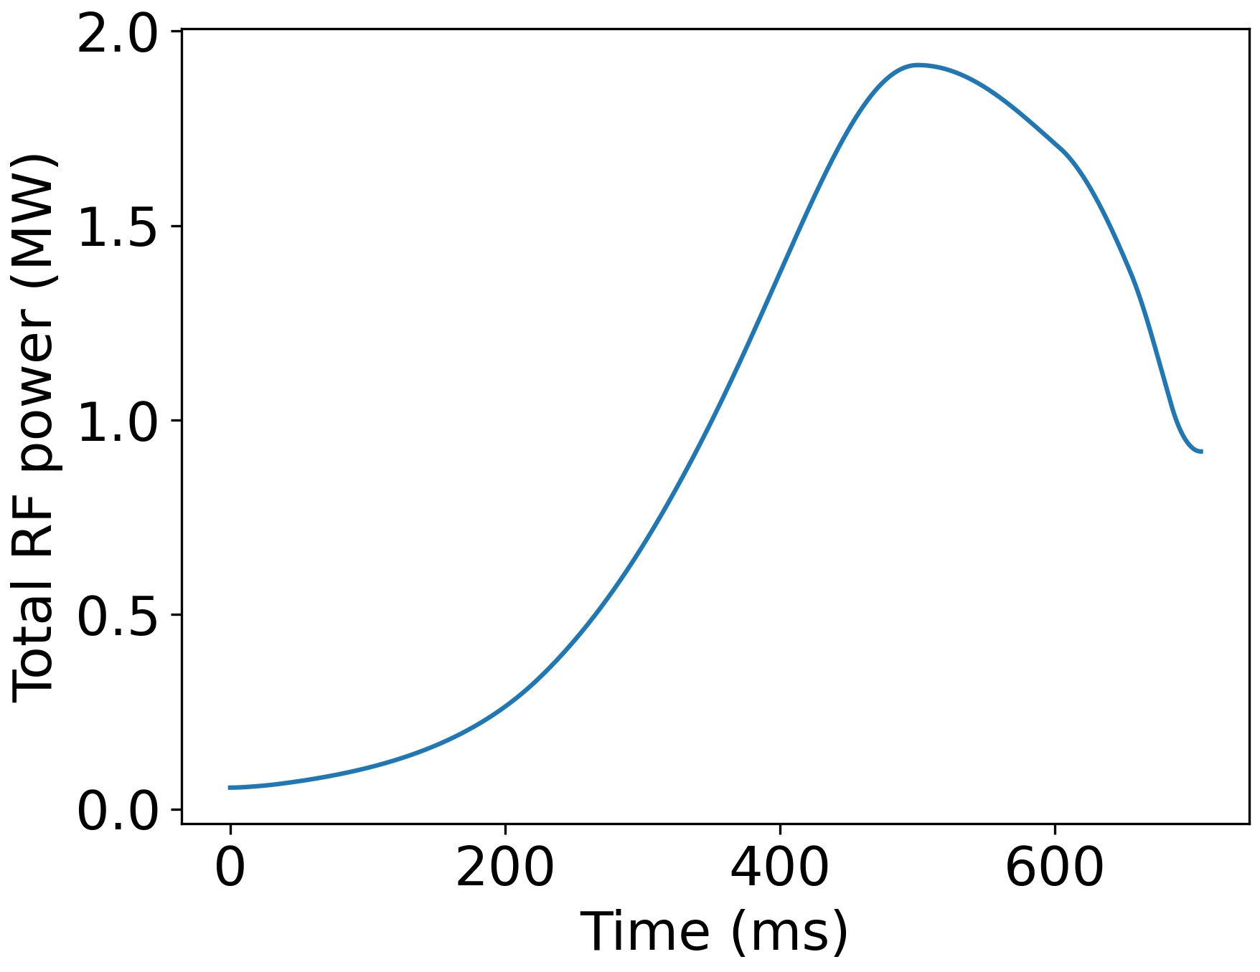
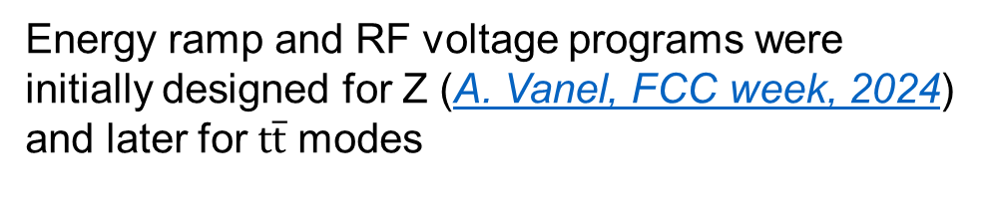
High-Energy Booster cycle
RF voltage and energy evolution for Z
Energy ramp and RF voltage programs were initially designed for Z (A. Vanel, FCC week, 2024) and later for $t\overline{t}$ modes

Slide 11








RF system block diagram
FCC feedback system assumed to be similar to one in the LHC (P. Baudrenghien et al, 2006)
$I_{b,rf}$, rf component of the beam current
Circulator
$I_{g}$, generator current
BW of 2 MHz
Generator
rf cavity
$I_{r}$, Reflected current
delay
Load
$V$, cavity voltage
+
–
Low-pass direct rf feedback
$V_{ref}$, reference voltage
$$Σ$$
$$Σ$$
+
+
$ε=V_{ref}−V$, error signal
High-pass direct rf feedback

Slide 12
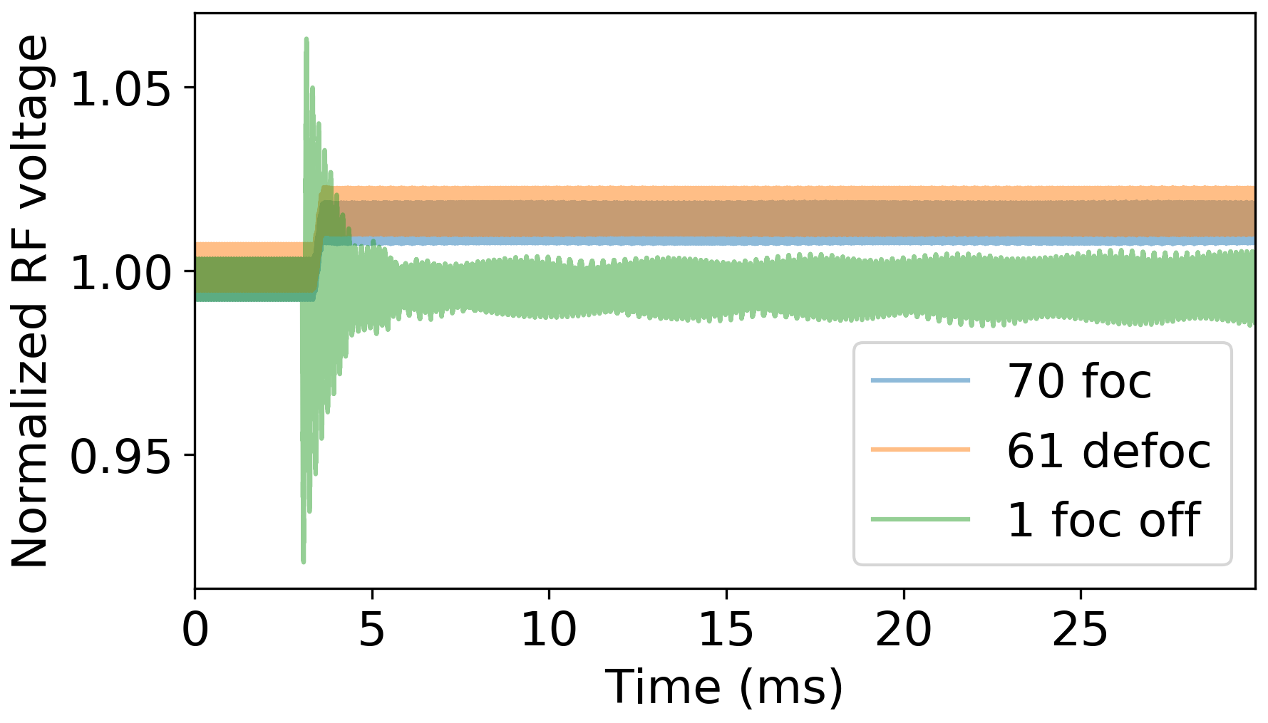
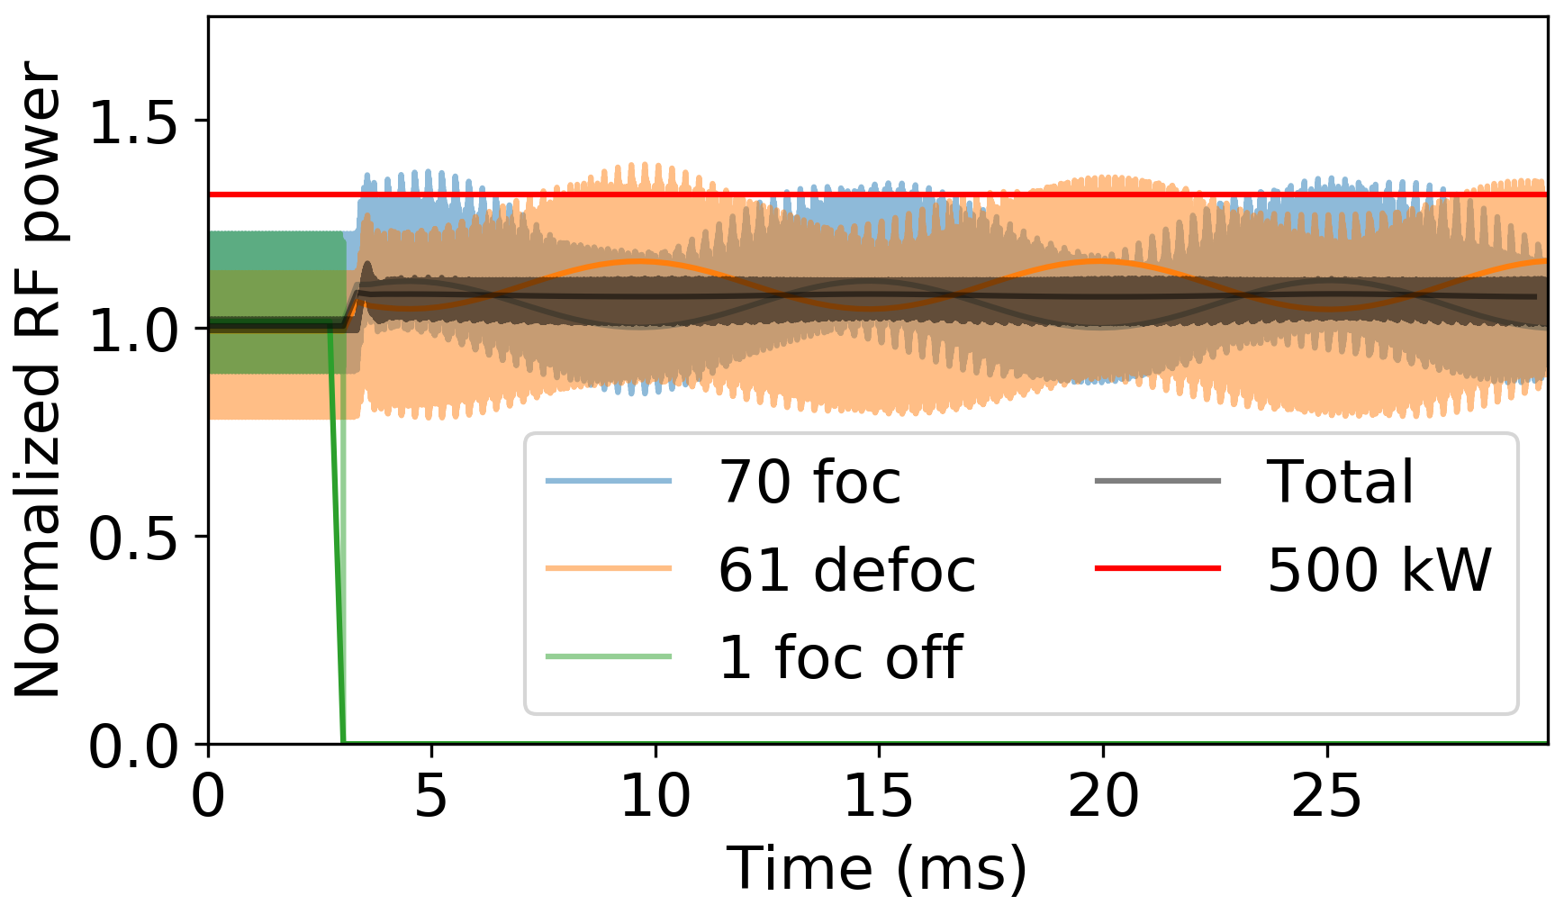
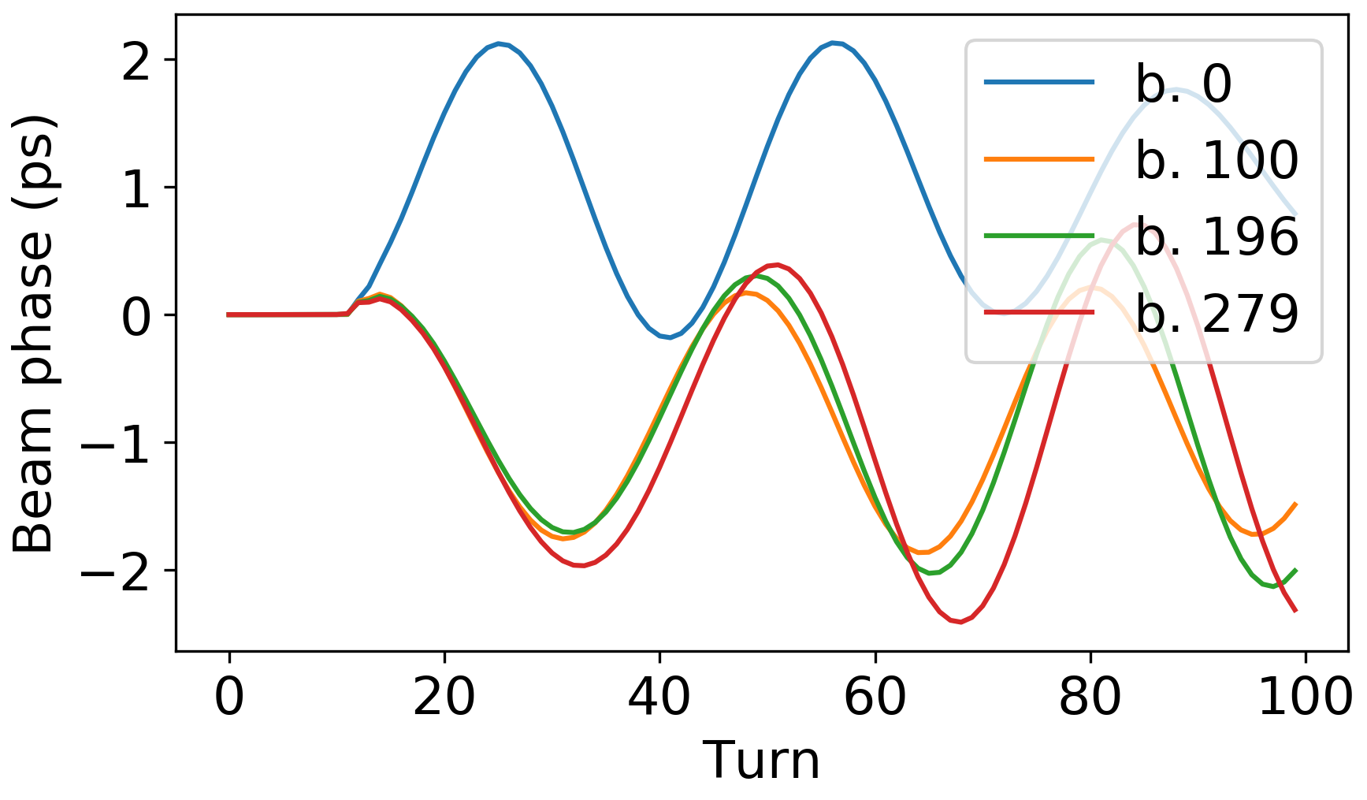

Trip of focusing cavity
Reaction time
Controlled voltage increase
Trip
Short RF voltage transients ~6%
Peak power of other cavities is modulated at synchrotron frequency (avg. <15%, peak <40%)
Initial bunch oscillation amplitude is <4% of rms bunch length
Beam is unstable without longitudinal damper due to uncompensated impedance
$σ_{z}$ ~ 48 ps

Slide 13
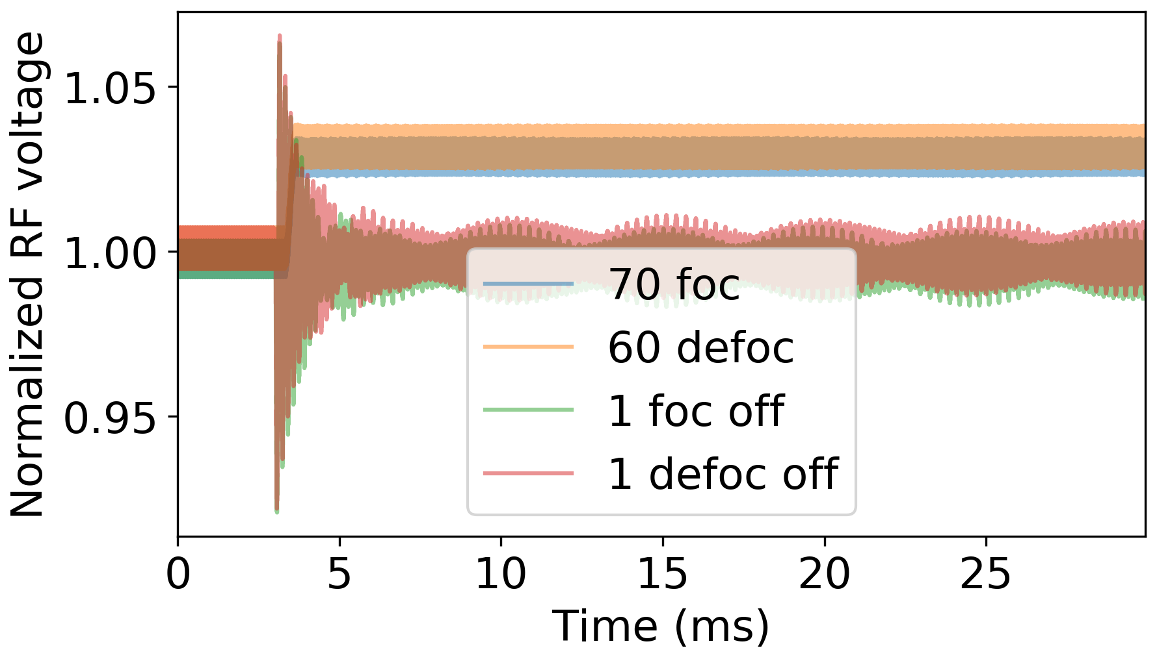
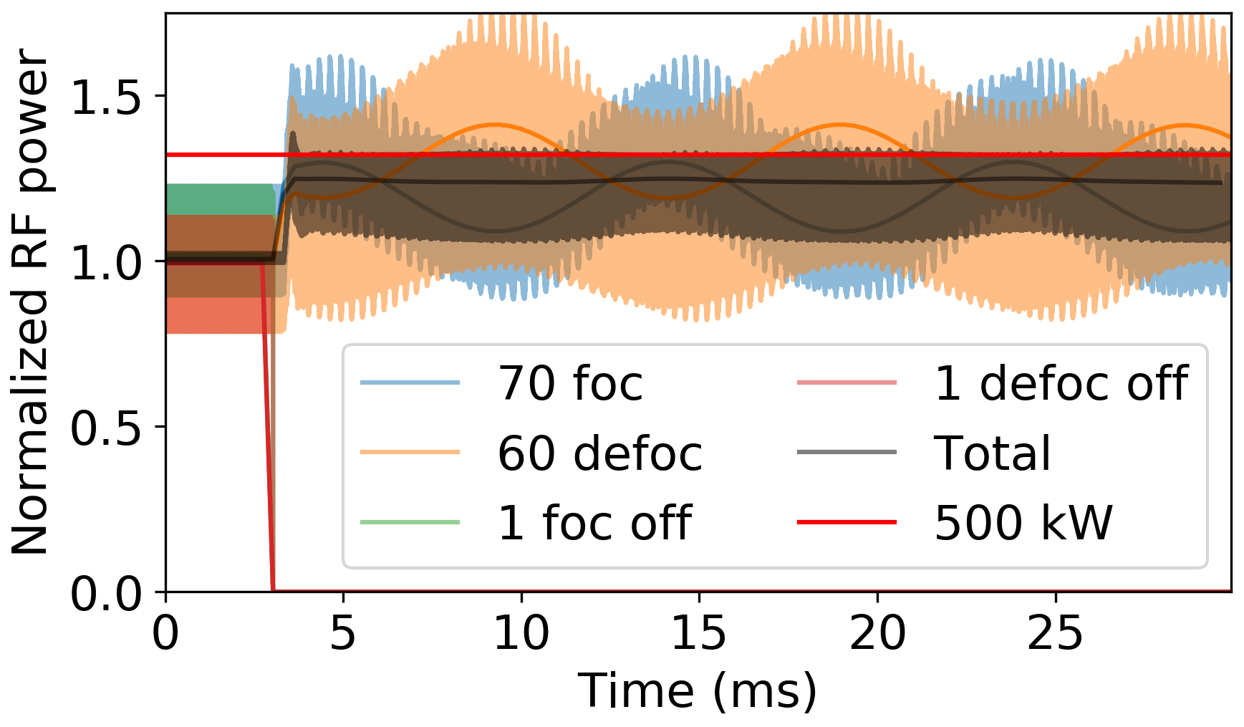
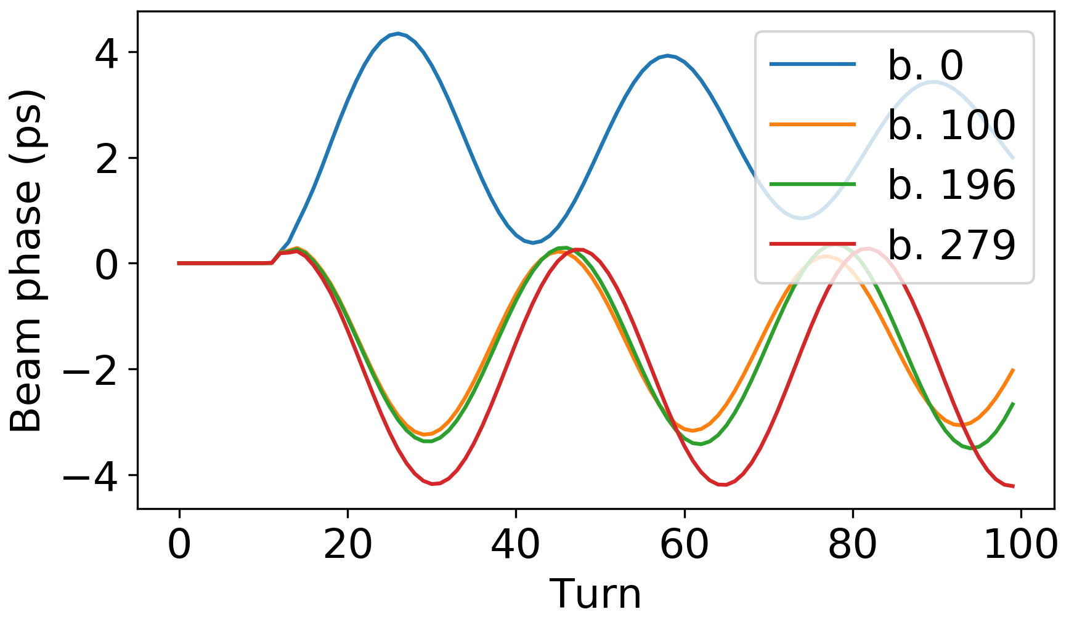

Trip of focusing and defocusing cavities
Reaction time
Controlled voltage increase
Trip
Short RF voltage transients ~6%
Peak power of other cavities is modulated at synchrotron frequency (avg. <45%, peak <80%)
Initial bunch oscillation amplitude is <8% of rms bunch length
Beam is unstable without longitudinal damper due to uncompensated impedance
$σ_{z}$ ~ 48 ps

