Slide 1
800 MHz cavity design update and new damping scheme (for Z, W, H booster)
Shahnam Gorgi Zadeh

Slide 2
Study goals
Cryomodule length reduction
Beam impedance constraint for booster
cavities in reverse phase operation (RPO)
Coaxial Extractors: were placed between cavities to extract HOM power from broadband impedance and damp trapped modes in interconnecting beam pipes
Length constraint: Coupler removal to save at least 795 mm per cryomodule (3 × 265 mm)
Evaluate effects on HOM impedance and update design if needed
The same number of cavities will be used for the Z, W and H booster system in the RPO
Evaluate the beam stability limit for different working points
950 mm
Coaxial extractor
685 mm

Slide 3
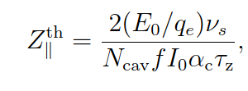
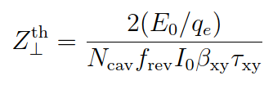
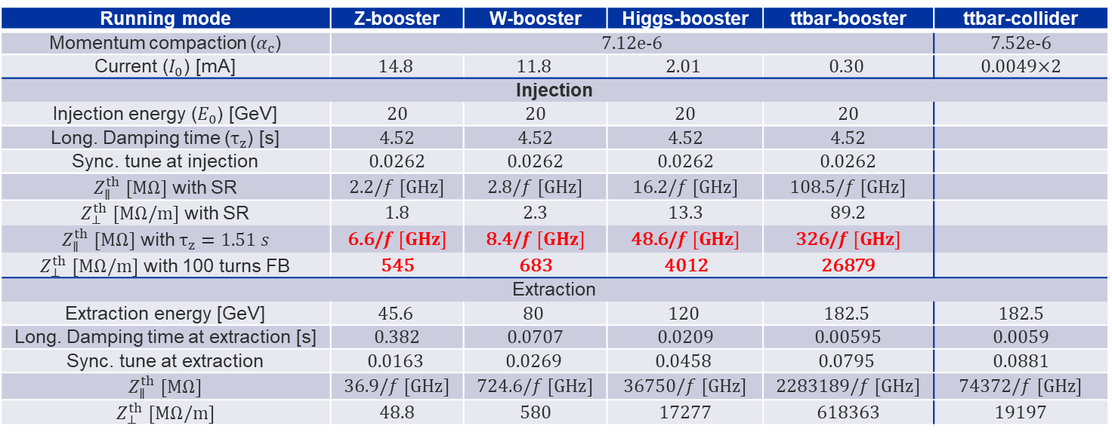

$t\overline{t}$ and booster stability parameters
Low energy and long damping time at injection leads to a low beam instability impedance limit for the booster cavities
A 100-turn feedback for the transverse plane, and a factor of three energy loss per turn from wigglers considered in the longitudinal plane impedance
Running mode | Z-booster | W-booster | Higgs-booster | ttbar-booster | ttbar-collider
Momentum compaction ($α_{c}$) | 7.12e-6 |  |  |  | 7.52e-6
Current ($I_{0}$) [mA] | $$14.8$$ | $$11.8$$ | $$2.01$$ | $$0.30$$ | 0.0049×2
Injection
Injection energy ($E_{0}$) [GeV] | 20 | 20 | 20 | 20
Long. Damping time ($τ_{z}$) [s] | 4.52 | 4.52 | 4.52 | 4.52
Sync. tune at injection | 0.0262 | 0.0262 | 0.0262 | 0.0262
$Z_{∥}^{th}$ $[MΩ]$ with SR | 2.2/$f [GHz]$ | 2.8/$f [GHz]$ | 16.2/$f [GHz]$ | 108.5/$f [GHz]$
$Z_{⊥}^{th}$ $[MΩ/m]$ with SR | 1.8 | 2.3 | 13.3 | 89.2
$Z_{∥}^{th}$ $[MΩ]$ with $τ_{z}=1.51 s$ | 6.6/$f [GHz]$ | 8.4/$f [GHz]$ | 48.6/$f [GHz]$ | 326/$f [GHz]$
$Z_{⊥}^{th}$ $[MΩ/m]$ with 100 turns FB | 545 | 683 | 4012 | 26879
Extraction
Extraction energy [GeV] | $$45.6$$ | $$80$$ | $$120$$ | $$182.5$$ | 182.5
Long. Damping time at extraction [s] | 0.382 | 0.0707 | 0.0209 | 0.00595 | 0.0059
Sync. tune at extraction | $$0.0163$$ | $$0.0269$$ | $$0.0458$$ | $$0.0795$$ | 0.0881
$Z_{∥}^{th}$ $[MΩ]$ | 36.9/$f [GHz]$ | 724.6/$f [GHz]$ | 36750/$f [GHz]$ | 2283189/$f [GHz]$ | 74372/$f [GHz]$
$Z_{⊥}^{th}$ $[MΩ/m]$ | 48.8 | 580 | 17277 | 618363 | 19197
$Transversal damping time \left(τ_{xy}\right)=2× longitudinal damping time (τ_{z})$
$β_{xy}=50 m$ for all working points, $f_{rev}=3307 Hz$, $N_{cav}$ is assumed 1 (a normalization to the number of cavities is needed)

Slide 4
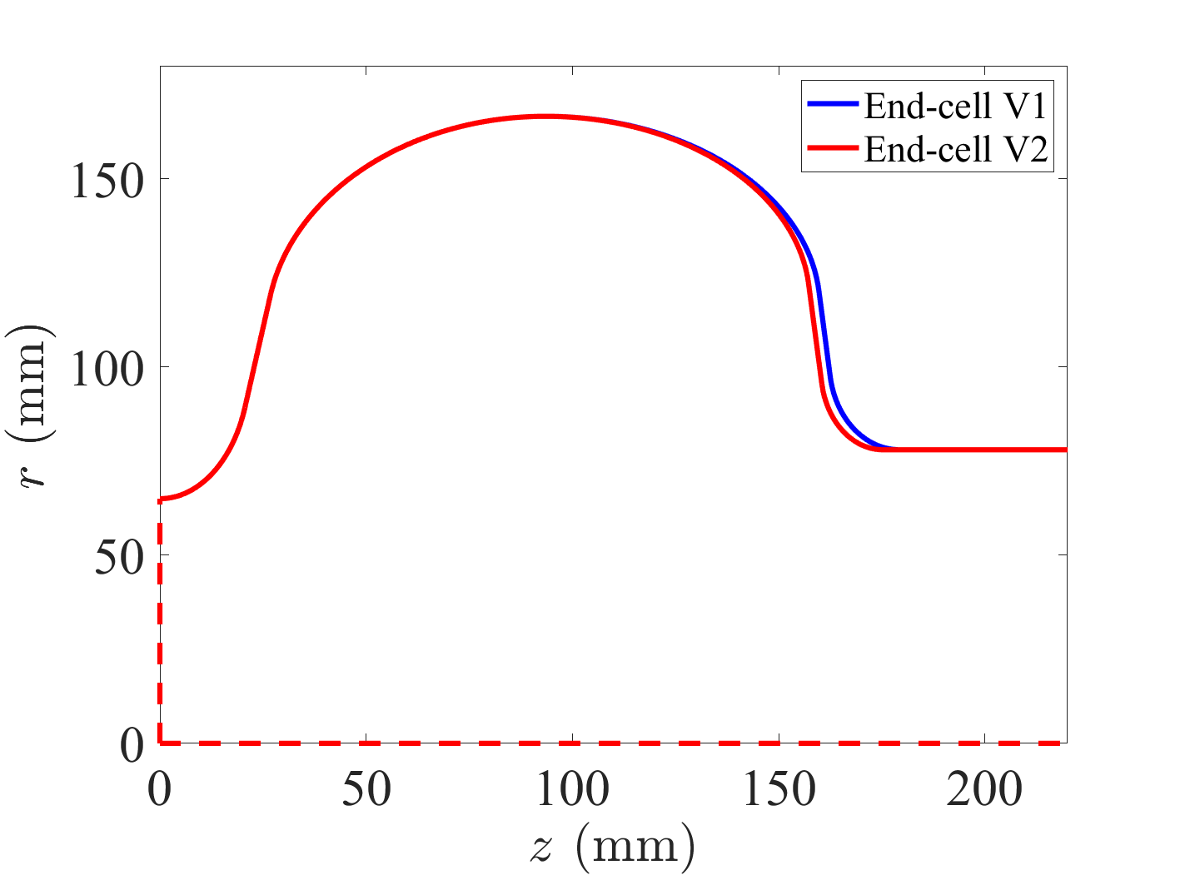
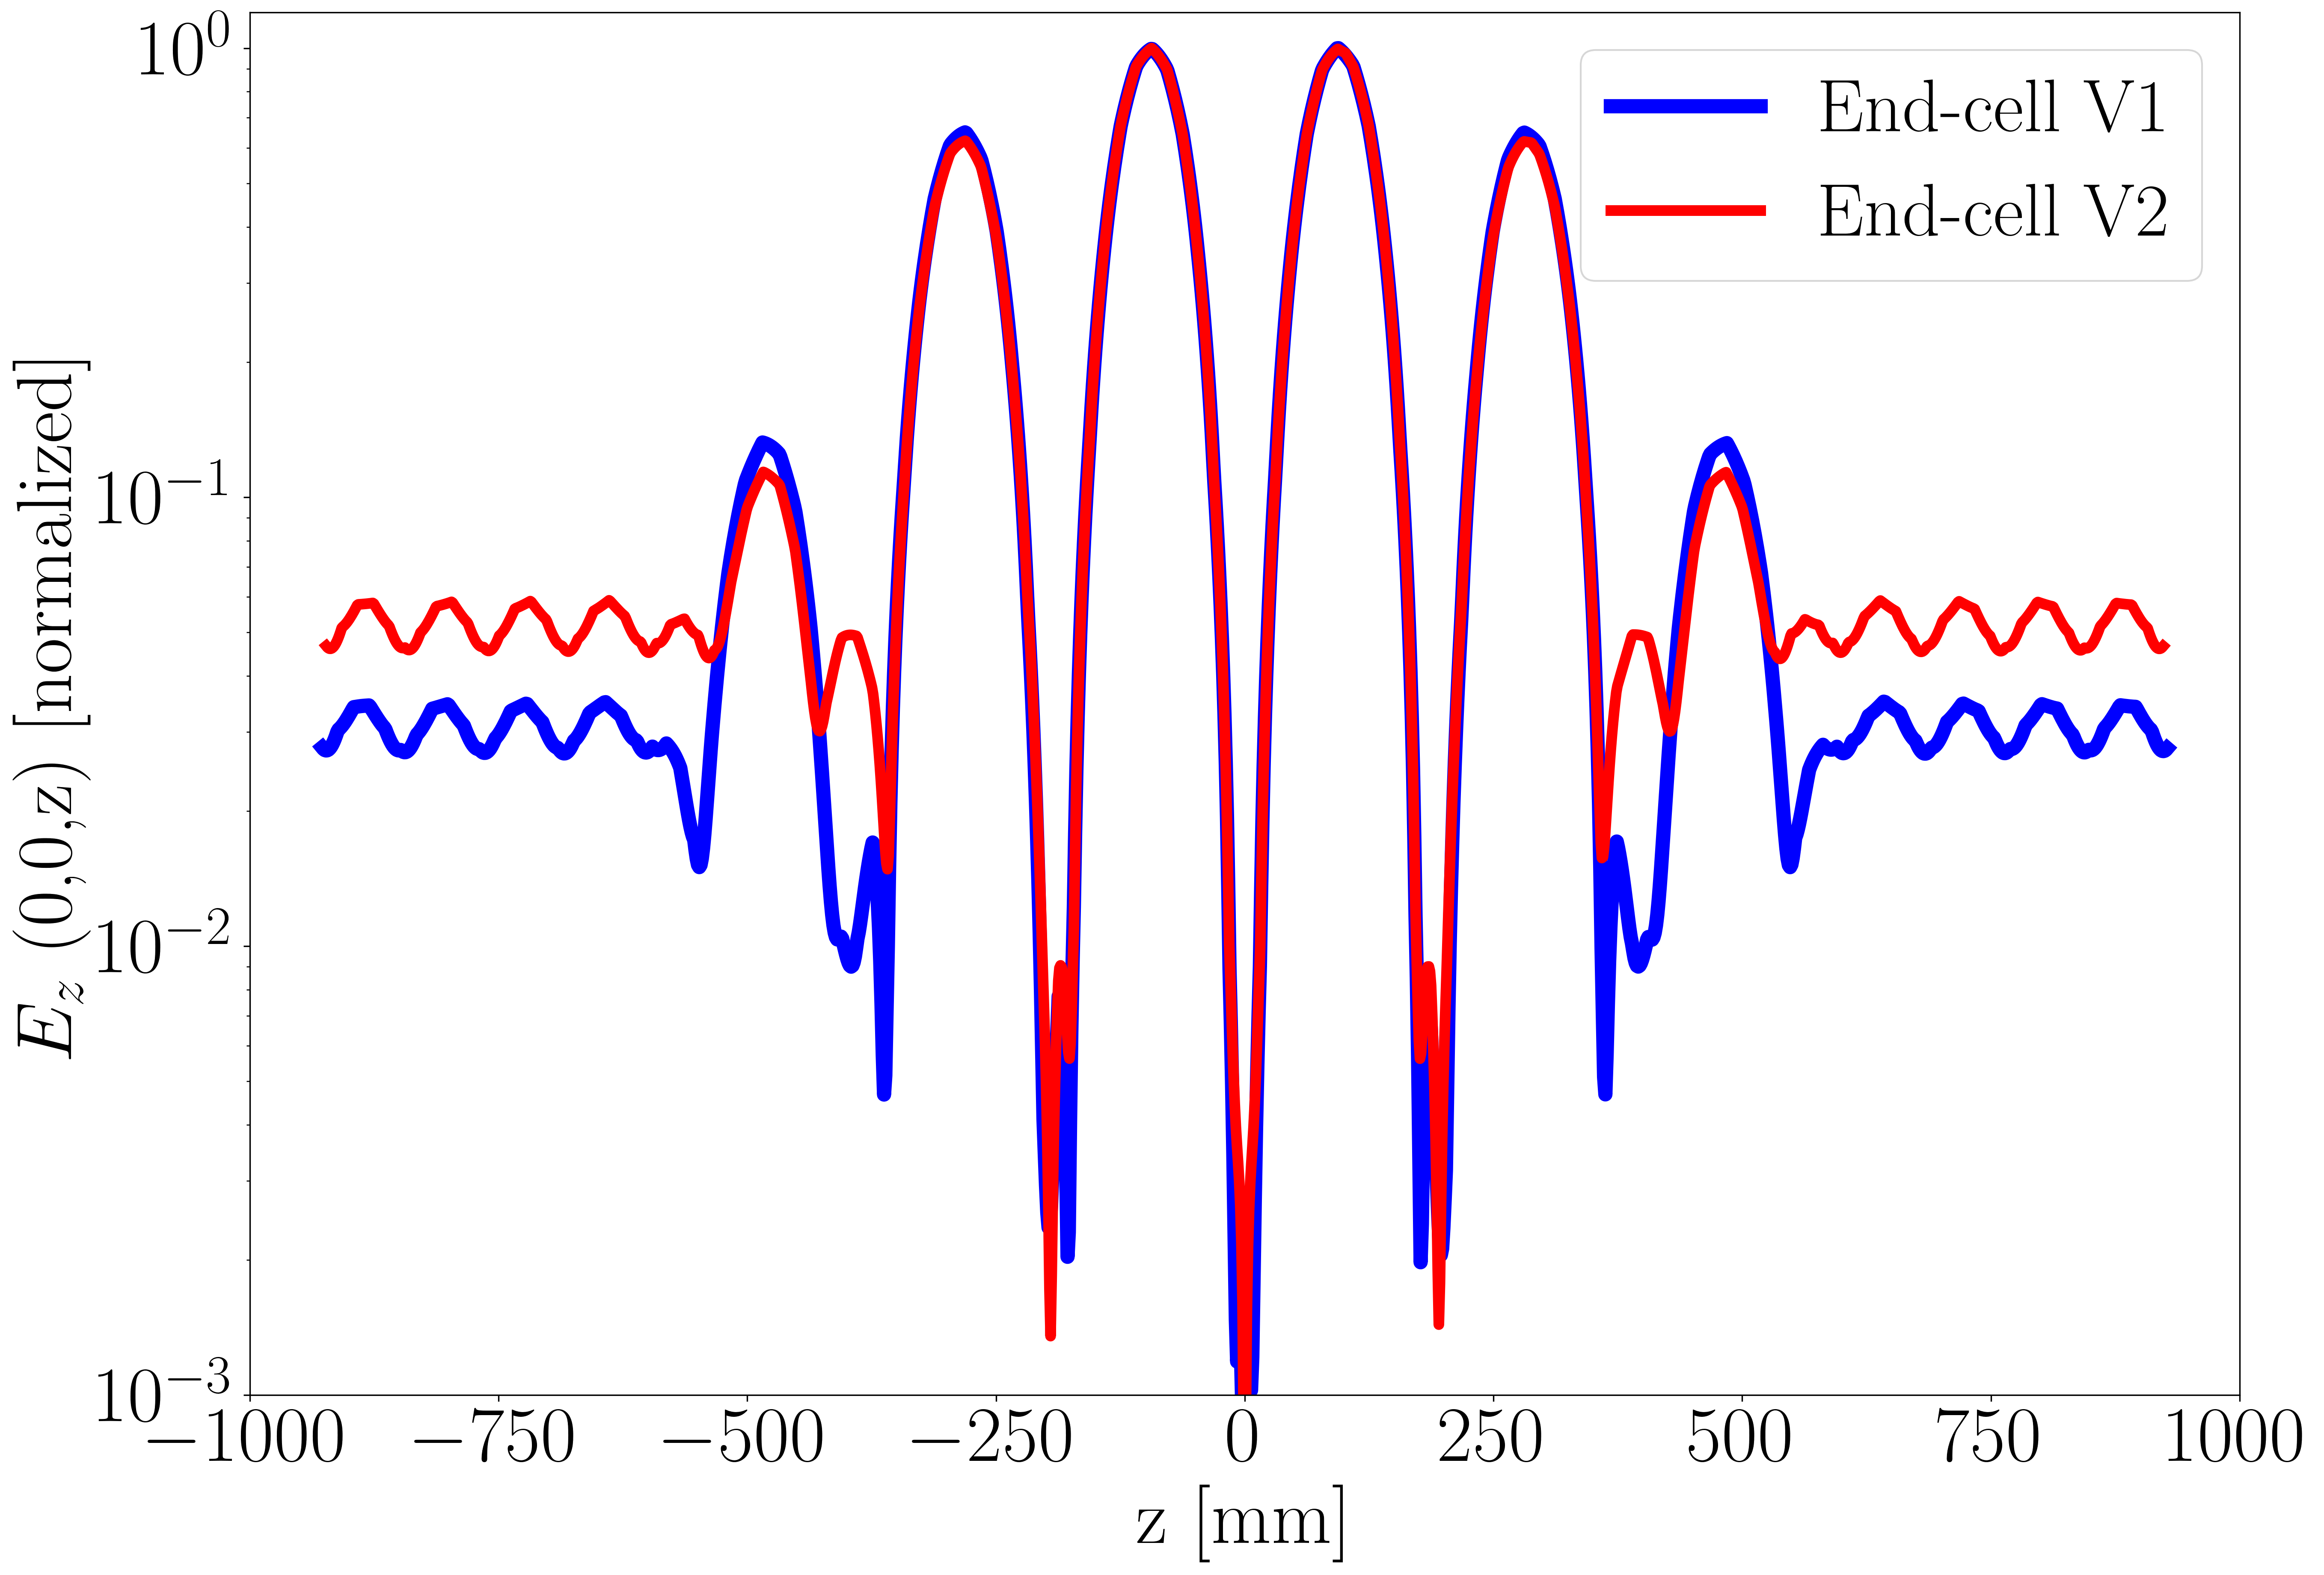
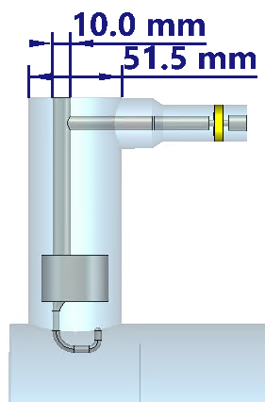
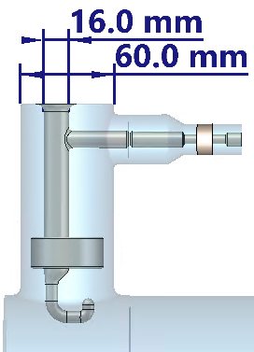
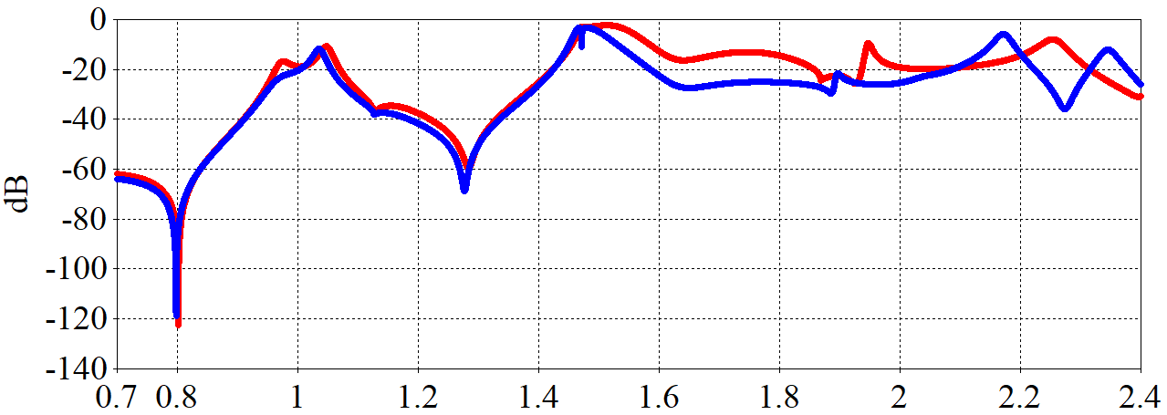
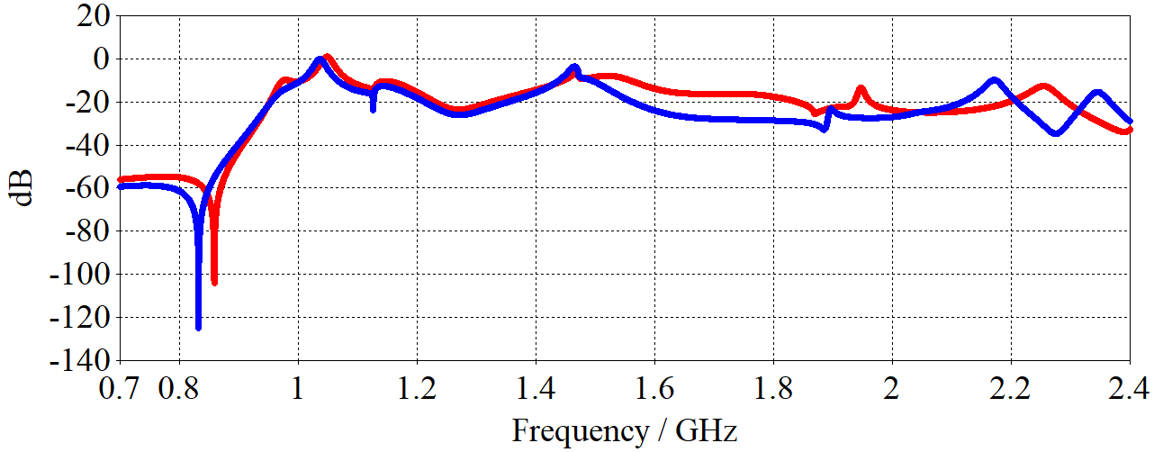
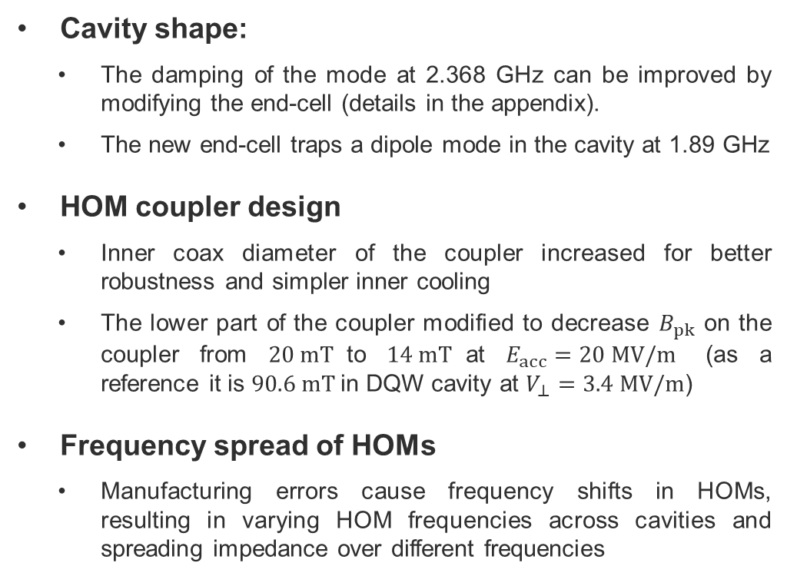
Parameters affecting total impedance
800 MHz end-cell
Mode at 2.368 GHz
Cavity shape:
  The damping of the mode at 2.368 GHz can be improved by modifying the end-cell (details in the appendix).
  The new end-cell traps a dipole mode in the cavity at 1.89 GHz
HOM coupler design
  Inner coax diameter of the coupler increased for better robustness and simpler inner cooling
  The lower part of the coupler modified to decrease $B_{pk}$ on the coupler from $20 mT$to $14 mT$at $E_{acc}=20 MV/m$ (as a reference it is $90.6 mT$in DQW cavity at $V_{⊥}=3.4 MV/m$)
Frequency spread of HOMs
  Manufacturing errors cause frequency shifts in HOMs, resulting in varying HOM frequencies across cavities and spreading impedance over different frequencies
1st Monopoles
V1
V2
TM01-TEM
V1
V2
1st Dipoles
TE11-TEM

Slide 5
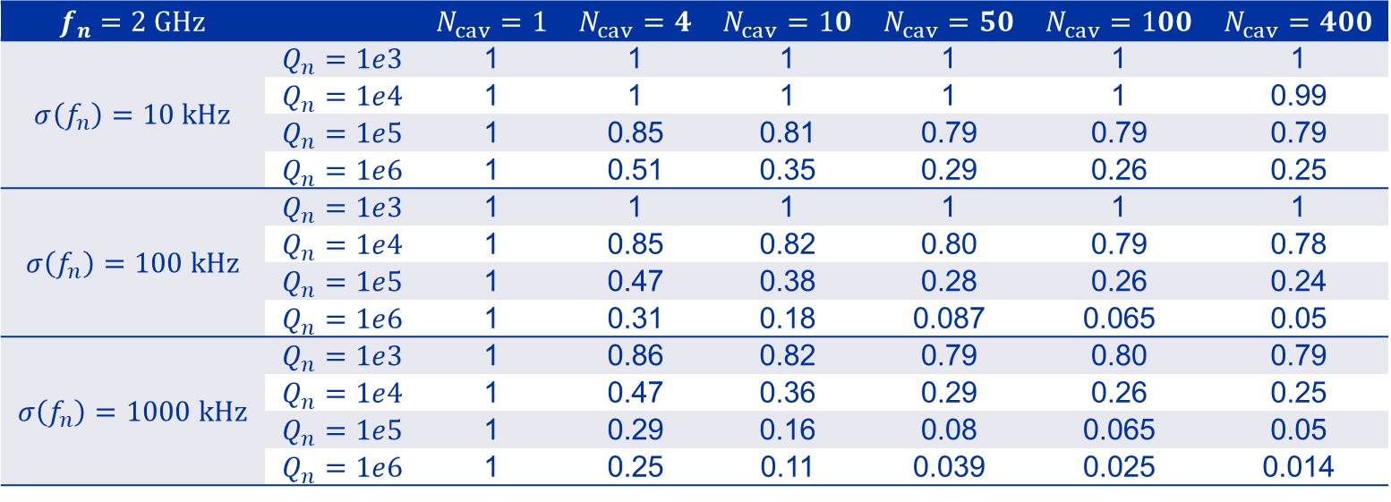
Frequency spread coefficient
If impedance for mode $m$ modelled by $Z_{∥,m}\left(f\right)≈\frac{1}{2}\frac{ R/Q_{∥,m}⋅Q_{m} }{1+jQ_{m}(f/f_{m}−f_{m}/f)}$ → $c=\frac{\sum_{n=1}^{N_{cav}}{Z_{∥,n,m}}}{N_{cav}Z_{∥,1,m}}$: the ratio of the total impedance of $N_{cav}$ cavities, each with a perturbed shape, to the impedance of $N_{cav}$ cavities with identical shape
$$f_{n}=2 GHz$$ |  | $$N_{cav}=1$$ | $$N_{cav}=4$$ | $$N_{cav}=10$$ | $$N_{cav}=50$$ | $$N_{cav}=100$$ | $$N_{cav}=400$$
$$σ\left(f_{n}\right)=10 kHz$$ | $$Q_{n}=1e3$$ | 1 | 1 | 1 | 1 | 1 | 1
 | $$Q_{n}=1e4$$ | 1 | 1 | 1 | 1 | 1 | 0.99
 | $$Q_{n}=1e5$$ | 1 | 0.85 | 0.81 | 0.79 | 0.79 | 0.79
 | $$Q_{n}=1e6$$ | 1 | 0.51 | 0.35 | 0.29 | 0.26 | 0.25
$$σ\left(f_{n}\right)=100 kHz$$ | $$Q_{n}=1e3$$ | 1 | 1 | 1 | 1 | 1 | 1
 | $$Q_{n}=1e4$$ | 1 | 0.85 | 0.82 | 0.80 | 0.79 | 0.78
 | $$Q_{n}=1e5$$ | 1 | 0.47 | 0.38 | 0.28 | 0.26 | 0.24
 | $$Q_{n}=1e6$$ | 1 | 0.31 | 0.18 | 0.087 | 0.065 | 0.05
$$σ\left(f_{n}\right)=1000 kHz$$ | $$Q_{n}=1e3$$ | 1 | 0.86 | 0.82 | 0.79 | 0.80 | 0.79
 | $$Q_{n}=1e4$$ | 1 | 0.47 | 0.36 | 0.29 | 0.26 | 0.25
 | $$Q_{n}=1e5$$ | 1 | 0.29 | 0.16 | 0.08 | 0.065 | 0.05
 | $$Q_{n}=1e6$$ | 1 | 0.25 | 0.11 | 0.039 | 0.025 | 0.014

Slide 6
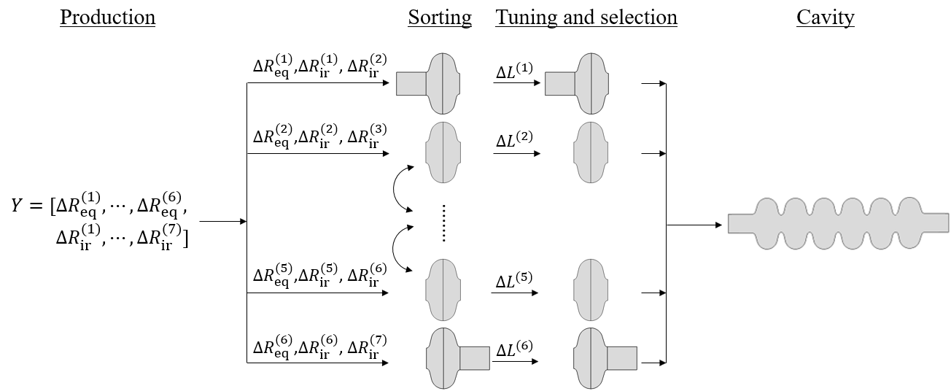
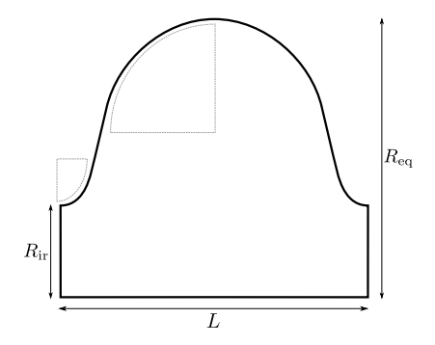
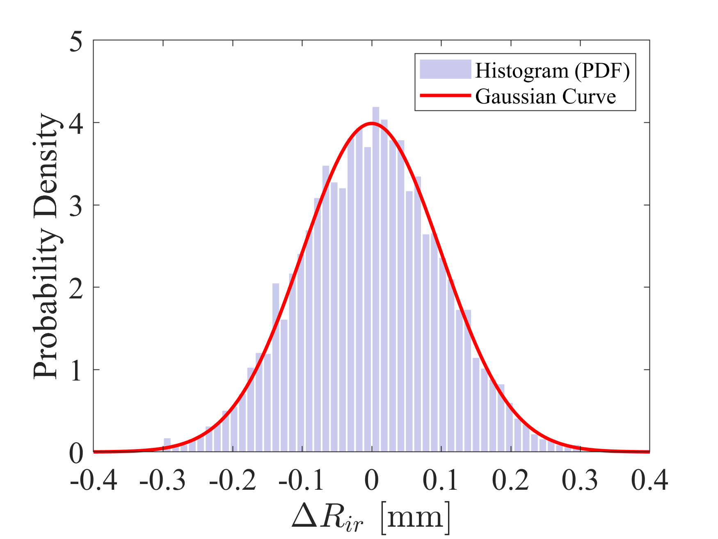
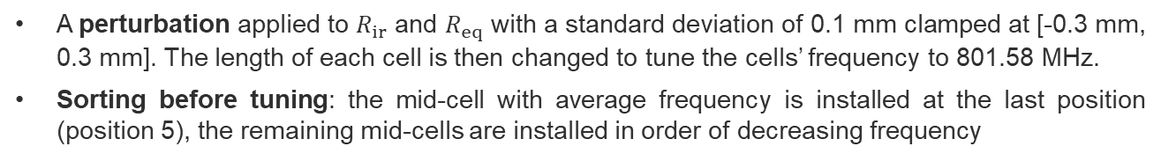
Perturbation analysis
A perturbation applied to $R_{ir}$ and $R_{eq}$ with a standard deviation of 0.1 mm clamped at [-0.3 mm, 0.3 mm]. The length of each cell is then changed to tune the cells’ frequency to 801.58 MHz.
Sorting before tuning: the mid-cell with average frequency is installed at the last position (position 5), the remaining mid-cells are installed in order of decreasing frequency
J. Corno, et al.Uncertainty modeling and analysis of the European X-ray free electron laser cavities manufacturing process, 2020

Slide 7
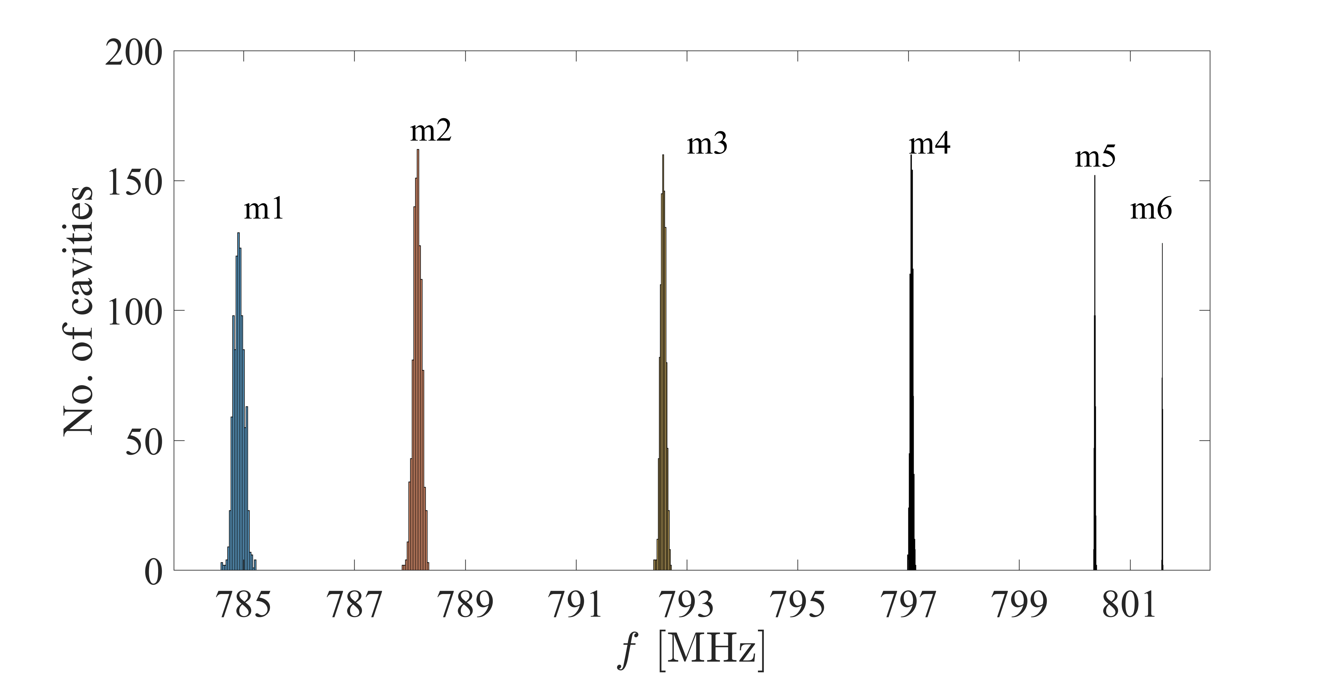
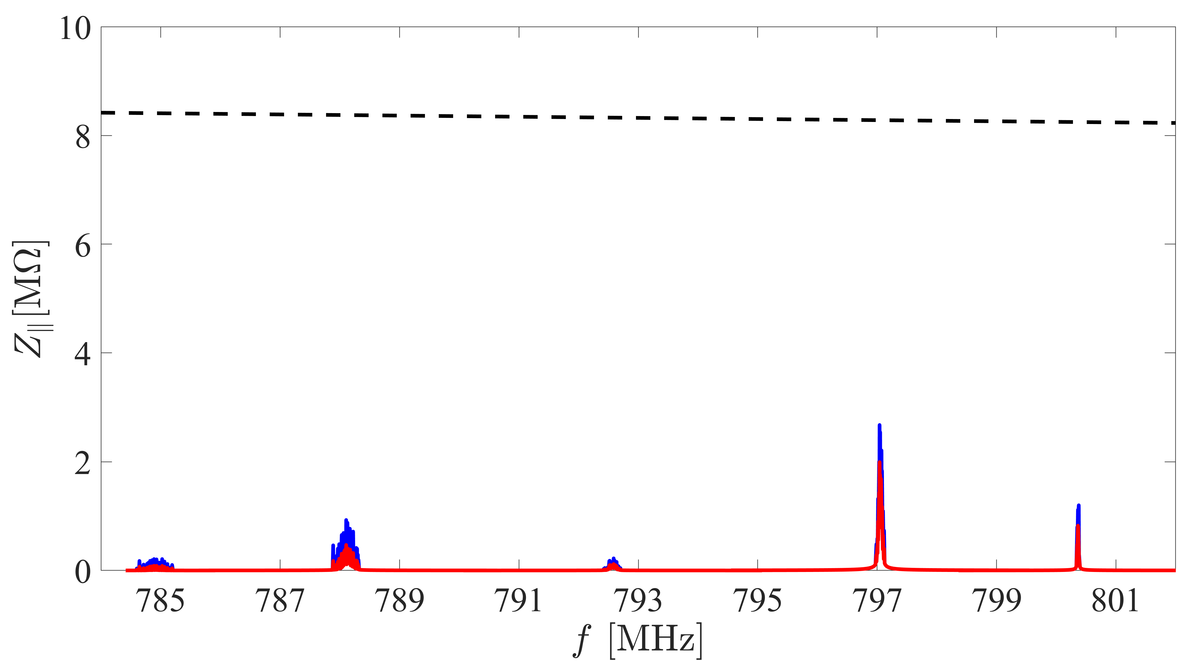


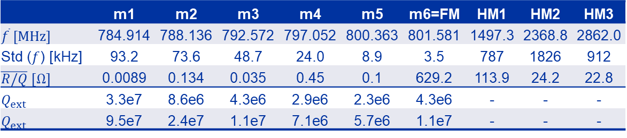
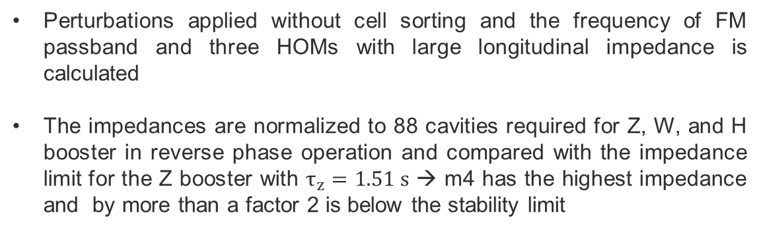
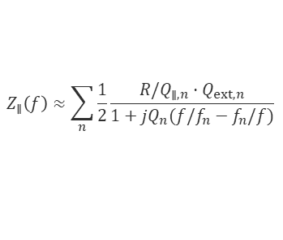
FM passband sensitivity to perturbations
Perturbations applied without cell sorting and the frequency of FM passband and three HOMs with large longitudinal impedance is calculated
The impedances are normalized to 88 cavities required for Z, W, and H booster in reverse phase operation and compared with the impedance limit for the Z booster with $τ_{z}=1.51 s$ → m4 has the highest impedance and by more than a factor 2 is below the stability limit
 | m1 | m2 | m3 | m4 | m5 | m6=FM | HM1 | HM2 | HM3
$$\overline{f} [MHz]$$ | 784.914 | 788.136 | 792.572 | 797.052 | 800.363 | 801.581 | 1497.3 | 2368.8 | 2862.0
Std ($f$) [kHz] | 93.2 | 73.6 | 48.7 | 24.0 | 8.9 | 3.5 | 787 | 1826 | 912
$\overline{R/Q} [Ω]$ | 0.0089 | 0.134 | 0.035 | 0.45 | 0.1 | 629.2 | 113.9 | 24.2 | 22.8
$$Q_{ext}$$ | 3.3e7 | 8.6e6 | 4.3e6 | 2.9e6 | 2.3e6 | 4.3e6 | - | - | -
$$Q_{ext}$$ | 9.5e7 | 2.4e7 | 1.1e7 | 7.1e6 | 5.7e6 | 1.1e7 | - | - | -
$Z_{∥}^{th}$ with $τ_{z}=1.51 s$ for Z_{B}
$$Q_{ext} of FM=1.1e7$$
$$Q_{ext} of FM=4.3e6$$
$$Z_{∥}\left(f\right)≈\sum_{n}{\frac{1}{2}\frac{ R/Q_{∥,n}⋅Q_{ext,n} }{1+jQ_{n}(f/f_{n}−f_{n}/f)}}$$
m4
m2
m5
m1
m3
$\overline{f}$=mean value of frequency, and Std ($f$)=standard deviation of frequency
HM is the higher order modes at different passbands with largest longitudinal R/Q
1000 samples were taken

Slide 8
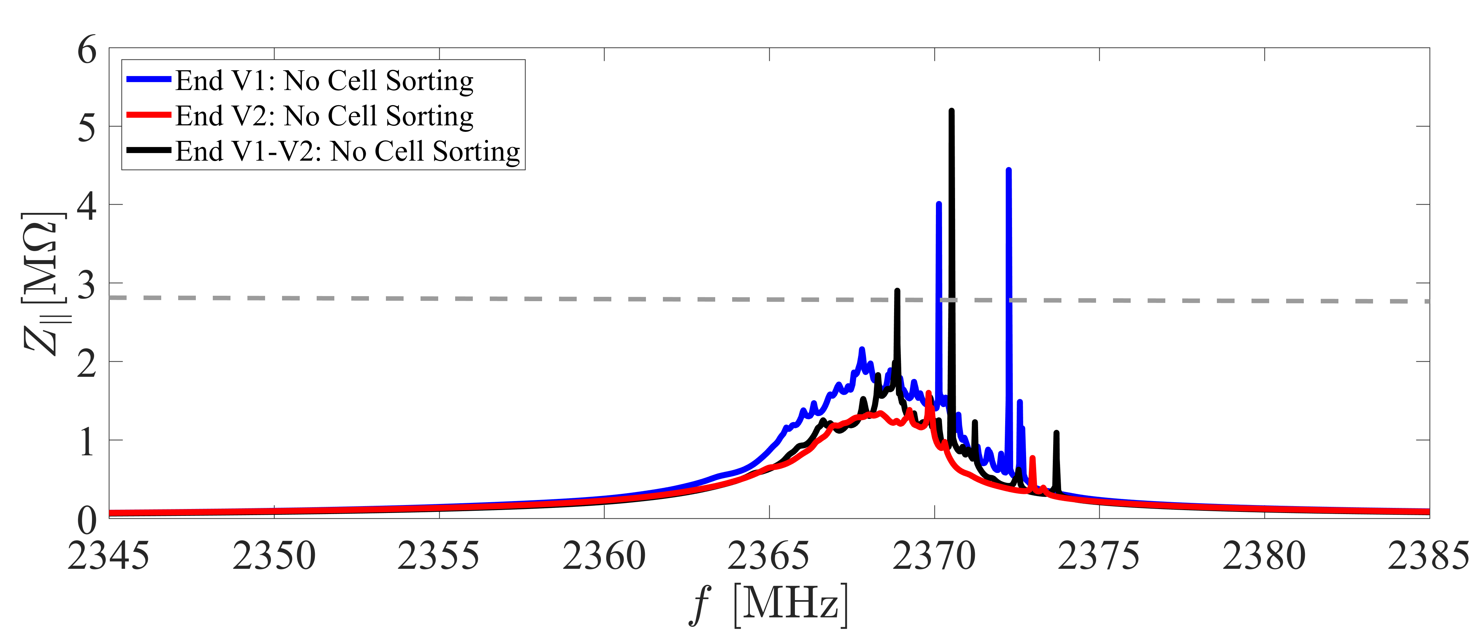
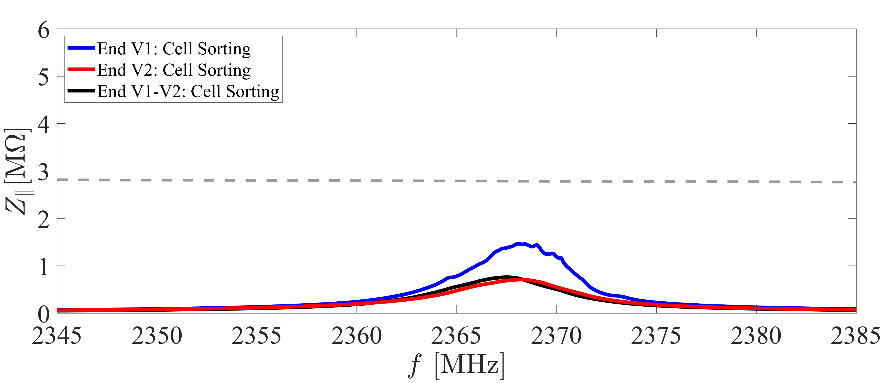
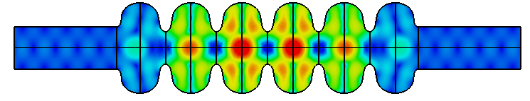

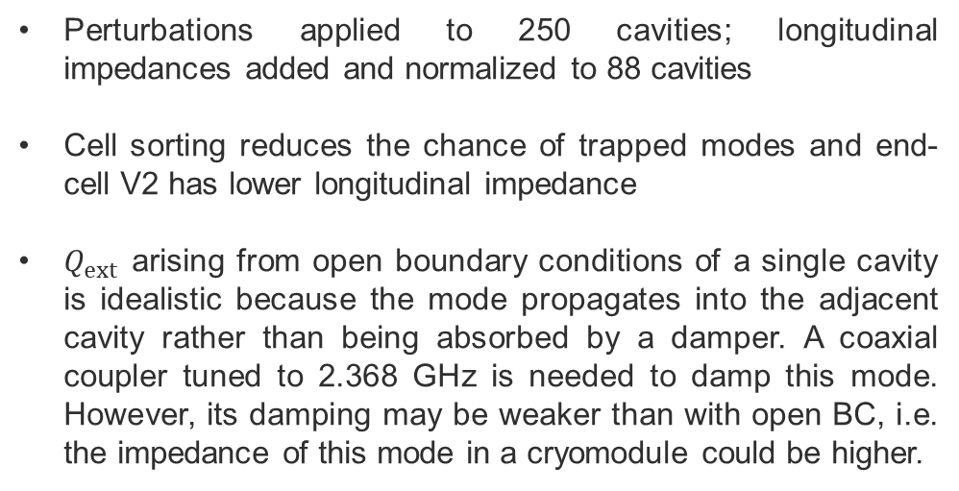
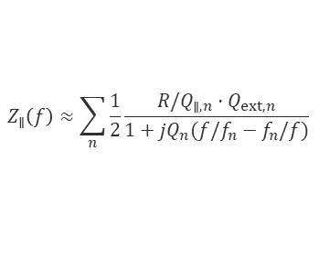


HOM sensitivity to perturbations
Superposition of $Z_{∥}$ of 88 perturbed cavities
Perturbations applied to 250 cavities; longitudinal impedances added and normalized to 88 cavities
Cell sorting reduces the chance of trapped modes and end-cell V2 has lower longitudinal impedance
$Q_{ext}$ arising from open boundary conditions of a single cavity is idealistic because the mode propagates into the adjacent cavity rather than being absorbed by a damper. A coaxial coupler tuned to 2.368 GHz is needed to damp this mode. However, its damping may be weaker than with open BC, i.e. the impedance of this mode in a cryomodule could be higher.
$Z_{∥}^{th}$ with $τ_{z}=1.51 s$ for Z_{B}
$$Z_{∥}\left(f\right)≈\sum_{n}{\frac{1}{2}\frac{ R/Q_{∥,n}⋅Q_{ext,n} }{1+jQ_{n}(f/f_{n}−f_{n}/f)}}$$
Cell sorting after perturbation
Impedance peak in worst-case deterministic scenario
$Z_{∥}^{th}$ with $τ_{z}=1.51 s$ for Z_{B}
Open BC
Open BC

Slide 9
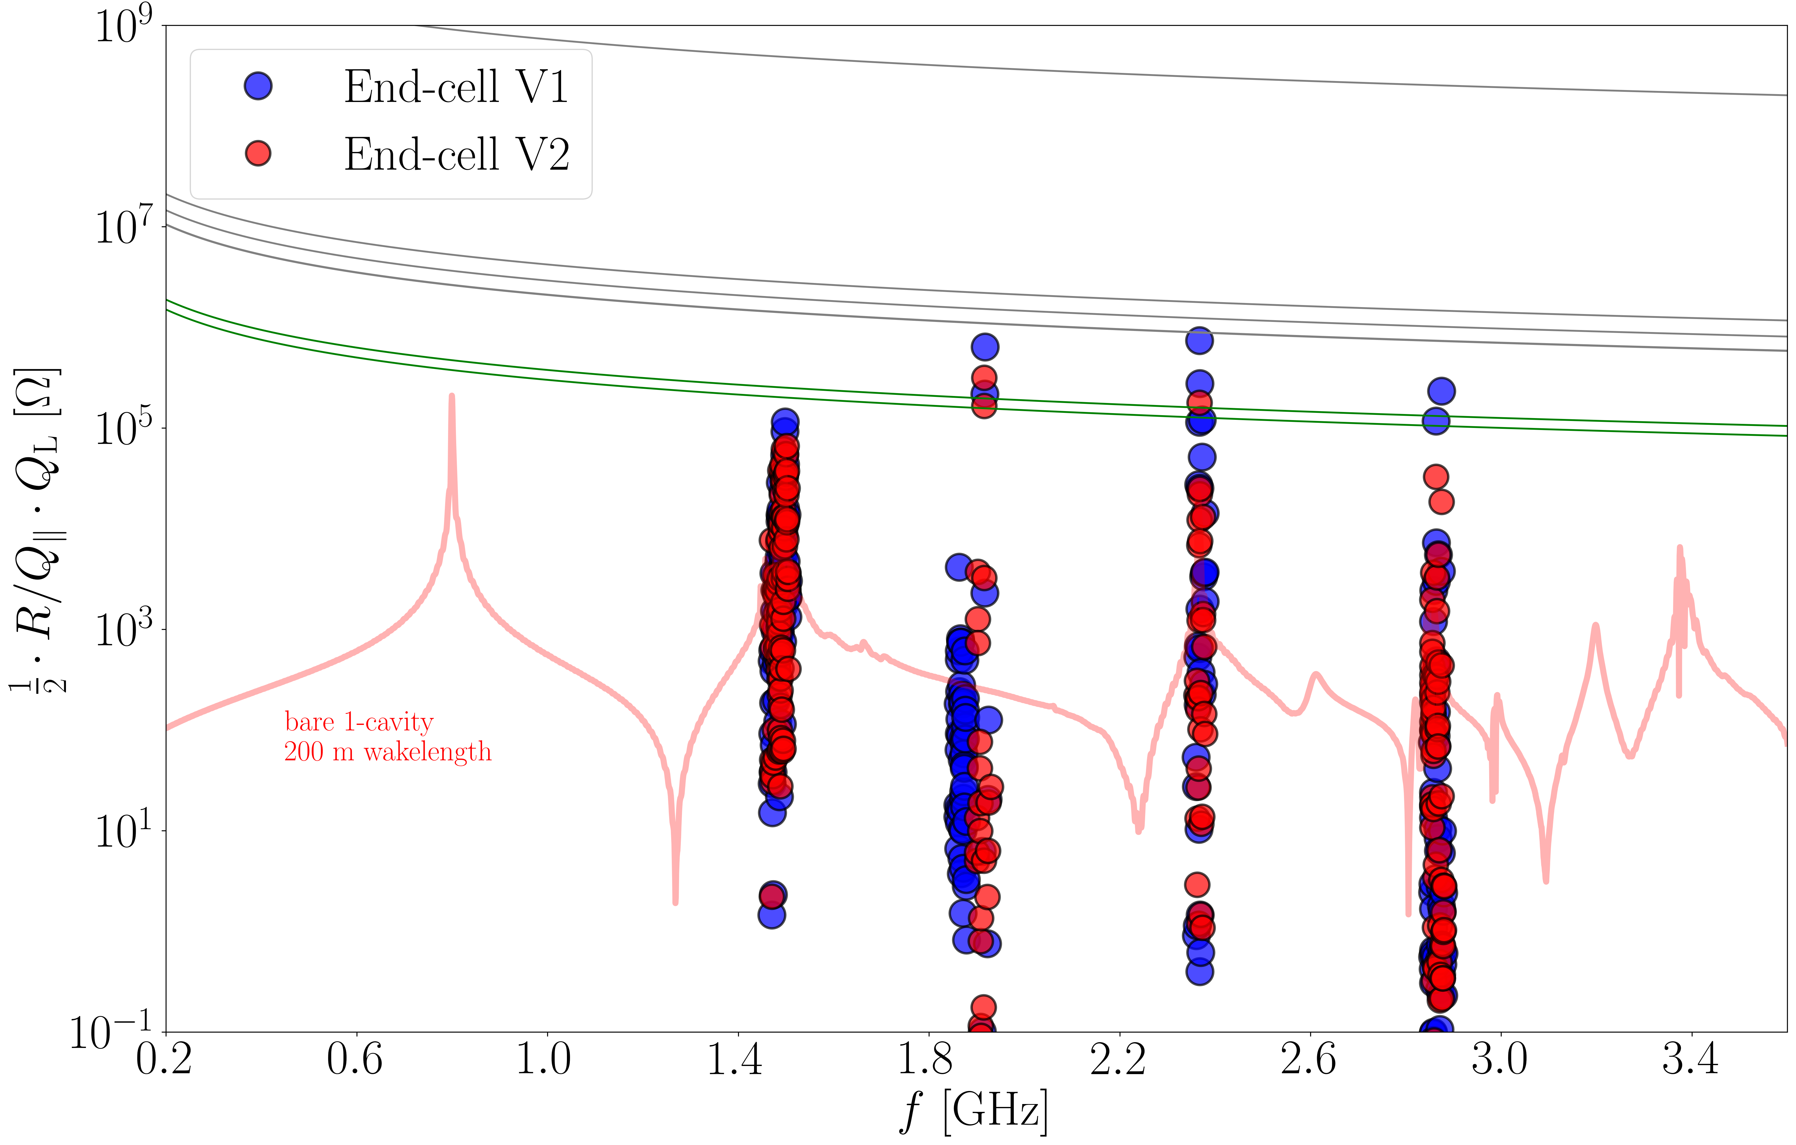
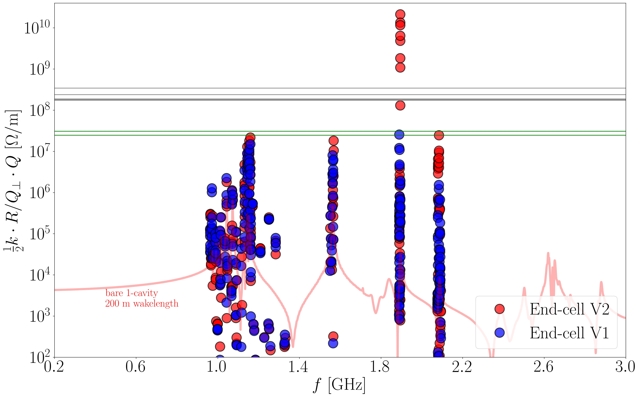
Impedance without perturbation in a module
tt_{C}
3
Z_{B} and tt_{B}
1
2
Z_{B} , W_{B}, H_{B}, tt_{B}, tt_{C}
W_{B} and H_{B}
W_{B} and Z_{B}
Reverse phase
4
W_{B} and Z_{B}
Reverse phase
1
3
$$f=1.916 GHz, R/Q=1.4 Ω, Q_{L}=4.5e5,c=0.08$$
$$f=1.894 GHz, R/Q_{⊥}=0.8 Ω, Q_{L}=1.4e9$$
2
4
$$f=2.367 GHz, R/Q=73.6 Ω, Q_{L}=4.9e3,c=0.33$$
$$f=2.084 GHz, R/Q_{⊥}=0.29 Ω, Q_{L}=3.9e6$$
End-cell V2 improves $Z_{∥}$ but worsens $Z_{⊥}$ peak. Asymmetric end-cells can provide a compromise between the two → next slide

Slide 10
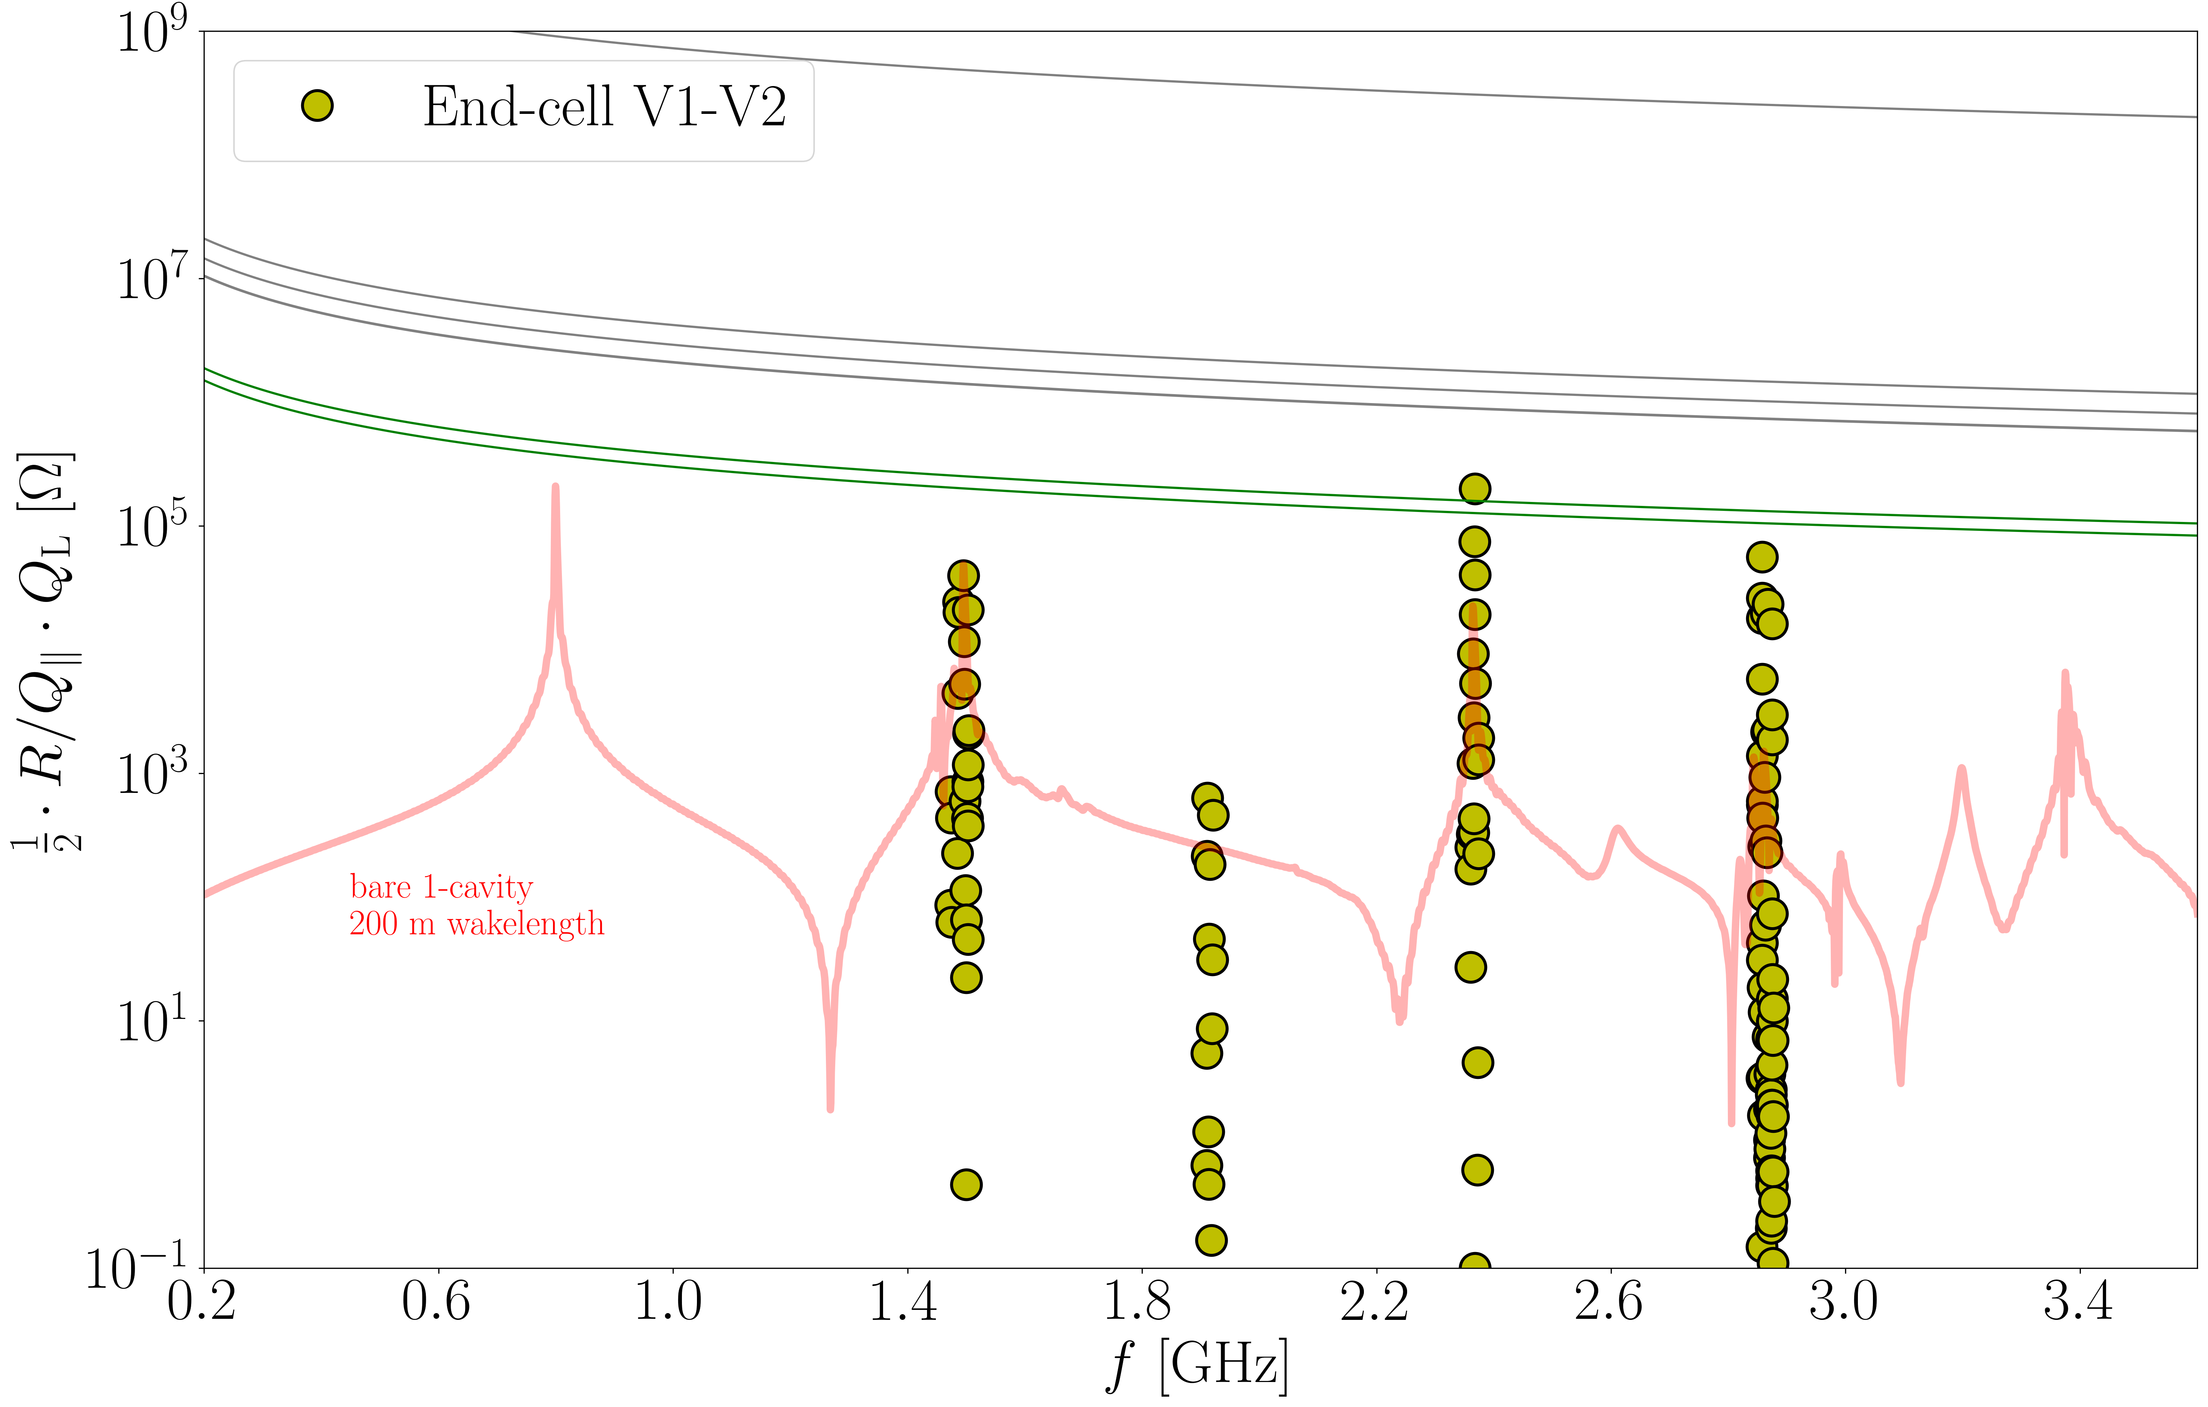
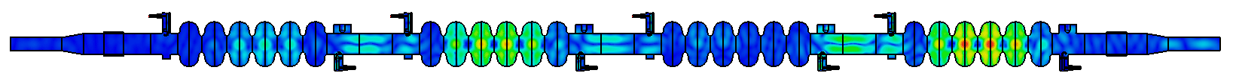
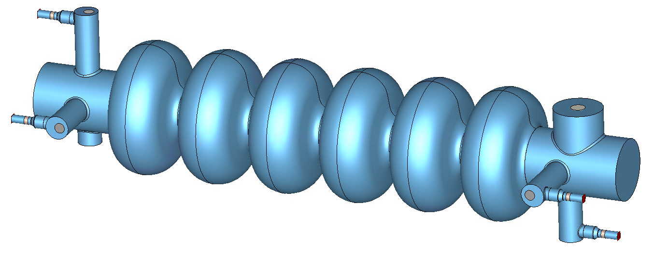

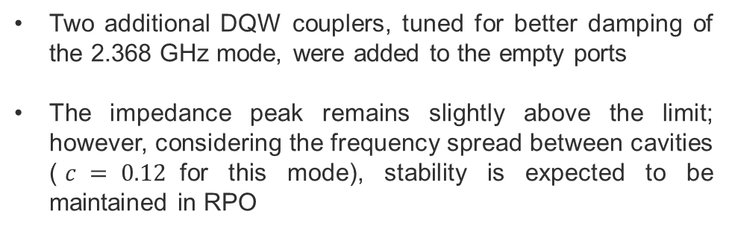
$Z_{∥}$ of asymmetric end-cells with 4 DQW couplers
Two additional DQW couplers, tuned for better damping of the 2.368 GHz mode, were added to the empty ports
The impedance peak remains slightly above the limit; however, considering the frequency spread between cavities ($c = 0.12$for this mode), stability is expected to be maintained in RPO
tt_{C}
W_{B} and H_{B}
Z_{B} and tt_{B}
1
W_{B} and Z_{B}
Reverse phase
1
$$f=2.3676 GHz, R/Q=18.0 Ω, Q_{L}=22.4e3,c=0.12$$

Slide 11
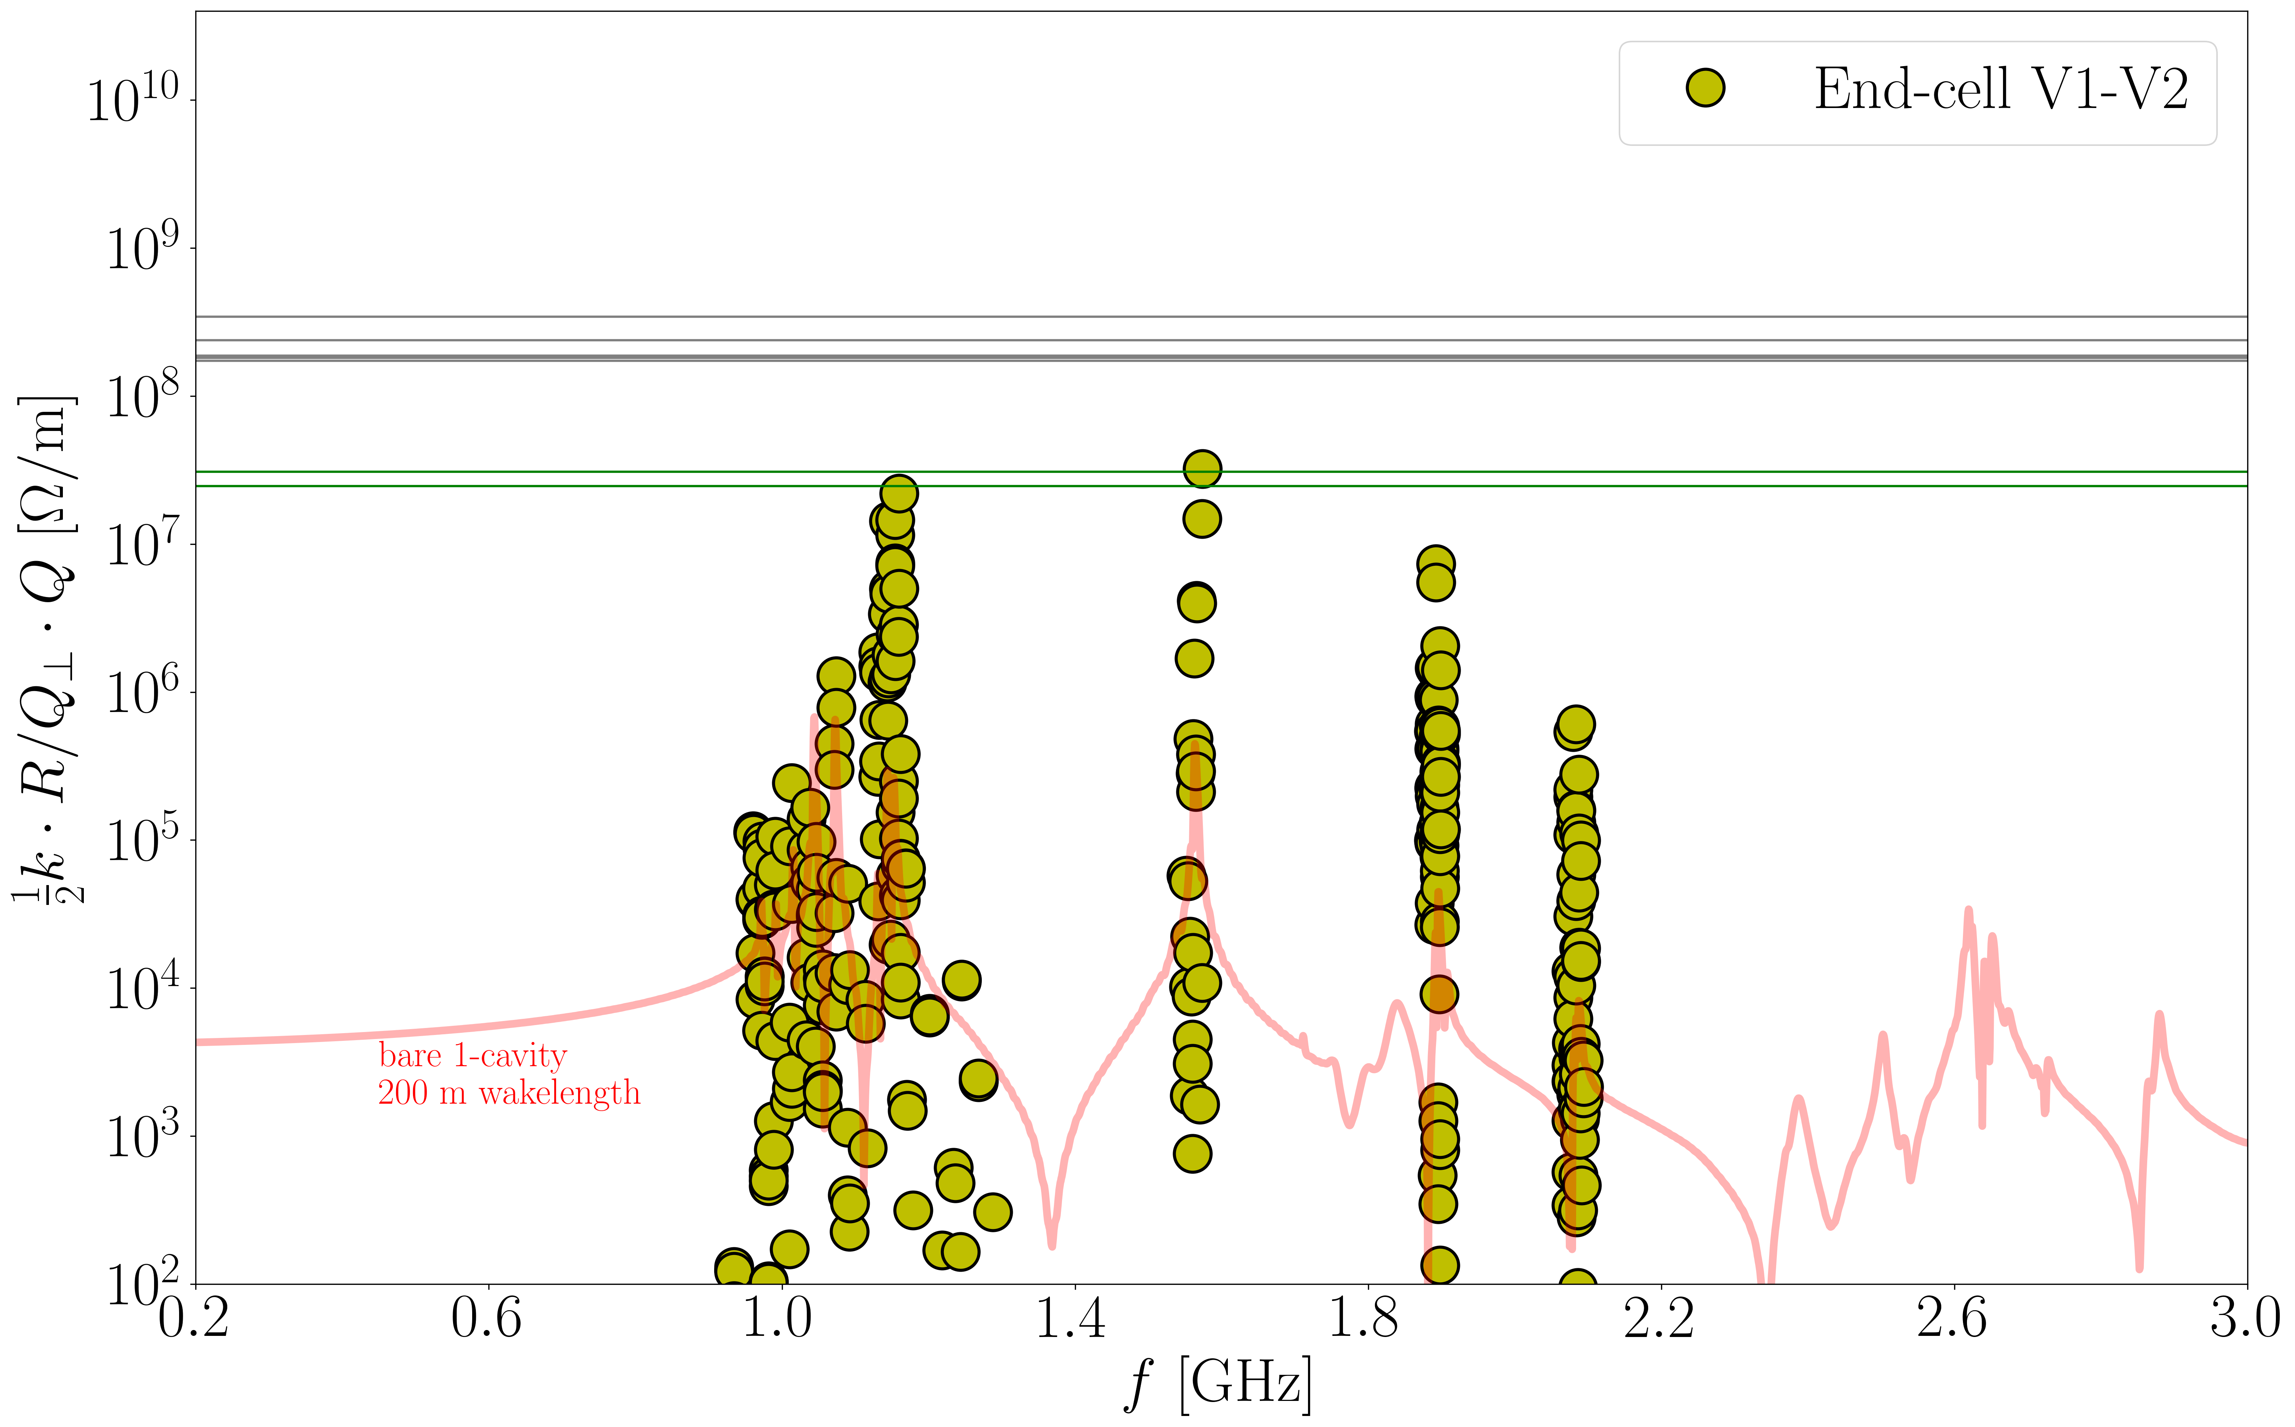
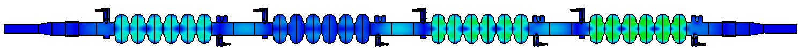
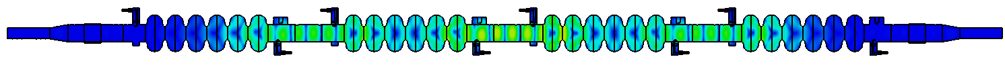



$Z_{⊥}$ of asymmetric end-cells with 4 DQW couplers
For transverse impedance we are also close to the stability limit, but the frequency spread between cavities can improve the stability limit by at least a factor five
Z_{B} , W_{B}, H_{B}, tt_{B}, tt_{C}
1
2
W_{B} and Z_{B}
Reverse phase
1
$$f=1.154 GHz,R/Q_{⊥}=54.0 Ω, Q_{L}=2.2e4$$
$$c\left(σ=0.5 MHz\right)=0.18$$
$$c\left(σ=1.0 MHz\right)=0.12$$
2
$$f=1.574 GHz,R/Q_{⊥}=53.5 Ω, Q_{L}=3.6e4$$
$$c\left(σ=0.5 MHz\right)=0.17$$
$$c\left(σ=1.0 MHz\right)=0.11$$

Slide 12
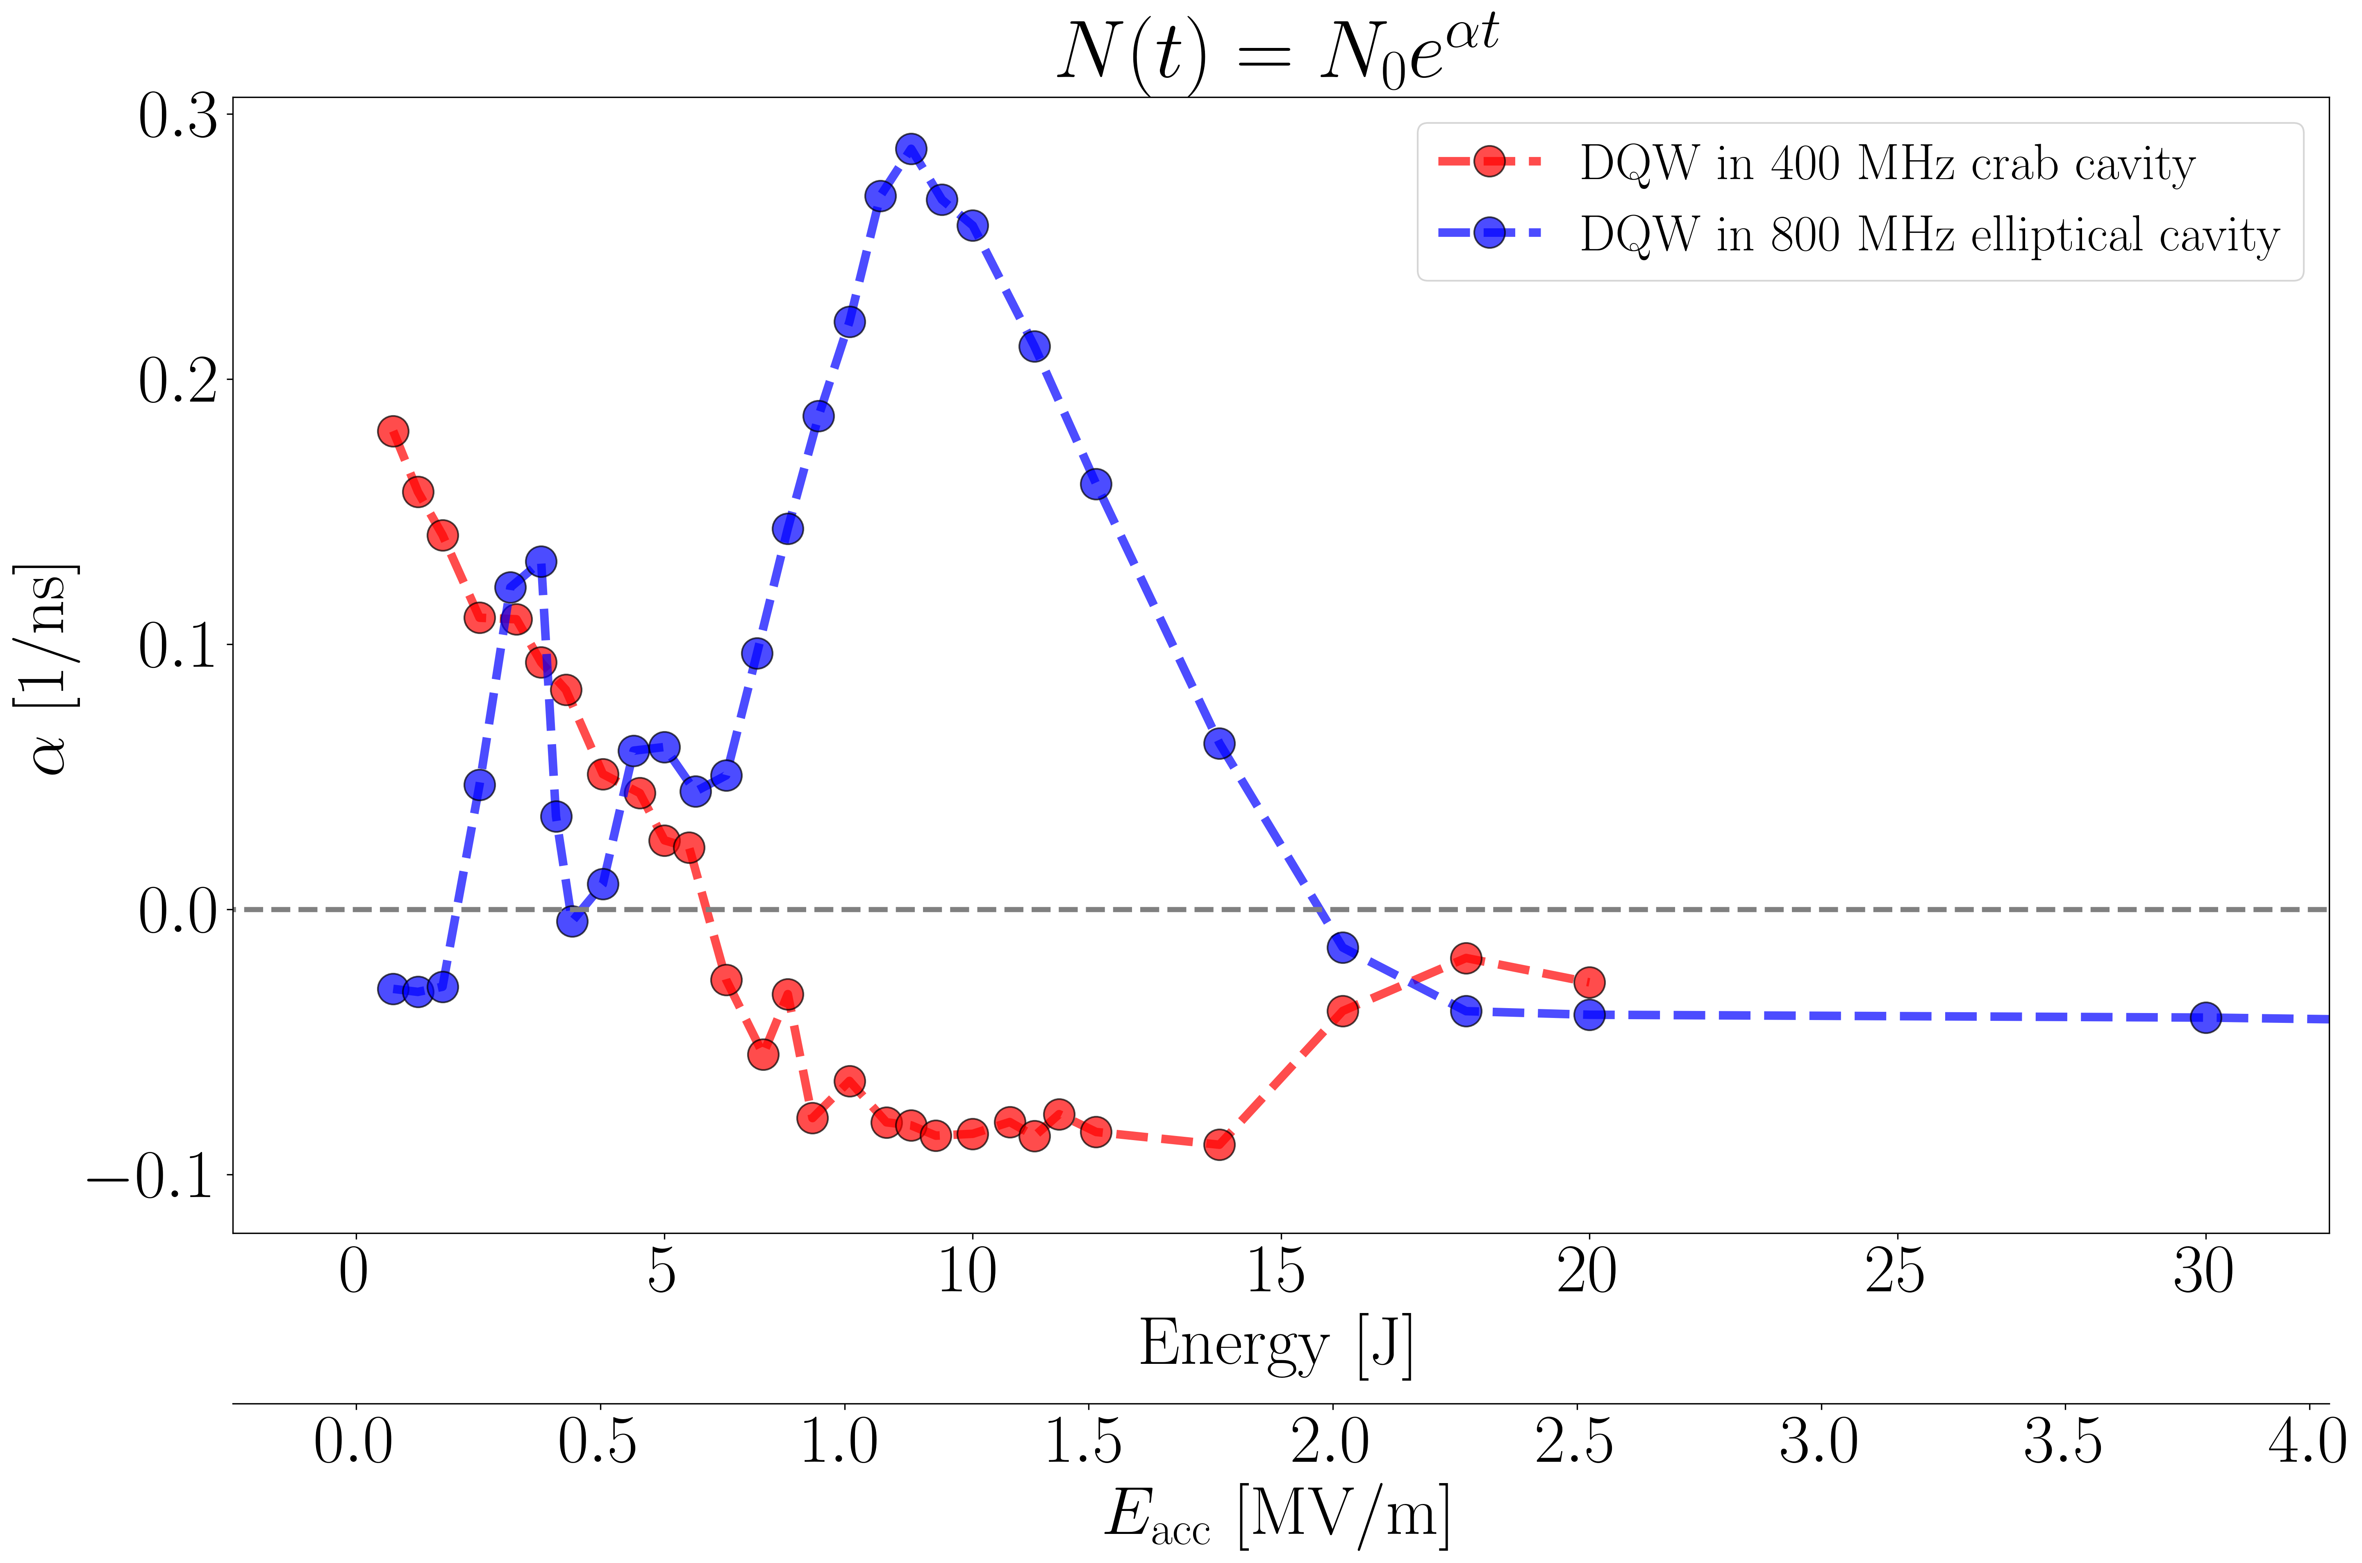
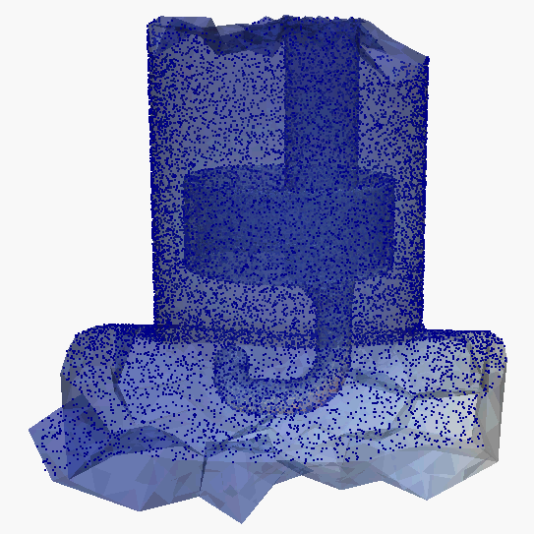
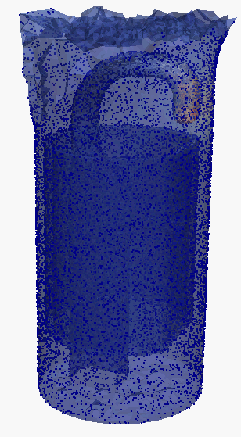
MP in DQW coupler
Strong multipacting (MP) can occur in the DQW coupler at low $E_{acc}$ (below 2 MV/m). Redesigning the shape of the capacitive section can help to eliminate MP in this coupler → to be studied
800 MHz elliptical cavity at 9 J in the cavity
400 MHz crab cavity at 2 J in the cavity

Slide 13
Conclusion
Module Length reduction:
  Inner coaxial couplers removed; rely on BLA and additional empty ports for HOM damping
  Saves ~0.8 m per module, potentially more with optimized tapering and BLA connections. Available vacuum gate valve diameter must be determined for further improvements!
Lower beam impedance limit at injection energy in RPO addressed by:
  Asymmetrical end-cell shape for better HOM damping
  The other two HOM ports were used by a different HOM coupler design to cover modes at other passbands
  Larger coupler dimensions for better mechanical robustness and inner cooling
  Cell-sorting during manufacturing to minimize trapped HOMs
  Stability achieved with limited margin
With the 6-cell cavity shape, port positions, and distances now fixed, these studies should follow:
  Improve HOM coupler designs for better HOM damping and reduced MP
  Beam tracking in the booster cavities to better understand the beam stability limits

Slide 14
Appendix

Slide 15


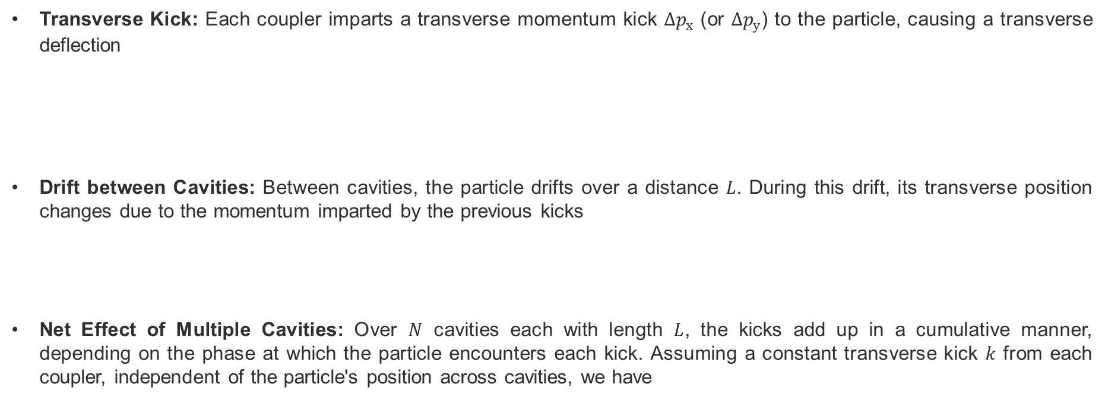

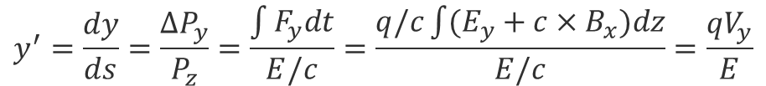

Coupler kick calculation
Transverse Kick: Each coupler imparts a transverse momentum kick $Δp_{x}$​ (or $Δp_{y}$​) to the particle, causing a transverse deflection
Drift between Cavities: Between cavities, the particle drifts over a distance $L$. During this drift, its transverse position changes due to the momentum imparted by the previous kicks
Net Effect of Multiple Cavities: Over $N$ cavities each with length $L$, the kicks add up in a cumulative manner, depending on the phase at which the particle encounters each kick. Assuming a constant transverse kick $k$ from each coupler, independent of the particle's position across cavities, we have
$$P_{z}$$
$$y^{′}=\frac{dy}{ds}=\frac{{∆P}_{y}}{P_{z}}=\frac{\int{F_{y}dt}}{E/c}=\frac{q/c\int{(E_{y}+c×B_{x})dz}}{E/c}=\frac{qV_{y}}{E}$$
z (s)
$${∆P}_{y}$$
$$\left[\begin{matrix}y \\ y′\end{matrix}\right]=\left[\begin{matrix}1 & R_{12}=L \\ 0 & 1\end{matrix}\right]\left[\begin{matrix}y \\ y′\end{matrix}\right]$$
$$∆y=L\frac{qV_{y}}{E}=Lk$$
$$y_{N}=y0+NLk+\left(N−1\right)Lk+⋯+2Lk+Lk=y_{0}+\frac{N(N+1)}{2}Lk$$
G. Burt, Transverse deflecting cavities

Slide 16
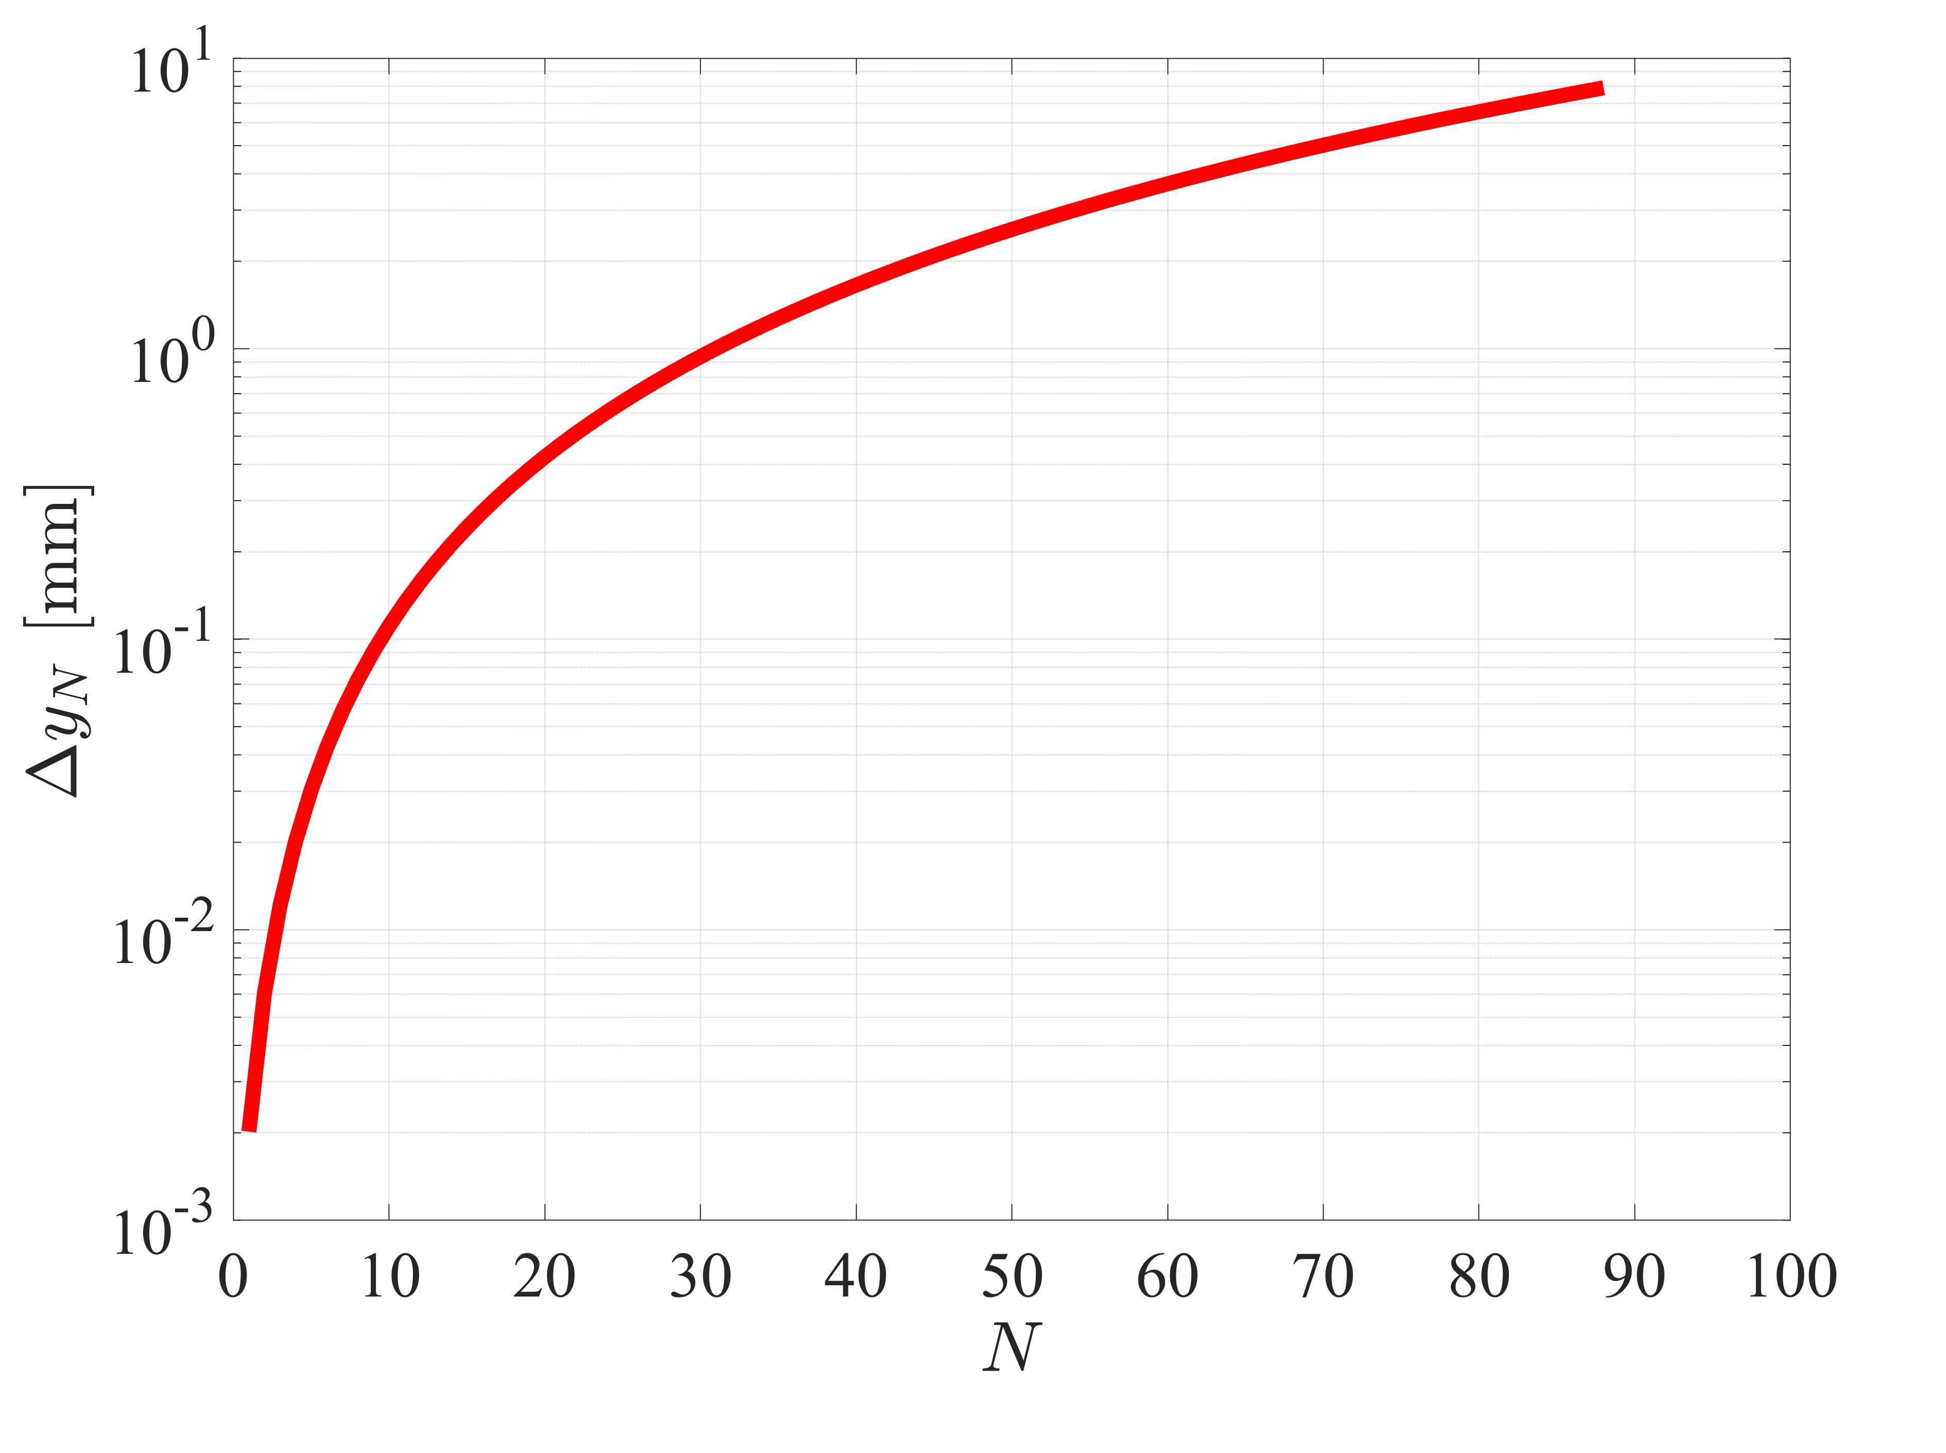
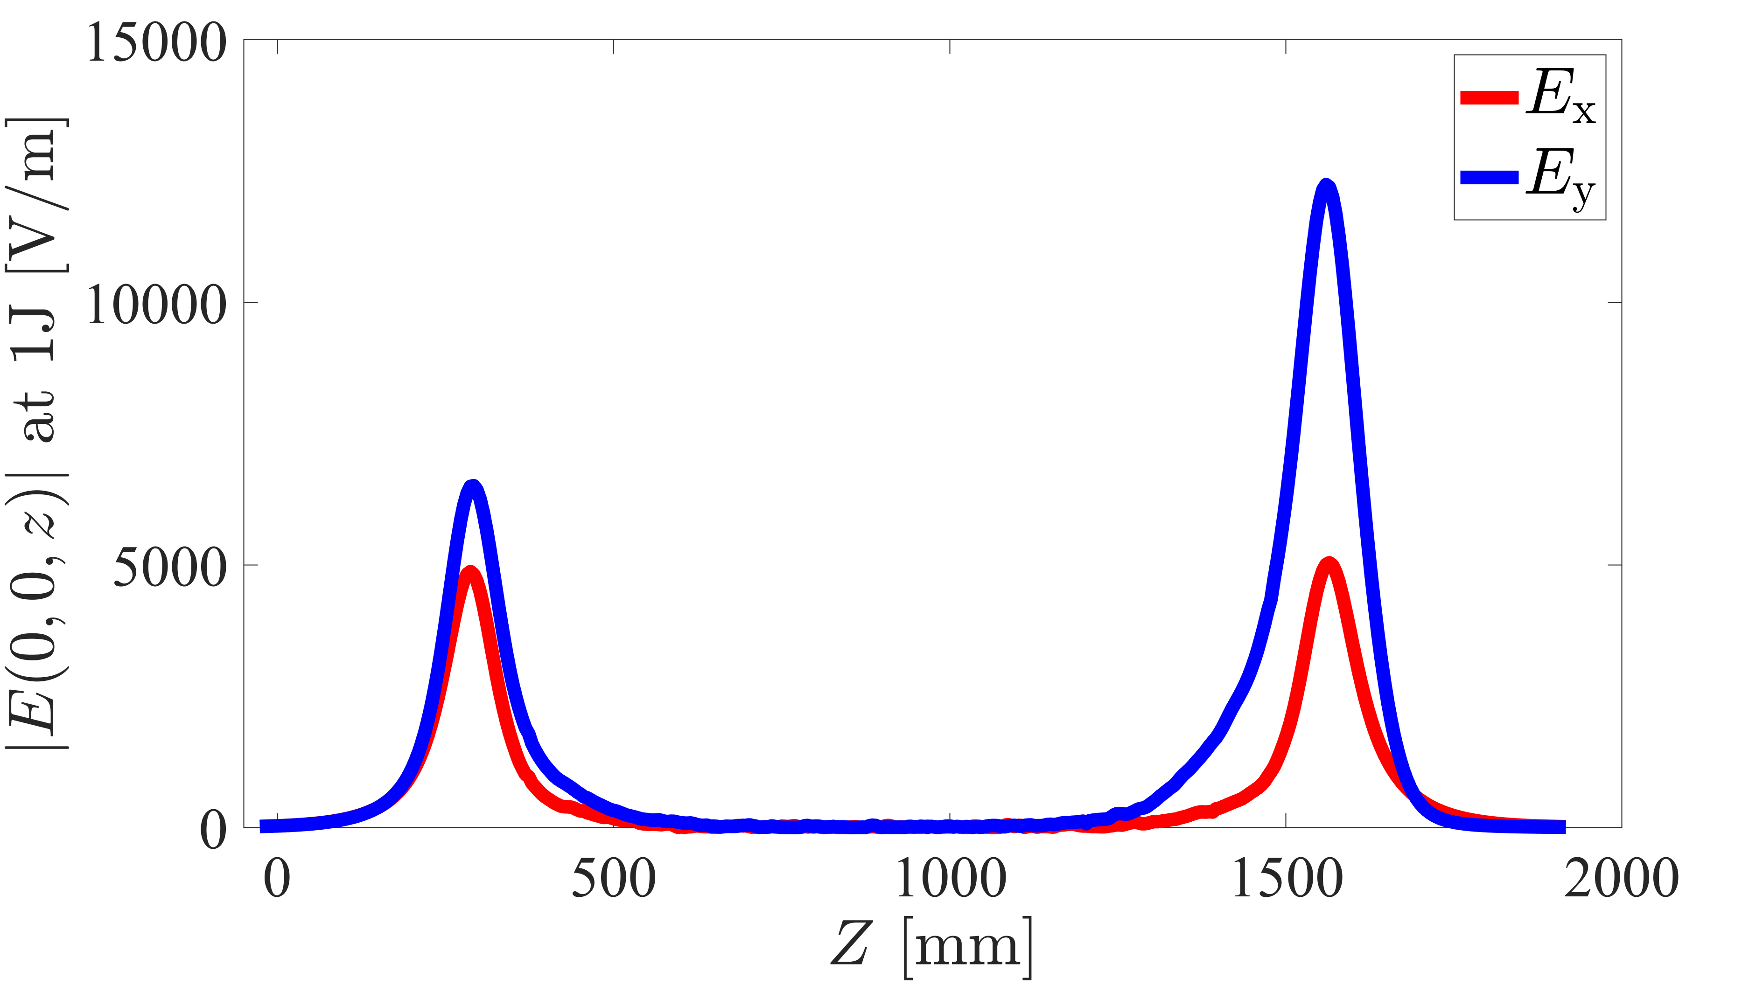
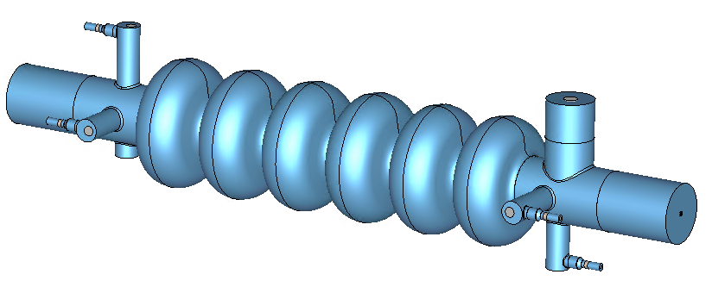

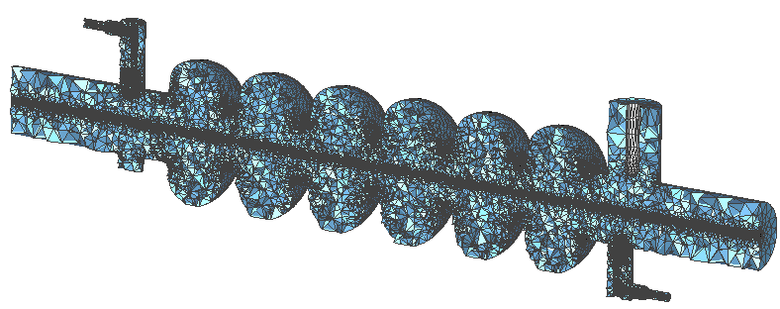
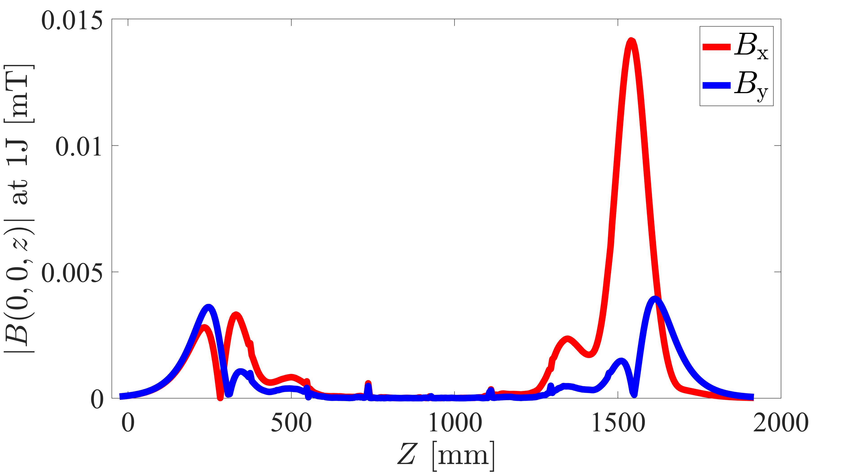

Coupler kick at 800 MHz
To limit the kick offset caused by the couplers to below 1 mm (an arbitrary threshold to be determined based on beam dynamics and operational tolerances) in the booster cavities, corrector magnets are needed at least every 30 cavities (approximately 90 m) to steer the bunch back to the centre
$${∆y}_{N}=\frac{N(N+1)}{2}L\frac{qV_{y}}{E}$$
$$E= 20 GeV$$
$$V_{y}=13 kV$$
$L=3 m$ (average length per cavity considering inter-cavity distances)
N: number of cavities

Slide 17
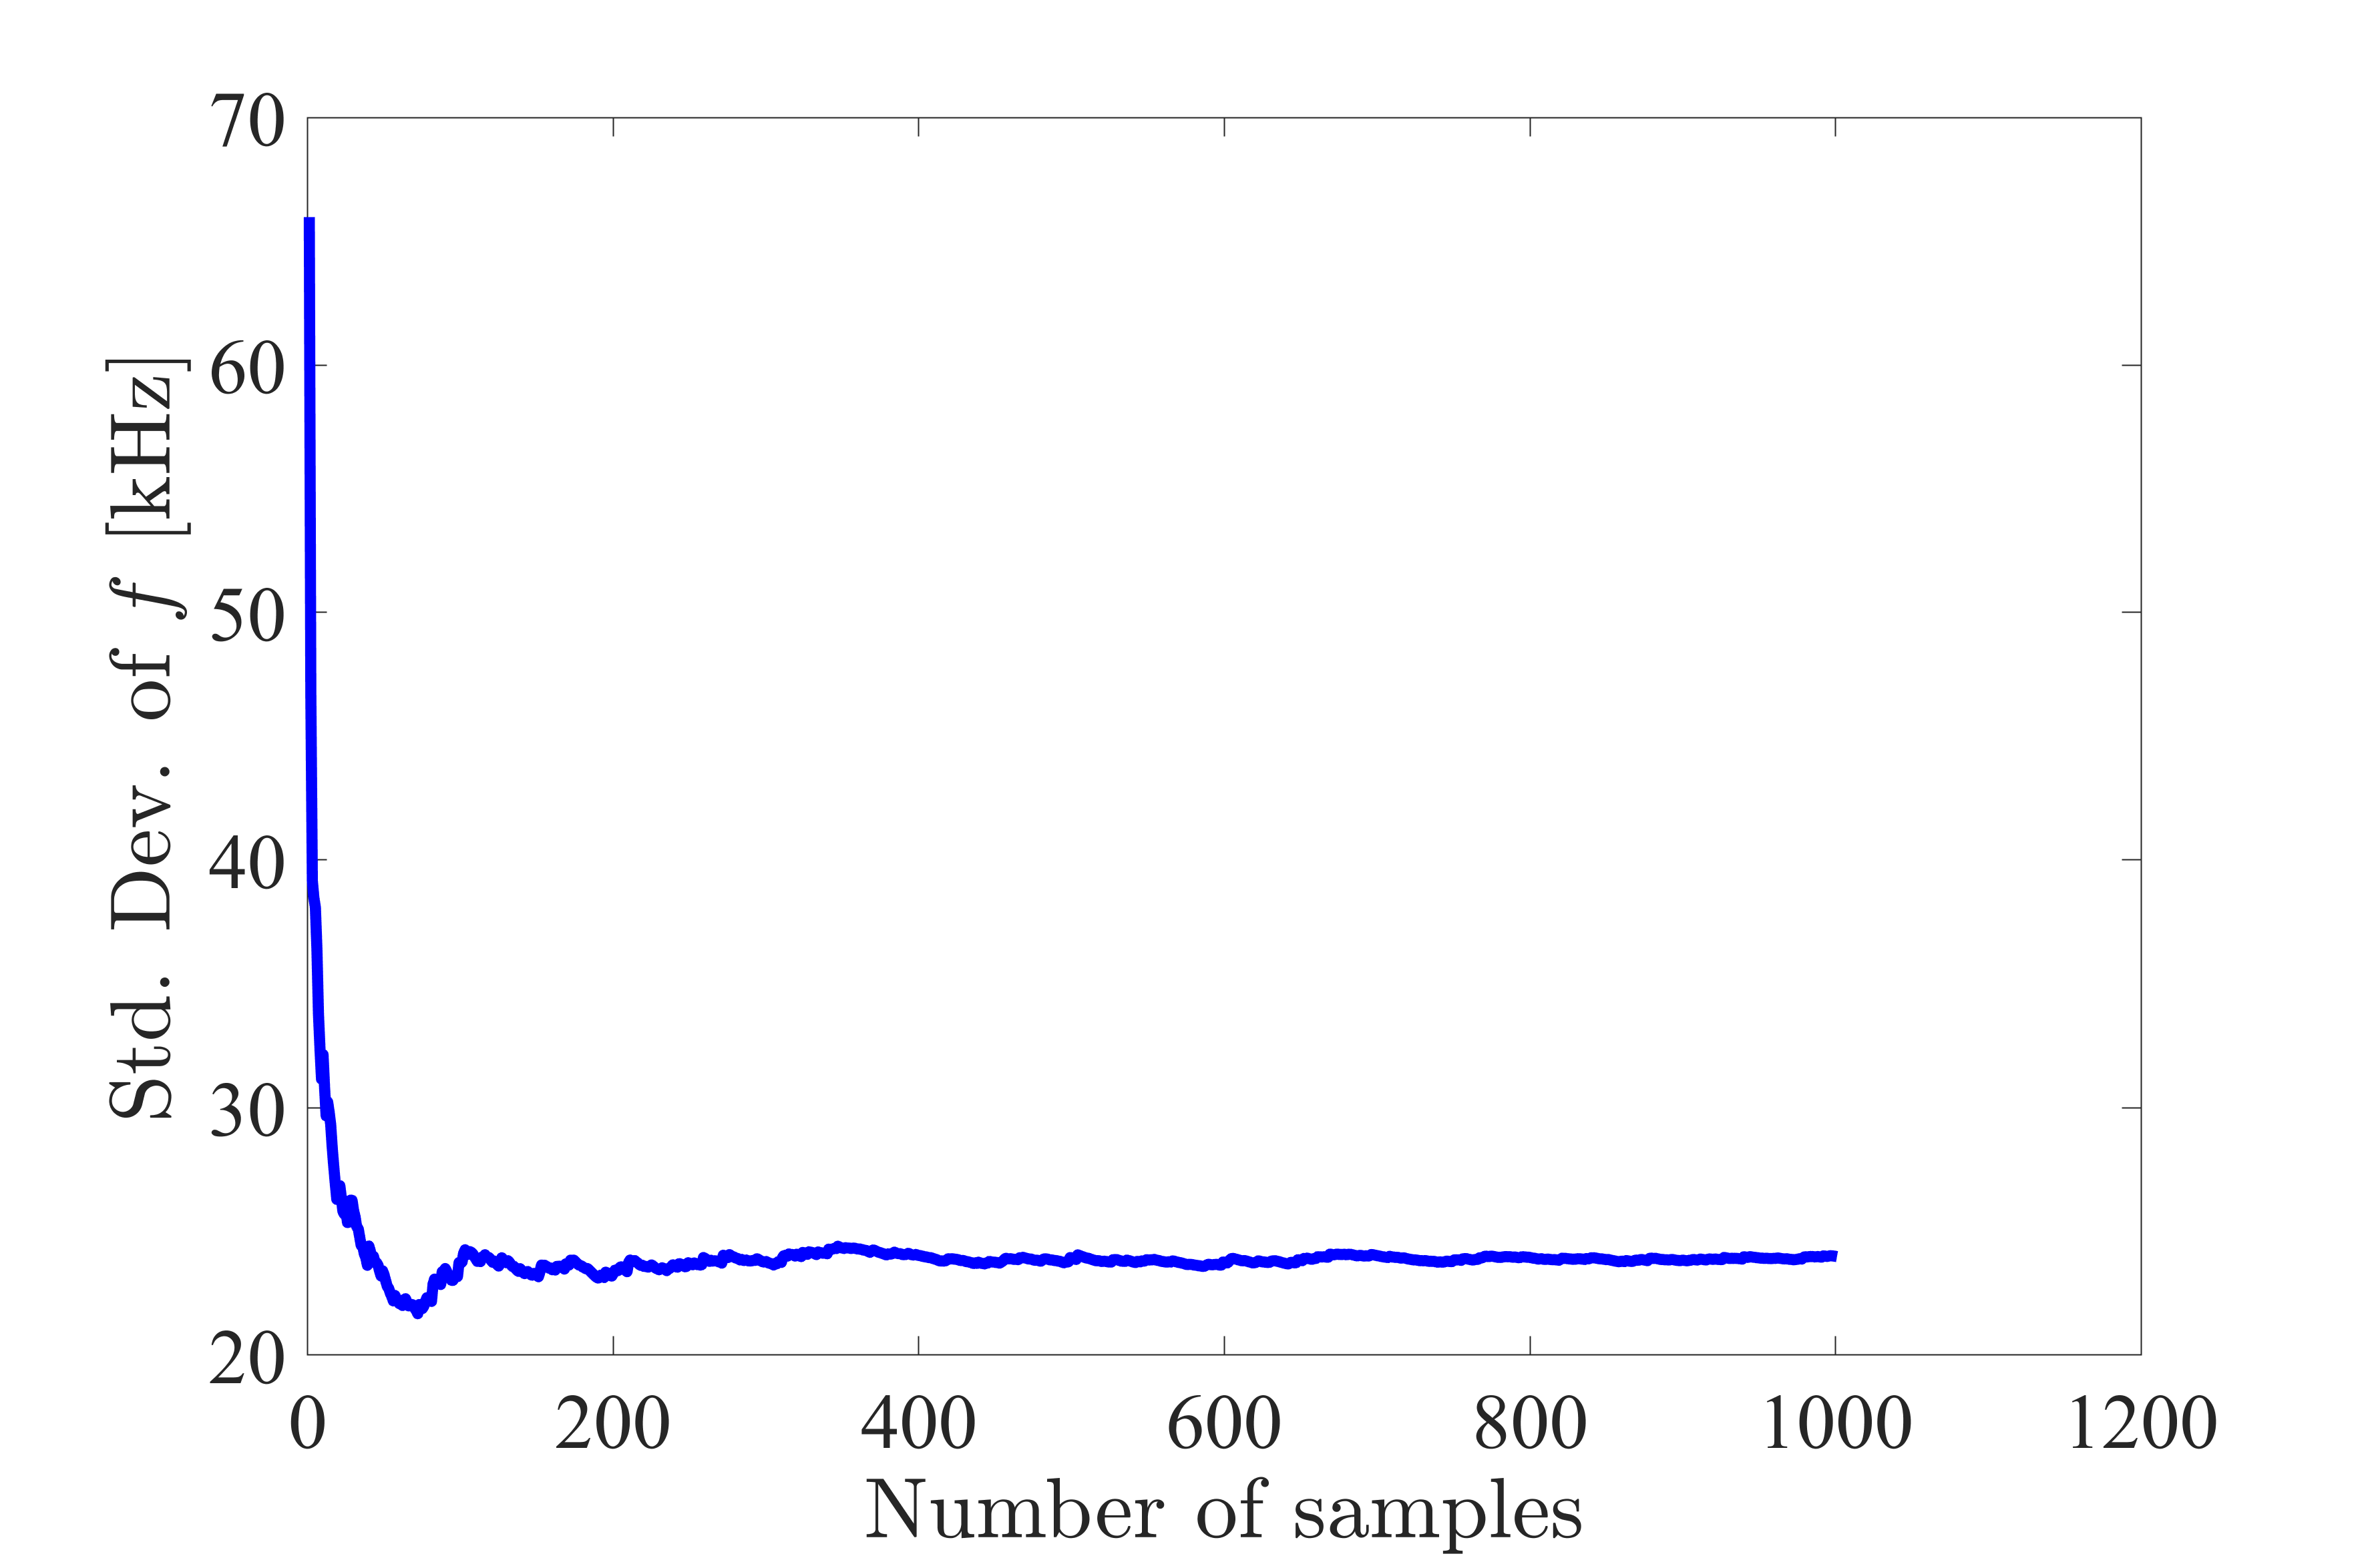
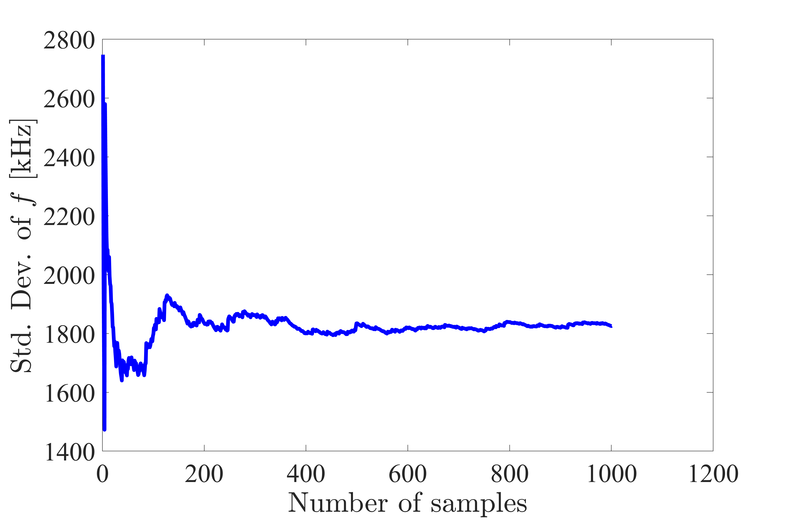
Convergence study of perturbation analysis
Mode 4 at FM passband
HM2

Slide 18
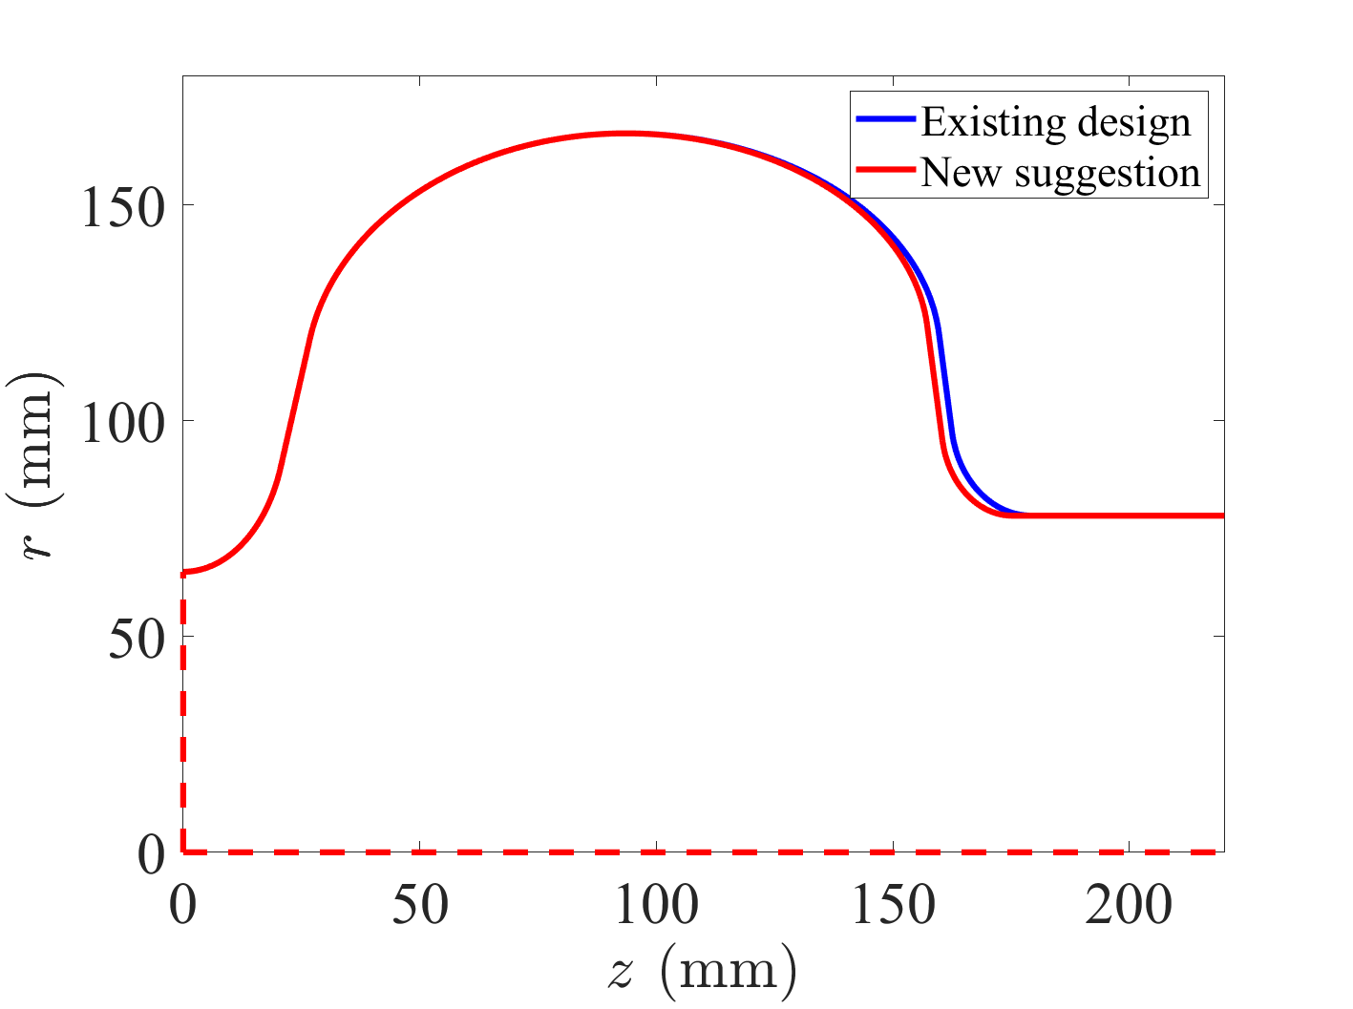
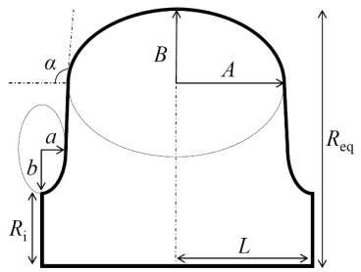
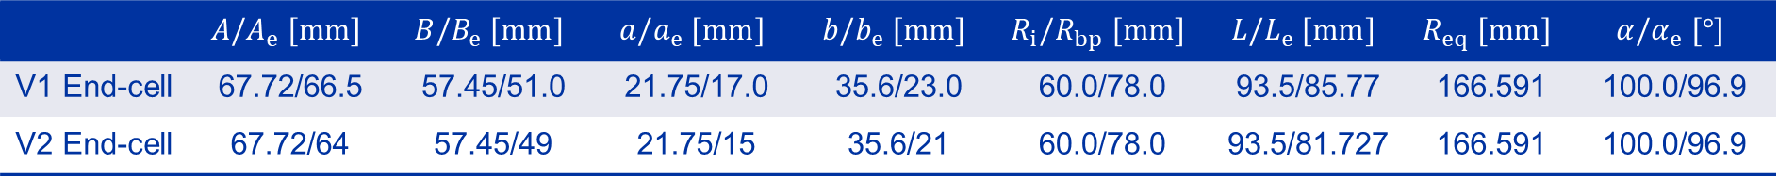

Cavity parameters
B
B_{e}
$$α_{e}$$
A
A_{e}
a
a_{e}
b
b_{e}
L_{bp}
R_{eq}
R_{i}
L
L_{e}
R_{bp}
 | $$A/A_{e} [mm]$$ | $$B/B_{e} [mm]$$ | $$a/a_{e} [mm]$$ | $$b/b_{e} [mm]$$ | $$R_{i}/R_{bp} [mm]$$ | $$L/L_{e} [mm]$$ | $$R_{eq} [mm]$$ | $$α/α_{e} [°]$$
V1 End-cell | 67.72/66.5 | 57.45/51.0 | 21.75/17.0 | 35.6/23.0 | 60.0/78.0 | 93.5/85.77 | 166.591 | 100.0/96.9
V2 End-cell | 67.72/64 | 57.45/49 | 21.75/15 | 35.6/21 | 60.0/78.0 | 93.5/81.727 | 166.591 | 100.0/96.9

Slide 19







Mode at 2.367 GHz untrapping
All analyzed end-cells have a radius of 78 mm, which is equal with the radius of the current design
Among the geometries that satisfy the conditions $E_{pk}/E_{acc}<2.1$, $B_{pk}/E_{acc}<4.4 mT/MV/m$, and a wall angle of the end cell above 96 degrees, the one with the lowest TMI is selected
$$Z_{min}$$
$$Z_{endcell}$$
$$Z_{max}$$
$$Trapped mode index \left(TMI\right)=\frac{\int_{z_{min}}^{z_{max}}{{\left|E_{\left(0,0,z\right)}\right|}^{2} dz}}{\int_{z_{endcell}}^{z_{max}}{{\left|E_{\left(0,0,z\right)}\right|}^{2} dz}}$$

Slide 20




New end-cell suggestion
Parameters | Existing end-cell design | New suggested end-cell
FM
Frequency [MHz] | 801.58 | 801.58
$R/Q$ [Ω] | 520.3 | 521.8
Geometry Factor [Ω] | 272.9 | 271.6
$G.R/Q$ [kΩ²] | 142.2 | 141.7
$B_{pk}{/E}_{acc}$ [$mT/(MV/m)$] | 4.33 | 4.38
$E_{pk}{/E}_{acc}$ [-] | 2.05 | 2.06
Cavity Active Length [mm] | 919.532 | 911.454
Beam Pipe radius [mm] | 78 | 78
Wall angle [degree] | 100/96.9 | 100/96.9
Field Flatness [%] | 99 | 99
HOM – Monopole modes
$Q_{ext}$ of mode f=1.494 GHz | 3.5e3 | 2.2e3
$Q_{ext}$ of mode f=2.367 GHz | 4.5e3 | 1.5e3
$Q_{ext}$ of mode f=3.38 GHz | 8.0e3 | 3.7e3
Mode at 2.367 GHz
Fundamental mode

Slide 21







Impedance of the HOM damped cavity
$Q_{radiated}=3.3e$3
$$Q_{ext−ports}=1.2e5$$
$$Q_{radiated}=1.5e5$$
$Q_{ext−ports}=7.5e$7

Slide 22



FM parameters of the 6-cell with asymmetric end-cells
Parameters | V1 end-cell | V1-V2 end-cell
FM
Frequency [MHz] | 801.584 | 801.584
$R/Q$ [Ω] | 630.4 | 631.2
Geometry Factor [Ω] | 272.8 | 272.2
$G.R/Q$ [kΩ²] | 172.0 | 171.8
$B_{pk}{/E}_{acc}$ [$mT/(MV/m)$] | 4.31 | 4.37
$E_{pk}{/E}_{acc}$ [-] | 2.04 | 2.06
Cavity Active Length [mm] | 1106.54 | 1102.497
Beam Pipe radius [mm] | 78 | 78
Wall angle [degree] | 100/96.9 | 100/96.9
Field Flatness [%] | 99 | 99
HOM – Monopole modes
$Q_{ext}$ of mode f=1.494 GHz | 5.0e3 | 3.8e3
$Q_{ext}$ of mode f=2.368 GHz | 9.0e3 | 4.9e3
$Q_{ext}$ of mode f=3.38 GHz | 1.0e4 | 8.2e3
V1 end-cell
V1 end-cell
V1 end-cell
V2 end-cell

Slide 23

FM passband sensitivity to perturbations for asymmetric end-cell
 | m1 | m2 | m3 | m4 | m5 | M6=FM | HM1 | HM2 | HM3
$$\overline{f} [MHz]$$ | 784.929 | 788.100 | 792.556 | 797.048 | 800.358 | 801.581 | - | 2367.3 | -
Std ($f$) [kHz] | 84.5 | 67.7 | 46.8 | 23.7 | 8.8 | 3.2 | - | 2024 | -
$\overline{R/Q} [Ω]$ | 0.005 | 0.15 | 0.006 | 0.40 | 0.076 | 630.0 | - | 16.0 | -
$$Q_{ext}$$ | 3.3e7 | 8.6e6 | 4.3e6 | 2.9e6 | 2.3e6 | 4.3e6 | - | - | -
$$Q_{ext}$$ | 9.5e7 | 2.4e7 | 1.1e7 | 7.1e6 | 5.7e6 | 1.1e7 | - | - | -
$\overline{f}$=mean value of frequency, and Std ($f$)=standard deviation of frequency
HM is the higher order modes at different passbands with largest longitudinal R/Q
250 samples were taken

