Slide 1
Study on injected beams
Takashi MORI
The 202nd FCC-ee Accelerator Design Meeting & 73rd FCCIS WP2.2 Meeting
12/02/2025

Slide 2
Motivation
The injection performance degradation as the increase of the stored beam current is one of the big issues for the SuperKEKB collider.
My reason for coming here is to gain and bring back new knowledge about injection through my research and contributions for FCC-ee.
  Injection efficiency, bootstrapping injection with 4 IPs, etc., …
I hope I could stay some months more; KEK does not completed the budgetary schedule including my stay expense yet…
Anyway, this is the first report of my study.

Slide 3
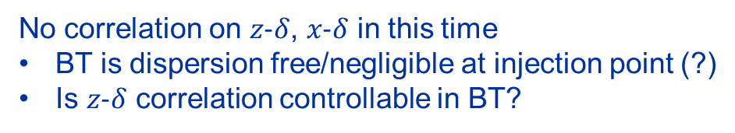
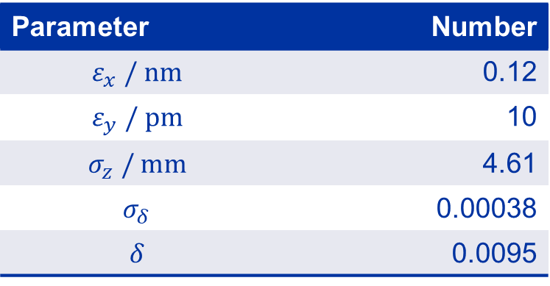
Injected beam parameters
Parameter | Number
$$ε_{x} / \text{nm}$$ | 0.12
$$ε_{y} / \text{pm}$$ | 10
$$σ_{z} / \text{mm}$$ | 4.61
$$σ_{δ}$$ | 0.00038
$$δ$$ | 0.0095
Transverse parameters: matched to the ring optics
No correlation on $z\text{−}δ$, $x\text{−}δ$ in this time
BT is dispersion free/negligible at injection point (?)
Is $z\text{−}δ$ correlation controllable in BT?
Ring lattice version: ‘FCCee_z_615_nosol’ provided by Oide-san
On-axis injection tracking with SAD
Xsuite version is already on going by Kyriacos, but the cross check is important.

Slide 4
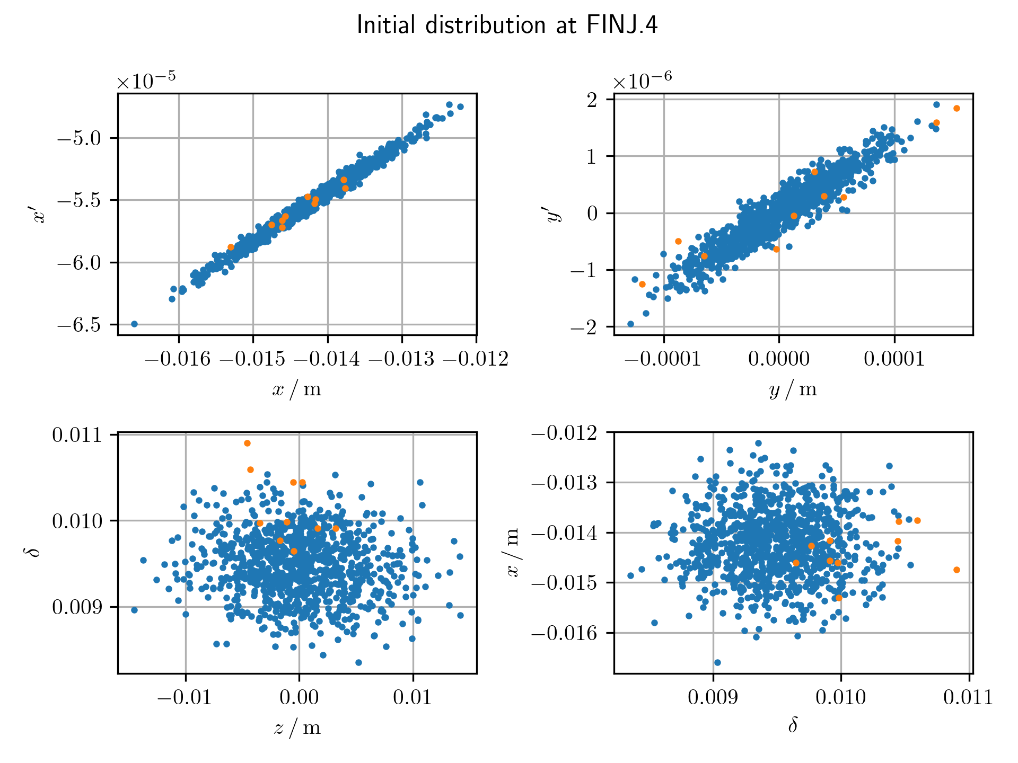
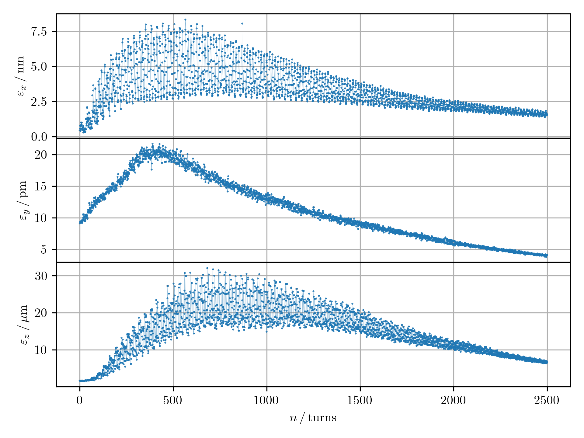
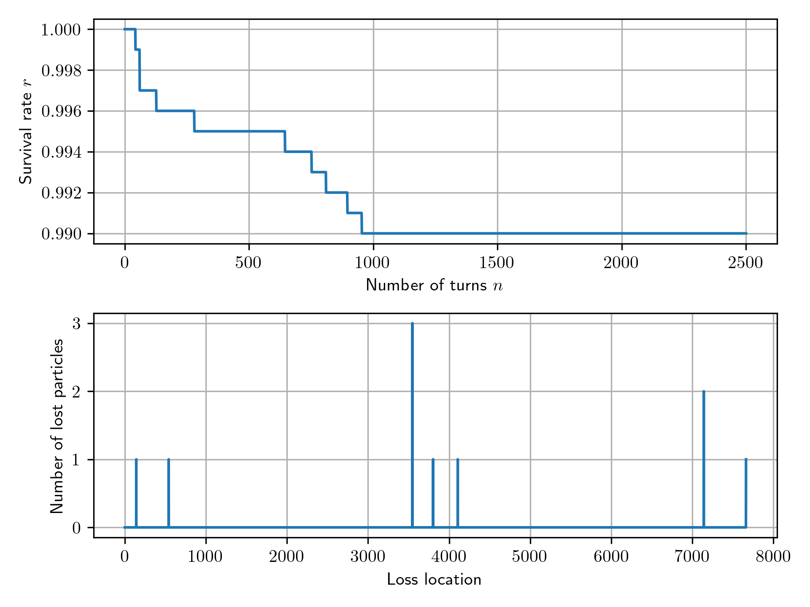
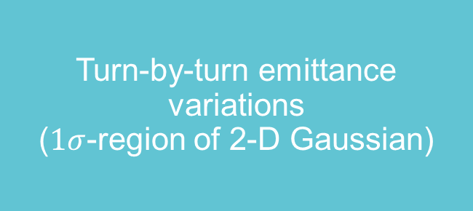
Result without beam-beam
Matched
Survival rate 99% (2500 turns)
& Loss map
?
Turn-by-turn emittance variations
($1σ$-region of 2-D Gaussian)
Initial distribution at FINJ.4
Orange dots will be lost before the final turn.

Slide 5
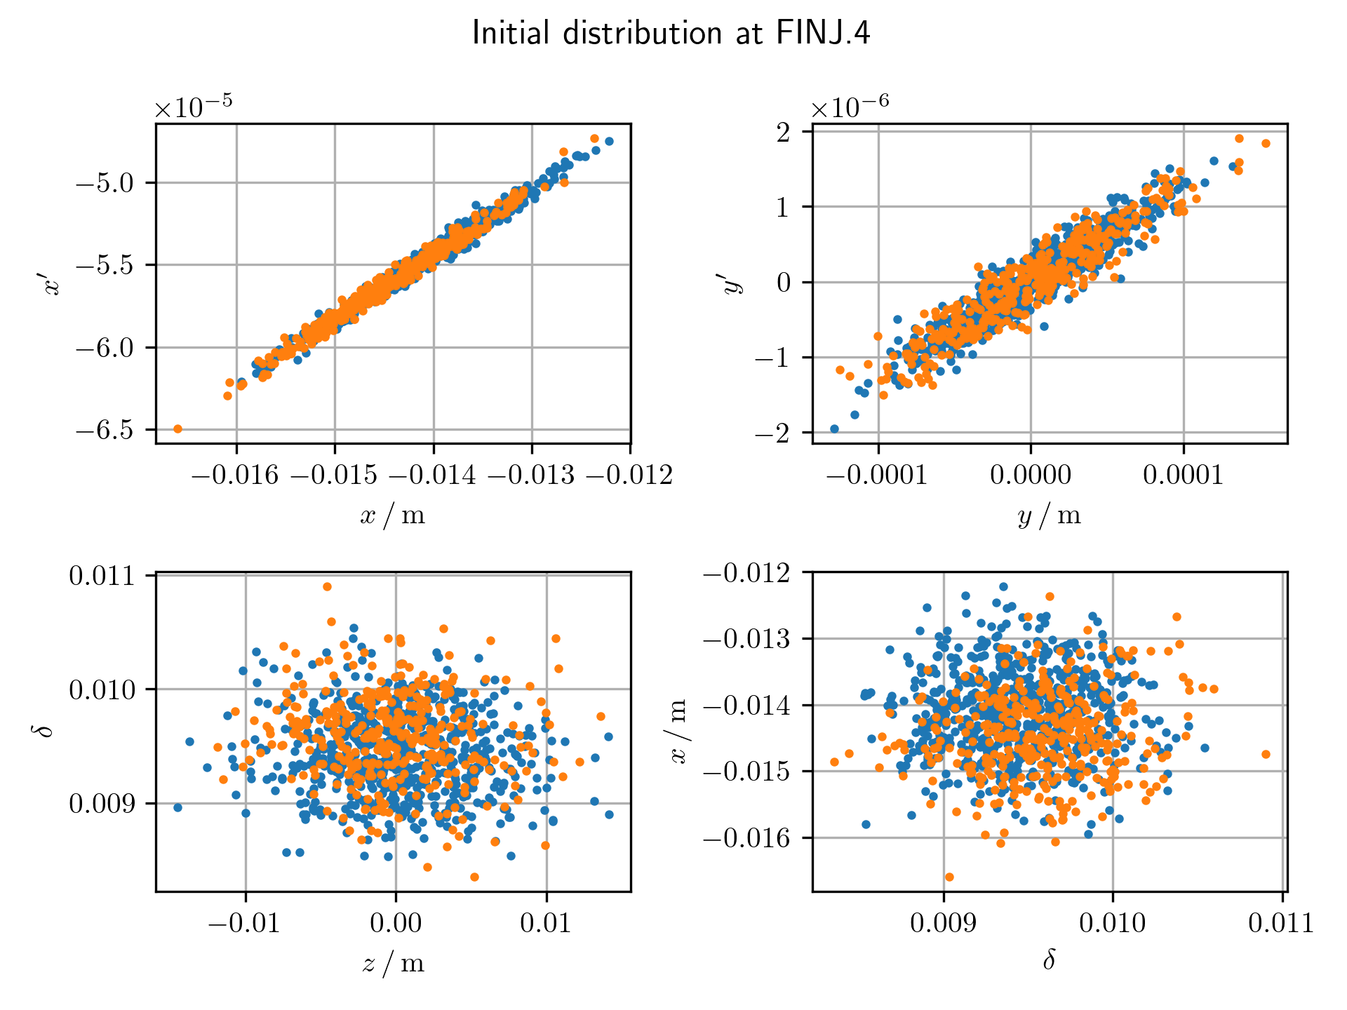
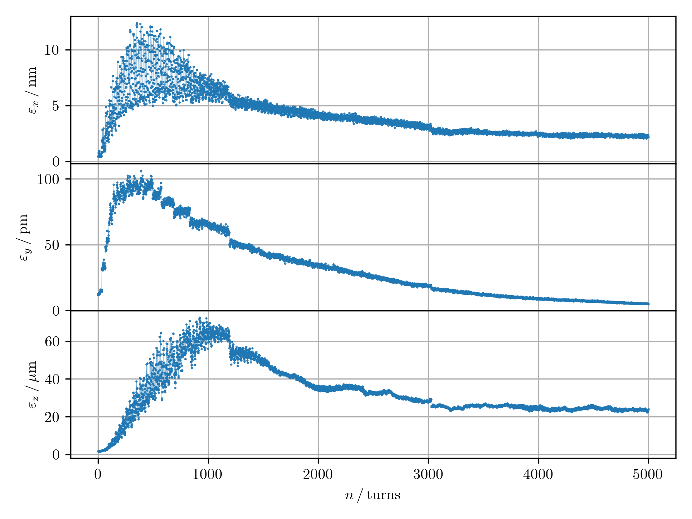
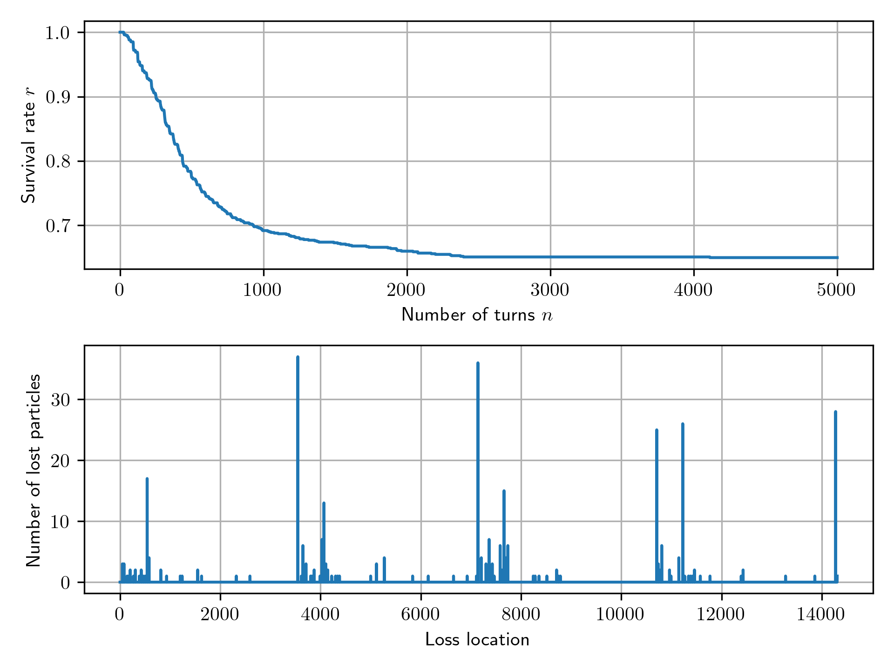
Result with beam-beam (BBWS)
Survival rate ~65% (5000 turns)
& Loss map
Turn-by-turn emittance variations
($1σ$-region of 2-D Gaussian)
Initial distribution at FINJ.4
Orange dots will be lost before the final turn.
Inj.
IPs

Slide 6
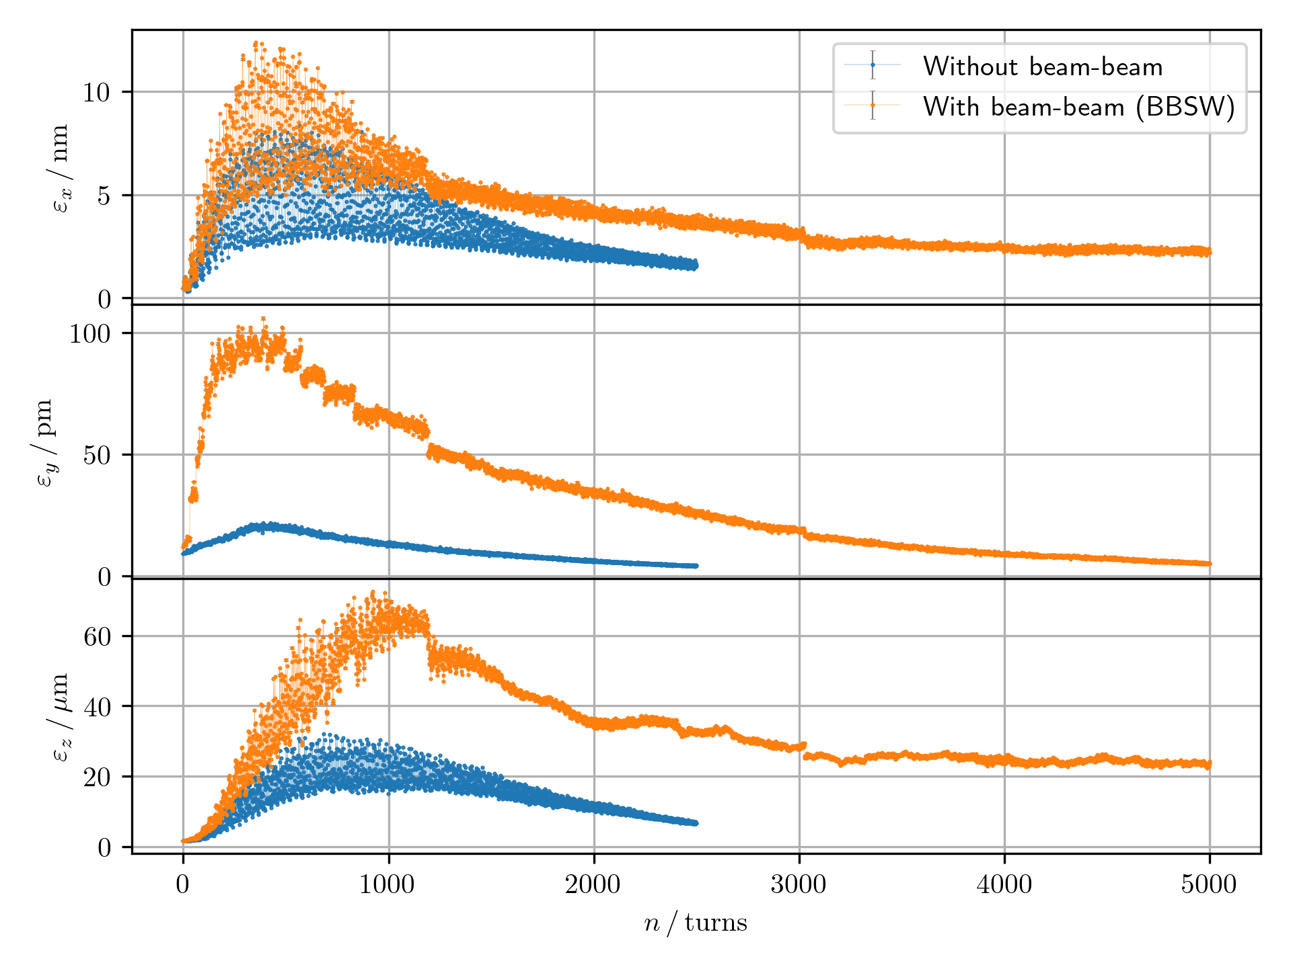
Comparison of emittance variations
Vertical emittance
  Huge emittance growth with beam-beam.
  Some growth (mismatch) without beam-beam.
  Is this reasonable?
Longitudinal emittance
Larger equilibrium emittance for beamstrahlung.

Slide 7
Next to do
  Check the condition and the consistency with Xsuite
  Input IP chamber structures (and collimators)
  Try other injection schemes
    Hybrid, MKI

Slide 8
Thank you for your attention!

Slide 9
Backup

Slide 10
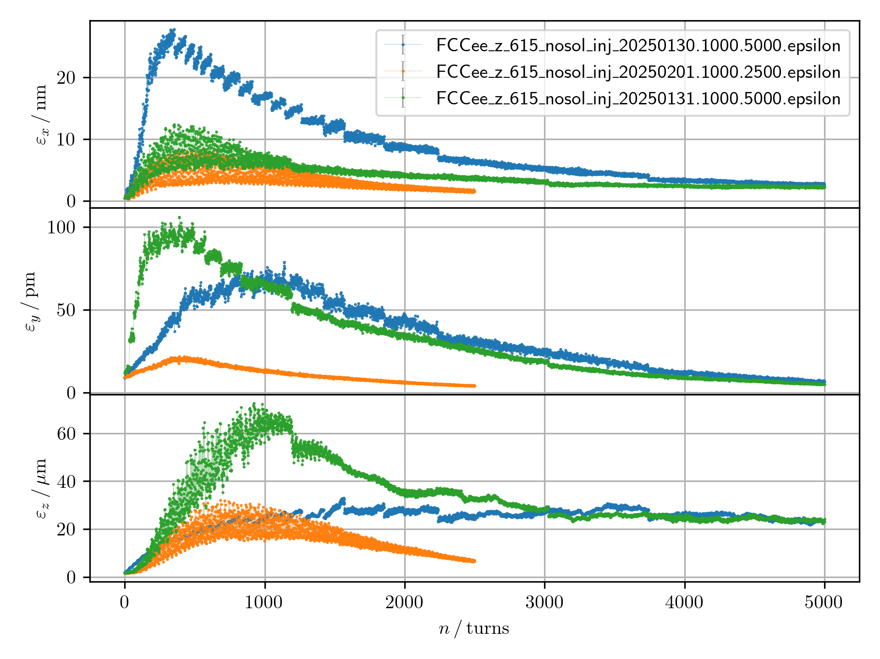
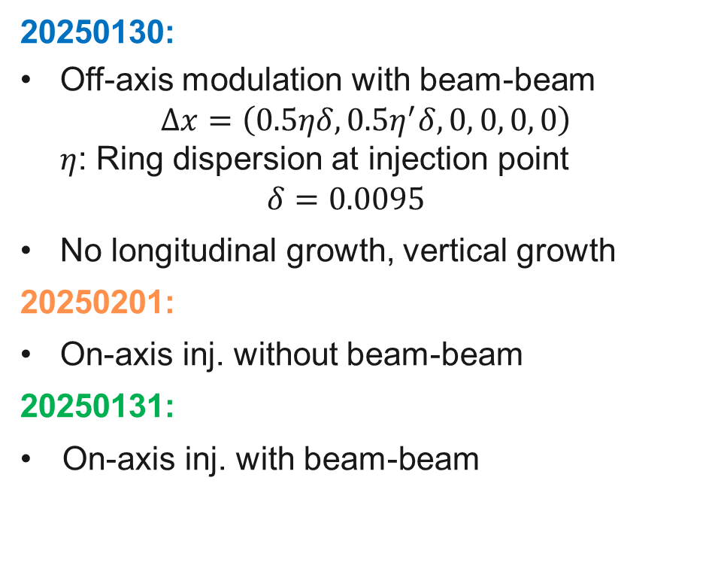
Comparison of emittance variations
20250130:
  Off-axis modulation with beam-beam
  $Δx=\left(0.5ηδ, 0.5η^{′}δ, 0, 0, 0, 0\right)$
  $η$: Ring dispersion at injection point
  $δ=0.0095$
  No longitudinal growth, vertical growth
  20250201:
  On-axis inj. without beam-beam
  20250131:
  On-axis inj. with beam-beam

Slide 11
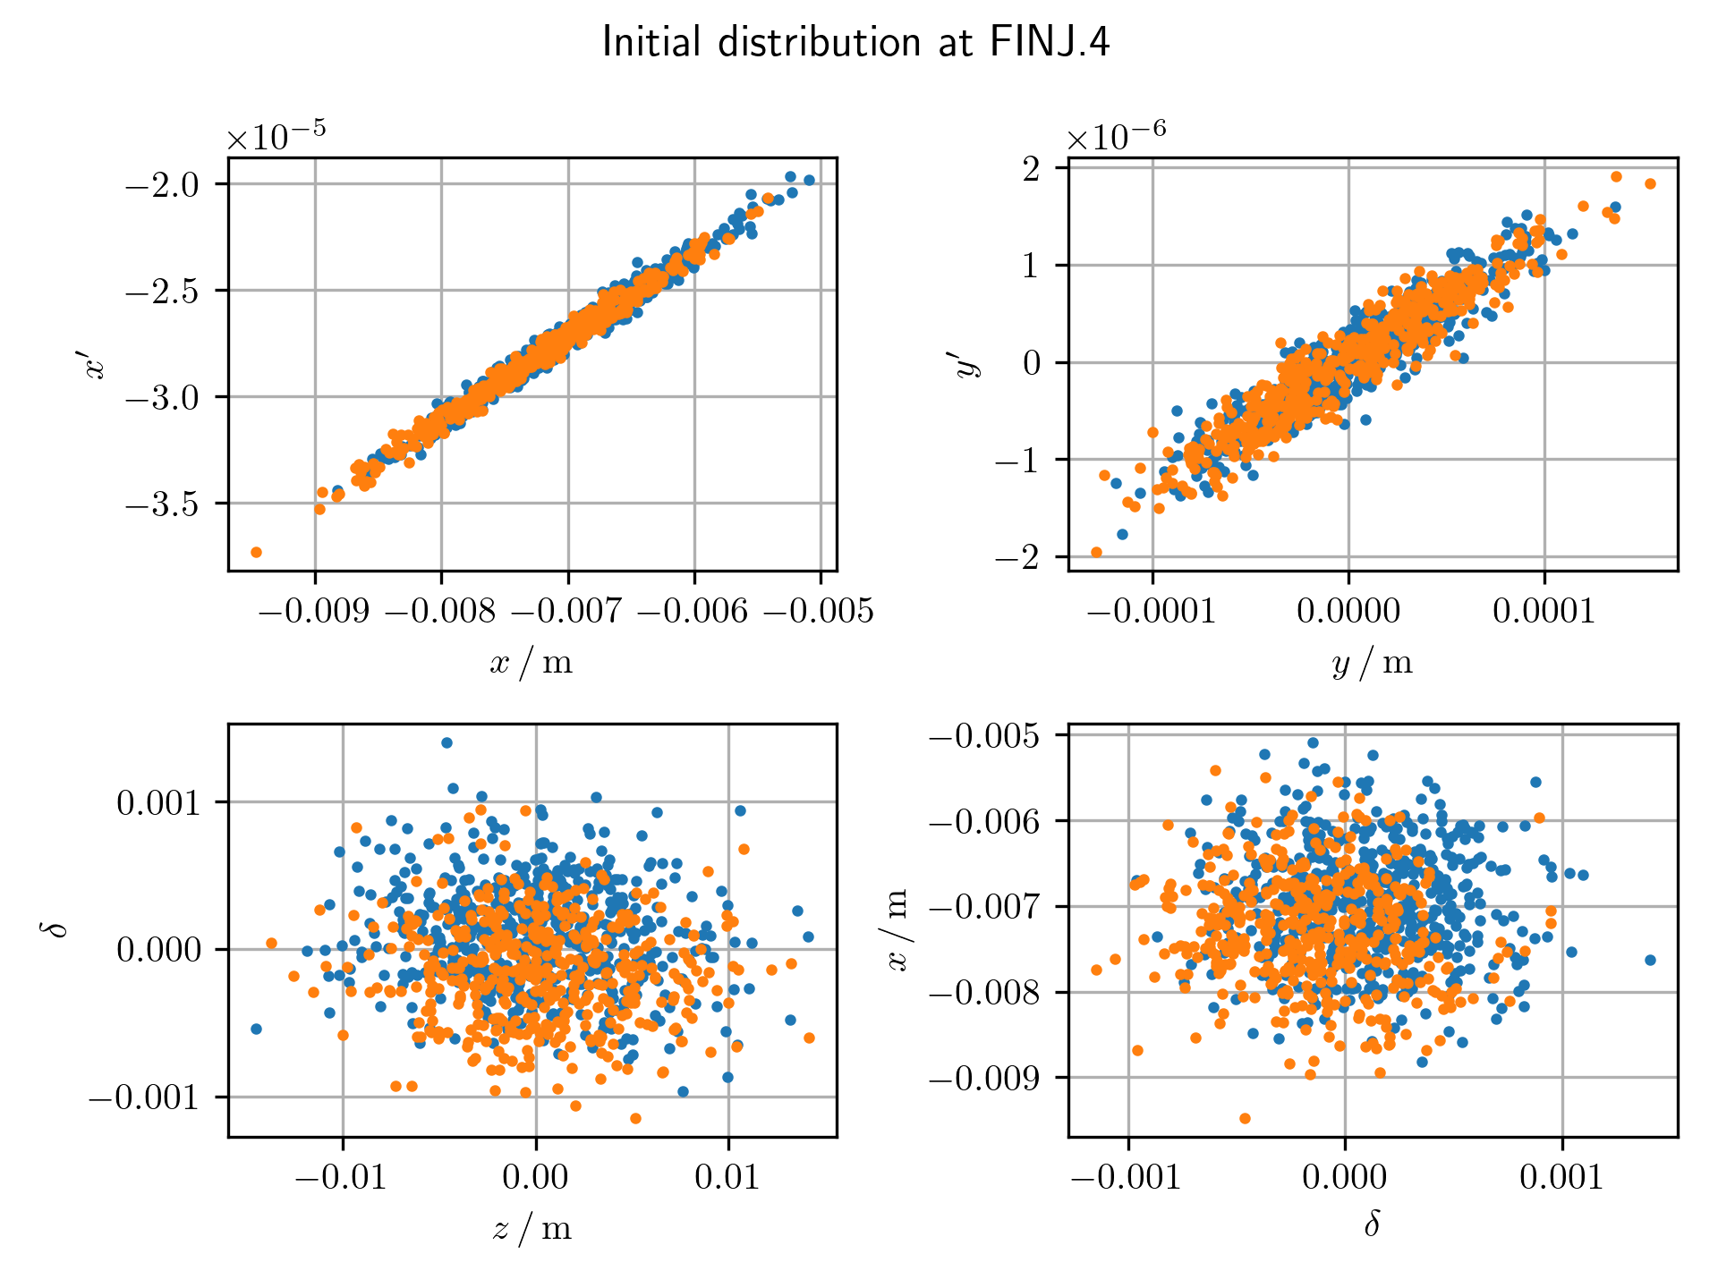
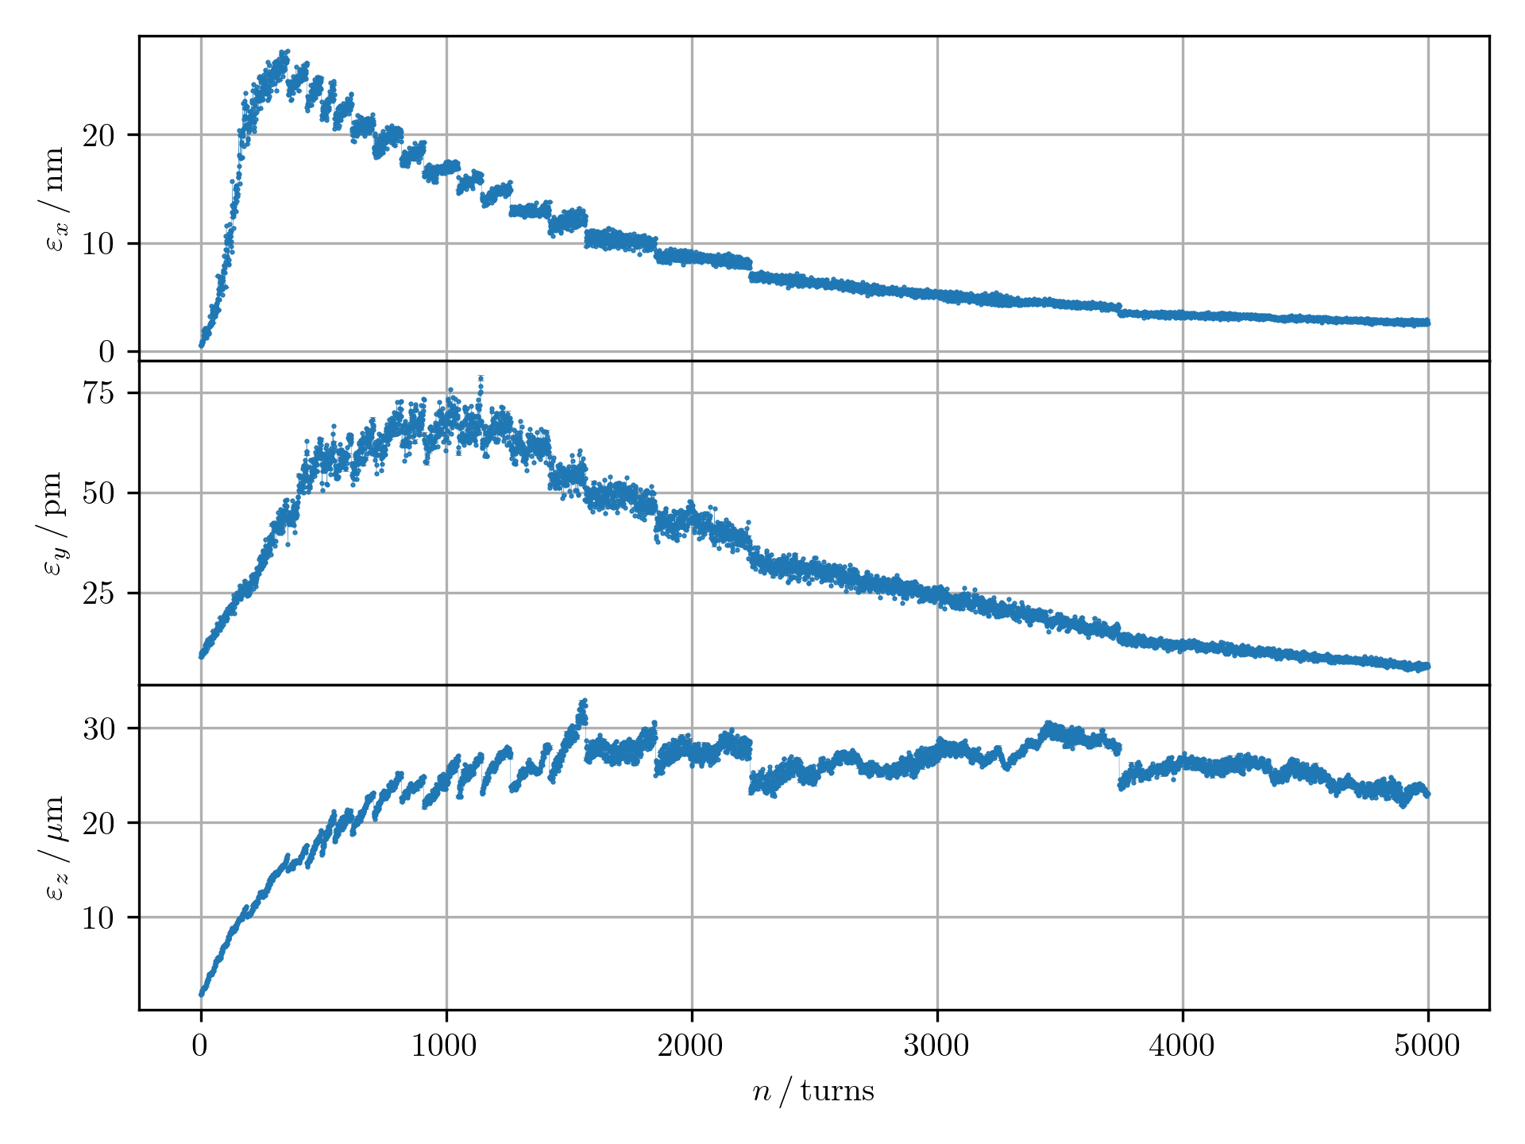
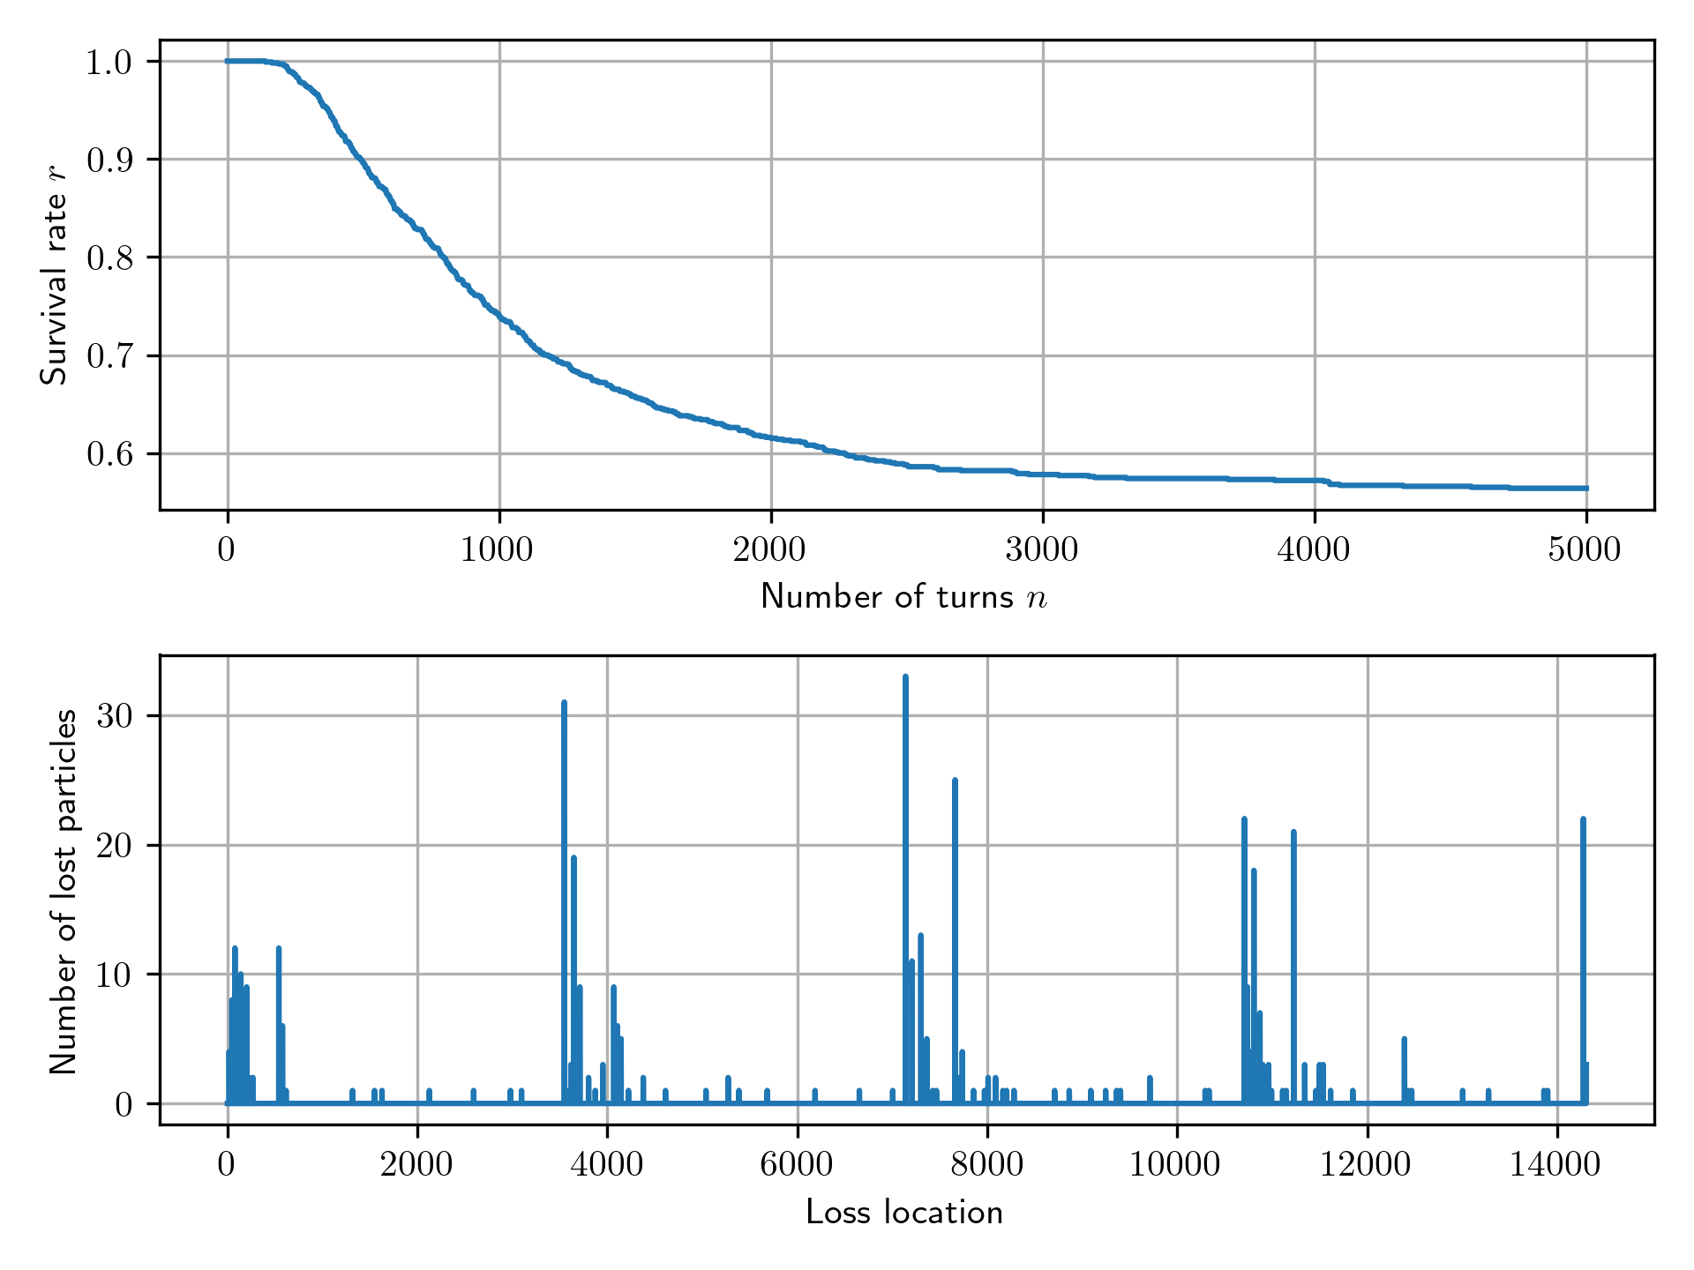
Result of off-axis modulation at FINJ.4 with beam-beam
Survival rate 67% (5000 turns)
& Loss map
Turn-by-turn emittance variations
($1σ$-region of 2-D Gaussian)
Initial distribution at FINJ.4

