Slide 1
Status update on RF duty factor studies at the FCC-ee booster
Ivan Karpov, Franck Peauger, and Lina Valle for FCC SRF WP1
with input from: Hannes Bartosik, Christian Carli, Antoine Chance, Frank Zimmermann
203rd Accelerator Design Meeting & 74th FCCIS WP2.2 Meeting, 27.02.2025

Slide 2
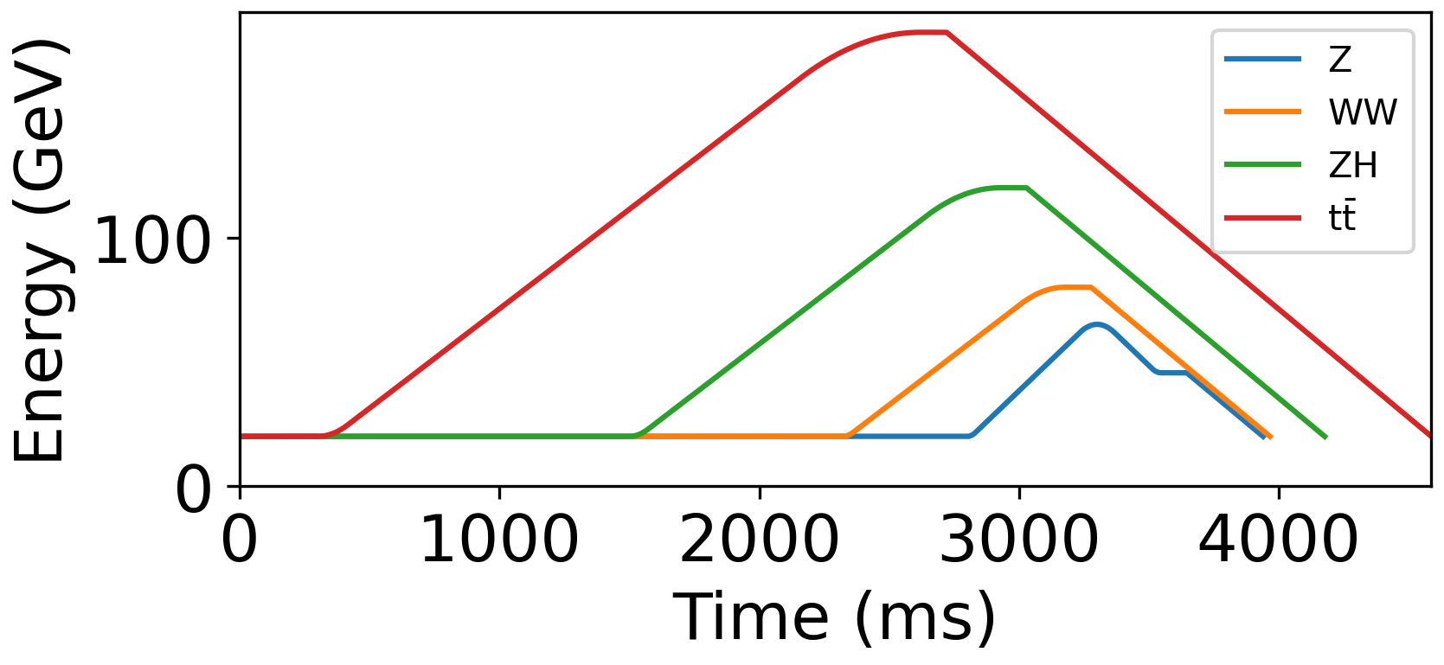
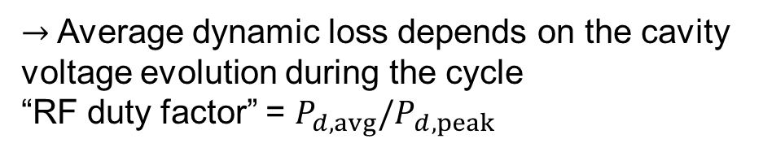
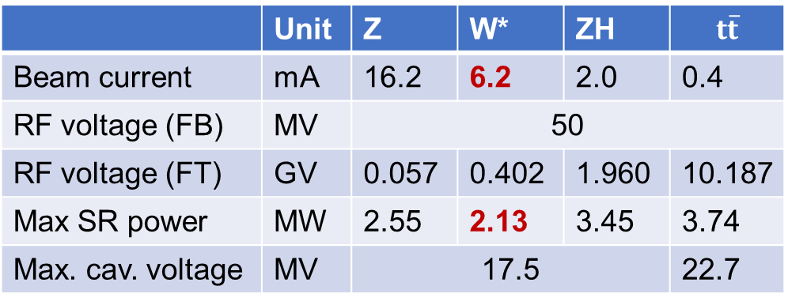
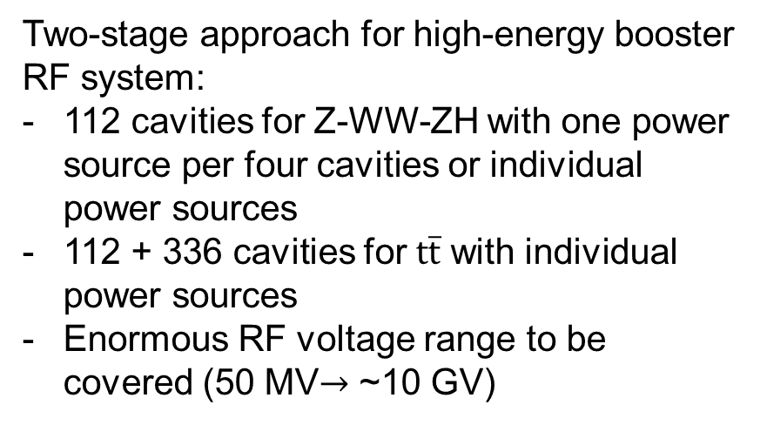
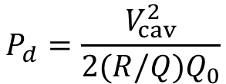
Introduction
Main RF-related parameters
Two-stage approach for high-energy booster RF system:
112 cavities for Z-WW-ZH with one power source per four cavities or individual power sources
112 + 336 cavities for $t\overline{t}$ with individual power sources
Enormous RF voltage range to be covered (50 MV$→$ ~10 GV)
 | Unit | Z | W* | ZH | $$t\overline{t}$$
Beam current | mA | 16.2 | 6.2 | 2.0 | 0.4
RF voltage (FB) | MV | 50
RF voltage (FT) | GV | 0.057 | 0.402 | 1.960 | 10.187
Max SR power | MW | 2.55 | 2.13 | 3.45 | 3.74
Max. cav. voltage | MV | 17.5 |  |  | 22.7
*Recent change of bunch charge $2.7×{10}^{10}→1.3×{10}^{10}$
$$P_{d}=\frac{V_{cav}^{2}}{2{(R/Q)Q}_{0}}$$
Energy programs for filling mode
Dynamic power loss:
Courtesy of
A. Chancé
$\left(R/Q\right)=315.2$ Ohm (circuit definition), $Q_{0}=3×{10}^{10}$
$→$ Average dynamic loss depends on the cavity voltage evolution during the cycle
“RF duty factor” = $P_{d,avg}/P_{d,peak}$

Slide 3
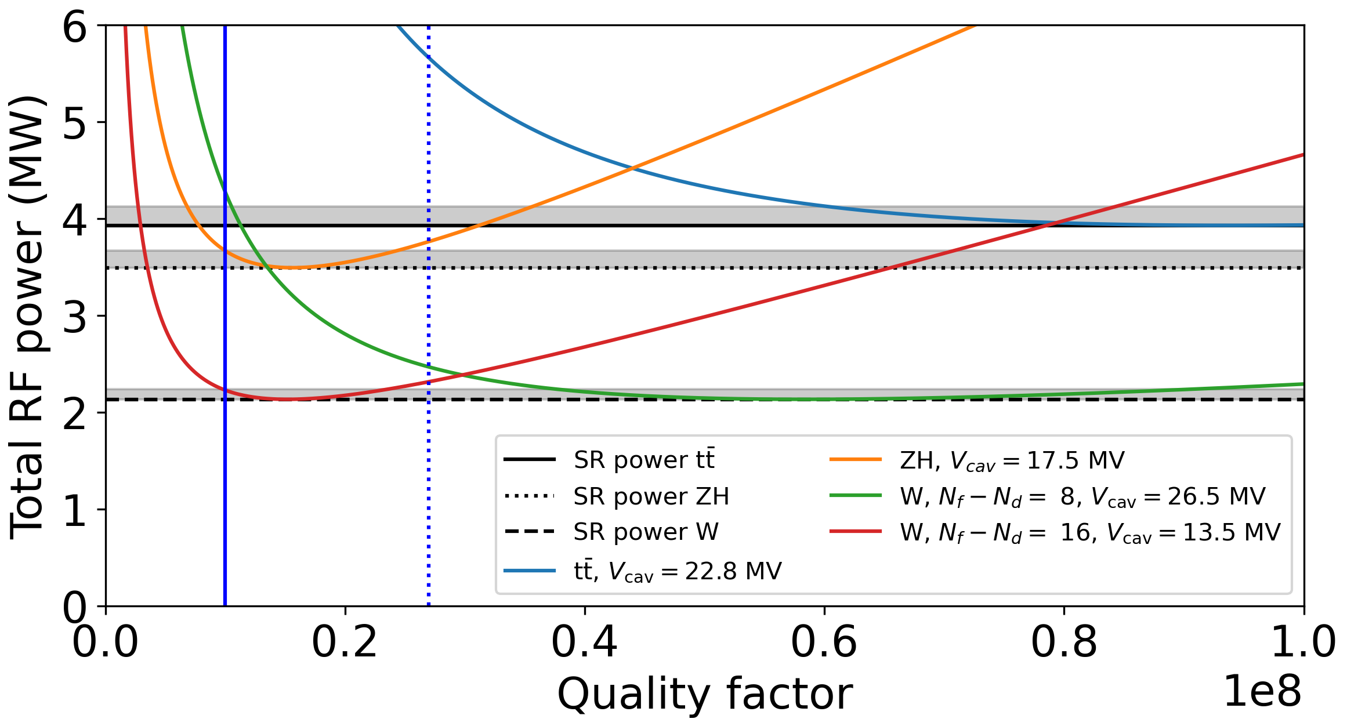
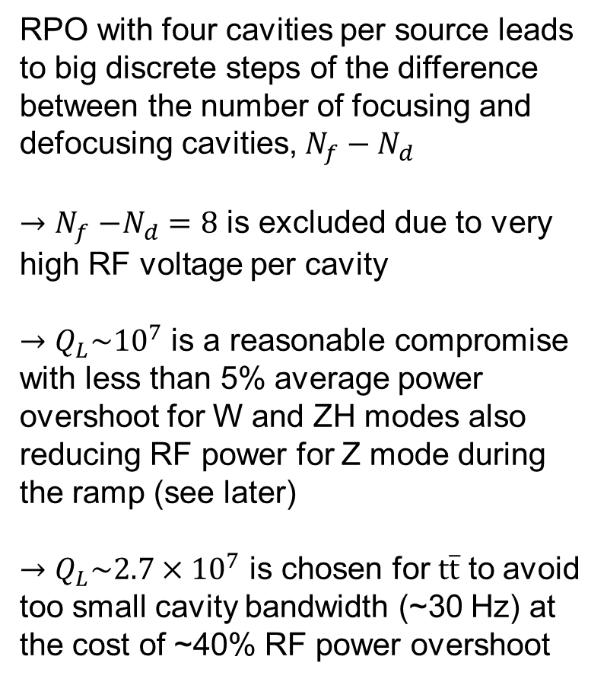
Optimal coupling: flattop considerations
RPO with four cavities per source leads to big discrete steps of the difference between the number of focusing and defocusing cavities, $N_{f}−N_{d}$
${→N}_{f}−N_{d}=8$ is excluded due to very high RF voltage per cavity
$→Q_{L}\sim {10}^{7}$ is a reasonable compromise with less than 5% average power overshoot for W and ZH modes also reducing RF power for Z mode during the ramp (see later)
$→Q_{L}\sim {2.7×10}^{7}$ is chosen for $t\overline{t}$ to avoid too small cavity bandwidth (~30 Hz) at the cost of ~40% RF power overshoot
RF power requirements at the extraction energy

Slide 4

Analysis for $t\overline{t}$ operating mode

Slide 5
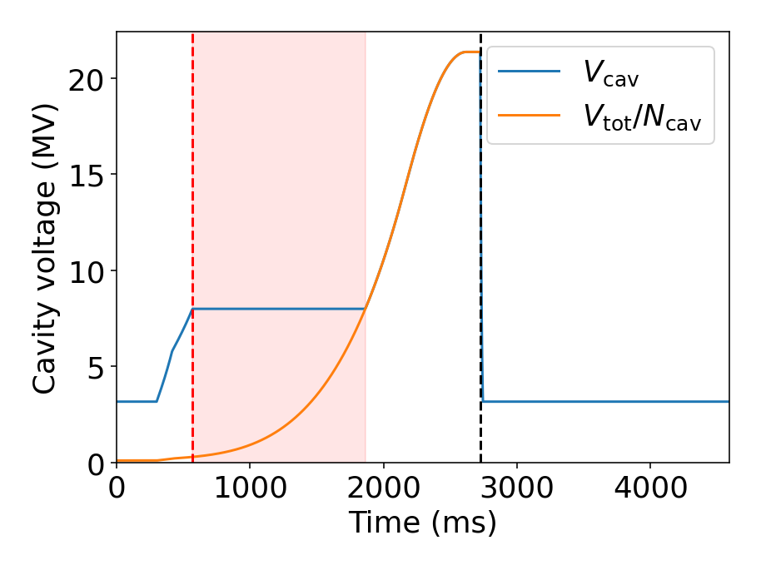
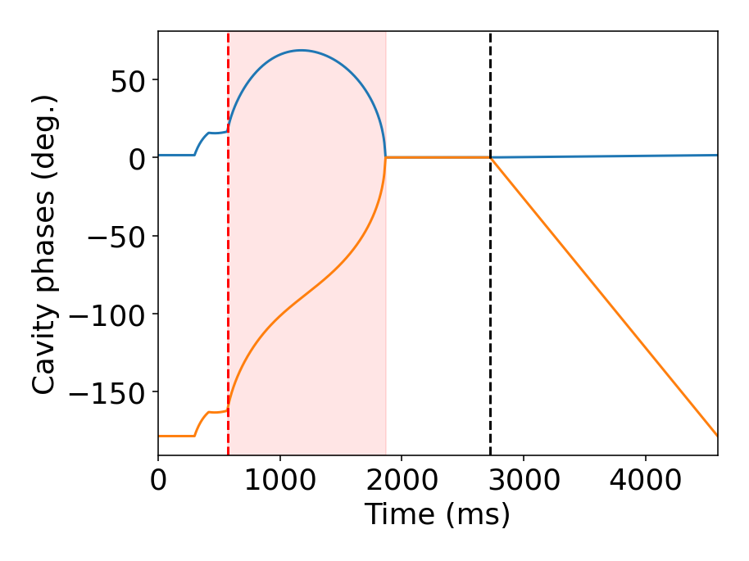
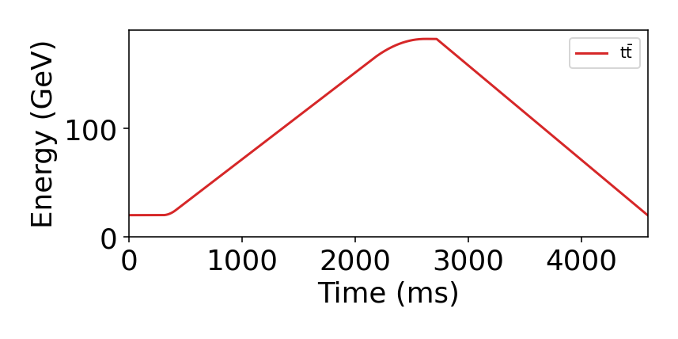
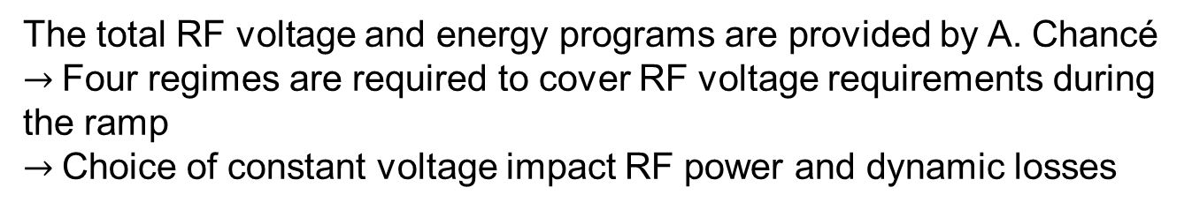


$t\overline{t}$ mode: RF voltage
Resetting phases for RPO
Voltage drop given by cavity filling time (11 ms)
RPO $N_{f}−N_{d}=16$
Constant
voltage
In-phase
voltage
ramp
The total RF voltage and energy programs are provided by A. Chancé
$→$Four regimes are required to cover RF voltage requirements during the ramp
$→$Choice of constant voltage impact RF power and dynamic losses

Slide 6
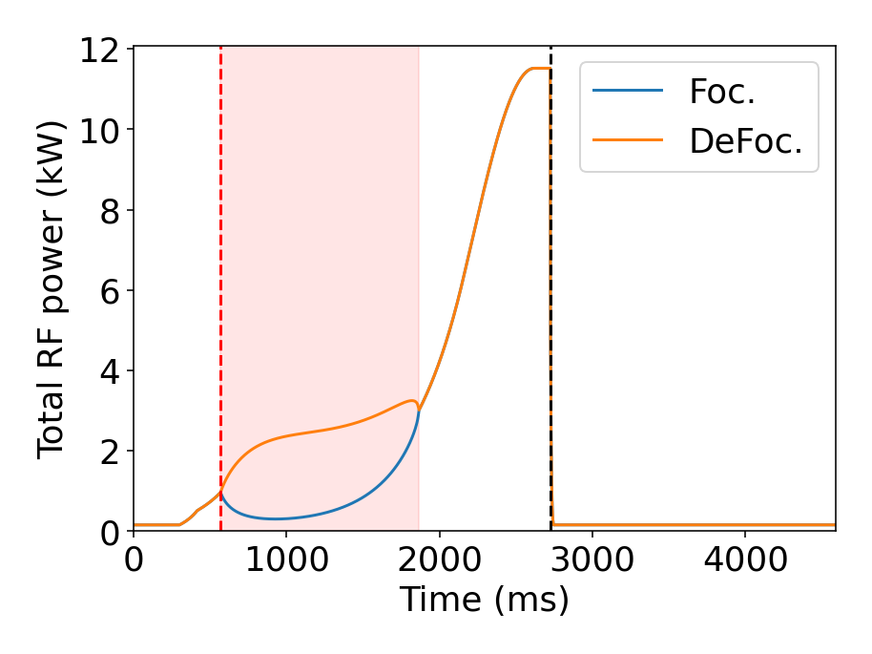
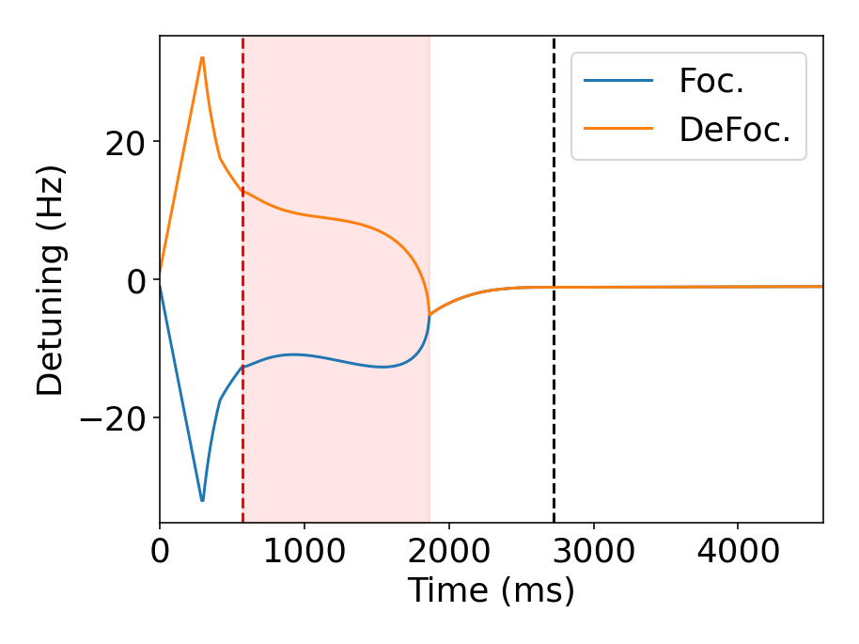

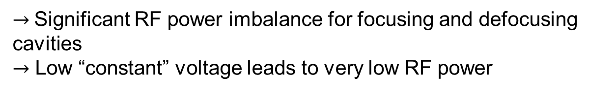
$t\overline{t}$ mode: RF power and detuning
$→$Significant RF power imbalance for focusing and defocusing cavities
$→$ Low “constant” voltage leads to very low RF power

Slide 7
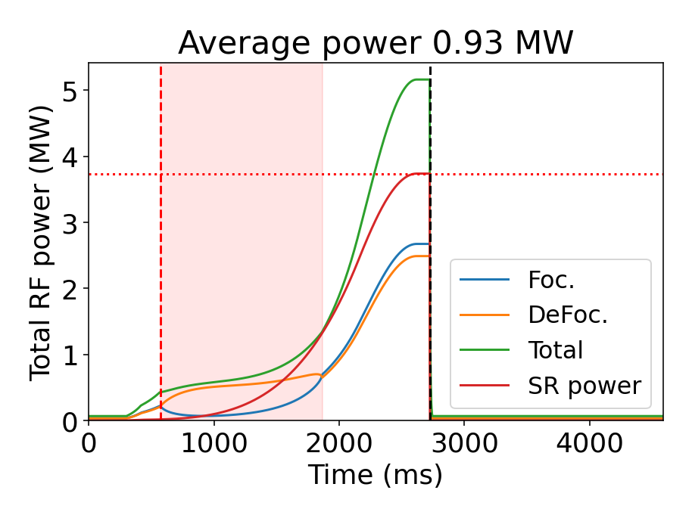
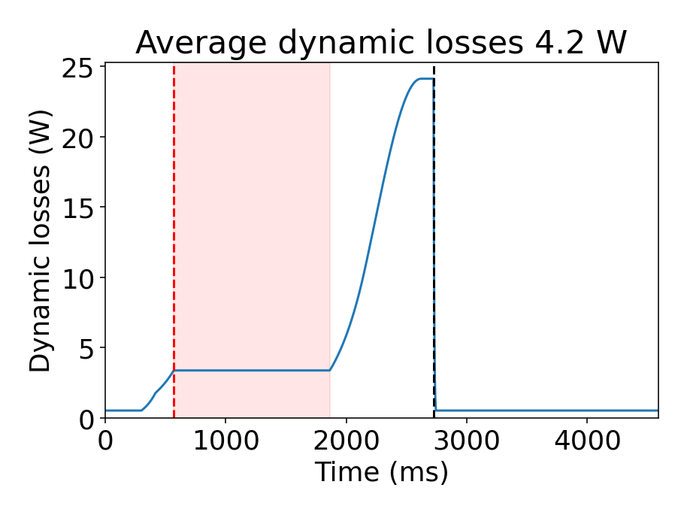

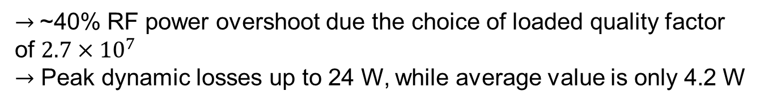
$t\overline{t}$ mode: total RF power and dynamic losses
$→$~40% RF power overshoot due the choice of loaded quality factor of $2.7×{10}^{7}$
$→$ Peak dynamic losses up to 24 W, while average value is only 4.2 W

Slide 8
Analysis for ZH operating mode

Slide 9
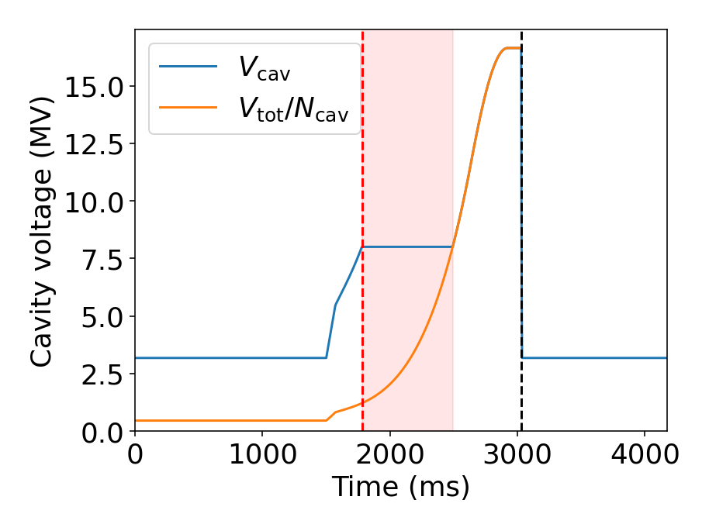
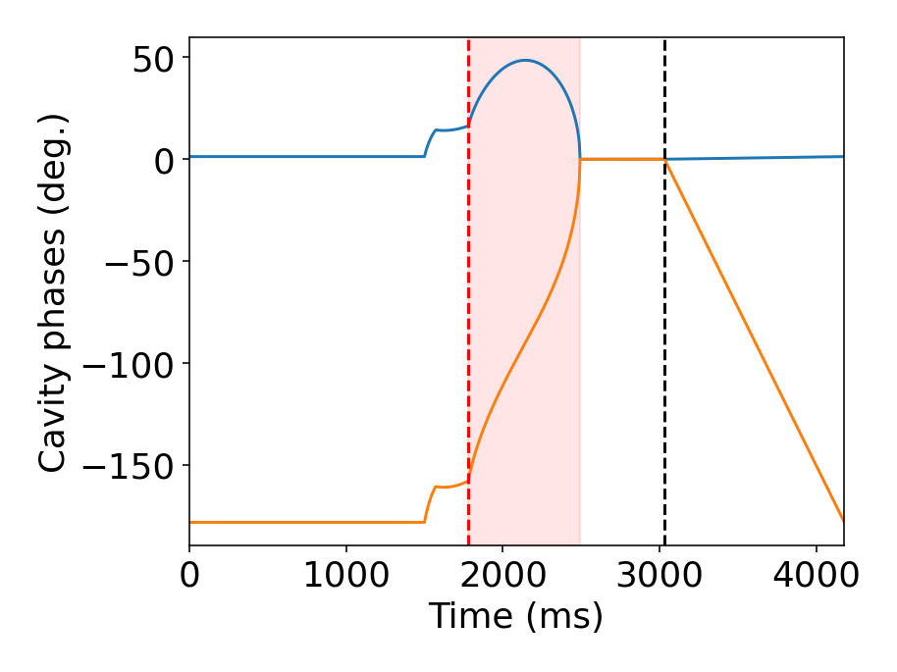
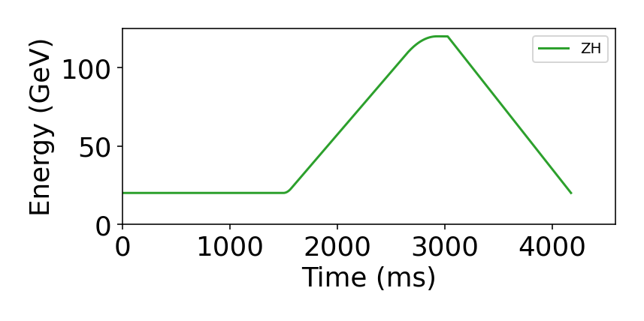
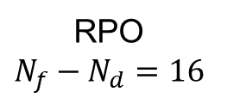
ZH mode: RF voltage
Voltage drop given by cavity filling time (4 ms)
Resetting phases for RPO
Constant
voltage
RPO
$N_{f}−N_{d}=16$
In-phase
voltage ramp
The total RF voltage and energy programs are provided by A. Chancé
$→$Four regimes are required to cover RF voltage requirements during the ramp
$→$Choice of constant voltage impact RF power and dynamic losses

Slide 10
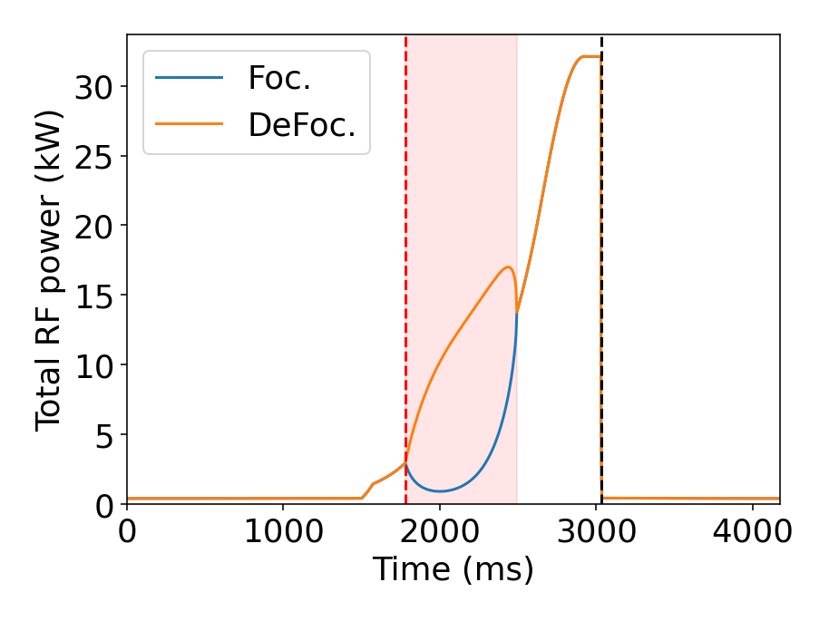
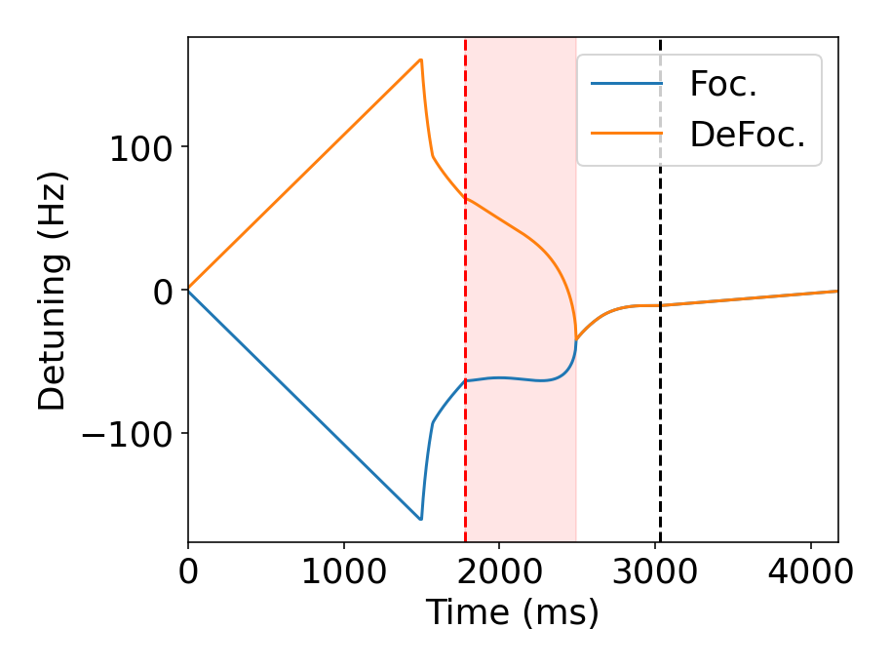
ZH mode: RF power and detuning
$→$Significant RF power imbalance for focusing and defocusing cavities
$→$ Low “constant” voltage leads to very low RF power

Slide 11
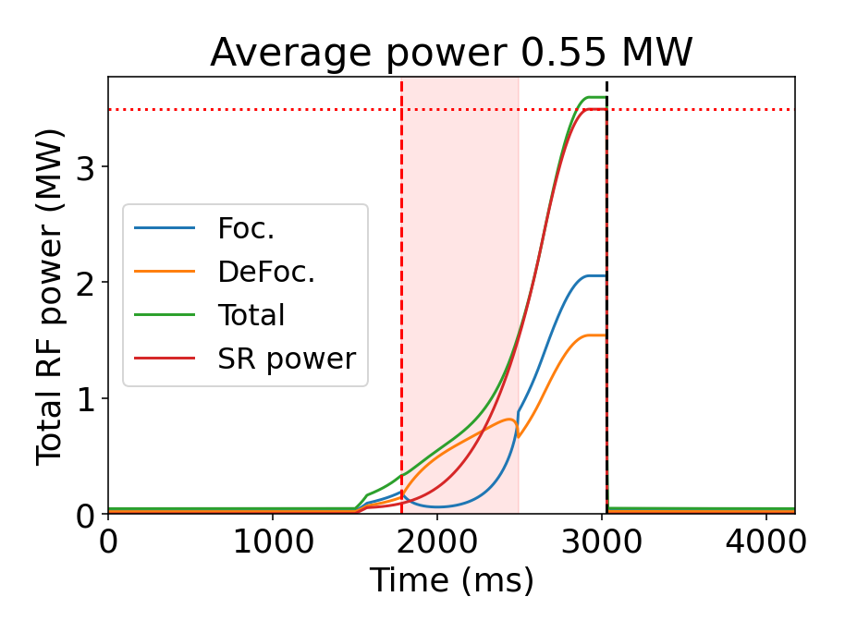
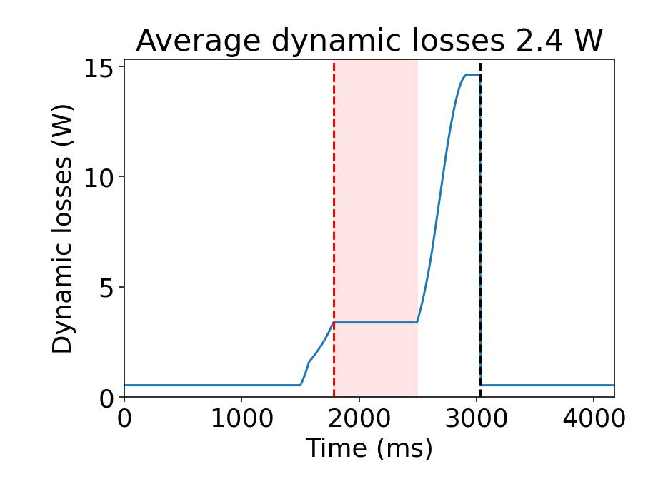
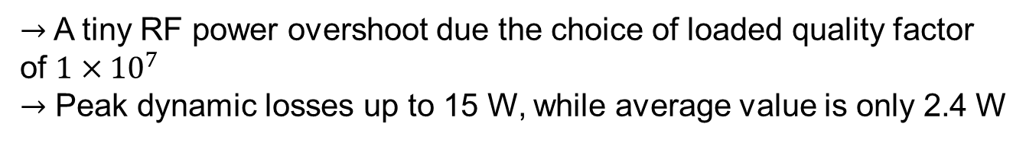
ZH mode: total RF power and dynamic losses
$→$A tiny RF power overshoot due the choice of loaded quality factor of $1×{10}^{7}$
$→$ Peak dynamic losses up to 15 W, while average value is only 2.4 W

Slide 12
Analysis for WW operating mode

Slide 13
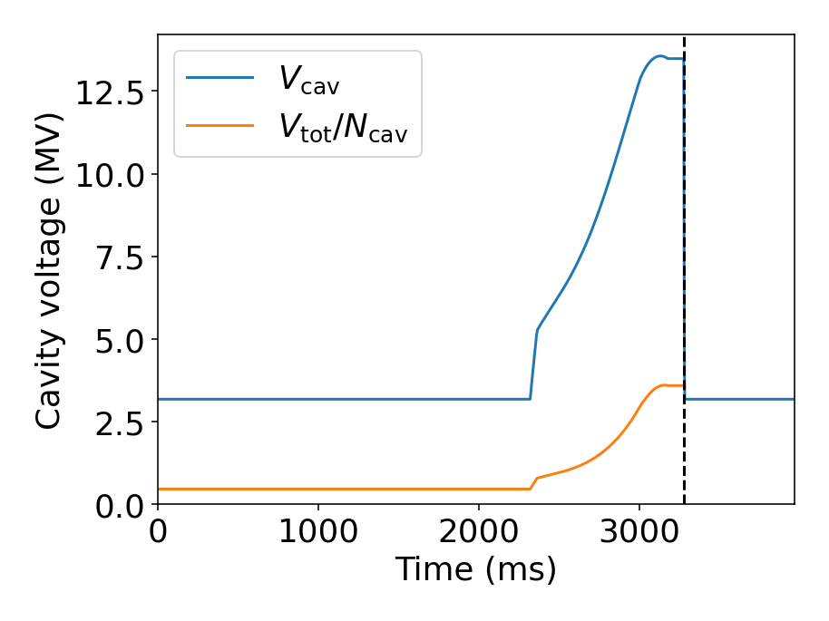
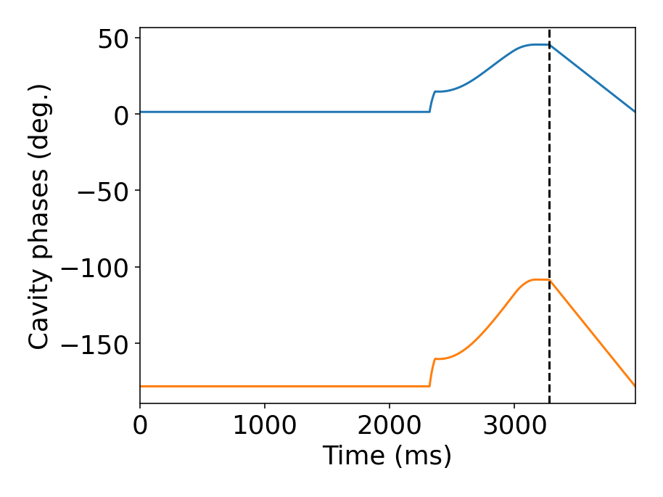
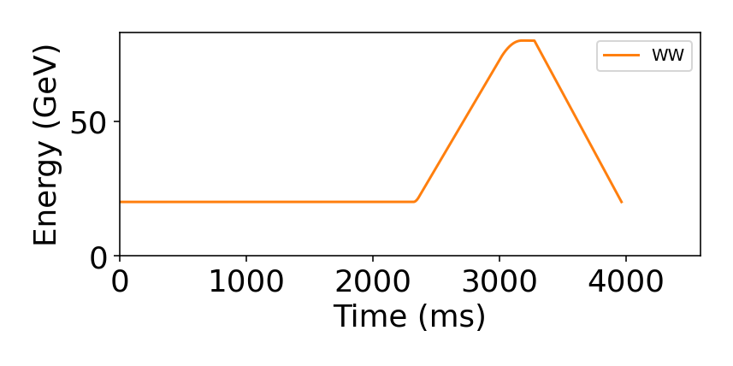
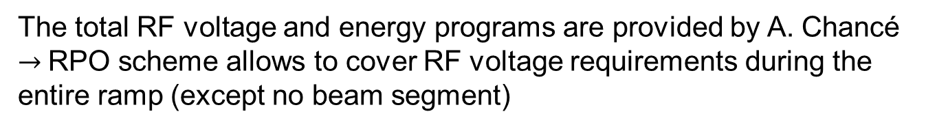
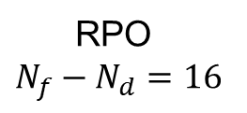
WW mode: RF voltage
Voltage drop given by cavity filling time (4 ms)
RPO
$N_{f}−N_{d}=16$
The total RF voltage and energy programs are provided by A. Chancé
$→$RPO scheme allows to cover RF voltage requirements during the entire ramp (except no beam segment)

Slide 14
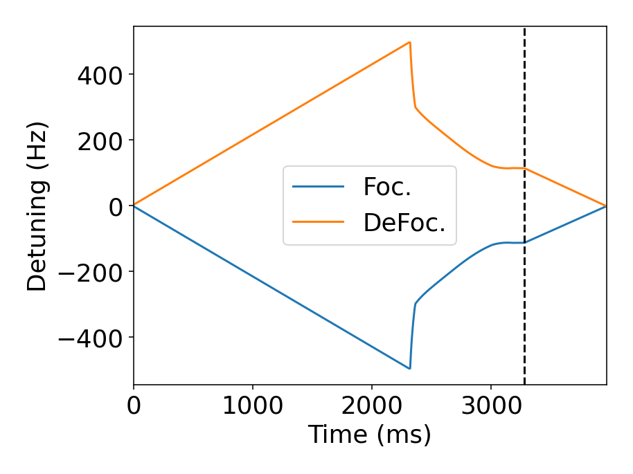
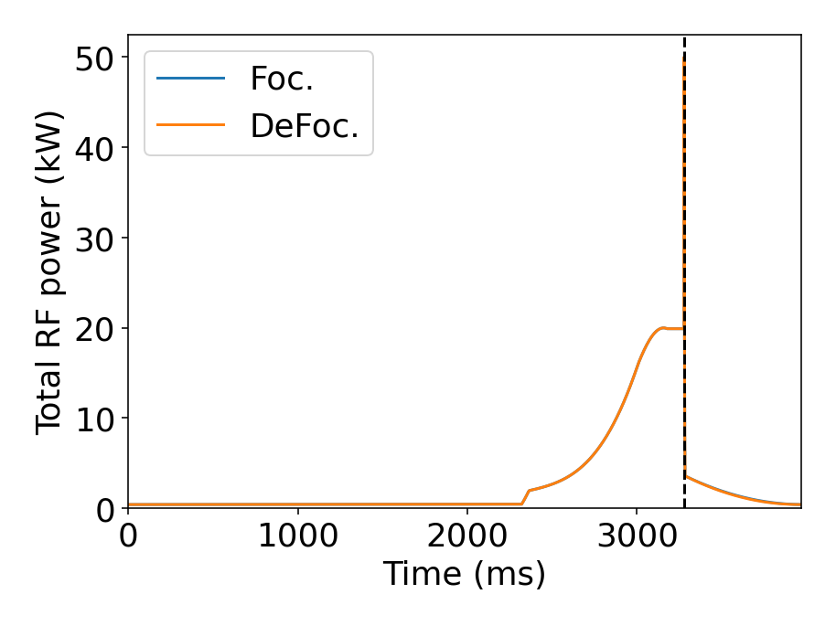
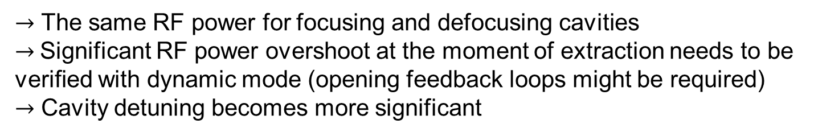
WW mode: RF power and detuning
$→$ The same RF power for focusing and defocusing cavities
$→$Significant RF power overshoot at the moment of extraction needs to be verified with dynamic mode (opening feedback loops might be required)
$→$ Cavity detuning becomes more significant

Slide 15
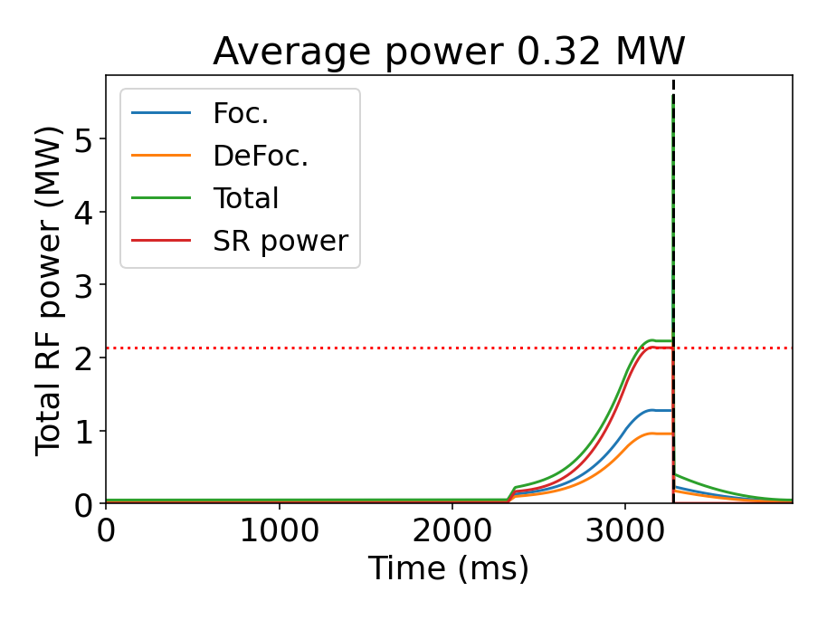
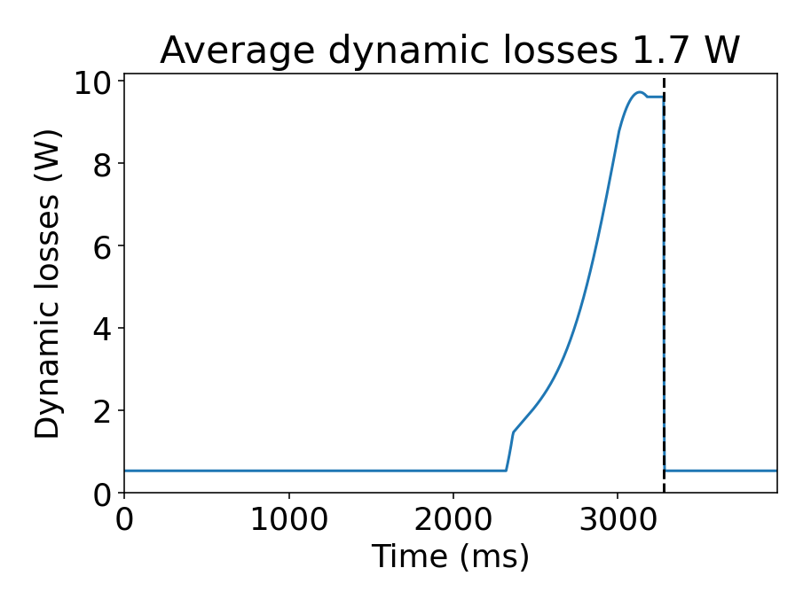
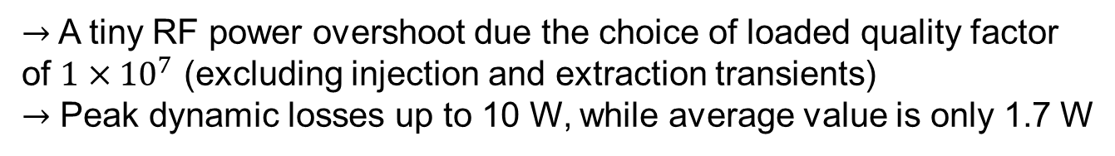
WW mode: total RF power and dynamic losses
$→$A tiny RF power overshoot due the choice of loaded quality factor of $1×{10}^{7}$ (excluding injection and extraction transients)
$→$ Peak dynamic losses up to 10 W, while average value is only 1.7 W

Slide 16
Analysis for Z operating mode

Slide 17
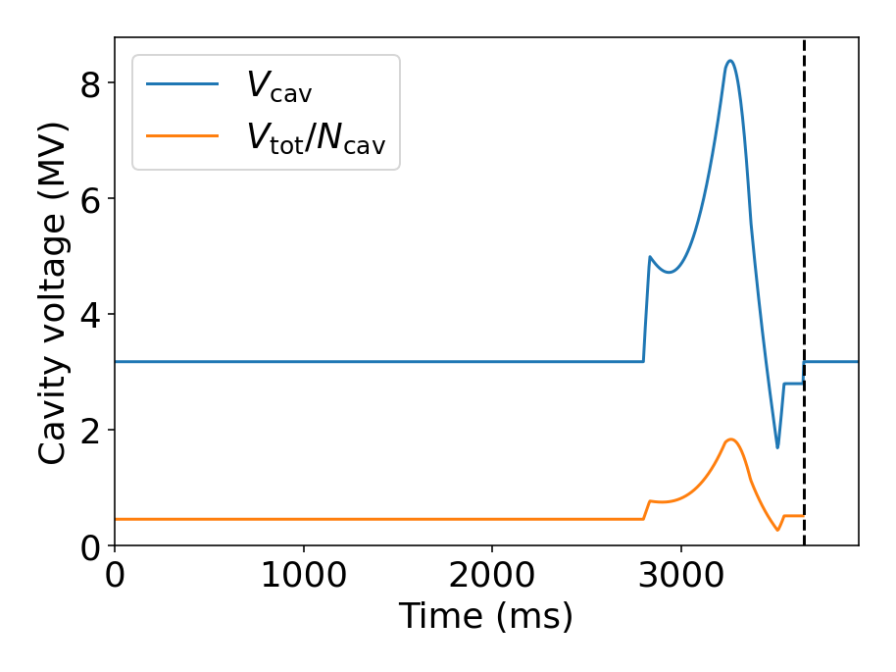
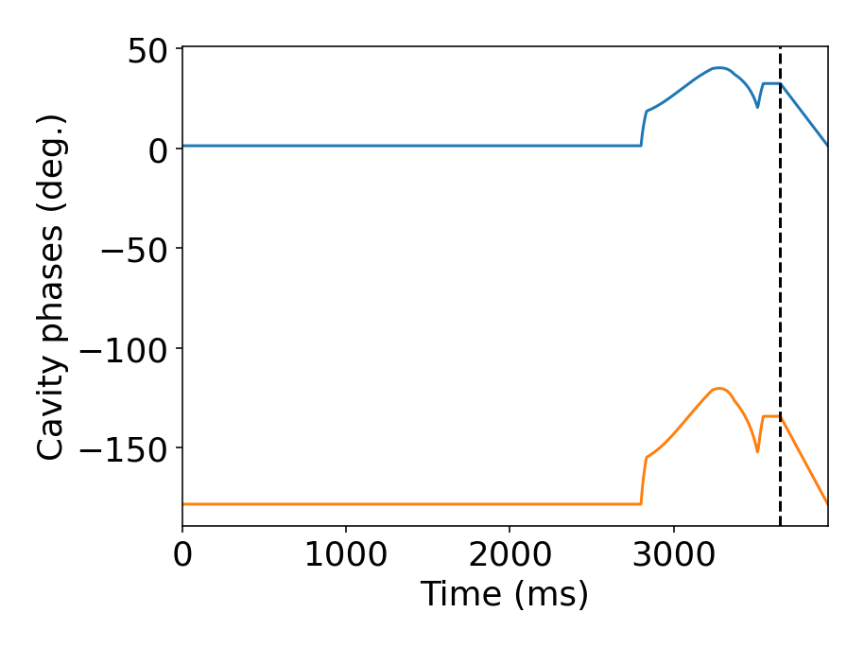
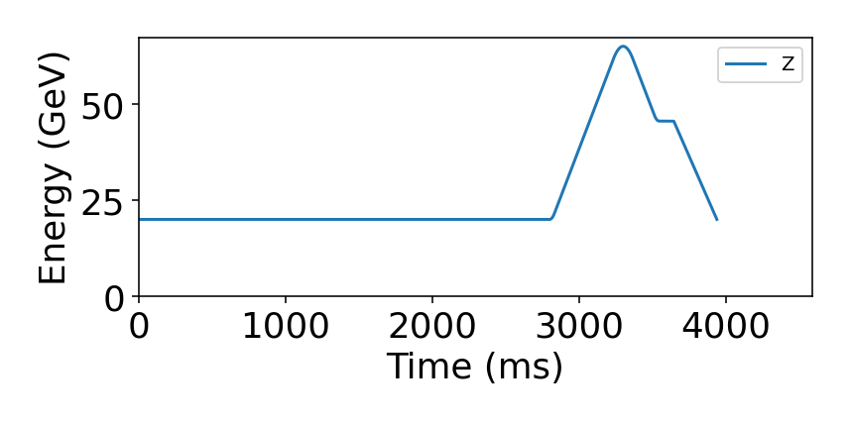
Z mode: RF voltage
RPO
$N_{f}−N_{d}=16$
The total RF voltage and energy programs are provided by A. Chancé
$→$RPO scheme allows to cover RF voltage requirements during the entire ramp (except no beam segment)
overshoot

Slide 18
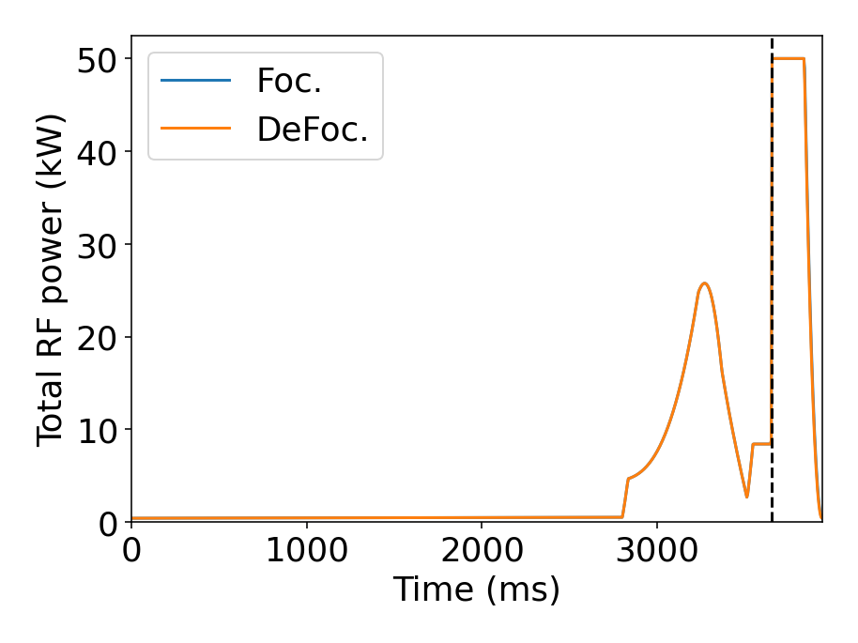
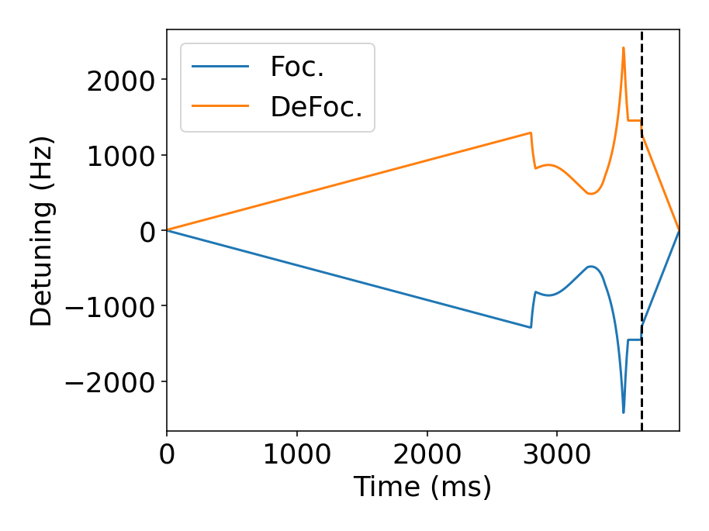
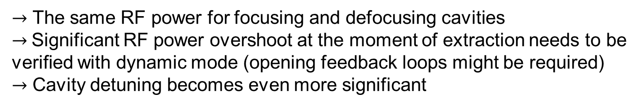
Z mode: RF power and detuning
Clamping at 50 kW
$→$ The same RF power for focusing and defocusing cavities
$→$Significant RF power overshoot at the moment of extraction needs to be verified with dynamic mode (opening feedback loops might be required)
$→$ Cavity detuning becomes even more significant
overshoot

Slide 19
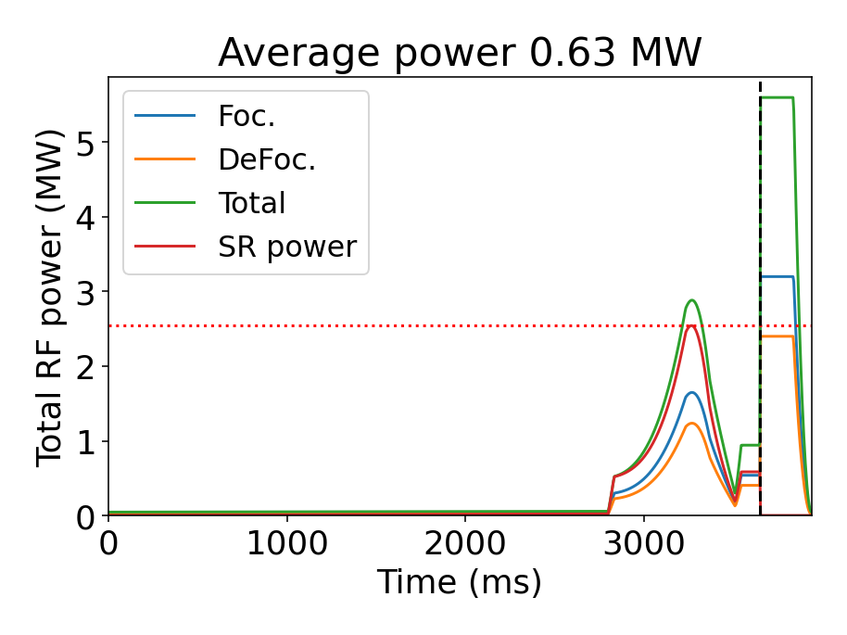
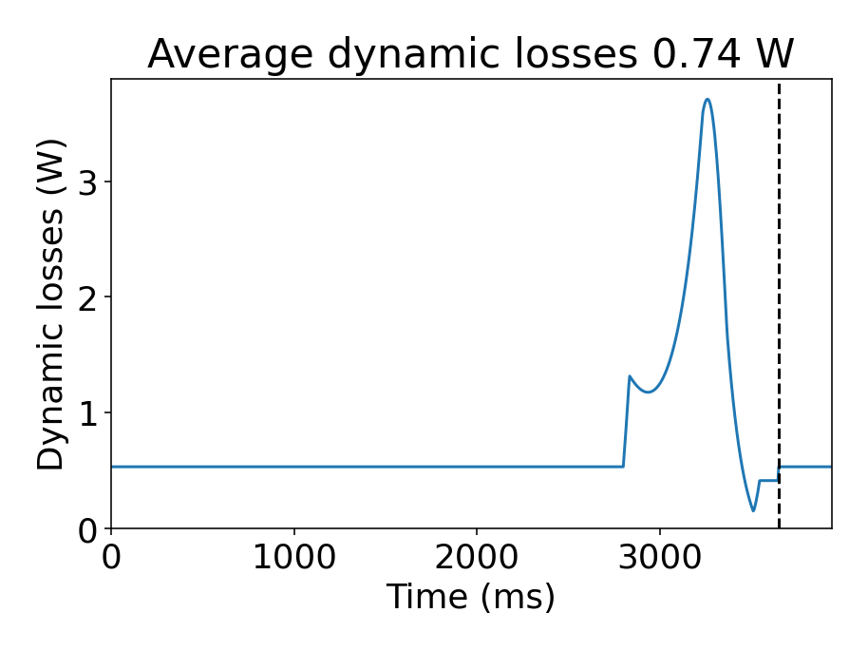
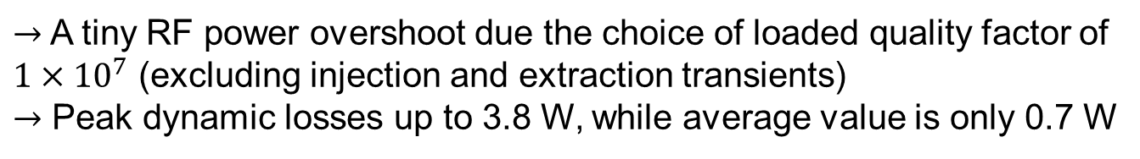
Z mode: total RF power and dynamic losses
$→$A tiny RF power overshoot due the choice of loaded quality factor of $1×{10}^{7}$ (excluding injection and extraction transients)
$→$ Peak dynamic losses up to 3.8 W, while average value is only 0.7 W
overshoot

Slide 20
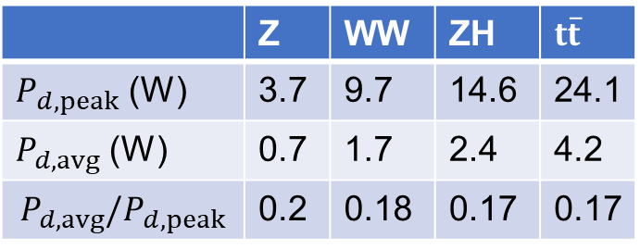
Conclusions
Reverse phase operation and other schemes are necessary to provide the required RF voltage during HEB ramps
First analysis shows significant lower average dynamic loss values compared to the peak values
Analysis of RF power transients is necessary to clarify average RF power requirements
Further optimization to be done based on requirements for the cryogenic systems
 | Z | WW | ZH | $t\overline{t}$
$P_{d,peak}$ (W) | 3.7 | 9.7 | 14.6 | 24.1
$P_{d,avg}$ (W) | 0.7 | 1.7 | 2.4 | 4.2
$$P_{d,avg}/P_{d,peak}$$ | 0.2 | 0.18 | 0.17 | 0.17
Thank you for your attention!

Slide 21
Backup slides

Slide 22
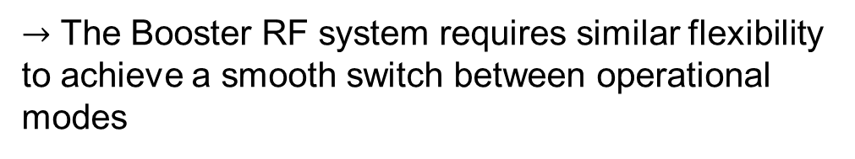
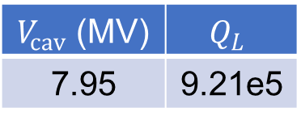
RF system
A common RF system design for Z, W, and ZH modes of the collider was adopted as a new baseline:
2 RF systems with 50 MW RF power and 1 GV of RF voltage
A low RF voltage for Z is achieved using Reverse phase operation mode (RPO, Y. Morita et al., 2009)
Splitting and combining beams in the RF straight section covers the RF voltage range for W and ZH
 | Energy (GeV) | Current (mA) | RF voltage (GV)
Z | 45.6 | 1283 | 0.088
W | 80 | 135 | 1.05
ZH | 120 | 26.7 | 2.1
RPO at Z
$→$ The Booster RF system requires similar flexibility to achieve a smooth switch between operational modes
$V_{cav}$ (MV) | $$Q_{L}$$
7.95 | 9.21e5

Slide 23
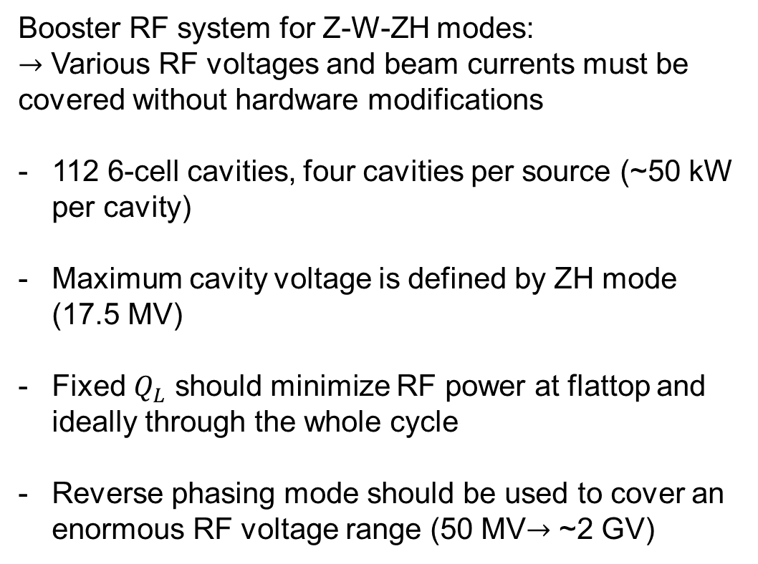
Design constraints
Booster RF system for Z-W-ZH modes:
$→$ Various RF voltages and beam currents must be covered without hardware modifications
112 6-cell cavities, four cavities per source (~50 kW per cavity)
Maximum cavity voltage is defined by ZH mode (17.5 MV)
Fixed $Q_{L}$ should minimize RF power at flattop and ideally through the whole cycle
Reverse phasing mode should be used to cover an enormous RF voltage range (50 MV$→$ ~2 GV)
Main RF-related parameters
 | Unit | Z | W | ZH
Beam current | mA | 16 | 13 | 2
RF voltage (FB) | MV | 50
RF voltage (FT) | MV | 57 | 402 | 1960
Max SR power | MW | 1.05 | 4.51 | 3.44

Slide 24



Coupled-bunch instabilities at 20 GeV
Assuming the same $N_{f}−N_{d}=16$, we need $V_{cav}$~ 3.1 MV to get 50 MV at injection energy
Minimizing RF power by detuning the cavities can drive coupled bunch instabilities
Optimal detuning during injection for Z
Main RF-related parameters
$→$ No margin for beam stability with direct RF feedback activated
We could profit from installing wigglers (1 wiggler $→$ gain of 4)

Slide 25

Detuning during cycle
Flattop
Injection process
Ramp-up
Ramp-down

Slide 26


RF power at injection
Large transients with the full feedback gain due to high peak beam current

Slide 27

RF power at injection
Reduction of gain by a factor of 5 significantly suppresses power transients
Feedback gain can be ramped up together with beam intensity
Additional margin with wigglers would be beneficial
Filling should be as uniform as possible

Slide 28




High-Energy Booster cycle
RF voltage and energy evolution for Z
Energy ramp and RF voltage programs were initially designed for Z (A. Vanel, FCC week, 2024) and later for $t\overline{t}$ modes

Slide 29








RF system block diagram
FCC feedback system assumed to be similar to one in the LHC (P. Baudrenghien et al, 2006)
$I_{b,rf}$, rf component of the beam current
Circulator
$I_{g}$, generator current
BW of 2 MHz
Generator
rf cavity
$I_{r}$, Reflected current
delay
Load
$V$, cavity voltage
+
–
Low-pass direct rf feedback
$V_{ref}$, reference voltage
$$Σ$$
$$Σ$$
+
+
$ε=V_{ref}−V$, error signal
High-pass direct rf feedback

