Slide 1

FCCee Collider DepolariZer Design Considerations
27.02.2025 FCCee Optics Design Meeting
W. Hofle
CERN SY-RF-BR
Acknowledgements:
I. Koop, G. Roy, D. Sittard
Epol WG

Slide 2
FCCee collider needs depolarizer kicker
27.02.2025 2025 FCCee Optics Meeting
Wolfgang Hofle
Basic functional requirements (for operation at Z and WW energies)
For resonant depolarization powerful transverse electromagnetic kickers are needed in FCCee that provide vertical kicks with fields that can be modulated to target witness bunches placed in gaps between the trains of bunches used for Physics
for Physics bunches the same type of kicker system can be used to continuously or on demand to shake the beam to prevent polarization build-up
The same kickers can also be used to fulfill the function of transverse feedback

Slide 3
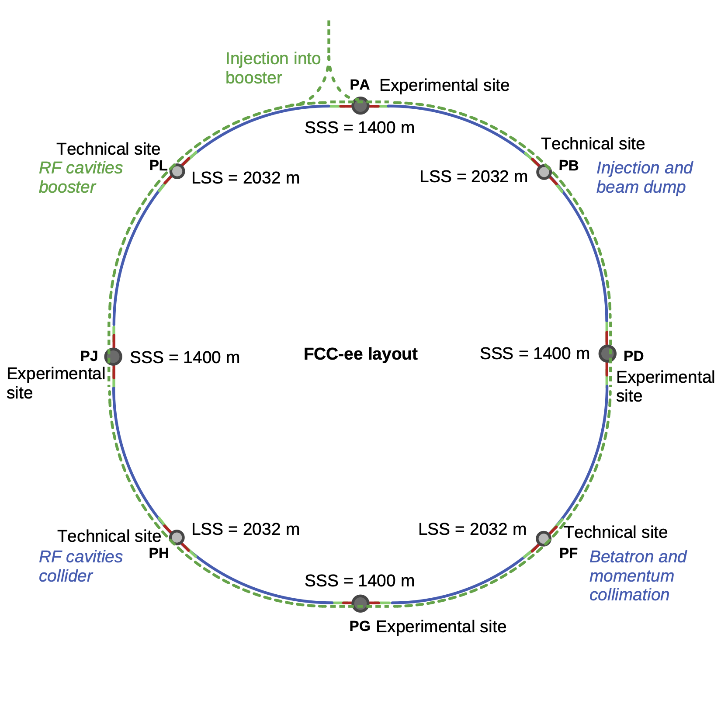
Considerations for placement in ring
27.02.2025 2025 FCCee Optics Meeting
Wolfgang Hofle
Update early of 2025:
PA:collider
transverse feedback kickers & depolarizer (1)
from the technical sites, locations where RF is located, offer advantages but space is an issue (in collider), and so are the large diameter beam pipes between cavities
experimental sites (PA, PG, PD, PJ)
  spaces considered:
    return arc (rejected, not good)
    regular arc
  implementation of any arc optics modification in four points preserves symmetry (4-fold)
booster
transverse feedback kickers
PD: collider
transverse feedback kickers & depolarizer (4)
PJ: collider
transverse feedback kickers & depolarizer (3)
no suitable space available (LSS)
PG: collider
transverse feedback kickers & depolarizer (2)

Slide 4
Depolarizer kickers and transverse feedback
14.01.2025 FCCee Physics Workshop
Wolfgang Hofle
Possible synergies with transverse feedback kickers
due to similar requirements for bandwidth synergy between the needed kickers for the transverse feedback and the depolarizer have been explored
long, O(m), stripline kickers operating at a multiple of the bunch repetition frequency offer good RF power efficiency and sufficient bandwidth
differences in requirements between transverse feedback and depolarizer kickers are
  depolarizer kicker only needed for vertical kicks, transverse feedback also for horizontal plane kicks
  implementation of depolarizer excitation as a modulated local orbit bump requires one or several sets of pairs of kickers with bending magnets in between
    no perturbation on experimental points permitted, may require tuning possibility with a third kicker per set of kickers
  kick strength required for depolarizer is high (total of 10 μrad) and adequate protection is needed to prevent acting on Physics bunches (loss of synchronisation with gaps)

Slide 5
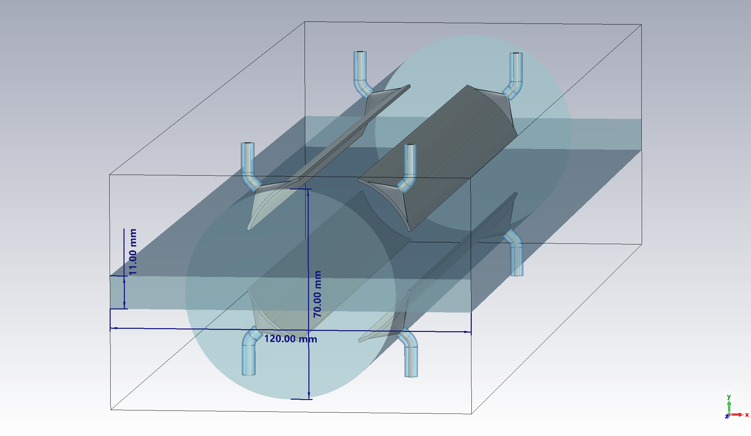
Stripline kicker: arc compatible version (1st version)
27.02.2025 2025 FCCee Optics Meeting
Wolfgang Hofle
Characteristics (good for transverse feedback, but too low shunt impedance for depolarizer with arc compatible diameter)
RF power
four electrodes arranged at 45 degrees
leaves horizontal plane free for synchrotron radiation absorbers similar as for BPM designs
compatible with vacuum chamber diameters of 60-70 mm foreseen for arcs (initial proposal)
small diameter also desirable for increased shunt impedance, but matching to 50 Ohm must be considered for both differential mode and common mode
universal design that can be powered to provide vertical or horizontal kicks, even simultaneously, power can be directed to plane that needs high level kicks
device is a backward coupler, powered at beam downstream ports and terminated at upstream ports
action on beam provided in equal parts from magnetic and electric fields
length can be adjusted to match actual needs for bandwidth
total kick strength provided by set of kickers, placed at the appropriate phase advance / optics as needed
up to 1m long
RF loads
RF power
RF loads
D. Sittard (CST)

Slide 6
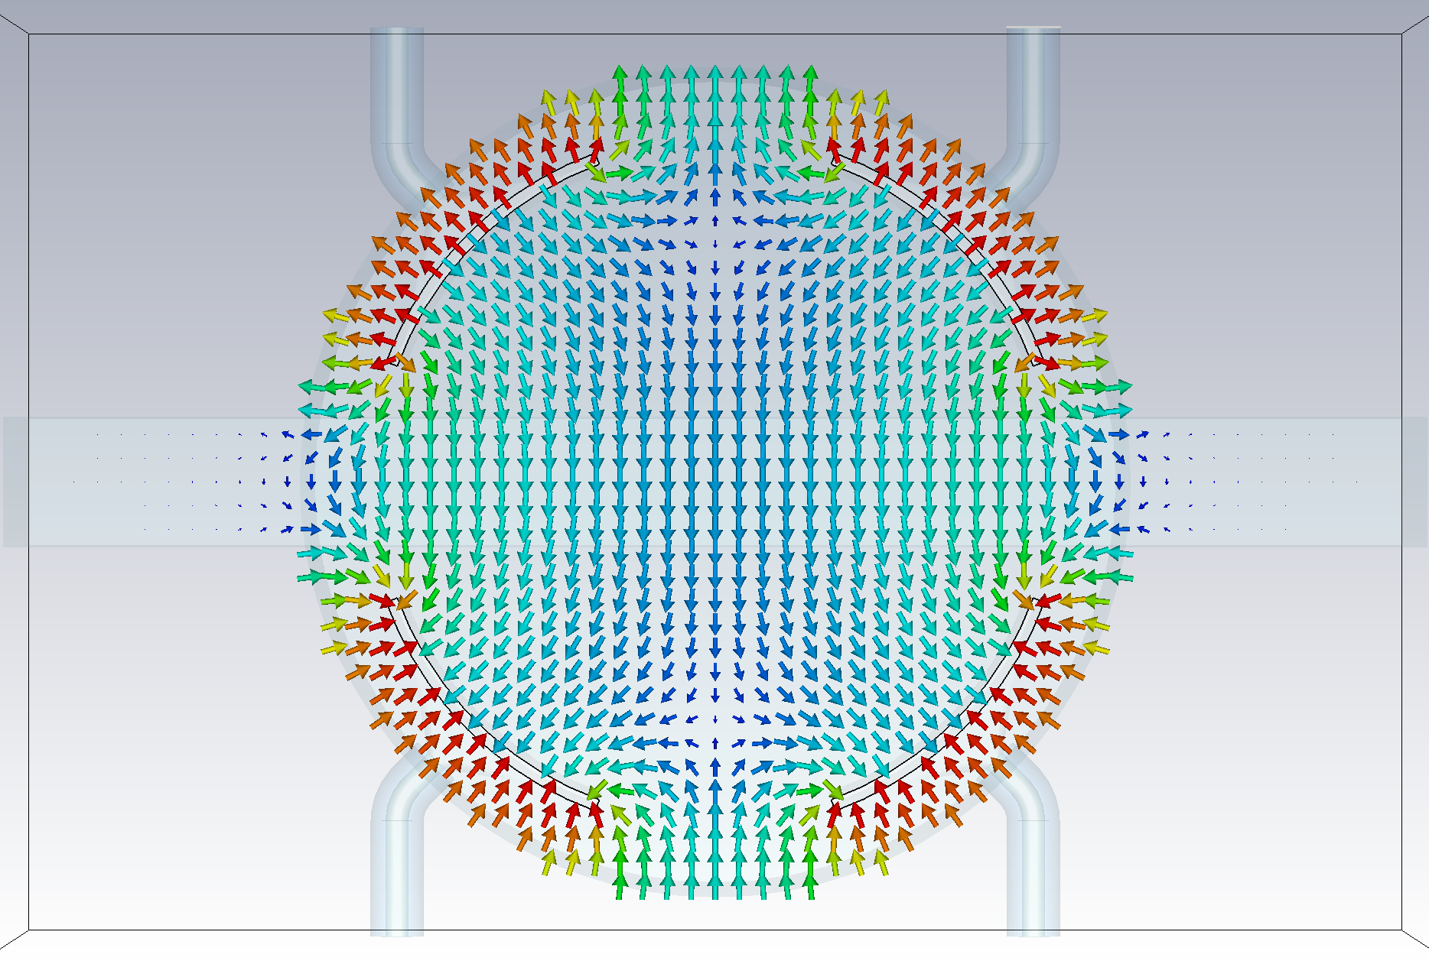
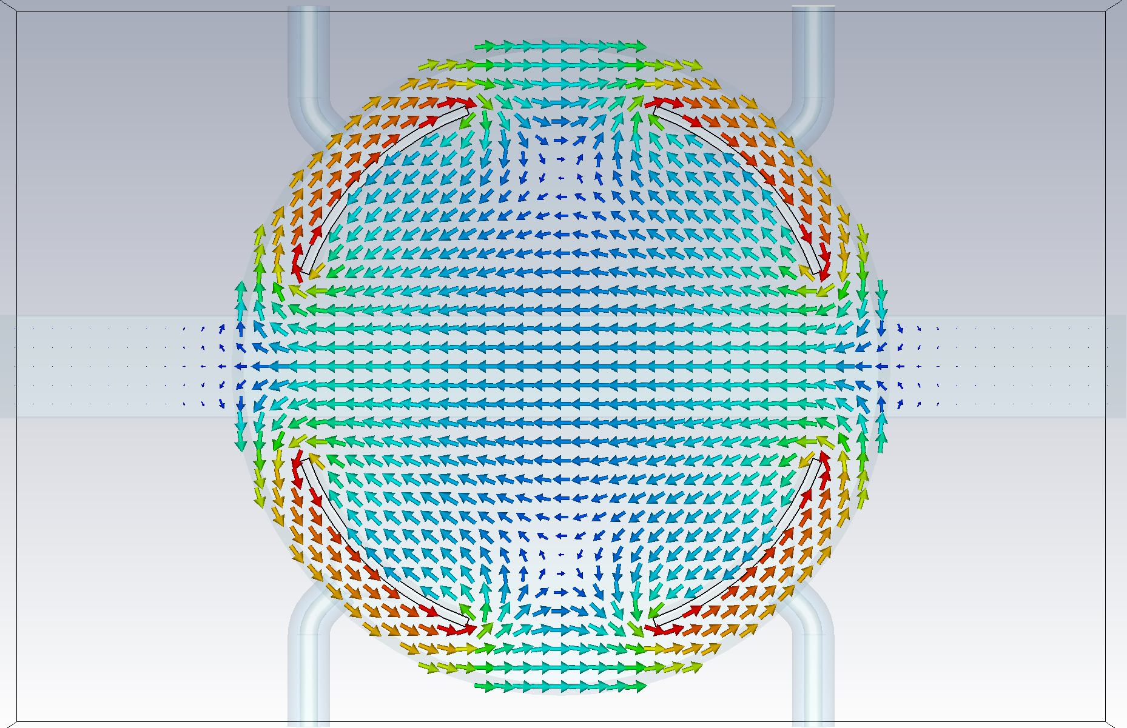
Stripline kicker: field plots (70 mm chamber)
27.02.2025 2025 FCCee Optics Meeting
Wolfgang Hofle
Electric field (vertical)
Magnetic field field (horizontal)
D. Sittard
vertical kick evenly split between electric and magnetic fields

Slide 7
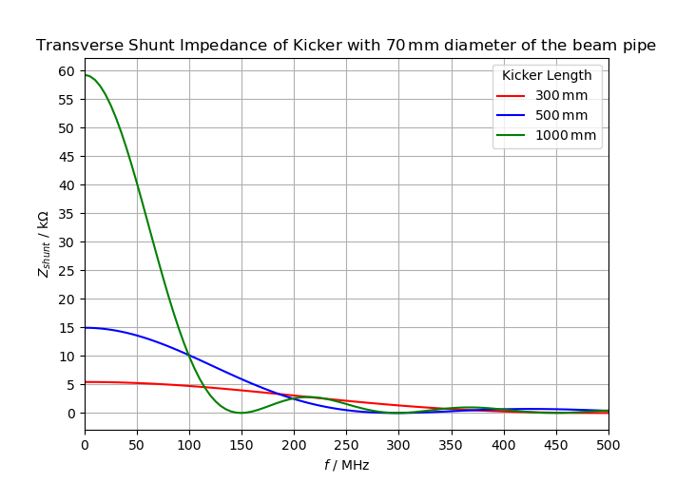
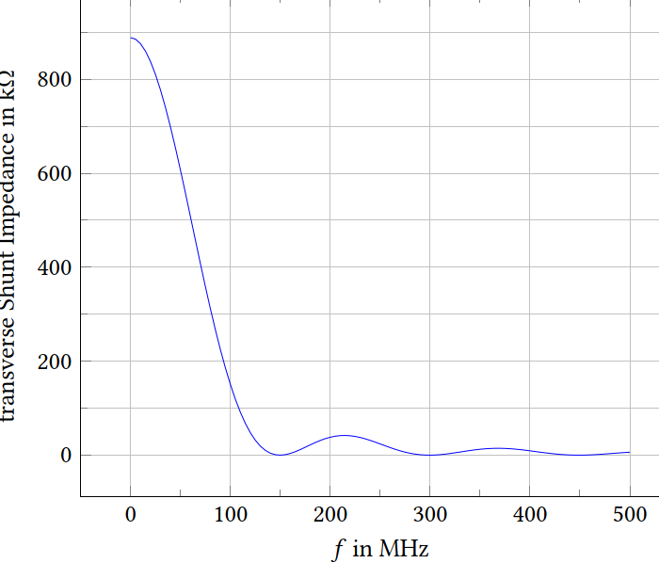

Shunt impedance kicker (four electrode version)
27.02.2025 2025 FCCee Optics Meeting
Wolfgang Hofle
Adaptation of length to bandwidth also possible (using 1 m long kickers for 40 MHz +/- 20 MHz)
26 mm vacuum chamber (→ 18 mm between electrodes)
70 mm vacuum chamber diameter (directly arc compatible)
→ power need reduced by factor 15.6
40 MHz
for 10 μrad @ 45.6 GeV
@40 MHz, 700 kΩ
4 electrodes
looks feasible, 1 m length
beam impedance check with BE-ABP needed
4 kickers
RF power (peak)
4x4x 35 kW
4x4x 2.26 kW
80 MHz
160 MHz
D. Sittard
integrated transverse kick 450 kV needed (split voltage over four kickers):
$$VT=\sqrt{2PZs}$$
total length per beam for kickers ~10 m (+ overhead tapers)
3 m per experimental point per beam (if split over four experimental points)

Slide 8
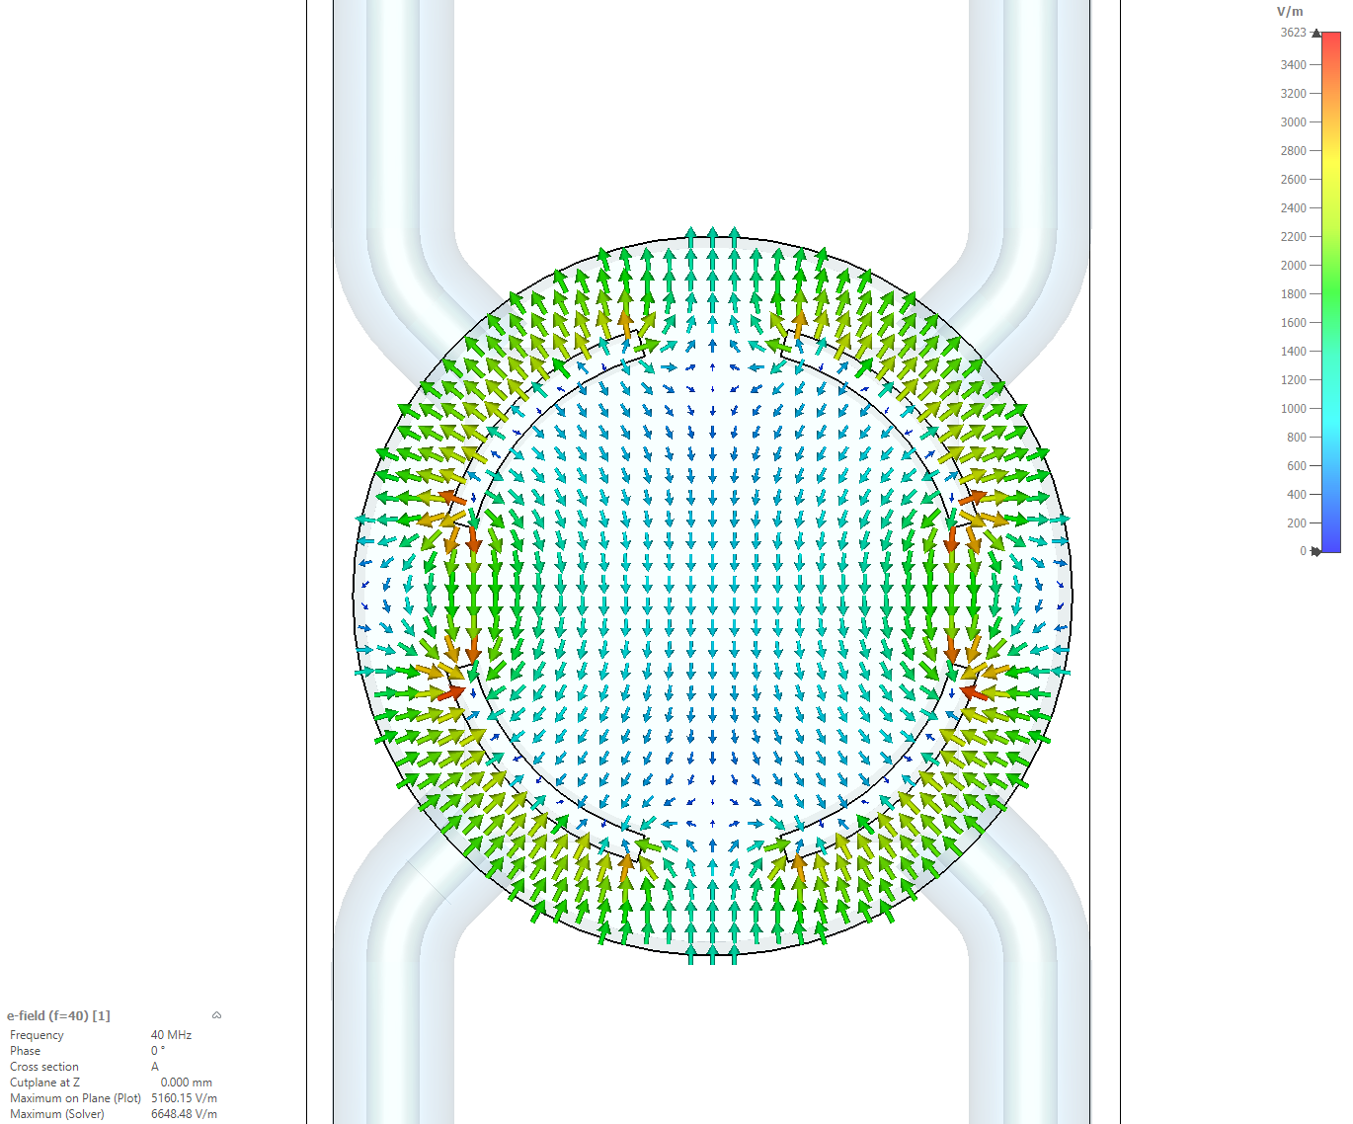
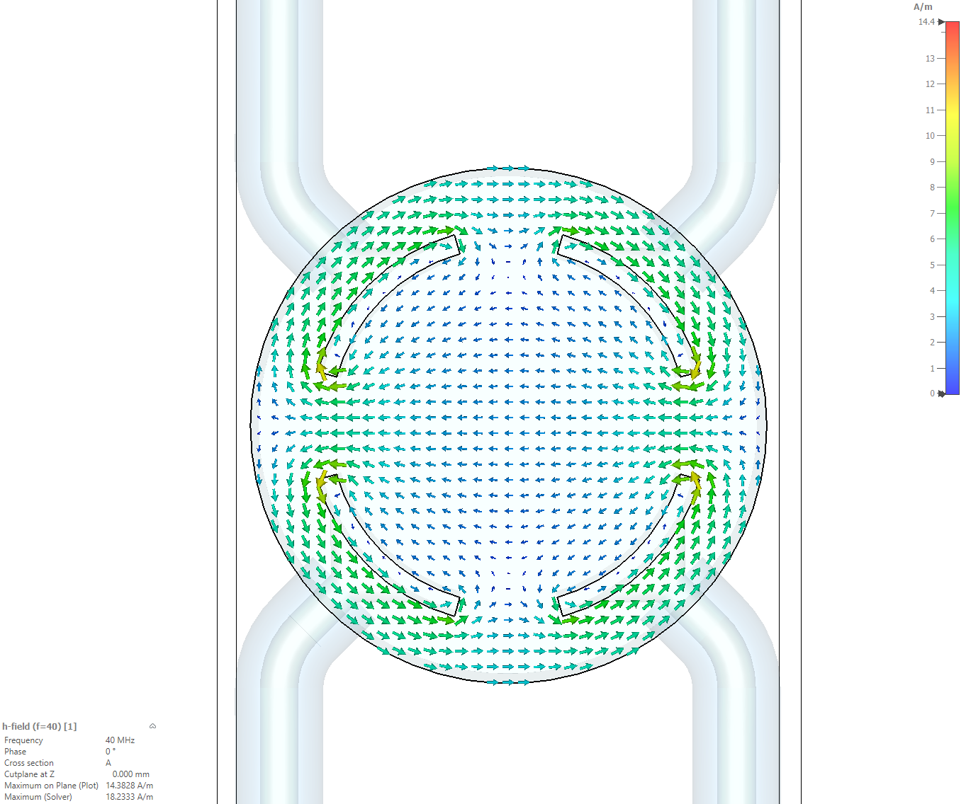
Stripline kicker: field plots (26 mm chamber)
27.02.2025 2025 FCCee Optics Meeting
Wolfgang Hofle
18 mm
Electric field (vertical)
Magnetic field field (horizontal)
D. Sittard
vertical kick evenly split between electric and magnetic fields
18 mm diameter stay clear aperture

Slide 9
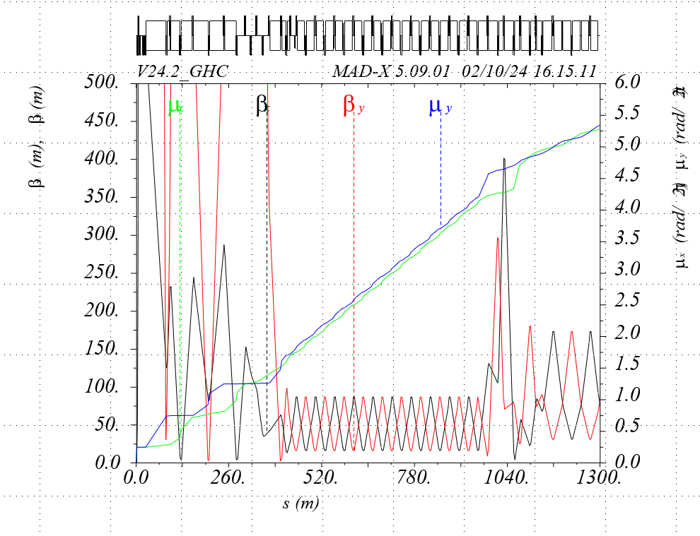
Placement in return arcs or in arcs?
27.02.2025 2025 FCCee Optics Meeting
Wolfgang Hofle
positron beam outgoing (clockwise) / right of IPs
return arcs would be suitable location for transverse feedback kickers
however, due to only two dipoles per FODO cell → less effect for depolarizer (according to I. Koop)
arc much better suited, but is space available?
Better to foresee to distribute depolarizers over eight locations
dedicated optics needed in return arc(s) adapted to the needs of the depolarizer kickers
(local modulated bump)
Kicker #9 additional degree of freedom to adjust closing of bump (depolarizer function)
OR regular arc
If concentrate in one experimental point → 10 m per return arc (e.g. PA) !
kickers 9
kickers 1-4
kickers 2-8
current optics plot: curtesy G. Roy

Slide 10
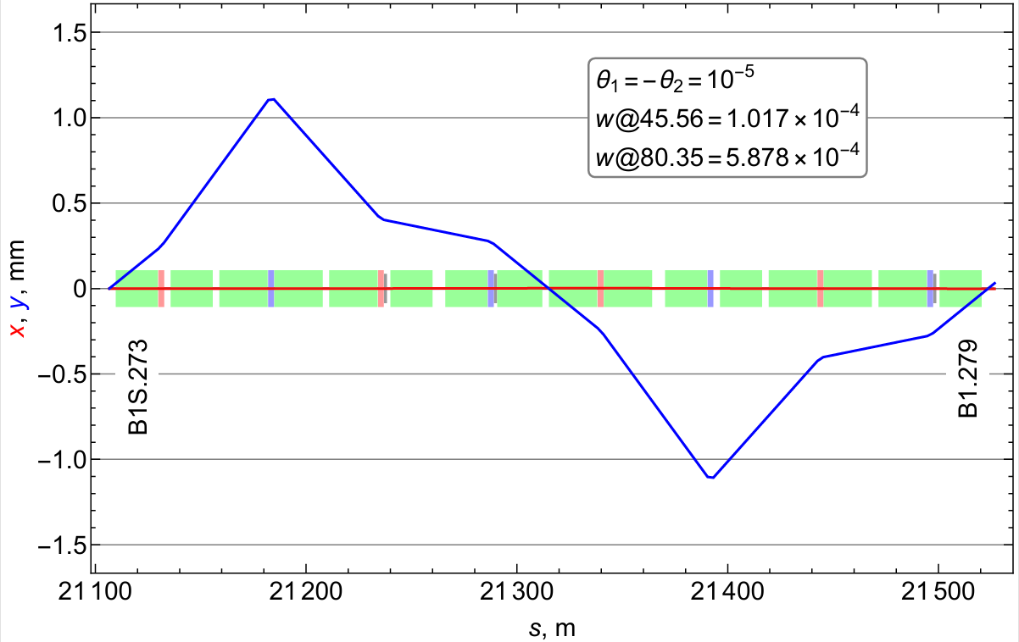
Placement in regular arcs re-visited
27.02.2025 2025 FCCee Optics Meeting
Wolfgang Hofle
positron beam outgoing (clockwise) / right of IPs
split system over eight locations, left and right of experimental points
chose kickers of lengths of 1 m, 26 mm chamber
→ at least 8 kickers per beam for four full wave bumps per beam
+ the optional third kicker to ensure bump closure (another 4 kickers per beam)
24 kickers in total
if distributed over four locations only 2.5x10-6 rad
Kicker 3
Kicker 1
Kicker 2
optional kicker 3 to ensure full wave bump is closed
Following proposal by I. Koop
https://indico.cern.ch/event/1471324/contributions/6220925/attachments/2963259/5212471/Koop-depolarizer%20review.pdf

Slide 11
Kick voltage and kick angle summary
27.02.2025 2025 FCCee Optics Meeting
Wolfgang Hofle
10 μrad at 45 GeV → 450 keV/c transverse momentum kick needed, at minimum two locations for implementing a closed bump with modulated amplitude can be provided by stripline kickers
  use sets of 1 m long kickers (RF matched to 50 Ω) with four electrodes for each location to create local modulated bump (2x4x2.26 kW = 18 kW peak RF power)
  four such systems per beam
  24 kickers in total for both beams combined, including the additional kicker to adjust closure
    for 16 main kickers: 144 kW peak RF power
    power needed for adjustment kickers is smaller

Slide 12
Next crucial steps – my view
27.02.2025 2025 FCCee Optics Meeting
Wolfgang Hofle
confirmation needed on available space in arcs or for modified return arc optics suitable for depolarizer
feasibility of small diameter vacuum chamber kicker needs confirmation
  beam impedance, needed tapers, synchrotron radiation
follow-up on machine protection considerations
optimization of electrode design, possible consideration of advantages of higher line impedance kicker

Slide 13
Thank you for your attention.
13.01.2025 FCCee Physics Workshop
Wolfgang Hofle
13

Slide 14
Spare
13.01.2025 FCCee Physics Workshop

Slide 15
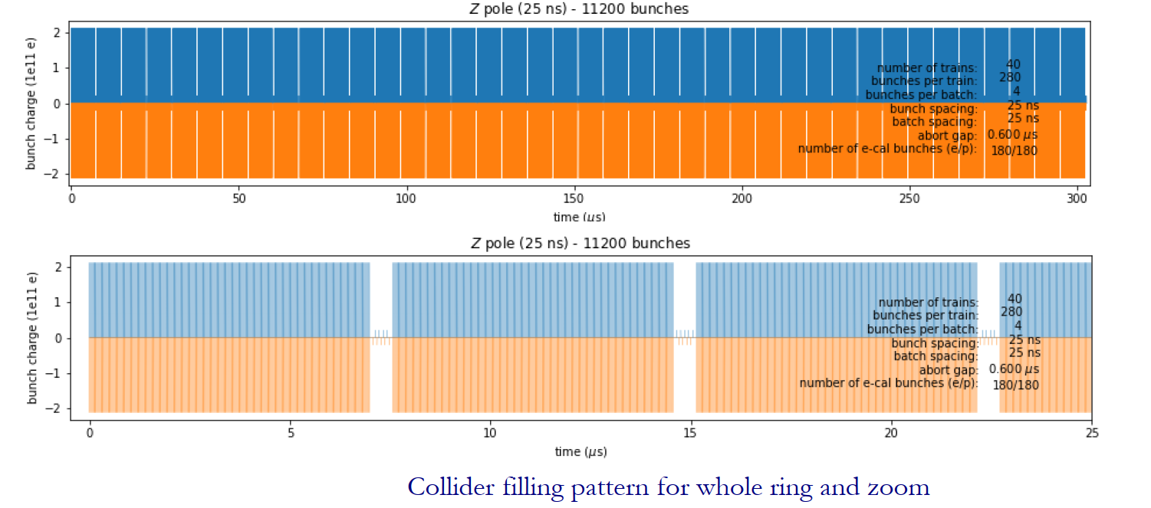
Filling pattern Z-pole – update of situation
14.01.2025 FCCee Physics Workshop
Wolfgang Hofle
Number of gaps was increased from 20 to 40
due to transient beam loading considerations in RF cavities
(I. Karpov)
C. Carli et al. @FCC SAC 19.11.24
e-cal bunches of at least one gap are affected by injection bump risetime, so effectively 175 (one beam), 176 (the other beam) useful bunches at maximum

Slide 16
Machine Protection considerations (03.10.24)
14.01.2025 FCCee Physics Workshop
Wolfgang Hofle
What can go wrong?
Mitigation
Excitations not correctly synchronized
Excitation amplitudes not correct leading to not closed depolarizing bumps
any of the other excitations that will certainly be used (AC dipole mode etc.) need to be protected against failures
very strong kicks possible comparable or even larger than at LHC injection
protection with BLMs of limited or of no use due to small beam size
monitoring of positions at appropriate distance from kickers in phase
global monitoring of beam position required turn-by-turn, independent of pick-ups used for TFB
interlocks need to be derived from this monitoring
beam Stoppers?
machine protection task force working group requested examination of failure scenarios and mitigations
from MP point of view not clear if entangling TFB and depolarizer system into one system is the optimum due to the different kick strength required for both systems and the possible failure scenario
  possibility to have common kickers, with combination of signals before kicker (pulsed system for de-polarizer, cw system for feedback function)

Slide 17
FCCee collider and booster transverse feedback systems
13.01.2025 FCCee Physics Workshop
Wolfgang Hofle
Key requirements
need bunch-by-bunch operation at 25 ns bunch spacing → defines bandwidth
can operate at multiple of bunch repetition frequency (short bunches) → no need to work in “base-band” as in LHC → helps as it reduces relative bandwidth
sets of RF matched strip-lines with carefully chosen length as kickers seem obvious choice
Booster:
  request to also operate to damp a significant transverse injection error → defines maximum kick requirements
    needs estimate of injection errors, filamentation time, … to define system
  moderate damping times only for instabilities (not beyond experience from LHC)
  single location in ring sufficient
Collider:
  need to damp very fast transverse instabilities → four turns risetime, high gain system
    favors distributed system with multiple pick-ups and kickers
    possibility of synergy with exciter for resonant depolarization (as in LEP)

Slide 18
Transverse Feedback Kickers
13.01.2025 FCCee Physics Workshop
Wolfgang Hofle
Requirements
bunch-by-bunch operation calls for +/- 20 MHz minimum for 25 ns bunch spacing
high gain required, not necessarily high kick strength
low noise electronics
prefered to provide feedback kicks in a band at a multiple of the bunch repetition frequency, nx40 MHz or nx50 MHz depending on bunch spacing
  lowest betatron frequency is very low in frequency (~660 Hz)
possibilities to distribute kicker system over several collider points considered before but seems at present not required, but needs independent confirmation
fast damping rates required for low order modes only
have a set of kickers available at different phase advances is an advantage (if fractional tune options close to 0.5 or integer, it is a must)
highest beta function for given aperture, low dispersion for associated set of pick-ups
additional synergy to be explored for applications as in LHC (AC-dipole for optics measurements …)

Slide 19
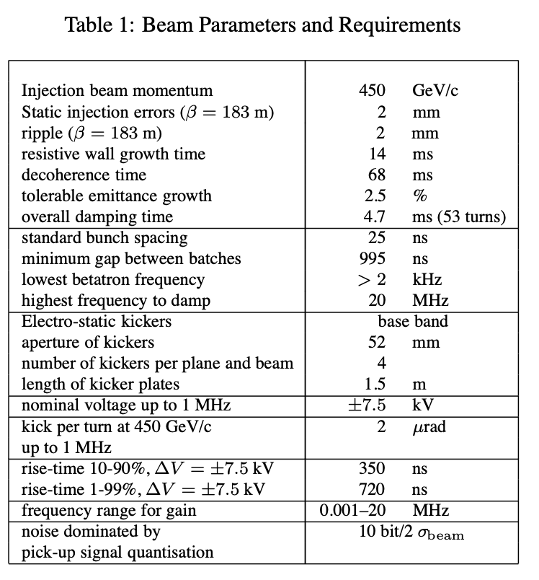
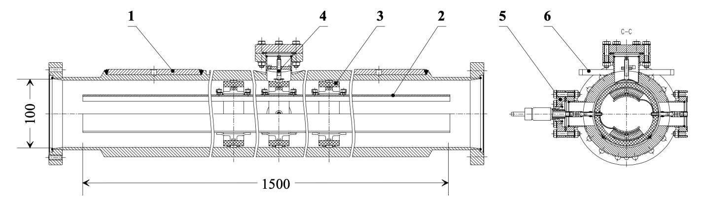
13.01.2025 FCCee Physics Workshop
Wolfgang Hofle
LHC ADT kicker (LHC transverse feedback)
  high impedance tetrode amplifiers
  kicks with electric field only
  6 m effective length split over 4 kickers twice as strong as depolarizer kicker system (2 μrad at 450 GeV/c)
  full amplitude not as bunch selective as needed for FCCee
  due to resonances not (readily?) suitable for short electron bunches
W. Hofle et al. PAC 2001

