Slide 2
Report on
High Field Magnet Programme
E. Todesco, HFM programme leader
B. Auchmann, HFM programme co-leader
13 Janaury 2025, FCC physics workshop

Slide 3
Contents
FCC-hh parameters and options
Roadmap
HFM directions and recent results
HTS outlook

Slide 4
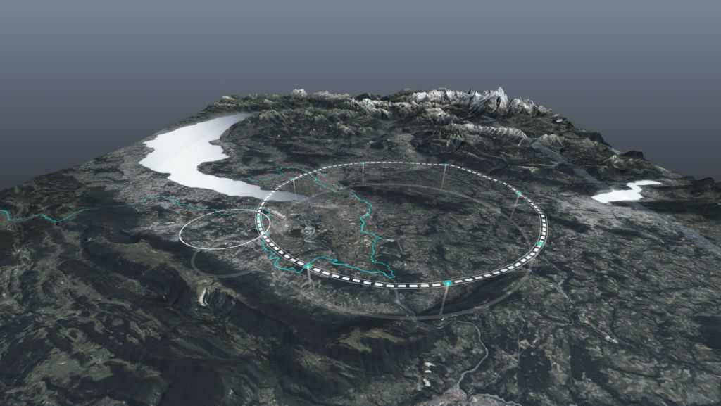
FCC-hh targets (Nb₃Sn)
As discussed in previous years, FCC-hh dipole operational field moved from 16 T to 14 T, for 85 TeV c.o.m energy
  14 T is reached with 0.80 loadline fraction rather than 0.86 (more reasonable margin)
  14 T is reached with conductor available today (20% more critical current than HL-LHC) rather than with FCC targets
  14 T allows rather than 16 T to significantly reduce the stresses in the coil (below 150 MPa), thus giving required margin for such a large production
    A maximum of 90 TeV could be reached with further improvements of filling factor
 |  | CDR 2019 | 2024-Nb₃Sn
Dipole field | (T) | 16.0 | 14.0
Dipole aperture | (mm) | 50 | 50
Dipole magnetic length | (m) | 14.3 | 14.3
Operational temperature | (K) | 1.9 | 1.9
Tunnel length | (km) | 100 | 90.7
Arc length | (km) | 82.0 | 76.9
Arc filling factor | (adim) | 0.80 | 0.83
Energy c.o.m. | (TeV) | 50+50 | 42.5+42.5
Loadline fraction | (adim) | 0.86 | 0.80
j_{c} at 16 T and 4.2 K | (A/mm²) | 1500 | 1200
Number of dipoles | (adim) | 4587 | 4440
Number of quadrupoles | (adim) | 760 | 520
FCC layout and evolution of parameters

Slide 5
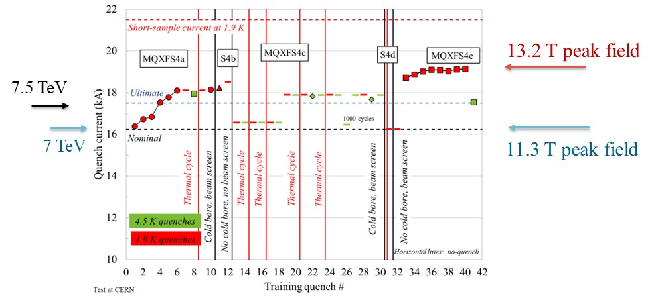
Margins
14 T operational field means that FCC-hh short models shall aim at reaching systematically 15-15.5 T
  We should avoid confusion between operational and achieved field: LHC dipoles reached 9.5 T, but they operate in the LHC slightly above 8.0 T
  HL-LHC experience: short models systematically reached >13 T, but they will operate at 11.3 T
MQXFS4 test results [S. Izquierdo Bermudez, J. C. Perez, P. Ferracin, F. Mangiarotti, et al.]

Slide 6
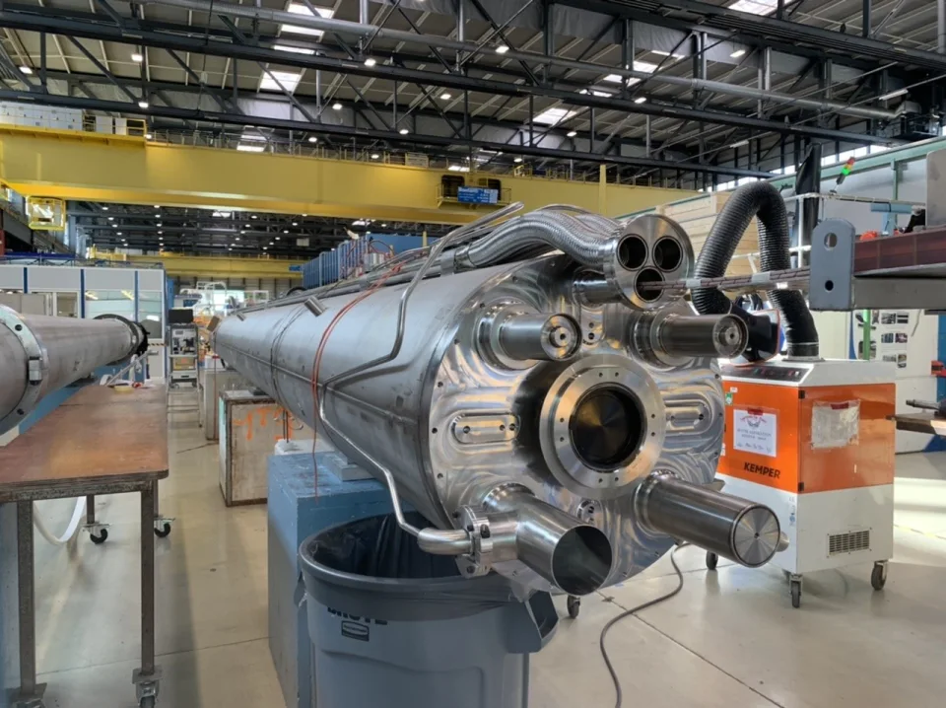
Options
4.5 K operation [P. Borges, R v. Weelderen et al. ]
  HL-LHC MQXF experience shows that all magnets reaching operational field at 1.9 K are also able to operate at 4.5 K
  It is a very daring reduction of margins, that should be fully proved on models
  Advantage: simpler cooling, and cheaper costs
20 m long magnets
  Advantage: reduction of production from 4440 to 3330 units, minor decrease of cost (6%) or increase in energy (3%)
12 T dipoles giving 73 TeV c.o.m.
  Advantage: 30% less conductor, 15-20% less cost per dipole
Powering test of first six conform MQXFA magnets
[J. Muratore, B. Ahia, S. Feher, G. Ambrosio et al. ]
One of the first 7-m.long Nb₃Sn magnets

Slide 7
Contents
FCC-hh parameters and options
Roadmap
HFM directions and results
HTS outlook

Slide 8
Roadmap for Nb₃Sn
At the beginning of 2024 we updated the roadmap for FCC based on the new parameters for Nb₃Sn dipoles
  This is a quite conservative roadmap, giving 10 years to make the scaling in length in two steps (first 5 m, then 15 m)
15 m long prototypes (>5 of each type)
5 m long prototypes of one selected design
(>5 of each type)
Short model program on two selected designs
(>5 of each type)
Ongoing 12 T and 14 T short models (seven designs, 1 or 2 of each type)
Selection of final design
to start long magnets
2024
2025
2026
2027
2028
2029
2030
2031
2032
2033
2034
2035
2036
2037
2038
2039
2040
2041
LHC RunIII
HL-LHC RunIV
HL-LHC RunV
HL-LHC RunVI

Slide 9
Roadmap for Nb₃Sn
This gives 2055 as possible start for FCC-hh at 90 TeV
  5-10 years can be gained by anticipation of some phases, more parallelization and early involvement of industry
  We are already planning anticipating the scaling in length to 5 m in 2025-2030 using HL-LHC conductor
Installation and commissioning
Production and test
Industrialization (pre-series magnets)
Tender for the series
2040
2041
2042
2043
2044
2045
2046
2047
2048
2049
2050
2051
2052
2053
2054
2055
2056
2057
LHC RunVI

Slide 10
Contents
FCC-hh parameters and options
Roadmap
HFM directions and results
HTS

Slide 11
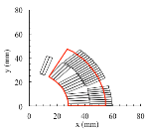
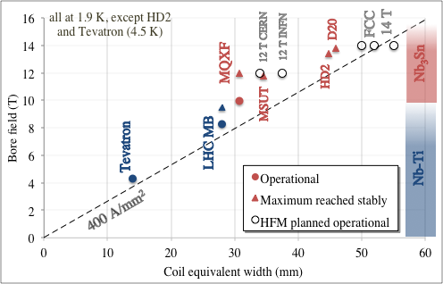
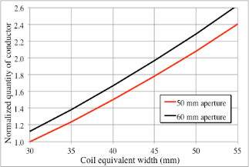
Where are we going ?
Maximum fields close to 14 T were achieved in short models
Equation for the field in a dipole
    j: overall (over insulated coil) current density w_{eq}: equivalent width of the coil
  We set targets of 14 T with three different designs: block (CERN and CEA), and common coil (CIEMAT): each design has advantages, we will see in the coming years the most promising
This is based on having a conservative value a 400 A/mm² overall current density as in the past, giving 50-55 mm coil width (it was 30 mm in LHC dipole)
    We will need 2 to 2.5 more conductor than in the LHC dipoles

Slide 12

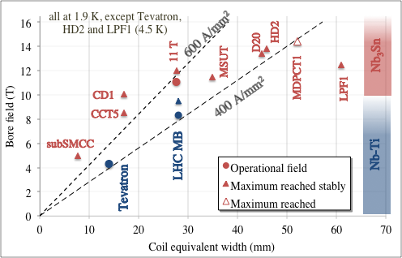


Where are we going ? Two more directions
Stress managed: mixing structure and coil, aiming at more efficient (and possibly cheaper) magnets – US MDP and PSI are working on this: only path above 15 T for HTS
Technology demonstrators: magnets with design parameters not compatible with accelerator, to explore the technology – CERN and IHEP are working on this
Fresca2
RMM

Slide 13
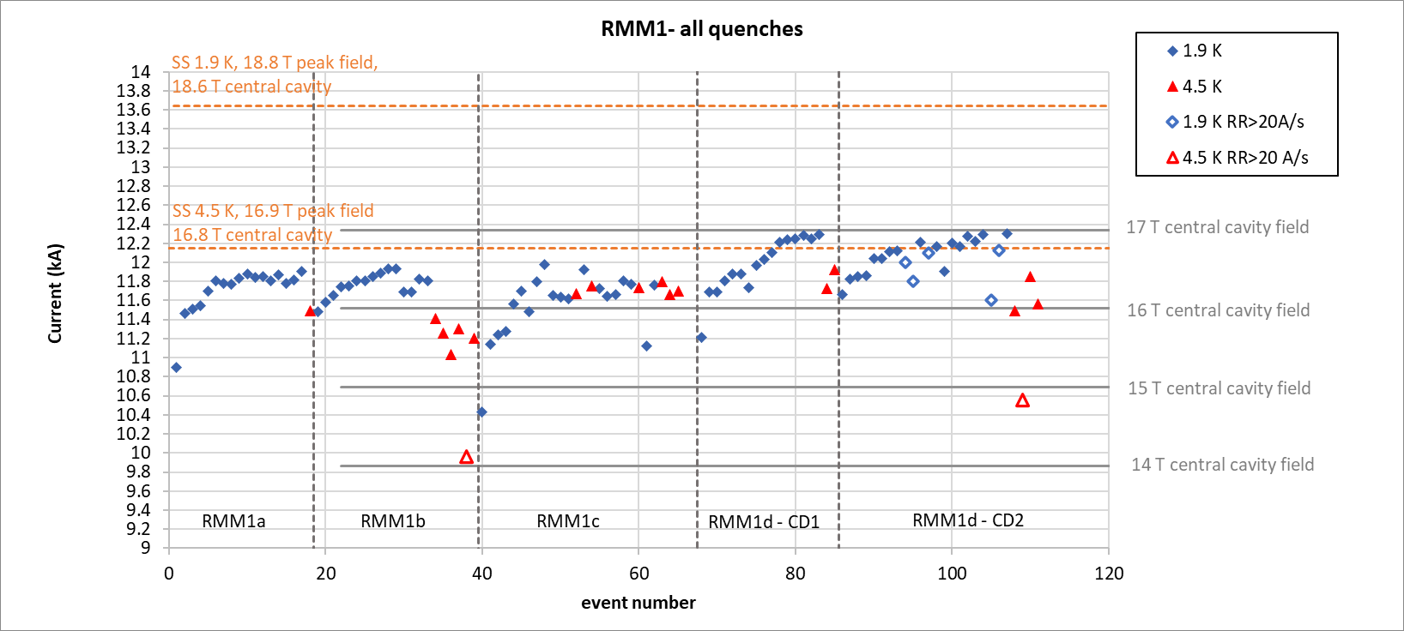
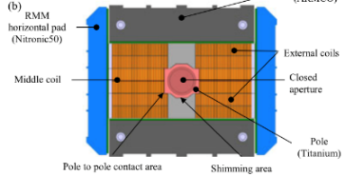
Recent results: Nb₃Sn magnets
RMM is a technology demonstrator launched by EuroCirCol
  This means a magnet to prove technology but not with a design compatible with accelerator (in this case too much conductor, and no flared ends)
  RMM reached 16.4 T in a 50 mm bore in 2022 – proves adequate margin for 14 T
  Second assembly reached 17 T (November 2024) no degradation
  The demonstrator can keep 15.75 T for 4 h) https://indico.cern.ch/event/1464833/
  We are working on cooling aspects
17 T
14 T
Cross-section and training of RMM [E. Gautheron, et al. IEEE TAS 33 (2023) 4004108, and G. Willering]

Slide 14
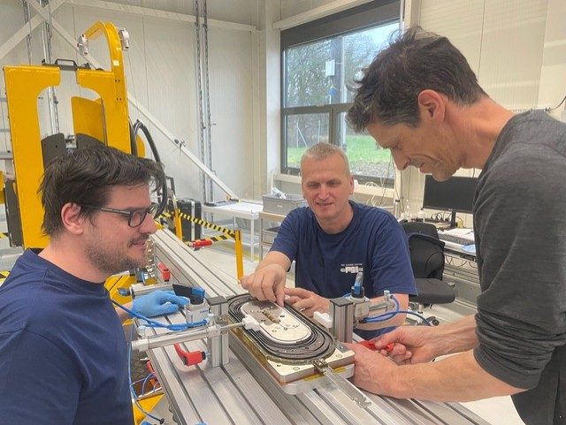
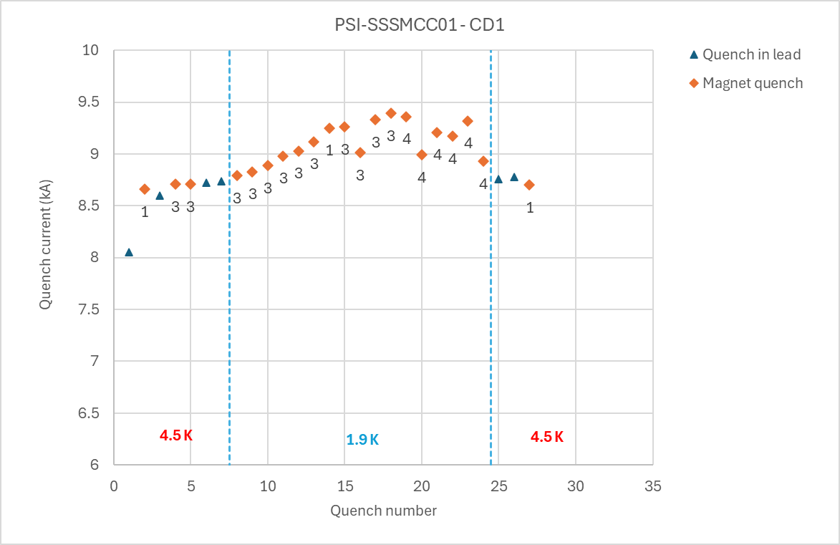
Recent results: Nb₃Sn magnets
SubSMCC is a small scale magnet based on stress management
  This is a new paradigm that could allow having more efficient magnets with higher current density - Similar path is pursued by the US MDP
  Peak field in the coil of 6.5 T reached, >5 T in in the centre (June 2024)
Short sample 1.9 K
Short sample 4.5 K
Manufacturing of SubSMCC in PSI (D. Araujo, B Auchmann, et al.)

Slide 15
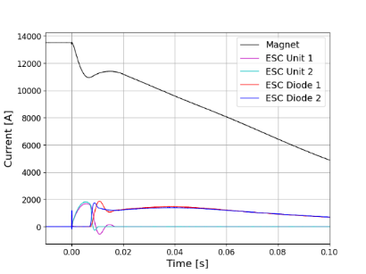
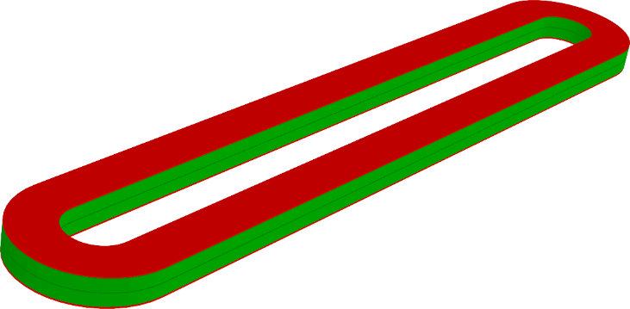
Recent results: improved protection
Larger current density → more compact and cheaper magnets
  One of the limits to large current densities is the protection – all energy has to be dumped in the coil
  Novel method proposed (E. Ravaioli et al.) and being tested at CERN (October 2024) to allow a part of energy extraction, and fast quenching
Copper coil and SC coil in ESC, and quench protection (E. Ravaioli, et al.)

Slide 16
Contents
FCC-hh parameters and options
Roadmap and ESPP papers
Directions and results
HTS

Slide 17
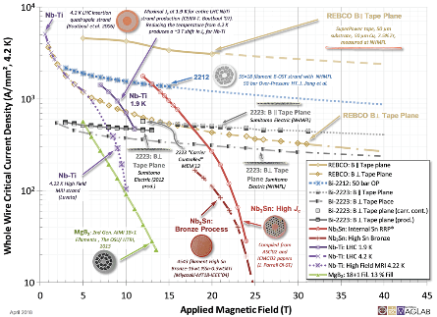
HTS opening ways above 14 T
HTS is a game changer in accelerator physics, since it could allow
  Operational fields well above 14 T due to the weak dependence of the critical current on the field
  Cooling at higher temperatures (possibly 20 K), giving less consumption and simpler cryogenics
Critical current versus field (please note semilog scale) [Courtesy of P. Lee]

Slide 18
HTS opening ways above 14 T
Three conductors on the market: are they good for our needs?
  BSSCO 2212 (mainly developed in the USA)
  REBCO (strong impulse from fusion investments of order of BCHF)
  IBS (Iron Based Superconductor, strong impulse from China)
Our requirements are very special:
  Field quality over a vast field range and reproducibility of 10 ppm of max field – very different from fusion magnets or solenoids
  Limited energy consumption, and cost
Dipoles up to 4 T were built (Eucard2), but without full proof that HTS technology can be used for accelerator main magnets
  A possible roadmap: prove viability within 2030 for short models and possibility of scaling in length by 2035
Some points are particularly tricky
  Hysteresis losses are large due to filament size
  Reproducibility and stability of transfer function (current redistribution)

Slide 19
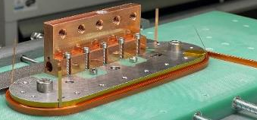
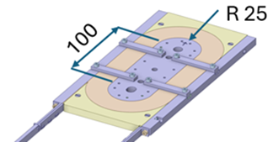
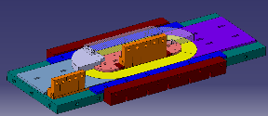
HTS news
Production line in KIT commissioned (B. Holzapfel et al.) in March 2024
At CERN, racetrack wound with dielectric insulated (DI) REBCO and went through preliminary tested at 77 K
  A research line of MI (metal insulated) is also active in HFM (CEA)
  Remember that all magnets for fusion are NI (non insulated) – not good for us
Then a test at 4.5 K – 20 K will be done
Optimized for number of racetracks
[A. Ballarino, et al., HFM TE day https://indico.cern.ch/event/1425262/ ]

