Slide 1
Some Thoughts About Readout
Bruce Schumm
Santa Cruz Institute for Particle Physics
DRD3 WG6 SiC LGAD Meeting
January 17 2025

Slide 2
Preamble
We’re just starting to think about this at SCIPP for the first time
Some of this may be naïve
That’s one of the points for presenting it

Slide 3
Two types of readout we’re considering
Optimized for fast timing
➔ Typically τ_{amp} ≈ τ_{rise}
➔ 0.5 – 1.5 GHz
Optimized for feature extraction
➔ The faster the better (if you can tolerate ~ √BW increase in noise)
➔ A bit of a focus at SCIPP recently

Slide 4

Fast Timing Readout Scaling Laws (?)
Readout designed to optimize
$$σ_{t}=\frac{σ_{V}}{{dV}/{dt}}$$
Per um of bulk, SiC pair creation rate is roughly (3.2/7.8) / (2.3/3.6) = 64% of Si
But SiC is twice as fast
So dV/dt would be ~25% larger?
SCIPP board OK for SiC LGAD?
Gain = 1 signal would be difficult though
 | Si | SiC
e/h energy | 3.6 eV | 7.8 eV
density | 2.3 g/cm³ | 3.2 g/cm³
V_{drift} (saturated) | 100 um/ns | 200 um/ns

Slide 5
Feature Extraction Readout (multi GHz)
A fast readout system may be able to
Extract features in pulse
Be sensitive to v_{drift} and τ_{impact} as a function of local field
Best geared towards large depositions due to readout noise (alpha particle)
Under study at SCIPP
“Chain only as strong as weakest link” (charge collection, signal path, signal transport, readout…)

Slide 6
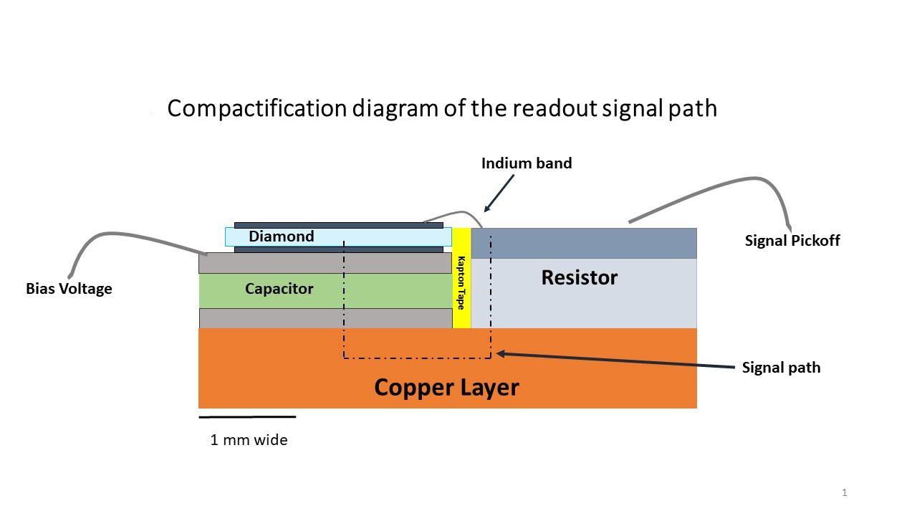
SCIPP Compact Signal Path Approach
Compact Signal Path
Make use of RF industry components to develop mm-scale signal path
Limit inductance, capacitance to push LC resonance above 10 GHz
Integrate with localized readout to eliminate signal transport degradation
Back-contact resistor
Single-layer capacitor

Slide 7
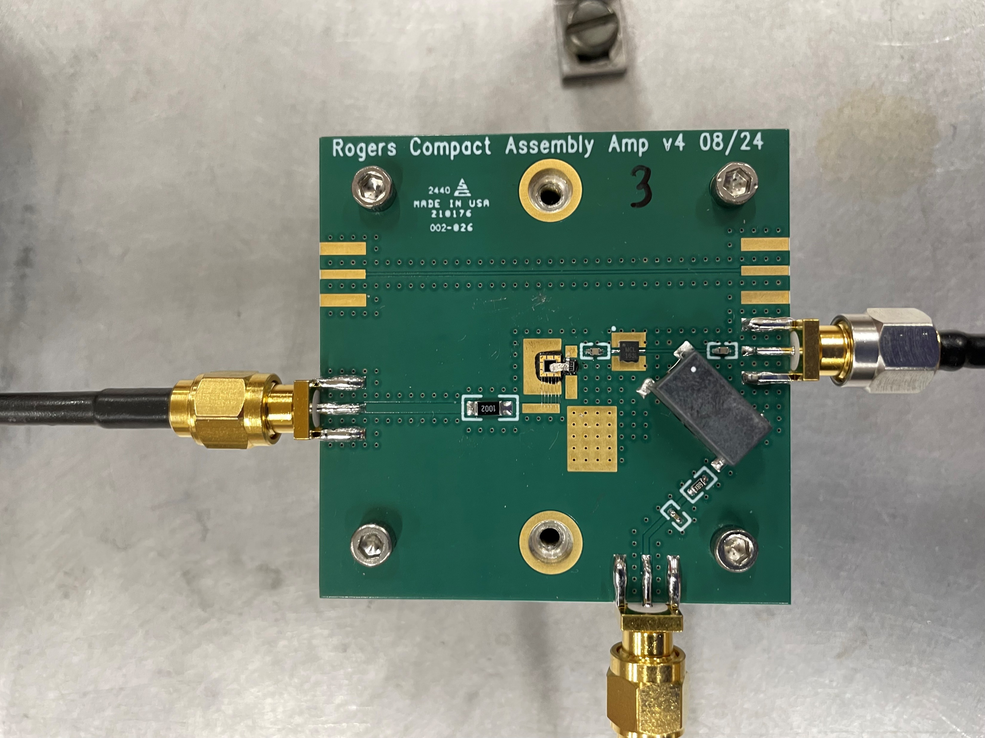
1.5x1.5 mm², 30 um thick diamond
Minicircuits EHA-163L+ RF amplifier

Slide 8
We’ve studied so far
Board with (slow) FR4 dielectric
Board with (fast) Rogers 4350b dielectric
And on these, excited with an alpha source (~ 5 MeV)
Silicon PiN on FR4
33 um, 2x2 mm² diamond on FR4
30 um, 1.5x1.5 mm² diamond on Rogers 4350b (results 5 days old)

Slide 9
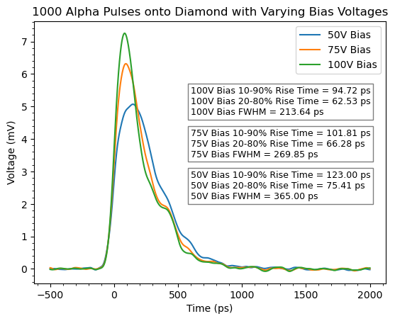
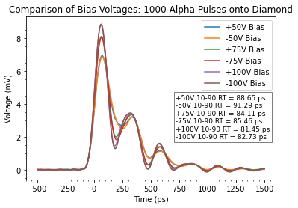
33 um Diam
FR4
30 um Diam
Rogers
50 um Si
FR4
Rogers assembly fast, but develops ringing
Taking into account 13 GHz scope BW, τ_{rise} = 81 ps is ~ 4.8 GHz
Si PiN pulse features (~500 ps collection time) appear visible
Systematic difference for +/- voltage (Rogers assembly) suggests possible sensitivity to hole vs. electron drift in diamond
Studies underway in ANSYS HFSS to identify source of limitations

