Slide 1
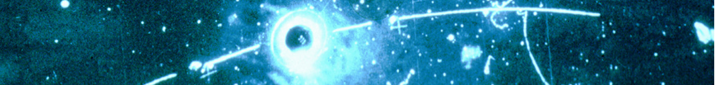
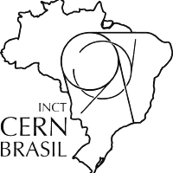



Hypergraph Neural Network track reconstruction pipeline for HL-LHC experiments
Connecting the Dots 2025
Image: Gargamelle/CERN
Rodrigo Estevam de Paula
Marco Aurelio Lisboa Leite
Vitor Heloiz Nascimento Universidade de São Paulo (BR)
14 November, 2025
FAPESP (2023/18484-6, 2022/14150-3, and 2020/04867-2)
CNPq/MCTI (INCT CERN Brasil 406672/2022-9)

Slide 2
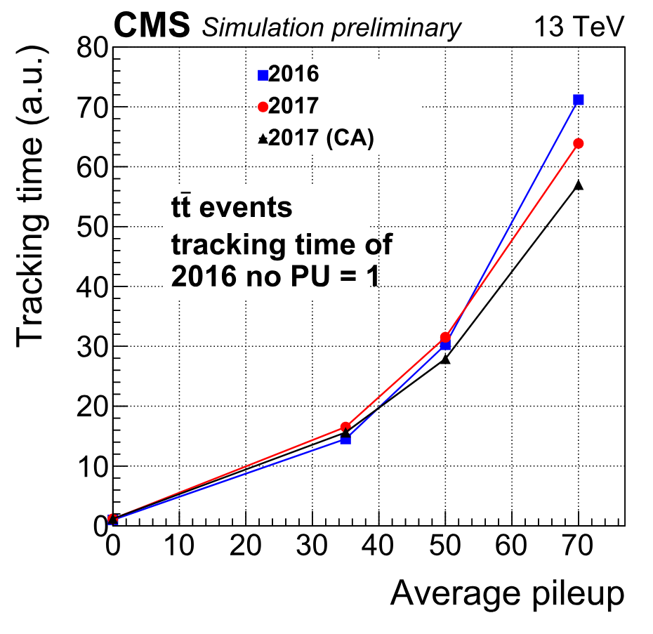
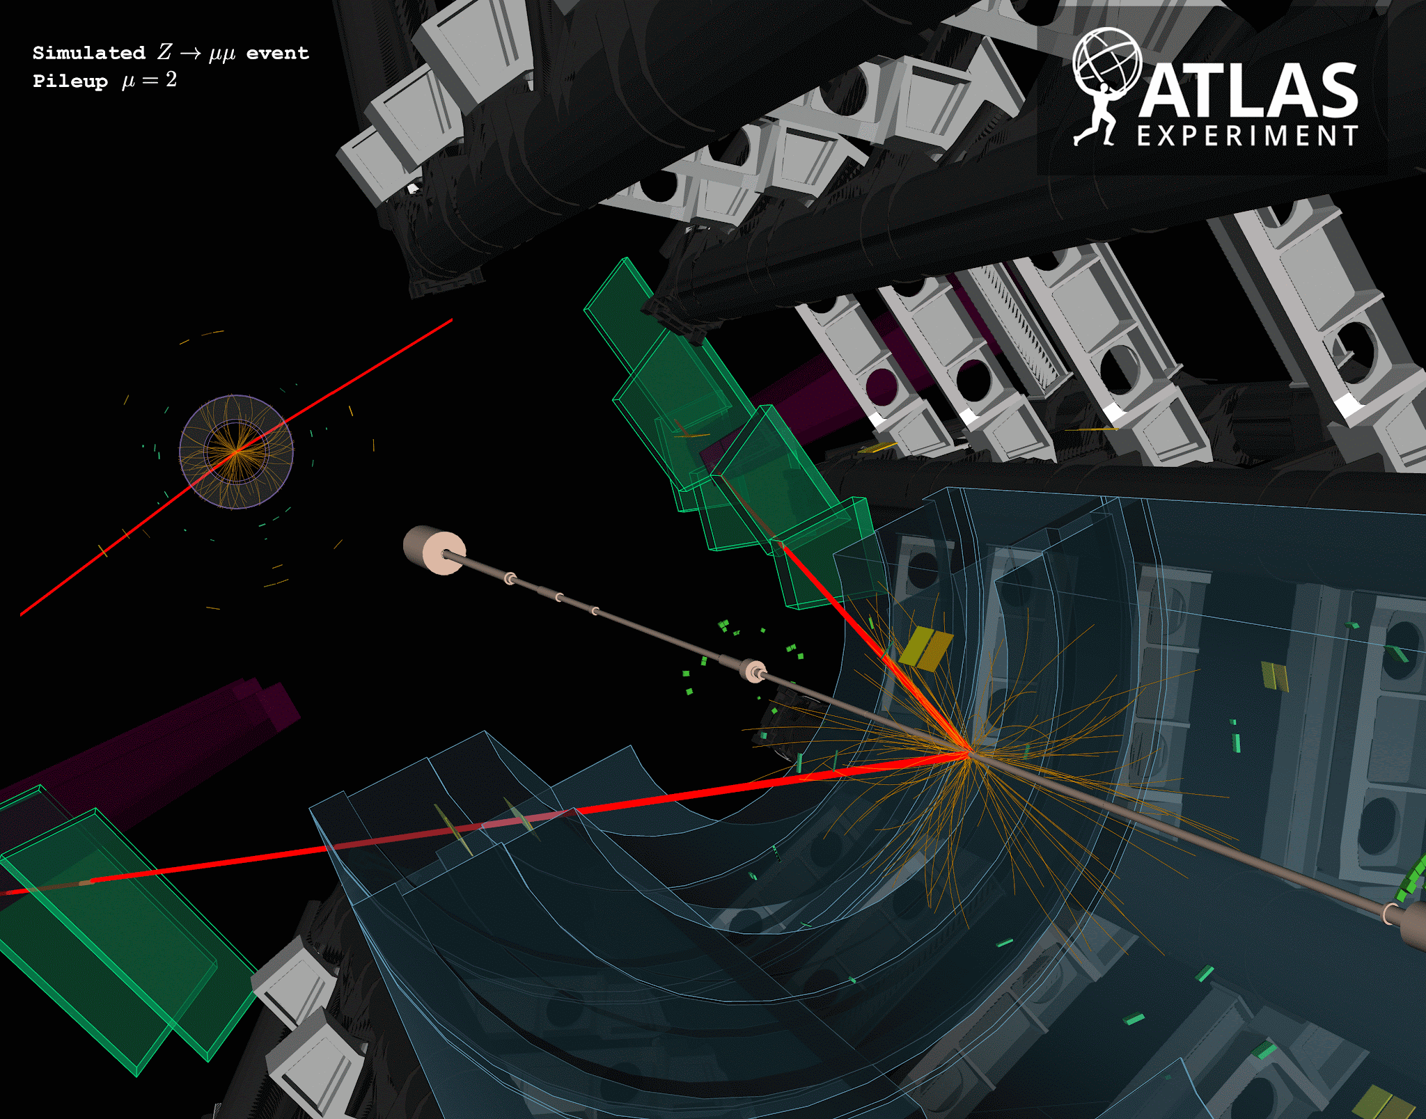
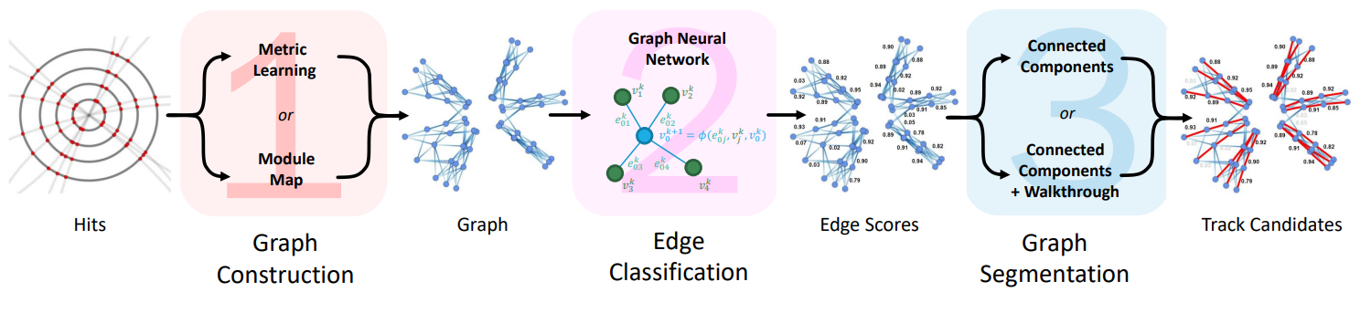
Charged particle tracking at the HL-LHC
Years ago, we realised that current track reconstruction pipelines used by LHC experiments would not have enough throughput to operate on the HL phase
Promising pipelines utilize Graph Neural Networks (GNNs) as a high-throughput alternative
Input graph represent hits as nodes and track segments as edges
The GNN then estimates the likelihood of the edge being part of a particle track
Selected track segments are then grouped into particle tracks
Highly parallelizable! Significantly decreasing runtime when processing high number of events
Daniel Murnane (2022) Graph Neural Networs for High Luminosity Track Reconstruction.EP-IT Data Science Seminar, CERN
Simulation of Z →μμ at the ATLAS experiment with increasing pileup (ATLAS event display UNSG-2021-29)
Wall time of the track reconstruction pipeline at the CMS experiment in function of increasing pileup (CMS Collaboration ,2017)

Slide 3
HyperGNN particle tracking pipeline
for HL-LHC experiments

Slide 4
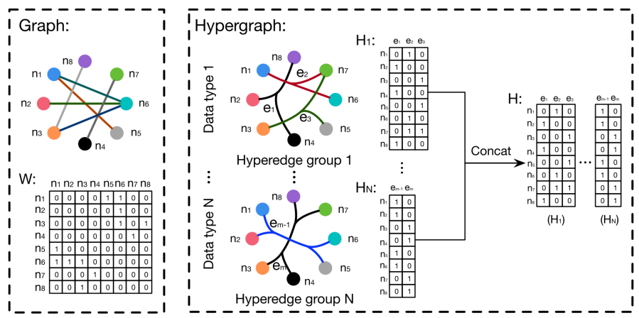
(Why) Hypergraphs?
Hypergraphs are graphs with edges that connect more than two nodes
Better represent node relationships that go beyond pairwise connections
The generalization and stability theorems formulated to GNNs can be extended to HGNNs
Possible to do spectral analysis of “filter response”
Yifan Feng et. al., Hypergraph Neural Networks

Slide 5
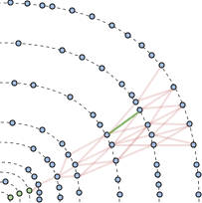
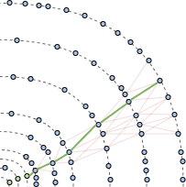
(Why) Hypergraphs in tracking?
Intuitively, is easier to predict if a whole set of nodes compose a track than if two nodes compose a segment
Supposing we model it well with our feature space
This representation would allow for a two-step pipeline, instead of three, as the track building would not be necessary
Only graph building and network inference

Slide 6
HyperGNN pipeline implementation

Slide 7
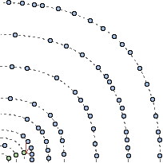
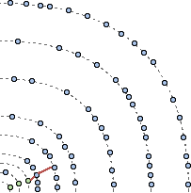
Hypergraph building - using simplified CKF
For now, we use a simplified version of CKF for the hypergraph building
It performs a multi-path extrapolation, without a measurement selection
Each possible path is a different hyperedge
We also removed the kalman update and material interaction simulation
Kept high efficiency (98.6%) but with low purity
The network should filter fake tracks, so high efficiency is required but purity is not
On a second iteration our method was 2x faster than CKF (from 8.0 s to 3.18 s) but with a bigger impact on efficiency
Efficiency dropped to 98%
We still need to find the best working point
Combinatorial Kalman Filter (CKF)
Hypergraph building algorithm

Slide 8
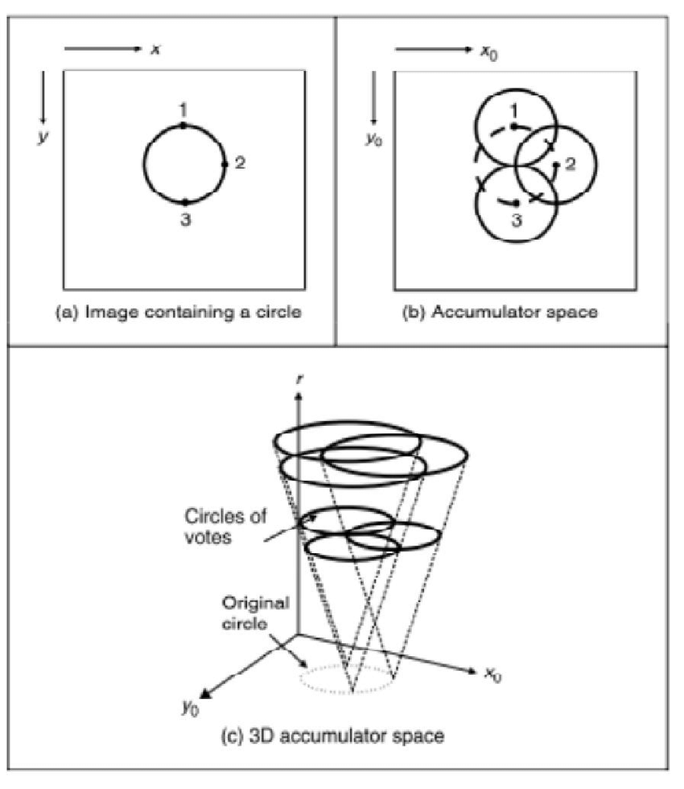
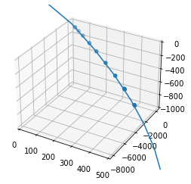
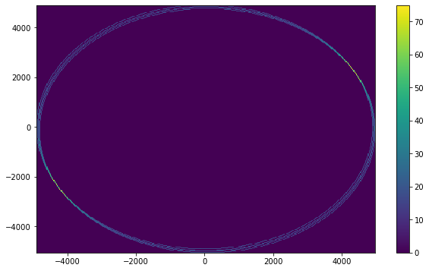
Hypergraph building - parametrized trajectory
As less accuracy on the extrapolation is required, we are studying the substitution of the numerical integration (4th order Range Kutta) by a parametrized helicoid extrapolation
An uniform magnetic field is required (at least per region)
The centre of the helicoid, as well as its radius, can be estimated with seed information
Could be used as a direct substitute for the numerical integration on the layer-by-layer extrapolation
Or used to find the surfaces that the trajectory interacts with
Would be followed by a tree search to find the possible paths
Example of extrapolated trajectory with parameterized helicoid compared to particle hits
The centre of the helicoid can be found with a Circular Hough Transform (CHT)

Slide 9
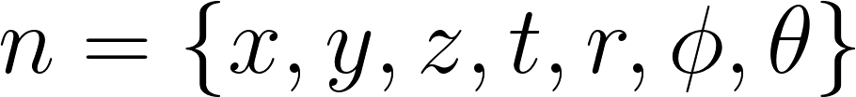
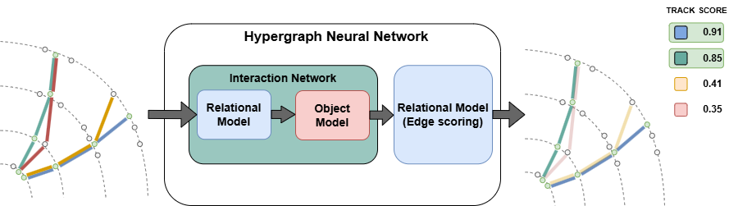
HyperGNN inference
For the feature space, we chose attributes easily accessible from the track finding algorithm
will expand in the future
We devised an HyperGNN architecture inspired by the Interaction Network (IN) design
Relational model ⇨ hyperedge-wise (track candidates) convolution
Object model ⇨ node-wise (hits) convolution
We chose the maximum function as an aggregator and edge-wise attention mechanism
Implemented with PyTorch and the conv.HypergraphConv layer

Slide 10
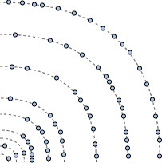
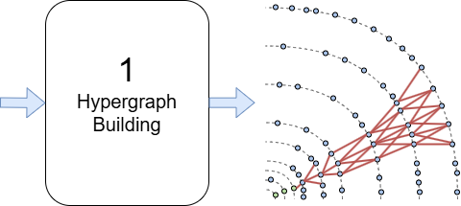
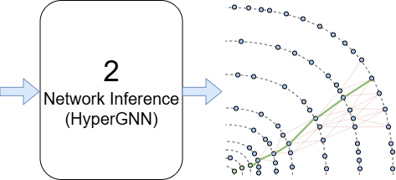
HyperGNN tracking pipeline
Modelling the event data as a hypergraph, we would have:
nodes: measurements (particle hits)
hyperedges: collection of measurements that compose a track candidate
Hypergraph building procedure (1)
We devised a new track finding algorithm based on the CKF to build the hypergraph
No measurement selection, resulting in a multi-path extrapolation
High rate of ‘fake tracks’ is affordable as the network will be responsible for filtering it out
Network inference (2)
We implemented an HyperGNN architecture inspired by the Interaction Network (IN) design to select particle trajectories from the candidates

Slide 11
HyperGNN pipeline evaluation

Slide 12
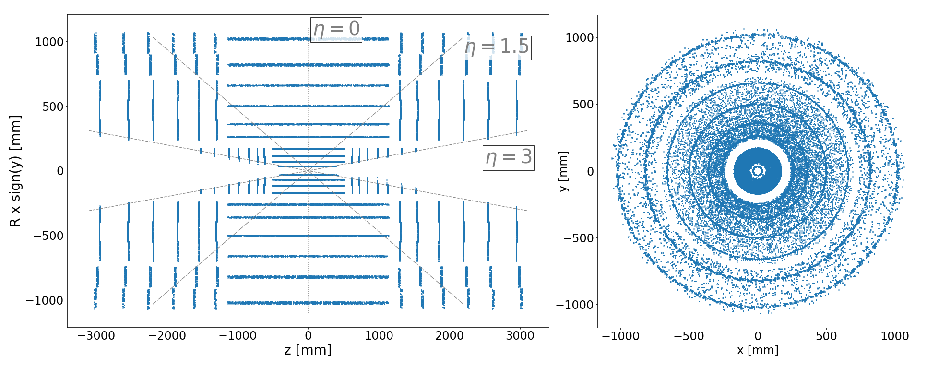
HyperGNN pipeline evaluation setup
Using the A Common Tracking Software (ACTS) framework for event simulation and evaluation of the track reconstruction
Simulated pp ⇀ t-tbar and 〈μ〉 = 200 (pileup) on the Open Data Detector (ODD)
Using FATRAS for detector response
pT > 1 GeV and |η| < 3
training on 450 events, testing on 50

Slide 13
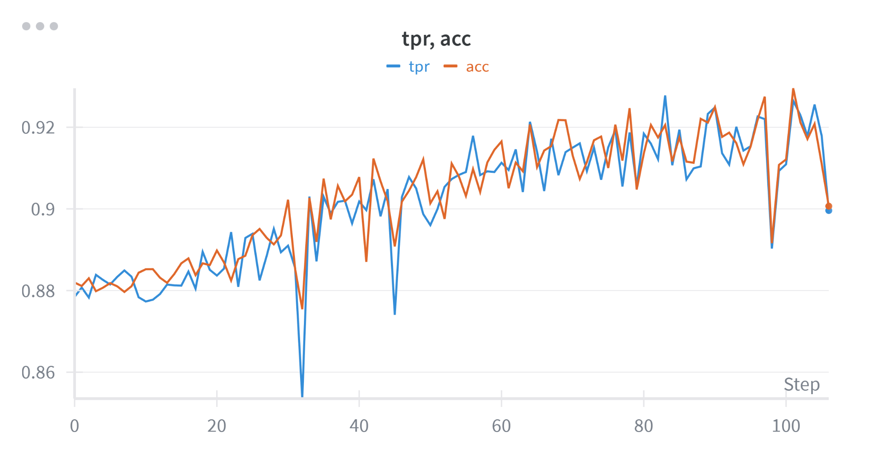
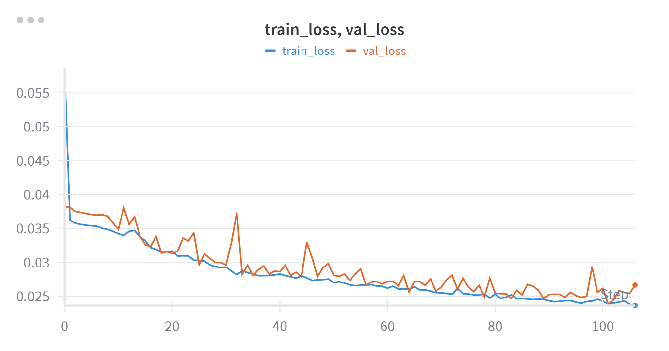
Pipeline evaluation - HyperGNN training
We use 50 of the training events for validation and threshold optimization
Chose threshold that maximizes AUC
Different models sizes were tested, varying number of nodes on the hidden layers
Best performing models occupy ~20 GB of RAM during training
Still need to improve the training procedure and tune the hyperparameters
Find best learning rate and weight decay

Slide 14
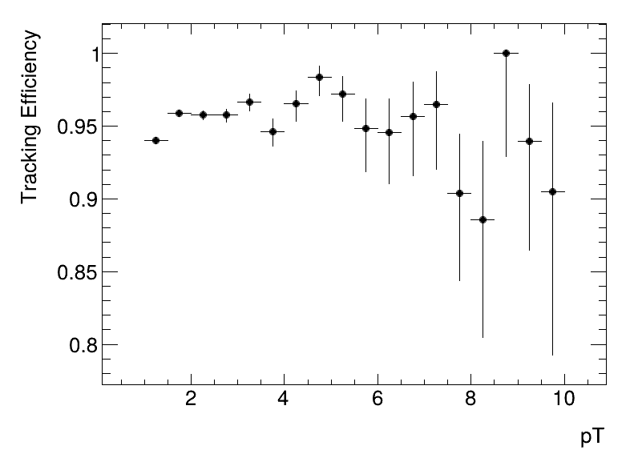
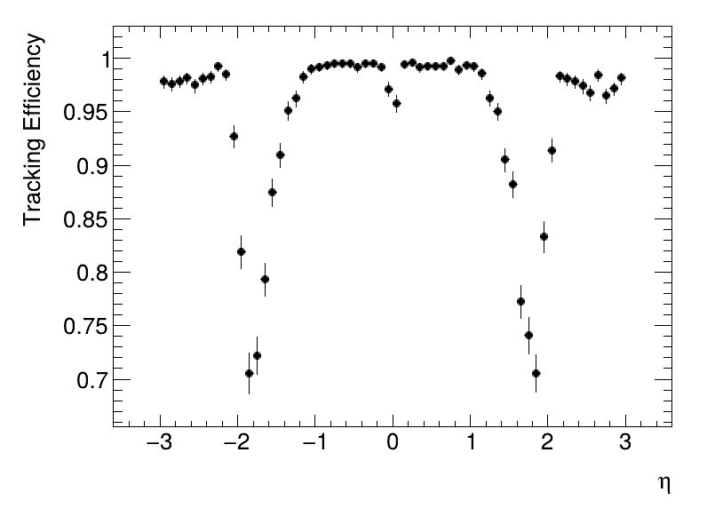
HyperGNN pipeline evaluation
The pipeline achieved a global efficiency of 94%
98.6% on the graph building stage
95% on the network selection
Plots below show efficiency of the network selection stage
Need to integrate output back to ACTS in order to generate global efficiency plots

Slide 15
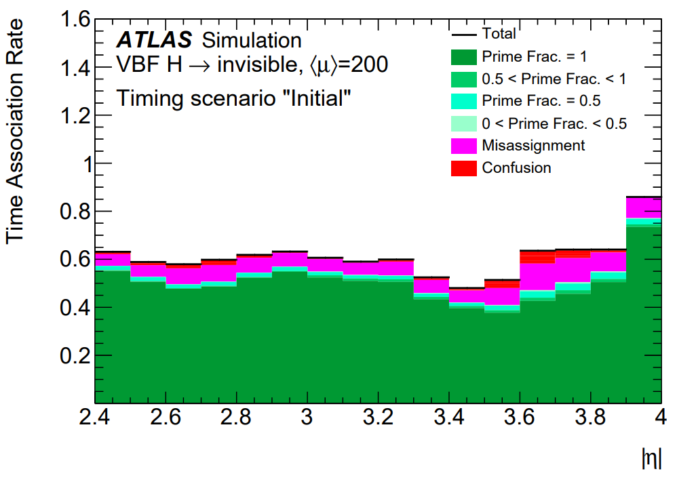
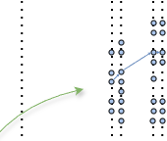
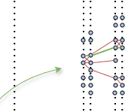
4D tracking pipeline with hypergraphs
We plan to adapt this pipeline to perform 4D tracking with a timing layer (e.g. ATLAS HGTD)
The main challenge of 4D tracking is the association of tracks with hits on the timing layer
Misassignaments significantly degrade the track time association and primary vertex time (t₀) reconstruction
An extrapolation with time information and that takes the whole path into account may enhance the association performance
Time association rate in function of pseudorapidity on the ATLAS experiment with HGTD
ATLAS HGTD TDR (ATLAS-TDR-031)
Extrapolation with CKF like algorithm
Extrapolation with hyperGNN

Slide 16
Summary and Next steps
Summary
New tracking methods are being developed to address the need of high-throughput at the HL phase
Being the GNN pipeline one of the most promising
We proposed a HyperGNN pipeline that shows high reconstruction efficiency on simulated HL-LHC events
Next Steps
Optimize graph building algorithm for runtime
Testing the substitution of the numerical integration extrapolation by a parameterized procedure
Adapt the code for parallel processing on GPUs
Improve network design
Find the workpoint that best ballance efficiency, memory usage and throughput
Integrate endcap timing layers for 4D tracking (e.g. ATLAS HGTD)
Adapt our model to make best usage of the region limited time measurements
Full comparison analysis with current GNN approaches

Slide 17
Thank you for your attention!
ありがとうございました!
Questions?
rodrigoestevam99@usp.br

Slide 18
References
[1] ATLAS Collaboration. Observation of a new particle in the search for the Standard Model Higgs boson with the ATLAS detector at the LHC. Physics Letters B,2021. https://doi.org/10.1016/j.physletb.2012.08.020.
[2] M. Gullstrand, and S.Maraš. “Using Graph Neural Networks for Track Classification and Time Determination of Primary Vertices in the ATLAS Experiment” (Dissertation). Disponível em http://urn.kb.se/resolve?urn=urn:nbn:se:kth:diva-288505
[3] JU, X. et al. Performance of a geometric deep learning pipeline for HL-LHC particle tracking. The European Physical Journal C, v. 81, n. 10, p. 876, out. 2021. ISSN 1434-6052. DOI: 10.1140/epjc/s10052- 021- 09675- 8. Disponivel em https://doi.org/10.1140/epjc/s10052-021-09675-8 .
[4] DeZoort, G., et al. "Charged Particle Tracking via Edge-Classifying Interaction Networks," in Computing and Software for Big Science, vol. 5, no. 1, 2021. Available at: https://arxiv.org/abs/2103.16701
[5] ATLAS Collaboration, “Technical Design Report: A High-Granularity Timing Detector for the ATLAS Phase-II Upgrade”. Technical report, CERN, Geneva, 2020. Disponível em: https://cds.cern.ch/record/2719855/files/ATLAS-TDR-031.pdf
[6] Santi, L., “4D Tracking at ATLAS” in HSF Seminar - 4D reconstruction. Available at: https://indi.to/YsmvK
[7] ATLAS Collaboration. ACTS documentation.
Disponivel em: https://acts.readthedocs.io/en/latest/index.html

Slide 19
Backup

