Slide 1
The Tiny Triplet Finder: a low silicon resource usage pattern recognition scheme and its test implementation in a low-cost FPGA device
Jinyuan Wu
Fermilab
Nov. 2025

Slide 2
Introduction
Applications of triplet finding
Problems with pairing
Tiny Triplet Finder
An example of track seeding engine using Tiny Triplet Finder
An implementation in Cyclone 5 FPGA

Slide 3
The Triplet Finding

Slide 4
From the Triplet Finder to Track Fitter
Track
Fitter
The triplets are group of at least 3 (but can be more than 3) hits that satisfy the first constraint.
The hits may arrive in arbitrary order.
A triplet finder reorganizes hits for further track fitting.

Slide 5
Triplet Finding: Barrel Geometry, r-phi & r-z views
At least three hits are needed to determine a track.
Curved tracks can also be determined.
A 3D triplet finding engine is needed to eliminate fake tracks.

Slide 6
Triplet Finding: Non-bend y-z view & y-t view
Consider a detector measuring both coordinates and time.
Three hits are needed for both y-z view and y-t view.
It requires a 3D triplet finding engine to eliminate fake tracks.

Slide 7
Triplet Finding: Double TPCs
T0
T1
T1
T0+const.
T2
(T1+T2)/2 = T0+const.
T2
Two TPCs drifting toward opposite directions and a timing layer are used to identify high-rate tracks.
Earlier track may arrive TPC pad later and vise versa.
T0, T1 and T2 satisfy a constraint, forming a triplet.

Slide 8
Pairing, Not Good

Slide 9
Pairing
Mark Pesaresi et. al. ACES 2020
Mainstream tracking algorithms: find a pair => find third => fit and find others

Slide 10
From Pairing to Triplet Seeding
Simple pairing will create more fake hit pairs, which must be eliminated in later stages.
When three or more hits (stubs) are picked up together in triplet seeding stage, less fake segments are expected.
fake
fake
Seeding with
Pairs
Seeding with
Triplets

Slide 11
Pairing vs Triplet Finding
L3
Coincidence
Search
Window
Low P_{T}
Tracks
L2
Hits/
Stubs
Pairing
Track
Fitter
Pairs
L1
Pairing causes large number of fake segments.
  To eliminate fakes, narrow coincidence window is needed.
    => Low PT tracks is not triggered. Physics cases are limited.
Triplet finding controls fakes well, allowing triggering on low PT tracks and enables broader physics program.
Hits/
Stubs
Triplet
Finding
Track
Fitter
Triplets

Slide 12
Tiny Triplet Finder

Slide 13
Computing Complexities of Hit Match Schemes
 | Software | FPGA Typical | FPGA Resource Saving Approaches
 | O(n²) for(){ for(){…} } | O(n)*O(N) Comparator Array | Hash Sorter O(n)*O(N): in RAM
 | O(n³) for(){ for(){ for(){…} } } | O(n)*O(N²) CAM, Hugh Trans. | Tiny Triplet Finder O(n)*O(N*logN)
 | O(n⁴) for(){ for(){ for(){ for() {…} }}}
Hit Matching
  Doublet
  Triplet
  4-hits

Slide 14
The Tiny Triplet Finder for Cylindrical Detector Geometry
C3
C2
C1
The Tiny Triplet Finer is a scheme to reuse a single set of track road coincidence logic for whole detector.
It uses shift (or rotate) to bring bit arrays to feed the track road coincidence logic.

Slide 15
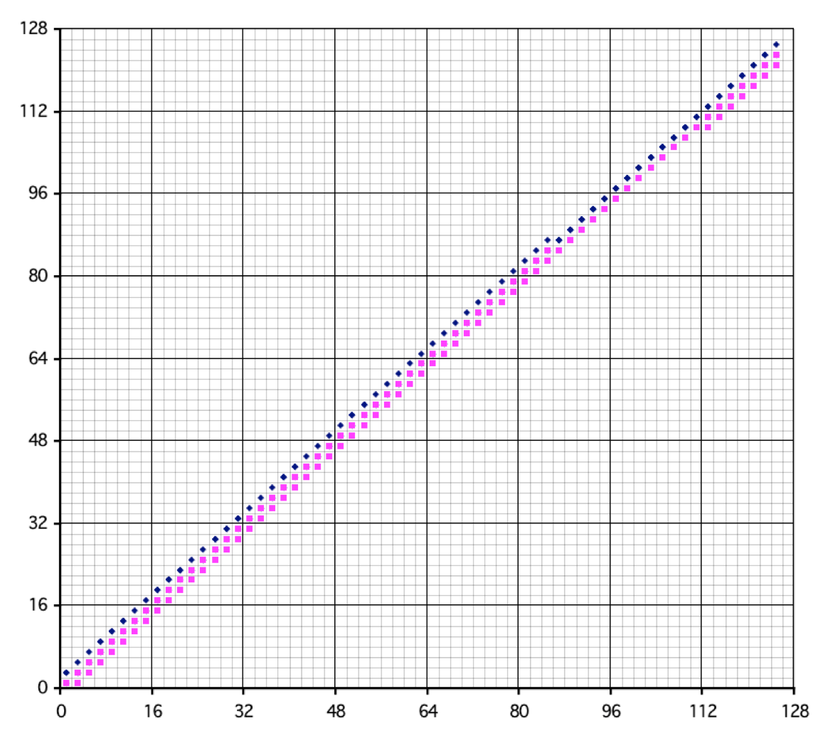
General Structure of the Tiny Triplet Finder
A typical Tiny Triplet Finder includes:
  Bit arrays for different layers of the detector.
  Shifters
  Bitwise coincidence logic.
Shifter
Bit-wise Coincident Logic
Shifter
Bit Array
Bit Array
*R1/R3
*R2/R3
Triplet Map Output To Decoder

Slide 16
A 3D Track Seeding Engine

Slide 17
Structure of the Seeding Engine: Two RAM Banks + Tiny Triplet Finders
RAM Banks
Tiny Triplet Finders
ROM
nZ1
nZ0
nZ375
(nZ2)
ROM
nPhi3
nZ3
nZ0
nZ0
nZ375
nZ375

Slide 18
Structure of the Seeding Engine: Single Physical RAM View
ROM
nZ1
nZ0
nZ375
(nZ2)
ROM
nPhi3
nZ3
nZ0
nZ0
nZ375
nZ375

Slide 19
General Timing
Event N
225 CLK
Event N+1
225 CLK
Event N+2
225 CLK
L1, L3
112 CLK
L2
112 CLK
R
Data Filling
Coincidence
Checking
Refreshing
ROM
nZ1
nZ0
nZ375
(nZ2)
ROM
nPhi3
nZ3
nZ0
nZ0
nZ375
nZ375

Slide 20
Operation: (1) Filling Hits
Event N
225 CLK
Event N+1
225 CLK
Event N+2
225 CLK
L1, L3
112 CLK
L2
112 CLK
R
Data Filling
ROM
nZ1
nZ0
nZ375
(nZ2)
ROM
nPhi3
nZ3
nZ0
nZ0
nZ375
nZ375

Slide 21
Operation: (2) Checking Coincidence
Event N
225 CLK
Event N+1
225 CLK
Event N+2
225 CLK
L1, L3
112 CLK
L2
112 CLK
R
Coincidence
Checking
ROM
nZ1
nZ0
nZ375
(nZ2)
ROM
nPhi3
nZ3
nZ0
nZ0
nZ375
nZ375

Slide 22
Pattern Shifting and checking
The bit patterns with the same z0 from Layer 1 and Layer 3 are shifted to align with the coincidence road array.
The amount of shift is determined by phi2.
Matching bits are output for further process.

Slide 23
Operation: (3) Refresh Cycle
Event N
225 CLK
Event N+1
225 CLK
Event N+2
225 CLK
L1, L3
112 CLK
L2
112 CLK
R
Refreshing
ROM
nZ1
nZ0
nZ375
(nZ2)
ROM
nPhi3
nZ3
nZ0
nZ0
nZ375
nZ375

Slide 24
The Seeding Engine & Clustering Buffer
Clustering
Buffer
P1
Full data of hits are stored in the clustering buffer.
After triplet finding, the full data are sent to the Kalman filter stage for further track fitting.
Hugh
Transform
Cells
Tiny
Triplet
Finder
P2
FIFO
To Kalman Filtering
Hugh
Transform
Cells
P3
Clustering
Buffer

Slide 25
Implementation in Cyclone 5 FPGA

Slide 26
Generated Events: r-z View
In 240 cm (z) x 10 degrees (phi) range, up to 112 hits per layer are generated, out of which, 10 are from good tracks.
The z0 of the vertices spread in +- 10 cm along beam axis.

Slide 27
The Events: r-phi View
Minimum PT: 2GeV/c.
The hits on Layer 2 is limited to 10 degrees, but hits on Layer 1 and 3 spread up to 16 degrees.
The impact parameters of the tracks: +- 2 mm.

Slide 28
Serving Range of Seeding Engine
In each TFP, 4 seeding engines are implemented, each serving 2.4 m (full length) x 10 degrees plus overlap.
Each engine sees <100 hits/layer per event.
The layer 2 is divided with exact 10-degree boundaries.
Overlapping in:
  Layer 1: +- 2.16 degrees, 14.3 degrees total
  Layer 3: +- 2.62 degrees, 15.2 degrees total

Slide 29
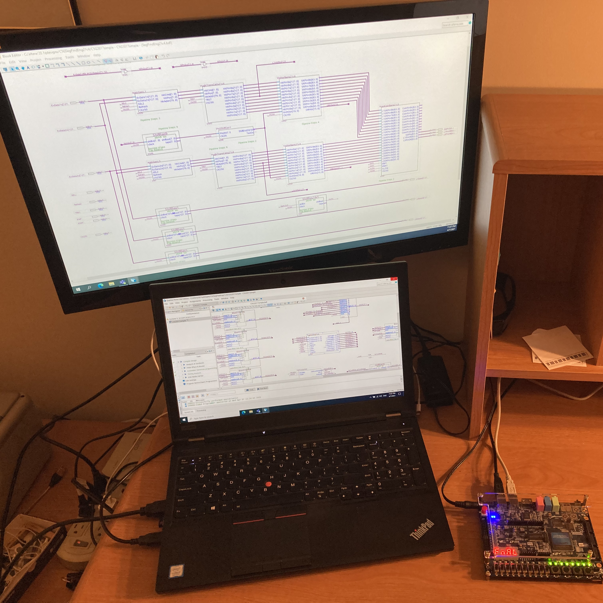
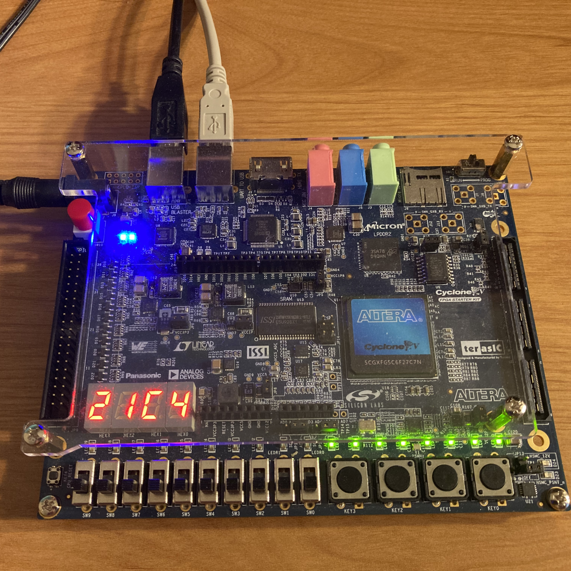
Home Test Stand and the Evaluation Module
The seeding engine core firmware is implemented in Altera C5G evaluation module (179 USD ea.).
The FPGA is Cyclone V GX 5CGXFC5C6F27C7N (171 USD ea.).

Slide 30
Structure of the seeding engine
The entire engine is organized as a pipeline so that it can run at high speed (250 MHz in Cyclone V).
Blocks: Address Generation; Hugh Trans. Cells; Shifter Bank; Road Coincidence

Slide 31
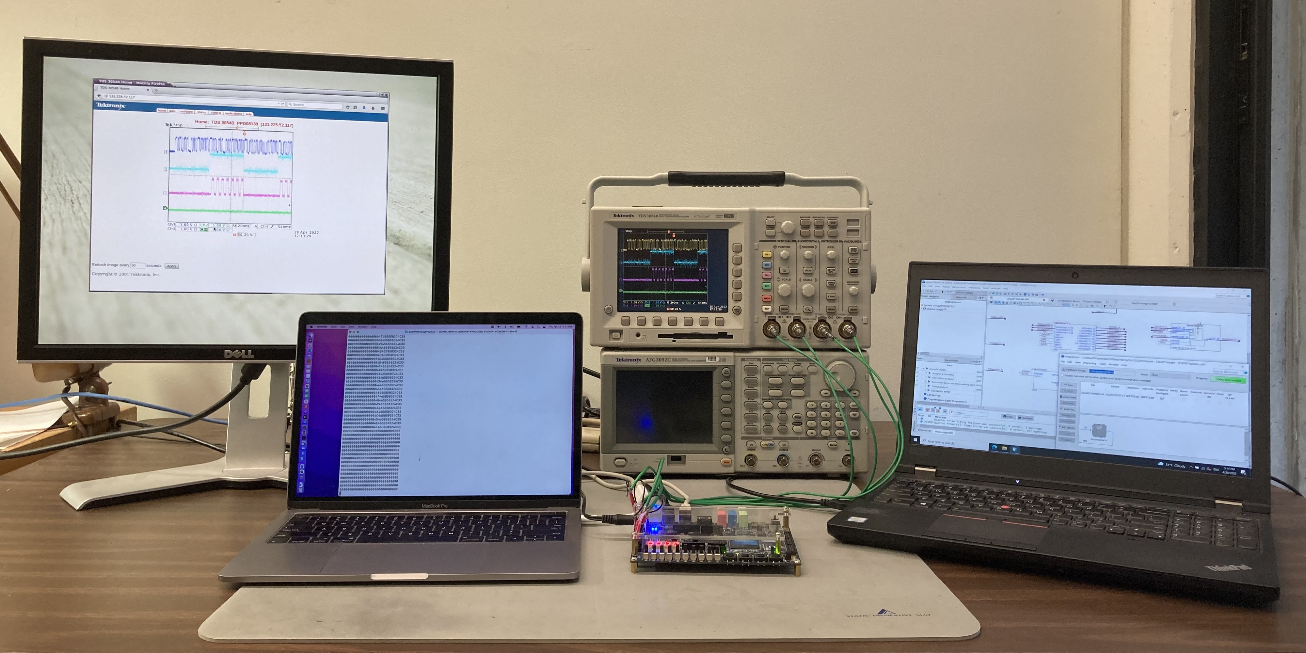
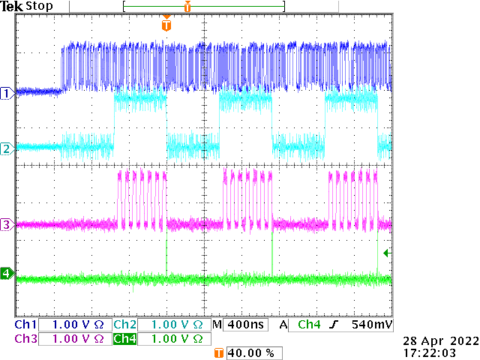
Test Stand and Operation Timing
Coincidence
Checking
Filling
Refreshing
DATA
CHK
CNT_CHK
REFRESH
Data and signal bits are brought out to monitor operation timing.
Each event takes 225 clock cycles @ 250 MHz:
  112 clock cycles for filling
  112 clock cycles for coincidence checking
  1 clock cycle for refreshing RAMs.

Slide 32
Register-Like Block RAM for Hit Patterns
Event N
225 CLK
Event N+1
225 CLK
Event N+2
225 CLK
L1, L3
112 CLK
L2
112 CLK
R
Single Clock Updating
Single Clock Reading
Single Clock Refreshing
The hit patterns are stored in the register-like BRAM.
Each hit is processed in a single clock cycle.
Single clock cycle refreshing allows fast preparation for next event.

Slide 33
Resources
Search with keywords: “Tiny Triplet Finder”:
2004:
https://indico.cern.ch/event/418639/contributions/1018431/attachments/868807/1216592/TTF_lecc2004p-v3.pdf
2006:
https://inspirehep.net/literature/733063
2021:
https://inspirehep.net/literature/1980573
2023:
https://arxiv.org/abs/2305.09834

Slide 34
Conclusion
Hardware triplet finding solution exists, so it is unnecessary to go through pairing.
The Tiny Triplet Finder uses O(n) operation time (2n+1 clock cycles per event) that matches data input rate and will not be jammed when messy events arrive.
The Tiny Triplet Finder uses O(N*log N) resources which can be implemented in intermediate sized FPGA for most applications.
A versatile 3D triplet finding engine based on Tiny Triplet Finder has been implemented that can be used for various detector geometries.

Slide 35
The End
Thanks

Slide 36
Introduction
Clustering is a doublet finding algorithm that consumes O(n^2) time if implemented in software.
The FPGA clustering scheme should match the data input rate, i. e., the resource usage is O(n)*O(N), where O(N) represents hardware portion.
The performance should not be affected by the number of hits and number of clusters: (no O(n^2) terms).

Slide 37
The Clustering Engine
Cluster
ID
Counter
Cluster
ID
Assignment
Logic
&
RAM
Input
Buffer
Delay
Buffer
Cluster
Output
Buffer
The input data are first used to fill the cluster ID RAM.
  Each isolated hit is giving a new cluster ID.
  Hits within certain distance in channel and time domain are assigned with same cluster ID.
The input data are looped through again and reorganized in the cluster output buffer.
Clustered data are output after reorganization.

Slide 38
The Cluster ID RAM
Time
CH
Hits stream into the cluster engine.
Cluster ID are to be assigned for each hit.
A memory array holds cluster ID.
Each cell holds a short time range.
{Cluster ID}

Slide 39
The Filling Process
A hit is used to address a cell.
Neighboring cells are also addressed, and contents are readout.
The cluster ID of the cells are to be determined.
  If no cells are filled, a new cluster ID will be filled into the center cell.
  If several cells are filled, they will be updated to the lowest (oldest) cluster ID.
{Cluster ID}

Slide 40
The Reading Process
Input hits are looped through again.
The cluster ID of each hit is readout.
Raw data are stored in cluster output buffer addressed by the cluster ID.
The clustered data are output from the cluster output buffer.
{Cluster ID}
Cluster
Output
Buffer
Input
Buffer
Delay
Buffer

Slide 41
The Read-Update Timing
D
WA
WE
RA
Q
X
D Q
D Q
D Q
Hit 0
Hit 1
Address
Delay
Process
Update
In slower applications, each hit is processed in 4 clock cycles:
  Clock cycle 1, 2: Read.
  Clock cycle 3: Process, choosing correct cluster ID.
  Clock cycle 4: Write back to cells.
The “register-like block RAM” is also available for faster applications, which process each hit in 1 clock cycle, instead of 4.

Slide 42
Register-Like Block RAM for Hit Patterns
Event N
225 CLK
Event N+1
225 CLK
Event N+2
225 CLK
L1, L3
112 CLK
L2
112 CLK
R
Single Clock Writing
Single Clock Reading
Single Clock Refreshing
The hit patterns are stored in the register-like BRAM.
Each hit is processed in a single clock cycle.
Single clock cycle refreshing allows fast preparation for next event.

Slide 43
Task sharing
Cluster Engine
The cluster engine takes multiple clock cycle to process an input hit.
Multiple cluster engines can be used to match the input rate.
Input stream fills each engine in a rotational manner. Each engine process some sets of events.
Input
Buffer
Cluster
Output
Buffer
Cluster Engine
Input
Buffer
Cluster
Output
Buffer
Cluster Engine
Input
Buffer
Cluster
Output
Buffer
Cluster Engine
Input
Buffer
Cluster
Output
Buffer

