Slide 1

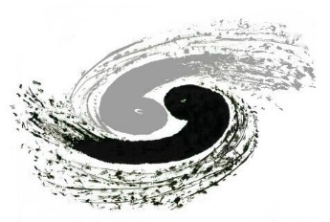

Application of ACTS to the CEPC Reference Detector
Yizhou Zhang, Weidong Li, Xiaocong Ai, Tao Lin
zhangyz@ihep.ac.cn
The Institute of High Energy Physics, IHEP, China
Connecting The Dots
The University of Tokyo
12th Nov 2025

Slide 2
2
1
Introduction
2
Application of ACTS to CEPCSW
Outline
3
Performance
4
R&D

Slide 3
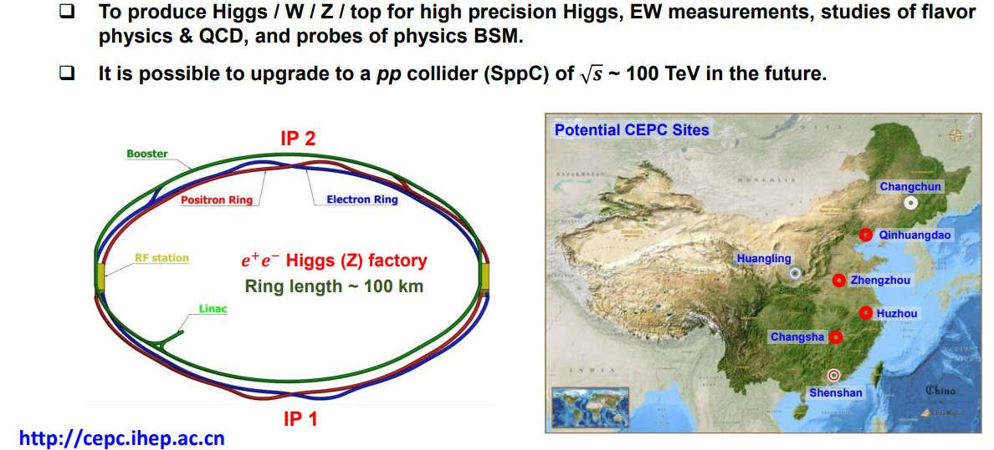
1
3
Introduction
Circular Electron Positron Collider (CEPC)
Higgs / Z / W factory proposed by the Chinese HEP community.
Accelerator & reference detector design and technology R&D are approaching maturity, with the TDR completed and progressing into the EDR phase.

Slide 4

1
4
Introduction
Circular Electron Positron Collider (CEPC)
CEPC
Not proposed in 2026-2030 project
aim to be proposed in 2031-2035 project
The greatest virtue is patience!

Slide 5
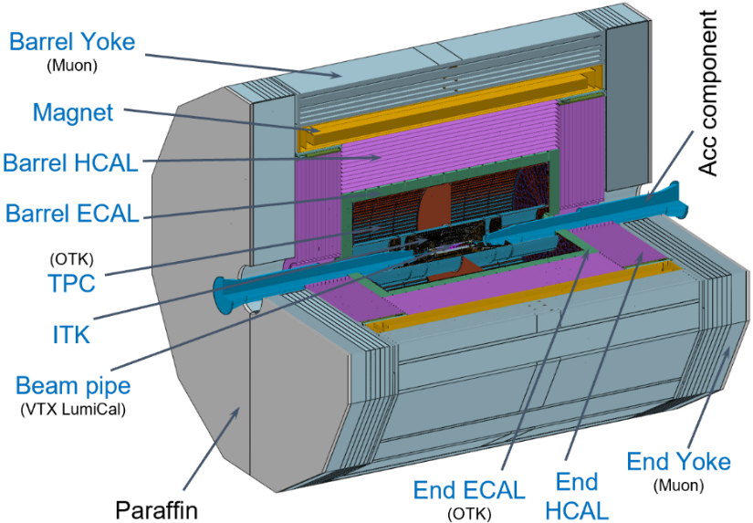
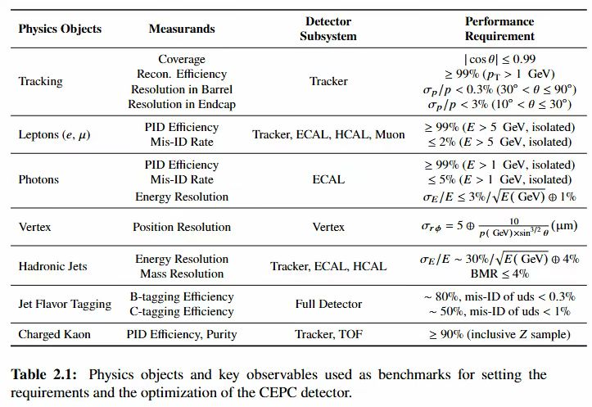
1
5
Introduction
CEPC Reference Detector
CEPC Reference Detector
VTX: Vertex Detector
ITK/OTK: Inner / Outer Silicon Tracker
TPC: Time Projection Chamber
ECAL: Crystal-bar ECAL
HCAL: Glass Scintillator HCAL
Muon: Muon Detector
Physics requirements
Tracking efficiency: Nearly 100%
Momentum resolution: < 0.3%
Particle Identification (PID): 2𝜎 separation between pions and kaons for P < ~ 20 GeV/c
Boson Mass Resolution (BMR): Better than 4%, among other features

Slide 6
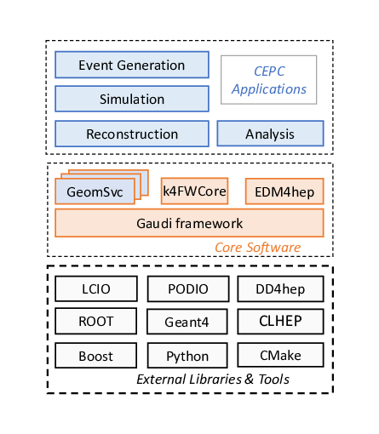
1
6
Introduction
CEPC Software: Architecture
The CEPC experiment is among the first to integrate with Key4hep
A common software stack designed for future HEP experiments such as CEPC, CLIC, FCC, and ILC
CEPCSW is organized as a multi-layer structure
Applications：simulation, reconstruction and analysis
Core software
External libraries
The key components of core software include:
Gaudi: defines interfaces to all software components
EDM4hep: generic event data model
DD4hep: detector geometry description
CEPC-specific components: GeomSvc, simulation framework, RDFAnalysis, beam background mixing, fast simulation, machine learning interface, etc.

Slide 7
1
7
Introduction
ACTS: Tracking Library
Software development background
Hardware: Computing is shifting toward multi-core CPUs and diverse accelerators (GPUs, FPGAs).
ML: Machine learning has become an essential component of high-energy physics experiments.
ACTS, A Common Tracking Software
Open source and experiment-independent toolkit for track reconstruction
Developed with modern C++ with unit testing and continuous integration
https://github.com/acts-project
Several R&D projects within the ACTS ecosystem
traccc: GPU R&D line（application see Neza’s talk）
ML-based alg: GNN based tracking, Seed Filter, Ambiguity Resolution …
…
More in Noemi’s, Corentin’s, Pierfrancesco’s and Yanqi’s talk, Andreas’ poster …

Slide 8
8
1
Introduction
2
Application of ACTS to CEPCSW
Outline
3
Performance
4
R&D

Slide 9
2
9
Application of ACTS to CEPCSW
Brief view
CEPCSW
Acts core
apply
Work steps:
Outside CEPCSW framework:
Geometry conversion (DD4hep → ACTS geo)
Material Mapping
Inside CEPCSW framework:
Event data model conversion (EDM4hep → ACTS)
Interface design
Tracking chain

Slide 10
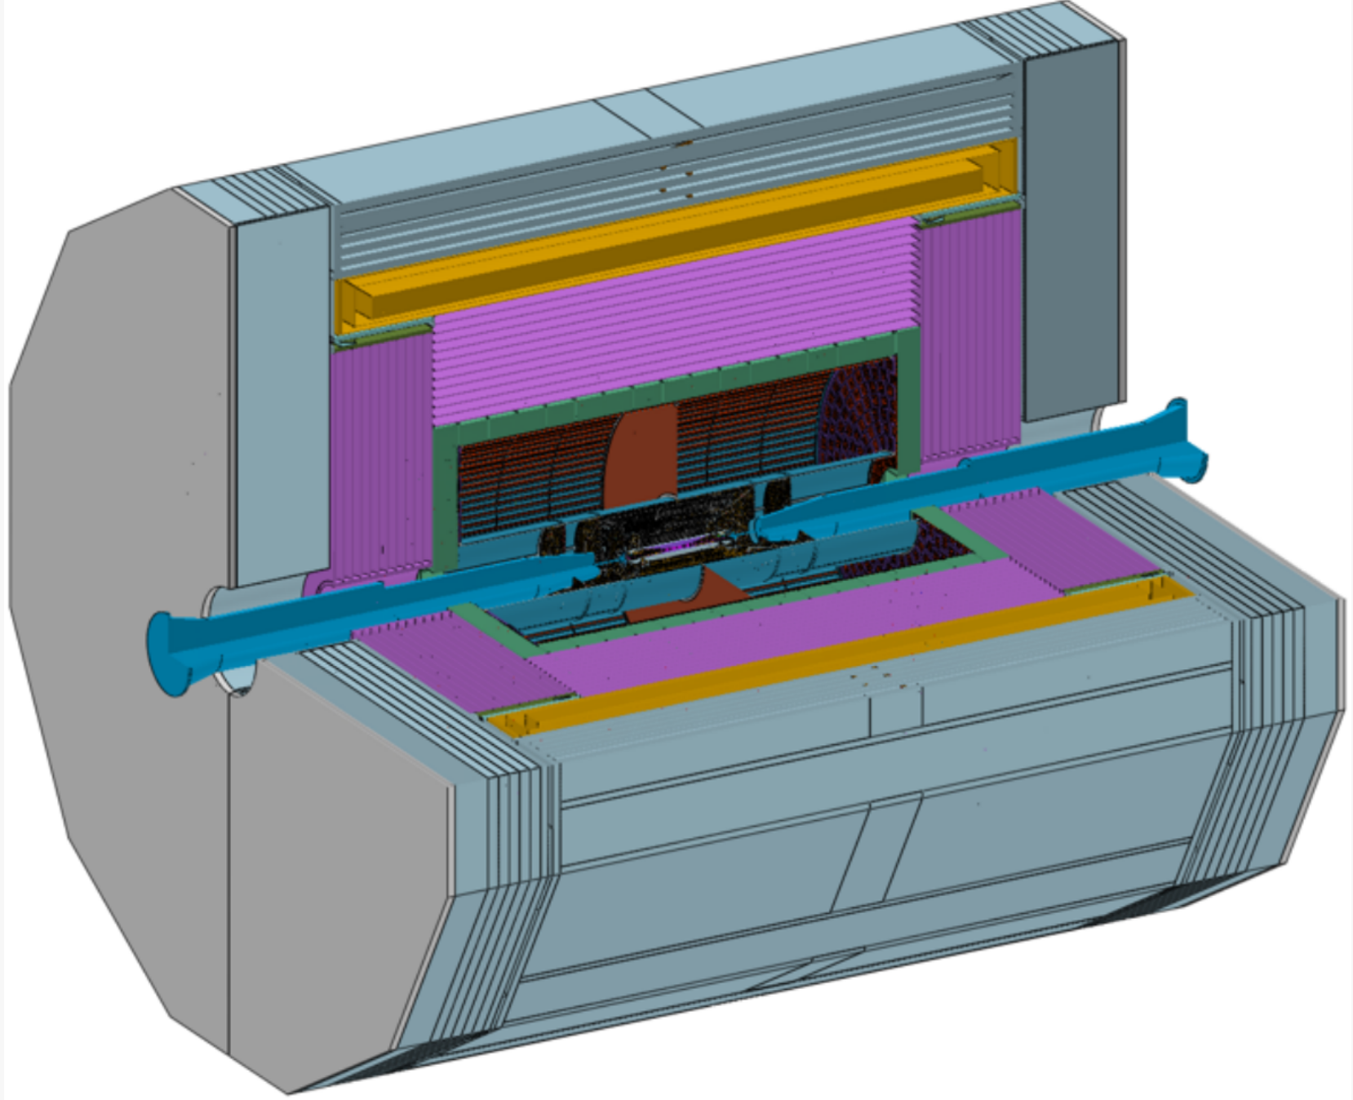
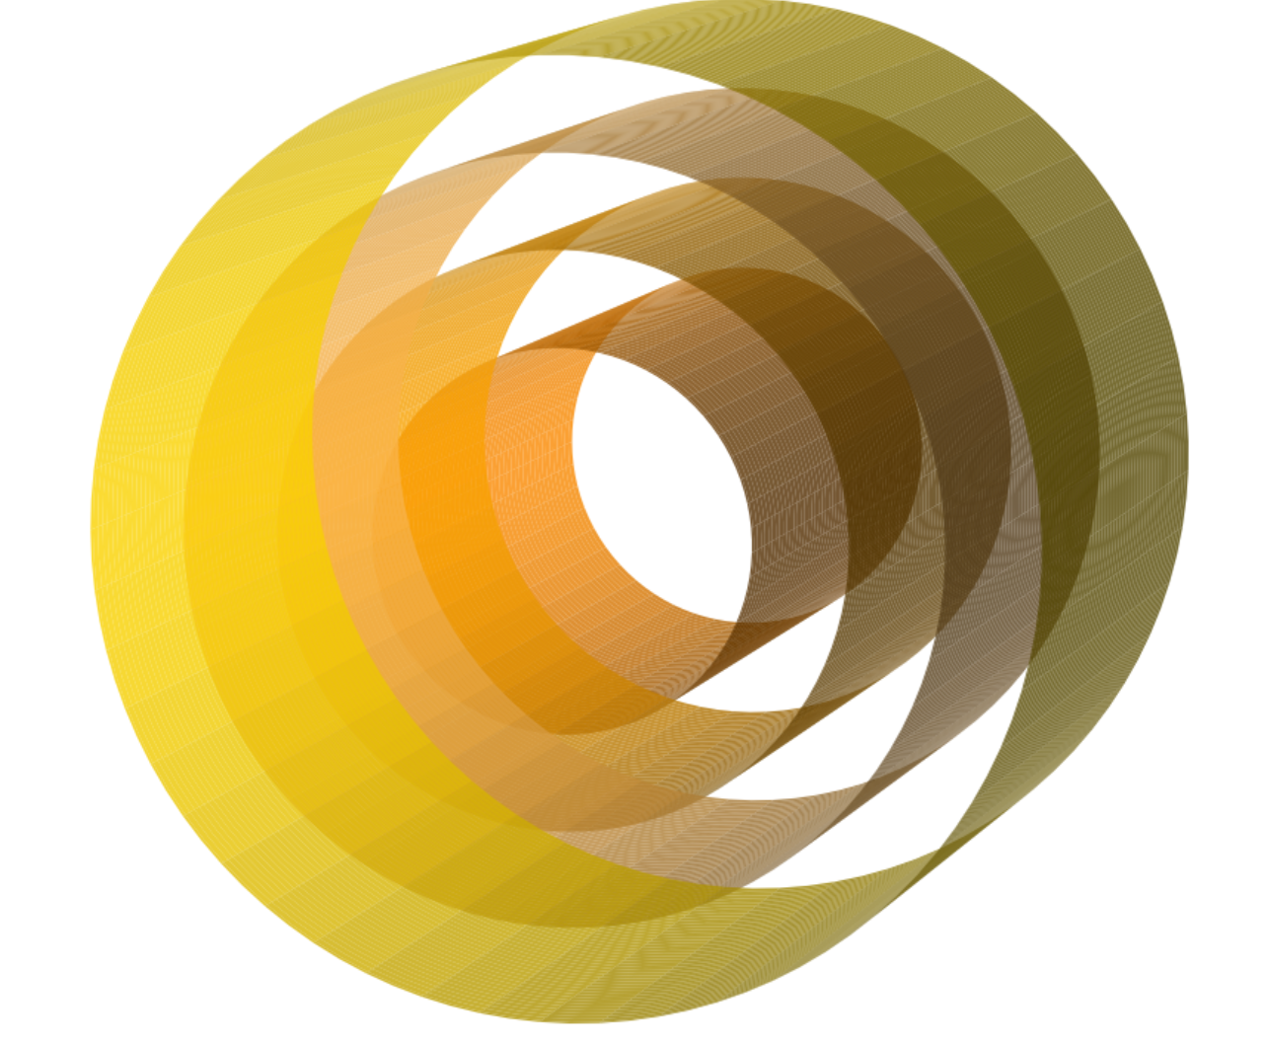
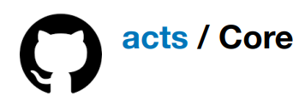
2
10
Application of ACTS to CEPCSW
ACTS Geometry Building
A simplified tracking-optimized geometry is converted from detailed geometry through ACTS’ tools.
ACTS material mapping mechanism
*0-3 layers of CEPC VTX
Detailed geometry
described by DD4Hep / Tgeo / GeoModel
Usually interfaced to Geant4
is unnecessary in track reconstruction
Geometry building in ACTS
Representing sensitive surfaces
Simplifying material

Slide 11
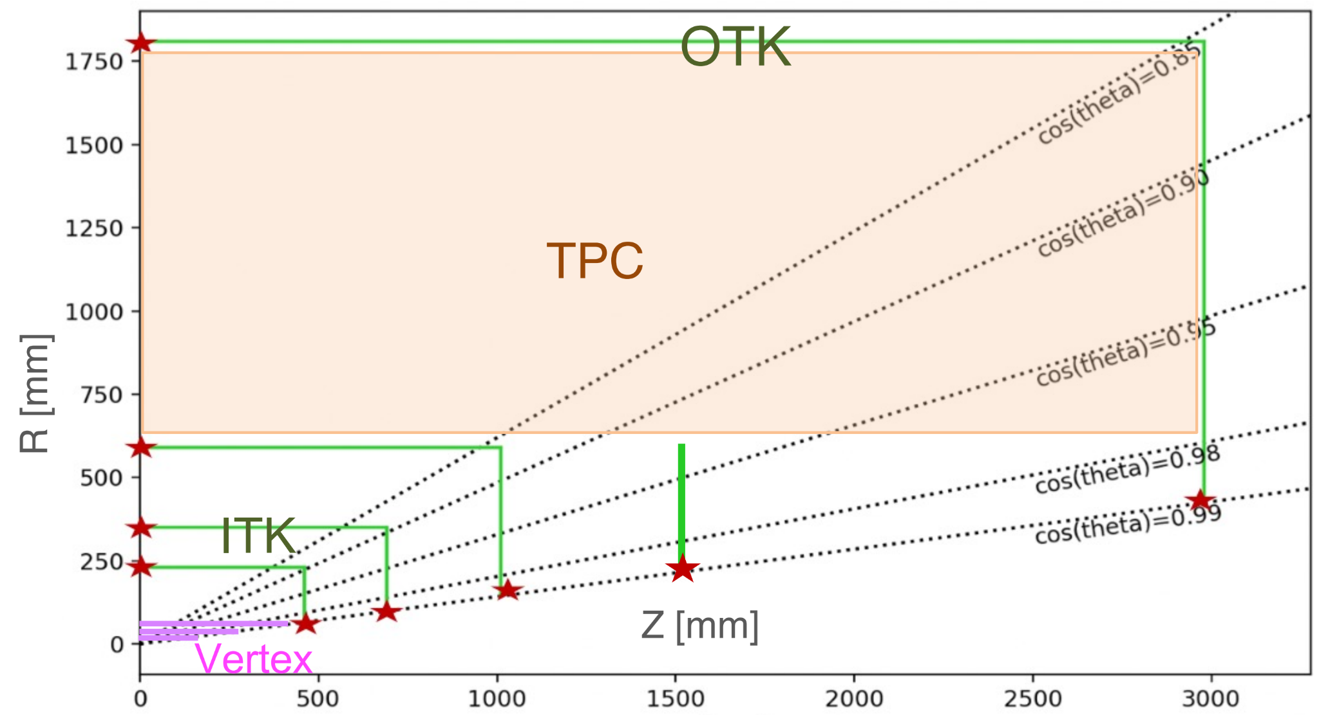
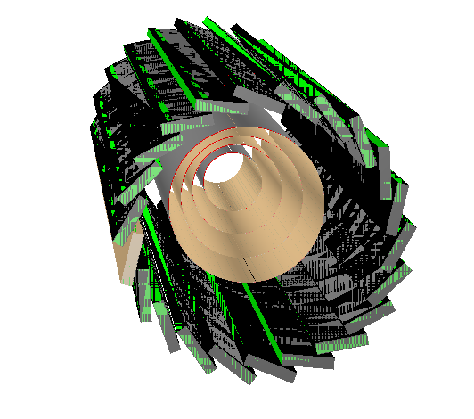
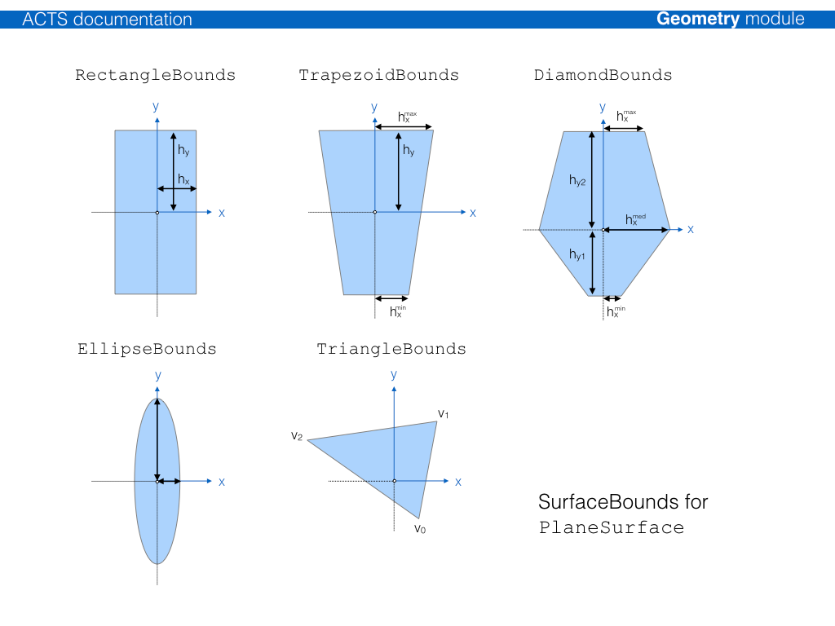

2
11
Application of ACTS to CEPCSW
ACTS Geometry Building
CEPC Tracking geometry in z-r
Full G4 simulation geometry of CEPCSW is described in DD4hep format
Convert to ACTS geometry through ACTS TGeo plugin (*DD4hep plugin should also work)
Barrels (VTX 5th|6th layer & ITK & OTK)
→ Acts::PlaneSurface (RectangleBounds)
EndCaps (ITK & OTK)
→ Acts::PlaneSurface (TrapezoidBounds)
Vertex Detector
4 Cylinder layers
1 Double-sided planer layer
Vertex Detector
ITK ( Inner Tracker )
TPC ( Time Projection Chamber )
OTK ( Outer Tracker )
CEPCSW geometry
(DD4hep)
ACTS
TGeo plugin
ACTS geometry
Class link

Slide 12
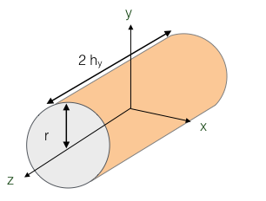
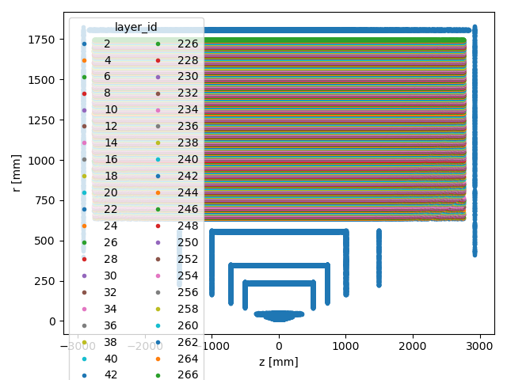
2
12
Application of ACTS to CEPCSW
ACTS Geometry Building
VTX (1st-4th layers) & TPC
→ Acts::CylinderSurface
Alternative application of ACTS in the TPC（gaseous tracker）
The surfaces required by ACTS are virtually constructed within the TPC gas volume, aligning with the TPC readout layers.
Consists of 223 layers of cylinder surface with a thickness of 5mm.
Simhits are read out at the central of each cylinder surface in G4 simulation.
Class link
CEPC Tracking geometry in z-r
(layer ids in colors)

Slide 13
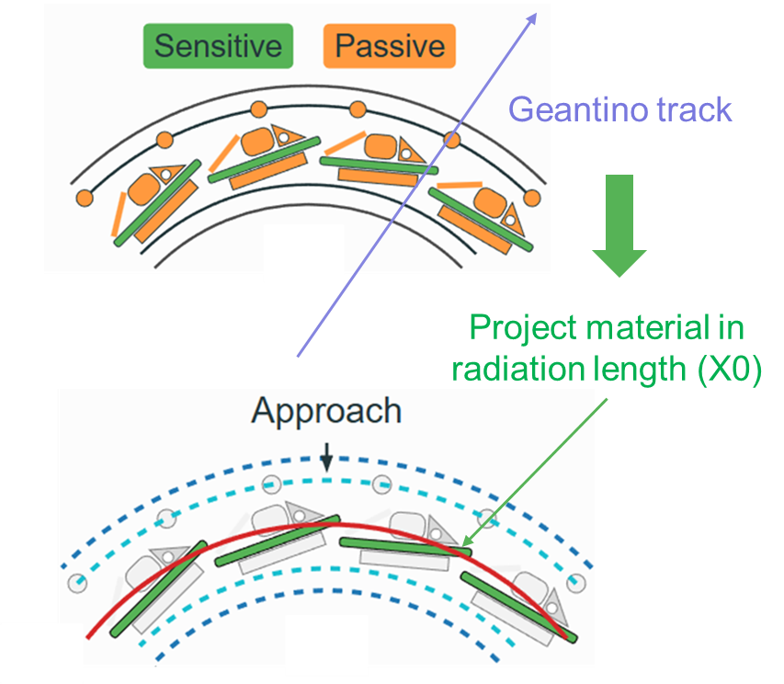
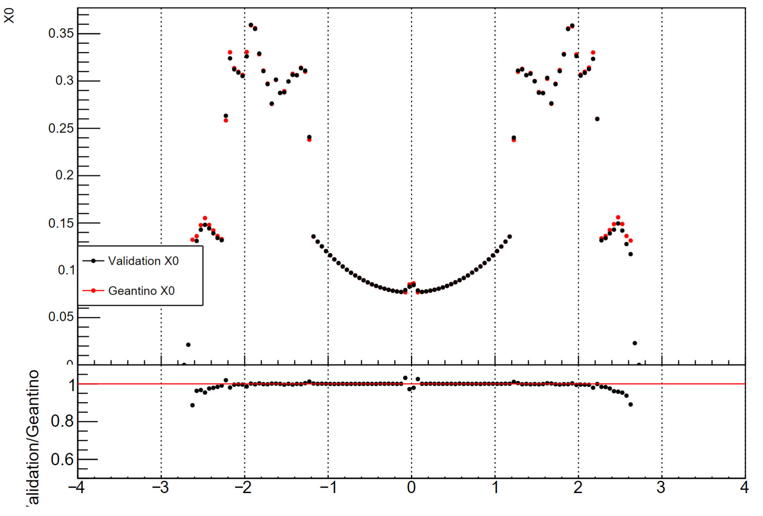
2
13
Application of ACTS to CEPCSW
Material Mapping
Geant4 simulation using detailed geometry
The Geant4 simulation employs detailed geometry to simulate particle steps using Geantinos.
It records the materials traversed by these steps and stores their corresponding radiation lengths (X₀)
Mapping
Each step is projected onto the nearest sensitive surface, then averaged across multiple events to generate a map.
Reference link
Validation of material mapping for the tracking detector in the CEPC RefDet
ACTS material mapping allows quasi-exact material modeling
η

Slide 14
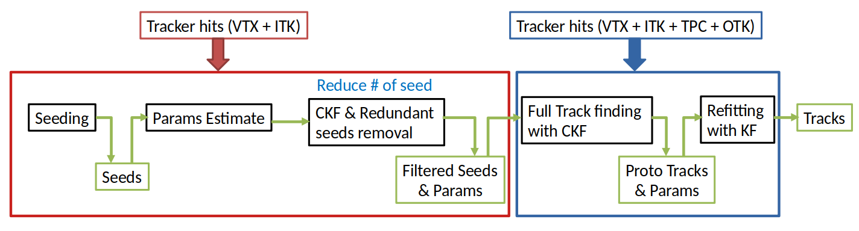
2
14
Application of ACTS to CEPCSW
Tracking chain with ACTS
Track finding has two steps
Silicon Tracking: Track finding in VTX + ITK (reduce # of seed)
ACTS forms seeds by combining 3 space points, typically from 3 different detector layers
Seeding in VTX + ITK (total 9 layers) will produce ≈ 80 triplet candidates for single track
Duplicate seeds are reduced by running CKF and removing the seeds with measurements already associated to found tracks
Full Tracking: Track finding in VTX + ITK + TPC + OTK
With filtered seeds & parameters from silicon tracking

Slide 15
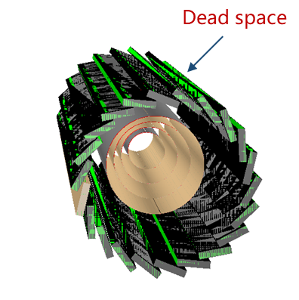
2
15
Application of ACTS to CEPCSW
Tracking chain with ACTS
Why seeding in VTX + ITK instead of only VTX?
VTX has dead space at center of z-axis
4 Cylinder (has dead space)
1 Double-sided planer (no dead space)
High background in VTX detector
Filter the seeds with the hits from ITK

Slide 16
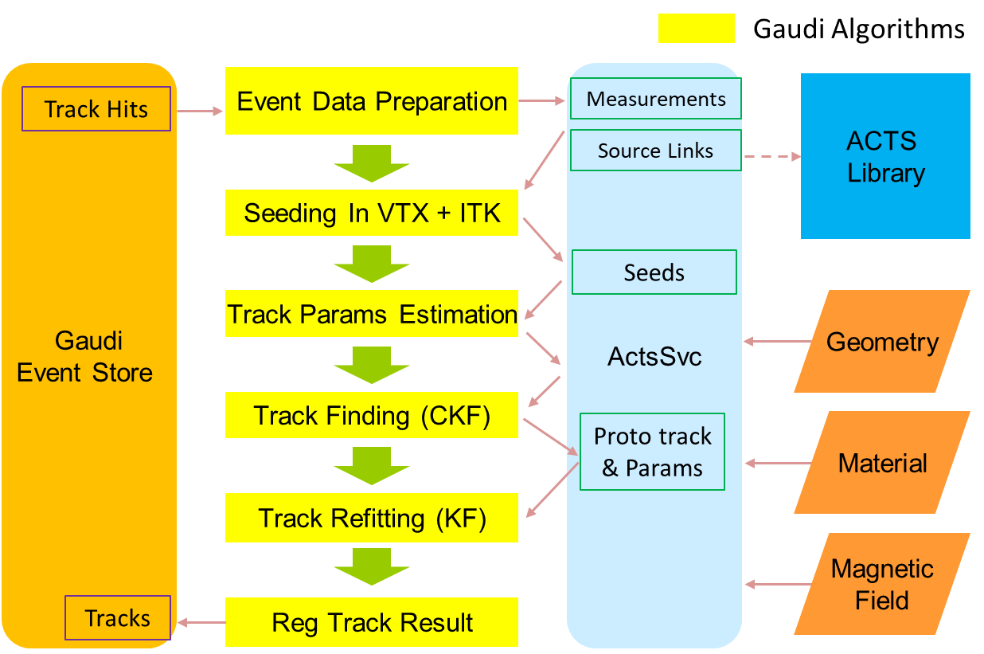
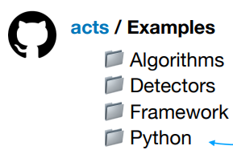
2
16
Application of ACTS to CEPCSW
Interface with CEPCSW
Integrate ACTS into the CEPCSW using the Gaudi Algorithms
Event Data Preparation
Retrieves Track Hits from the Gaudi Event Store
Convert the hits in EDM4hep format to ACTS’ Measurements & Source Links
Tracking chain algorithms
Seeding & params estimation
Track finding using CKF
Track fitting using KF or GSF
Register tracking results with the Gaudi Event Store
Not intended for production
But showcase how to assemble a track reconstruction chain using the tools from the toolbox
A Gaudi Service ActsSvc was also developed to store the data across the Gaudi Algorithms.

Slide 17

2
17
Application of ACTS to CEPCSW
Event data model conversion
Track hits
Measurements
Source Links
Par & cov
gid
global position (3D)
→ Local position (2D)
CEPCSW cellid → ACTS gid
Different bit field & number scheme

Slide 18
18
1
Introduction
2
Application of ACTS to CEPCSW
Outline
3
Performance
4
R&D

Slide 19
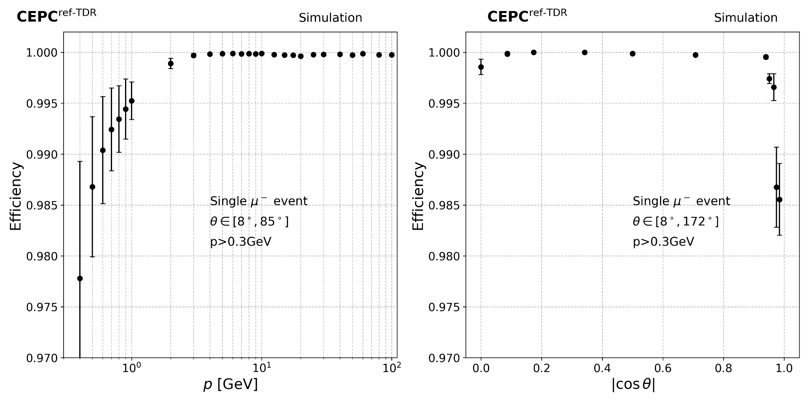
3
19
Performance
Tracking efficiency
Around the region θ=90°, efficiency drops due to the membrane cathode spanned between two rings in the center of the TPC.

Slide 20
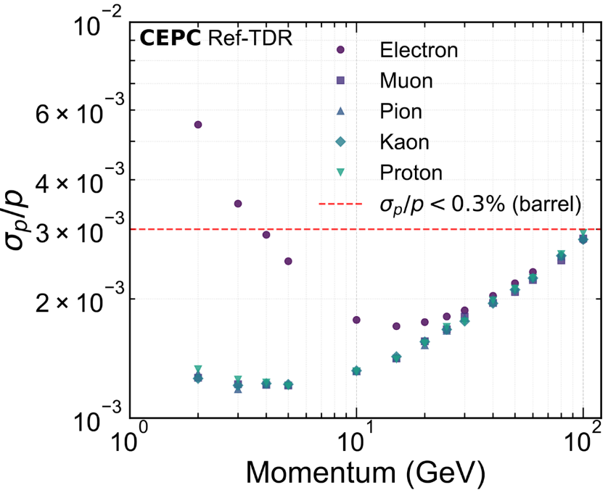
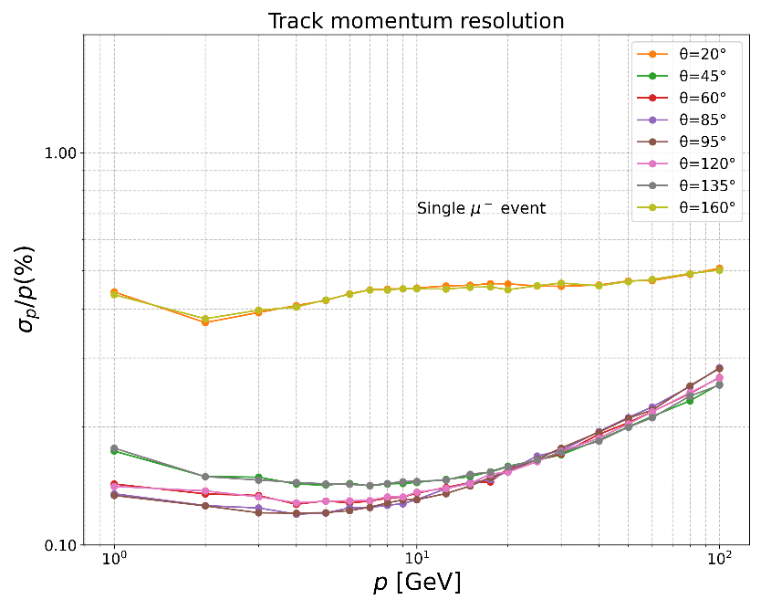
3
20
Performance
Tracking resolution
Momentum resolution vs Momentum with different particle (left) & angle (right)
Momentum resolution meets TDR design specifications
For electron reconstruction, P resolution is not gaussian distributed.
With a theta of 20° or 160°, track hits are mainly distributed on EndCaps.
TDR design specifications

Slide 21
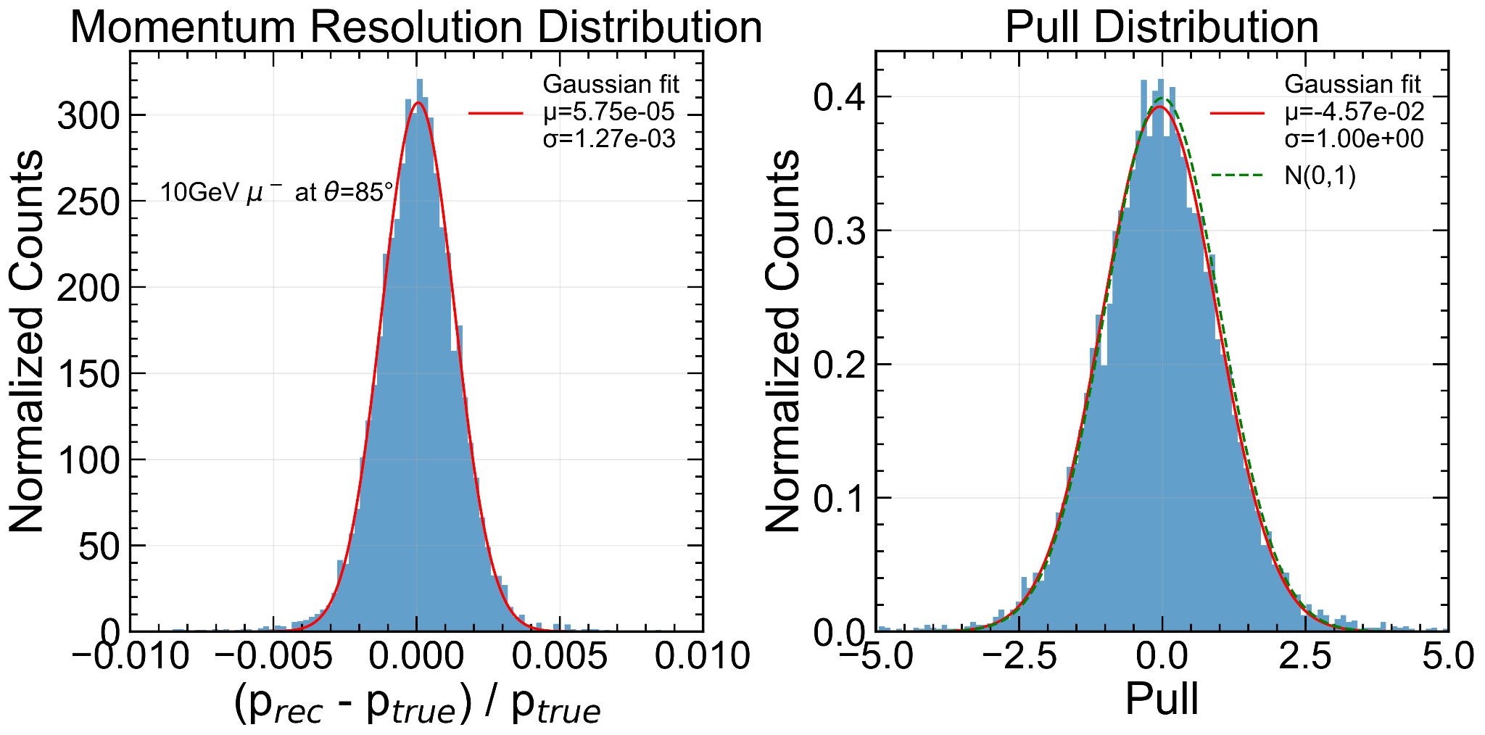
3
21
Performance
Track fitting validation
Pull distribution shows the uncertainties of momentum provided by ACTS Kalman Fitter (KF) are valid
The tracking performance achieved with ACTS shows excellent agreement with full detector simulations.

Slide 22
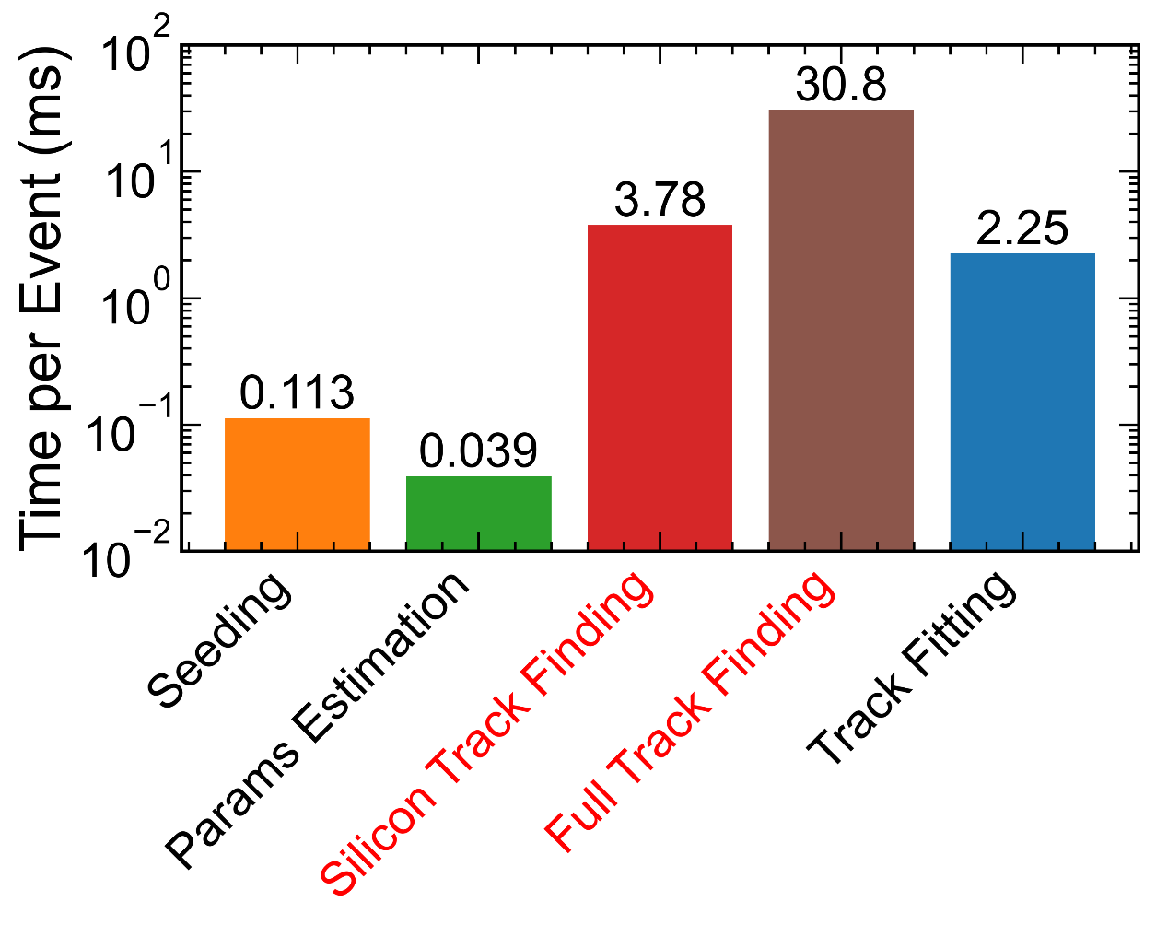
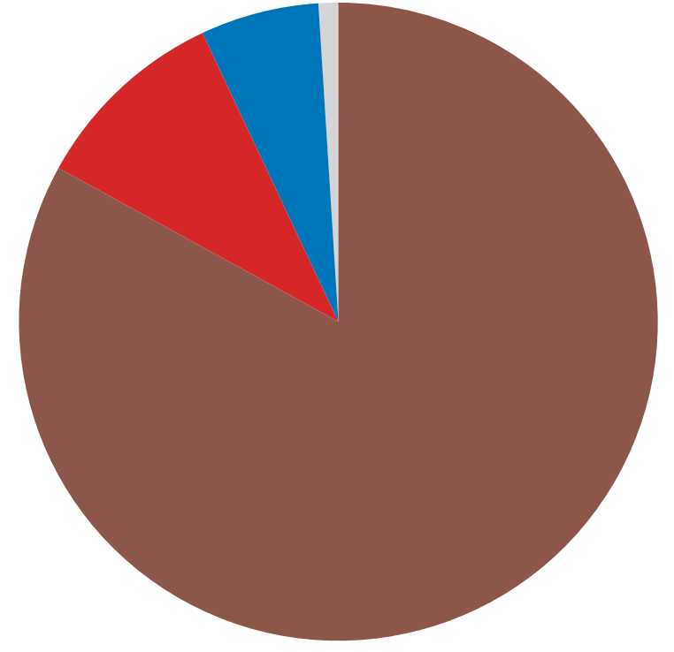
3
22
Performance
Computing performance
Time cost of reconstruction for single-track (μ-) events:
Tested with single thread at:
Intel(R) Xeon(R) Silver CPU 4214 @ 2.20GHz
Total ≈ 37ms/event
Time cost percentages
Full Track Finding 83%
Silicon Track Finding 10.2%
Track Fitting 6.07%
Others 0.73%

Slide 23
23
1
Introduction
2
Application of ACTS to CEPCSW
Outline
3
Performance
4
R&D

Slide 24
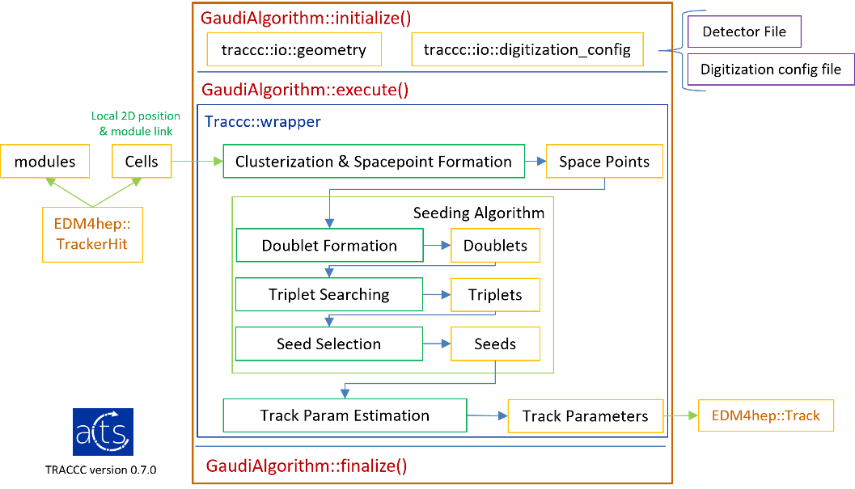
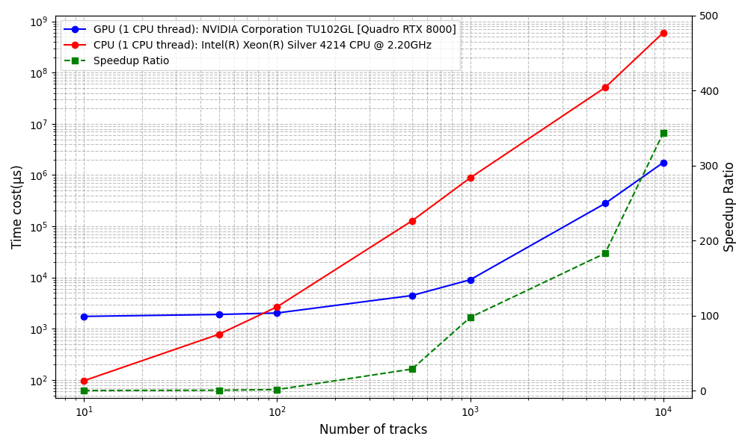
4
24
R&D
traccc
Apply traccc seeding algorithm in CEPCSW
Seeding time comparing CPU & GPU vs # of tracks
traccc, one of the R&D project of ACTS, provides high-performance parallel tracking software
Compatible with complex hardware architectures (e.g., CPU, GPU, FPGA)
Applied seeding alg in CEPCSW, tested its physical & computing performance
details see link

Slide 25
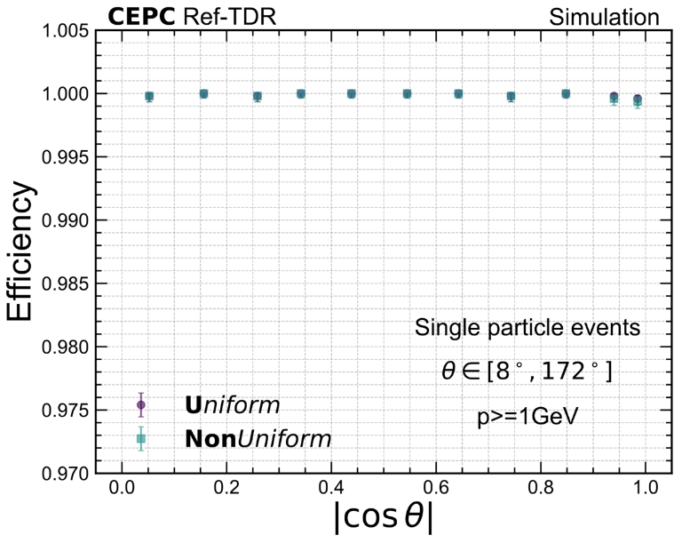
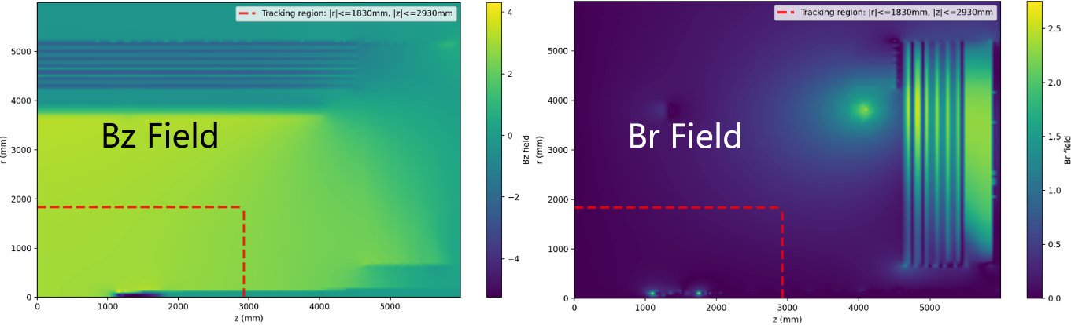
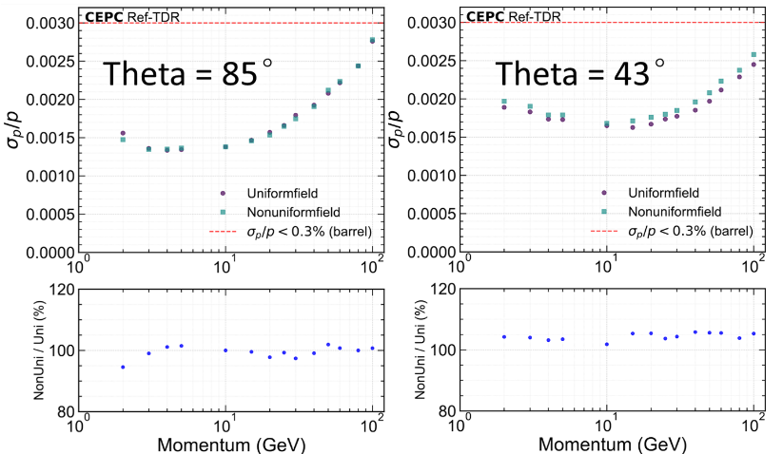
4
Non-uniform magnetic field rec
25
R&D
Non-uniform magnetic field map
The magnetic field is generated within the range r/z=[0,6] m, with a sampling interval of 50 mm
Tracking performance is studied using muons with ACTS under non-uniform magnetic field conditions
Minimal impact on reconstruction efficiency, with a maximum resolution degradation of approximately 5%.

Slide 26
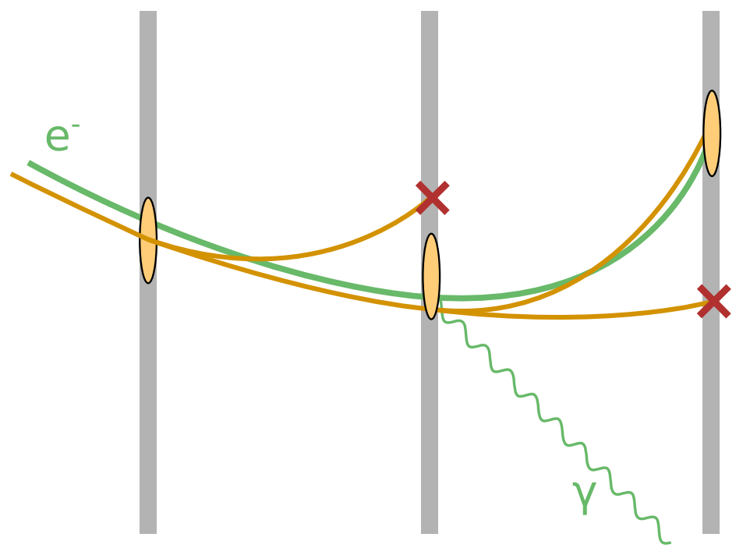
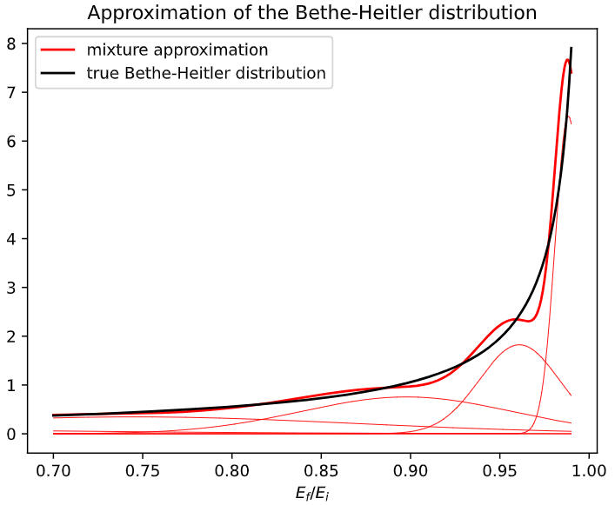
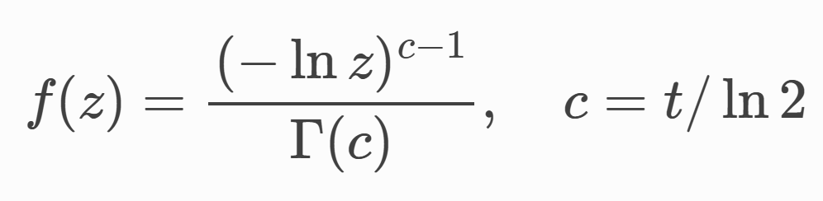
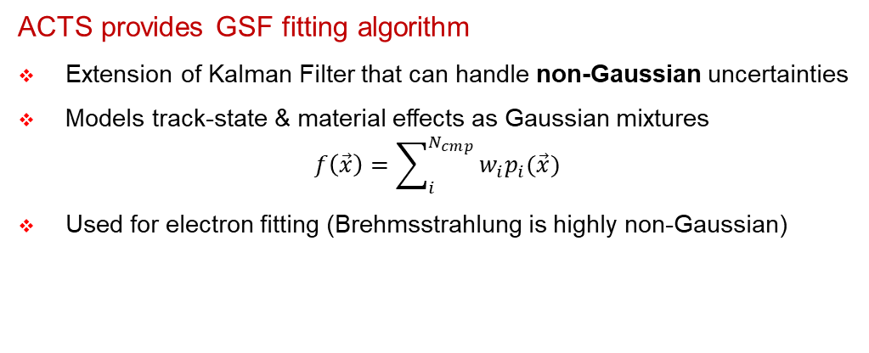
4
26
R&D
Gaussian Sum Fitter
pic link
ACTS provides GSF fitting algorithm
Extension of Kalman Filter that can handle non-Gaussian uncertainties
Models track-state & material effects as Gaussian mixtures
$$f\left(\vec{x}\right)=\sum_{i}^{N_{cmp}}{w_{i}p_{i}(\vec{x})}$$
Used for electron fitting (Brehmsstrahlung is highly non-Gaussian)
The Bethe Heitler distribution
describes the probability distribution of energy loss of electrons after passing through a certain length of matter.
On a surface with material, the BH distribution is approximated with a fixed number (usually 6) of gaussian components for each component.
pic link

Slide 27
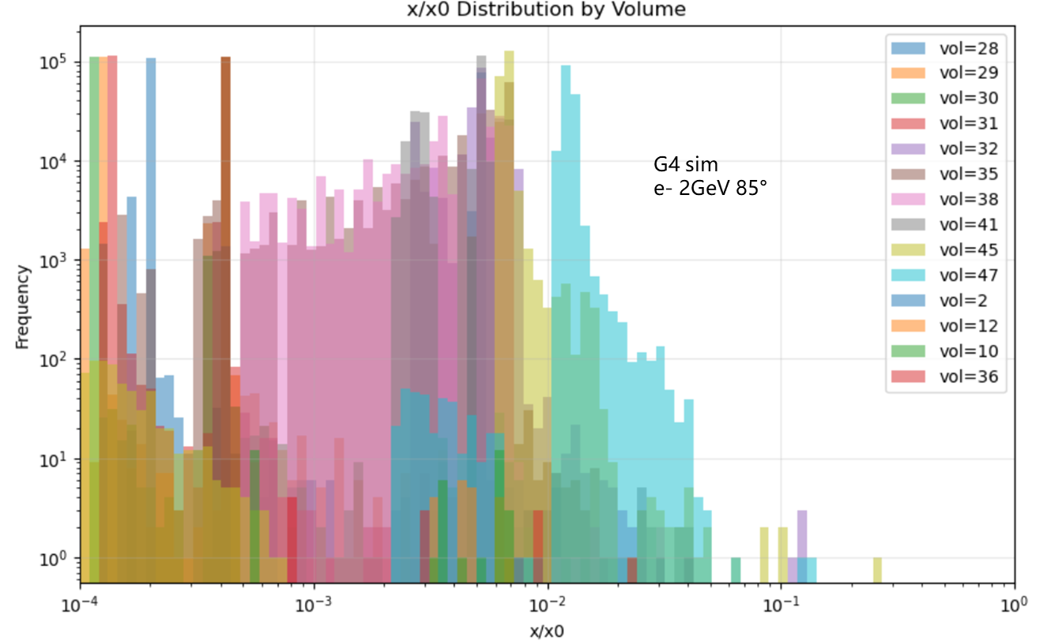
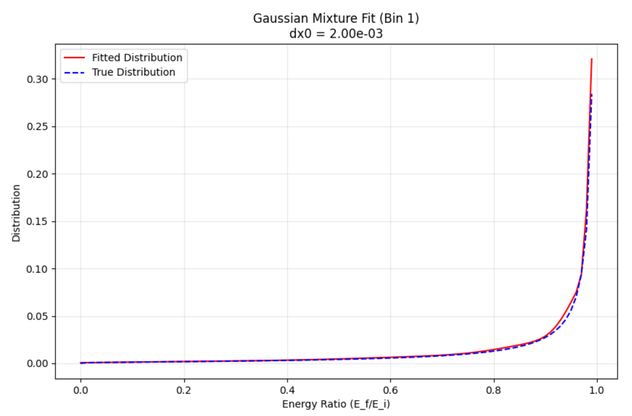
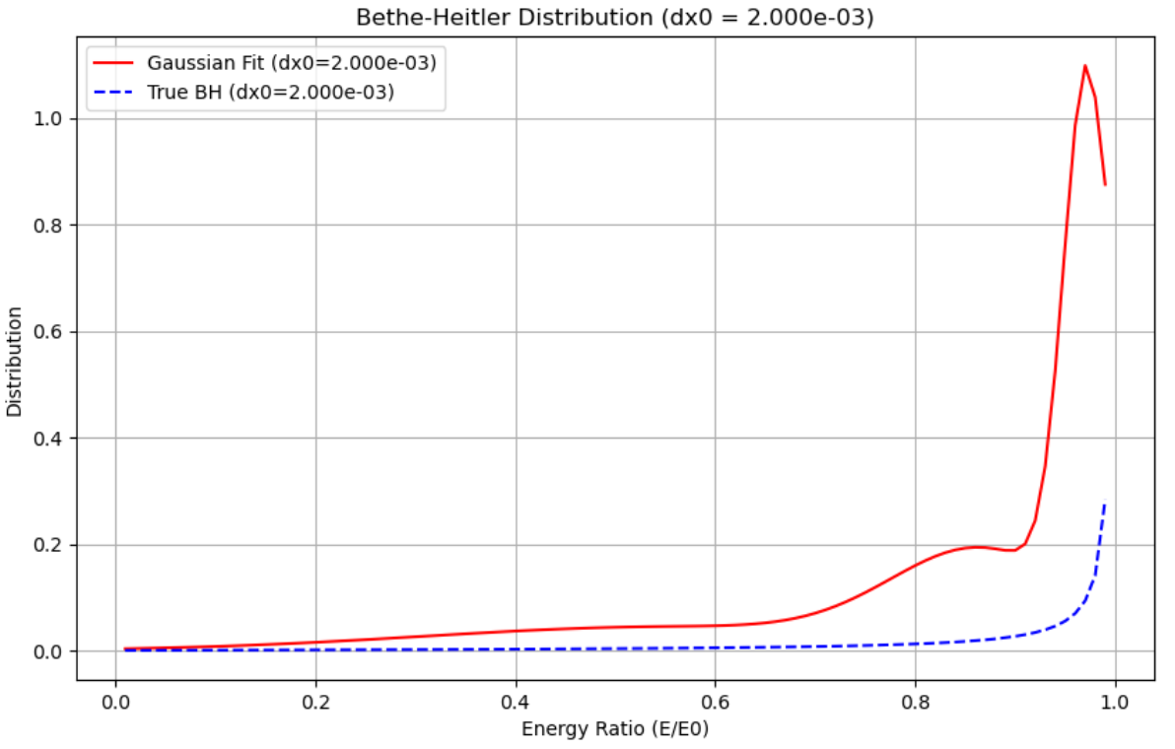
4
27
R&D
Gaussian Sum Fitter
GSF in CEPC
The material budget of CEPC ref-det is low.
ACTS’ default Gaussian-mixture param approximates BH distribution at thick material well, but bad at thin material.
Optimizing the Gaussian-mixture parameters using gradient descent. Trying to get better approximation to BH distribution at thin material.
material passing through of every tracking step
default params
dx0 = 2e-3
updated params
dx0 = 2e-3
default param approximate BH
poorly at low dx0
updated param approximate BH
better at low dx0

Slide 28
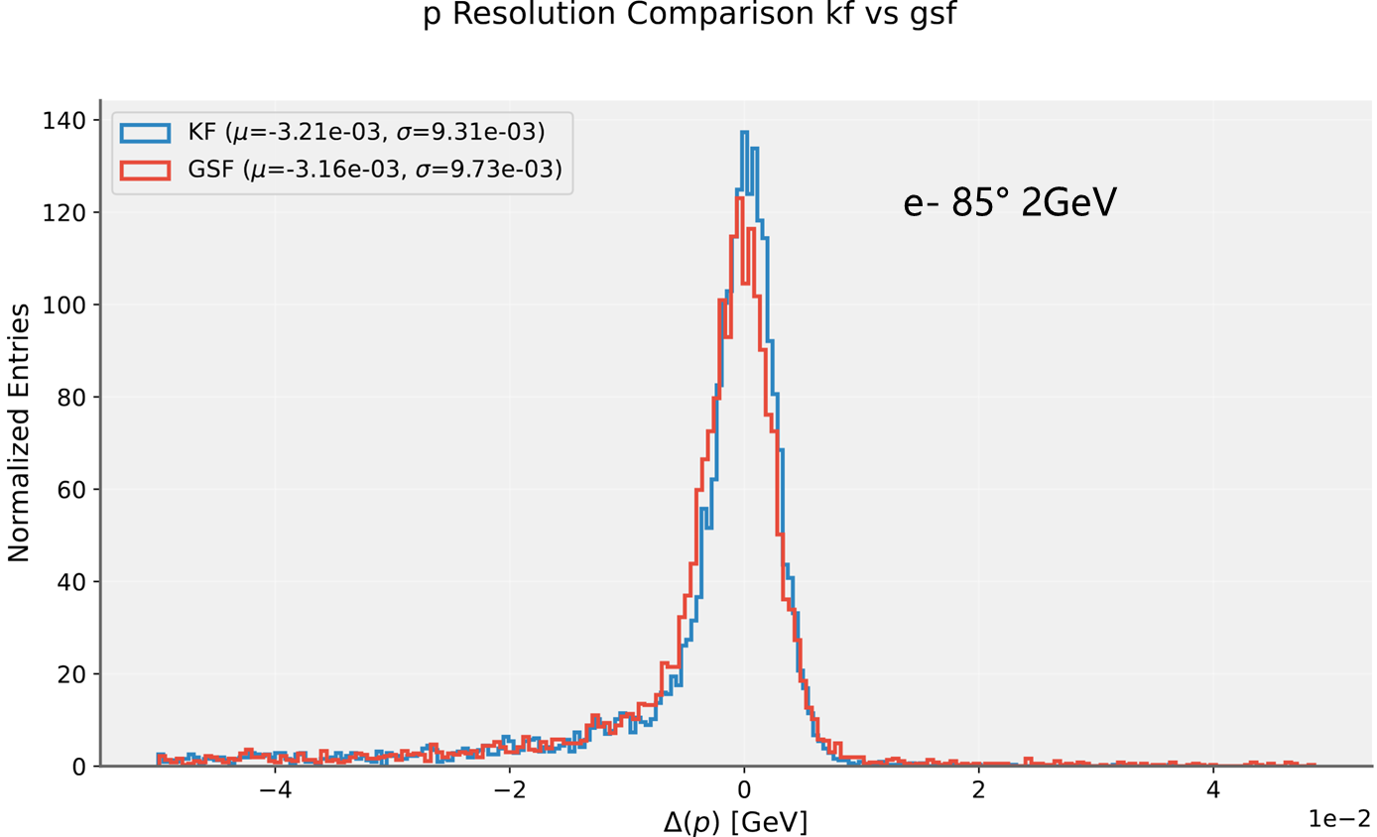
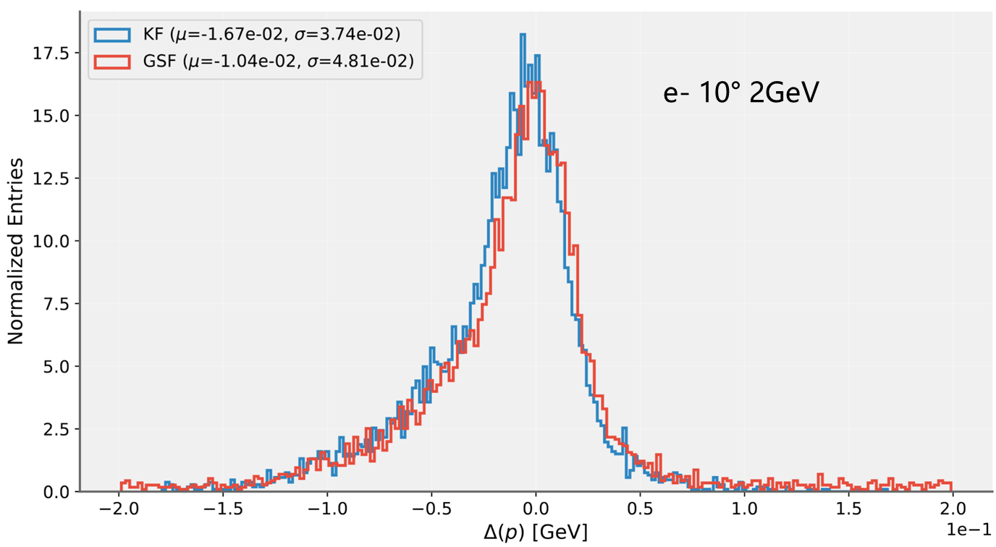
4
28
R&D
Gaussian Sum Fitter
p resolution comparison kf & gsf
CEPC ref-det reconstruction
GSF doesn’t show much improvement comparing to KF
Need debugging
Electron reconstruction with Acts will be available soon, see Andreas’ poster

Slide 29
29
Summary
ACTS has been successfully integrated into CEPCSW
See repository
ACTS has been implemented for track reconstruction in CEPC RefDet.
Covering a wide range of trackers, e.g. silicon (planar, stitched) and gaseous (TPC)
R&D works
traccc: implies seeding algorithm in GPU to CEPCSW
GSF: implied in electron fitting; no significant improvement due to the thin tracking material
Next to do:
Further ACTS’ GPU & ML implement in CEPCSW

Slide 30
Thank You
Yizhou Zhang, Weidong Li, Xiaocong Ai, Tao Lin
zhangyz@ihep.ac.cn
The Institute of High Energy Physics, IHEP, China
Connecting The Dots
The University of Tokyo
12th Nov 2025

Slide 31
Backup

Slide 32
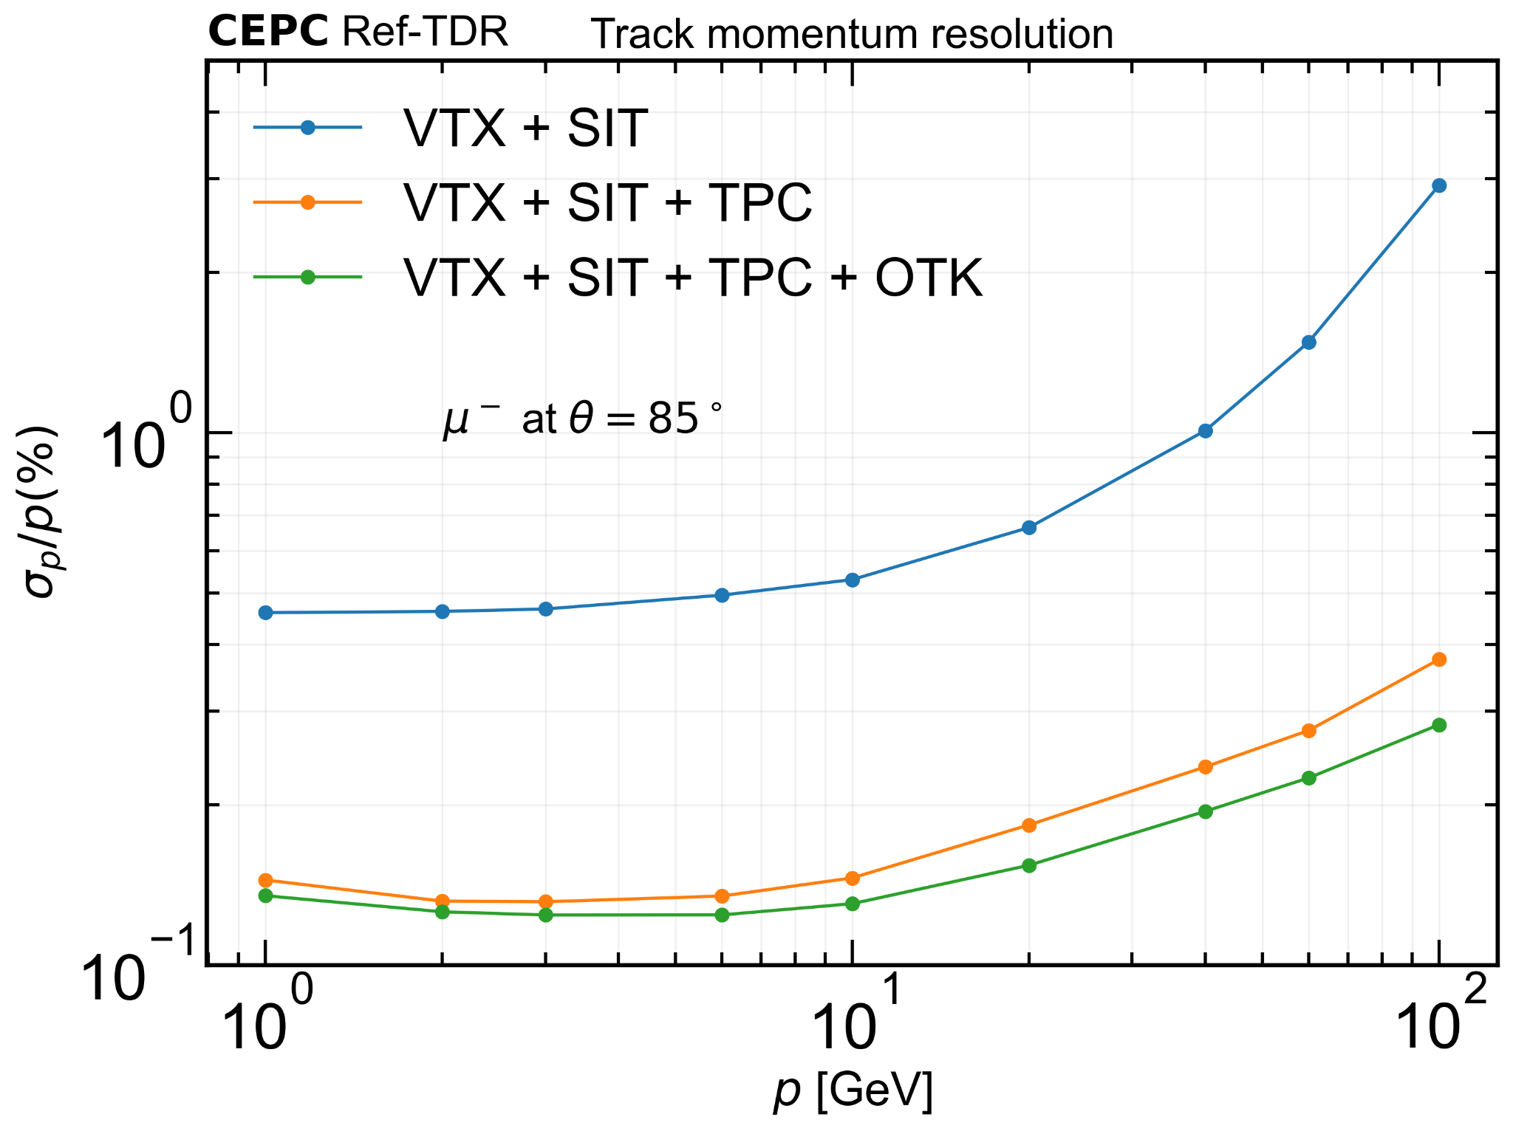
3
32
Performance
Tracking resolution
The TPC in conjunction with the OTK is able to provide the longest possible radial lever arm for the track fit, improving the resolution at the high momentum region (about 10-20% better than without OTK)

Slide 33
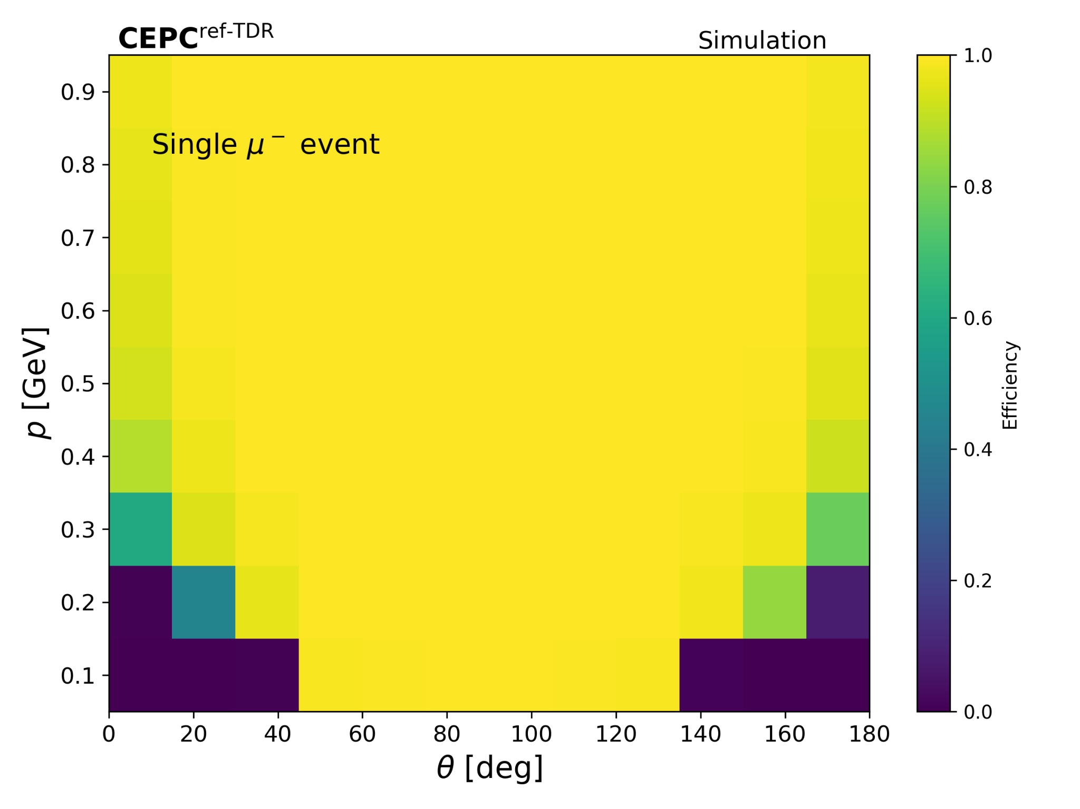
Tracking efficiency
Good efficiency for low momentum tracks as well
The efficiency of each bin is analysed with fixed p and theta.

Slide 34
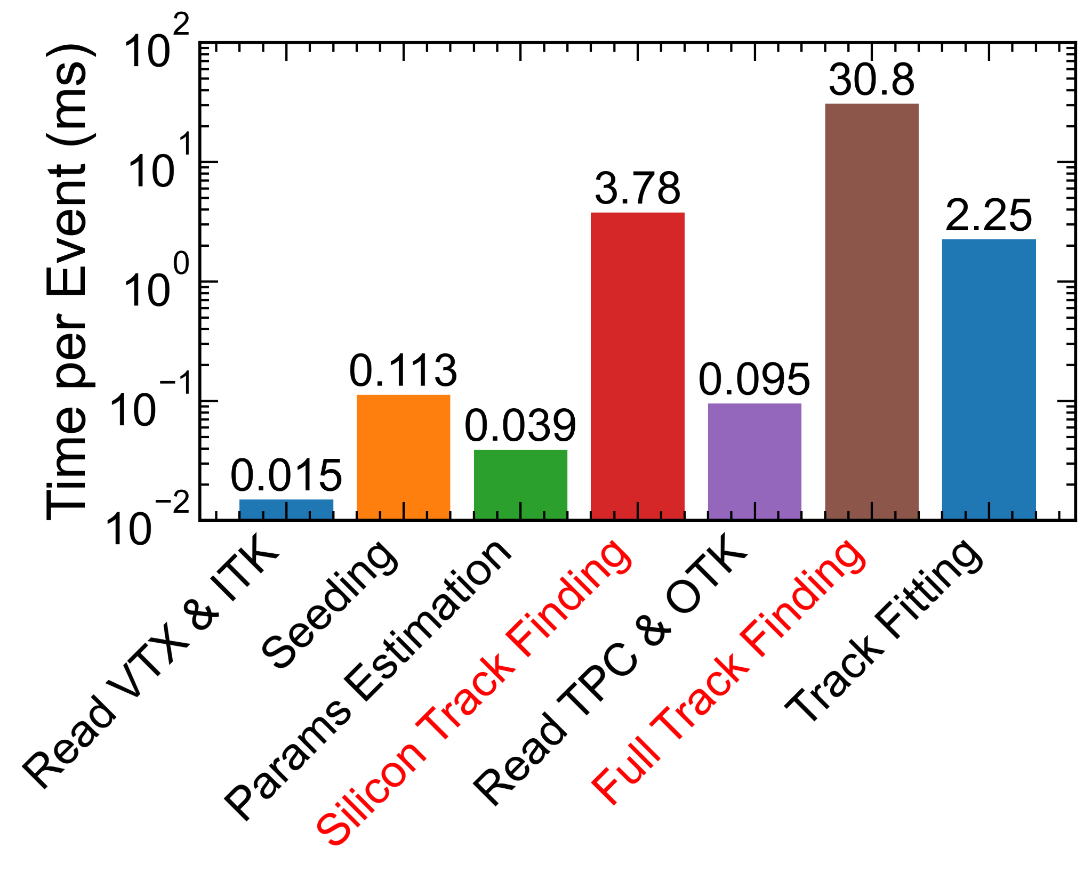
3
34
Performance
Computing performance
Time cost of reconstruction for single-track events:
Tested with single thread at:
Intel(R) Xeon(R) Silver CPU 4214 @ 2.20GHz
Total ≈ 37ms/event
Time cost percentages
Full Track Finding 83%
Silicon Track Finding 10.2%
Track Fitting 6.07%
Others 0.73%

Slide 35

1
35
Introduction
Circular Electron Positron Collider (CEPC)
CEPC
Not proposed in 2026-2030 project
aim to start operation in 2031-2035 project
The greatest virtue is patience!

Slide 36
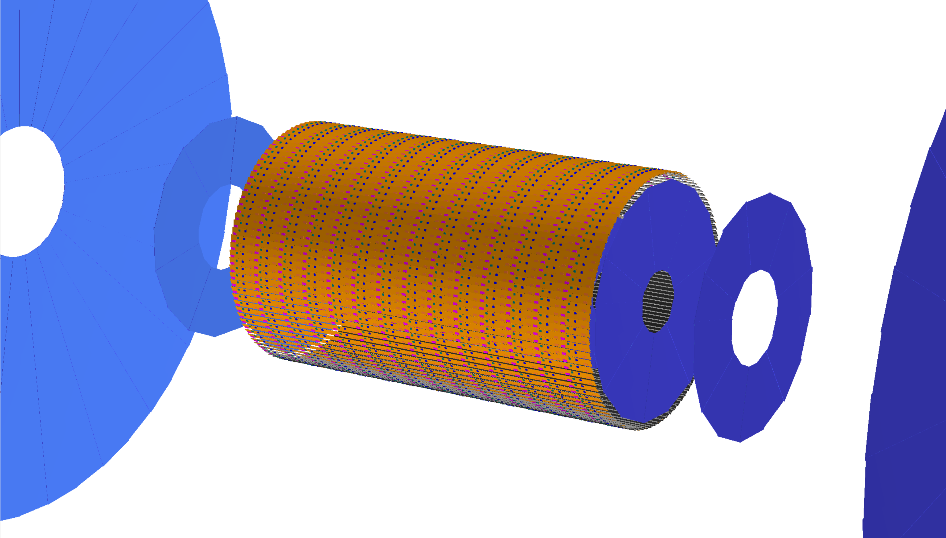
36
Dead space

