Slide 1
Welcome to BE-ABP-CAP!
New section on Computational Accelerator Physics
Giovanni Iadarola
ABP-CAP meeting 24 Jan 2024

Slide 2
Who are we?
CAP
Computational
Accelerator Physics
G. Iadarola (SL)
R. De Maria
L. Deniau
A. Latina
F. Van Der Veken
LD staff opening (very soon)
S. Lopaciuk (FELL)
F. Murgia (GRAP)
B. Abreu Figueiredo (DOCT)
I. Angelis (DOCT)
S. Buijsman (DOCT)
P. Desire Valdor (DOCT)
V. Mussat (DOCT)
L. Pauwels (DOCT)
A. Scurria (TECH)
S. Solstrand (TECH)
S. Van Der Schueren (DOCT)
16 section members:
5 staff (soon to become 6)
2 Postdocs
7 Doctoral Students
2 Technical students

Slide 3
Our mandate
The Computational Accelerator Physics (CAP) section specializes in developing advanced numerical methods for the modelling, designing, and simulating particle accelerators.
Key responsibilities:
Software Development and Maintenance:
  Design, develop, and maintain the CERN software stack for accelerator design, operation, and beam physics simulations.
Advanced Numerical Methods:
  Develop numerical methods for modelling and analysis of beam dynamics in particle accelerators (optics, tracking, TPSA, particle-matter interaction, synchrotron radiation, collective effects)
  Ensure know-how retention and dissemination.
Integrated Accelerator Models:
  In collaboration with all ABP sections, build and maintain comprehensive and flexible accelerator models for the present accelerator complex and for future facilities, encompassing layout, optics, correction procedures, aperture, magnetic imperfections, misalignments, collimation configurations, impedances.
  Ensure versioning and implement automatic integrity checks

Slide 4
Our mandate
The Computational Accelerator Physics (CAP) section specializes in developing advanced numerical methods for the modelling, designing, and simulating particle accelerators.
Key responsibilities (cont’d):
Accelerator Design and Optimization: Contribute to the design and optimization of particle accelerators and beamlines by supporting the full exploitation of the developed software tools and integrating advanced multi-physics models.
Management of Computing Resources: Identify the needs for hardware resources for beam physics computing and coordinate the exploitation of the available computing facilities.
Expertise and Support: Provide expertise and technical support in numerical modeling and simulations to the CERN accelerator physics community and to collaborators.

Slide 5
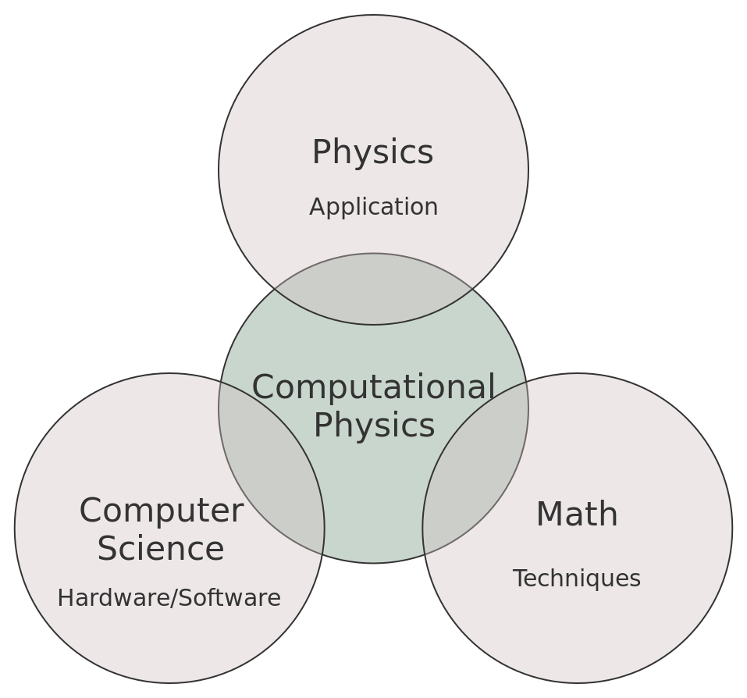
Our core competencies
Beam dynamics
Optics
Electrodynamics (field generation in magnets, cavities, beam-beam, spacecharge)
Statistical mechanics
Radiation
Beam-matter interaction
Intra Beam Scattering
…
High-quality software
High-performance computing
Software architecture
Automatic testing
Parallel computing
Design and development of user interfaces
Linear algebra
Ordinary/Partial differential equations
Hamiltonian methods
Statistical methods
Lie algebra
Quaternions
…

Slide 6
Early-career researchers
Two thirds of our section are made by early-career researches (students, post-docs)
Creating the conditions for your professional growth is a priority!
  This means growing your skills in view of next career steps
    General and specific technical competencies
    Presentation skills
    Writing skills
  Training younger generation is an important duty for more experienced members of the team: this should be fostered and recognized
Section meetings are a perfect place to do that
Practice and improve your presentation skills
Have discussions, get feedback
Learn from more experienced colleagues

Slide 7
Section meetings
Tentatively weekly meetings
Friday morning 9:30
Structure:
General information
One technical presentation

