Slide 1
Linear and Muon Colliders at CERN
28th Jan 2025
John Osborne, Edward MacTavish
With thanks to Angel Navascues Cornago, Amine Mejri and Charlotte Desponds for the drawings and Geoprofiler.
SCE-SAM-FS

Slide 2
Linear Colliders
CLIC & ILC

Slide 3
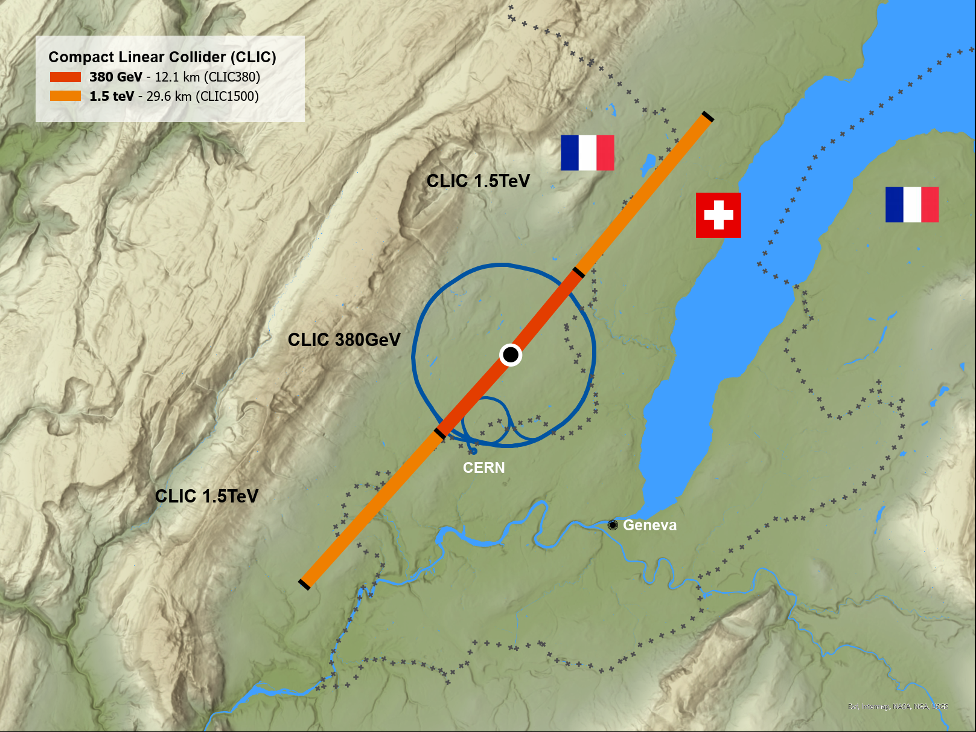
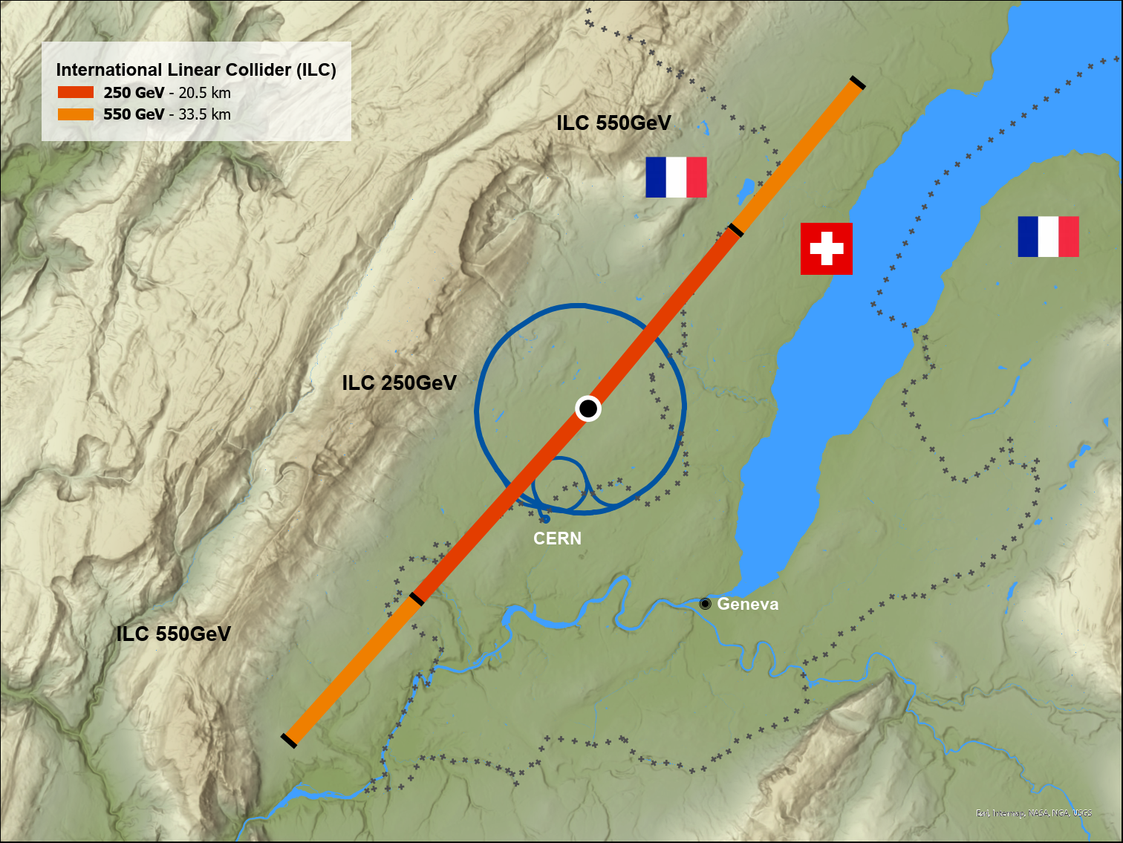
Geographical Layout
CLIC at CERN
Starting with ILC SRF Technology

Slide 4
CLIC

Slide 5
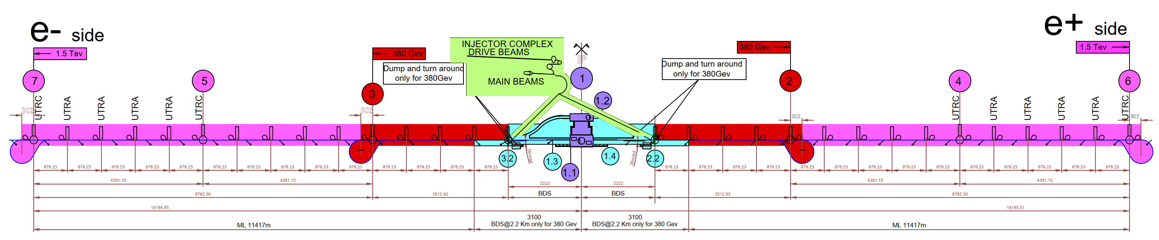
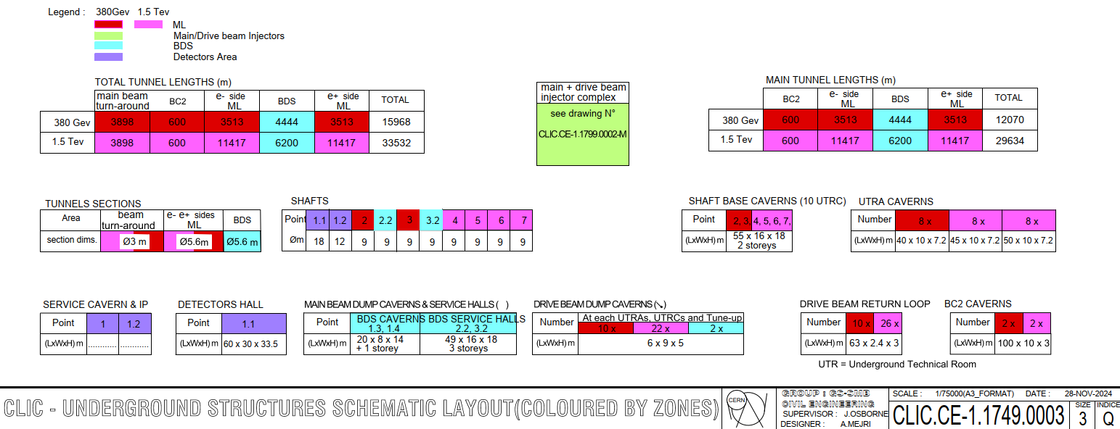
Underground Structures Schematic
29.6km
12.1km
Now only considering the Drive Beam option and not the Klystron option.
The 3TeV stage is no longer being considered.
Laser Straight
380GeV Main Tunnel length of 12.1Km
(Displayed in Red).
1.5TeV Main Tunnel length of 29.6Km
(Displayed in Pink).

Slide 6
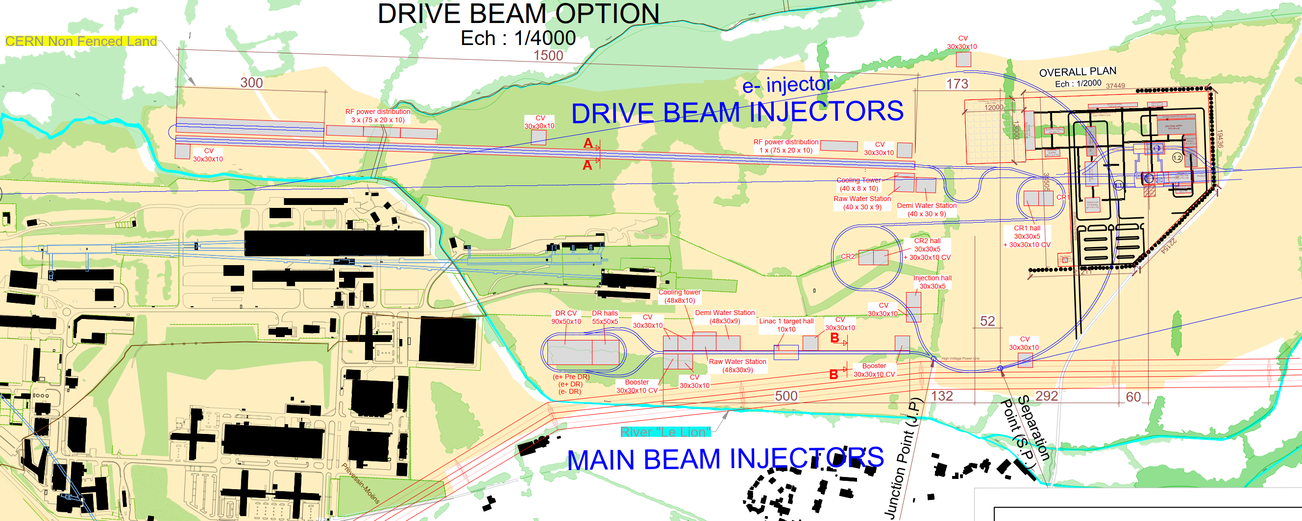
Injector Complex Layout on Prévessin Site
Whole Injector Complex is located on CERN land.
The complex now avoids all existing CERN infrastructure.
Drive Beam Injectors location has been adjusted to avoid the river ‘Le Lion’.
Booster has been integrated into the Main Beam Injector, alongside the stacking of the damping rings.

Slide 7
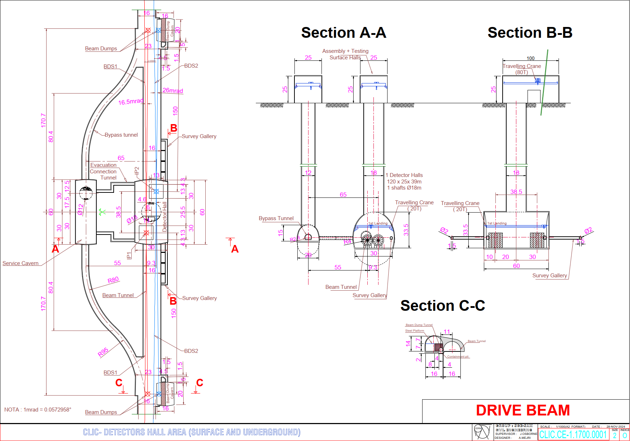
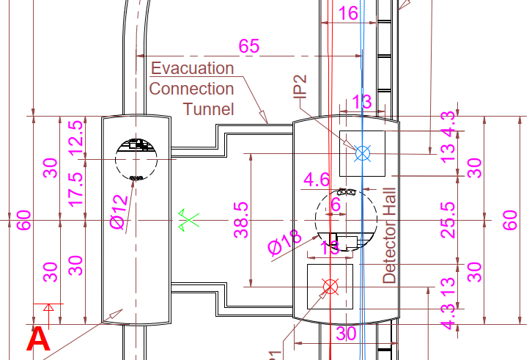

Interaction Region
Updated to facilitate 2 Detectors.
A 30m x 60m Detector Hall facilitates both detectors with their centers separated by 38.5m.
Main LINAC’s have a 20mrad crossing angle and the Beams have crossing angles of 16.5mrad and 26mrad.
BDS Tunnel has been widened to 16m to account for both beam lines and the 9.3m separation between them.
Tunnel Widening occurs over 2km either side of the Detector hall.

Slide 8
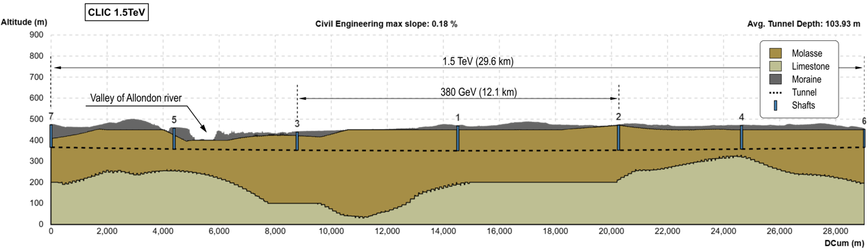
Geological Profile
Geological Profile for 380GeV and 1.5TeV stages with 3TeV removed.
Comfortably housed within good Molasse rock. (no need for site investigation to confirm this)
Gland Depression is no longer an issue, thus there is scope to reduce the shaft depths.

Slide 9
ILC Type Design at CERN
The ILC type design at CERN is based on the ILC 250 GeV and 550 GeV designs from Japan.
These designs are being adapted for the CERN region, notably,
    The use of a circular main tunnel cross section.
    A 2-IP option with offset detectors as used in CLIC.
    Vertical shafts replacing the inclined access tunnels.

Slide 10
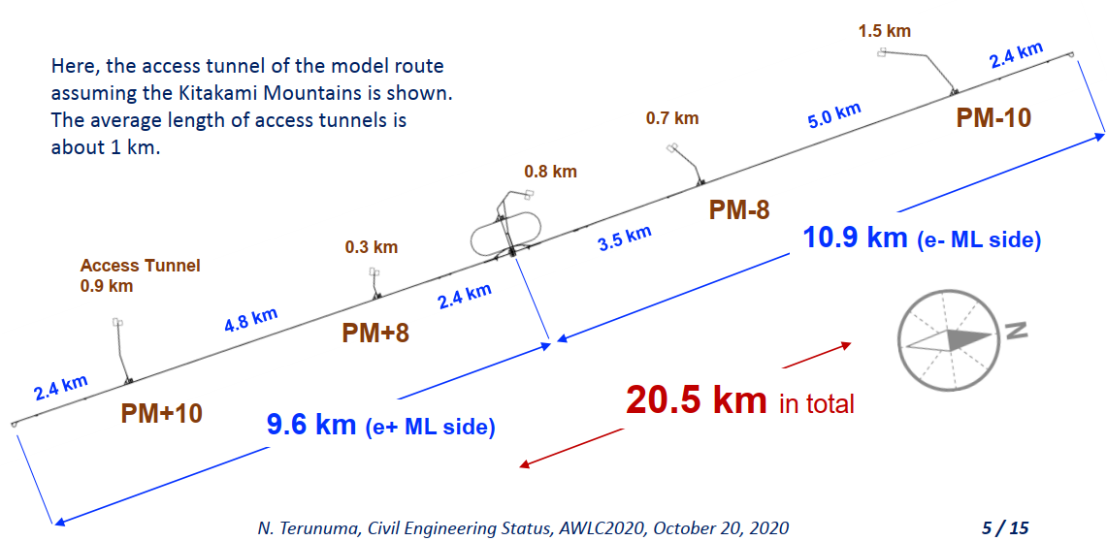
ILC Japan 250 GeV Schematic

Slide 11
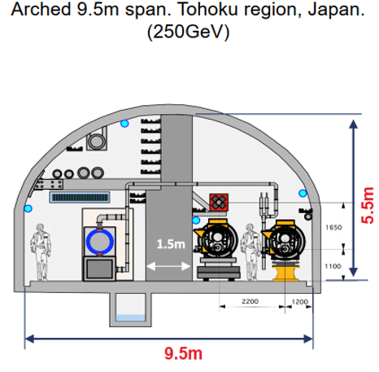
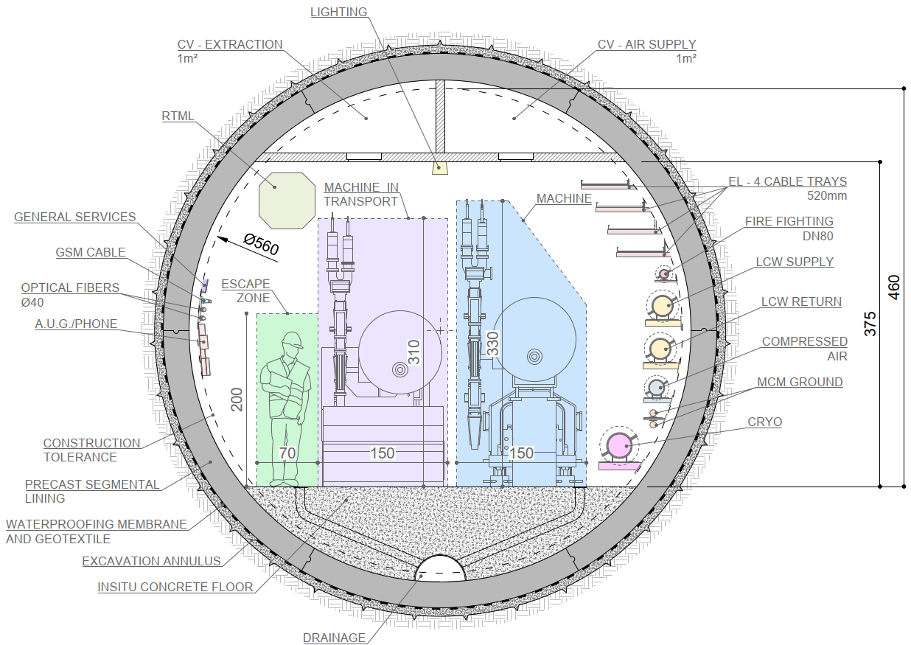
ILC Japan Typical Tunnel Cross Section
ILC Japan Cross section Implemented at CERN
5.6m Internal
Diameter

Slide 12
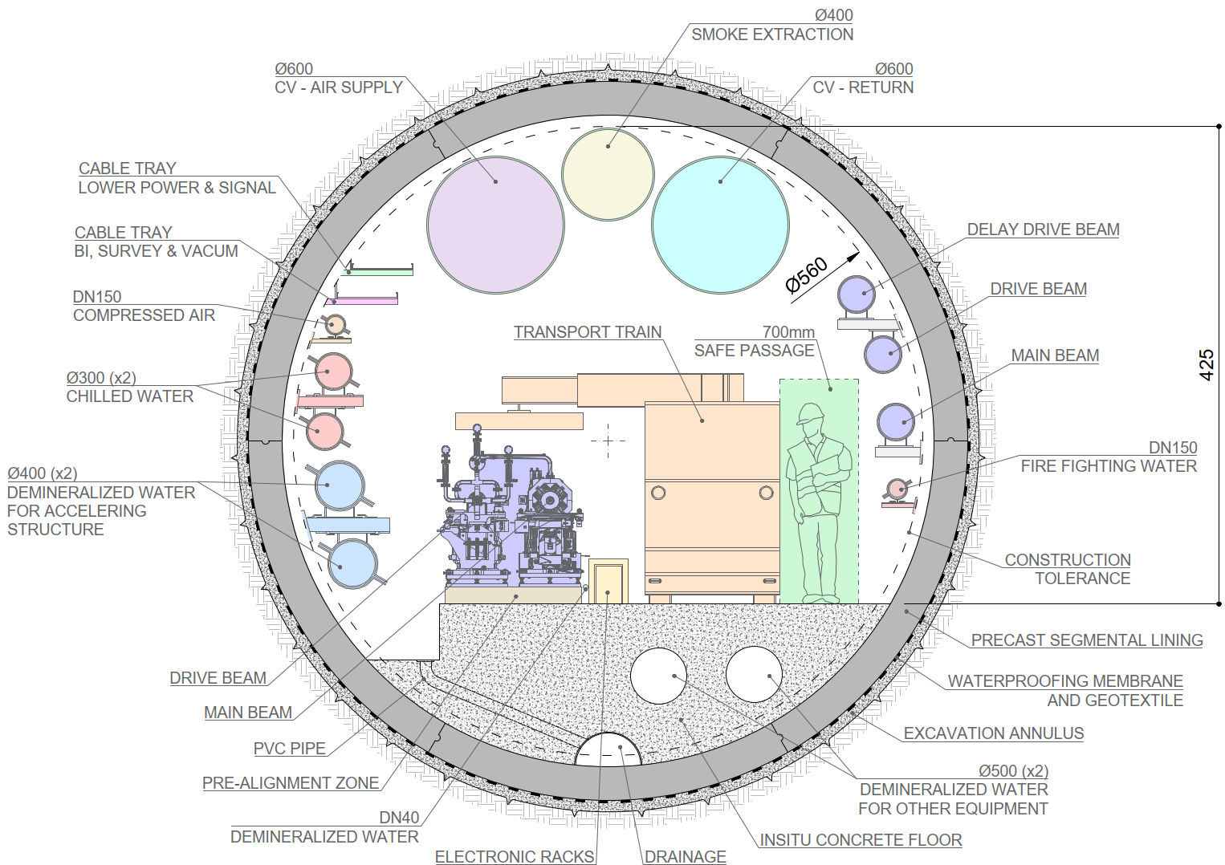
CLIC Typical Tunnel Cross Section
5.6m Internal
Diameter
ILC Japan Cross section Implemented at CERN
5.6m Internal
Diameter

Slide 13
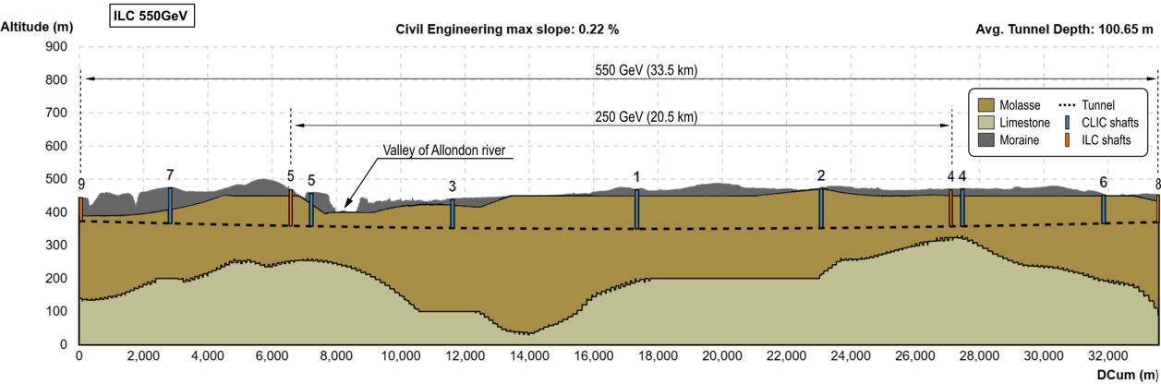
Geological Profile
CLIC
Ongoing Geographical study to optimise and share common shaft locations between CLIC and ILC.
CLIC is symmetrical either side of the interaction region.
ILC is not symmetrical either side of the interaction region.
Shafts at 4&5 for both studies will be unified.
It is easier to adapt the CLIC shafts to the ILC design due to the Cryo design constraints of the ILC.
ILC
(33.5km)
(20.5km)

Slide 14
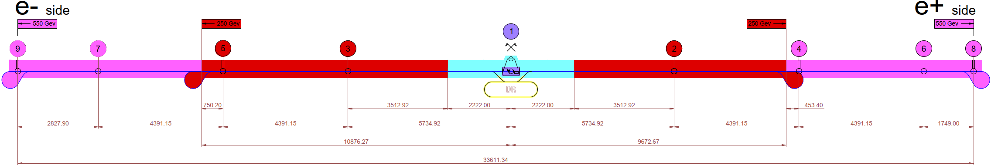
Underground Structures Schematic
CLIC
29.6km
12.1km
ILC
33.5km
20.5km

Slide 15
2-IP Design
For ILC, alike CLIC the 2 detectors will be offset.
Main LINAC crossing angle for both studies of 20mrad.
IR region crossing angles :
  16.5mrad and 26mrad beam angles for CLIC
  14mrad and 26mrad beam angles for ILC

Slide 16
Conclusions and Next Steps
CLIC surface injection complex has been optimized in 2024 and avoids clashes with existing infrastructure.
Design modifications are on-going to share alignments and shaft location for CLIC and ILC housed at CERN.
Further studies required to ensure shafts are located in environmentally suitable locations.
Conduct further work into the interaction region, finding a solution for the stabilisation of the final focus element QD0, and finding a solution for maintenance work (whilst the other detector is operational).
Now we are getting close to a baseline design, a Cost & Schedule exercise can be completed for both studies at CERN.
The ILC and CLIC designs at CERN are being optimised to have as much synergy as possible ready for an LCF decision at CERN.

Slide 17
Muon Collider

Slide 18
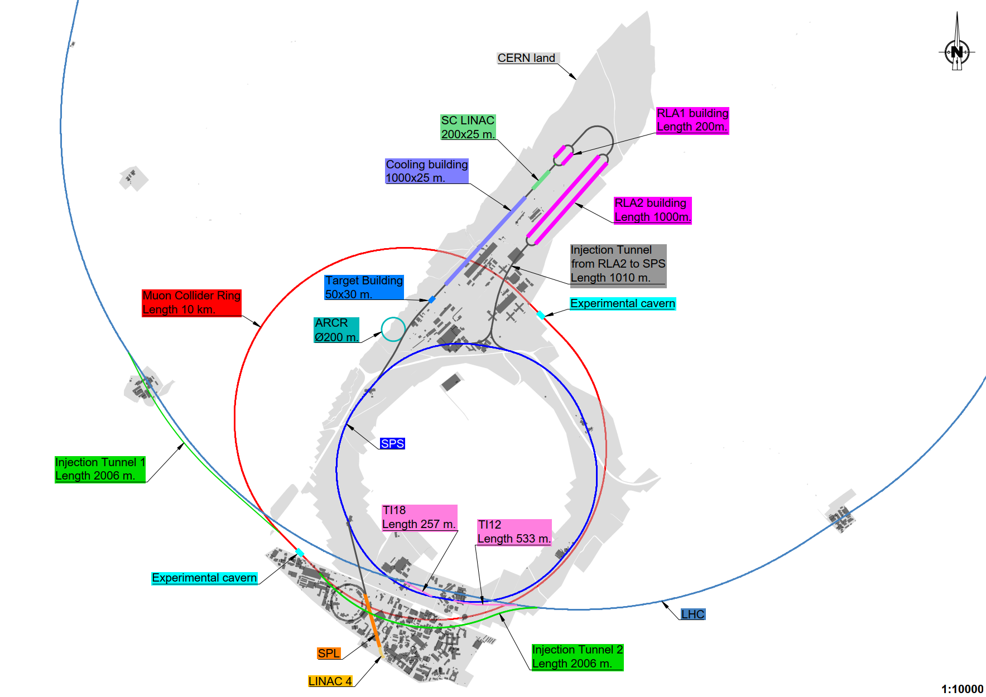
Muon Collider Complex
Initiating at LINAC 4, ultimately, injecting into the Collider ring from the LHC.
Focus around reusing existing CERN infrastructure.
Entirety of the surface works are located on CERN owned land.

Slide 19
Conclusions and Next Steps
The Muon Collider complex will undergo further iterations on each component based on design changes and requirements.
Additional surface works such as service buildings will be designed and integrated into the complex.
Now we are getting close to a baseline design, a Cost & Schedule exercise can be completed for the study at CERN.

Slide 20
LEP3

Slide 21
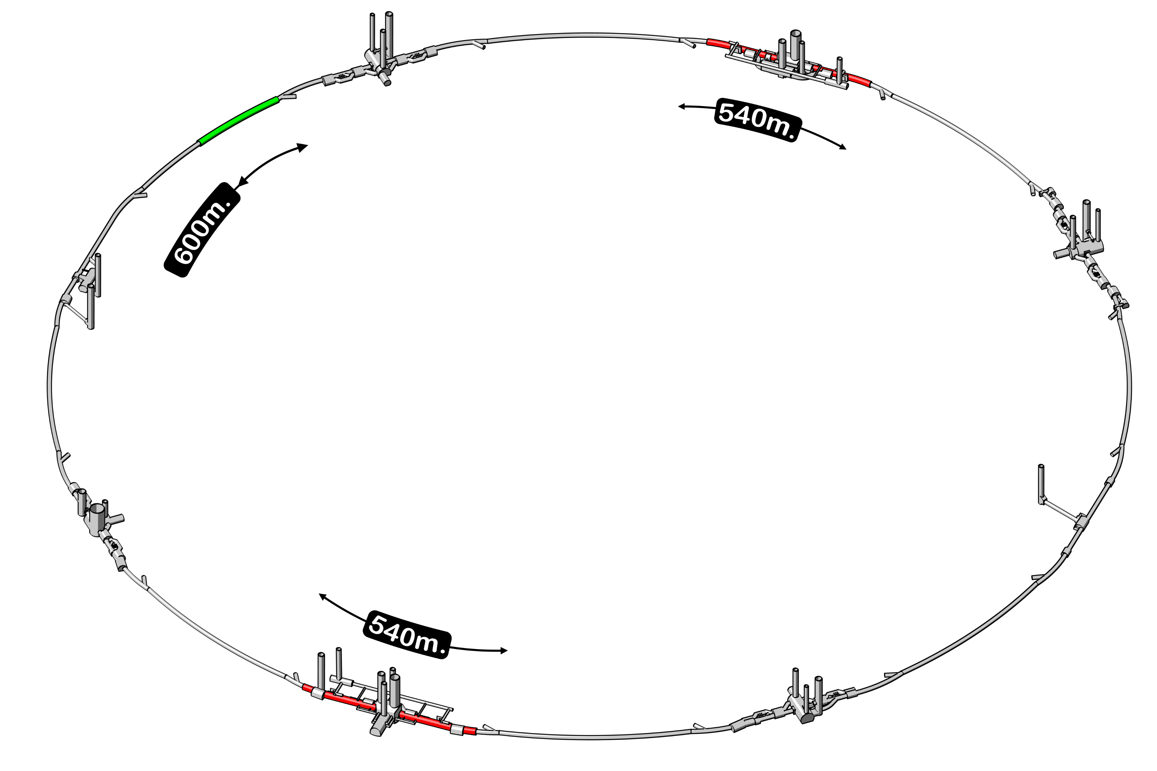
Tunnel widening 270m either side of CMS (increased from existing 3.76m to 7m diameter)
Tunnel strengthening over 600m in Jura section (inner steel ‘submarine’ solution).
Tunnel widening 270m either side of ATLAS (increased from existing 4.40m to 7m diameter)
Proposed Civil Works for LEP3 in existing LHC Tunnel

Slide 22
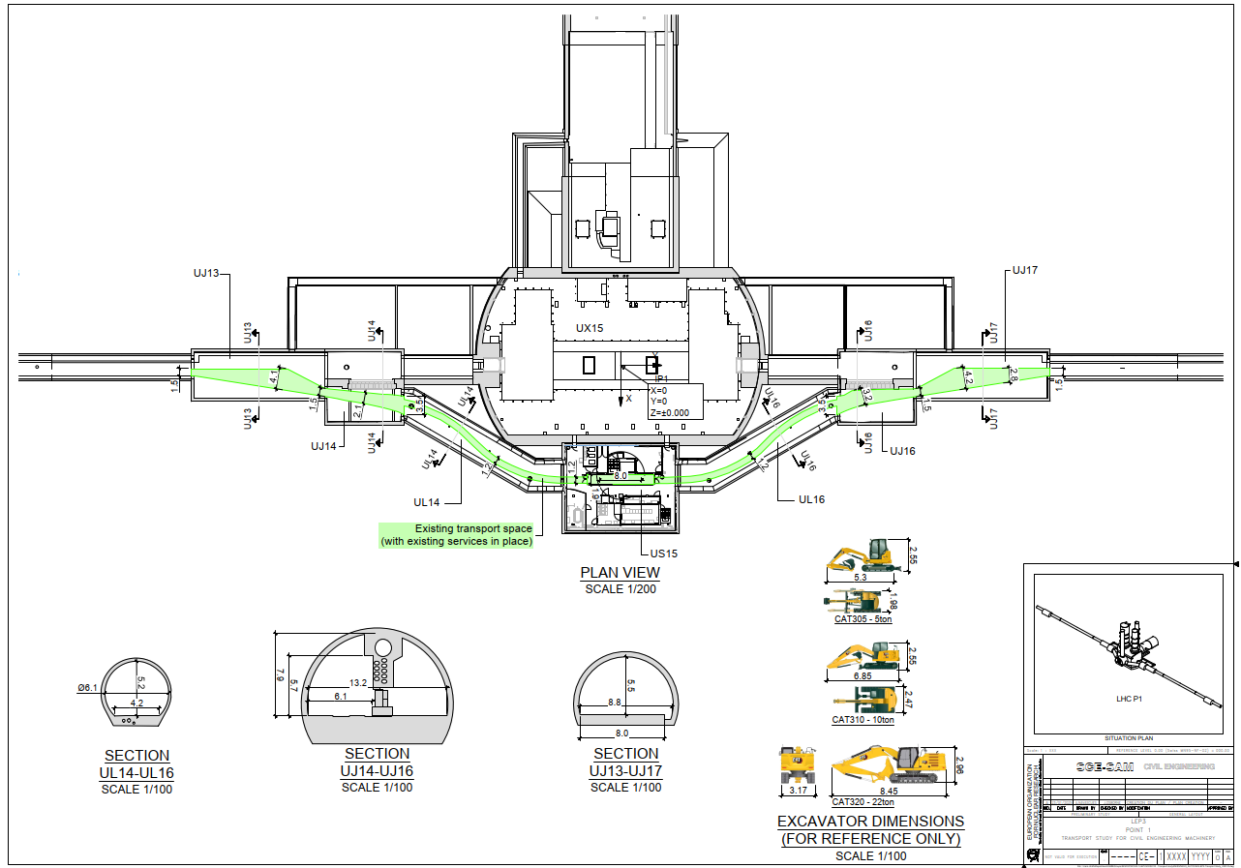

Slide 23
