Slide 1



⁷⁹Zn^{gs,1/2+}(d,p)⁸⁰Zn
How the N=50 gap evolves close to ⁷⁸Ni ? How to characterise shape coexistence ?
An ISS proposal
A. Gottardo, L. Gaffeney
ISS collaboration

Slide 2
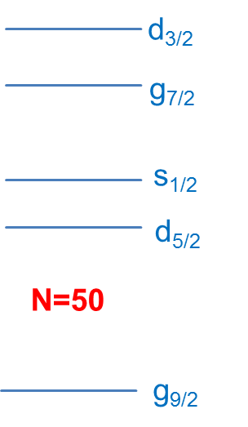
The N=50 isotones towards ⁷⁸Ni
Zr90
Zr91
Zr92
Zr93
Y89
Sr84
Sr86
Sr87
Sr88
Rb85
Rb87
Kr78
Kr80
Kr82
Kr83
Kr84
Kr86
Br79
Br81
Br85
Se76
Se77
Se78
Se80
Se82
Se84
As75
As83
Ge74
Ge76
Ge81
Ge82
fp proton space
Ga81
Zn79
Zn80
Cu79
Ni70
Ni71
Ni72
Ni73
Ni74
Ni75
Ni76
Ni77
Ni78
50
Quasi-SU(3) scheme: gds shells

Slide 3
Evolution of the N=50 gap
Mass gap: from measured Sn values
Quadratic behaviour of the shell gap
Spectroscopic gap: from 5⁺,6⁺ levels which are a g_{9/2}-d_{5/2} N=50 core excitation
Spectroscopy shows a decrease until Z=31
?
Phys. Rev. C 100, 011301(R) (2019)
J. Hakala et al., Phys. Rev. Lett. 101, 052502 (2008)
S. Baruah et al., Phys. Rev. Lett. 101, 262501 (2008)
K. Heyde et al., Phys. Lett. B 176, 255 (1986).
T. Rzaca-Urban et al., Phys. Rev. C 76, 027302 (2007)
How does the spectroscopic N=50 gap evolve in ⁸⁰Zn ? Is there the re-increase seen by mass measurements ?

Slide 4
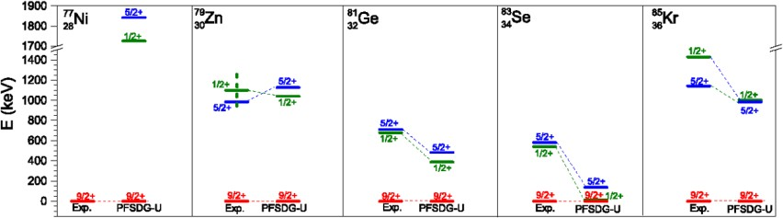
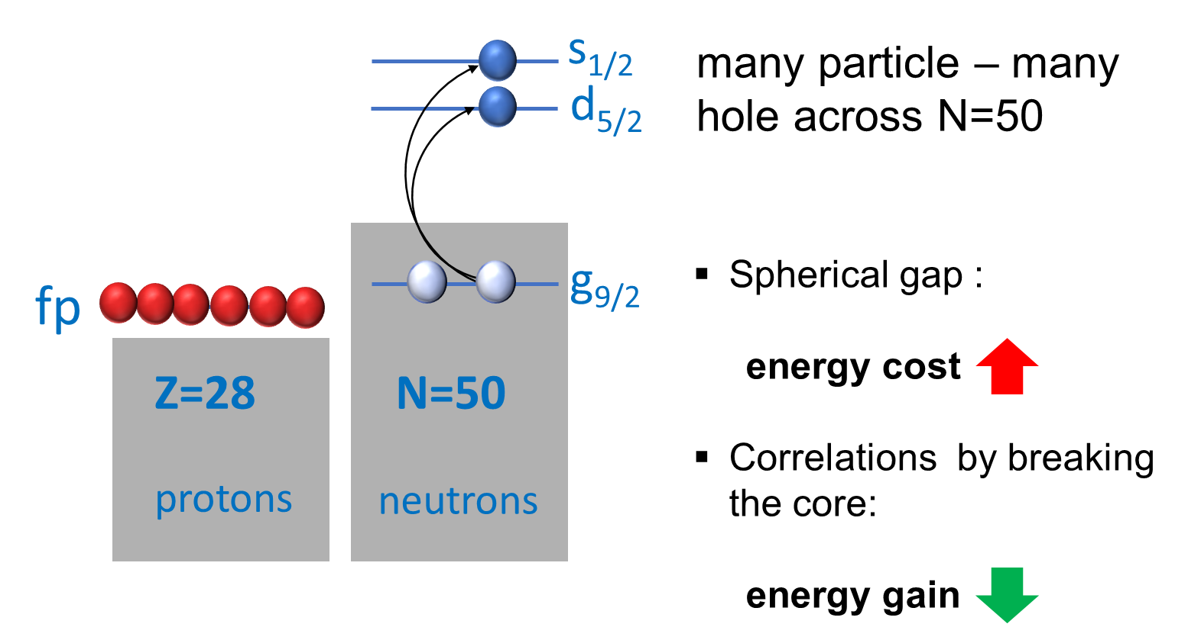
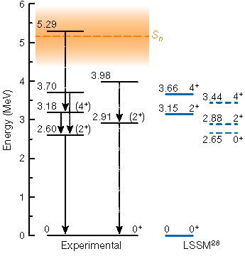
Shape coexistence towards and at ⁷⁸Ni
Intruder 5/2⁺, 1/2⁺ states in N=49 isotones
C. Wraith et al., Phys. Lett. B 771 (2017) 385391
⁷⁸Ni
Prediction (and observation ?) of
a well deformed 4p-4h intruder structure in ⁷⁸Ni
F. Nowacki et al., Phys. Rev. Lett. 117, 272501 (2016)
R. Taniuchi et al., Nature 569, 53–58 (2019)

Slide 5
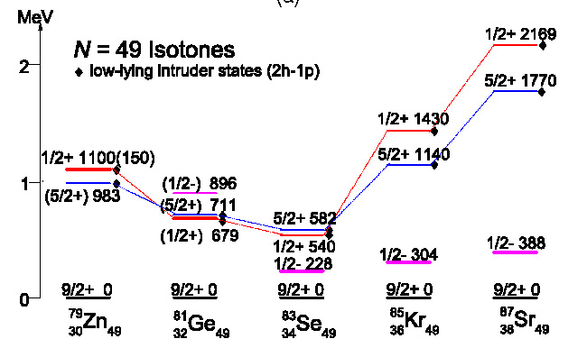
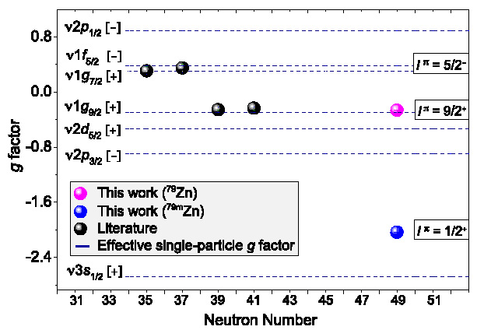
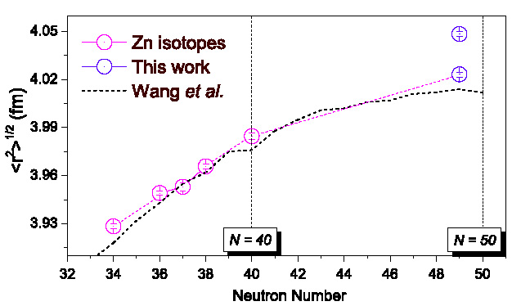
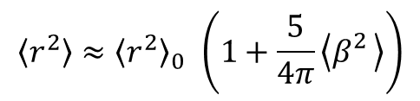
What is known in ^{79,80}Zn (I)
The 1/2⁺ state in ⁷⁹Zn has a dominant ν(g_{9/2}⁻² s_{1/2}) character
Large isomer shift. Large deformation (β~0.22) or large radius ?
$$\left\langle r^{2}\right\rangle ≈{\left\langle r^{2}\right\rangle }_{0 }\left(1+\frac{5}{4π}\left\langle β_{}^{2}\right\rangle \right)$$
X. F. Yang et al. Phys. Rev. Lett. 116, 182502 (2016)
s_{1/2}
N=50
g_{9/2}

Slide 6
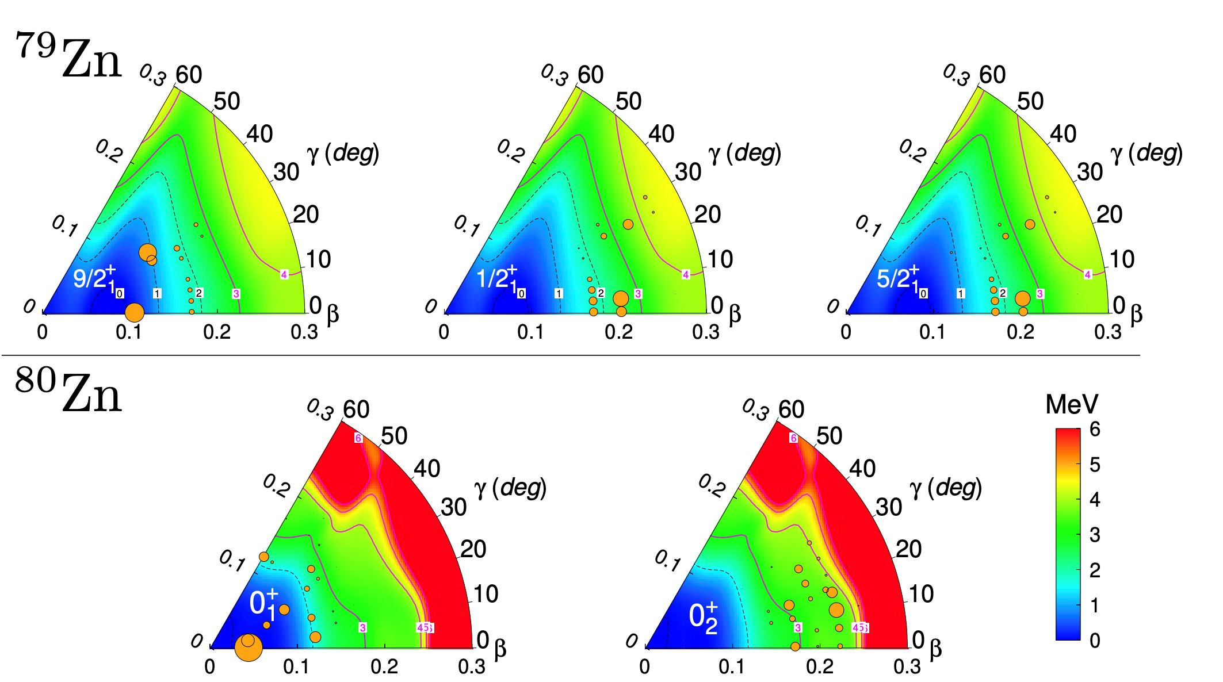
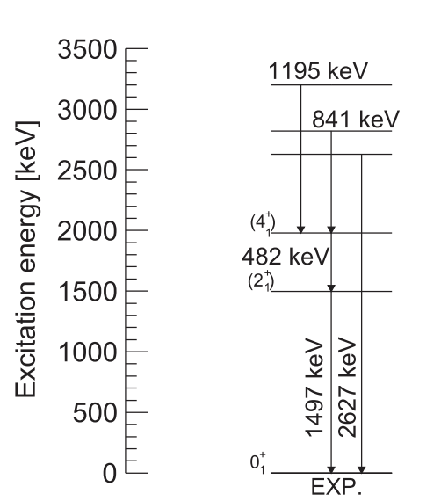
What is known in ^{79,80}Zn (II)
Mass measurement at ISOLDE measured the exact energy of the 1/2⁺ isomer (943 keV)
Mixed ISOL beam: ⁷⁹Zn gs + ⁷⁹Zn 1/2⁺ (7%)
Shell-model calculations point to the same deformed intruder structure in ^{79,80}Zn
In ⁸⁰Zn, only the 2⁺ and 4⁺ states are known
discrete nonorthogonal shell-model
L. Nies et al., Phys. Rev. Lett. 131, 222503, 2023
2⁺ discovered at ISOLDE ! Phys. Rev. Lett. 99, 142501 (2007)
Phys. Rev. C 93, 024320 (2016)

Slide 7
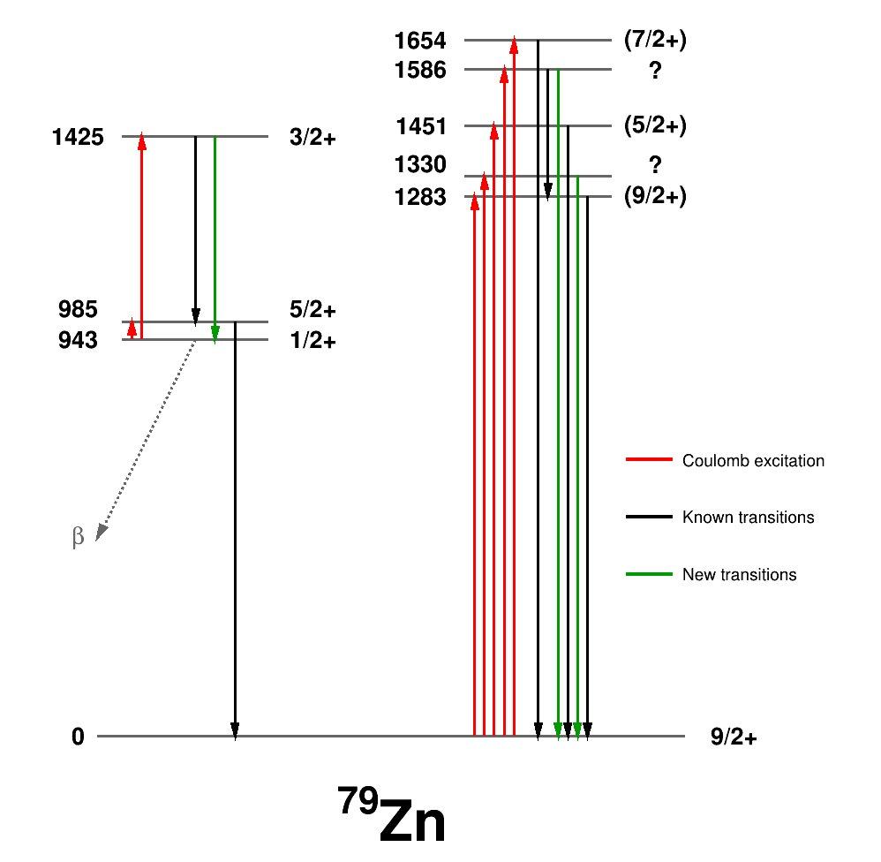
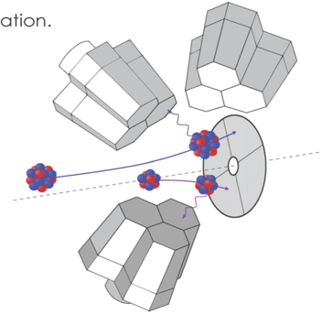
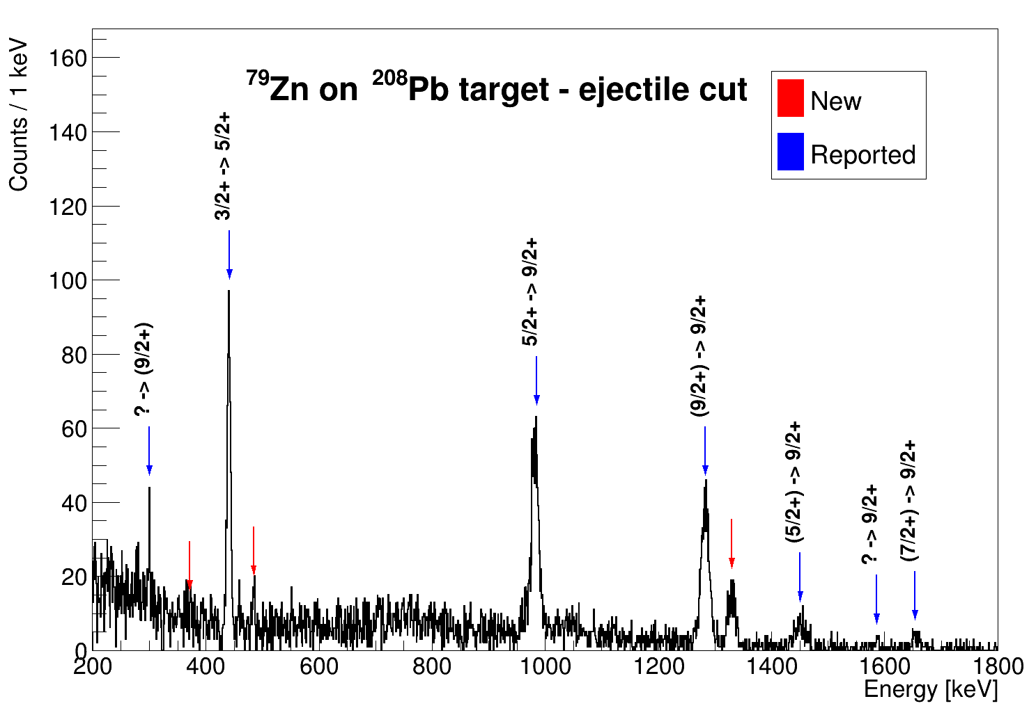
IS646: ⁷⁹Zn Coulex at ISOLDE (Sep. 24)
Coulex on both gs and isomeric 1/2+ state
Energy | Eff. corr. counts
300.5 | 495
441.6 | 4562
484.8 | 468
983.5 | 9709
1283.5 | 9439
1331.5 | 3291
1449.7 | 2212
1582.5 | 316
1656 | 922
1/2⁺ Coulex
∼1.0・10⁴
Large Coulex on the 1/2⁺ isomer: rotational band(K=1/2)-like structure
GS Coulex
∼1.6・10⁴

Slide 8
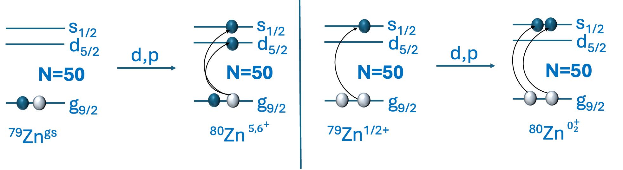
What we can learn from ⁷⁹Zn^{gs,1/2+}(d,p)⁸⁰Zn
Transfer on the ⁷⁹Zn 9/2⁺ gs
Transfer on the ⁷⁹Zn 1/2⁺ isomer
When N=50 is broken, more proton excitations
𝜋p_{1/2}
𝜋p_{3/2}
𝜋f_{7/2}
Discovery potential:
(d,p) on the ⁷⁹Zn gs will populate the 5⁺, 6⁺ breaking the core with $ℓ$=0,2 : g_{9/2}-d_{5/2}, g_{9/2}-s_{1/2}
(d,p) on the ⁷⁹Zn 1/2⁺ will populate the intruder $0_{2}^{+}$ breaking the core with $ℓ$=0: (g_{9/2})⁻² (s_{1/2})² , (g_{9/2})⁻² (d_{5/2})²

Slide 9
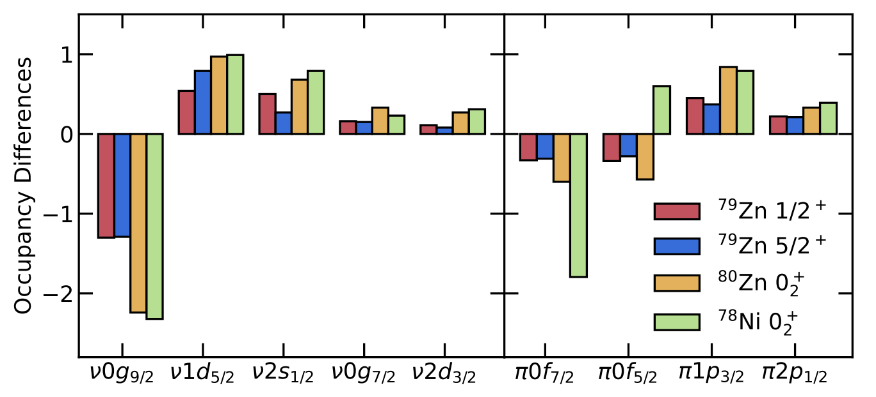
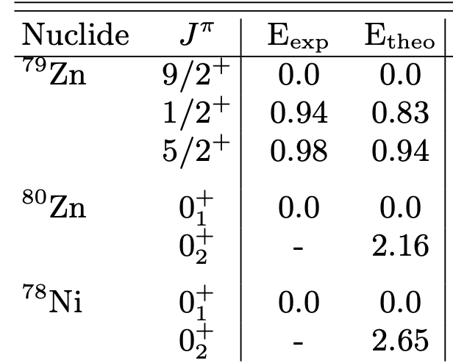






Shell-model predictions
L. Nies et al., Phys. Rev. Lett. 131, 222503, 2023, PFSDG-U
𝜋p_{1/2}
𝜋p_{3/2}
𝜋f_{7/2}
Neutrons
Protons
Simplified interaction breaking only
the N=50 core (GWB from Oxbash library)
E [MeV]
$$5_{2}^{+}$$
$$6_{1}^{+}$$
3
$$5_{1}^{+}$$
Difference of occupancies among the excited states and the gs in ^{79,80}Zn, ⁷⁸Ni
2
$$0_{2}^{+}$$
$$2_{1}^{+}$$
Shell-model calculations support the schematic shell-model picture
From the interaction, we get the level energies and SF to simulate the reactions
1
0
$$0_{1}^{+}$$
⁸⁰Zn

Slide 10
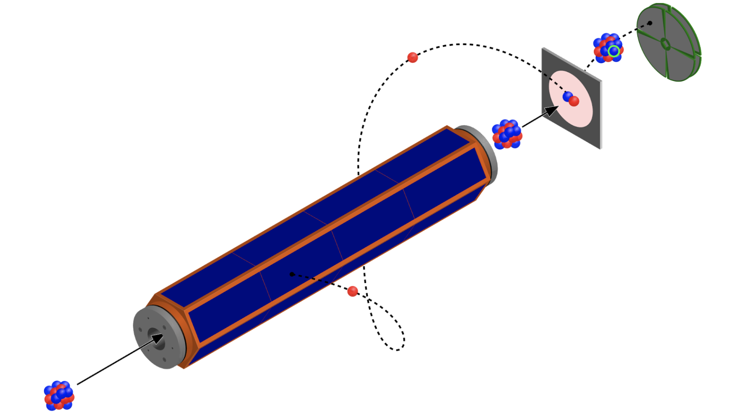
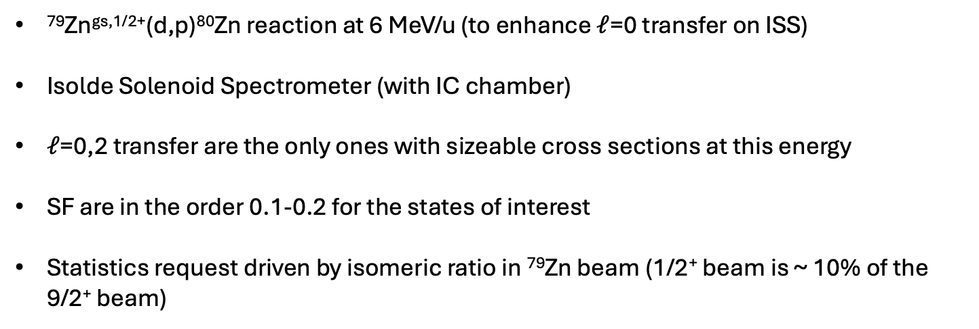
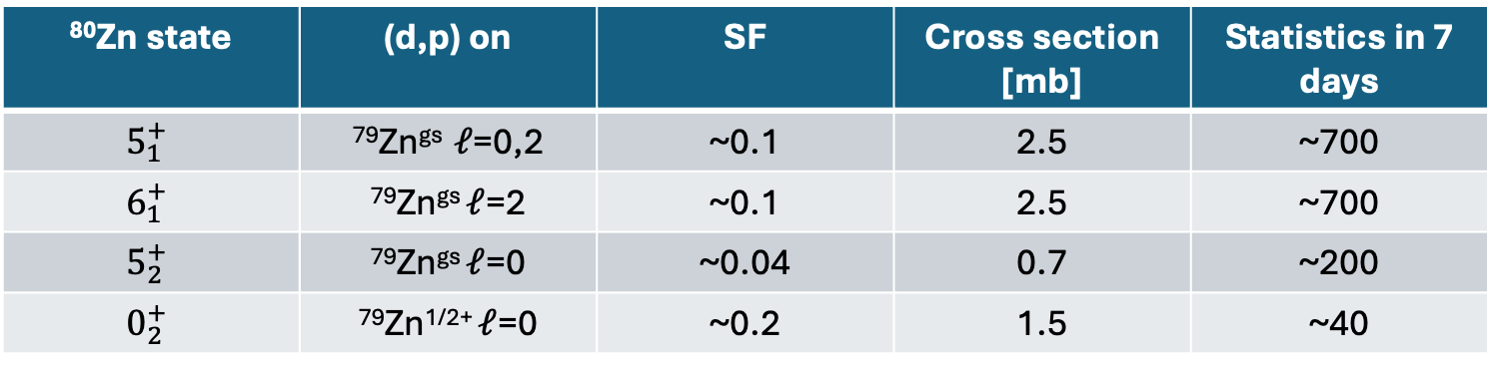
Proposed measurement on ISS:
21 shifts of beam on target
⁷⁹Zn^{gs,1/2+}(d,p)⁸⁰Zn reaction at 6 MeV/u (to enhance $ℓ$=0 transfer on ISS)
Isolde Solenoid Spectrometer (with IC chamber)
$ℓ$=0,2 transfer are the only ones with sizeable cross sections at this energy
SF are in the order 0.1-0.2 for the states of interest
Statistics request driven by isomeric ratio in ⁷⁹Zn beam (1/2⁺ beam is ~ 10% of the 9/2⁺ beam)
⁸⁰Zn state | (d,p) on | SF | Cross section [mb] | Statistics in 7 days
$$5_{1}^{+}$$ | ⁷⁹Zn^{gs} $ℓ$=0,2 | ~0.1 | 2.5 | ~700
$$6_{1}^{+}$$ | ⁷⁹Zn^{gs} $ℓ$=2 | ~0.1 | 2.5 | ~700
$$5_{2}^{+}$$ | ⁷⁹Zn^{gs} $ℓ$=0 | ~0.04 | 0.7 | ~200
$$0_{2}^{+}$$ | ⁷⁹Zn^{1/2+} $ℓ$=0 | ~0.2 | 1.5 | ~40

Slide 11
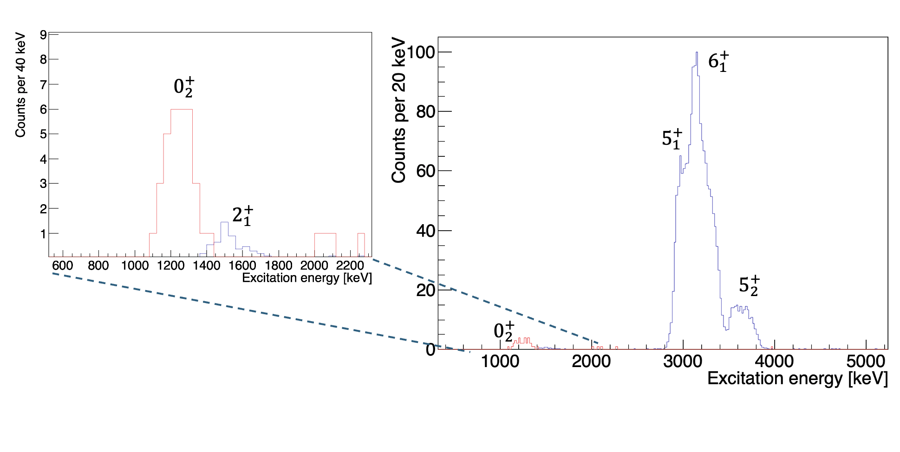
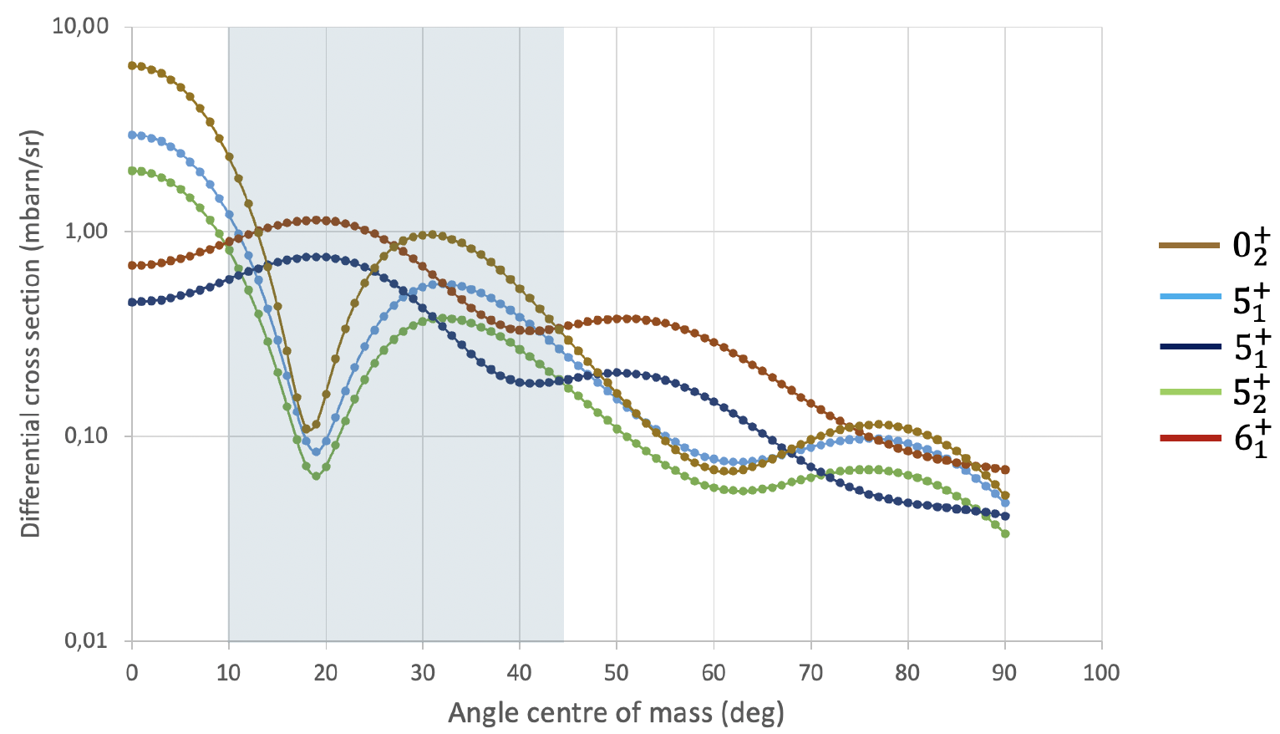
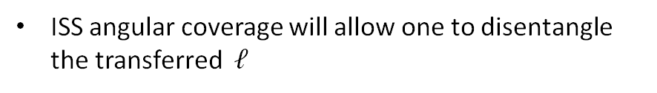
Simulation of the ISS results
Excitation energy assuming transfer on gs for Q-value
Monte Carlo simulation with a 300 𝜇g/cm² CD2 target
Rough idea on how the excitation spectra might look like
A thinner target (100-150 𝜇g/cm² ) will be ready to be used during the experiment looking at near-line spectra
ISS angular coverage will allow one to disentangle the transferred $ℓ$

Slide 12
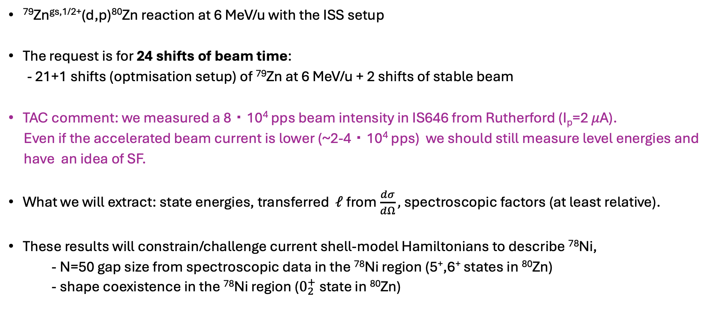
Conclusions, TAC comment
⁷⁹Zn^{gs,1/2+}(d,p)⁸⁰Zn reaction at 6 MeV/u with the ISS setup
The request is for 24 shifts of beam time:
- 21+1 shifts (optmisation setup) of ⁷⁹Zn at 6 MeV/u + 2 shifts of stable beam
TAC comment: we measured a 8・10⁴ pps beam intensity in IS646 from Rutherford (I_{p}=2 𝜇A).
Even if the accelerated beam current is lower (~2-4・10⁴ pps) we should still measure level energies and
have an idea of SF.
What we will extract: state energies, transferred $ℓ$ from $\frac{dσ}{dΩ},$spectroscopic factors (at least relative).
These results will constrain/challenge current shell-model Hamiltonians to describe ⁷⁸Ni,
- N=50 gap size from spectroscopic data in the ⁷⁸Ni region (5⁺,6⁺ states in ⁸⁰Zn)
- shape coexistence in the ⁷⁸Ni region ($0_{2}^{+}$ state in ⁸⁰Zn)

Slide 13
Thank for your attention !

Slide 14
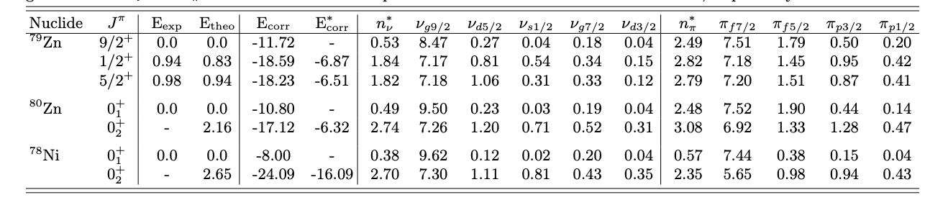
Shell-model PFSDG-U

Slide 15
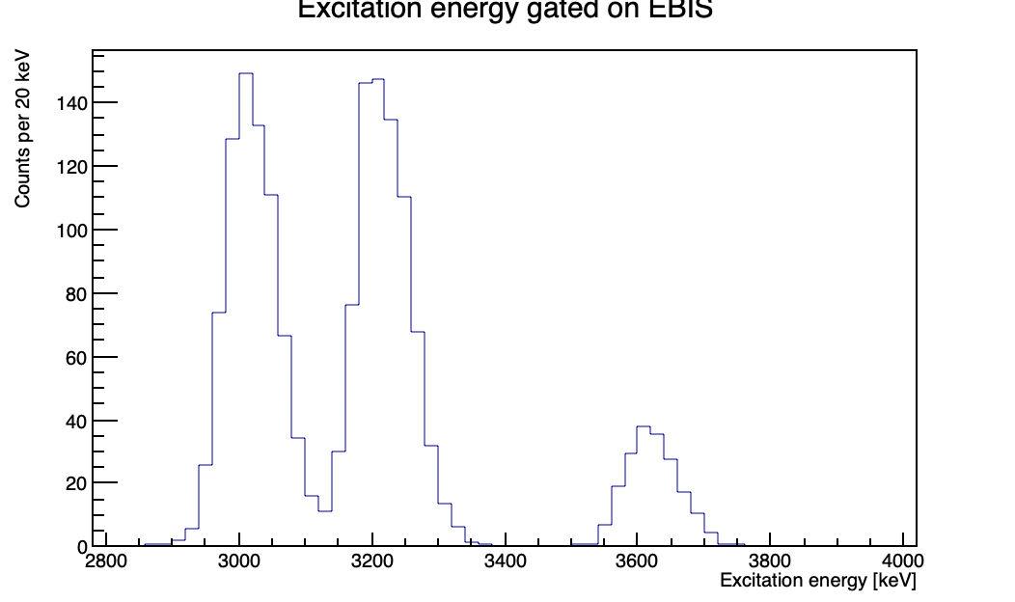
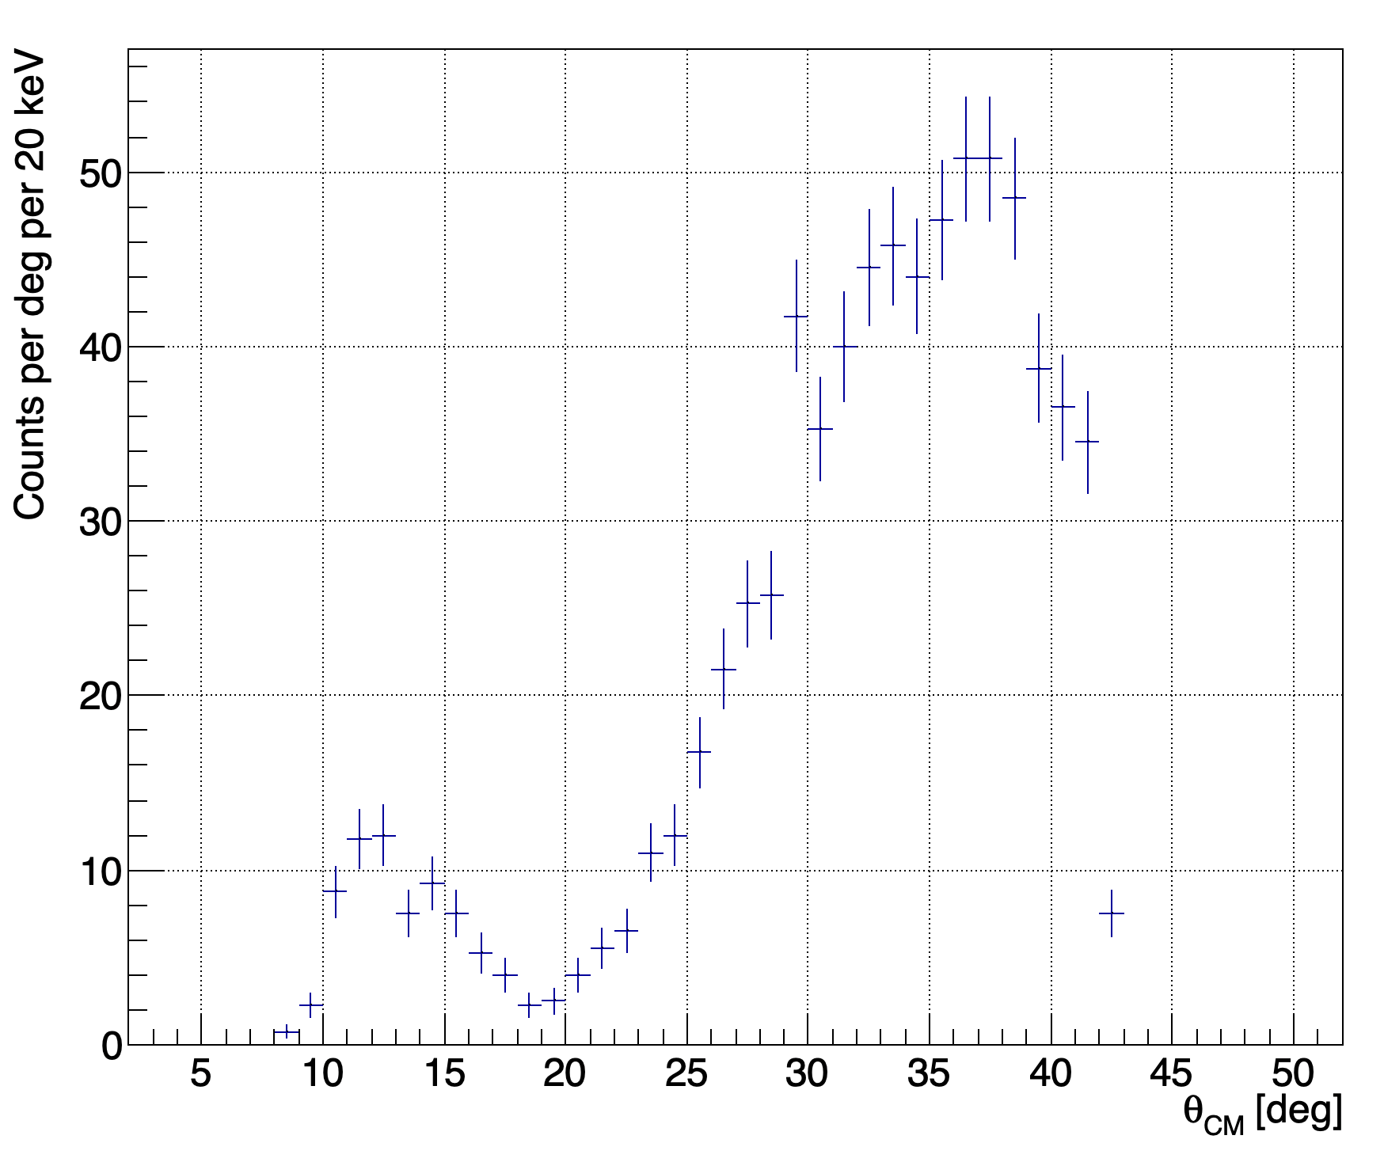
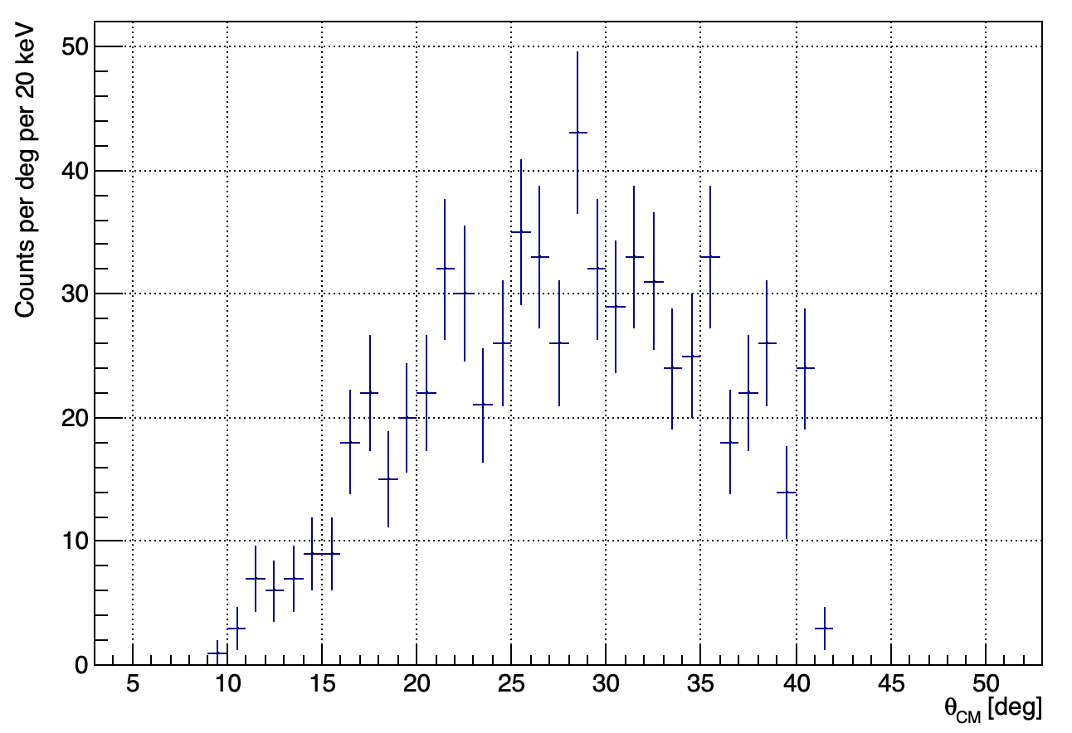





Thinner target 100-150 𝜇g/cm²
To be used in case after a few days of thick target to help disentagle the 5⁺,6⁺ states at around 3 MeV.
$$5_{1}^{+}$$
$$6_{1}^{+}$$
$ℓ$=0
$$5_{2}^{+}$$
$ℓ$=2

Slide 16
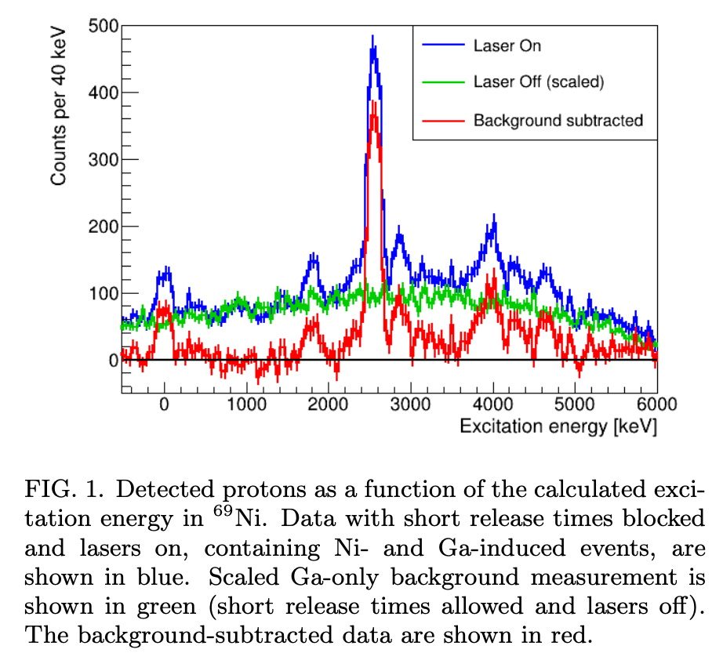
Fusion-evaporation backround
We intend to use the ionisation chamber and perform event-by-event recoil coincidences,
we have the 68Ni spectrum to give an idea of the background level with similar mass and similar beam intensity. In this case, we did not use the ionisation chamber, so background will be lower for 79Zn.

