Slide 1
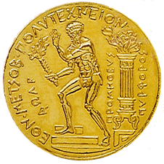


Study of semiconductor detectors’ performance at NEAR
M. Diakaki¹, M. Bacak², C. Weiss^{2,3}, E. Griesmayer^{2,3}, K. Kaperoni¹, M. Kokkoris¹,
J. Bartolomé⁴, Z. Eleme⁵, V. Foteinou⁵, C. Guerrero⁴, D. Hainz², E. Jericha²,
S. Kopanos¹, I. Kopsalis¹, V. Michalopoulou¹, N. Patronis⁵, A. Reina⁴, R. Vlastou¹
and the n_TOF Collaboration⁶
¹National Technical University of Athens, Greece
²TU Wien, Atominstitut, Stadionallee 2, 1020 Wien, Austria
³www.cividec.at
⁴Universidad de Sevilla, Spain
⁵University of Ioannina, Greece
⁶www.cern.ch/n_TOF

Slide 2
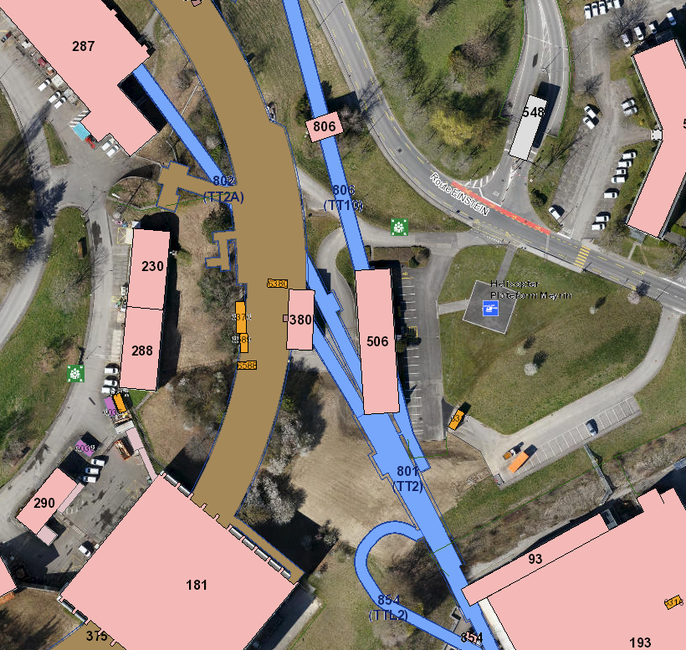
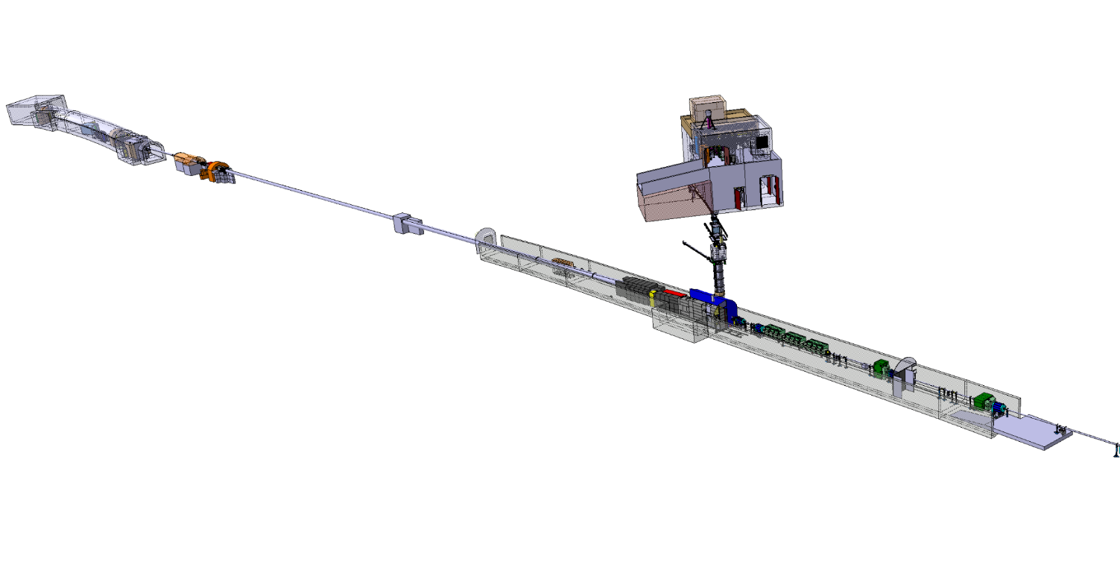
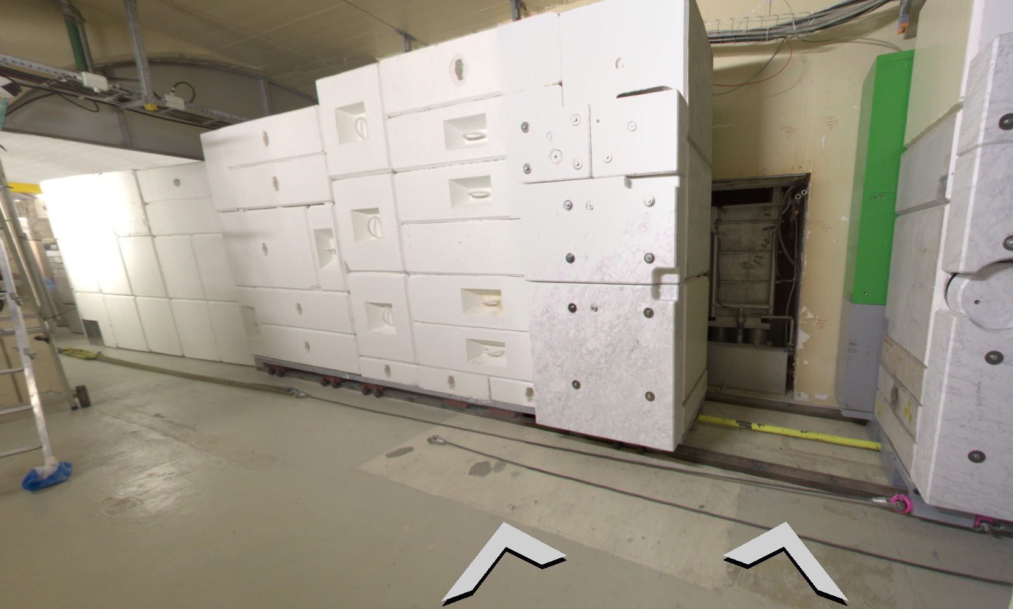
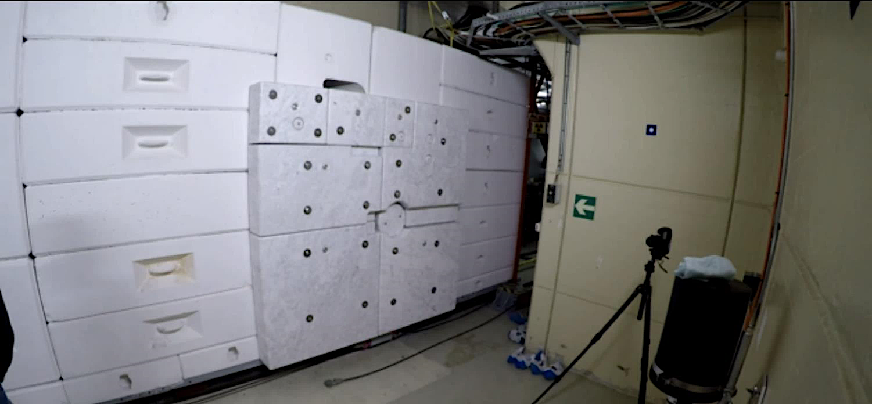
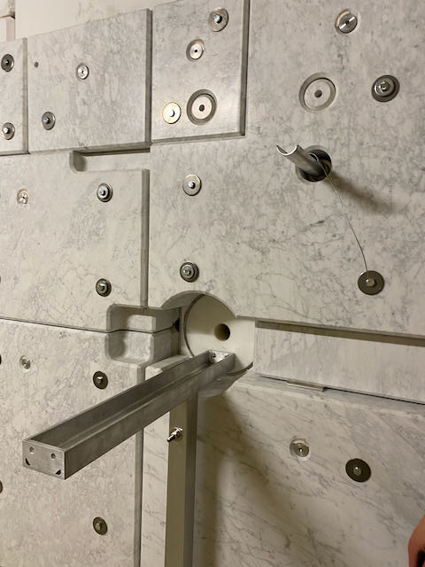
The n_TOF NEAR station
Very close to the Pb spallation target (~2m flight path)
Commissioned in 2021
n_TOF mixed field irradiation station [4] for various applications:
EAR1
EAR2
TT2A- 802
NEAR
Protons from PS
n_TOF target pool
Possible applications [1-3]:
Nuclear Astrophysics
Nuclear energy production studies
Radiation damage studies (conditions close
to accelerator facilities)
……
neutrons
[1] M. Cecchetto et al., IEEE TRANSACTIONS ON NUCLEAR SCIENCE, VOL. 70,
NO. 8, AUGUST 2023
[2] A. Mengoni et al., CERN-INTC-2020-073; INTC-I-222 (2020)
[3] E. Stamati, et al., CERN-INTC-2022-008; INTC-P-623 (2022)
[4] M. Ferrari et al., Phys. Rev. Accel. Beams 25, 103001 (2022)
Photos from A.P. Bernardes presentation, n_TOF meeting 25/11/2021
Notes:
Mobile shielding wall

Slide 3
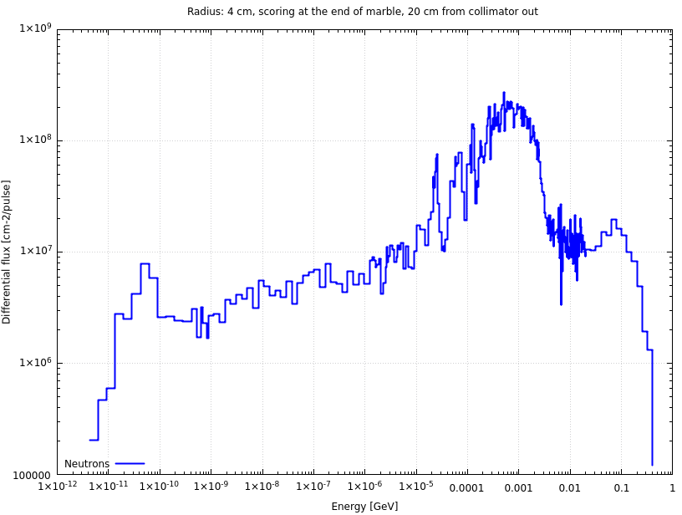
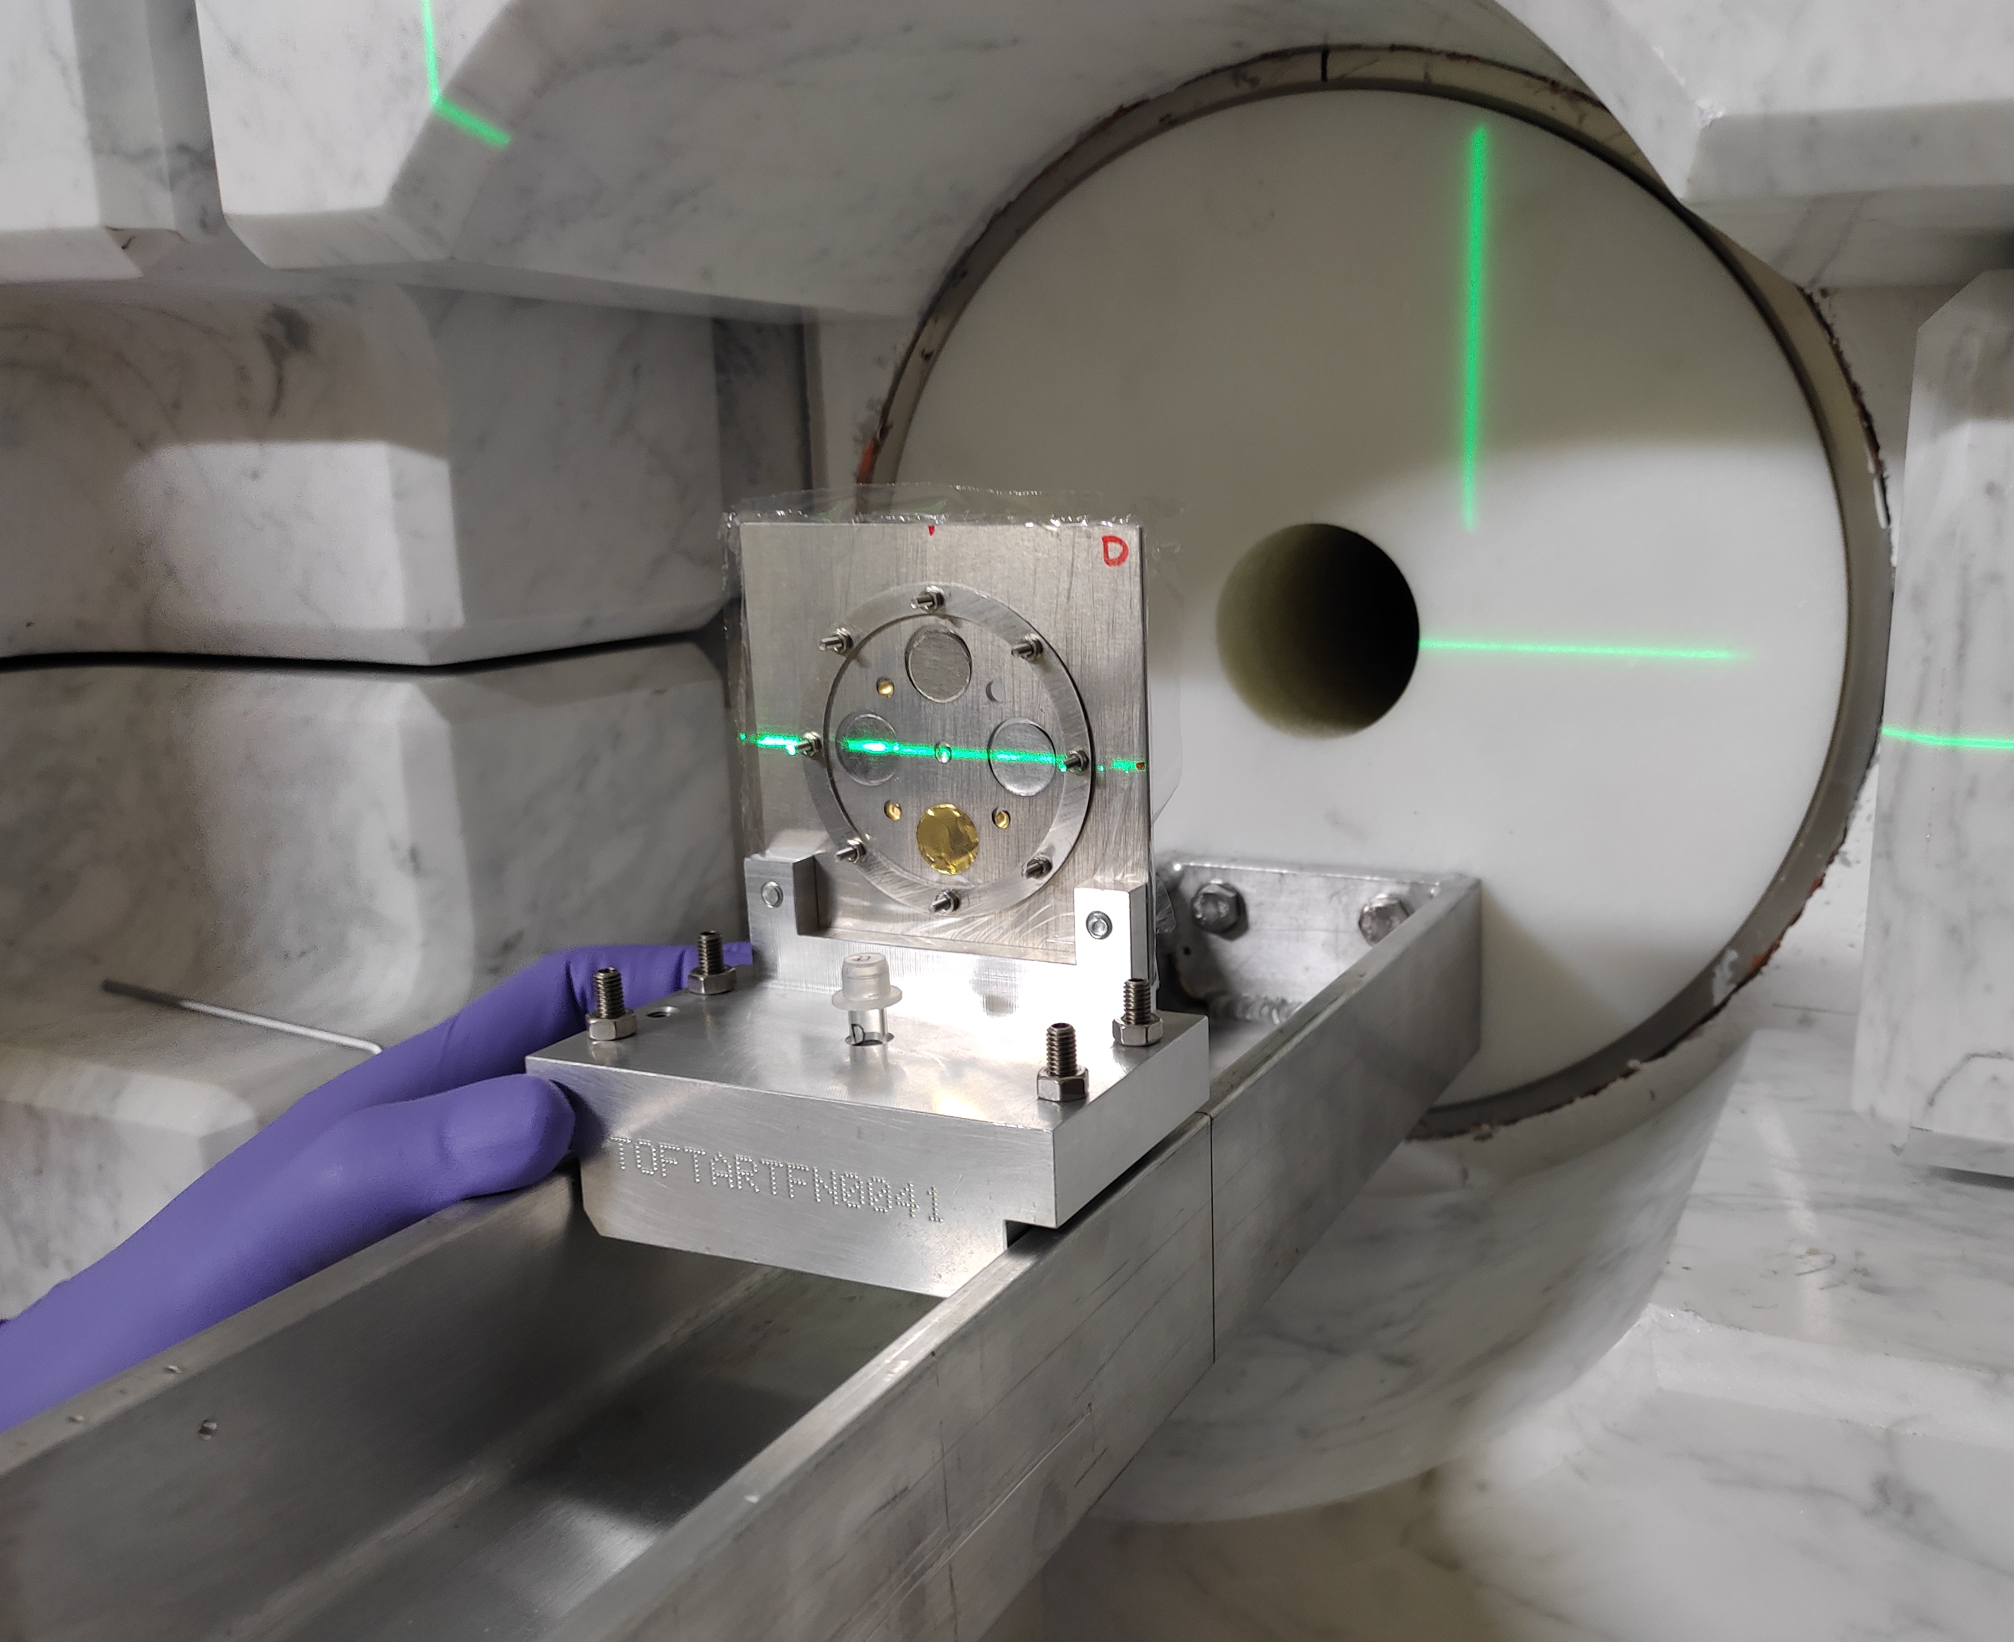
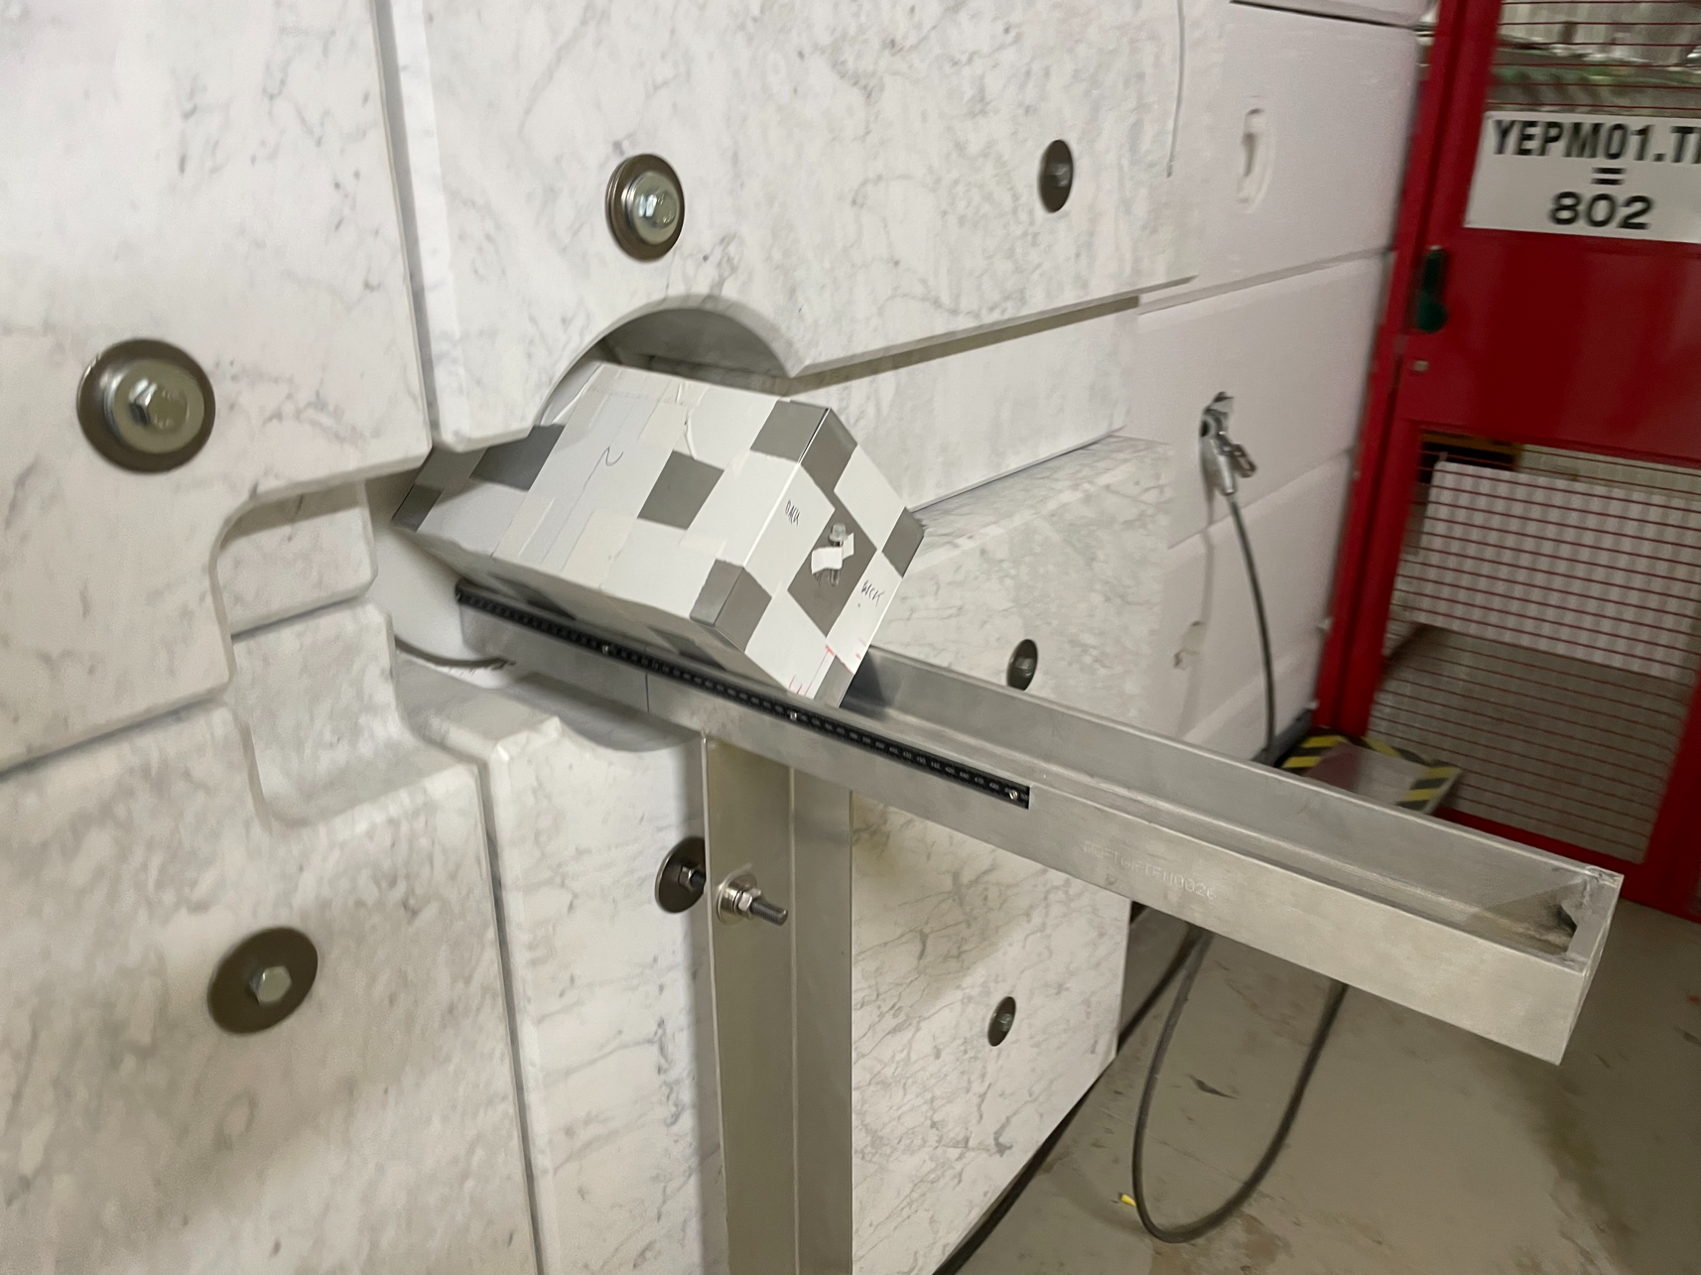
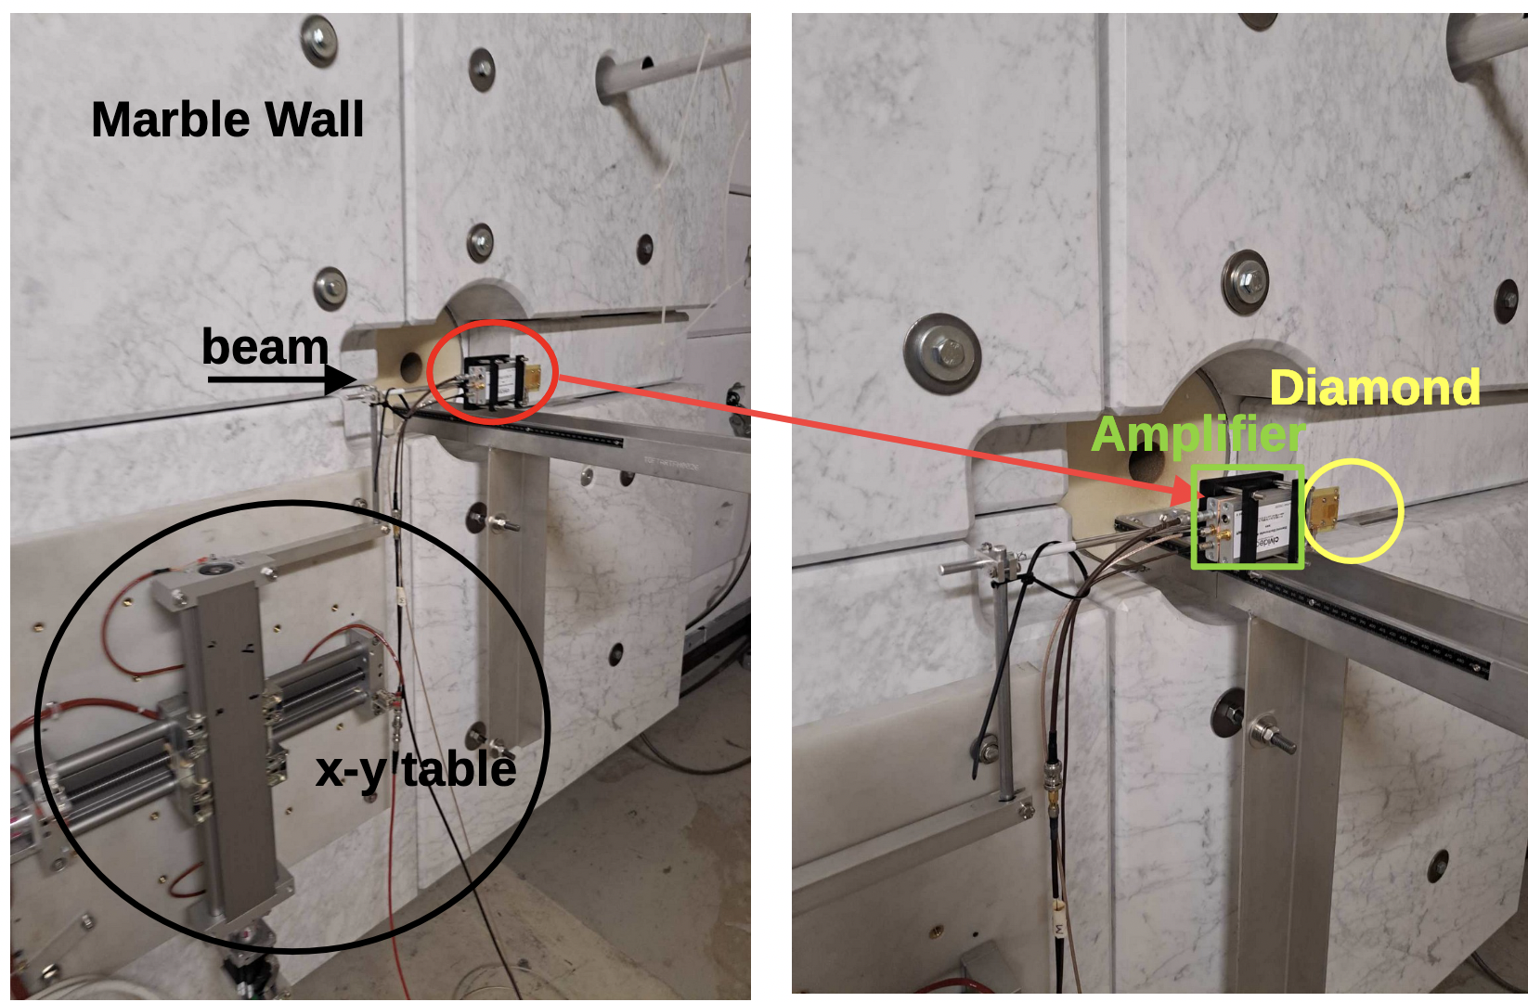
Commissioning of the NEAR station
Extensive Monte Carlo Simulations [1,4,5]
Multiple Foil Activation Analysis (MAM1 and MAM2 configurations) [5]
Moderation-Absorption technique (ANTILOPE) [5]
Active diamond detector measurement of fluence and profile [6,7,8]
[1] M. Cecchetto et al., IEEE TRANSACTIONS ON NUCLEAR SCIENCE, VOL. 70,
NO. 8, AUGUST 2023
[4] M. Ferrari et al., Phys. Rev. Accel. Beams 25, 103001 (2022)
[5[E. Stamati et al., EPJ Web of Conferences 284, 06009 (2023)
[6] M. Diakaki et al., CERN-INTC-2022-022 / INTC-P-631 (2022)
[7] K. Kaperoni et al., RAP CONFERENCE PROCEEDINGS, VOL. 8, PP. 79–83, 2023
[8] K. Kaperoni et al., Presentations at n_TOF Collaboration meetings

Slide 4

Active diamond detector measurements – Overview
Diamond sensor + electronics especially developed by CIVIDEC Instrumentation [9] for the measurements at NEAR:
Fast-response, high-radiation-hardness, high-resolution, low-noise radiation detector
Single-crystal sensor fabricated via the CVD (Chemical Vapour Deposition) technology.
Characteristics: 50 μm thickness, 4x4 mm² active surface (Τhin detector to cope with harsh NEAR conditions [10])
[9] CIVIDEC Instrumentation, https://cividec.at/
[10] M. Angelone and C. Verona, J. Nucl. Eng. 2021, 2, 422–470
Notes:
As already discussed in the introduction section, neutron detection represents one of
the earliest and yet most important application of diamond detectors.

Slide 5
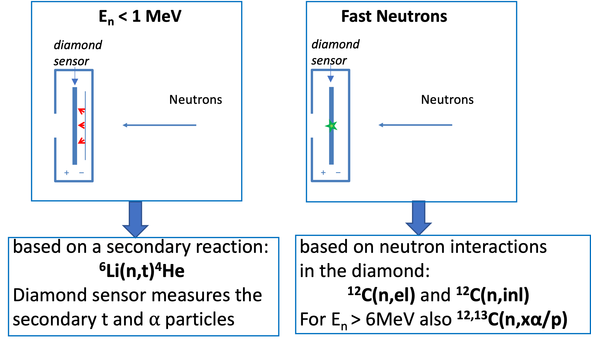
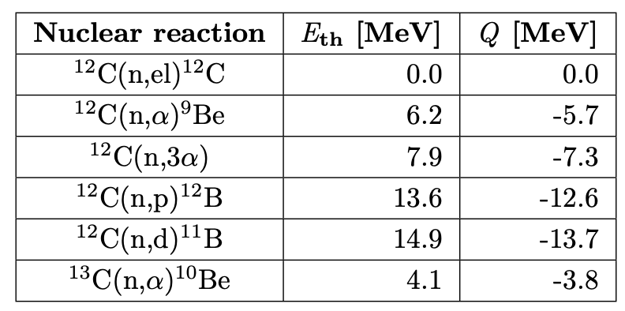
Active diamond detector measurements – Overview
Diamond sensor + electronics especially developed by CIVIDEC Instrumentation [9] for the measurements at NEAR:
Fast-response, high-radiation-hardness, high-resolution, low-noise radiation detector
Single-crystal sensor fabricated via the CVD (Chemical Vapour Deposition) technology.
Characteristics: 50 μm thickness, 4x4 mm² active surface (Τhin detector to cope with harsh NEAR conditions [10])
Neutron Detection Principle:
⁶LiF converter
[9] CIVIDEC Instrumentation, https://cividec.at/
[10] M. Angelone and C. Verona, J. Nucl. Eng. 2021, 2, 422–470
This principle already used in fission reactors and
fusion tokamaks [10]

Slide 6
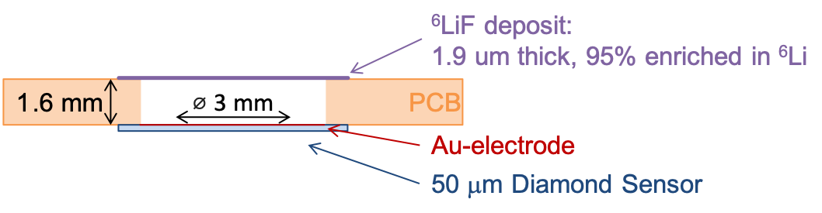
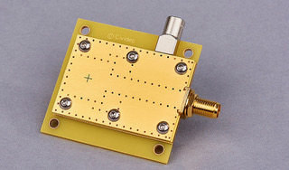
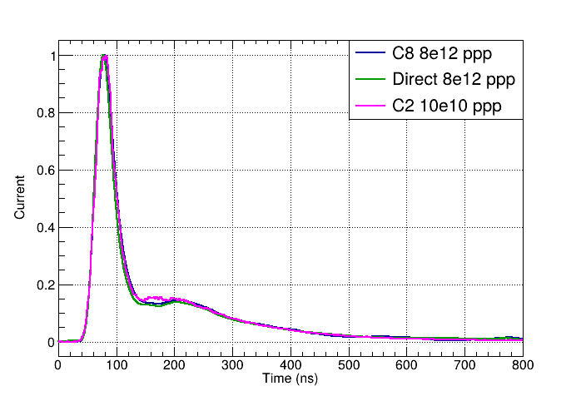
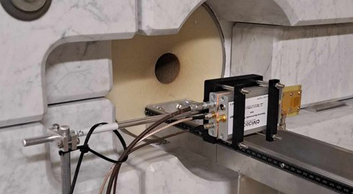
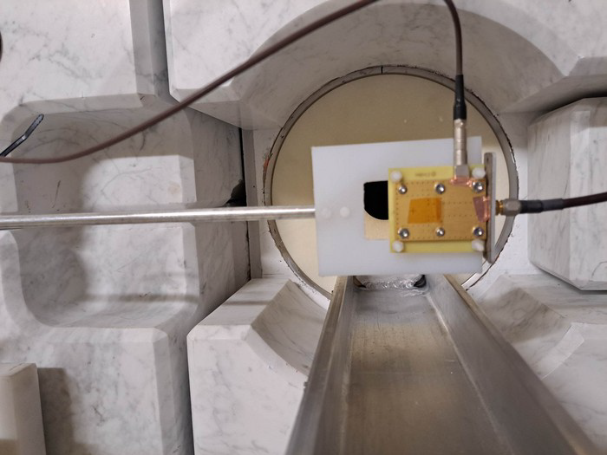
Active diamond detector measurements – Overview
Schematics of detector setup:
Electronic / Readout setups used:
10 MHz DC-coupled amplifier (“C8”) : Low gain, no saturation at g-flash: high neutron energies
2 GHz AC-coupled 40 dB amplifier (“C2”) : High gain, very fast AC readout (pulse height mode) - no saturation for 10e10 ppp
No preamplification stage (“Direct”) : 70 m cable betweeen detector and DAQ.
A,B)
C)
Very good agreement
Notes:
C8 and dIRECT HAVE SLIGHTLY DIFFERENT BANDWISTH

Slide 7
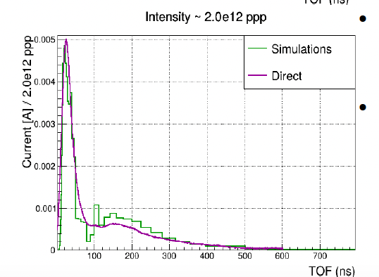
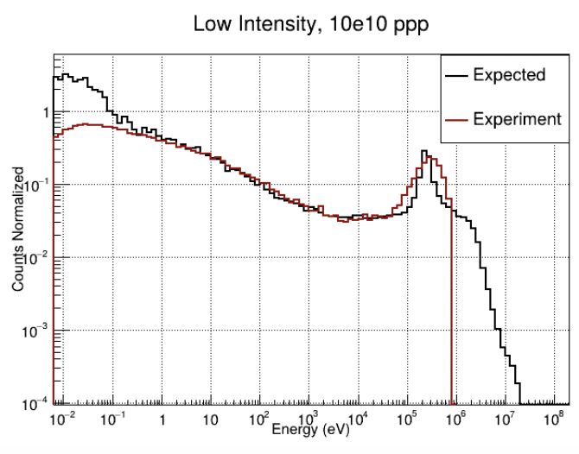
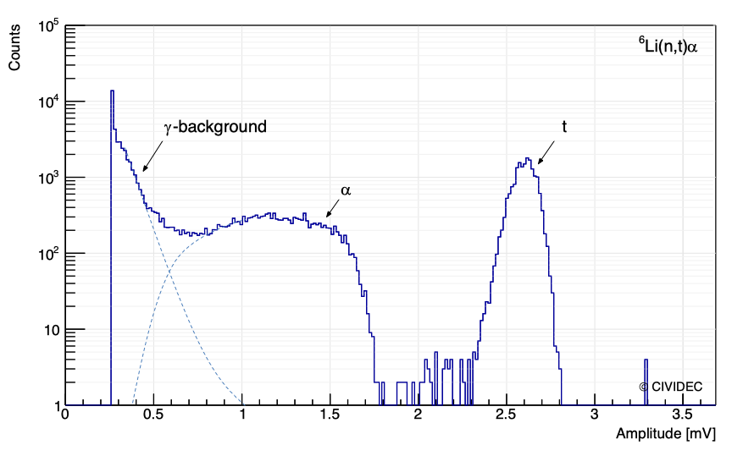
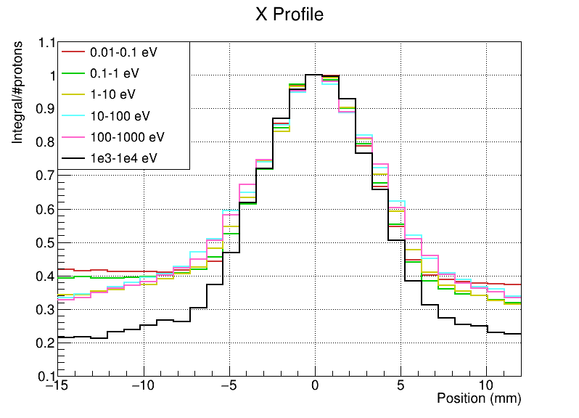
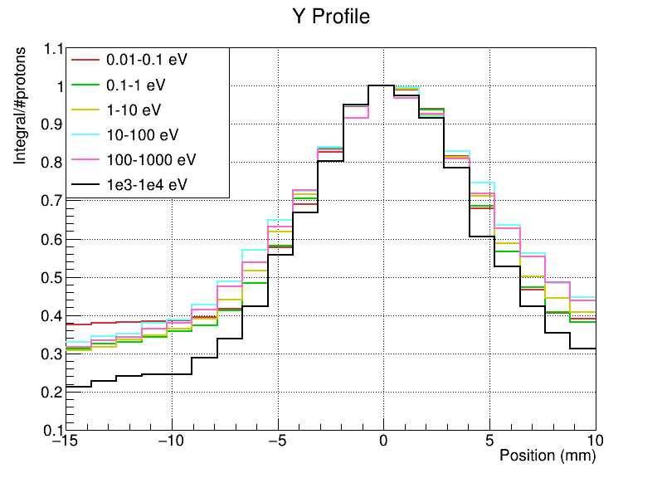
Active diamond detector measurements – Overview
Different configurations and measurements:
Neutron flux measurements:
>100keV
Neutron beam profile measurements:
+ Other configurations:
5mm B₄C filter
Position close to the wall
Au and Cd filters.
Good preliminary results,
Finalisation and Monte Carlo simulations
ongoing.
cm
cm

Slide 8
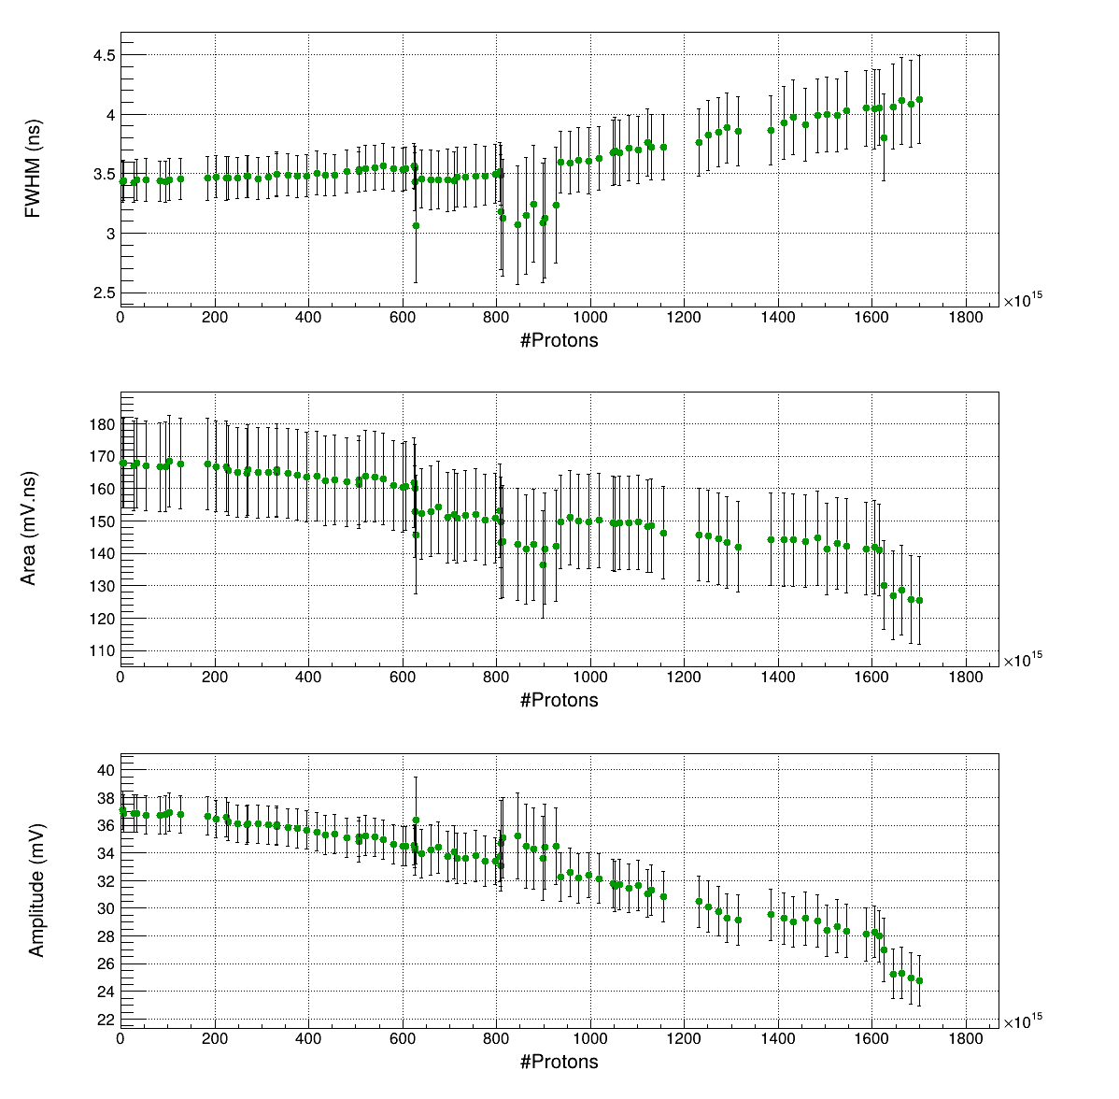
Active diamond detector measurements – Overview
Interesting degradation of detector’s performances (C2):
Deterioration of signal characteristics:
- Broadening of FWHM,
- Lowering of area
- Lowering of Amplitude
Typically due to radiation damage:
Defects of various types in the lattice, due to
energetic recoil nuclei/ from nuclear collisions and reactions
(vacancies and displaced atoms in interstitial sites, trapping - detrapping process, polarization effects [10]….)
All these effects have been / are currently being extensively
studied for neutron irradiation on CVD diamonds due to their
usage for neutron detection at various fields [10-11]
Campaign: August 2023
[10] M. Angelone and C. Verona, J. Nucl. Eng. 2021, 2, 422–470 and ref therein
[11] M. Passeri et al., Nuclear Inst. and Methods in Physics Research, A 1010 (2021) 165574 and ref therein
Notes:
The effects produced by the radiation depend upon several factors, dose-rate, fluence, type
of radiation, and temperature being the most important.
The radiation-induced defects are both vacancies, which act as traps
located at deep energy levels and displaced atoms interstitials generated by Rutherford
scattering and knock-on atoms. The energy per unit path lost by the incident particle due
to displacement processes is called non-ionizing energy loss (NIEL), and it depends on the
projectile nucleus atomic number and energy.
Thermal neutrons do not have a noticeable effect on carbon since their energy results lower than the minimum average energy of 43 eV requested for a single vacancy-interstitial creation.

Slide 9
Why new measurements are needed ???
Interesting to study radiation hardness of our thin sCVD detector at the NEAR neutron field.
Lifetime of diamond as neutron monitor at NEAR.
General results on radiation damage of 50 μm sCVD in white neutron beam from spallation source. Ιnteresting for various applications using diamond detectors as neutron monitors – fission / fusion reactors, accelerator environments, atmospheric environments etc) (complete ongoing PhD work).
Notes:
The effects produced by the radiation depend upon several factors, dose-rate, fluence, type
of radiation, and temperature being the most important.
The radiation-induced defects are both vacancies, which act as traps
located at deep energy levels and displaced atoms interstitials generated by Rutherford
scattering and knock-on atoms. The energy per unit path lost by the incident particle due
to displacement processes is called non-ionizing energy loss (NIEL), and it depends on the
projectile nucleus atomic number and energy.
Thermal neutrons do not have a noticeable effect on carbon since their energy results lower than the minimum average energy of 43 eV requested for a single vacancy-interstitial creation.

Slide 10
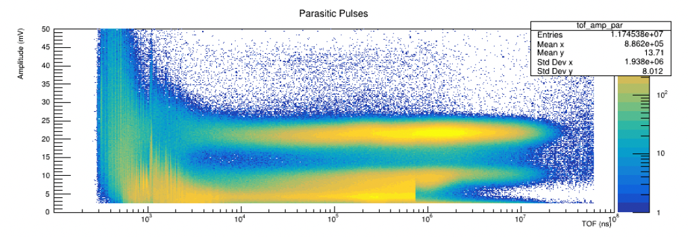
Why new measurements are needed ???
Interesting to study radiation hardness of our thin sCVD detector at the NEAR neutron field.
Lifetime of diamond as neutron monitor at NEAR.
General results on radiation damage of 50 μm sCVD in white neutron beam from spallation source. Ιnteresting for various applications using diamond detectors as neutron monitors – fission / fusion reactors, accelerator environments, atmospheric environments etc) (complete ongoing PhD work).
BUT : The data we collected with the sCVD up to now are not sufficient
1) Counting rate not reduced throughout the campaigns
=> No proper quantification of lifetime of sCVD as detector
at NEAR
Notes:
The effects produced by the radiation depend upon several factors, dose-rate, fluence, type
of radiation, and temperature being the most important.
The radiation-induced defects are both vacancies, which act as traps
located at deep energy levels and displaced atoms interstitials generated by Rutherford
scattering and knock-on atoms. The energy per unit path lost by the incident particle due
to displacement processes is called non-ionizing energy loss (NIEL), and it depends on the
projectile nucleus atomic number and energy.
Thermal neutrons do not have a noticeable effect on carbon since their energy results lower than the minimum average energy of 43 eV requested for a single vacancy-interstitial creation.

Slide 11
Why new measurements are needed ???
Interesting to study radiation hardness of our thin sCVD detector at the NEAR neutron field.
Lifetime of diamond as neutron monitor at NEAR.
General results on radiation damage of 50 μm sCVD in white neutron beam from spallation source. Ιnteresting for various applications using diamond detectors as neutron monitors – fission / fusion reactors, accelerator environments, atmospheric environments etc) (complete ongoing PhD work).
BUT : The data we collected with the sCVD up to now are not sufficient
2) Two different sources of radiation damage:
Interaction of fast neutrons
=> recoil nuclei from elastic/inelastic
scattering and other reactions ANYWHERE in the sensor
=> Homogeneous Radiation damage
b) Interaction of slow neutrons
=> alpha and triton recoils of the ⁶Li(n,t)⁴He reaction
=> No proper quantification of the two factors of
radiation damage
LiF
Notes:
The effects produced by the radiation depend upon several factors, dose-rate, fluence, type
of radiation, and temperature being the most important.
The radiation-induced defects are both vacancies, which act as traps
located at deep energy levels and displaced atoms interstitials generated by Rutherford
scattering and knock-on atoms. The energy per unit path lost by the incident particle due
to displacement processes is called non-ionizing energy loss (NIEL), and it depends on the
projectile nucleus atomic number and energy.
Thermal neutrons do not have a noticeable effect on carbon since their energy results lower than the minimum average energy of 43 eV requested for a single vacancy-interstitial creation.

Slide 12
Why new measurements are needed ???
Interesting to study radiation hardness of our thin sCVD detector at the NEAR neutron field.
Lifetime of diamond as neutron monitor at NEAR.
General results on radiation damage of 50 μm sCVD in white neutron beam from spallation source. Ιnteresting for various applications using diamond detectors as neutron monitors – fission / fusion reactors, accelerator environments, atmospheric environments etc) (complete ongoing PhD work).
BUT : The data we collected with the sCVD up to now are not sufficient
3) Data from different campaigns, with different characteristics
the setup slightly changed each time,
the neutron beam profile at NEAR was measured
the detector was used at other measurements (EAR1, EAR2)
=> conversion from protons on n_TOF target to neutrons on
detector is not straightforward
=> not possible to combine all campaigns in one consistent
study of radiation damage effects with respect to neutron dose
Notes:
The effects produced by the radiation depend upon several factors, dose-rate, fluence, type
of radiation, and temperature being the most important.
The radiation-induced defects are both vacancies, which act as traps
located at deep energy levels and displaced atoms interstitials generated by Rutherford
scattering and knock-on atoms. The energy per unit path lost by the incident particle due
to displacement processes is called non-ionizing energy loss (NIEL), and it depends on the
projectile nucleus atomic number and energy.
Thermal neutrons do not have a noticeable effect on carbon since their energy results lower than the minimum average energy of 43 eV requested for a single vacancy-interstitial creation.

Slide 13
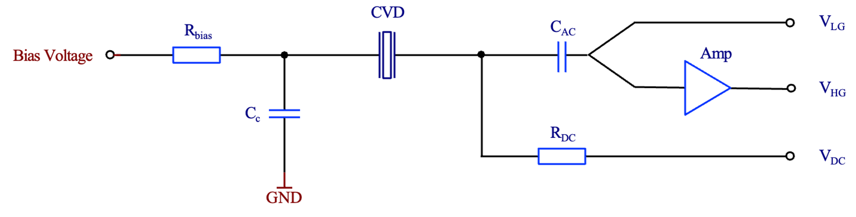
New experimental setup & proton request
Propose to measure with two 50 μm thick new diamond sensors IN PARALLEL, one with and one without ⁶LiF converter (=> disentangle the two sources of radiation damage)
Same neutron irradiation conditions (few cm flat top profile)
For each detector the following electronics setup proposed:
=> Three readouts in parallel in order to combine maximum possible information in-beam:
V_{LG}: AC output without amplification (high neutron energy region)
V_{HG}: AC output with amplification (low neutron energy region - signals from the ⁶Li(n,t) reaction )
V_{DC}: DC measurement of the dark current of the sensor
First time such a combined readout scheme implemented for monitoring of Radiation Damage vs Neutron Dose .
⁶LiF
few cm
AC-AC-DC splitter

Slide 14
New experimental setup & proton request
After the end of the irradiation campaign, Electron Paramagnetic Resonance (EPR) spectroscopy measurements will be performed at the NSCR “Demokritos”, Greece [12,13] for an offline study of the structure defects.
BEAM TIME ESTIMATION (sCVD): continuous campaign with 6 × 10¹⁸ protons estimated to be sufficient to reach the point where the tritons’ pulse height ~ background.
[12] M. Kokkoris et al., Nucl. Inst. and Methods in Phys. Res. B 195 (2002) 414–421
[13] G. Mitrikas, M. Kokkoris et al., Eur. Phys. J. AP 21, 163–170 (2003)

Slide 15
New experimental setup & proton request
After the end of the irradiation campaign, Electron Paramagnetic Resonance (EPR) spectroscopy measurements will be performed at the NSCR “Demokritos”, Greece [12,13] for an offline study of the structure defects.
BEAM TIME ESTIMATION (sCVD): continuous campaign with 6 × 10¹⁸ protons estimated to be sufficient to reach the point where the tritons’ pulse height ~ background.
EXTENSION OF THE PROPOSED RADIATION DAMAGE STUDY TO SiC:
Interesting to study radiation hardness of SiC sensor of the same thickness under the same conditions [14,15], which is also a very important material used in electronics and is interesting for future applications (mainly accelerator environments – high energy physics at CERN)
=> Replicate the proposed setup for sCVD and run at a different campaign
BEAM TIME ESTIMATION (SiC): continuous campaign with 6 × 10¹⁸ protons estimated to be sufficient.
[12] M. Kokkoris et al., Nucl. Inst. and Methods in Phys. Res. B 195 (2002) 414–421
[13] G. Mitrikas, M. Kokkoris et al., Eur. Phys. J. AP 21, 163–170 (2003)
[14] T. Gaggl et al., Nucl. Inst. and Methods in Phys. Res. A 1040 (2022) 167218
[15] A. Gospner et al., 2023 JINST 18 C11027

Slide 16
Conclusion
Proton request:
We propose a systematic study of
The lifetime of a 50 μm sCVD diamond sensor as neutron monitor at NEAR.
The two different components of the radiation damage (fast neutrons=> homogeneous , slow neutrons => “layer”)
Record the detector performance vs increasing radiation with three different readouts => combine the maximum information possible.
Offline study of the crystal defects with Electron Paramagnetic Resonance (EPR) spectroscopy
sCVD:
6 × 10¹⁸ protons
The same study is proposed for a 50 μm thick SiC sensor in order to compare the two materials' performance in the harsh environment of NEAR.
SiC:
6 × 10¹⁸ protons
Total: 1.2 × 10¹⁹ protons requested in two campaigns
Thank you!
Notes:
n/cm2/7e12
n/cm2/day
days/1e18
aNEAR at marble end
8.40E+08
1.44E+13
69480
υπολόγισα με βάση τα δικά σου:
1,35E+10 n/cm2/bunch
0,16 cm2 (embadon anixneyth 4*4μμ2)
2,16E+09 n/bunch θα φαει ο ανιχνευτης
4,63E+06 bunches αντεχει να φαει μεχρι τα 10^16 νετρονια που λεει η Christina οτι αρχιζει να χανει σε resolution
--------
6,43E+01 days (thewrwntas 3000 bunches/hour)
άρα αντέχει και με το παραπάνω για τις μέρες που θα είναι στο NEAR.

Slide 17
Extra slides

Slide 18
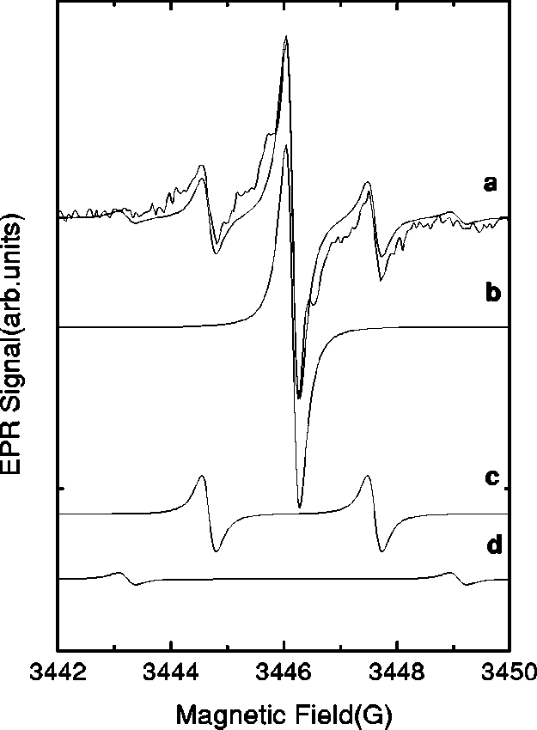
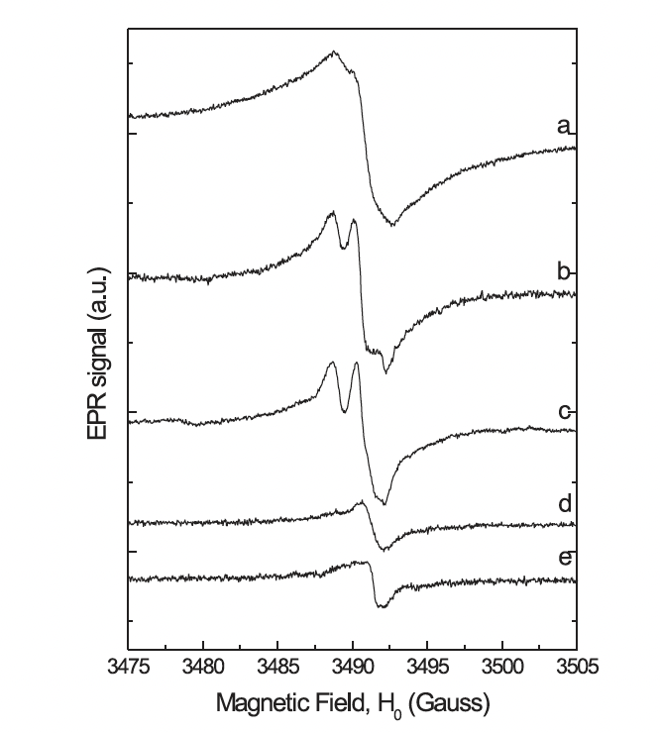
EPR
An EPR spectrum is usually directly measured as the first derivative of the absorption resonance of microwave radiation. The microwave is kept at a fixed frequency and the magnetic field is swept. For a specific microwave frequency (with energy hv), a resonance occurs at a magnetic field of B=hv/g_{e}μ_{B,} for free electrons. When the electron is not free B=hv/gμ_{B}, where g different to g_{e} , which means that the electron has gained or lost angular momentum through spin–orbit coupling, and the value of g that occurs from the EPR measurement (since hv is known, μ_{B} is known and B is estimated as the position of the resonance (i.e. the value of B where the derivative is 0) gives information about the nature of the atomic or molecular orbital (in our case from defects) containing the unpaired electron.
Example of EPR measurement of different defects created from the irradiation of 12 MeV protons ins 300 um SiC wafers (taken from H. J. von Bardeleben et al., PHYSICAL REVIEW B, VOLUME 62, NUMBER 15 (2000): “Proton-implantation-induced defects in n-type 6H- and 4H-SiC: An electron paramagnetic resonance study”):
Trace region:
End-of-range defects:
“cluster” defects
[13] G. Mitrikas, M. Kokkoris et al.,
Eur. Phys. J. AP 21, 163–170 (2003)

Slide 19
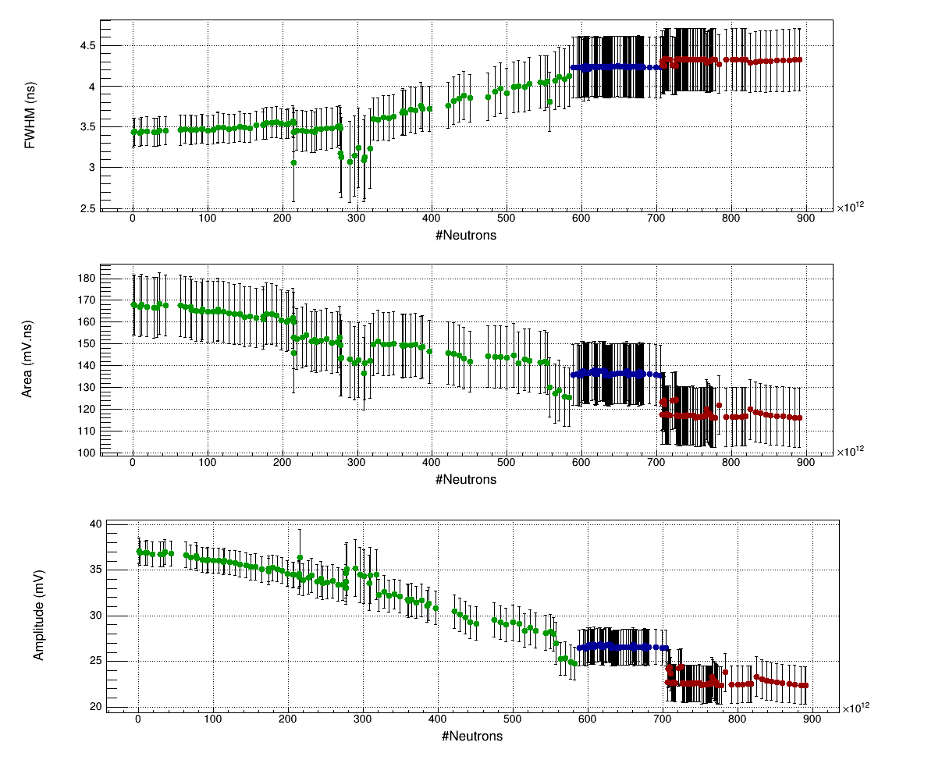
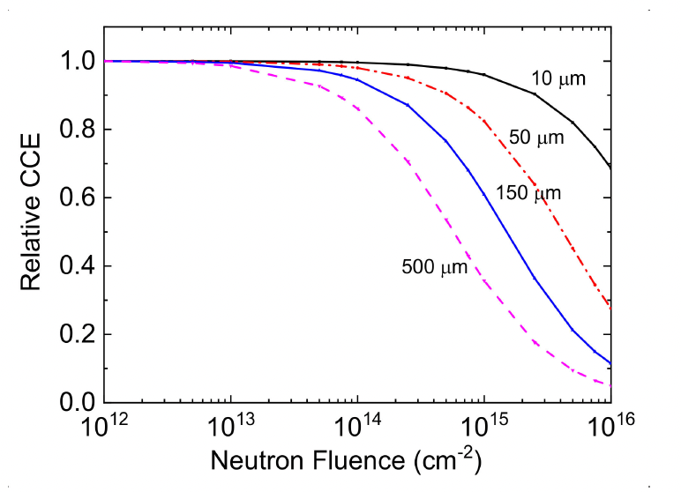
Notes:
Strong polarization effects produced by the trapping of charge carriers in the defects produced by the
neutron irradiation are observed already at about 4 ⋅ 1014 n∕cm2 in the 100 μm thick sCD. A software correction
of the polarization effect is proposed, which enables to extend the sCD range of operation up to higher fluences.
Taking into account such correction, a 50 μm thick sCD is expected to reach 1015 n∕cm2 with a CCE greater
than 0.7.

Slide 20
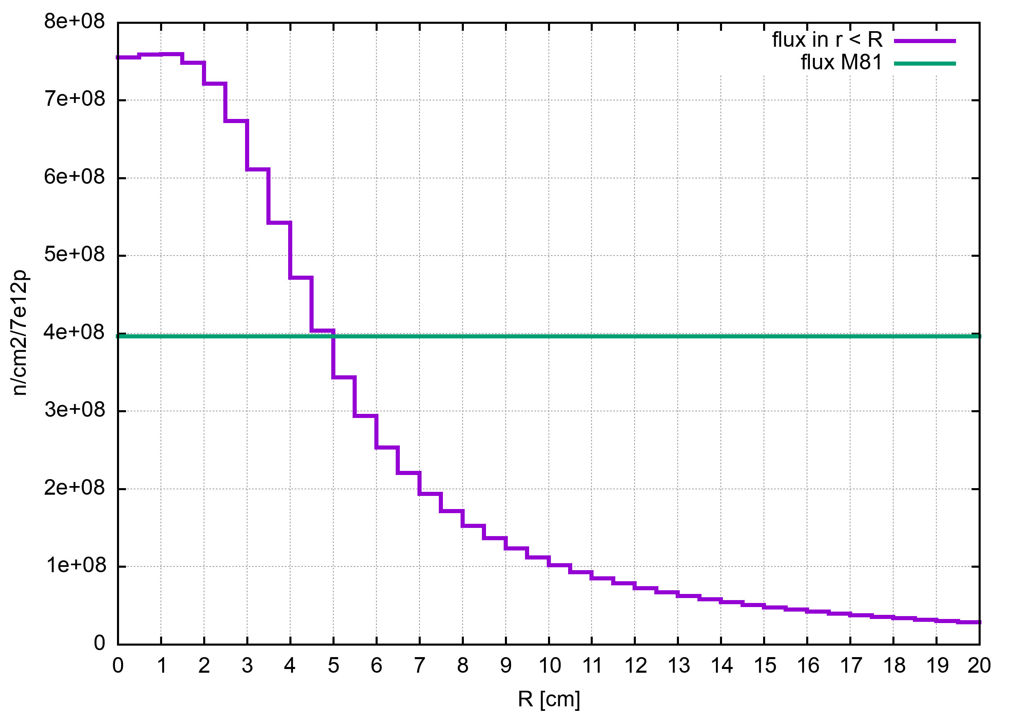
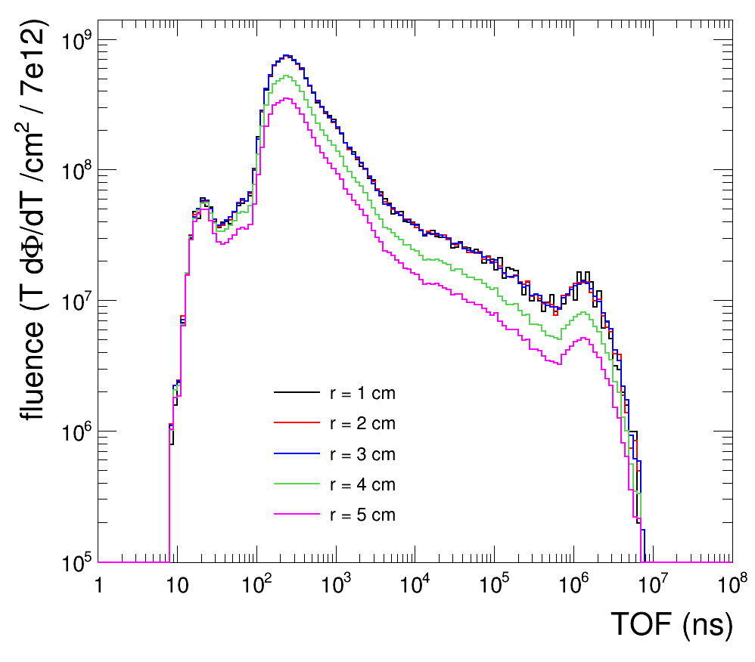
NEUTRON FLUENCE CHARACTERISATION at NEAR (simulations)
Radial dependence of neutron fluence:
Beam spot ~4 cm radius

Slide 21
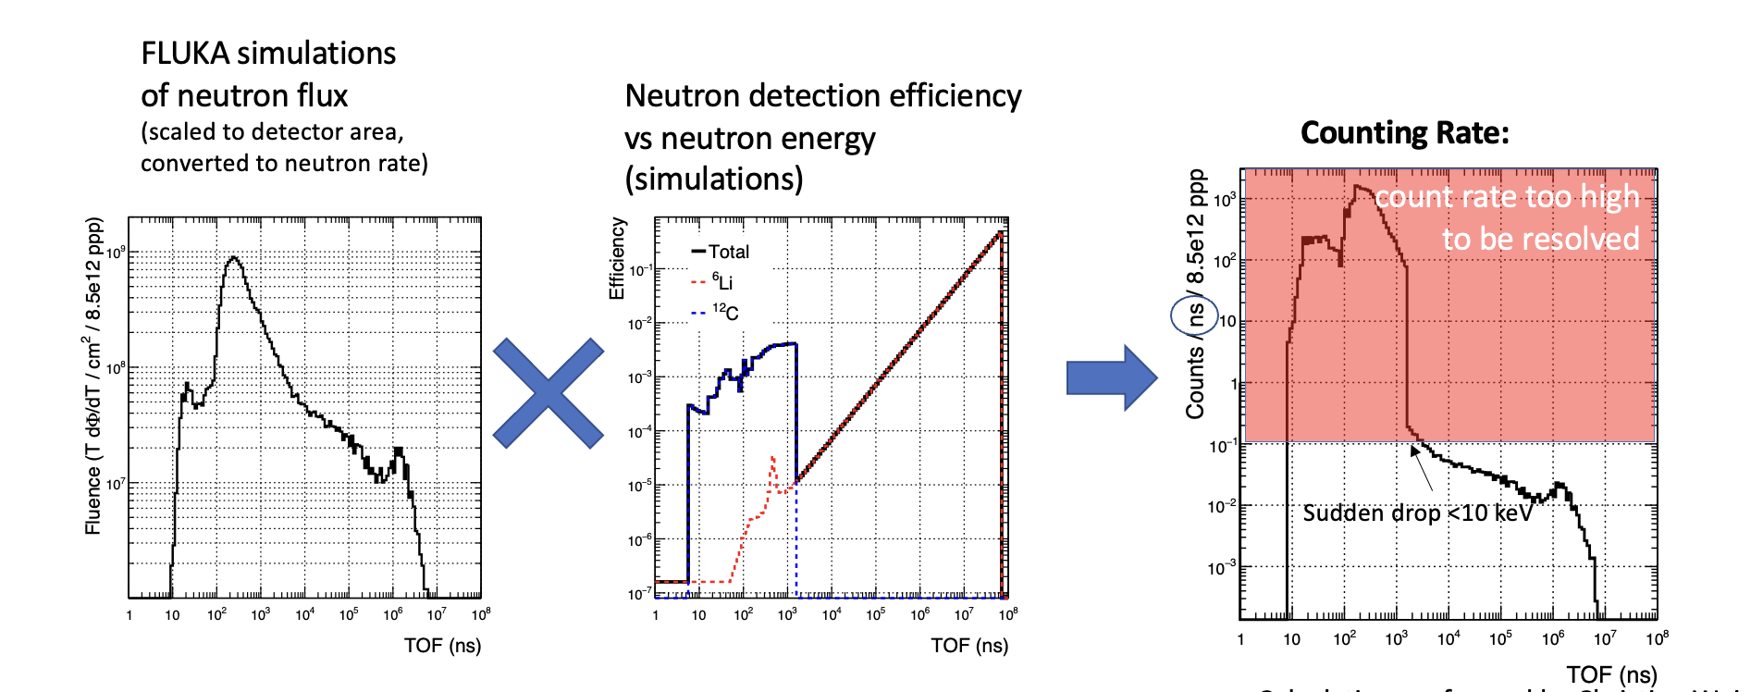
Notes:
conservative 1 pulse / 10 ns, in order to avoid pile-up

Slide 22
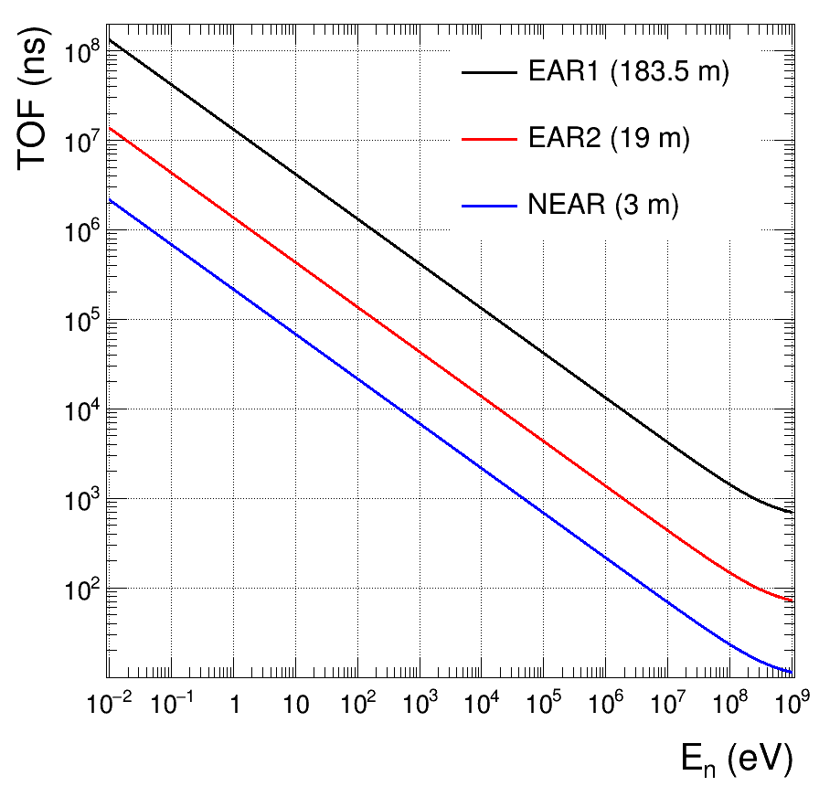

Slide 23
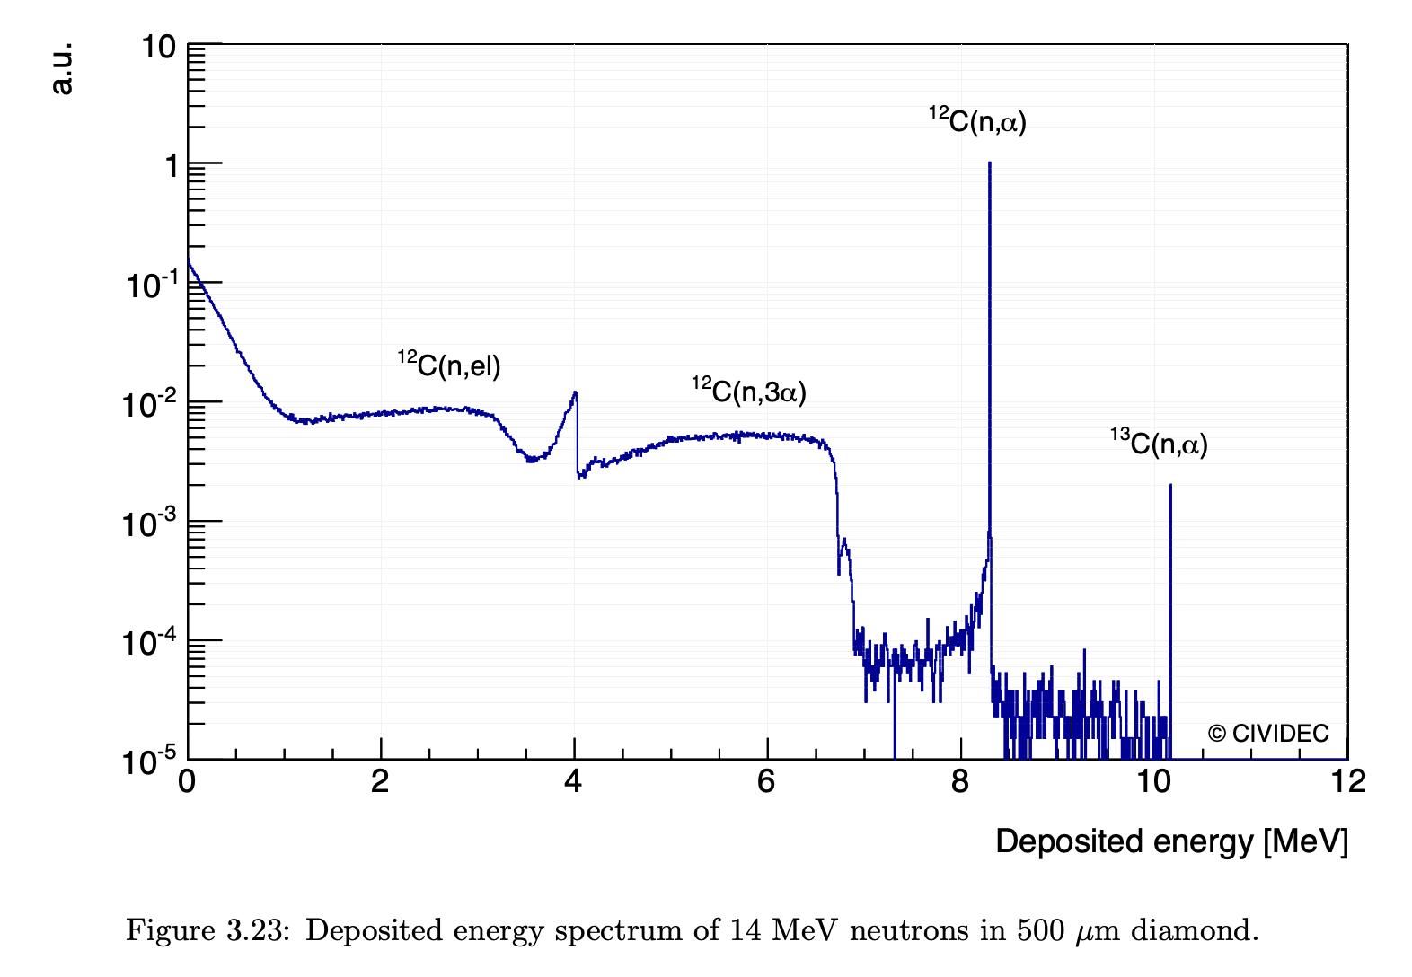
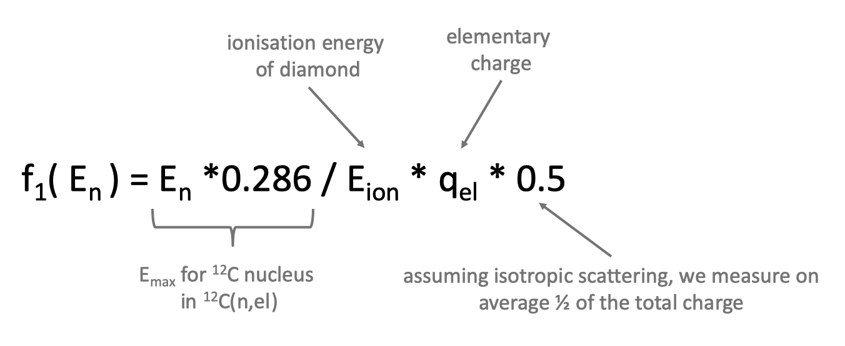
Conversion yield
Energy Interval | ε (ENDF/B-VIII.0) | Q_{μ} [fC]
E_{n} < 10 keV | ⁶Li(n,a)t | Q-value/2/E_{ion}*q_{el} = 29.4 fC
10 keV < E_{n} < 1 MeV | ⁶Li(n,a)t ¹²C(n,tot) | Q-value/2/E_{ion}*q_{el} = 29.4 fC f₁( E_{n} ), see below
E_{n} > 1 MeV | ¹²C(n,tot) | f₂( E_{n} ), Geant4 P. Kavrigin

Slide 24
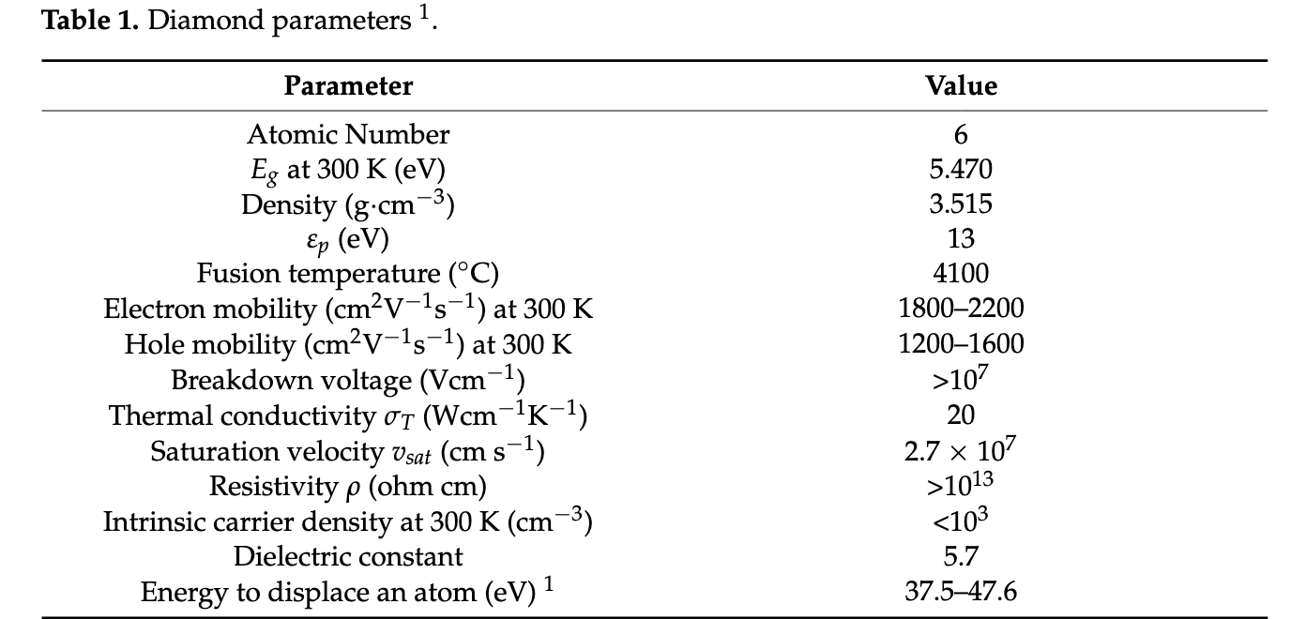

Slide 25
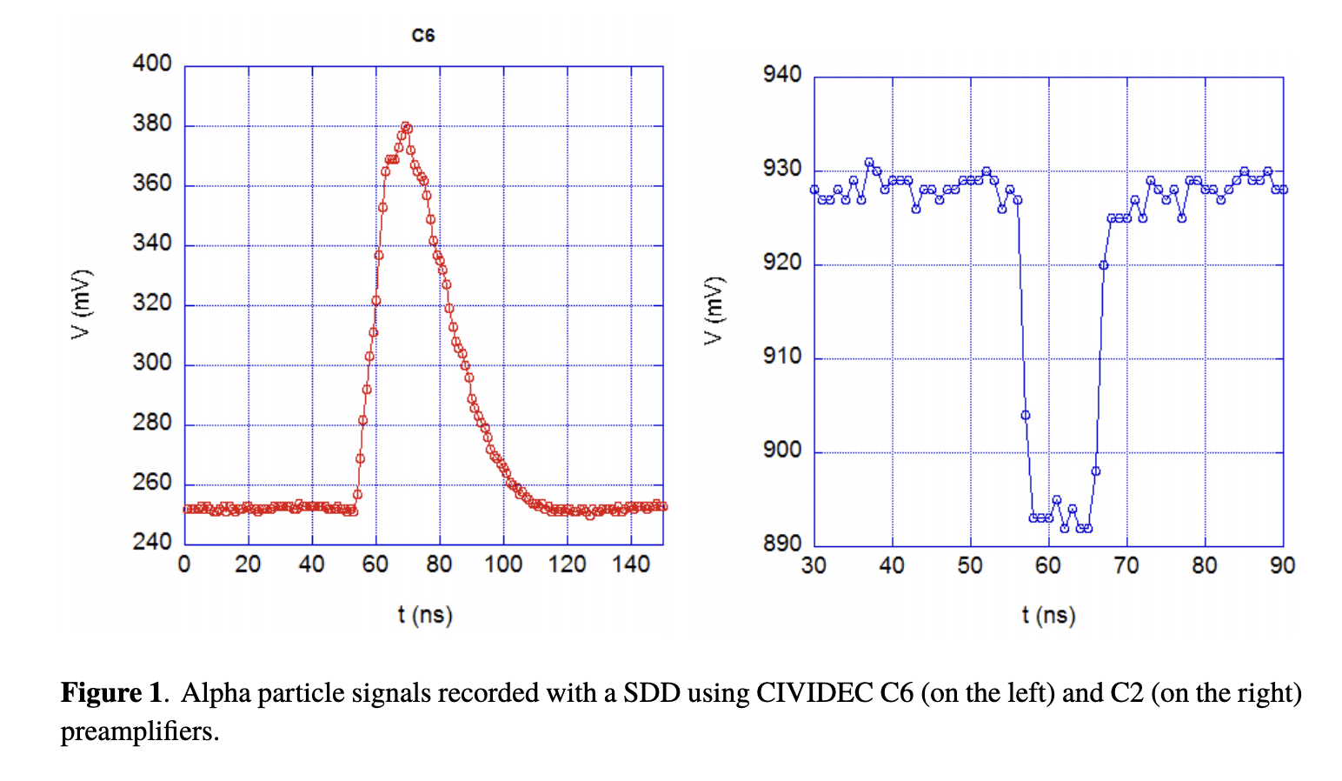
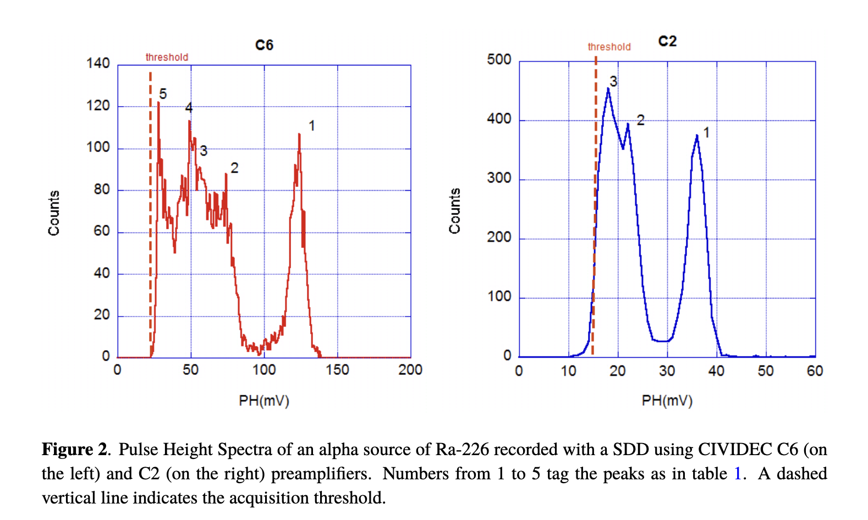
10 ns
From Cazzaniga et al., 2016 JINST 11 P07012

Slide 26
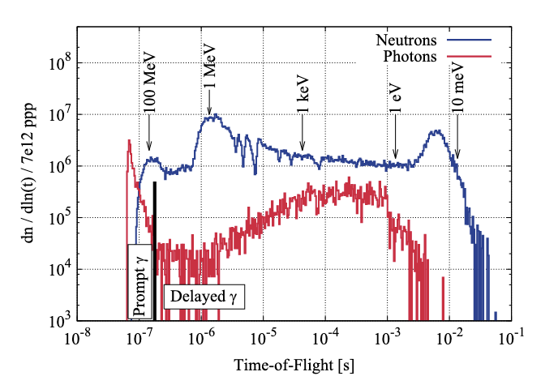
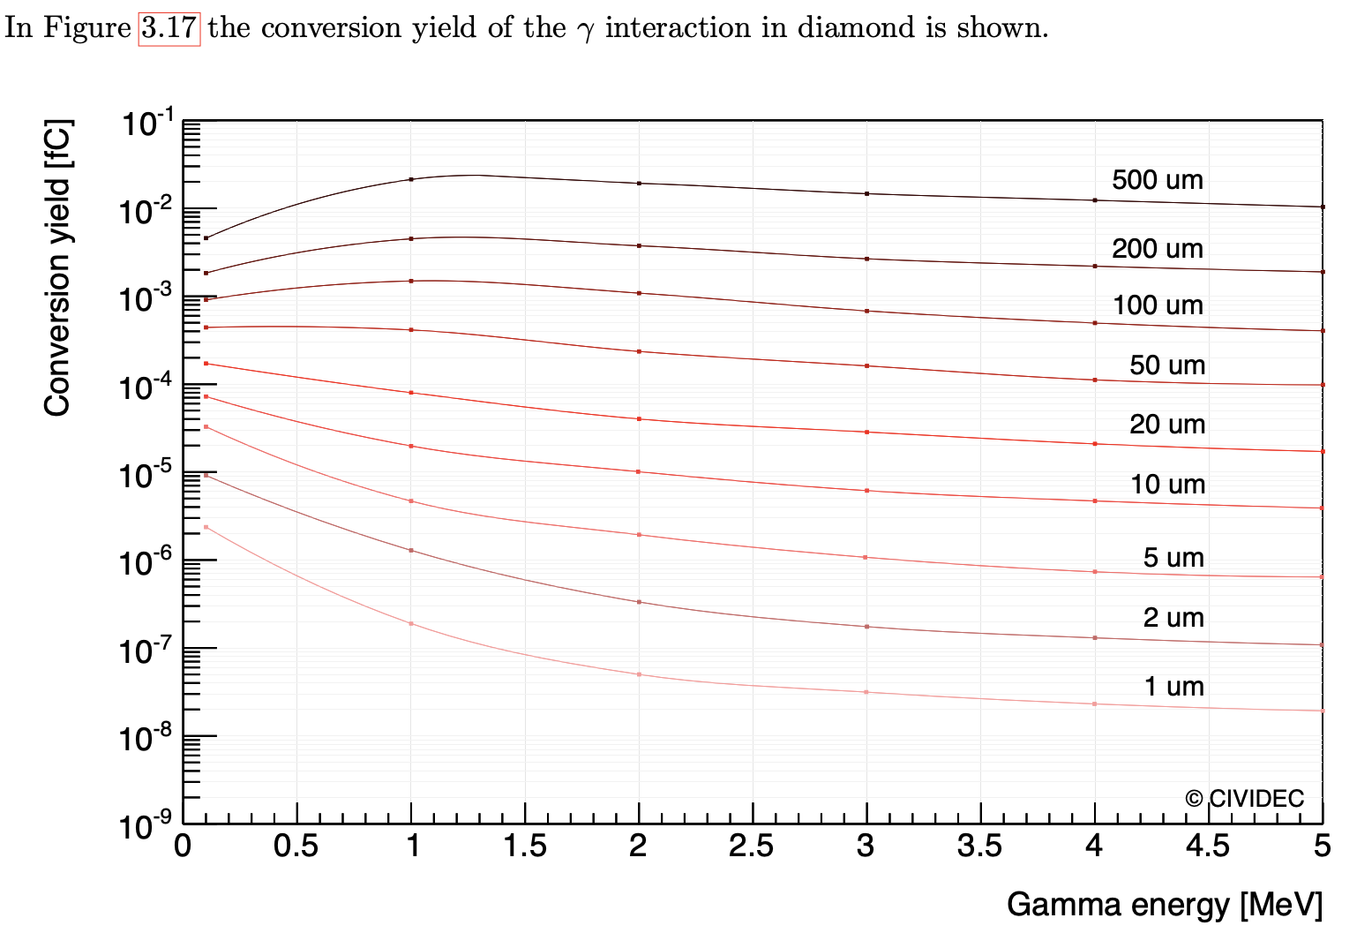
Gamma background, grossier estimation from EAR2 simulations
Delayed gammas
not expected to
significantly influence the
measurement

Slide 27
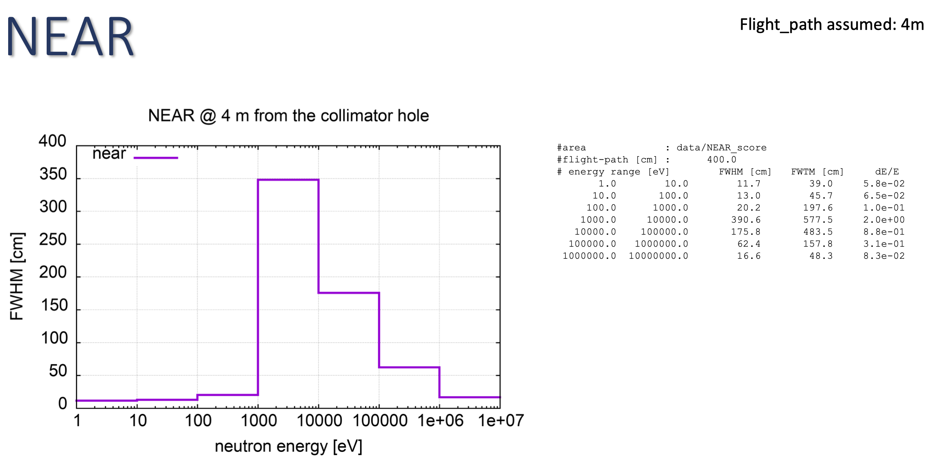
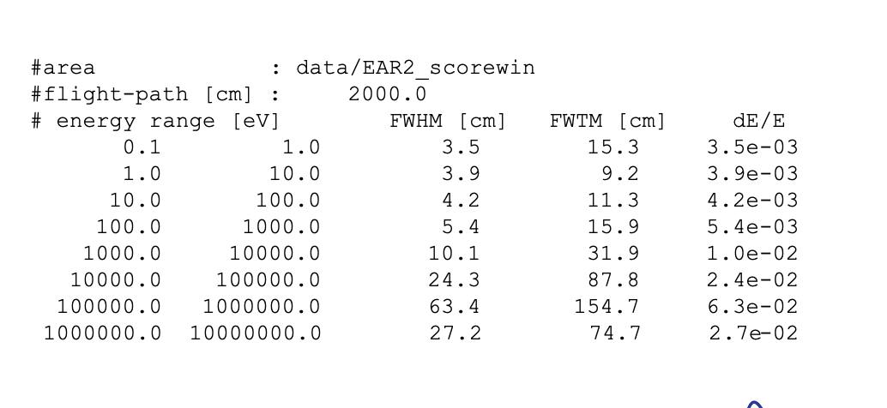
Resolution for TOF measurements at NEAR
From the presentation of A. Mengoni, n_TOF collaboration meeting, 30-31 May 2022

