Slide 1
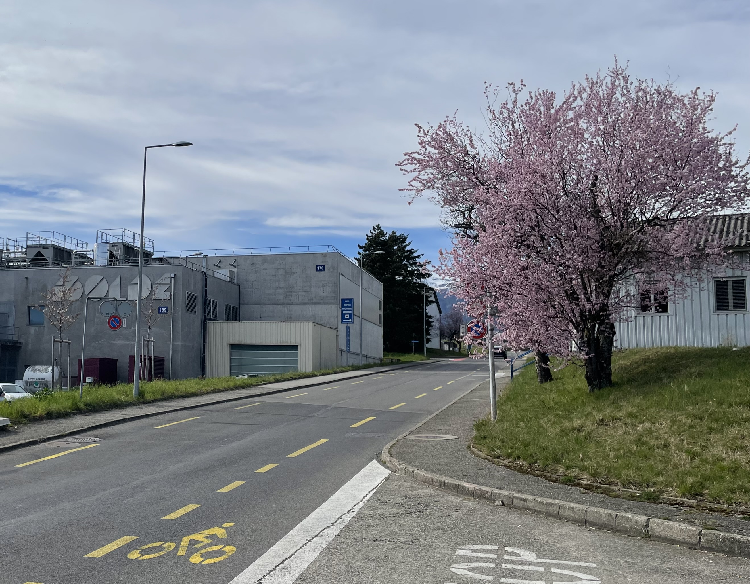

Photo: CERN 2004
ISOLDE report
INTC 78
February 2025 - Hanne Heylen

Slide 2
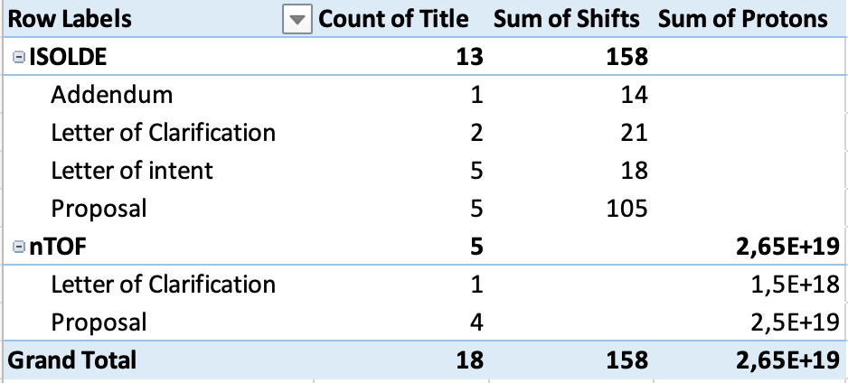
INTC 78 summary
Supposed to be dedicated HIE-ISOLDE meeting with few exceptions, but only 3 HIE-ISOLDE proposals and 2 LoIs.
General comment Technical Advisory Committee for ISOLDE
The current performance of the 7-gap amplifiers in the post-accelerator restricts the
acceptable A/Q ratio and, consequently, put constraints on the beam's charge state.
1 shifts = 8 hours; 1 day~ 1 x 10¹⁷ protons

Slide 3
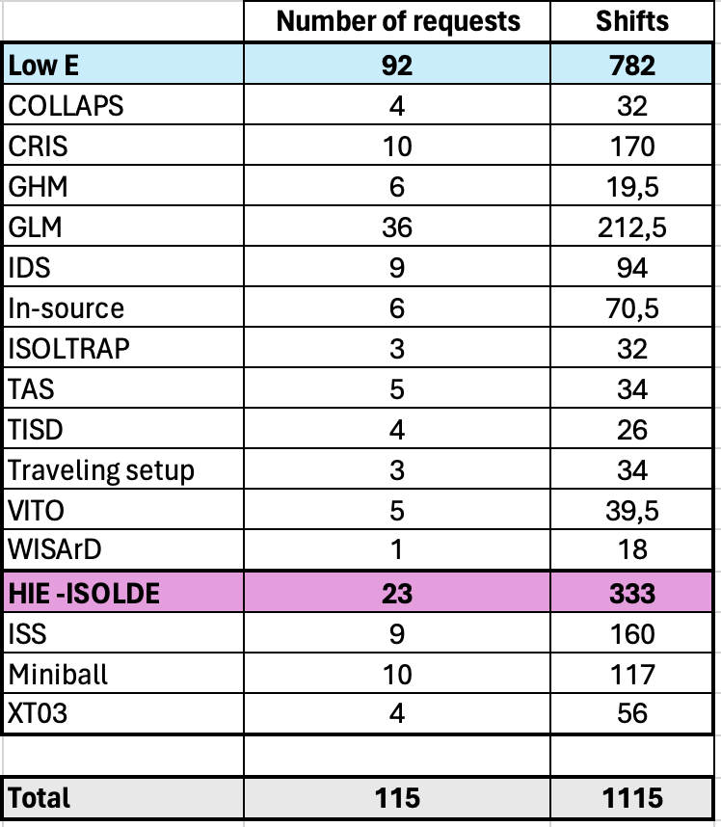
ISOLDE – beam requests 2025
Requested shifts per category

Slide 4
2024 statistics
ISOLDE Beam pie 2024
Beams were delivered to 44 distinct IS/LOIs (9 HIE-ISOLDE)
A total of 426 shifts were delivered for physics, beam development and ad-hoc measurements
RILIS was used in just over 50% of cases, while molecular beams were used for 20% of the delivered beams

Slide 5
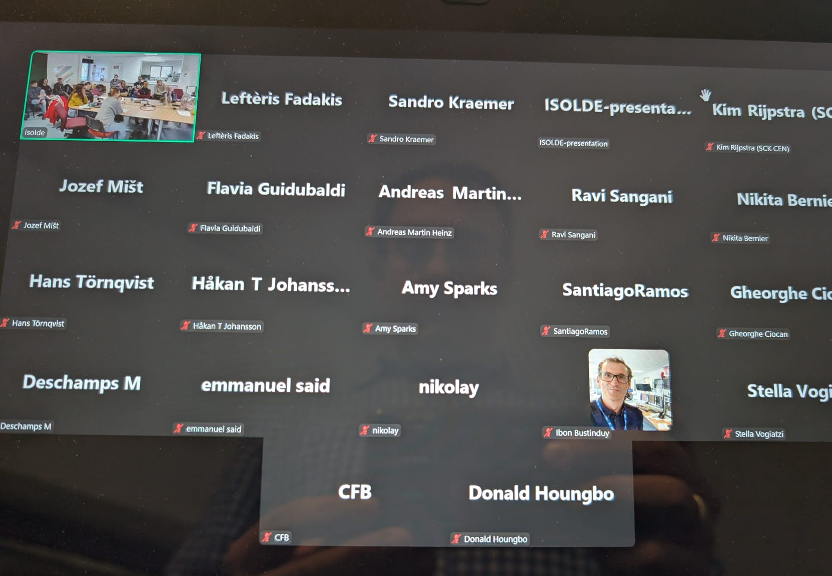
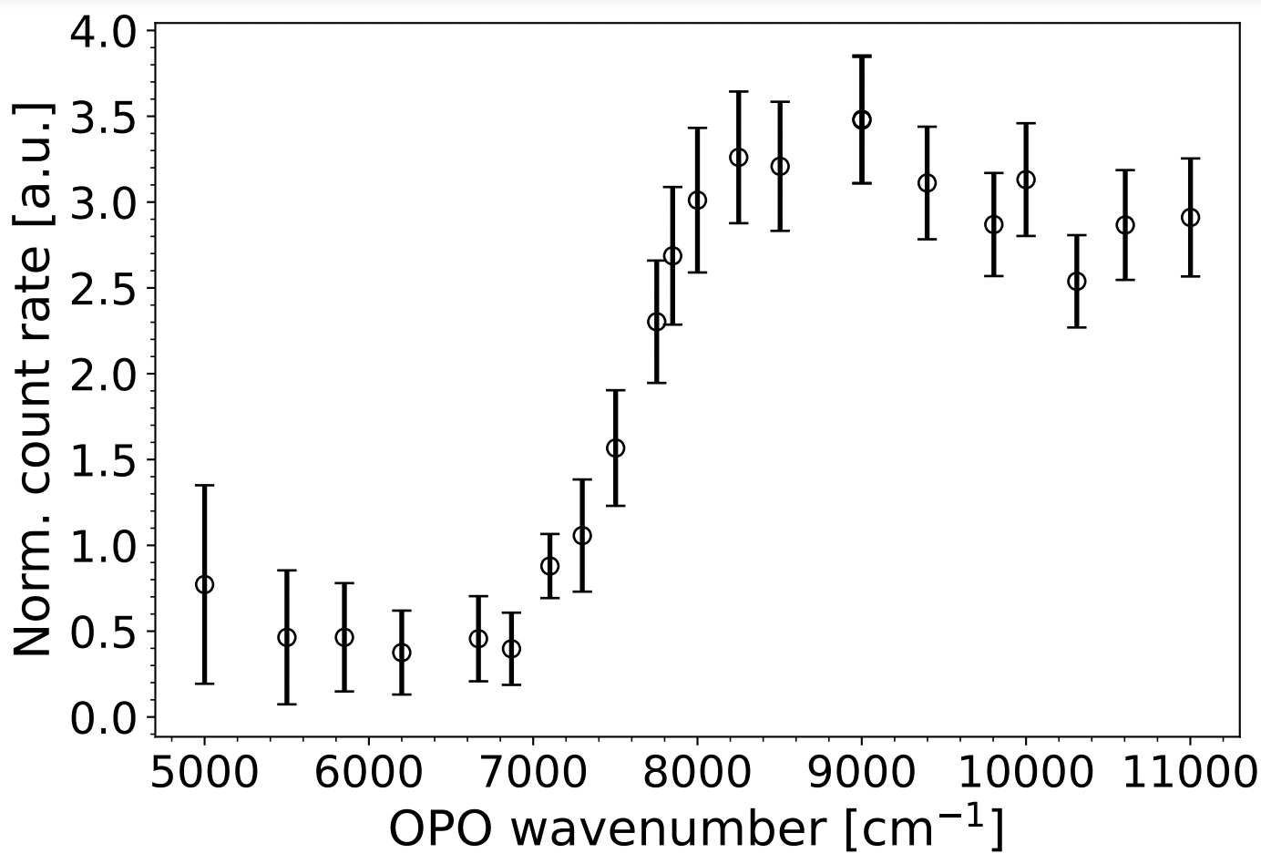
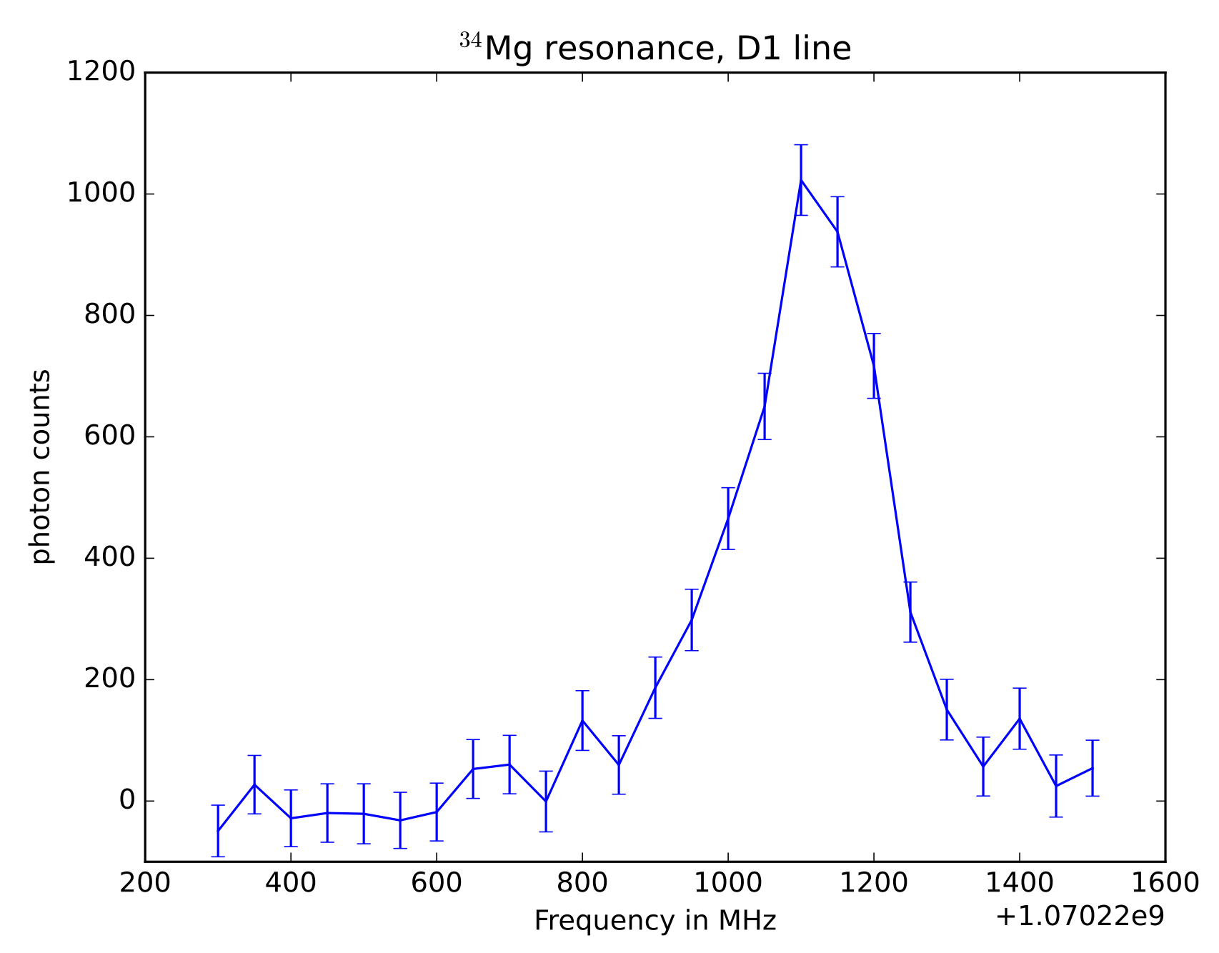
Highlights 2024
IS671 – ³⁴Mg @MIRACLS
First collinear laser spectroscopy measurements of exotic isotopes in a MR-ToF device. This device allows to repeatedly probe the same ions during the >1000 revolutions and hence significantly increase sensitivity
Used 1.7 GeV protons to increase yields (2024 1st year with 1.7 GeV production runs)
Photodetachment threshold
Preliminary
IS758 - Study of RaF− anions at CRIS
The production of RaF- is a promising method for decelerating and trapping molecules, followed by laser photodetachment to provide cold, slow neutral molecules for future high precision studies
Negative RaF- anions successfully produced through double charge exchange process at CRIS
First laser photodetachment of RaF- was observed and its threshold determined
Separator course followed by 12 people in person, and around 30 online participants
Recording: https://cernbox.cern.ch/s/w4CRKtv2D1mTAml
³⁴Mg produced with ~80 ions/s

Slide 6
Key dates
2025
Protons for low energy physics - March 28th.
Physics for HIE ISOLDE is expected to started around June 13th.
Protons will stop for ISOLDE on December 8th.
Potentially, there will be a short winter physics campaign (details TBC)
Note: LS3 for ISOLDE: no physics in 2026 and 2027, restart in Q2 2028 (not aligned with LS3 for LHC)

Slide 7
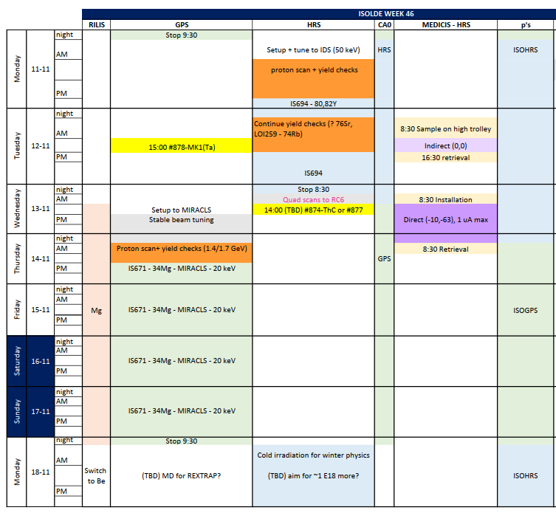
Scheduling …
~50 experiments per year
  Typically, 1 day up to 1 week
  Sequential scheduling (parallel only for GLM/GHM)
  During working hours: target changes, separator setup, yield checks, RILIS optimisation, HIE-ISOLDE setup, …
  Irradiations for “Winter physics”
  No fast switching between between GPS and HRS (yet) → central beam line bottleneck
  Unforeseen problems, Machine Developments (MD), …
Limited amount of targets can be produced each year
  ~30 targets <> 50 experiments + additional constraint on actinide targets
  A lot of work on top of the visible “online work”: production, testing on offline separators, disposal, … (50kCHF)
  LIST: more elaborate to produce and operate.
Take away message: squeezing in a few shifts impacts more than you might think!

Slide 8

Scheduling …
Criteria which improve scheduling chances
Priorities determined by experimental collaborations (PhD students, funding, scientific interest, …)
Beam for as many groups (>< collaborations) as possible
From summer onwards, priority to HIE-ISOLDE runs (typically, alternate with Low E)
Groups affected by suspension of GLM/GHM in 2024
Synergies with other runs (same target-ion source, same RILIS scheme, … )
Criteria which reduce scheduling chances
Exotic targets, especially if only requested for very few shifts
  LOI situation is difficult!
  Runs cannot be scheduled before yields have been confirmed (if requested by INTC)
Genuine concern about feasibility (old runs) and/or safety (TAC comments, …)
Unclear beam request (need to spend too much time to understand history, requirements, …)
Little flexibility in terms of availabilities

Slide 9
Announcements
Crane activities for users is allowed again (under certain conditions)
New technician hired – expected to start in March.
Changes in radioactive source management – storage location will be modified and a Source Responsible will be appointed per installation.
Activities in GLM/GHM area are allowed again

