Slide 1
ISOLDE Technical Report
78th Meeting of the INTC – 05/02/2025
Joachim Vollaire (Technical Coordinator) on behalf of ISOLDE Technical Teams

Slide 2

Outline
Overview of YETS activities and 2025 restart
LS3 planning for ISOLDE projects
ISOLDE Improvement Program – Update

Slide 3
Overview of YETS activities (primary areas)
Removal of targets from the target area before the YETS:
  22 targets transferred to MEDICIS storage for possible re-use/serve as backup
  30 targets that had failed or “obsolete” backup units transferred to the ISR storage area
  Few targets that had failed in 2024 kept for post-irradiation analysis in 2025 (hotcell)
Frontend maintenance ongoing
Several technical visits for LS3 projects preparation (concrete core drilling)
HT powering and safety interlocks consolidation
Target cooling circuits controls consolidation
Remaining activities:
  Vacuum system maintenance, laser windows exchange, HVAC maintenance….
  Cooling fan installation for MEDICIS irradiation
Stable beam commissioning to start on the 03/03
BTY line commissioning on the 21/03

Slide 4
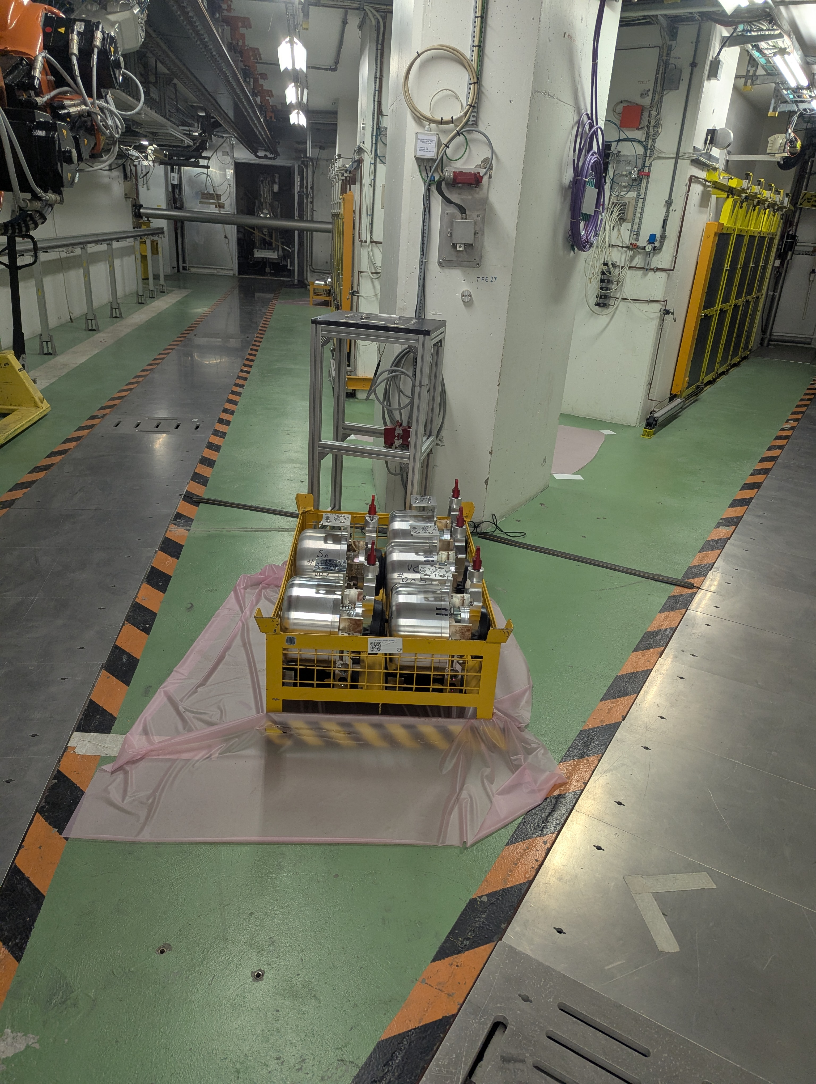
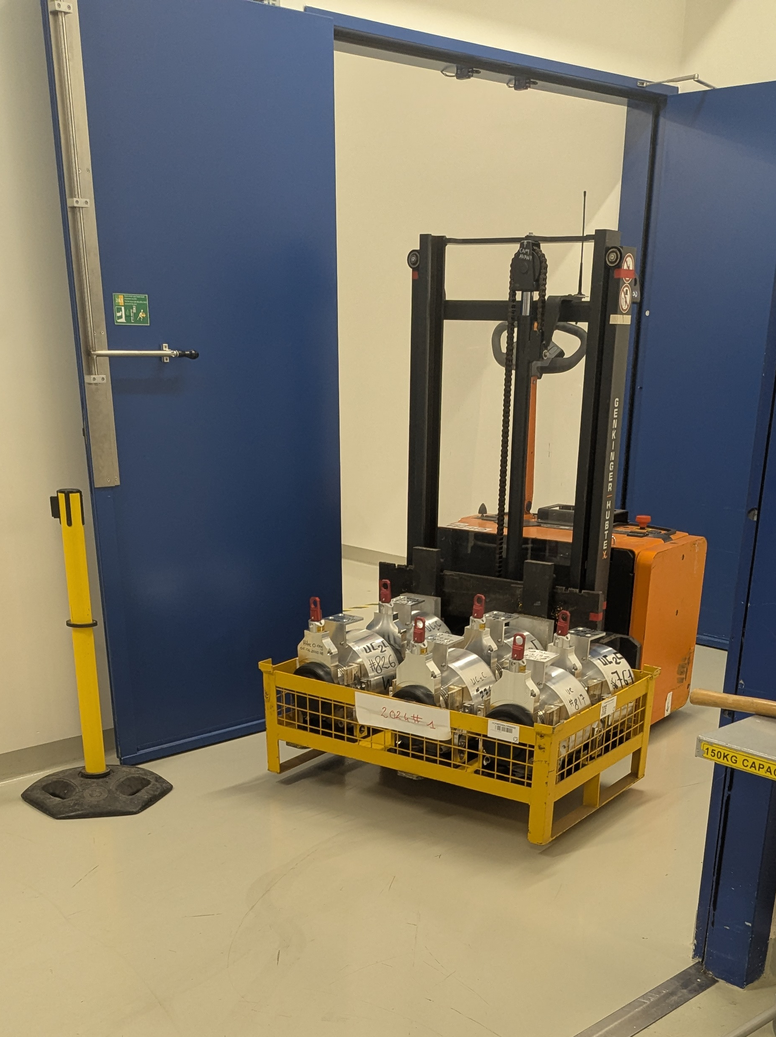
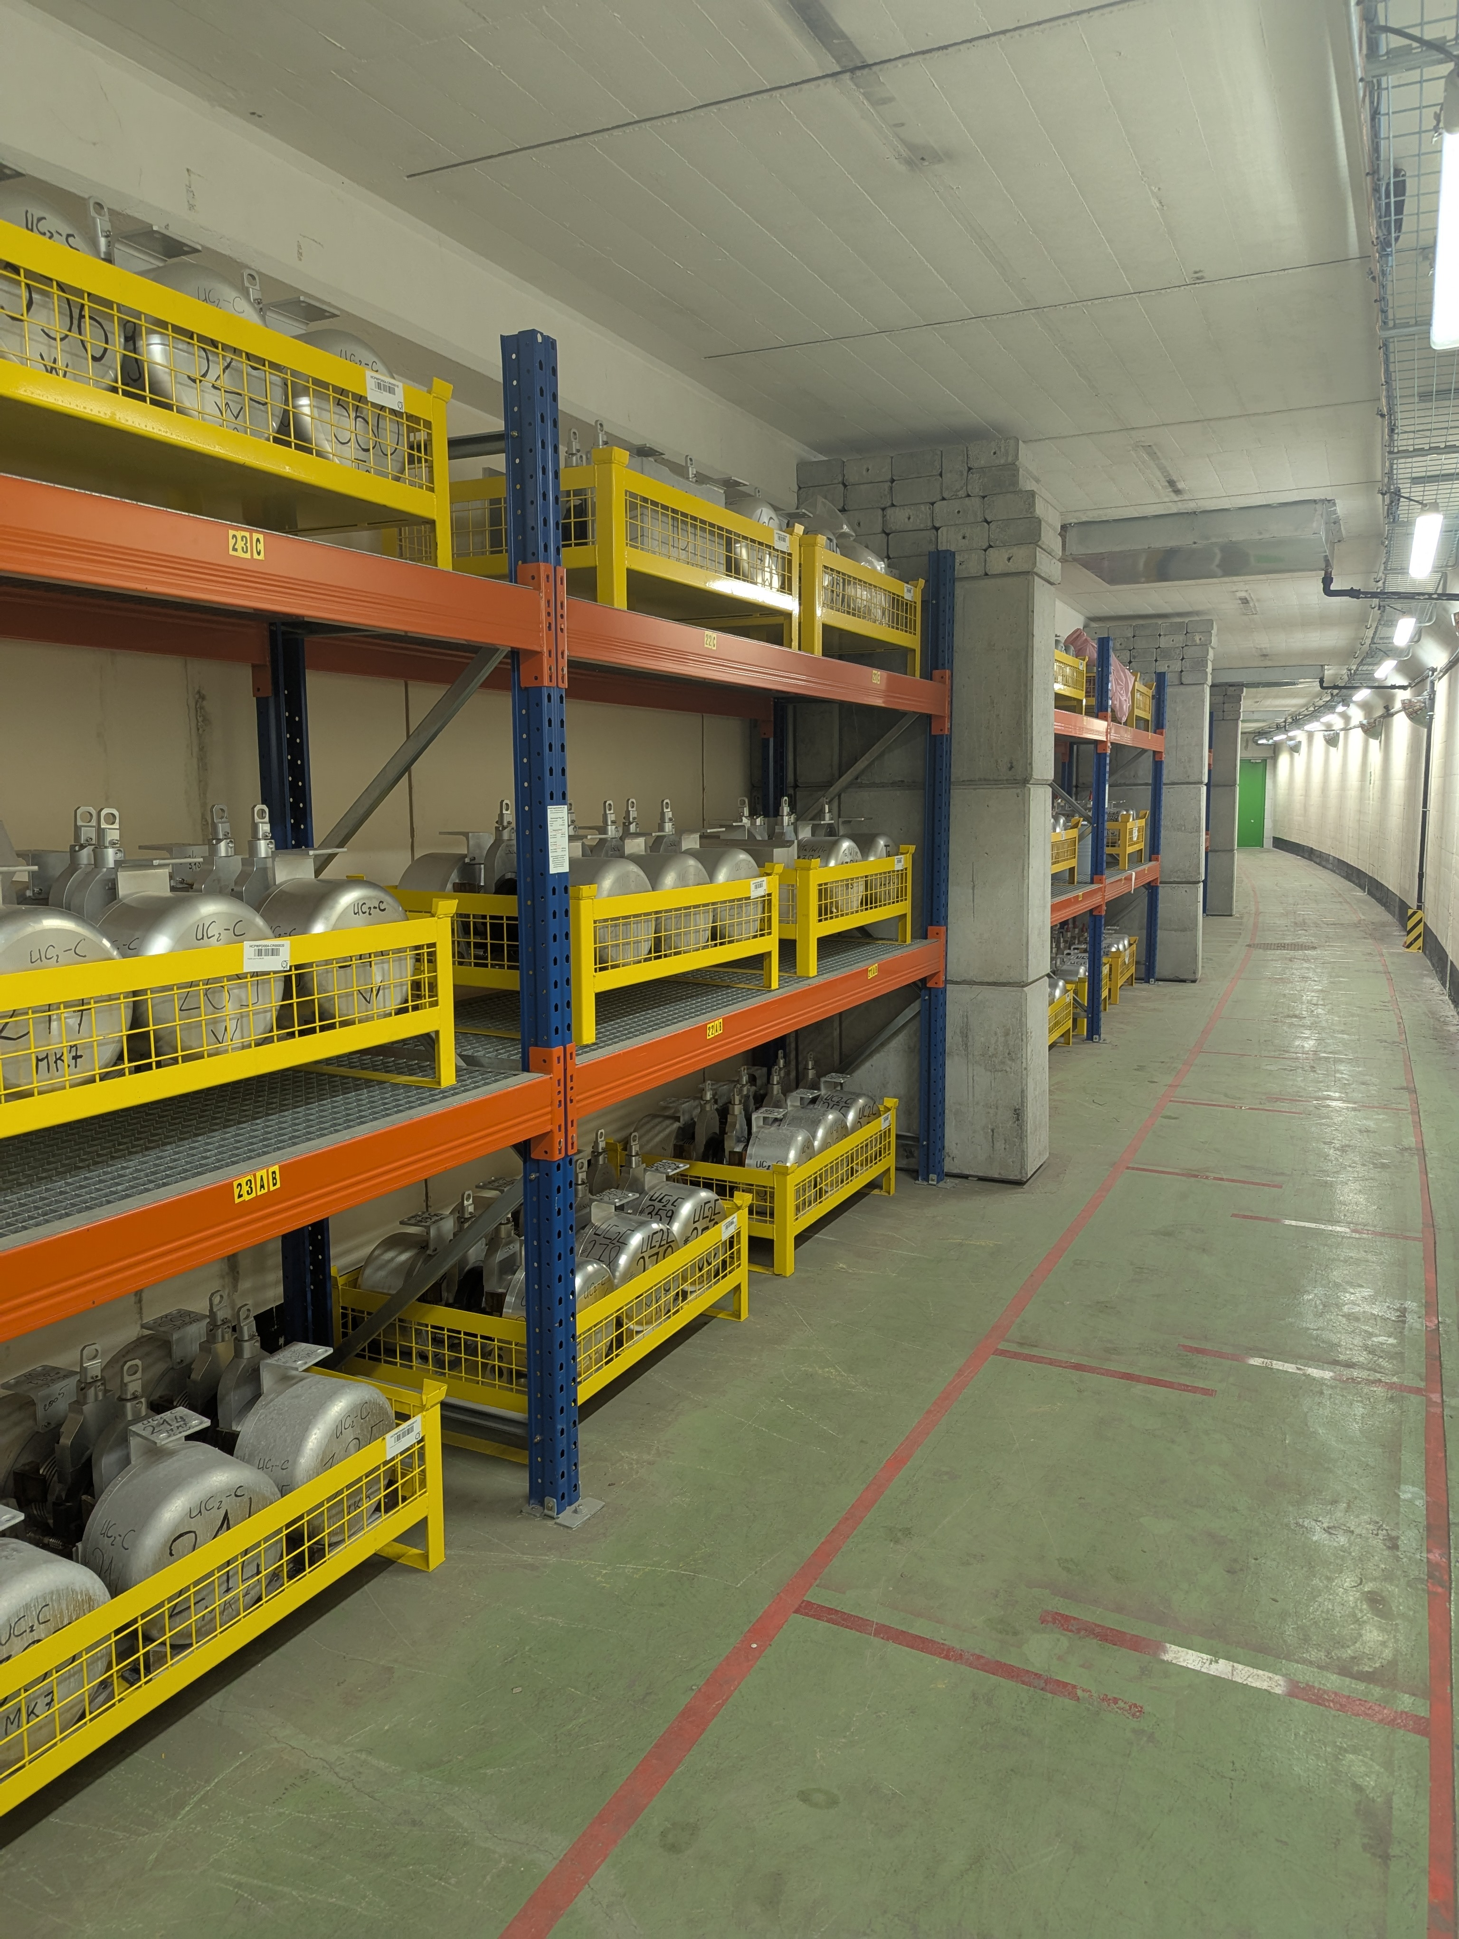
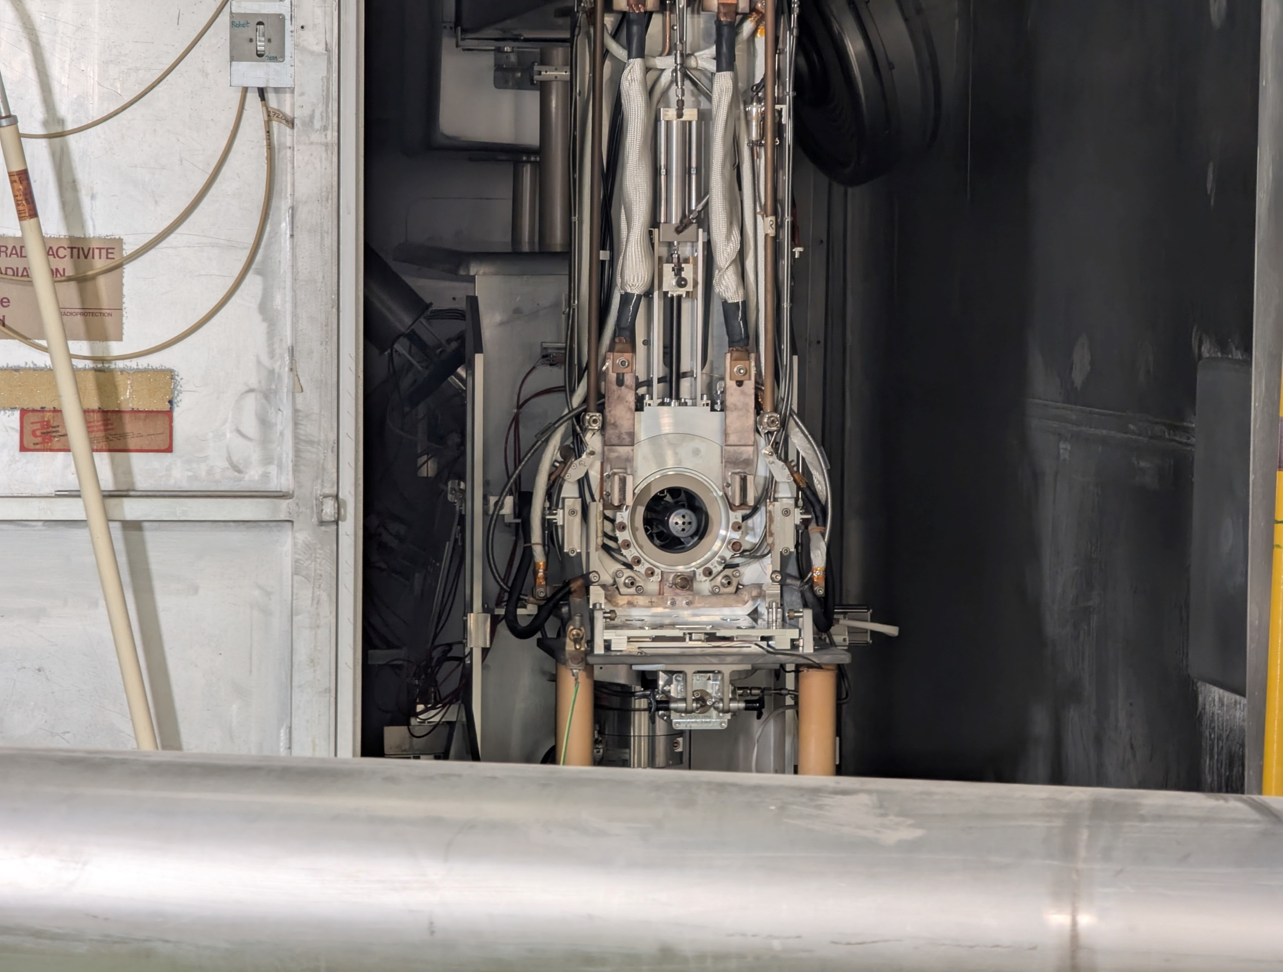
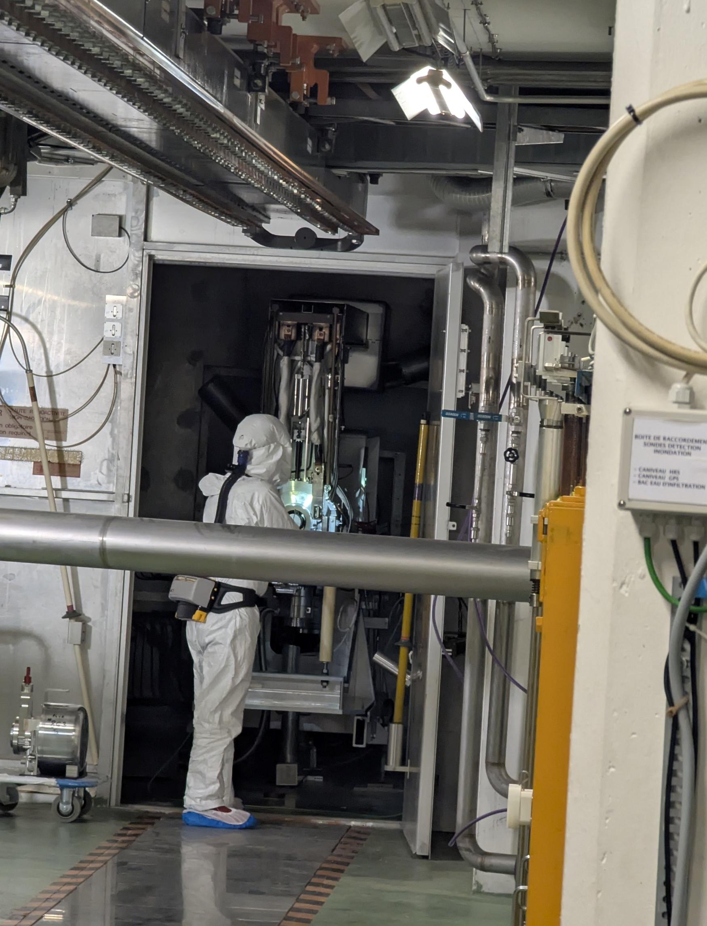
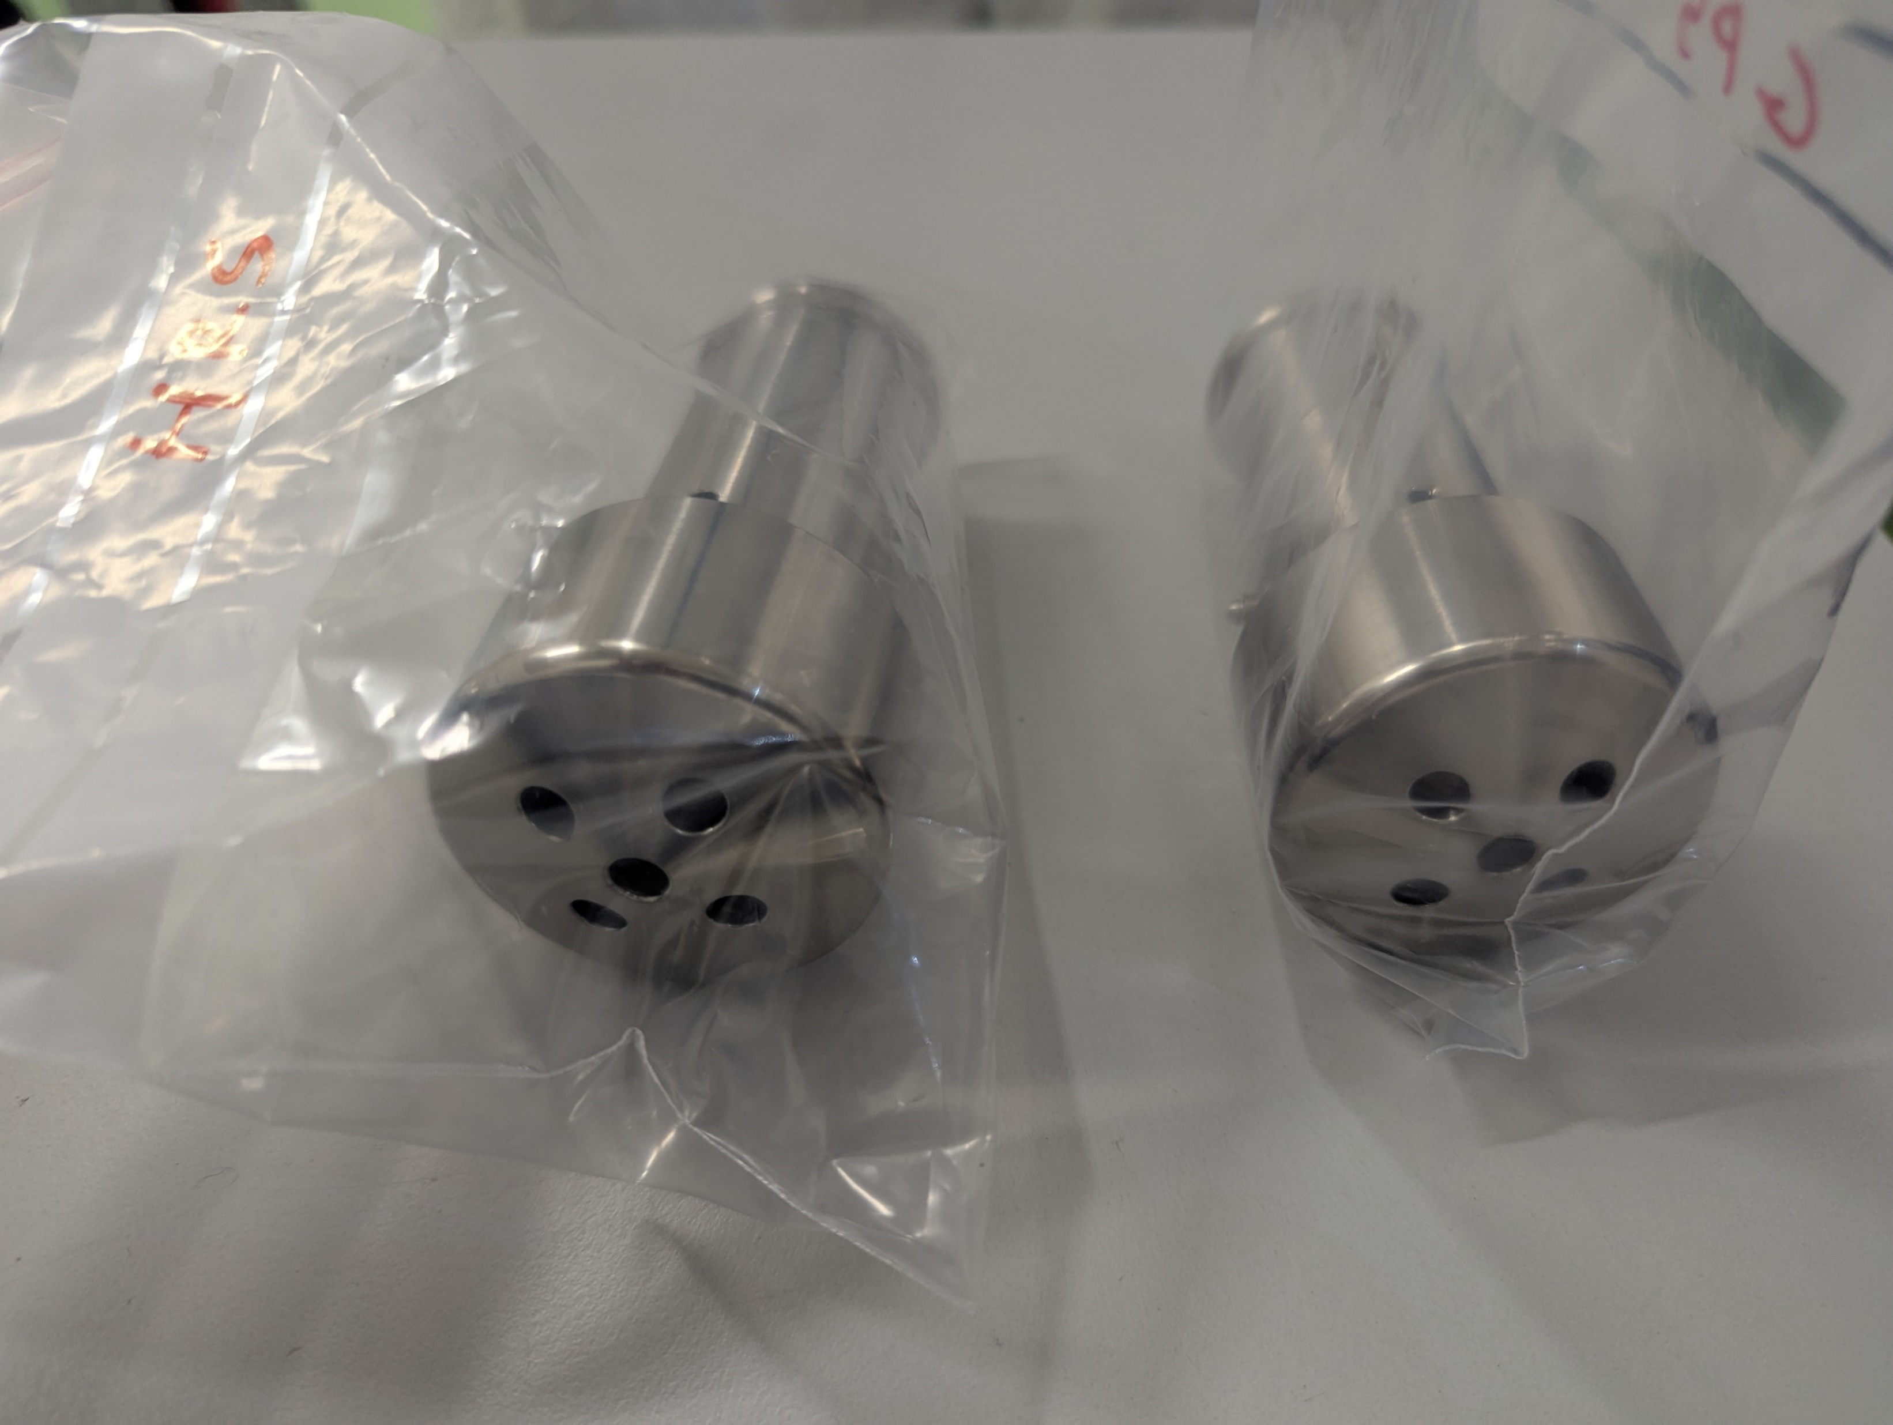
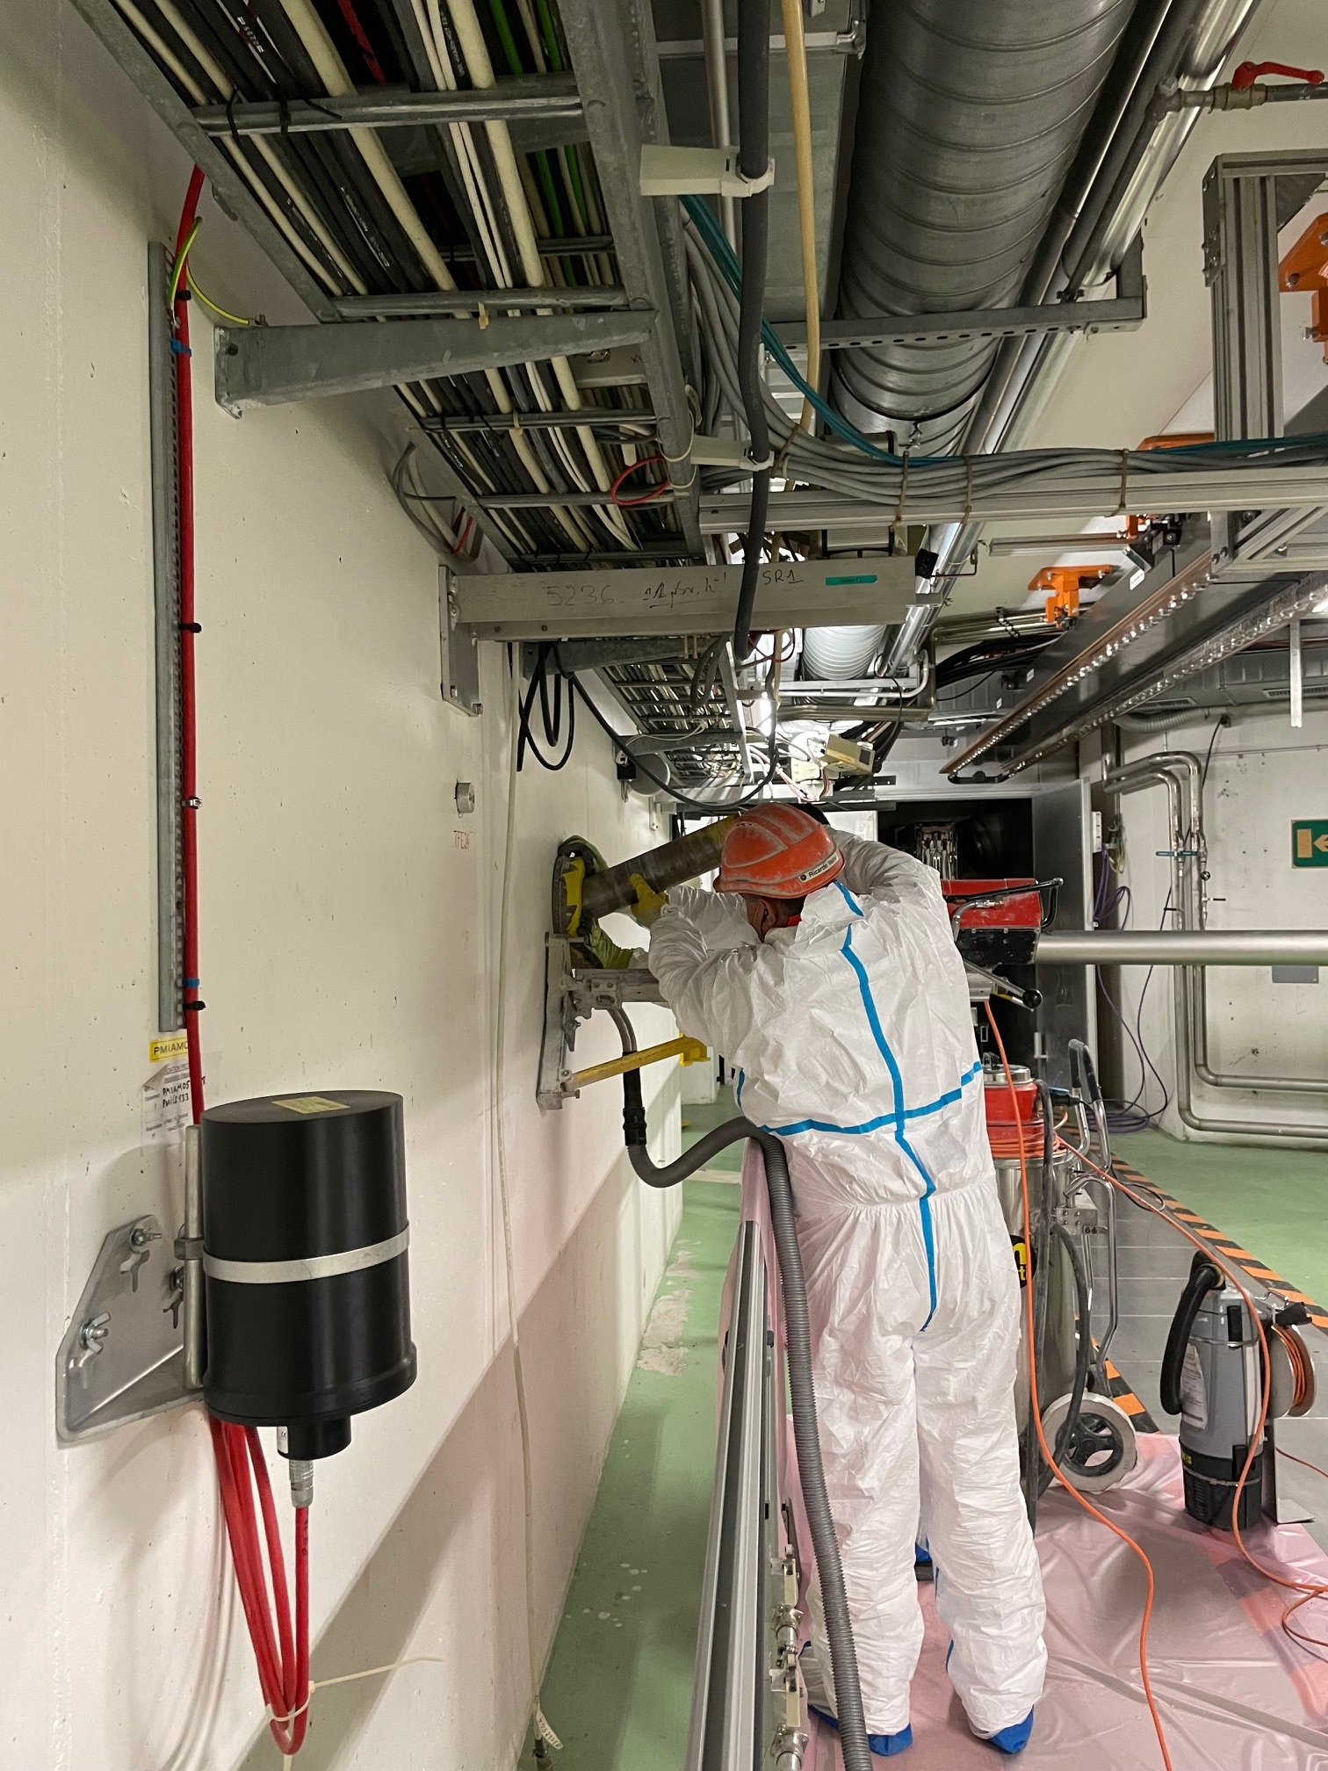
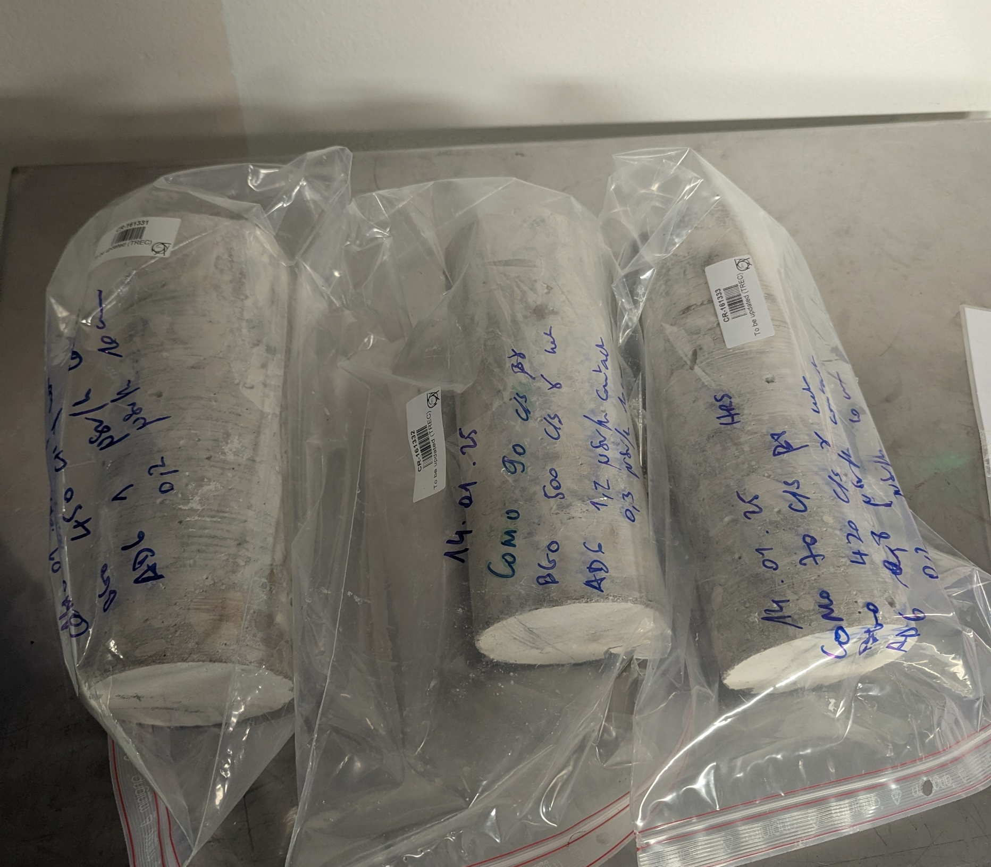
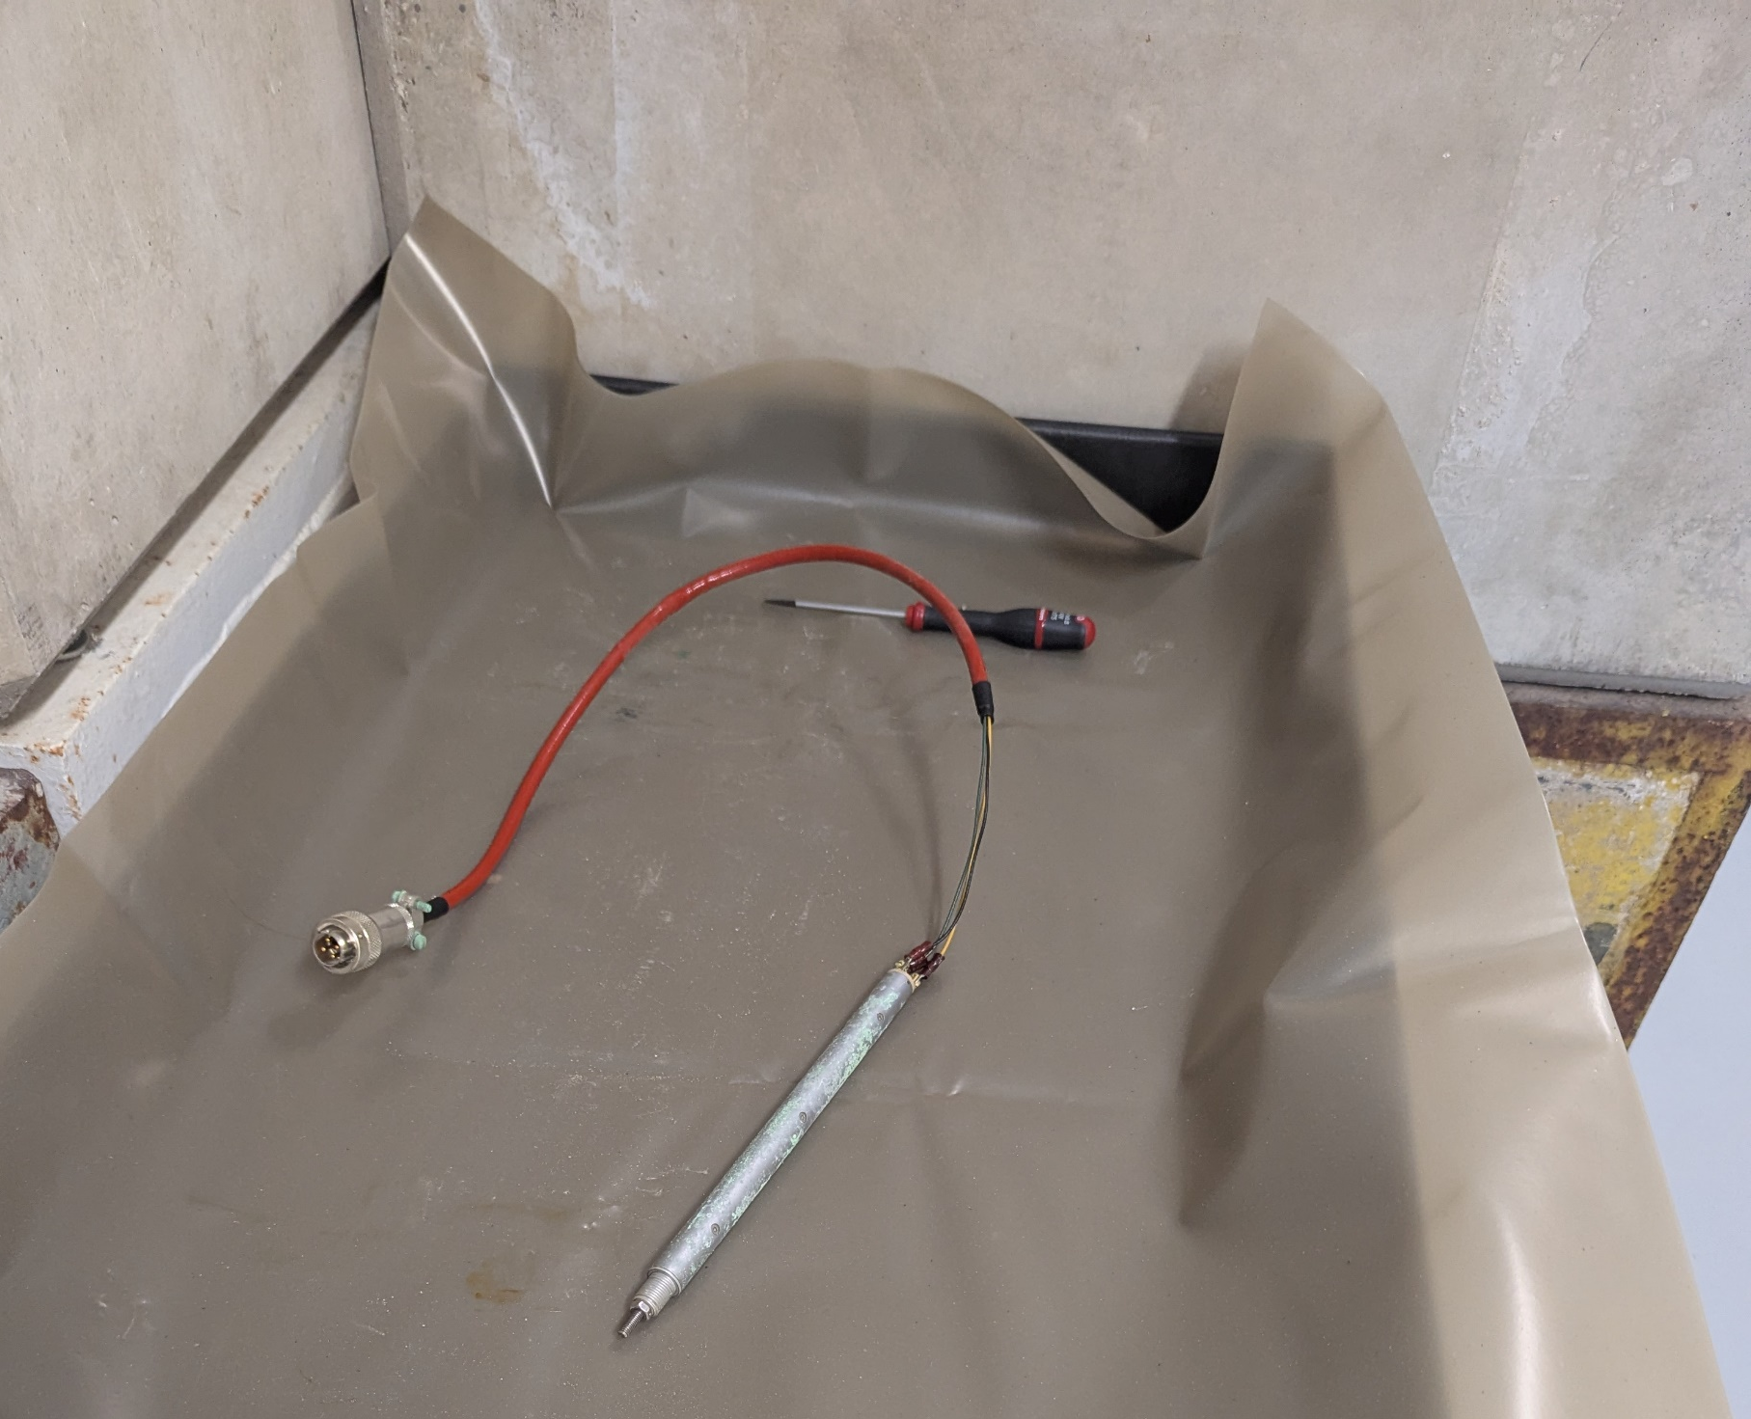
YETS activities in pictures
Targets handling for storage in the ISR
Extraction electrodes exchange
Concrete samples (compression tests)

Slide 5
YETS activities (HIE-ISOLDE, hall, RILIS…)
Experimental HALL
Overhead crane modification (PUMA setup powering) & WISArD crane upgrade
RILIS laboratory electrical consolidation as of mid-February
ISCOOL RFQ intervention to fix issues with the switching voltage for the bunch ejection. Time structure measurements with CRIS during commissioning
REX- HIE ISOLDE
Hand-over of the SC Linac to TE-CRG on the 12/11/24 for tests (cold helium gas circulation in the 4 shields of HIE ISOLDE cryomodules, using evaporated gas from the 2kL dewar)
Standard warm-up procedure started on the 03/12/24. YETS activities ongoing
21/04/2025 Start of HIE-ISOLDE Beam Commissioning
HIE ISOLDE stable beam to Exp. Stations on the 02/06 and start of HIE ISOLDE Physics on the 13/06 (3 weeks gain thanks to cryo and RF optimization)

Slide 6
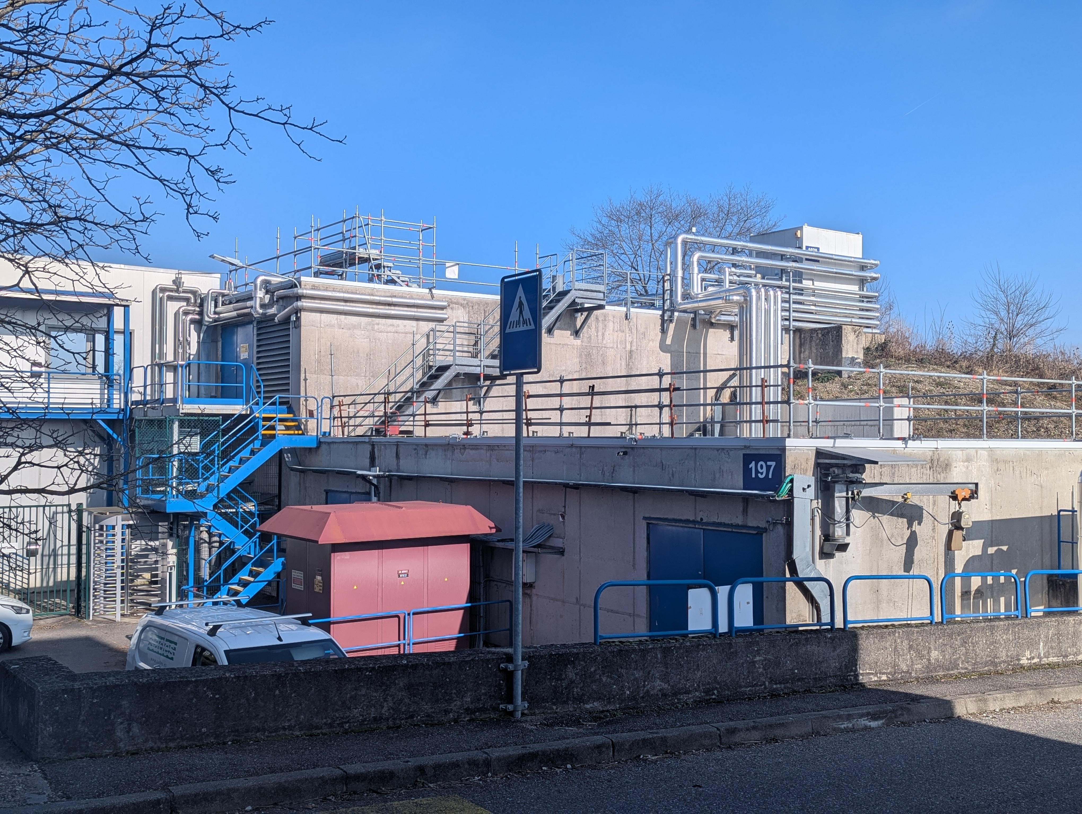
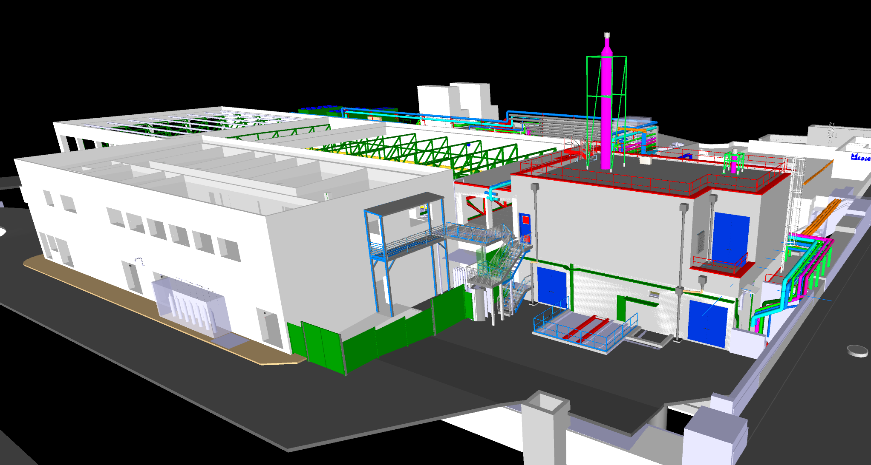
Building 197 extension – Work to start in February
Building 197 extension for ventilation hardware
(primary areas fire safety compliance)
New construction site in Front of building 508
Outside stairs for Building 508 not accessible for a few months
Entrance to the experimental hall from the Jura side will remain accessible

Slide 7
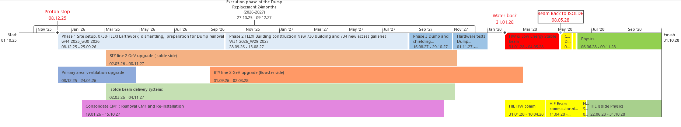
Looking forward: LS3 at ISOLDE
ISOLDE Beam Dumps replacement requires a 24 months time window for execution
Careful analysis of activities proposed as part of ISOLDE improvement program (see next slides) considering the availability of groups supporting CERN wide activities
Scenario with ISOLDE stopping physics end of 2025 favoured to maximise likelihood of MTP requests endorsement. Synchronization with the PS Booster restart
Proposed timeline for activities by ISOLDE technical teams
Ongoing PS Booster LS3 planning optimization to synchronize with ISOLDE date

Slide 8
CERN MTP exercise – ISOLDE Improvement Program
Budget / Manpower requests for different projects, activities and studies not already approved (IBDRS, RILIS laboratory upgrade and fire safety improvement…)
Effort led by BE-OP-ISO and SY-STI-RBS/LP sections in close collaboration with equipment owners
Exercise ongoing for review in the coming weeks and arbitration toward March/April

Slide 9
 | Request | Technical Scope | Motivation / Implications
1 | Consolidation of offline facilities and pump stands | Upgrade of pump stands and two mass Frontend setups coupled to a mass separator [YOL1, YOL2] used for the production, calibration and characterization of targets for the provision of radioactive ion beams. | A failure of the current equipment might induce significant delays in the target production cycle, which directly translates to the physics program of ISOLDE online. CONS proposal submitted but not approved.
2 | BTY upgrade (with extra for PC) | Reconfiguration of the beam line and replacement of magnets compatible with ppm operation and 2.0 GeV. Proposal includes spares consolidation. | Limit physics capability as production yields for several radionuclide of interest have shown increased yields (fragmentation and exotic spallation products). PPM operation not possible for focusing Q100 (energy saving).
3 | ISOLDE power converters (phase 2) | Four 60 kV high voltage insulation transformers (end of life). 16 DC power converters installed in the isolated HV platforms and are used for a variety of functions such as target heating, anode powering, etc… | Material obsolescence and urgent replacement for the target heating as failure of the target heating causes damage to the high value targets (physics and radioactive waste). CONS proposal submitted but not approved.
4 | Pulsing of the central beamline (CA0) | Hardware (power converters and HV switches) and software needed to quickly switch settings of the CA0 line. | Quickly switching the settings of the CA0 line will allow the quasi simultaneous transports of beams from both GPS and HRS targets increasing the shifts dedicated to physics.
5 | NMR probes for HRS separator magnets | Consolidation of the NMR probes for the HRS separator magnets used to regulate the power converters. | Consolidation of the NMR probes is needed to profit from the new power converters planned to be replaced during LS3.
6 | Fixing issues with ISCOOL cooler/buncher | Fixing outstanding issues. Injection of buffer gas from outside the HV cage. Additional diagnostics. | Increase for ISOOL cool that result in lower beam transmission and inadequate time structure. Improved safety.
7 | Tape station for development | Installation of the spare tape station in the GLM line for target development. | Allow target development using the GPS target while delivering beam for physics from HRS effectively increasing the shifts dedicated to physics.
8 | MagneToF for offline2 and ISOLDE | Development and manufacturing of MagneToF detectors for offline2 and ISOLDE. | Single-ion detection capabilities will allow better characterization of beams and facilitate research, development and operation at the ISOLDE facility and offline laboratories.

Slide 10
 | Request | Technical Scope | Motivation / Implications
9 | Fixing REXTRAP discharges and cooler/buncher improvement | QUEST to identify the source of the discharges in the REXTRAP and improve the performance of the ISCOOL. | Limitation in the transmission through the REXTRAP and the ISCOOL cooler/buncher resulting in lower beam intensities to users.
10 | NEG pumping upstream of CM1 | Purchasing and installation of a NEG cartridge next to CM1. | Improve the vacuum pressure upstream of CM1 reducing the contamination and the degradation in performance of the SRF cavities. Higher beam energies and lower maintenance cost.
11 | QUEST for RF and beam dynamics studies | QUEST to initiate the beam dynamics studies for a future normal conducting upgrade of REX. | The REX RF cavities are ageing will need to be replaced in the future. The design and manufacturing of these structures takes years, and the initial studies need to be launched soon to be ready if one of these cavities fail.
12 | Consolidation of the 202 MHz RF amplifier and LLRF | Replacement of the existing 202 MHz amplifier and LLRF by a solid-state amplifier and a digital LLRF system. | Delaying the consolidation could lead to complete failure of the amplifier with a considerable downtime for repair. It will also allow to lower the energy consumption and to reduce the set-up time of the accelerator.
13 | Consolidation of cryomodule 1 (CM1) | Transport of the CM1 to SM18, dismounting and reprocessing of all the cavities, possible replacement of the most degraded ones | Degraded operations with the gradient of the cavities in CM1 at ~ 55 % of nominal limiting the beam energy and imposing constrains on the experimental program of the facility.
14 | Construction of a spare cryomodule (CM5) | Procurement of the CM’s vacuum vessel, helium vessel, thermal shield and supporting frame. Assembly of a full spare cryomodule. | Enable the future consolidation of CM2, CM3 and CM4 without impact on the physics program (YETS not long enough without a spare CM). Reduce the impact of physics in case of failure of a solenoid or cavity component.
15 | Integration of 2kL LHe dewar in the cryoplant | Integration and commissioning of the 2kL LHe dewar. | Minimize the impact on the SRF cavities in case of non-scheduled interruption of the cryoplant.
16 | Study and design of LN2 cooling system for CMs | Study and design of a LN2 cooling system that can be used to maintain CMs at ~90K during the YETS. | Slow down the degradation in performance of the SRF cavities and the impact on the maximum beam energy and the experimental program of the facility. Reduce the maintenance needs of the CMs.

Slide 11
 | Request | Technical Scope | Motivation / Implications
17 | Fixing phase/power jumps in the IHS structure | Investigation to identify the source of the phase/power jumps and solving the issue. | Reduction of the interventionas and the downtime associated to these faults increasing the shifts for physics.
18 | Fixing RF instabilities for the 7GP1 and 7GP3 structures | Investigation to dentify the source of the inestabilities at high RF peak power and solving the issue. | Currently degraded operations since mass/charge ratio is limited to 4.0 (nominal 4.5) imposing constrains on the experimental program.
19 | Repair of the vacuum leak in the 9GP RF structure | Opening up the RF structure, characterization of RF / vacuum seals, manufacturing and installalation of new ones, retuning of the RF structure. | Reduction of risk of failure (potentially months of downtime) if the leak rate increases further. Limiting the contamination and degratation of the SRF cavities in CM1.
20 | RF stand-by support after LS3 | Upgrade support from day-time to stand-by and the consolidation of the REX RF amplifiers is completed. | Reduction of the machine downtime and the potential risk of failure of impacted experiments.

Slide 12
Proposed timeline for LS3 activities at ISOLDE

Slide 13
Budget requests
 | Request | 2025 | 2026 | 2027 | 2028 | 2029 | 2030 | Total
1 | Consolidation of offline facilities and pump stands | 136 | 294 | 253 | 30 | 12 |  | 725
2 | BTY upgrade (with extra for PC) | 550 | 825 | 495 | 30 |  |  | 1900
3 | ISOLDE power converters (phase 2) | 70 |  |  | 160 |  |  | 230
4 | Pulsing of the central beamline (CA0) | 100 | 145 |  |  |  |  | 245
5 | NMR probes for HRS separator magnets |  | 245 | 120 |  |  |  | 365
6 | Fixing issues with ISCOOL cooler/buncher | 40 | 40 | 20 |  |  |  | 100
7 | Second tape station for machine development | 50 | 50 |  |  |  |  | 100
8 | MagneToF detectors for offline2 and ISOLDE | 65 | 45 |  |  |  |  | 110
9 | REXTRAP discharges - cooler/buncher improvement |  | 105 | 105 | 105 |  |  | 315
10 | NEG pumping upstream of CM1 |  |  | 15 |  |  |  | 15
11 | QUEST for RF and beam dynamics studies |  | 105 | 105 |  |  |  | 210
12 | Consolidation of REX 9GP LLRF and amplifier |  | 195 | 405 |  |  |  | 600
13 | Consolidation of CM1 |  |  | 275 |  |  |  | 275
14 | Construction of a spare cryomodule (CM5) |  |  | 300 |  | 1200 | 200 | 1700
15 | Integration of 2kL LHe dewar in cryoplant
16 | Study and design of LN2 cooling system for CMs

Slide 14
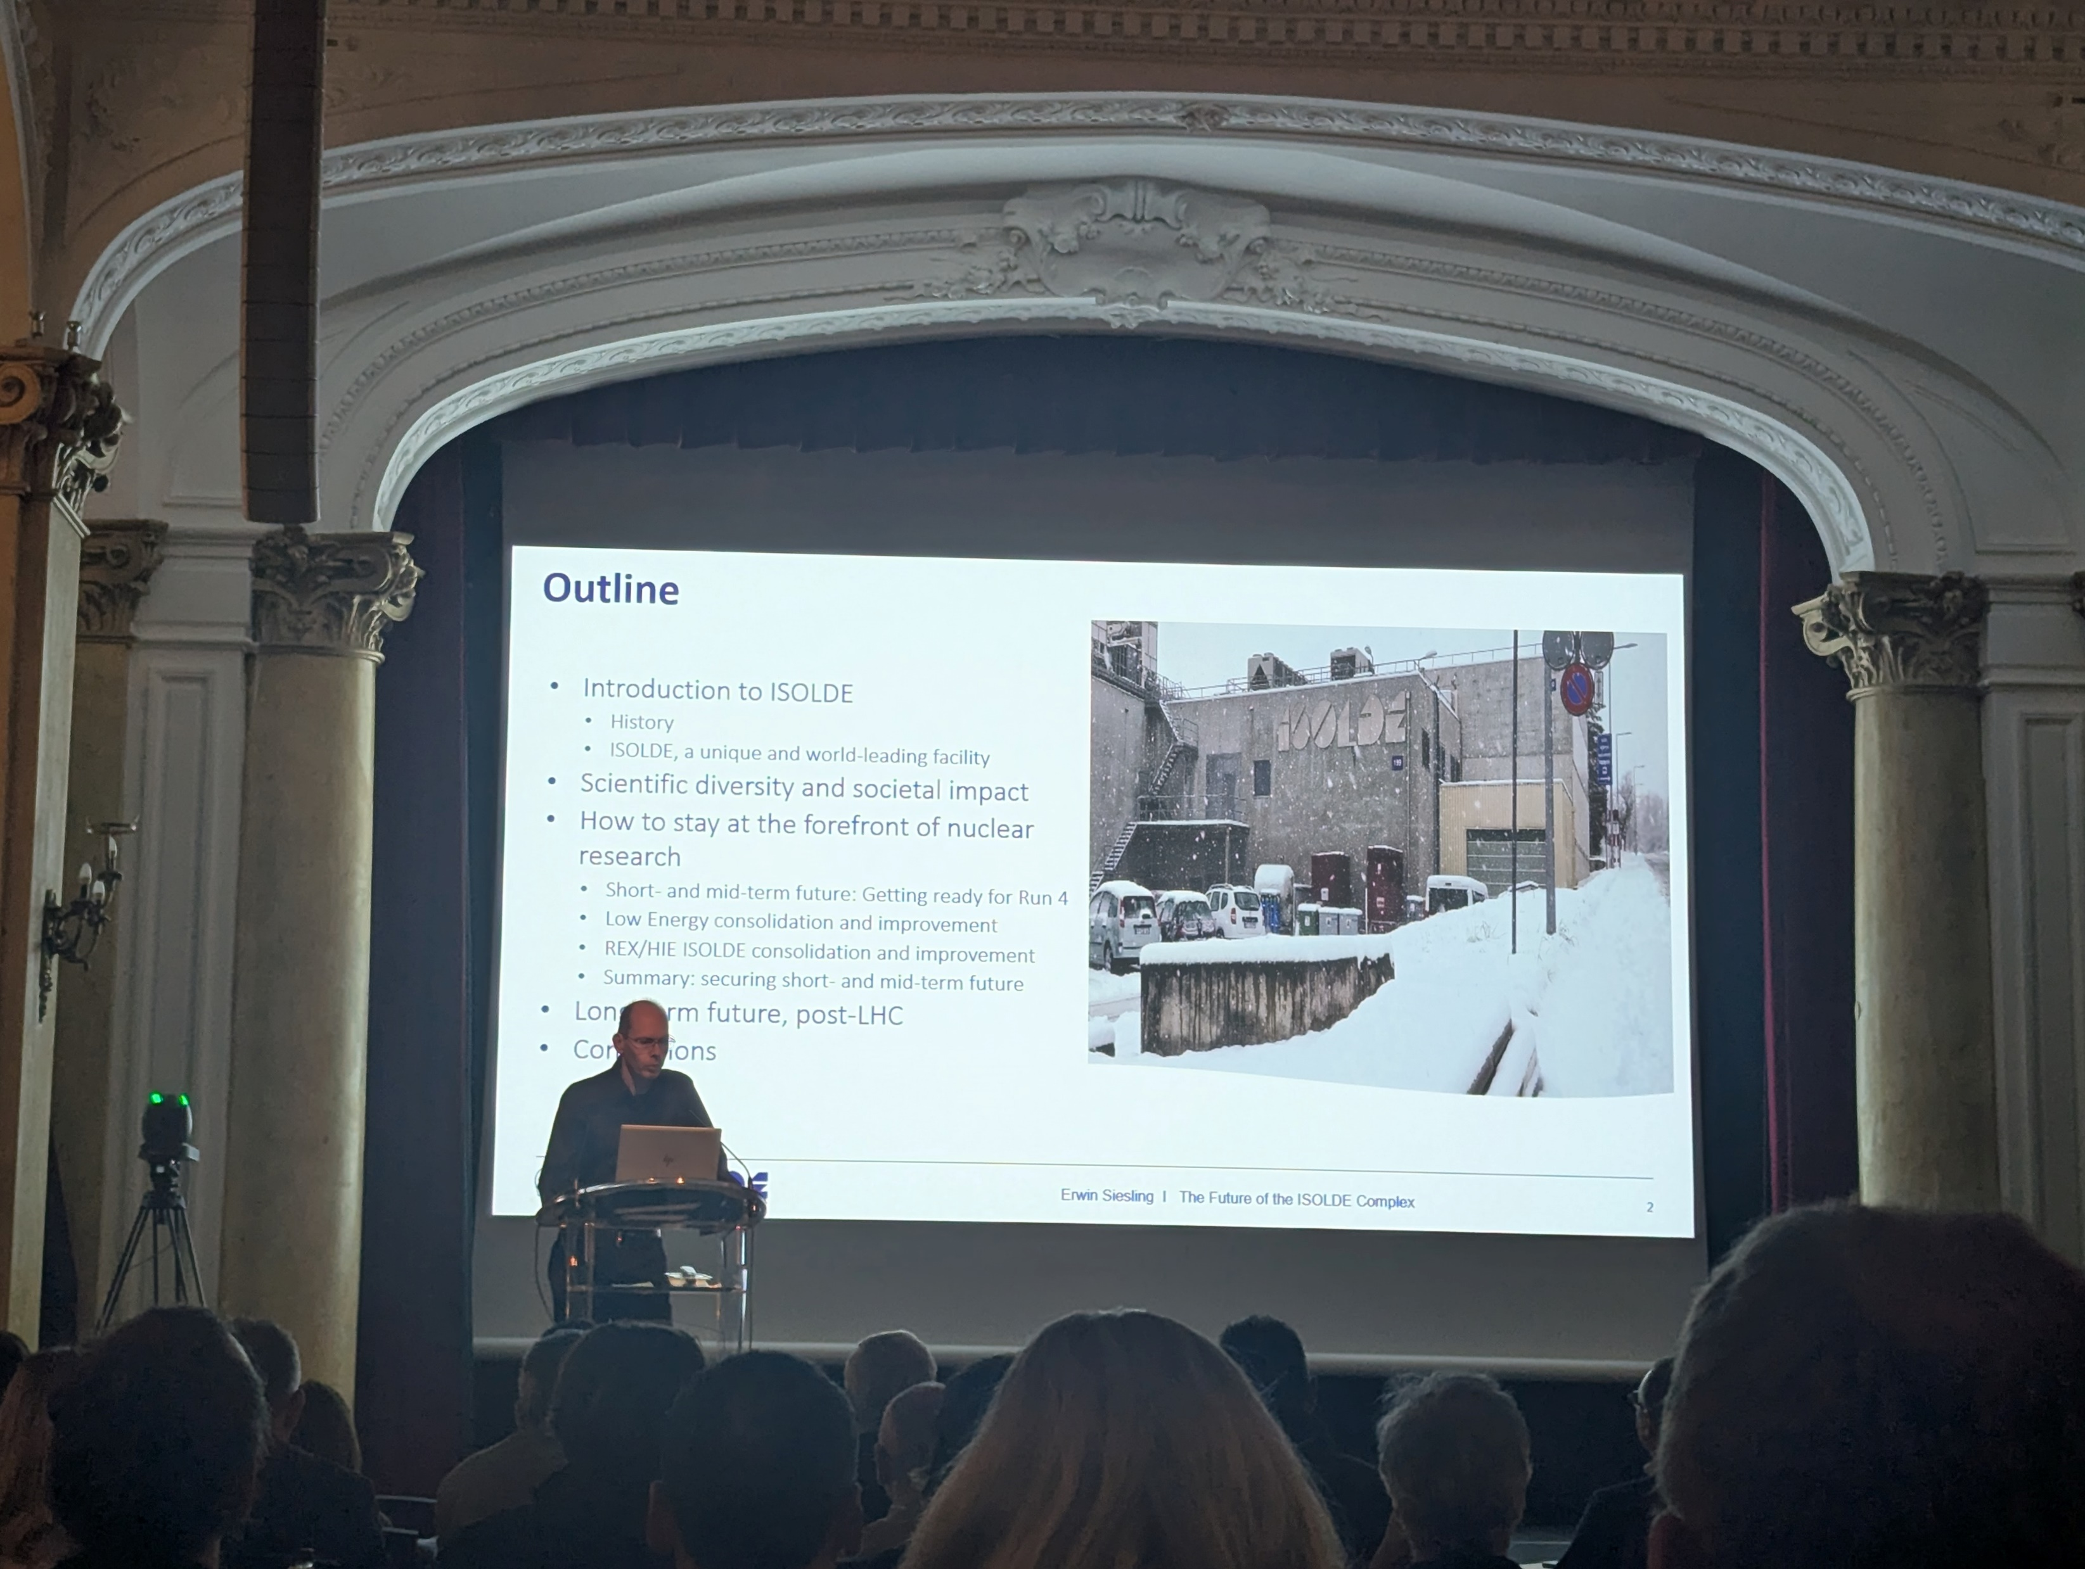
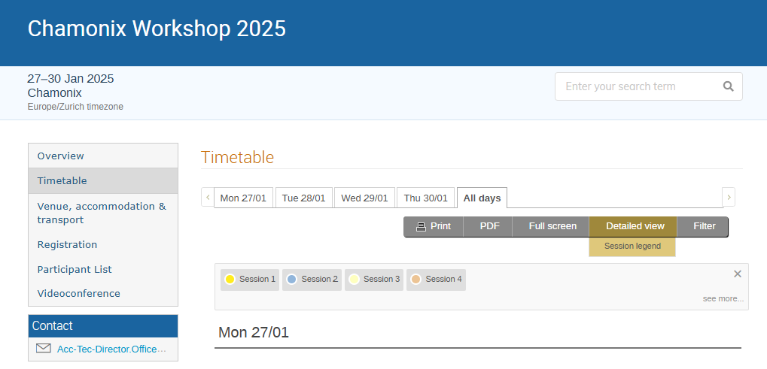
Conclusions
YETS activities are ongoing. Readiness for 2025 physics (last year before LS3 at ISOLDE)
MTP exercise for non-approved items of the ISOLDE Improvement Program. LS3 planning optimization with equipment group and PS Booster coordination
https://indico.cern.ch/event/1469359/contributions/6233083/attachments/3005480/5297618/The%20future%20of%20the%20ISOLDE%20Complex%20_%20Chamonix%2029_01_2024%20_%20ES%20_final.pdf
https://indico.cern.ch/event/1469359/timetable/#all.detailed

