Slide 1
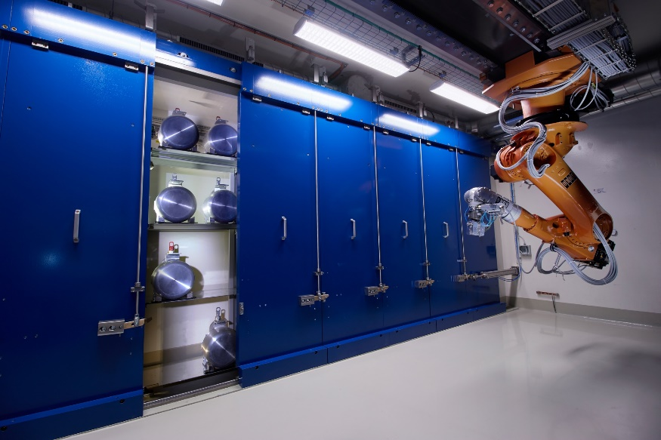

CERN-MEDICIS
Production of radionuclides for medical research
On the way to clinical translation ….
Charlotte DUCHEMIN, CERN, SY-STI-RBS
MEDICIS experimental program coordinator & PRISMAP technical manager
On behalf of the MEDICIS local dream-team, collaboration and all contributors
05 Feb 2025 – INTC EDMS 3230562

Slide 2
Summary
Quick reminder of MEDICIS integration within the ISOLDE complex
Our current irradiation possibilities : to produce our radionuclides
A view of MEDICIS activity delivered since 2018 and increasing demand
Our deliveries last year and where/which research projects
Clinical translation: where we are now and implications for ISOLDE
Long-term plan
EDMS 3230562

Slide 3
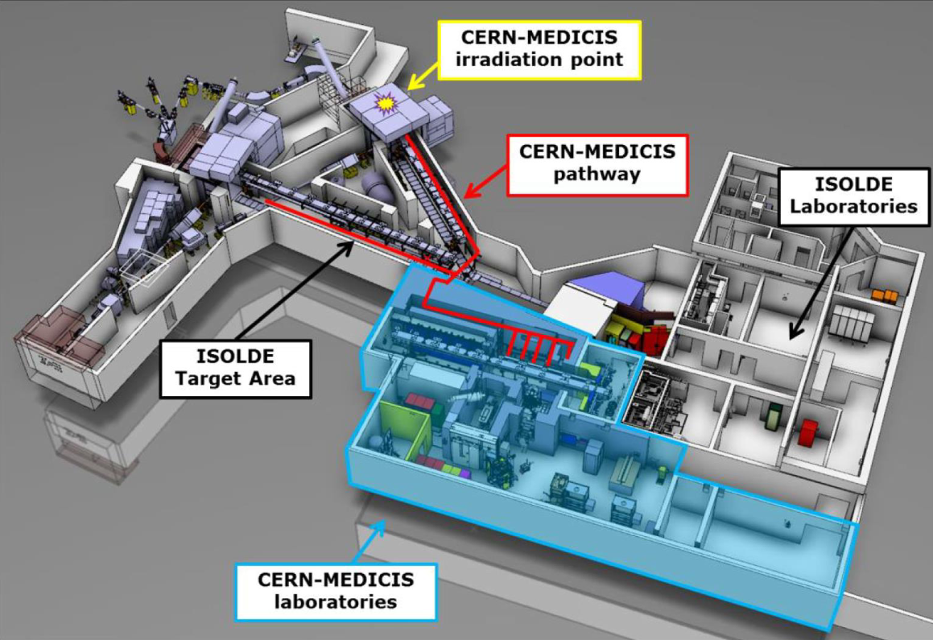
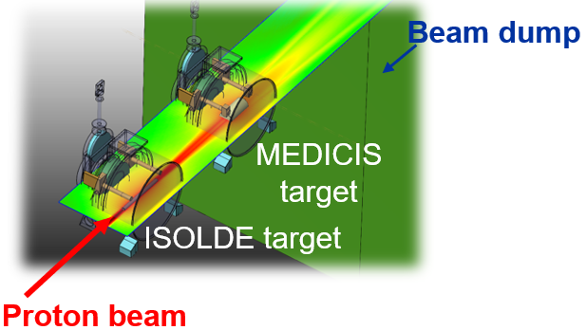
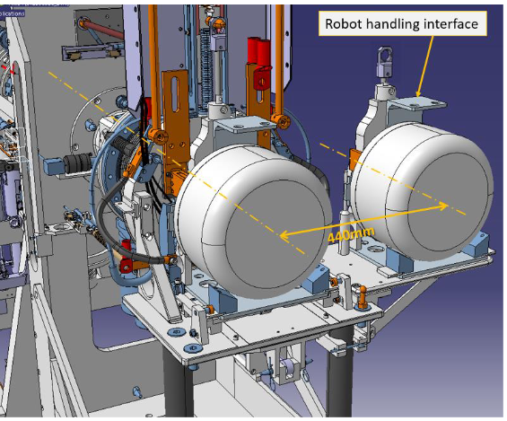
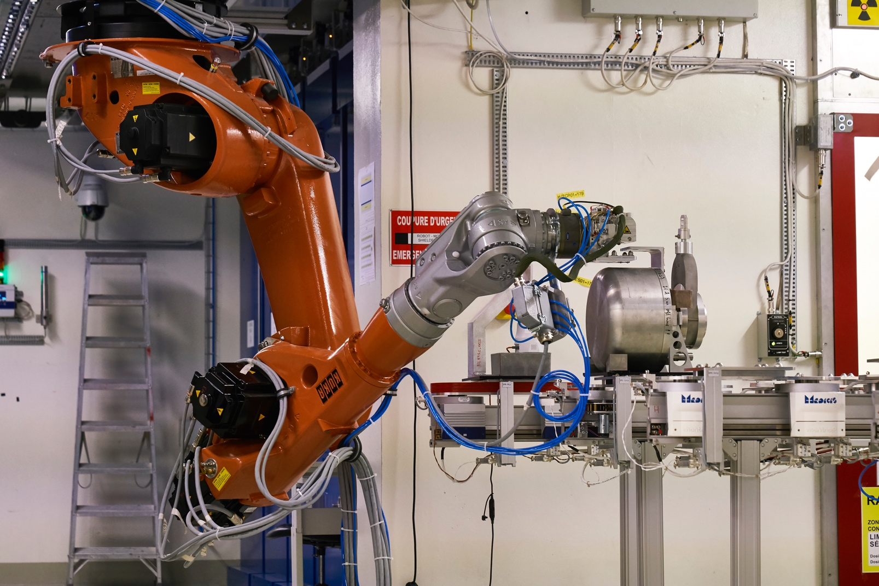
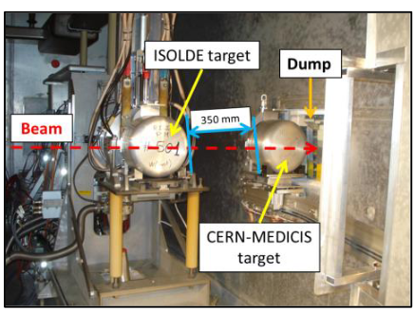
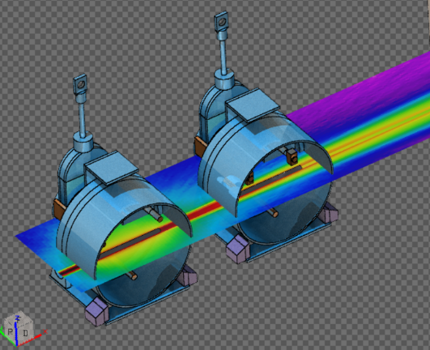
CERN-MEDICIS - integration within the ISOLDE complex
Jura
Salève
Since 2021
GPS
Irradiation Station
Class A laboratories
EDMS 3230562

Slide 4

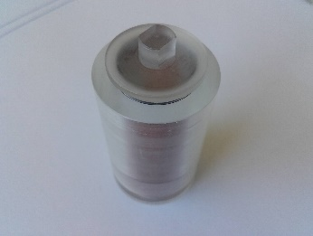
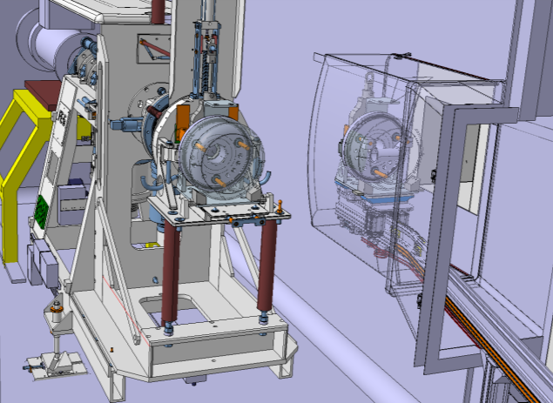







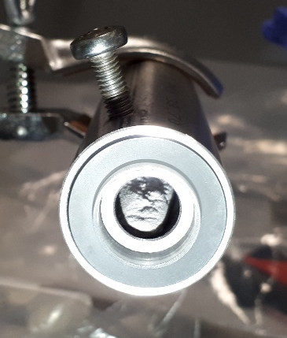
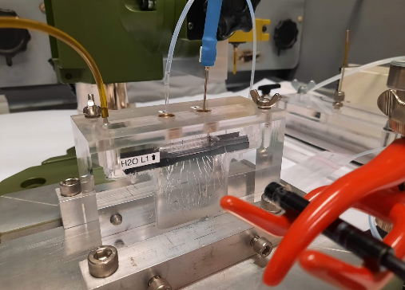
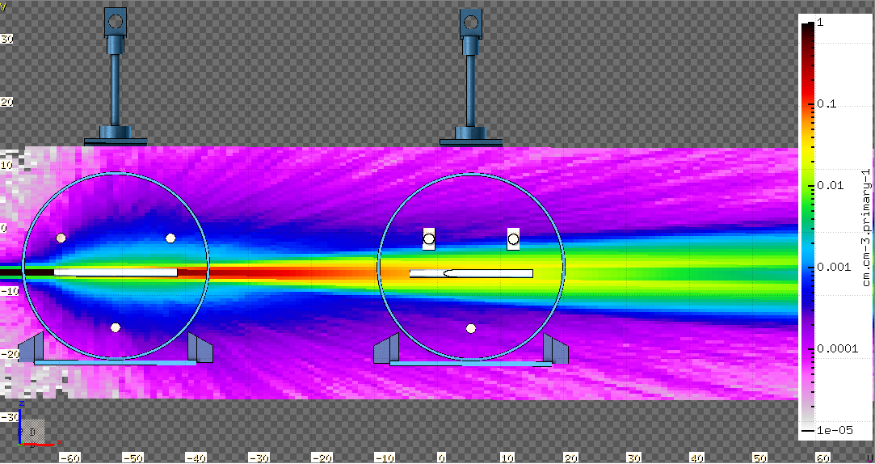
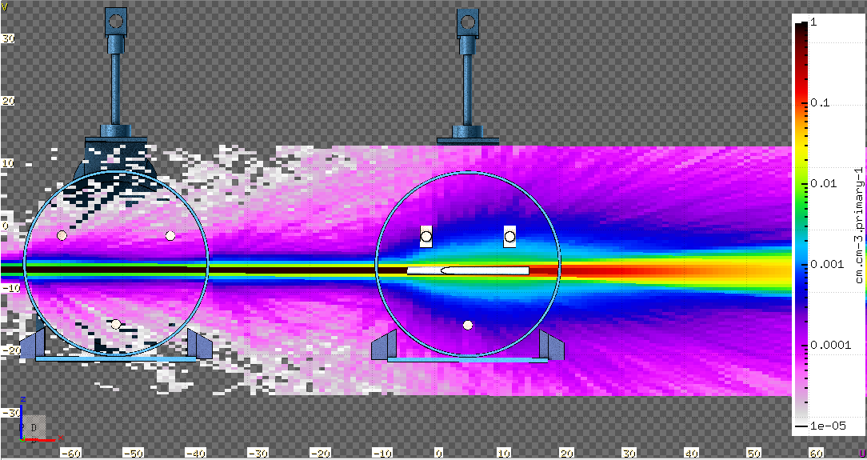
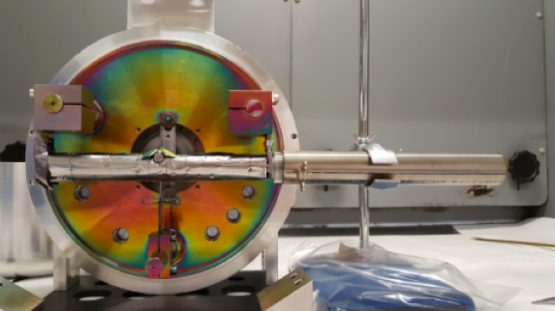
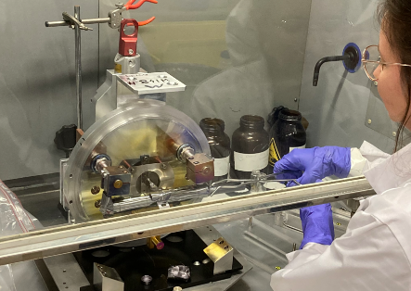
CERN-MEDICIS - irradiation possibilities
External sources produced at partner institutes
Indirect irradiation at ISOLDE (1.4 GeV)
Recycle the protons
Direct irradiation at ISOLDE (1.4 GeV)
1st time tested already in 2018
MEDICIS Target
MEDICIS Target
ISOLDE Target
ISOLDE Target
Isotopes for ISOLDE
Beam dump
Beam dump
Protons 1.4 GeV
Protons 1.4 GeV
Same radionuclide inventory but x10 difference in production yield
The only mode of operation during LS
Total particle fluence
cm.cm-3.primary-1
Total particle fluence
cm.cm-3.primary-1
Courtesy of SY-STI-TCD
Typical target material used at MEDICIS similar to ISOLDE (Ta, molten Pb, ThO/ThC) with new ones (TiC, V foils)
EDMS 3230562

Slide 5
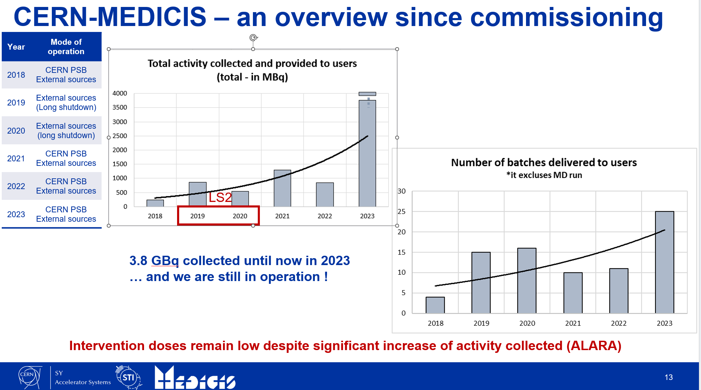
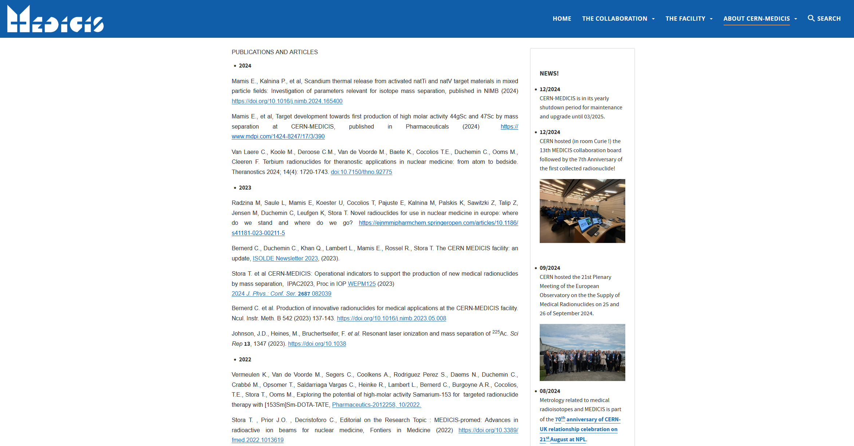
Increasing demand and activity delivered since first year of operation in 2018
Thanks to increased experience in the operation of the facility AND smooth and efficiency coordination between MEDICIS and ISOLDE without perturbing the ISOLDE physics program
Slide presented at the ISOLDE workshop end of 2023
And many scientific publications every year
(more details on https://medicis.cern)
EDMS 3230562

Slide 6






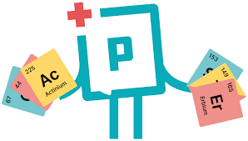







CERN-MEDICIS –2024 productions and deliveries
Ra-224/Pb-212
1x 710 MBq
1x 130 MBq
1x 270 MBq
1x 380 MBq
Ra-225/Ac-225
1x 105 MBq
1x 115 MBq
1x 30 MBq
1x 40 MBq
1x 10 MBq
1x 80 MBq
Tm-165/Er-165
1x 100 MBq
In development:
Tb-155*
1x 7 MBq
1x 1 MBq
Sc-47*
1x 10 MBq
Eu-145 & Gd-149
20 MBq
A first:
K-43
1x 10 MBq
All values presented are at the time of the End Of Collection (EOC)
72% collection efficiency reached for Ra ! ( = activity collected vs activity at start)
2 GBq total collected ! including 1.5 GBq Ra-224/Pb-212 & 380 MBq Ra-225/Ac-225 ….
Respectively corresponding to 8 and 38 clinical doses !
But why such a high demand for these two radionuclides?
*combined with systematic dedicated release studies as part of P. Kalnina PhD thesis (2024-2027) & E. Mamis PhD thesis (defended in Oct 2024)
EDMS 3230562

Slide 7
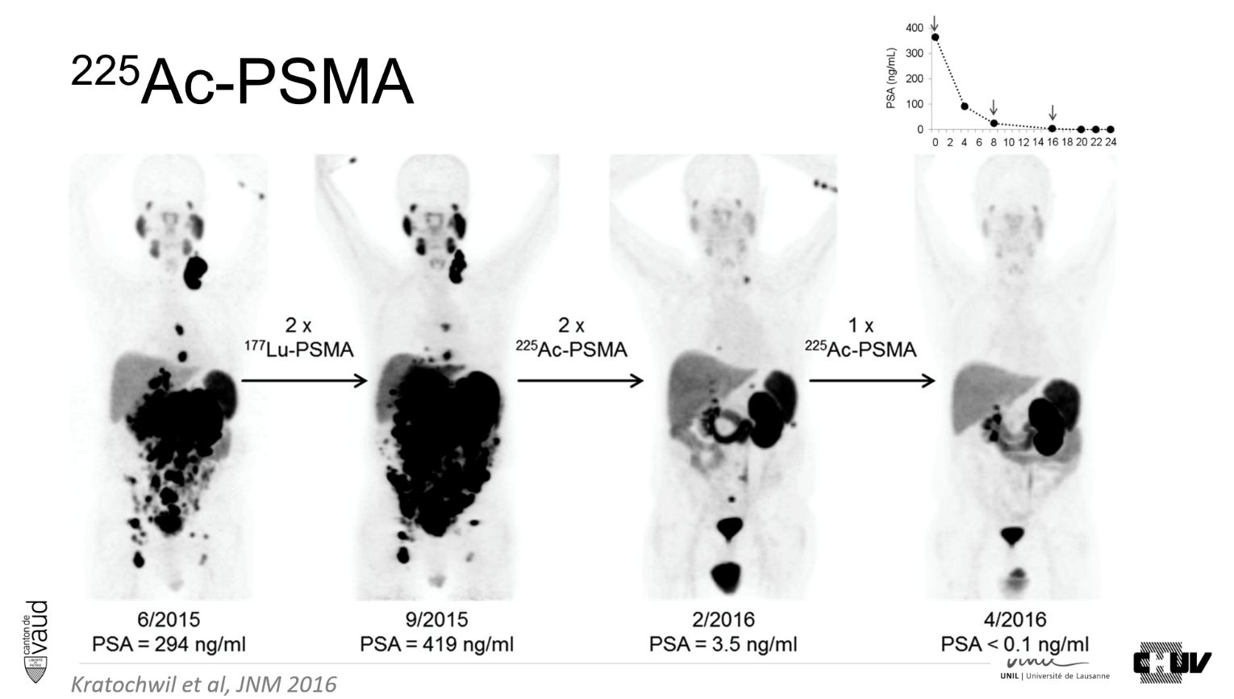
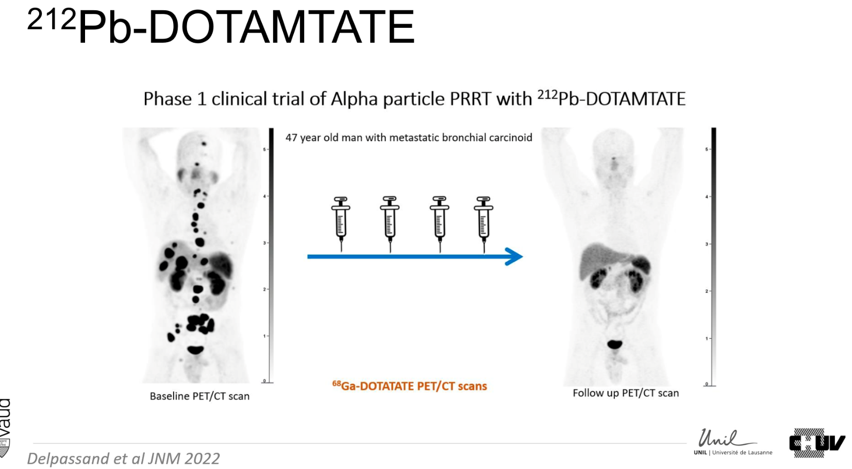
CERN-MEDICIS: radionuclides and research projects
Why such a high demand for these two radionuclides
Ra/Ac-225 and Ra-224/Pb-212
Very limited world-wide availability of these radionuclides required to speed-up research of targeted alpha therapy
HIGH DEMAND to pursue research efficiently as clinical trials = injection into patients
These radionuclides are produced and delivered by CERN-MEDICIS with high purity and high efficiency >50%
*Kratochwil et al. Journal of nuclear medicine, 2016
**Delpassand et al. Journal of nuclear medicine, 2022 Courtesy of Prof. John Prior (CHUV)
EDMS 3230562

Slide 8

Requests to go for clinical trials
Because MEDICIS showed already its possibility/capability to produce activity levels and purity levels suitable for clinical applications
Both from externally irradiated samples and irradiations at ISOLDE
The latter successfully tested in 2024 thanks to a smooth and efficient coordination with ISOLDE without perturbing the ISOLDE physics program ☺
The authorization to provide our radionuclides for clinical trials is going to be discussed at the CERN council in March 2025 and it is pending for approval.
EDMS 3230562

Slide 9


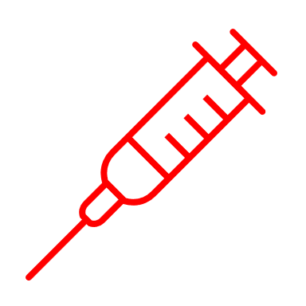



Requests to go for clinical trials – projects concerned
Sm-153 from external sources (reactor product) → do not involve irradiations at ISOLDE but irradiations at partner institutes
Ra-224/Pb-212 project → involve irradiations at ISOLDE (ThC with 1.4 GeV)
  Success in 2024 leading to the request to move to clinical application in Dresden Hospital in Germany in 2025
47 projects selected for funding within PRISMAP
providing radionuclides and transnational accesses to external researchers
Only 2 are ready to move to clinical trials
1 needs us and
our Ra capabilities ! ☺
CERN-MEDICIS is one of the pillar of PRISMAP, the European medical isotope program
A single entry-point for external user to get access to medical radionuclides for cancer research
INFRA-2-2020 European Commission www.prismap.eu
Coordinated by CERN
Involving key European infrastructures in the production of medical radionuclides such as MEDICIS, ILL, SCK CEN, PSI, POLATOM, Hevesy Lab, ARRONAX, JRC K.
EDMS 3230562

Slide 10



Requests to go for clinical trials – where we are now and implications for ISOLDE
  We know we are capable of producing the amount of activity of Ra-224/Pb-212 that would be necessary for future clinical trials → tested in 2024 with up to 700 MBq produced
  Requirements to move forwards in 2025:
  Produce 200 to 500 MBq Ra-224/Pb-212 (x3) for shipping to Dresden Hospital in Germany
  Need about 24 hours direct irradiation of ThC with 1.4 GeV beam and 2 uA at ISOLDE
  Operate without perturbing the ISOLDE physics program
      During stable set-up time for instance, as currently done.
      Or during slots usually dedicated to development time (TISD CERN-internal for instance)
    Concrete example: clinical deliveries from JRC Karlsruhe are scheduled every two months with the planning known for the year to come
  However, as patients will be scheduled and waiting: these irradiations must be flagged
  as critical/sensitive, known at least couple months in advance and not be delayed
EDMS 3230562

Slide 11

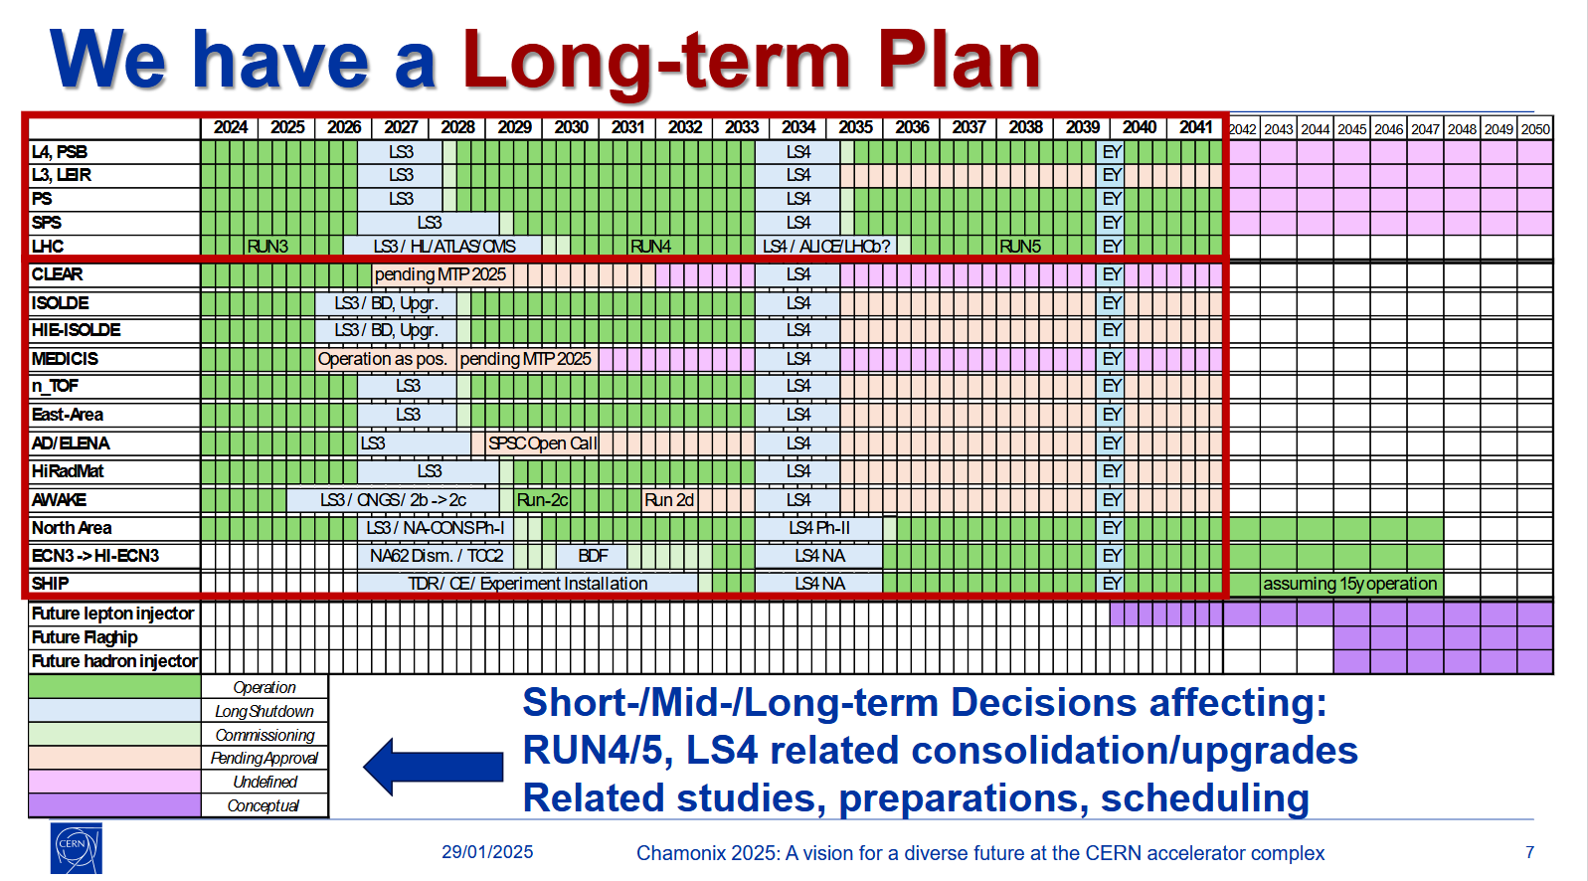
And on the long term …
Following successful international review end of 2023, MEDICIS is now submitting the formal approval request to run up to 2031 …
Taken from M. Brugger, M. Lamont, Chamonix workshop 2025
EDMS 3230562

Slide 12
Executive summary
Since 2018 MEDICIS operates by taking beam at ISOLDE without perturbing the physics program (good coordination required!)
Clinical translation at MEDICIS requested for two ongoing projects → being evaluated by the CERN council
One project would require direct irradiation at ISOLDE
  To be coordinated “as usual” but with a special flag: critical/sensitive

Slide 13
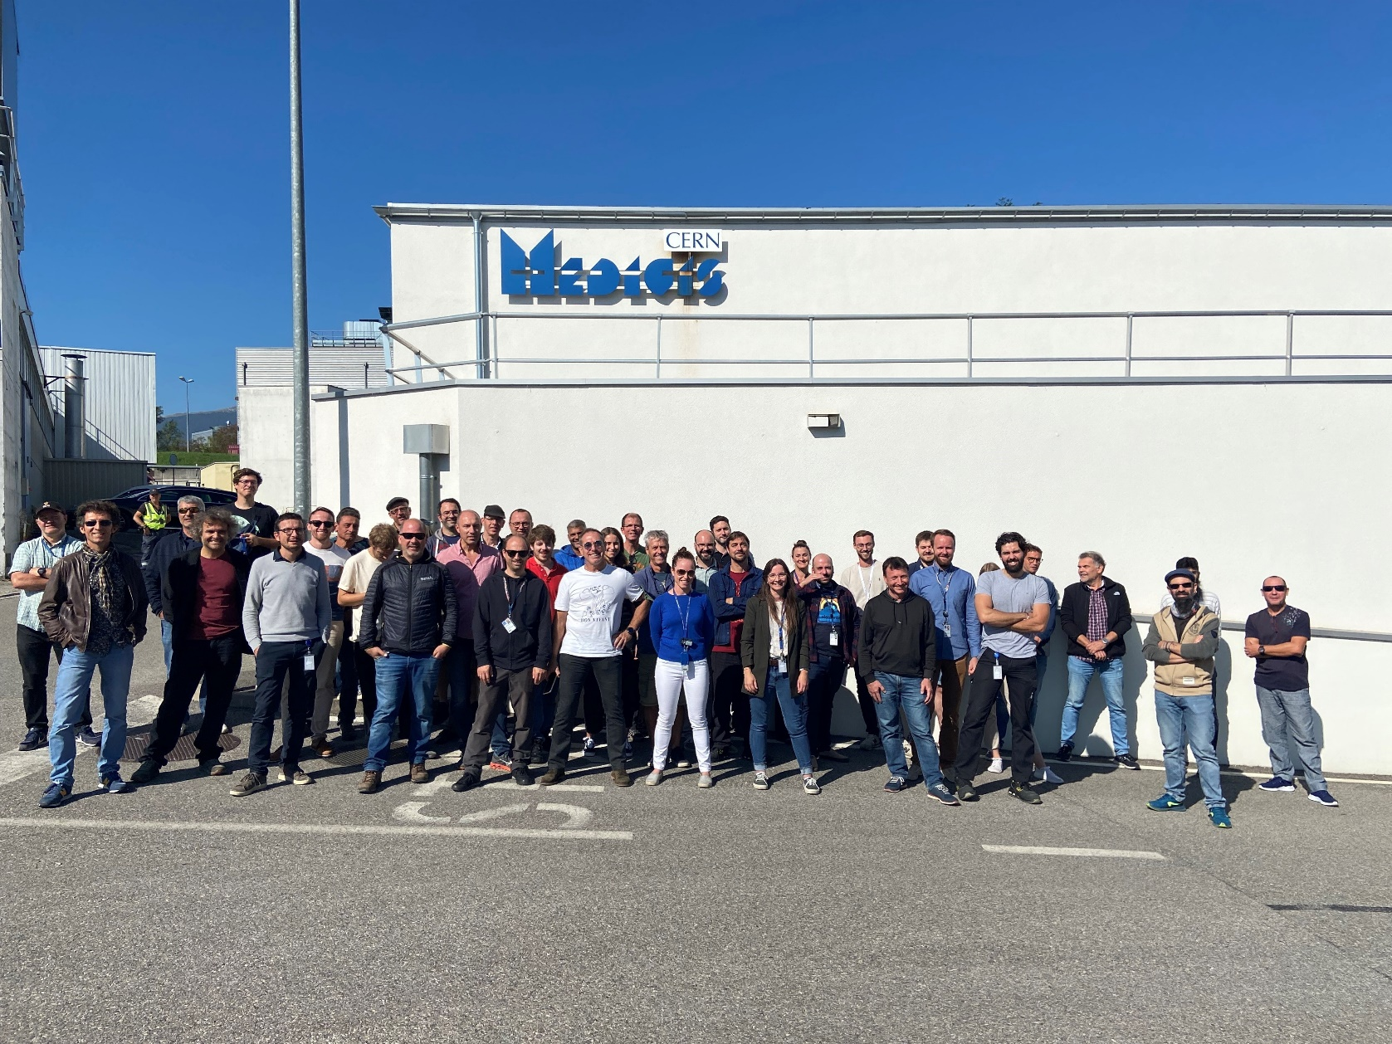
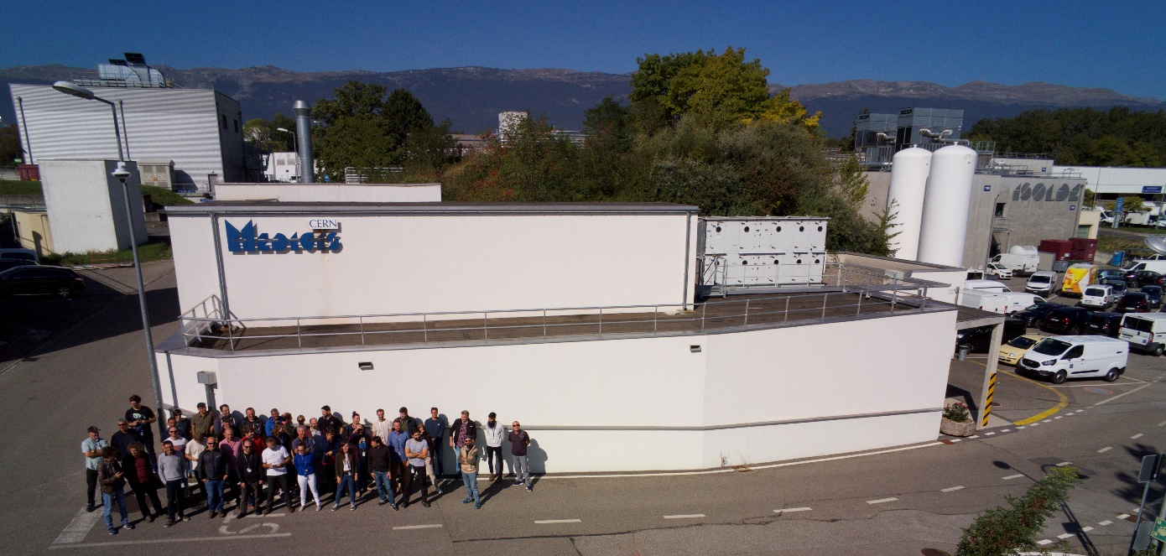
A BIG THANKS TO ALL THE PEOPLE, GROUPS, SERVICES, INSTITUTES, COLLABORATION … INVOLVED IN MEDICIS!
THANK YOU FOR
YOUR ATTENTION !
Any questions/concerns?
THE Dream-Team
Charlotte.Duchemin@cern.ch
EDMS 3230562

