Slide 1



Non-topological Solitons
University of Virginia
Mikheil Sokhashvili
September - 2025
University of Virginia

Slide 2

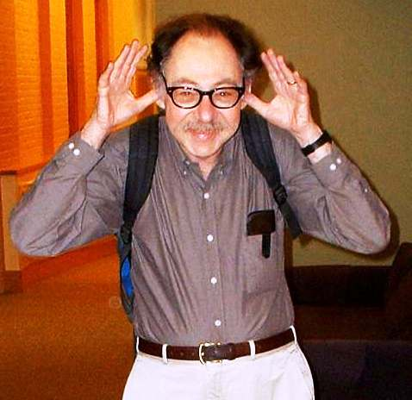
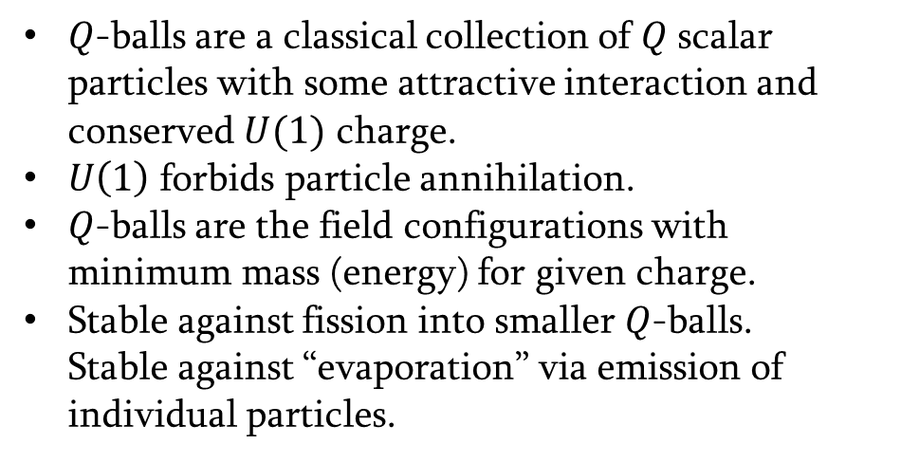
What Are $Q$-balls?
$Q$-balls are a classical collection of $Q$ scalar particles with some attractive interaction and conserved $U(1)$ charge.
$U\left(1\right)$ forbids particle annihilation.
$Q$-balls are the field configurations with minimum mass (energy) for given charge.
Stable against fission into smaller $Q$-balls.
Stable against “evaporation” via emission of individual particles.
[Chat - GPT]
[Coleman, 1985]
1

Slide 3
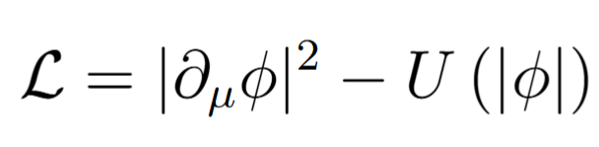
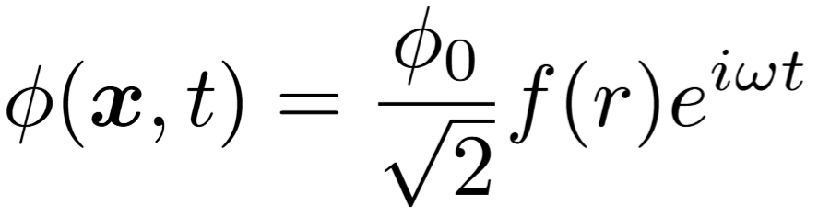
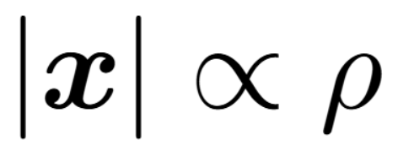
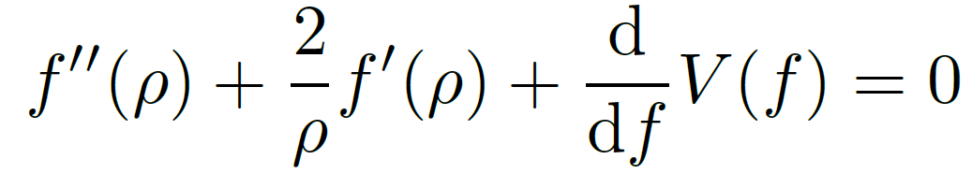
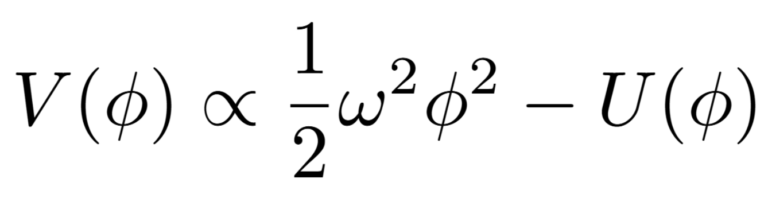
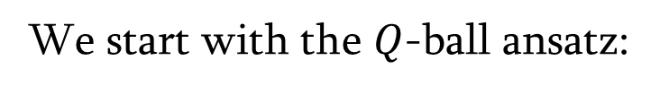
Mathematical Formulation of a $Q$-Ball
We start with the complex scalar field Lagrangian
We start with the $Q$-ball ansatz:
,
Equation of motion takes the following form
,
With this ansatz we get rid of the time dependence and reduce to one dimensional problem.
2

Slide 4






Analogy to One-Dimensional Mechanics Problem
Equation of motion:
Boundary conditions
$ρ−$ time
$f−$ spatial coordinate
$$f′(0)=0$$
Effective Potential:
$$f(∞)=0$$
$$V$$
[Coleman, 1985]
$$φ$$
Notes:
Mention vacuum decay

Slide 5
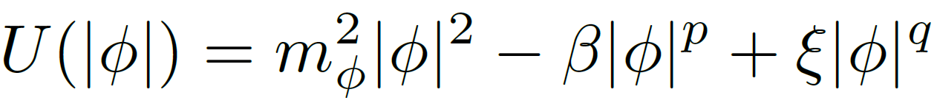
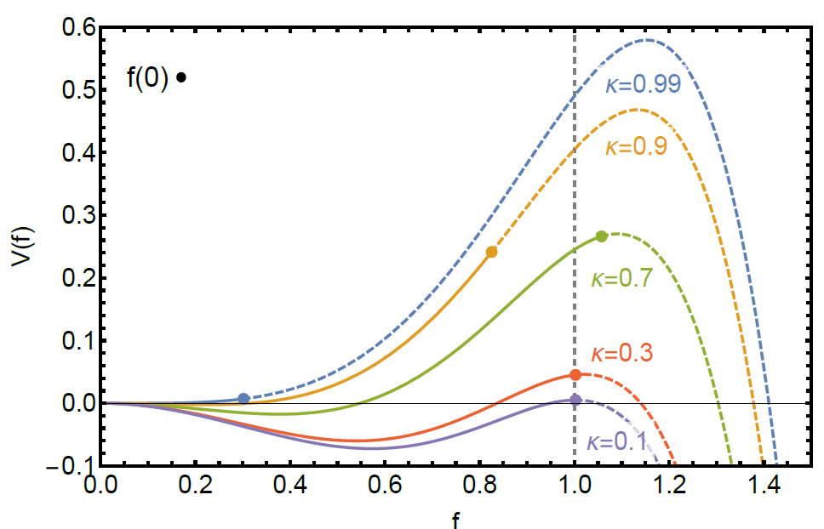
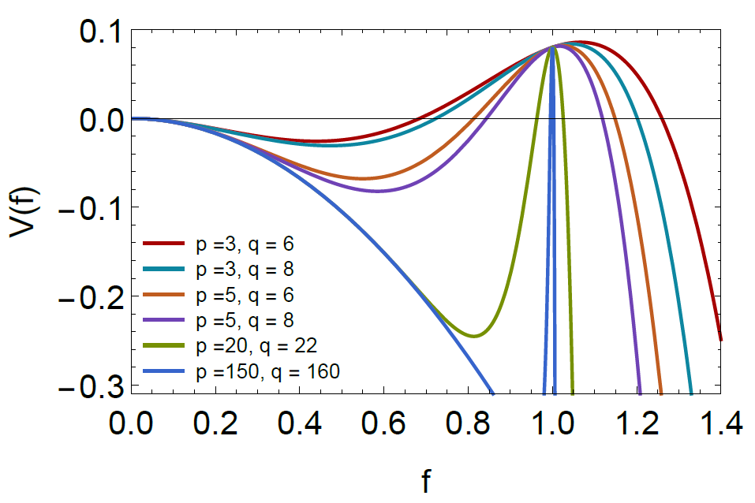






Polynomial Potential
Physical potential:
$$2<p<q$$
Effective potential:
$p=4$ and $q=6$
Arbitrary $p$ and $q$
$$κ=0.4$$
Bigger $κ$ means taller peak
Larger $p$ or $q$ means sharper hill
$κ≪1$ leads to the thin-wall limit
$p$ is more significant
[Heeck, Rajaraman, Riley, Verhaaren, 2021, “Understanding Q-Balls Beyond the Thin-Wall Limit” ]
[Heeck, Sokhashvili, Phys. Rev. D 107 (2023)]
Notes:
Mention vacuum decay

Slide 6
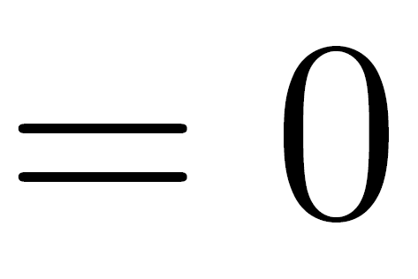
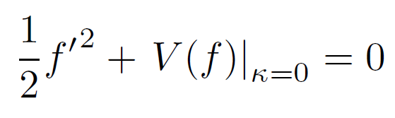
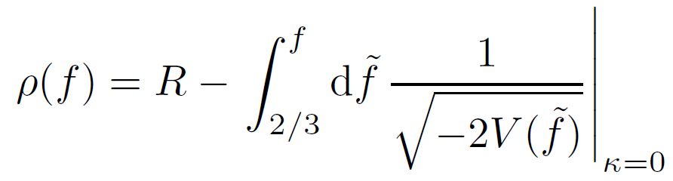

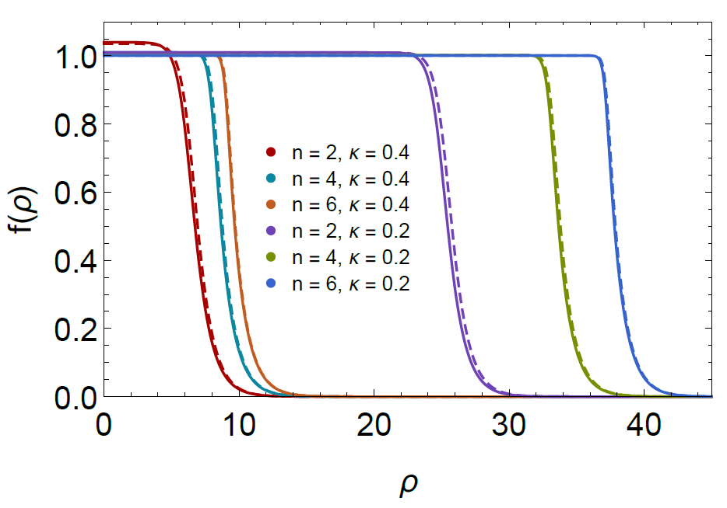
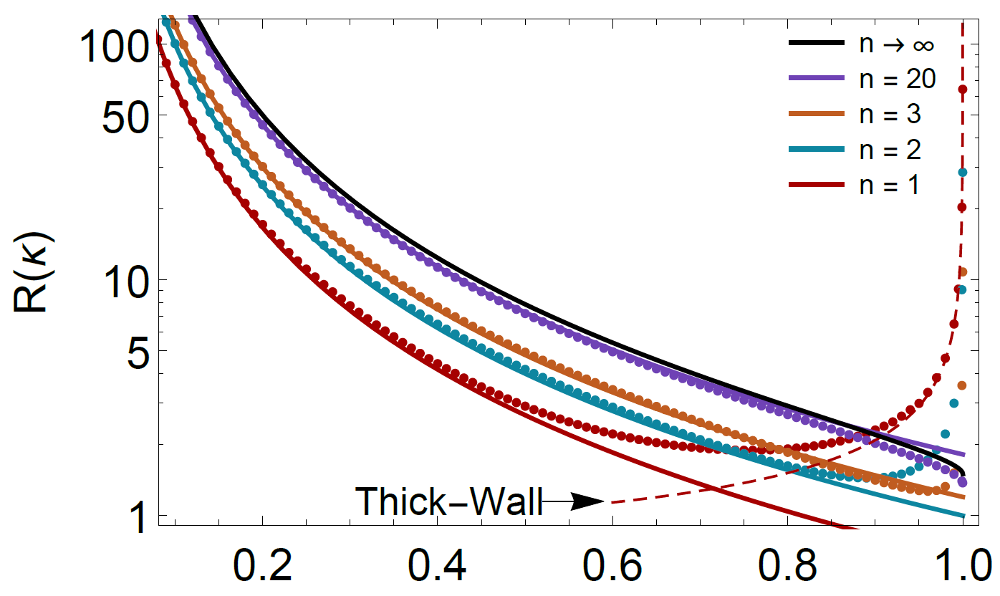
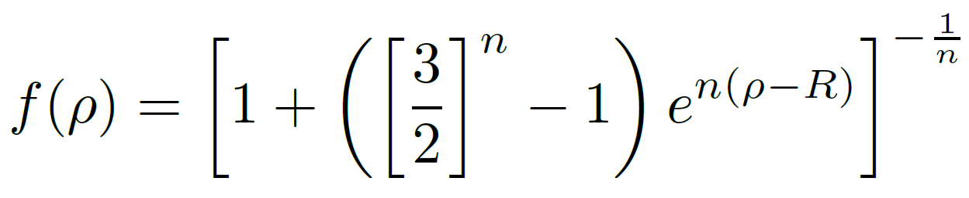
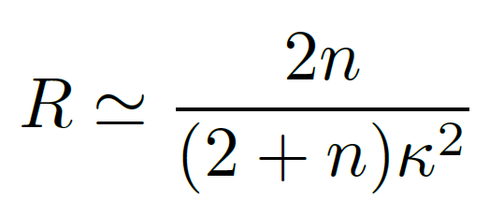


Coleman’s Thin-Wall Limit $(κ≪1)$
Equation of motion:
Initial
$$κ=0$$
$$\frac{κ^{2}}{2}$$
Energy conservation:
Final
Profile solution:
[Coleman, 1985]
Equidistant exponents:
Original potential:
[Heeck, Sokhashvili, Phys. Rev. D 107 (2023)]
[AnyBubble]
Coleman approximated with a step-function

Slide 7
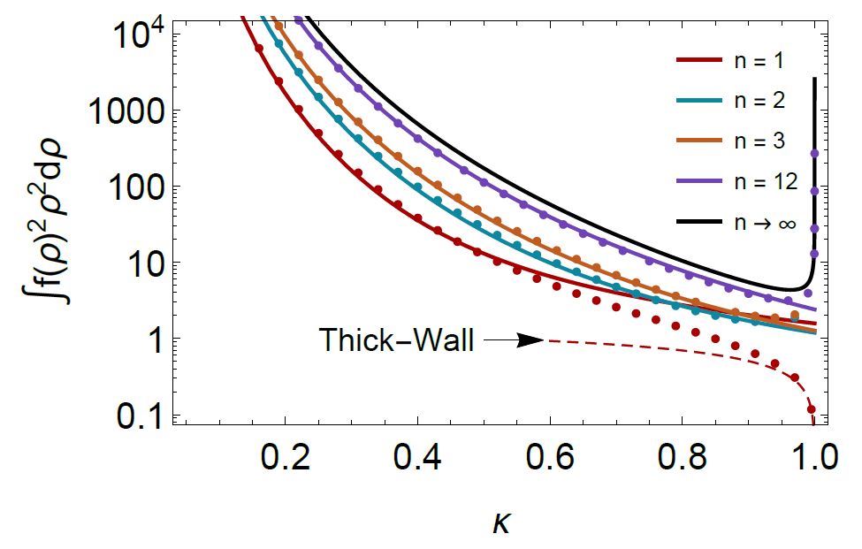
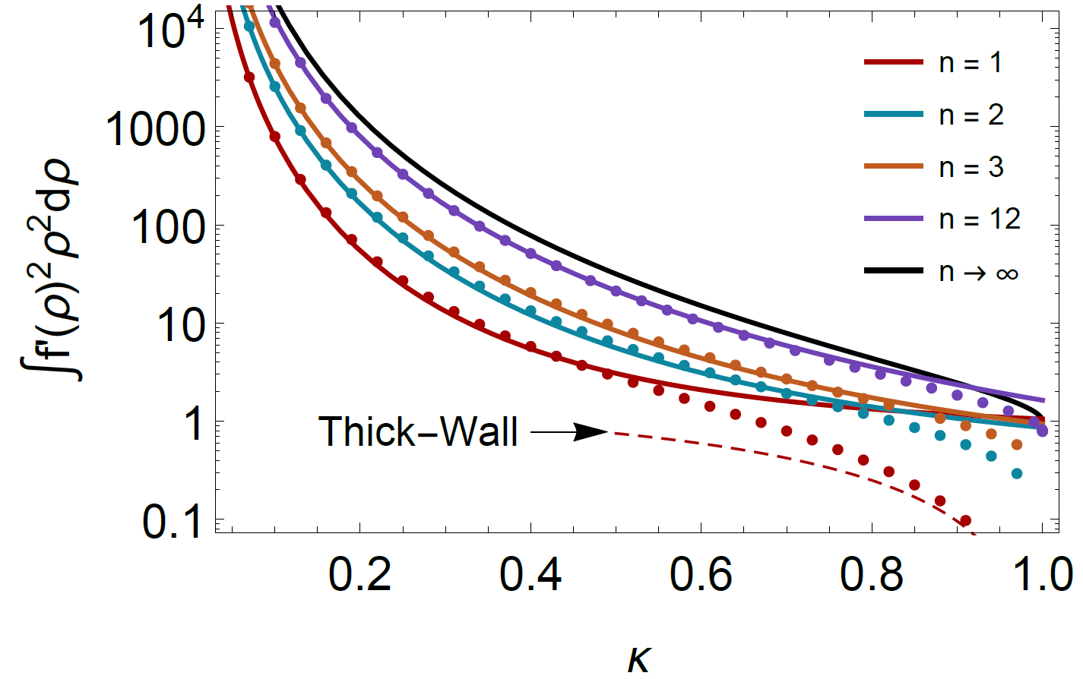
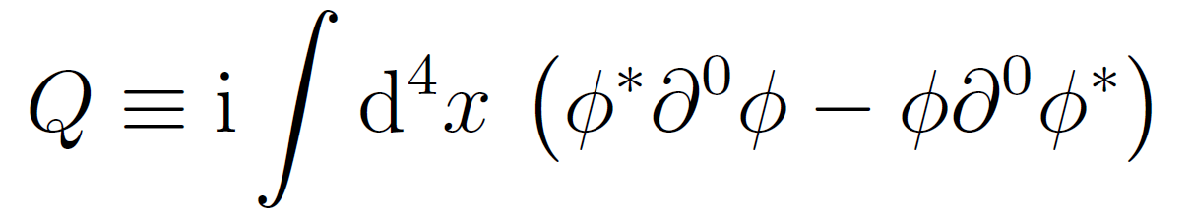
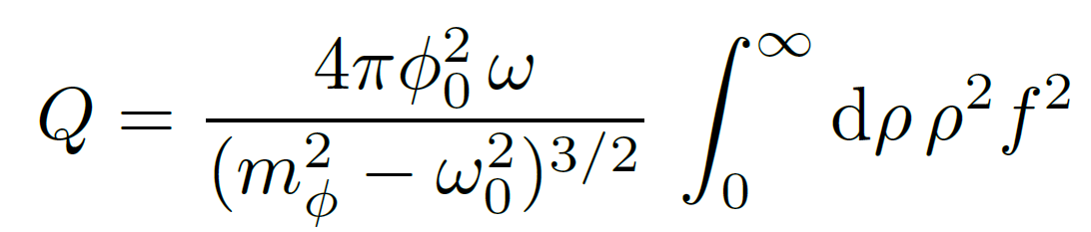
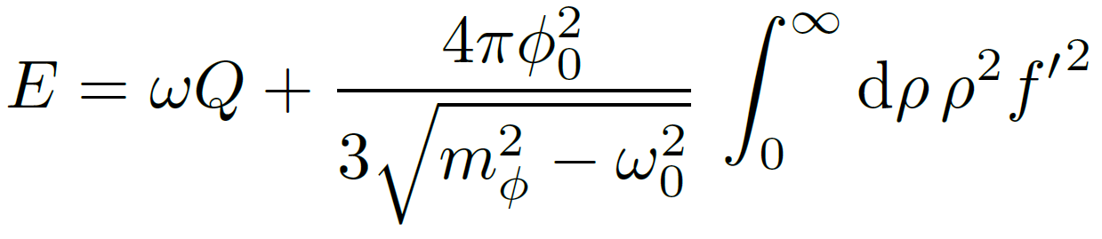
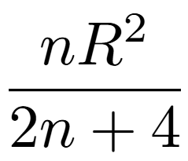
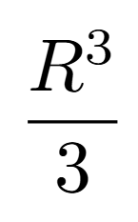



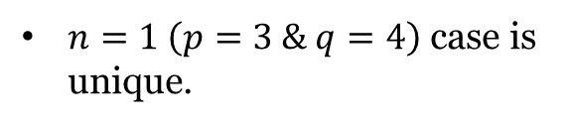
Important Integrals
Our approximations work better for larger exponents.
Agreement holds till $κ≈0.8$.
$$M$$
$n=1 \left(p=3 \& q=4\right)$ case is unique.
$Q∝M∝V$, “$Q$-matter”

Slide 8
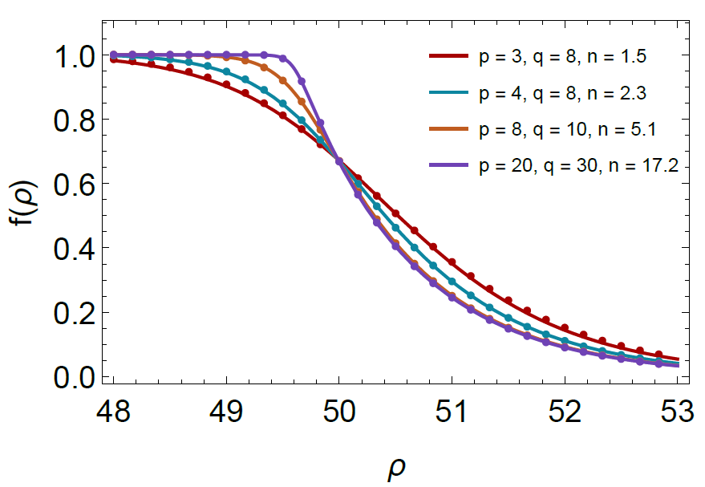
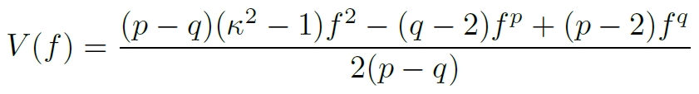
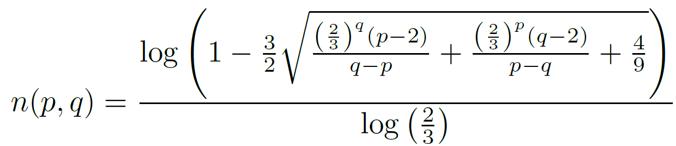
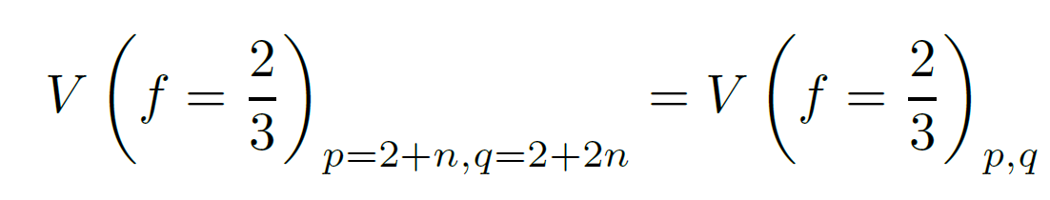




General Exponents
Find corresponding $n$ for arbitrary $p$ and $q$:
$$p$$
$$n(p,q)$$
$$q$$
Effective potential:
Match values at the radius:

Slide 9
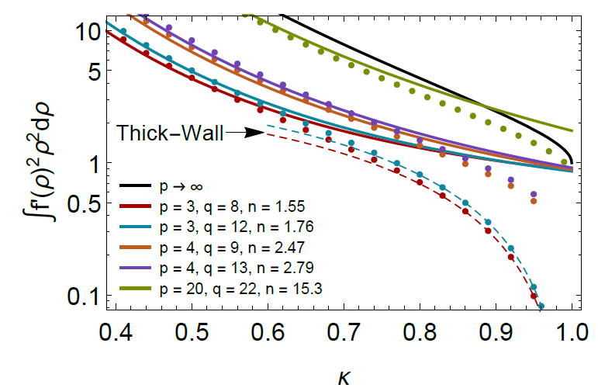
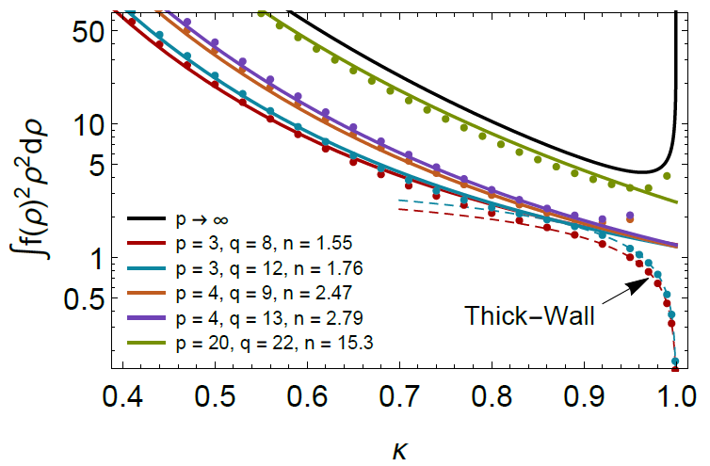
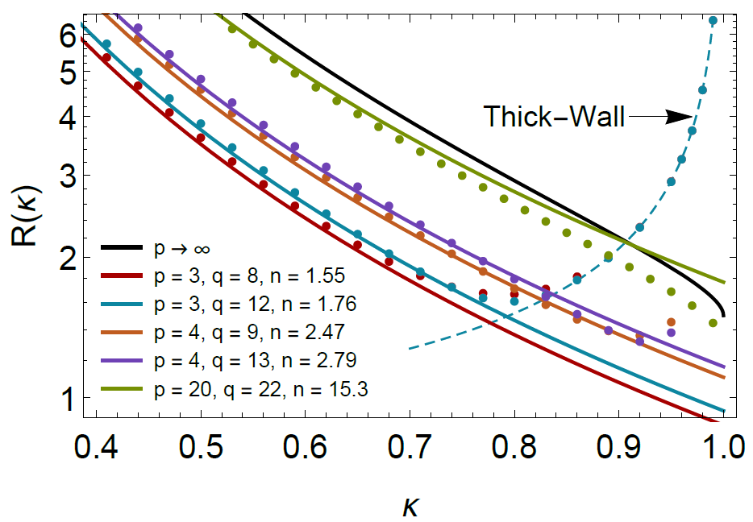

General Exponents Data
Still excellent agreement for $κ≤0.8$.
Still works better for larger exponents.
Naturally, works better somewhat equidistant exponents.
Still holds for completely non-equidistant ones.

Slide 10

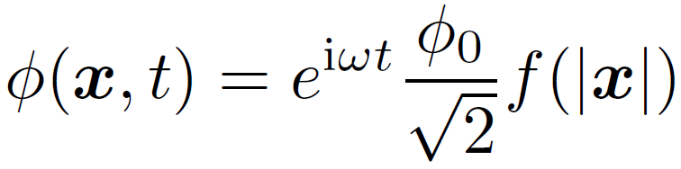
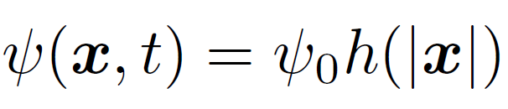
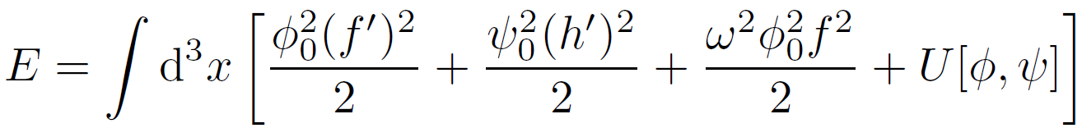
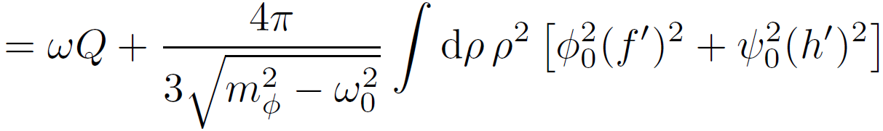
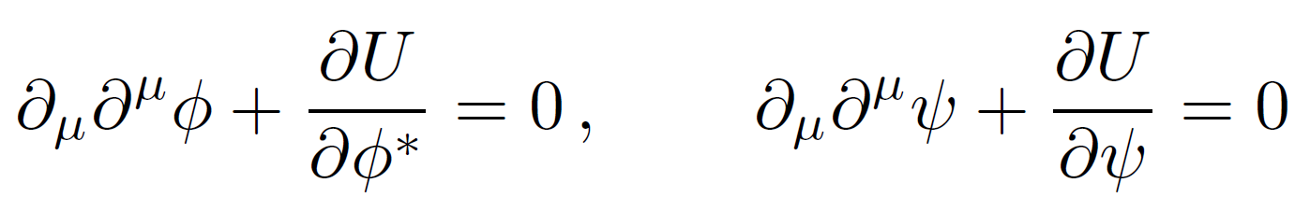
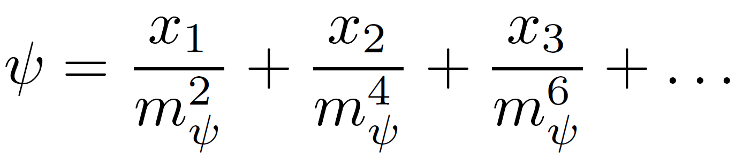
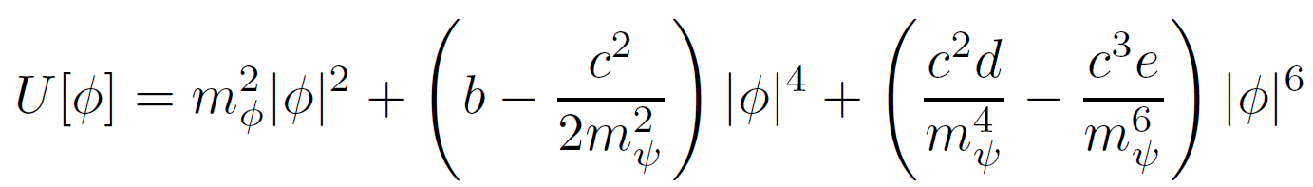
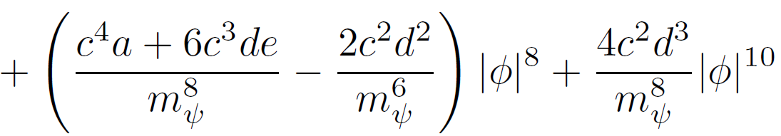
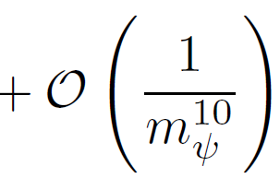

UV Completion
Original potential :
Non-renormalizable terms
UV potential:
$U\left(1\right)$ particle
Mediator
$$M$$
Extra term
Massive mediator
Equations of motion:

Slide 11
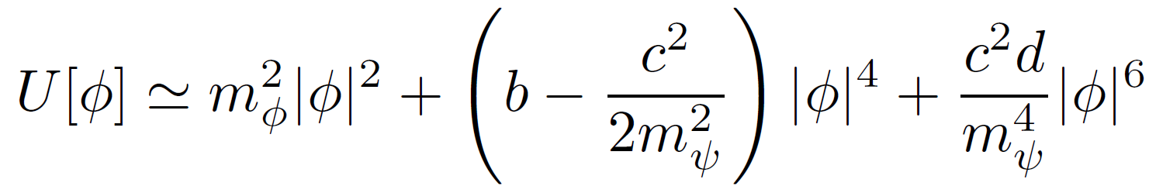
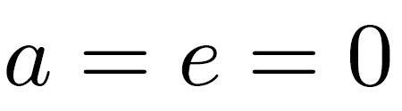
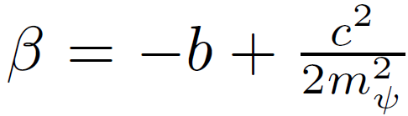
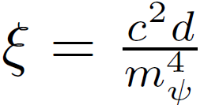












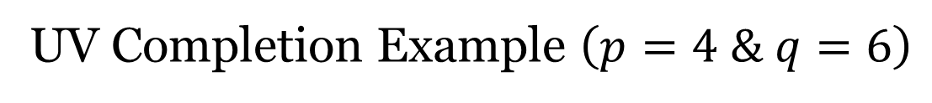









UV Completion Example $\left(p=4 \& q=6\right)$
$$\frac{1}{p^{2}−m^{2}}$$
$$φ$$
$$\overline{φ}$$
$$φ$$
$$\overline{φ}$$
$$φ$$
$$\overline{φ}$$
$$φ$$
$$\overline{φ}$$
$$ψ$$
$$φ$$
$$≈{|φ|}^{6}$$
$$\overline{φ}$$
$$φ$$
$$ψ$$
$$ψ$$
$$\overline{φ}$$
$$ψ$$
$$\overline{φ}$$
$$ψ$$
$$φ$$

Slide 12
Friedberg-Lee-Sirlin Model

Slide 13
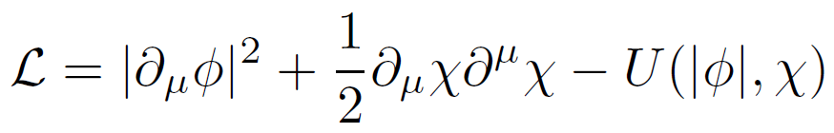
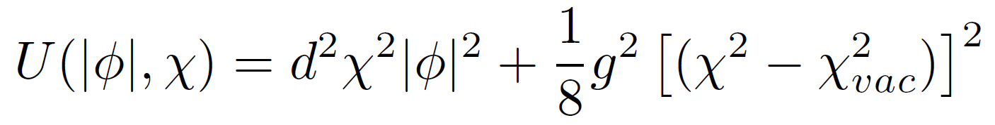





Friedberg-Lee-Sirlin Model (FLS)
FLS Lagrangian is
where
Similar to $Q$-balls ansatz
The equations of motion read
[Friedberg, Lee, and Sirlin, 1976, “Class of scalar-field soliton solutions in three space dimensions” ]

Slide 14









Friedberg-Lee-Sirlin Model (FLS)
Equations of motion:
$$κ=0.6$$
Assuming $κ≪1$
Boundary conditions:
$f′(0)=0$
$f(∞)=0$
Work-Friction calculation
$f$ is smooth

Slide 15




FLS Soliton Profiles
Unstable
[J. Heeck and M. Sokhashvili, Eur. Phys. J. C 83 (2023)]

Slide 16





Radii and Integrals
Radius is independent of $η$
Separate predictions for large and small $η$
Predictions work best for very large $η$ or very small $η$

Slide 17










Charge and Energy
Small $κ$, Large $η$
Small $κ$, small $η$ is qualitatively similar.
Different from Q-balls
$$M$$
For $Q$-balls both $Q$ and $E$ simply scale with the soliton volume.
Large $κ$, Small $η$
Different from Q-balls
$$M$$
Similar to Q-balls
[J. Heeck and M. Sokhashvili, Eur. Phys. J. C 83 (2023)]

Slide 18
Alternative Approach

Slide 19












Traditional Approach by Sidney Coleman
Analogy to one-dimensional mechanics problem
$$V$$
$$V$$
$$V$$
$$φ$$
$$φ$$
$$φ$$
Boundary conditions
$r−$ time
$$φ′(0)=0$$
$φ−$ spatial coordinate
$$φ(∞)=0$$
[Coleman, 1985]
18

Slide 20











Tunneling Potential Approach
Instead of using the field $φ$ as a variable we rewrite everything in terms of the “total energy”:
“Total energy” is better behaved so we have a better chance of describing it with Taylor series.
EOM
$U(1)$ Charge
$$0$$
Mass
$$M=$$
$$M$$
$$0$$
19

Slide 21







Estimates of The Energy
Linear
Quadratic
Cubic
Quartic
First three levels of approximation emerge by demanding boundary conditions at the origin and $φ_{0}$.
One can leave $a_{4}$ to be a free parameter and minimize the $Q$-ball mass with respect to both $a_{4}$ and $φ_{0}$.
Alternatively, $a_{4}$ in the Quartic approximation can be determined by demanding that $ℇ\left(φ\right)$ satisfies EOM at some intermediate point.
Instead of solving this differential equation we will minimize $M$ for given $Q$.
20

Slide 22




Example 1: Polynomial Potentials
Dashed red line is an analytic approximation in the thin-wall $(κ≪1)$ limit. [Heeck, Sokhashvili, Phys. Rev. D 107 (2023)]
“Energy” estimates describe both the field and the energy integral with increasing accuracy.
Tunneling approach takes orders of magnitude less time than the direct numerical codes.
Even though the cubic approximation does not describe the field with good accuracy it describes the energy integral very well.
21

Slide 23




Example 2: Flat Potential
Dashed red line is an analytic approximation in the
large $Q$-ball $(κ≪1)$ limit.
Here we used $a_{4}$ as a free parameter and minimized $Q$-ball energy with respect to both $φ_{0}$ and $a_{4}$.
Varying $a_{4}:$
  Takes longer than basic tunneling approach
  Still takes orders of magnitude less time than the classical numerical approach
  Improves the accuracy over the one-parameter tunneling approach
$M∝Q^{3/4}$ just like in the FLS for large solitons.
22

Slide 24

Summary
Introduced the mechanical analogy solution to Q-balls by Coleman.
Generalized the case of $p=4$ and $q=6$ to arbitrary exponents.
Compared $Q$-balls to FLS solitons.
Introduced the alternative approach via minimizing the “total energy” of a particle from that analogy.
Demonstrated the effectiveness of this approach in two examples distinct examples.
This talk is based on following papers:
  J. Heeck and M. Sokhashvili, “Q -balls in Polynomial Potentials”,
  Phys. Rev. D 107 (2023)
  J. Heeck and M. Sokhashvili, “Revisiting the Friedberg–Lee–Sirlin Soliton Model”,
  Eur. Phys. J. C 83 (2023)
  J. R. Espinosa, J. Heeck and M. Sokhashvili, “Revisiting the Friedberg–Lee–Sirlin Soliton Model”,
  Phys. Rev. D 108 (2023)
23

