Slide 1



Opening up baryon number violating operators
Diana Sokhashvili
Collaborators: Julian Heeck, Anil Thapa

Slide 2
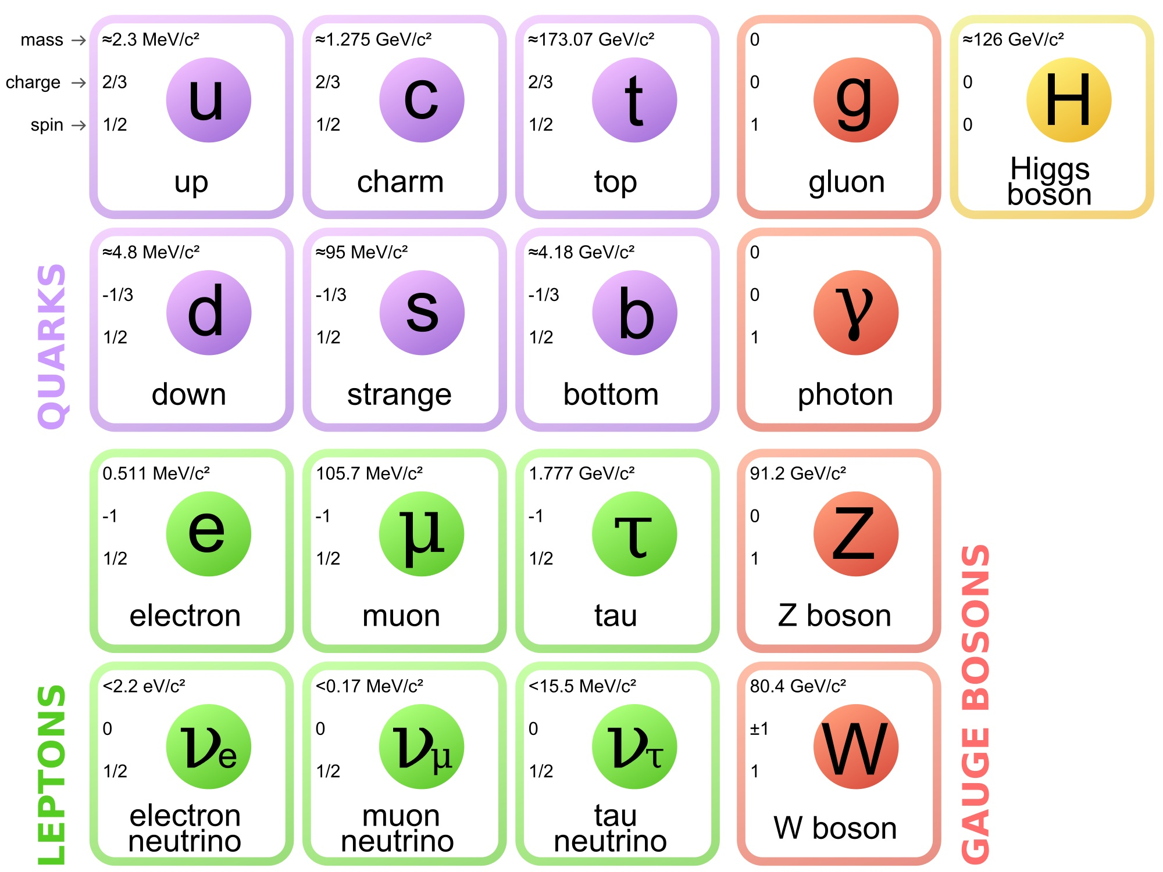
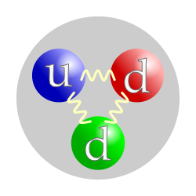
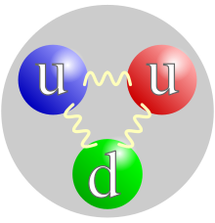
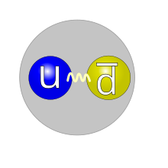
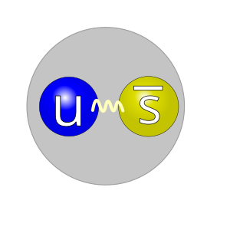

Standard Model
We can assign ${U(1)}_{B}$ charge 1/3 to quarks
Global symmetry of SM Lagrangian
Three quarks combine to form baryons (B = 1)
ex:
Neutron
Proton
Quark and antiquark form mesons (B = 0)
ex:
[Wikipedia]
Pion
Kaon

Slide 3
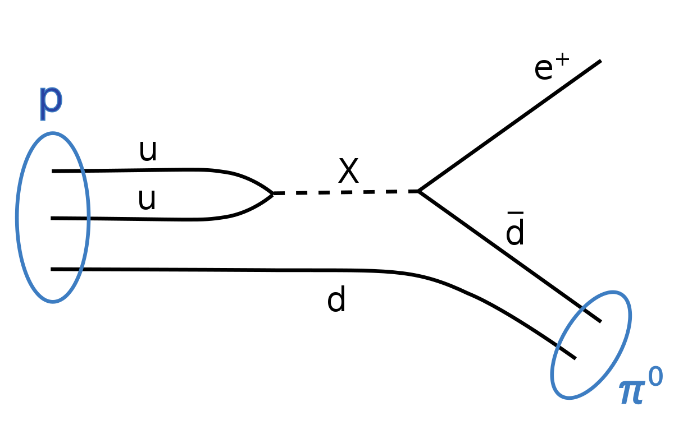
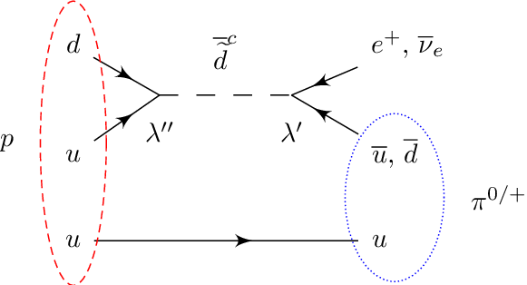
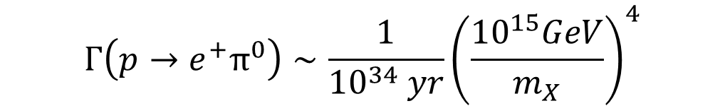

Why baryon number violation is important
Grand Unified Theories (GUTs)
Supersymmetry (SUSY)
Example: proton decay
$$τ_{P}\sim \frac{m_{X}^{4}}{m_{p}^{5}}$$
$$Γ\left(p→e^{+}π^{0}\right)∼\frac{1}{{10}^{34} yr}{\left(\frac{{10}^{15}GeV}{m_{X}}\right)}^{4}$$
GUTs, which can unify the fundamental forces of nature, predict that the proton can decay into lighter particles.
SUSY doubles the number of particles compared to Standard Model and imposes symmetry among fermions and bosons. New particles can mediate the proton decay.
Notes:
What can I add for susuy?? Example: proton decay SUSY. (R-parity violating supersymmetry)

Slide 4
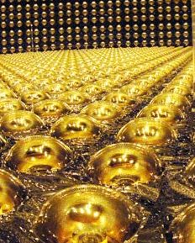
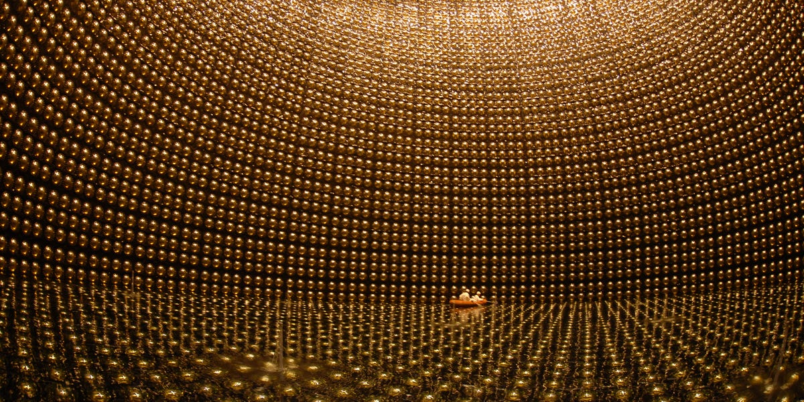

Super-Kamiokande
Photosensors
photo-multiplier-tubes (PMTs)
Cylindrical stainless steel tank filled with 50,000 tons of water
Equipped with 13,000 photomultipliers
Calculated proton lifetime > ${10}^{34}$ years
Notes:
Remove uude partchange lambda to m

Slide 5
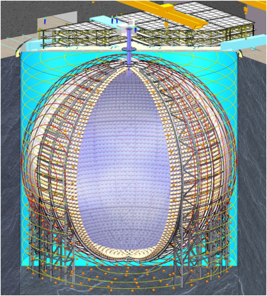
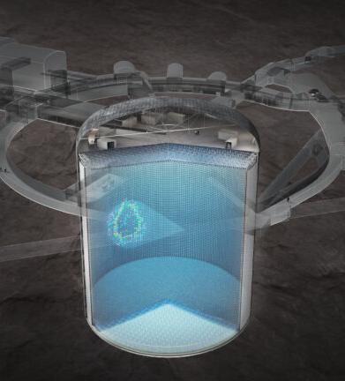
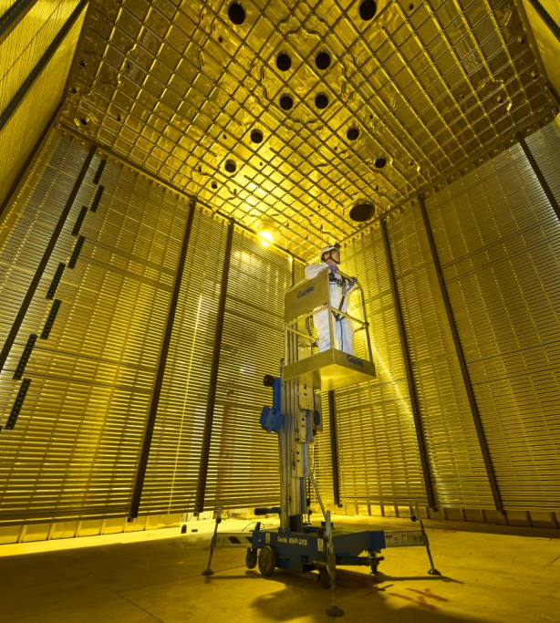
Future detectors
JUNO
(China)
Hyper-Kamiokande
(Japan)
DUNE
(USA)
LABs/ Scintillation
Fiducial mass: 20 kt
Water/ Cherenkov
Fiducial mass: 187 kt
Liquid Argon/ Scintillation
Fiducial mass: 40 kt
Start year: 2025
Start year: 2027
Start year: 2028
Notes:
Include size or expected reach fiducial size linear alkybenzene

Slide 6
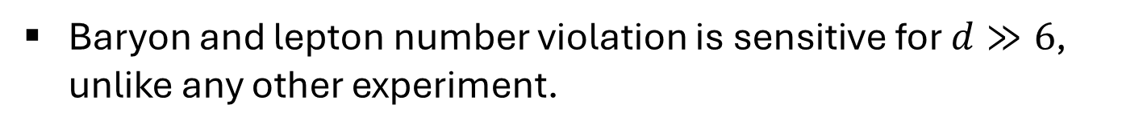




Standard Model Effective Field Theory
$$ℒ=ℒ_{SM}+\frac{LLHH}{Λ}+\sum_{j}{\frac{𝒪_{i}}{Λ^{2}}}+\sum_{j}{\frac{𝒪_{i}^{′}}{Λ^{3}}}+\sum_{j}{\frac{𝒪_{i}^{′′}}{Λ^{4}}}+…$$
$$∆B=∆L=1$$
$$∆B=−∆L=1$$
$$∆B=∆L=1$$
Baryon and lepton number violation is sensitive for $d≫6$, unlike any other experiment.
Notes:
Write out entire L.

Slide 7
































BNV landscape
[J. Heeck & Takhistov, PRD ‘20]

Slide 8
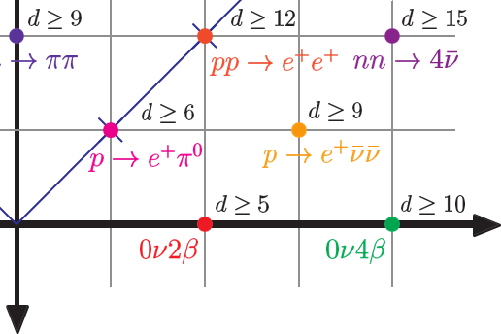


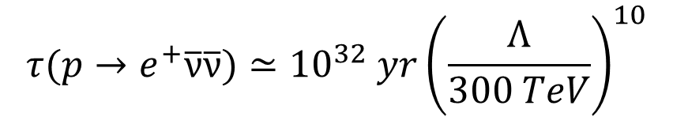


Weinberg’s selection rule (Example)
Impose $U{\left(1\right)}_{3B−L}$ on SMEFT
$\left(∆B,∆L\right)=\left(1, 3\right)$
$$d_{min}≥ \frac{9}{2}|∆B|+\frac{3}{2}|∆L|+δ_{sign\left(∆B∆L\right),−1}δ_{\left|∆L mod 2\right|,1}$$
[Kobach ‘16; Helset, Kobach, ‘19]
[DS, Julian Heeck, PLB, ‘25]
$$τ(p→e^{+}\overline{\text{ν}}\overline{\text{ν}})≃{10}^{32} yr{\left(\frac{Λ}{300 TeV}\right)}^{10}$$
$$d_{min}≥9$$

Slide 9
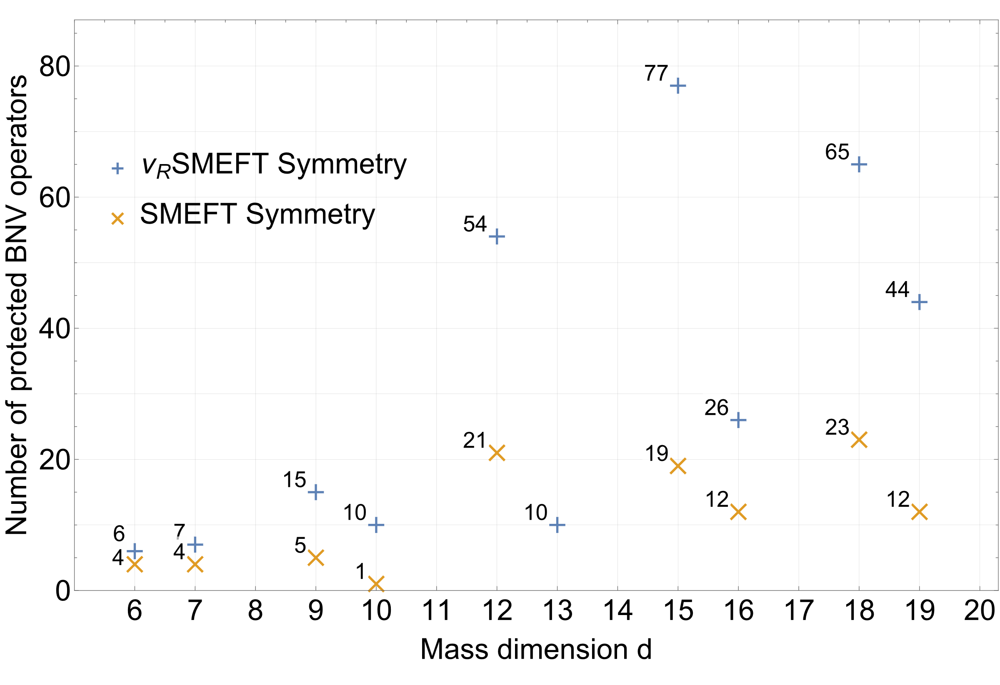
Symmetry protected operators

Slide 10

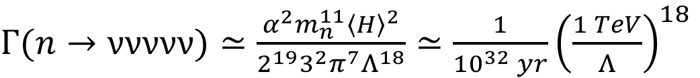


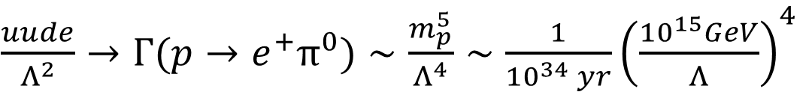
Examples of testable rates of BNV
Dim 6
$\frac{uude}{Λ^{2}}→Γ(p→e^{+}π^{0})∼\frac{m_{p}^{5}}{Λ^{4}}∼\frac{1}{{10}^{34} yr}{\left(\frac{{10}^{15}GeV}{Λ}\right)}^{4}$
$\left(∆B,∆L\right)=\left(1, 1\right)$
Dim 13
$Γ(n→\text{ννννν})≃\frac{{α^{2}m}_{n}^{11}{\left\langle H\right\rangle }^{2}}{{2^{19}3^{2}π^{7}Λ}^{18}}≃\frac{1}{{10}^{32} yr}{\left(\frac{1 TeV}{Λ}\right)}^{18}$
$\left(∆B,∆L\right)=\left(1, −5\right)$
Dim 15
$Γ(p→e^{+}\overline{\text{ν}}\overline{\text{ν}}\overline{\text{ν}}\overline{\text{ν}}\overline{\text{ν}}\overline{\text{ν}})≃\frac{{α^{2}m}_{p}^{17}}{{2^{30}3^{3}5^{2}π^{11}Λ}^{22}}≃\frac{1}{{10}^{34} yr}{\left(\frac{100 GeV}{Λ}\right)}^{22}$
$\left(∆B,∆L\right)=\left(1, 7\right)$

Slide 11
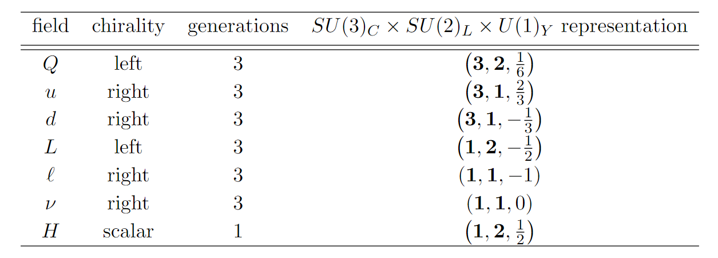
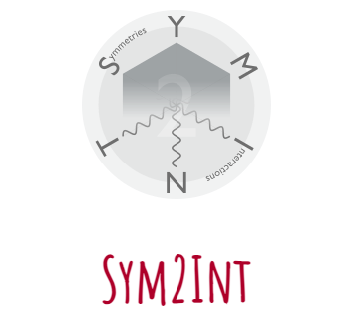










Generate operators
Dim
Operators
Total
operators
6
$duQL, QQue, QQQL …$
6 operators
7
$QQd\overline{L}\overline{H},ddQ\overline{e}\overline{H}, ddu\overline{L}\overline{H}…$
7 operators
8
$uuQL\overline{H}\overline{H},uude\overline{H}H…$
10 operators
9
$uuQLLL, ddd\overline{d}\overline{d}e …$
62 operators
10
$dd\overline{d}QQLH,ddd\overline{d}uLH…$
112 operators
11
$dddd\overline{d}\overline{e}\overline{H}H …$
131 operators
12
$dddd\overline{L}\overline{L}\overline{e}\overline{H} …$
480 operators
13
$\overline{d}QQQQLLLH…$
782 operators
https://renatofonseca.net/sym2int
14
$uuQLLLLLHH…$
984 operators
15
$ddQQQQQQQL …$
2627 operators

Slide 12
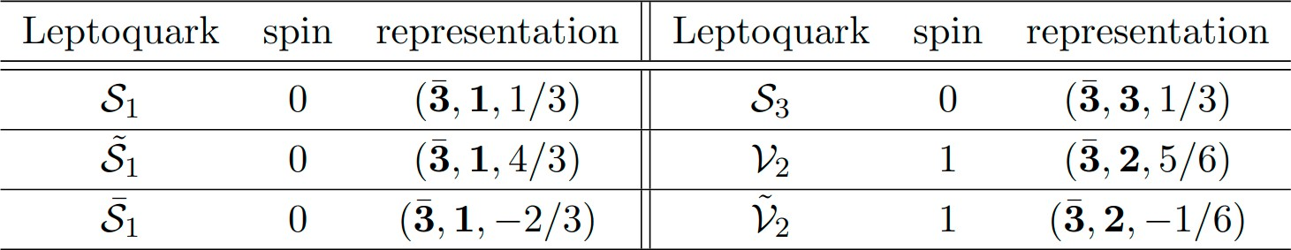
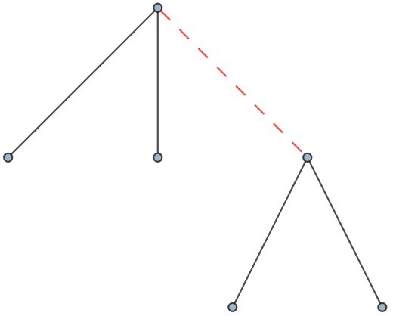
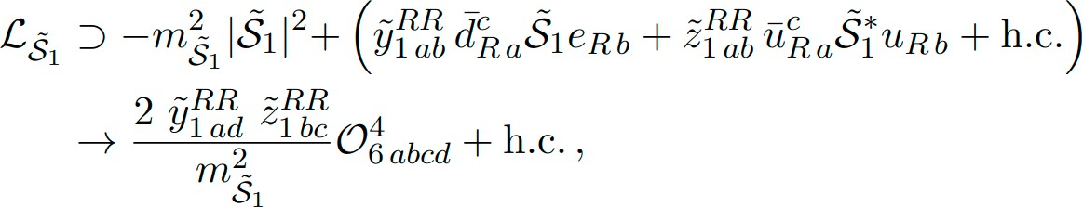






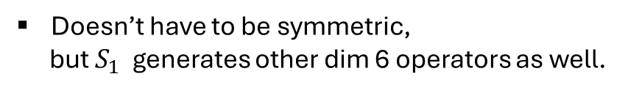






Opening up operators (dim 6 example)
antisymmetric
$${\tilde{S}}_{1}$$
u
u
[Buchmuller, Ruckl, Weyler, ‘87; Dorsner++, 1603.04993]
d
e
Operator UV completion
$$S_{1}$$
$$duQL$$
$$S_{1}, V_{2}, {\tilde{V}}_{2}$$
Doesn’t have to be symmetric,
but $S_{1}$ generates other dim 6 operators as well.
$$QQue$$
$$S_{1}, V_{2}$$
u
d
$$QQQL$$
$$S_{1}, S_{3}$$
u
e
$$duue$$
$$S_{1}, {\tilde{S}}_{1}$$

Slide 13
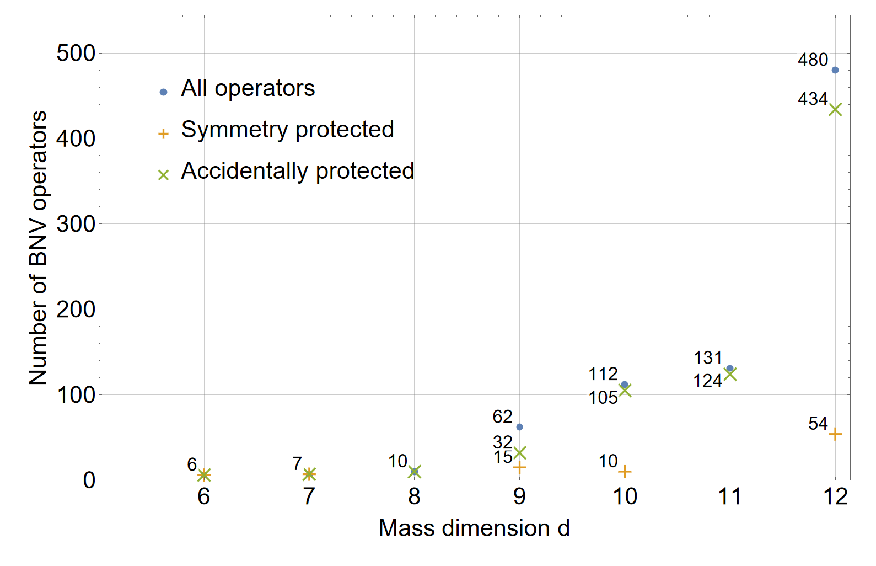
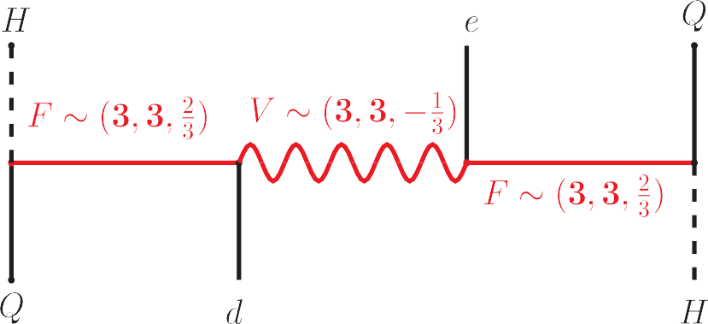
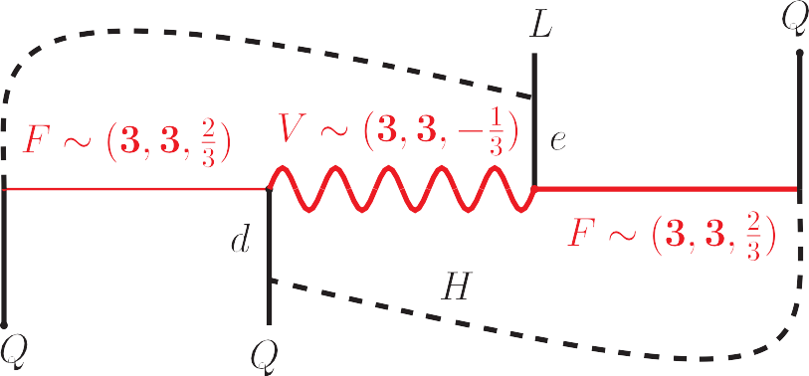

Accidentally protected operators
loop-induced d = 6 operator QQQL generated by the same particles
accidentally protected operator $HHQQde$
Notes:
6 - 6 7 - 7 8 - 10 9 - 32 10 - 105 11 – 124 12 - 434

Slide 14
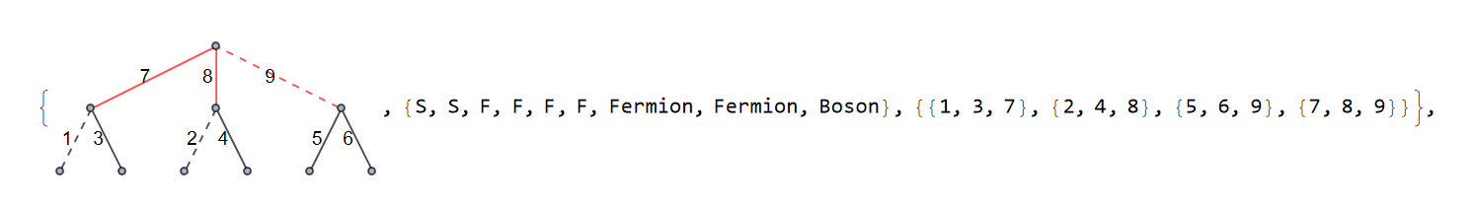
Generate topologies
To obtain topologies, we use the FeynArts package for Mathematica to generate all possible diagrams and then remove topologically equivalent ones.
https://feynarts.de

Slide 15
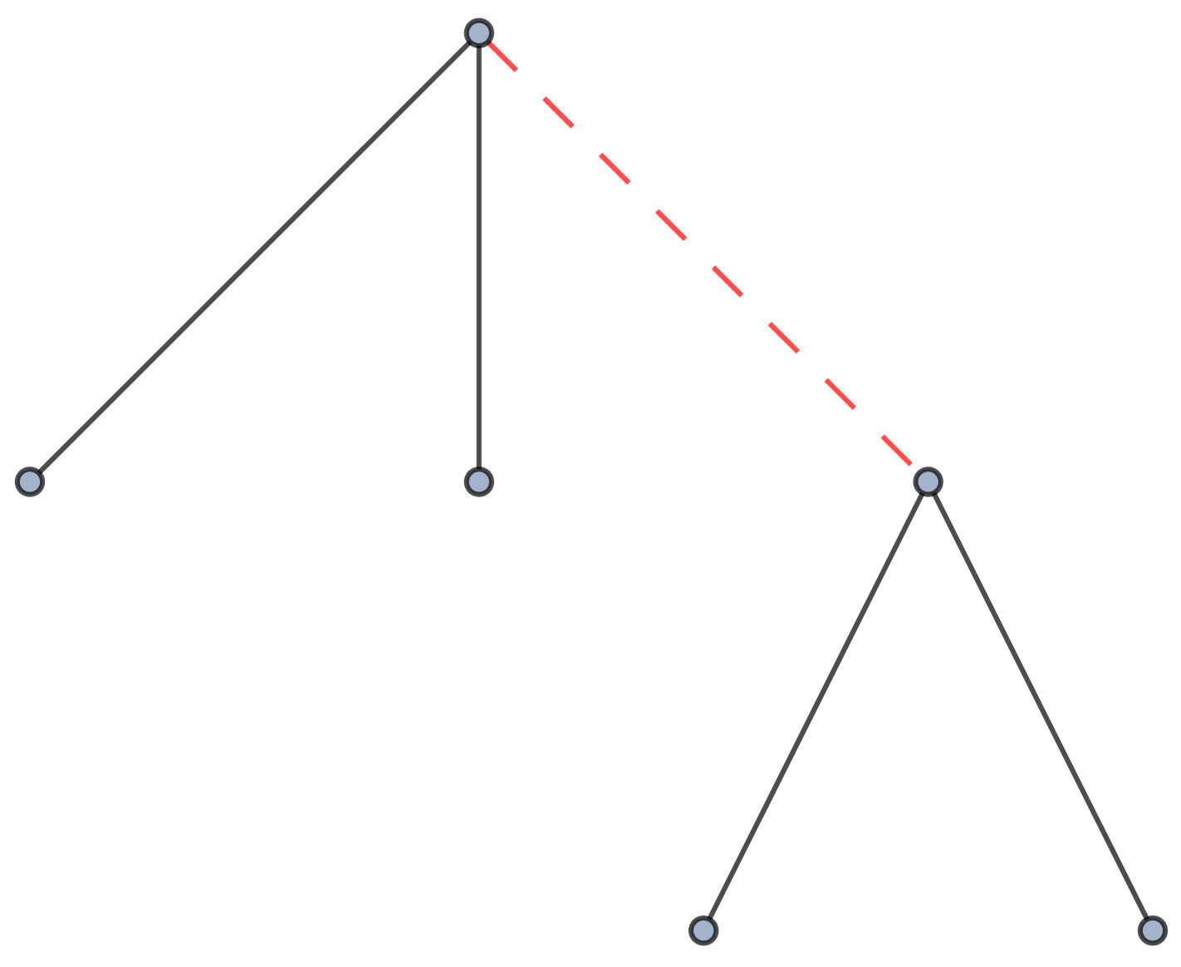
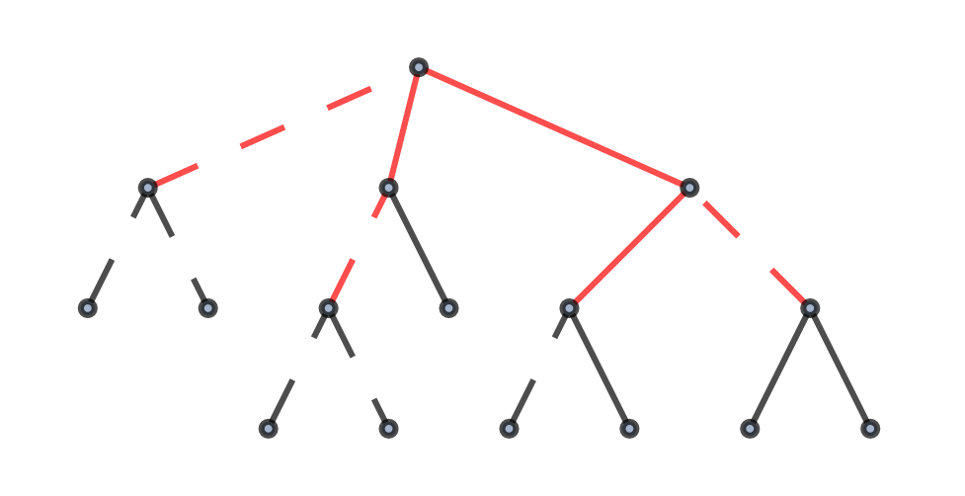
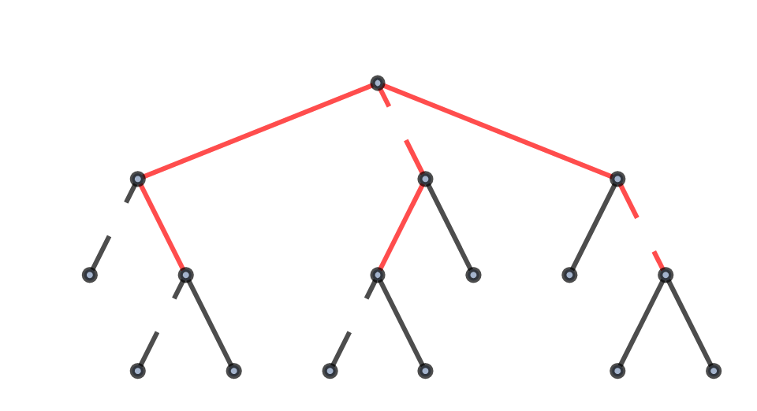
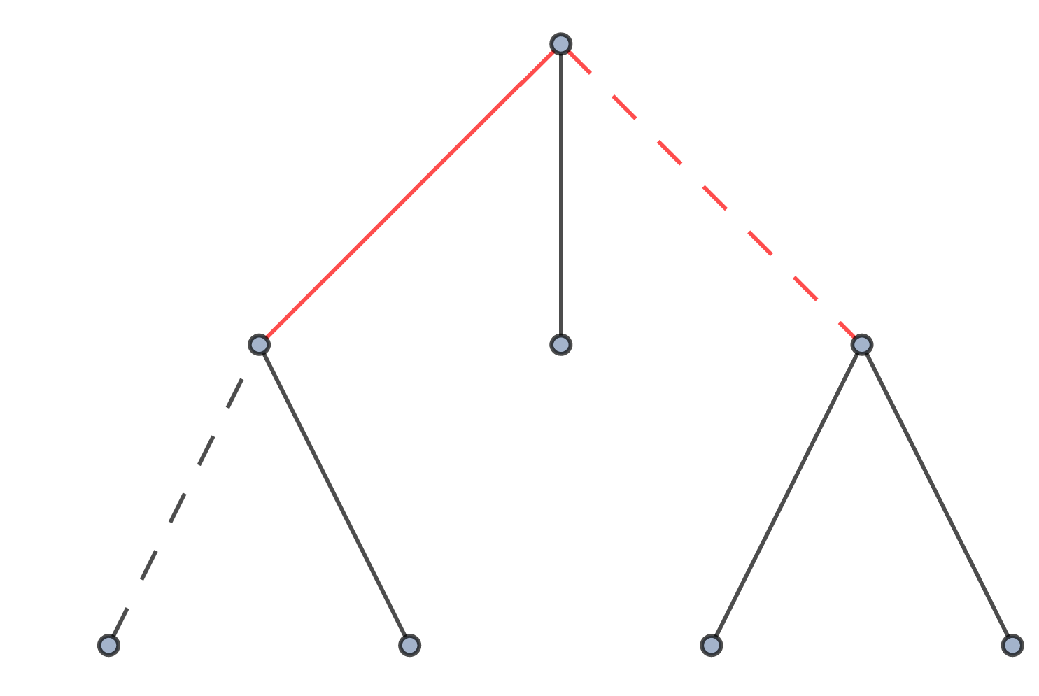
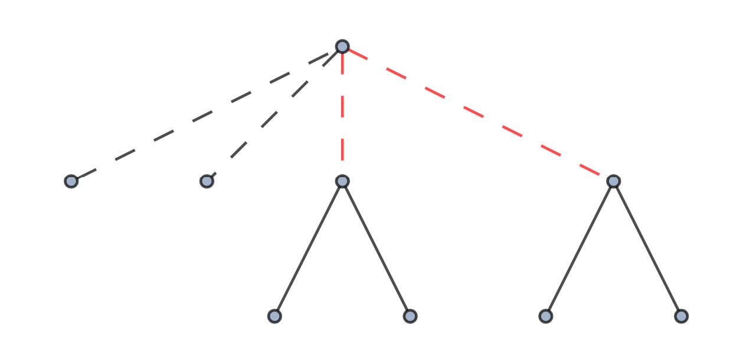
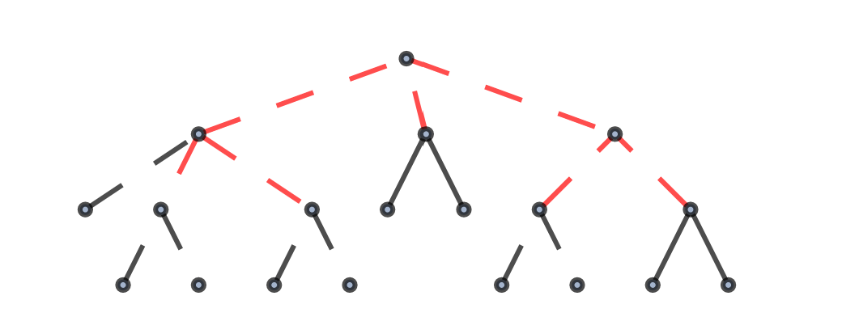
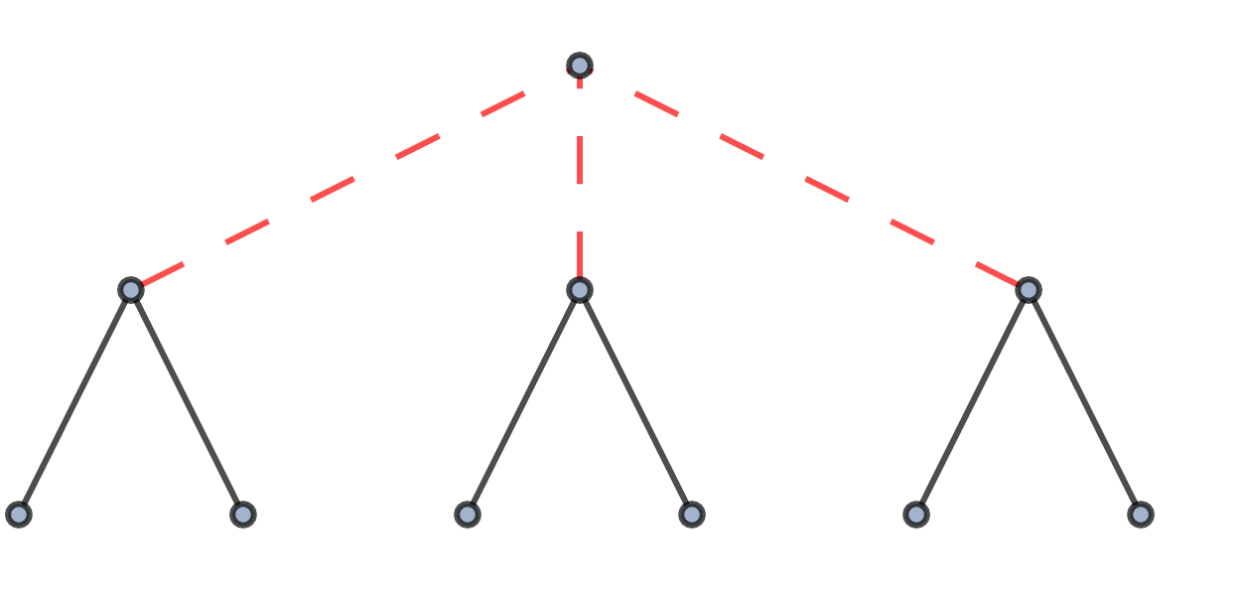
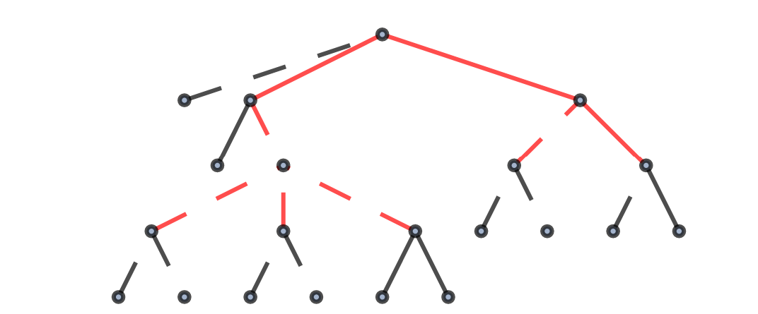
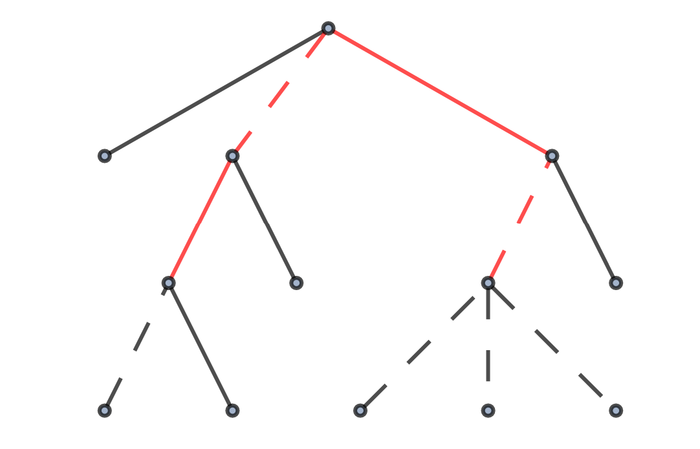
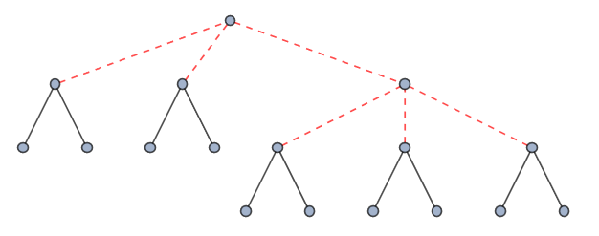
Topologies
External boson
Internal boson
External fermion
Internal fermion
Dim 6
Dim 11
+ 298 more
Dim 7
+ 1 more
Dim 12
+ 1059 more
Dim 8
+ 7 more
Dim 13
+ 3688 more
Dim 9
+ 24 more
Dim 14
+ 13028 more
Dim 10
+ 88 more
Dim 15
+ 45906 more

Slide 16
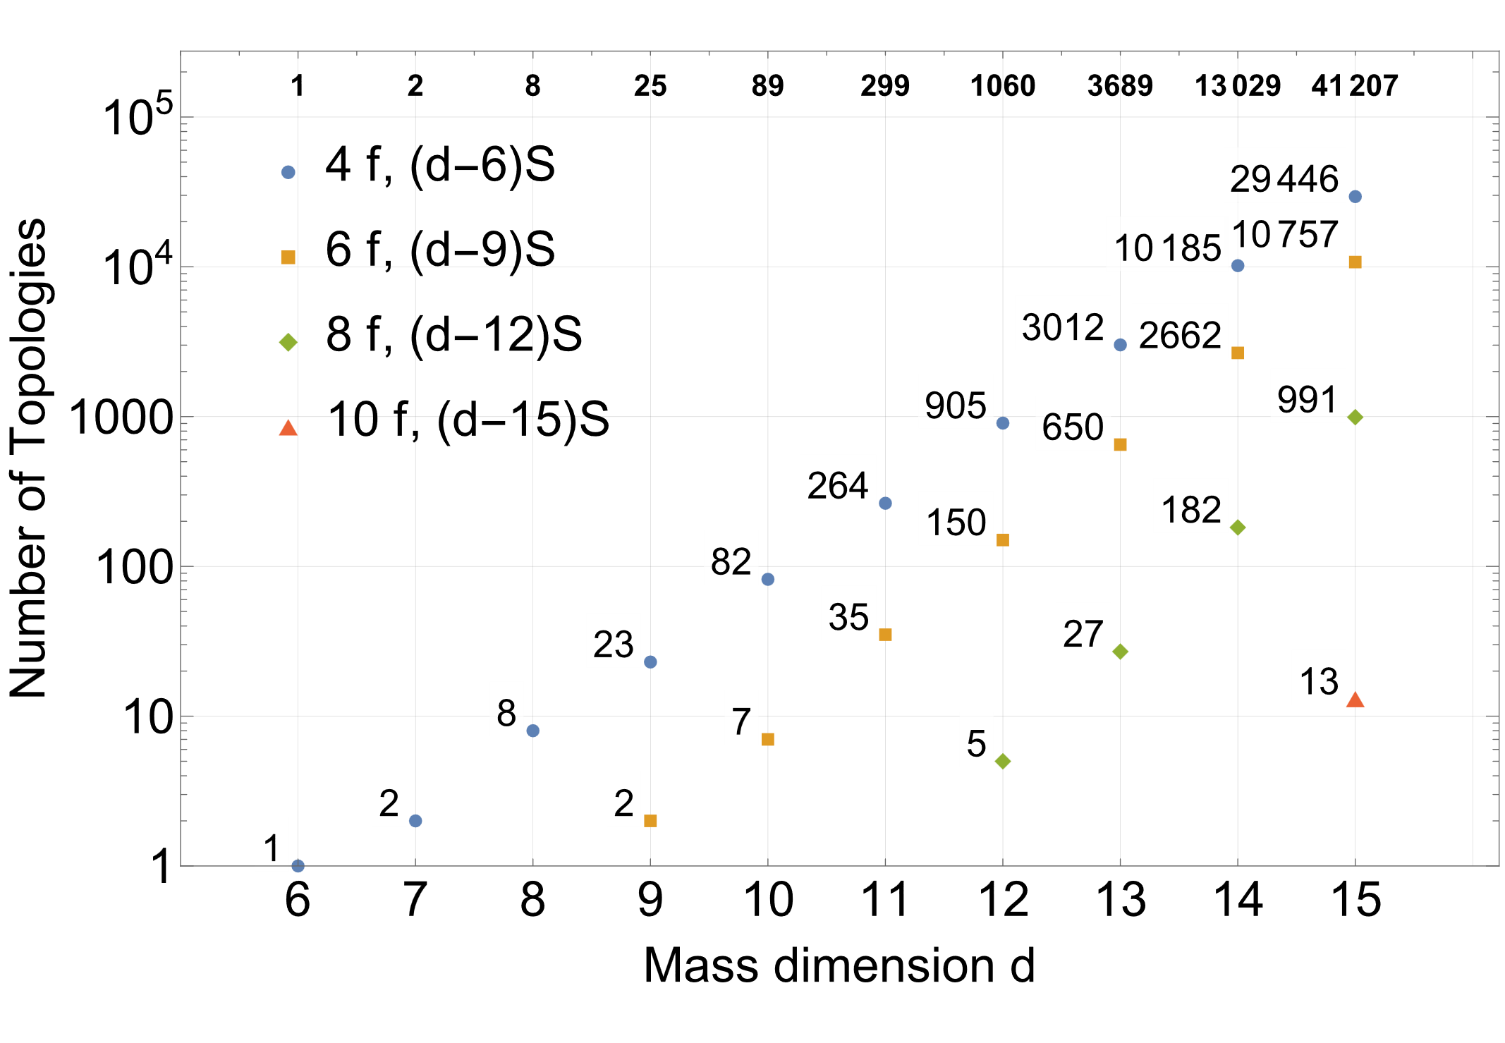
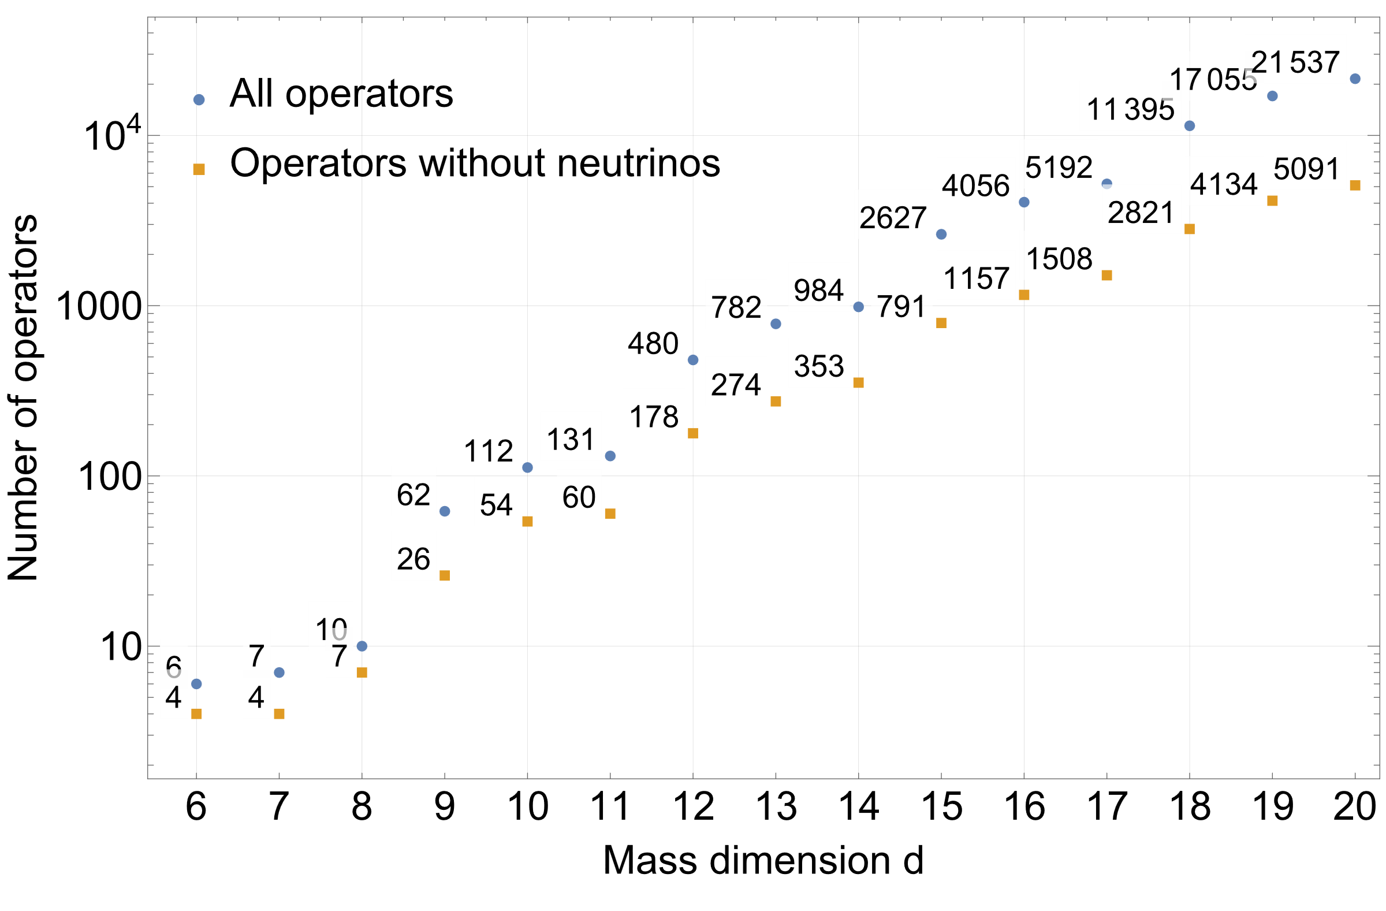
Number of operators and topologies

Slide 17
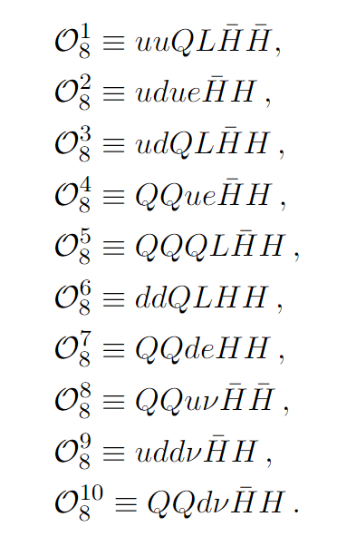
Example (dim 8)

Slide 18







Possible permutations
Operator: $ddLQHH$
$$\{\{H H d d L Q\}, \{H H d d Q L\} ,\{H H d L d Q\}, \{H H d L Q d\}, \{H H d Q d L\}, \{H H d Q L d\},$$
$$\{H H L d d Q\} ,\{H H L d Q d\} ,\{H H L Q d d\} ,\{H H Q d d L\}, \{H H Qd L d\}, \{H H Q L d d\}\}$$
$$P_{3}$$
d
d
$$P_{2}$$
$$P_{6}$$
H
$$P_{1}$$
H
$$P_{5}$$
$$P_{4}$$
L
Q

Slide 19
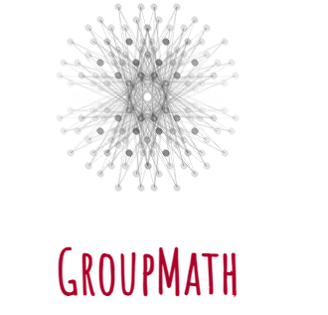
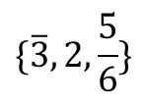
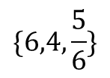
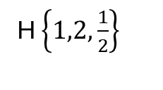
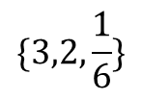
















$$\left\{3,1,−\frac{1}{3}\right\}$$
Internal particles
d $\{3,1,−\frac{1}{3}\}$
$$SU(3)×SU(2)×U(1)$$
d $\left\{3,1,−\frac{1}{3}\right\}$
H $\left\{1,2,\frac{1}{2}\right\}$
H $\left\{1,2,\frac{1}{2}\right\}$
$$\{3,2,\frac{1}{6}\}$$
$\{3,2,\frac{1}{6}\}$, $\{\overline{3},1,\frac{1}{3}\}$, $\{\overline{3},2,\frac{5}{6}\}$
$\{3,2,\frac{1}{6}\}$, $\{\overline{3},3,\frac{1}{3}\}$, $\{\overline{3},2,\frac{5}{6}\}$
$$\{\overline{3},1,\frac{1}{3}\}$$
$$\{\overline{3},2,\frac{5}{6}\}$$
$$\{\overline{3},2,\frac{5}{6}\}$$
$$\{\overline{3},3,\frac{1}{3}\}$$
Q $\{3,2,\frac{1}{6}\}$
$$\{\overline{3},4,\frac{5}{6}\}$$
L $\{1,2,−\frac{1}{2}\}$
$$\{6,1,\frac{1}{3}\}$$
$$\{6,2,\frac{5}{6}\}$$
$$\{6,2,\frac{5}{6}\}$$
$$\{6,3,\frac{1}{3}\}$$
https://renatofonseca.net/groupmath
$$\{6,4,\frac{5}{6}\}$$

Slide 20







Lorentz group $(SU(2)×SU(2))$
For internal fermions we need to make sure that chirality is flipped to ensure that fermions are massive
External scalars
External fermion
$$F_{R}$$
$$F_{L}$$
$$F_{L}$$
$$F_{R}$$
External vector
For internal bosons we determine whether they are vector or scalar
Internal scalars
Internal fermion
Internal vector
$$B_{V}$$
$$B_{S}$$

Slide 21
Internal particles
d
H
H
d
d
H
H
d
$$\{3,2,\frac{1}{6}\}$$
$$\{3,2,\frac{1}{6}\}$$
$$F_{L}$$
$$F_{R}$$
$$\{\overline{3},1,\frac{1}{3}\}$$
$$\{\overline{3},2,\frac{5}{6}\}$$
$$\{\overline{3},1,\frac{1}{3}\}$$
$$\{\overline{3},2,\frac{5}{6}\}$$
Q
L
Q
L
$\{3,2,\frac{1}{6}\}$, $\{\overline{3},1,\frac{1}{3}\}$, $\{\overline{3},2,\frac{5}{6}\}$
${\left\{3,2,\frac{1}{6}\right\}}_{F}$, ${\left\{\overline{3},1,\frac{1}{3}\right\}}_{V}$, ${\left\{\overline{3},2,\frac{5}{6}\right\}}_{V}$

Slide 22


Permuting fields around topology
Topology:
Operator: $ddLQHH$

Slide 23

UV completions
Now do this
778 405
more times
To get over
10 terabytes
of data

Slide 24





New particles
Fully explored in literature
Dimension 6
[2306.12578, 1711.10391 …]
Incomplete results in literature
Dimension 7
[2306.12578, 2307.10380 …]
Incomplete results in literature
Dimension 8
[2306.12578 …]
Fraction of results in literature
Dimension 9
[1210.6598, 9307254 …]
Dimension 10
.
.
.
[J. Heeck, D. Sokhashvili, A. Thapa]

Slide 25

New particles
Dim 11
Dim 12
Fraction of results
in literature
[1212.4556 …]
Dim 13
Dim 14
Dim 15
Only includes symmetry
protected operators
[J. Heeck, D. Sokhashvili, A. Thapa]

Slide 26
Conclusion:
Baryon number violation is uniquely sensitive to heavy new physics, probing mass dimensions ≫ 6.
We generated all allowed operators and corresponding topologies up to dimension 15.
We found all UV completions for operators up to d = 14 and symmetry-protected operators for d = 15 in terms of scalars, fermions, and vectors, including right-handed neutrinos.
(Previously, only incomplete results were available up to dimension 8, and only a small fraction of results for higher dimensions.)
We investigated cases that could potentially be dominant due to symmetry or accidental protection.
Our method can be easily applied to other operators—for example, those violating the lepton number. The only limiting factor is the presentation of actual results due to the large number of solutions.
Useful for model building and for identifying new signatures to look for in the event of discovery in Super-Kamiokande, Hyper-Kamiokande, JUNO, or DUNE.

Slide 27
Thank you for your attention!

Slide 28






















Derivative operators
H $\{1,2,\frac{1}{2}\}$
H $\{1,2,\frac{1}{2}\}$
H↔H asymmetry
$$P_{1}$$
$$P_{2}$$
$$S_{11} \{3,2,−\frac{5}{6}\}$$
$$S_{2} \{3,1,−\frac{1}{3}\}$$
$$S_{1} \{3,1,−\frac{4}{3}\}$$
$$2⊗2=1_{A}⊕3_{S}$$
$$P_{3}+P_{4}$$
$$P_{1}+P_{3}+P_{4}$$
$$P_{5}+P_{6}$$
$$P_{3}$$
$$P_{6}$$
$$H⊗H$$
$$P_{4}$$
$$P_{5}$$
Q $\{3,2,\frac{1}{6}\}$
d $\{3,1,−\frac{1}{3}\}$
Q $\{3,2,\frac{1}{6}\}$
e $\{1,1,−1\}$
$$\frac{1}{{\left(P_{1}+P_{3}+P_{4}\right)}^{2}−m_{S_{11}}^{2}}≈−\frac{1}{m_{S_{11}}^{2}}−\frac{{\left(P_{1}+P_{3}+P_{4}\right)}^{2}}{m_{S_{11}}^{4}}+…$$
Vanishes due to H↔H
[Idea based on paper by
J. Gargalionis, R. Volkas.
2009.13537]
$edHD^{2}(HQQ)$, dim 10 operator

