Slide 1
Boundary Value Solution for Spin-Polarized Flow
or
Boundary Value Solution for Viscous Liquid Flow in Carbon Nanotubes and its Application
to Spin-Polarized Current Enhancement
Tamar Berberashvili, Vakhtang Gogichaishvili & Paata Kervalishvili
Georgian Technical University
New Trends in High-Energy Physics 2025
15-19 September, 2025
Batumi,Georgia

Slide 2
Abstract
Spin Polarization in Carbon Nanotubes (CNTs) is an advanced topic at the intersection of nanotechnology, quantum physics, and spintronics. It refers to the imbalance in the population of spin-up and spin-down electrons in a system. In spintronic devices, this property is used to encode information using electron spin, instead of or in addition to charge. CNTs are ideal for spintronics: because of low spin-orbit coupling (Spin states persist longer), weak hyperfine interactions (especially in 12C, which has no nuclear spin), ballistic transport of electrons travelling long distances without scattering and quantum coherence supporting via quantum states. Carbon nanotubes are cylindrical structures made of rolled-up graphene sheets, and are excellent one dimensional conductors.
Presenting Theoretical model includes estimation of effectiveness of carbon nanotubes for accelerating the spin-polarized current as well as a boundary value problem relative to the flow velocity of fluid. This approach has been stated considering main peculiarities of the problem, in particular, taking into account Debye electric double layer and external friction (friction between viscous fluid and nanotube wall). Solution of assigned boundary problem has been determined in the form of infinite series.

Slide 3
Outline:
Theoretical Model
Methodology of Solutions
Results & Discussion
Conclusion

Slide 4
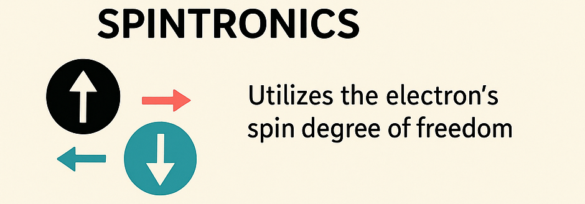
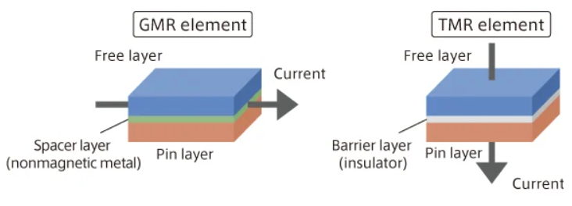
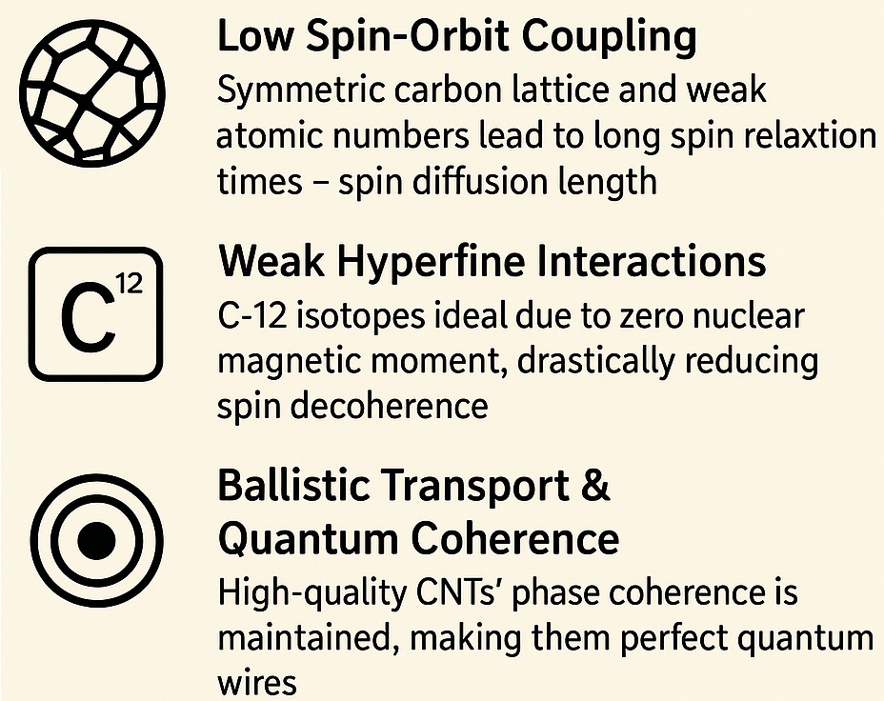
Introduction
Spintronics is a paradigm that utilizes the electron's spin degree of freedom.
Newly developed key concepts of spintronics like
Giant Magnetoresistance (GMR) and
Tunnel Magnetoresistance (TMR)
are the bedrock of spintronic devices.
Among the main advantages of CNTs for spintronics CNTs for Spintronics:

Slide 5
The Problem & Our Approach:
While the electronic properties of CNTs are well-studied, the role of fluid dynamics within the nanotube, especially for spin-polarized carrier transport, is a novel angle. Introduce the concept of using a fluidic medium (a viscous liquid) inside the CNT as a means to influence or enhance spin current.
Here is a central research question:
How does the flow of a viscous liquid inside a CNT, under the influence of electric double layers and wall friction, affect the transport dynamics of a spin-polarized current

Slide 6
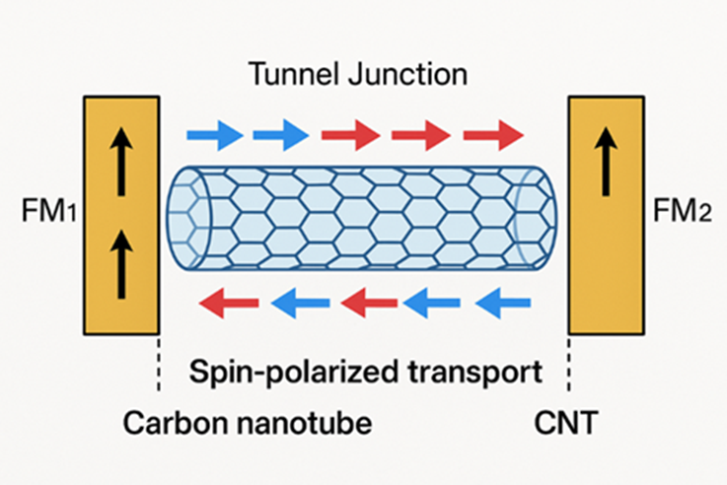
Experimental and Theoretical Models
Physical System Description:
Fig. 1 The scheme of elaborated experimental setup combined with ferromagnetic electrodes is based on spin valve effect (change of resistant between contacts) and tunneling contacts.

Slide 7
Spintronic Device with a Fluid-Filled Carbon Nanotube
Carbon Nanotube (CNT) with Viscous Fluid Flow
=============================================
▼ Z (Axial Direction)
|
| R (Radius) +---------------------------+
| | | |
| ▼ | Viscous Liquid |
| .----. | (Flow →) |
| .' '. | |
| / \ | + Ions + |
| | Core | | - Ions - |
| \ / | |
| '. .' | |
| '----' | |
| | | Debye Double Layer |
| | | (Stern + Diffuse) |
| | | |
+-------+------------------------------------+
| Wall of Carbon Nanotube (CNT) |
+-------------------------------+
▼ r (Radial Direction, from center 0 to wall R)
[Illustration of Spin Valve Effect:]
Parallel Magnetization (Low R): [M →] ---->--- [M →]
Antiparallel Magnetization (High R): [M →] ---->--- [M ←]

Slide 8
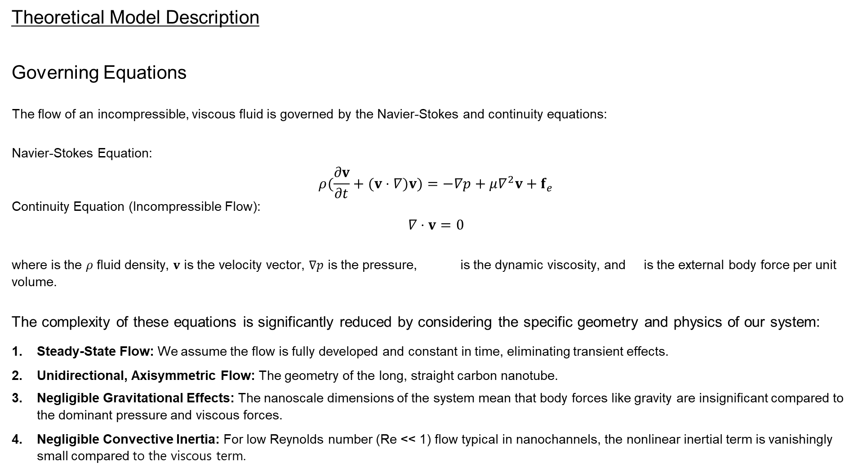
Theoretical Model Description
Governing Equations
The flow of an incompressible, viscous fluid is governed by the Navier-Stokes and continuity equations:
Navier-Stokes Equation: $$ρ(\frac{∂v}{∂t}+(v⋅∇)v)=−∇p+μ∇^{2}v+f_{e}$$ Continuity Equation (Incompressible Flow): $$∇⋅v=0$$
where is the 𝜌 fluid density, 𝐯 is the velocity vector, ∇𝑝 is the pressure, $μ∇^{2}v$ is the dynamic viscosity, and $f_{e}$is the external body force per unit volume.
The complexity of these equations is significantly reduced by considering the specific geometry and physics of our system:
Steady-State Flow: We assume the flow is fully developed and constant in time, eliminating transient effects.
Unidirectional, Axisymmetric Flow: The geometry of the long, straight carbon nanotube.
Negligible Gravitational Effects: The nanoscale dimensions of the system mean that body forces like gravity are insignificant compared to the dominant pressure and viscous forces.
Negligible Convective Inertia: For low Reynolds number (Re << 1) flow typical in nanochannels, the nonlinear inertial term is vanishingly small compared to the viscous term.

Slide 9
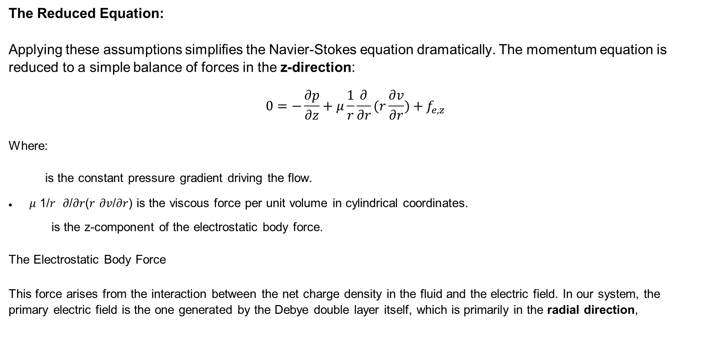
The Reduced Equation:
Applying these assumptions simplifies the Navier-Stokes equation dramatically. The momentum equation is reduced to a simple balance of forces in the z-direction:
$$0=−\frac{∂p}{∂z}+μ\frac{1}{r}\frac{∂}{∂r}(r\frac{∂v}{∂r})+f_{e,z}$$
Where:
$\frac{∂p}{∂z}$is the constant pressure gradient driving the flow.
𝜇 1/𝑟 𝜕/𝜕𝑟(𝑟 𝜕𝑣/𝜕𝑟) is the viscous force per unit volume in cylindrical coordinates.
$f_{e,z}$is the z-component of the electrostatic body force.
The Electrostatic Body Force $f_{e,z}$
This force arises from the interaction between the net charge density in the fluid and the electric field. In our system, the primary electric field is the one generated by the Debye double layer itself, which is primarily in the radial direction,

Slide 10
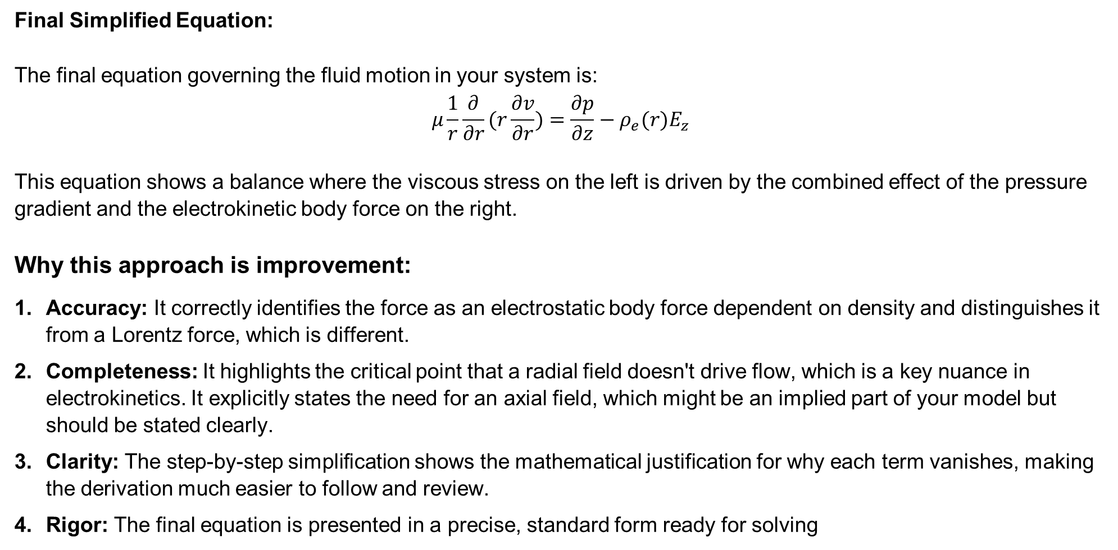
Final Simplified Equation:
The final equation governing the fluid motion in your system is: $$μ\frac{1}{r}\frac{∂}{∂r}(r\frac{∂v}{∂r})=\frac{∂p}{∂z}−ρ_{e}(r)E_{z}$$
This equation shows a balance where the viscous stress on the left is driven by the combined effect of the pressure gradient and the electrokinetic body force on the right.
Why this approach is improvement:
Accuracy: It correctly identifies the force as an electrostatic body force dependent on density and distinguishes it from a Lorentz force, which is different.
Completeness: It highlights the critical point that a radial field doesn't drive flow, which is a key nuance in electrokinetics. It explicitly states the need for an axial field, which might be an implied part of your model but should be stated clearly.
Clarity: The step-by-step simplification shows the mathematical justification for why each term vanishes, making the derivation much easier to follow and review.
Rigor: The final equation is presented in a precise, standard form ready for solving

Slide 11

Boundary Value Problem Formulation
The system is governed by two coupled phenomena: electrostatics (Poisson-Boltzmann equation) and hydrodynamics (modified Navier-Stokes equation). The complete boundary value problem is defined by the following set of differential equations and their associated boundary conditions.
1. Electrostatics: The Poisson-Boltzmann Problem
The electric potential due to the Debye double layer is described by the Poisson-Boltzmann equation. For a symmetric electrolyte (e.g., KCl, NaCl) and assuming a low potential (< 25 mV) for linearization (Debye-Hückel approximation), the equation and its boundary conditions are: $$∇⋅(ε∇ψ)=−ρ_{e}$$
For a constant permittivity $\epsilon$ and using the Boltzmann distribution for ions, this simplifies to the linearized form: $\frac{1}{r}\frac{d}{dr}(r\frac{dψ}{dr})=\frac{2n_{0}z^{2}e^{2}}{εk_{B}T}ψ=κ^{2}ψ$, where 1/kappa is the Debye-Hückel parameter, and kappa ais the Debye length.$\frac{dv}{dr}∣_{r=0}=0$

Slide 12
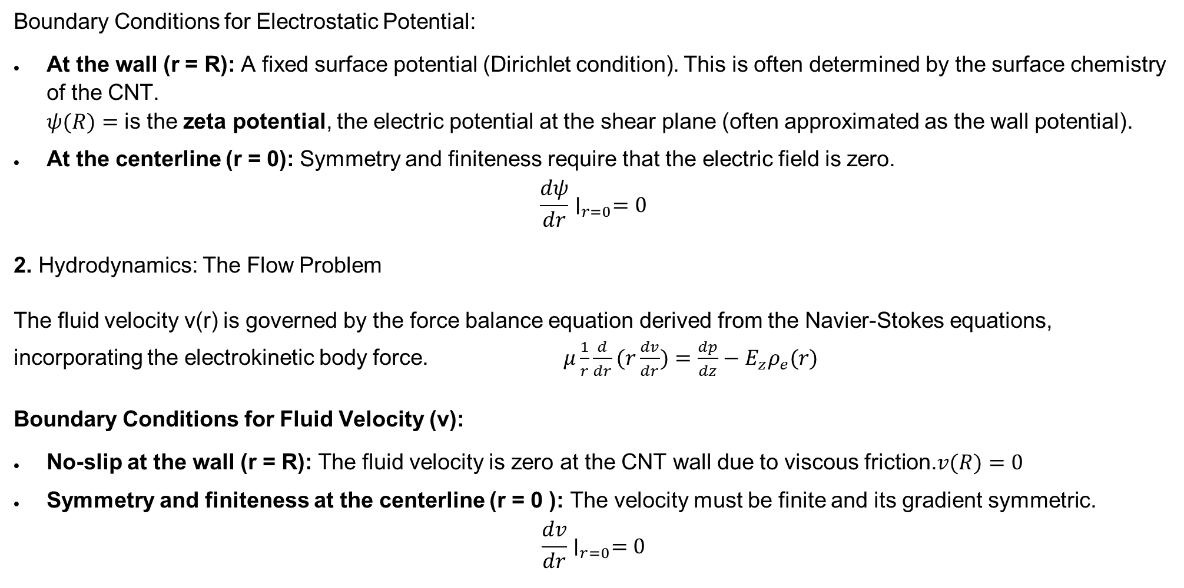
Boundary Conditions for Electrostatic Potential:
At the wall (r = R): A fixed surface potential (Dirichlet condition). This is often determined by the surface chemistry of the CNT. $ψ(R)=$ is the zeta potential, the electric potential at the shear plane (often approximated as the wall potential).
At the centerline (r = 0): Symmetry and finiteness require that the electric field is zero. $\frac{dψ}{dr}∣_{r=0}=0$
2. Hydrodynamics: The Flow Problem
The fluid velocity v(r) is governed by the force balance equation derived from the Navier-Stokes equations, incorporating the electrokinetic body force. $μ\frac{1}{r}\frac{d}{dr}(r\frac{dv}{dr})=\frac{dp}{dz}−E_{z}ρ_{e}(r)$
Boundary Conditions for Fluid Velocity (v):
No-slip at the wall (r = R): The fluid velocity is zero at the CNT wall due to viscous friction.$v(R)=0$
Symmetry and finiteness at the centerline (r = 0 ): The velocity must be finite and its gradient symmetric. $\frac{dv}{dr}∣_{r=0}=0$

Slide 13

Results and Discussion
Here we are presenting the analytical solutions to the boundary value problem and discusses their physical implications for spin transport in carbon nanotubes.
1.Electrostatic Potential and Charge Distribution
The solution to the linearized Poisson-Boltzmann equation with the specified boundary conditions yields the classic potential distribution for a cylindrical nanochannel: $ψ(r)=ζ\frac{I_{0}(κr)}{I_{0}(κR)}$ where Io is the modified Bessel function of the first kind of order zero.
2. Velocity Profile of the Viscous Fluid
The solution of fluid velocity can be expressed as the sum of a particular solution (due to the electrokinetic forcing term) and the complementary solution (to satisfy the boundary conditions): $$v\left(r\right)=v_{p}\left(r\right)+v_{h}\left(r\right).$$
The full solution for the velocity, accounting for both the pressure gradient and the electro-osmotic flow driven by the axial field, is given by: $$v(r)=\frac{1}{4μ}\frac{dp}{dz}(r^{2}−R^{2})+\frac{εE_{z}ζ}{μ}(1−\frac{I_{0}(κr)}{I_{0}(κR)})$$

Slide 14
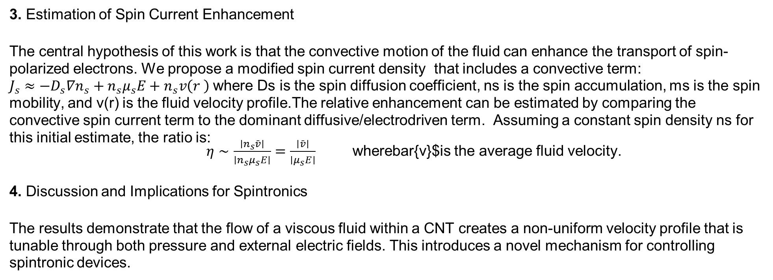
3. Estimation of Spin Current Enhancement
The central hypothesis of this work is that the convective motion of the fluid can enhance the transport of spin-polarized electrons. We propose a modified spin current density that includes a convective term: $J_{s}≈−D_{s}∇n_{s}+n_{s}μ_{s}E+n_{s}v\left(r \right)$where Ds is the spin diffusion coefficient, ns is the spin accumulation, ms is the spin mobility, and v(r) is the fluid velocity profile.The relative enhancement can be estimated by comparing the convective spin current term to the dominant diffusive/electrodriven term. Assuming a constant spin density ns for this initial estimate, the ratio is: $η∼\frac{∣n_{s}\overset{ˉ}{v}∣}{∣n_{s}μ_{s}E∣}=\frac{∣\overset{ˉ}{v}∣}{∣μ_{s}E∣}$ wherebar{v}$is the average fluid velocity.
4. Discussion and Implications for Spintronics
The results demonstrate that the flow of a viscous fluid within a CNT creates a non-uniform velocity profile that is tunable through both pressure and external electric fields. This introduces a novel mechanism for controlling spintronic devices.

Slide 15
The convective enhancement of spin current proposes a paradigm shift from purely solid-state spin transport to fluidic-spintronic hybrid transport. This could lead to devices where information encoded in spin is modulated not only by magnetic fields but also by hydraulic or electrokinetic means. For instance, in a spin valve, the magnetoresistance ratio could be tuned by applying a pressure gradient across the channel, adding a new functional dimension to the device.
Future work will involve a fully coupled spin-drift-diffusion model incorporating the calculated profile and experimental validation of this effect using ferromagnetically contacted CNTs under flow conditions.

Slide 16
Conclusion
A theoretical model coupling viscous fluid flow and spin transport in CNTs was developed.
The boundary value problem, accounting for the Debye layer and wall friction, was solved analytically via an infinite series expansion.
The resulting flow profile was analyzed and shown to be dependent on electrokinetic phenomena.
It was estimated that the fluid flow could provide a significant mechanism for enhancing spin-polarized current, proposing a novel principle for active spintronic device operation.

Slide 17
References
Fundamental Spintronics & CNT Properties
1. Wolf, S. A., et al. (2001). Spintronics: A spin-based electronics vision for the future. Science, 294(5546), 1488-1495.
2. Žutić, I., Fabian, J., & Das Sarma, S. (2004). Spintronics: Fundamentals and applications. Reviews of Modern Physics, 76(2), 323.
Tsukagoshi, K., Alphenaar, B. W., & Ago, H. (1999). Coherent transport of electron spin in a ferromagnetically contacted carbon nanotube. Nature, 401(6753), 572-574.
Kervalishvili P. and Lagutin A. , Nanostructures, magnetic semiconductors and spintronics, Microelectronics Journal, (2008), 39 pp.1060–1065.
Kervalishvili. P. Semiconducting Nanostructures - Materials for Spintronics. Nanotechnology Perceptions, (2005) Vol. 1, N 3.
6. Sahoo, S., et al. (2008). Electric field control of spin transport. Nature Physics, 4(9), 656-661.
Carbon Nanotubes as Quantum Wires & Spin Valves
7. Nair, N., et al. (2018). Spin transport in carbon nanotubes. Journal of Physics: Condensed Matter, 30(40), 403001.
8. Hills, G., et al. (2019). Modern microprocessor built from complementary carbon nanotube transistors. Nature, 572(7771), 595-602. 7. Cottet, A., et al. (2006). Nanospintronics with carbon nanotubes. Semiconductor Science and Technology, 21(11), S78.
Nanofluidics & Electrokinetic Phenomena (Debye Layer)
9. Bocquet, L., & Charlaix, E. (2010). Nanofluidics, from bulk to interfaces. Chemical Society Reviews, 39(3), 1073-1095.
10. Schoch, R. B., Han, J., & Renaud, P. (2008). Transport phenomena in nanofluidics. Reviews of Modern Physics, 80(3), 839.
11. Kirby, B. J. (2010). Micro- and Nanoscale Fluid Mechanics: Transport in Microfluidic Devices. Cambridge University Press.
12. Berberashvili T., Gogichaishvili V., Kervalishvili P., Formulation and solution of boundary value problem of viscous liquid flow in nanotube taking into account external friction. (2024), Nanotechnology 2024, Tbilisi, October 2024, Georgian Technical University.
Analytical Methods (Series Solutions for BVP)
16. Myint-U, T., & Debnath, L. (2007). Linear Partial Differential Equations for Scientists and Engineers. Birkhäuser Boston.
17. Birk, G., & Györgyi, S. (2022). Analytical solutions for electroosmotic flow in cylindrical micro-and nanochannels. Physics of Fluids, 34(8), 082007.

Slide 18
Thank you very much

