Slide 1
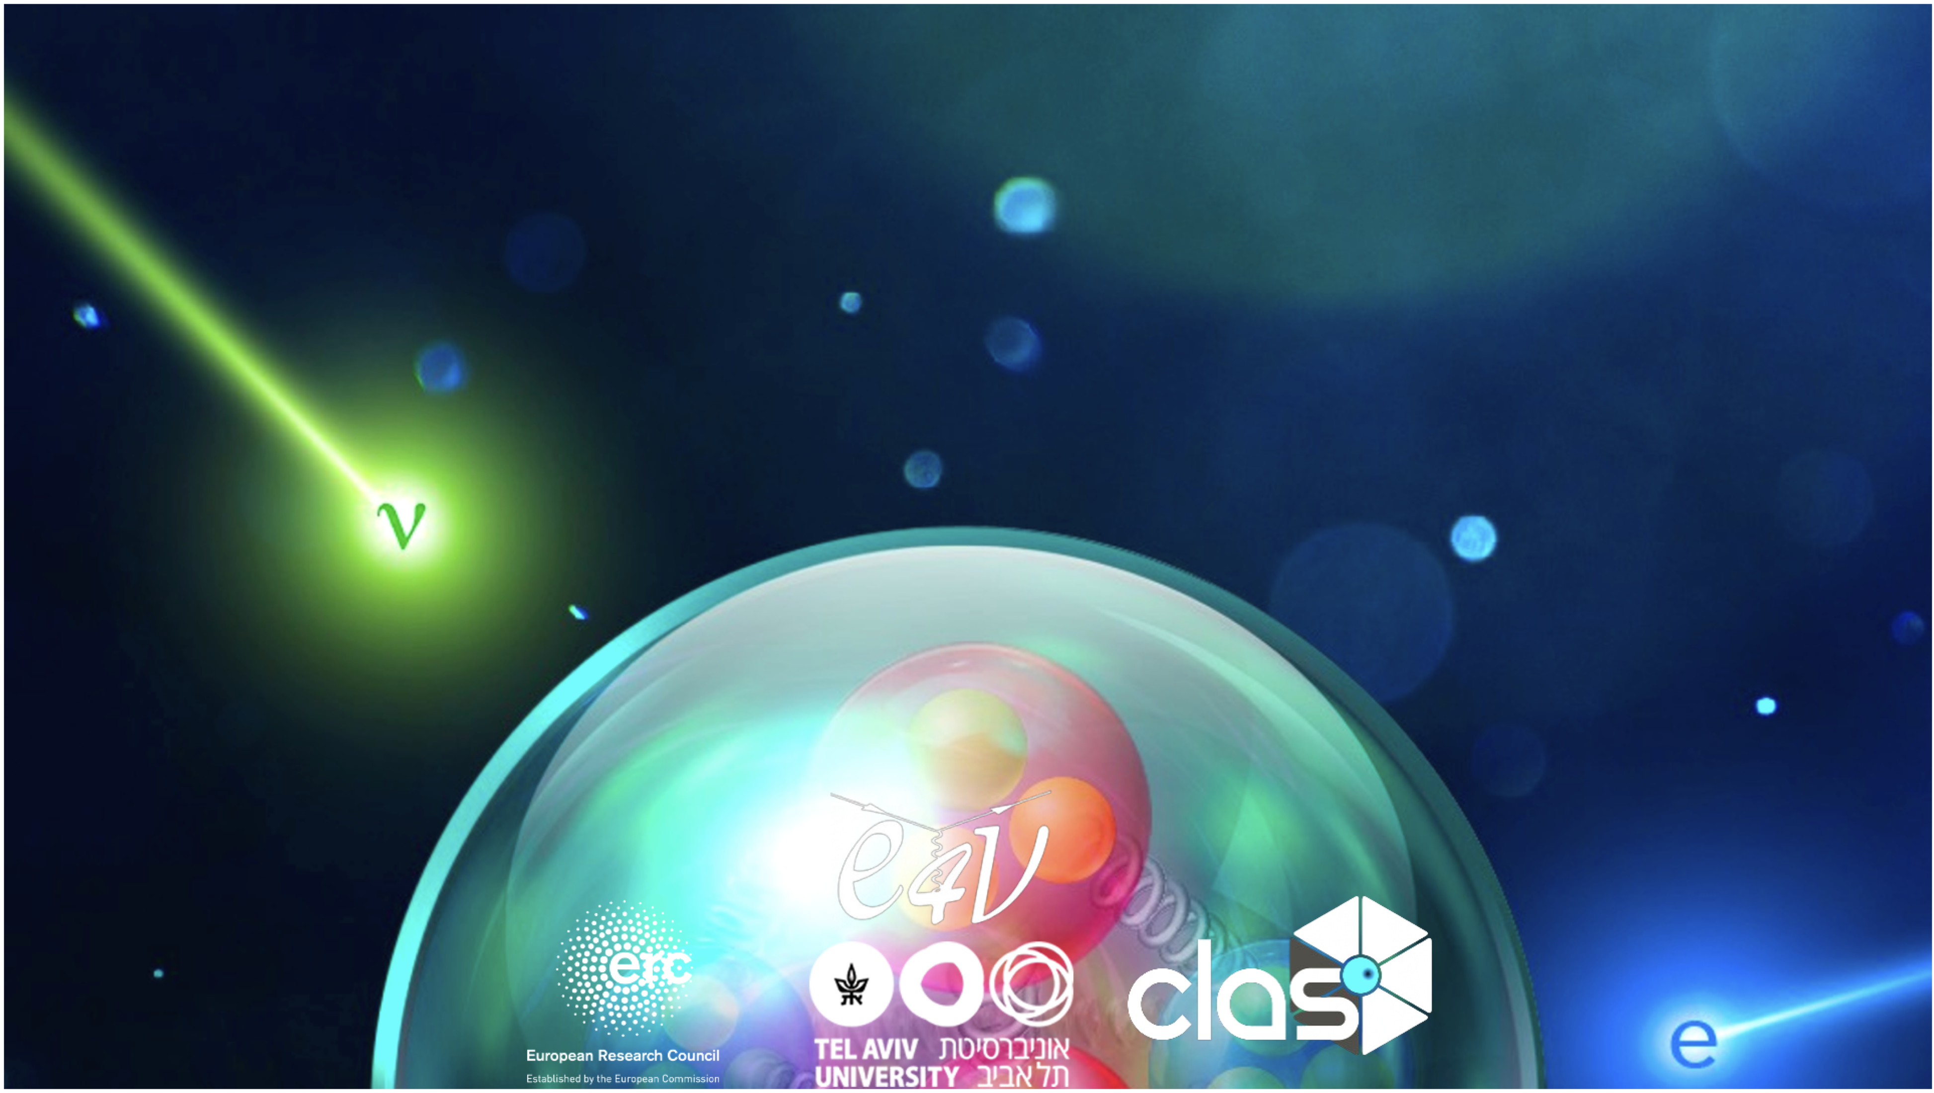
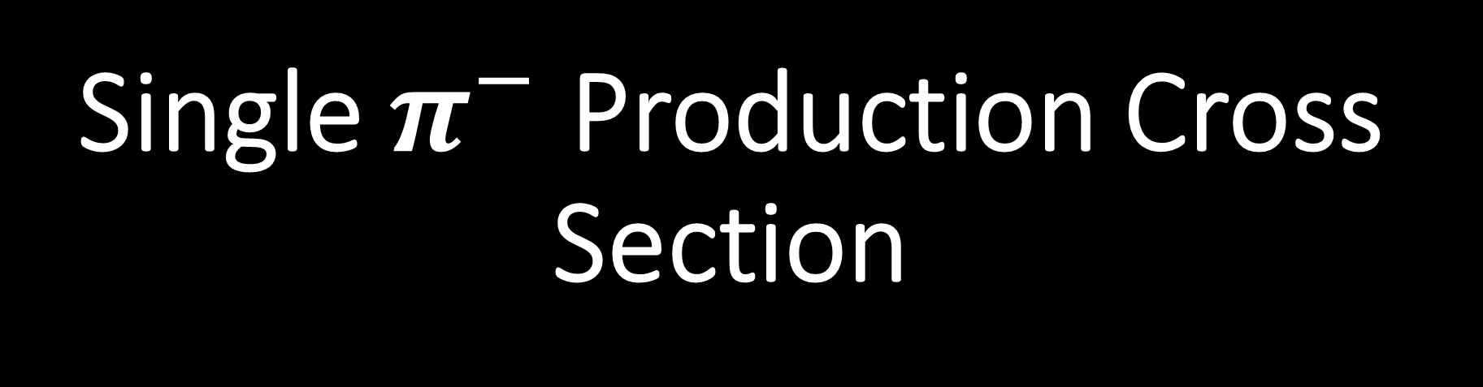
Single $π^{−}$ Production Cross Section
Brittany Cohen

Slide 2
Table of Contents
Signal definition and analysis procedures
MC and data comparison

Slide 3
Signal Definition

Slide 4
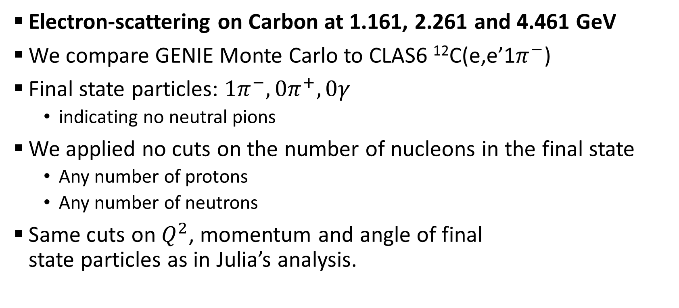



Event Selection
Electron-scattering on Carbon at 1.161, 2.261 and 4.461 GeV
We compare GENIE Monte Carlo to CLAS6 ¹²C(e,e’1$π^{−}$)
Final state particles: $1π^{−}, 0π^{+},0γ$
  indicating no neutral pions
We applied no cuts on the number of nucleons in the final state
  Any number of protons
  Any number of neutrons
Same cuts on $Q^{2}$, momentum and angle of final
state particles as in Julia’s analysis.
$$π^{−}$$
$$e^{−}$$
$$γ$$

Slide 5
MC and Data
Comparison

Slide 6



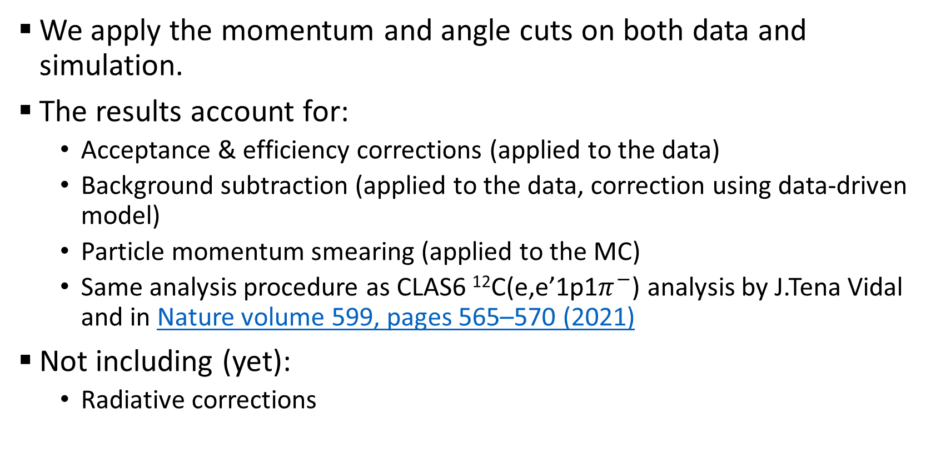
MC Simulation and Data
We apply the momentum and angle cuts on both data and simulation.
The results account for:
  Acceptance & efficiency corrections (applied to the data)
  Background subtraction (applied to the data, correction using data-driven model)
  Particle momentum smearing (applied to the MC)
  Same analysis procedure as CLAS6 ¹²C(e,e’1p1$π^{−}$) analysis by J.Tena Vidal and in Nature volume 599, pages 565–570 (2021)
Not including (yet):
  Radiative corrections
$$π^{−}$$
$$e^{−}$$
$$γ$$

Slide 7
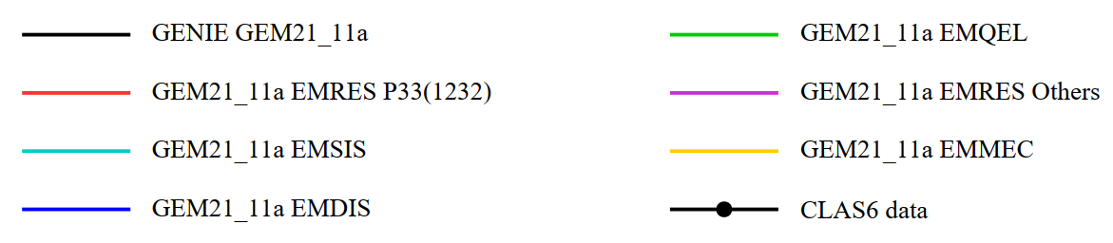
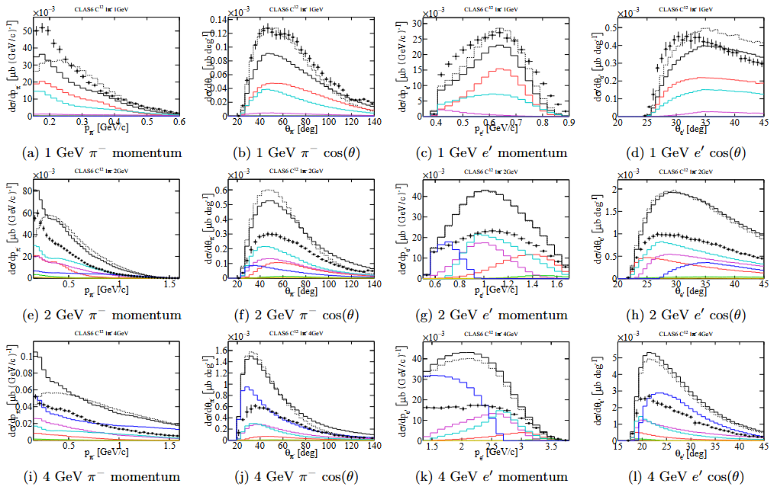
Detected Particle Kinematics
Data shows that GENIE has a clear issue describing
the cross-section normalization and its shape.
More observables in the backup slides (pion angle, electron momentum and angle).
GENIE
Preliminary
Preliminary
Preliminary
No FSI

Slide 8

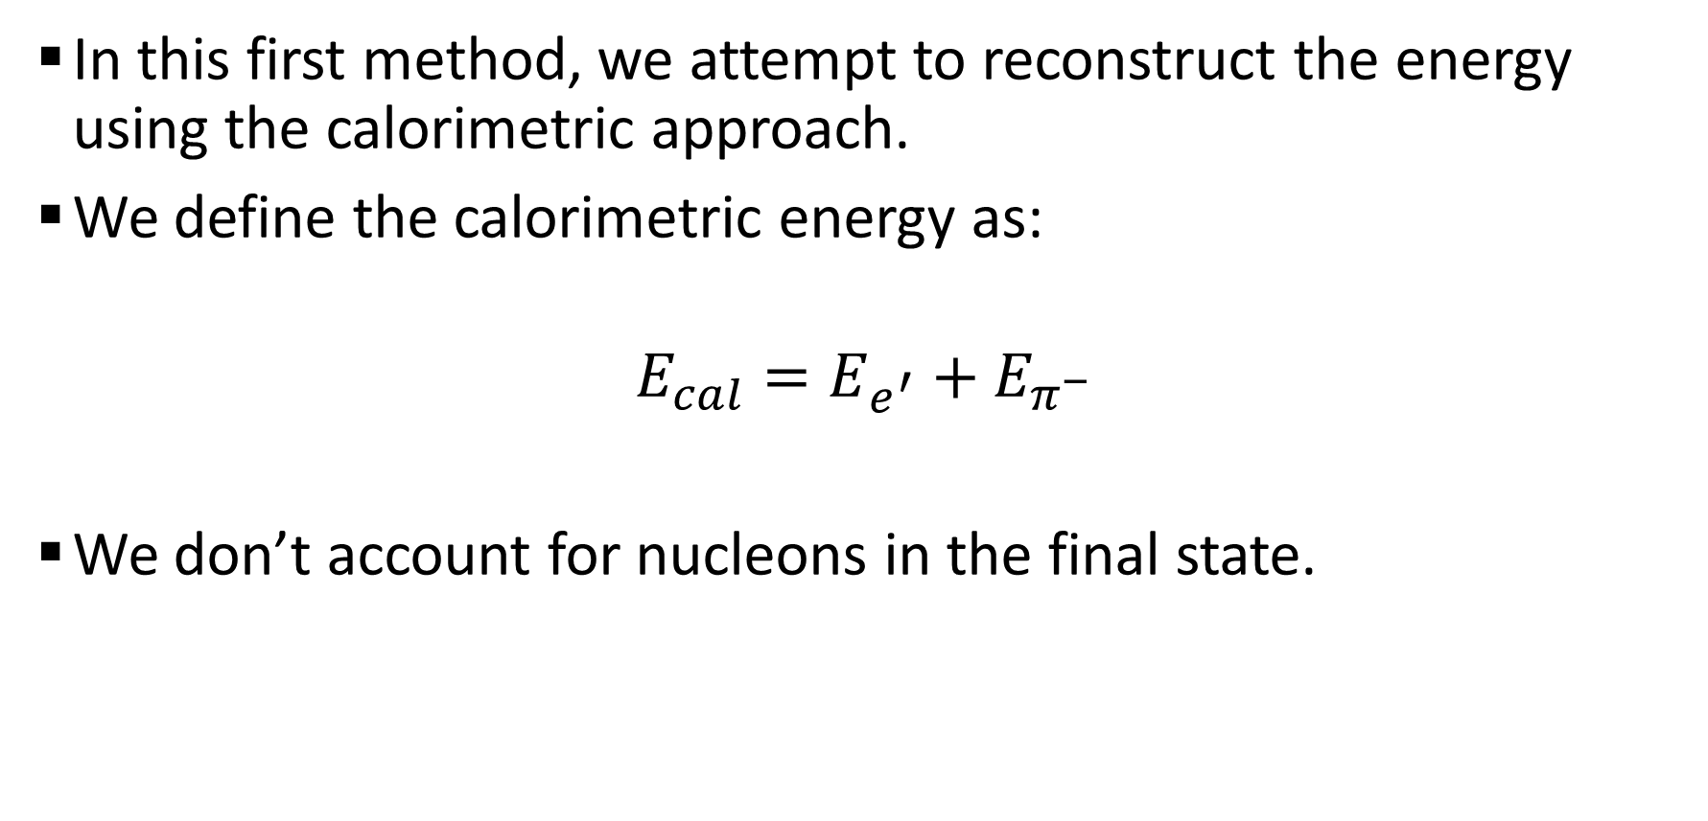
Reconstructed $E_{e}$ - Method 1
In this first method, we attempt to reconstruct the energy using the calorimetric approach.
We define the calorimetric energy as:
$$E_{cal}=E_{e^{′}}+E_{π^{−}}$$
We don’t account for nucleons in the final state.
Notes:
Speak about the shifts here

Slide 9
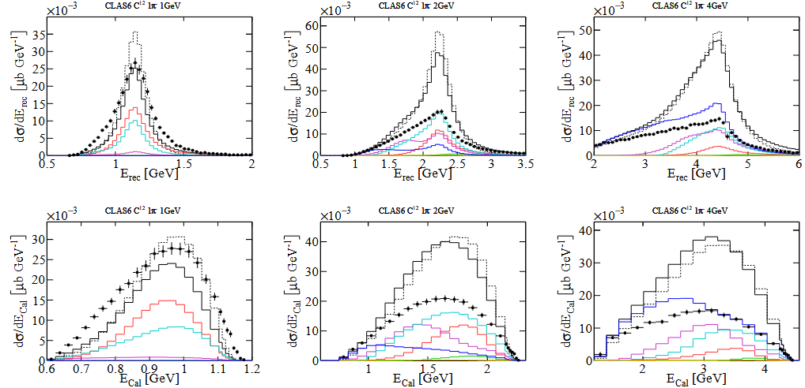
Reconstructed $E_{e}$ - Method 1
This method fails to reconstruct the correct beam energy:
  Due to missing particles.
  Nucleons and multiple pion production events.
Shape and normalization not well described by GENIE.
This data tells us that GENIE cannot describe the bias in the reconstructed energy.
GEM21_11a
QEL
Delta
Other RES
MEC
SIS
DIS
Preliminary
Preliminary
Preliminary
Notes:
Speak about the shifts here

Slide 10

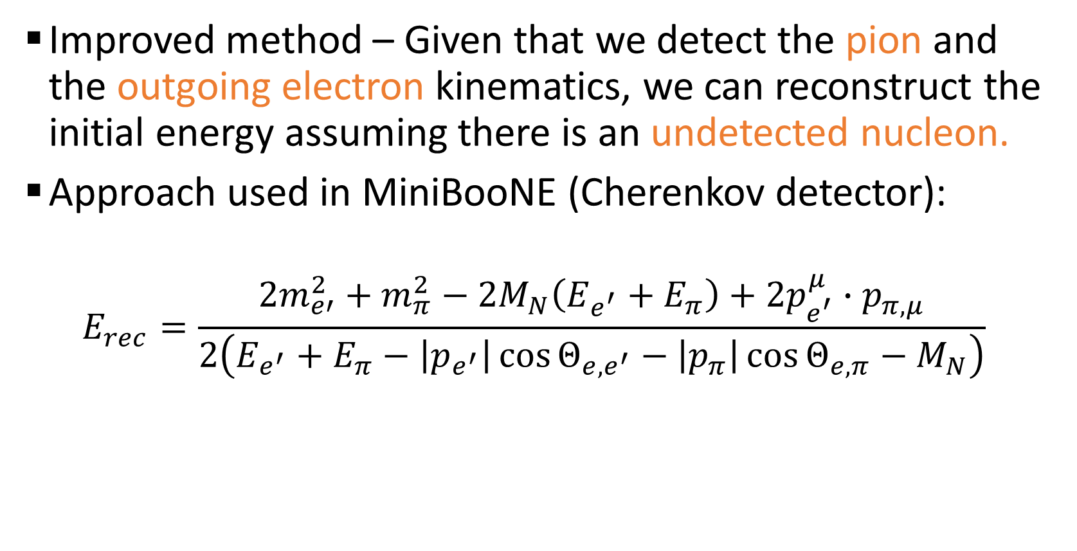
Reconstructed $E_{e}$ - Method 2
Improved method – Given that we detect the pion and the outgoing electron kinematics, we can reconstruct the initial energy assuming there is an undetected nucleon.
Approach used in MiniBooNE (Cherenkov detector):
$$E_{rec}=\frac{2m_{e′}^{2}+m_{π}^{2}−2M_{N}\left(E_{e^{′}}+E_{π}\right)+2p_{e^{′}}^{μ}∙p_{π,μ}}{2\left(E_{e^{′}}+E_{π}−\left|p_{e^{′}}\right|\cos{Θ_{e, e^{′}}}−\left|p_{π}\right|\cos{Θ_{e, π}}−M_{N}\right)}$$
Notes:
Speak about the shifts here

Slide 11
Reconstructed $E_{e}$ - Method 2
Can Reconstruct beam energy position
  Tails due to additional particles under thresholds.
Shapes of MC and data plots are similar at 1GeV.
Tail grows with energy due to multiple-pion production at higher E
GEM21_11a
QEL
Delta
Other RES
NoFSI
MEC
SIS
DIS
Preliminary
Preliminary
Preliminary
Notes:
Speak about the shifts here

Slide 12

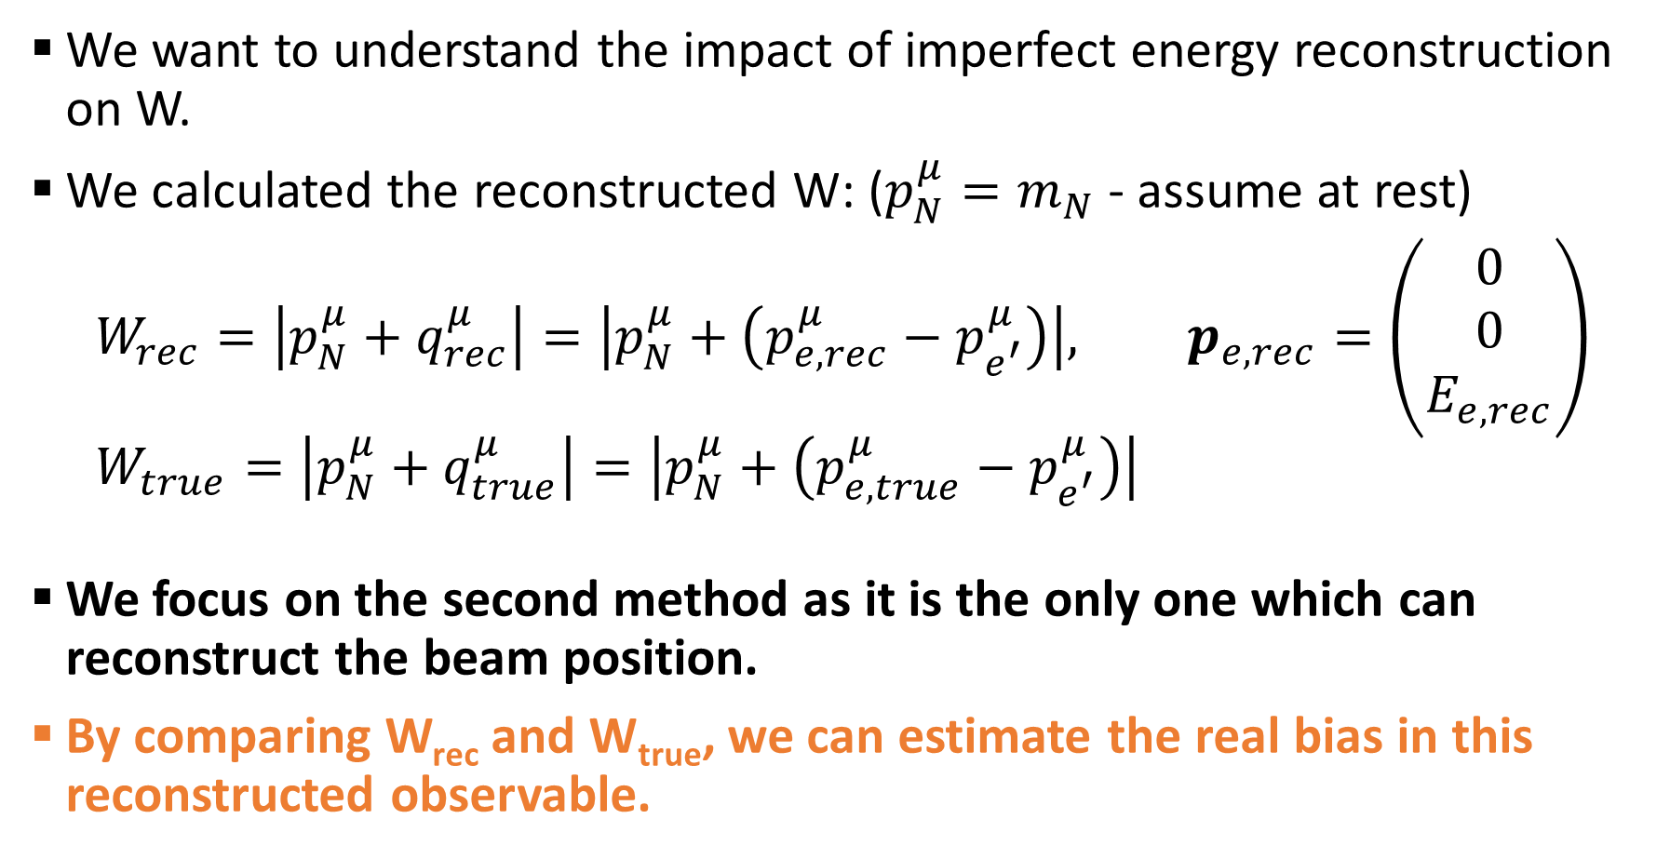
Reconstructed $W$
We want to understand the impact of imperfect energy reconstruction on W.
We calculated the reconstructed W: ($p_{N}^{μ}=m_{N}$ - assume at rest)
$$W_{rec}=\left|p_{N}^{μ}+q_{rec}^{μ}\right|=\left|p_{N}^{μ}+\left(p_{e,rec}^{μ}−p_{e^{′}}^{μ}\right)\right|, p_{e,rec}=\left(\begin{matrix}0 \\ 0 \\ E_{e,rec}\end{matrix}\right) \\ W_{true}=\left|p_{N}^{μ}+q_{true}^{μ}\right|=\left|p_{N}^{μ}+\left(p_{e,true}^{μ}−p_{e^{′}}^{μ}\right)\right|$$
We focus on the second method as it is the only one which can reconstruct the beam position.
By comparing W_{rec} and W_{true}, we can estimate the real bias in this reconstructed observable.

Slide 13
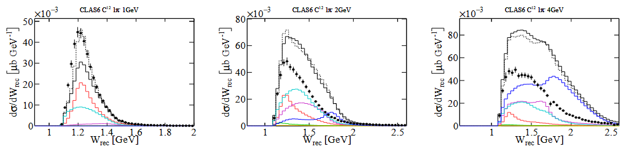
Reconstructed $W$
Normalization is off for the different energies.
Shape differences exist, but less significant.
How much does it differ from the actual distribution?
GEM21_11a
QEL
Delta
Other RES
MEC
SIS
DIS
Preliminary
Preliminary
Preliminary
Notes:
More pronounced second peak – the reconstructed W treats all events as if they were single pion events

Slide 14
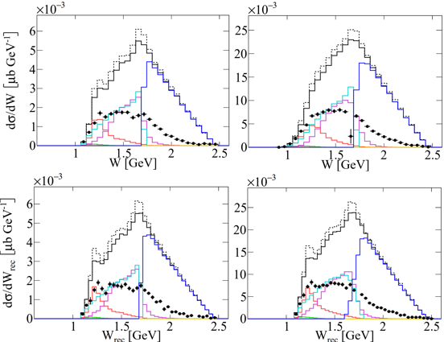



Reconstructed $W$
We applied cuts on energy reconstruction accuracy.
We compared the reconstructed W to W calculated using the known beam energy for both MC simulation data and CLAS6 data.
We only show the 4GeV case.
Preliminary
5% Accuracy:
Carbon $4 GeV$
Carbon $4 GeV$
GEM21_11a
QEL
Delta
Other RES
MEC
SIS
DIS
Preliminary
Preliminary
Preliminary
W and $W_{rec}$ very similar

Slide 15
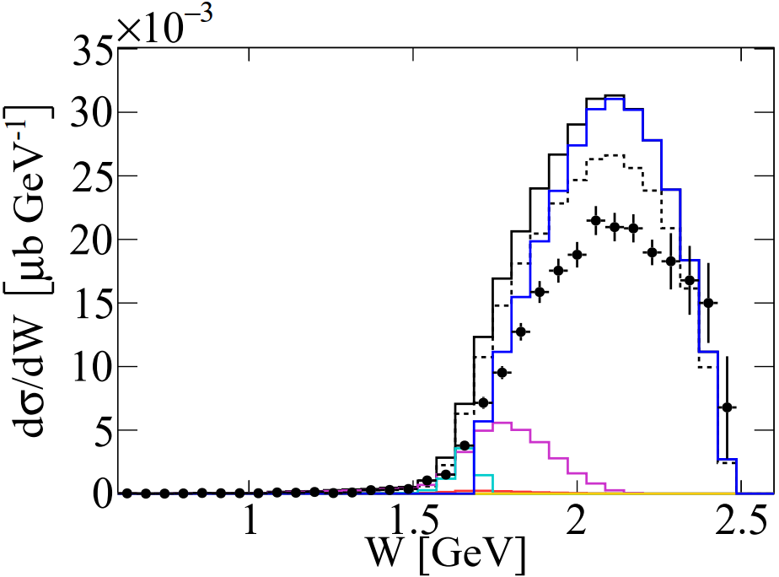
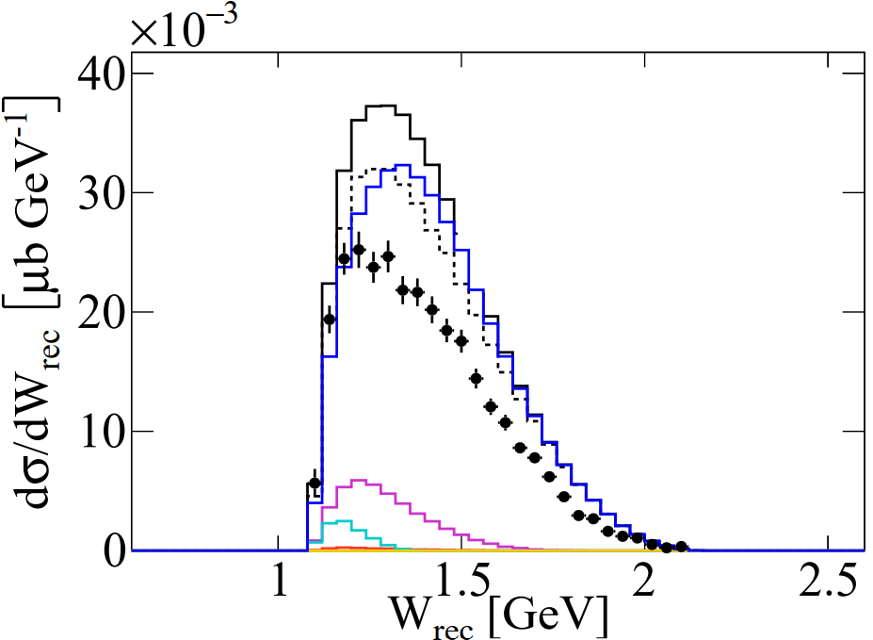
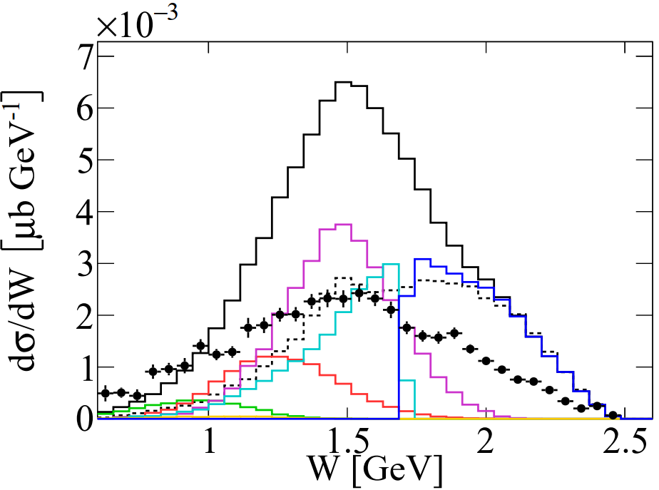
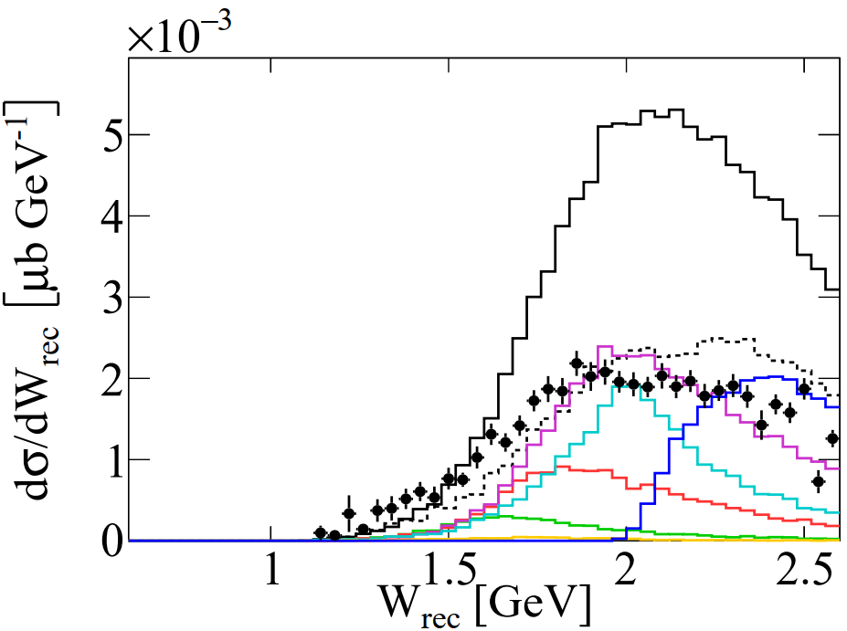


Reconstructed $W$
E_{rec}<E_{e} -20%:
GEM21_11a
QEL
Delta
Other RES
MEC
SIS
DIS
Preliminary
Preliminary
Preliminary
Tail dominated by multi-pion production events
True W > 2 GeV but W_{reco} still peaks at delta region
E_{rec}>E_{e} +20%:
GEM21_11a
QEL
Delta
Other RES
MEC
SIS
DIS
Preliminary
FSI effect
Preliminary
Preliminary
Dominated by events which contribute
to high $W_{rec}$ due to FSI
Notes:
Top: Tail is dominated by multi-pion production events, True W > 2 GeV, W_{reco} still peaks at delta region

Slide 16
Conclusions

Slide 17
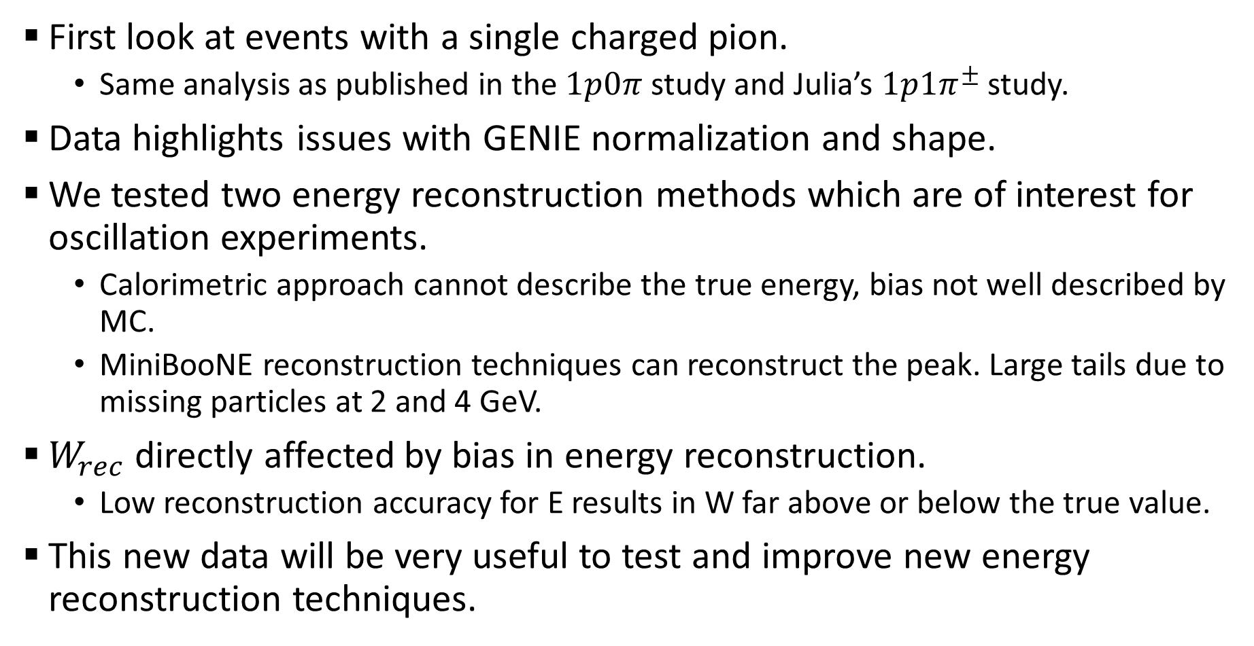
Conclusions
First look at events with a single charged pion.
  Same analysis as published in the $1p0π$ study and Julia’s $1p1π^{±}$ study.
Data highlights issues with GENIE normalization and shape.
We tested two energy reconstruction methods which are of interest for oscillation experiments.
  Calorimetric approach cannot describe the true energy, bias not well described by MC.
  MiniBooNE reconstruction techniques can reconstruct the peak. Large tails due to missing particles at 2 and 4 GeV.
$W_{rec}$ directly affected by bias in energy reconstruction.
  Low reconstruction accuracy for E results in W far above or below the true value.
This new data will be very useful to test and improve new energy reconstruction techniques.
Notes:
Selecting for a single pion – we treat the event as if it did only emit a single pion, but it’s actually a more complex event.

Slide 18
Thank You!

Slide 19
Backup Slides

Slide 20
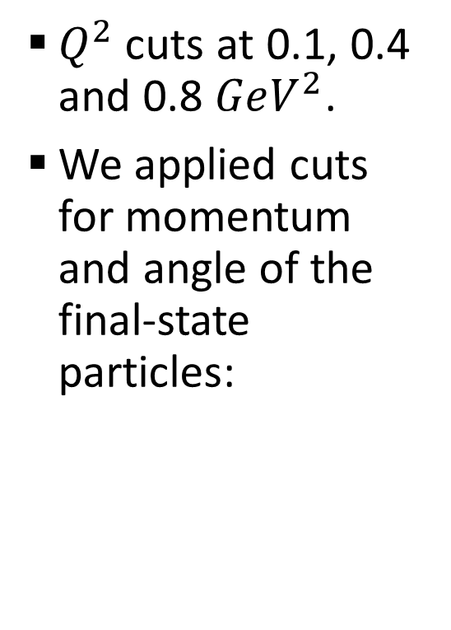
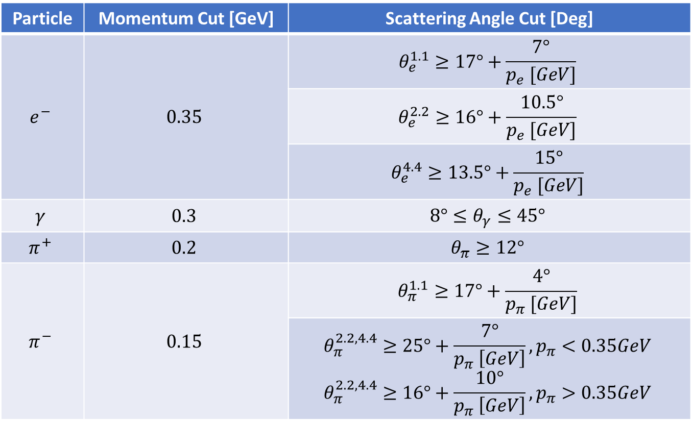
Event Selection
Cuts consistent with previous CLAS6 analysis:
Nature volume 599, pages 565–570 (2021)
$Q^{2}$ cuts at 0.1, 0.4 and 0.8 $GeV^{2}$.
We applied cuts for momentum and angle of the final-state particles:
Particle | Momentum Cut [GeV] | Scattering Angle Cut [Deg]
$$e^{−}$$ | $$0.35$$ | $$θ_{e}^{1.1}≥17°+\frac{7°}{p_{e} [GeV]}$$
 |  | $$θ_{e}^{2.2}≥16°+\frac{10.5°}{p_{e} [GeV]}$$
 |  | $$θ_{e}^{4.4}≥13.5°+\frac{15°}{p_{e} [GeV]}$$
$$γ$$ | $$0.3$$ | $$8°≤θ_{γ}≤45°$$
$$π^{+}$$ | $$0.2$$ | $$θ_{π}≥12°$$
$$π^{−}$$ | $$0.15$$ | $$θ_{π}^{1.1}≥17°+\frac{4°}{p_{π} [GeV]}$$
 |  | $$θ_{π}^{2.2, 4.4}≥25°+\frac{7°}{p_{π} \left[GeV\right]}, p_{π}<0.35GeV$$ $$θ_{π}^{2.2, 4.4}≥16°+\frac{10°}{p_{π} \left[GeV\right]}, p_{π}>0.35GeV$$

Slide 21
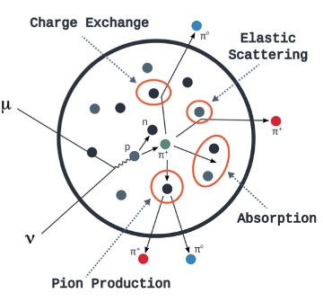
Event Types
There are several different scattering types that occur during a collision:
  QEL scattering
  RES scattering
  MEC scattering
  DIS and SIS scattering
FSI – we measure final state particles that don’t correspond to the actual collision
Notes:
Meson Exchange Current (MEC) , Deep Inelastic Scattering (DIS)

Slide 22
MC Results

Slide 23
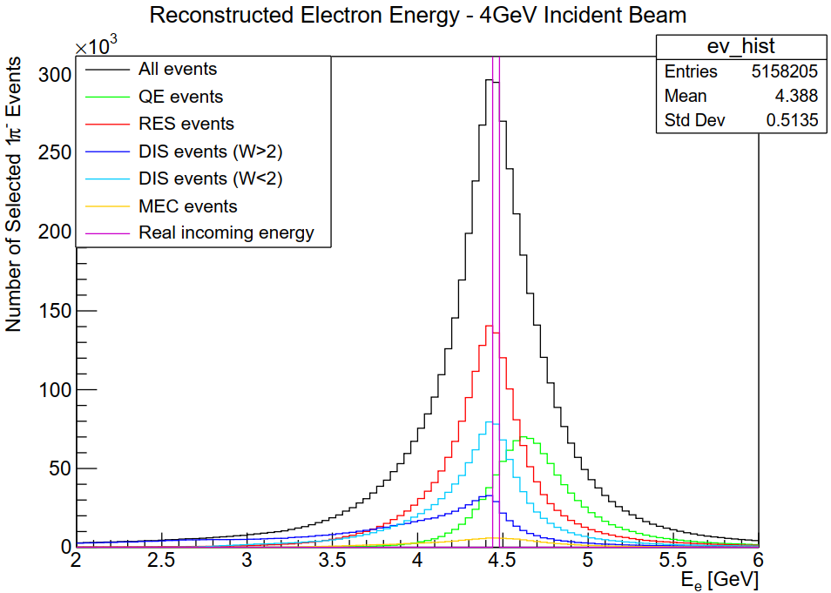
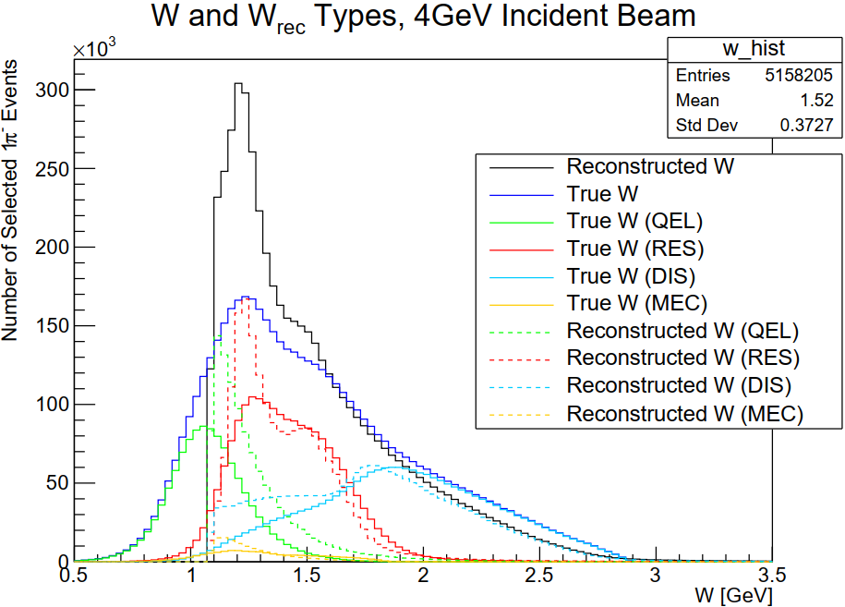
MC Results
DIS tail to the left, QEL events shifted to the right as expected.
Too many QEL events due to a problem with the simulation.
QEL

Slide 24
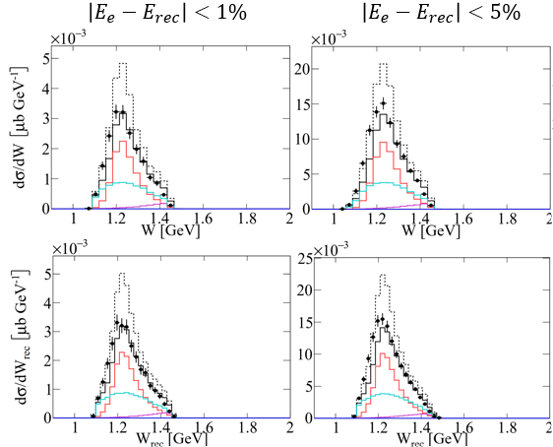
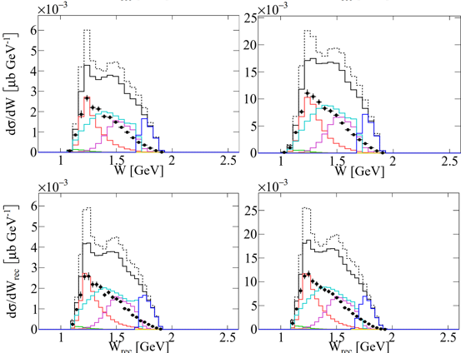





$\left|E_{rec}−E_{e}\right|<1\%$ and $5\%$ Cut
Similar shapes for $W$ (top row) and $W_{rec}$ (bottom row) at 1% accuracy.
Minor divergence between $W$ and $W_{rec}$ at 5% accuracy for 2 and 4GeV beam energies.
$$1 GeV$$
$$2 GeV$$
$$4 GeV$$
Preliminary
Preliminary
Preliminary

Slide 25

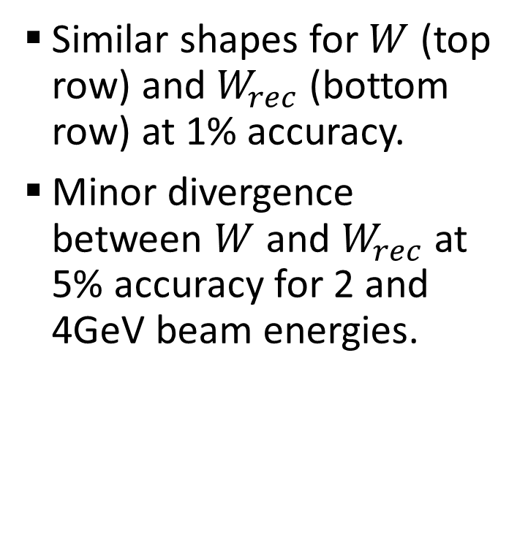
$\left|E_{rec}−E_{e}\right|<1\%$ and $5\%$ Cut
$$1 GeV$$
Similar shapes for $W$ (top row) and $W_{rec}$ (bottom row) at 1% accuracy.
Minor divergence between $W$ and $W_{rec}$ at 5% accuracy for 2 and 4GeV beam energies.
Preliminary

Slide 26

$\left|E_{rec}−E_{e}\right|<1\%$ and $5\%$ Cut
$$2 GeV$$
Similar shapes for $W$ (top row) and $W_{rec}$ (bottom row) at 1% accuracy.
Minor divergence between $W$ and $W_{rec}$ at 5% accuracy for 2 and 4GeV beam energies.
Preliminary

Slide 27

$\left|E_{rec}−E_{e}\right|<1\%$ and $5\%$ Cut
$$4 GeV$$
Similar shapes for $W$ (top row) and $W_{rec}$ (bottom row) at 1% accuracy.
Minor divergence between $W$ and $W_{rec}$ at 5% accuracy for 2 and 4GeV beam energies.
Preliminary

Slide 28
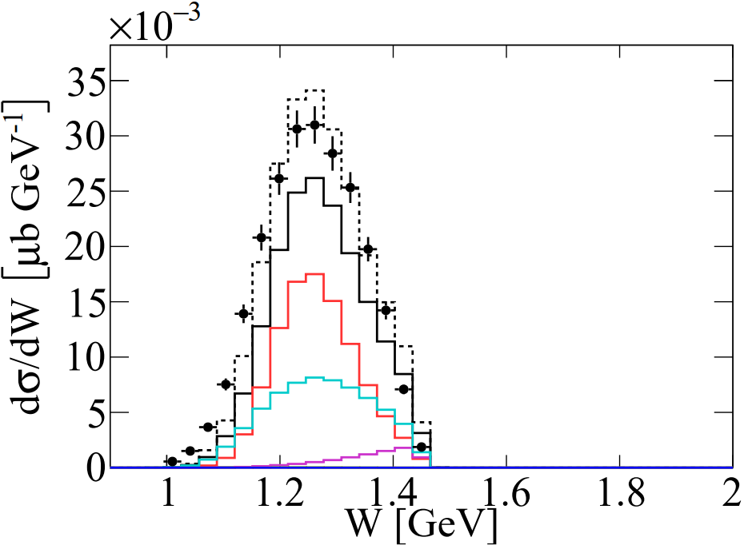
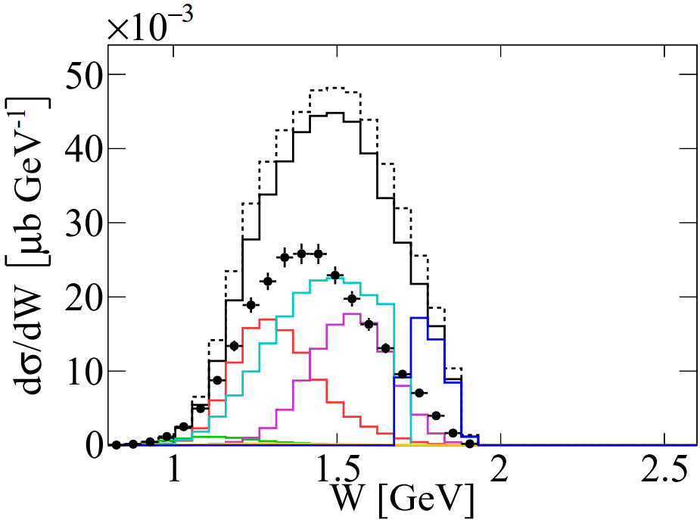
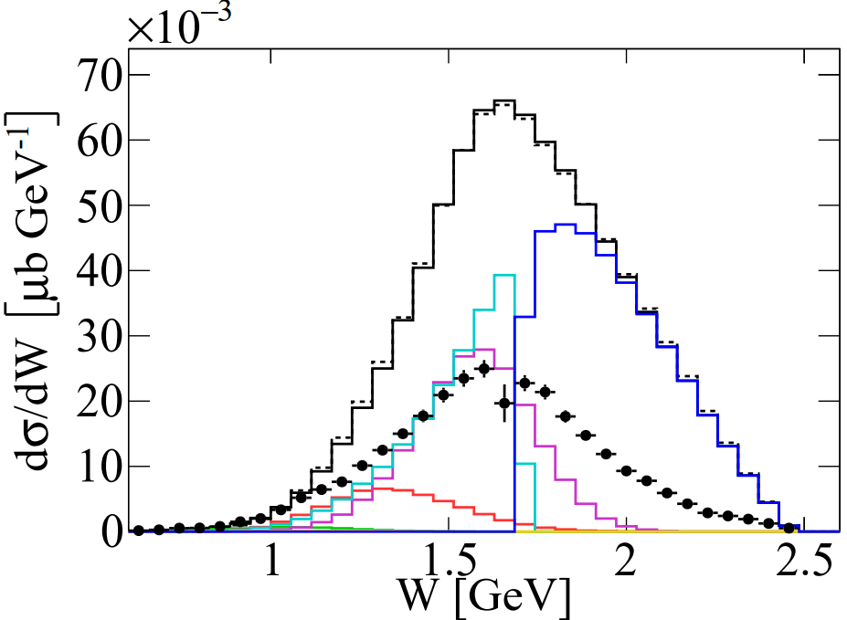
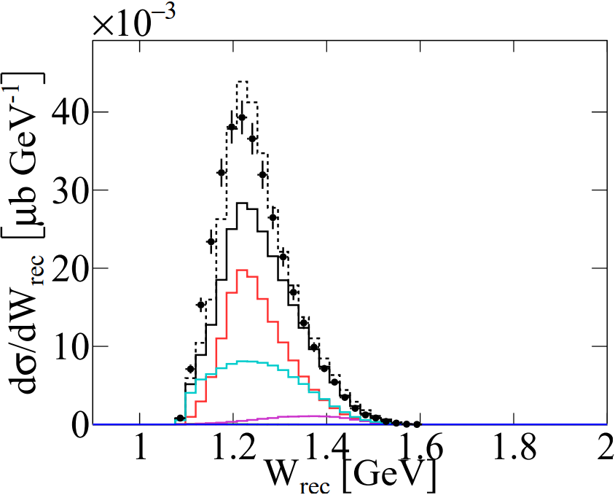
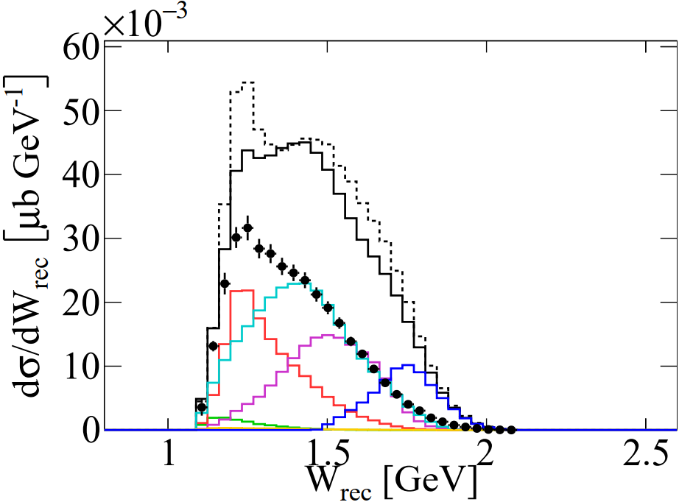
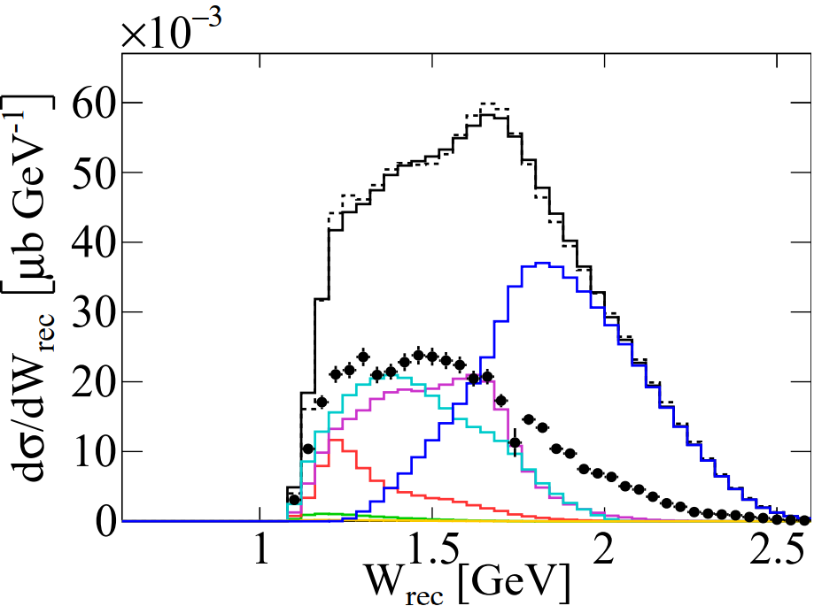




$\left|E_{rec}−E_{e}\right|<20\%$ Cut
Reconstructed W shifts away from true W w.r.t 5% and 1% cuts.
There is more bias on the 4GeV reconstruction than 1GeV reconstruction.
$$1 GeV$$
$$2 GeV$$
$$4 GeV$$
Preliminary
Preliminary
Preliminary

Slide 29
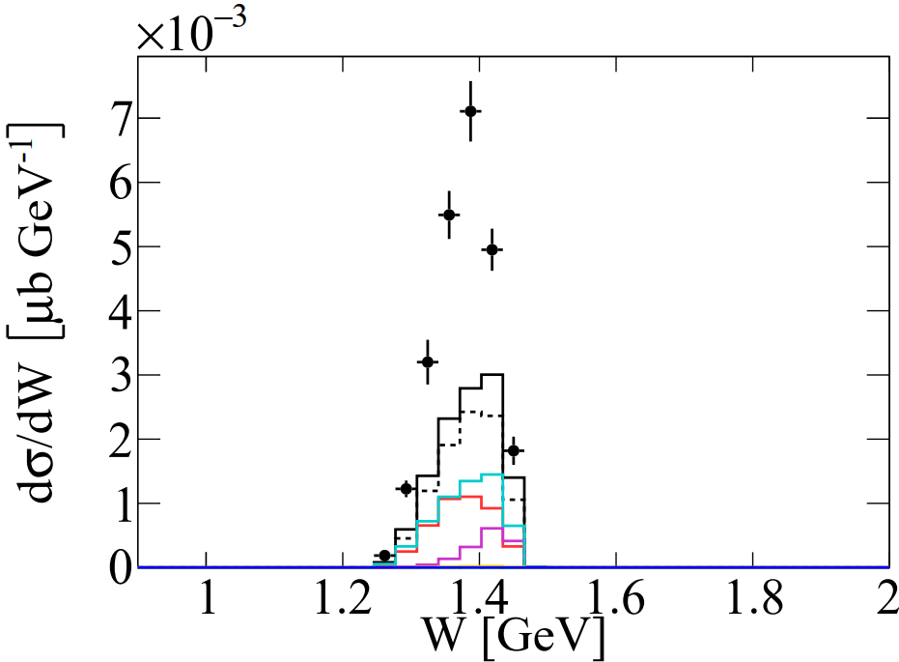
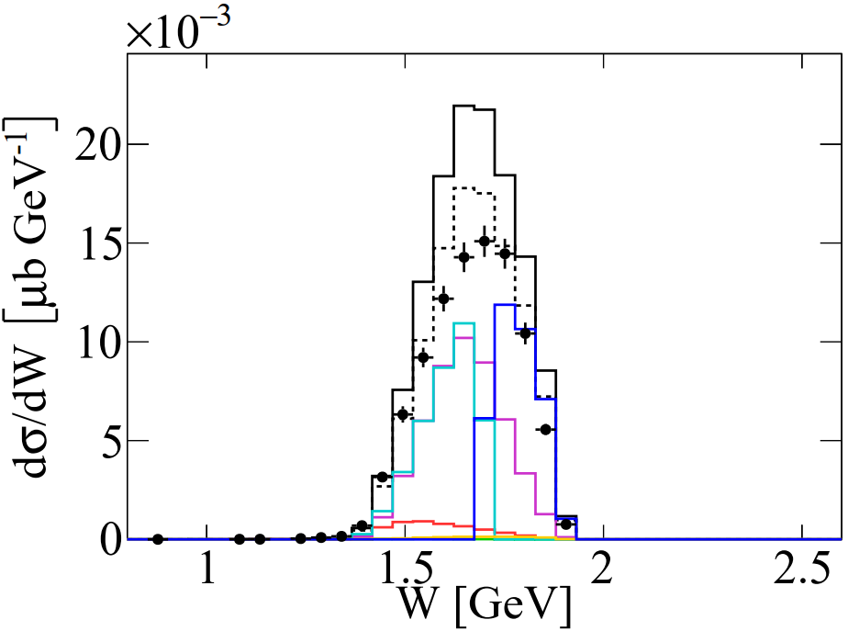
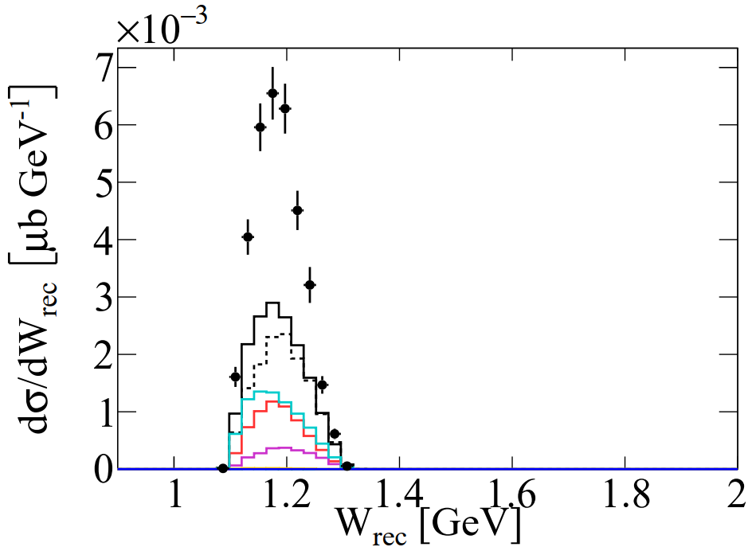
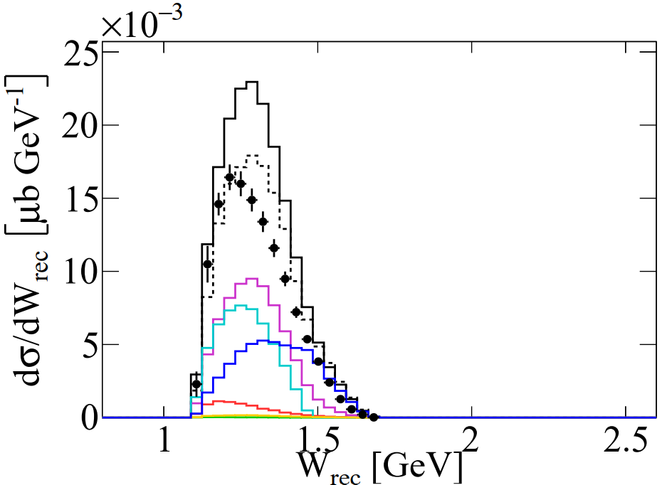




$E_{rec}<E_{e} −20\%$ Cut
Mostly events with multiple undetectable particles. We only measure a part of the total energy of the system so reconstruct below the true W too. Smaller cross-section for 1GeV
$$1 GeV$$
$$2 GeV$$
$$4 GeV$$
Preliminary
Preliminary
Preliminary

Slide 30
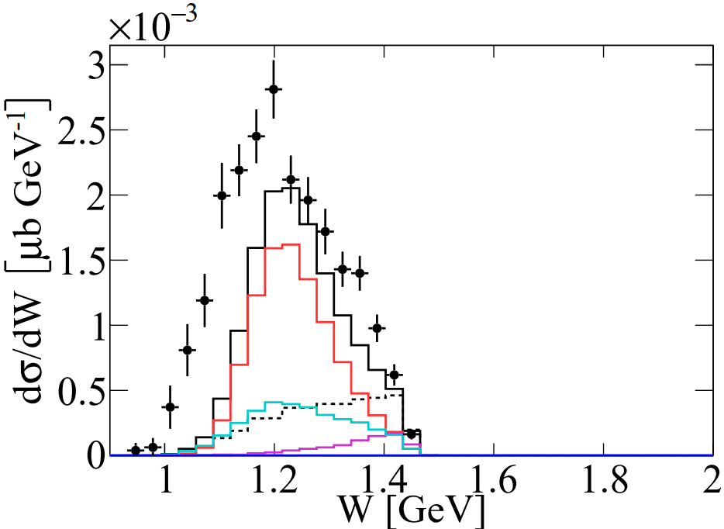
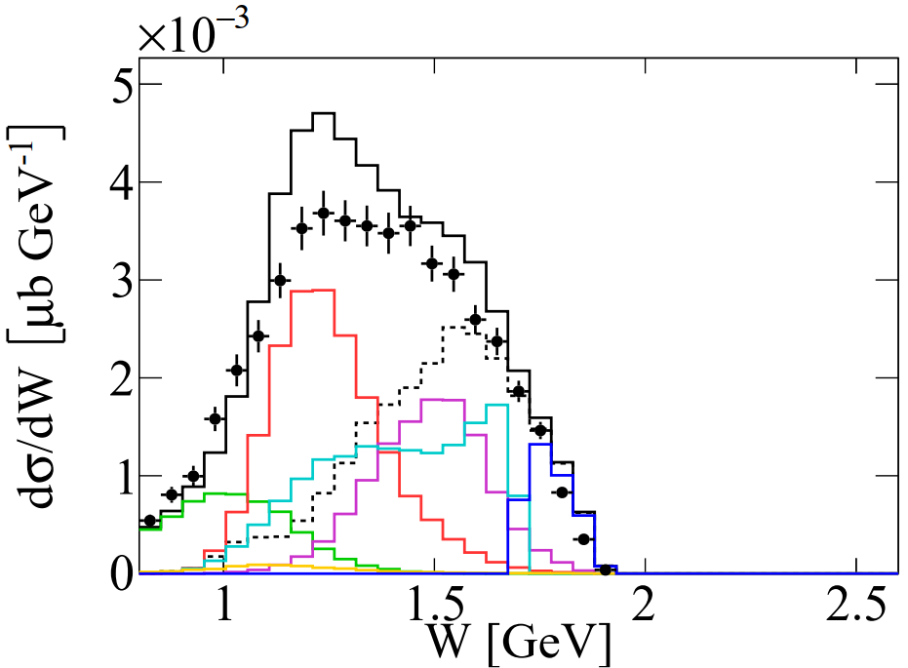
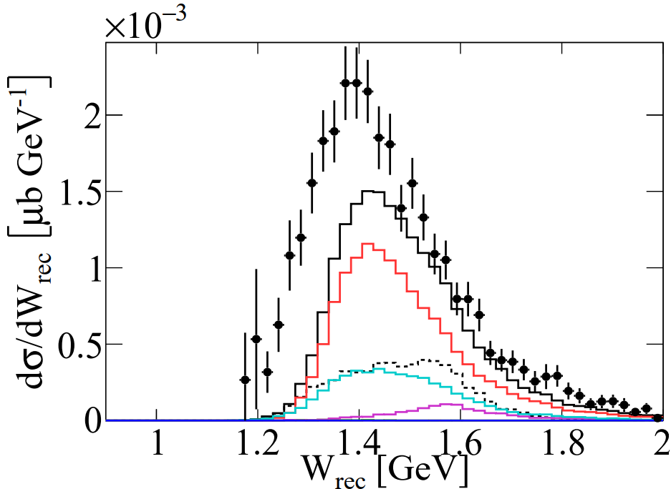
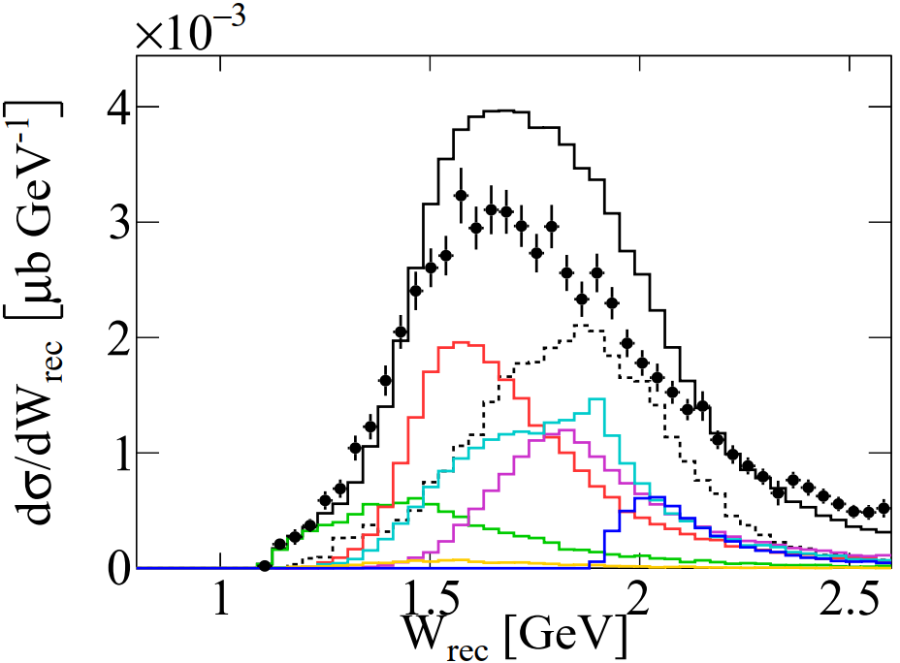




$E_{rec}>E_{e}+20\%$ Cut
Events at which reconstructed Ee is a lot higher than true Ee have a higher reconstructed W.
$$1 GeV$$
$$2 GeV$$
$$4 GeV$$
Preliminary
Preliminary
Preliminary

