Slide 1



Inclusive Electron Scattering Using the CLAS12 Detector
Matan Goldenberg
Under the guidance of Dr Adi Ashkenazi
The e4nu First Collaboration Meeting
13/3/25

Slide 2
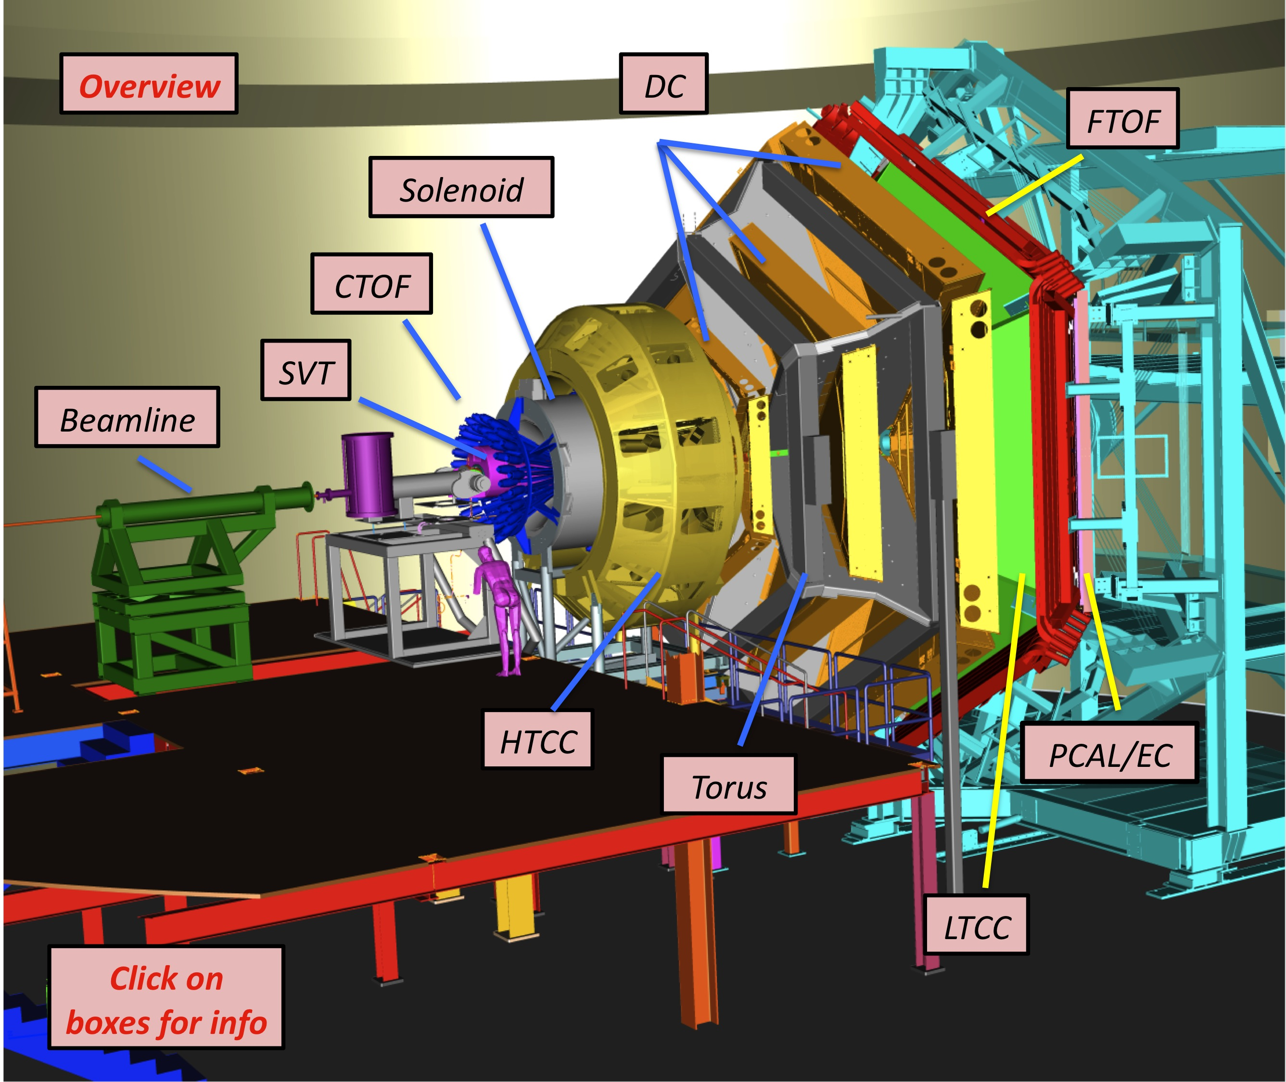
A production of new inclusive cross sections:
Data from the CLAS12 experiment
Kinematics in regions relevant for future oscillations experiments
12C & Second ever 40Ar inclusive cross section

Slide 3
Goal for today`s discussion:
Checking what is needed to be done in order to finalize the inclusive cross sections,
and have them ready for publication.

Slide 4
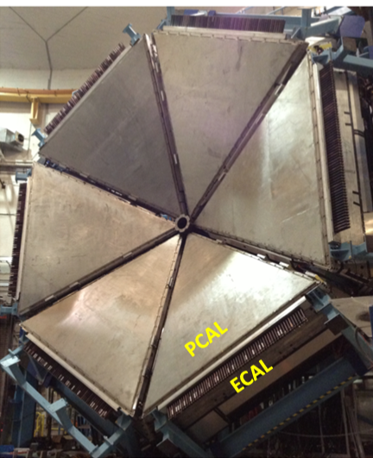
The CLAS12 experiment
Hexagonal shape
6 panels around the Beamline axis
EM Calorimeter acceptance:
Theta coverage : 5⁰ - 35⁰
Phi acceptance: 50% - 85%

Slide 5
The CLAS12 experiment
Beam Energies: 2, 4, 6 GeV
Targets:
1H, 2D, 4He, 12C, 40Ca, 48Ca, 120Sn
40Ar
Event Selection: events with 1 e⁻.

Slide 6
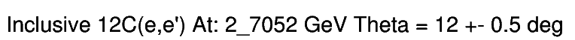
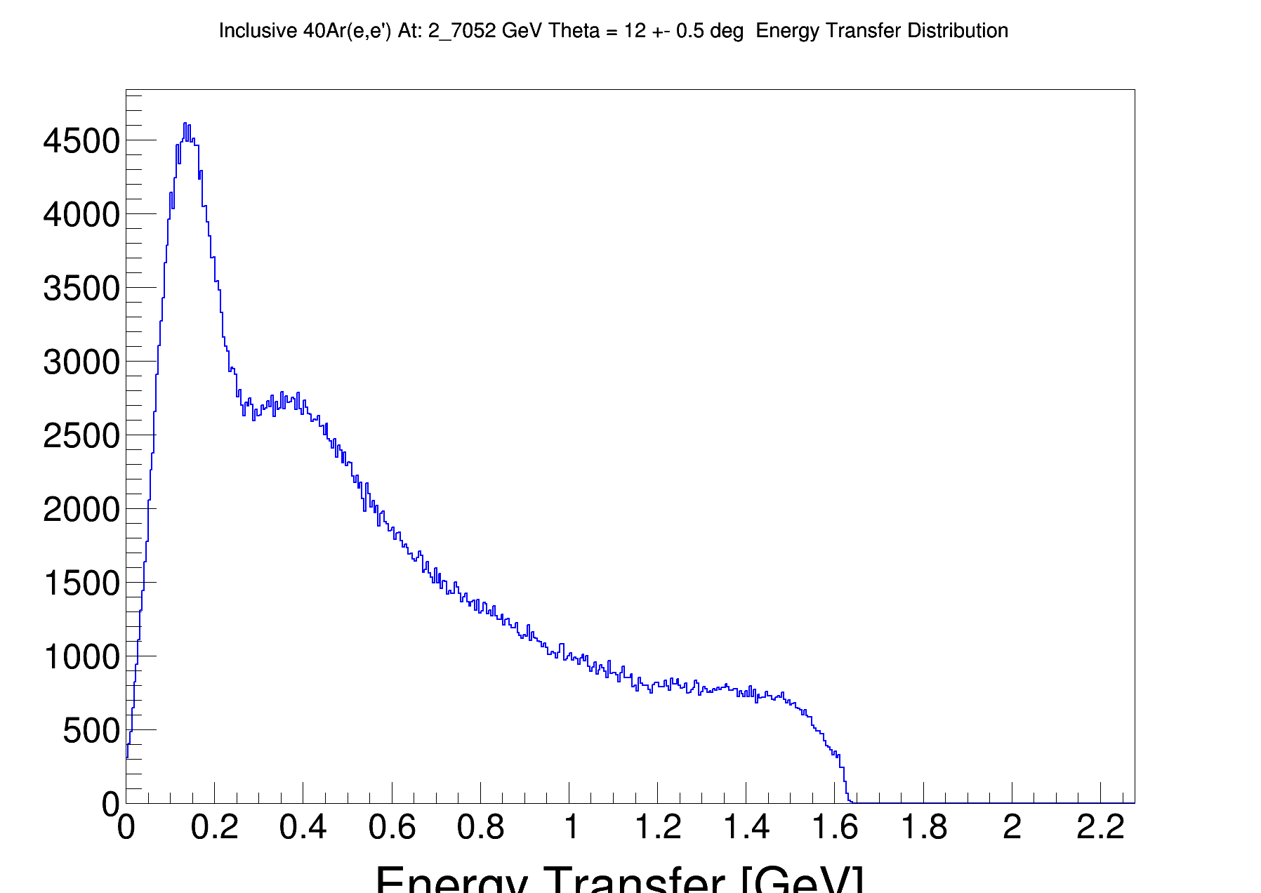
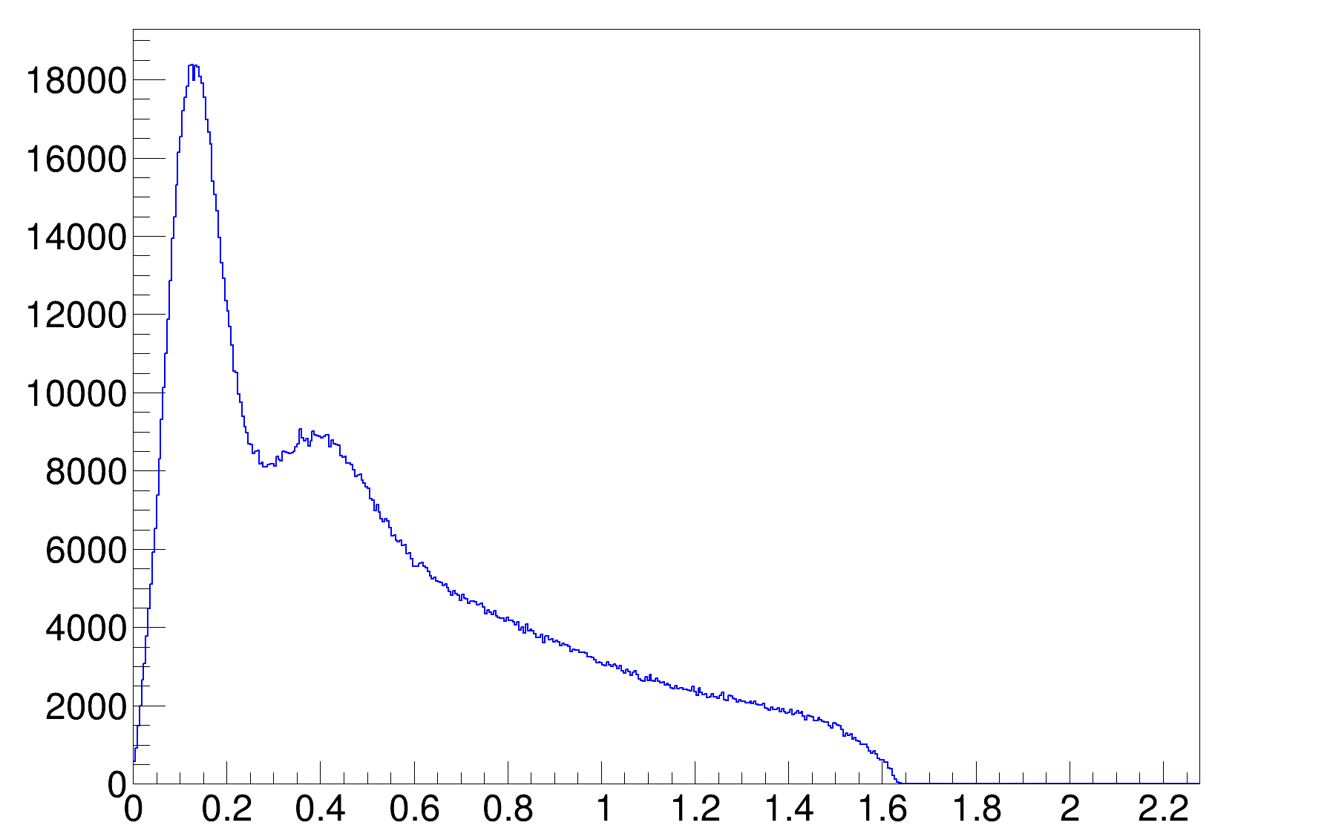
Producing the Inclusive Cross Section:
A measurement example: 2 GeV at 12⁰ for 12C & 40Ar
2.07052
2.07052
# events
# events
Energy Transfer [GeV]
Energy Transfer [GeV]

Slide 7
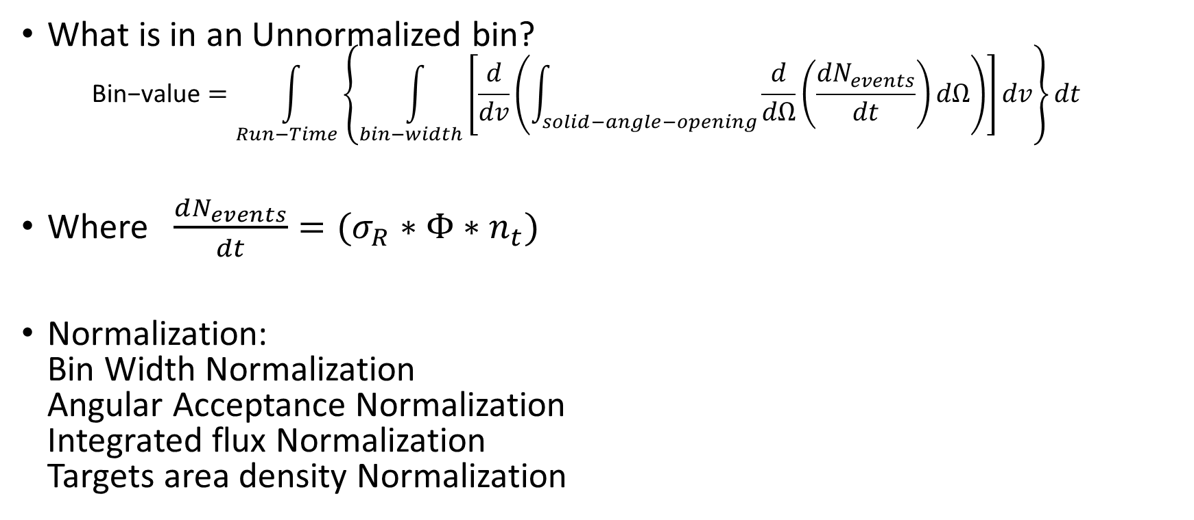
Normalization to physical units
Normalization to Cross-Section:
What is in an Unnormalized bin?
$\text{Bin}\text{−}\text{value}=\int_{Run−Time}{\left\{\int_{bin−width}{\left[\frac{d}{dv}\left(\int_{solid−angle−opening}{\frac{d}{dΩ}\left(\frac{dN_{events}}{dt}\right)}dΩ\right)\right]dv}\right\}dt }$
Where $\frac{dN_{events}}{dt}=(σ_{R}∗Φ∗n_{t})$
Normalization:
Bin Width Normalization
Angular Acceptance Normalization
Integrated flux Normalization
Targets area density Normalization

Slide 8
Accounting to acceptance
Normalization to Cross-Section:
Say N events, were supposed to be measured with perfect acceptance
How many were measured in fact?
Computed by passing a GENIE simulation through a GEMC (GEant4 Monte Carlo) simulation of the detector, and counting how many events survived.

Slide 9
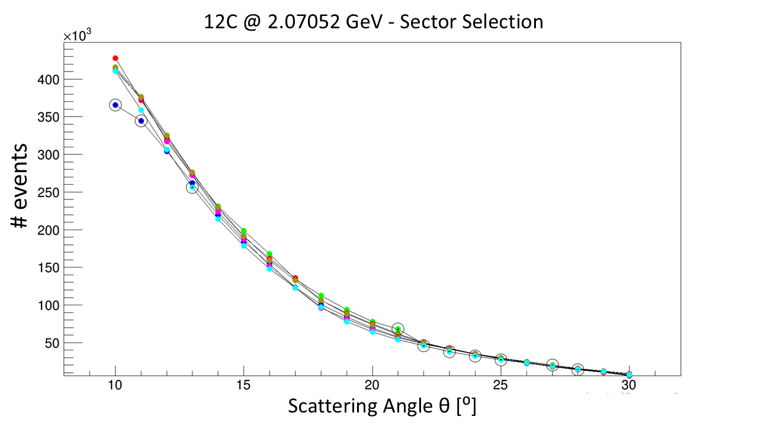
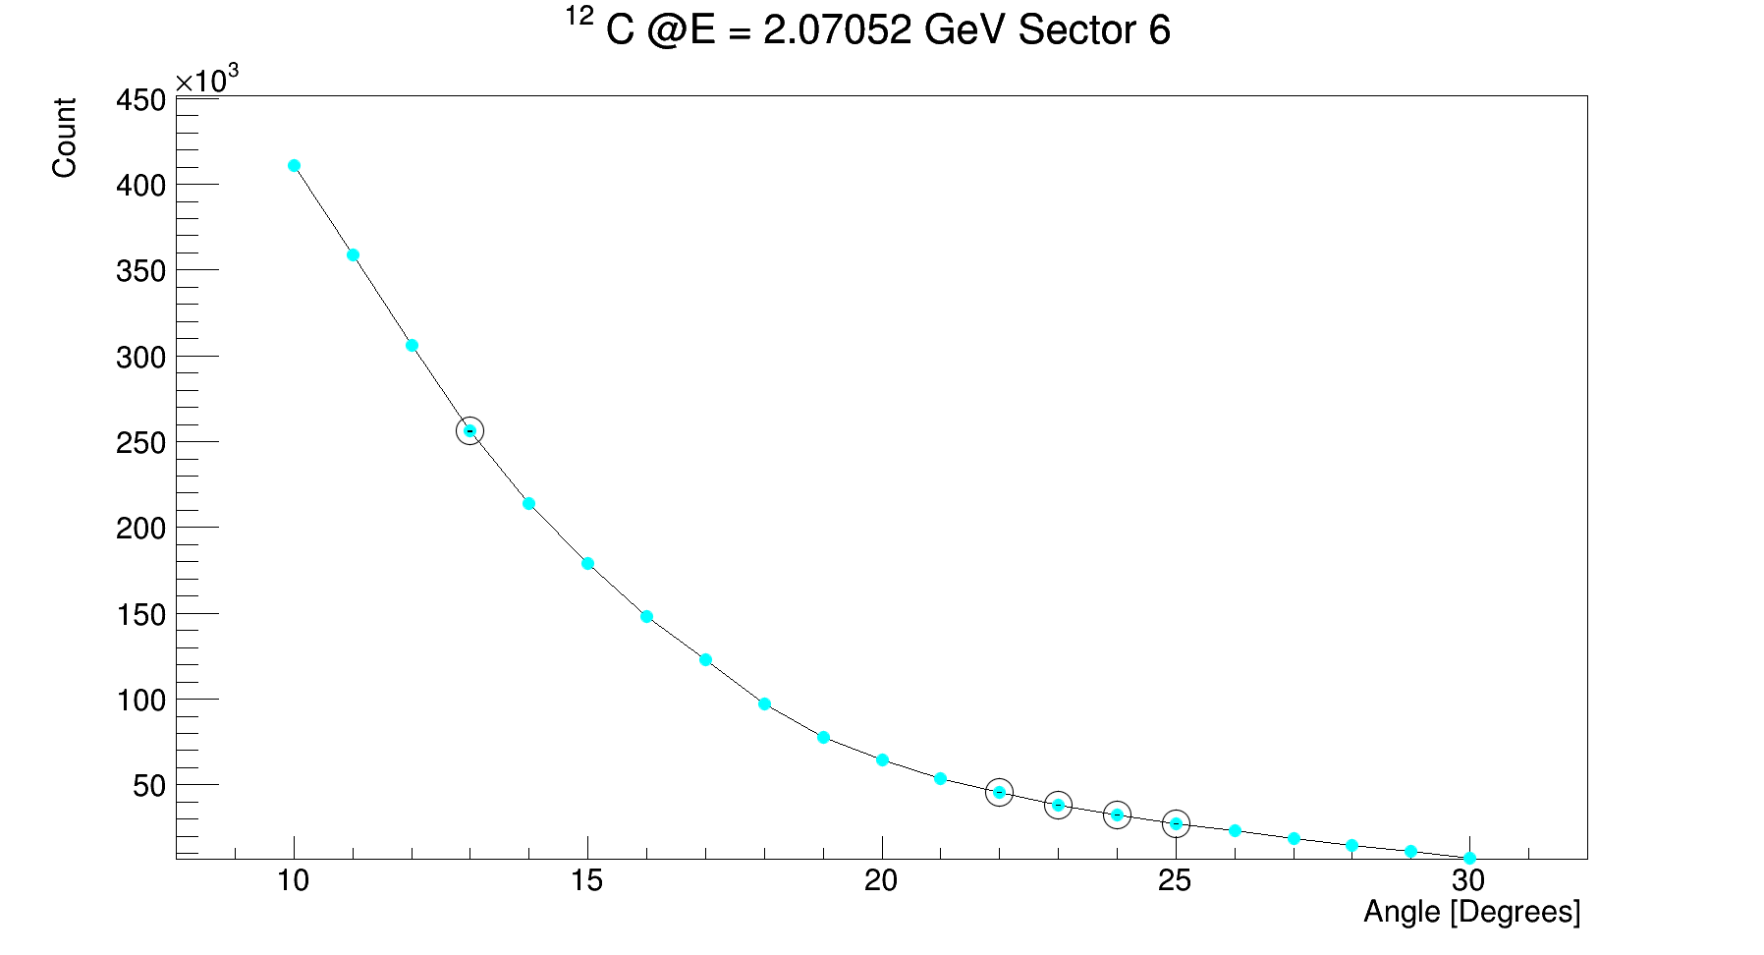
Outlier Sectors
More details
Detector is hexagonal, and can be naturally divided to 6 parts.
Despite the parts are naively equal, there might be small differences between them at certain scattering angles.
In order to avoid cross section bias, outlier sectors were not considered in the accounting for acceptance.
*Circle indicates an outlier sector

Slide 10
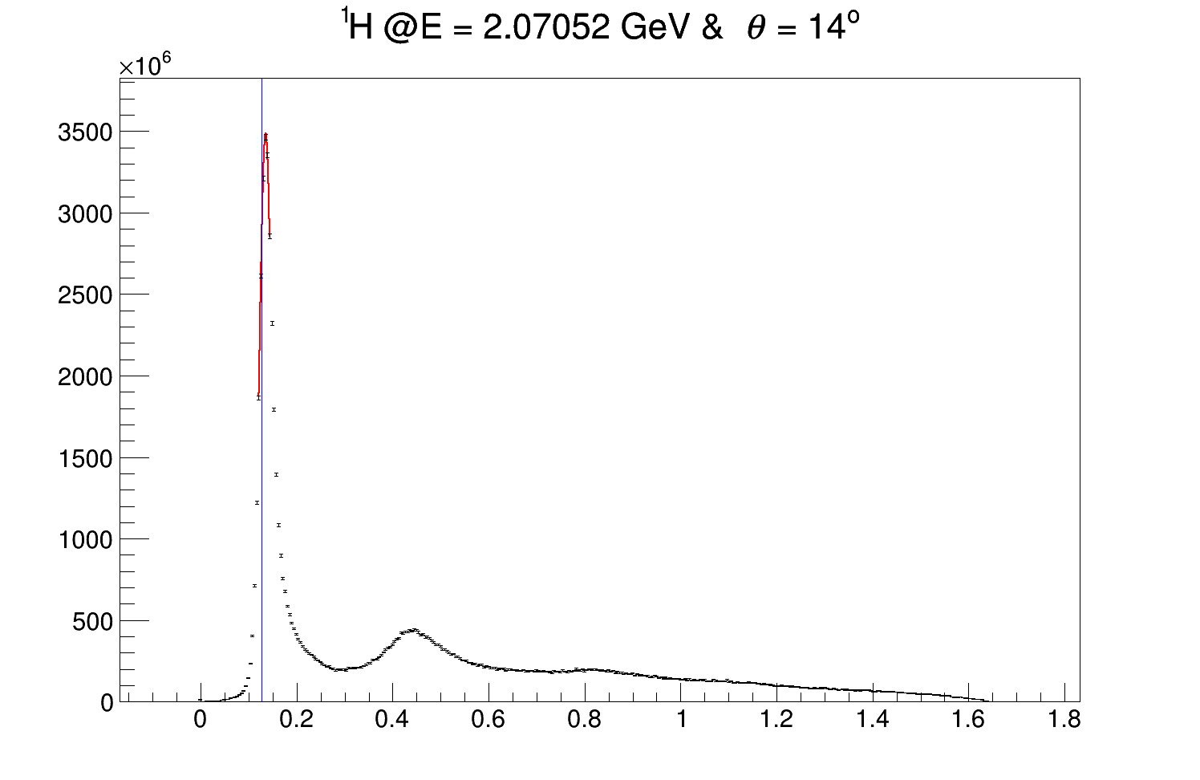
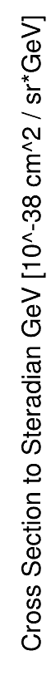
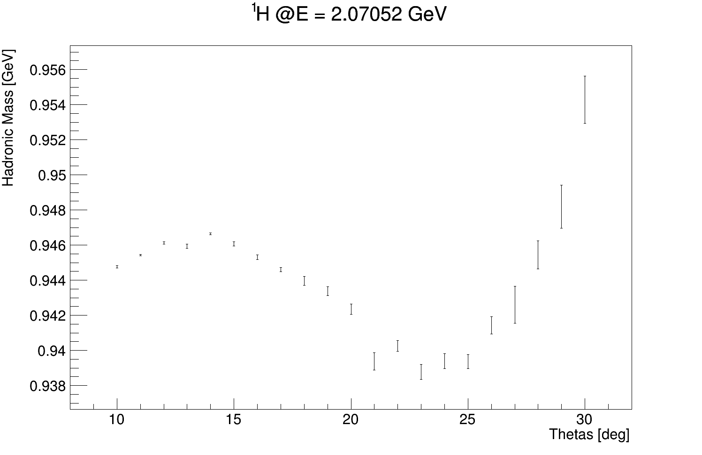
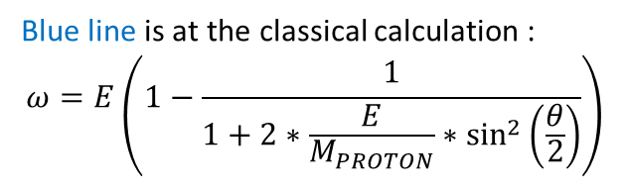
The need for a kinematical correction:
There is a miss alignment between observed e-1H elastic scattering peak location, and calculation:
More details
theta = 14±0.5⁰
Blue line is at the classical calculation :
$$ω=E\left(1−\frac{1}{1+2∗\frac{E}{M_{PROTON}}∗\sin^{2}\left(\frac{θ}{2}\right)}\right)$$
Proton Mass

Slide 11
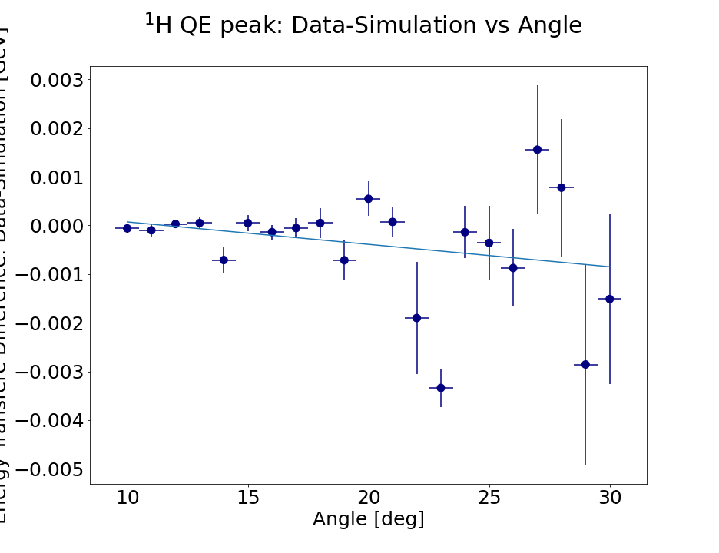
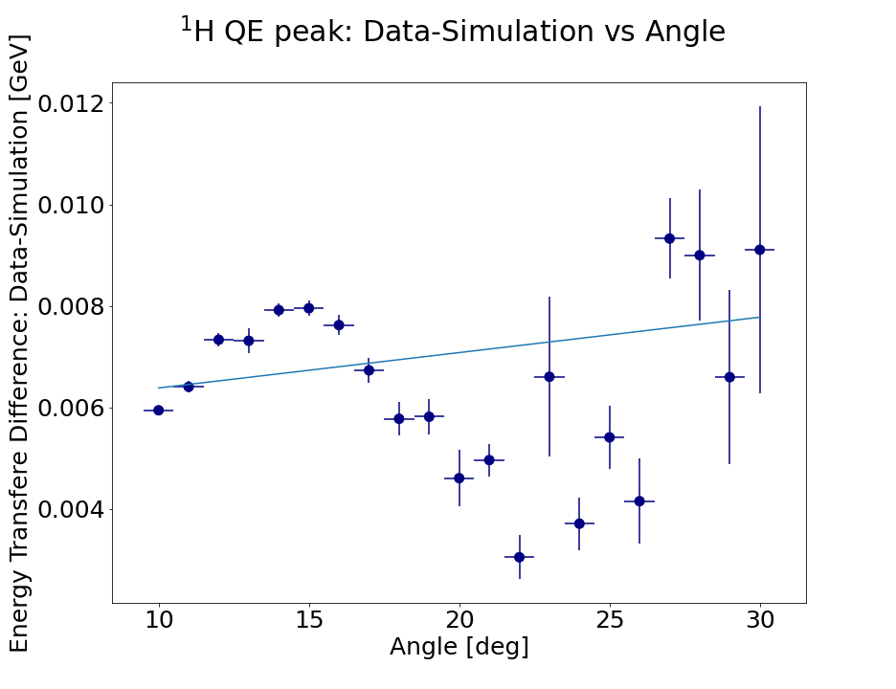
Sector 3:
Before: After:
¹H QE peak: Data-Calculation vs Angle
¹H QE peak: Data-Calculation vs Angle
Energy Transfer Difference: Data-Calculation [GeV]
Energy Transfer Difference: Data-Calculation [GeV]

Slide 12
Radiative corrections
Normalization to Cross-Section:
A simulation based correction is applied to the data on a bin-by-bin basis.
=>
MO, TSAI -RevModPhys.41.205
MO, TSAI -RevModPhys.41.205

Slide 13
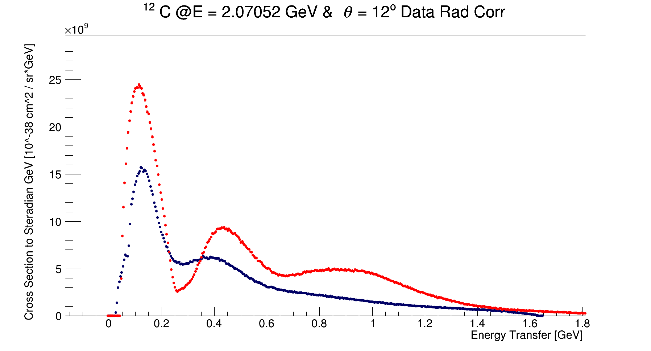
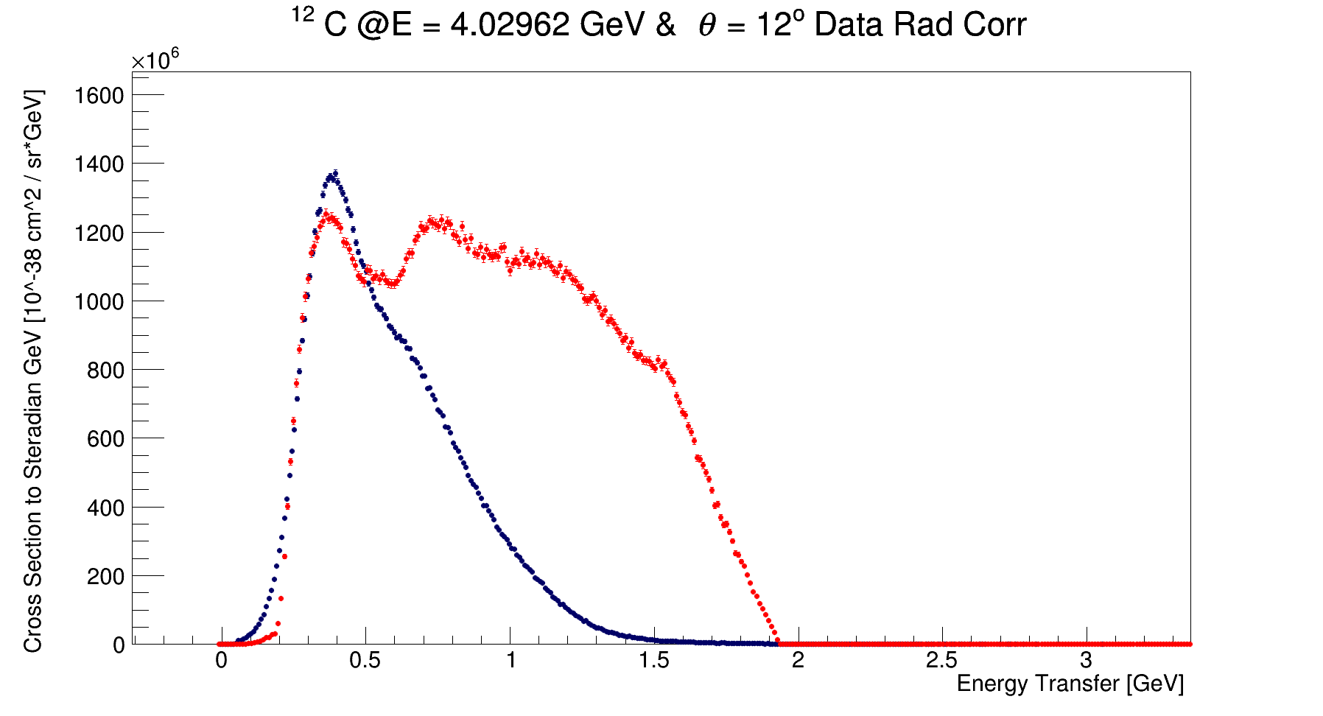
Preliminary Cross Sections Results:
2 & 4 GeV cross section of 12C at 12⁰ are compared to GENIE RFG.
There is a visible shape difference between CLAS12 data and GENIE RFG.
QE peak is well predicted.
There are still detector effects unaccounted for.
Blue – radiative corrected CLAS12
Red – GENIE RFG

Slide 14
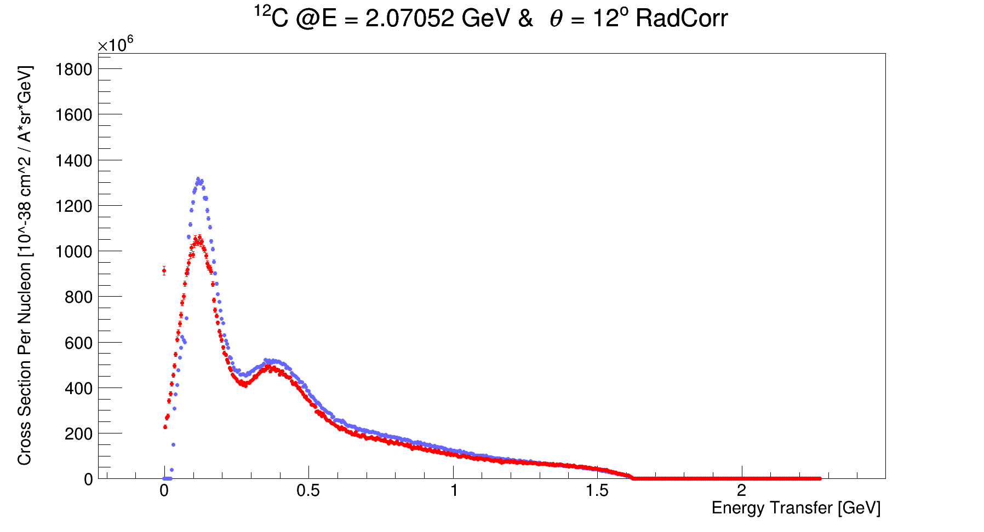
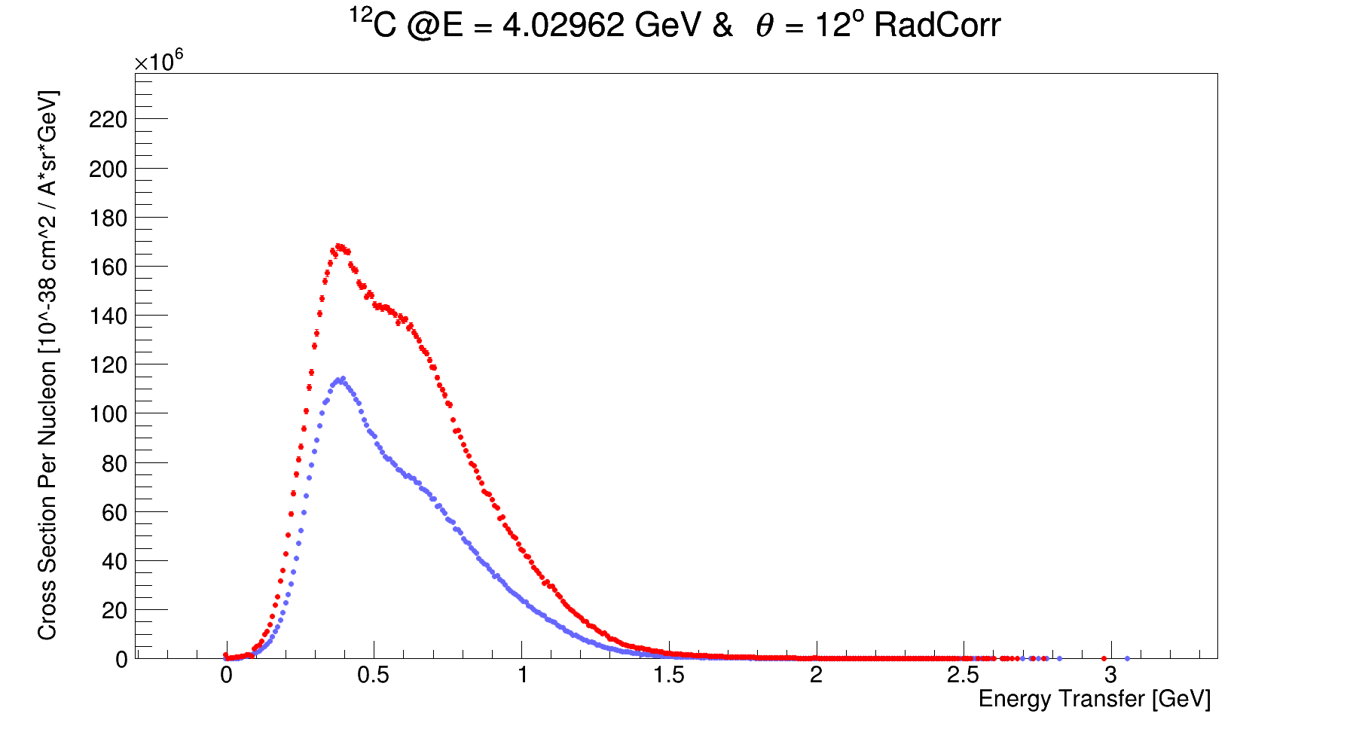
Preliminary Cross Sections Results:
12C & 40Ar per nucleon 2 & 4 GeV at 12⁰
The cross section per nucleon is not the same for 12C and 40Ar.
A valuable input for scaling models (such as GENIE SusaV2).
For example: 2 GeV at 12⁰ agreement in RES peak, non-agreement in QE peak
Blue –12C
Red – 40Ar
Both are radiative corrected

Slide 15
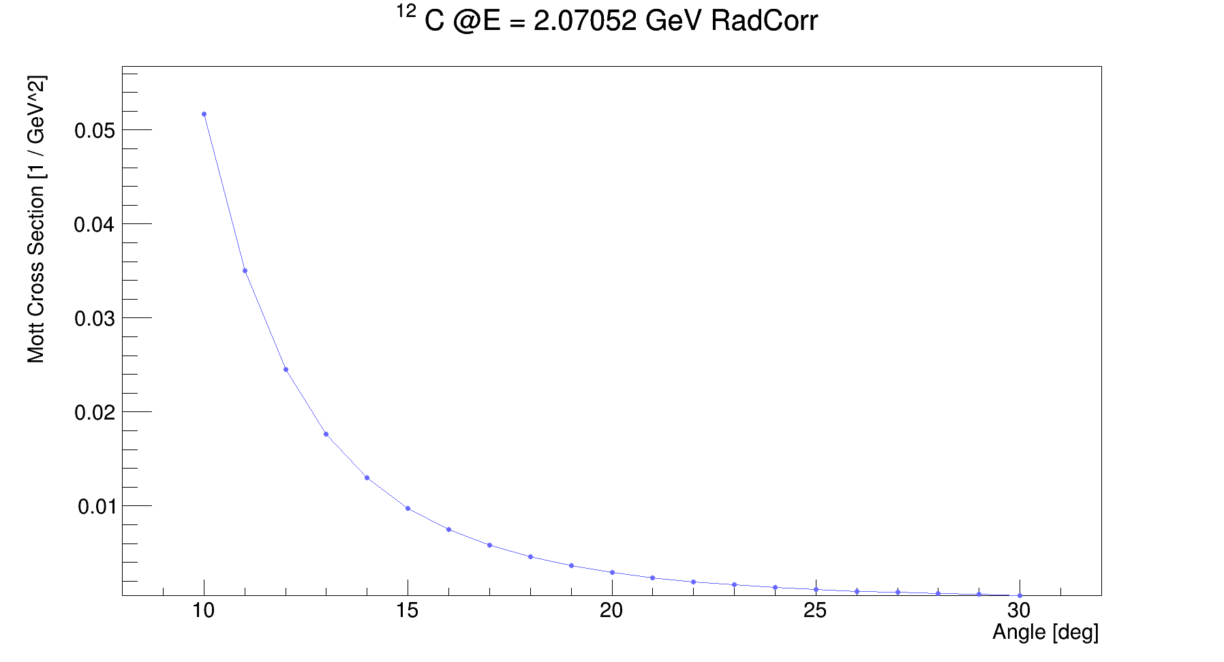
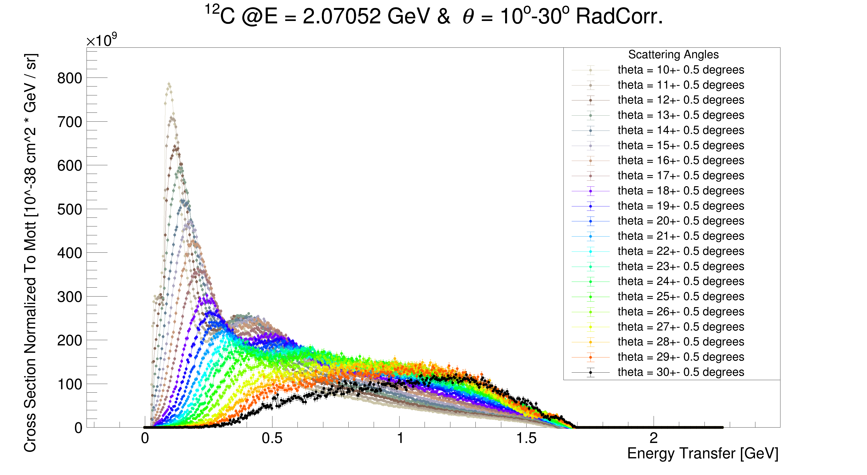
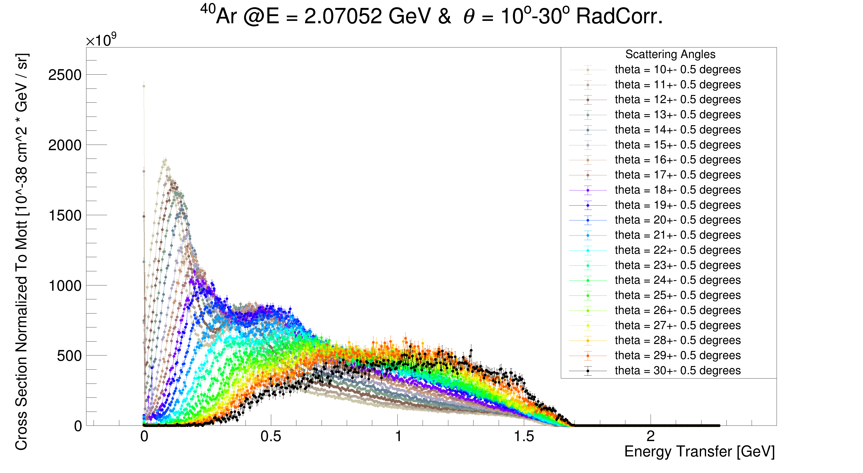
Resulting 2 GeV
Preliminary
Cross Sections
(Normalized to Mott [GeV⁻²])
Mott
10⁰
12C
40Ar
30⁰

Slide 16
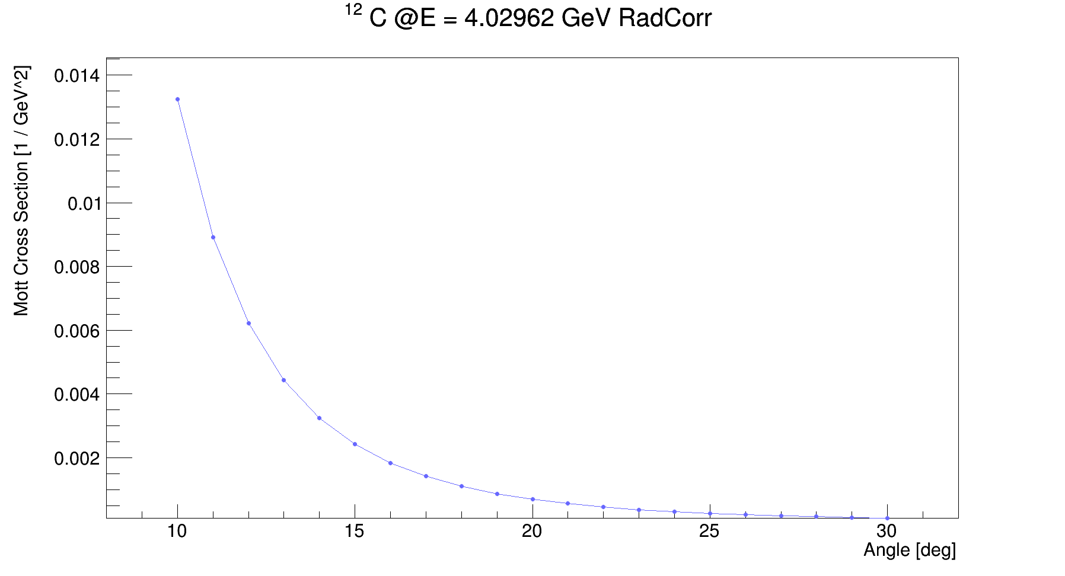
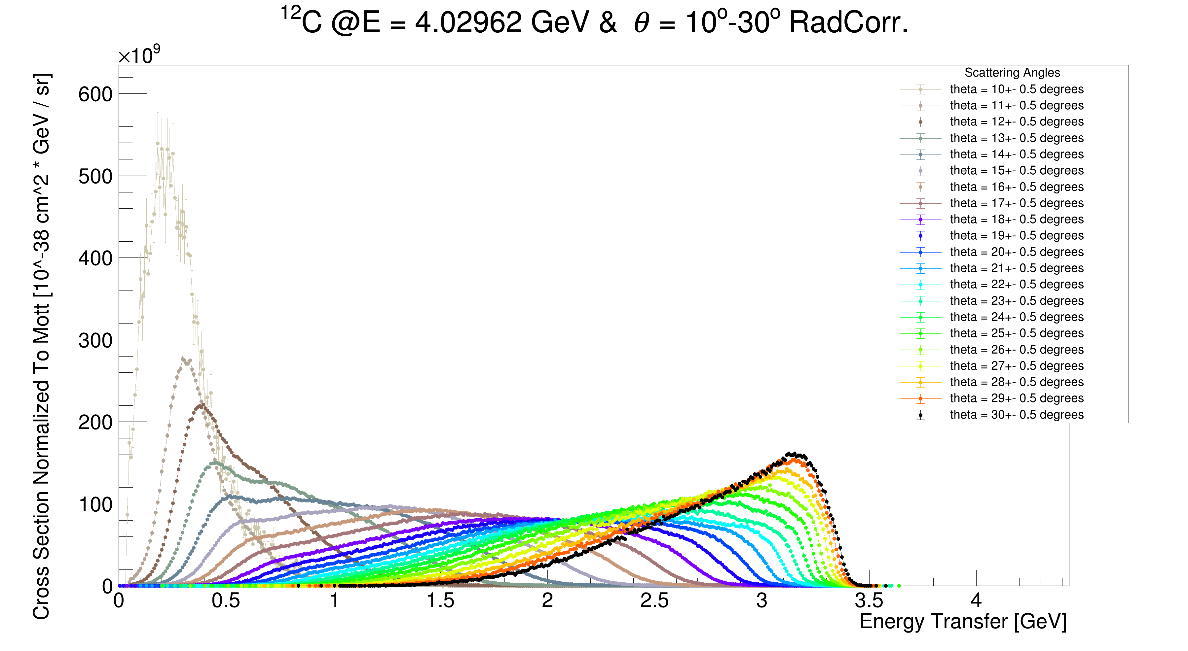
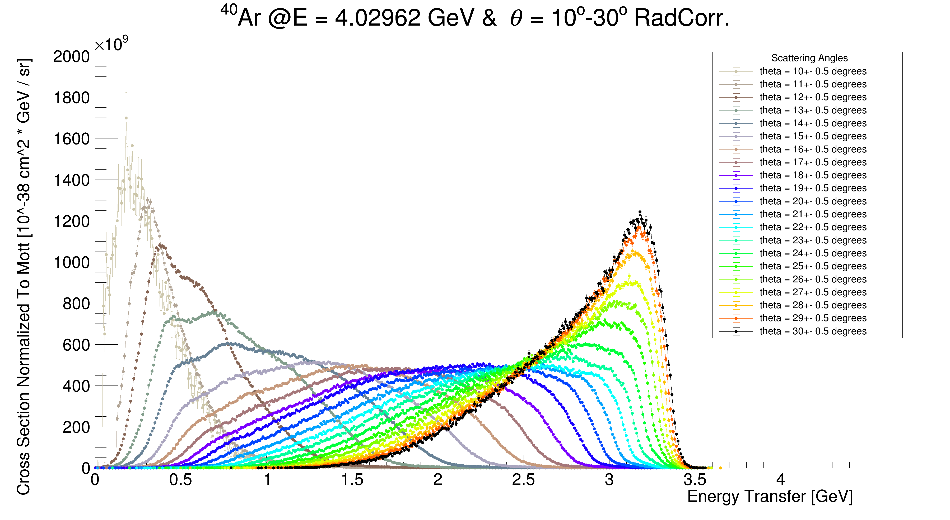
Resulting 4 GeV
Preliminary
Cross Sections
(Normalized to Mott [GeV⁻²])
Mott
12C
40Ar
10⁰
30⁰

Slide 17
Next Steps With CLAS12 Data
Correct for more systematics.
Produce 6 GeV inclusive distributions.
Use More target elements.
Finalize, and publish the cross sections.

Slide 18
Discussion points:
Momentum correction for all the distribution.
No hydrogen data in 4 GeV.
Integer angles is an arbitrary choice. Maybe something better?
Do we want 1H cross sections?
Robust estimation of cross section uncertainty.
What more is needed?
Thank You!

Slide 19
Thank You

Slide 20
A Binding Energy Study
Using Inclusive Electron Scattering
Matan Goldenberg
Under the guidance of Dr Adi Ashkenazi
The e4nu First Collaboration Meeting
14/3/25

Slide 21
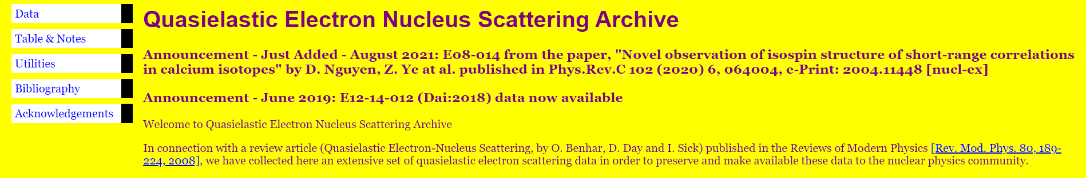
QE peak difference between Data and Simulation
1) A tuning study:
GENIE parameter of interest:
nucleon binding energy in GENIE RFG and LFG models
Find the observed QE peak’s location in energy transfer distributions, in 12C data and in simulation.
Compare their differences to kinematical variables (mainly, the 3D momentum transfer at QE peak).

Slide 22
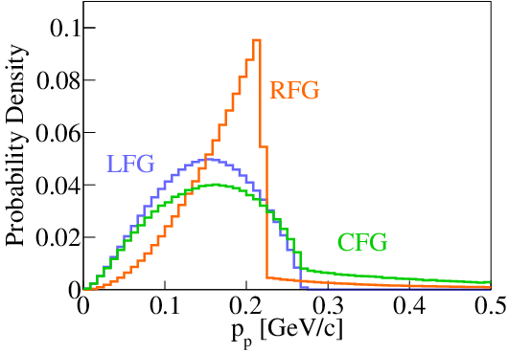
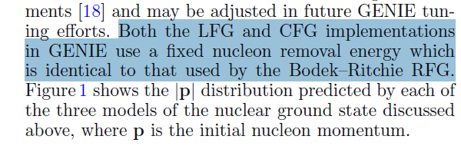
Nuclear Models Used in GENIE
Eur. Phys. J. Spec. Top. 230, 4449–4467 (2021)
Relativistic Fermi Gas Model (RFG):
Binding Energy = A constant value.
Local Fermi Gas Model (LFG):
Binding Energy = Same as RFG.
Nucleon’s momentum distribution is dependent on the nucleon’s location.

Slide 23
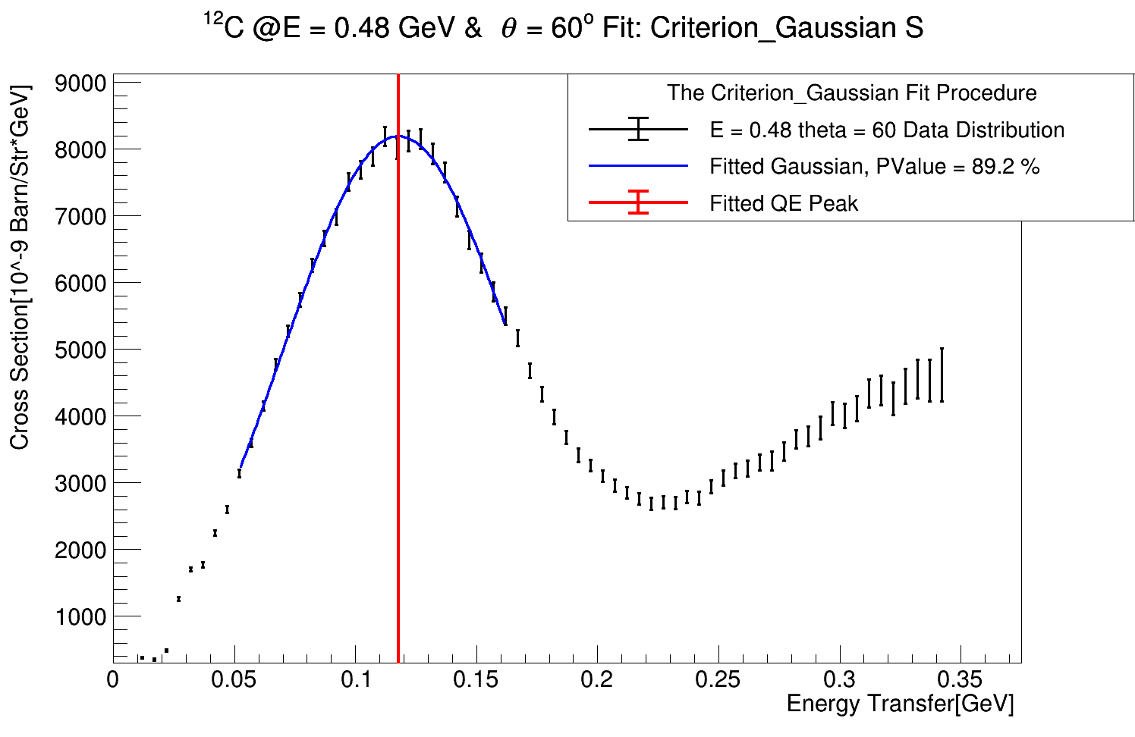
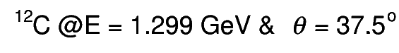
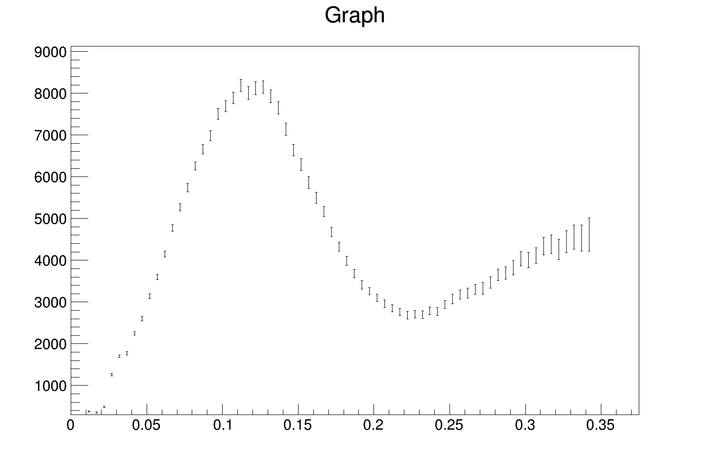
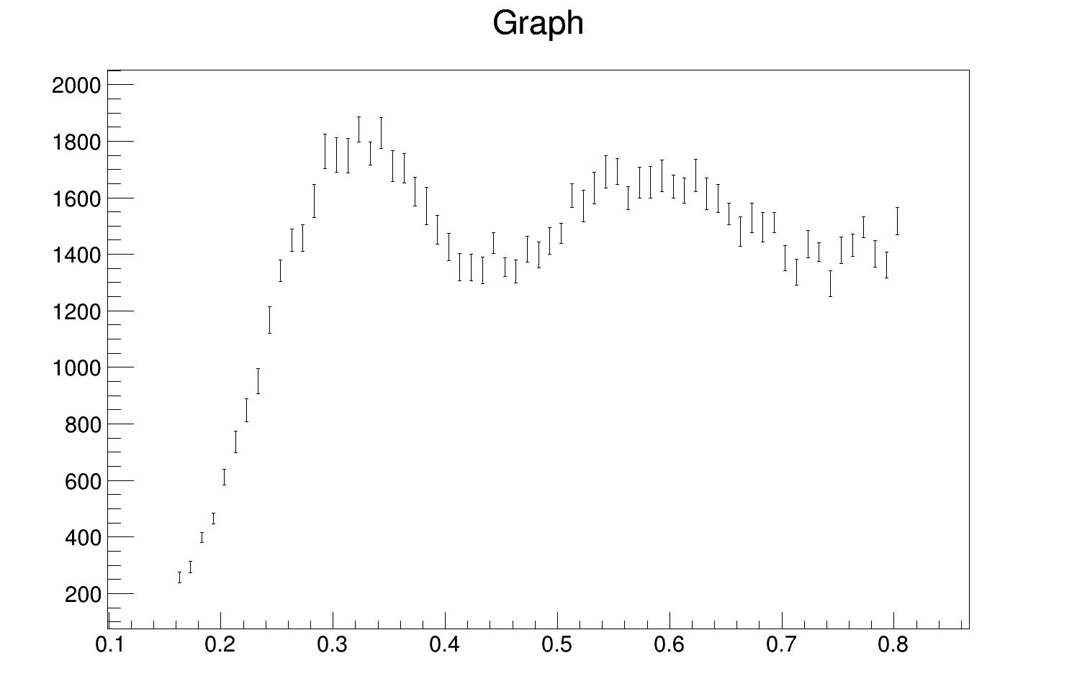
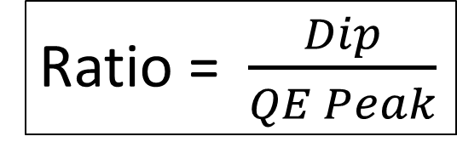
The Dip to QE Peak Ratio
Ratio = $\frac{Dip}{QE Peak}$
A qualitative way to label the different data distributions:
The higher the ratio is, the more non-QE processes are present at the QE peak region, thus effectively shifting the peak!
SLAC
Data
Saclay
Data
QE
QE
Dip
Dip to QE peak ratio = 33%
Dip to QE peak ratio = 73%
Dip

Slide 24
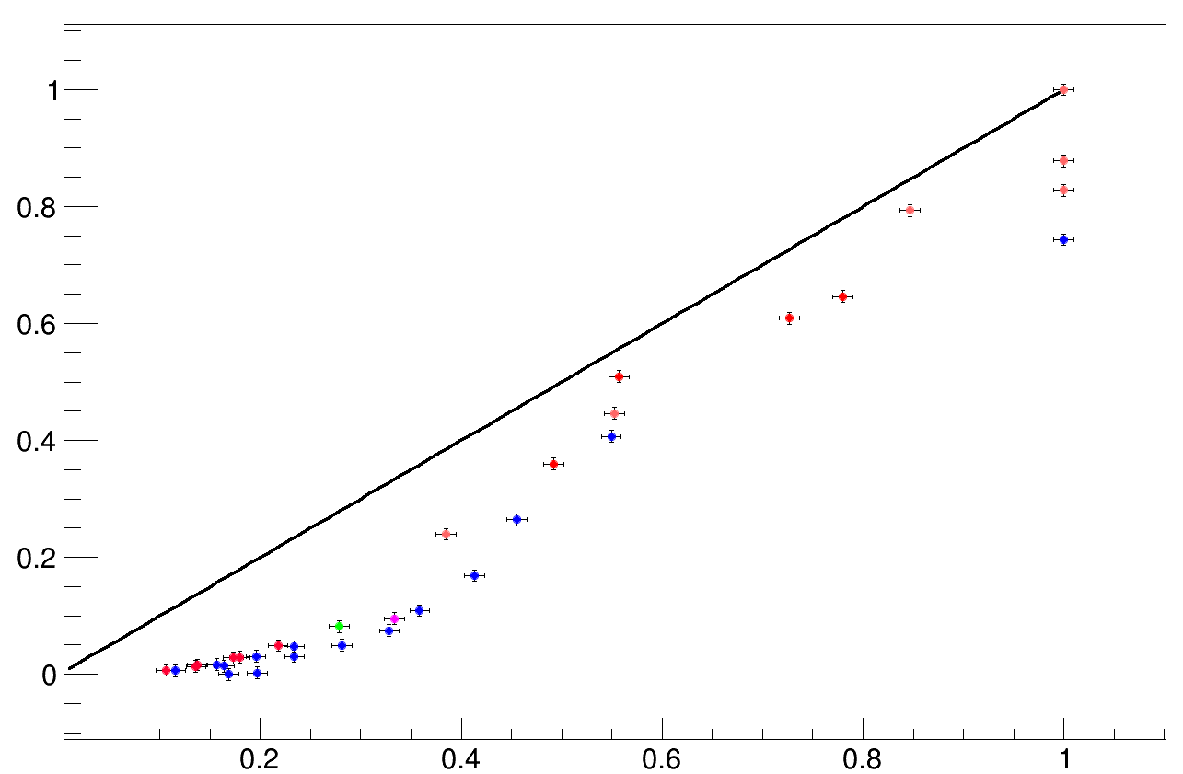
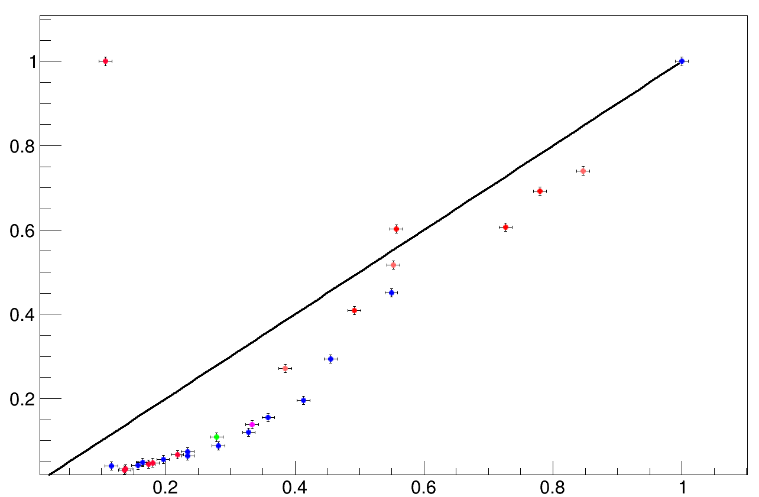

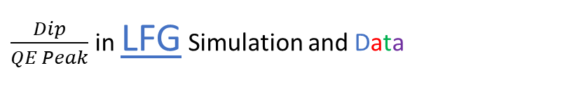


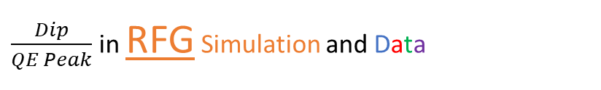

The Dip to QE Peak Ratio
Ratio = $\frac{Dip}{QE Peak}$
A qualitative way to label the different data distributions
A demonstration of the shape difference between data and simulation
$\frac{Dip}{QE Peak}$ in LFG Simulation and Data
$\frac{Dip}{QE Peak}$ in RFG Simulation and Data
$\frac{Dip}{QE Peak}$ in Simulation [1]
$\frac{Dip}{QE Peak}$ in Simulation [1]
*Black line is y=x
$\frac{Dip}{QE Peak}$ in Data [1]
$\frac{Dip}{QE Peak}$ in Data [1]

Slide 25
Results

Slide 26
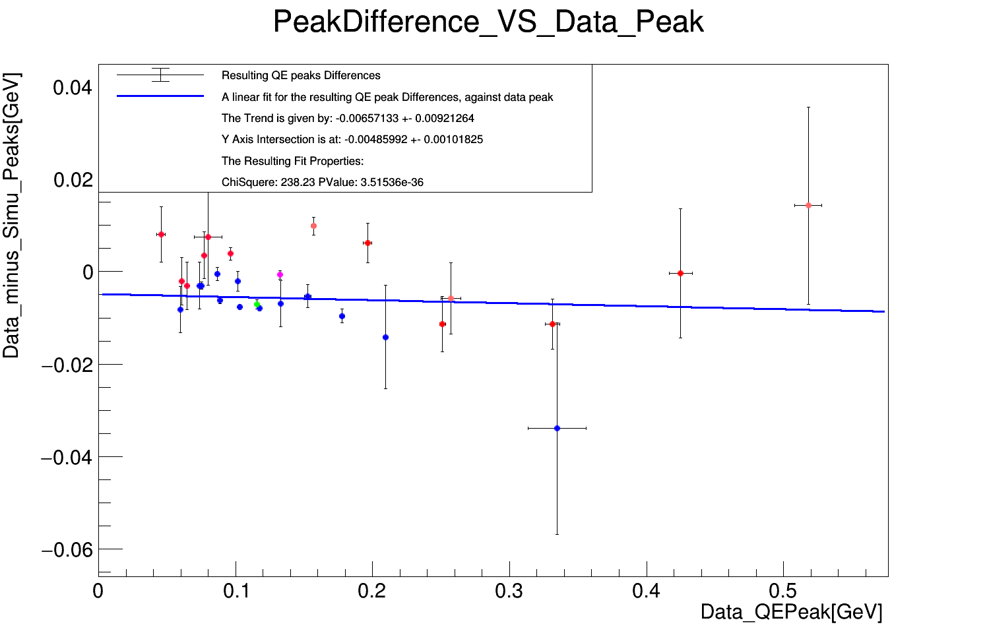
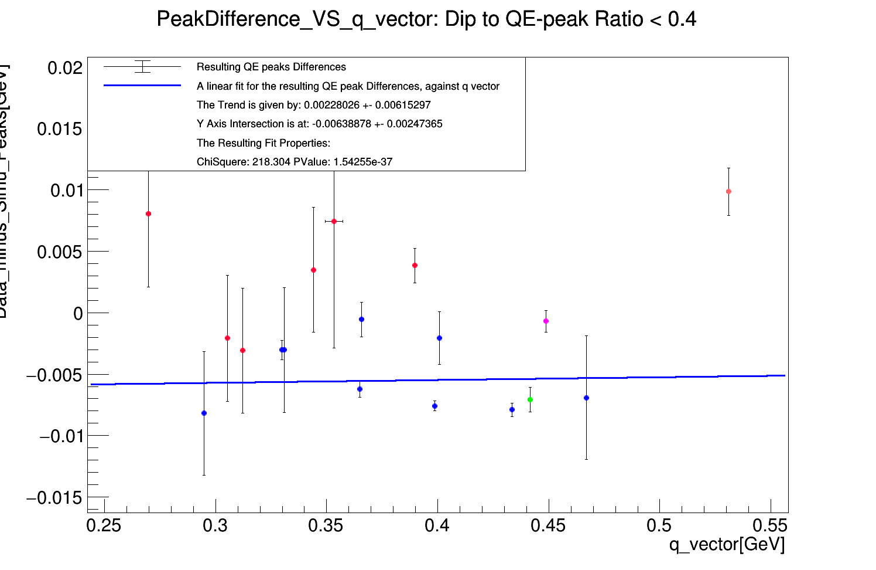

Results - GENIE RFG
$$\frac{Dip}{QE Peak}<0.4$$
Data to Simulation
QE peak location difference
against the 3D momentum transfer.
Results were checked for different cuts on the Dip to QE peak ratio.
Blue line is a linear fit
Data is color coded by source.

Slide 27
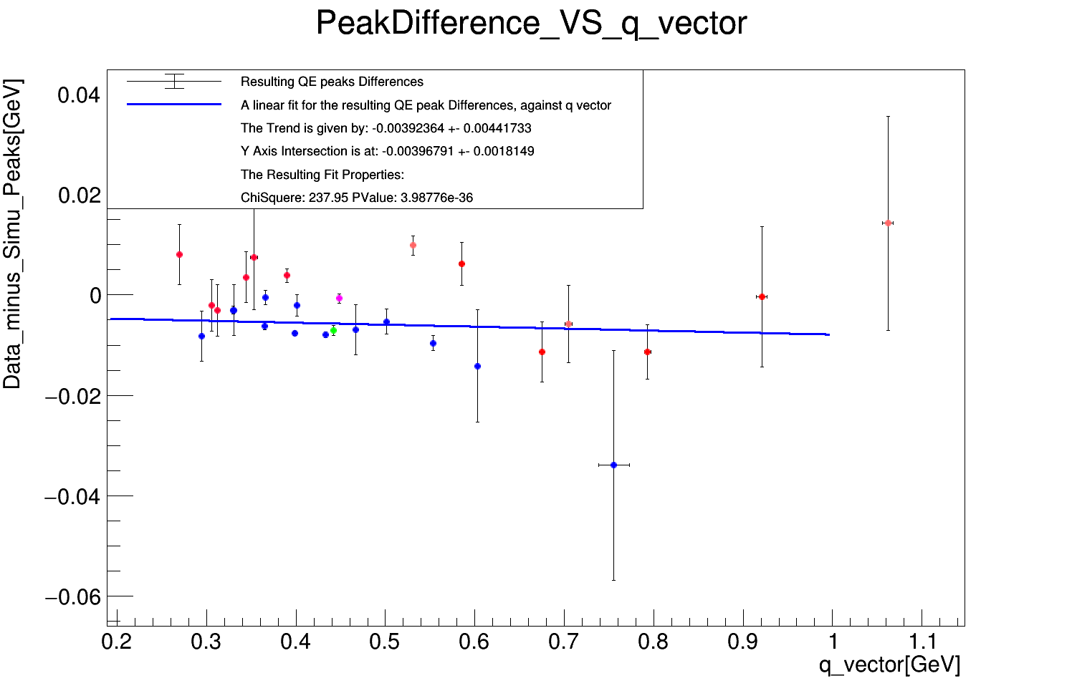


Results - GENIE RFG - Fitted trends are flat!
Indicating that GENIE RFG does not require tuning!
$\frac{Dip}{QE Peak}$ < 0.4
NO $\frac{Dip}{QE Peak}$ cut

Slide 28
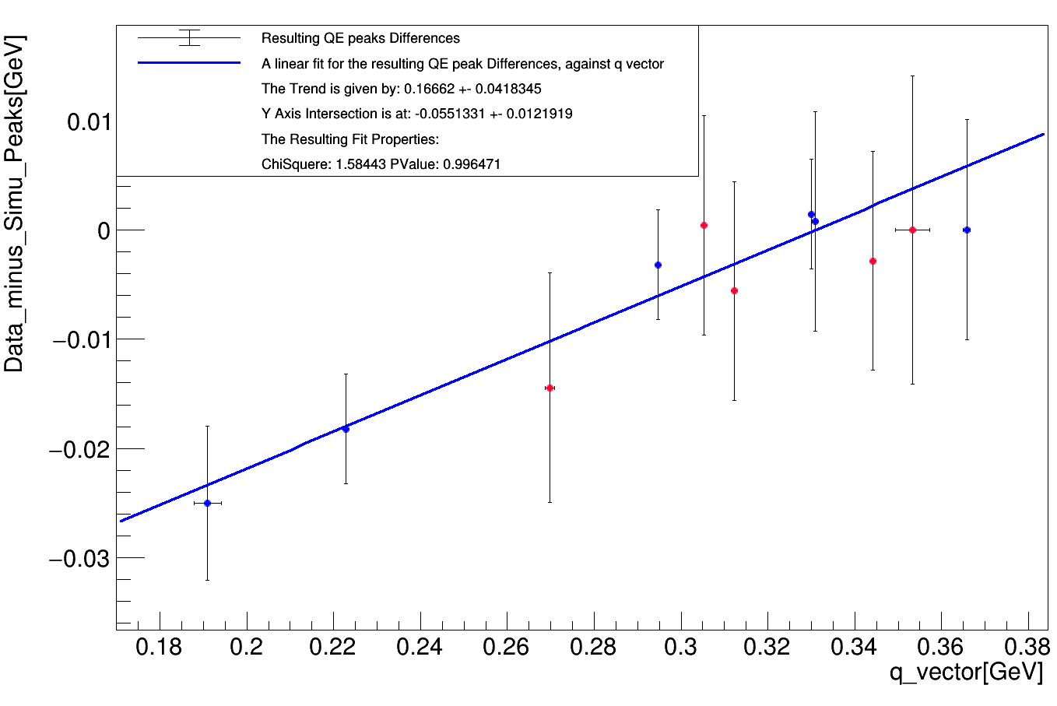
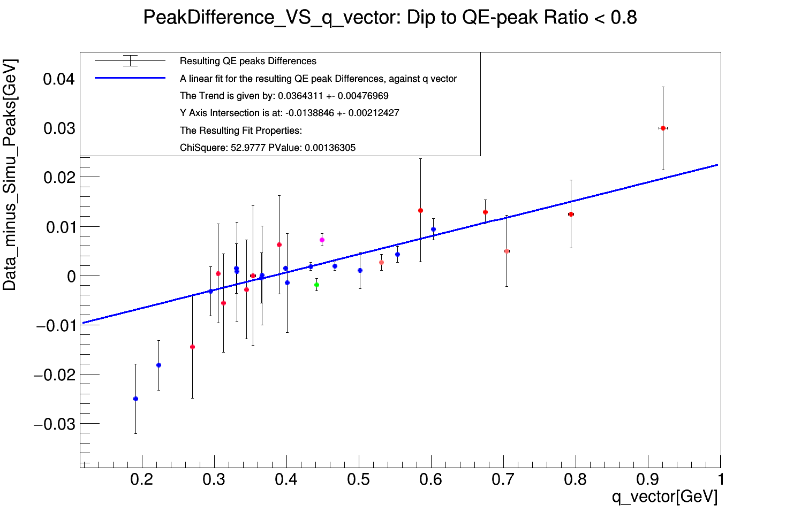
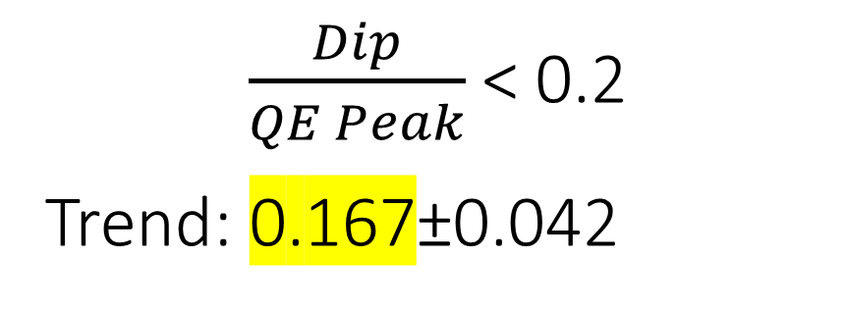
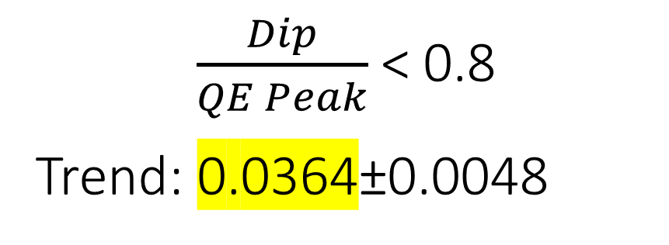
Results - GENIE LFG - Fitted trends are NOT flat!
Right plot can be used to tune the LFG model!
$\frac{Dip}{QE Peak}$ < 0.2
Trend: 0.167±0.042
$\frac{Dip}{QE Peak}$ < 0.8
Trend: 0.0364±0.0048
Clear trend!
Outliers?

Slide 29
1) A tuning study: Results summary
No need for correction in GENIE RFG.
A 3D momentum transfer correction could be made for the
nucleon binding energy in the GENIE LFG model, based on the presented fit.
These results are empirical, thus MEC & RES dependent.
Observed shape differences between data and simulation:
Dip to QE peak ratio
QE peak width (backup)
  GENIE RFG-> too wide
  GENIE LFG-> too narrow.
Are inputs for future tuning efforts!

Slide 30
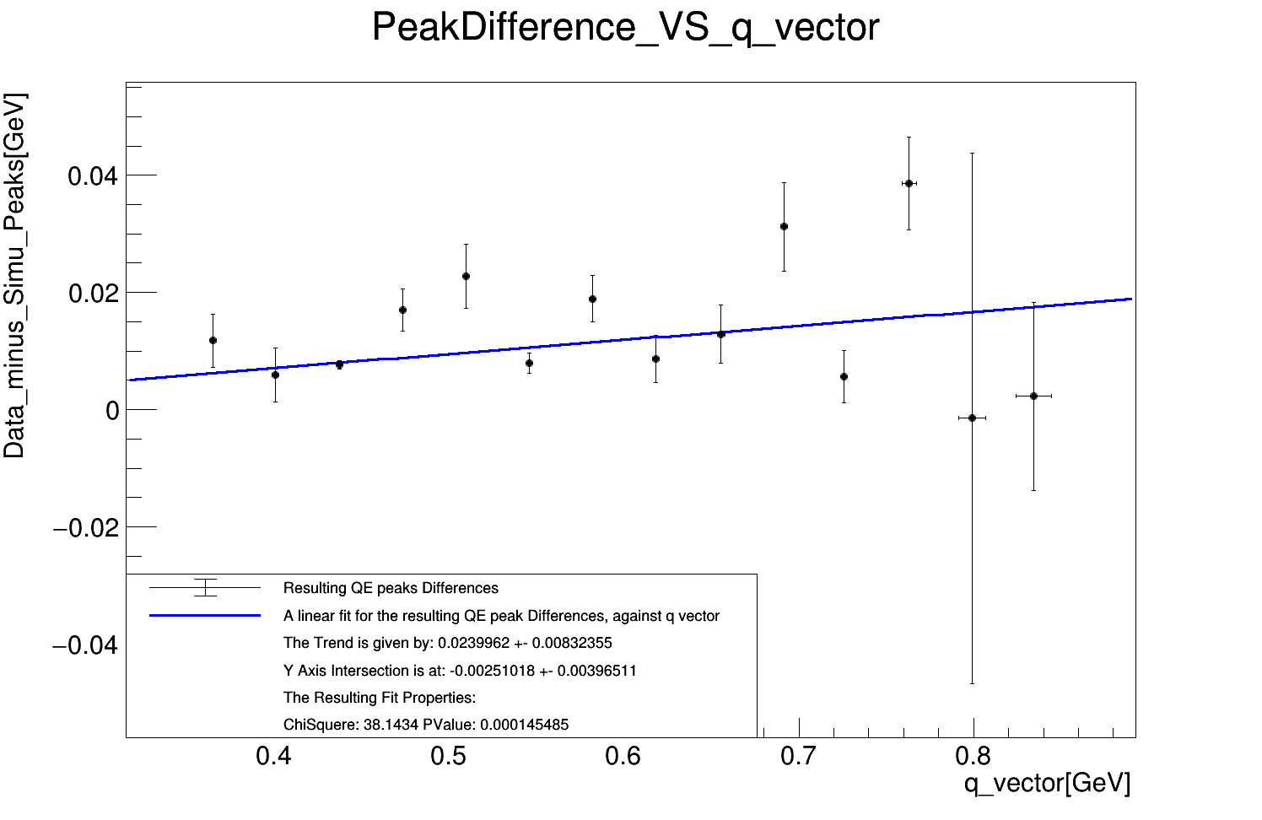
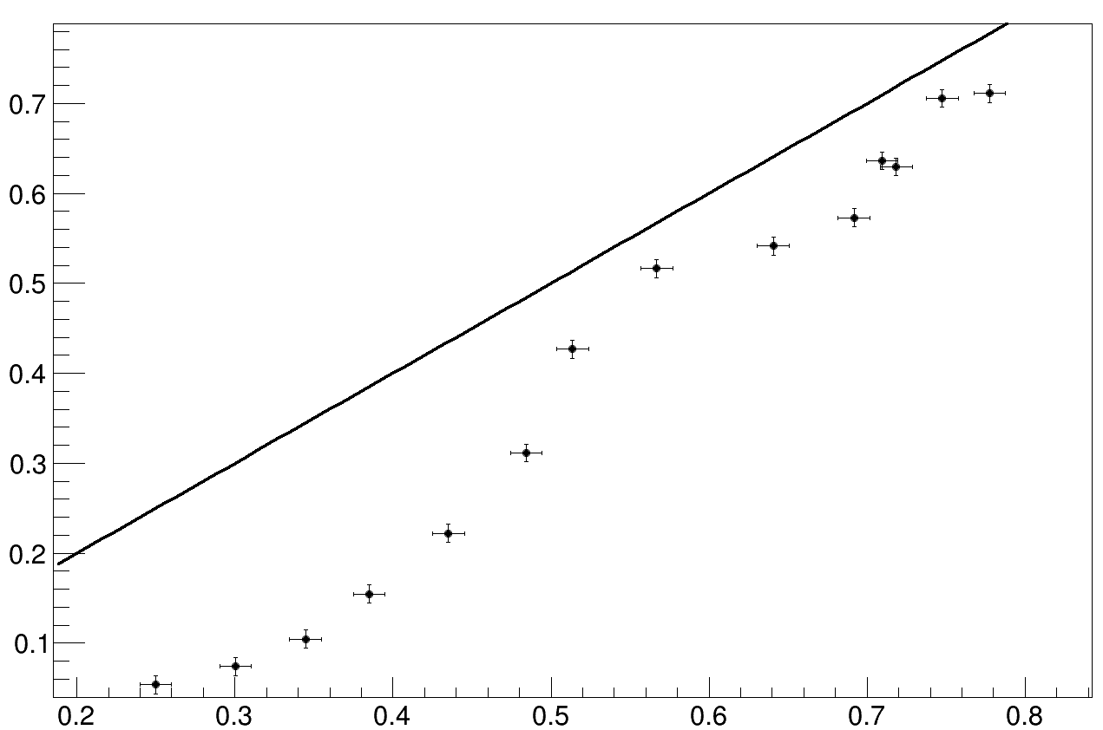


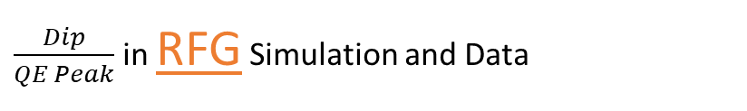
CLAS12 data and GENIE RFG – Return to part 1:
We have now new inclusive 12C distributions at 2 GeV!
QE peaks compered:
No clear indication for a need to tune.
Consistent with the result seen for historical data distributions.
$\frac{Dip}{QE Peak}$ in RFG Simulation and Data
$\frac{Dip}{QE Peak}$ in Simulation [1]
*Black line is y=x
$\frac{Dip}{QE Peak}$ in Data [1]

Slide 31
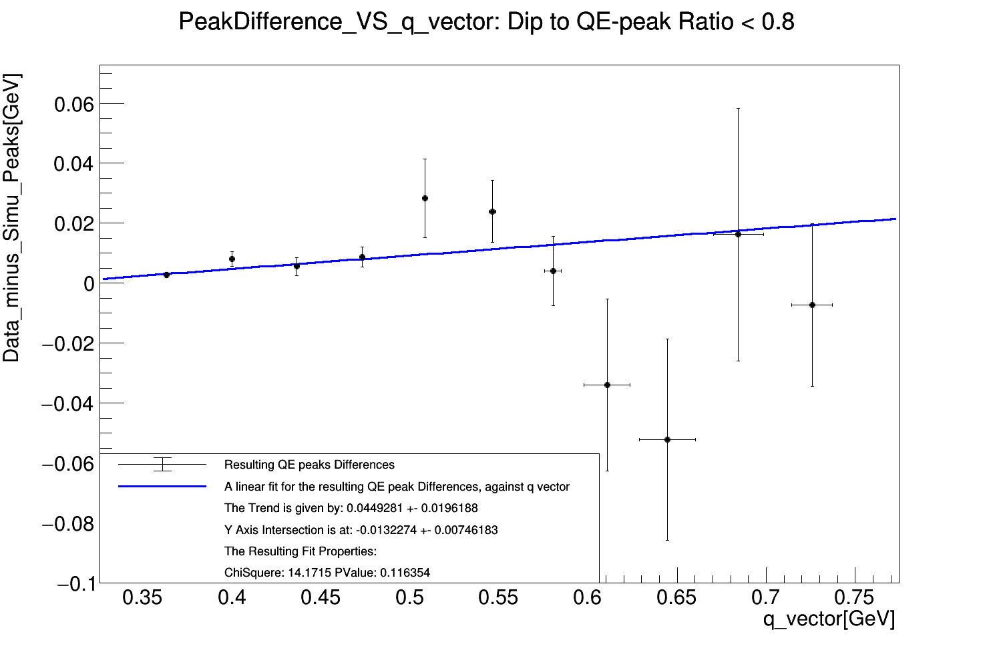
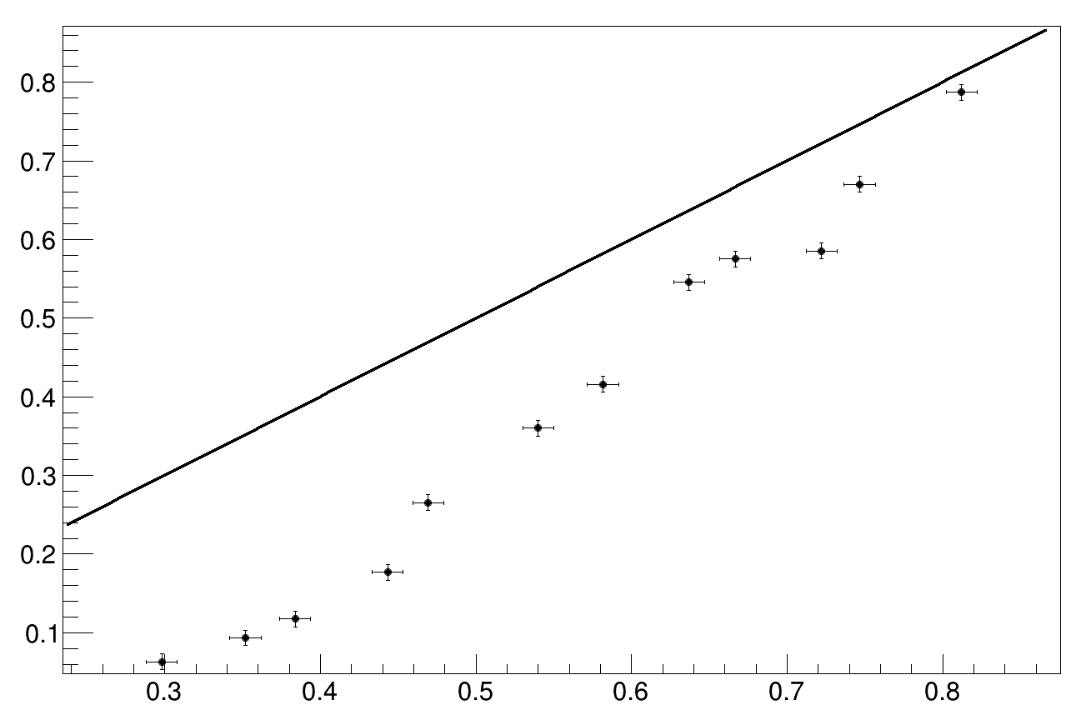
CLAS12 data and GENIE RFG – Return to part 1:
We have now new inclusive 40Ar distributions at 2 GeV!
Similar to 12C, No clear indication for a need to tune.
Some uncertainties are too large to make a determination.
$\frac{Dip}{QE Peak}$ in RFG Simulation and Data
$\frac{Dip}{QE Peak}$ in Simulation [1]
*Black line is y=x
$\frac{Dip}{QE Peak}$ in Data [1]

Slide 32
Thank You

Slide 33
Back up I
0. Full Motivation
1. Verifying the original properties of the different experiments
2. A shape difference – the Data & Simulation QE widths (FWHM)
3. Data Selection
4. The Dip to QE Peak Ratio
5. The Fitting Procedure
6. The Path to a Robust Fitting Procedure
7. RFG and LFG – additional results
Slide Ratio
Slide CLAS12
Slide Mott
Presentation Beginning
Slide HD Results
Slide Normalization
Slide conclusion

Slide 34
Back up II
8. The CLAS12 detector & Electron Identification
9. Normalization to physical units
10. Accounting to acceptance (avoiding Outlier Sectors)
11. Radiative corrections
12. Momentum correction for the 2 GeV case
13. Cross Sections: 2 GeV examples

Slide 35
0
Full Motivation

Slide 36
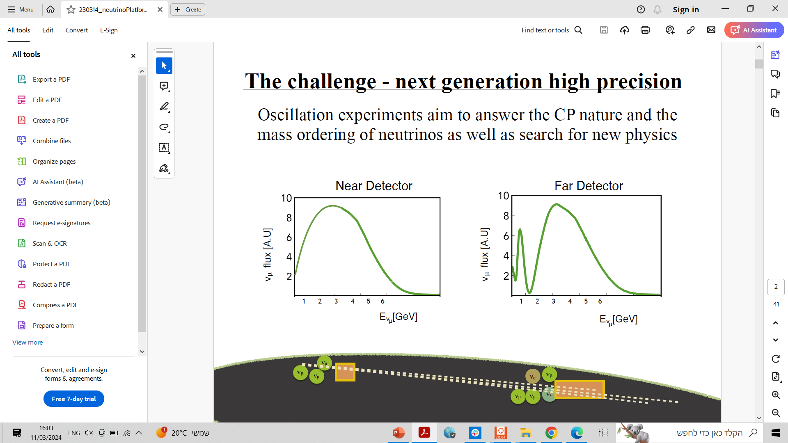

Motivation:
The Big Goal
Measuring neutrino oscillation parameters!
Wide Spread!

Slide 37
Motivation:
The Big Goal
Very Challenging!
Requires an event generator!
(Which use many models with many parameters!)
Problem: Data is not always sufficient for all needs!
Measuring neutrino oscillation parameters!
Wide Spread!

Slide 38

Solution: use electron-nucleus scattering data as well!
So Why Electrons?
Same target – the atomic nucleus
Similar vector part of interaction
Mono-chromatic beams – Easier!
High statistics
Abundant historical measurements!
E4nu - PhysRevD.103.113003
Initial
Final
Initial
Final

Slide 39
Lepton Nucleus
Interaction Mechanisms
When a lepton hits the nucleus, one of the following 4 processes
can take place:
QE
MEC
RES
DIS
Electron-nucleus scattering cross section mechanisms
dσ/(dE dΩ)

Slide 40

Lepton Nucleus
Interaction Mechanisms
When a lepton hits the nucleus, one of the following 4 processes
can take place:
QE – One nucleon is emitted from the nucleus
MEC
RES
DIS

Slide 41
Lepton Nucleus
Interaction Mechanisms
When a lepton hits the nucleus, one of the following 4 processes
can take place:
QE
MEC – Two nucleons are emitted
RES
DIS

Slide 42
Lepton Nucleus
Interaction Mechanisms
When a lepton hits the nucleus, one of the following 4 processes
can take place:
QE
MEC
RES – an Exited nucleon is emitted,
and decays into a nucleon and a meson
DIS

Slide 43
Lepton Nucleus
Interaction Mechanisms
When a lepton hits the nucleus, one of the following 4 processes
can take place:
QE
MEC
RES
DIS – Interaction with a quark – “Deeply inelastic”

Slide 44
Our Neutrino Nucleus Monte Carlo
Event Generator is:
“Factorize the problem”:
Lepton part
nuclear part
FSI
etc
Has an electron scattering version:
“eGENIE”

Slide 45
Nuclear Models Used in GENIE
Relativistic Fermi Gas Model (RFG):
Binding Energy = A constant value.
Local Fermi Gas Model (LFG):
Binding Energy = Same as RFG.
Nucleon’s momentum distribution is dependent on the nucleon’s location.
Eur. Phys. J. Spec. Top. 230, 4449–4467 (2021)

Slide 46



The Energy Transfer Distribution of Inclusive Electron Nucleus Scattering
Dip
Observed
dσ/(dE dΩ)
The observed QE peak
Max QE contribution
Energy transfer ($E_{e}^{initial}−E_{e′}^{final}$)

Slide 47
1
Verifying the original properties of the different experiments

Slide 48
What Is Needed?
Generate GENIE Simulations that mimic the conditions of the original experiments!
BUT: What were the original properties of each experiment?
Main issue: The spectrometer`s angular acceptance!
Each lab had its own systematics, and own documentation (some were not detailed enough or unavailable)
We have of the angular (dΩ) acceptances for Some of them in range 0.5⁰ – 4⁰ .
An example for a spectrometer experiment
Benhar, Day, Sick - RevModPhys.80.189

Slide 49

Verifying the original properties of the different experiments:

Slide 50

Angular acceptance of spectrometers
Ranging between 0.5⁰ – 4⁰
Angular acceptance (deg) | simulation peak [GeV] | Relative Peak Deviation from 1⁰ | peak diference [GeV] | Relative Peak Difference Deviation from 1⁰
0.1 | 0.1927 | 1.65% | 0.0035 | 47.02%
0.2 | 0.1903 | 0.41% | 0.0059 | 11.54%
0.3 | 0.1891 | -0.24% | 0.0071 | -6.84%
0.4 | 0.1893 | -0.12% | 0.0069 | -3.29%
0.5 | 0.1897 | 0.10% | 0.0065 | 2.90%
0.6 | 0.1901 | 0.30% | 0.0061 | 8.46%
0.7 | 0.1896 | 0.05% | 0.0066 | 1.32%
0.8 | 0.1896 | 0.02% | 0.0066 | 0.60%
0.9 | 0.1897 | 0.10% | 0.0065 | 2.99%
1 | 0.1895 | 0.00% | 0.0067 | 0.00%
1.5 | 0.1893 | -0.14% | 0.0069 | -3.94%
2 | 0.1889 | -0.33% | 0.0073 | -9.51%
2.5 | 0.1885 | -0.57% | 0.0077 | -16.25%
3 | 0.1878 | -0.92% | 0.0084 | -26.07%
5 | 0.1829 | -3.49% | 0.0133 | -99.44%
7.5 | 0.1741 | -8.13% | 0.0221 | -231.48%
10 | 0.1605 | -15.34% | 0.0357 | -437.05%
12 | 0.1473 | -22.31% | 0.0489 | -635.53%
1⁰ -> 3⁰
Δ ~ 1.7 MeV
Angular acceptance = 1⁰
peak diff. ~ 6.7 MeV
1⁰ -> 0.5⁰
Δ ~ 200 KeV
1⁰ -> 10⁰
Δ ~ 29 MeV
Energy transfer [GeV]

Slide 51
We have of the angular (dΩ) acceptances for Some of them
Are in range: 0.5⁰ – 4⁰
Effect is ~ 1 MeV.
Negligible.

Slide 52
2
A shape difference – the Data & Simulation QE widths (FWHM)

Slide 53
We tried to deduce dΩ from the data to GENIE comparison:
3 Different GENIE Tunes for inclusive electron scattering were plotted on an equivalent Data set
3 Tunes :
G18_10a_02_11a (G18 + LFG)
G18_02a_02_11a (G18 + RFG)
G21_11b (Susav2)
3 Data sets:
Saclay, Barreau:1983ht, 0.44 GeV at 60⁰
HEPL, Whitney:1974hr, 0.5 GeV at 60⁰
SLAC, Day:1993md, 2.02 GeV at 15.022⁰

Slide 54

Data
Simulation

Slide 55
No solution.
Go Back!
G18 + RFG -> always too wide
G18 + LFG -> always too narrow.
=> An indication for a shape difference between data and simulation!

Slide 56
3
Data Selection

Slide 57

Data Selection
QE peak needs to be visible!
A good simulation by GENIE (default Q^2 cut)

Slide 58

Data Color code:
Go Back!

Slide 59
4
The Dip to QE Peak Ratio

Slide 60



A Shape Difference Between Data and Simulation!
GENIE
LFG
SLAC
Data
# events
~1/3
~1/2
Energy transfer [GeV]
Energy transfer [GeV]
A First hint that the problem with simulating the QE process in GENIE is with the other processes – the “Back Ground”

Slide 61
5
The Fitting Procedure

Slide 62

Fit Range Selection Criterion: χ² – 2*ndf
A
E(χ²)= ndf
Criterion1 = χ² – ndf => E(Criterion1)= 0
Criterion2 = χ² / ndf => E(Criterion2)= 1
Both are constant (up to fluctuations)
with respect to ndf, will not prefer B to A.
Criterion = χ² – 2*ndf => E(Criterion)= -1*ndf
B
C

Slide 63
A Simple Gaussian Fit
SLAC
Data
GENIE
# events
Energy transfer [GeV]
Energy transfer [GeV]

Slide 64
Final Fitting Procedure:
4 fit sub-procedures:
“Parabola + criterion”:
(fitting all possible ranges to a parabola, and taking the best one, according to a criterion chisq – 2* ndf)
”Gaussian + criterion”:
(fitting all possible ranges to a gaussian, and taking the best one, according to a criterion chisq – 2* ndf)
”Max bin to 2/3 of max bin”:
(finding the max bin in QE region, and fitting (a gaussian) to a range which is determined by finding the bins where xsec is 2/3 of that max)
”2 iter + 10L&3R”:
(first iteration is fitting a gaussian to the range: classical QE ± 50 MeV, second iteration is to range: QE from first iteration + 3 points to the right and 10 to the left)

Slide 65

“Parabola + criterion”
Saclay
Data
The 4 Fit Procedures:
“Parabola + criterion”
” Gaussian + criterion”
” Max bin to 2/3 of max bin”
” 2 iter + 10L&3R”
vertical line: fitted QE Peak
S / F in title:
Procedure Success / Failed
P-Value in Legend

Slide 66

“Gaussian + criterion”
The 4 Fit Procedures:
“Parabola + criterion”
” Gaussian + criterion”
” Max bin to 2/3 of max bin”
” 2 iter + 10L&3R”
vertical line: fitted QE Peak
S / F in title:
Procedure Success / Failed
P-Value in Legend

Slide 67

“Max bin to 2/3 of max bin”
The 4 Fit Procedures:
“Parabola + criterion”
” Gaussian + criterion”
” Max bin to 2/3 of max bin”
” 2 iter + 10L&3R”
vertical line: fitted QE Peak
S / F in title:
Procedure Success / Failed
P-Value in Legend

Slide 68

“2 iter + 10L&3R”
QE from first iteration
+
3 points to the right
10 points to the left
The 4 Fit Procedures:
“Parabola + criterion”
” Gaussian + criterion”
” Max bin to 2/3 of max bin”
” 2 iter + 10L&3R”
vertical line: fitted QE Peak
S / F in title:
Procedure Success / Failed
P-Value in Legend

Slide 69
Final Fitting Procedure:
Determining the QE peak location: QEP±ΔQEP
If “Parabola + criterion” success:
QEP = peak location from “Parabola + criterion” procedure.
ΔQEP = sqrt ((fit uncertainty)^{^2} + std(Success procedures)^{^2})
If “Parabola + criterion” fails
& 2 or 3 fit procedures successes
=> QEP = average of the successes
ΔQEP = sqrt ((max success fit uncertainty)^{^2} + std(Success procedures)^{^2})
Else: (0 or 1fit procedures successes)
QEP = QE peak bin
ΔQEP = Bin-Width

Slide 70

The 4 Fit Procedures QE Peaks: same colors:
“Parabola + criterion”
” Gaussian + criterion”
” Max bin to 2/3 of max bin”
” 2 iter + 10L&3R”
Success – Full Marker
Fail – Empty Marker
Final Selected Value:
In a Black vertical line

Slide 71
6
The Path to a Robust Fitting Procedure
(Validity of the Study)

Slide 72
Naïve Fitting procedure
Model: Simple Gaussian (3 parameters)
Fitting range possibilities: All possible ranges in the data/simulation , under the following restrictions:
1. the Classical approximation for the QE peak must be inside the range
2. fitted peak must be inside the range
Fitting range criterion: Chisq – 2*ndf
Simulation Properties:
Binning: Match the Data`s
Opening angle: 1/50 rad

Slide 73
Naïve Fitting procedure
SLAC
Data
GENIE
G18
# events
Energy transfer [GeV]
Energy transfer [GeV]

Slide 74


Previous Studies:
NEUT event generator
Similar Result!
Up to systematics
& My uncertainties (Preliminary) are under estimated
S. Dolan et al.
arXiv:2301.09195
~ 30 MeV
~ 30 MeV
Range I used

Slide 75
Adding Linear Background
Data:
Fit function: Gaussian + linear BG
BG is not negative & increasing
step function where the Linear BG crosses the x axis
5 parameters
Simulation Properties:
Cut on QE (only QE events were selected)
Fit function: Simple Gaussian (3 parameters)
Binning: Match the Data`s
Opening angle: 1/50 rad

Slide 76


Adding Linear Background
GENIE
G18
Saclay
Data
# events
Energy transfer [GeV]
Energy transfer [GeV]

Slide 77
double gaussian fit
Motivation: simulating the BG as a gaussian
6 parameters (3 for each Gaussian)
Useless to determine the location of the distributions peak.
-> No peak analysis here.
Successful fits are interesting – prove separability
& Show the effect of the Background on QE peak.

Slide 78




Data
Simulation decomposition:
GENIE
G18

Slide 79
Adding Linear Background – slightly different model
Data & Simulation:
Fit function: Gaussian + linear BG
BG is starts at 0.135 GeV & increasing
step function where at 0.135 GeV for the Linear BG
4 parameters
Simulation Properties:
Binning: Match the Data`s
Opening angle: 0.5 Degrees

Slide 80



Fit Results Example
Results with CLAS12 data
GENIE
G18
CLAS12
Data
Energy transfer [GeV]
Energy transfer [GeV]

Slide 81
Correcting the Parameter:
(validity of the study)
There are 2 sources for QE peak miss-modeling:
Miss-modeling of the QE process
Miss-modeling of the other processes in the peak region.
The goal is to correct only for the first!
Correction can be empirical – effectively for both

Slide 82
7
RFG and LFG – additional results

Slide 83




GENIE RFG

Slide 84

G18_02a – fitted trends are flat!
Dip to QEpeak ratio < 0.4
Trend: 0.011+-0.014
NO Dip to QEpeak ratio cut
Trend: -0.0066+-0.0092

Slide 85



GENIE LFG

Slide 86


G18_10a – fitted trends – difference!
Dip to QEpeak ratio < 0.2
Trend: 0.50+-0.13
Dip to QEpeak ratio < 0.8
Trend: 0.0752+-0.0094

Slide 87

RFG VS LFG
RFG Peak against LFG Peak
RFG Peak [GeV]
LFG Peak [GeV]

Slide 88

RFG VS LFG
Peak Difference against RFG Peak
RFG – LFG Peaks [GeV]
RFG Peak [GeV]

Slide 89
G18_10a – fitted trends – difference!
Dip to QEpeak ratio < 0.2
Trend: 0.50+-0.13
Dip to QEpeak ratio < 0.8
Trend: 0.0752+-0.0094
Outliers?

Slide 90


G18_10a – low energy transfer QE peaks
Saclay

Slide 91


G18_10a – low energy transfer QE peaks
Saclay

Slide 92


G18_10a – low energy transfer QE peaks
SLAC

Slide 93
8
The CLAS12 detector &
Electron Identification

Slide 94
The CLAS12 experiment
Contains:
Vertex tracker
Cherenkov Counters
EM calorimeter
pre – shower calorimeter
etc.

Slide 95

The CLAS12 experiment
Electron Identification: (cuts)
More then 2 photo electrons in HTCC
(avoiding low momentum pions)
Sampling Fraction in [0.2,0.28]
def: $SF= \frac{Deposit Energy}{Measured Momentum}$
(avoiding minimum ionizing pions)
Hit location cut (avoid edge effects)

Slide 96
9
Normalization to physical units

Slide 97
Normalization to physical units
Normalization to Cross-Section:
What is in an Unnormalized bin?
$\text{Bin}\text{−}\text{value}=\int_{Run−Time}{\left\{\int_{bin−width}{\left[\frac{d}{dv}\left(\int_{solid−angle−opening}{\frac{d}{dΩ}\left(\frac{dN_{events}}{dt}\right)}dΩ\right)\right]dv}\right\}dt }$
Where $\frac{dN_{events}}{dt}=(σ_{R}∗Φ∗n_{t})$
Normalization:
Bin Width Normalization
Angular Acceptance Normalization
Integrated flux Normalization
Targets area density Normalization

Slide 98
10
Accounting to acceptance
(avoiding Outlier Sectors)

Slide 99
Accounting to acceptance
Normalization to Cross-Section:
Say N events, were supposed to be measured with perfect acceptance
How many were measured in fact?
Computed by passing a GENIE simulation through a GEMC (GEant4 Monte Carlo) simulation of the detector, and counting how many events survived.

Slide 100
Outlier Sectors
Detector is hexagonal, and can be naturally divided to 6 parts.
Despite the parts are naively equal, there might be small differences between them at certain scattering angles.
In order to avoid cross section bias, outlier sectors were not considered in the accounting for acceptance.
*Circle indicates an outlier sector

Slide 101


The Chauvenet’s criterion
For each $n∈ℕ$, a critical value Z_{n} is defined so that the probability for a normally distributed variable X_{i}(μ=0,σ=1) to be sampled in range [- Z_{n}, Z_{n}] is:
$P\left(X_{i}∈\left[−Z_{n},Z_{n}\right]\right)=\frac{2n−1}{2n}$
Given n samples of a random variable X:
The expected number of samples outside
[- Z_{n}, Z_{n}] is 0.5.
Such a sample is considered an outlier.
Usage: Each target, energy and angle.

Slide 102



Outlier Sectors
12C - 2.07052 GeV
10.5 Expected outliers
~ what we get
# events
# events
Agreement!
*Circle indicates an outlier sector
Scattering Angle θ [⁰]
Scattering Angle θ [⁰]
1H - 2.07052 GeV
# events
# events
Scattering Angle θ [⁰]
Scattering Angle θ [⁰]

Slide 103



Outlier Sectors –
Not dominated by randomness!
12C - 2.07052 GeV
12C – 4.02962 GeV
# events
10.5 Expected outliers
Result is 21!
# events
Scattering Angle θ [⁰]
Scattering Angle θ [⁰]
40Ar - 2.07052 GeV
40Ar – 4.02962 GeV
# events
10.5 Expected outliers
Result is only 1!
# events
Scattering Angle θ [⁰]
Scattering Angle θ [⁰]

Slide 104
11
Radiative corrections

Slide 105
Radiative corrections
Normalization to Cross-Section:
A simulation based correction is applied to the data on a bin-by-bin basis.
=>
MO, TSAI -RevModPhys.41.205
MO, TSAI -RevModPhys.41.205

Slide 106
12
Momentum correction for the 2 GeV case

Slide 107

Electron-1H scattering
Momentum correction for the 2 GeV case:
Why needed?
How performed?
Elastic peak location:
$ω=E\left(1−\frac{1}{1+2∗\frac{E}{M_{PROTON}}∗\sin^{2}\left(\frac{θ}{2}\right)}\right)$

Slide 108
The need for a kinematical correction:
There is a miss alignment between observed e-1H elastic scattering peak location, and calculation:
theta = 14±0.5⁰
Blue line is at the classical calculation :
$$ω=E\left(1−\frac{1}{1+2∗\frac{E}{M_{PROTON}}∗\sin^{2}\left(\frac{θ}{2}\right)}\right)$$
Proton Mass

Slide 109


1H CLAS12 VS Classical Calculation
¹H QE peak: Data-Calculation vs Angle
¹H QE peak: Data vs Calculation
Energy Transfer Difference: Data-Calculation [GeV]
Calculated Energy Transfer [GeV]

Slide 110






1H CLAS12 VS Classical Calculation – Different Sectors
¹H QE peak: Data-Calculation vs Angle
¹H QE peak: Data-Calculation vs Angle
¹H QE peak: Data-Calculation vs Angle
Sector 1
Sector 3
Sector 5
¹H QE peak: Data-Calculation vs Angle
¹H QE peak: Data-Calculation vs Angle
¹H QE peak: Data-Calculation vs Angle
Sector 2
Sector 4
Sector 6

Slide 111
Sector 3: only seems flat, same structure
¹H QE peak: Data-Calculation vs Angle
Energy Transfer Difference: Data-Calculation [GeV]
¹H QE peak: Data-Calculation vs Angle

Slide 112


Basic Momentum Correction:
Correction per Beam & Angle & Sector
We decided to shift each of the 1H distributions at 2GeV, so the observed peak would match the calculated one.
12C & 40Ar distributions at 2GeV would be shifted accordingly.

Slide 113

Result:
Momentum correction for the 2 GeV case:
All Sectors
Proton Mass

Slide 114





1H CLAS12 VS Classical Calculation – Different Sectors – after correction
¹H QE peak: Data-Calculation vs Angle
¹H QE peak: Data-Calculation vs Angle
¹H QE peak: Data-Calculation vs Angle
Sector 1
Sector 3
Sector 5
¹H QE peak: Data-Calculation vs Angle
¹H QE peak: Data-Calculation vs Angle
¹H QE peak: Data-Calculation vs Angle
Sector 2
Sector 4
Sector 6

Slide 115
Sector 3:
Before: After:
¹H QE peak: Data-Calculation vs Angle
¹H QE peak: Data-Calculation vs Angle
Energy Transfer Difference: Data-Calculation [GeV]
Energy Transfer Difference: Data-Calculation [GeV]

Slide 116

Discrepancy between real Beam Energy & recorded value
Proton Mass

Slide 117

Discrepancy between real Beam Energy & recorded value
E – real beam energy
E0 – logged beam energy
E = E0 + ΔE
W(E, θ) =~ Mp
W(E, θ) = W(E0, θ) + ΔE* ( -2*(2E0 - ν)*(1-cos(θ)) )

Slide 118
13
Cross Sections:
2 GeV examples

Slide 119




Cross section 12C & 40Ar example data & simulation
Blue – radiative corrected CLAS12
Red – GENIE G18

Slide 120
Back up - Edge

