Slide 1
CERN POLAB BOX Program update
Vincent Schenk, Christian Scheuerlein, Pavan Chaganti, François-Olivier Pincot, Roland Piccin
(TE/MSC/SMT)
14/10/2025

Slide 2
Contents
POLAB BOX program
POLAB BOX program: Gantt chart
First POLAB BOX produced at CERN
Conclusions and perspectives

Slide 3
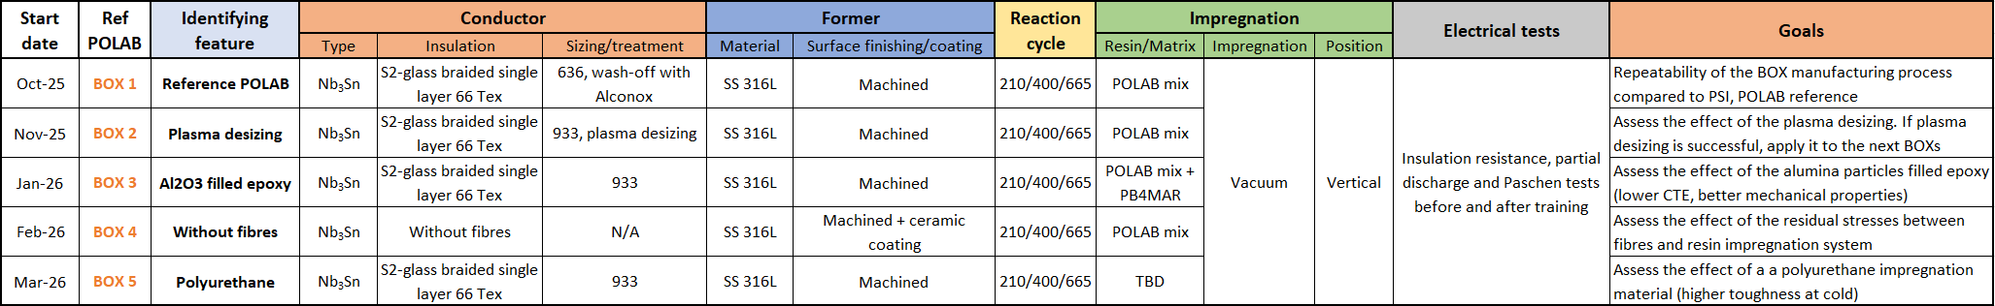
1. POLAB BOX Program
POLAB BOX Program objectives: study different impregnation systems or fibre treatments (while using the already existing BOX data set), before upscaling to SMC or bigger model coils
Produced, electrical tests in progress:
Test plan:
Status: 5 BOX formers available

Slide 4
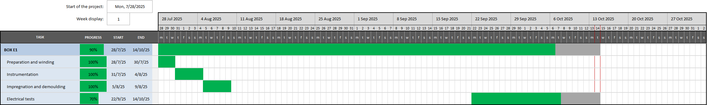
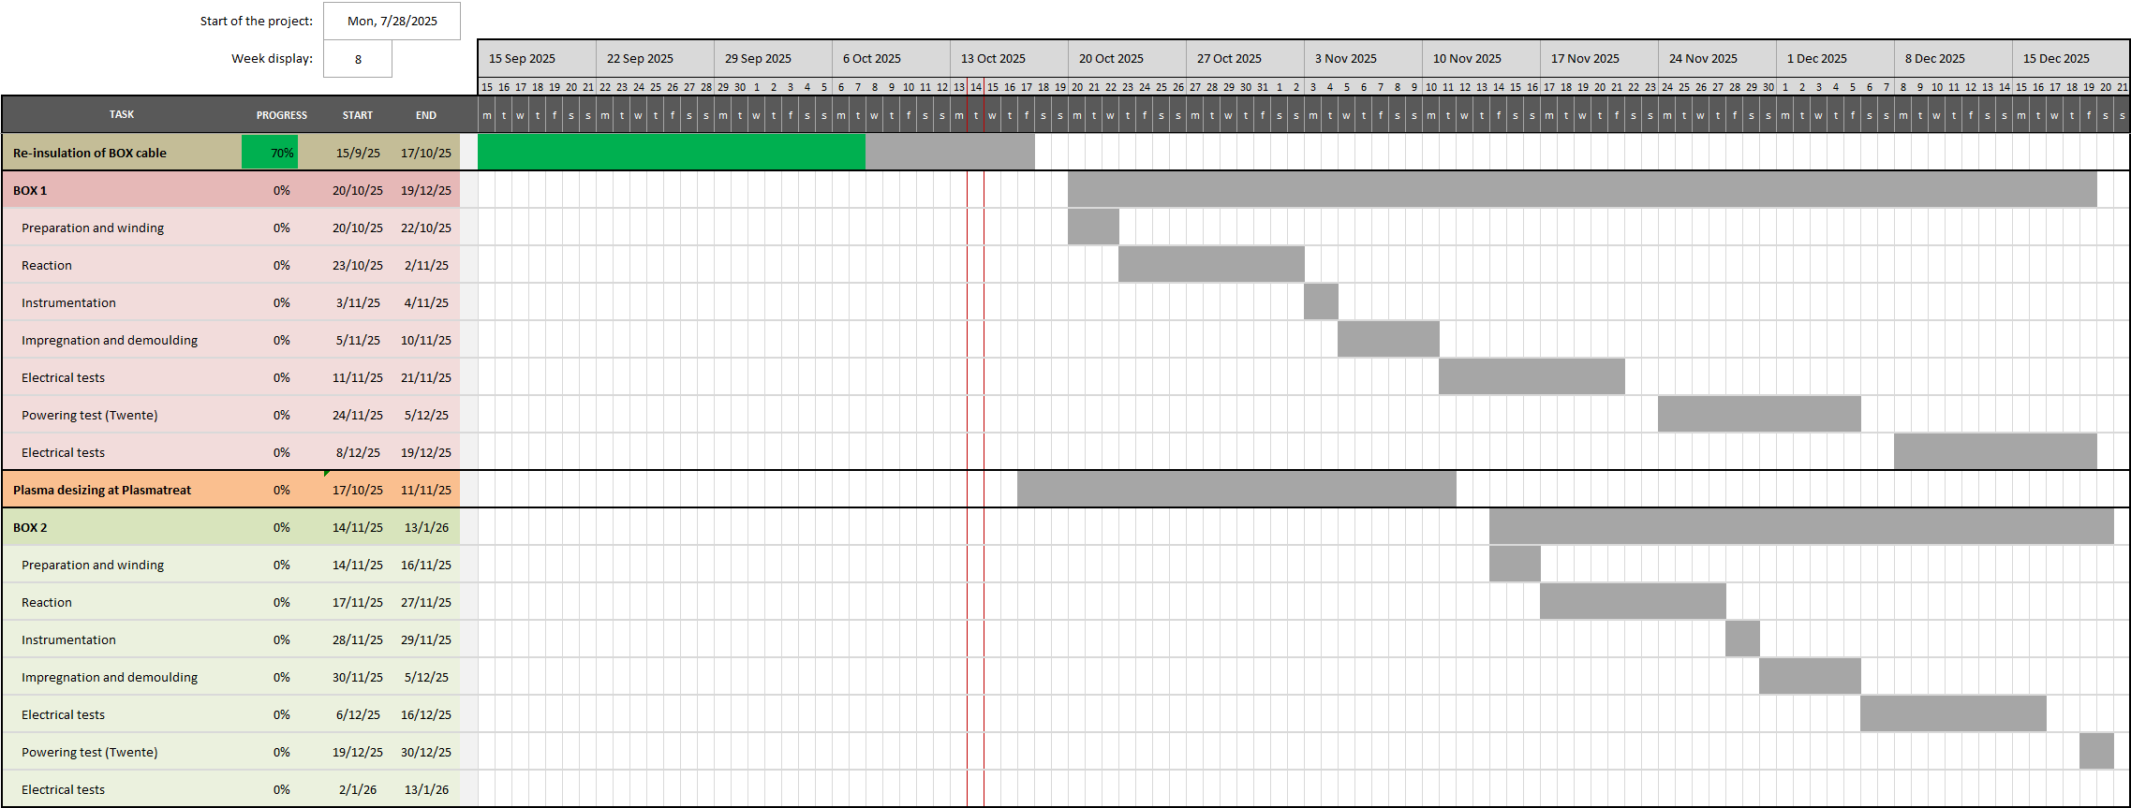
2. POLAB BOX Program: Gantt chart

Slide 5
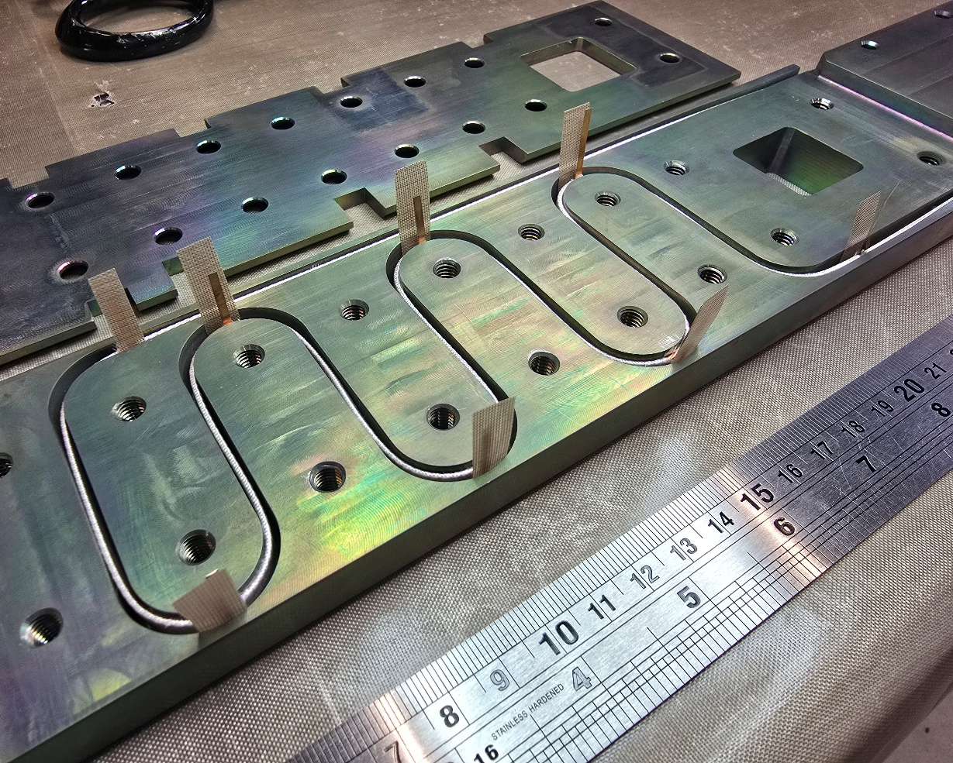
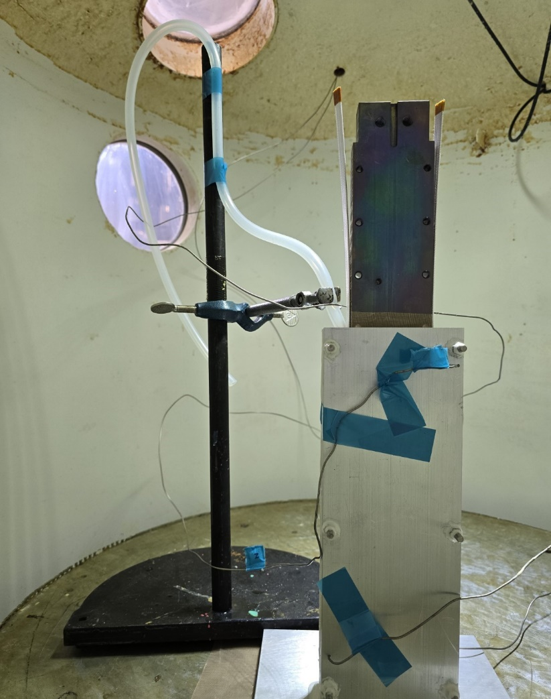
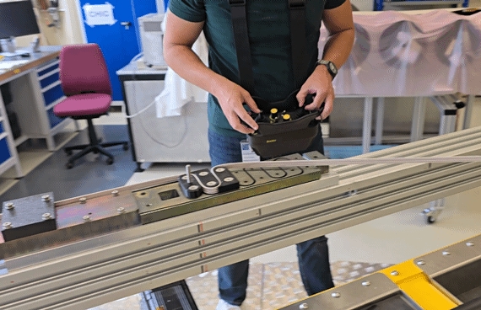
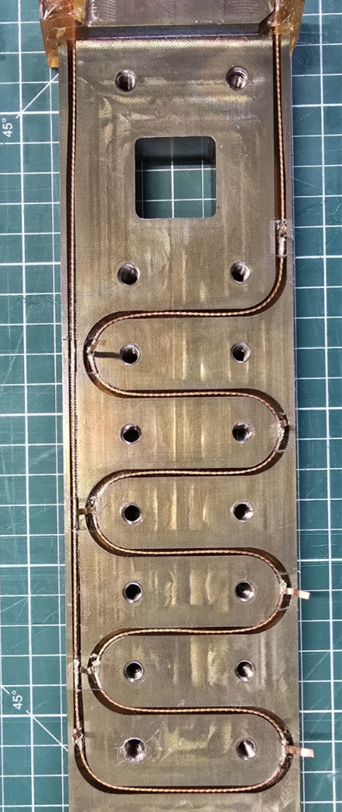
3. First POLAB BOX produced at CERN
This first BOX, POLAB BOX E1 was produced to apply at CERN the manufacturing procedure defined at PSI, and to define and implement the electrical tests for future BOXs
Winding
Instrumentation
Impregnation
Demoulding

Slide 6
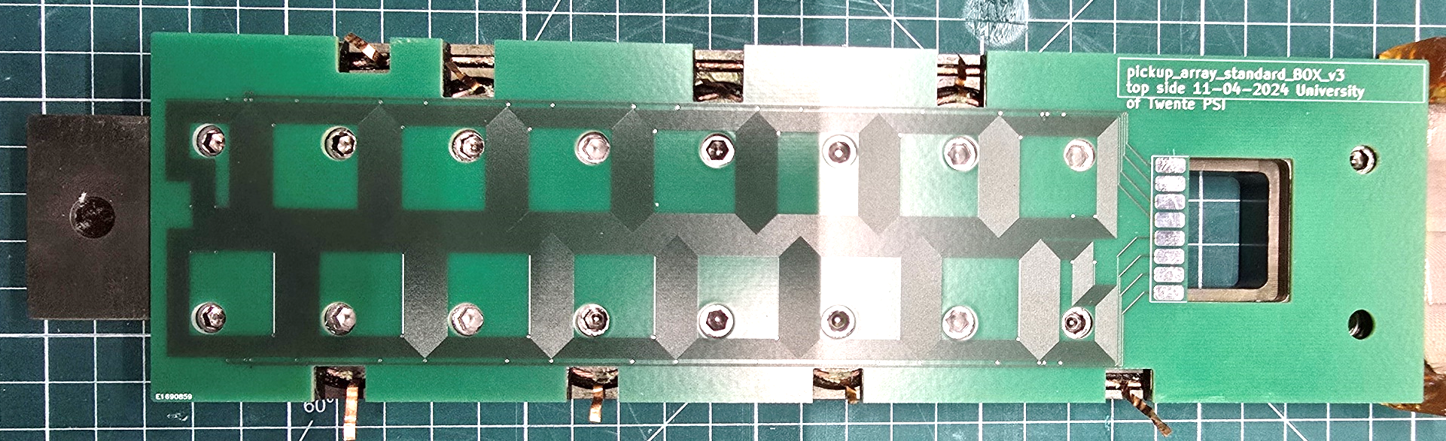
4. Conclusions and perspectives
POLAB BOX program has started, and the first BOX has been produced, validating the manufacturing process in-house at CERN
The definition and implementation of electrical tests are in progress
The first 5 BOXs are planned and should be produced and tested before summer 2026
Perspectives:
Quench antennas developed at Twente (J. Steenlandt) for quench detection might be assembled in the future BOXs
Investigate the possibility to test the BOX samples in Fresca 2 (after testing at Twente)
Quench antenna (https://indico.cern.ch/event/1501585/), courtesy of J. Steenlandt

