Slide 1




IPPOG International Masterclasses 2025
The Video Conference
IMC Moderators training
Ana Peixoto
24th February 2025
Notes:
https://indico.cern.ch/event/882172/

Slide 2
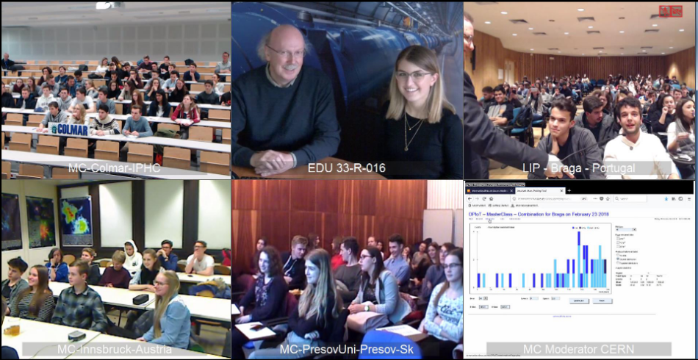
Moderators
Video Conference
You are going to be the face of CERN to hundreds of students around the world!
In pairs you will hold a video conference via Zoom to a group of institutes who have all done the same masterclass exercise during their day.
The video conference (VC) allows the students to come together to combine and discuss their results under your guidance in a light hearted and fun way.

Slide 3
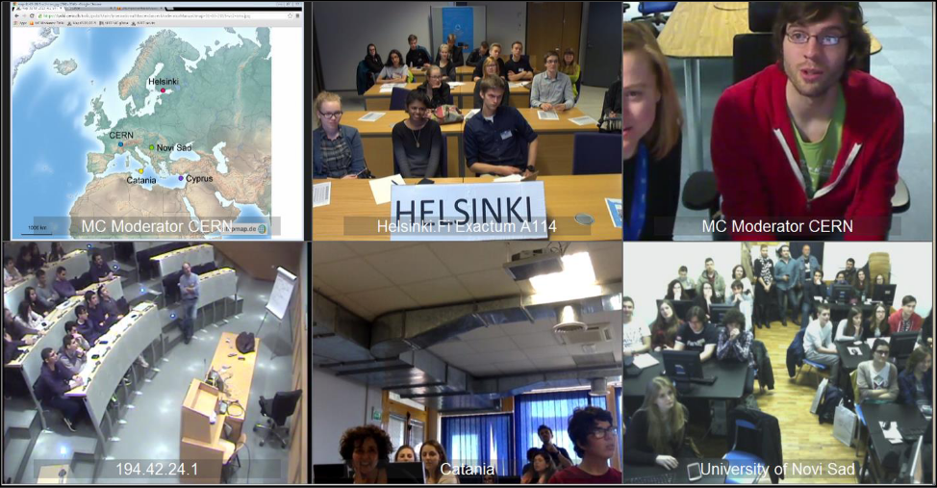
Aims
Video Conference
Convey the internationality of the event.
Demonstrate how physicists work together internationally.
Encourage students to exchange experiences between masterclasses.
Demonstrate improvement in accuracy by combination of different data sets.
Be a FUN end to a long day!
3-5 institutes participating in each session

Slide 4
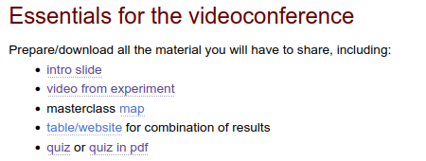
General information
Video Conference
Moderators Manual – has all the information you need for the VC!
Manual has quick links and information
Use Zoom to setup the video conference.
  Moderators will have alternative host permissions, if they have a CERN Zoom account.
  Step by step instructions are in the Twiki.
  Make sure you know how to use the shared desktop.
  Mute any noisy participants if necessary!

Slide 5
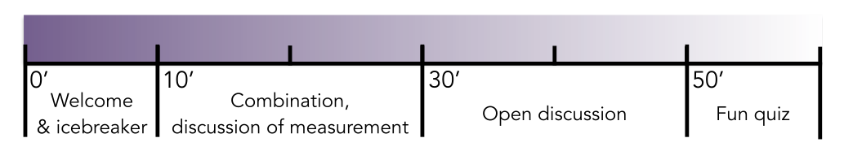
Check the one-pager for moderators here:
https://twiki.cern.ch/twiki/pub/Main/InternationalMasterclassesModeratorManual/One_pager_for_moderators-2025.pdf
Timeline
Video Conference
One hour video conference (16h – 17h sharp) with 3-5 institutes.
If both moderators are at CERN: Arrive at the correct room at 15:30 to get everything setup and prepared.
Otherwise (1 at CERN + 1 remotely or 2 remotely) : connect to the correct Zoom meeting room 30 minutes in advance (i.e. by 15:30) to meet your co-moderator and get everything setup and prepared.
Two locations for the VC:
4/S-020 except Wednesdays and Fridays. 4/3-004 for those days (Wed and Fri)
Agree with your co-moderator which chat function you want to use to in case you need to communicate with each other during the video conference.
  Option in Zoom to message the co-host.
  Skype, Mattermost or other platform also fine if you prefer.

Slide 6
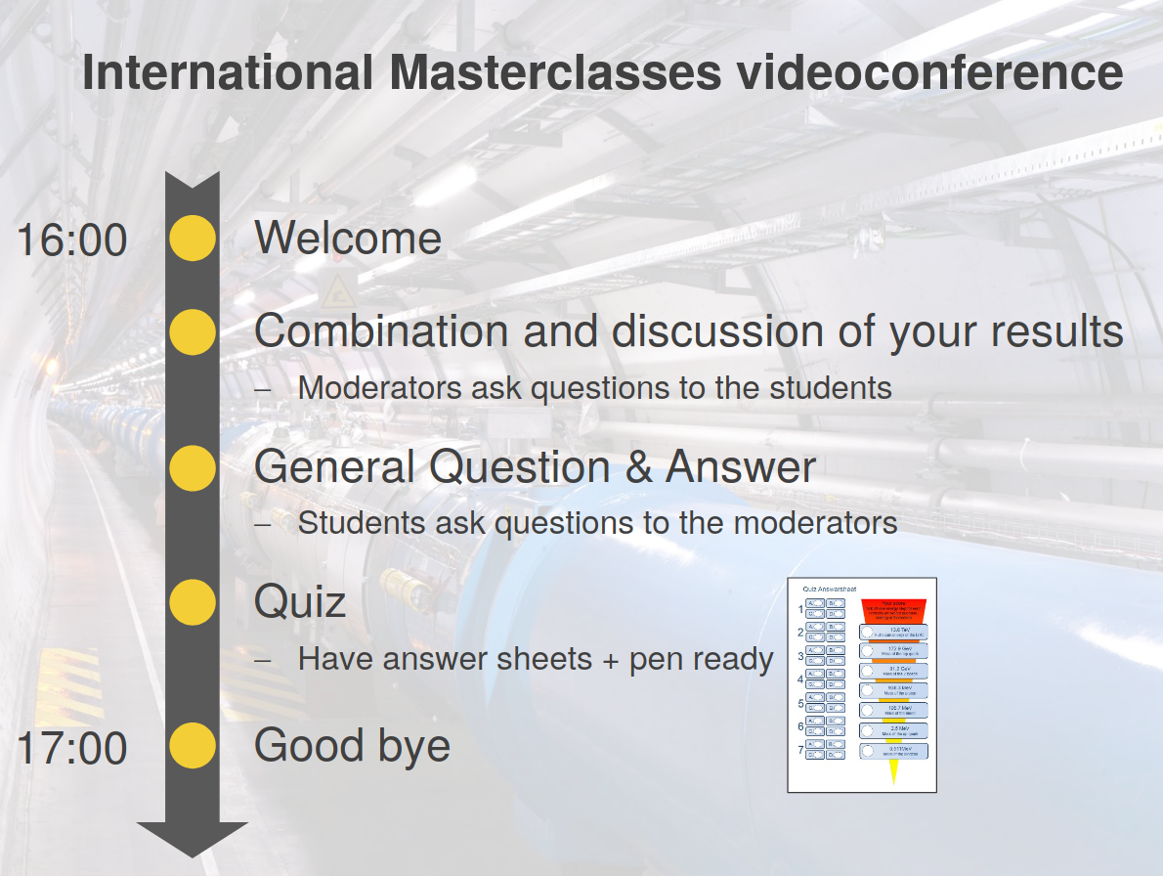
Welcome & Icebreaker
Video Conference
The welcome has to be on schedule, clear and interactive!
Students should immediately feel that this is a two-way conversation and they should actively take part in the VC.
Introduce yourself, say a little about your research and explain where you are.
  “Hello! My name’s Katharine and I work on the ATLAS detector. My research focuses on searching for new particles that can decay to two Higgs bosons.”
  “Right now we are sitting at CERN. CERN is the largest centre for particle physics research in the world and the place to be for a particle physicist”
Go through the VC timeline and explain what will be happening in the next hour.
  Share the provided intro slide.

Slide 7
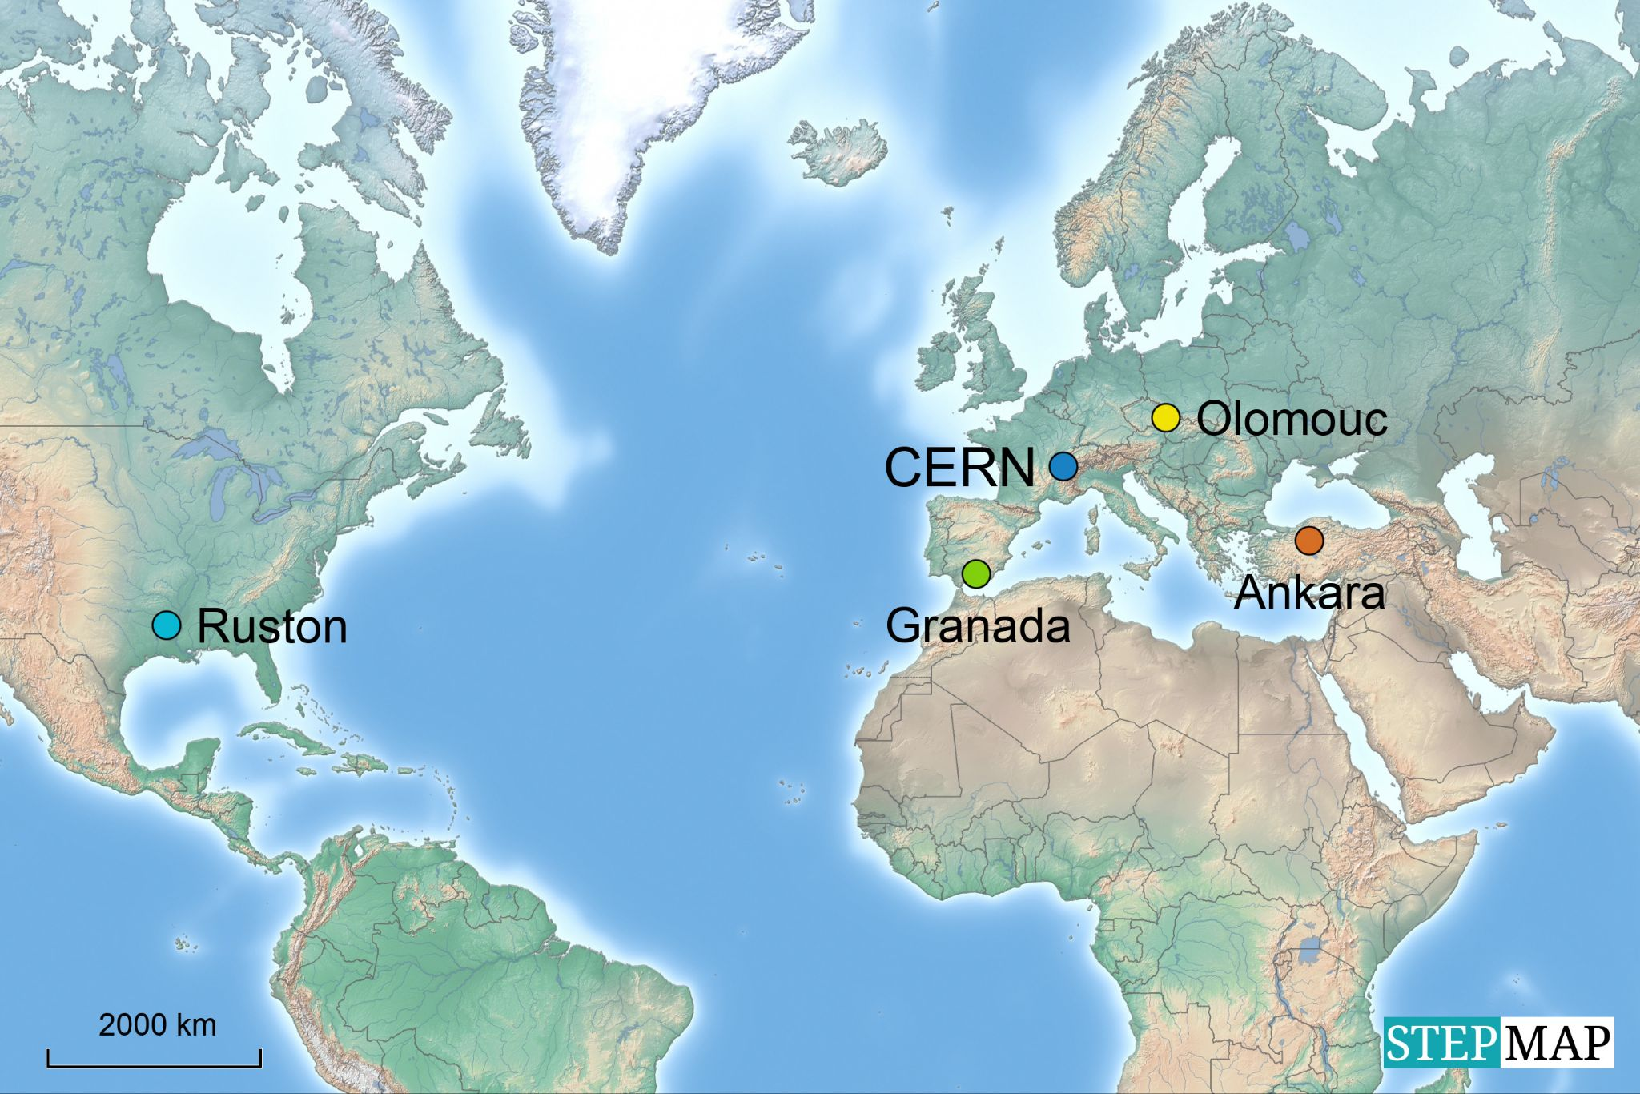
Welcome & Icebreaker
Video Conference
Share a map showing all the connected sites.
  Use to explain to the institutes in which order they will be addressed (e.g. north to south).
Ask one short, friendly question to each institute (sometimes suggested by the local organisers).
  “Barcelona, how did you find the exercises today?”
  “Vienna, have you seen the VERA accelerator?”
  More ideas for questions available from the TWiki

Slide 8

Welcome & Icebreaker
Video Conference
A real example from a masterclass last year!

Slide 9
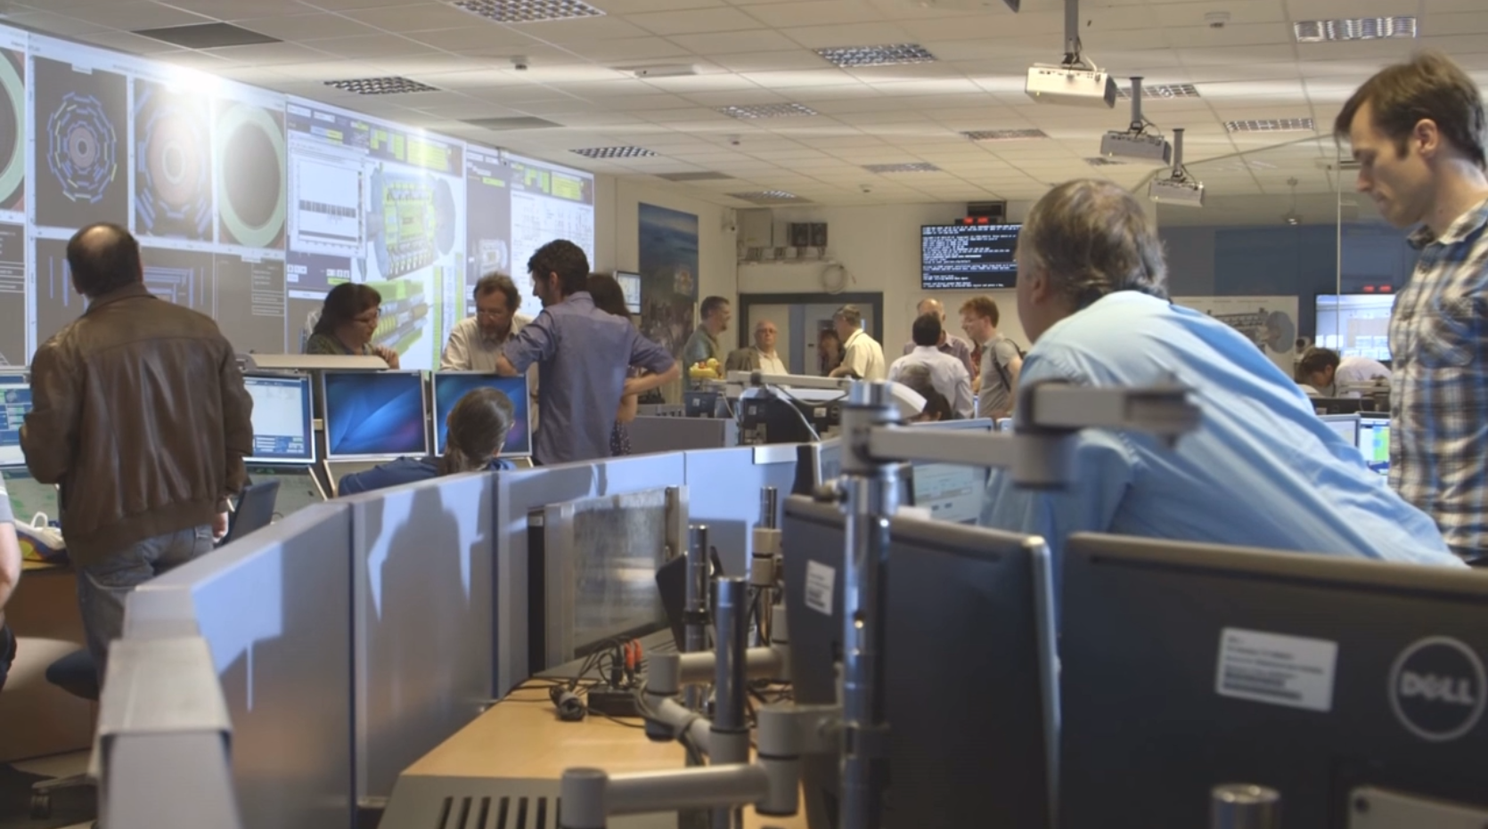
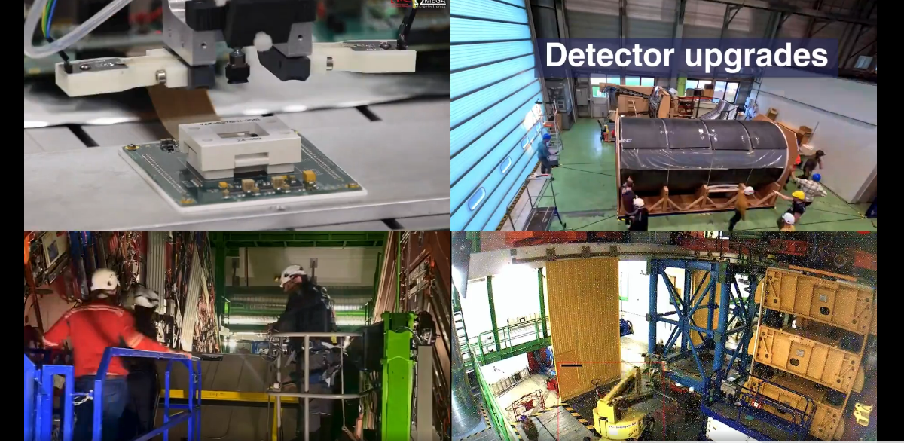
Welcome & Icebreaker
Video Conference
ATLAS, CMS and ALICE collaborations (LHCb connects from the pit) have now a short video to give a hint of our day-to-day life is at the LHC experiments control rooms
  Experimental cavern
  Upgrade work at the surface
  Data analysis
This new effort try to help the students to understand our job but also allows to generate more doubts and questions from them
  Please keep us informed about the feedback you get from the video part!
ATLAS
Control Room
CMS

Slide 10
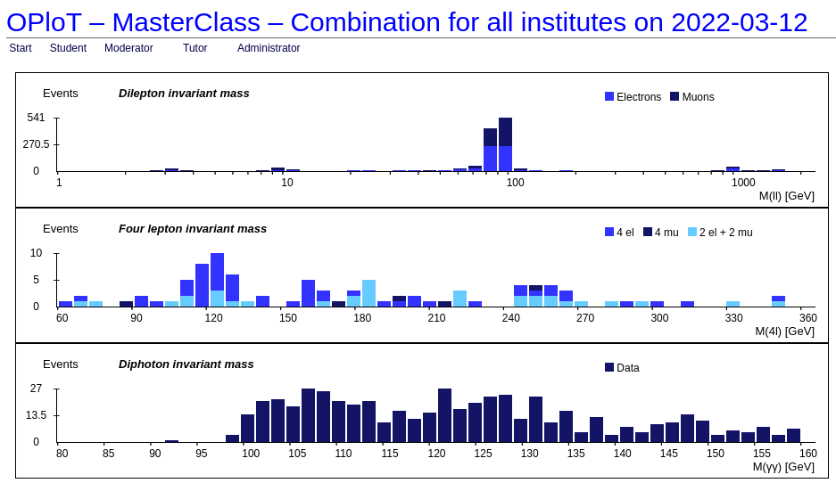
Discussion of measurements & Combination
Video Conference
Share the combination results on Zoom.
Summarise and comment on the combination.
  Note that all groups in the VC have done the same measurement, but using different datasets.
  Don’t comment on results from individual institutes.
Compare to the theory/experimental results.
Stress why using different data from different sources is beneficial (stats and reduces bias).

Slide 11
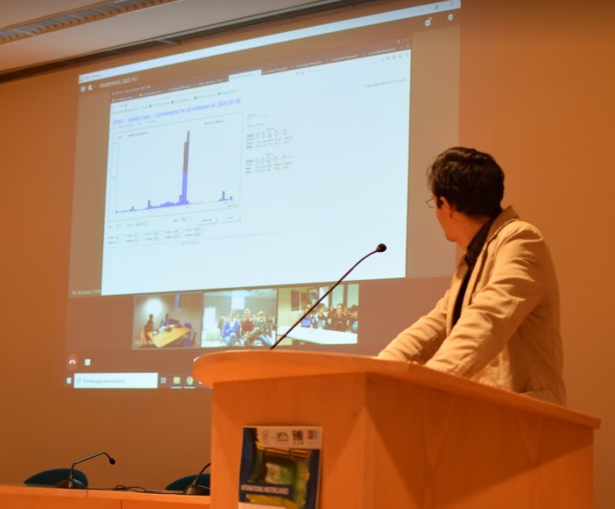
Discussion of measurements & Combination
Video Conference
Ask each group questions about their measurement.
Questions have been pre-agreed by the authors of each measurement.
  Follow the individual training for the measurement you are doing!
Examples include:
  Where are the peaks in the mass histogram? What do they represent?
  How would you interpret the blue and green areas? What do they mean?
See the TWiki for list of questions for each measurement.

Slide 12
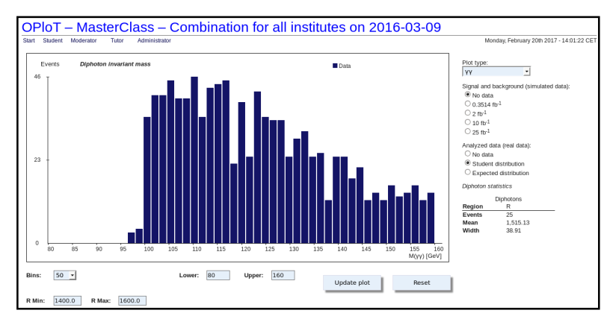
Discussion of measurements & Combination
Video Conference
Example from ATLAS Z-path:
Moderators show the diphoton invariant mass distribution
Possible question:
Do you see a peak corresponding to the Higgs boson?
Moderator discussion:
Explain about statistical limitations of the measurements and that H->yy is a very rare process.

Slide 13
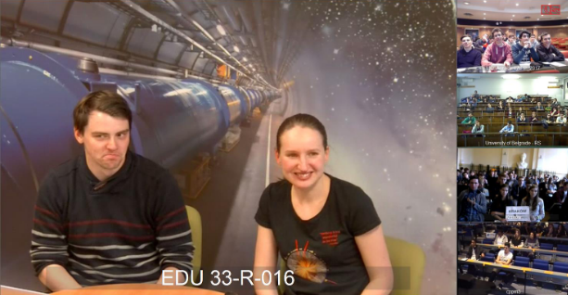
Open discussion
Video Conference
Discussion expands to more open and general questions. They can be on anything from…
  Life at CERN.
  LHC size/magnets/cost/power consumption.
  The Big Bang, dark matter, black holes, time travel…
  How to become a particle physicist.
Ask the institutes to come up with more general questions.
  1 question per institute per round.
Repeat/rephrase the question to:
  Make sure you understood correctly.
  Help other groups understand.
Give a short concise answer.
  It is okay if you cannot answer a question!

Slide 14
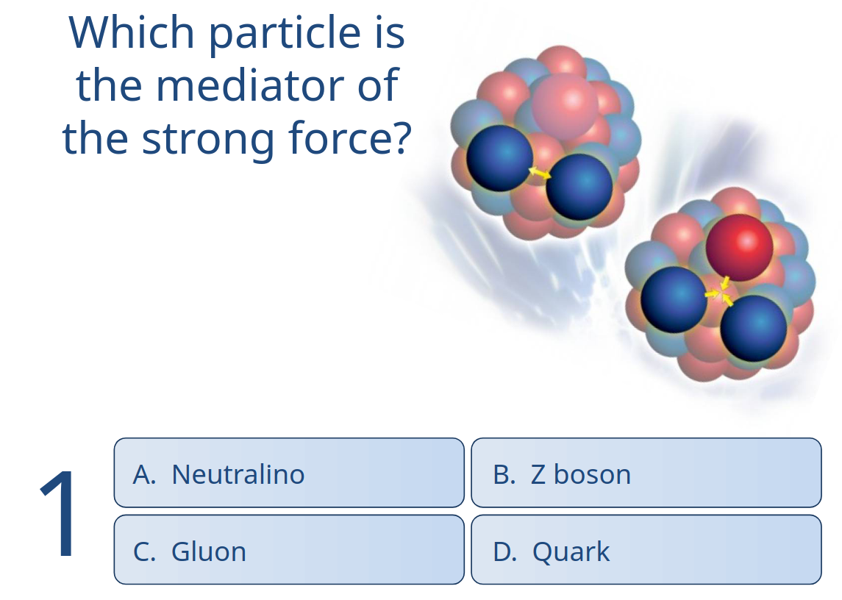
Quiz
Video Conference
“Who Wants To Be A Millionaire” style quiz
Seven multiple-choice questions.
Correct answer revealed after each question.
Each student plays alone and can share their answer with the colleagues.
No comparisons, no prizes!

Slide 15
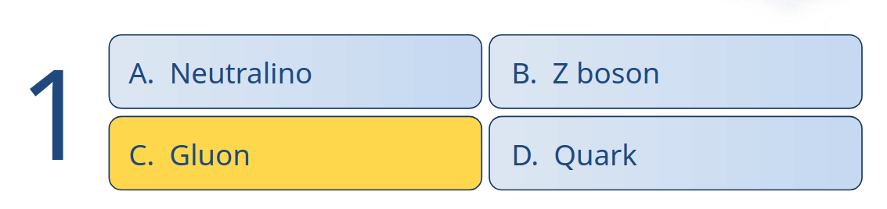
Quiz
Video Conference
Read out question
Start timer
Reveal correct answer and answer choices

Slide 16
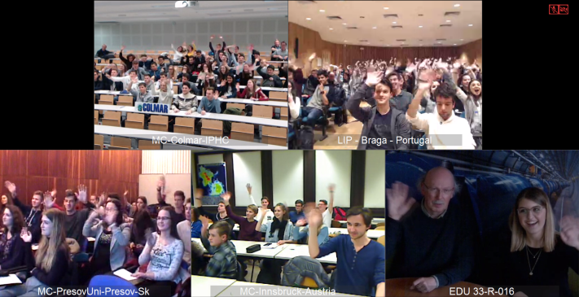
Goodbye
Video Conference
There must be a clear and common end to the VC after one hour.
Say goodbye to everyone and thank them for taking part.
Do not keep discussion going even if the students are still asking questions.
  If they and you want some discussion can continue after the goodbye on a voluntary basis.

Slide 17
Summary
Video Conference
Arrive 30 minutes before the start of the VC.
Set up the Zoom conference following the step by step instructions on the TWiki (instructions also in the manual).
Have the “one pager for moderators” document to hand.
Download the map - this must be done each time (also available in the Twiki).
Have the experiment video open.
Have the link to the tables for the combination already open.
Agree with your co-moderator in advance who will do each step.
Follow the suggested timeline where possible, but use some common sense too.
  e.g. if there are few institutes joining and the students do not have lots of questions then you may finish a bit early - that’s fine!
All the info you need is on the TWiki and in the manual:
https://twiki.cern.ch/twiki/bin/view/Main/InternationalMasterclassesModeratorManual

Slide 18
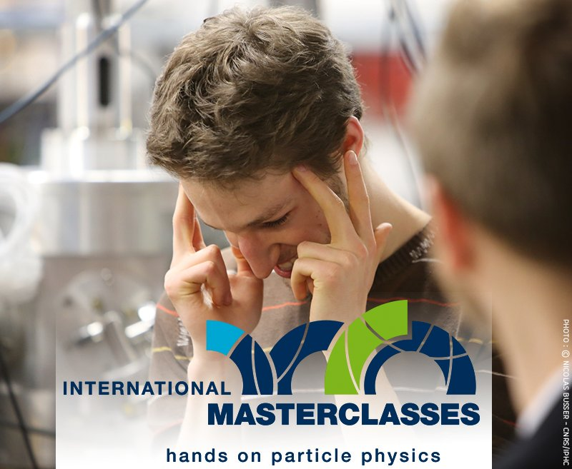
Things it should not do
Video Conference
Things it should not do:
Provide a deeper understanding of the physics.
Teach English to the students.
Contain a basic discussion of the measurement.
Create a competition between the institutes.
Before your first moderation:
Feel free to observe one of the other video conferences before moderating your first session - ask in the Mattermost for the Zoom link.
Join the Mattermost channel for moderators - join here
  Ask questions to organisers or other moderators.
  Provide fast informal feedback to us about what’s working well and what isn’t.

Slide 19
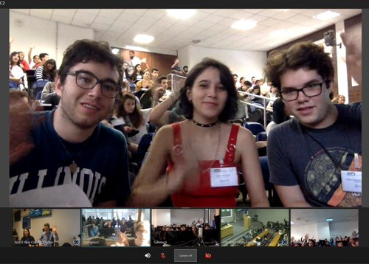
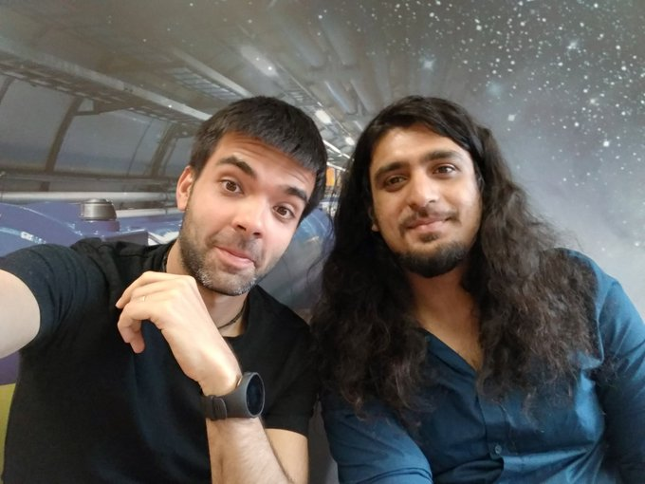
Join our Mattermost channel: here
And finally!
Video Conference
Smile, initiate two-way conversations with the students, meet your colleagues and have FUN!

Slide 20
Thanks!

