Slide 1
Moderators´ orientation
Uta Bilow, TU Dresden 24.02.2025

Slide 2
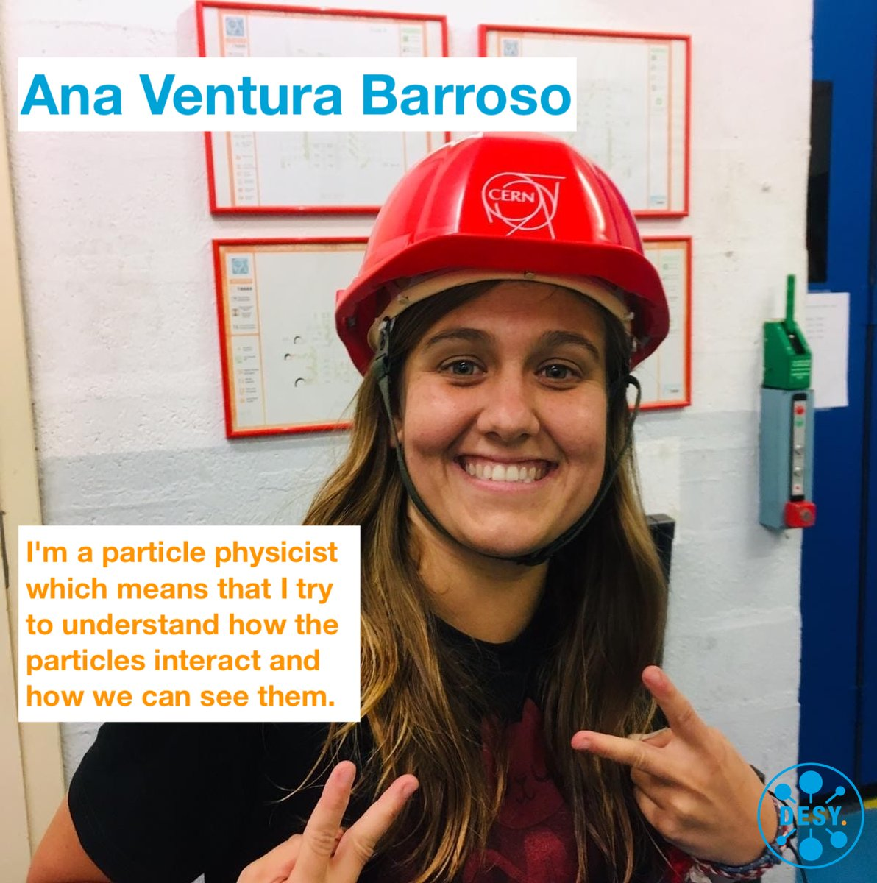
Inspiring the next generation
“
I did this masterclass in 2012 when in high school and that's why I decided to study physics so I would love to encourage people to join our community.
”
Moderator since 2021

Slide 3
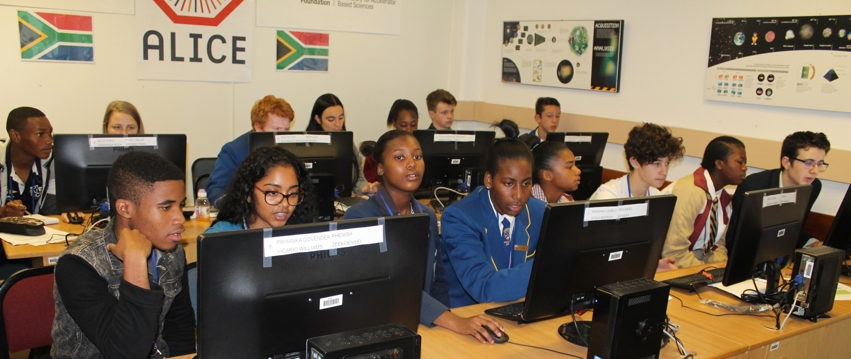
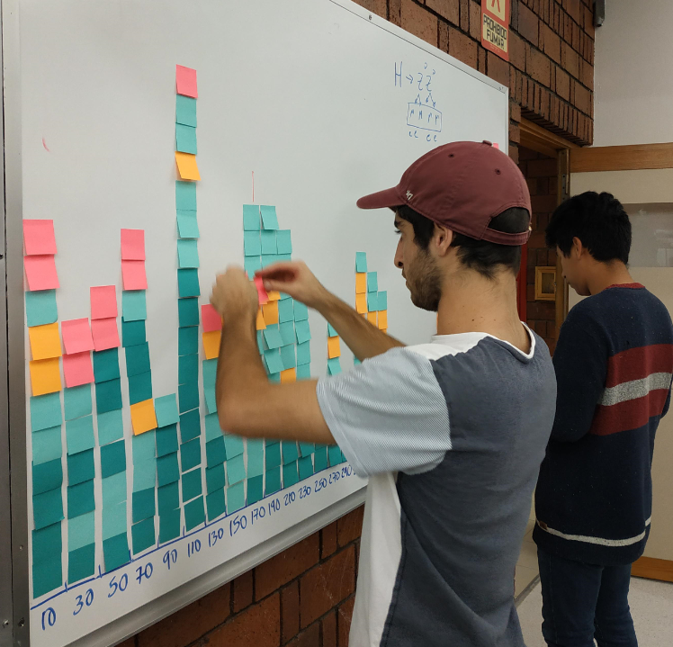
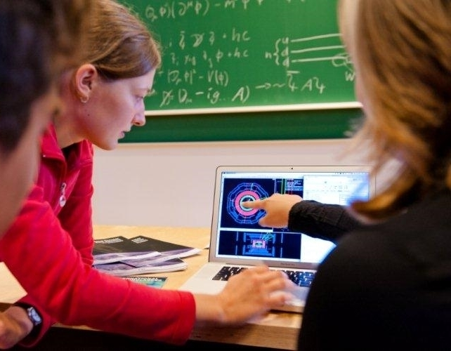
The idea behind Masterclasses
High school students (16-19y) at a university or research lab
Act as a „scientists for one day“
Close to current research
Hands-on activity
Real scientific data
Relevant methods and tools
Nature of science
Organisation of HEP research
Meeting and discussion with scientists

Slide 4
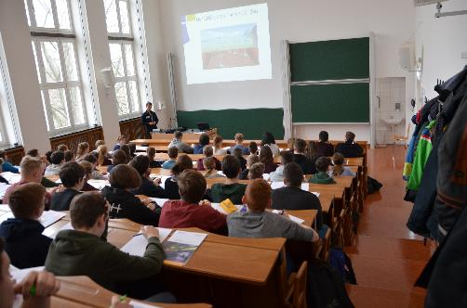
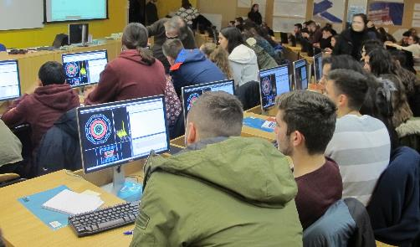
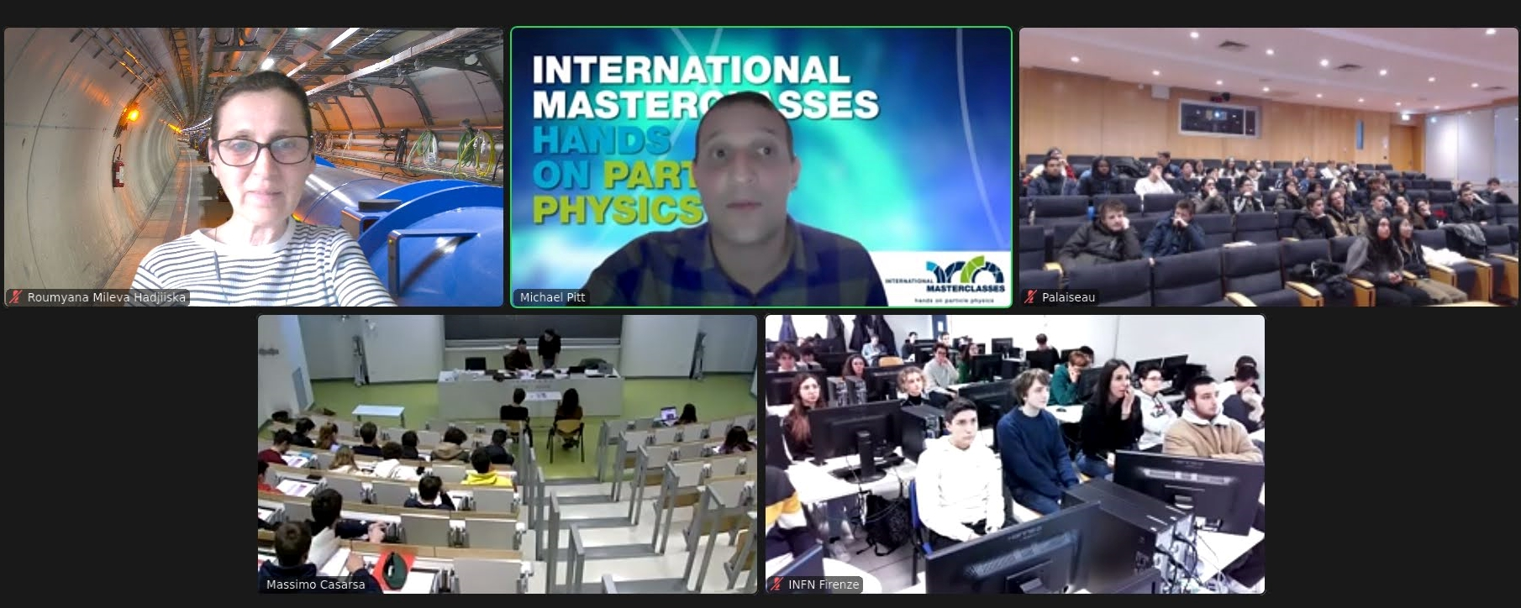
Sample agenda
8:30 - 9:00 registration & welcome
9:00 - 10:00 introduction to Particle Physics (standard model, detectors, accelerators)
10:30 - 11:30 second talk or tour
12:00 - 13:00 lunch break
13:00 - 15:00 data analysis: measurement with LHC data
15:00 - 16:00 local combination + discussion
16:00 - 17:00 video conference with CERN
(3-5 groups from different countries = international collaboration)
You might be sitting here!

Slide 5
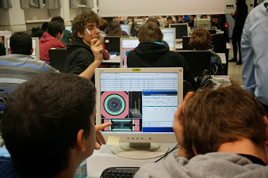
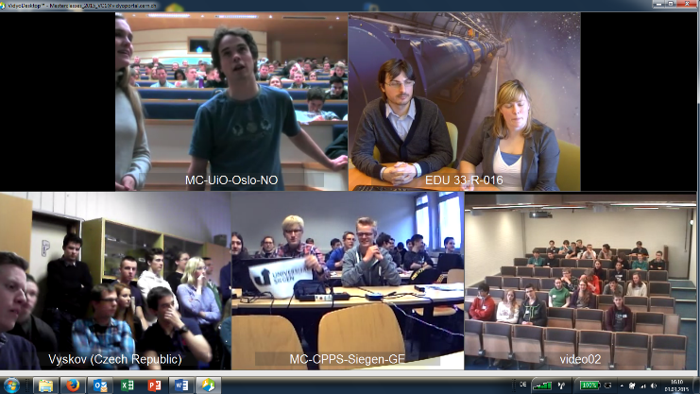
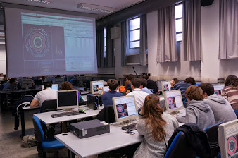
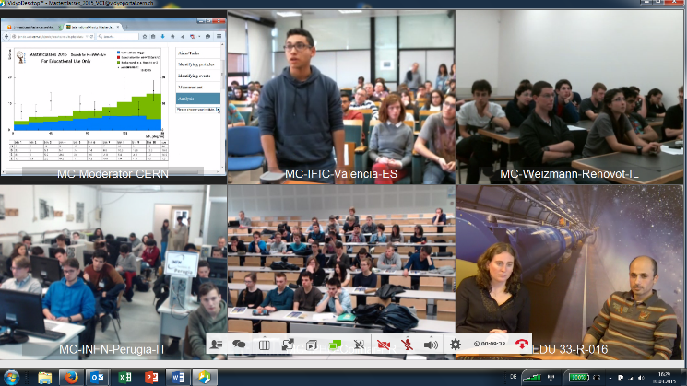
Central elements: data analysis + international collaboration + connection to CERN

Slide 6
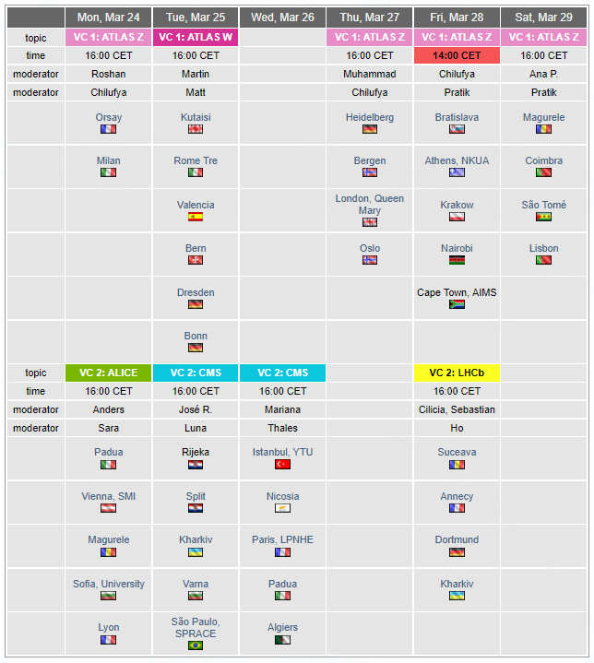
Schedule
Schedule at https://physicsmasterclasses.org/index.php?cat=schedule&page=schedule_2025
International Masterclasses period: 24.2. – 11.4.2025 (7 weeks)
6 different measurements
  (2x ATLAS, CMS, 2x ALICE, LHCb)
Each institute picks their favourite date
2 moderators chair each session (LHCb: 3)
Assignment according to your availability

Slide 7
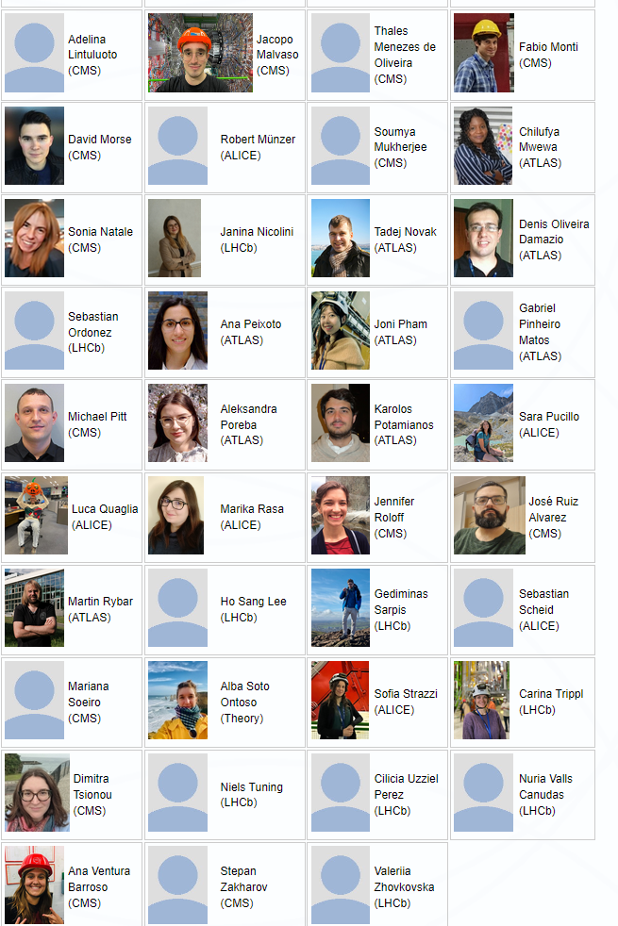
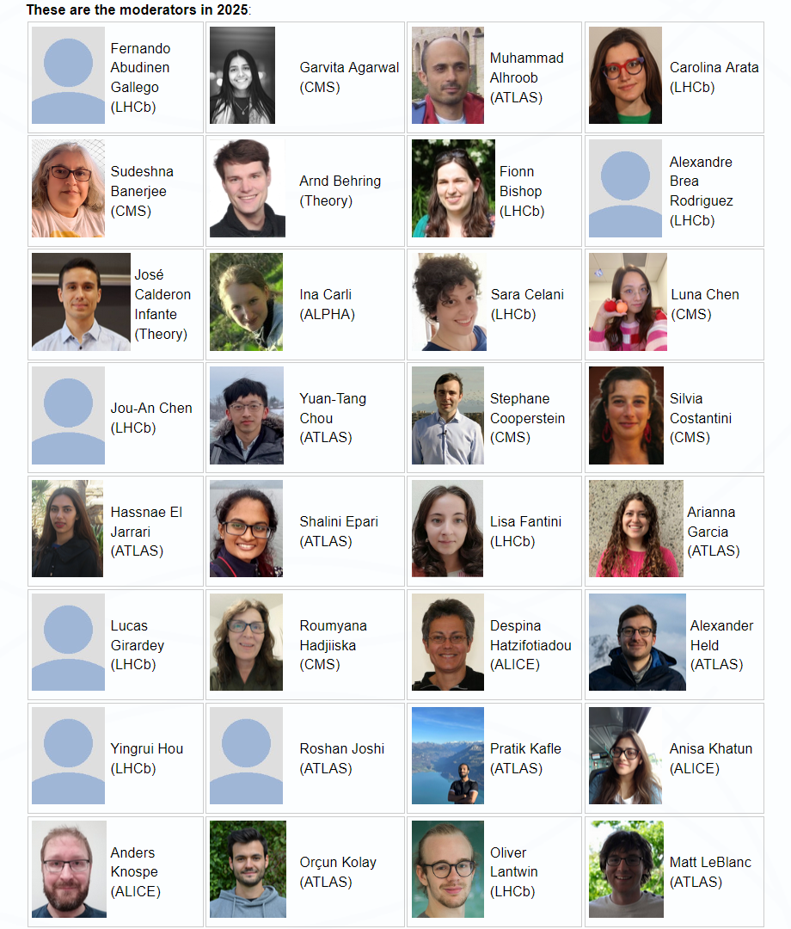
Moderators team
If your photo is missing, please send it to Uta

Slide 8
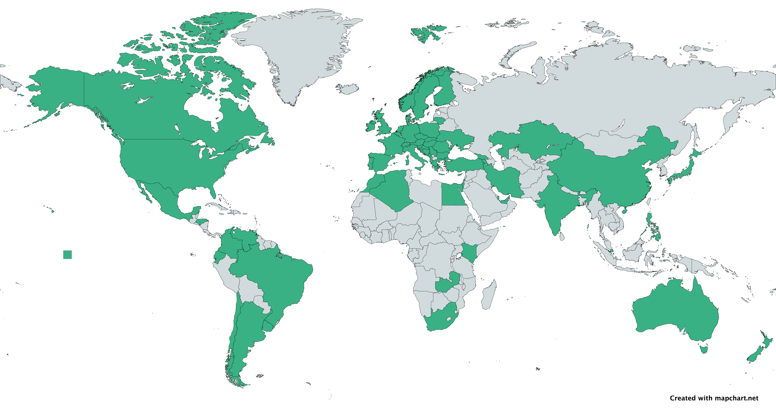
International Masterclasses
>60 countries, >220 institutes
key activity of IPPOG (International Particle Physics Outreach Group)
Masterclasses: LHC, Belle II, Neutrinos experiments, Auger, Particle Therapy, ...
Moderation centers: CERN, Fermilab, KEK, GSI, Malargue
More at https://ippog.org/imc-international-masterclasses

Slide 9
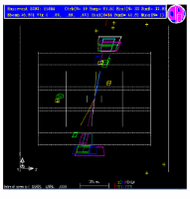
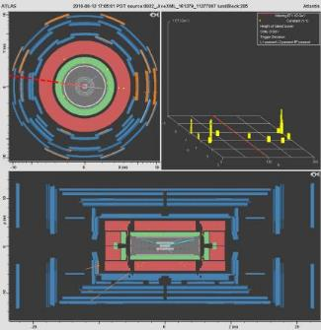
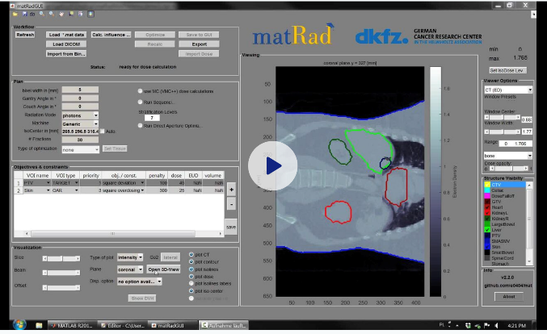
Brief history of IMC
Idea from UK, 1996 (R. Barlow et al.)
1997: 1. Masterclass with 7 institutes (LEP data)
1998: nationwide uptake in UK
2005: Adopted by (E)IPPOG for all Europe
2006: U.S. joined program (QuarkNet)
2011: LHC-based Masterclasses
2014: all 4 LHC experiments involved
2019: MINERvA Neutrino Masterclass
2020: Belle II Masterclass and Particle Therapy Masterclass
CERN courier 2005: MC spreads the word for physics
CERN courier 2014: MC in the LHC era

Slide 10
IMC: a growing program
2005: 18 countries 2025: 64 countries

Slide 11
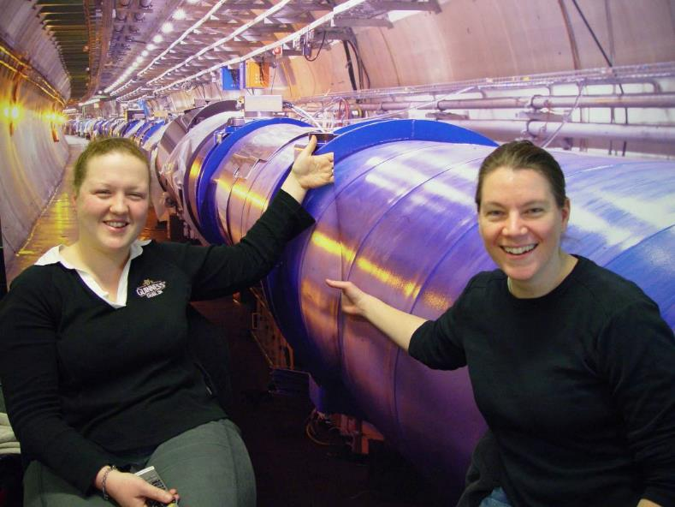
Quotes from Masterclass moderators:
“The best thing is actually answering the questions and seeing how excited and how happy they are, waving at the camera. They're really excited to be talking to physicists based at CERN!”
“It is very satisfying, because we do many video conferences and rarely do people cheer on the other side if you say something. Here they do!”
Thank you for being part of IMC25 – enjoy your sessions!

