Slide 1


Jet Substructure Tuning Efforts Eda Erdoğan, Bora Işıldak, Salim Çerçi, Deniz Sunar Çerçi
16/01/2025
YTU CMS MEETING

Slide 2
Latest Efforts
ATLAS (and ALICE) LJP measurements in the literacy check for validation (in ATLAS: top quark pair production, separately for jets from hadronic decays of the W boson and for b-quark jets is measured, A14, A2 tunes in PYTHIA8 with ATLAS, Monash+CR tune, better model the data)
Is LEP data tune necessary instead of LHC data?
Color reconnection check was suggested
What else can be done with the α_{s} ^{FSR} tune (TimeShower:alphaSvalue) before diving more into hadronization?
Better sensitivity check is required in parameter ranges, especially hadronization parameters

Slide 3
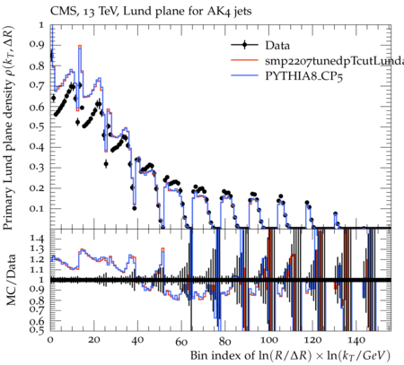
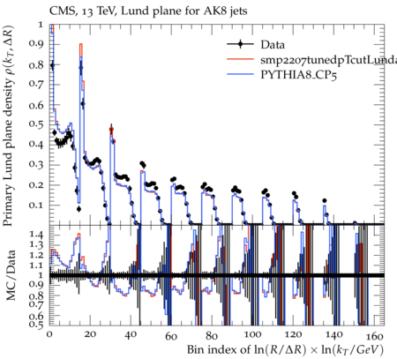
Latest Results
1) Pre-tune of α_{s} ^{FSR :}
^{StringZ:aLund = 0.371}
^{StringZ:bLund = 0.672}
^{TimeShower_pTmin = 0.56}
2) α_{s} ^{FSR} tune afterwards:
TimeShower:alphaSvalue = 0.117
Expecting higher values of α_{s} !

Slide 4
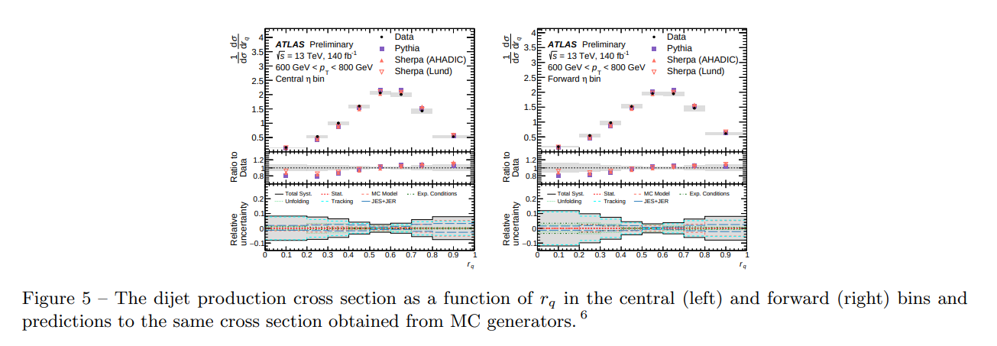
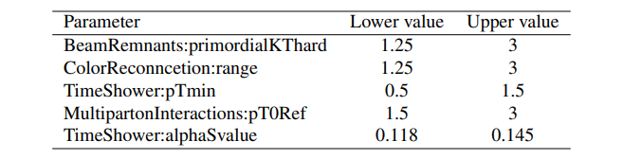
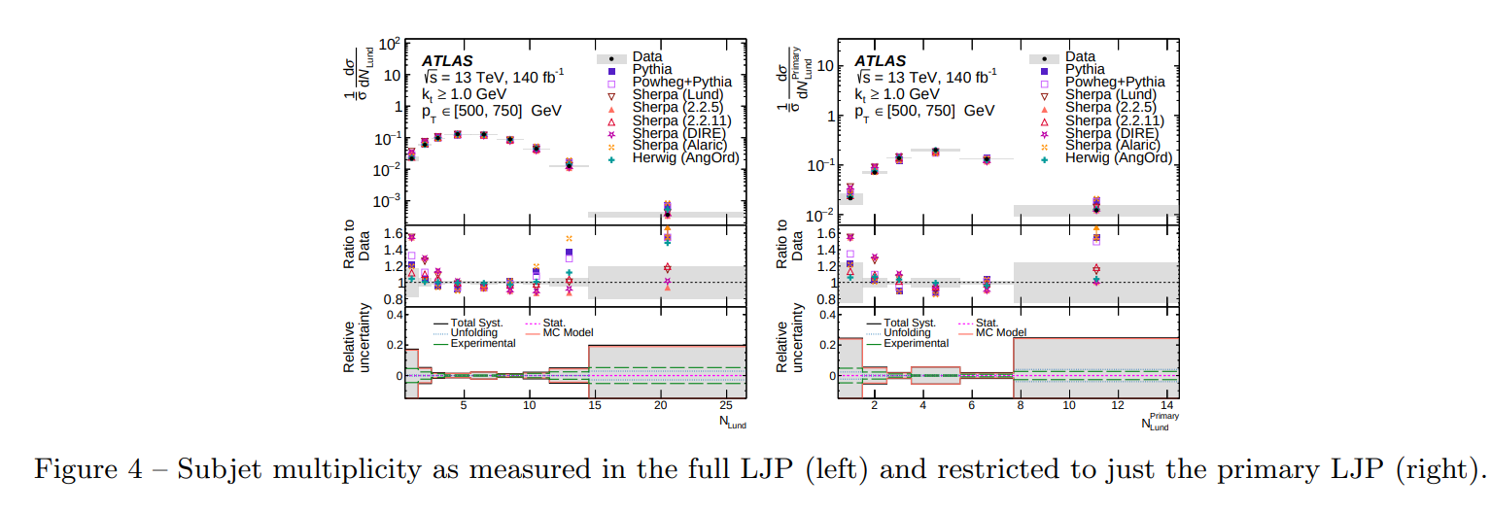
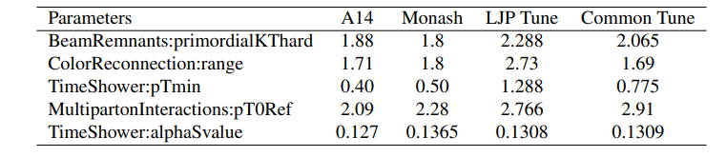
ATLAS Measurements for Reference

