Slide 1
CERN Baltic Group Conference
(CBC 2025)
Pre-preparatory discussion
January 16, 2025

Slide 2
CERN Baltic Group Conference in Kaunas, Lithuania (1)
Content:
- Date;
- Conference venue;
- Organizing and scientific committees;
- Topics covered in the conference;
- Plenary talks - Lecturers to be invited;
- Fees;
- etc.

Slide 3
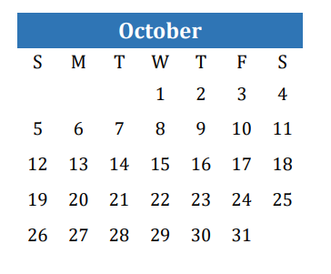
CERN Baltic Group Conference in Kaunas, Lithuania (2)
CBG Conference:
14-16th of October, 2025
2025
16th CBG General Meeting:
16-17th of October, 2025

Slide 4
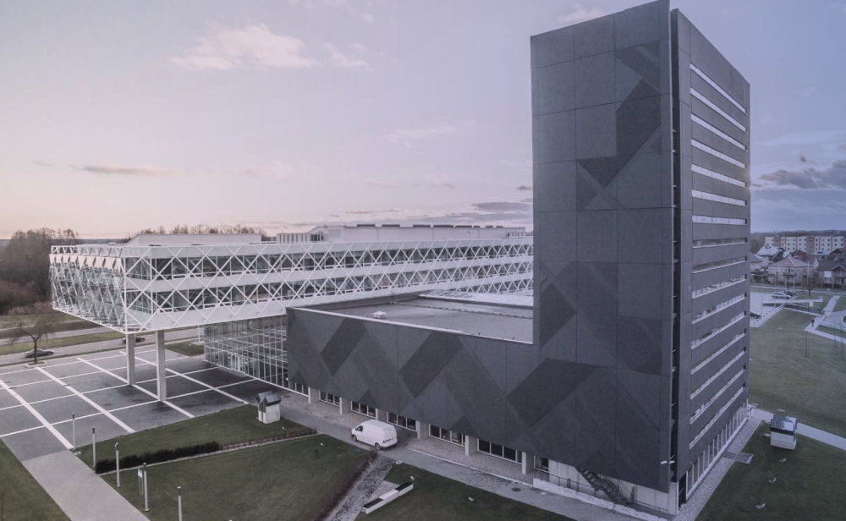
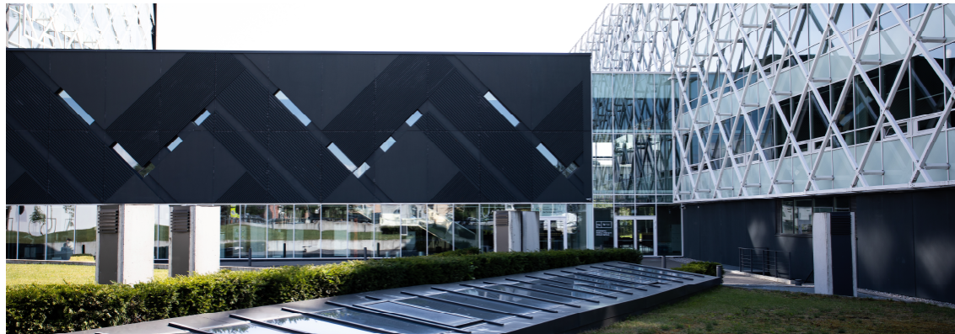
CERN Baltic Group Conference in Kaunas, Lithuania (3)
Venue
KTU Santaka Valley
K. Barsausko st. 59, Kaunas
https://nivc.ktu.edu/slenis-santaka/

Slide 5



CERN Baltic Group Conference in Kaunas, Lithuania (4)
Local organizing committee:
Lithuanian consortium for particle physics

Slide 6
CERN Baltic Group Conference in Kaunas, Lithuania (5)
Registration
The registration/conference fee is 50 Euros, payable either via an online bank transfer.
Notes:
The registration/conference fee is 50 Euros, payable either via an online bank transfer or by cash upon arrival.

Slide 7

CERN Baltic Group Conference in Kaunas, Lithuania (6)
The CBG Conference link:
It should be cloned from 3rd CBG Conference;
Institutional logos;
Poster

Slide 8
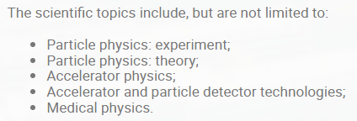
CERN Baltic Group Conference in Kaunas, Lithuania (7)
Scope and scientific topics
Lecturers to be invited

Slide 9
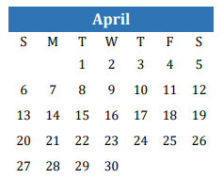

15th CERN Baltic Group General Meeting in Vilnius, Lithuania
Date:
7-8 April, 2025
2025
The host institution:

Slide 10
An agreement of CERN Baltic Group:
“The Baltic School of High-Energy Physics and Accelerator Technologies (BSHEPAT) is an annual summer school established by the CERN Baltic Group (CBG), taking place in one of the three Baltic states.”
The dedicated CBG Coordination Team Meeting is needed.
30th or 31st of January will be sent via Doodle.

