Slide 1

Removing the
HMPID
GdC (INFN Bari and CERN CH)

Slide 2




Agenda
Review of HMP installation: 2006
Review of aluminium absorber installation: 2021
Study of HMP removal: 2026
Dismantling sequence
Document on dismantling tasks procedure

Slide 3



Introduction
After a glorious run time 2010-2026, the detector removal and the project closing is approaching!
To remind what we did, in the following slides a glimpse on a photo's gallery for the main installation steps. Credits to Antonello Di Mauro.

Slide 4
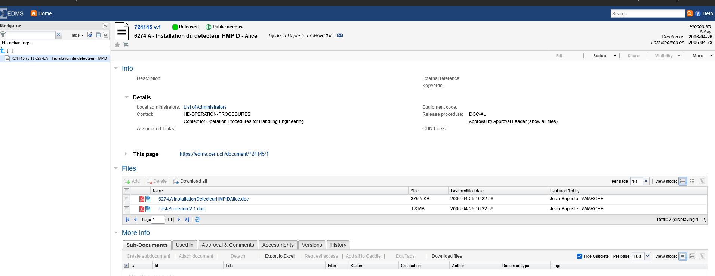
Installation Documents

Slide 5
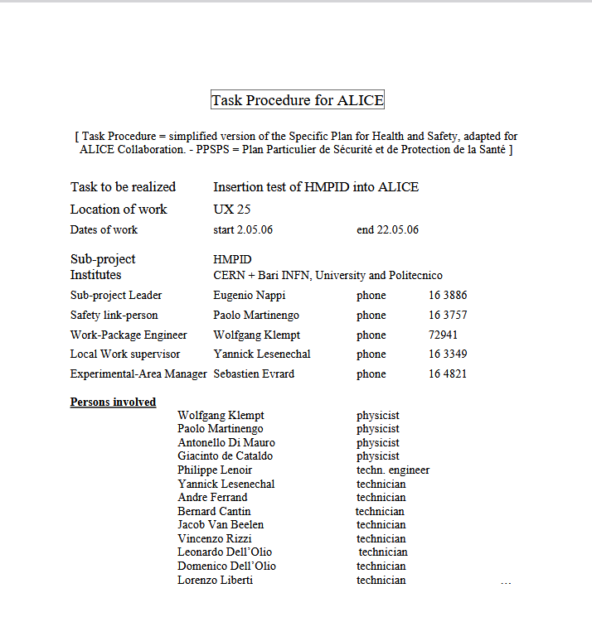
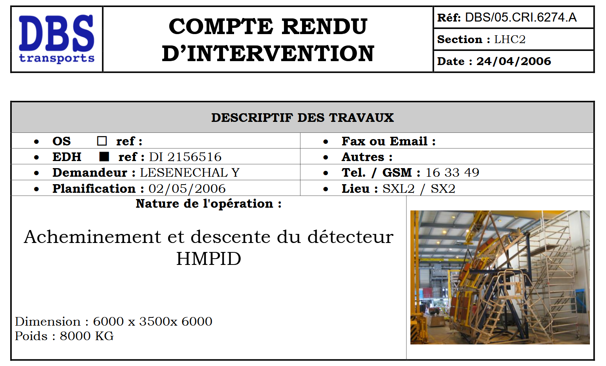

Slide 6
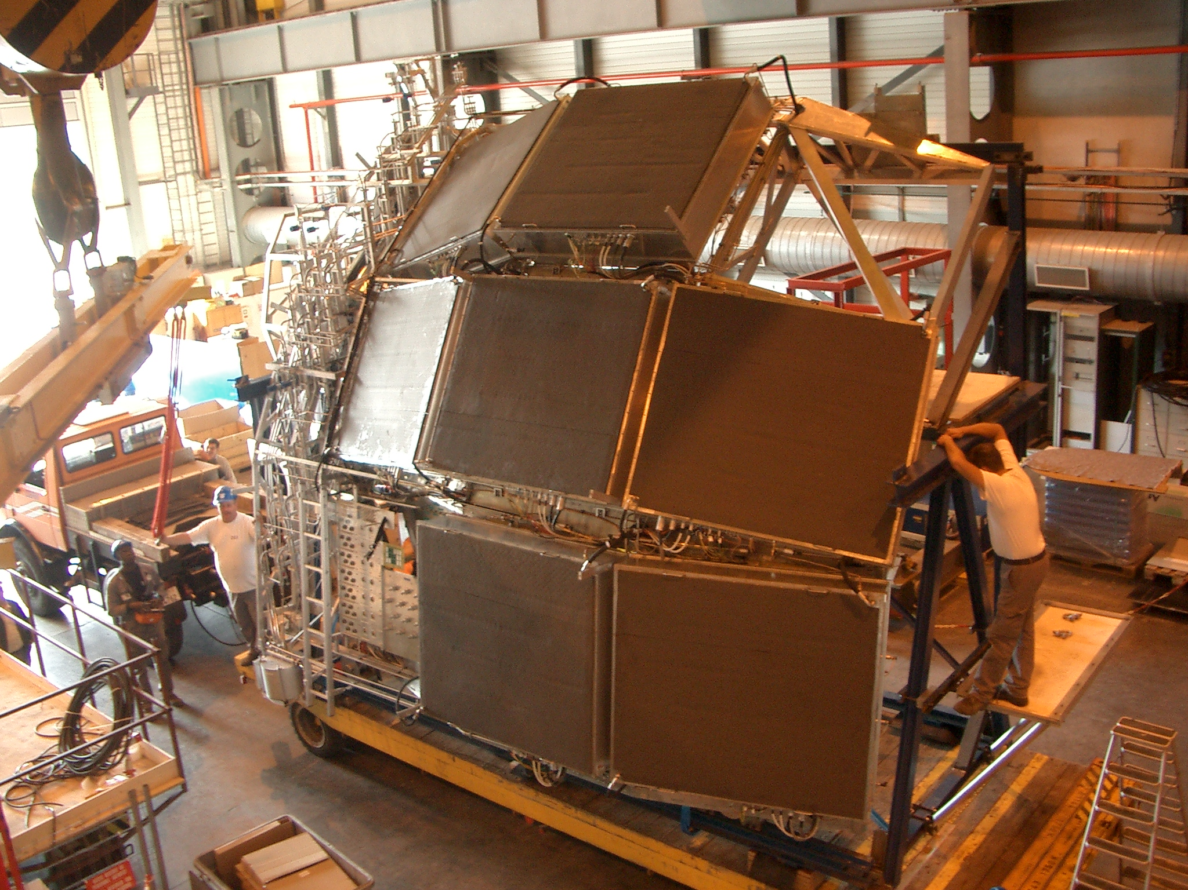
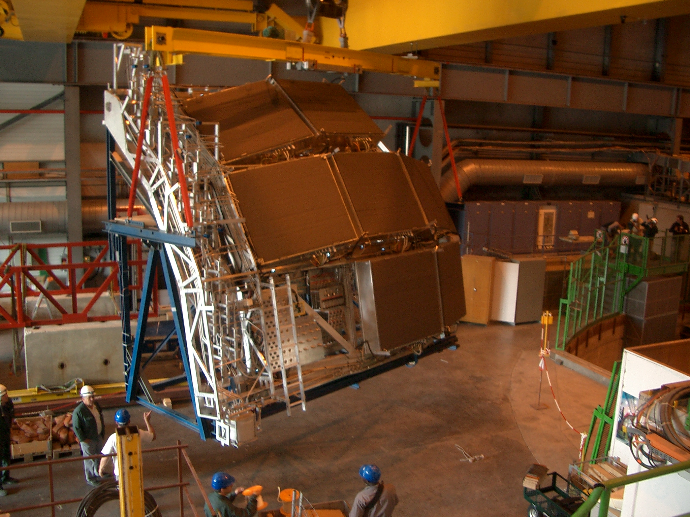
Review of HMP installation: Sept 2006
Bleu support structure of the cradle: to be find and restored

Slide 7
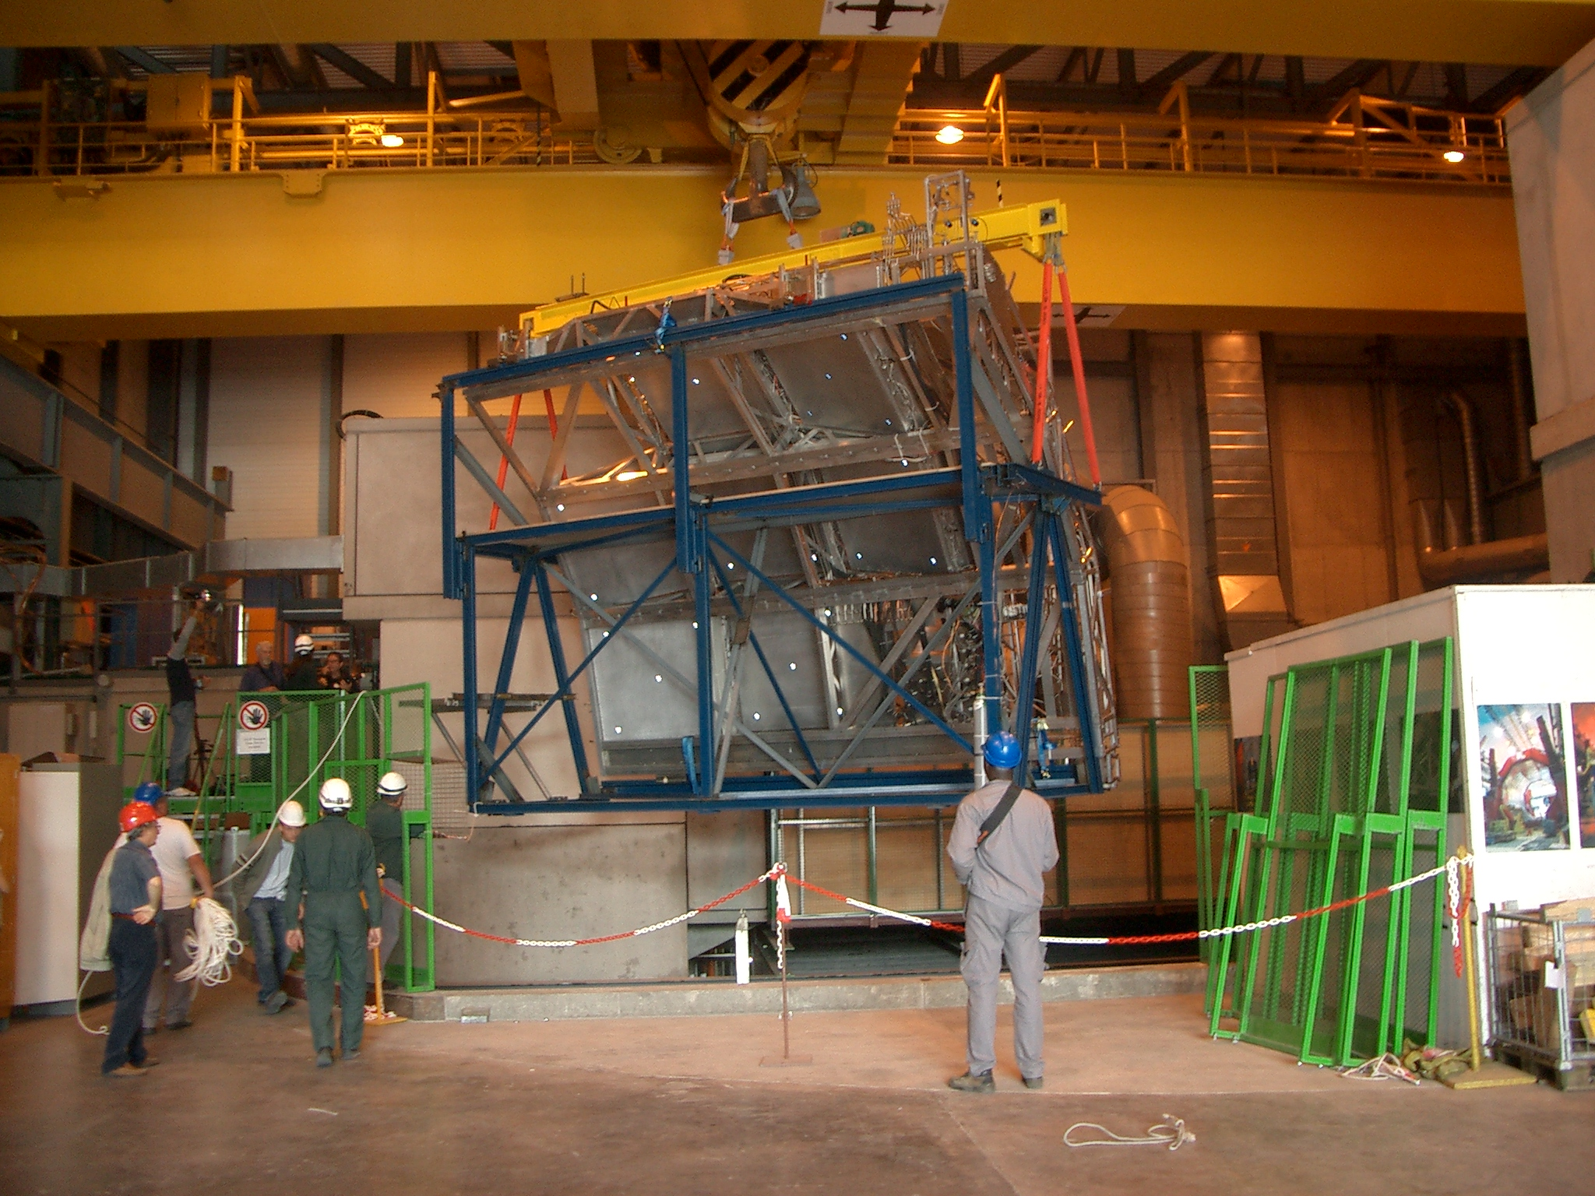
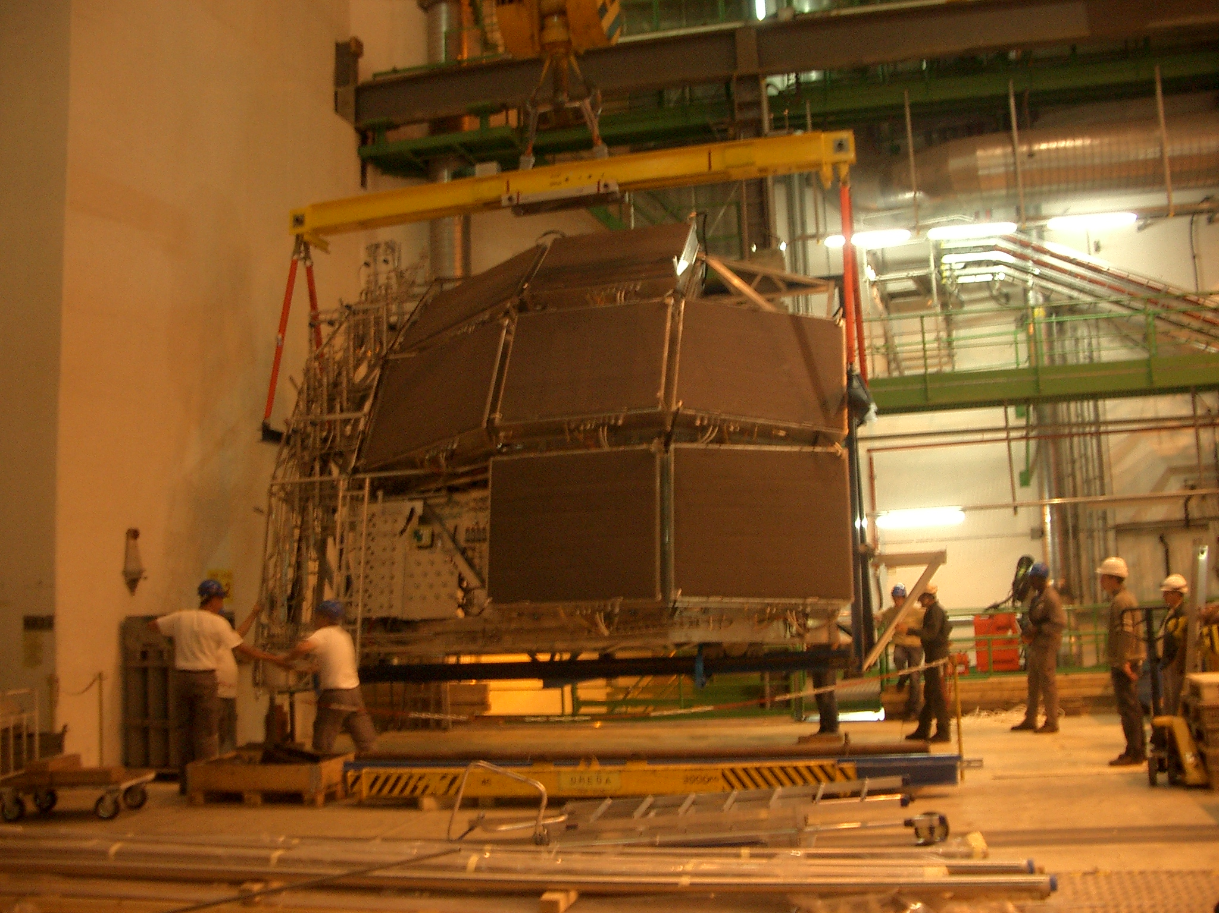
Review of HMP installation: Sept 2006
From the surface down in the experimental site
Arriving in the cavern UX25

Slide 8
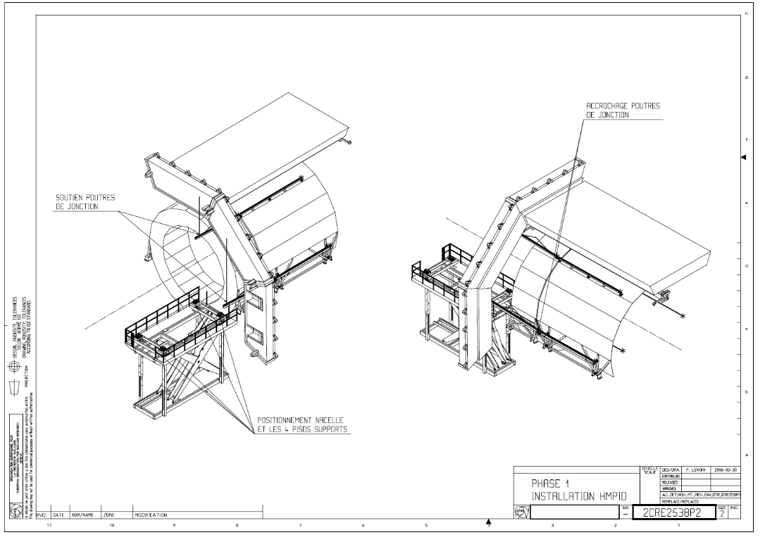
Review of HMP installation: Sept 2006

Slide 9
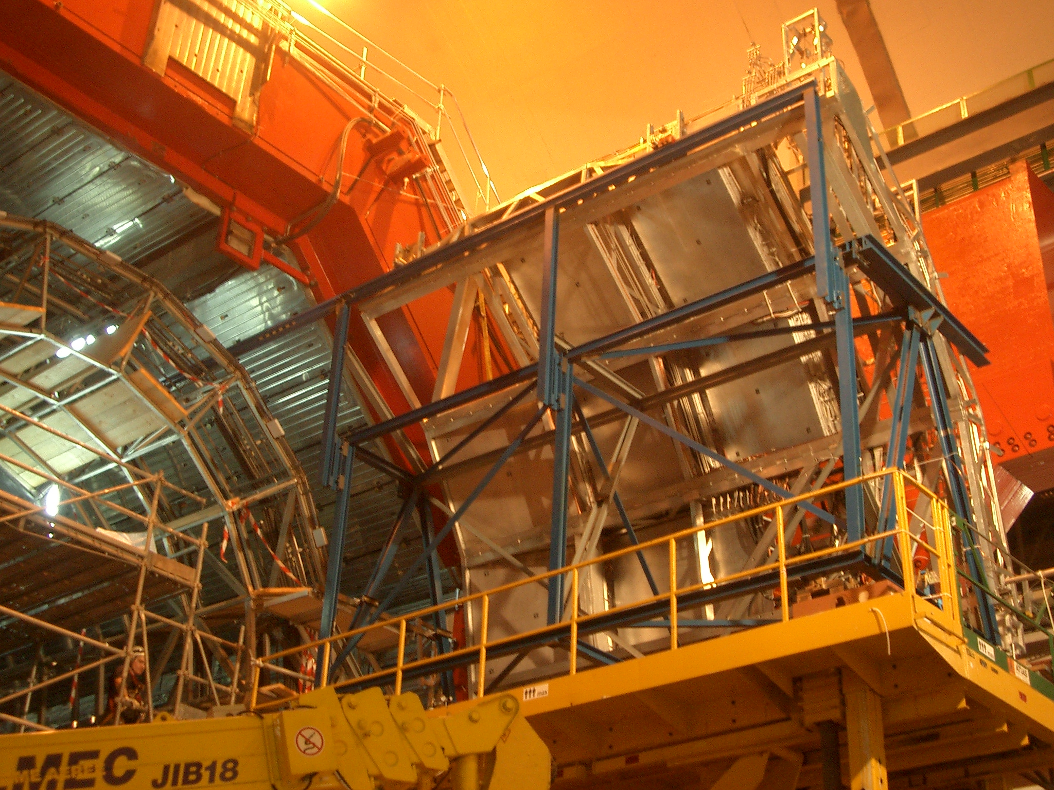
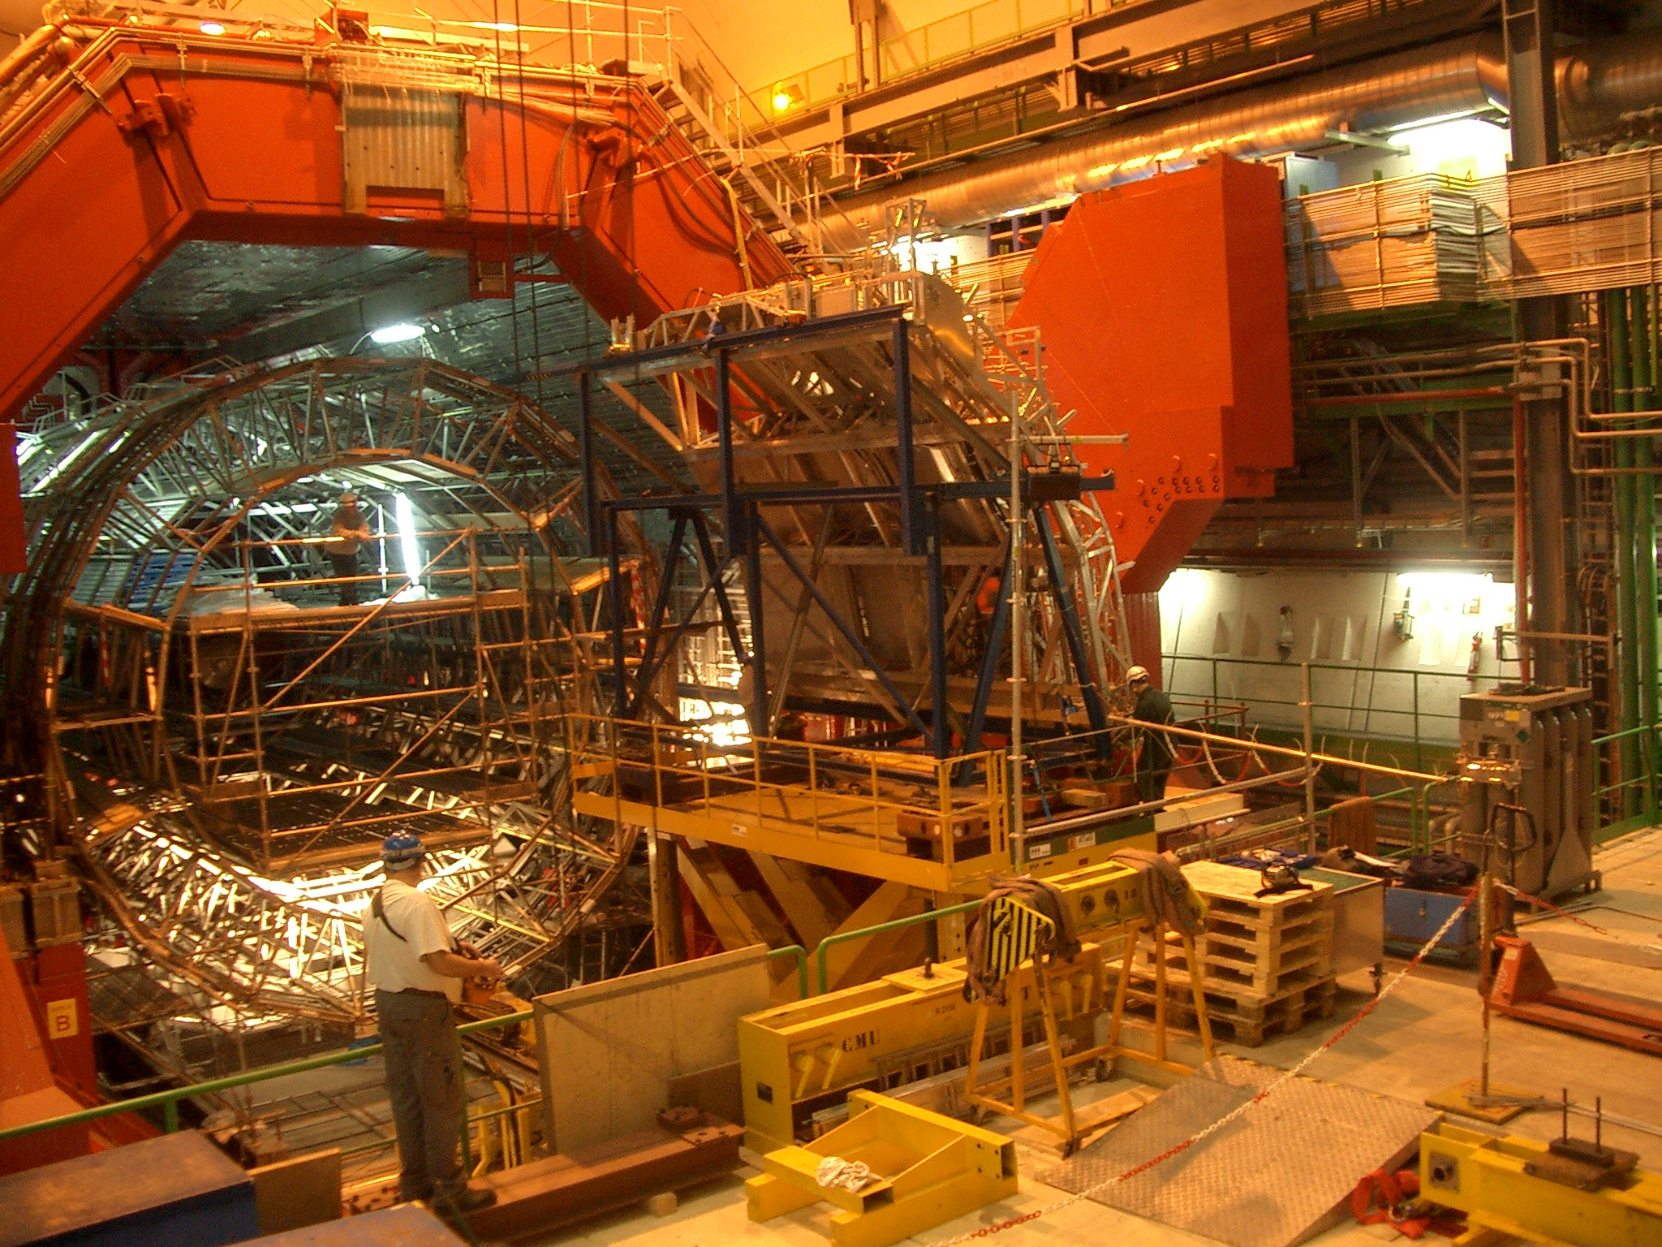
Review of HMP installation: Sept 2006
Preparing HMP insertion in L3 magnet
Top transfer rail
Lifting platform
Lifting platform
Installation of transfer rails

Slide 10
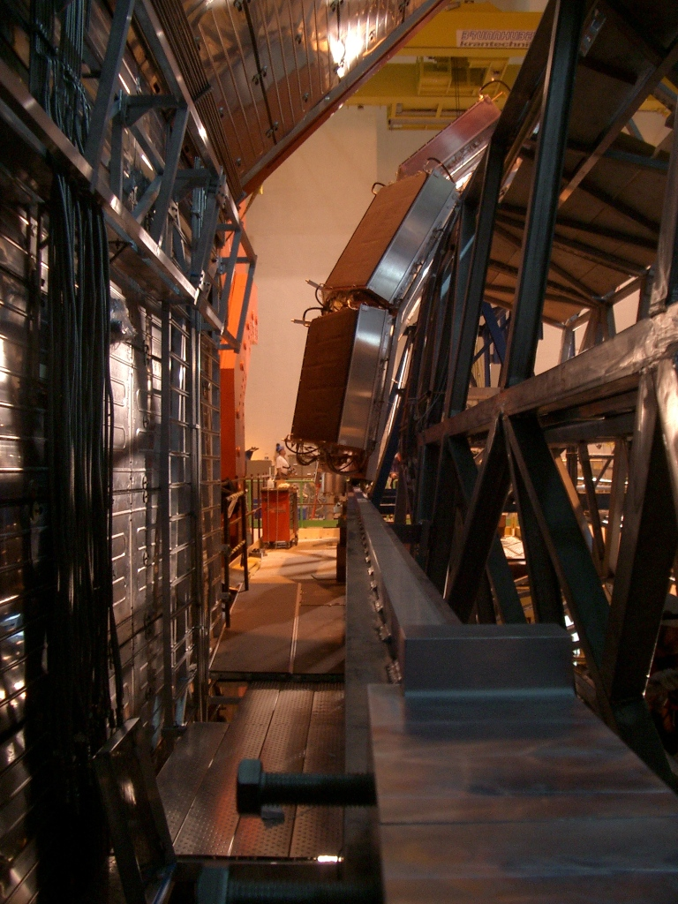
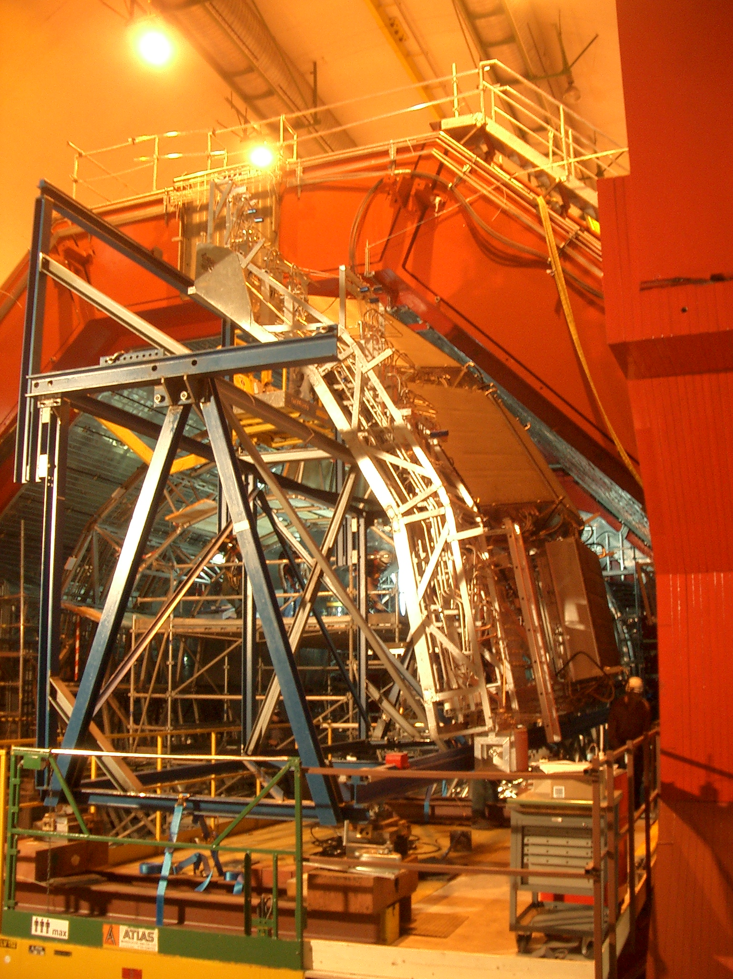
Review of HMP installation: Sept 2006
HMP pulled(/pushed?) in by the insertion trolley’s
(not visible ☹) . To be investigated!!
HMP rail on the ALICE space frame in the magnet
bottom transfer rail
Fixing belts of the cradle support

Slide 11
Review of HMP installation: Sept 2006
No photos in the archive for the mounting on the cradle of C₆F₁₄ intermediate tank 1.

Slide 12
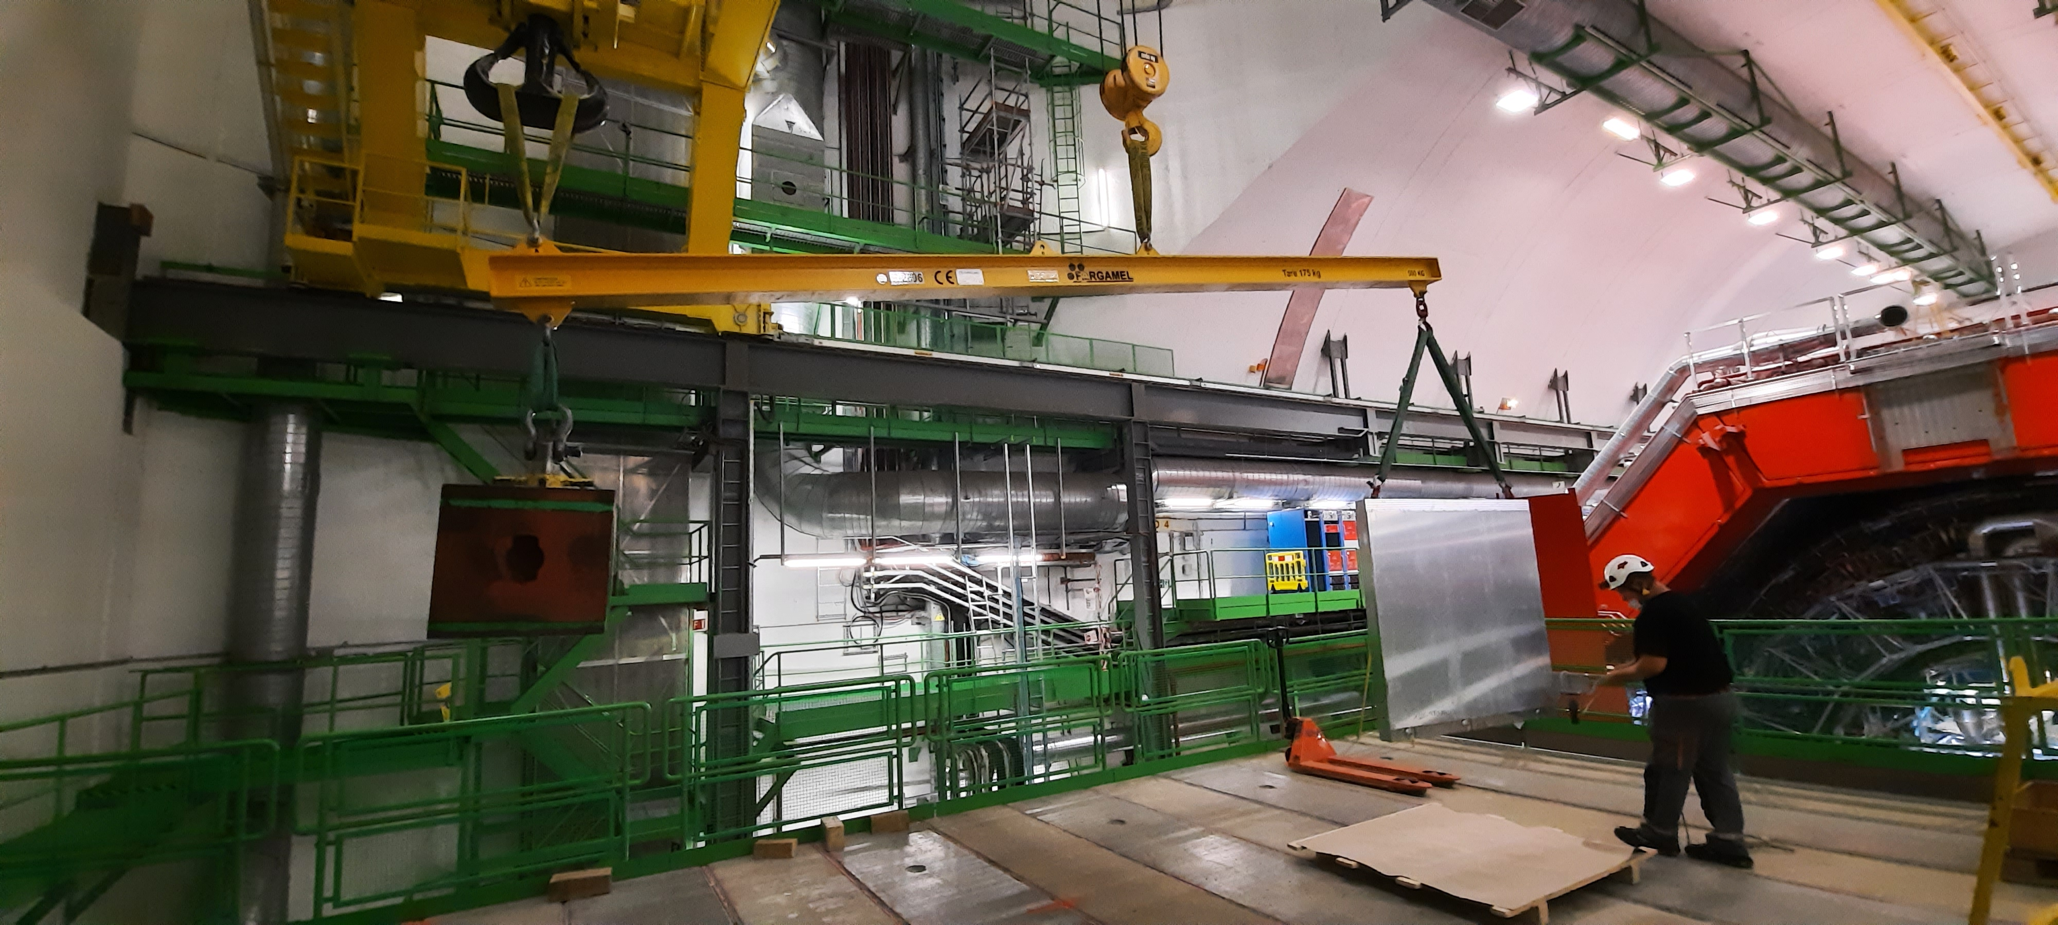
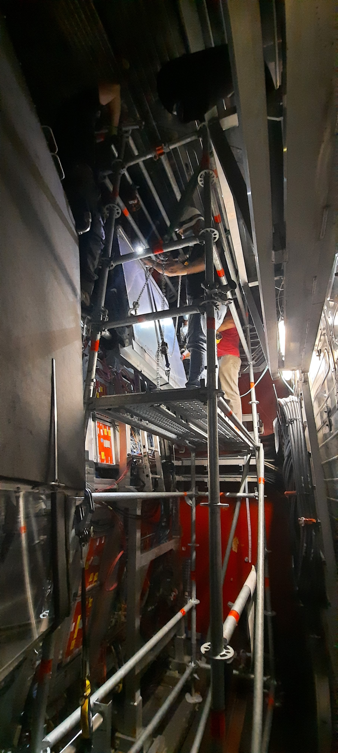
Absorber installation : June 2021

Slide 13
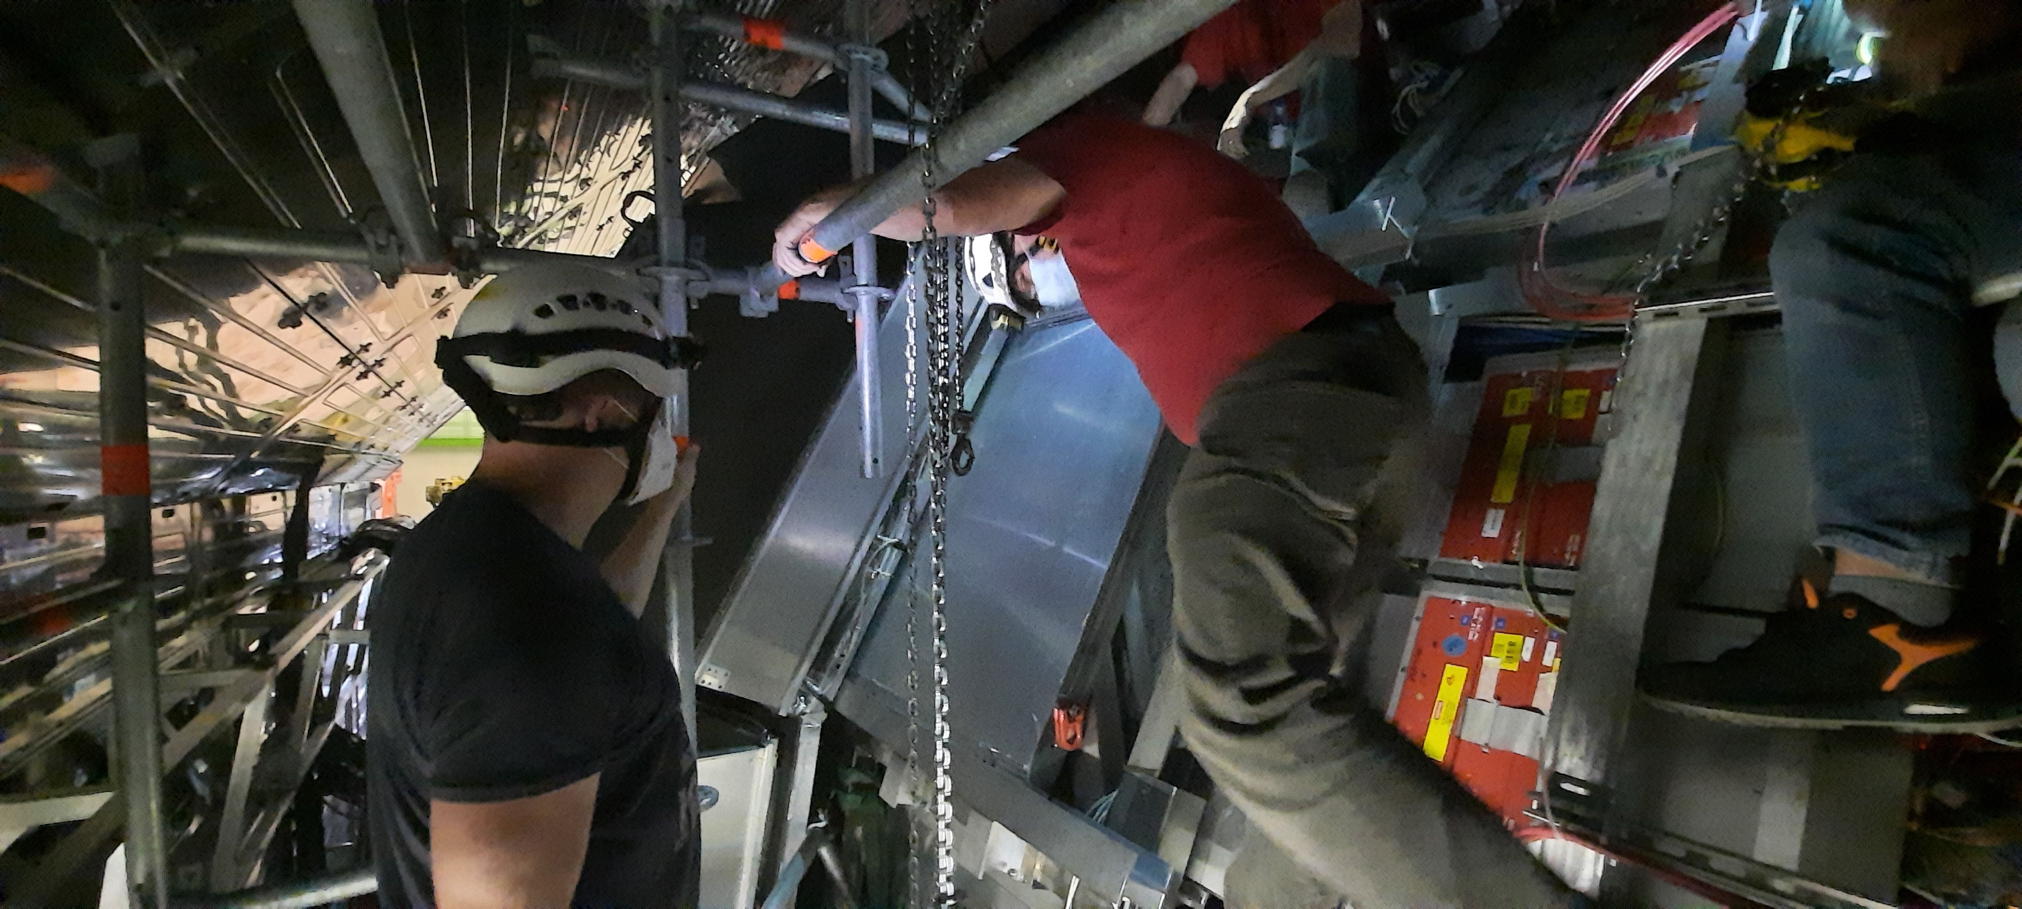
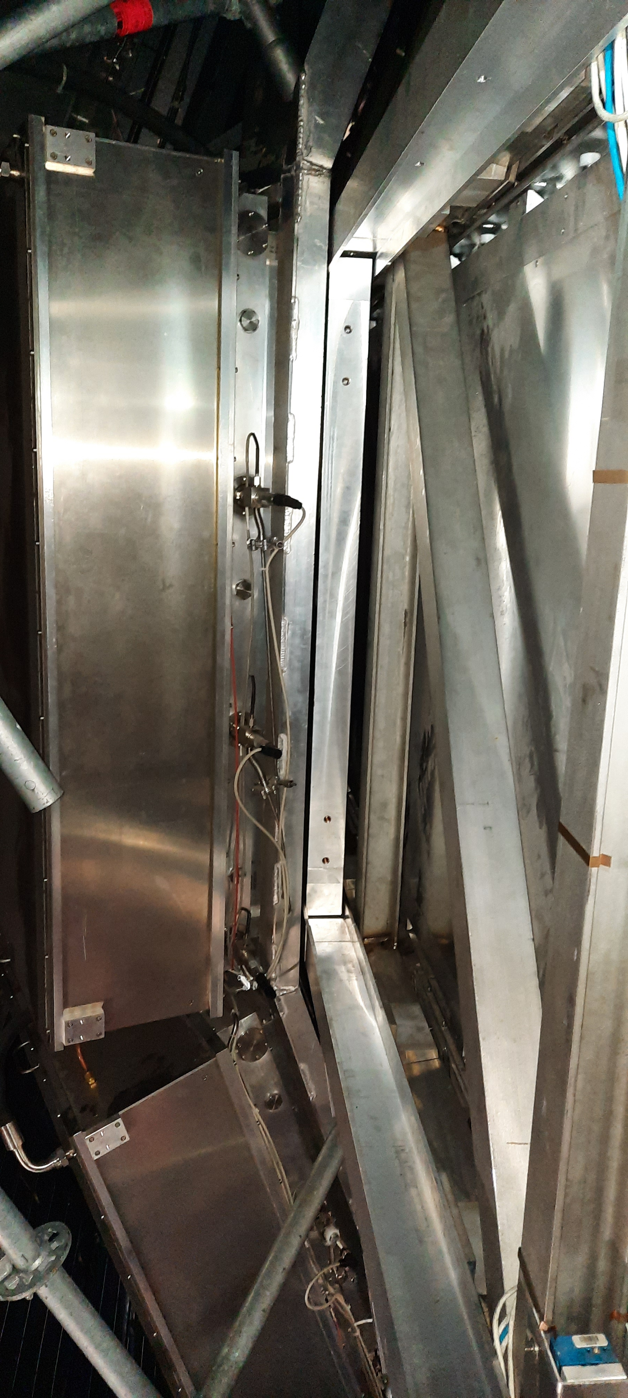
Absorber installation on module
4 and 2

Slide 14
Temporary Summary
Aluminum absorbers:
  1) must be removed to allow the installation of the HMPID cradle on the support structure??
  2) stay mounted since the HMPID installation on the support structure is still possible ??
Bleu support structure of the cradle: to be find and restored. If not available, new project for its production? ☹
CR4 and CR5 devices removal: planning?
Conclusion : so far, no actions spot in UX25 to be carried out during the YETS 2024-2025

Slide 15
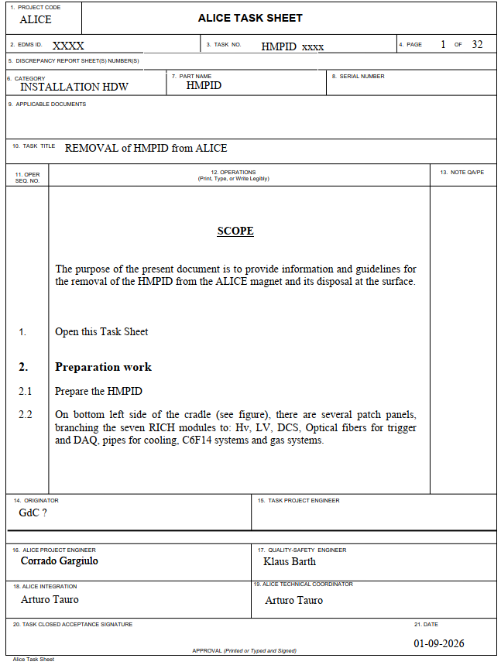
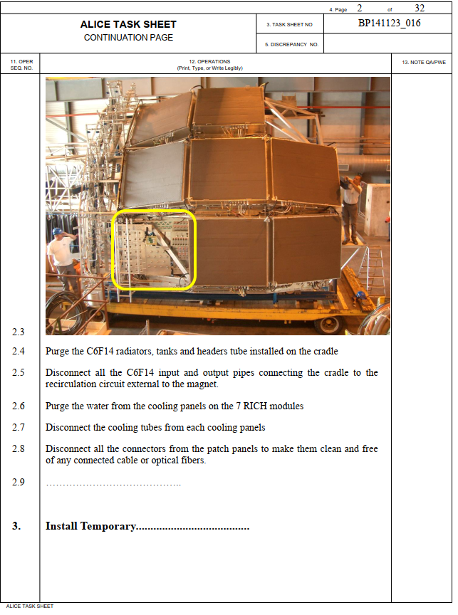
Preparation of the new document for the HMP removal

