Slide 1


Redesign of the CLIC Main Beam Injector Complex
Y. Zhao, S. Doebert, A. Grudiev, A. Kurtulus, A. Latina, CERN
Revised version after CLIC Project Meeting
20/01/2025

Slide 2
Outline
Introduction
New injector complex design
Beam based alignments
Jitter amplifications
Conclusions

Slide 3
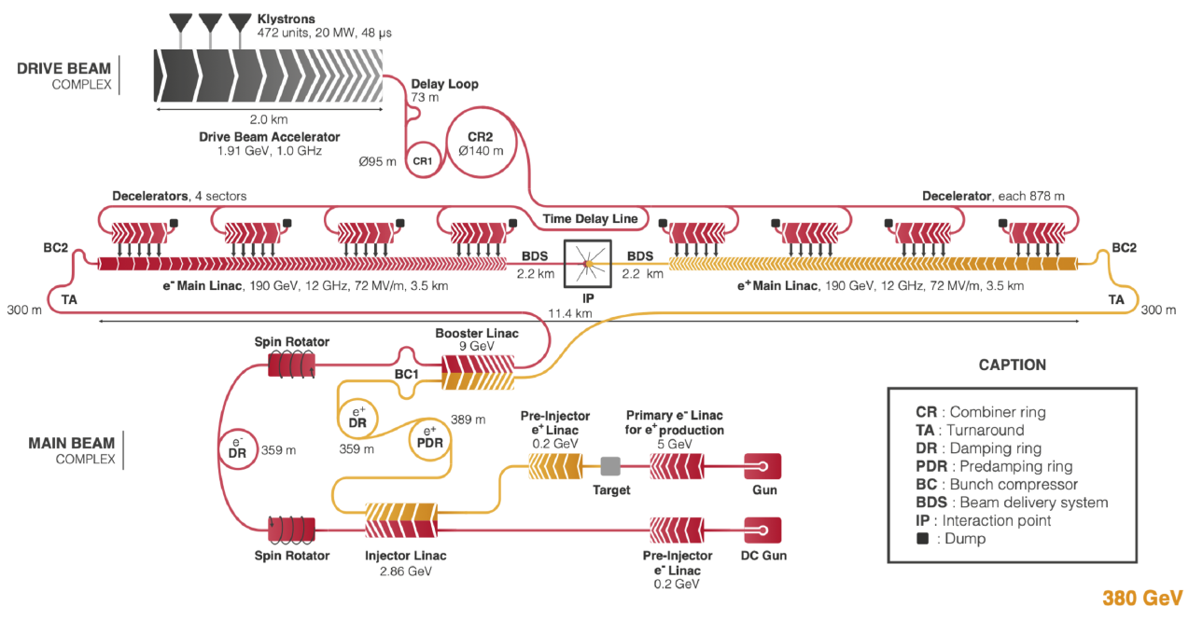
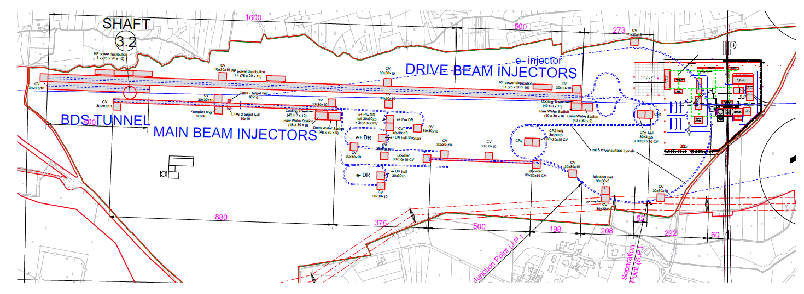
Introduction
CLIC collider complex and Main Beam (MB) Injector complex
(DBA @ 380 GeV)
MB Injector Complex
(Image credit: CLIC)
Baseline (old) design
(Image credit: CLIC)

Slide 4
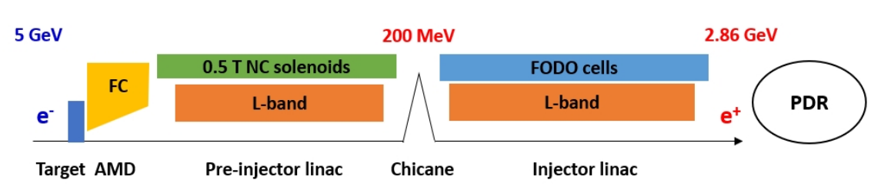
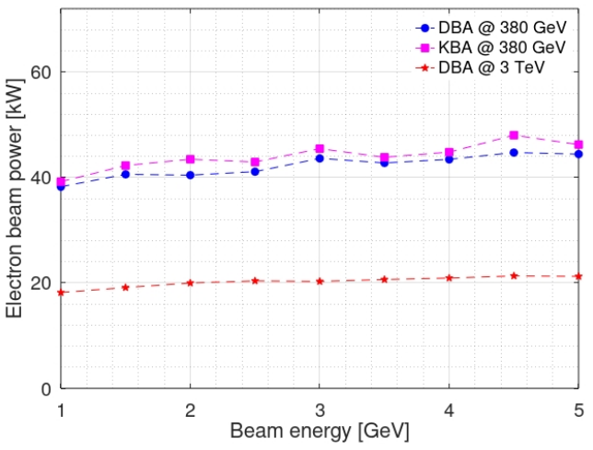
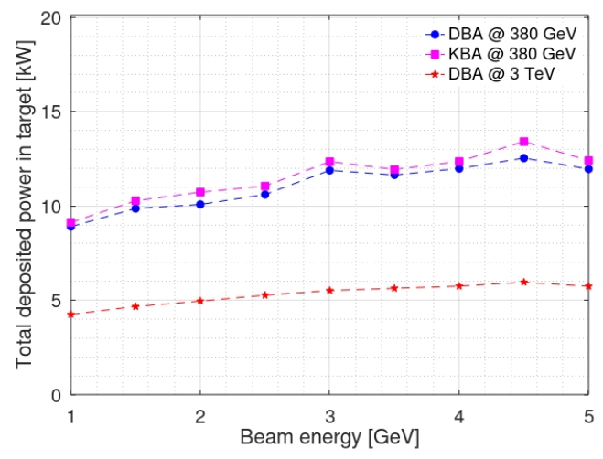
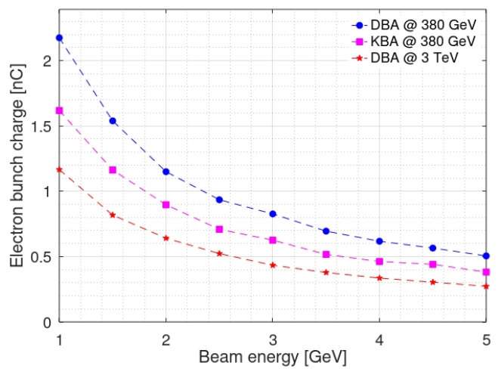
Introduction
Based on our latest e+ source simulation (CLIC-Note-1200), it is possible to reduce the e- beam energy from 5 GeV to ~2.3 GeV (assuming 1 nC max.)

Slide 5
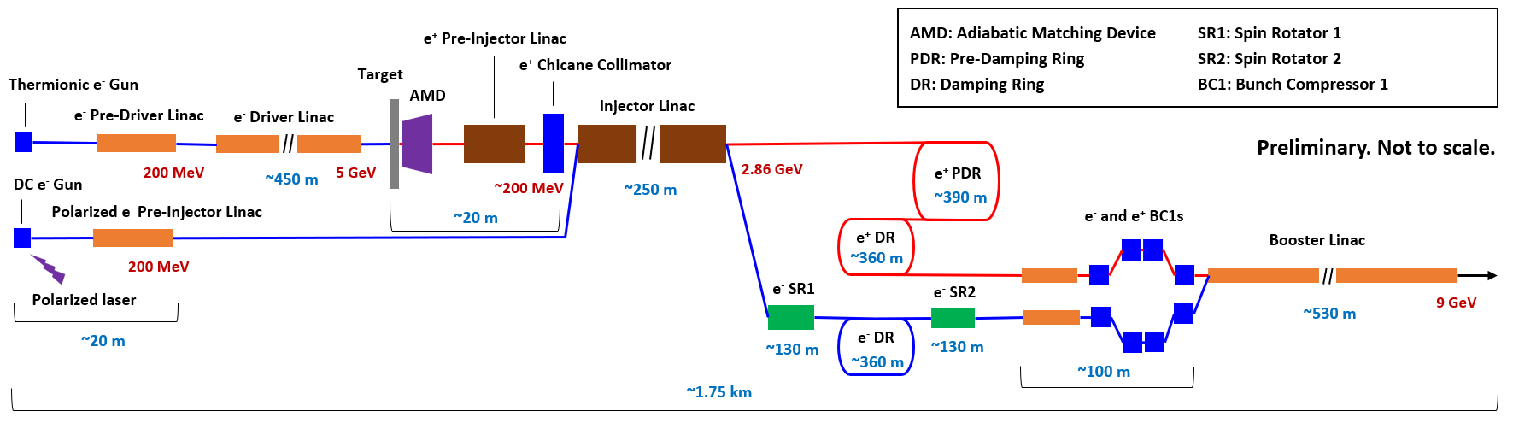
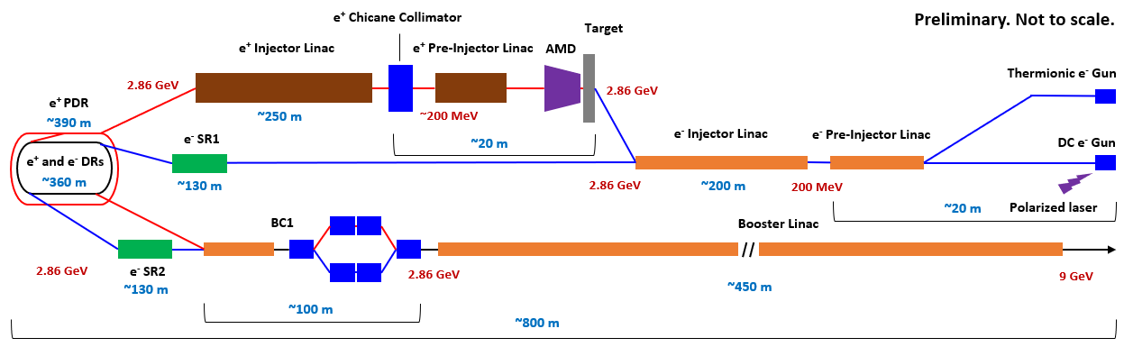
New injector complex design
Baseline (old) design schematic layout
Alternative (new) design schematic layout – In progress

Slide 6
New injector complex design
We currently only focus on the (re)design of:
  e- Injector Linac, e+ Source, BC1 Linac, Booster Linac
New 3 m long RF acc. structures are used (as Adnan presented), replacing the 1.5 m “CLIC L-band” structure (a = 20—14 mm)
e+ Source linacs requires larger aperture (a ≥ 20 mm) due to large beam size. Other linacs can use smaller aperture (a < 20 mm)

Slide 7
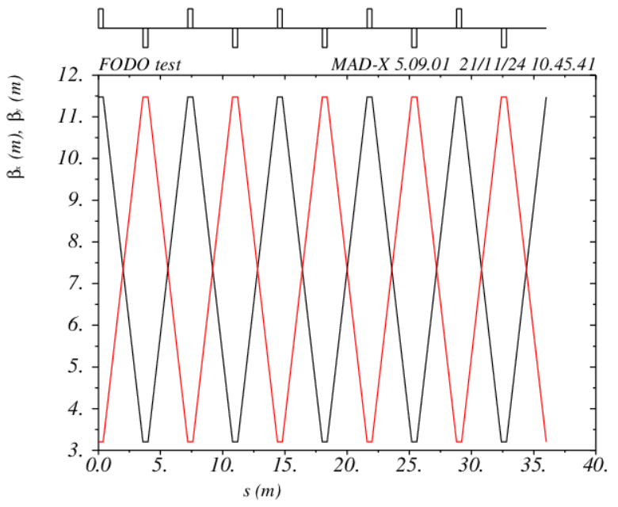
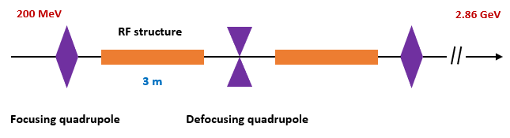
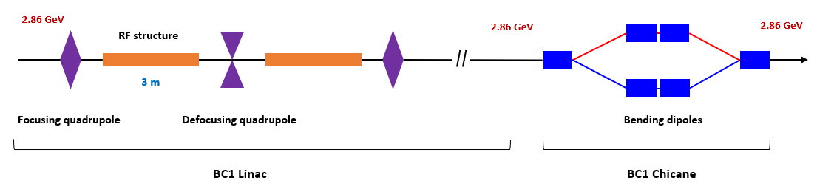
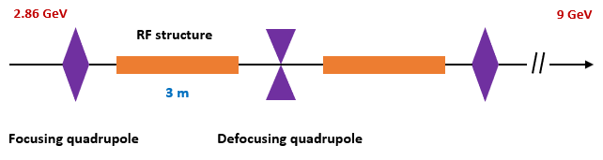
New injector complex design
Design of e- linacs
e- Injector Linac
BC1 Linac
FODO phase advance: 76.345°
Spacing 3.2 m, k1 ~ 0.8584 m⁻¹
Booster Linac
New L-band RF structure is used
  2 GHz, L = 3 m, a0 = 18 mm (21—15), d0 = 3.66mm (3.26—4.06)
  60 cells, 2π/3 phase advance per cell
Doubling number of structures between quads increases jitter amplification significantly (e.g. F = 1.1 → 1.3 in Booster Linac), though misalignment effect is smaller

Slide 8
New injector complex design
Design parameters and results for e- linacs (DBA@380 GeV)
  Simulation using RF-Track (Gaussian bunch w/ collective effects)
  Voltages for BC1 and Booster Linac are from our latest RTML optimization (CLIC-Note-1199). Energy losses in arcs are compensated with higher gradient
Parameter | e- Injector Linac | BC1 Linac | Booster Linac
Bunch charge | ~1.0 nC | ~0.83 nC | ~0.83 nC
E | 0.200—2.86 GeV | 2.86 GeV | 2.86—9.01 GeV
E spread | 1%—0.15% | 0.12%—1.2% | 1.2%--0.4%
Bunch length | 1 mm | 1.8 mm | ~410 um
Emittance [X, Y] | Ploar.: [10, 10] um Unpol.: [50, 50] um | [700, 5] nm | [~704, 5] nm
Structures (w/ spare modules) | 58+2 | 10+2 | 124+4
Length (w/ spare modules) | ~249 m | ~50 m | ~531 m
Gradient | 15.347 MV/m | 15.017 MV/m | 16.579 MV/m

Slide 9
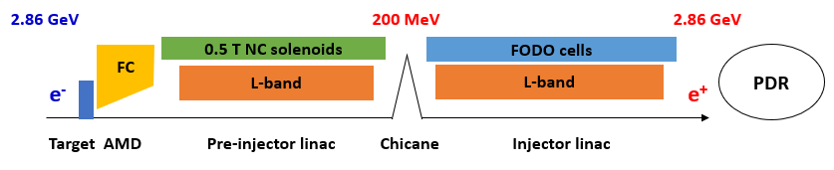
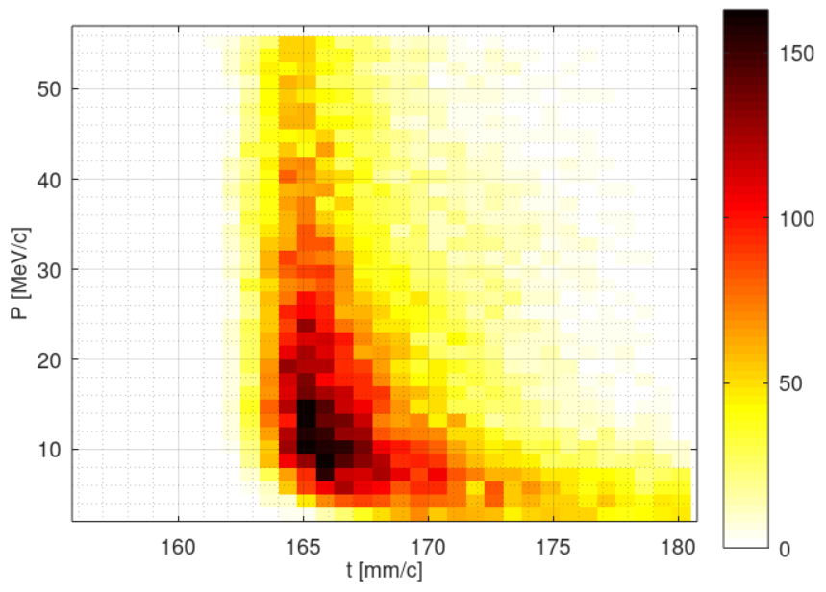
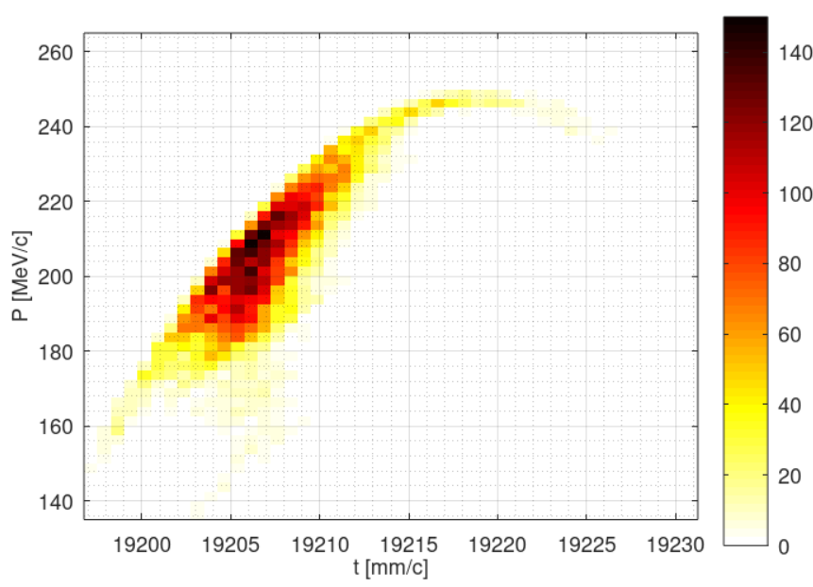
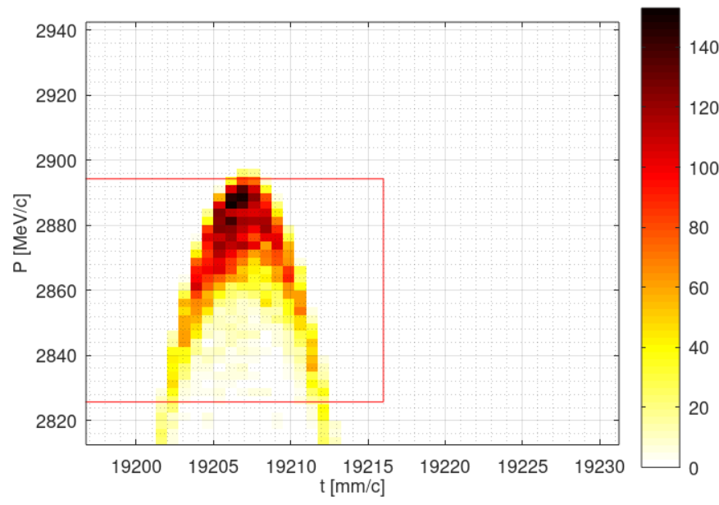
New injector complex design
New e+ Source design is much more complicated and is in progress
Preliminary test (6D simulation to 200 MeV) shows expected results, that, assuming a 10% loss in the Injector Linac and a 20% loss in PDR & DR:
  PDR accepted e+ yield ~ 1.0, Electron bunch charge ~ 1.0 nC, PEDD ~ 33 J/g (required: < 35 J/g)
New e- E spread (rms) | 0.15%
New e- spot size (rms) | 2.5 mm
New target thickness | 16.5 mm
AMD exit Pre-Injector Linac exit Injector Linac exit

Slide 10
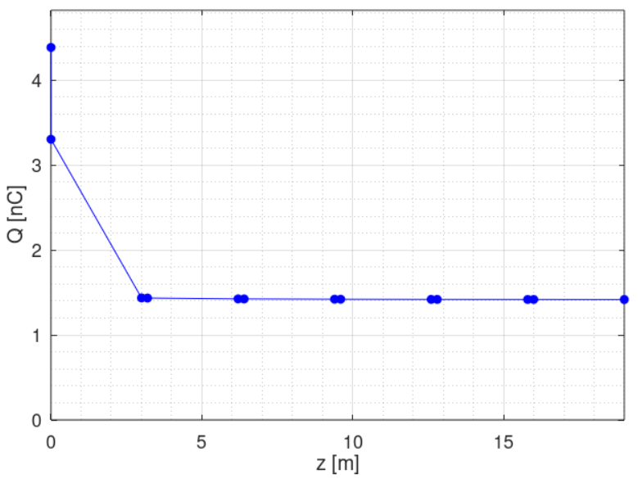
New injector complex design
e+ bunch charge evolution in Pre-Injector Linac
  Assuming a 1 nC e- beam

Slide 11
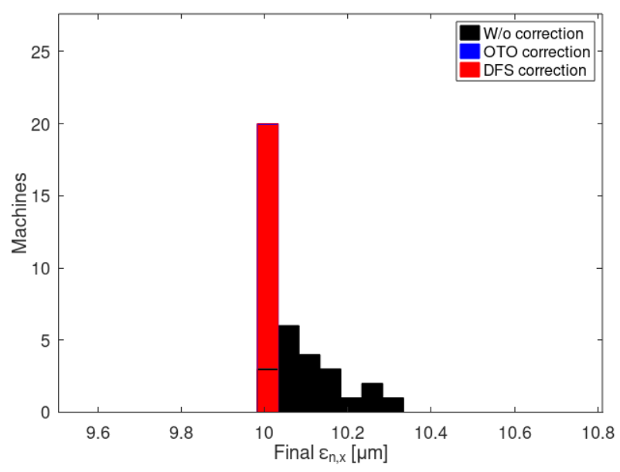
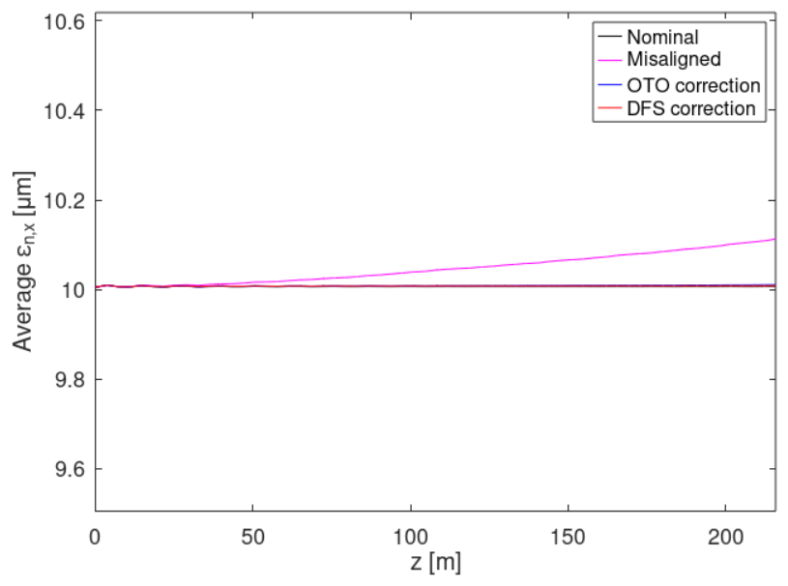
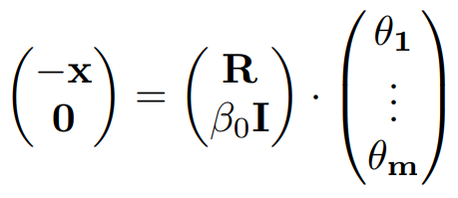
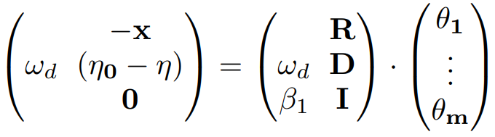
Beam based alignments
Beam based alignment (BBA) for e- Injector Linac
Misalignments
  Position error (x, y): σ = 100 um (Quads, RFs, BPMs)
  Angular error (roll, pitch, yaw): σ = 100 urad (Quads, RFs, BPMs)
  BPM resolution: σ = 1 um
  More in progress
BBA methods (typical approches)
  One-To-One (OTO) orbit correction
  Dispersion-Free Steering (DFS) correction
Well corrected.

Slide 12
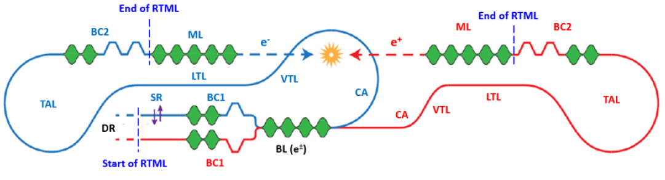
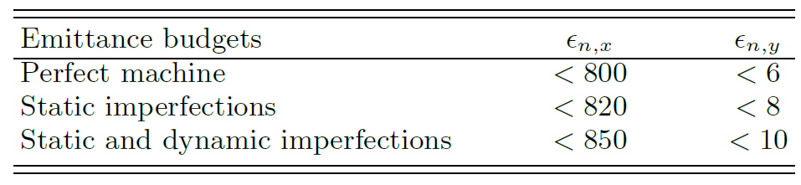
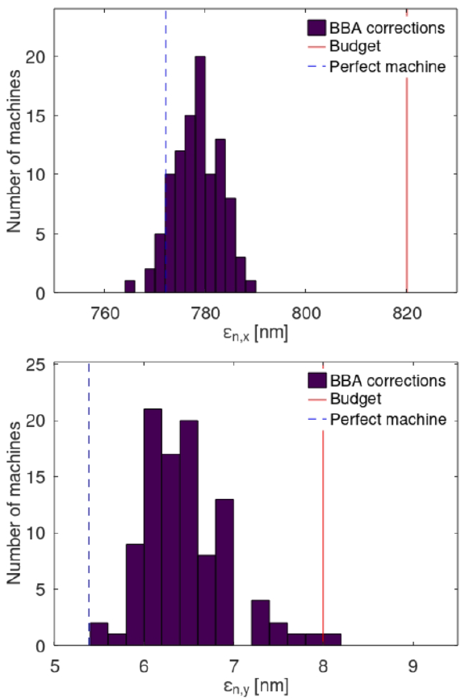
Beam based alignments
BBA for BC1 and Booster Linac is not particularly studied, as they are already included in the Rings-To-Main-Linac (RTML) beamline, where a complicated start-to-end BBA is applied with tight emittance growth budgets in RTML (CLIC-Note-1199)
Required: ≥ 90% good machines
Achieved: 99% (1% ε measurement error)
Achieved: 94% (10% ε measurement error)
Preliminary tests show that BBA could still work with structure aperture for BC1 and Booster Linac reduced from a0 = 17 mm to even a0 = 11 mm

Slide 13
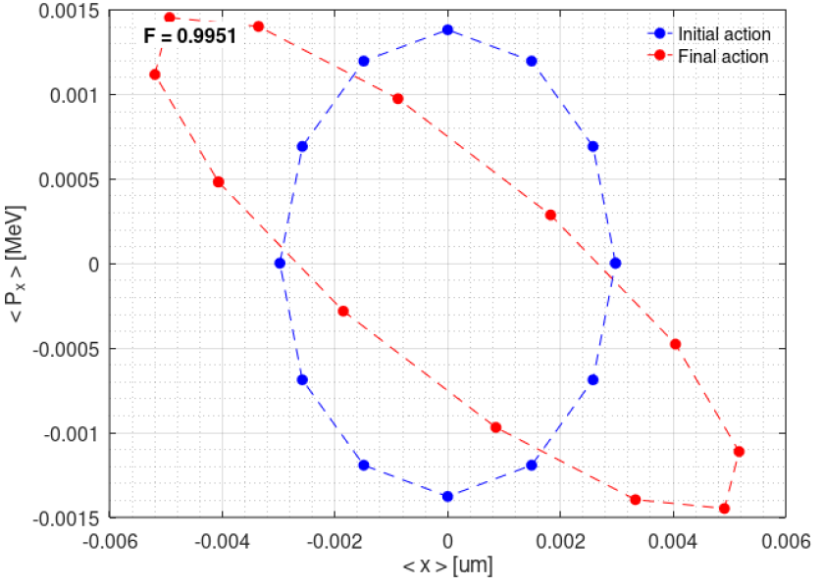
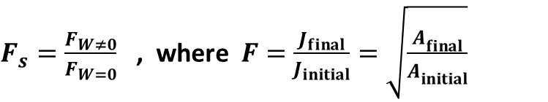
Jitter amplifications
Jitter amplification due to short-range wakefield (SRWF) is studied for Booster Linac (old design). Simulation using RF-Track
Initial jitter assumed: 10%*σ(X, Px). Amplification independent on initial jitter
Jitter amplification factor definition:
${F_{s}=\frac{F_{W≠0}}{F_{W=0}}}_{}$, where ${F=\frac{J_{final}}{J_{initial}}=\sqrt{\frac{A_{final}^{}}{A_{initial}^{}}}}_{}$
J: jitter, A: Action (ellipse area)
Jitter amplification factor (Fs) | Value
W/o SRWF | 0.986
W/ SRWF | 0.995
Due to SRWF | 1.01
Fs < 1 even w/o SRWF, due to the BNS damping effect (when E spread > 0)

Slide 14
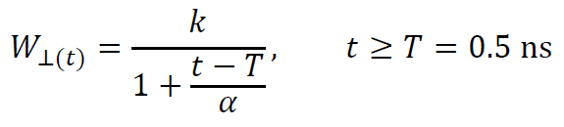
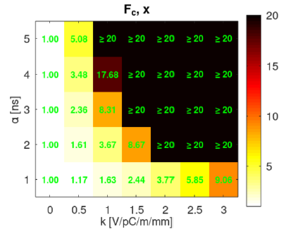
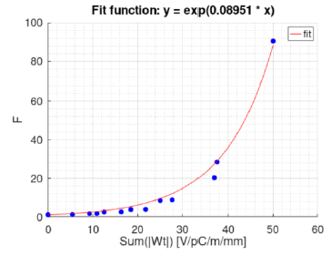
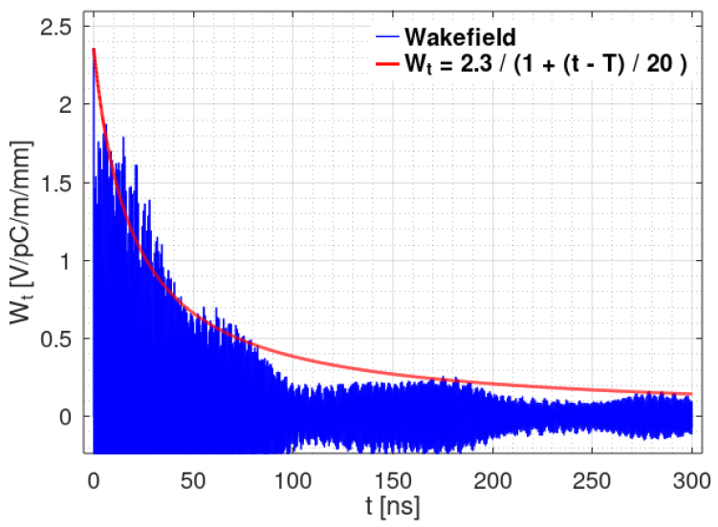
Jitter amplifications
Jitter amplification due to long-range wakefield (LRWF) is studied in steps:
  Definition of wake criteria from jitter amplification study, using an approximate wake envelope function (though effect is overestimated with envelope). A 2D scan is performed with different parameters (k, α), with single particle simulation (similar to full bunch simulation)
F grows with Sum(|Wt|) over bunches exponentially
Finally, Sum(|Wt|) over bunches < 10 V/pC/m/mm is used as the wake criteria for RF design
Arbitrary LRWF (from a test design)

Slide 15
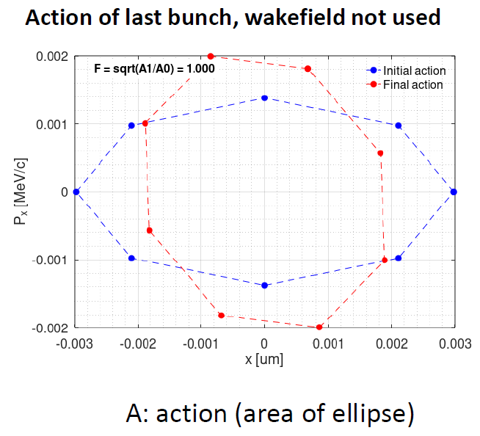
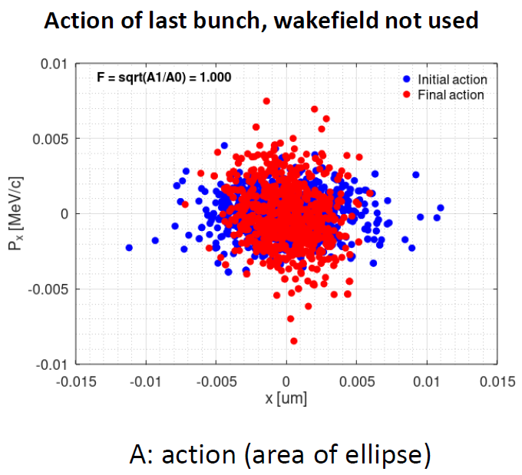
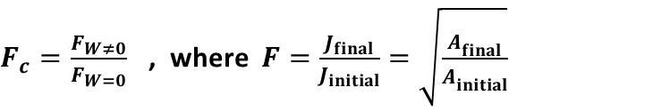
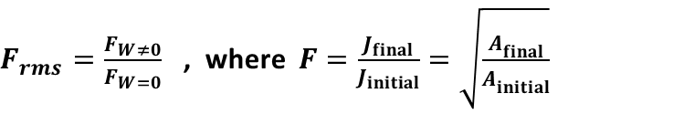
Jitter amplifications
Jitter amplification due to long-range wakefield (LRWF) is studied in steps:
  Definition of wake criteria
  RF structure optimization (see Adnan’s presentation)
  Wake test for jitter amplification
Coherent jitter: trains evenly distributed on the ellipse (bunches have the same position in transverse phase space)
Incoherent jitter: trains randomly distributed in transverse phase space (bunch positions are also random)
${F_{c}=\frac{F_{W≠0}}{F_{W=0}}}_{}$, where ${F=\frac{J_{final}}{J_{initial}}=\sqrt{\frac{A_{final}^{}}{A_{initial}^{}}}}_{}$
${F_{rms}=\frac{F_{W≠0}}{F_{W=0}}}_{}$, where ${F=\frac{J_{final}}{J_{initial}}=\sqrt{\frac{A_{final}^{}}{A_{initial}^{}}}}_{}$

Slide 16
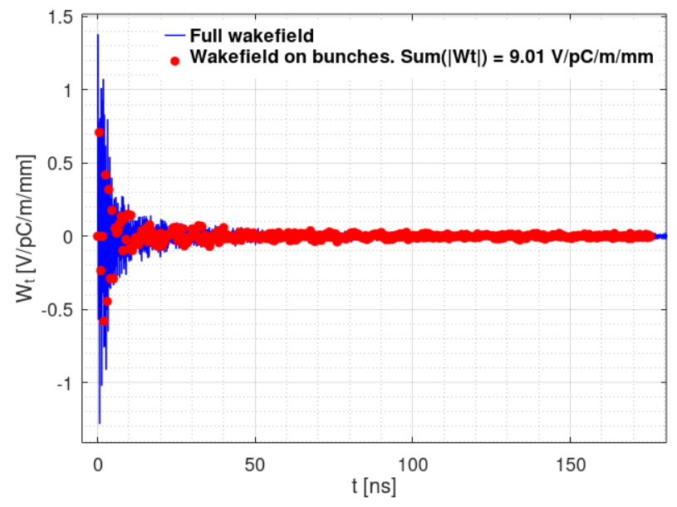
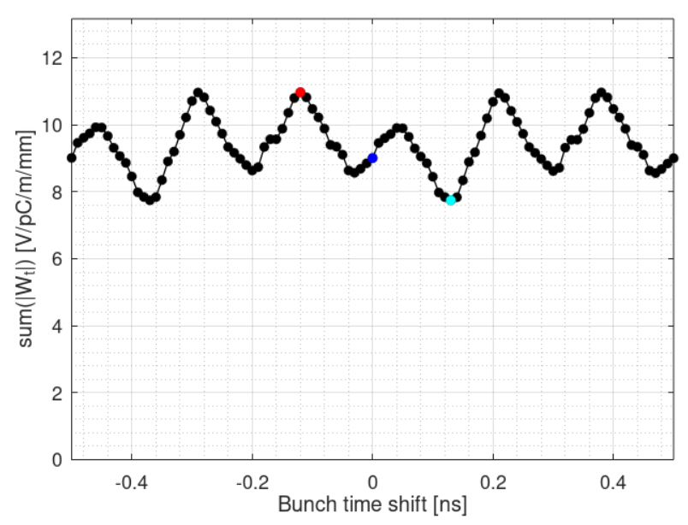
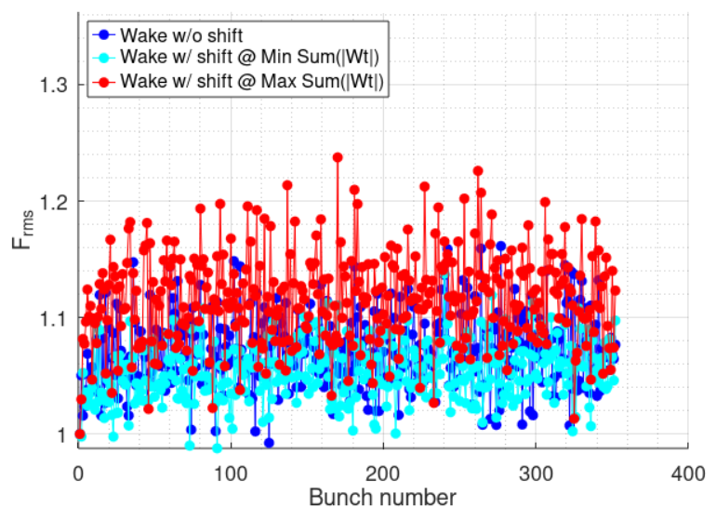
Jitter amplifications
For stability, we shift the wakefield by ±0.5 ns, and take the worst wake (maximum sum(|Wt|)), which proves to be the worst jitter amplification
a0 = 17 mm
Jitter amplification is taken to be the average of the last 200 bunches
  For incoherent jitter, 100 trains are simulated (average is similar to 1000 or more trains)
Jitter amplification | e- Injector Linac | e+ Injector Linac | BC1 Linac | Booster Linac
Fc | 1.01 | In Progress | 1.00 | 1.00
Frms | 1.53 |  | 1.00 | 1.12

Slide 17
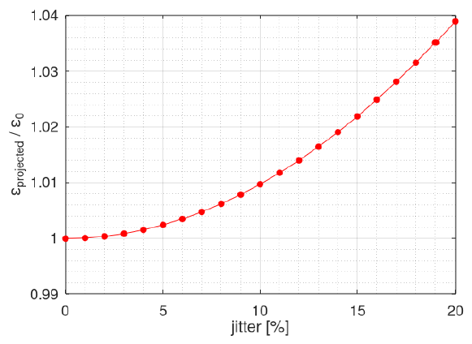

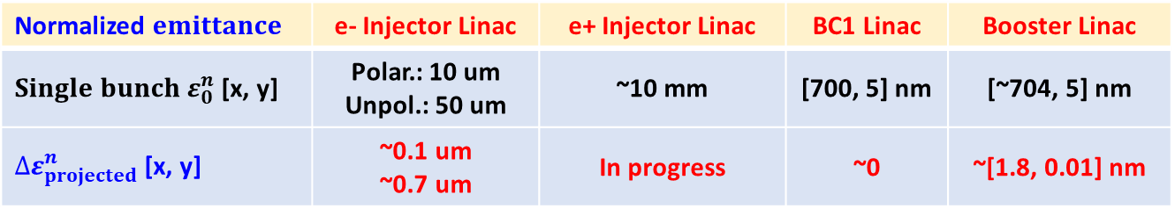

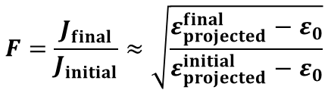

Jitter amplifications
From incoherent jitter amplification to projected emittance growth (full train)
  Taking the average projected emittance of randomly jittered trains
$\frac{ε_{projected}^{}}{ε_{0}}≈1+J^{2}$ ,
$$J_{}≈\sqrt{\frac{ε_{projected}^{}}{ε_{0}}−1}$$
$$F=\frac{J_{final}}{J_{initial}}≈\sqrt{\frac{ε_{projected}^{final}−ε_{0}}{ε_{projected}^{initial}−ε_{0}}}$$
$$Δε_{projected}^{}≈ε_{0}∙J_{initial}^{2}∙\left(F^{2}−1\right)$$
So the projected emittance growth can be estimated (e.g. 10% initial jitter):
Normalized $emittance$ | e- Injector Linac | e+ Injector Linac | BC1 Linac | Booster Linac
${Single bunch ε}_{0}^{n}$ [x, y] | Polar.: 10 um Unpol.: 50 um | ~10 mm | [700, 5] nm | [~704, 5] nm
$Δε_{projected}^{n}$ [x, y] | ~0.1 um ~0.7 um | In progress | ~0 | ~[1.8, 0.01] nm

Slide 18
Conclusions
CLIC Main Beam Injector complex redesigned with simplified layout. Much shorter total length and e- Injector Linac length
Study focused on Drive beam-Based Acceleration (DBA) mode @ 380 GeV
Preliminary study of misalignments. Well corrected with BBA
Jitter amplifications in the linacs estimated, that are small and acceptable
Work in progress
  Reoptimise e+ source, including e+ Injector Linac redesign
  Update RTML design and BBA study using new BC1 Linac and Booster Linac
  RTML e+ beam transfer lines redesign for Civil Engineering consistency, though not included in the Injector Complex

Slide 19
BACKUP

Slide 20
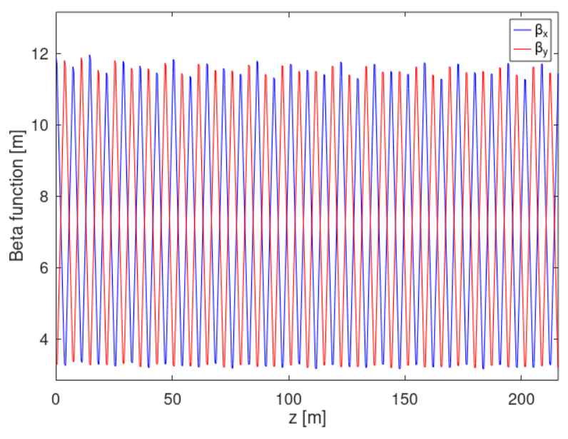
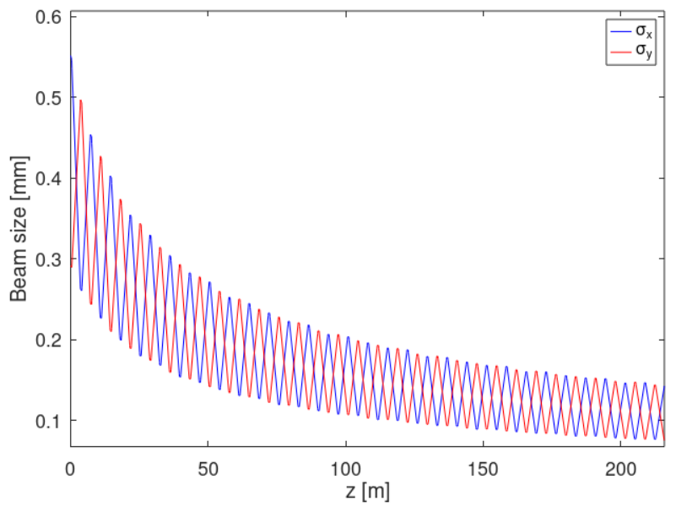
New e- Injector Linac design
Results from RF-Track
Parameter | Unit | Value
Final E | GeV | 2.860
Final E spread | % | 0.15
Emittance growth | um | 0

Slide 21
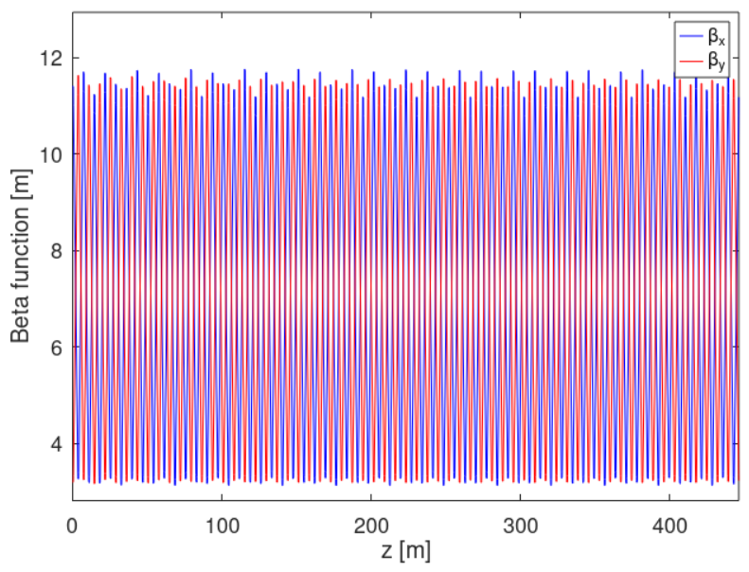
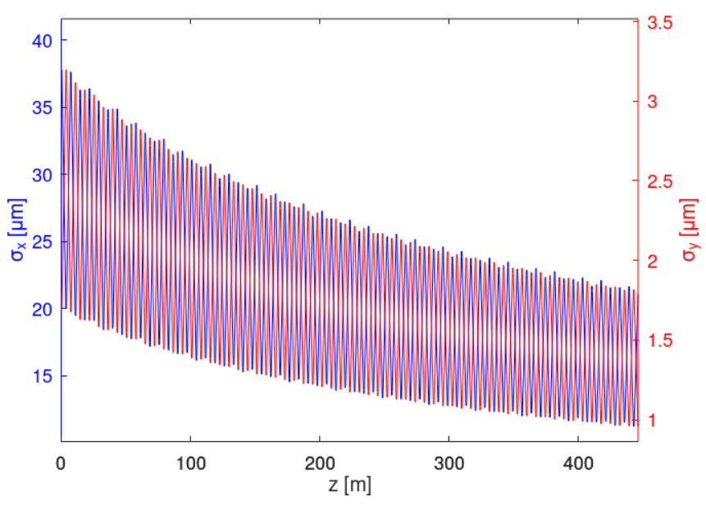
New Booster Linac design
Results from RF-Track
Parameter | Unit | Value
Final E (energy losses in RTML considered) | GeV | 9.010
Final E spread | % | 0.39
Emittance growth | nm | 0

