Slide 1
CLIC MB Injector Summary Tables
Kurtulus, A. Grudiev, S. Doebert, A. Latina, Y. Zhao
20/01/2025

Slide 2
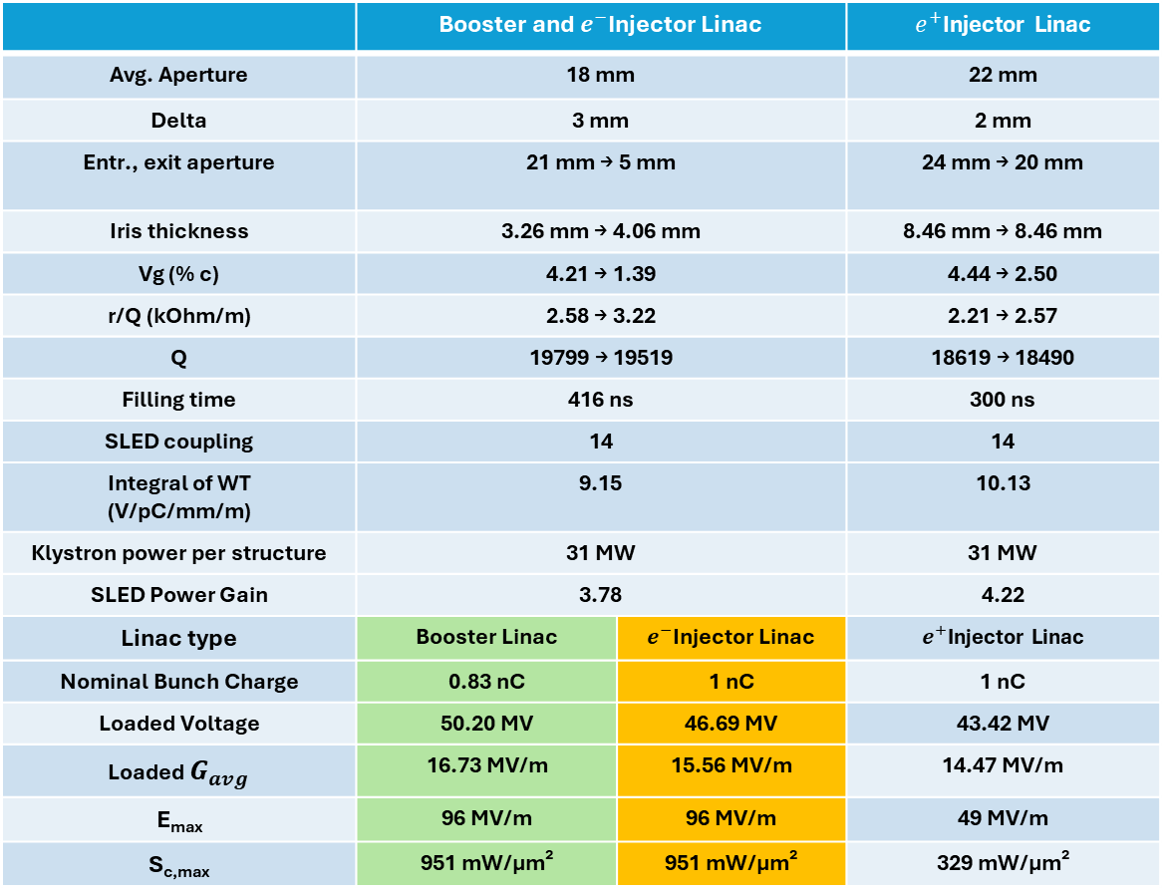
CLIC Booster, $e^{−}$ and $e^{+}$ Injector Linac Structure Parameters
f = 2 GHz, Length = 3m, Phase advance = 2π/3, Q_{0,SLED} = 2e5, T_{klystron} = 5 us
 | Booster and $e^{−}$Injector Linac |  | $e^{+}$Injector Linac
Avg. Aperture | 18 mm |  | 22 mm
Delta | 3 mm |  | 2 mm
Entr., exit aperture | 21 mm → 5 mm |  | 24 mm → 20 mm
Iris thickness | 3.26 mm → 4.06 mm |  | 8.46 mm → 8.46 mm
Vg (% c) | 4.21 → 1.39 |  | 4.44 → 2.50
r/Q (kOhm/m) | 2.58 → 3.22 |  | 2.21 → 2.57
Q | 19799 → 19519 |  | 18619 → 18490
Filling time | 416 ns |  | 300 ns
SLED coupling | 14 |  | 14
Integral of WT (V/pC/mm/m) | 9.15 |  | 10.13
Klystron power per structure | 31 MW |  | 31 MW
SLED Power Gain | 3.78 |  | 4.22
Linac type | Booster Linac | $e^{−}$Injector Linac | $e^{+}$Injector Linac
Nominal Bunch Charge | 0.83 nC | 1 nC | 1 nC
Loaded Voltage | 50.20 MV | 46.69 MV | 43.42 MV
Loaded $G_{avg}$ | 16.73 MV/m | 15.56 MV/m | 14.47 MV/m
E_{max} | 96 MV/m | 96 MV/m | 49 MV/m
S_{c,max} | 951 mW/μm² | 951 mW/μm² | 329 mW/μm²

Slide 3

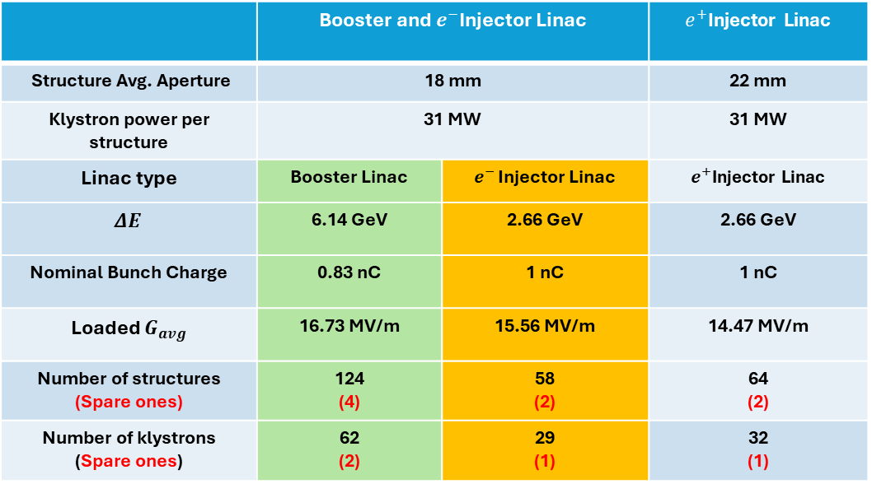


CLIC Booster, $e^{−}$ and $e^{+}$ Injector Linac RF Module
 | Booster and $e^{−}$Injector Linac |  | $e^{+}$Injector Linac
Structure Avg. Aperture | 18 mm |  | 22 mm
Klystron power per structure | 31 MW |  | 31 MW
Linac type | Booster Linac | $e^{− }$Injector Linac | $e^{+}$Injector Linac
$$ΔE$$ | 6.14 GeV | 2.66 GeV | 2.66 GeV
Nominal Bunch Charge | 0.83 nC | 1 nC | 1 nC
Loaded $G_{avg}$ | 16.73 MV/m | 15.56 MV/m | 14.47 MV/m
Number of structures (Spare ones) | 124 (4) | 58 (2) | 64 (2)
Number of klystrons (Spare ones) | 62 (2) | 29 (1) | 32 (1)
Klystron
$P_{k}$
RF Pulse Compressor
$P_{gain}$
Accelerating Structure
Accelerating Structure

