Slide 1
Graphene-optimized Silicon Carbide Detector (GSCD) Plan
WG6 subproject with RG 6.4
Notes:
Now let me show our proposal.

Slide 2
Motivation and Goals
Prototype —GSCD1 Prototype —GSCD2
Graphene
Graphene
electrode
Passivation layer
PIN/LGAD epitaxial structure
electrode
Used as an electrode
Reduces the contact barrier
Graphene is used as an electrode
Goals:
Reduce the contact barrier and improve the P-ohmic contact performance—— GSCD2
Reduces the rising time and improves the time sensitivity of the device.——GSCD1/GSCD2
Notes:
The motive and Goals of this proposal are using graphene to improve charge collection rate and time resolution.
There are two schemes /skiːm/:
1、Using graphene as an electrode to make GSCD one structure detector to remove the metal.
2、The GSCD two structure detector to reduce the contact barrier and improve the P-ohmic
/ˈəʊmɪk/ contact performance.

Slide 3
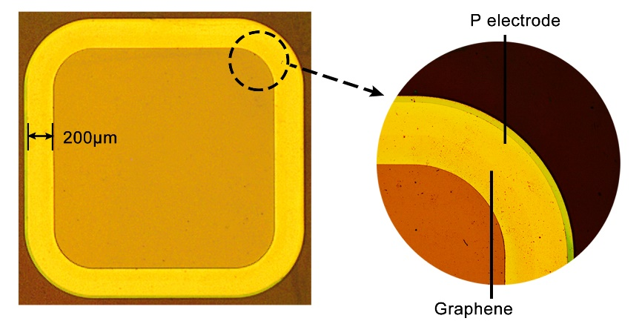
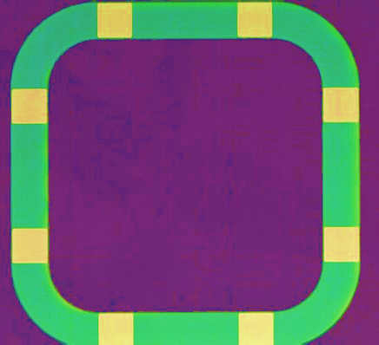
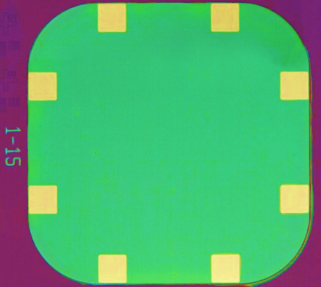
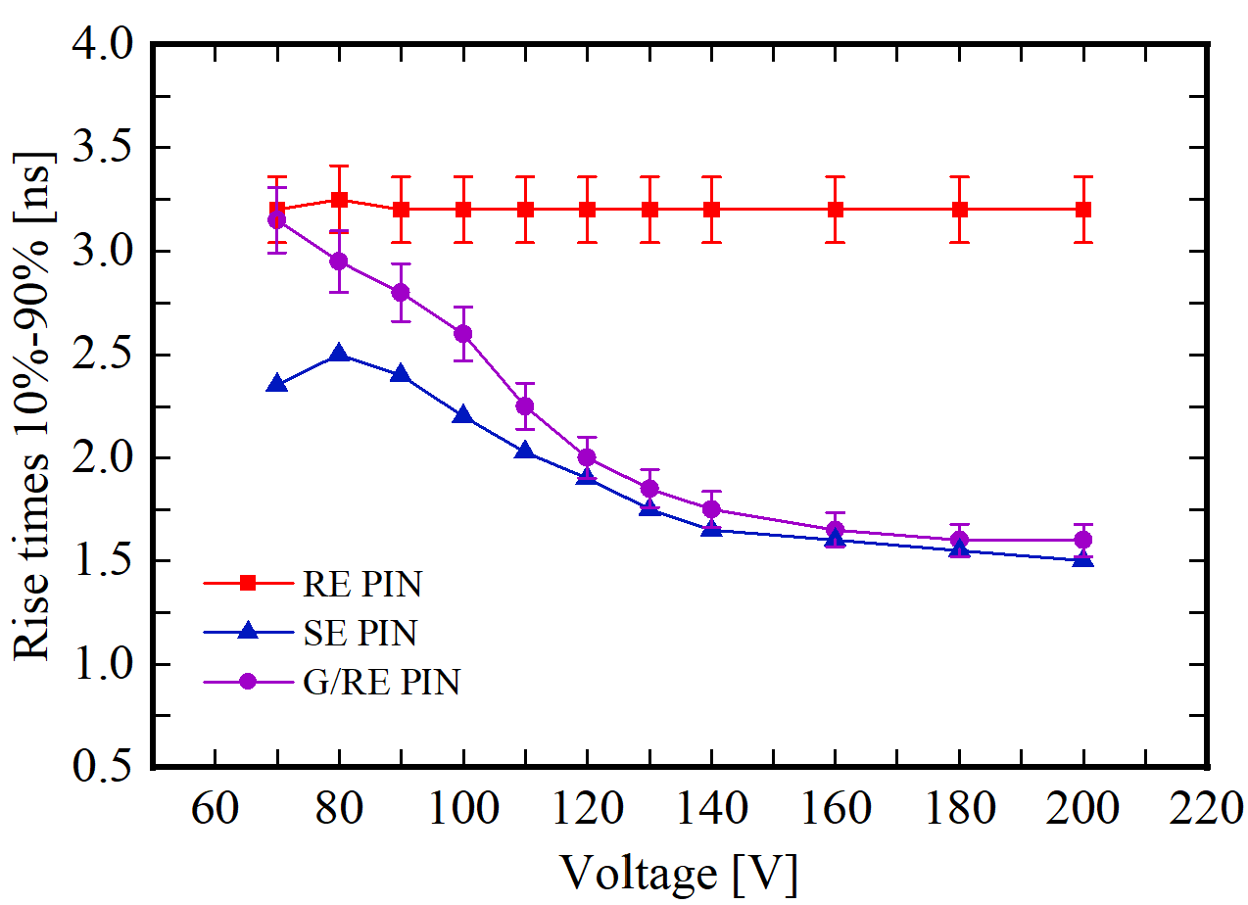
Research Progress——GSCD1(G/RE PIN)
Prototype —GSCD1(G/RE PIN)
Ring Electrode
Ring Electrode
Surface Electrode
Graphene
electrode
Pad
PIN epitaxial structure
electrode
Graphene/Ring Electrode PIN: G/RE PIN
Ring Electrode PIN: RE PIN
Surface Electrode PIN: SE PIN
Rise time（ ＞ 120V）: RE PIN＞ G/RE PIN ≈ SE PIN
A small signal rise time of a device means that the device is more sensitive to time response. The graphene optimizes the RE PIN signal response time and can replace metal for particle detector electrode materials.

Slide 4
Scientific problems to be solved
How to effectively improve charge collection rate and time resolution?
  Using graphene to reduce the contact barrier and improve the P-ohmic contact performance
  Graphene is used as an electrode
How to reduce graphene defects?
  Transfer graphene to direct growth graphene on SiC
Readout electrical board and readout ASICs?
  Improve signal-to-noise ratio
  impedance mismatch
Effect of irradiation on the performance
  Effects of different irradiation types on 4H-SiC devices
  Understanding of temperature dependence
Notes:
We mainly solve the above scientific /ˌsaɪənˈtɪfɪk/ problems:
Firstly How to effectively improve charge collection rate and time resolution?
We can use graphene as an electrode or use it to reduce the contact barrier and improve the P-ohmic contact performance
Secondly, How to reduce graphene defects?
Transfer graphene to direct growth graphene on SiC
Thirdly, Readout electrical board and readout ASICs need to improve signal-to-noise ratio /ˈreɪʃiəʊ/ and impedance mismatch /ɪmˈpiːdns ˌmɪsˈmætʃ/.
Fourthly, Effect of irradiation /ɪˌreɪdiˈeɪʃ(ə)n/ on the performance: Effects of different irradiation types on graphene and SiC; Understanding of temperature dependence

Slide 5
Deliverables & time scales & contributing institutions
No. | Title | Description | Start date | End date | Institutions
Di.1 | Fabrication of Graphene/SiC PIN | Fabrication of Graphene/SiC PIN | 1/2025 | 8/2025 | IHEP
Di.2 | Fabrication of Graphene/SiC LGAD | Fabrication of Graphene/SiC LGAD | 8/2025 | 12/2025 | IHEP
Di.3 | Electronics Readout | Development of the readout single board and ASICs | 6/2025 | 12/2025 | IHEP, IAT
Di.4 | Characterization | IV, CV, Charge collection, time resolution test | 1/2026 | 12/2026 | IHEP, JLU, IAT
Di.5 | Irradiation | Irradiation Graphene/SiC devices | 1/2027 | 6/2027 | IHEP
Di.6 | Study of Irradiation Defects | Analysis of device defects caused by different types of irradiation | 1/2027 | 6/2027 | IHEP, IAT
JLU: Jilin University
IAT: Shandong Institute of Advanced Technology
Notes:
This is Deliverables & time scales & contributing institutions /ˌɪnstɪˈtjuːʃənz/. Our contributing institutions include IHEP, JLU, IAT.

Slide 6
Collaborative work
WG2, 3, 5: characterization of irradiated and non-irradiated devices
WG4: modelling of radiation damage
WG8: dissemination and outreach
Converge on a WG6 subproject with RG 6.4 Two-dimensional material detector
Welcome to join us!
Contact Person
wangcc@ihep.ac.cn
Notes:
Our proposal will work with WG2, 3, 4,5 and 8. Converge on a WG six subproject with RG six point four two-dimensional material detector. Welcome to join us! Please contact me if you are interested.

