Slide 1



A pixel readout prototype in 28 nm CMOS for time resolution study
M. Menouni, M. Barbero, R. Boudagga, D. Fougeron, E. Mariton, A. Martin
CPPM/IN2P3 - Aix-Marseille Univ, France
TWEPP 2025 Topical Workshop on Electronics for Particle Physics
6–10 oct. 2025
Rethymno, Crete, Greece

Slide 2
Outline
Introduction
  The context of the project
Chip design
  Fast amplifier design
  Pixel array prototype and simulations
Test results
  Test set-up description
  Output voltage versus the input charge
  Threshold scan and tuning
  Noise measurement
  Jitter versus input charge
  Threshold effect on the jitter
  Time walk correction
Conclusion and perspectives

Slide 3
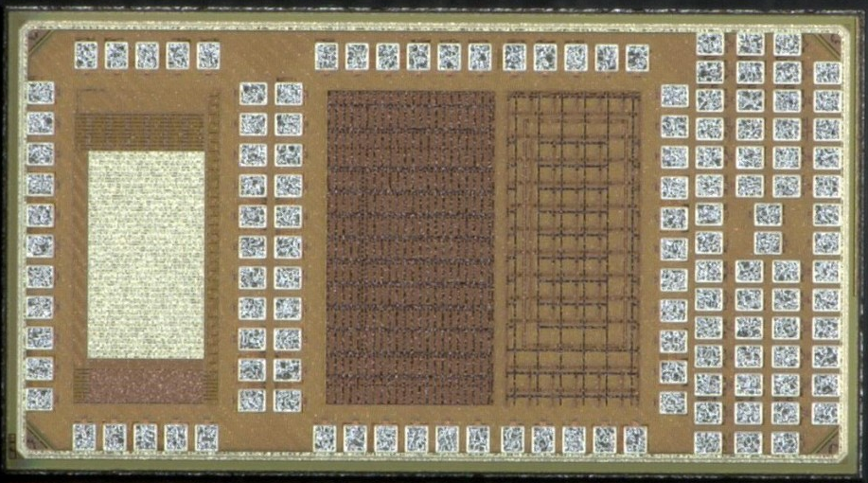
The context of the project
R&D around hybrid pixels for future upgrades and future colliders with the 28nm CMOS technology
The design is part of the R&D project DEPHY, IN2P3 master project dedicated to hybrid and monolithic pixels chip design
The main objectives :
  Small pixel size -> 25µm × 25µm
  Time measurement with a resolution better than 50ps
  Low power
  Radiation tolerance up to a few Grad
Context :
  This work is done in relation to the CERN R&D Program on technologies for future experiments
  This work is carried out in 2 working groups within the DRD projects
    WG 7.3a : High Performance ADCs and TDCs
    WG 7.4b : Radiation resistance of advanced CMOS nodes
Single
devices
Pixel array
SET
RO - TID
Mini@sics of 2×1 mm2 consisting of 4 main blocks
  Analog pixel array (25×12 µm2) with Fast charge amplifiers for high time resolution
  SET test structures
  Ring Oscillators for TID tests on digital standard cells
  Test structures for TID tolerance studies

Slide 4
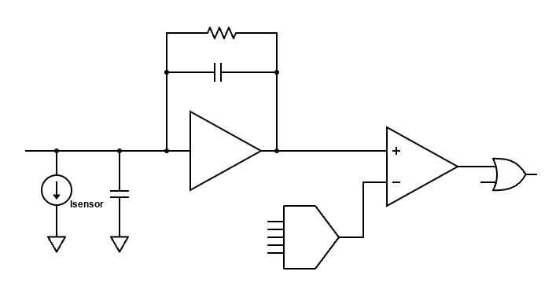
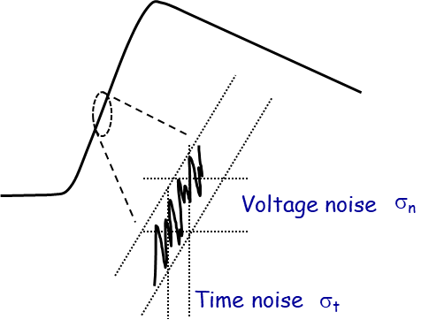
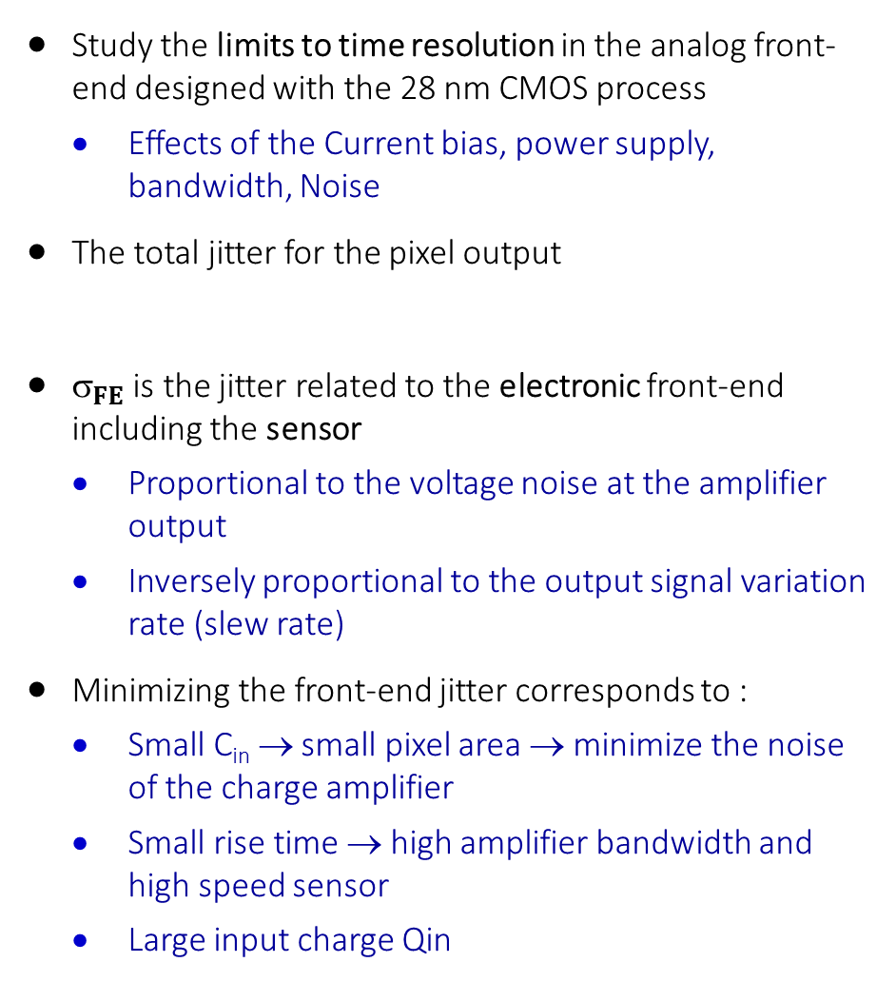
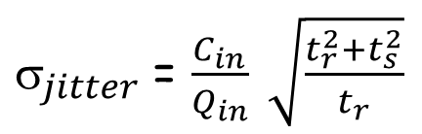
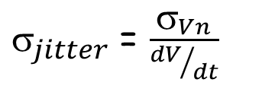
Fast amplifier design
Analog FE pixel design
Study the limits to time resolution in the analog front- end designed with the 28 nm CMOS process
  Effects of the Current bias, power supply, bandwidth, Noise
The total jitter for the pixel output
$_{FE}$is the jitter related to the electronic front-end including the sensor
  Proportional to the voltage noise at the amplifier output
  Inversely proportional to the output signal variation rate (slew rate)
Minimizing the front-end jitter corresponds to :
  Small C_{in} → small pixel area → minimize the noise of the charge amplifier
  Small rise time → high amplifier bandwidth and high speed sensor
  Large input charge Qin
Cf
CSA
HitOr
$$_{total}^{2} =_{Landau}^{2}+_{FE}^{2}+ _{clock}^{2}{+ }_{timewalk}^{2}+_{TDC}^{2}$$
Cs
Comp
DAC
$_{jitter}$= $\frac{σ_{Vn}}{{dV}/{dt}}$
$_{jitter}$= $\frac{C_{in}}{Q_{in}} \sqrt{\frac{t_{r}^{2}+t_{s}^{2}}{t_{r}}}$
t_{r} : the amplifier rise time
t_{s} : the drift time of the charge in the sensor
Q_{in} : input charge
C_{in} = C_{s} + C_{CSA-input}

Slide 5
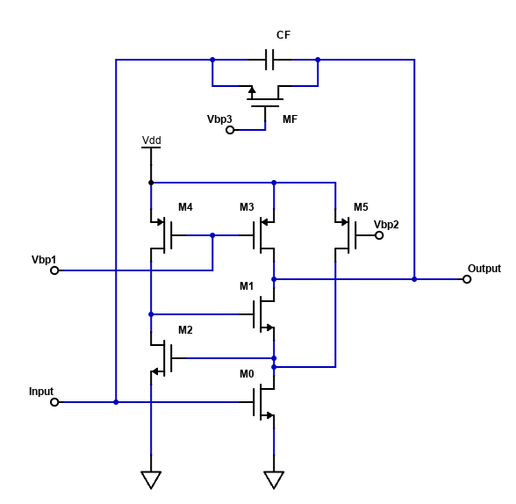
Fast amplifier design
The fast amplifier is based on regulated cascode stage
  Input transistor M0 has 2 bias sources
  I1 : set up to 2µA
  I2 : set from 1µA to 10 µA
  Find the good compromise for low power and timing performances
  DC operating point is set by the input transistor (M0) bias (typically 300 mV) → 600 mV for the signal range
  The feedback resistance is realized by a simple transistor MF
  ToT proportional to the input charge
Hysteresis stage is attached to the discriminator to avoid multiple switching that can be caused by the noise
Programmable 5 bit DAC used for local threshold tuning
I1
I2

Slide 6
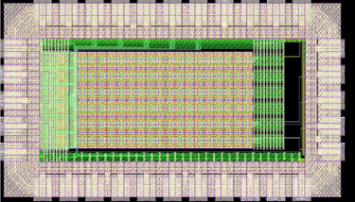
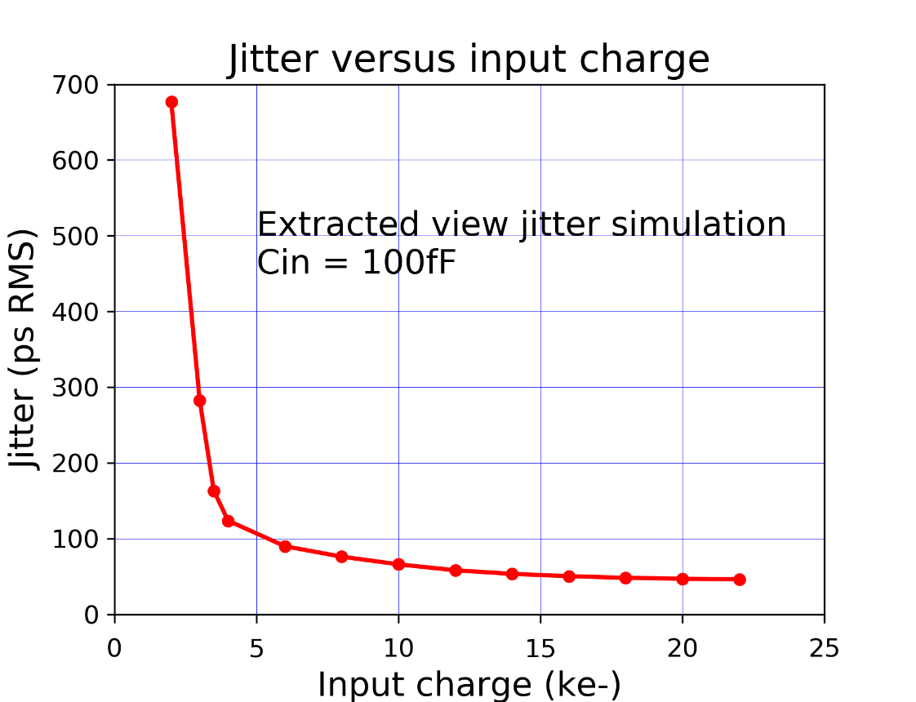
Analog FE pixel prototype
A pixel array of 36 × 12 cells where only the analog part is considered and implemented
For each pixel :
  MOM capacitance connected to each preamplifier input
  Different input capacitance values were implemented
Each pixel contains : CSA + Discriminator + 5 bit tuning DAC
  The pixel size : 20 µm × 12 µm
  The typical power consumption is 8 µW/pixel
Large bandwidth buffers (> 1GHz) implemented and connected to a few pixels for direct measurement
Simulations for I_{CSA} = 4 µA extracted view
  Jitter = 125 ps RMS for input charge of 4 ke-
  Jitter < 50 ps RMS for input charge >15 ke-
Pixel array of 36 × 12 pixels

Slide 7
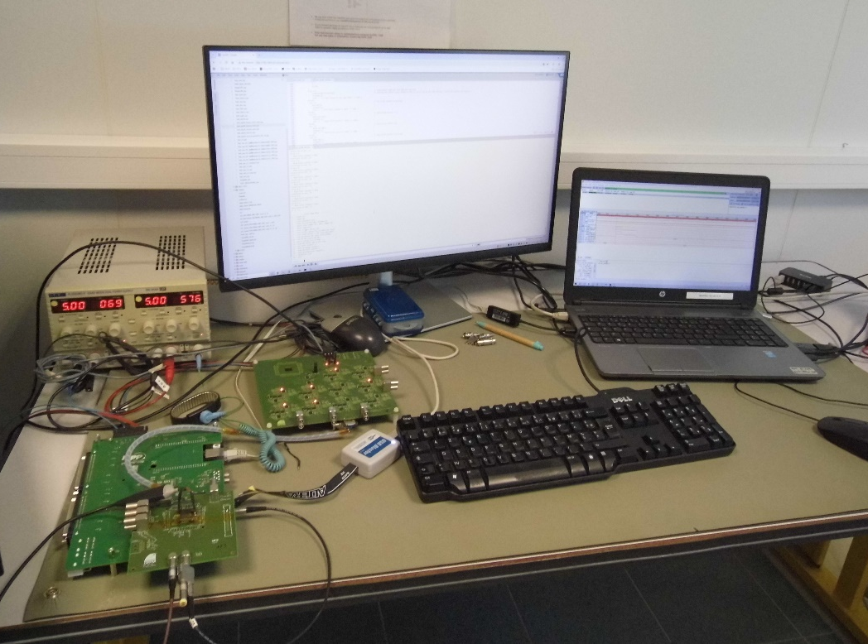
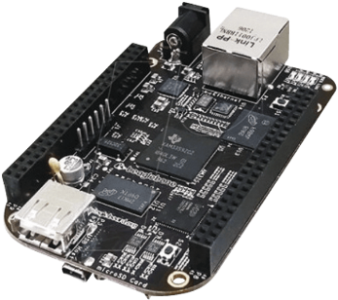
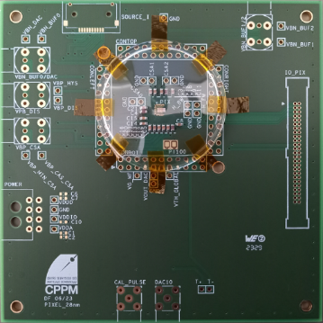
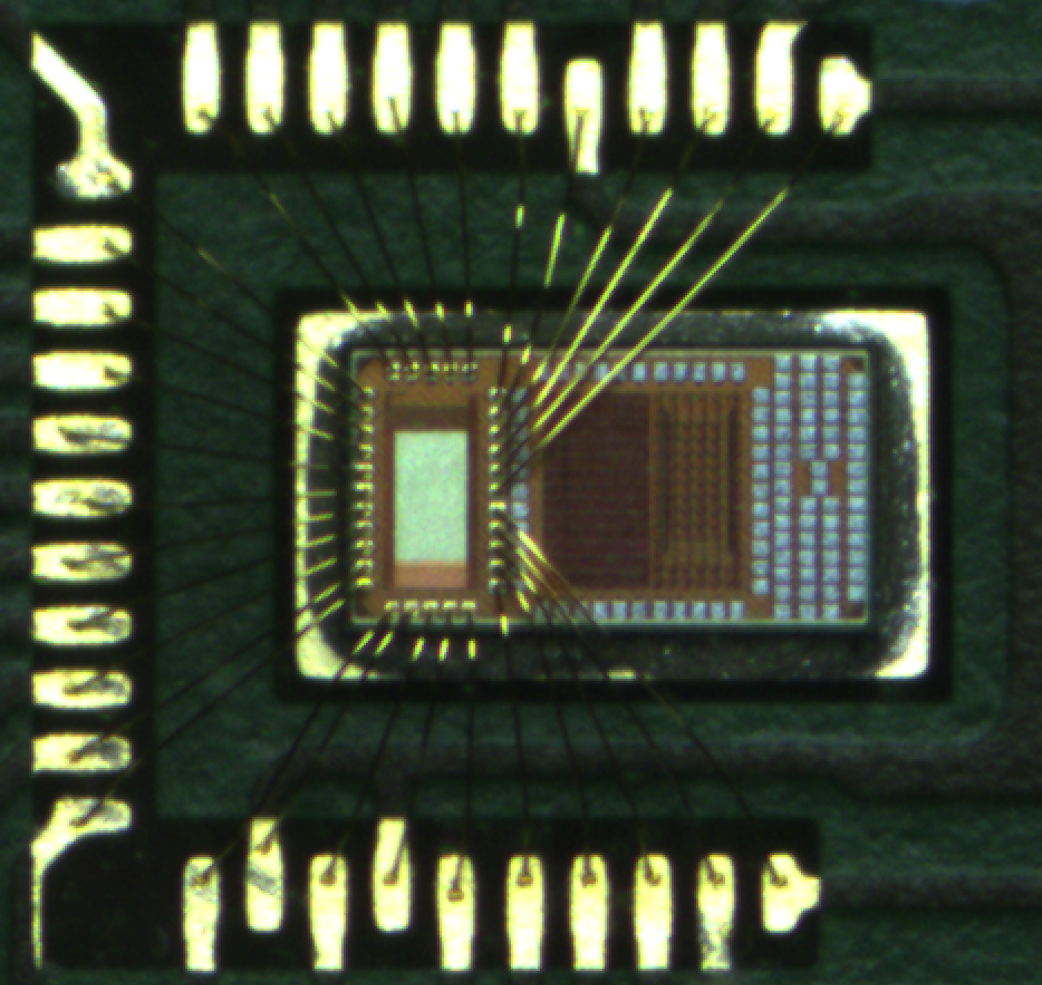
Test setup
The test set-up based on a mini PC board
  An FPGA deals with the low level interface (clock, IO. . . )
  16 bit DAC, 14 bit ADC implemented
  High level programming framework (C++)
  Easy Ethernet interface
  Up to 50 m link
16 bit DAC controlled by the nano PC board
  The threshold voltage
  Feedback transistor bias
  Injection charge level
The injection circuit is integrated in the DAQ board
The bias currents for the chip are generated from a dedicated card
Large bandwidth oscilloscope used for jitter measurements
Bias currents card
Acquisition board
Pixel Chip

Slide 8
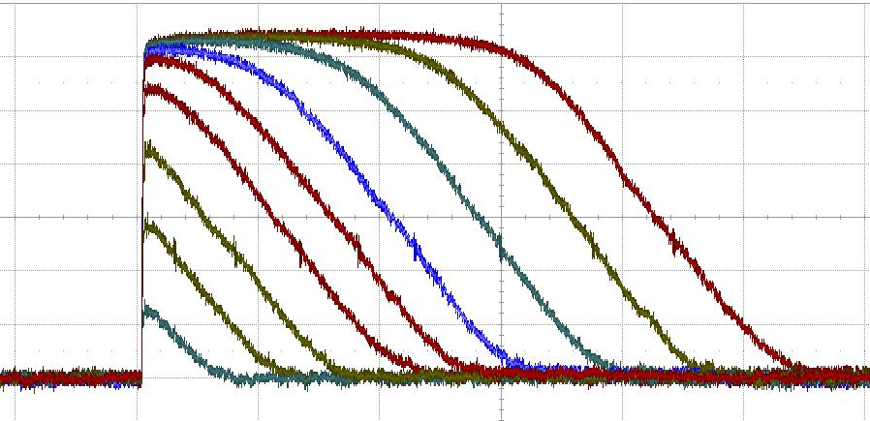
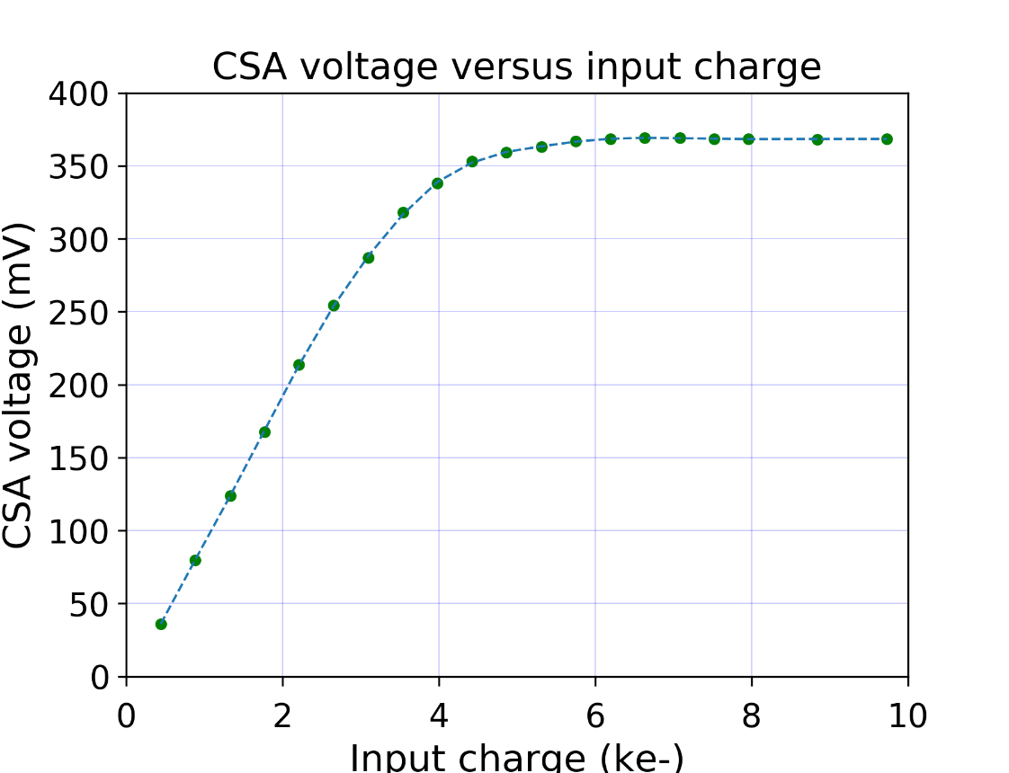
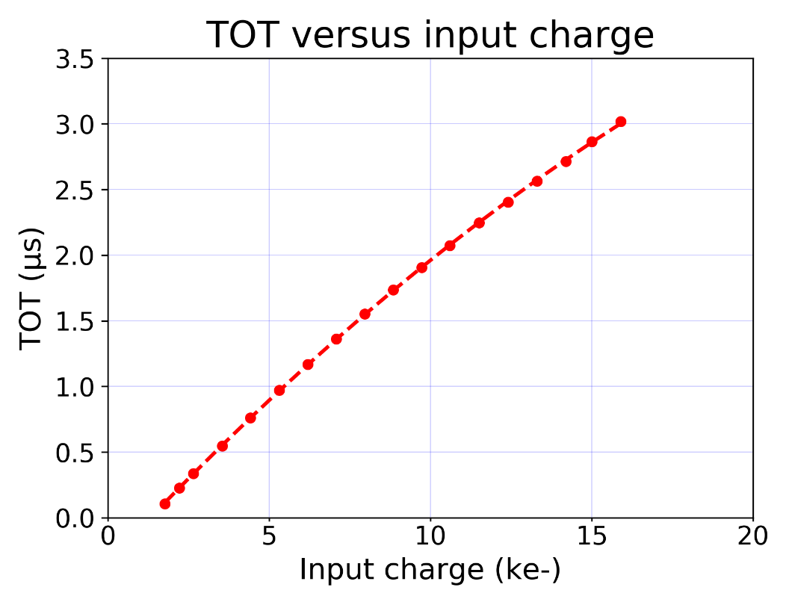
Output voltage vs input charge
CSA base line ~ 300 mV
The response is linear up to 4000 e-
Conversion gain = 95 µV/e-
Saturation from 4500 e-
The time over threshold information can be exploited to measure higher charges
60 mV
500 ns

Slide 9
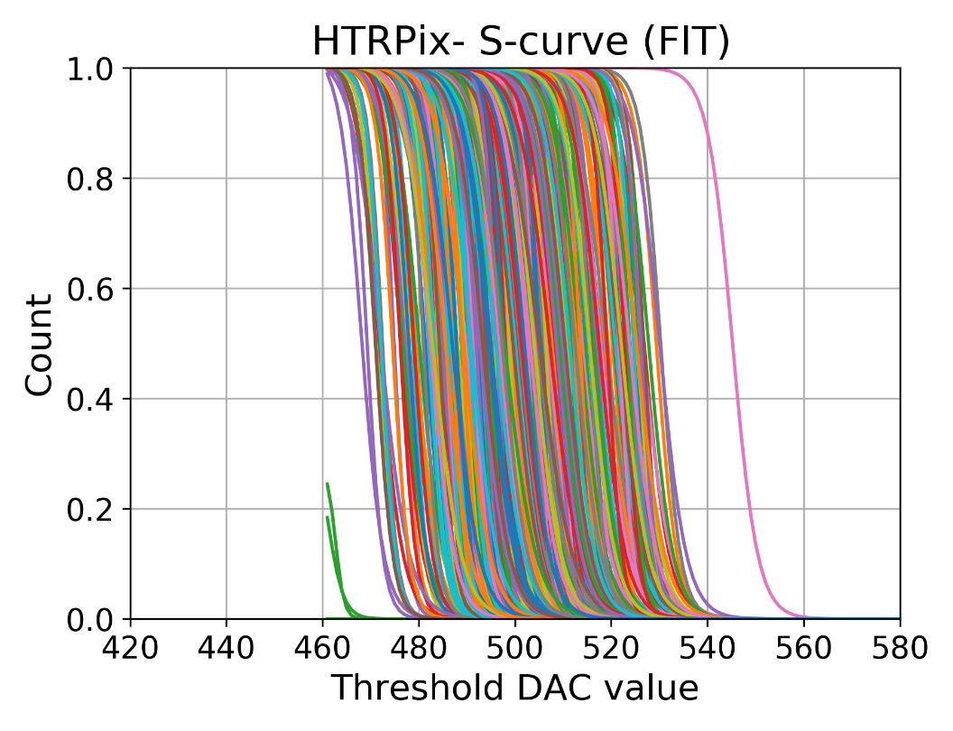
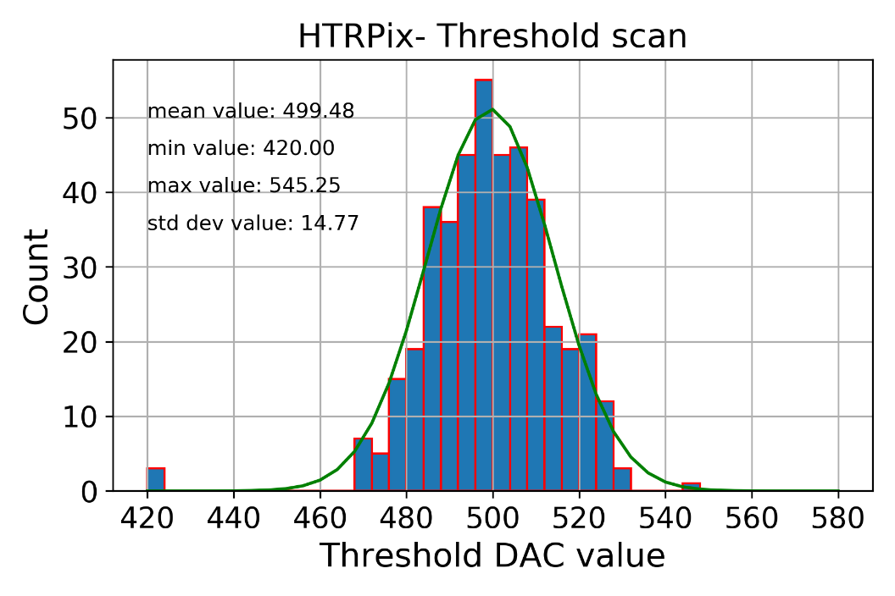
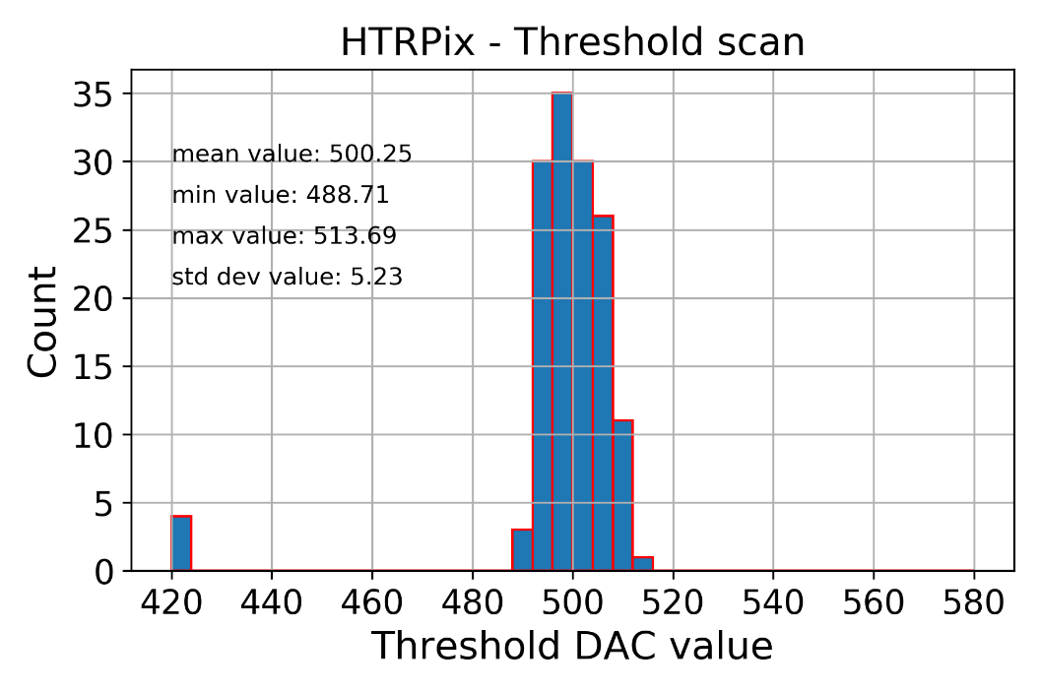
Threshold scan and tuning
GDAC value (LSB)
S-cuves are plotted for the whole pixel array containing 432 pixels
Threshold scan
  Mean value = 2000 e-
  Threshold dispersion = 130 e- RMS
Threshold tuning
  Mean value = 2000 e-
  Threshold dispersion = 52 e- RMS

Slide 10
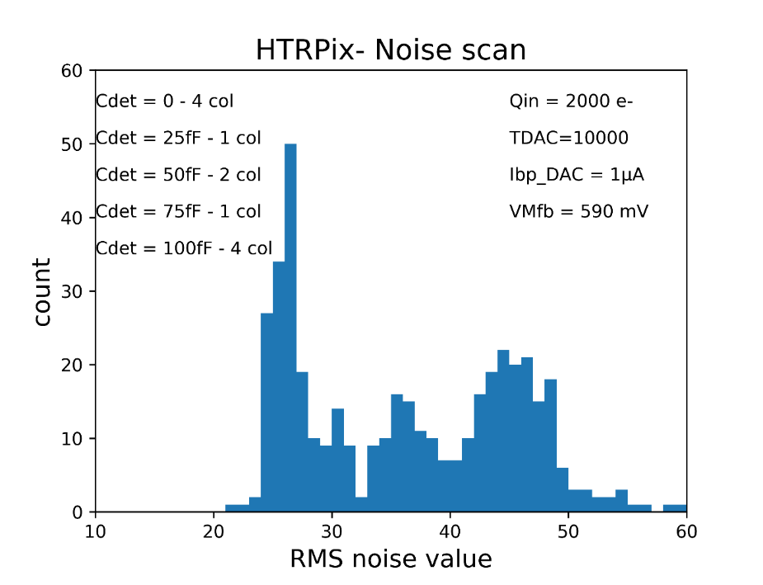
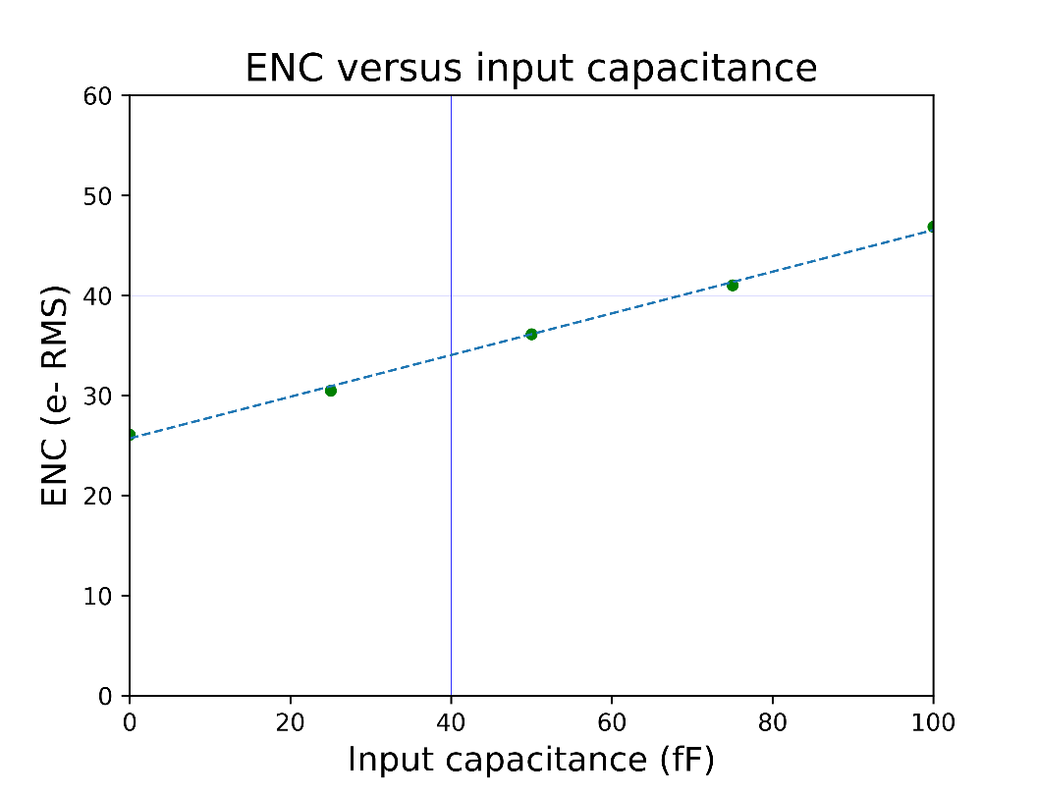
Noise measurements
The pixels are connected to MOM capacitances to add the effect of the detector capacitance
  Cdet varies from 0 to 100 fF
For Cdet = 100 fF → RMS noise = 47 e-
For Cdet = 0 → RMS noise = 26 e-
The ENC is corresponding to the value predicted by simulations

Slide 11
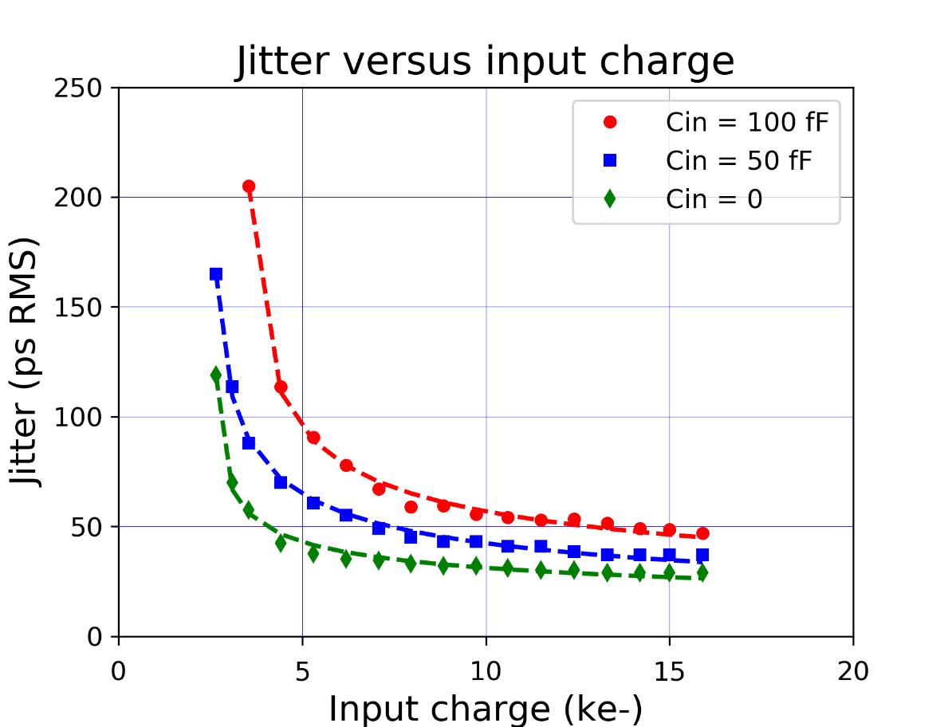
Jitter versus the input charge
The time resolution measured with large bandwidth oscilloscope (BW = 4 GHz)
The measurements based on the histogram of the time delay between the injection charge and the pixel output
For large charge (> 15 ke-), the jitter level is lower than 50 ps RMS for Cin = 100 fF
The jitter is 37 ps RMS for Cin = 50 fF
Differences were observed between measurements and simulations, particularly for small charges
Measurements showed that the jitter level depends substantially on the applied threshold especially for small charges

Slide 12
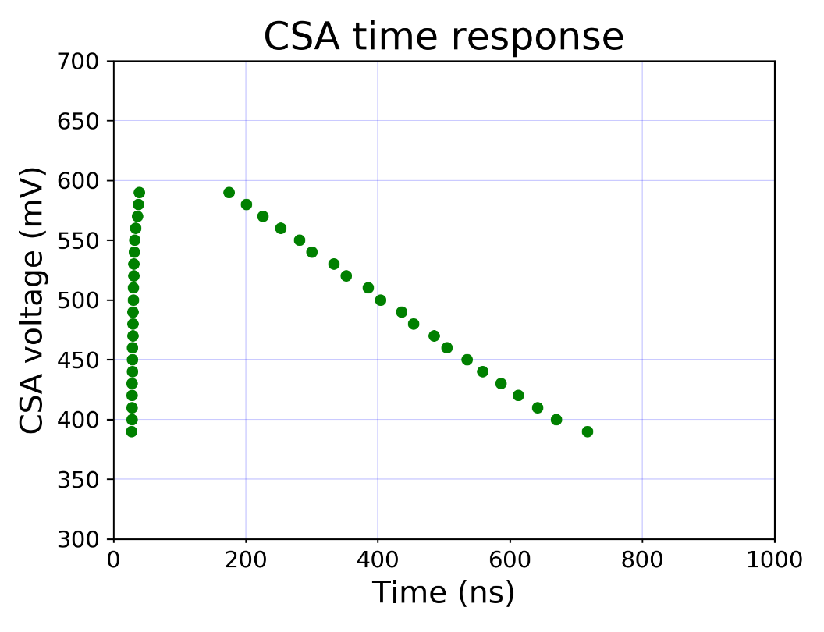
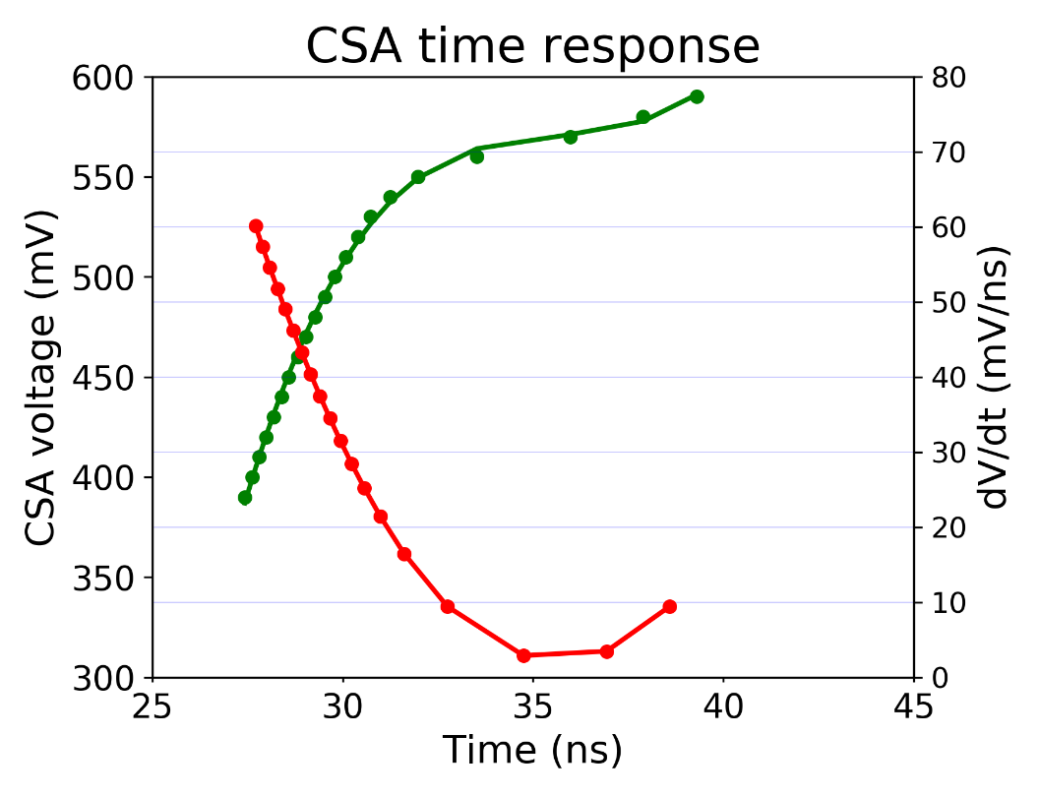
  Threshold effect on the jitter
The CSA analog output voltage is reconstructed point by point from the threshold scan
The reconstruction is based on the mean value of the delay between the input charge and the comparator output
The input charge is small and set here to 2600e- → in the linear region of the CSA
The ΔV/Δt = 60 mV/ns for CSA voltage around 400 mV
The ΔV/Δt = 15 mV/ns for CSA voltage around 520 mV

Slide 13
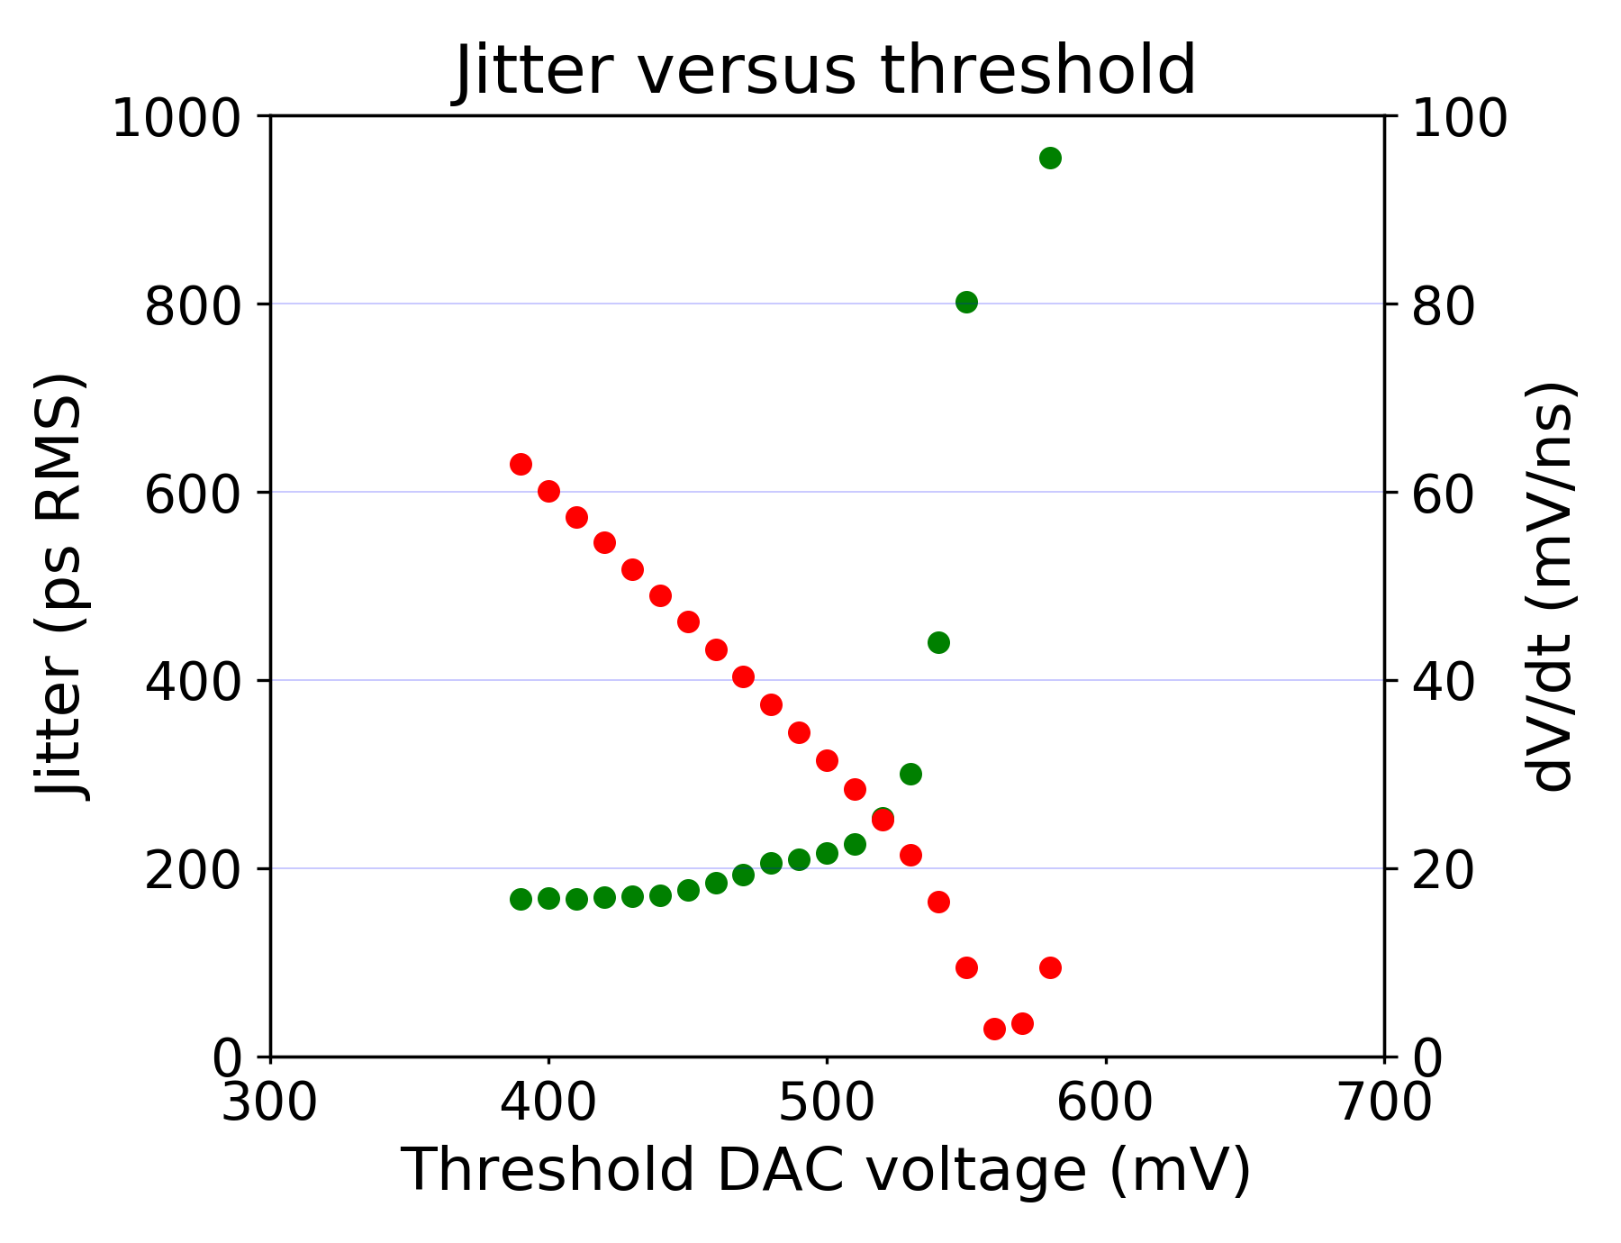
Threshold effect on the jitter
The level of the jitter depends on the threshold value because of the ΔV/Δt variation
DAC = 400 → jitter = 168 ps RMS
DAC = 520 → jitter = 253 ps RMS
Jitter variation of 34 %
This can explain the difference between simulations and measurement observed during first measurements

Slide 14
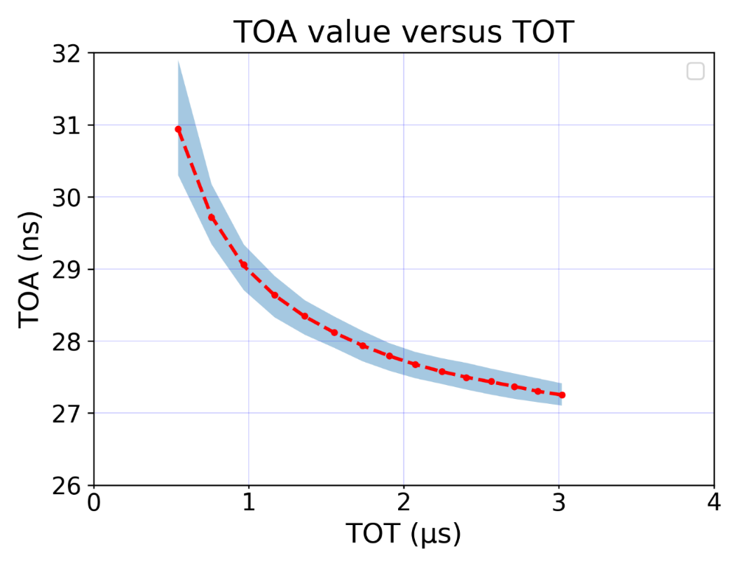
Time walk correction
Related to the variation of the deposited charge event-by-event
Variation of the time of arrival (ToA)
Time walk can be corrected by correcting the time of arrival (ToA)
  Assumes calibration based on the time over the threshold (ToT)
Measurements
  ToA spread due to the time walk is around
  5 ns including the jitter part
  ToT used for the time walk correction
TDCs for ToA and ToT measurements will be implemented in the next version of the prototype

Slide 15
Conclusion and perspectives
The 28nm CMOS pixel prototype shows that the specifications in terms of noise and time resolution can be reached
A radiation campaign scheduled for TID effects evaluation
Continuation of the project :
A new 28 nm large pixel array under design and focused on :
  TDCs implementation for time measurements (ToA and ToT)
  Bump bond the readout chip with sensor array
Prototype submission scheduled for
Q2-2026
Technology | CMOS 28 nm
Matrix | 36 × 12 pixel
Pixel pitch | 25 µm
Charge to voltage gain | 95 mV/ke-
Typical Power consumption | 8 µW / pixel (analog)
- CSA amplifier | 50%
- Discriminator | 35%
- Tuning DAC | 15%
Equivalent Noise Charge (ENC) | 45 e- rms
Timing resolution | 50 ps rms

Slide 16
Thank you for your attention

Slide 17
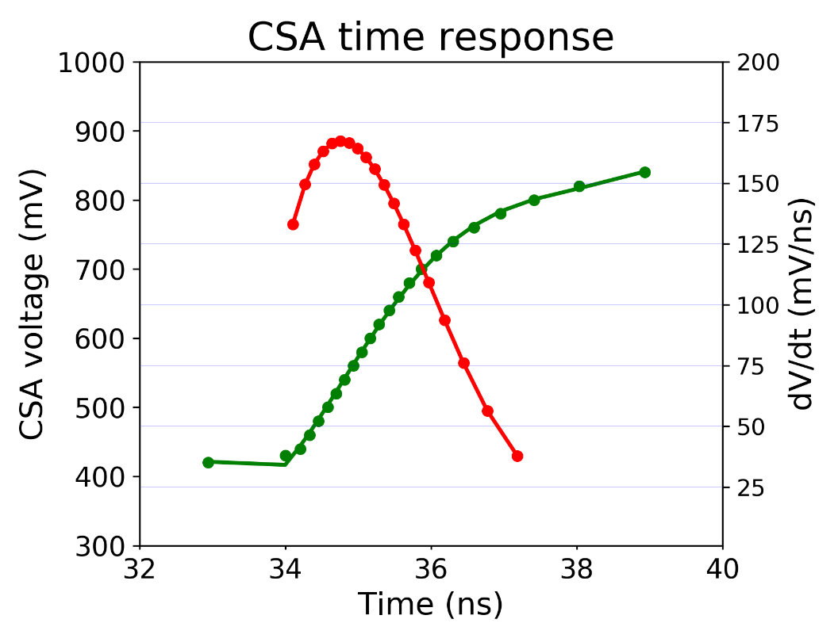
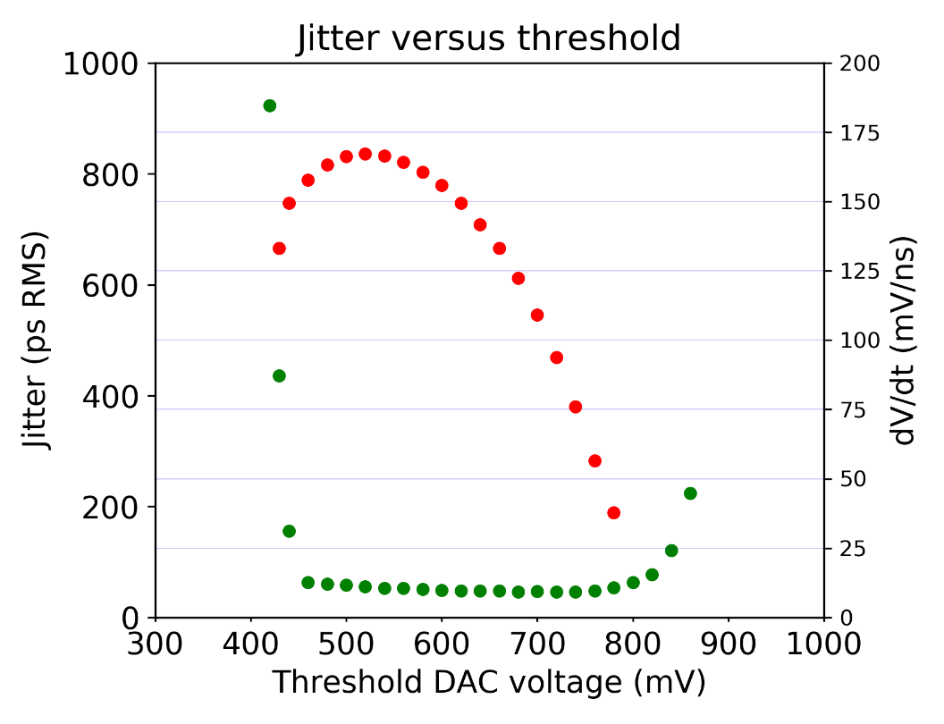
CSA time response for large input charge
The leading edge of the CSA analog output was rebuilt from the threshold scan
The maximum ΔV/Δt of this signal estimated to 160mV/ns
  Almost compatible with the estimation given by simulations
Low jitter does not coincide with the low threshold
The threshold level is not set to the minimum value
  Due to the shape of the signal near the base line
  The jitter level below 50 ps RMS is obtained for a threshold of 650 mV (3500 e-)

Slide 18
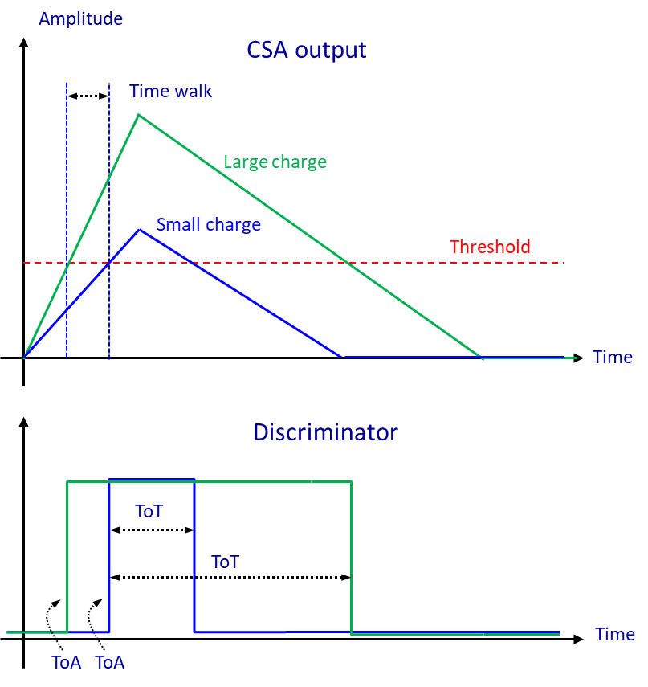

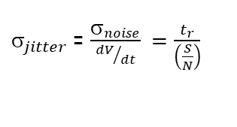




Time resolution
The time resolution of a detector can be expressed as follows:
$_{total}^{2} ={_{jitter}^{2}+ }_{timewalk}^{2}$ $+ _{Landau}^{2}+_{TDC}^{2}$
Due to the noise of the electronic front-end including the sensor
The jitter is proportional to the rise time and inversely proportional to the S/N ratio.
The rise time depends on the FE bandwidth and is proportional to the drift time of charge in the sensor
Related to the variation of the deposited charge event-by-event
Variation of the time of arrival (TOA)
Time walk is corrected by :
  variable threshold → Constant fraction discriminator (CFD)
  constant threshold correction
    Correct the time of arrival (TOA) with a calibration based on the time over the threshold (TOT)
Due to the Landau distribution of the deposited charge
Represents the spatial variation of the deposited charge along the path
  Charges from different depths are collected at different times.
The effect is small for thinner devices or sensors with short drift times
  Absent in 3D detectors
  Not negligible in LGAD sensors
Due to the Time to Digital Converter (TDC) binning
Bin size divided by which is in general small
$$_{jitter}$$
$$_{Landau}$$
$_{jitter}$= $\frac{σ_{noise}}{{dV}/{dt}} =\frac{t_{r}}{\left(\frac{S}{N}\right)}$
$$_{TDC}$$
$$_{timewalk}$$
$$\sqrt{12}$$

Slide 19
Timing requirements in the future experiments
The ATLAS and CMS tracker upgrades
  The two innermost pixel layers will need to be replaced after 5 years
  The pixel time resolution of 50 ps is needed to boost the ATLAS performance
Electron Ion Collider (EIC)
  New accelerator to be built at Brookhaven National Laboratory will start operating In 2031
  4D detectors based on AC-LGADs are envisioned to provide timing capability
  Time resolution of 30 ps is required
  Spatial resolutions of 15 μm to 150 μm depending on the location.
Electron colliders
  Linear colliders ( ILC, CLIC) and Circular colliders (FCC-ee)
  High precision is required for physics measurements
  Pixel size in the vertex detector < 25 µm x 25 µm
  Time resolution at the ns level is required
  Potential applications of precision timing at the ps level under investigation
Future Circular Collider tracker (FCC-hh)
Efficient reconstruction of charged particle tracks in an environment of high pileup density (1000 pileup)
  Position: 7.5 - 9.5 μm, Time resolution = 5 ps
  Radiation levels: 40 Grad and 6×10¹⁷ neq/cm2
    40 times more intense than the HL-LHC.
  A big challenge in sensor design and ASICs
Muon Collider
  Initial studies indicate that single hit resolutions of 20-30 ps are sufficient to reduce the Beam-Induced Background (BIB) to a manageable level

Slide 20
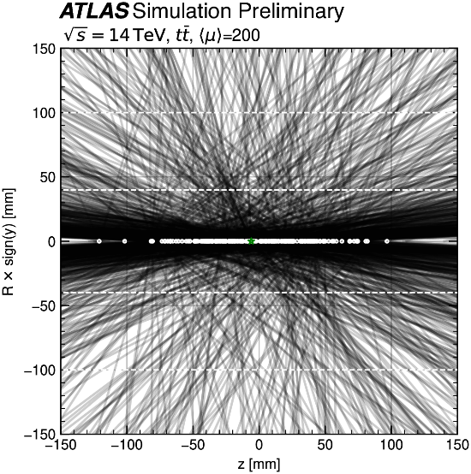
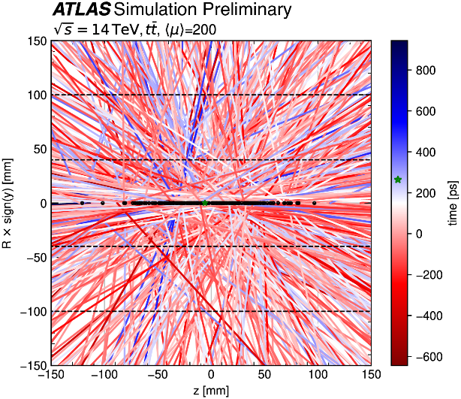
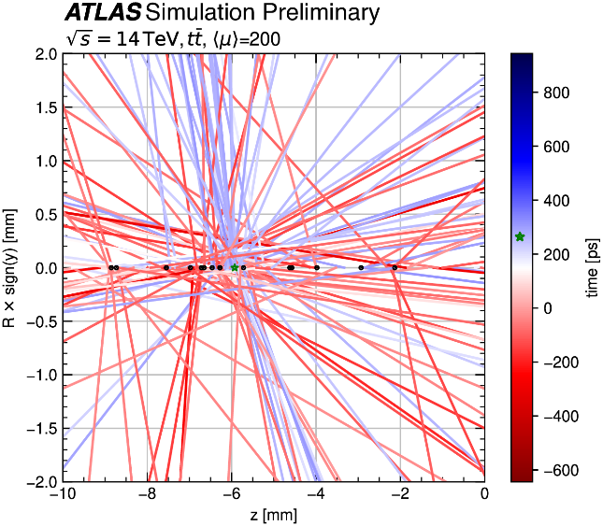
The effects of timing
Pile-Up (PU) level increase for the HL-LHC
  PU average of 200 during HL-LHC (5-10 × LHC)
  PU adds a new level of ambiguity to the reconstruction process
  When timing information is available for the tracks, the association
  of track to vertices becomes less ambiguous
4D tracking
  Using timing at each layer along the tracks
  For the rate of 200 PU events/BC, timing resolutions of 30 ps is expected to reduce by a factor of 5 the number of pileup tracks per primary vertex
Without track-timing
With track-timing
Zoom in the spatial coordinate
timing
Investigating the impact of 4D Tracking in ATLAS Beyond Run 4,
Tech. rep., CERN, Geneva (2023), ttps://cds.cern.ch/record/2870326
Timing information will be more important at future high-energy,
high-luminosity hadron colliders with much higher levels of pileup

Slide 21
Timing sensors for high radiation levels
LGAD sensors
3D sensors
LGAD sensors under irradiation → Modification of the gain implant profile
Not adapted for fluence > 2-3 × 10¹⁵ neq/cm²
Doug Berry:FERMILAB-CONF-22-284-PPD1
Developed and tested within the TimeSPOT project
Pixels of 55 µm pitch
No performance loss up to fluences of
2.5 × 10¹⁶ neq/cm²
Boron +Carbon
Gallium +Carbon
Boron (Low drift)
Boron (High drift)
Cadmium
Fraction of gain still active versus neutron irradiation
M. Ferrero et. Al : Nuclear Inst. and Methods in Physics Research, A 919 (2019) 16–26

Slide 22
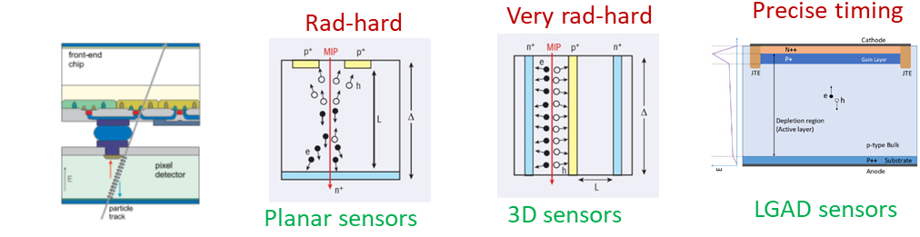
Pixel design for 4D tracking
For the next upgrades or next generation of hadron collider :
  ATLAS, CMS and LHCb trackers upgrades (Run5),
  or for FCC–hh -> Very long-term
  High spatial resolution and high time precision
  Very high radiation tolerance
  Hybrid pixels with a dedicated ASIC bonded to the sensor is
  the best suited to these applications
Sensor candidates currently being considered for 4D tracking
  LGAD sensors with modification of the gain implant profile
    Not yet satisfying a fluence > 2-3 × 10¹⁵ MeV neq/cm²
  3D-trench sensors developed and tested within the TimeSPOT
  project
    No performance loss up to fluences of
    2.5 × 10¹⁶ MeV neq/cm²
Front end electronics
  Need of higher density and higher speed regarding the RD53 chip designed with the 65 nm process
  28nm CMOS technology is considered as the next node for highly integrated chips such as pixel readout chips
ATLAS/CMS inner layers upgrades
Pixel size | 25µm × 25 µm
Sensor capacitance | < 50 fF
Time resolution | < 50 ps RMS
Consumption (pixel) | <5 µA
Threshold | <600 e-
Hit rate | 8 GHz/cm²
Hit rate (pixel) | 5 kHz
TID | > 1 Grad
M. Ferrero et. Al : Nuclear Inst. and Methods
in Physics Research, A 919 (2019) 16–26
Doug Berry:FERMILAB-CONF-22-284-PPD1

