Slide 1

5‘’++‘’4
JINST 20, T06005 (2025)
A two-stage time-stretching TDC
with discrete components
Yanbo Chu, Zhicai Zhang
Department of Engineering Physics,
Tsinghua University
9 October 2025

Slide 2
01
Introduction
02
TDC design
03
Performance of time-stretching unit
CONTENT
04
Two-stage time-stretching
05
Conclusion

Slide 3
CONTENT
Introduction
01
Background
Time-stretching principle
Multi-stage time-stretching principle

Slide 4
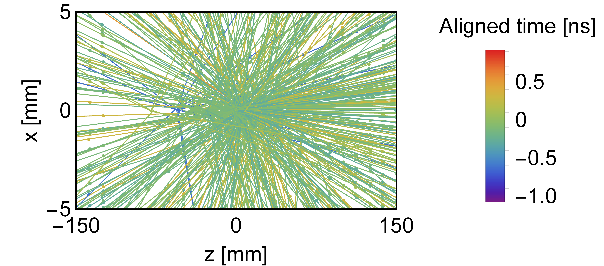
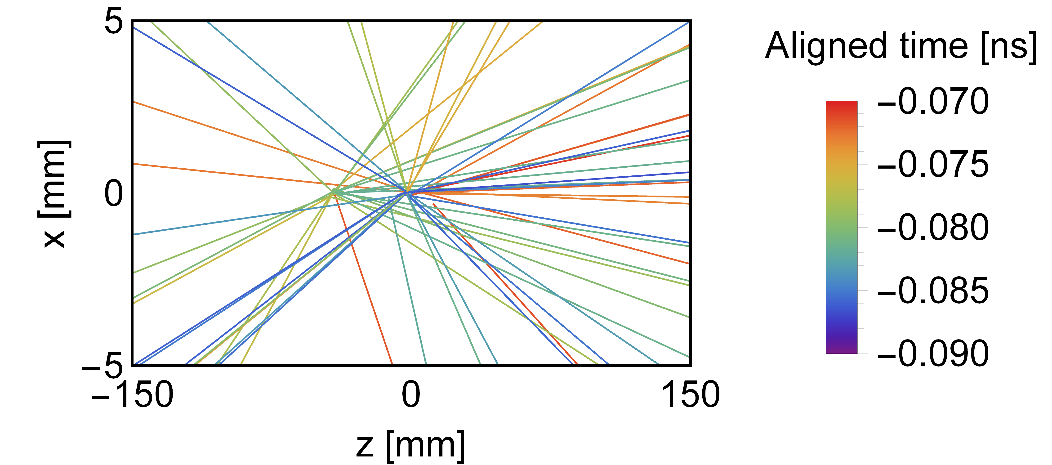
1.1 Background
Timing precision at the tens of ps level is critical for high-energy physics experiments.
For example, in hadron colliders, precise timing of charged particles is essential for efficient vertex reconstruction and pileup mitigation under high-luminosity conditions.
Future 4D pixel detectors require TDCs providing tens of ps resolution with power consumption at the tens of µW per channel level.
The tracks spread over
a bunch crossing (~1ns)
Tracks in 20ps range
^{42 collisions,}
^{difficult to distinguish}
track numbers decreased significantly
Back-
ground

Slide 5
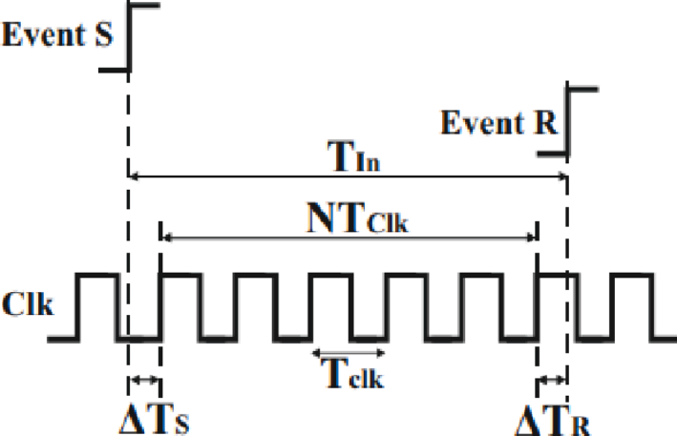
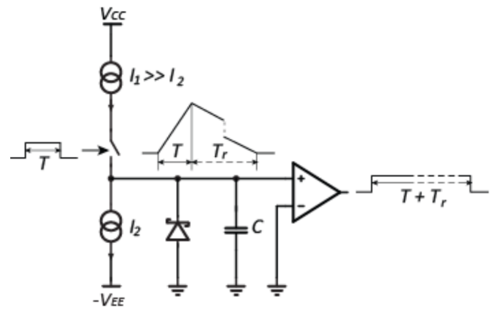
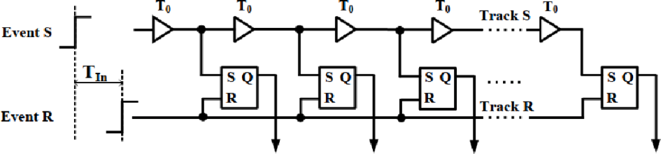
1.2 Time-stretching principle
Various TDCs have limitations in time resolution, power consumption, dead time and so on.
Clock based TDC
No conversion time,
Requires high frequency clock and high power consumption
Delayline TDC
High time resolution
Limited by circuit design difficulty and power consumption, difficult to calibrate
Time-stretching TDC
Can achieve high resolution with a low frequency clock, low power consumption
The dead time is extremely long

Slide 6
1.2 Time-stretching principle
Time-stretching TDC
Can achieve high resolution with a low frequency clock, low power consumption
The dead time is extremely long
This study proposes to reduce the dead time through multi-stage time-stretching.

Slide 7
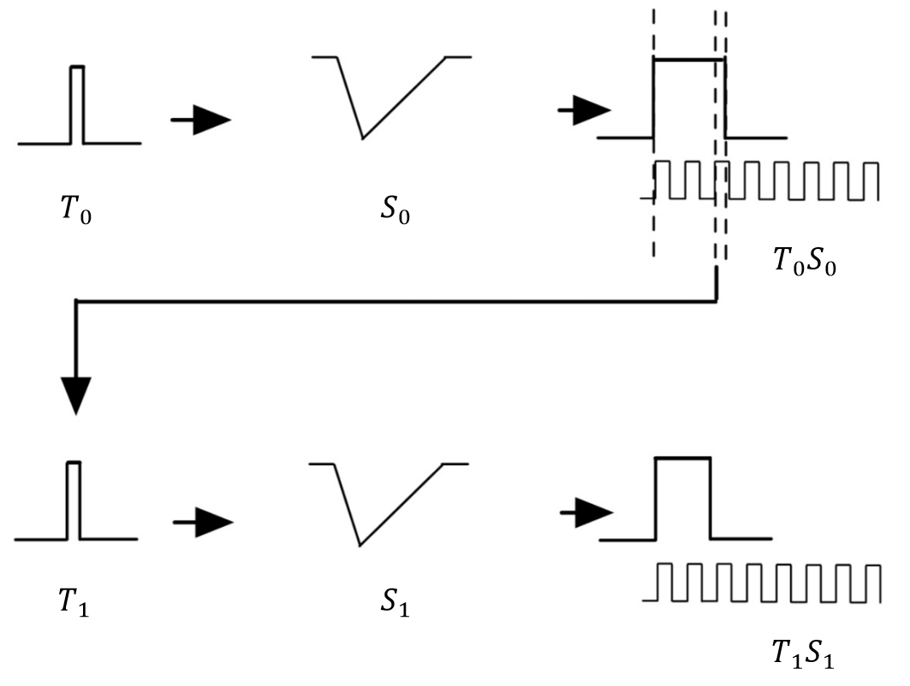
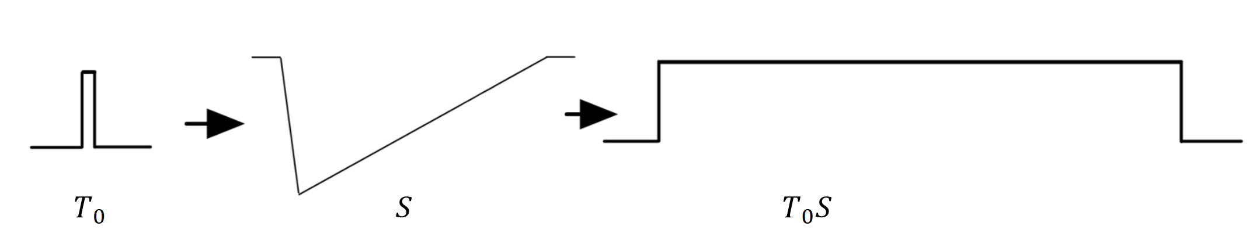

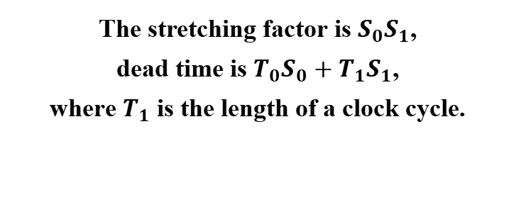


1.3 Multi-stage time-stretching principle
stretch $S$ times in one step
stretch $S_{0}, S_{1}$ times
in two steps
Use a large current to discharge and a small current to charge a capacitor
The stretching factor is $S_{0}S_{1}$,
dead time is $T_{0}S_{0}+T_{1}S_{1}$,
where $T_{1}$ is the length of a clock cycle.
The stretching factor is $S$, dead time is $T_{0}S$,
where $T_{0}$ is TOA range.

Slide 8
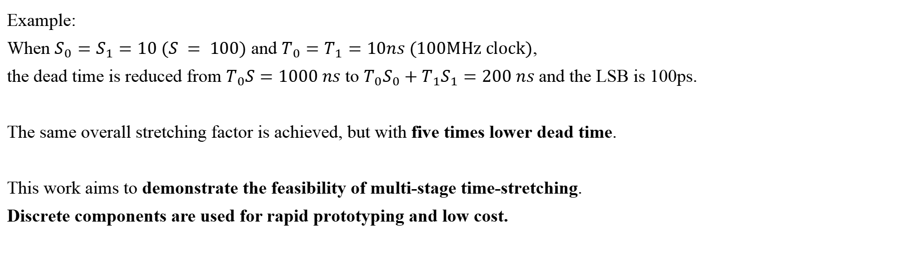
1.3 Multi-stage time-stretching principle
Example:
When $S_{0}=S_{1}=10 (S = 100)$ and $T_{0}=T_{1}=10ns (100MHz clock)$,
the dead time is reduced from $T_{0}S=1000 ns$ to $T_{0}S_{0}+T_{1}S_{1}=200 ns$ and the LSB is 100ps.
The same overall stretching factor is achieved, but with five times lower dead time.
This work aims to demonstrate the feasibility of multi-stage time-stretching.
Discrete components are used for rapid prototyping and low cost.

Slide 9
CONTENT
TDC design
02
Time-stretching circuit
Multi-stage time-stretching

Slide 10
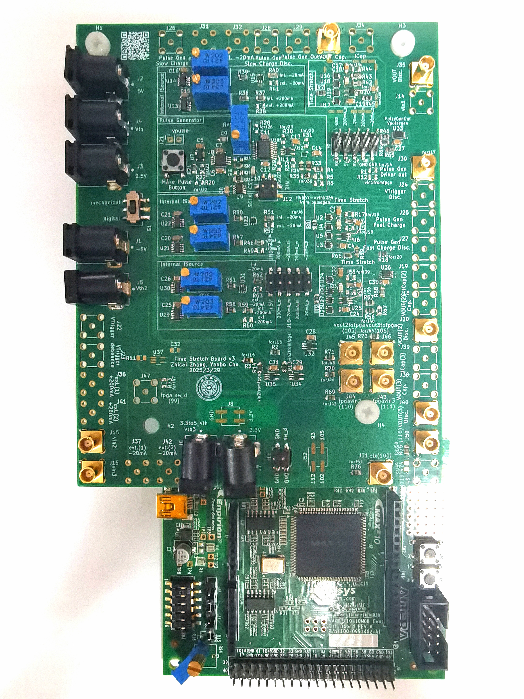
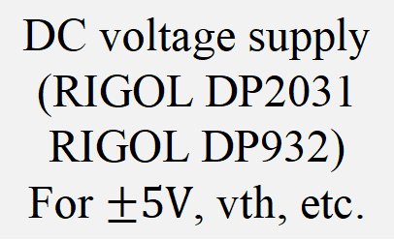
Time-stretching (1st stage)
DC voltage supply
(RIGOL DP2031
RIGOL DP932)
For $±5V$, vth, etc.
Onboard pulse generator
Time-stretching (2nd stage)
To a 3 GHz oscilloscope
(RIGOL DS70304)
For reference timing
measurement
Onboard current source (LT3092) for time-stretching unit
Intel MAX 10 FPGA
for counter and edge detection

Slide 11
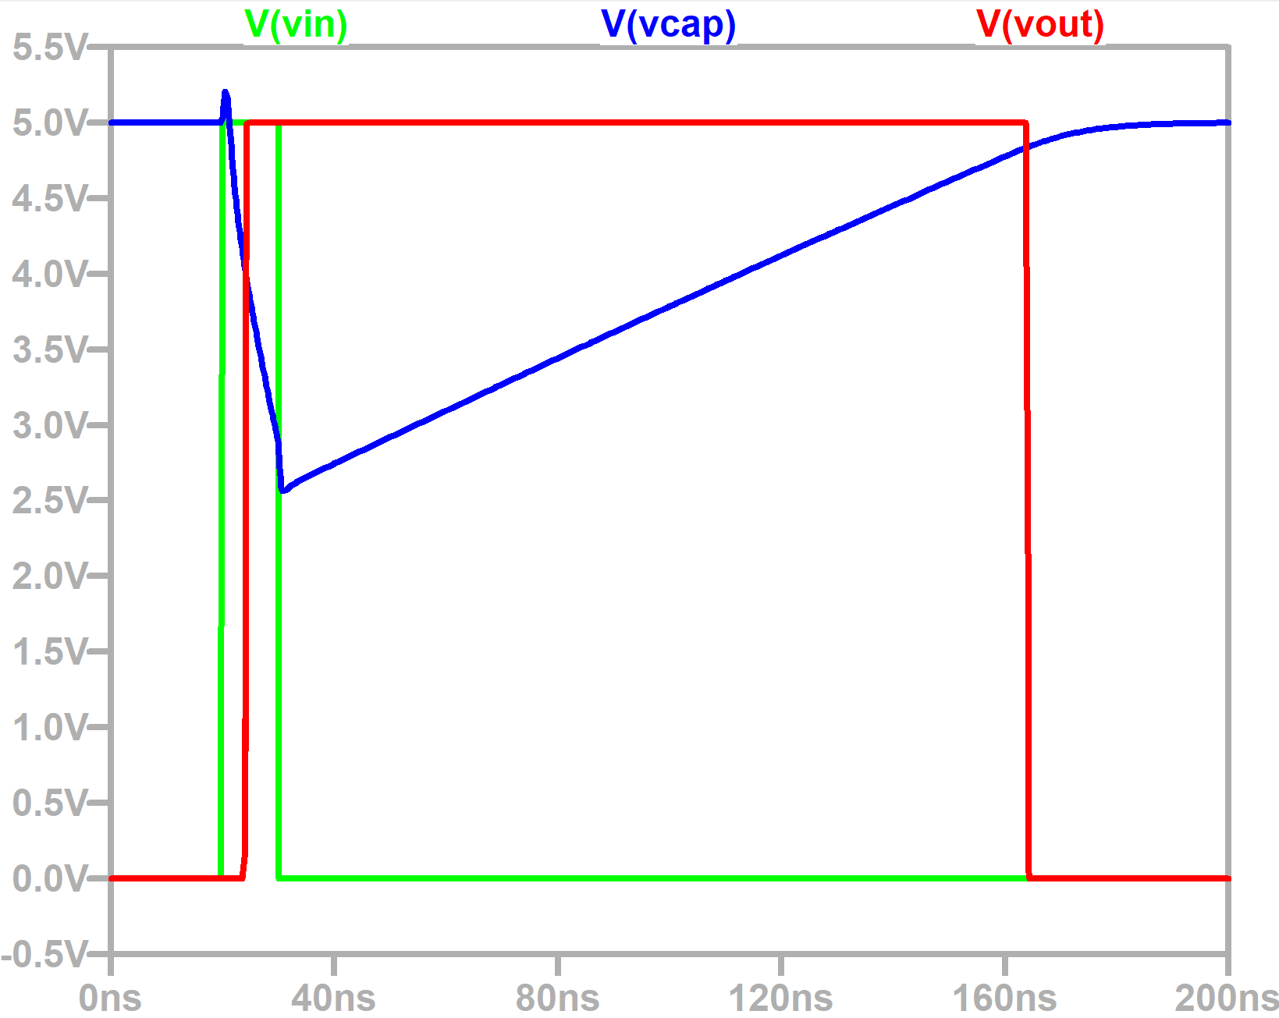
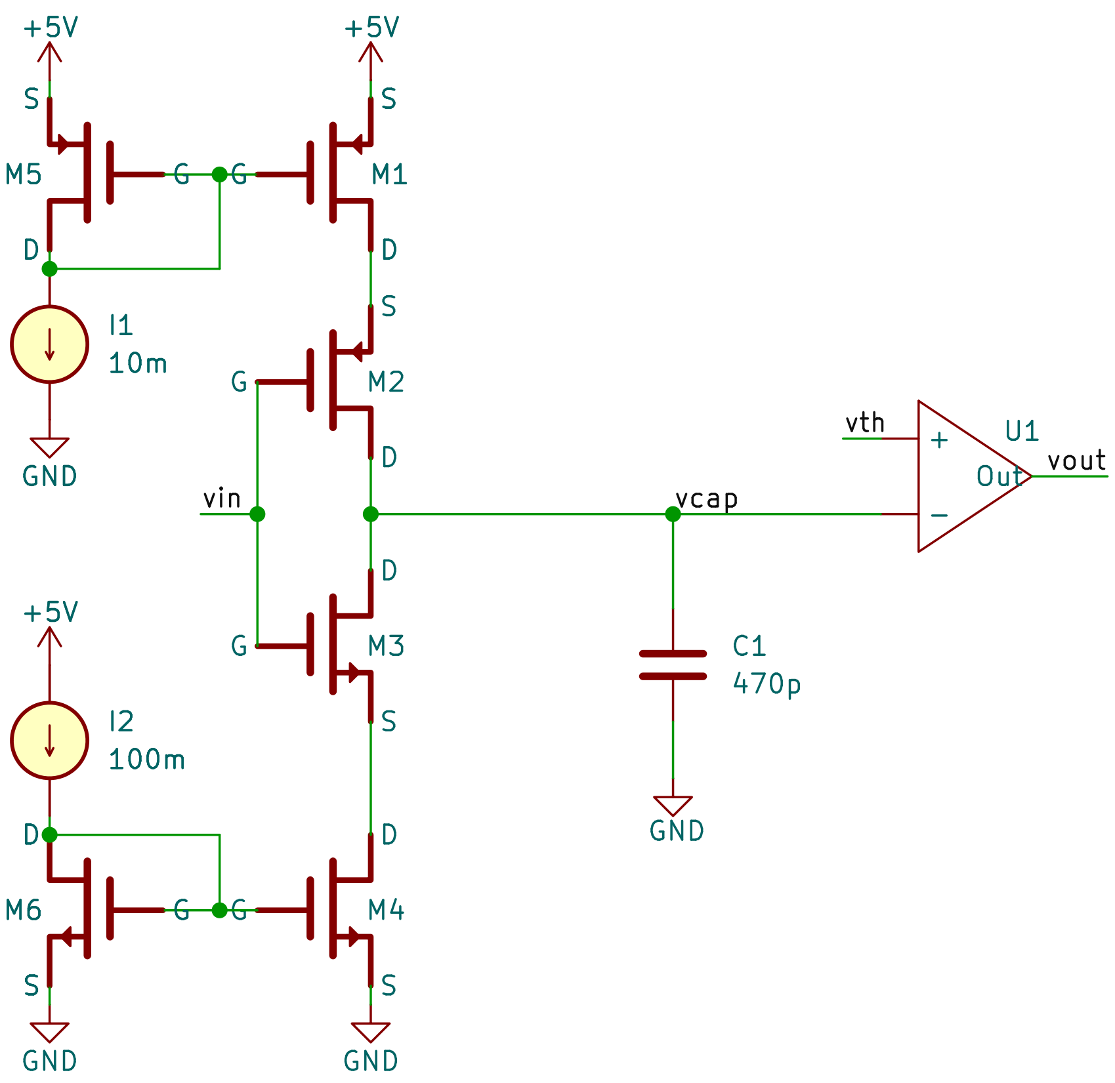
2.1 Time-stretching circuit
Current mirror
circuit
Output strtched signal through comparator
You can see that vin is effectively stretched to vout
The capacitor is discharged with a large current and charged with a small current
Vin high level, M3 open, large current discharge
Vin low level, M2 open, small current charge
Output strtched signal vout through comparator

Slide 12
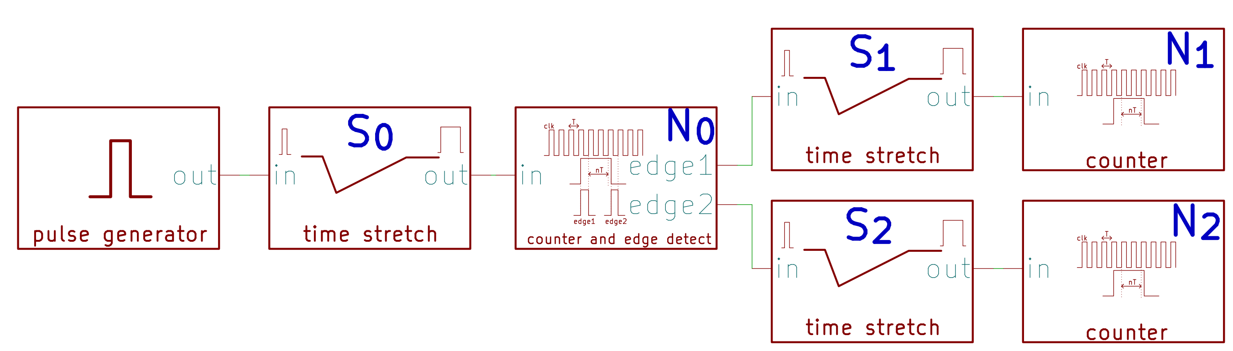
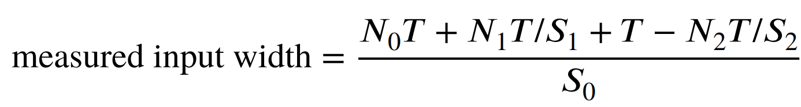
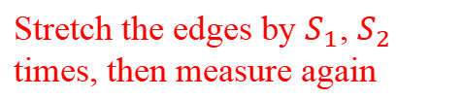
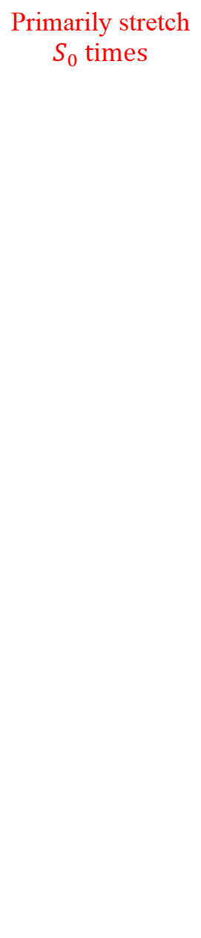
2.2 Multi-stage time-stretching
Stretch the edges by $S_{1}$, $S_{2}$ times, then measure again
Measured by a 100 MHz counter, output the two extra edges of the pulse
Primarily stretch $S_{0}$ times
多级放大流程

Slide 13
CONTENT
Performance of time-stretching unit
03
Time-stretching unit performance
Time-stretching jitter
Measure signal width with FPGA

Slide 14
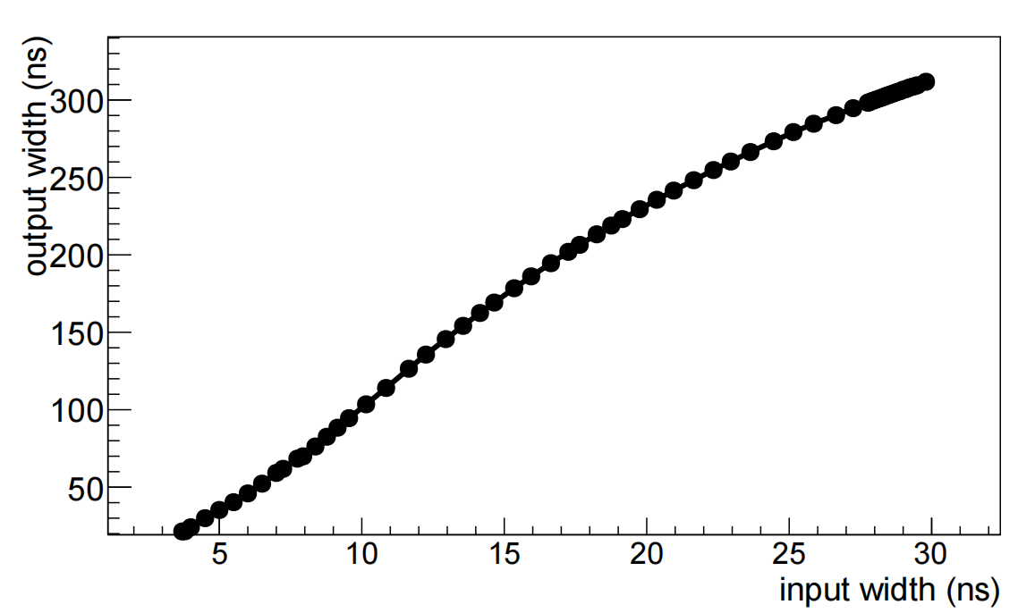
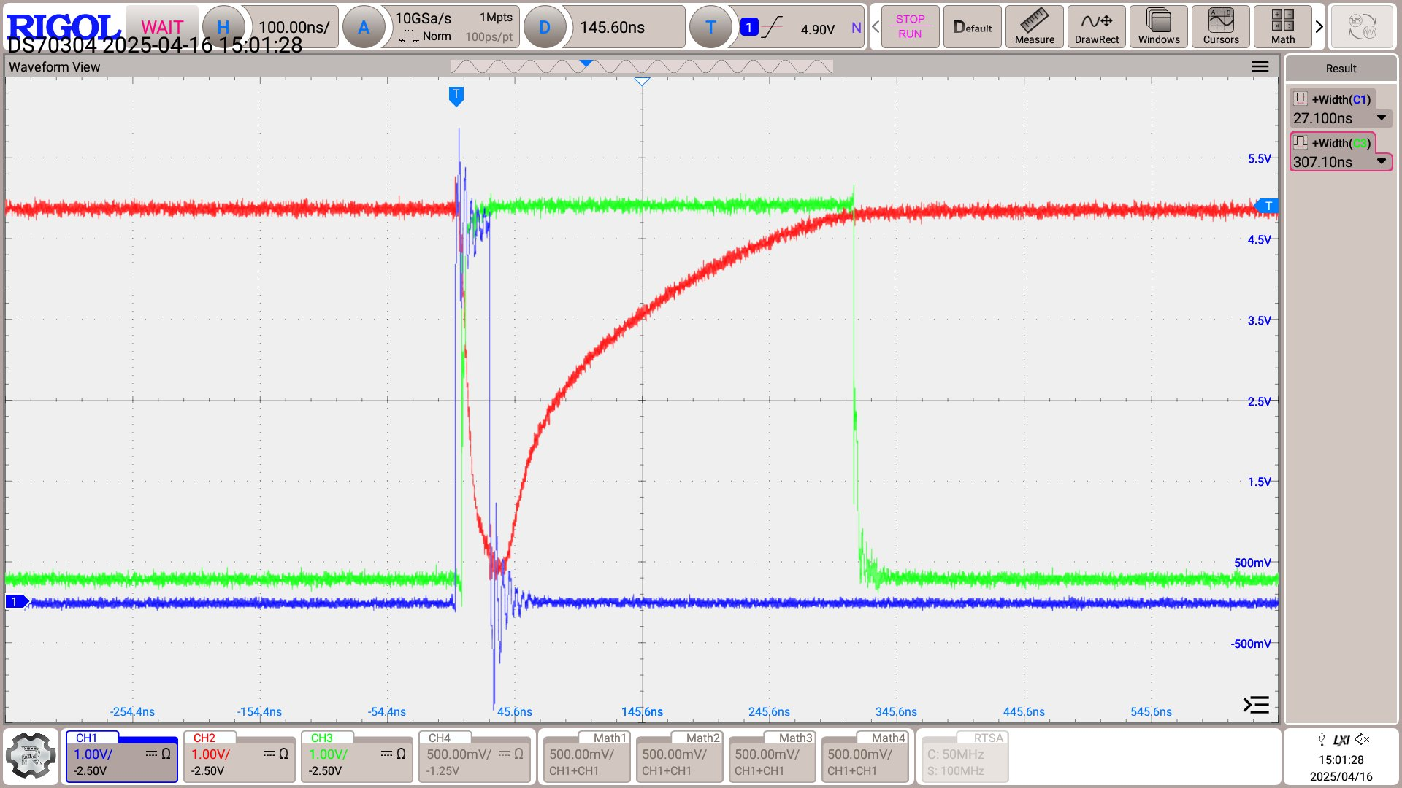
3.1 Time-stretching unit performance
Nonlinear response
Requires look up table
Blue (CH1): Test signal
Red (CH2): Voltage signal on the capacitor
Green (CH3): Stretched signal, output by comparator
You can see effective stretching. By measuring the stretched signal width for different input widths, we get a calibration curve

Slide 15
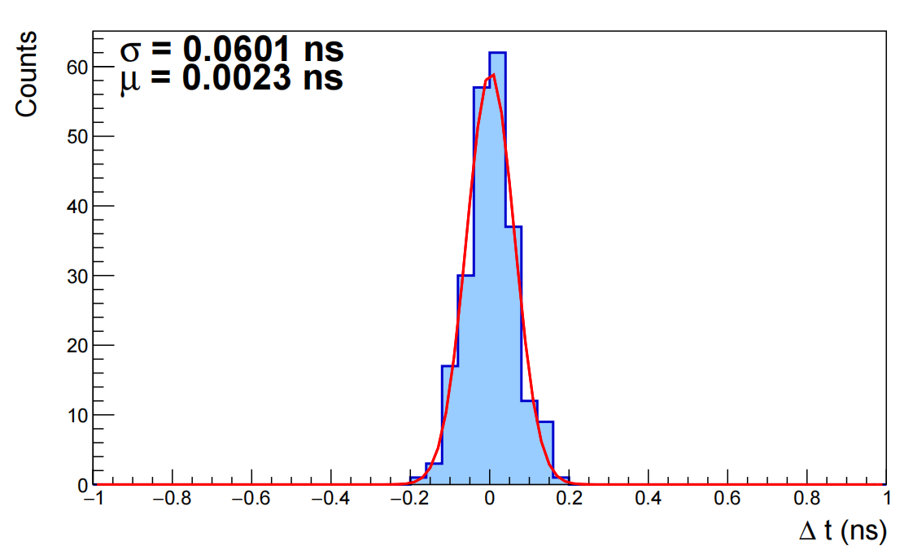
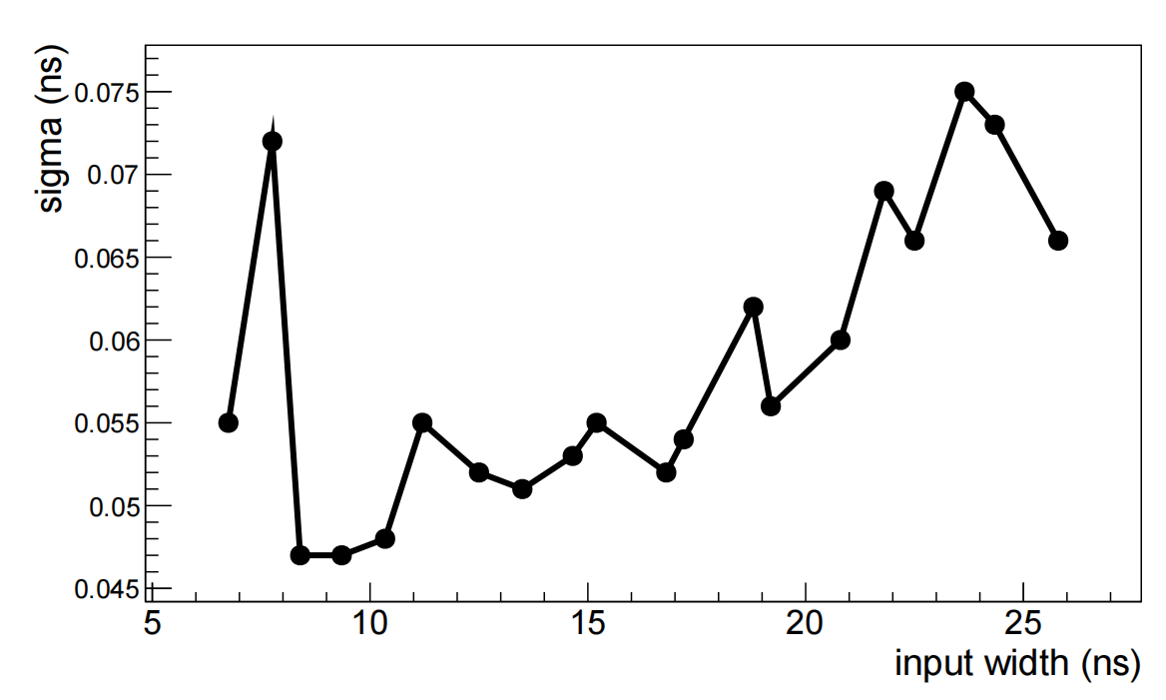

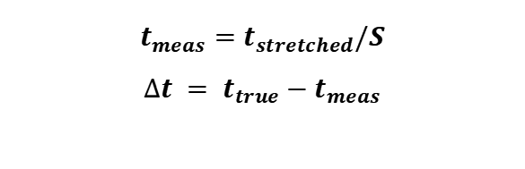
3.2 Time-stretching jitter
Error distribution of input signal with 20ns width
$$t_{meas}=t_{stretched}/S$$
$$∆t = t_{true}−t_{meas}$$
Plot $σ_{error}$ vs input width curve.
Within 25ns range $σ_{error}$ is less than 75ps. The stretching factor fluctuates little.

Slide 16
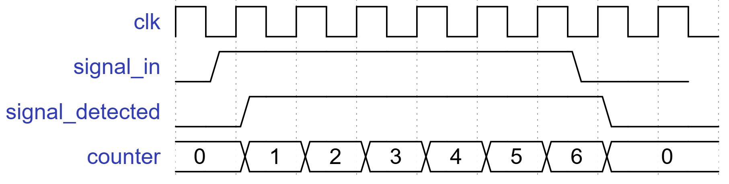
3.3 Measure signal width with FPGA
The 100MHz counter and edge detection of the stretched signal is implemented by FPGA
edge1
edge2

Slide 17
CONTENT
Two-stage time-stretching
04
Output edges
Secondary time-stretching
Overall resolution

Slide 18
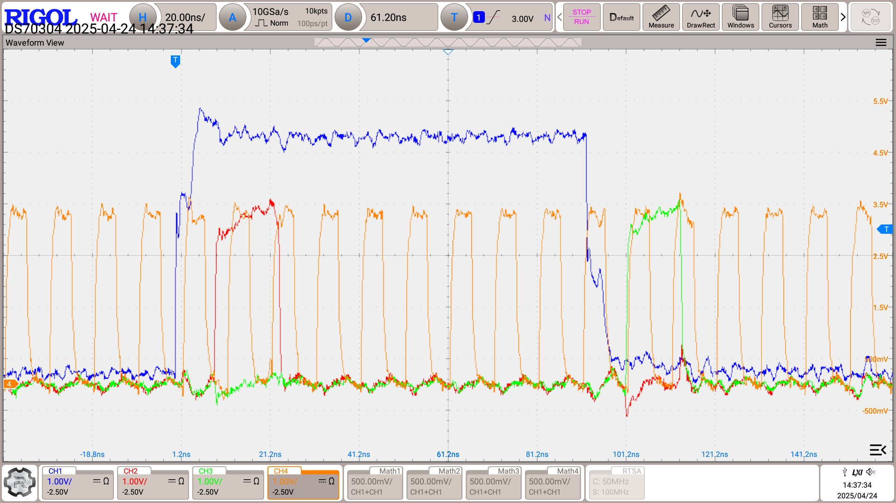
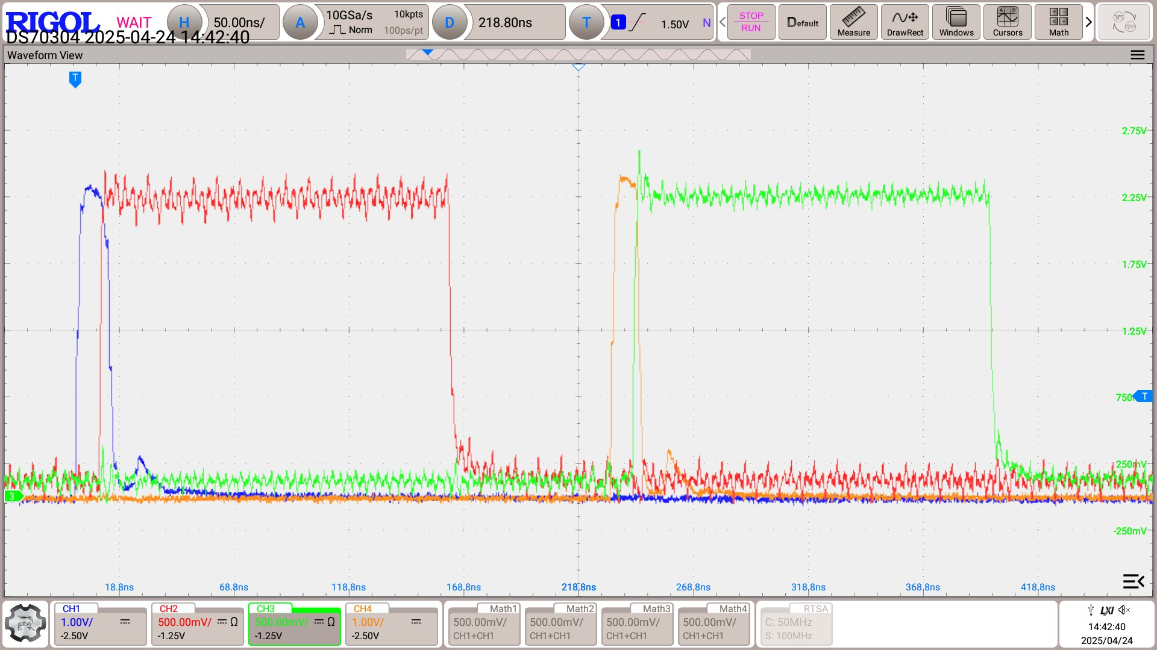
4.1 Output edges
stretched test pulse
edge1
stretched edge1
edge2
stretched edge2
clock
edge1
edge2
(a) edge detection
(b) second stage stretching for the edges
Example pulses of the signal chain of the two-stage time-stretching TDC. There is a certain delay and an additional clock cycle is added to edges.

Slide 19
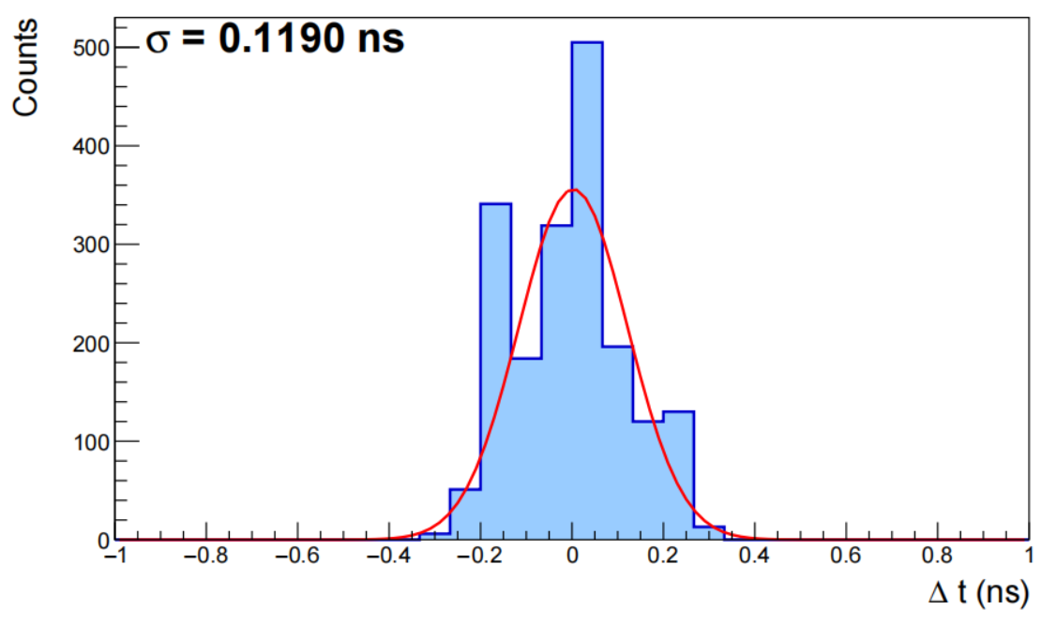
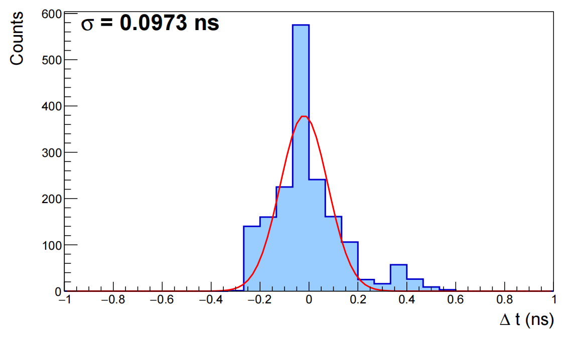
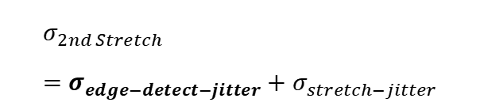
4.2 Secondary time-stretching
(a) edge1 error distribution
(b) edge2 error distribution
$$σ_{2nd Stretch}=σ_{edge−detect−jitter}+σ_{stretch−jitter}$$
The errors between the measured values of edge1 and edge2 and the true values are shown in the figure.
The error is less than 120 ps; after accounting for the 10× stretching, this corresponds to less than 12 ps.
for input

Slide 20
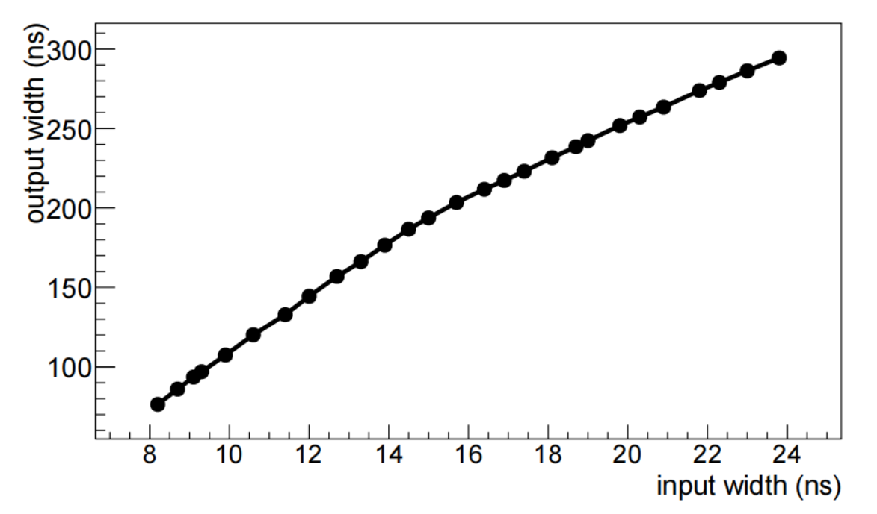
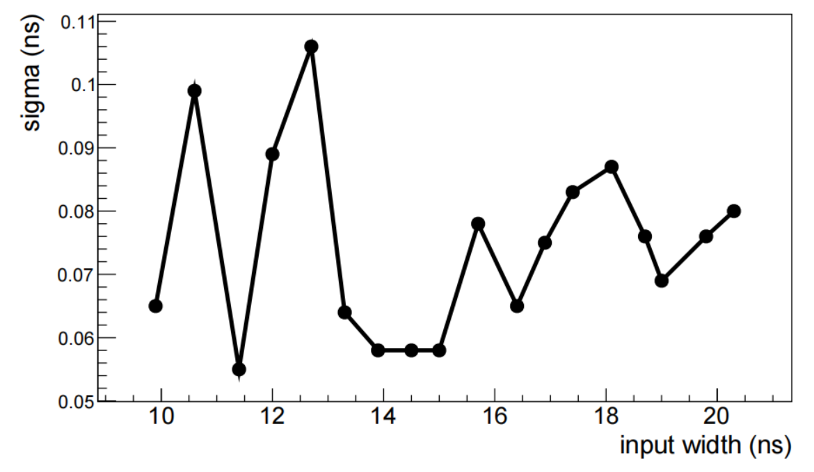
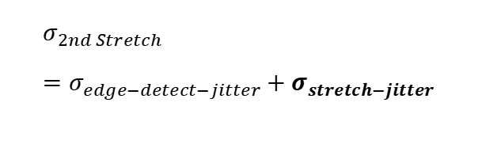

4.2 Secondary time-stretching
$$σ_{stretch−jitter}$$
$$σ_{2nd Stretch}=σ_{edge−detect−jitter}+σ_{stretch−jitter}$$
Take edge1 stretching circuit as an example, calibration curve and error are shown.
The error is less than 120 ps; after accounting for the 10× stretching, this corresponds to less than 12 ps.
for input

Slide 21
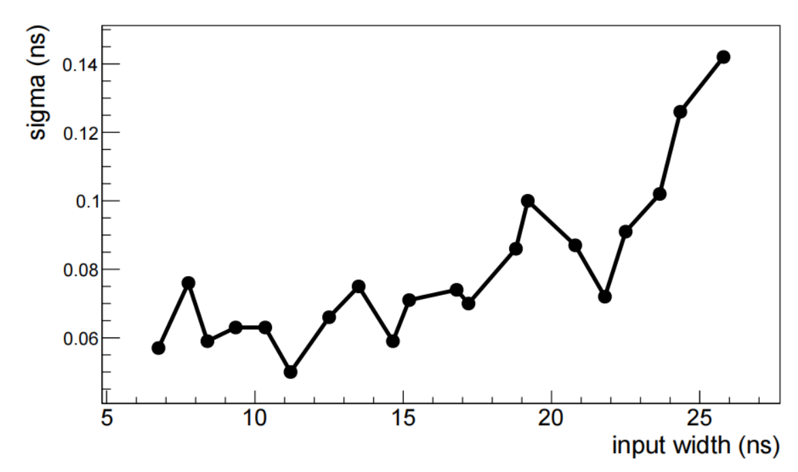
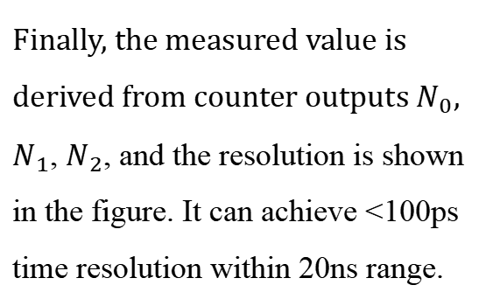
4.3 Overall resolution
Finally, the measured value is derived from counter outputs $N_{0}$, $N_{1}$, $N_{2}$, and the resolution is shown in the figure. It can achieve <100ps time resolution within 20ns range.

Slide 22
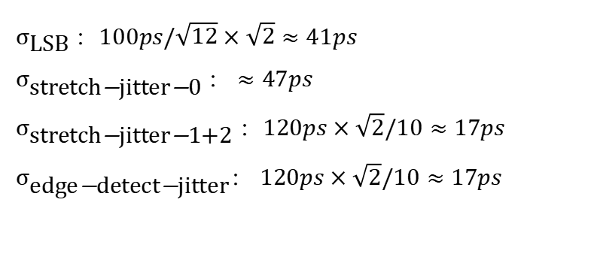
4.3 Overall resolution prediction vs measurement
$σ_{\text{LSB}}$：$100ps/\sqrt{12}×\sqrt{2}≈41ps$
$σ_{\text{stretch}\text{−}\text{jitter}\text{−}\text{0}}$： $≈47ps$
$σ_{\text{stretch}\text{−}\text{jitter}\text{−}\text{1+2}}$：$120ps×\sqrt{2}/10≈17ps$
$σ_{\text{edge}\text{−}\text{detect}\text{−}\text{jitter}}$： $120ps×\sqrt{2}/10≈17ps$
Taking the 10ns input signal as an example. The analysis shows that the standard deviation is 67ps, and the measured standard deviation is 63ps, which is in line with the prediction.

Slide 23
CONTENT
Conclusion
05
conclusion
outlook

Slide 24
5.1 Conclusion
1
A two-stage time-stretching TDC was implemented with discrete components.
At each stretching factor of approximately 10 times, the LSB is reduced by a factor of 100 from the width of a clock cycle. At 100MHz clock rates, the time resolution is better than 100ps.
2
Compared with single-stage stretching, the dead time is significantly reduced.
For a 10ns input signal, with an additional half clock cycle (5ns), the TDC needs less than 300ns of conversion time, which is 5 times smaller than the dead time of the 100 times stretching circuit.

Slide 25
5.2 Outlook
As a parameter optimization test platform
Enable low-cost time measurements
This provides a reference for the design of future 4D (time information) pixel detectors using modern CMOS processes (requiring uW level power consumption, time resolution less than 35ps, and event rate exceeding 100kHZ).
As a low-cost time measurement system in use, it achieves a time resolution better than 100 ps, making it suitable for precise timing systems such as neutrino detectors.

Slide 26
This work has been published in JINST. For more details, please see our paper. I’d be glad to discuss further during the conference.
Y. Chu and Z. Zhang, A two-stage time-stretching TDC with discrete components, JINST 20, T06005 (2025).

Slide 27
5‘’++‘’4
Thanks!
Yanbo Chu, Zhicai zhang
Department of Engineering Physics,
Tsinghua University

Slide 28
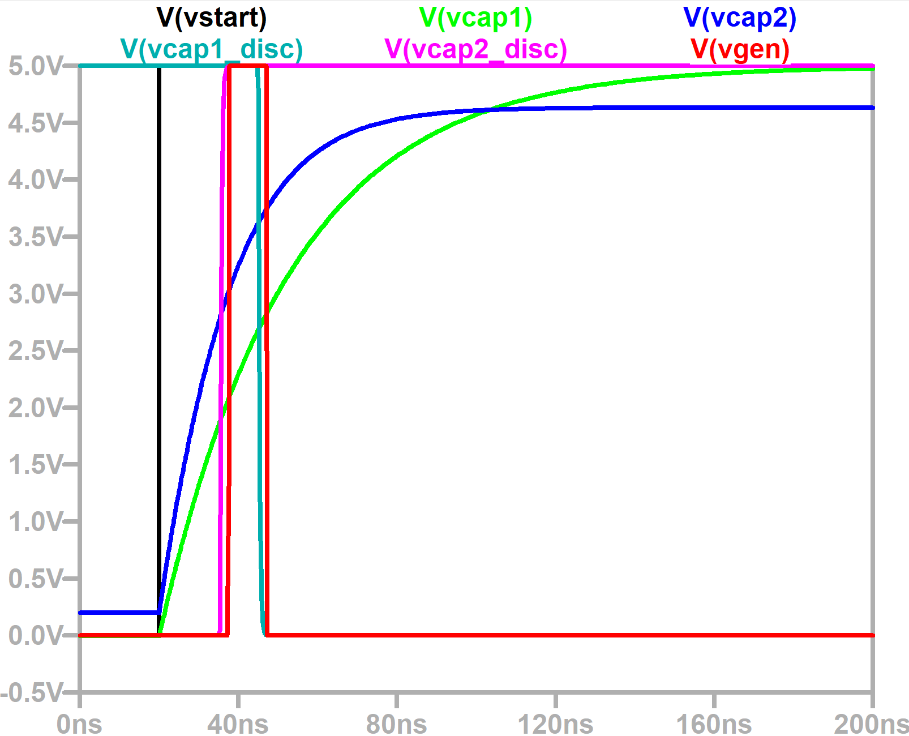
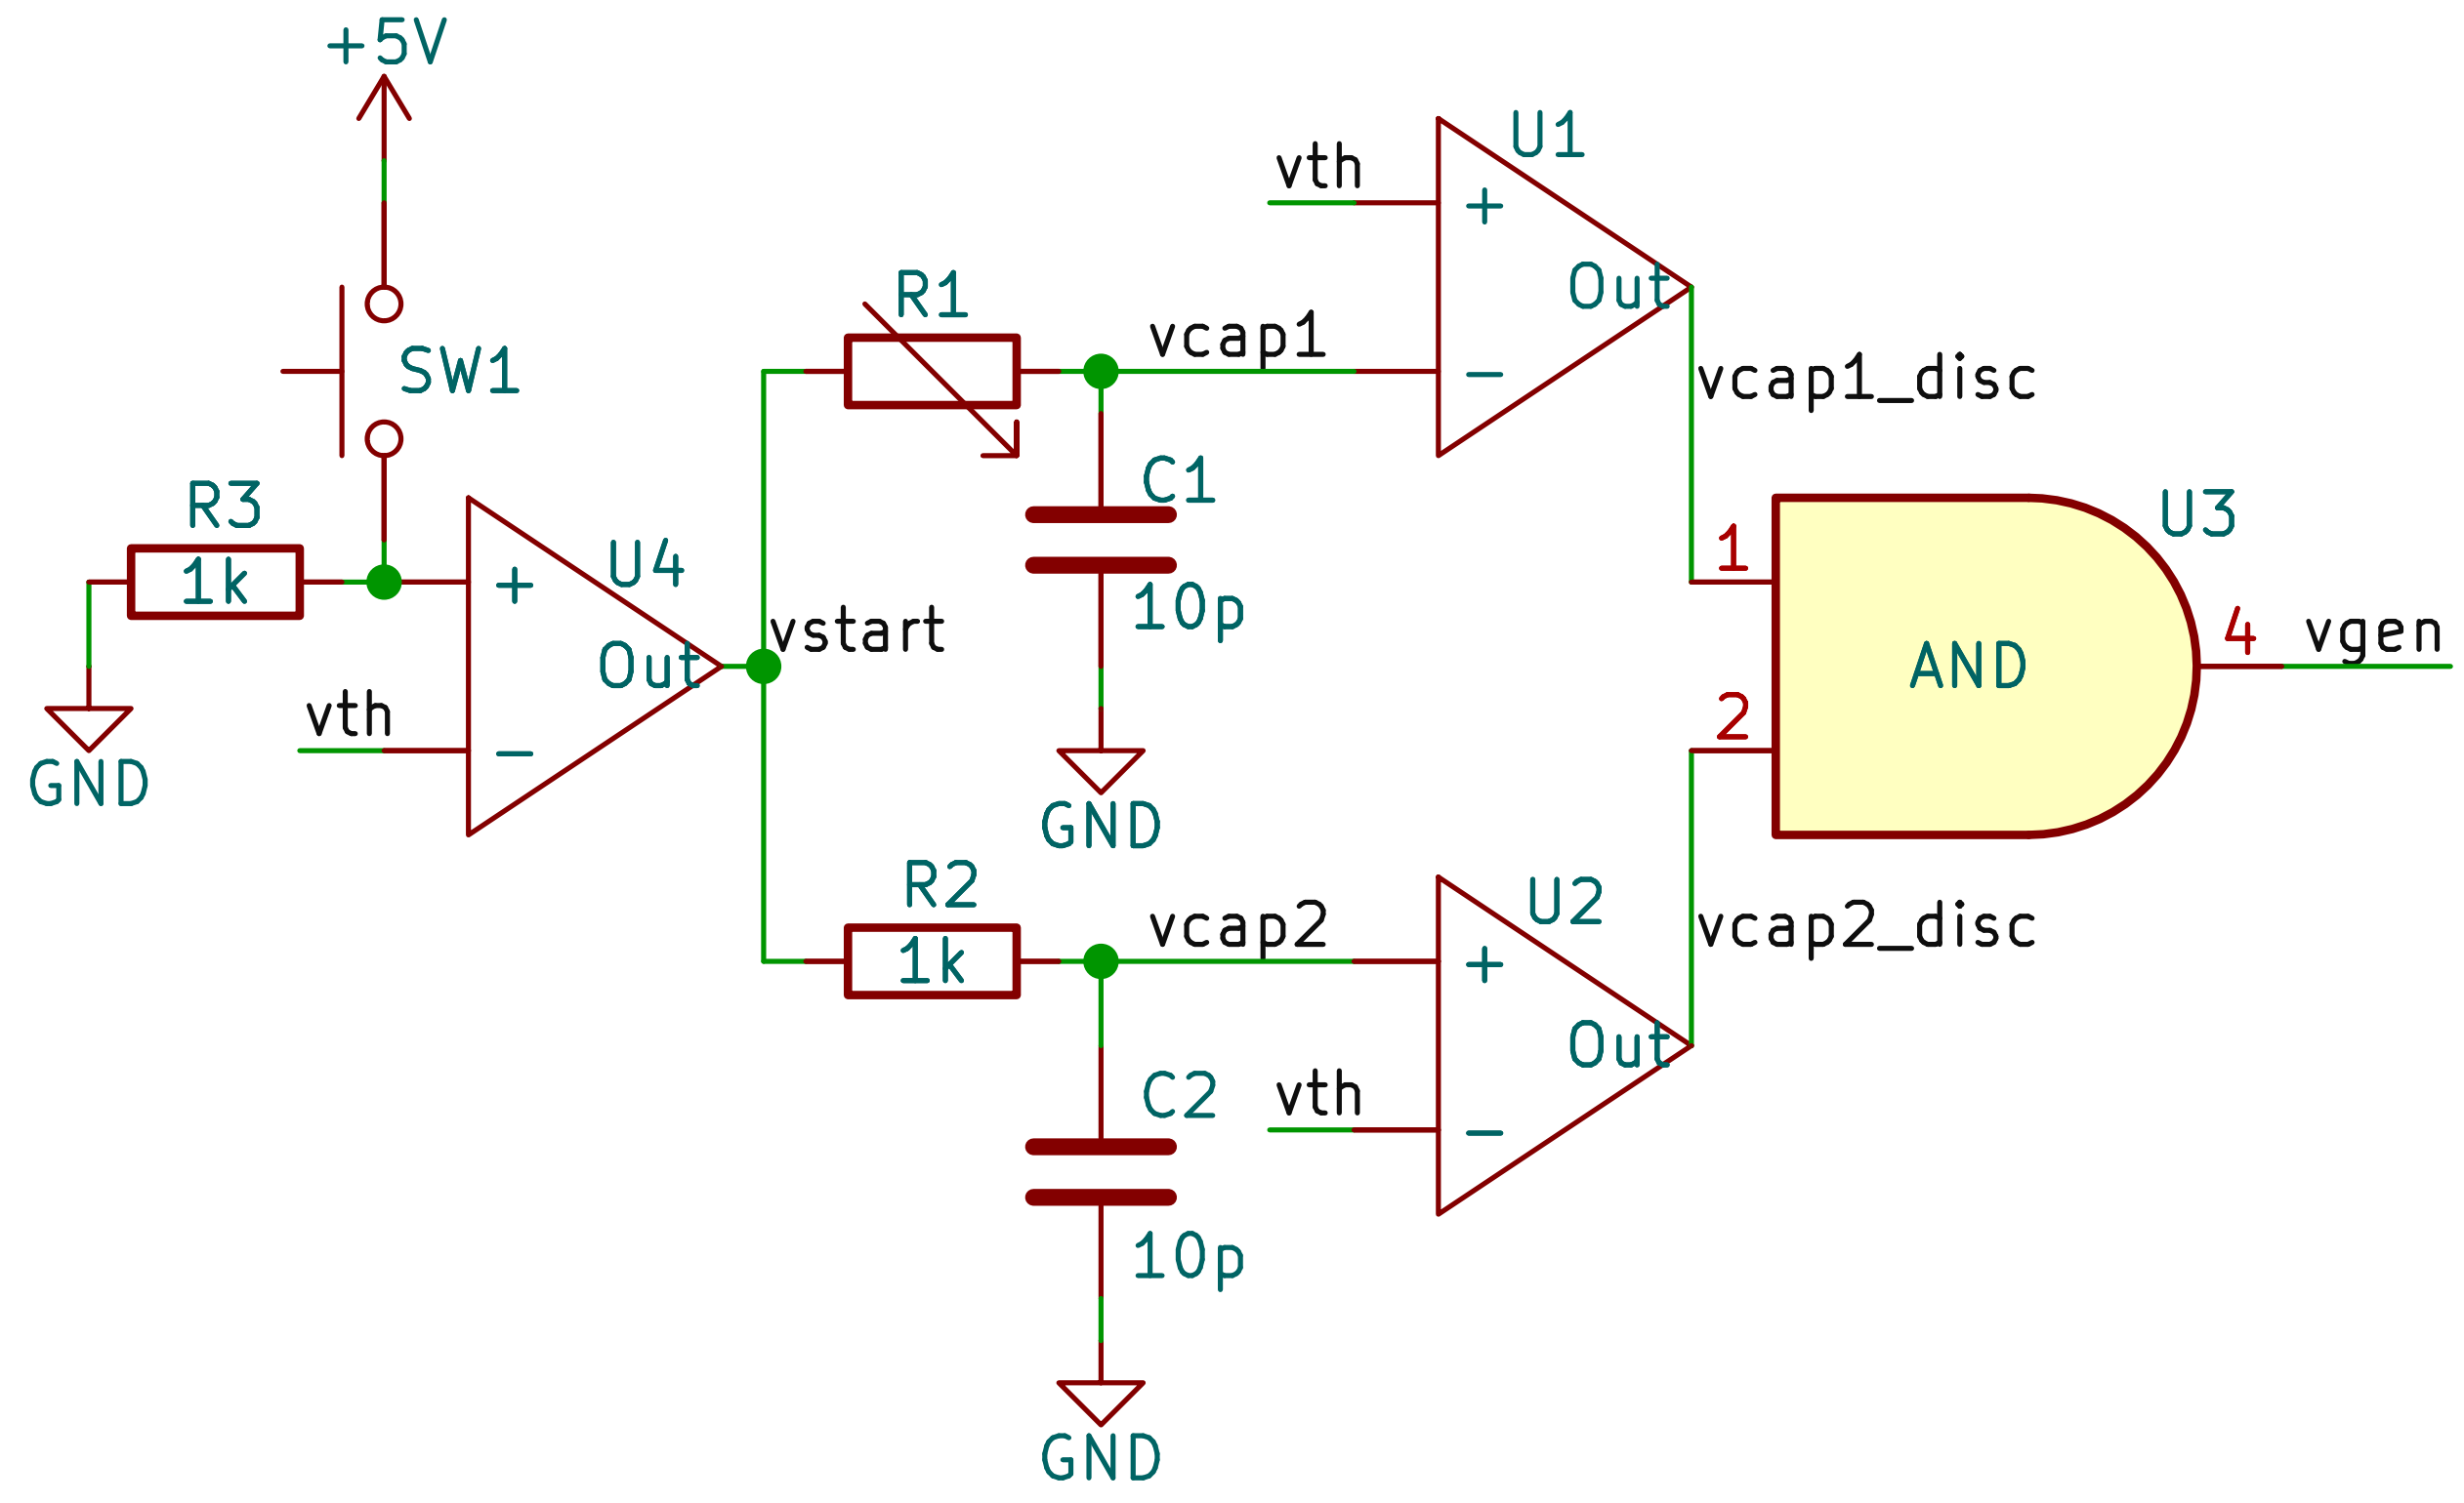
2.3 Signal generator
Based on different RC delays, a ns-level signal can be generate and controlled by microcontroller. Signal width can also be controlled by variable resistance.
Can be used to generate a batch of test signals of a specific width for calibration

Slide 29
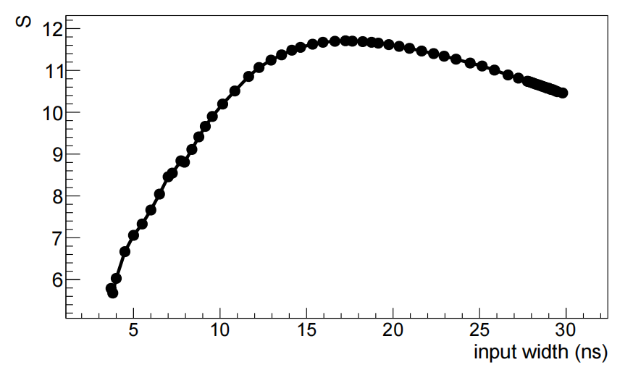
Time-stretching calibration
The calibration curve shows a certain nonlinearity. The curve of the amplification factor with the variation of input signal width is shown in the right figure, and the change of amplification factor can be clearly seen
The change in magnification makes it impossible to use linear fitting directly to restore the input signal width from the output signal width, but requires a lookup table for linear interpolation

Slide 30
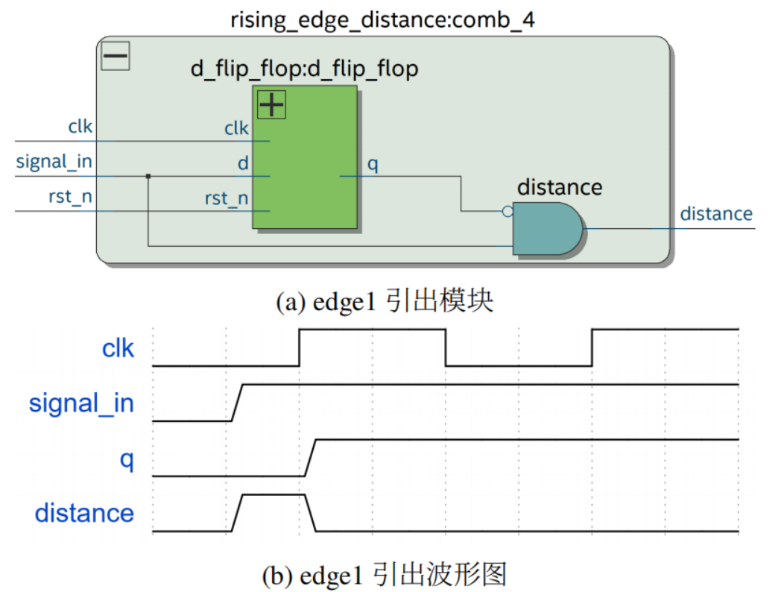
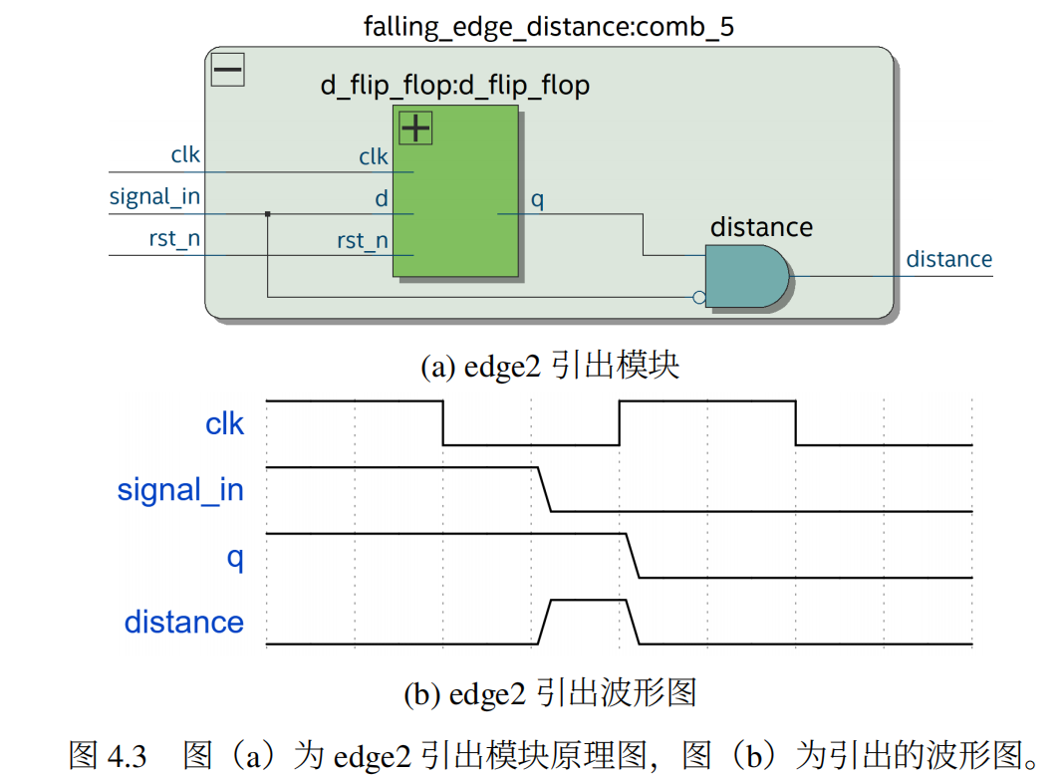
4.1 Output edges
(a) edge1 output module
(a) edge2 output module
(b) edge1 output waveform
(b) edge2 output waveform
output
process
signal_in turns high
q is pulled up on the next clock rising edge
edge1 = !q and signal_in

Slide 31
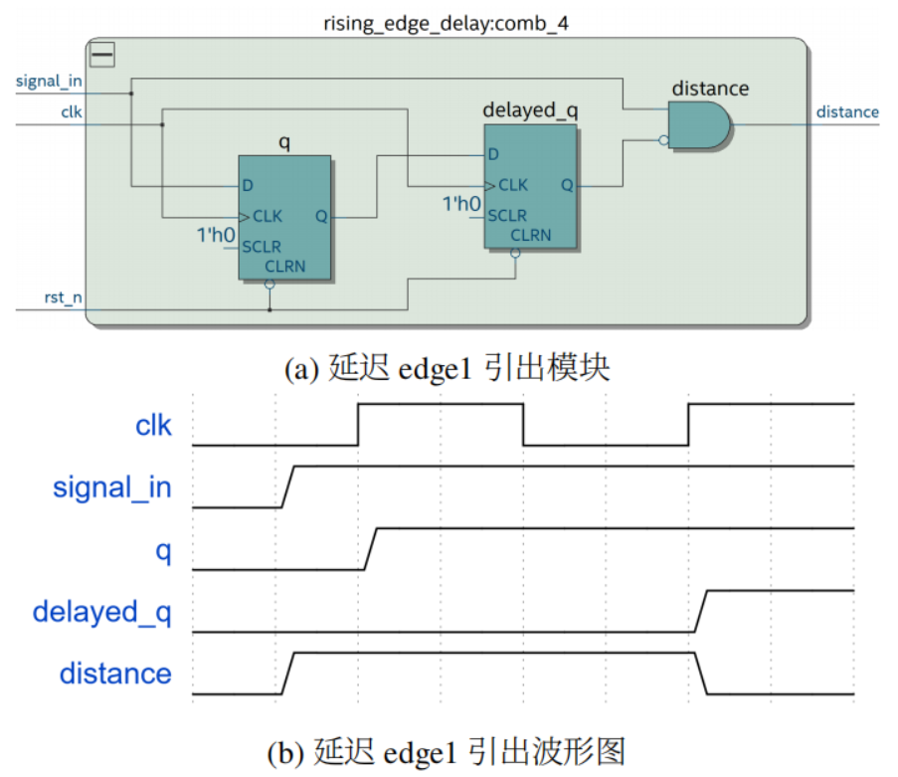
4.1 Output edges
The current edge width is randomly in a clock cycle of 10ns. When the width is less than 5ns, it can’t be stretched effectively. Therefore, an additional clock cycle is added to it.
(a) modified edge1 output module
Others remain the same, but q is used as an input to another trigger, resulting in a delayed_q that is one clock cycle later.
After the delay:
edge1= !delayed_q and signal_in
(b) modified edge1 output waveform

Slide 32
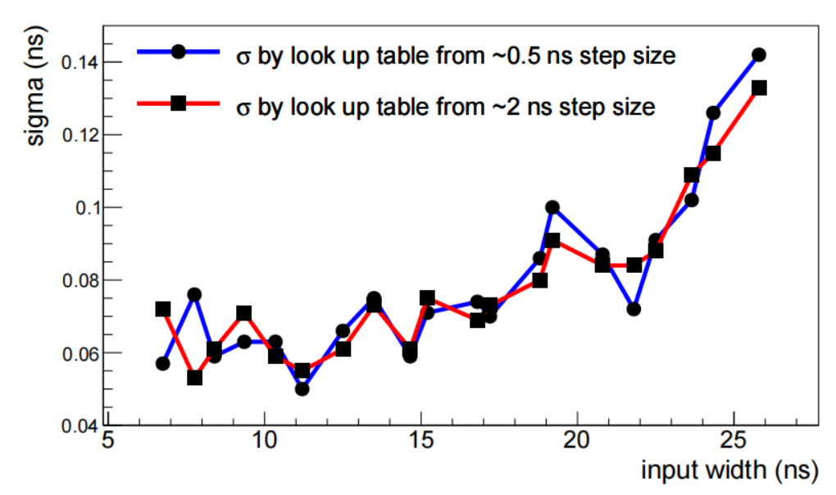
Calibration
The left figure shows the comparison of resolution when using different lookup tables. The blue data point is every 0.5ns, while the red data point is every 2ns. The lookup table is significantly smaller than the blue
In the case of a large number of channels, it is impossible for TDC to use the oscilloscope scale. One method is to input a signal with a known width and use an additional scale to TDC the amplification factor per step of the scale.
The calibration curve contains a large number of data points
(Enter one data point every 0.5ns)
Reducing the lookup table reduces the difficulty of the scale
Similar resolution performance can be achieved with far fewer data points than are currently available

Slide 33
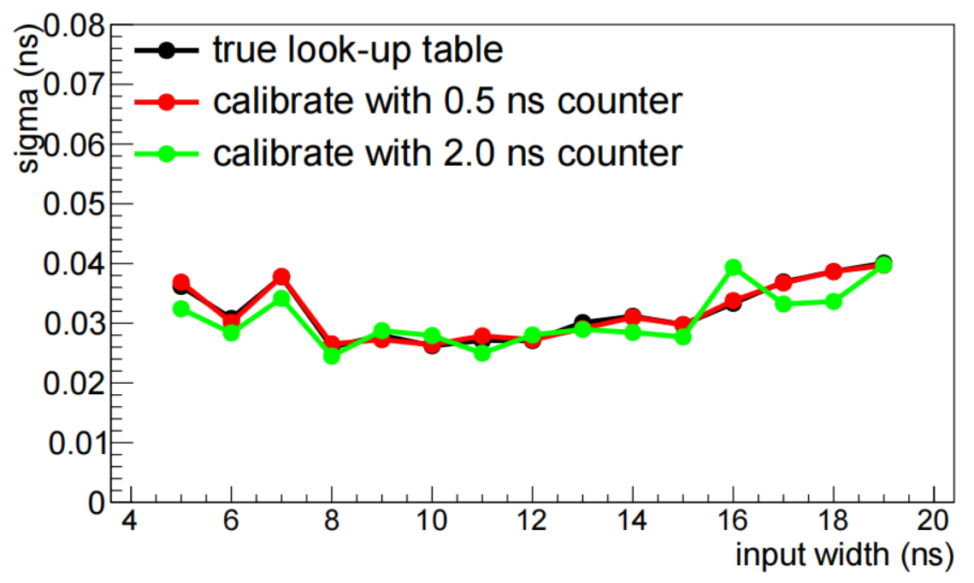
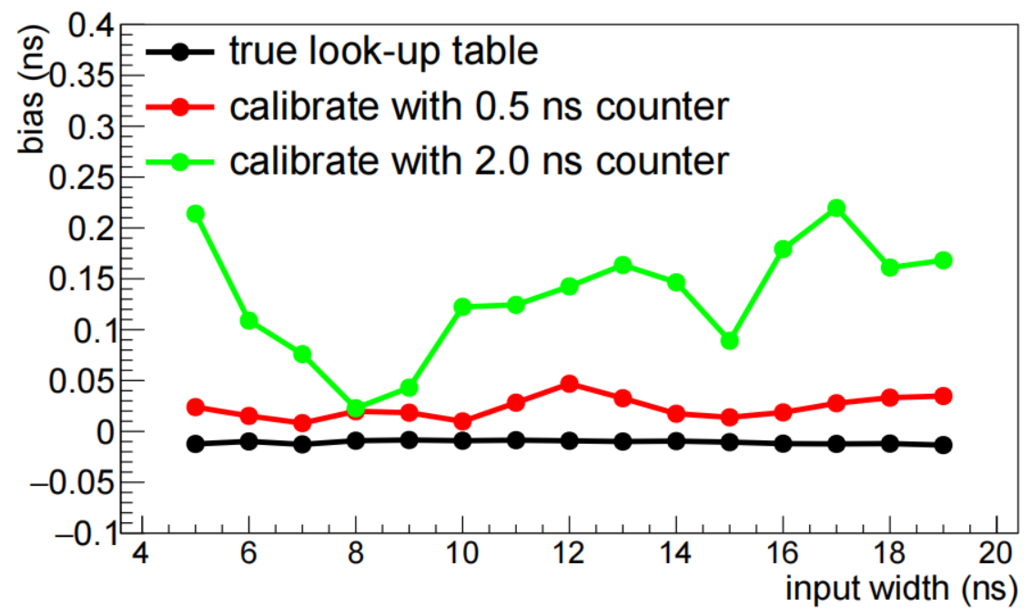
Calibration
If the deviation can be physically derived, such as the trajectory of different particles on a PV, then the deviation can be scaled so that it does not affect the measurement.
The figure above simulates the use of 0.5ns and 2ns clock cycles as scale for TDC. The left figure shows the time resolution, and the right figure shows the deviation from the true value
There is almost no effect on the resolution, but the 2ns clock will cause an additional fixed deviation.

