Slide 1


A Low-Power LGAD–Timepix Dosimeter for Biological Space Radiation Monitoring
Space Exploration Technologies
HORIZON-CL4-2022-SPACE-01
Michele Caselle on behalf of ALCYONE collaboration

Slide 2


Background and motivation
What is the major limiting factor for a sustained human presence in deep space, such as on Mars?
The Global Exploration Roadmap (GER) from the International Space Exploration Coordination Group identifies radiation exposure as the foremost of the top five spaceflight hazards in deep-space manned exploration missions
Addressing this challenge is essential for the future of human space exploration
How can we make humans and plants radiation-tolerant for long-term deep-space missions?

Slide 3







HORIZON-CL4-2022-SPACE-01
ALCYONE project
The project proposes a compact, low-power scientific payload that enables the autonomous execution of experiments on cell cultures matching designed for nanosatellite missions and other space platforms, key components are:
Bio‑analytical strategy: Bioluminescent cell‑based biosensors to develop a living‑cell radiation sensor
Lab‑on‑chip technology: Integrated thin‑film electronics to sustain and monitor live cell cultures
Low‑power dosimeter system: Dual‑use application as a space dosimeter, and potentially as laboratory diagnostic instrumentation for bioluminescence applications not currently available on the market.

Slide 4
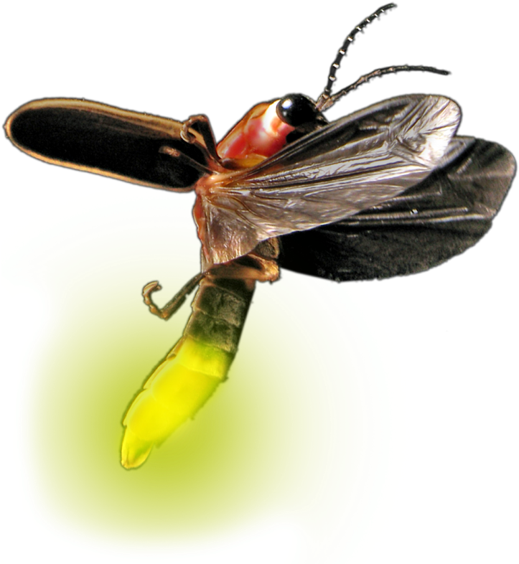


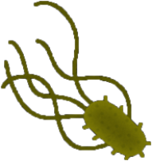





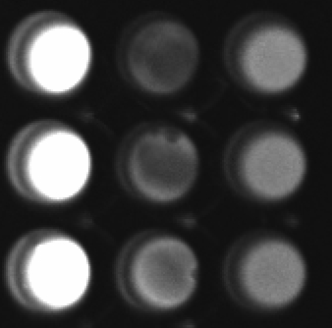



Biosensors based on luciferase reporters
Cells are transformed into BIOSENSORS through a luciferase synthetic plasmid
Yeast Saccharomyces cerevisiae
GENETIC ENGINEERING
Mammalian HEK293
BIOSENSORS are activated by DNA damage repair system
DNA damage can be inducted via space radiation and altered gravity.
Activated biosensors express luciferase measured in counts (n)
Altered Gravity
Bacterium
Escherichia coli
Radiation
Biosensors
on lab-on-chip
Cyanobacterium
Chroococcidiopsis sp. CCMEE 029
Courtesy of: Costanza Maria Martella and Mara Mirasoli
Credit: Lab. Astrobiology and Molecular Biology of Cyanobacteria
Lab. Astrobiology and Molecular Biology of Cyanobacteria
Images created with www.BioRender.com

Slide 5
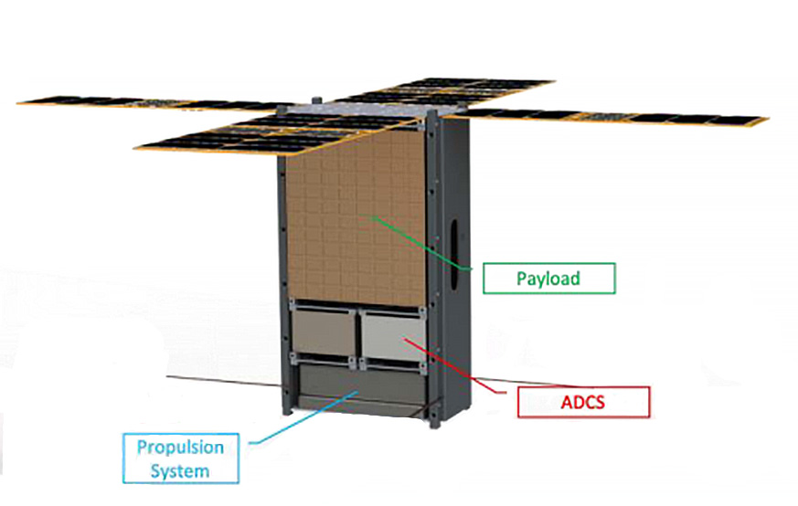
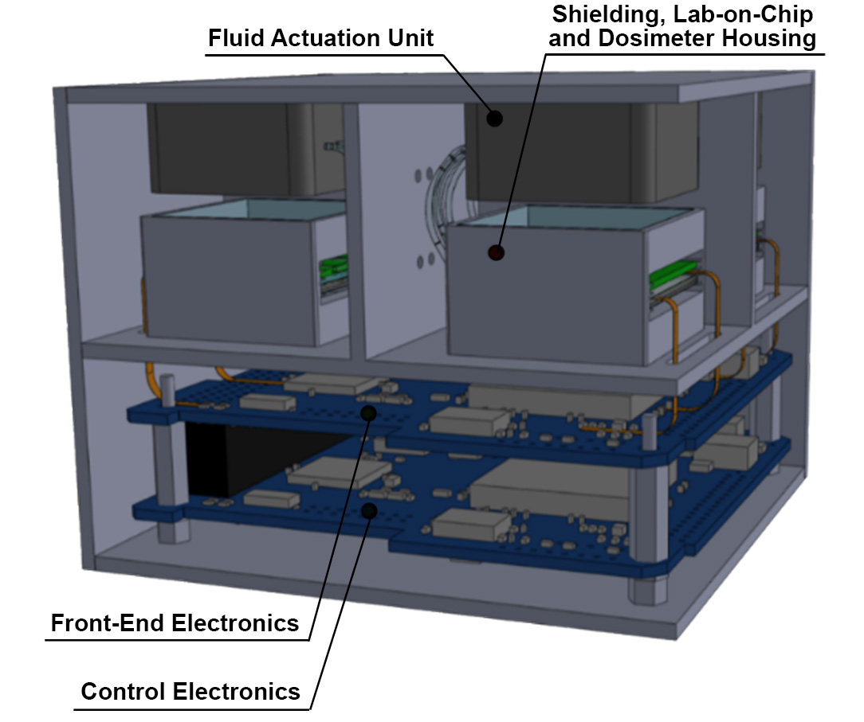
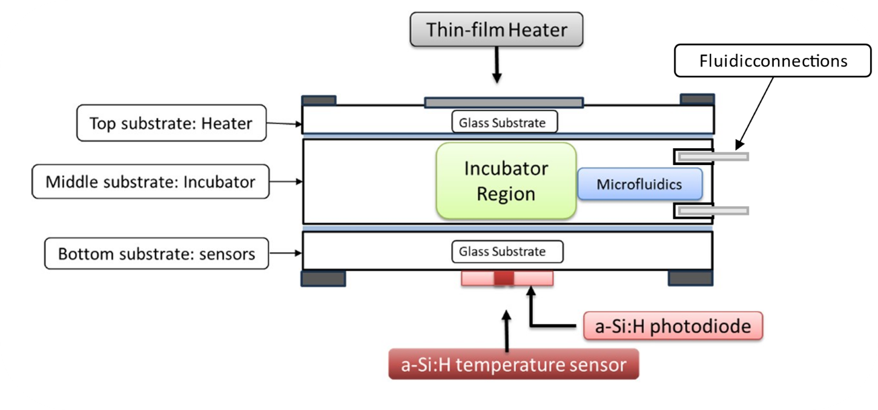
Overall system view -scientific payload
payload
Lab-on-chip
Cubesats
which provides all necessary support to keep the cell alive.
Biology-focused CubeSats. The incubator for cell culture requires advanced technologies. It provides all necessary support to keep the cell alive. The system integrates micro-heaters, as well as gas delivery systems for oxygen (O₂), carbon dioxide (CO₂), and all necessary nutrients. Additionally, it incorporates amorphous silicon sensors for both light detection and temperature monitoring
Incubator
*PDMS stands for Polydimethylsiloxane, a silicone-based low toxicity, and unique hydrophobicity.
KIT contribution
Notes:
This structure will later undergo wafer-to-wafer (W2W) bonding to achieve a sealed environment.

Slide 6
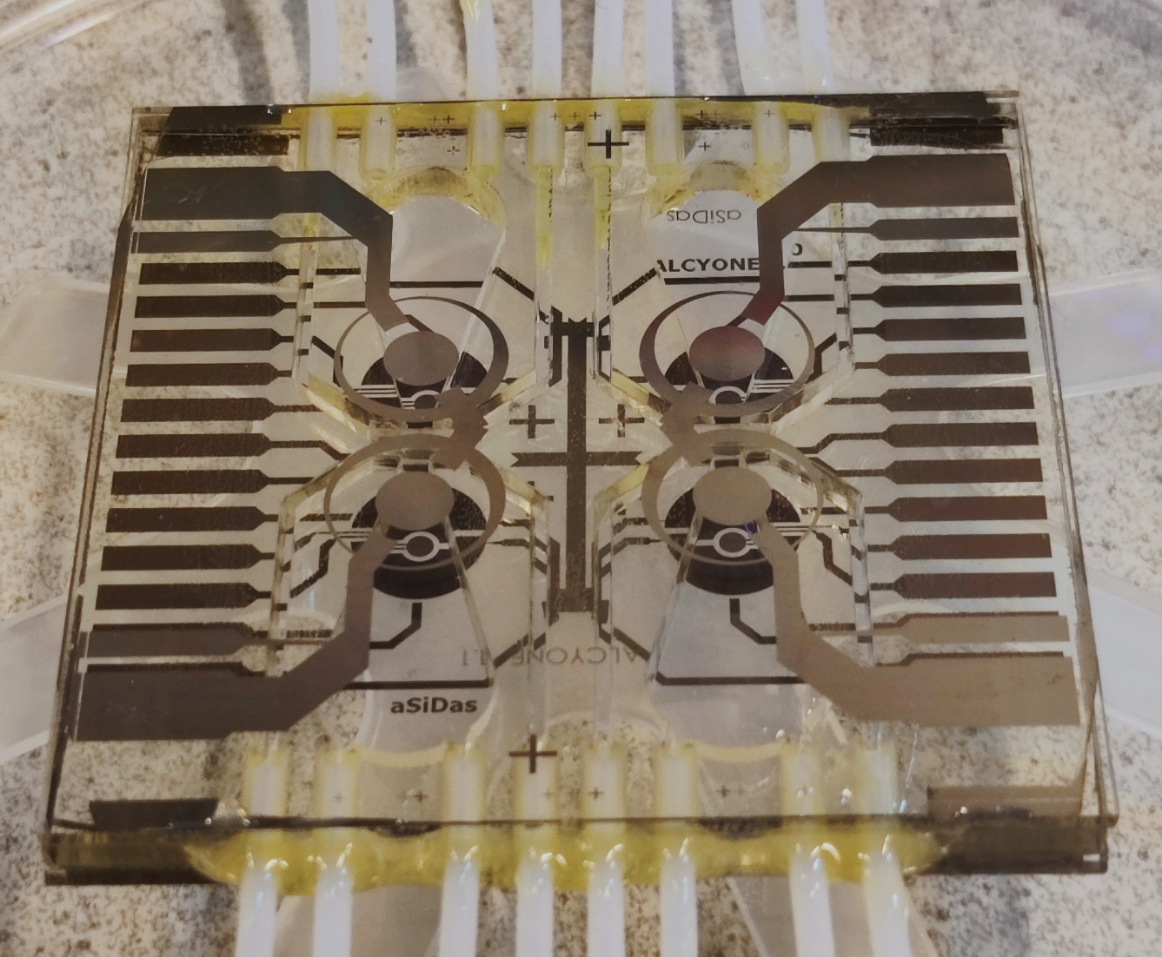
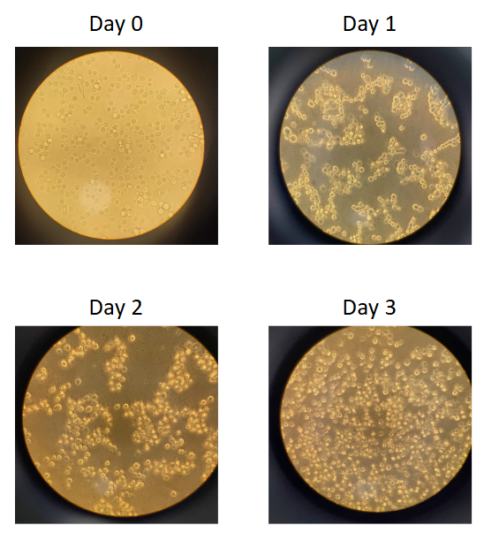
Overall system view -scientific payload
payload
Lab-on-chip
Cubesats
Thermal-Sensor
Photo-Sensor
A cell culture capable of growing under well-controlled conditions inside a lab-on-chip incubator
Cell-incubator
Resistive Heater
Incubator
Courtesy of: Augusto Nascetti and Han Gardeniers
KIT contribution
Notes:
This structure will later undergo wafer-to-wafer (W2W) bonding to achieve a sealed environment.

Slide 7
Overall system view -scientific payload
Dosimeter
payload
Lab-on-chip
Cubesats
Thermal-Sensor
Photo-Sensor
A cell culture capable of growing under well-controlled conditions inside a lab-on-chip incubator
Cell-incubator
Resistive Heater
Incubator
Courtesy of: Augusto Nascetti and Han Gardeniers
KIT contribution
Notes:
This structure will later undergo wafer-to-wafer (W2W) bonding to achieve a sealed environment.

Slide 8

Precise dosimeter for lab- and space- applications
Solar flare or coronal mass ejection (CME) emissions radiation
Key features are:
Space application:
low-power and high-efficiency dosimeter
High-granularity pixelated detector
Laboratory setup for high-sensitivity bioluminescence detection
Capable of detecting the faint luciferase light
Single bacteria photon emission

Slide 9
Precise dosimeter for lab- and space- applications
Solar flare or coronal mass ejection (CME) emissions radiation
Key features are:
Space application:
low-power and high-efficiency dosimeter
High-granularity pixelated detector
Laboratory setup for high-sensitivity bioluminescence detection
Capable of detecting the faint luciferase light
Single bacteria photon emission
Why LGADs ?
Space Applications: additional signal gain reduces Timepix3 power consumption without significant performance loss, crucial for nanosatellite constraints
Bio‑Lab Instrumentation: gain significantly enhances detection of weak biological signals, enabling improved sensitivity for bacterial light detection

Slide 10
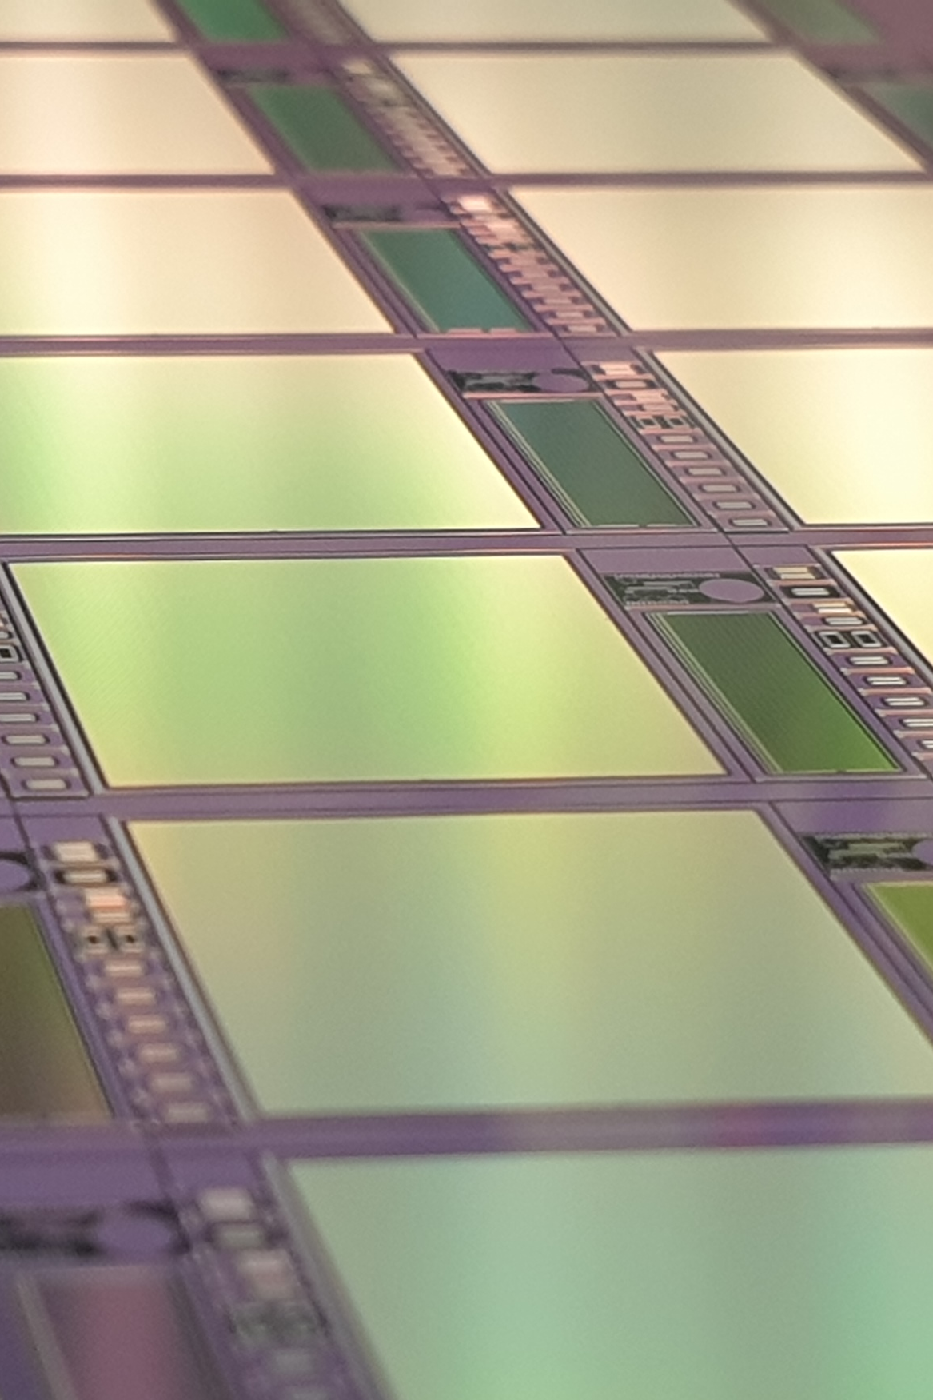

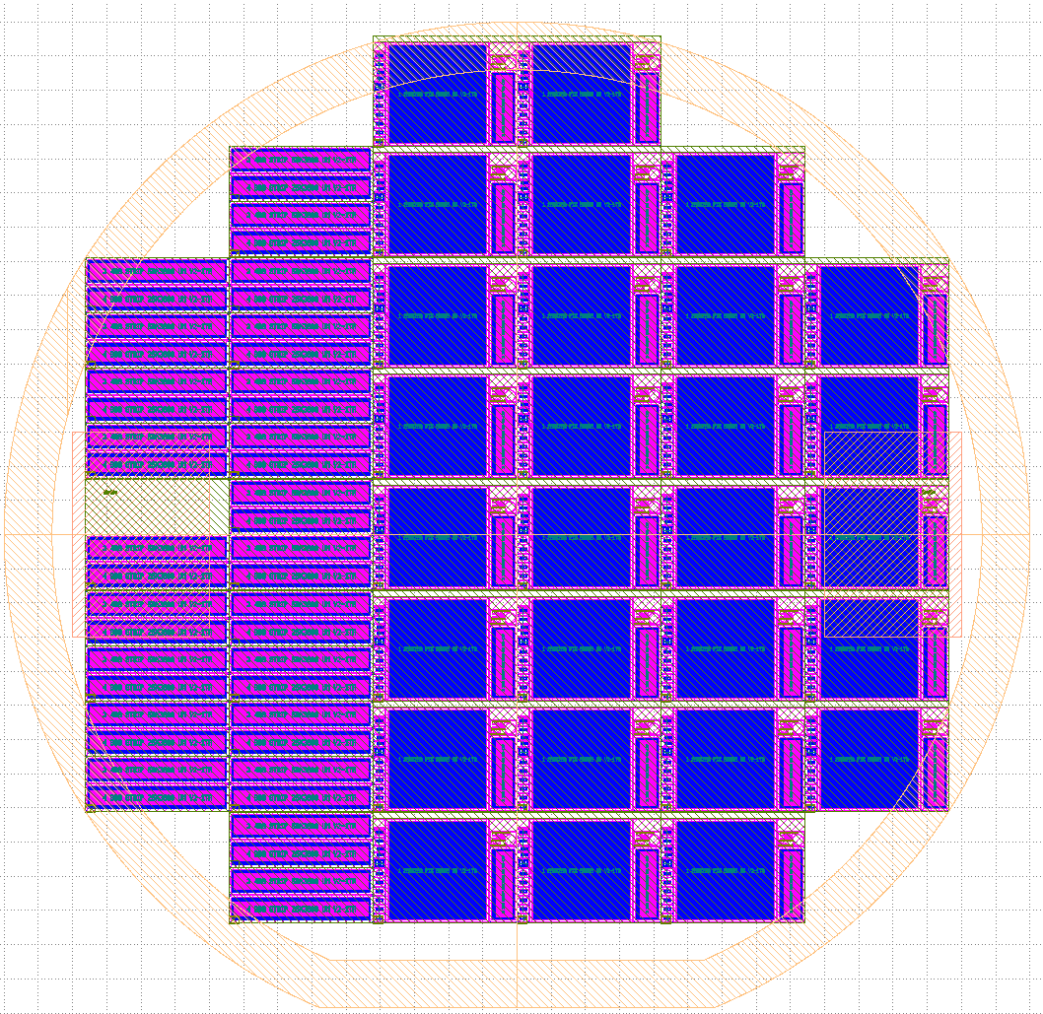
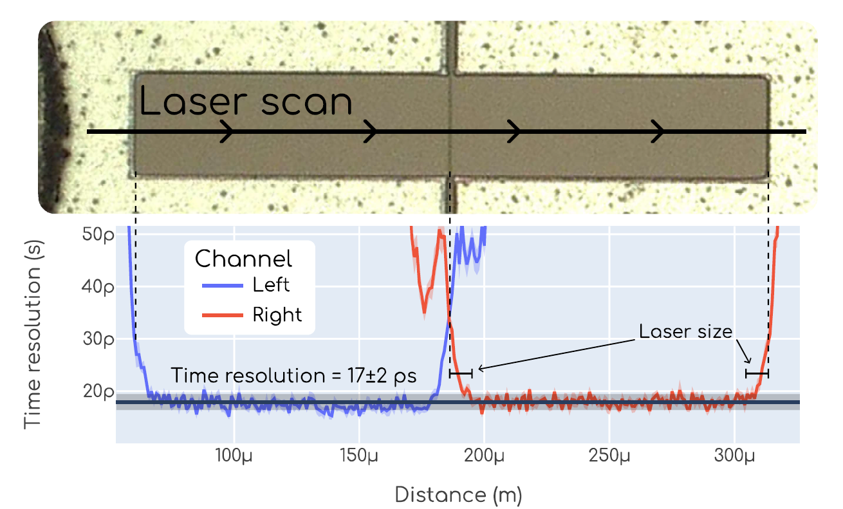
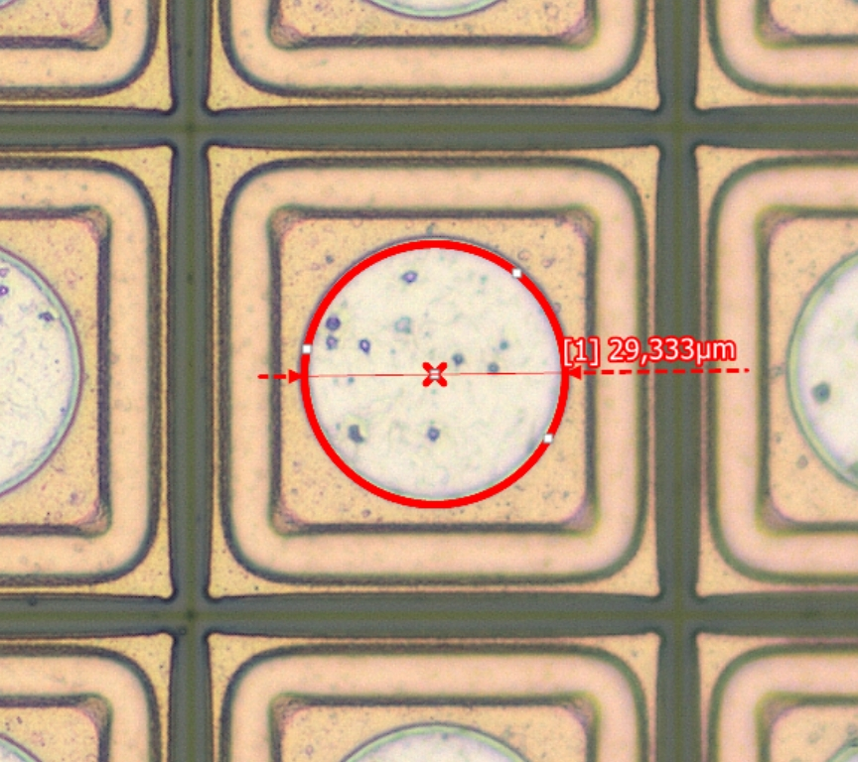
Funded by BMBF: 05K22VK2
Trench Isolated LGAD engineering run
Produced the first engineering run of Trench Isolated LGAD sensors, featuring a full-reticle area design with high spatial (pixel pitch 55 μm) and time resolution expected of a few tens of picoseconds
Microstrip for future
beam diagnostic instrumentation
Pixel matrix (Timepix3)
ALCYONE Pixel
TI-LGAD sensor
Pixel 1
Pixel 2
pixel
Pixel
First batch delivered
TCT characterization ECFA DRD3
Courtesy of: INFN-TO and UZH. A scanning Transient Current Technique
TI-LGAD sensor produced by FBK

Slide 11
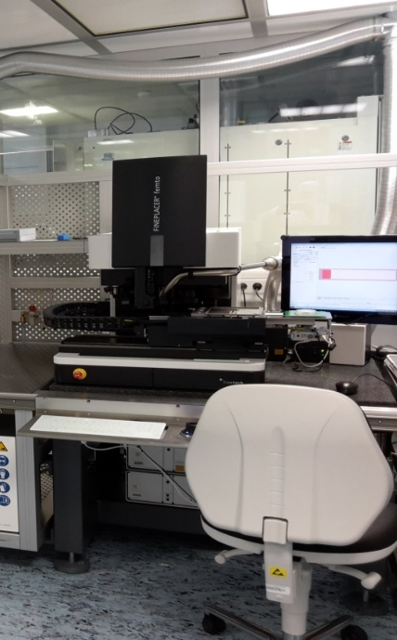
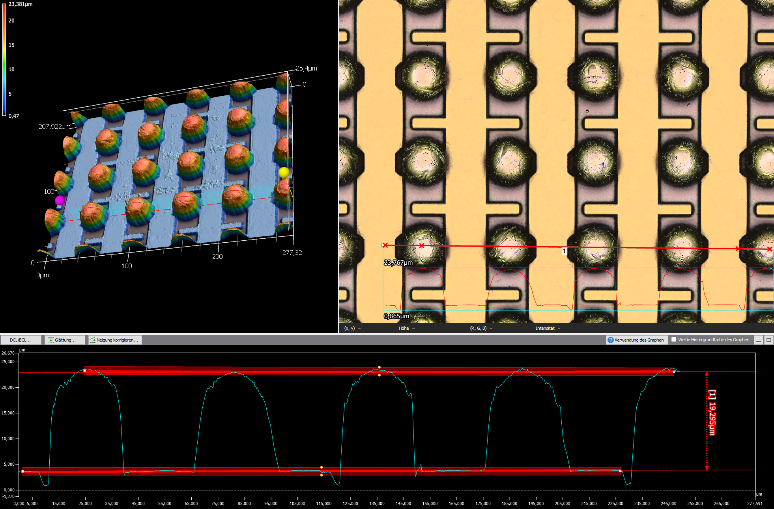
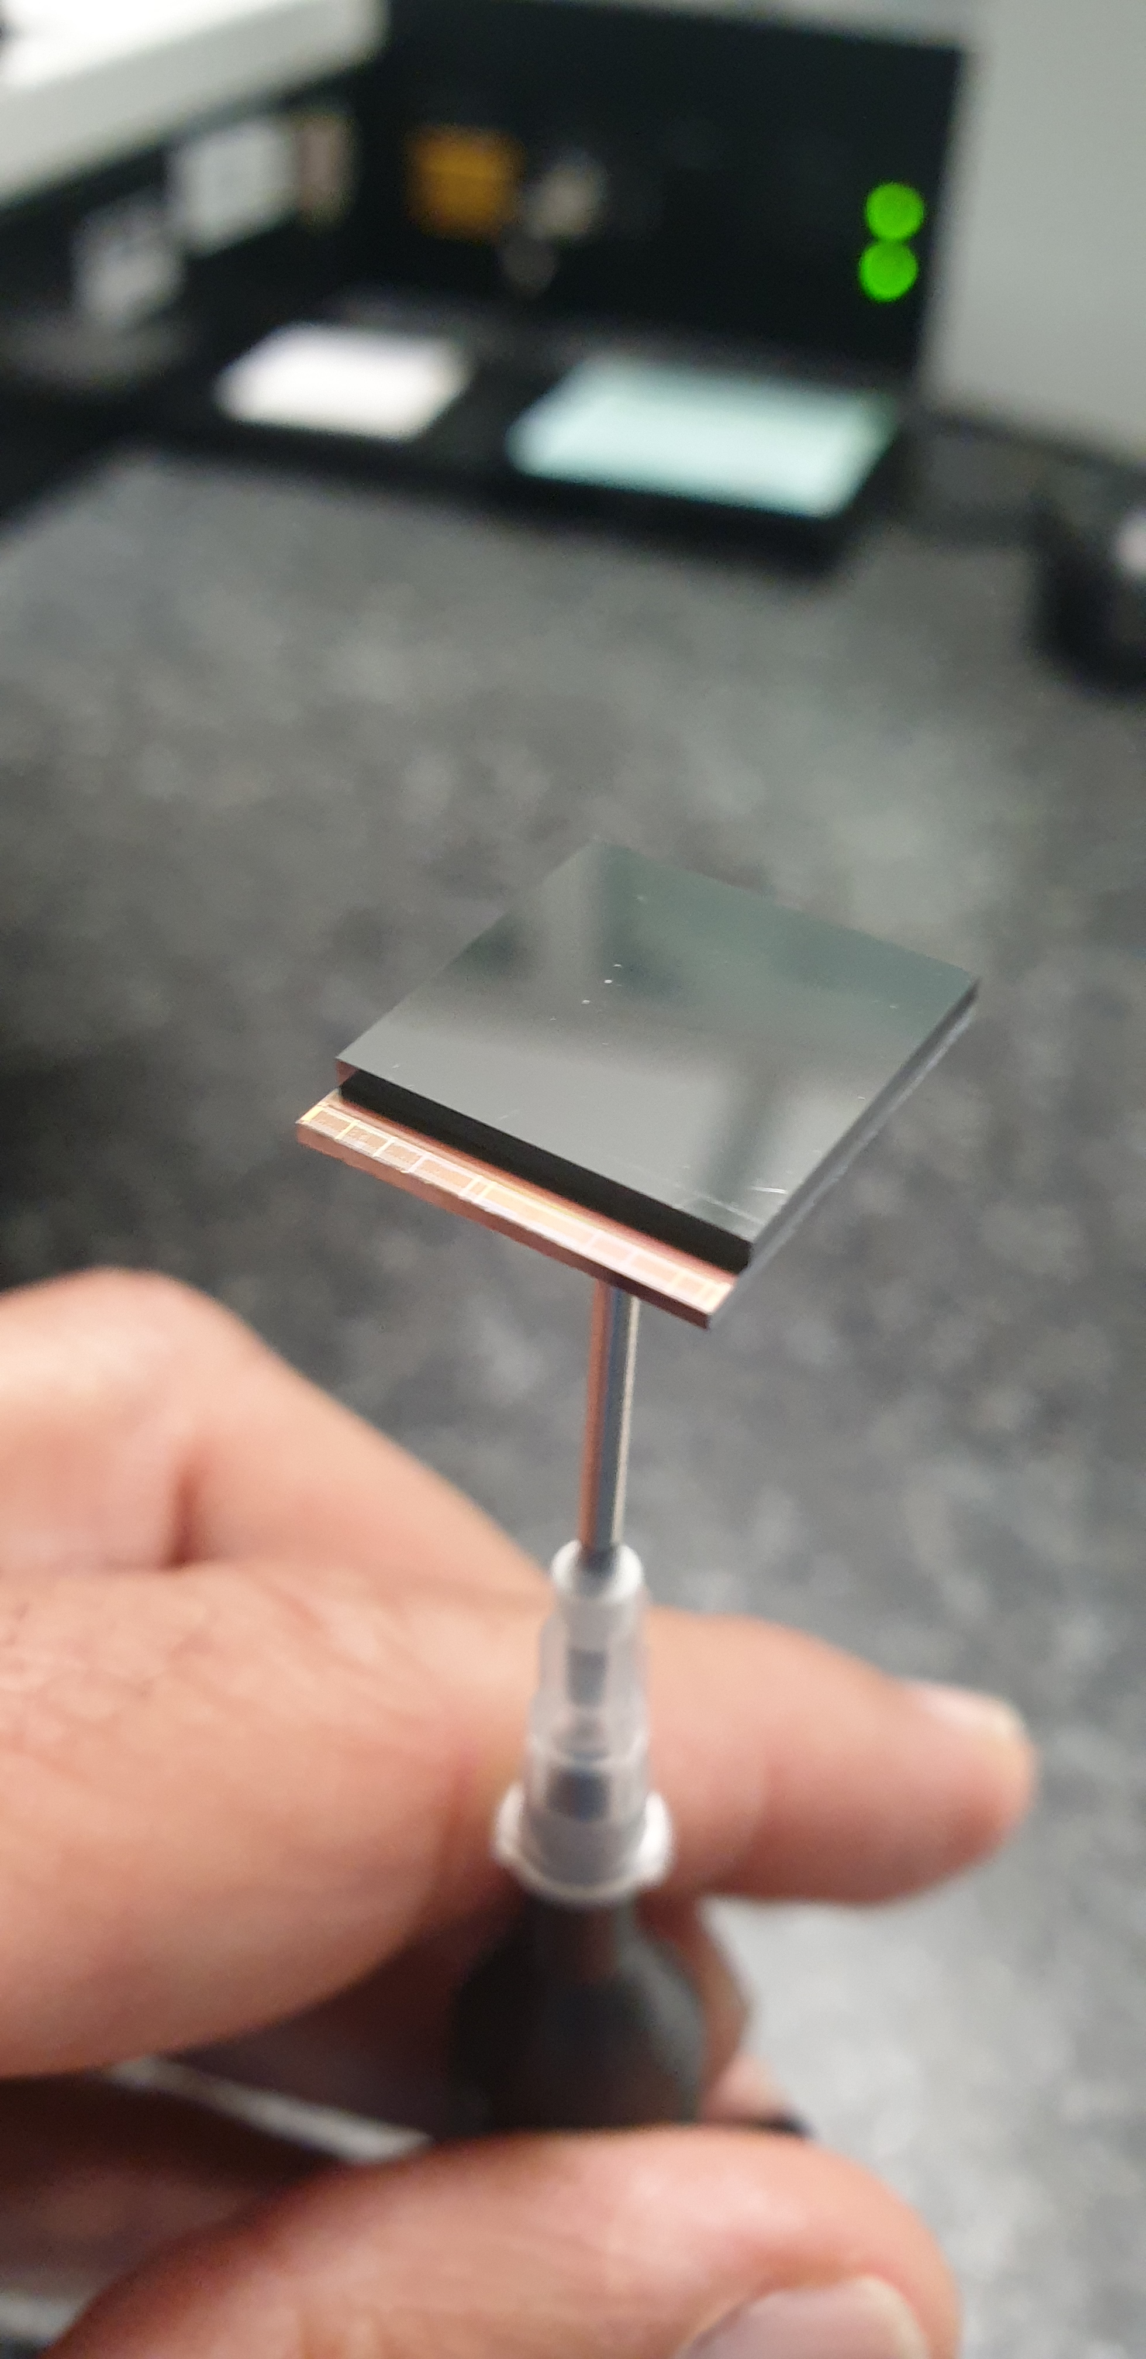
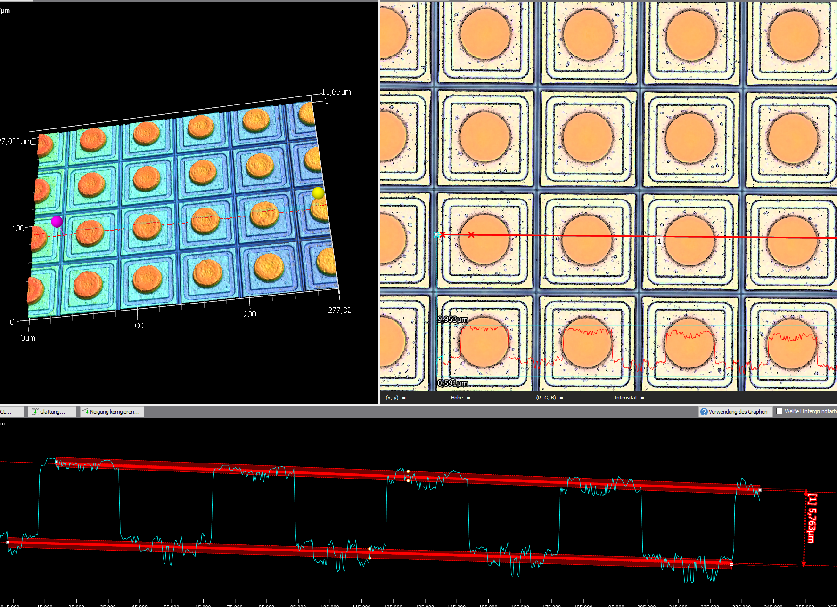
Bump-bonding technology at KIT
ALCYONE combines agile in‑house Au‑Stud and low‑temperature In-Sn/UBM bump‑bonding technologies to enable rapid Si-Timepix3 prototyping and robust CdTe hybridization, extending detector capabilities from silicon to high‑energy photon detection for space exploration
Bump-Bonded structure @KIT
In–Sn bumps @ IZM
Further details, talk by A. Lale, Integration, Intercon. & Packaging session
ENIG (Zn/Ni/Au) @ CERN
Notes:
Electroless Nickel Immersion Gold

Slide 12
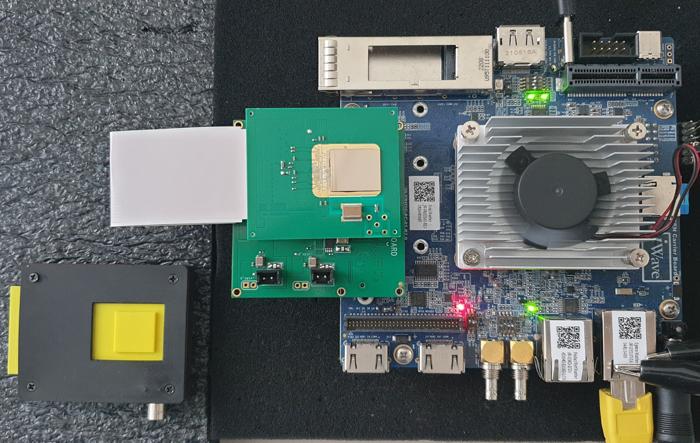

Dosimeter system
ALCYONE combines bespoke KIT‑developed readout electronics with iWave’s low‑power DAQ based on Zynq UltraScale+ processing
Key Components:
Custom PCB (KIT): low‑noise readout ASICs optimized for maximum data throughput of Timepix3, with a modular approach allowing multiple detector cards to be mounted
Potential integration of the detector with TI‑LGAD and CdTe sensors to extend detector capabilities
DAQ System (iWave): scalable, high‑throughput architecture with real‑time data processing and storage
~ 10 cm
Timepix3
ZYNQ US+
Detector card
Detector housing
Service card
ETH (1GbE)
System-on-Module readout acquisition
Collaboration on-going with

Slide 13
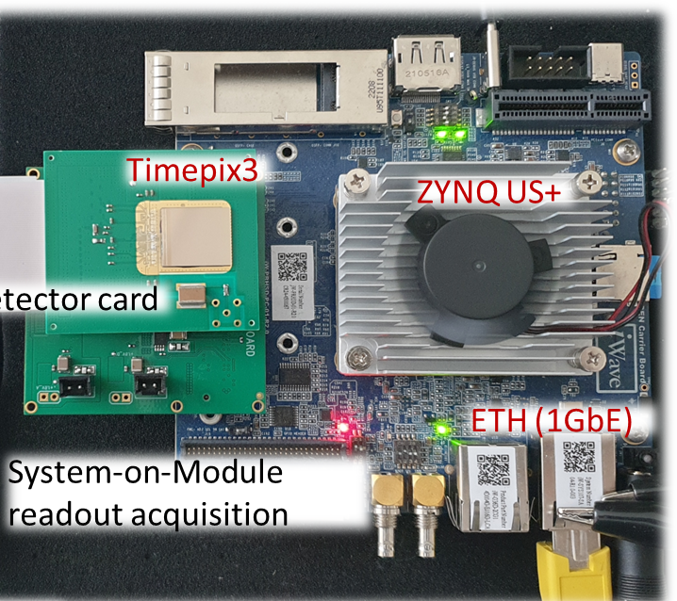

The Innovation: Fully Standalone Intelligent Detector
Timepix3/4 detectors normally require a PC to host all software components required for normal operation, calibration, characterization, threshold equalization, and graphical user interface control
PC-link

Slide 14

The Innovation: Fully Standalone Intelligent Detector
Timepix3/4 detectors normally require a PC to host all software components required for normal operation, calibration, characterization, threshold equalization, and graphical user interface control
PC-link
limited bandwidth and access
Furthermore, Timepix3/4 detectors generate large volumes of data per acquisition. With limited bandwidth for communication with Earth, efficient on‑detector data compression becomes essential

Slide 15
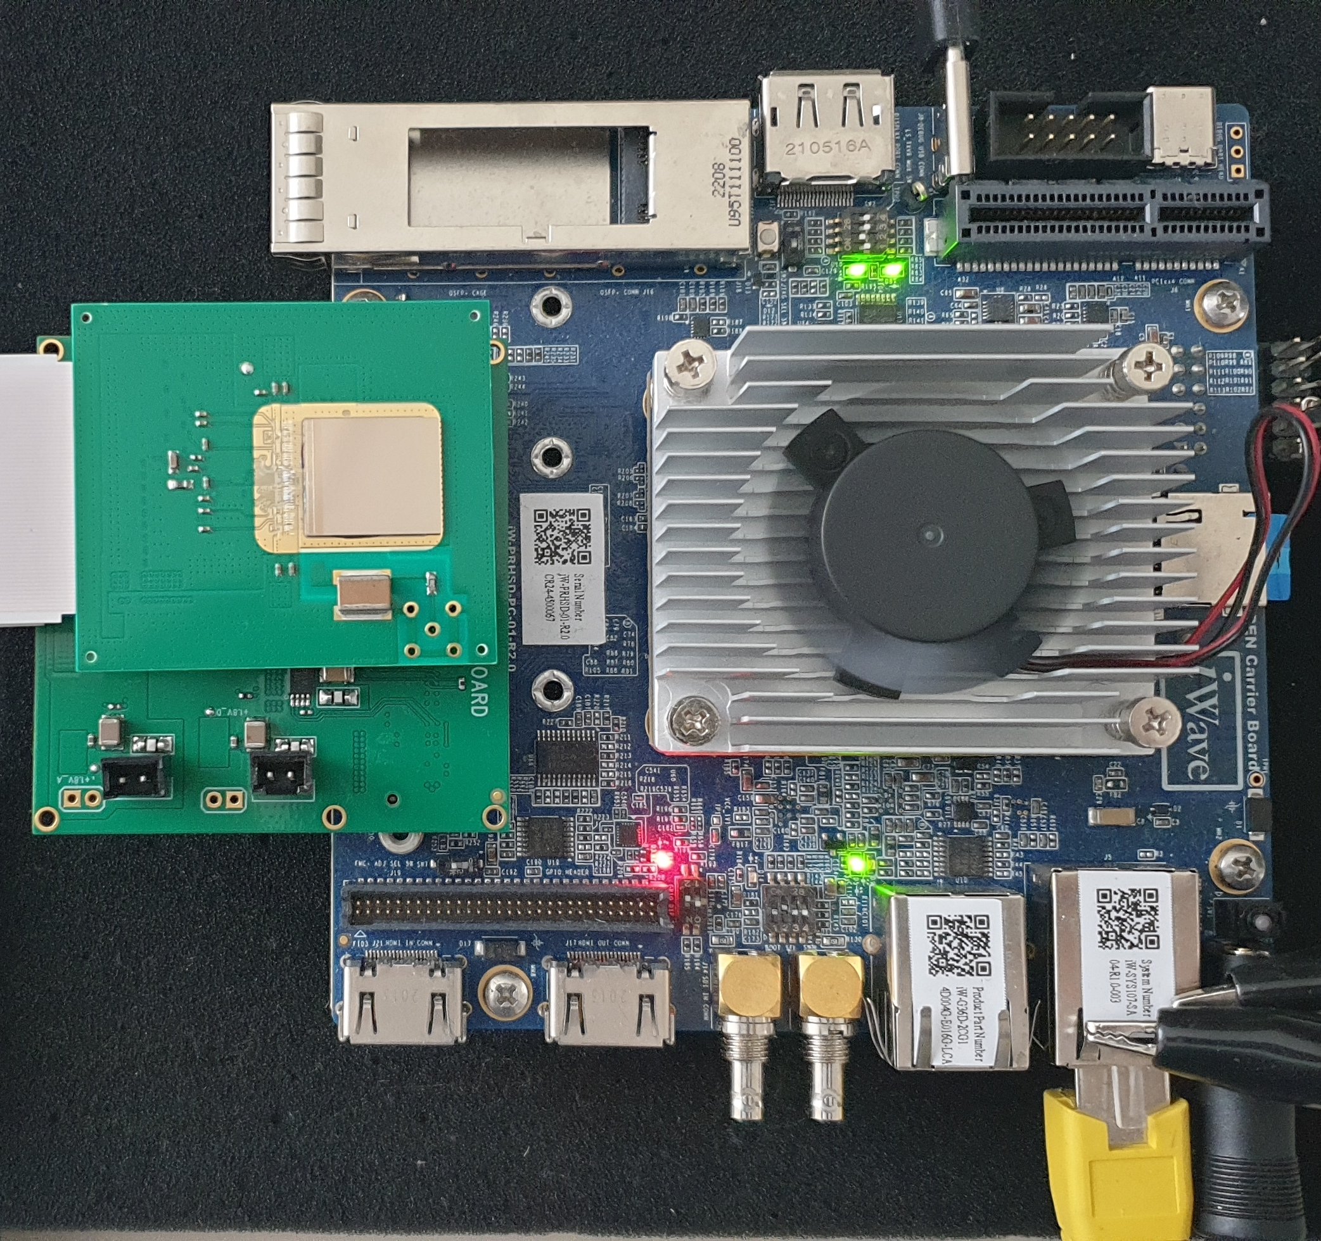
The Innovation: Fully Standalone Intelligent Detector
All tier‑levels: FPGA, PetaLinux, custom drivers, application layers, and servers, are deployed and executed natively on‑device, making it ideal for a compact, standalone dosimeter
User operation via web-browser (GUI)
Control/Readout from/to mission‑control electronics
Sharing files from/to subsystems
Timepix3
ZYNQ US+
Detector calibration and threshold equal.
FPGA firmware
AXI interface
Python GUI
Python ETH server
SAMBA
Python custom driver (MMAP and KIT DMA)
Server Web
Calibration
Fast and reliable partial or full FPGA reconfiguration without reboot.
Detector card
FPGA reconf.
Service card
PetaLinux
ETH (1GbE)
System-on-Module readout acquisition
Thanks to M. Gruber (Uni. Bonn)
FPGA
The detector operates autonomously, acquiring and processing data in real time, performing calibration, combined into a compact, low-power design, paving the way for intelligent space-borne detection

Slide 16
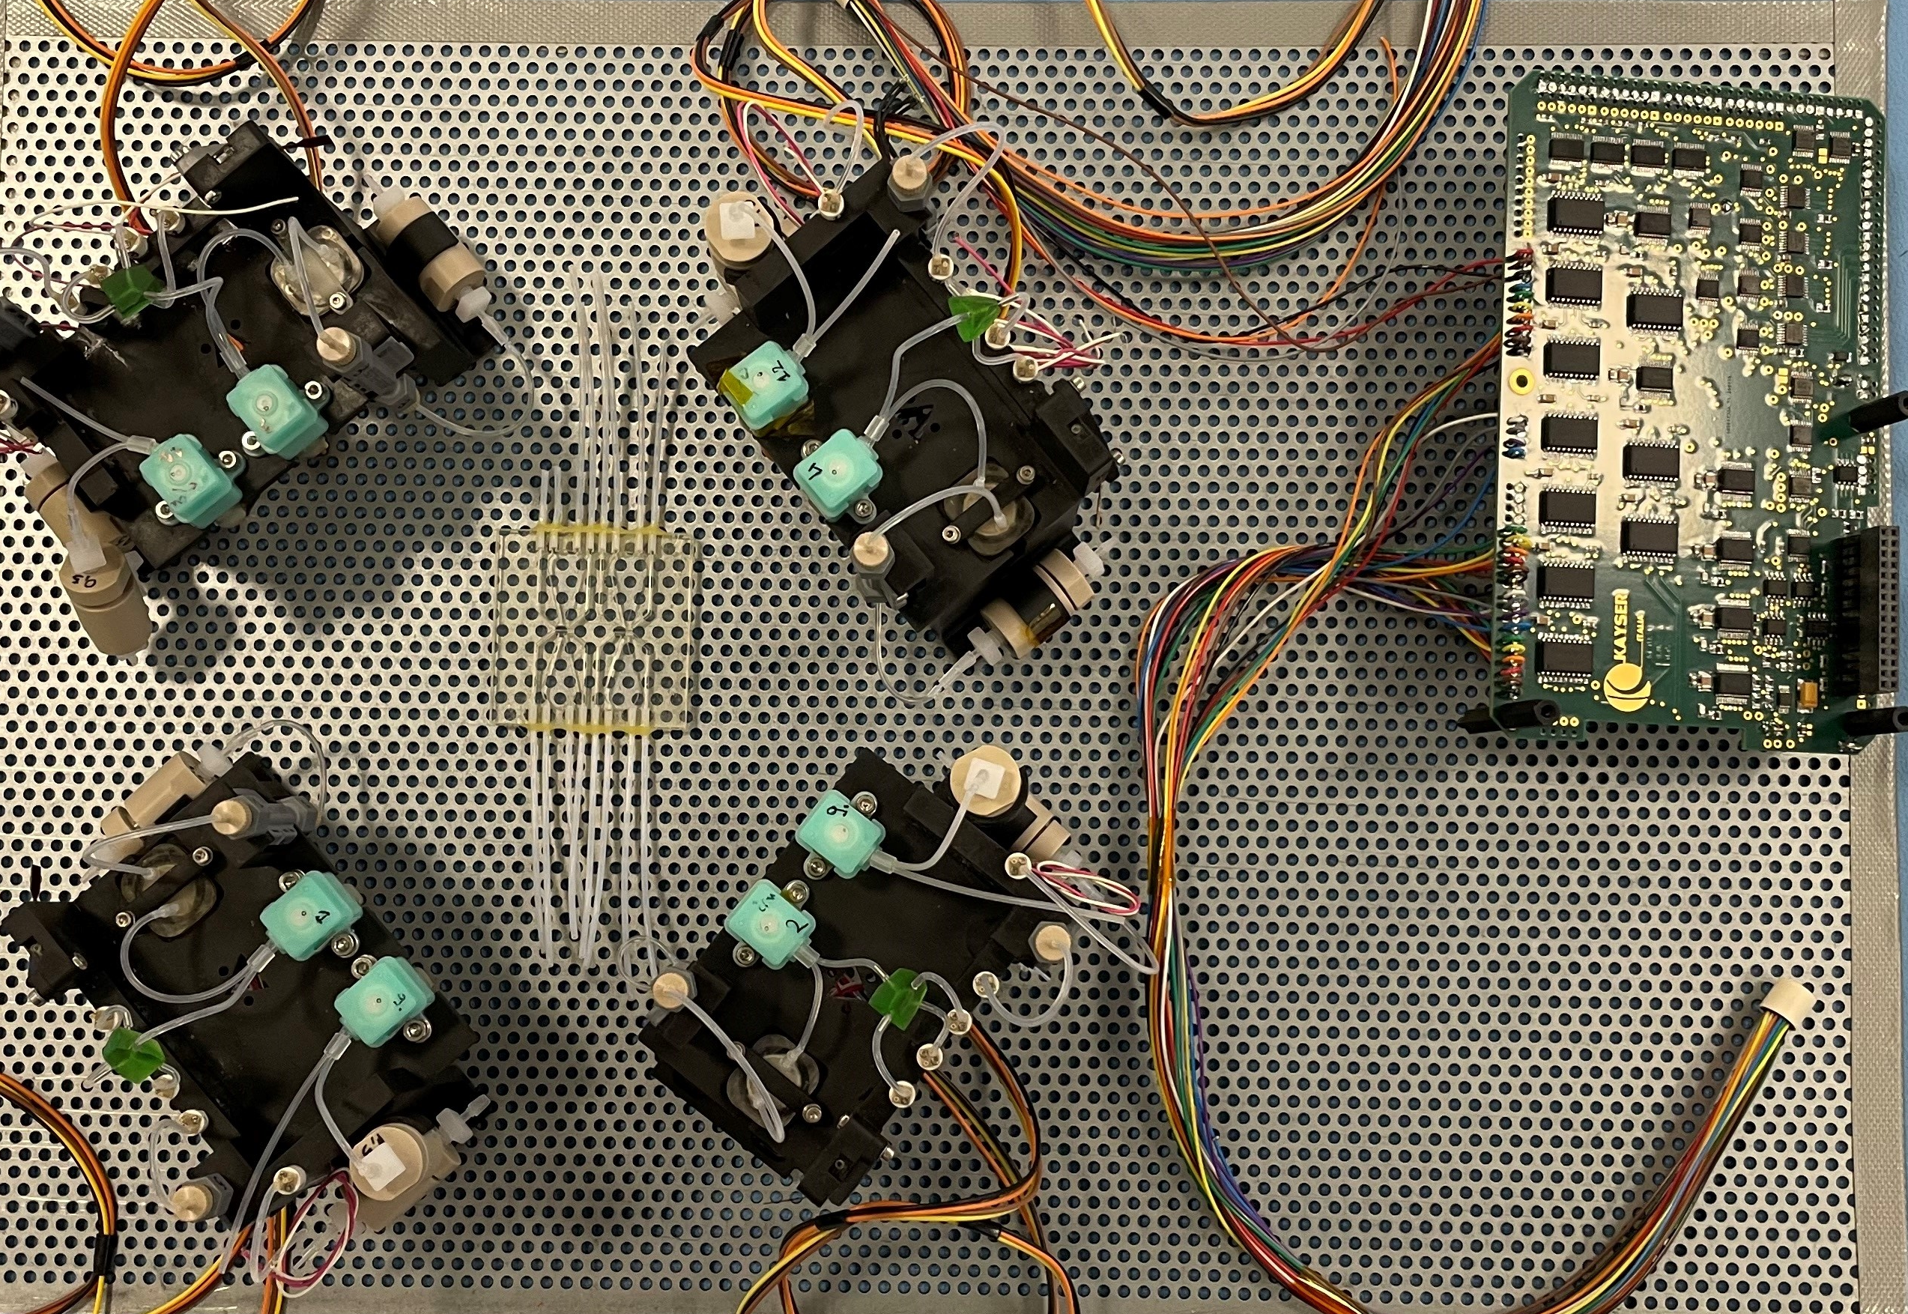
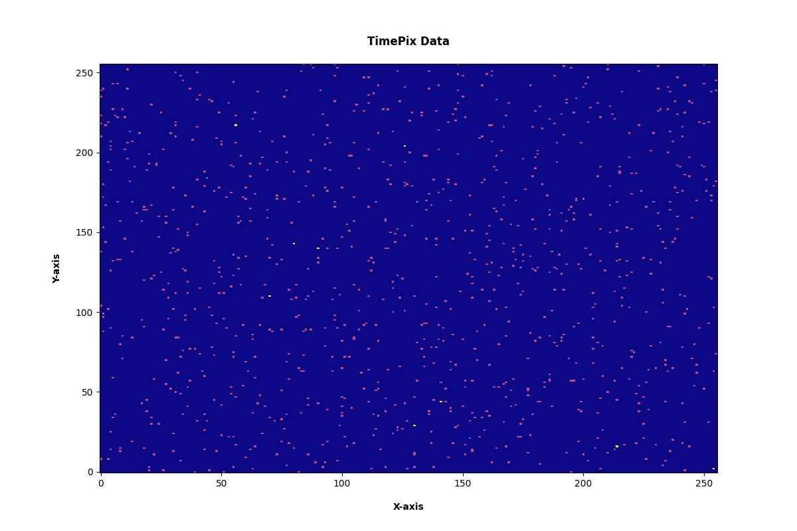

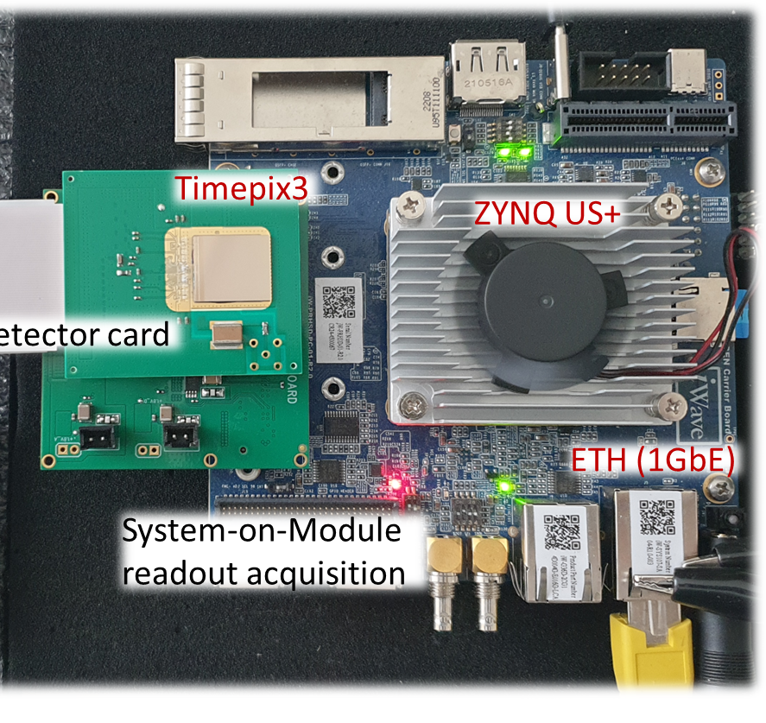

Dosimeter: Mission Operation Overview
The ALCYONE dosimeter system is designed with flexibility to support both laboratory testing and future integration into space-borne platforms
System Interface: Standard Ethernet connection between dosimeter and spacecraft BreadBoard (BB)
Normal Operation: Only the total accumulated dose integrated over the entire sensor matrix is stored, integration period and acquisition rate are programmable
Special Event Mode: Triggered by high‑radiation events (e.g., solar particle events), the dosimeter acquires a full dataset, including per‑pixel energy and timing information. Data are processed and compressed on the dosimeter into formats such as PNG and stored in a shared folder for retrieval
BreadBoard
Shared folder with BB
Actuators
ETH (1GbE)
Timepix3 data
Heatmap 3D-plot
Incubator
Shared
folder
Lab-on-chip and mission electronics
ETH (TCP/IP)
Space-borne platform
ETH request
Dosimeter
Power ON/OFF, Calibration and Readout
User GUI
(Kayser)
Software‑defined error detection and autonomous operation can be reprogrammed on‑the‑fly from Earth without any power‑cycle interruption

Slide 17
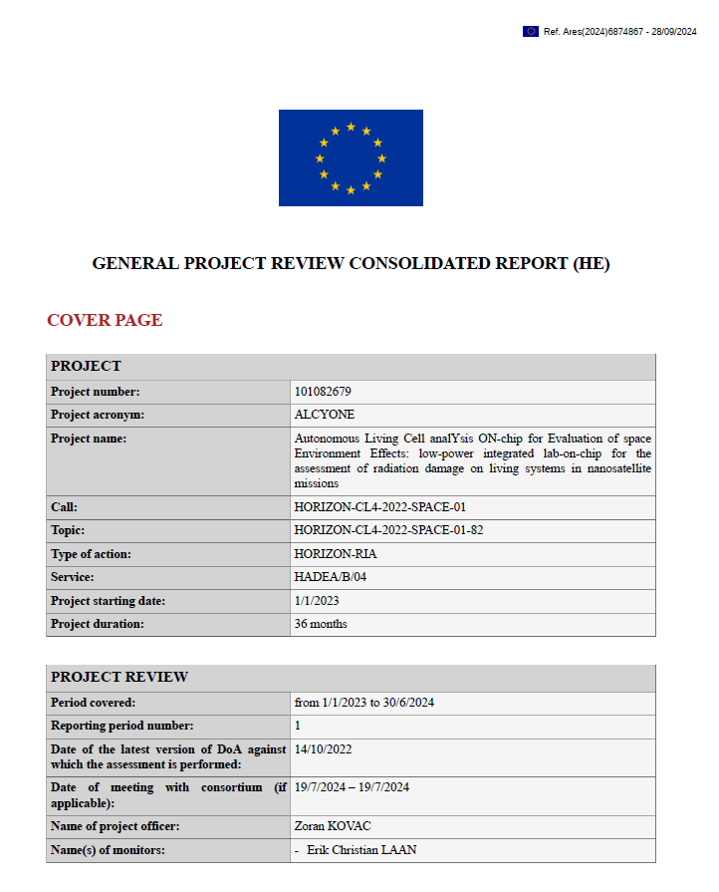
Conclusions
ALCYONE’s Mission: Develop fundamental technologies for future long‑duration human space missions
TI‑LGAD as Key Sensor Technology:
Significant reduction in Timepix power consumption:
Analog power: 600 mW → 56 mW
Digital power: 320 mW → 159 mW, achieved by reducing data lines and matrix clock frequency to 5 MHz
Mid-Term EU Evaluation: The program received an outstanding overall assessment, with special recognition for the dosimeter system and its enabling technologies
Don’t miss it! We invite you to visit Poster ID: 184 (N. Sharif) for a detailed technical discussion and comprehensive insights into the latest advancements in detector and space instrumentation technology
Notes:
The KIT dosimeter developed within the ALCYONE project — based on the Timepix family of hybrid pixel detectors combined with a high-granularity LGAD sensor — has attracted significant attention as an innovative, high-performance dosimetry system. Its unique characteristics make it a strong candidate for deployment not only within ALCYONE but also in a wide range of future space exploration missions where precise, compact, and autonomous radiation monitoring is essential

Slide 18



Thanks for your attention
Horizon Europe Grant agreement No. 101082679
NASA's Artemis II,

Slide 19
Backup

Slide 20
Micro-incubators
Lab-on-a-chip innovation: Designing for microgravity
Thin-film sensors and actuators onto the same substrates that constitute the micro-incubator, making it a ‘real’ lab-on-chip device that does not require external laboratory instrumentation for handling the local environmental conditions as well as for monitoring the status of the incubated biological samples.
Photo-Sensor
Thermal-Sensor
Cell-incubator
Resistive Heater
A cell culture capable of growing under well-controlled conditions inside a lab-on-chip incubator.
Courtesy of: Augusto Nascetti and Han Gardeniers

Slide 21
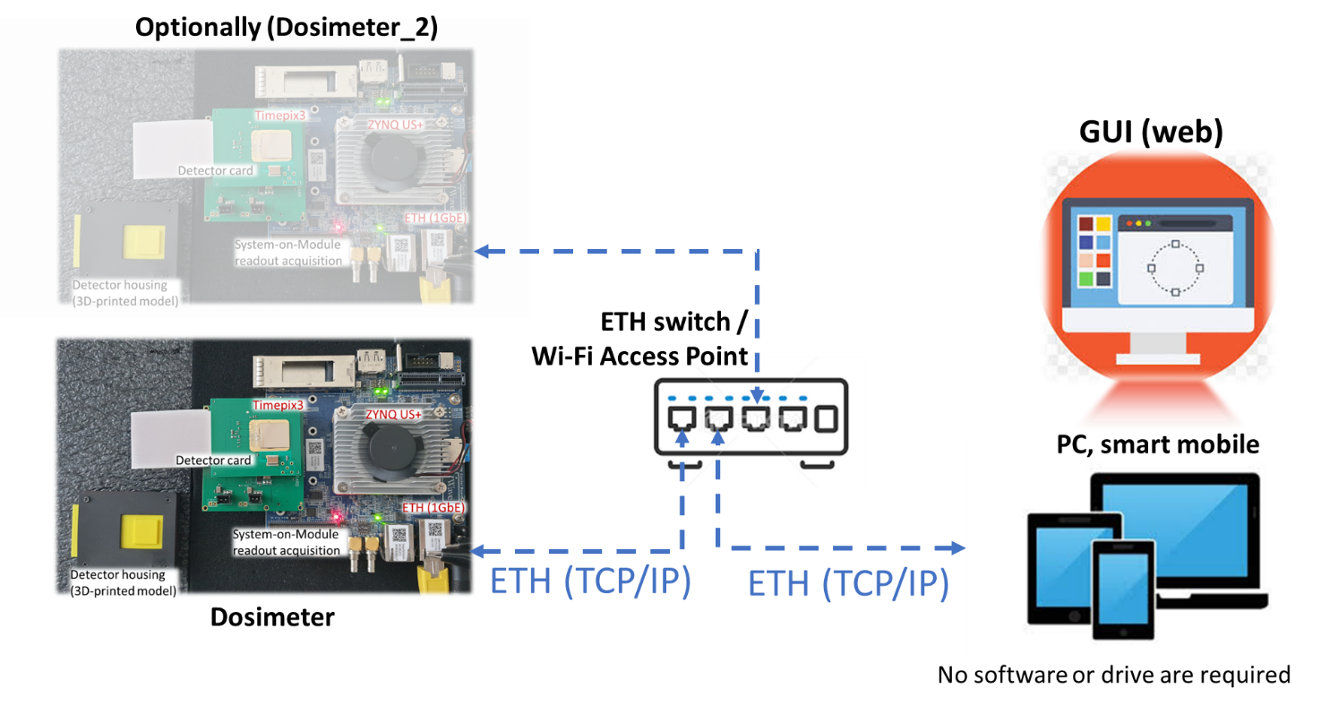
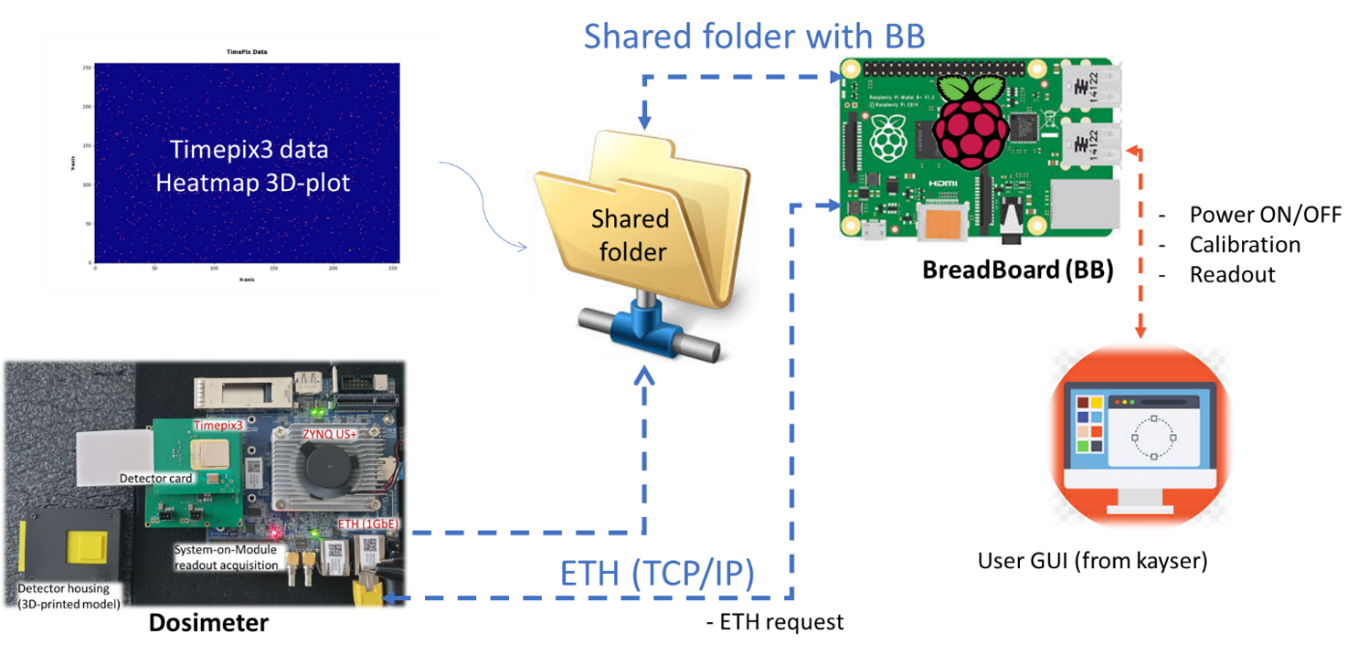
Contribution of the KIT team (dosimenter for space)
The ALCYONE dosimeter system is designed with flexibility to support both laboratory testing and future integration into space-borne platforms.
Lab-test detector
Space-born platform
During standard mission operation, the dosimeter operates in a low-bandwidth mode, transmitting only the total accumulated dose. In special conditions, such as the detection of a solar particle event or other high-radiation phenomena, the BB can request the complete dataset.
Dosimeter system is employed for experimental setups dedicated to bioluminescence detection, where extremely high sensitivity and precise spatial resolution are required

Slide 22
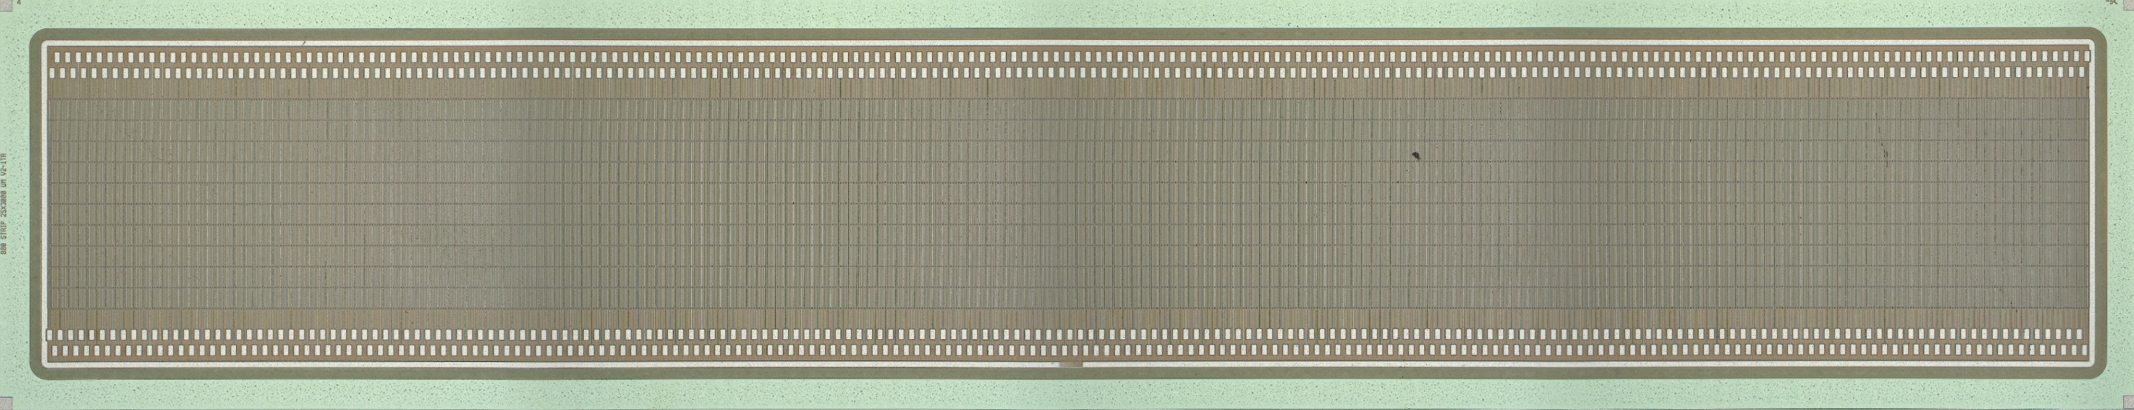
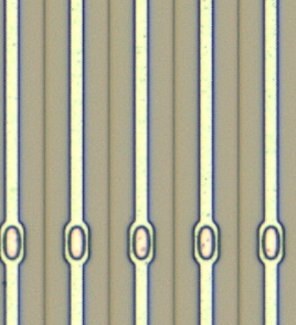

Towards novel beam diagnostic detectors
Novel Sensors Enabling Novel Instrumentation
Large-area pixelated 2D matrix with 55 µm pixel pitch
Three operation modes:
2D beam profile at high-event rate ( > 80 Event/sec)
Arrival time measurements with 1.5 ns resolution (current system), optionally down to 200 ps
Time and energy measurements per each particle/photon
pixel
Pixel
Microstrip sensor with 25 µm channel pitch operating in continuous mode over 20 Mfps
Longitudinal beam profile measurement when coupled with electro-optical spectral decoding and transverse beam profile measurement for precise energy spread determination
µstrip
PhotonDiag 2025, Sep 2 – 4, 2025, Liverpool Guild of Students Andreas Ebersoldt

Slide 23
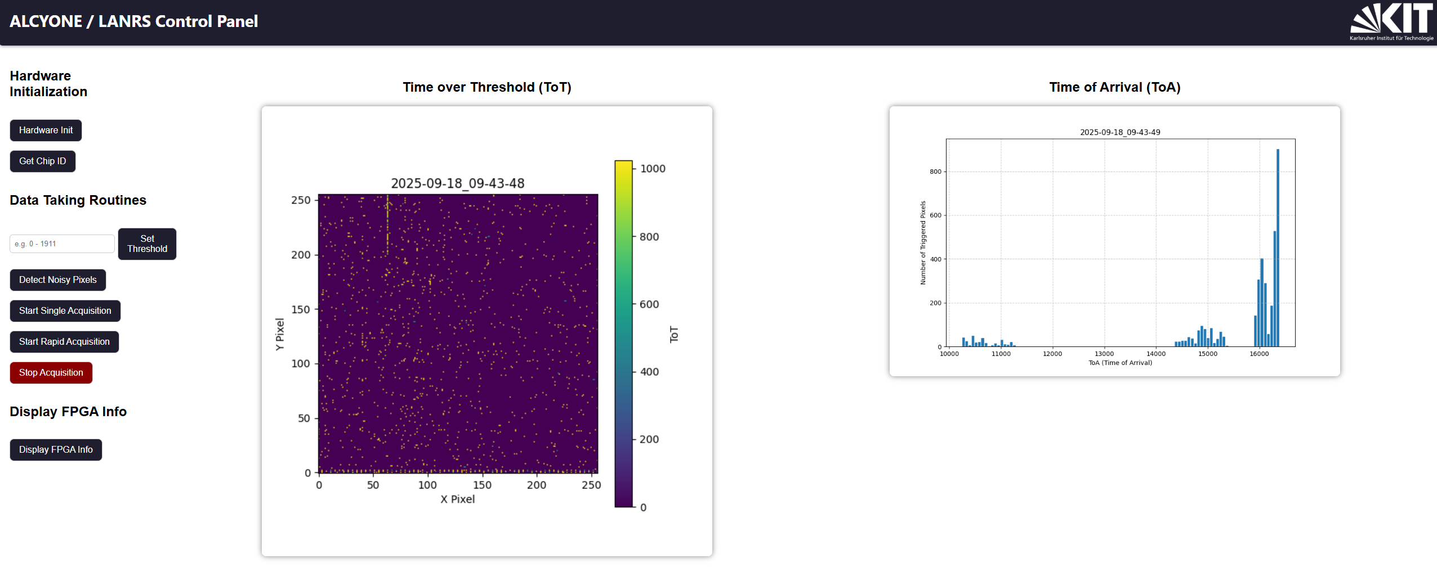
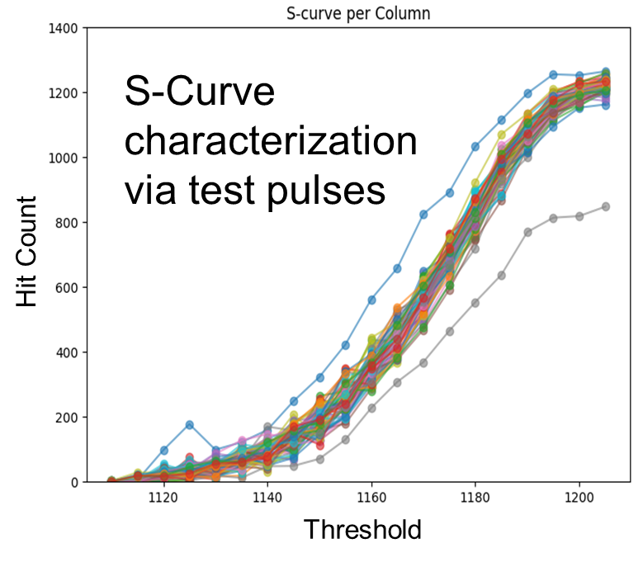
Dosimeter: Mission Operation Overview
The ALCYONE dosimeter provides a web-based GUI for efficient detector control, enabling configuration, real-time monitoring, and data acquisition from any device. This interface allows operators to perform routine tasks quickly and easily
Advanced calibration, including S‑curve measurements, is available via a command‑line shell, complementing the web GUI for ease of use. Both are accessible through the main onboard control system (BreadBoard) and thus can be operated from Earth

Slide 24
