Slide 1

Designing ASICs for HEP Experiments: Turning painful mistakes into practical guidelines for future ASICs
Davide Ceresa
Thursday 9th of October 2025 – TWEPP 2025 – Rethymno, Creete, Greece

Slide 2

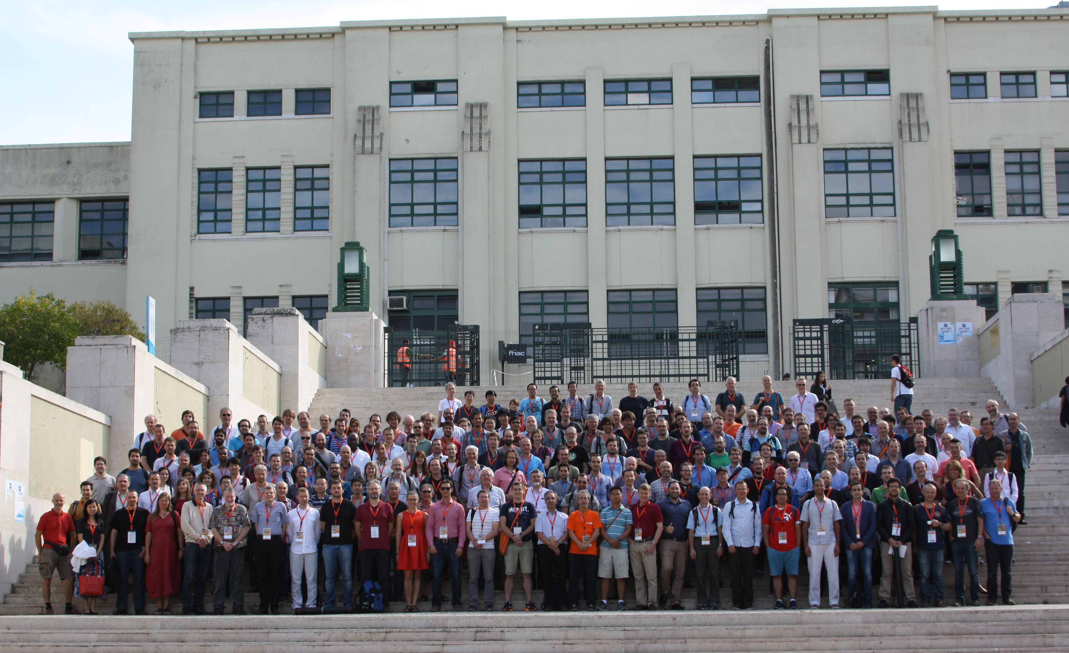
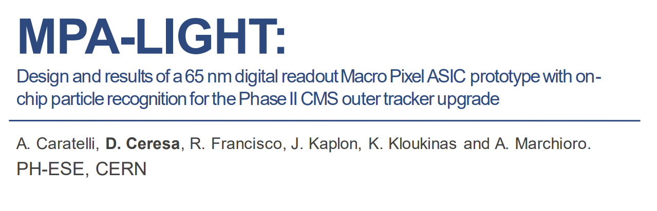
About Me: 10+ years into ASIC design for HEP

Slide 3
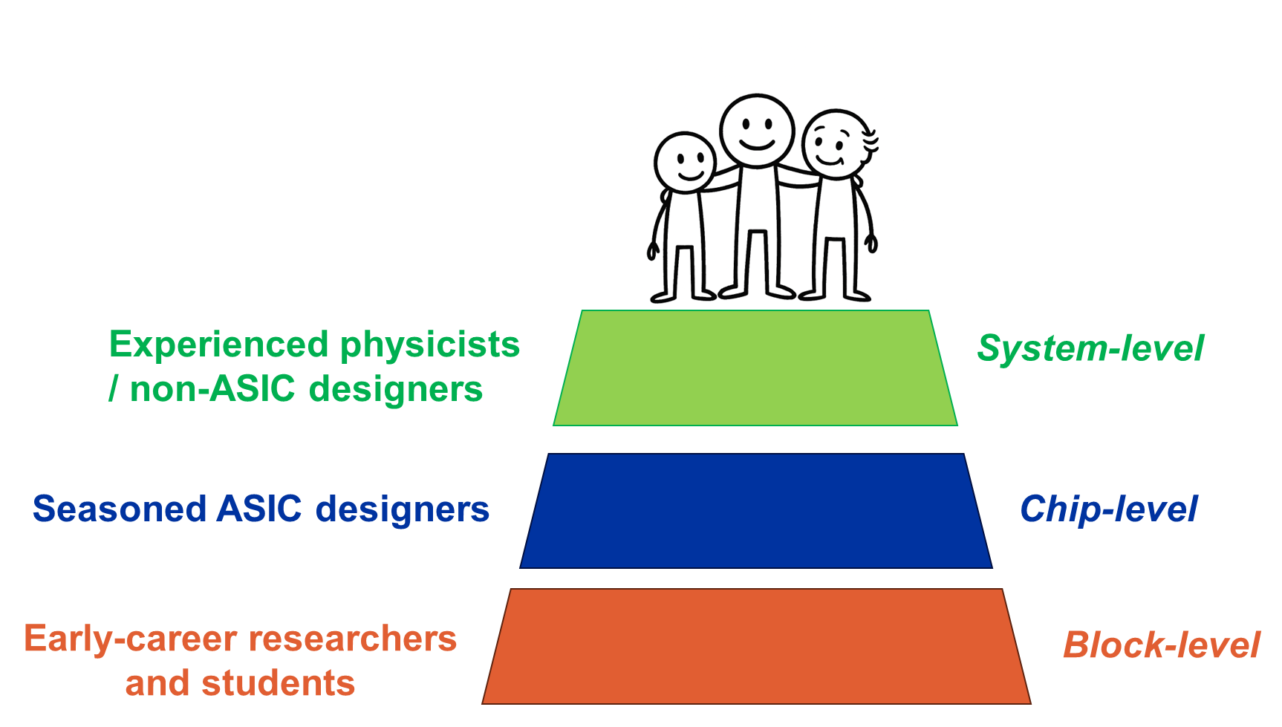
Designing ASICs for HEP Experiments: Key Challenges
🔑 Non-replicable systems
🔑 System-level complexity
🔑 Longevity and reliability
🔑 Limited resources
🔑 Long design and testing cycles

Slide 4
Designing ASICs for HEP Experiments: Key Challenges
Aspect | CERN HL-LHC ASICs | Big Semi (Qualcomm, Broadcom,…)
Engineers per ASIC | ~2–10 | 50–1000
Total ASIC designers | ~150–200 | 2000–10,000+
Timescale | 5–10 years | 1.5–2 years
Unique ASIC / cycle | ~50–60 across 4 experiments | 50+ across product families
🔑 Non-replicable systems
🔑 System-level complexity
🔑 Longevity and reliability
🔑 Limited resources
🔑 Long design and testing cycles

Slide 5
Designing ASICs for HEP Experiments: Key Challenges
🔑 Non-replicable systems
🔑 System-level complexity
🔑 Longevity and reliability
🔑 Limited resources
🔑 Long design and testing cycles
Each design cycle introduces new technologies, methodologies, and challenges.

Slide 6
The Digital Impact: Mixed-Signal ASICs
Analog accuracy drives performance, while digital logic drives system behavior and integration.
Mixed-Signal Readout ASIC
ANALOG
DIGITAL
Readout
Serializer
Front
End
Digitizer
Sensor
Digitizers enable a fully digital readout:
Robust to Noise
High Bandwidth
On-chip data compression and selection
Multi-chip data aggregation

Slide 7
The Digital Impact: Digital-on-Top (DoT) methodology
Digital-on-Top Mixed-Signal Readout ASIC
DIGITAL
ANALOG
Readout
Serializer
Front
End
Digitizer
Bring the advantages of the digital domain to the chip-level!
Top-level RTL description for full-chip verification and system-level simulation
Automated flow, easy to modify and respin
Chip-level timing and power analysis

Slide 8
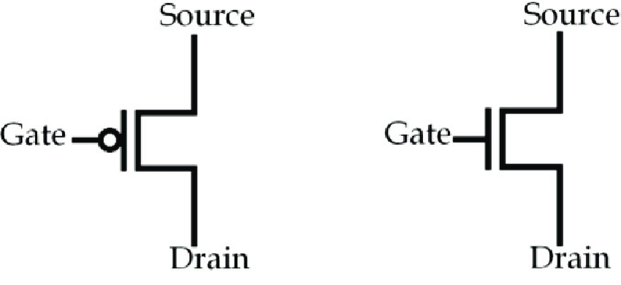
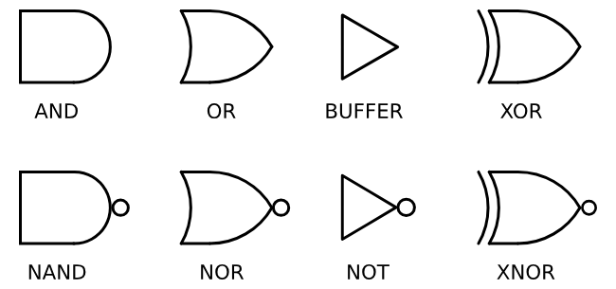
The Digital Impact: Analog vs Digital flow
Analog Domain
Digital Domain
Transistor model
Schematic design
Block description
RTL design
Transistor model
Full-Custom Layout
Implementation
Synthesis + P&R
Gate Library
Analysis
Signoff Analysis
Design
Analog block
Digital block
Verification
Analog simulation
Digital simulation

Slide 9
The Digital Impact: Analog vs Digital flow
handle huge complexity
Code-based
Analog Domain
Automated flow
Digital Domain
Transistor model
Schematic design
Block description
RTL design
Transistor model
Full-Custom Layout
Implementation
Synthesis + P&R
Gate Library
Analysis
Signoff Analysis
Higher abstraction
level
Analytical
Design
Analog block
Digital block
Verification
Analog simulation
Digital simulation
Discrete

Slide 10

The Digital Impact: Digital-on-Top flow
Analog Domain
Digital Domain
Transistor model
Schematic design
RTL design
Transistor model
Full-Custom Layout
Synthesis + P&R
Gate Library
Signoff Analysis
Analog block
Model
Chip Implementation
Design
Verification
Analog simulation
Digital simulation

Slide 11

The Digital Impact: The digital designer’s point of view
Path toward submission
RTL Design &
Implementation
Non-Digital block
Integration
Signoff Analysis

Slide 12
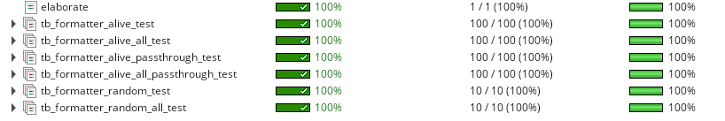
RTL Design and Implementation: Data Aggregation Problem
Frame size depends on FE occupancy and mode of operation
FE Data 0
FIFO 0
Data Aggregation & Formatting
HEADER
…
…
PKT #1
Event frame
PKT #2
FE Data N
FIFO N
…
PKT #500
RTL design
Verification Environment
Verification Regression report
DUT
STIMULI
MONITOR
SCOREBOARD

Slide 13
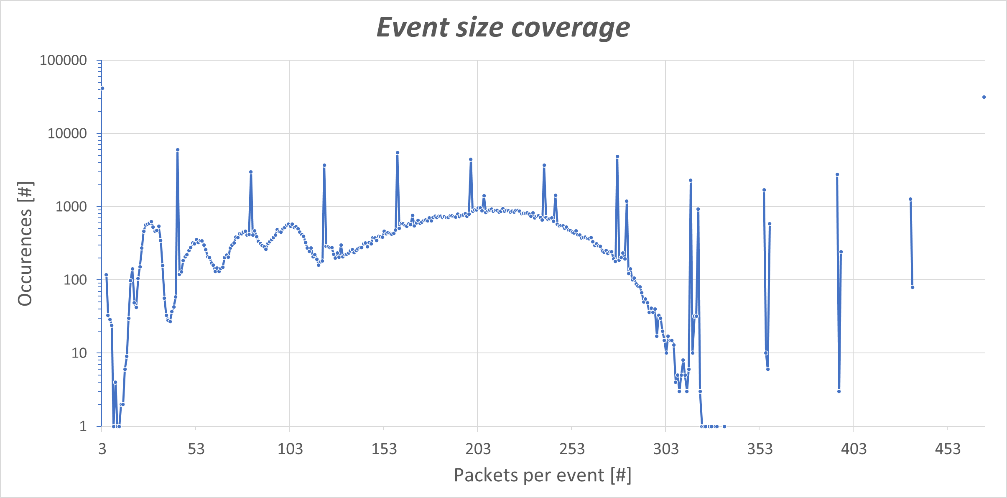
RTL Design and Implementation: Data Aggregation Problem
> 10s failures appeared after fixing coverage
Verification MUST include Coverage
Avoid Data-dependent Control logic
Coverage for a fully passing regression

Slide 14

RTL Design and Implementation: The Hidden Cost of Clever Logic
The digital flow offers designers enormous flexibility.
But the hidden cost of such flexibility often surfaces late, typically during functional coverage analysis, or worse, only after integration and system testing.
Automated flow
Digital flow
Code-based
RTL design
Transistor model
P&R flow design
Gate Library
Signoff Analysis
Higher abstraction
level
Analytical
Digital block
Spiderman #1, 1962

Slide 15
Guidelines I: A Versatile, not overcomplicated design
1. Clear separation of data and control paths
2. Design with Hardware and Verification in Mind
3. Static configuration with controlled start-up sequence
4. Early and comprehensive coverage analysis
Path toward submission
RTL Design &
Implementation
Non-Digital block
Integration
Signoff Analysis

Slide 16
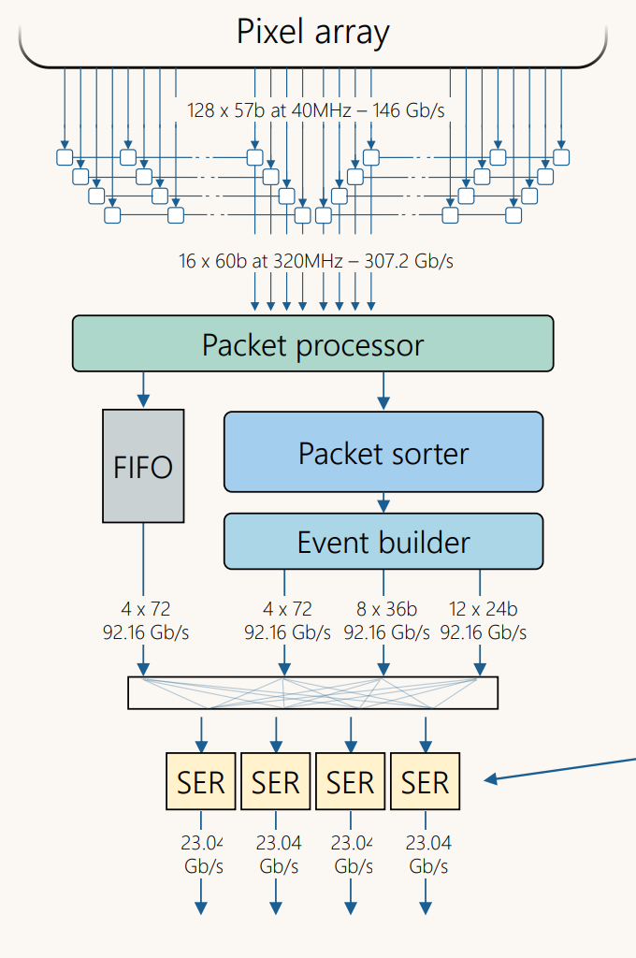
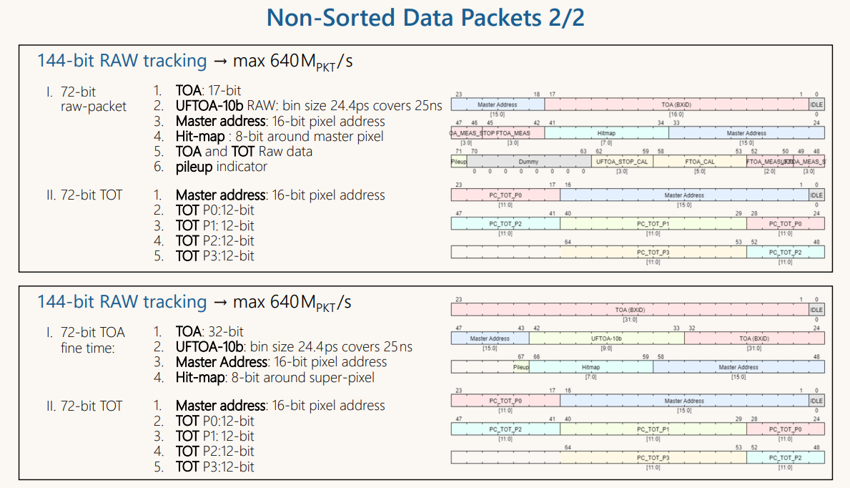
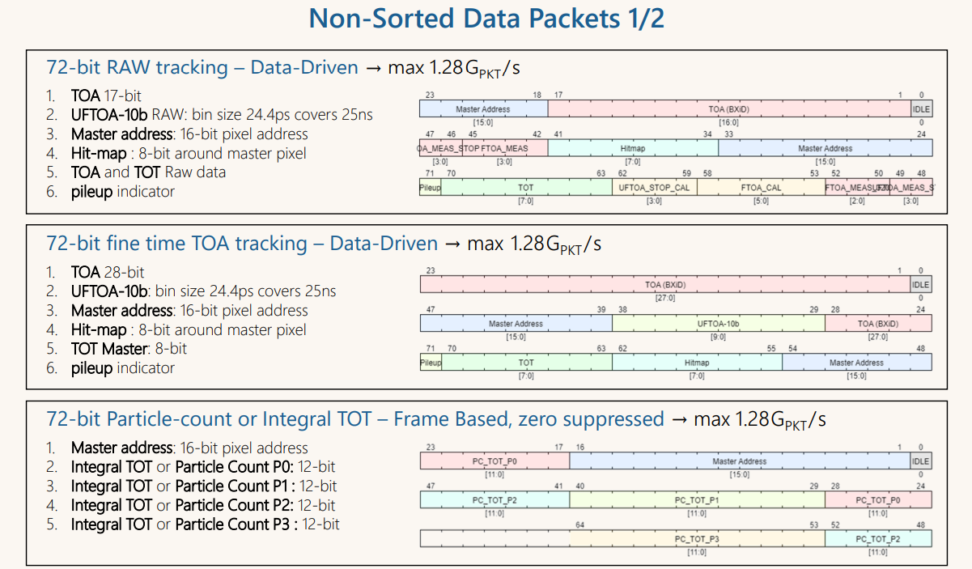
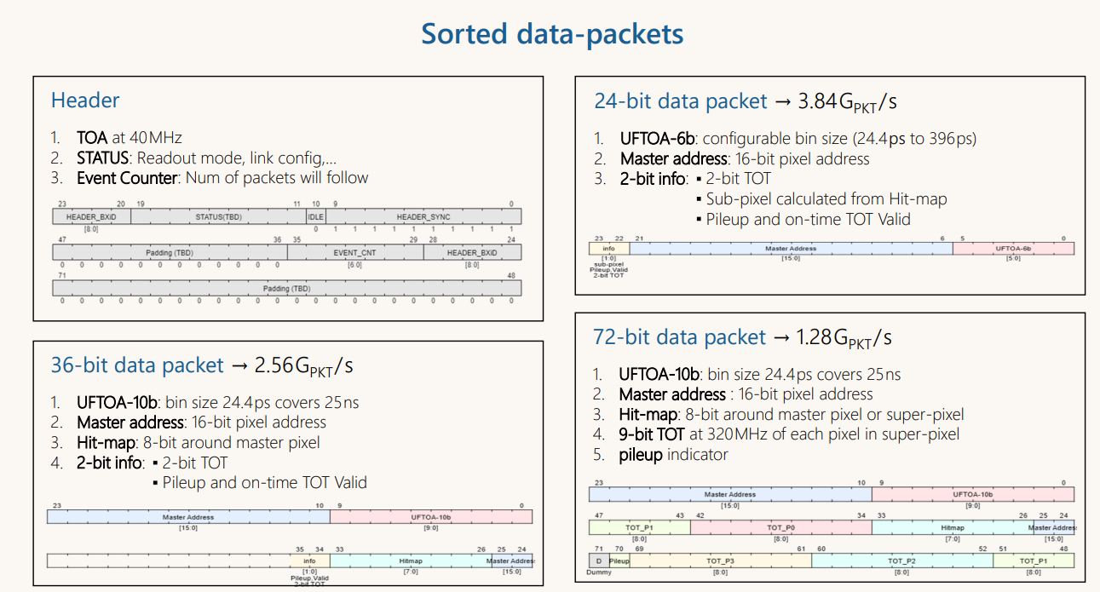
Best Practice Examples: Data formatting
LA-Picopix : A 4-lane 100 Gbps Data-Driven Pixel Readout Chip
Use a single packet size aligned with the Physical Layer.
Support multiple packet types, minimizing impact on control/data transfer.
Avoid mixing packet formats; any mode change requires a soft reset.
>10 operation modes share the same packet size

Slide 17


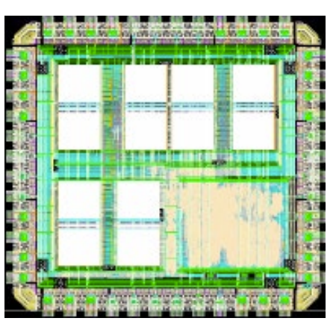

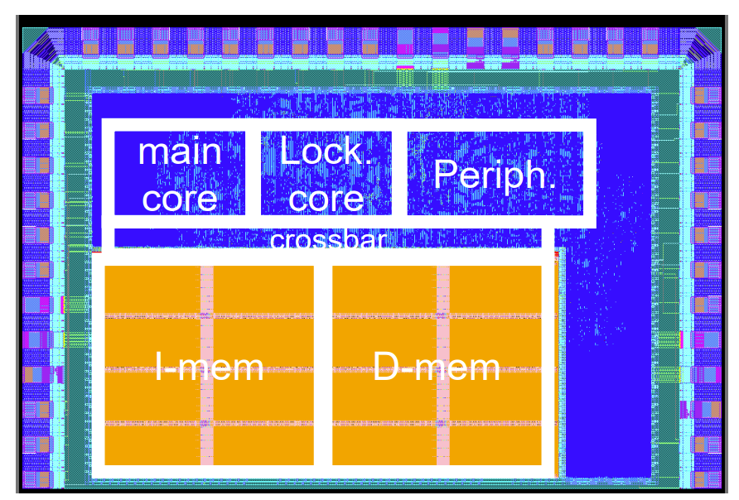
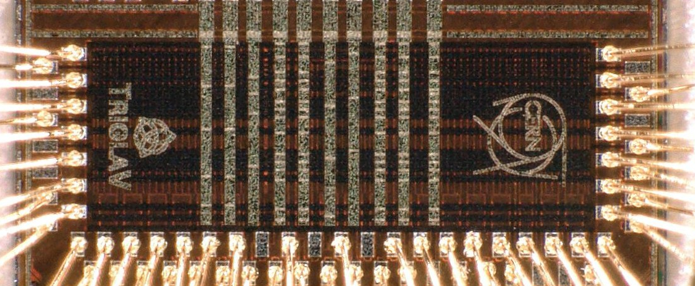
R&D Topic: Toward standardization & programmability?
Workshop: RadTol RISC-V SoC
https://indico.cern.ch/event/1556239/
STRV 28 nm
TriglaV 28 nm
https://indico.cern.ch/event/1502285/contributions/6554384/
RIBEX 28 nm
…other solutions needs to be explored: eFPGA, CGRA, … .

Slide 18

The Digital Impact: The digital designer’s point of view
Path toward submission
RTL Design &
Implementation
Non-Digital Block
Integration
Signoff Analysis

Slide 19
Non-Digital Block Integration: Characterization step
Analog Domain
Digital Domain
Transistor model
Schematic design
RTL design
Transistor model
Full-Custom Layout
P&R flow design
Gate Library
Signoff Analysis
Analog block
Model
Chip Implementation
Design
Verification
Analog simulation
Functional simulation
Formal simulation

Slide 20
Non-Digital Block Integration: Characterization step
Analog Domain
Digital Domain
Transistor model
Schematic design
Implementation models
RTL design
Transistor model
Full-Custom Layout
P&R flow design
Gate Library
Timing, power, signal integrity data
Signoff Analysis
Design
Analog block
Characterization
Chip Implementation
Verification
Analog simulation
Verilog, Verilog-AMS,…
Functional simulation
Simulation models
Formal simulation

Slide 21
Non-Digital Block Integration: Corrupted model
SRAM MACRO
Example: Integration of an SRAM compiler-generated
Observed Issue
Failures detected during testing.
No failures predicted by analog simulations.
No violations during P&R and sign-off analysis.
Findings:
Large capacitance at SRAM clock input.
Simulations and characterization assumed an ideal clock buffer
Root Cause:
Hidden timing failure due to a mismatch between idealized simulation assumptions and actual integrated load conditions.
CLK
Large internal
capacitance
Ideal buffer
Wrong Setup/Hold timing margin in implementation model

Slide 22

Non-Digital Block Integration: Macro integration in a DoT design
Analog Domain
Digital Domain
Schematic design
RTL design
Integration
Full-Custom Layout
P&R flow design
Signoff Analysis
Modeling
Model
Validation
Analog block
Chip Implementation
Verification
Analog simulation
Digital simulation

Slide 23
Non-Digital Block Integration: Characterization step
Analog Domain
Digital Domain
Transistor model
Schematic design
RTL design
Transistor model
Full-Custom Layout
Included
in the tool
P&R flow design
Gate Library
Characterization & Validation
Signoff Analysis
Design
Analog block
Digital Block
Verification
Accurate,
transistor-level, continuous signal
Analog simulation
Functional simulation
Mixed-Signal sim.
Post-Layout
Close the loop!

Slide 24
Guidelines II: A Robust Mixed-Signal Implementation Flow
1. Identify analog–digital boundaries and critical blocks
2. Address timing-critical blocks with care
3. Extend verification beyond digital-only approaches
4. Validate macro quality and modeling accuracy
Path toward submission
RTL Design &
Implementation
Non-Digital Block
Integration
Signoff Analysis

Slide 25
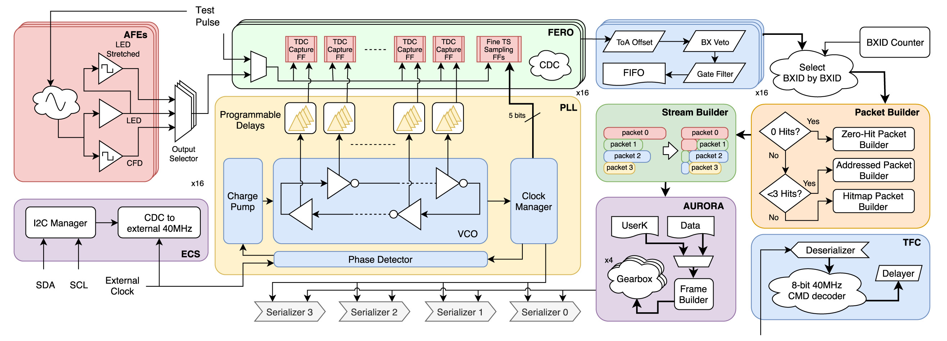
Best Practice Examples: Analog-Digital-Mixed Signal boundaries
LHCb FastRICH Example: A 16-channel TDC-based Fast Timing (25 ps) readout chip
https://doi.org/10.1016/j.nima.2024.169664
A/D Boundary
Analog Domain
⚠ Custom Flip-Flop
Digital Domain
Digital TDC

Slide 26

Best Practice Examples: Integration and Verification flow
Example: Mixed-Signal flow for a Latch-based Time-to-Digital Converter block
Capture FF Analog design
TDC Digital design
Schematic & Layout
RTL design
models
SPICE Simulation
P&R flow design
CONFORT
ZONE
Characterization & Validation
Capture FF block
TDC block
VCD simulation Post-Layout analog simulation with stimuli and expected response from Verification environment
Schematic
& Layout
Analog simulation
Functional
MS simulation
Stimuli and
expected response
Post-Layout
Analog Verification
Chip-level Digital Verification

Slide 27


The Digital Impact: The digital designer’s point of view
Path toward submission
RTL Design &
Implementation
Non-Digital block
Integration
Signoff Analysis

Slide 28
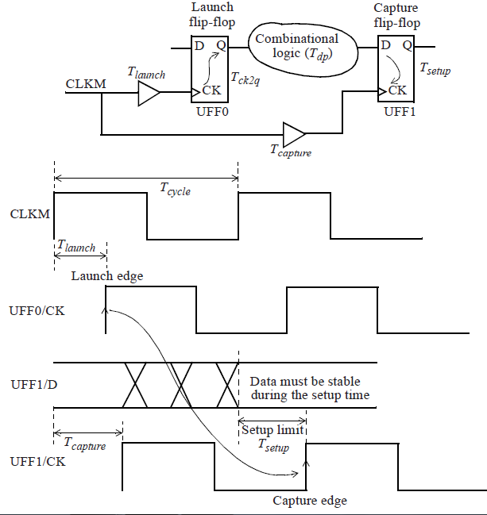
Signoff Analysis: What is an Analysis!?
Example: Static Timing Analysis
Analytical calculation based on the gate library:
Setup/Hold/Propagation Delay/…/ for a certain corner
Checking compliance under static assumptions for Process-Voltage-Temperature

Slide 29
Signoff Analysis: Dynamic vs Static current consumption
Peak current
Current
Average current
Time
T₁
T₂
In ASICs with a large digital component, current consumption is highly dynamic.
Specifications typically define current consumption in terms of average values.
The Power Delivery Network (PDN) is designed based on these specifications, considering factors such as bonding approach (Wire vs Bump), package type, and module design

Slide 30
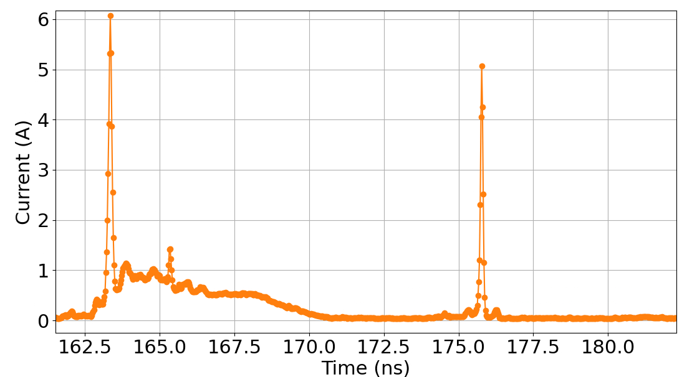
Signoff Analysis: Dynamic Power Analysis
Real-life example: Dynamic power Analysis based on post-layout netlist simulation
Post-Layout simulation
Current Extraction
Chip activity
Vector-based current profile in FF corner
Clock rising
edge
Clock falling
edge
Avg. Current
~ 500 mA

Slide 31
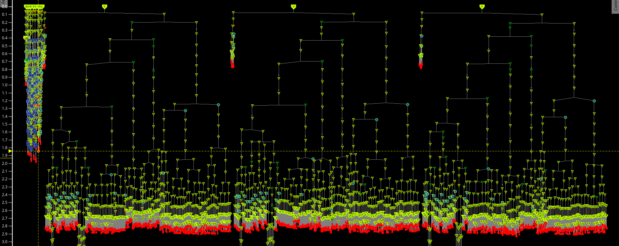
Signoff Analysis: Dynamic Power Analysis
Triplicated clock distribution tree
Causes a large current peak at clock switching
Insertion delay [ns]
The clock is aligned for most of the logic in the chip
Skew < 200ps
Consequence of over-optimized design

Slide 32
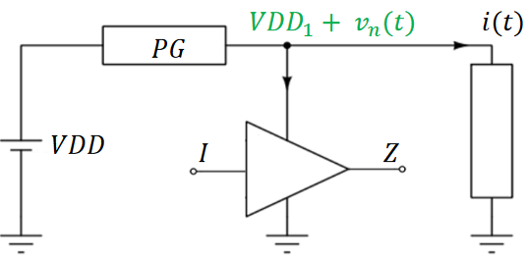
Signoff Analysis: Dynamic Power Analysis
Real-life Example: Dynamic power Analysis based on post-layout netlist simulation
Post-Layout simulation
Current Extraction
Voltage rail analysis with package parasitics
Chip activity
Current profile
Vector-based current profile in FF corner
Clock rising
edge
Clock falling
edge
Avg. Current
~ 500 mA

Slide 33
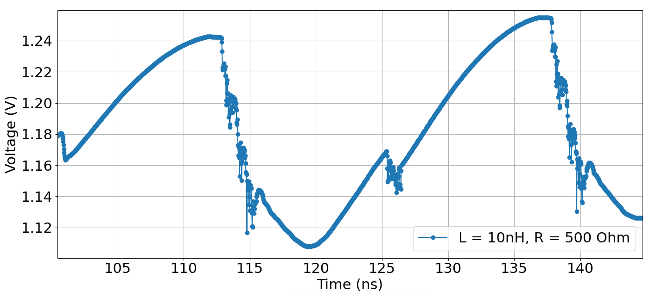
Signoff Analysis: Dynamic Power Analysis
Real-life Example: Dynamic power Analysis based on post-layout netlist simulation
Post-Layout simulation
Current Extraction
Voltage rail analysis with package parasitics
Wirebond in QFN package
Chip activity
Current profile
Vector-based current profile in FF corner
Voltage (VDD – VSS) drop
Clock rising
edge
Clock falling
edge
Avg. Current
~ 500 mA

Slide 34
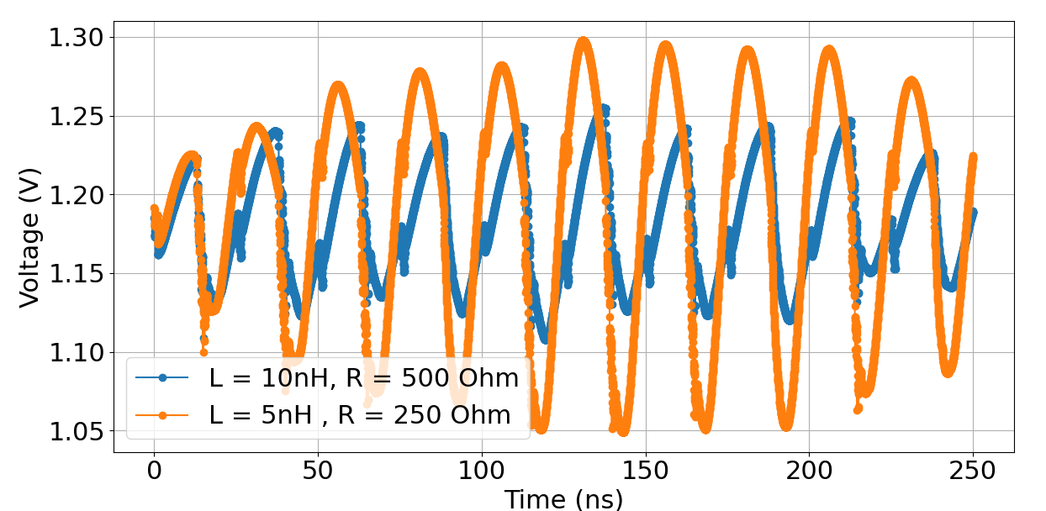
Signoff Analysis: Dynamic Power Analysis
Real-life Example: Dynamic power Analysis based on post-layout netlist simulation
Post-Layout simulation
Current Extraction
Voltage rail analysis with package parasitics
Wirebond in QFN package
Chip activity
Current profile
Vector-based current profile in FF corner
Voltage for different pkg. parasitic
Assumes stable supply
Clock rising
edge
Clock falling
edge
Strong supply oscillation
Avg. Current
~ 500 mA

Slide 35
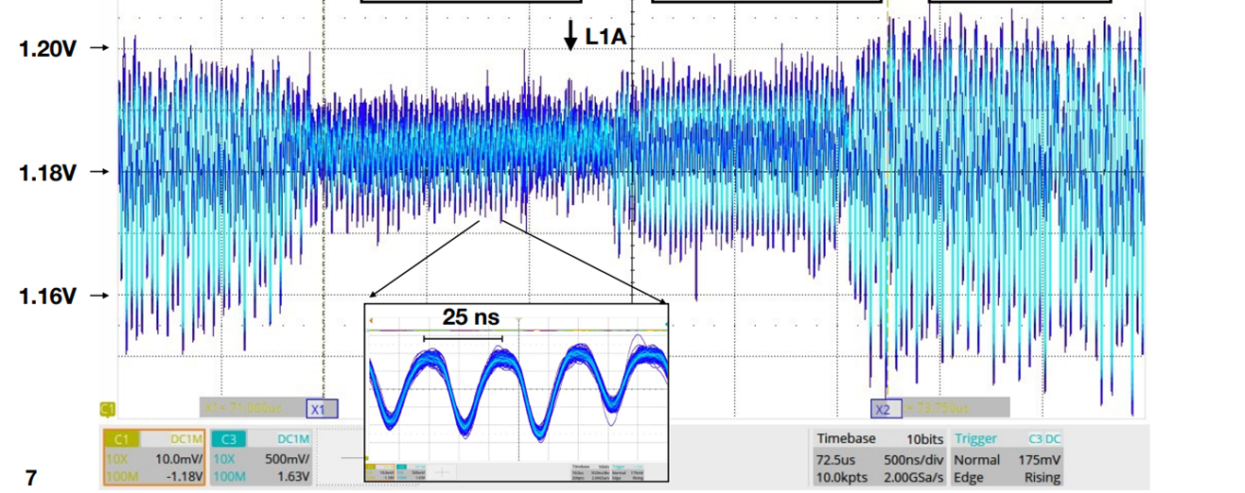

Signoff Analysis: Dynamic Current & Parasitic
Voltage probing on-package
NO ACTIVITY
MID ACTIVITY
HIGH ACTIVITY
Data Corruption caused by large dynamic current in combination with significant parasitic inductance
$$V=L⋅\frac{ⅆI}{ⅆt}$$
Static assumption is not valid anymore

Slide 36
Guidelines III: System-level integration flow
Perform early system-level power modelling
2. Co-design ASIC, PCB, and packaging with PDN awareness
3. Allocate sufficient on-chip decoupling capacitance during floorplanning
4. Validate with IR-drop and EM simulations including package parasitic
Path toward submission
RTL Design &
Implementation
Non-Digital block
Integration
Signoff Analysis

Slide 37
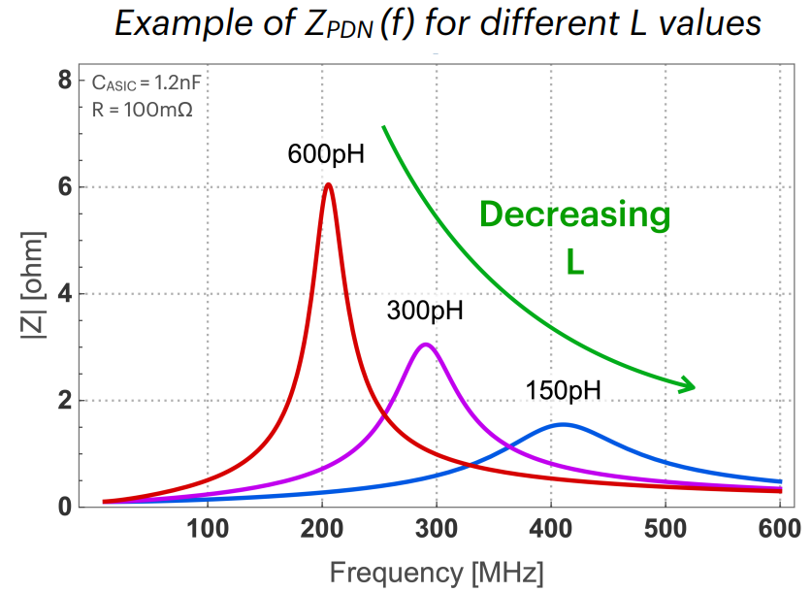
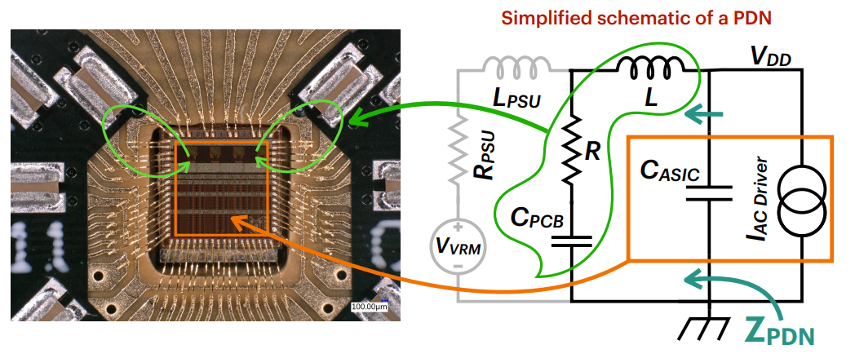
Best Practice Example: A module-level power model
Signal and Power Integrity using Ansys Electronics Desktop: Practical Case Studies, F. Martina [ https://indico.cern.ch/event/1518027/ ]
2 - Evaluate Power Delivery Network (PDN)
Assess PDN quality under defined current and parasitic conditions.
1 - Develop a Simplified Power Model
Include average and peak current sources.
Model on-chip parasitics and off-chip parasitics.
3 - Set Implementation Constraints
Define package and assembly specifications.
Verify ASIC and package compliance with specs.

Slide 38
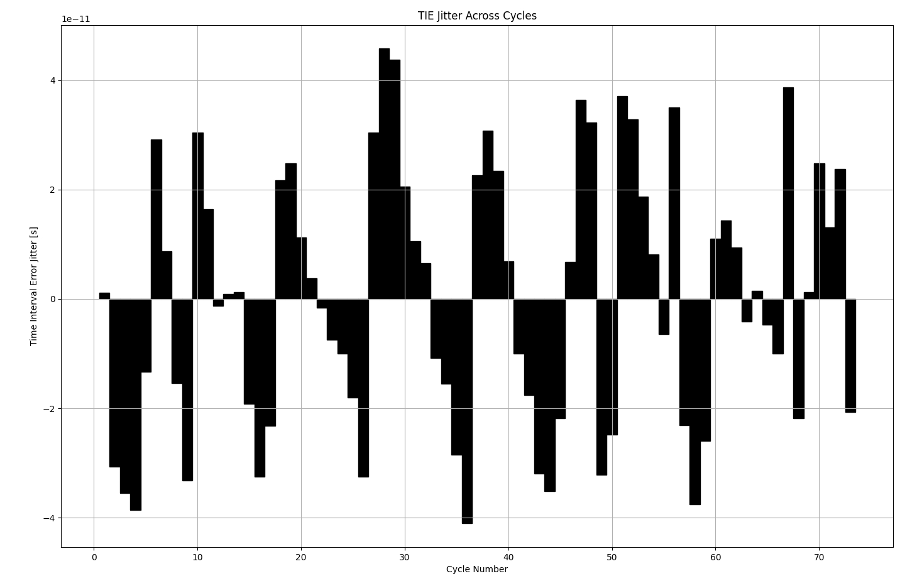
R&D Topic: IR-drop induced Jitter Analysis
Post-Layout simulation
Current Extraction
Voltage rail analysis with package parasitics
Chip activity
Current profile
TIE Jitter across cycles
Instances Voltage
IR-drop induced
Jitter Analysis
+ 40 ps
Presented at TWEPP ‘23
https://cds.cern.ch/record/2906018
- 40 ps

Slide 39
Guidelines: Summary
Where to implement these guidelines
Design
1. Clear separation of data and control paths
2. Design with Hardware and Verification in Mind
3. Static configuration with controlled start-up sequence
4. Early and comprehensive coverage analysis
Integration
1. Identify analog–digital boundaries and critical blocks
2. Address timing-critical blocks with care
3. Extend verification beyond digital-only approaches
4. Validate macro quality and modeling accuracy
Analysis
1. Perform early system-level power modelling
2. Co-design ASIC, PCB, and packaging with PDN awareness
3. Allocate sufficient on-chip decoupling capacitance
4. Validate with IR-drop and EM simulations before tapeout
?
Path toward submission
Design
Integration
Analysis

Slide 40

Conclusion: Chip Skeleton
Chip Skeleton
Block Diagram
Macro requirements
A/D Boundaries
Early Power model
Architecture Exploration
Packaging
System integration
Verification flow
…
Early Virtual Prototyping
Guidelines
Requirements
HEP projects evolve → specifications cannot be expected to remain fixed from the start.
Control this evolution with Infrastructural specifications, aka the “chip skeleton”:
Defined early in the project
Assessed through initial virtual prototyping studies
Discussed and/or reviewed with external experts

Slide 41

Thank You!

