Slide 1



Novel monochromatic and tunable γ-ray light sources through exposure of acoustically modulated monocrystals to ultra-relativistic charged particles beams
Nektarios A. Papadogiannis^{1,2*}
M. Kaniolakis^{1,2}, K. Kaleris^{1,2}, E. Kaselouris^{1,2}, Y. Orphanos^{1,2}, M. Bakarezos^{1,2}, V. Dimitriou^{1,2}, Michael Tatarakis^{1,3}
¹Institute of Plasma Physics and Lasers, Hellenic Mediterranean University (HMU), Rethymnon, Greece
²Physical Acoustics and Optoacoustic Lab, MTA, HMU
²Department of Electronic Engineering, HMU, Chania, Greece
*email: npapadogiannis@hmu.gr

Slide 2

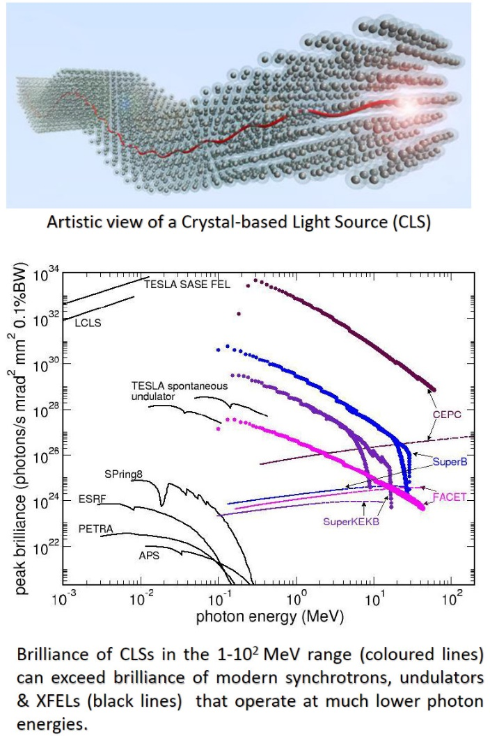
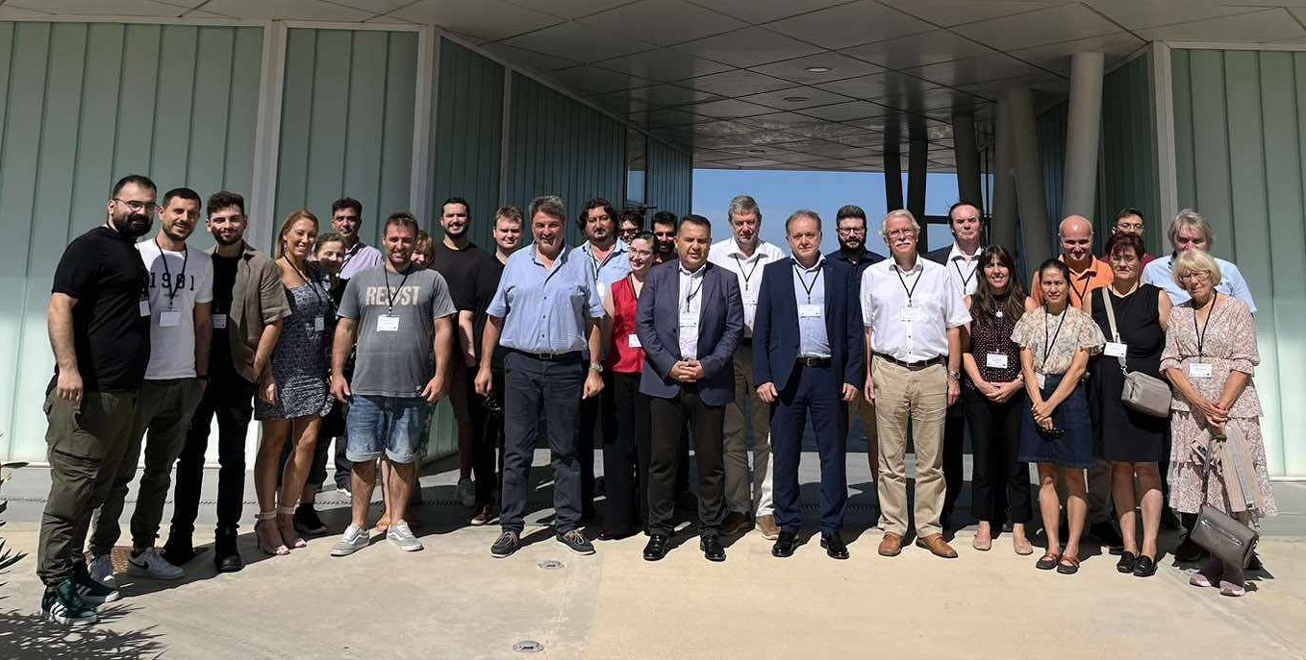
TECHNO-CLS: The European try for Crystalline Undulators for γ-ray generation
European Innovation Council (EIC) Pathfinder Project TECHNO-CLS (2022-2027)
Horizon Europe EIC-Pathfinder Project TECHNO-CLS: "Emerging technologies for crystal-based gamma-ray light sources"
TECHNO-CLS project aims at the breakthrough in technologies needed for designing and practical realisation of novel gamma-ray Light Sources (LS) operating at photon energies from ~100 keV up to GeV range that can be constructed through exposure of oriented crystals (linear, acoustical bent and periodically bent) to the beams of ultra-relativistic charged particles.

Slide 3
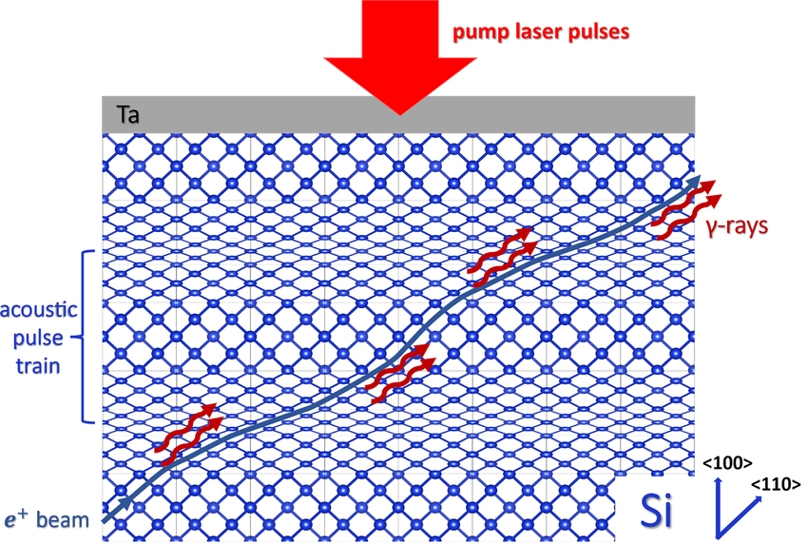
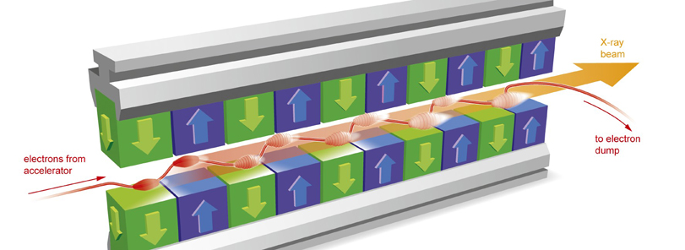
Crystalline vs Magnetic Undulator
Magnetic Undulator
λ_{u}~ 1-10 cm, ℏω=1-10 KeV
Crystalline Undulator
λ_{u}~ 1-100 μm, ℏω=0.1-10 ΜeV
K. Kaleris, E. Kaniolakis Kaloudis, Emmanouil E. Kaselouris, K. Kosma, E. Gagaoudakis, V. Binas, S. Petrakis, V. Dimitriou, M. Bakarezos, M. Tatarakis, & N. A. Papadogiannis, Applied Physics A. 129, 1007 (2023)
Creator: Cyprian Lothringer
Copyright: European XFEL

Slide 4
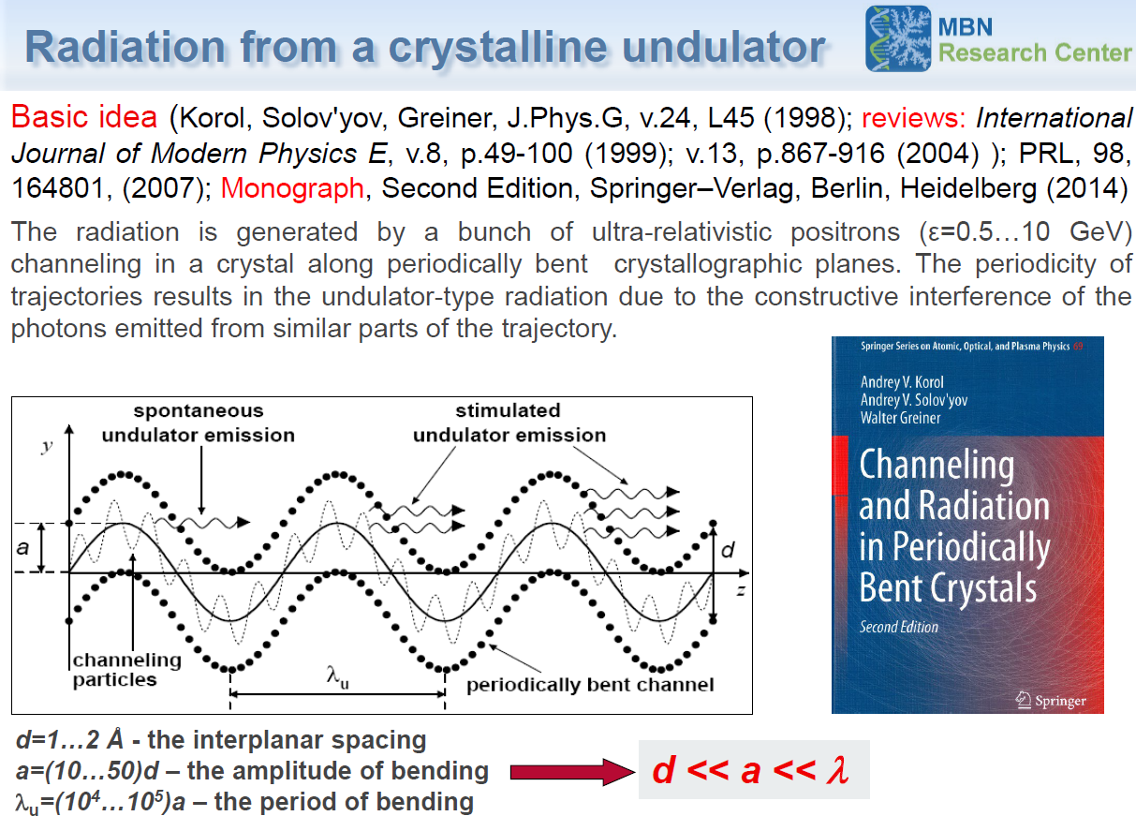
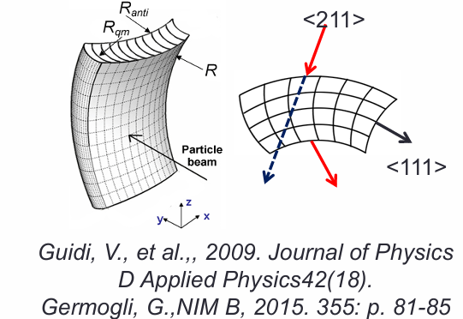

First Idea:
Mechanically bend crystals

Slide 5
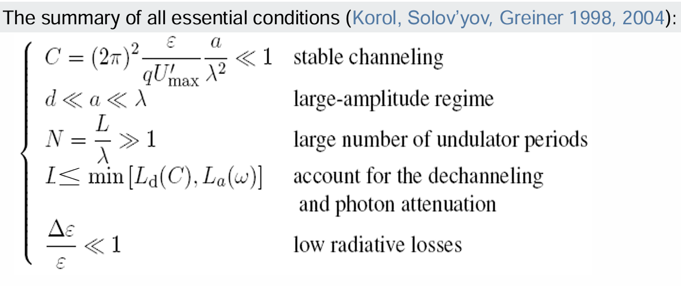
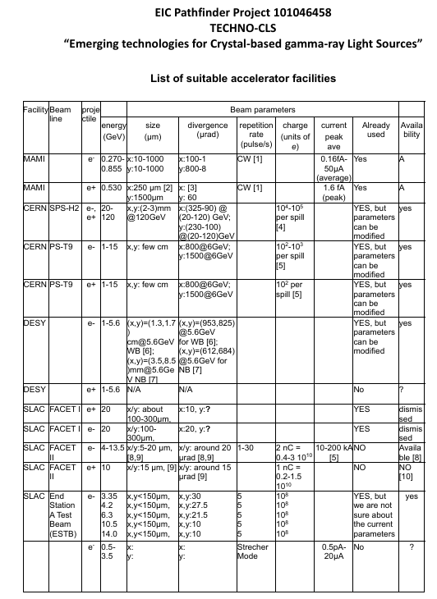
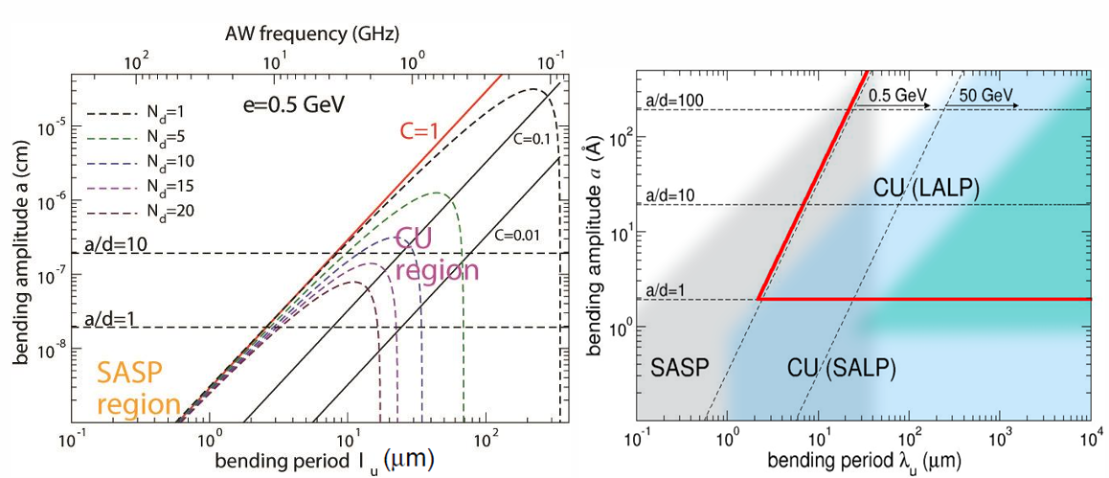
CU parameters – conditions and suitable accelerators

Slide 6
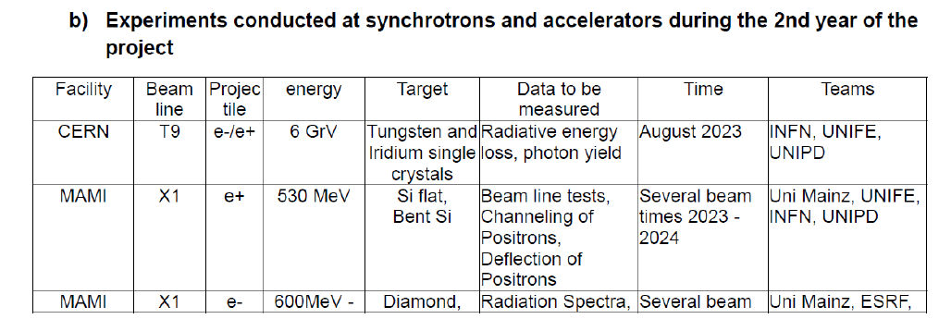
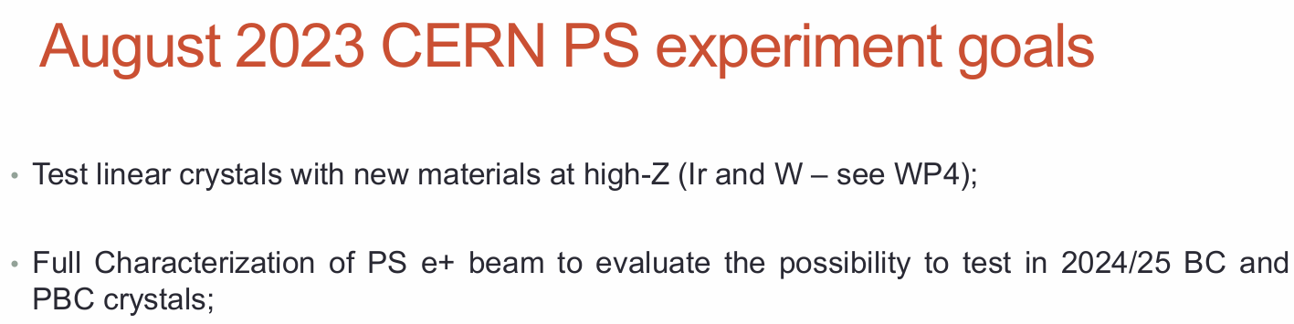
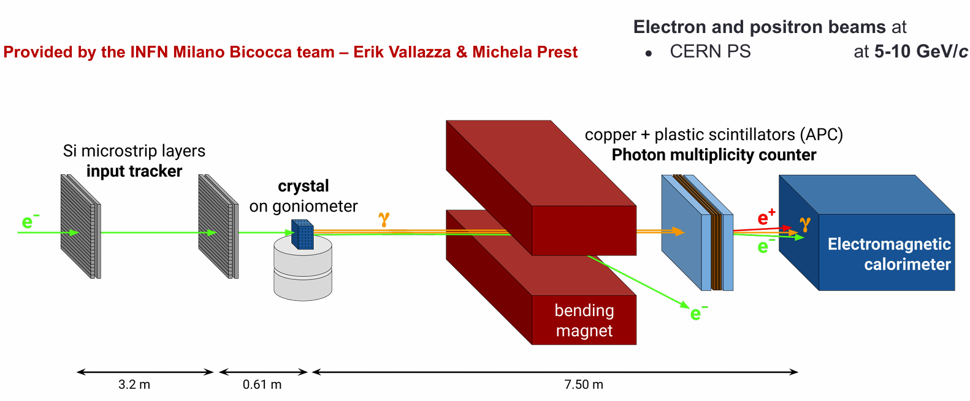

Experiments in various accelerators

Slide 7
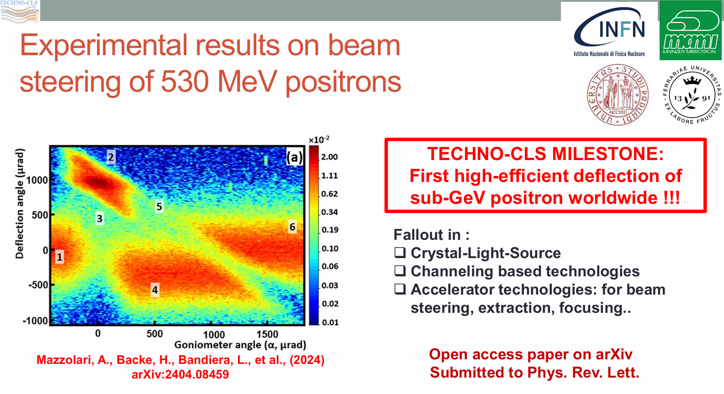
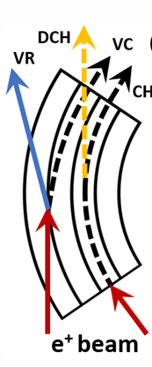
Mechanically bend crystals first experimental results in MAMI
Mechanisms of interaction between charged particle beams and bent crystals
CH-Channeling
DCH -Dechanneling arises due to incoherent scattering leading to inefficiency!
VR-Volume reflection or volume capture (VC)
(1) and (6) the crystal is not aligned to the beam. (2) Indicates channeling, (3) points to dechanneling, (4) identifies VR, and (5) identifies VC.

Slide 8
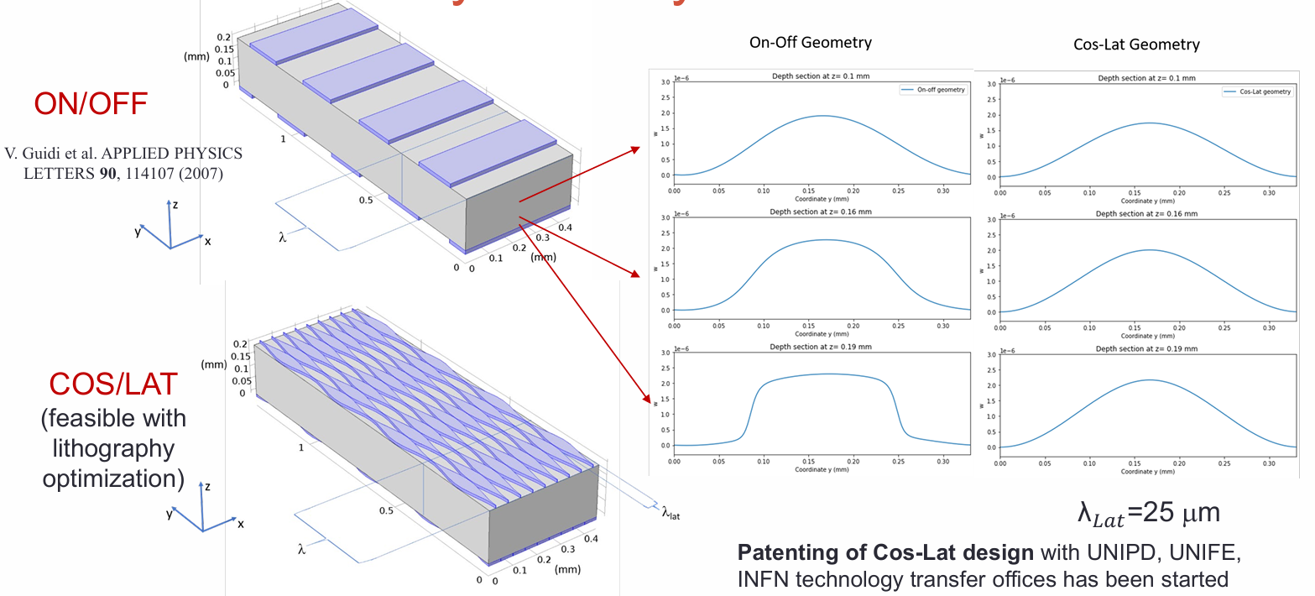
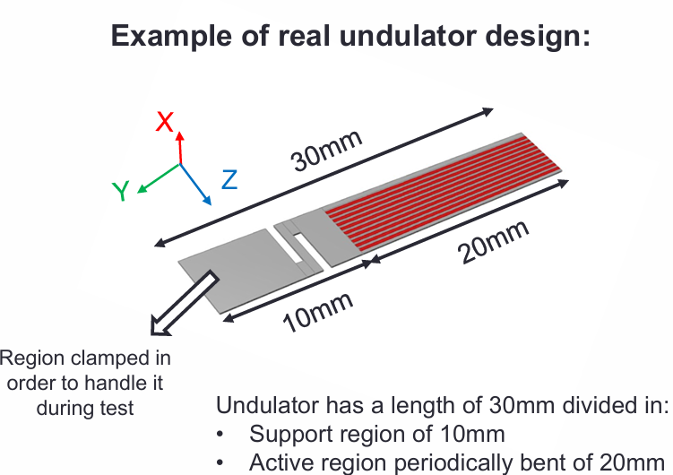
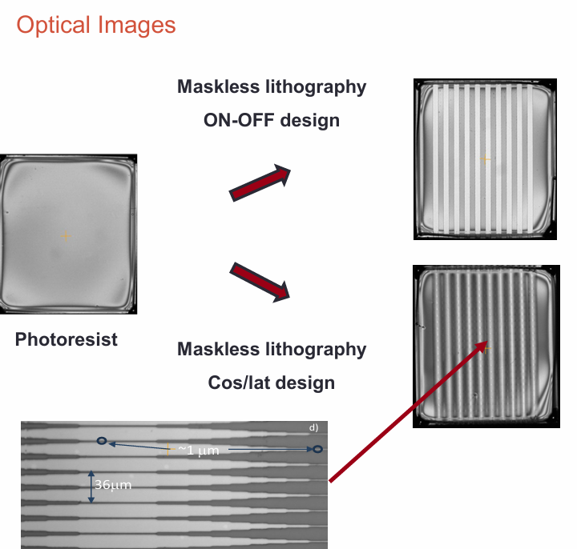
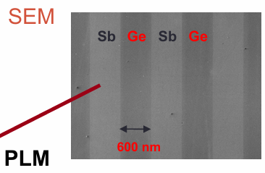
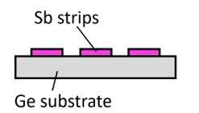
Manufacturing Periodically bent crystals (static)

Slide 9
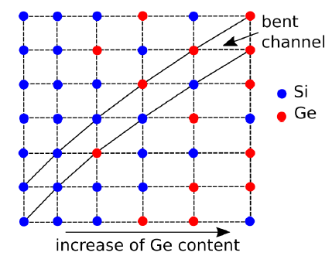
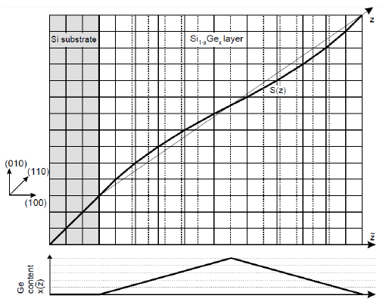
Channeling in binary crystalline bending structures (static)
Bending can be achieved by variation of the dopant content in binary crystals [1]
Ge and Si have different lattice parameters which leads to a deformation in Si_{1−x} Ge_{x} [2]
Scheme of Si_{1−x} Ge_{x} crystal bending due to variation of Ge content [3].
[1] Mikkelsen& Uggerhøj, NIMB 160(2000) 435
[2] Krause, Korol,Solov’yov, &Greiner, NIMB, 483(2002) 455
[3] Korol, Solov’yov, Greiner, “Channeling and radiation in periodically bent crystals”, Springer (2014)
Model by
MBN Explorer ®
Using MD methods

Slide 10
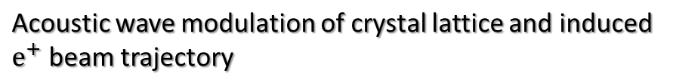
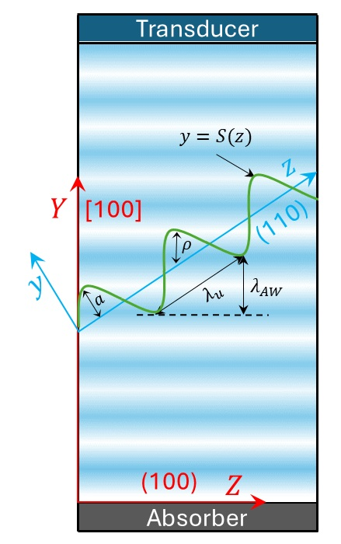
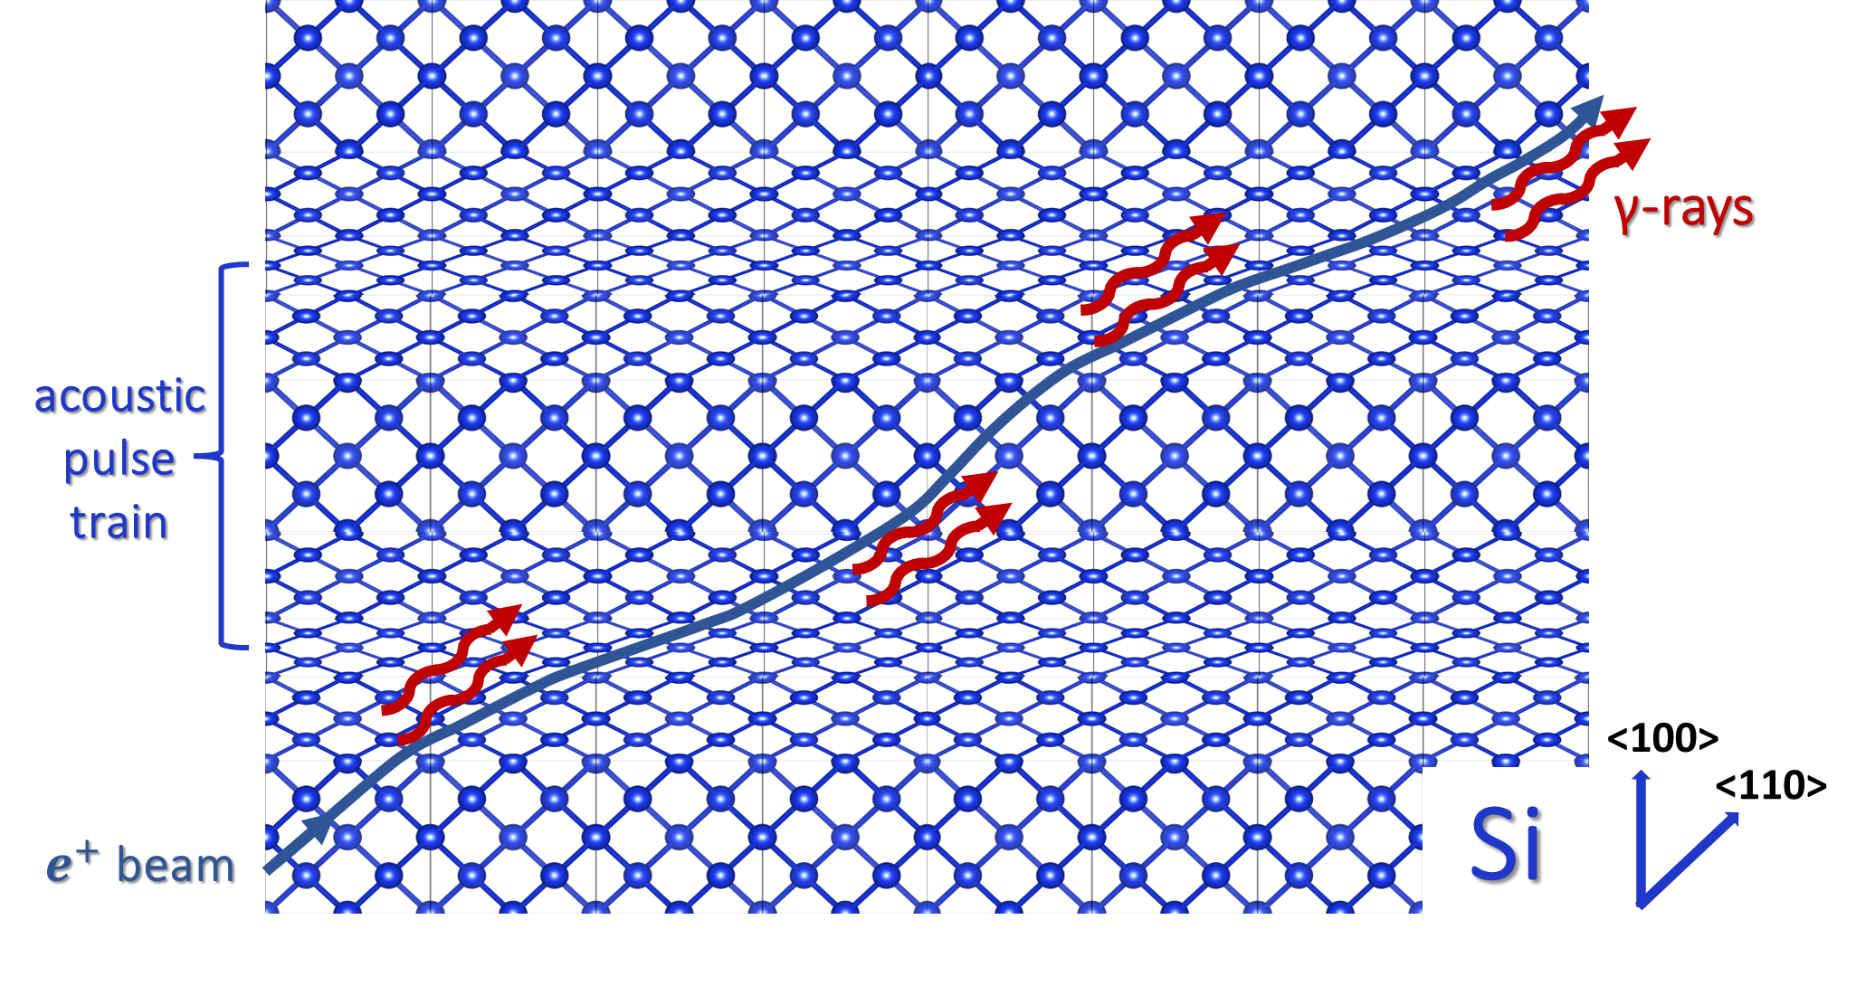

Acoustic Crystalline Undulators: principle of operation
Acoustic crystalline undulator: device structure
Novel Idea!

Slide 11
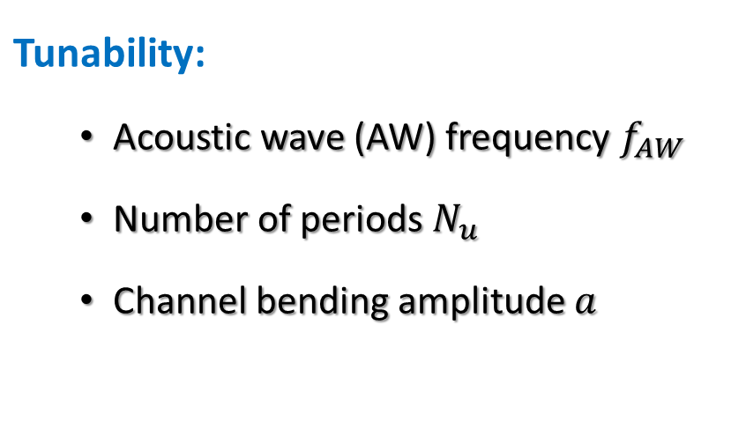
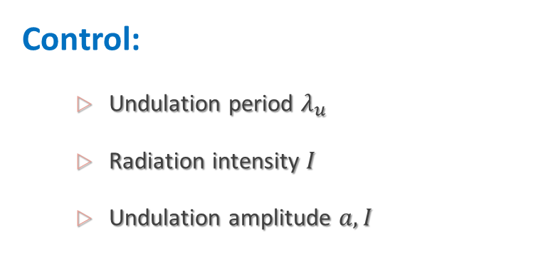
Acoustic Crystalline Undulators: expected advantages!
AW CUs will allow for real-time experimental optimization and scanning of a broad parameter range!

Slide 12
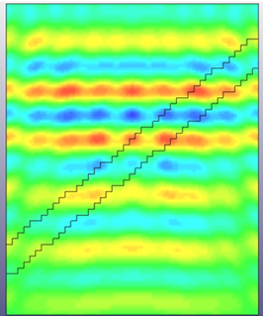
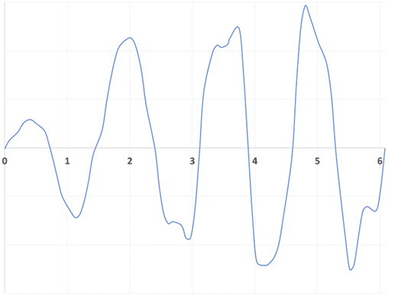
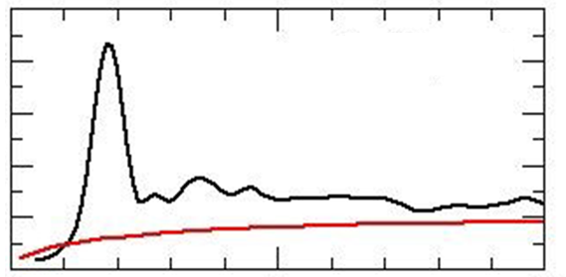
A-CU modeling: proof of principle
Step1
Simulate acoustic wave propagation inside crystal
Step2
Extract the displacement of the lattice planes due to the pressure distribution
Step3
Calculate particle trajectories and generated γ-ray radiation
Finite element method
(LSDYNA)
Molecular dynamics
(MBN explorer)
Undulation peak
Displacement
Radiation intensity
Photon Energy
Diagonal distance
K. Kaleris, E. Kaselouris, V. Dimitriou, E. Kaniolakis-Kaloudis, M. Bakarezos, M. Tatarakis & N. A Papadogiannis
G. B. Sushko, A. V. Korol & A. V. Solov’yov
Physical Review Accelerators and Beams 28 (3), 033502 (2025)

Slide 13


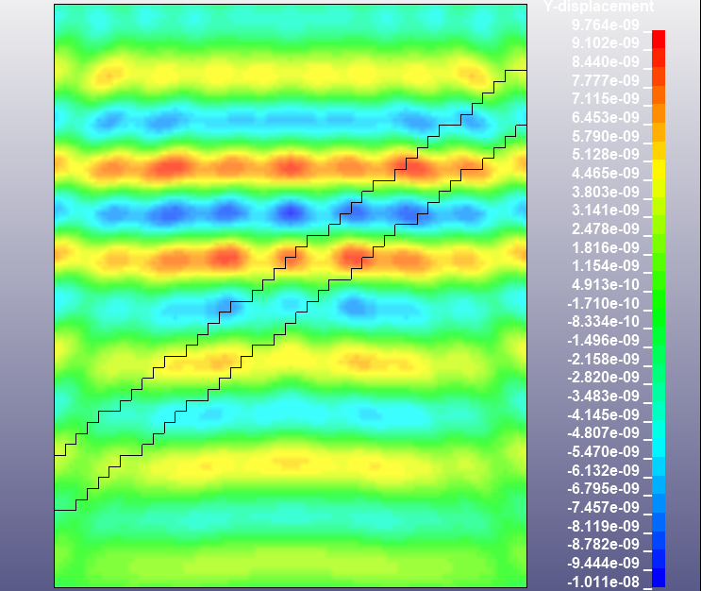
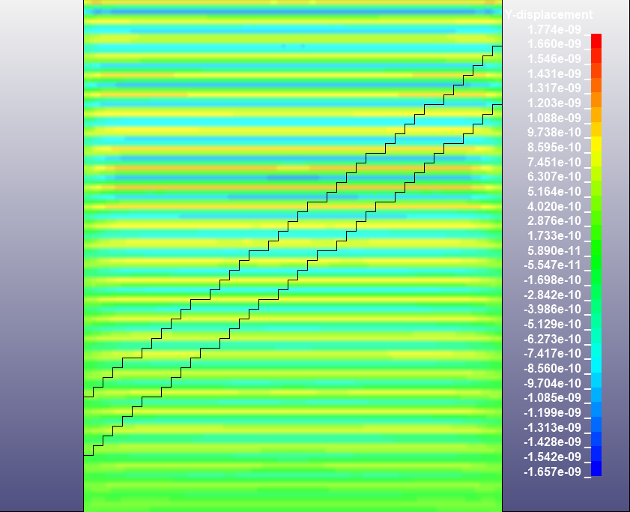
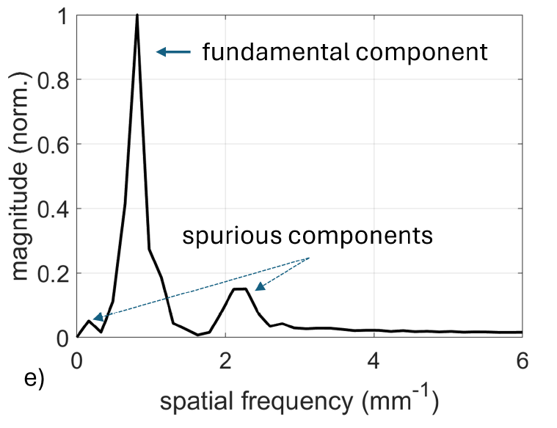
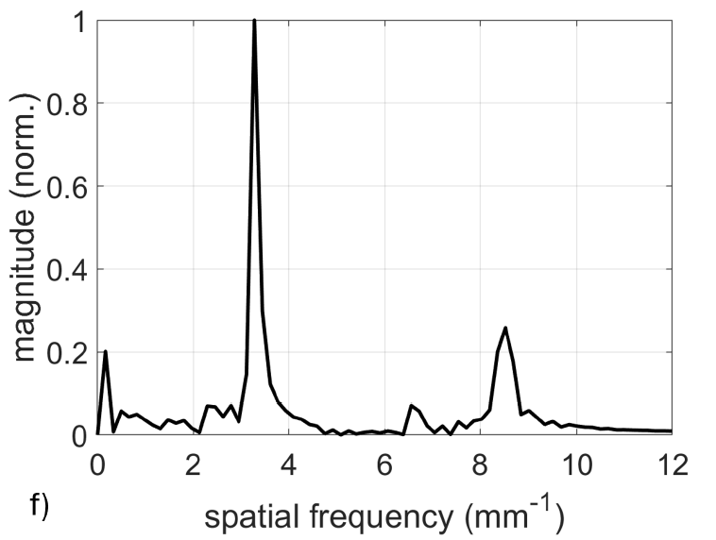
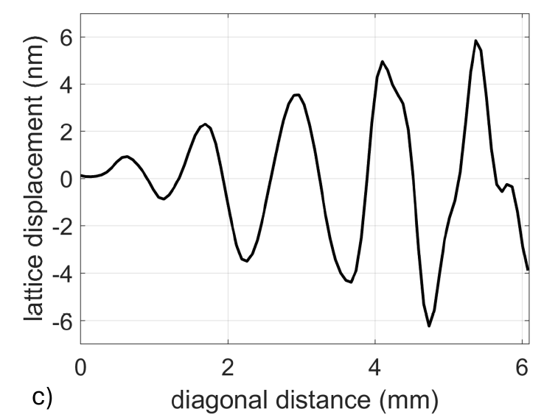
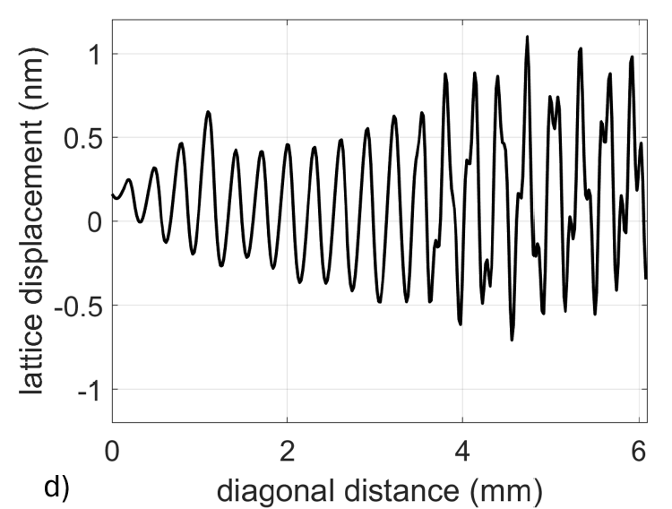
Near single frequency sinusoidal profiles
Increasing the excitation frequency
f = 10MHz
f = 40MHz

Slide 14

Calculation of 20GeV positrons exemplary trajectories
K. Kaleris, E. Kaselouris, E. Kaniolakis-Kaloudis, M. Bakarezos, M. Tatarakis, V. Dimitriou, N. A. Papadogiannis and G. B. Sushko, A. V. Korol, A. V. Solov’yov, Narrowband γ-ray radiation generation by acoustically driven crystalline undulators, Phys. Rev. Accel. Beams 28, 033502 (2025).
MBN Explorer

Slide 15
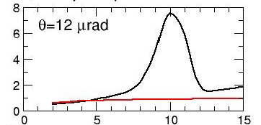


A-CU γ-ray radiation tunability!!!
10 MHz
40 MHz
Photon Energy (MeV)
Photon Energy (MeV)
Undulation period: γ-ray photon energy
Peak @ ~2 MeV
Peak @ ~10 MeV
Number of periods: radiation intensity
Periods: 5
Periods: 20
K. Kaleris, E. Kaselouris, E. Kaniolakis-Kaloudis, M. Bakarezos, M. Tatarakis, V. Dimitriou, N. A. Papadogiannis and G. B. Sushko, A. V. Korol, A. V. Solov’yov, Narrowband γ-ray radiation generation by acoustically driven crystalline undulators, Phys. Rev. Accel. Beams 28, 033502 (2025).

Slide 16
Experiments towards
the realization of AW CU

Slide 17
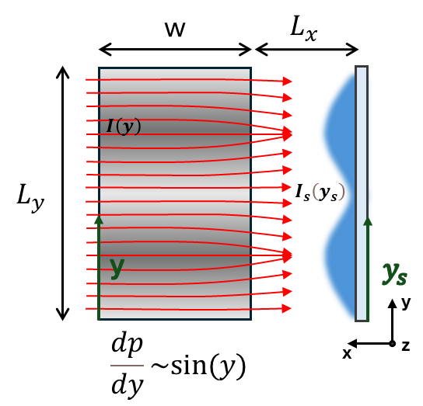




Imaging of dynamic acoustic fields
Fast Laser Refractive Imaging (FLRI)
Δy=y-y_{s}

Slide 18

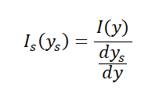

Computational model
Assuming there is no light lost due to refraction, all the initial optical intensity reaches the camera sensor:
The derivative can be calculated by ys:

Slide 19
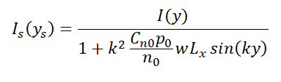
Computational model
So finally we get:
Equation links the light intensity captured by camera to the pressure amplitude of the high frequency ultrasounds and also yields the modulation of the initial intensity distribution!!!
Emmanouil Kaniolakis Kaloudis, TECHNO-CLS, Bremerhaven 2025

Slide 20
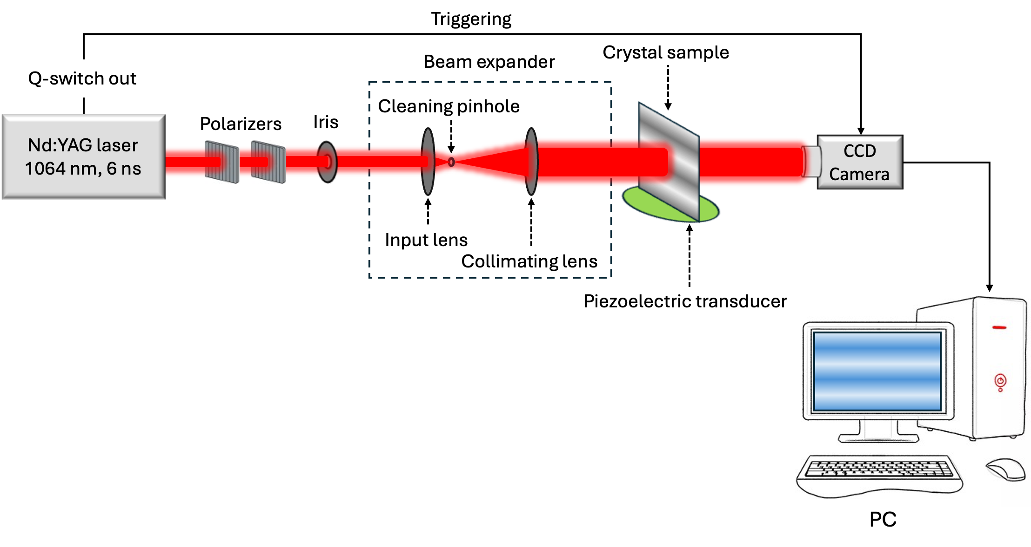
FLRI experimental set up
Fast probing via 6 ns laser pulses allows for static imaging (snapshots) of the dynamic acoustic field inside thin crystals!!!

Slide 21

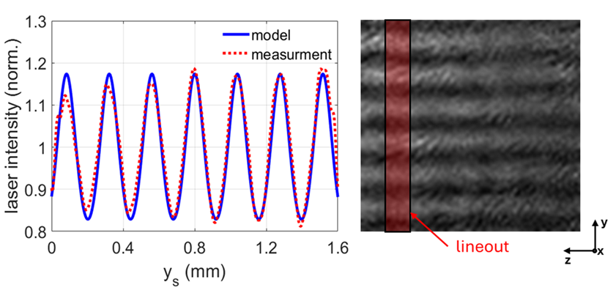
FLRI results and signal processing
Characteristic images of TeO2 crystal obtained with phase imaging technique: without excitation (left), with excitation (right)
Analysed image, demonstrating the fringes generated by the deflection of light from the refractive index gradient
Quantification of the 2D spatial distribution of the acoustic pressure field
FLRI captures the images of the light intensity distribution
Division of the acoustically modulated image (signal) by the unmodulated image (reference)
The new image clearly reveals the intensity distribution of the laser beam due to the pressure gradients in the crystal sample, since any irregularities of the laser beam profile are suppressed
3) The 1D representation of the intensity distribution is taken via a lineout along the y direction of the divided image.

Slide 22
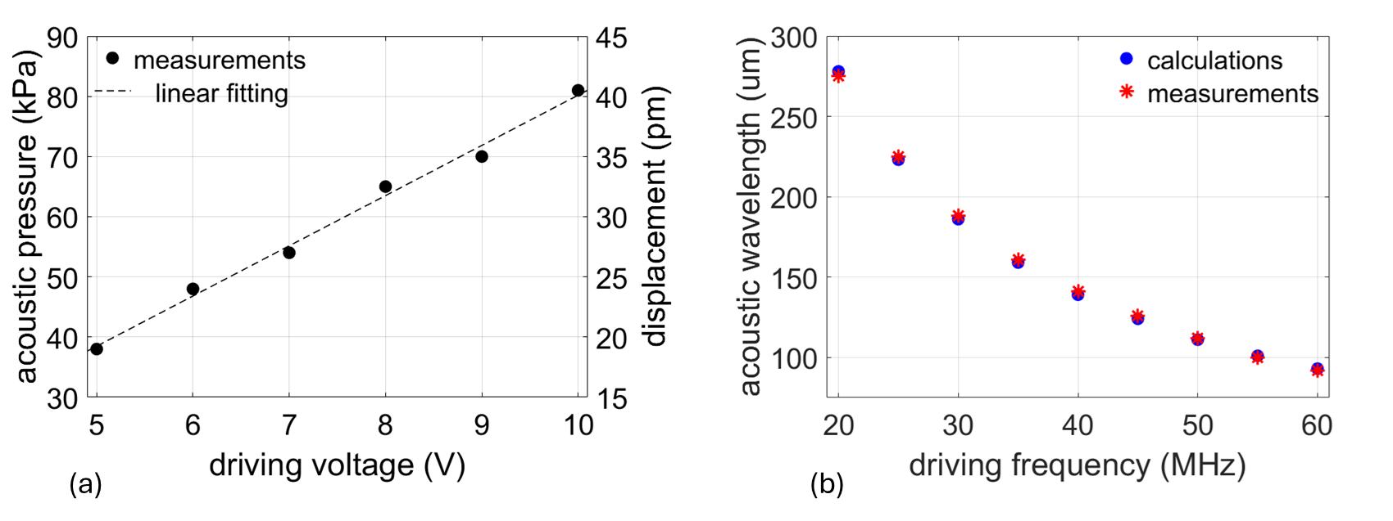
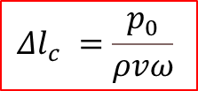
Computational model validation
Results of parametric study
Validation of linear relation between:
Acoustic Pressure / Lattice Displacement and Driving Voltage
Validation of inverse proportionality between:
Acoustic wavelength and Driving Frequency
C_{no}= Δl_{c}/V
Calculation of lattice displacement from the experimentally estimated pressure amplitude

Slide 23
Computational model validation
Signal Analysis (for 25 MHz, 10 Vpp)
Intensity modulation line-out
Image captured via FLRI
Pressure: 80 ± 5 kPa
Displacement: 40 pm
Wavelength: 340±20 um

Slide 24
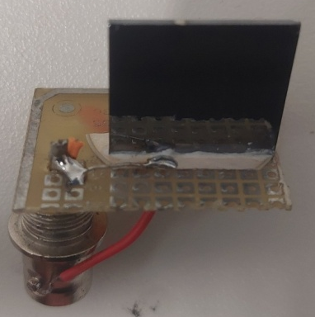
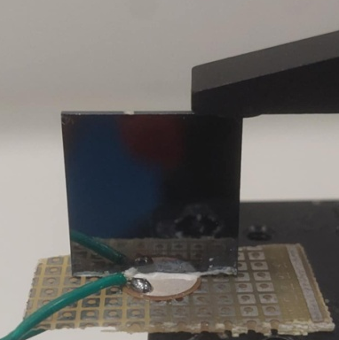
A-CU Devices under characterization
10 MHz device
20 MHz device
200 μm thickness PZT transducer
Si <100> crystal
20×20×1 mm³
100 um thickness PZT transducer
The transducer is bonded on the Si crystal using a thin film of vacuum epoxy, ensuring low acoustic losses!!!

Slide 25
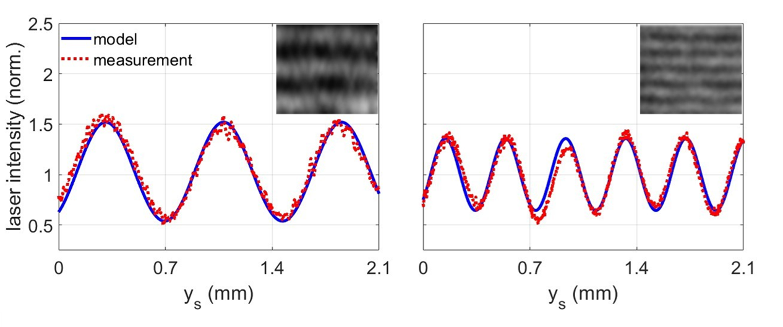
Characterization of the dynamic acoustic field in Si based devices
Plots: line-out and model estimation of the optical intensity modulation due to the acoustic field at the time instance of probing.
10 MHz device
20 MHz device
21.40 MHz
Pressure: 295 ± 4 kPa
Displacement: 0.12 nm
Wavelength: 390±9 μm
10.92 MHz
Pressure: 1530 ± 17 kPa
Displacement: 1.10 nm
Wavelength: 774±11 um
Insets: images of the optical intensity pattern captured by FLRI, depicting a snapshot of the dynamic acoustic field in the 1 mm - thin crystal.
Kaniolakis et al. Precise control of high frequency ultrasounds in thin crystals for the development of tunable narrowband and directional γ-ray sources, under minor revision in JASA

Slide 26
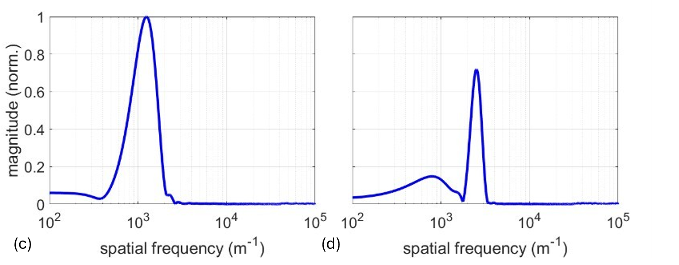
Characterization of the dynamic acoustic field in Si based device
Frequency domain representations of the line-outs of the optical intensity modulation, obtained via FFT
Strong harmonic components indicate the suitability of the devices for the generation of narrowband γ radiation.
10 MHz device
20 MHz device
Peak: 1295 m⁻¹
Peak: 2538 m⁻¹

Slide 27

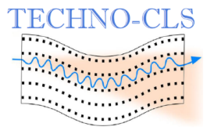
Successful characterization of HFUS in Si <100> crystals with nominal resonance frequencies of 10 MHz and 20 MHz, using FLRI and supported by a specially developed computational model.
Kaniolakis et al. Precise control of high frequency ultrasounds in thin crystals for the development of tunable narrowband and directional γ-ray sources. Underreview in JASA
Towards higher frequencies !!!

Slide 28
The role of ultrafast lasers in generation of localized ultra high frequency acoustic waves in crystals

Slide 29
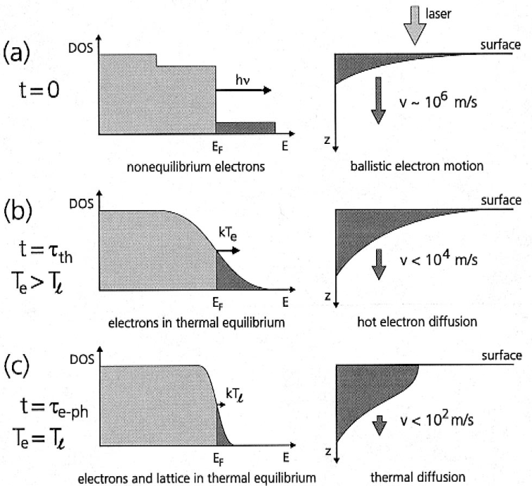
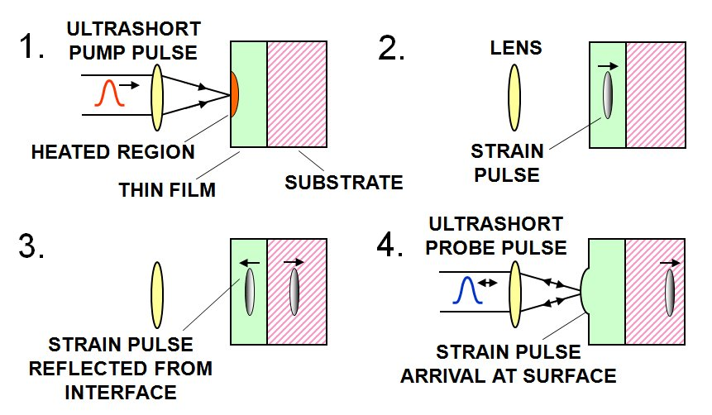
Ultrafast phenomena in metallic optoacoustic transducers
Electron dynamics
Lattice Dynamics
J. Hohlfeld et al., Chem. Phys. 251, 237 (2000)
Laser-induced localize strain
Strain propagation
Strain reflection from interface
Detection of strain at surface (echo)
Non-thermal electron excitation
Electron thermalization (via e-e & e-ph)
Electron-lattice thermal equilibrium

Slide 30

Degenerate pump-probe transient reflectivity typical set-up
Brillouin scattering observation through interference:
Reflected beam from material surface
+
Reflected beam from
fast moving strain pulse

Slide 31

New results in Tantalum/Silicon
20 nm Tantalum on Si
Super fast electronic excitation
Fast electron-phonon
transferring
The oscillation period depends on the sound speed in any depth of the substrate
Visibility of oscillations depends on the intensity of nanoacoustic wave in any depth of the substrate
Brillouin oscillations in substrate (Si)

Slide 32



Acoustically-driven Crystalline Undulators for γ-ray generation
Design principle
Working principle
Travelling acoustic waves
Piezo-electric driving
From: A. V. Korol, A. V. Solov'yov, W. Greiner, Channeling and Radiation in Periodically Bent Crystals, Springer (2013)
Ultrafast Laser driving
K. Kaleris, E. Kaniolakis-Kaloudis, E. Kaselouris, K. Kosma, E. Gagaoudakis, V. Binas, S. Petrakis, V. Dimitriou, M. Bakarezos, M. Tatarakis, N. A. Papadogiannis, Efficient ultrafast photoacoustic transduction on Tantalum thin films, Applied Physics A (2023) 129:527

Slide 33


Studying the transducers’ nature - Experiments
E. Tzianaki, et al, Optics Express 23, 17191 (2015)
K. Kaleris, et al , Applied Physics A (2023) 129:527

Slide 34







Computational model based on FEA in LS-DYNA software

Slide 35


Results – Tantalum on Si induce train of nanoacoustic strains!
Calculated strain pulse distribution in 25 nm metal/Si systems as a function of depth, at different time instants.
Solid blue and orange lines correspond to Ta/Si and Ti/Si cases, respectively. Vertical dashed line corresponds to the metal/Si interface position
Solid blue and dot-dashed red lines correspond to Ti/Si and Ag/Si cases, respectively. Vertical dashed line corresponds to the metal/Si interface position

Slide 36

Results II– Tantalum on Si induce train of nanoacoustic strains!
Calculated strain distribution in 25 nm metal/Si systems as a function of time, for a depth of 4 nm in the Si substrate
Solid blue and orange lines correspond to Ta/Si and Ti/Si cases, respectively.

Slide 37
Possible Applications of monochromatic and brilliant
γ-rays
Generated by CU

Slide 38


Slide 39


Slide 40


Slide 41
Relativistic
e⁻ and e⁺ micro-accelerators
via Multi-TW and PW lasers
N.A. Papadogiannis¹
Grigoriadis¹, G. Andrianaki1, I. Tazes¹, M. Bakarezos¹, V. Dimitriou¹, E. Benis², M. Tatarakis¹
IPPL, HMU Greece
Physics Dep, UoI, Greece

Slide 42




Traditional Relativistic electron accelerators

Slide 43






Classic light EM-Fields(a) vs Relativistic EM-Fields(b)
Lorentz
a) Classic Fields α₀<1 (b) Relativistic Fields α₀>1 ->
α₀<<α₀²
-> α₀>> α₀²
x
Oscillation in x-axes
₀<1
z
x
z
Acceleration in z-axes

Slide 44
Generation of Laser-Plasma waves
Physical 1D system example: EM pulse, λ=1μm, τ_{pulse}=100 fsec, Plasma, n₀=10¹⁸ cm⁻³ (λ_{p}=30μm) (i.e. cτ_{pulse} ~ λ_{p})
Non-relativistics case, a₀=0.3
Relativistics case, a₀=2.0

Slide 45




Laser Plasma miniature electron accelerators
The ponderomotive force (gradient of laser intensity) pushes electrons away from axis and generates a charge separation between ions and electrons
100 μm

Slide 46


The Dream electron beam by LWFA
First theoretical prediction of non-linear plasma waves as accelerators Tajima and Dawson, PRL, 43, 267 (1979)
First experimental demonstration of monoenergetic (~100 MeV) electron generation from relativistic laser-plasma interactions
Mangles, S.P.D. et al., Nature, 431, 535 (2004)
Geddes, C.G.R. et al., Nature, 431, 538 (2004)
Faure, J. et al., Nature, 431, 541 (2004)
First >GeV demonstration of monoenergetic electron generation
Leemans, W.P. et al., Nature Physics, 2, 696 (2006)
Long interaction length, i.e. 33 mm,
via guiding through a Hydrogen filled,
discharge capillary
46

Slide 47



Electron Injection in plasma bubbles
Ponderomotive forces of laser larger than space charge restoring force of the ions
ion
cavity
ion
cavity
Laser Wakefield Acceleration (LWFA)
Plasma waves with Ε-field > 100 GV/m
Electron energy gain: Mev to GeV
V. Malka

Slide 48





LWFA experimental station @ IPPL
Clark EL, Grigoriadis A, Petrakis S, et al. High-intensity laser-driven secondary radiation sources using the ZEUS 45 TW laser system at IPPL/HMU, High Power Laser Science and Engineering. 2021;9:e53. doi:10.1017/hpl.2021.38

Slide 49


Slide 50


The role of laser nozzle geometry
Nozzle Density Profile
He
He
Nozzle Density Profile
Interferometric Characterisation
Interferometric Characterisation
Electron Spectra
Electron Spectra
0.8 mm Nozzle
3 mm Nozzle
850 mJ
950 mJ
A Grigoriadis et al 2022 Plasma Phys. Control. Fusion 64 044007
G Andrianaki et al 2023, Rev. Sci. Instrum. 94, 103309

Slide 51




Generation of Betatron radiation I
Lanex
X-ray CCD
CCD
A. Grigoriadis et al
Applied Physics Letters 118, 13 (2021)

Slide 52



Generation of Betatron radiation Varying the gas nature
570 mJ
A. Grigoriadis et al Applied Physics Letters 118, 13 (2021)
He
N₂
Ne
Ar
Self Injection
Ionisation Injection

Slide 53


Non-linear QED approach for betatron radiation in a laser wakefield accelerator
Non-linear QED (classical regime) accurately models LWFA betatron radiation
Reproduces experimental results across targets and laser powers with reduced computational cost
Simplifies experimental reproducibility by minimizing runs and parameter scans
Provides an efficient framework for advanced LWFA schemes (ionization injection, multi-stage, high-power lasers)
Ong, J.F., Berceanu, A.C., Grigoriadis, A. et al. Non-linear QED approach for betatron radiation in a laser wakefield accelerator. Sci Rep 14, 605 (2024)

Slide 54
The role of the laser chirp on LWFA

Slide 55








Light Synthesizer – Mode-locking for fs pulses
ω₁
ω₂
ω₃
ω₄
ω₅
ω₆
0
t
Graphs by R. Trebino Open Acess Presentations

Slide 56


Chirp of an ultrashort Gaussian-like laser pulse
A chirped laser pulse has an E-Field:
where:
The instantaneous frequency is:
which is:
So the frequency increases linearly with time.
Positive chirp β>0
Negative chirp β<0

Slide 57



Slide 58
The Experimental set-up for chirp experiments
Grigoriadis, A., Andrianaki, G., Tazes, I. et al. Efficient plasma electron accelerator driven by linearly chirped multi-10-TW laser pulses. Sci Rep 13, 2918 (2023).

Slide 59


Method to varying the chirp (Dazzlers or AOPDF)
The AOPDF (for Acousto-Optic Programmable Dispersive Filter) relies on a longitudinal interaction between a polychromatic acoustic wave and a polychromatic optical wave in the bulk of a birefringent crystal.
Optical signals in the hundreds of Terahertz range are then controlled by RF signals in the tens of Megahertz range.
The spectral phase control is as accurate as the material properties of the crystal are known, without any assumption or hypothesis, thus allowing users to fully trust the shaping characteristics. The Dazzler phase control is obtained through the control of group delays versus wavelength.
The interaction between an optical wave and an acoustic wave also prevents the user from spectral phase discontinuities inherent to pulse shaper based on pixelated modulators.
Unlike other ultrafast pulse shapers relying on 4-f lines to spatially disperse the spectral components, the Dazzler does not require a complex optical set up. The Dazzler crystal is the only component inserted in your setup, and installation is performed in only few minutes.
Moreover, due to the physics of the acousto-optic interaction, the Dazzler system only requires a single point calibration to achieve accurate results.

Slide 60

Typical Experimental Results on electron acceleration
FTL pulse
Grigoriadis, A., Andrianaki, G., Tazes, I. et al. Efficient plasma electron accelerator driven by linearly chirped multi-10-TW laser pulses. Sci Rep 13, 2918 (2023).

Slide 61
Theoretical Modelling Method
Model utilizing PIC Simulations
2D PIC simulations performed in the EPOCH PIC code
The computational domain was set as 120×100 μm and was discretized by 2400×500 cells, with 5 particles per cell
The gas density geometry, determined in our earlier works, was used in the code, while the gas type was set to fully ionized He
The laser pulse parameters were set according to the ones experimentally used
The simulations ran for three cases of laser pulses: i) an FTL pulse, ii) a positively chirped pulse and a negatively chirped pulse. In the latter, the chirped value was set at +400 fs², which corresponds to the positive chirp value with the highest electron energy measured
A moving window configuration was used for a total simulation time of 11.4 ps.

Slide 62
Results of the theoretical Model
Grigoriadis, A., Andrianaki, G., Tazes, I. et al. Efficient plasma electron accelerator driven by linearly chirped multi-10-TW laser pulses. Sci Rep 13, 2918 (2023)
PIC Simulation clearly show that Positively chirped pulses generate finally the highest maximum electron kinetic energy compared to the negatively chirped and the FTL pulses
Positively chirped pulses show a large energy gain rate that is wider in time, compared to the negatively chirped and FTL pulses, thus resulting in the highest maximum electron kinetic energy.

Slide 63




The role of laser chirp in relativistic electron acceleration using multi-electron gas targets
K-shell electrons of nitrogen can be field-ionized by tunneling near 0 chirp
Mechanism of direct ionization injection of inner-shell electrons in multi-electron targets, that proceeds at appropriate laser peak intensities and laser chirp values, also contributes to the efficient electron acceleration resulting in relatively high maximum electron energies
Larger plasma density requires higher positive chirp values for efficient electron acceleration.
He
A Grigoriadis et al 2023 Plasma Phys. Control. Fusion 65 044001

Slide 64







LWFA electrons
10⁵ positrons per pulse in 5% energy bandwidths around 0.5 GeV
160 TW Gemini Laser @ RAL UK (collaboration QUB, IC, UM Ann Arbor, CLF RAL)
Narrow energy spread Positrons
Breit–Wheeler processes

Slide 65
Coherent Transition Radiation (CTR)
How CTR is Generated?
Electron Nanobunch Formation:
Ultra High-intensity laser pulses with a target, accelerating electrons into dense, sub-micron-sized relativistic electron "nanobunches“
2.Phase Coherence:
These nanobunches maintain a synchronized, "coherent" phase relationship, meaning their electromagnetic waves align, leading to constructive interference and enhanced radiation intensity.
3. Transition to Vacuum and CRT generation:
When these nanobunches are emitted through the rear surface of the material, they undergo a rapid change in the electromagnetic field. This change, or "transition," at the boundary between the material and vacuum, generates the coherent transition x-ray or γ-ray radiation!

Slide 66

Coherent Transition Radiation to accelerate positrons
Bethe-Heitler process: high-energy photons (light particles) create matter—specifically, an electron and a positron pair—when they pass near a heavy nucleus
Electron acceleration driven by LWFA has made remarkable progress reached multi-GeV energies with a small energy spread
The acceleration of pre-generated positrons is not as straightforward as it was for electrons. A key issue is that the plasma wakefield valid for electron acceleration defocuses positively charged particles
Coherent Transition Radiation (CTR) proposed to accelerate positrons and obtained a quasi-monoenergetic positron beam:
  Stage I: generation and acceleration of high-charge high-energy electrons with LWFA
  Stage II: positron generation in high Z material (eg copper target) via Bethe-Heitler process
  Stage III: acceleration process of positrons. Dense electron bunch from LWFA induce strong CTR inside the copper target that propagating into a vacuum, capable of trapping and accelerating positrons for a long distance.
  Simulation results show that the CTR field is up to 10's GV m⁻¹, which captures and accelerates the positrons to peak energies up to 500 MeV (energy spread ~20%). An external longitudinal magnetic field of 30 T is also applied to guide the electrons and positrons during the acceleration process.
Shanghai Institute of Optics and Fine Mechanics Chinese Academy of Sciences

Slide 67


Multi-GeV electrons using LWFA
Kim, H.T.; P et. al. Multi-GeV LaserWakefield Electron Acceleration with PW Lasers. Appl. Sci. 2021, 11, 5831

Slide 68


Laser Plasma accelerators: a promising research field for the future
Field gradients of different accelerator technologies and their relation to wavelength and frequency of the accelerating field.
Non-exhaustive overview of laboratories working on laser-driven (black) and particle beam-driven (green) plasma wakefield acceleration.
Hidding, B., Hooker, S., Jamison, S., Muratori, B., Murphy, C., Najmudin, Z., Pattathil, R., Sarri, G., Streeter, M., Welsch, C., Wing, M., & Xia, G. Plasma Wakefield Accelerator Research 2019 - 2040: A community-driven UK roadmap compiled by the Plasma Wakefield Accelerator Steering Committee (PWASC), arxiv (2019)
IPPL-HMU
This rapid scientific and technological progress is now posing the realistic question as to whether plasma-based acceleration could be a viable complementary technology for the next generation of particle colliders to break the TeV barrier

Slide 69





European Strategy for Particle Physics 2022 report recognizes the potentiality of Laser Plasma acceleration

Slide 70

Advanced and Novel Accelerators for Colliders (Towards TeV Collider)
Eric Esarey, Lawrence Berkeley National Laboratory
ANA: potential for multi-TeV collider
− 1-10 GV/m: compact linacs
− Ultrashort bunches: reduce power
− Gamma-gamma, polarized e⁺e⁻
• Vigorous research, rapid progress − >1000 pubs/yr
• Strong European endorsement
− EuPRAXIA
• Next Steps: Upgrade existing facilities
− Remain productive and competitive
− Ensure progress on R&D roadmap
• Need for integrated design study
− Include auxiliary systems
• Need design for intermediate energy facility
− Build physics case 20-100 GeV
• Intermediate applications
− Light sources, compact accelerators

Slide 71



Acknowledgement
Part of the presented work was funded by the European Commission through Horizon Europe EIC-Pathfinder-2021 Project TECHNO-CLS (Project No. 101046458). The HMU team acknowledges the grant of computational time by the Greek Research and Innovation Network in the National HPC facilities ARIS under project ID pr016025-LaMPIOS III.

Slide 72


