Slide 1


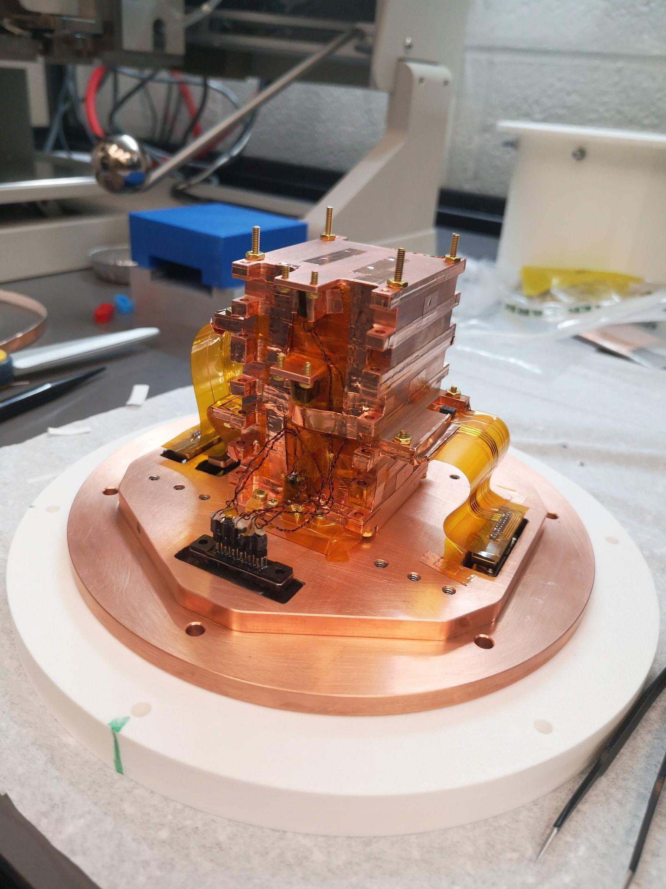
Observations of the Low Energy Excess Using HVeV Detectors
Kyle Kennard
for the LEGENDRE Project

Slide 2
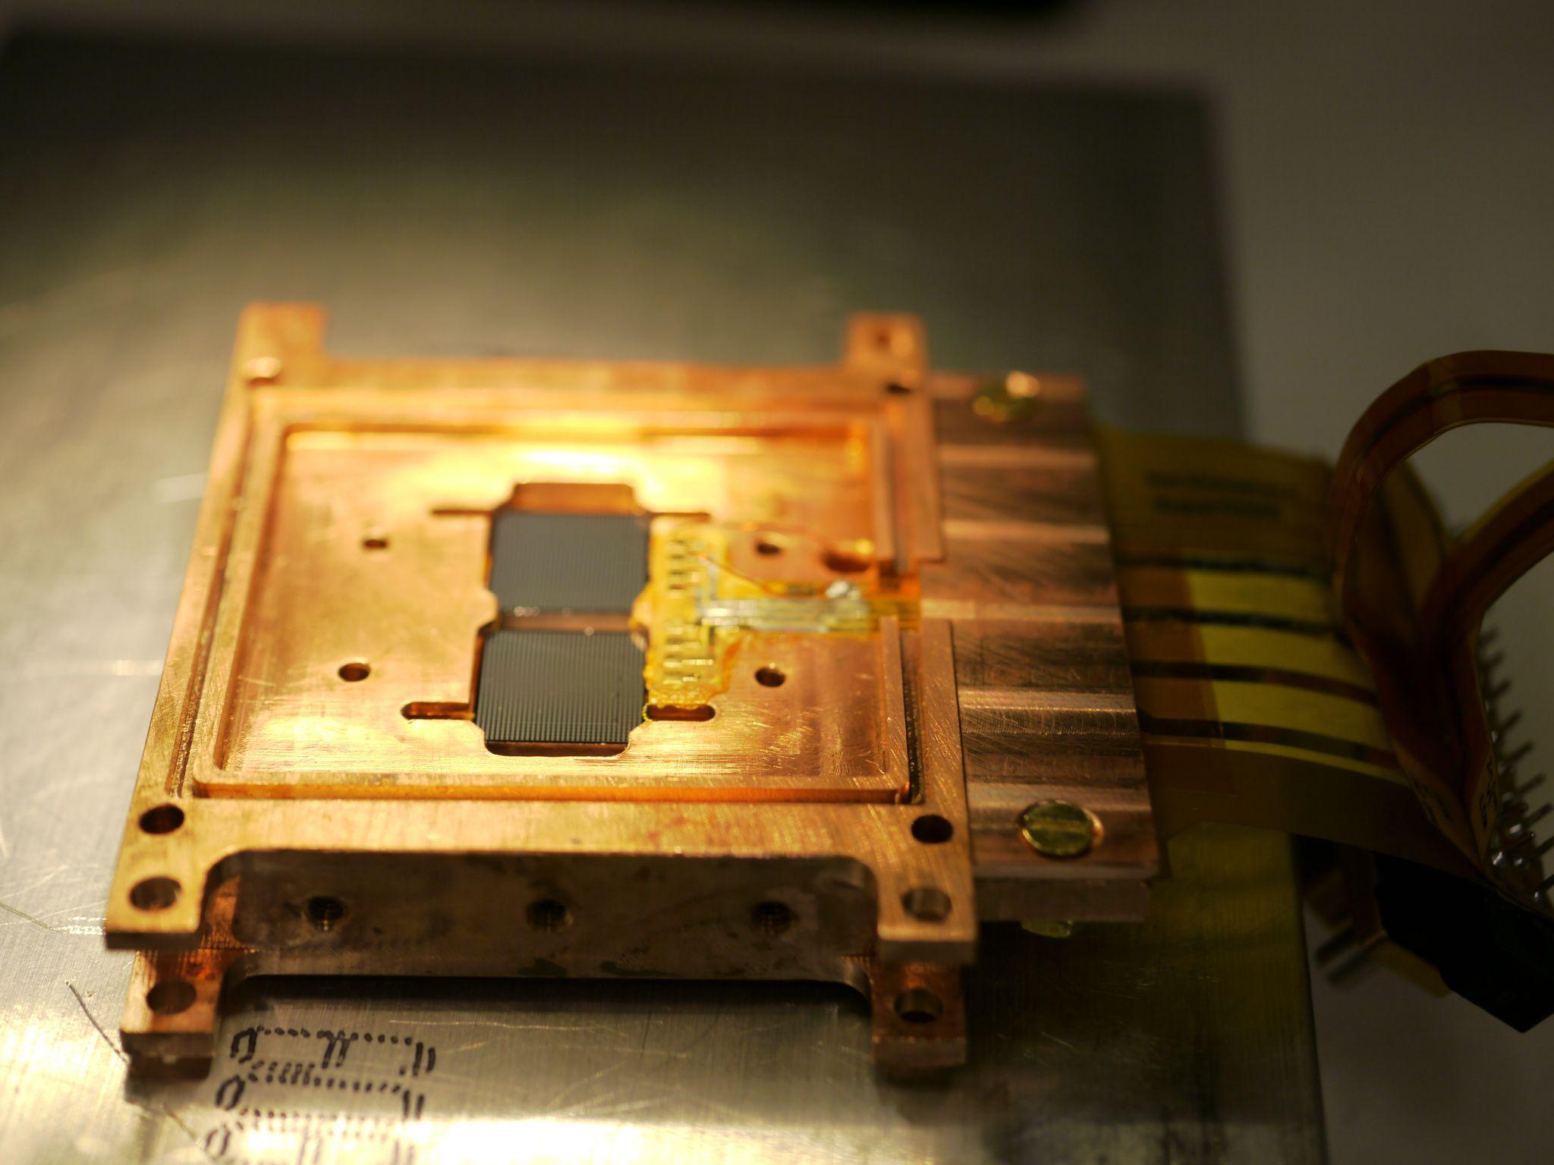
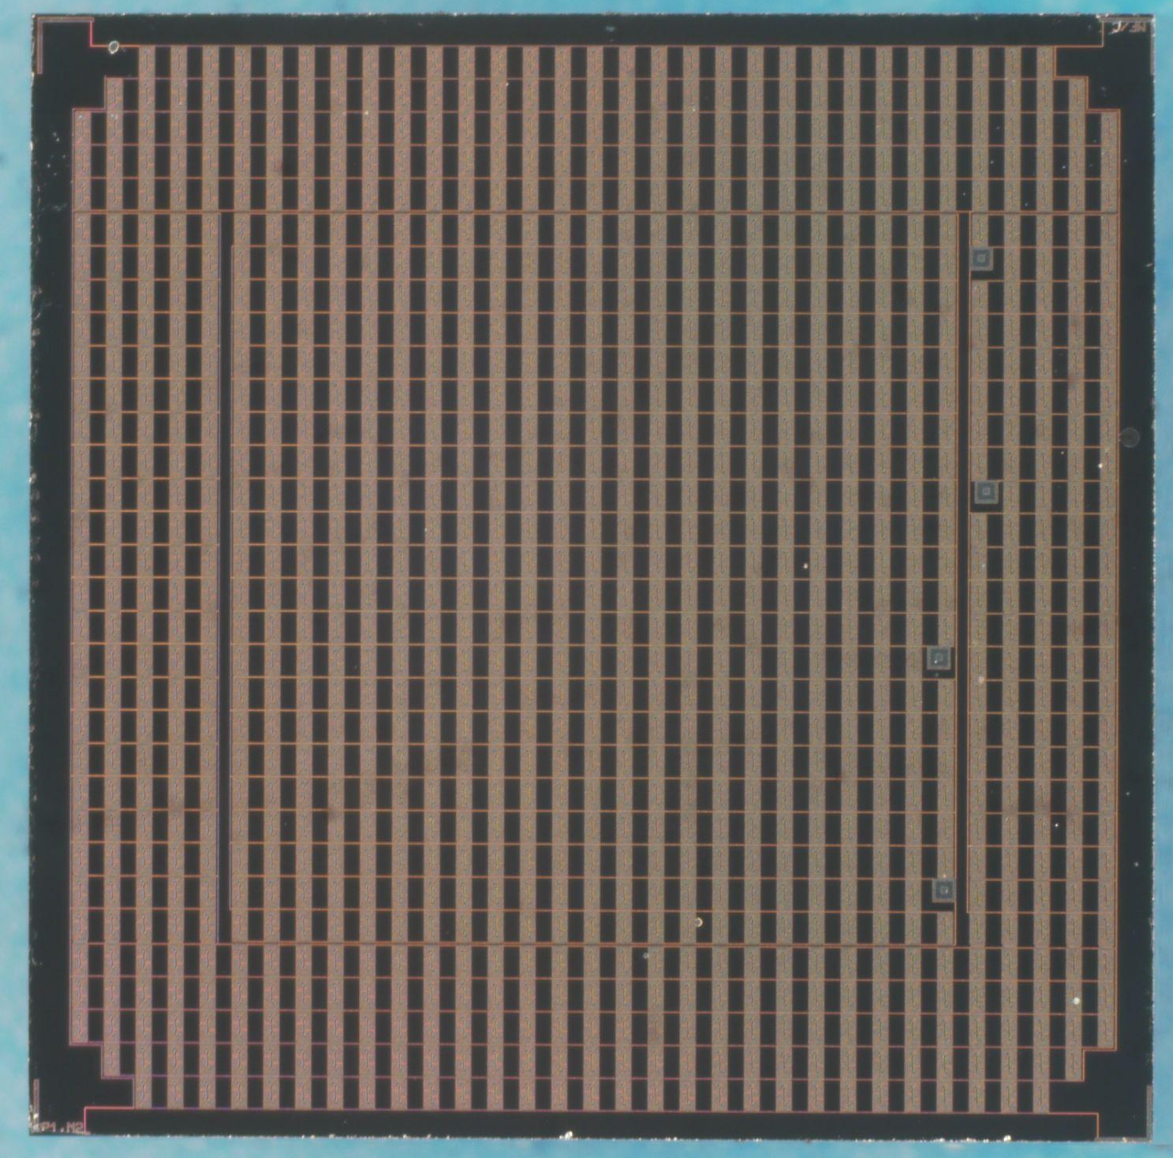
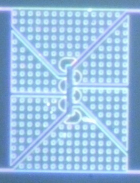
The LEGENDRE Project
Uses SuperCDMS-HVeV detectors to study the Low Energy Excess
1-gram Si detectors (1cm x 1cm x 4 mm)
Equipped with two parallel arrays of phonon sensors (QETs)
HVeV detectors offer
eV-scale resolution
Position sensitivity
Sensitivity to both ionizing and non-ionizing components
Different mask designs (different Al/W coverage)
Outer channel
Inner
Channel
Notes:
Explain what HVeV detectors have to offer and why they are good at observing the low energy excess

Slide 3
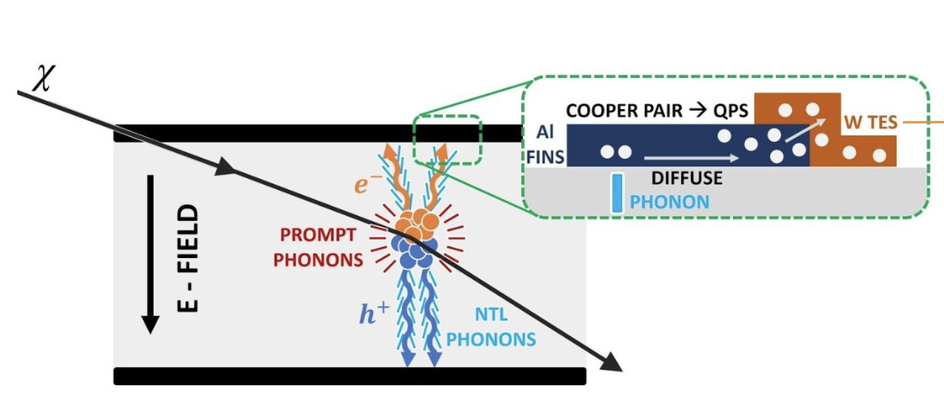
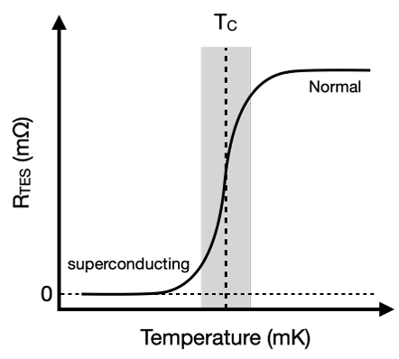

Detector Schematic
~ 60 mK
Phonons break QPs in Al fins which diffuse into the TES
Voltages biases usually O(10-100 V)
DM interacts with cold crystal
Generates phonons and charge carriers
Freed charges accelerated by E-Field
Charges emit more phonons
Total Phonon Energy

Slide 4
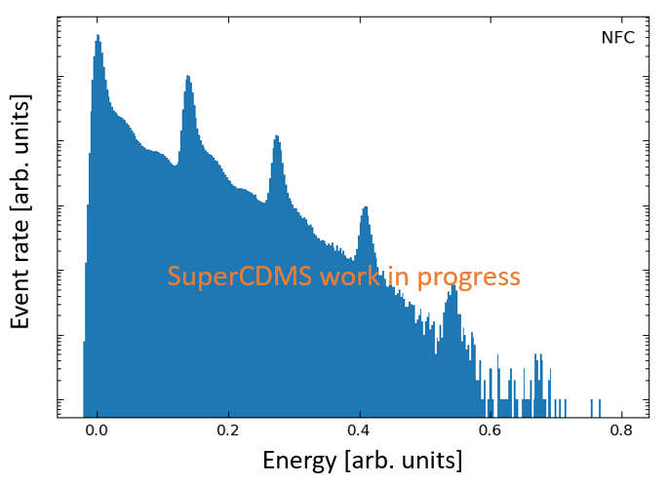
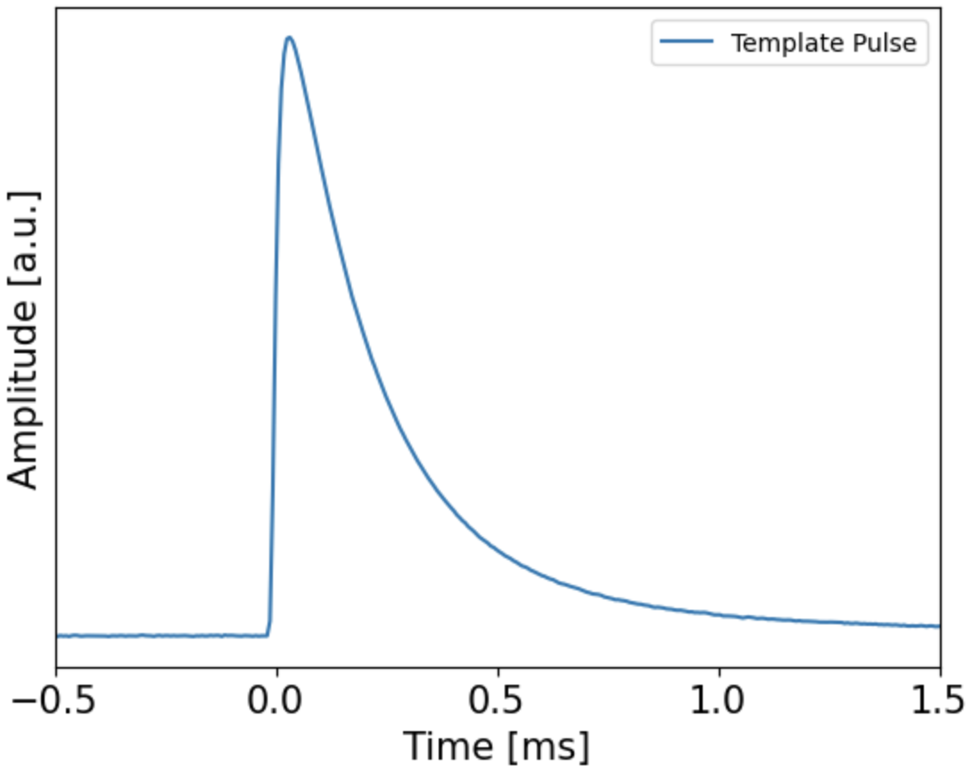
Expected Response
Example Energy Spectrum
Response from Particle Interaction
1 eh
2 eh
3 eh
4 eh
Height of pulse gives estimate of energy
Peaks correspond to number of electron-hole (eh) pairs broken

Slide 5
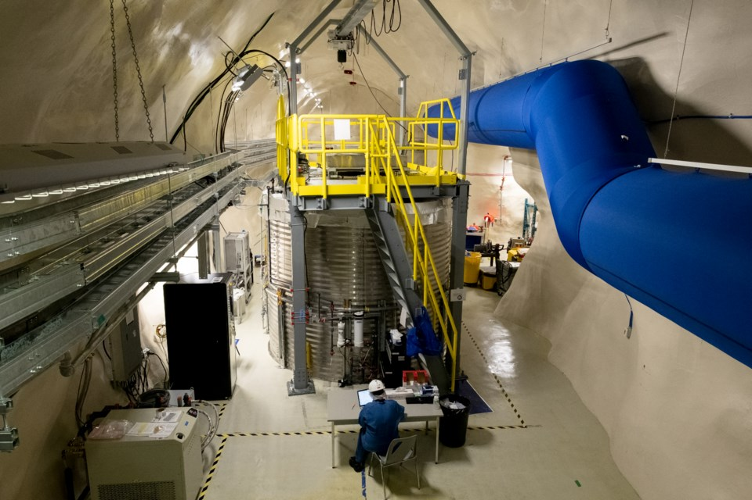
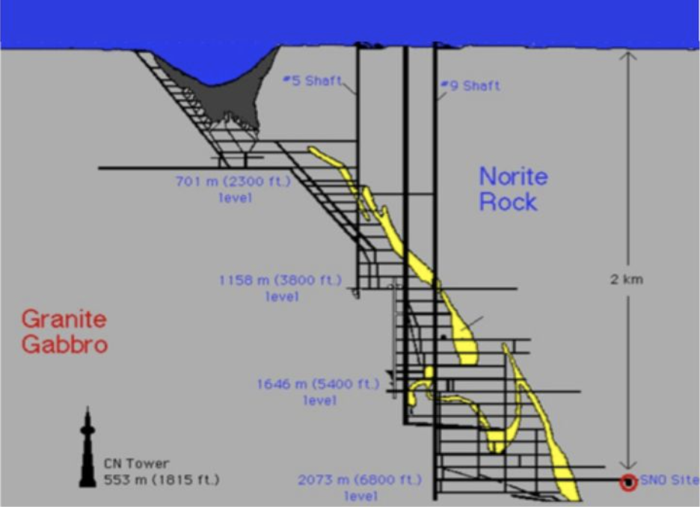
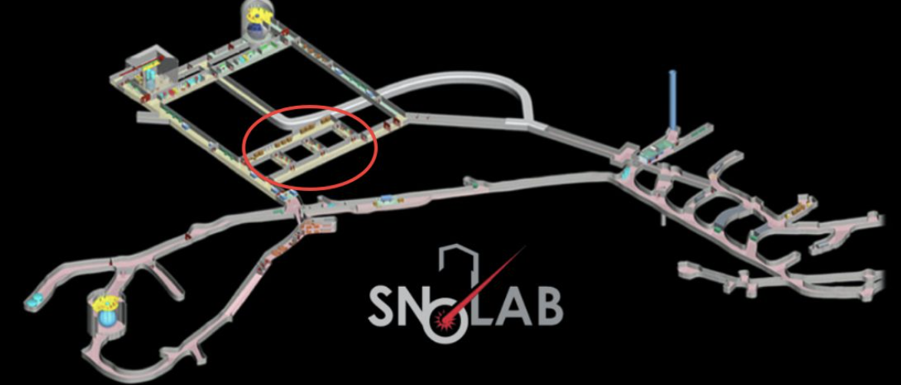
LEGENDRE Run 1: We Need to Go Deeper…
To SNOLAB!
Whole lab is Class 2000 clean room or better
2 km underground (~ 6000 m.w.e.)

Slide 6

LEGENDRE Run 1: HVeV@CUTE
Operated in dilution fridge (~14 mK) at the CUTE facility in SNOLAB
Payload of six HVeV detectors
LEDs for calibration
Primary Goal:
Study the Low Energy Excess (LEE)!
Shape, rate, position of LEE
Comparison to data taken on the surface
Study of possible ionizing component
Rate as a function of Al coverage
… and another dark matter search.
There will be a talk at LTD!

Slide 7
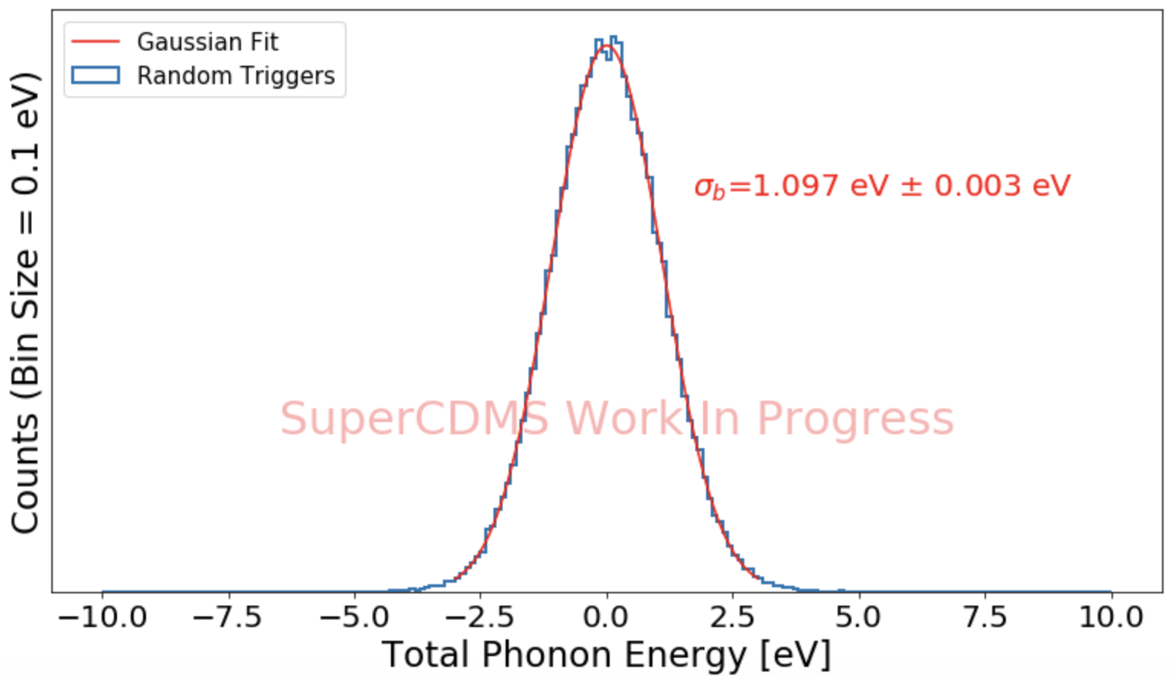
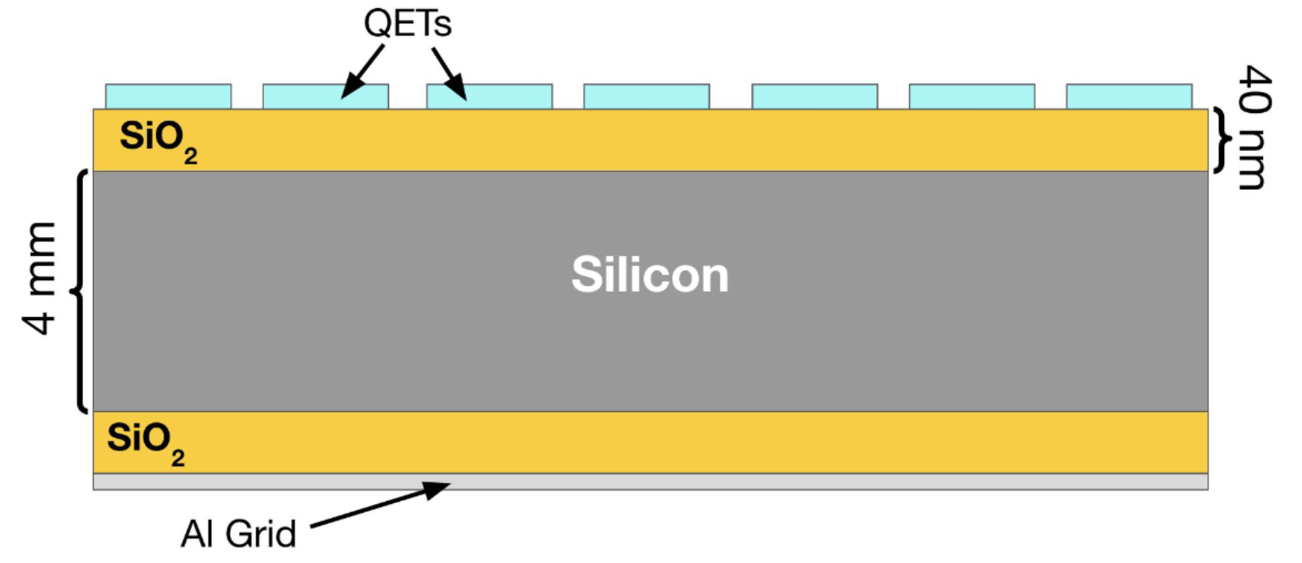
Meet the Detectors
Re-running the 4 detectors used at NEXUS…
… and two new detectors:
Lower T_{c} (~45 mK as opposed to ~65 mK from NEXUS R4 detectors)
Layer of SiO₂ to reduce possible leakage of charge carriers from QETs
Previously tested at NEXUS & showed ~1.1 eV baseline resolution!

Slide 8

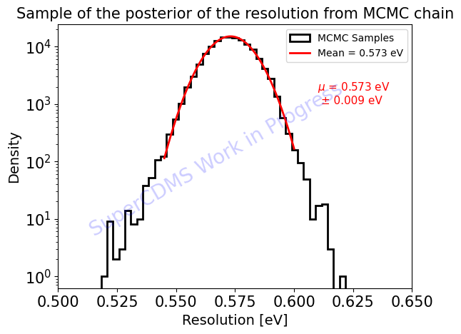
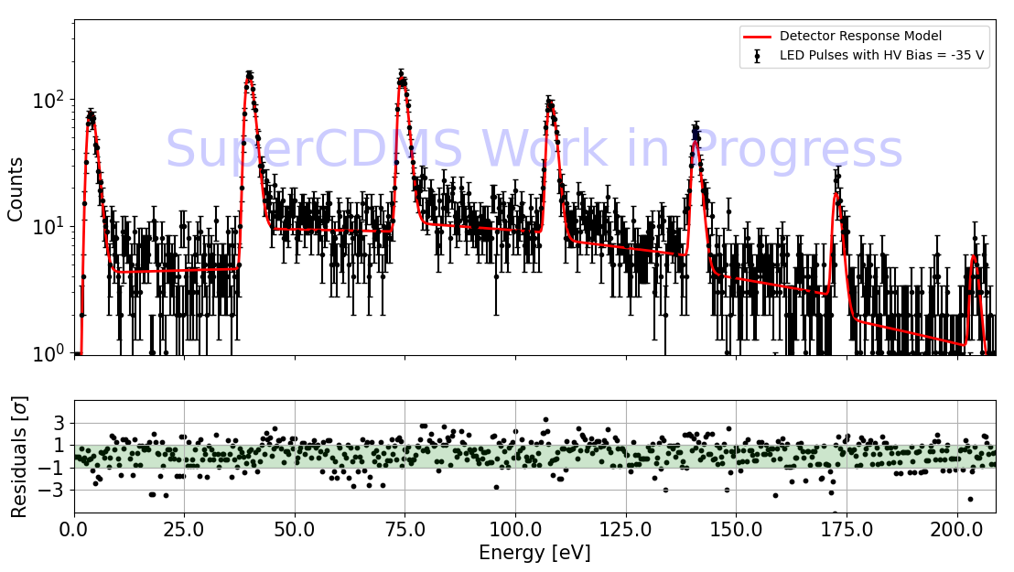
LED Calibration for SiO₂ Detector
SiO₂ HVeV achieved 0.573 eV baseline resolution!
Detector response model fit to LED calibration data
Notes:
Make it clear that this is the same detector that previously got a 1.1 eV resolution.

Slide 9
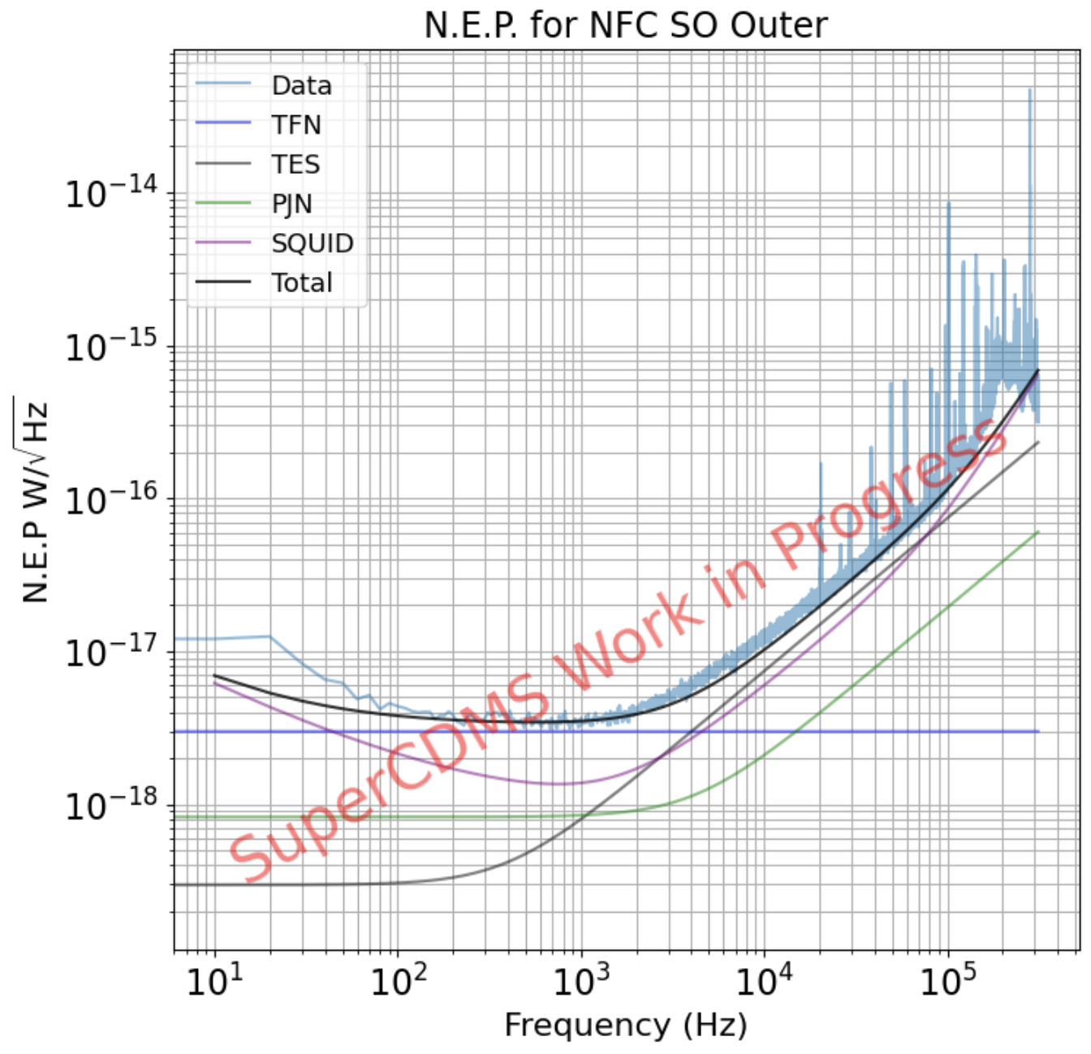
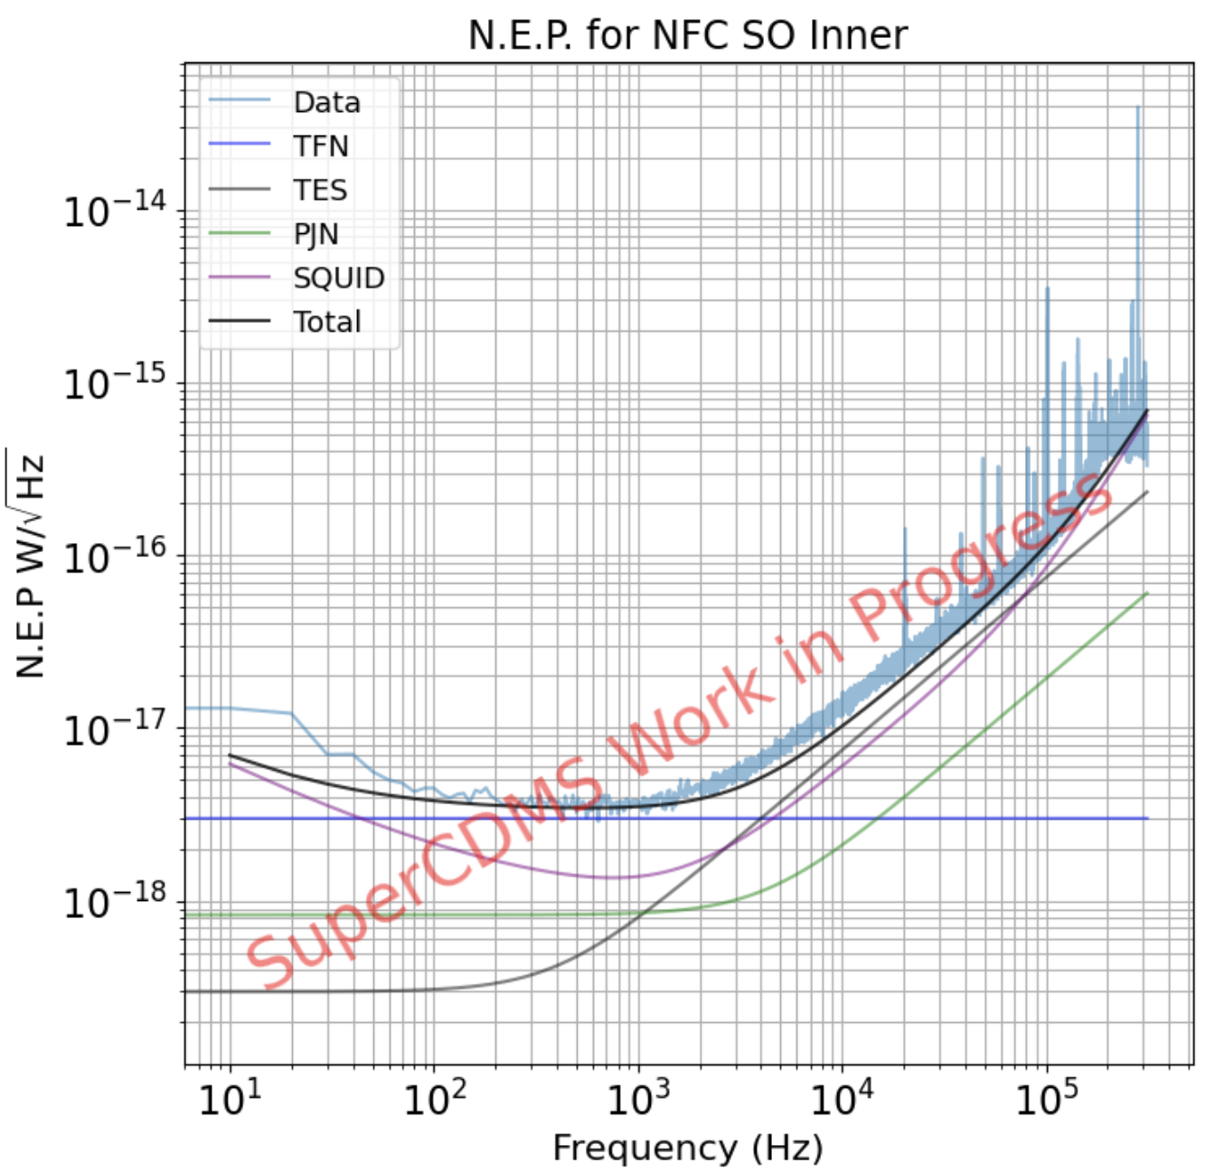
Excellent Noise Conditions!
Modeling shows very little excess is observed
Behavior is as expected
Below 1 kHz, limited by thermal fluctuation noise
Above 1 kHz, limited by TES and SQUID noise
Credit: Aditi Pradeep
Notes:
Do I really need this slide?

Slide 10
Data Taken —A Lot of Ground to Cover
Data Taking Lasted 4½ months
HV Background studied for biases between ±100 V
0V Background studied throughout the run with partial warm-ups
Effects of Pre-bias on leakage
LED Calibration data across many voltages
Effects of vibration on LEE
Effects of external radiation on LEE
Electron-Recoil Dark Matter search
May 2nd
Reached Base Temp
August 22nd
Partial Warm-up to 7K
May
June
July
August
September
June 15th
Partial Warm-Up to 20K

Slide 11
First Big Questions
Much work to be done but a few questions to start with…
Are there ionizing components of the LEE?
Compare backgrounds in HV data to 0V.
How does the LEE change with time?
Examine shape and rate of 0V background throughout the run.
Is the LEE shared between channels?
Study how the energy of LEE events are distributed among channels.

Slide 12
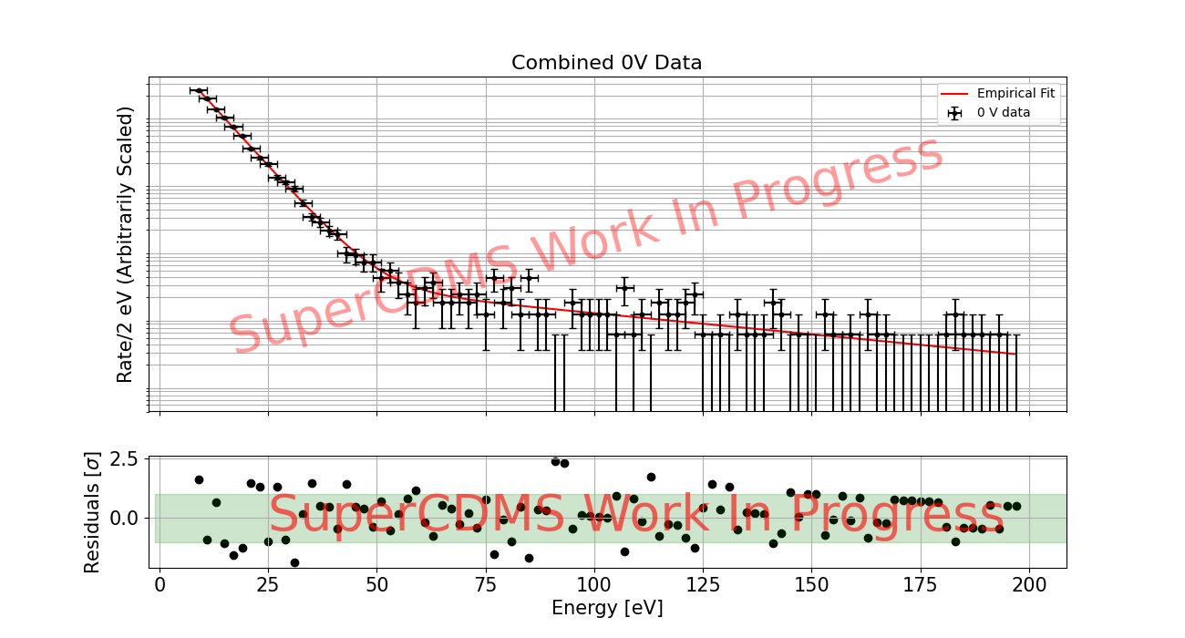
0V Spectrum
Are there ionizing components of the LEE?
No!
Data taken with various HV biases have a background component described by the 0V spectrum!
Notes:
Do I really need this slide?

Slide 13
0V Spectrum
Are there ionizing components of the LEE?
No!
Shape is described well by a double exponential
“Fast” Component: ~6 eV
“Slow” Component: ~70 eV
99.5% of the PDF is given by the fast component
Spectrum contains ~200 hours of live time
Notes:
Do I really need this slide?

Slide 14
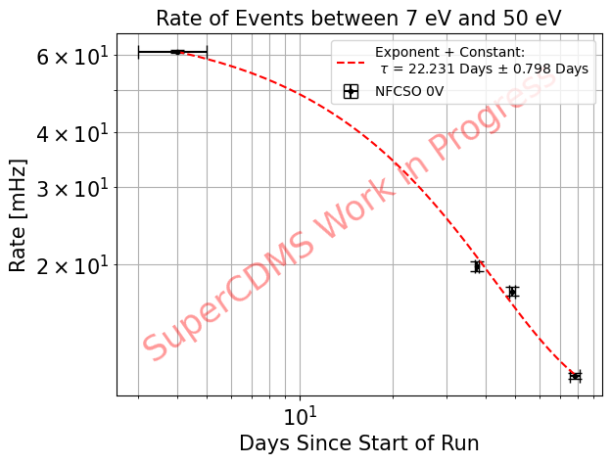
LEE Rate vs. Time
How does the LEE change with time?
Same shape,
different rate
Shape of 0V spectrum is constant over the run
Rate of decay well-described by an exponential + constant
  Power law not able to describe data as well
  Not enough data to fit to models that decay to 0 (e.g. double exponential)
Rate of decay seems constant for different energy slices up to ~150 eV

Slide 15
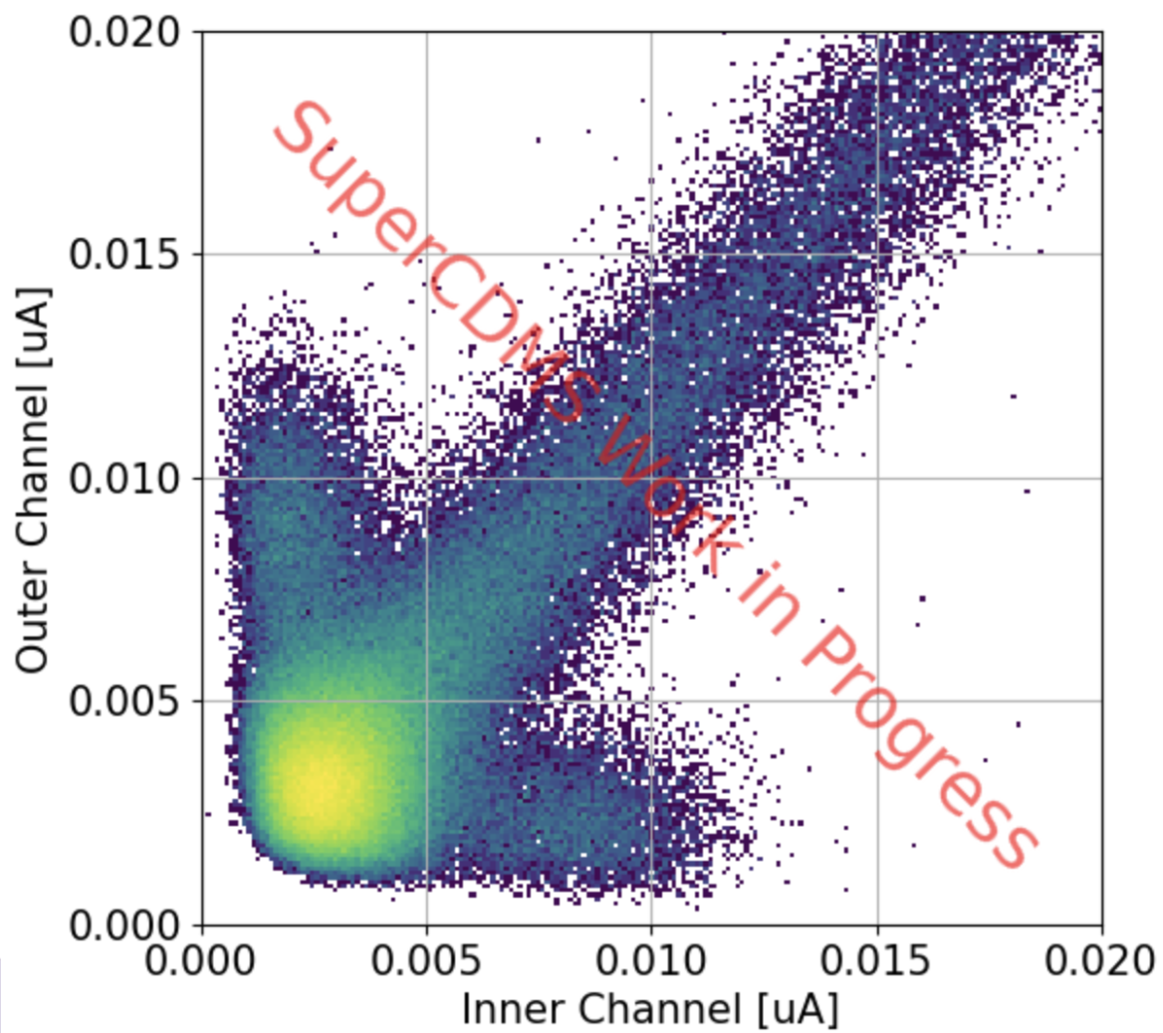
Partition of 0V Background
Is the LEE shared between channels?
Mostly!
But not all of it!
Outer channel
Inner
Channel
Can estimate radial position of events using two-channel layout.
We see singles!
(events primarily on one channel)
Notes:
Do I really need this slide?

Slide 16
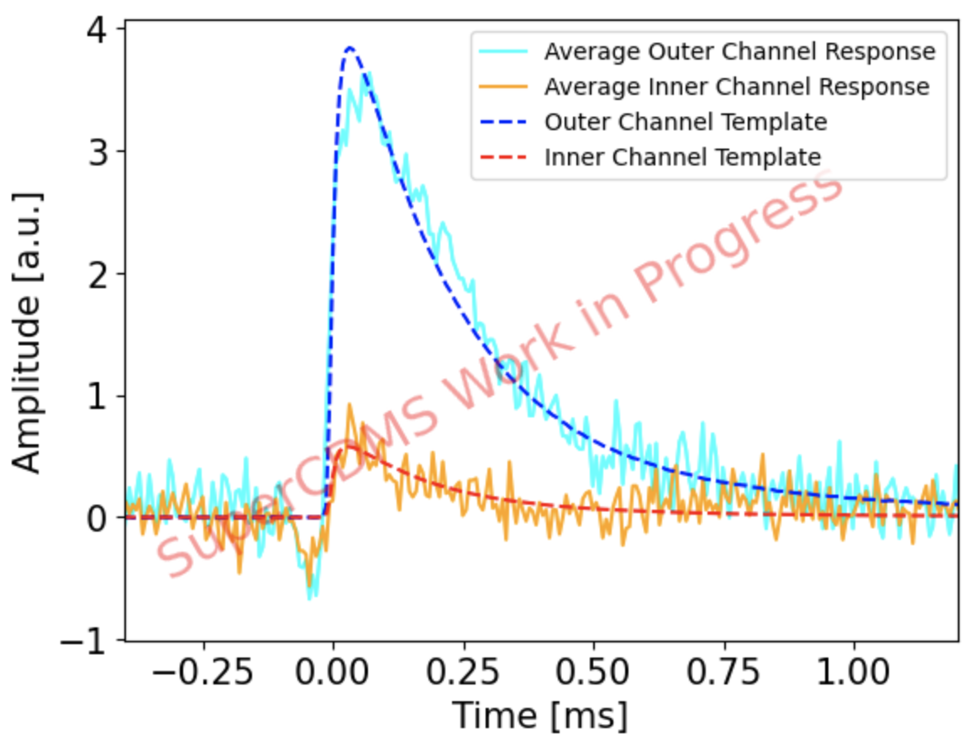

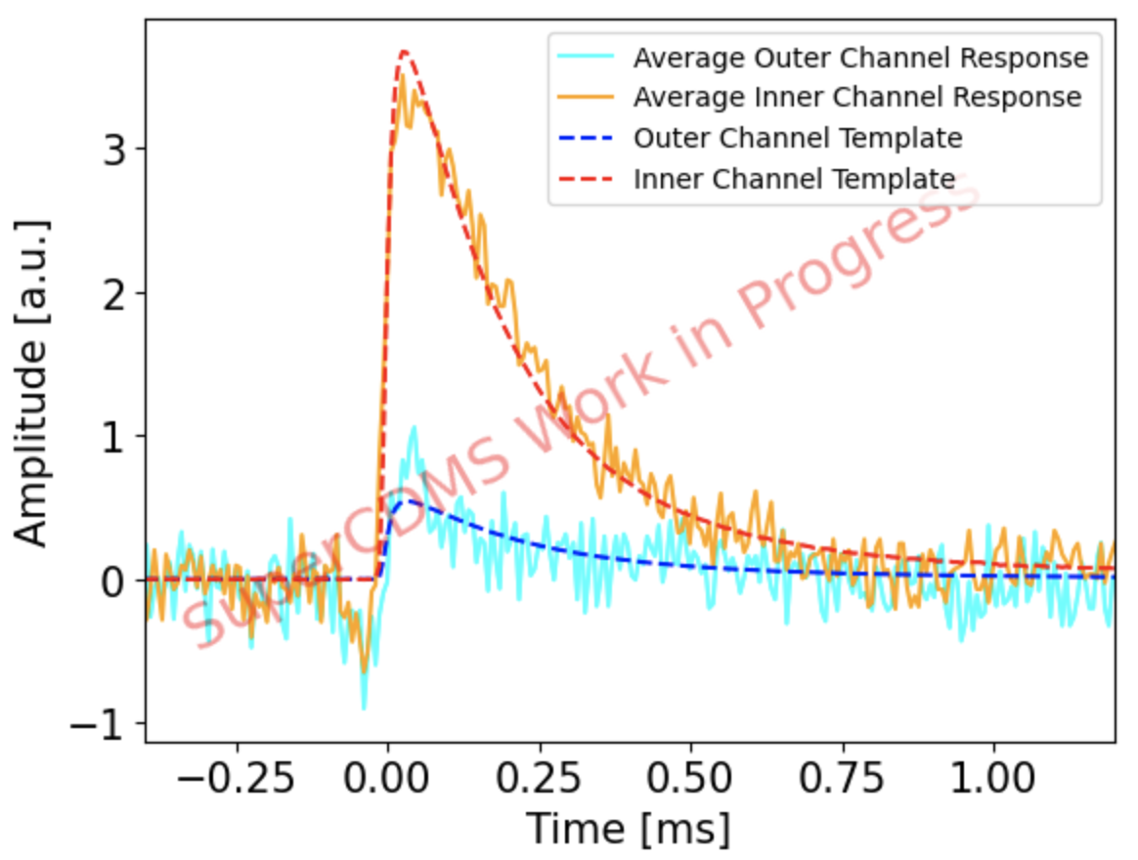
Partition of 0V Background
Outer channel
Singles match expected response from a particle interaction
“Dip” in average traces caused by sinusoidal noise
Notes:
Do I really need this slide?

Slide 17
What about the other detectors?
This is just one detector!
Currently working to analyze data for all detectors to answer some other big questions:
Are these behaviors consistent across all detectors?
Are there dependencies on:
  Al coverage?
  T_{C}?
  TES geometry?
Notes:
Do I really need this slide?

Slide 18
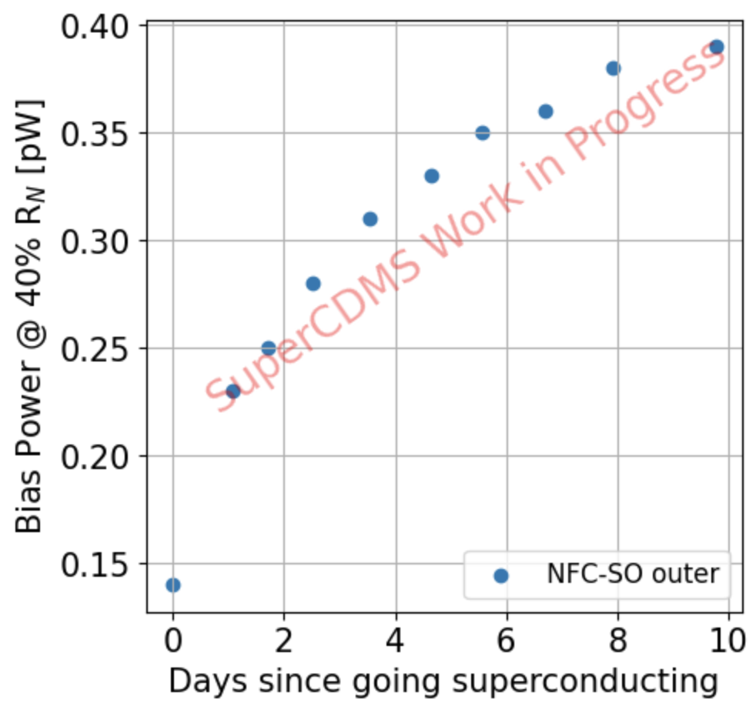
Looking Near/Below Threshold
Observed a shifting bias power at the beginning of the run.
What caused this?
Want to examine correlated noise throughout run to investigate possible sub-threshold events.
Notes:
Do I really need this slide?

Slide 19
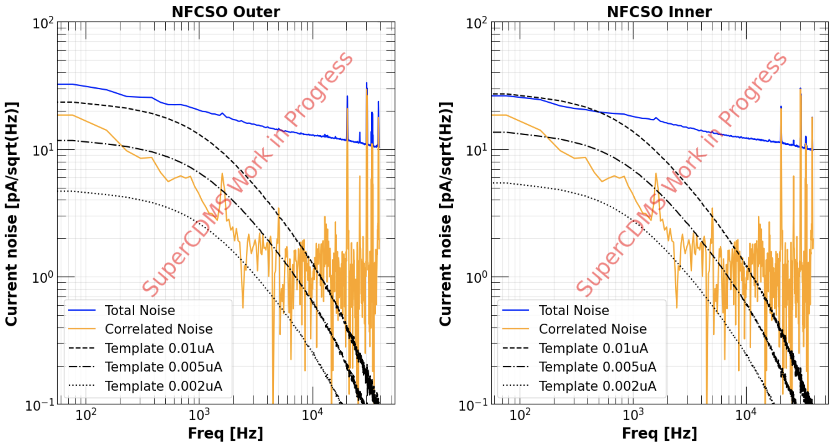
Correlated Noise
After bias point stabilized, low amounts of correlated noise which doesn’t match expected shape for pulses
Detailed study needed!
Notes:
Do I really need this slide?

Slide 20
Summary of Current Observations
Recoil spectrum of the LEE can be described by a double exponential
The rate of LEE decays in time with a characteristic time constant of ~20-25 days
Though most of the LEE is shared between channels, we observe a component of the LEE which deposits most of its energy on one channel
In stable configuration, we are dominated by uncorrelated noise which matches expectations
  Dominated by thermal fluctuation noise at low frequencies
  Dominated by TES noise at high frequencies
Notes:
Do I really need this slide?

Slide 21
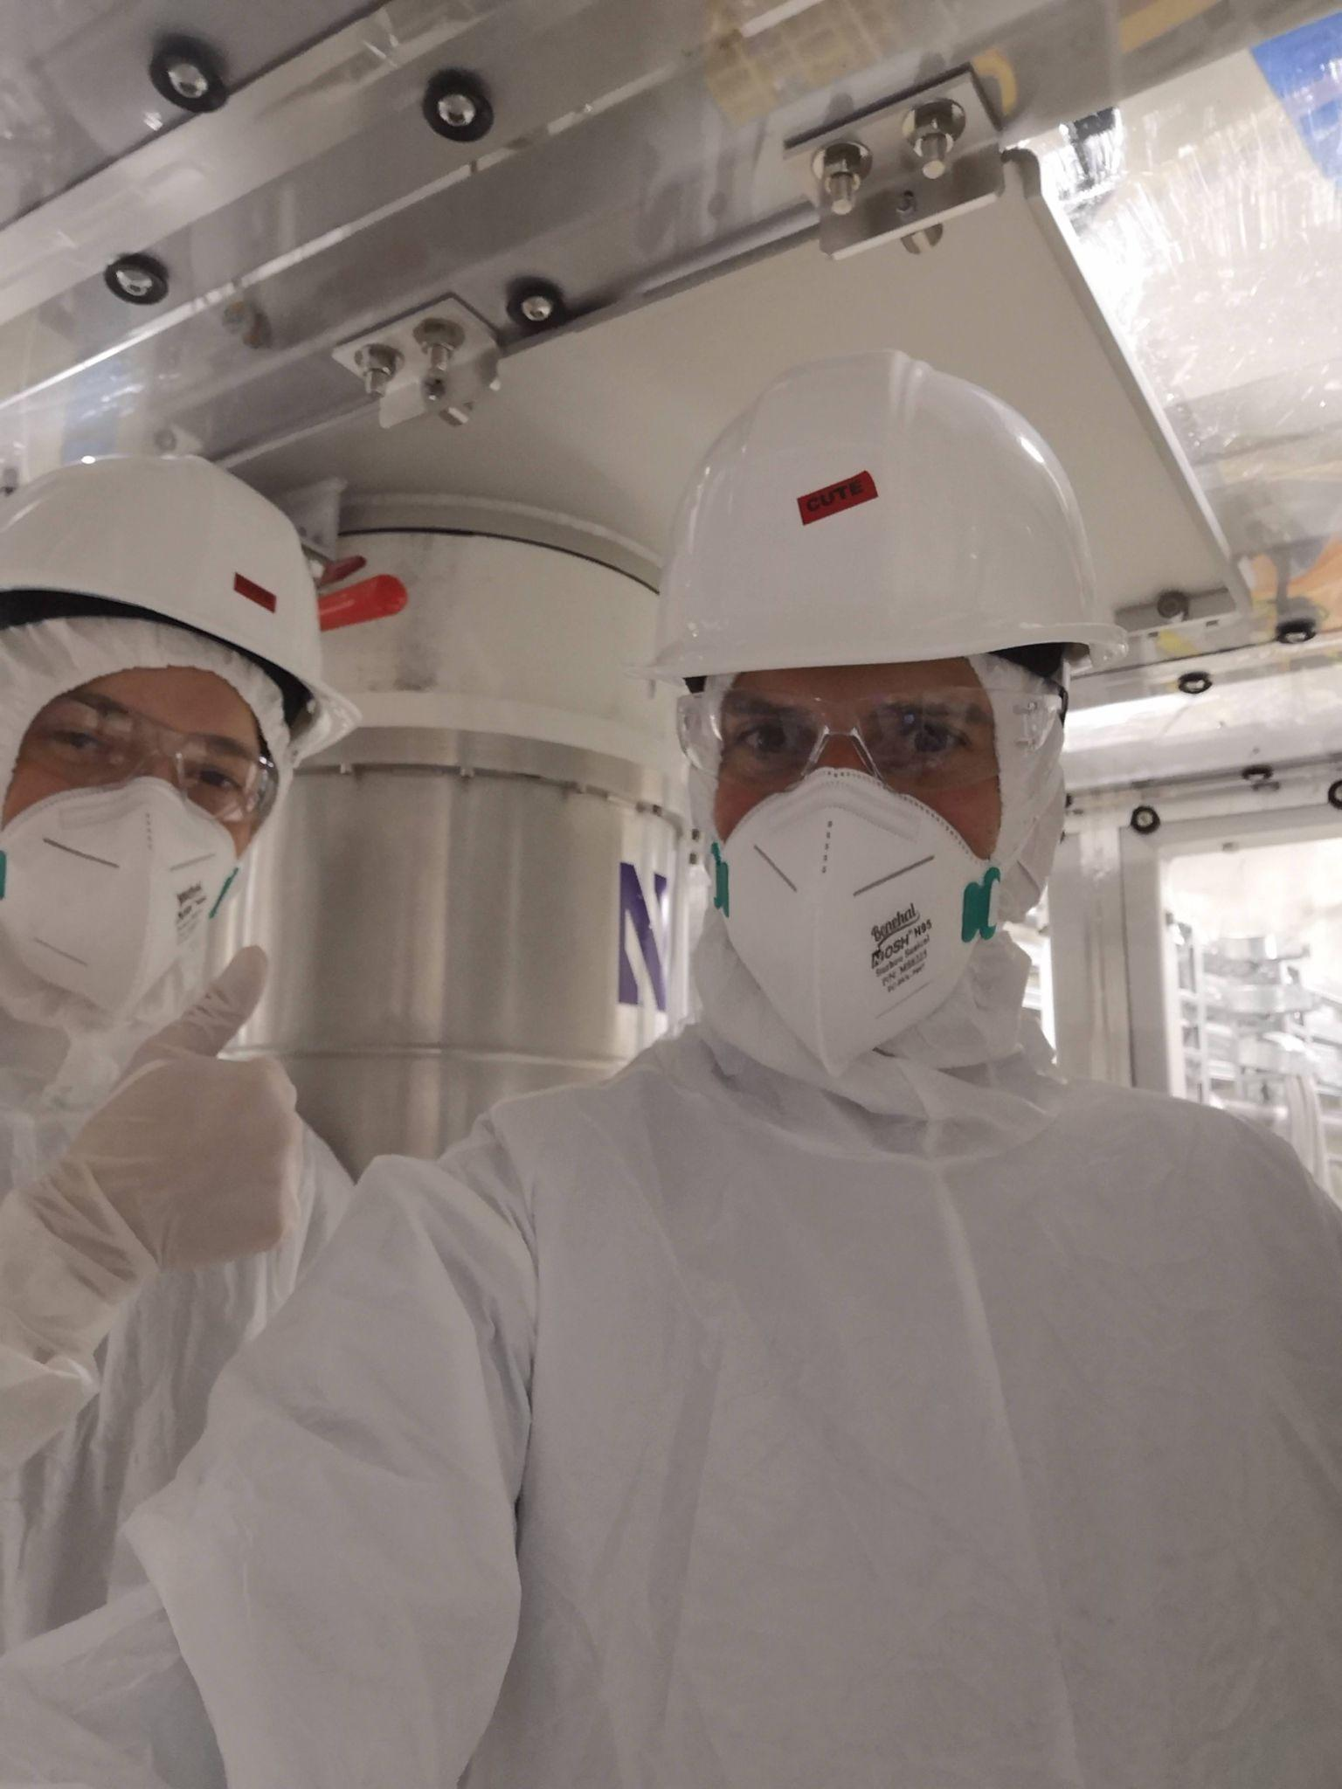
Much more planned!
Analysis ongoing!
Currently working on electron-recoil dark matter search
  Talk at LTD. Please stop by for more information!
Lots of analysis still left to do!
To name a few…
  Examine the other detectors
  Comparison to results from NEXUS
  Dependence of Al coverage on LEE rate
  Partition studies of LEE and leakage
  Bias Power vs. time
  Characterization of partial warm-up effects
Neutrino/Dark Matter Section: June 4th @ 11:30am
Notes:
Do I really need this slide?

Slide 22
Bonus Slides

Slide 23

Charge-Trapping & Impact Ionization
Events that can happen on a charge’s journey through the crystal…
Charge-Trapping
Propagating charge falls into a trap state
Gain back a portion of recombination energy
Lose NTL energy
Impact-Ionization
Propagating charge scatters off electron and ionizes it
Gain NTL energy
Surface Trapping
Charges recombine on surface instead of propagating through E-Field
Lose ~100% of NTL energy
Trap-state
Detector Surface
e
Valence e⁻
e
e
e
Charge falls into trap
Propagating Charge
e
Propagating Charge
e
Valence e⁻ gets ionized
e
h

Slide 24
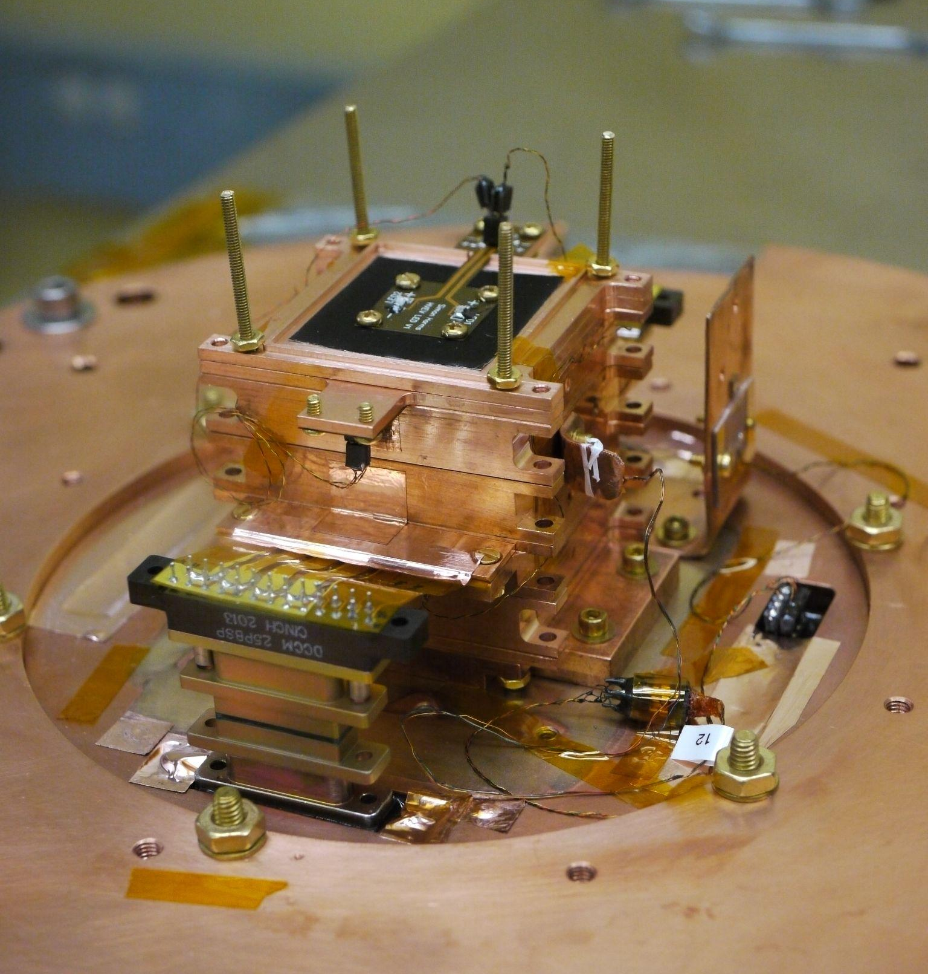
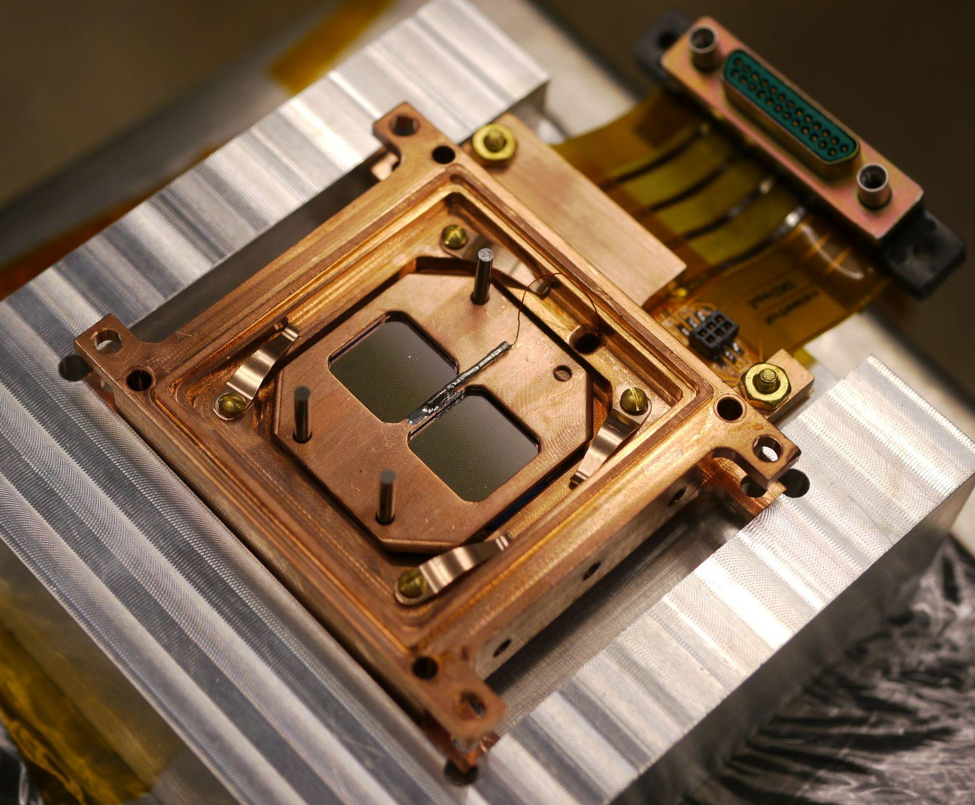

Previous Study at NEXUS — HVeV R4
NEXUS: Shallow underground site at Fermilab
Tower of four detectors, each with an LED
Boxes with LEDs (used for calibration)
Light-tight copper housings:
Attempt to reduce IR backgrounds
Avoids scintillating materials
Notes:
Do we need this?

Slide 25
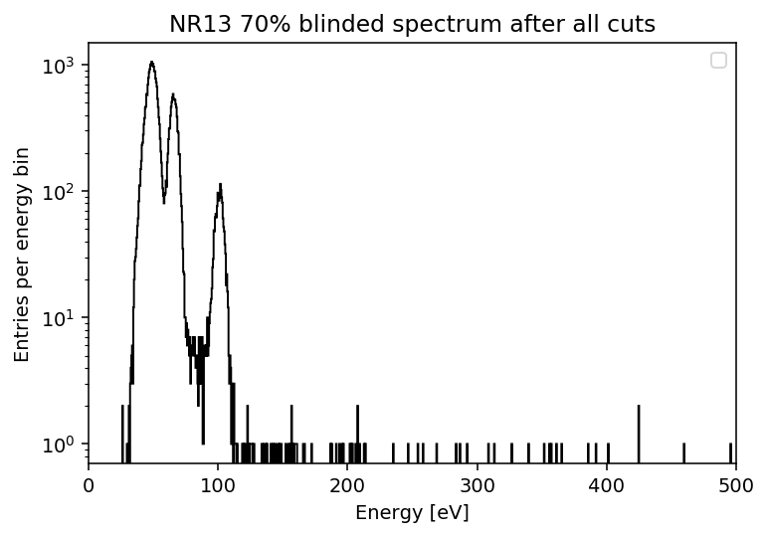
Previous Study at NEXUS — HVeV R4
Results from NEXUS
~2.5 eV resolution
Electron-recoil dark matter search (paper coming soon!)
1eh Peak
2 & 3 eh
Questions from NEXUS:
Where do leakage events come from?
Are higher energy events from LEE or leakage?
Origin of these events?
Need to understand backgrounds
Low- Energy Excess
Notes:
Do we need this?

