Slide 1
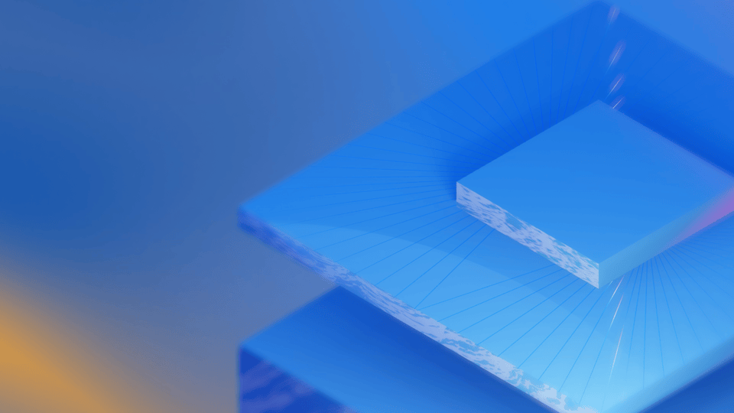
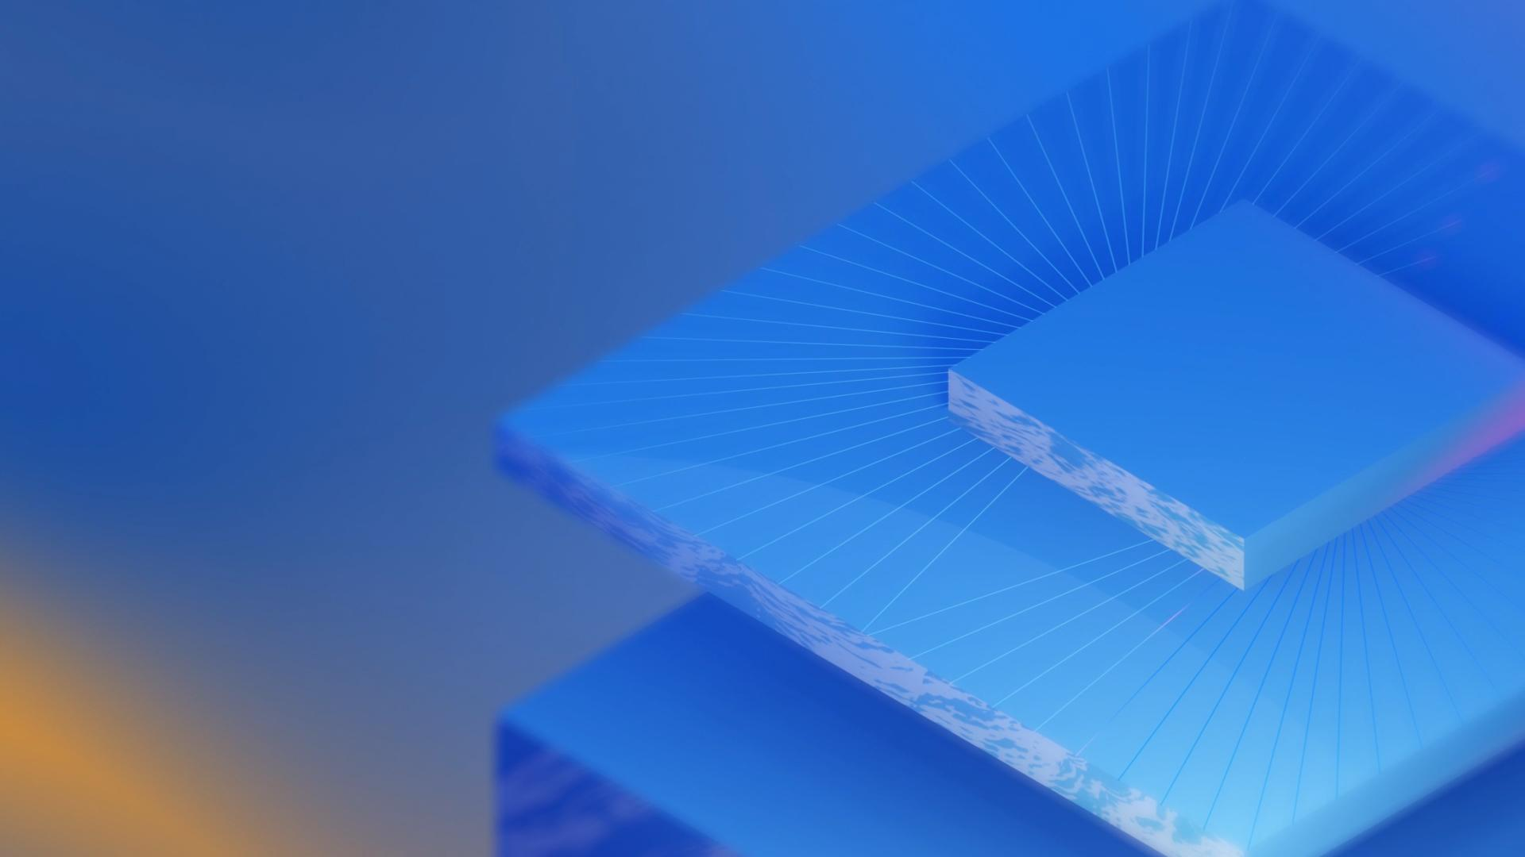


Correlated error bursts in a superconducting qubit array
Vlad Kurilovich
Matt McEwen, Kevin Miao, Gabrielle Roberts, Alex Opremcak
….and many other co-authors @ Google Quantum AI

Slide 2


Transmon qubit: an elementary building block of our processor
Weakly nonlinear
resonator
Inductance = JJ
Josephson junction
Koch et al., PRA 76 042319 (2007)
Schuster Thesis (Yale, 2007); Kelly Thesis (UCSB, 2015)
1

Slide 3
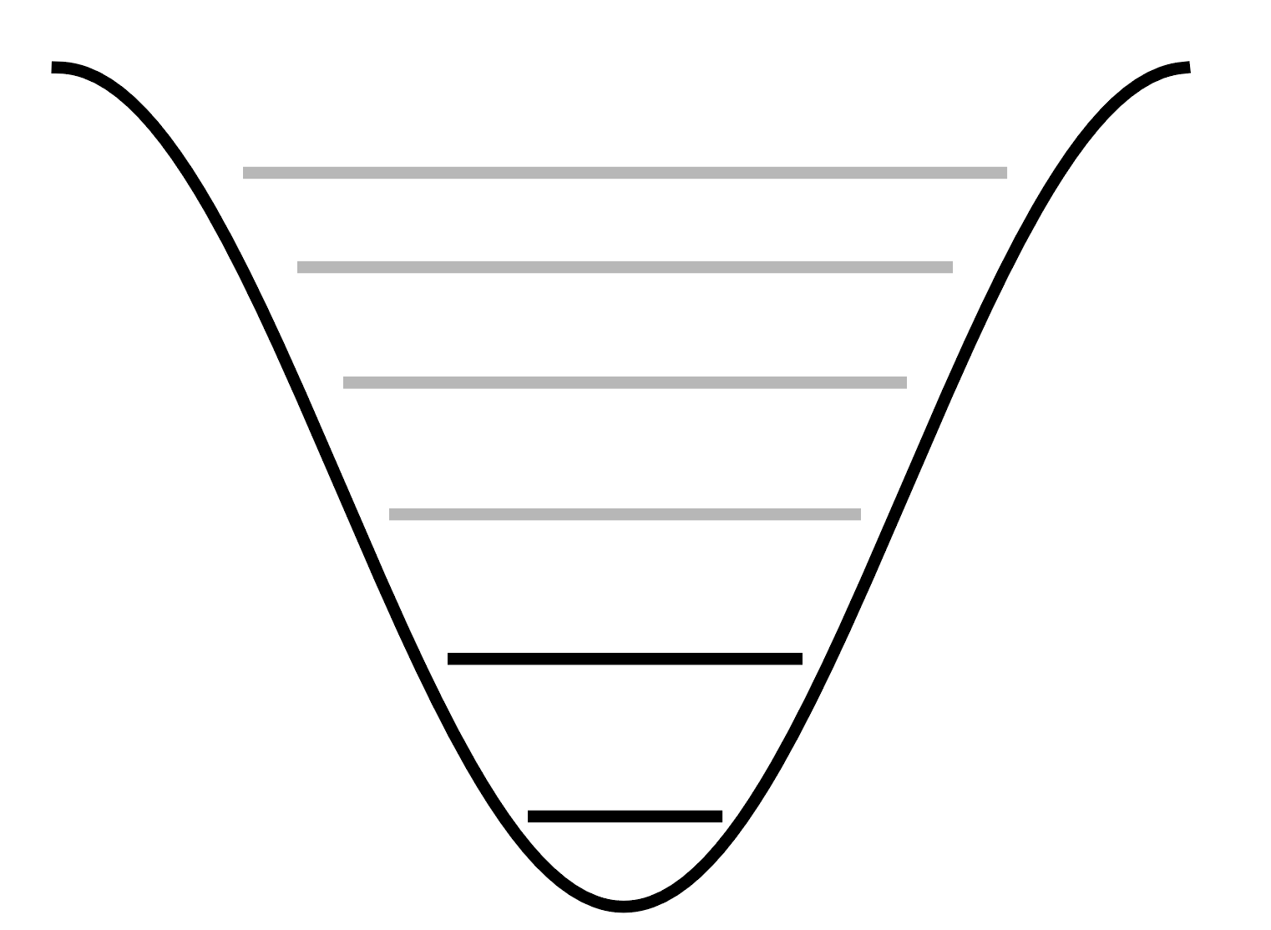


Transmon qubit: an elementary building block of our processor
Weakly nonlinear
resonator
Inductance = JJ
Josephson junction
T1 ≈ 100 µs, Q ~ 10⁶
frequency
≈ 6 GHz
Koch et al., PRA 76 042319 (2007)
Schuster Thesis (Yale, 2007); Kelly Thesis (UCSB, 2015)
1

Slide 4
Transmon qubit: an elementary building block of our processor
Weakly nonlinear
resonator
Inductance = JJ
Josephson junction
T1 ≈ 100 µs, Q ~ 10⁶
frequency
How do we make a quantum computer from these faulty components?
≈ 6 GHz
Koch et al., PRA 76 042319 (2007)
Schuster Thesis (Yale, 2007); Kelly Thesis (UCSB, 2015)
1

Slide 5
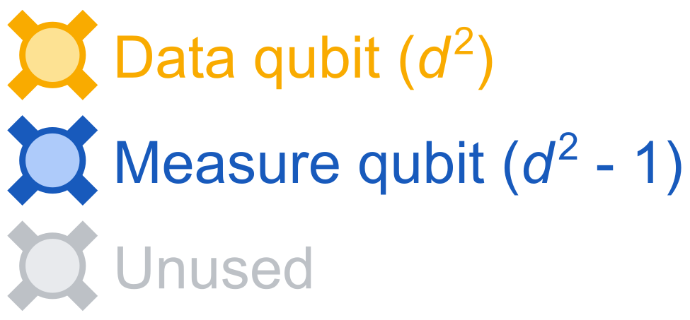
How to make a useful quantum bit?
Quantum error correction:
An excellent logical qubit from faulty physical qubits
=
2

Slide 6
How to make a useful quantum bit?
Quantum error correction:
An excellent logical qubit from faulty physical qubits
=
2

Slide 7
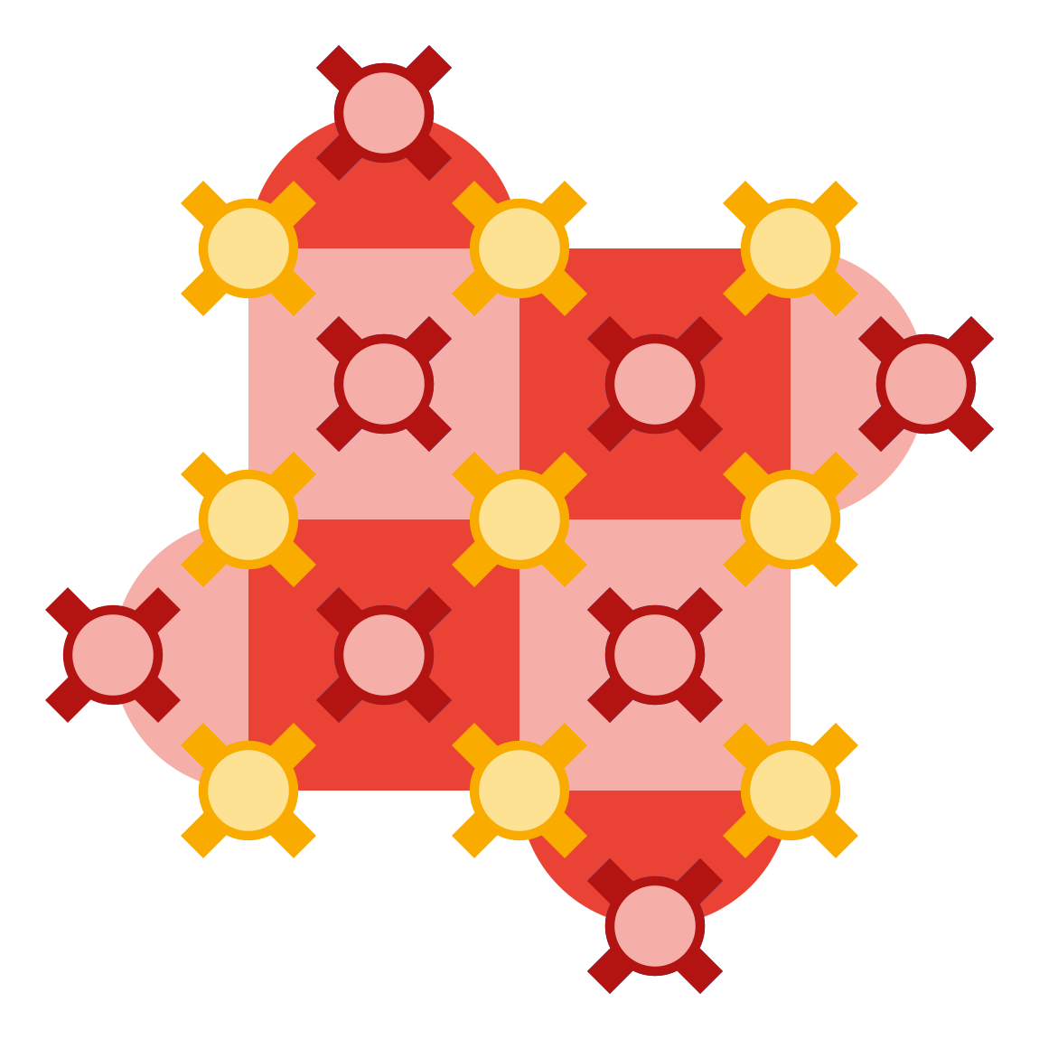
How to make a useful quantum bit?
Quantum error correction:
An excellent logical qubit from faulty physical qubits
=
2

Slide 8
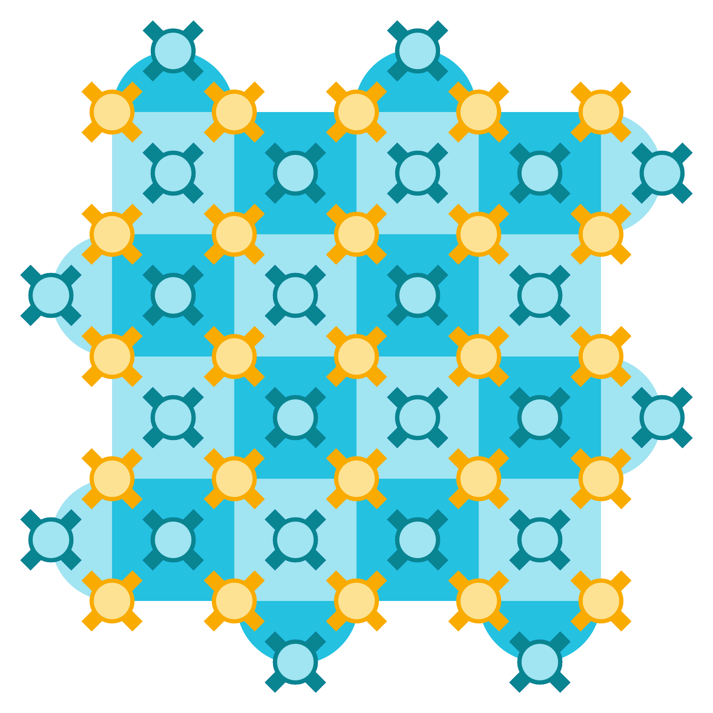
How to make a useful quantum bit?
Quantum error correction:
An excellent logical qubit from faulty physical qubits
=
2

Slide 9
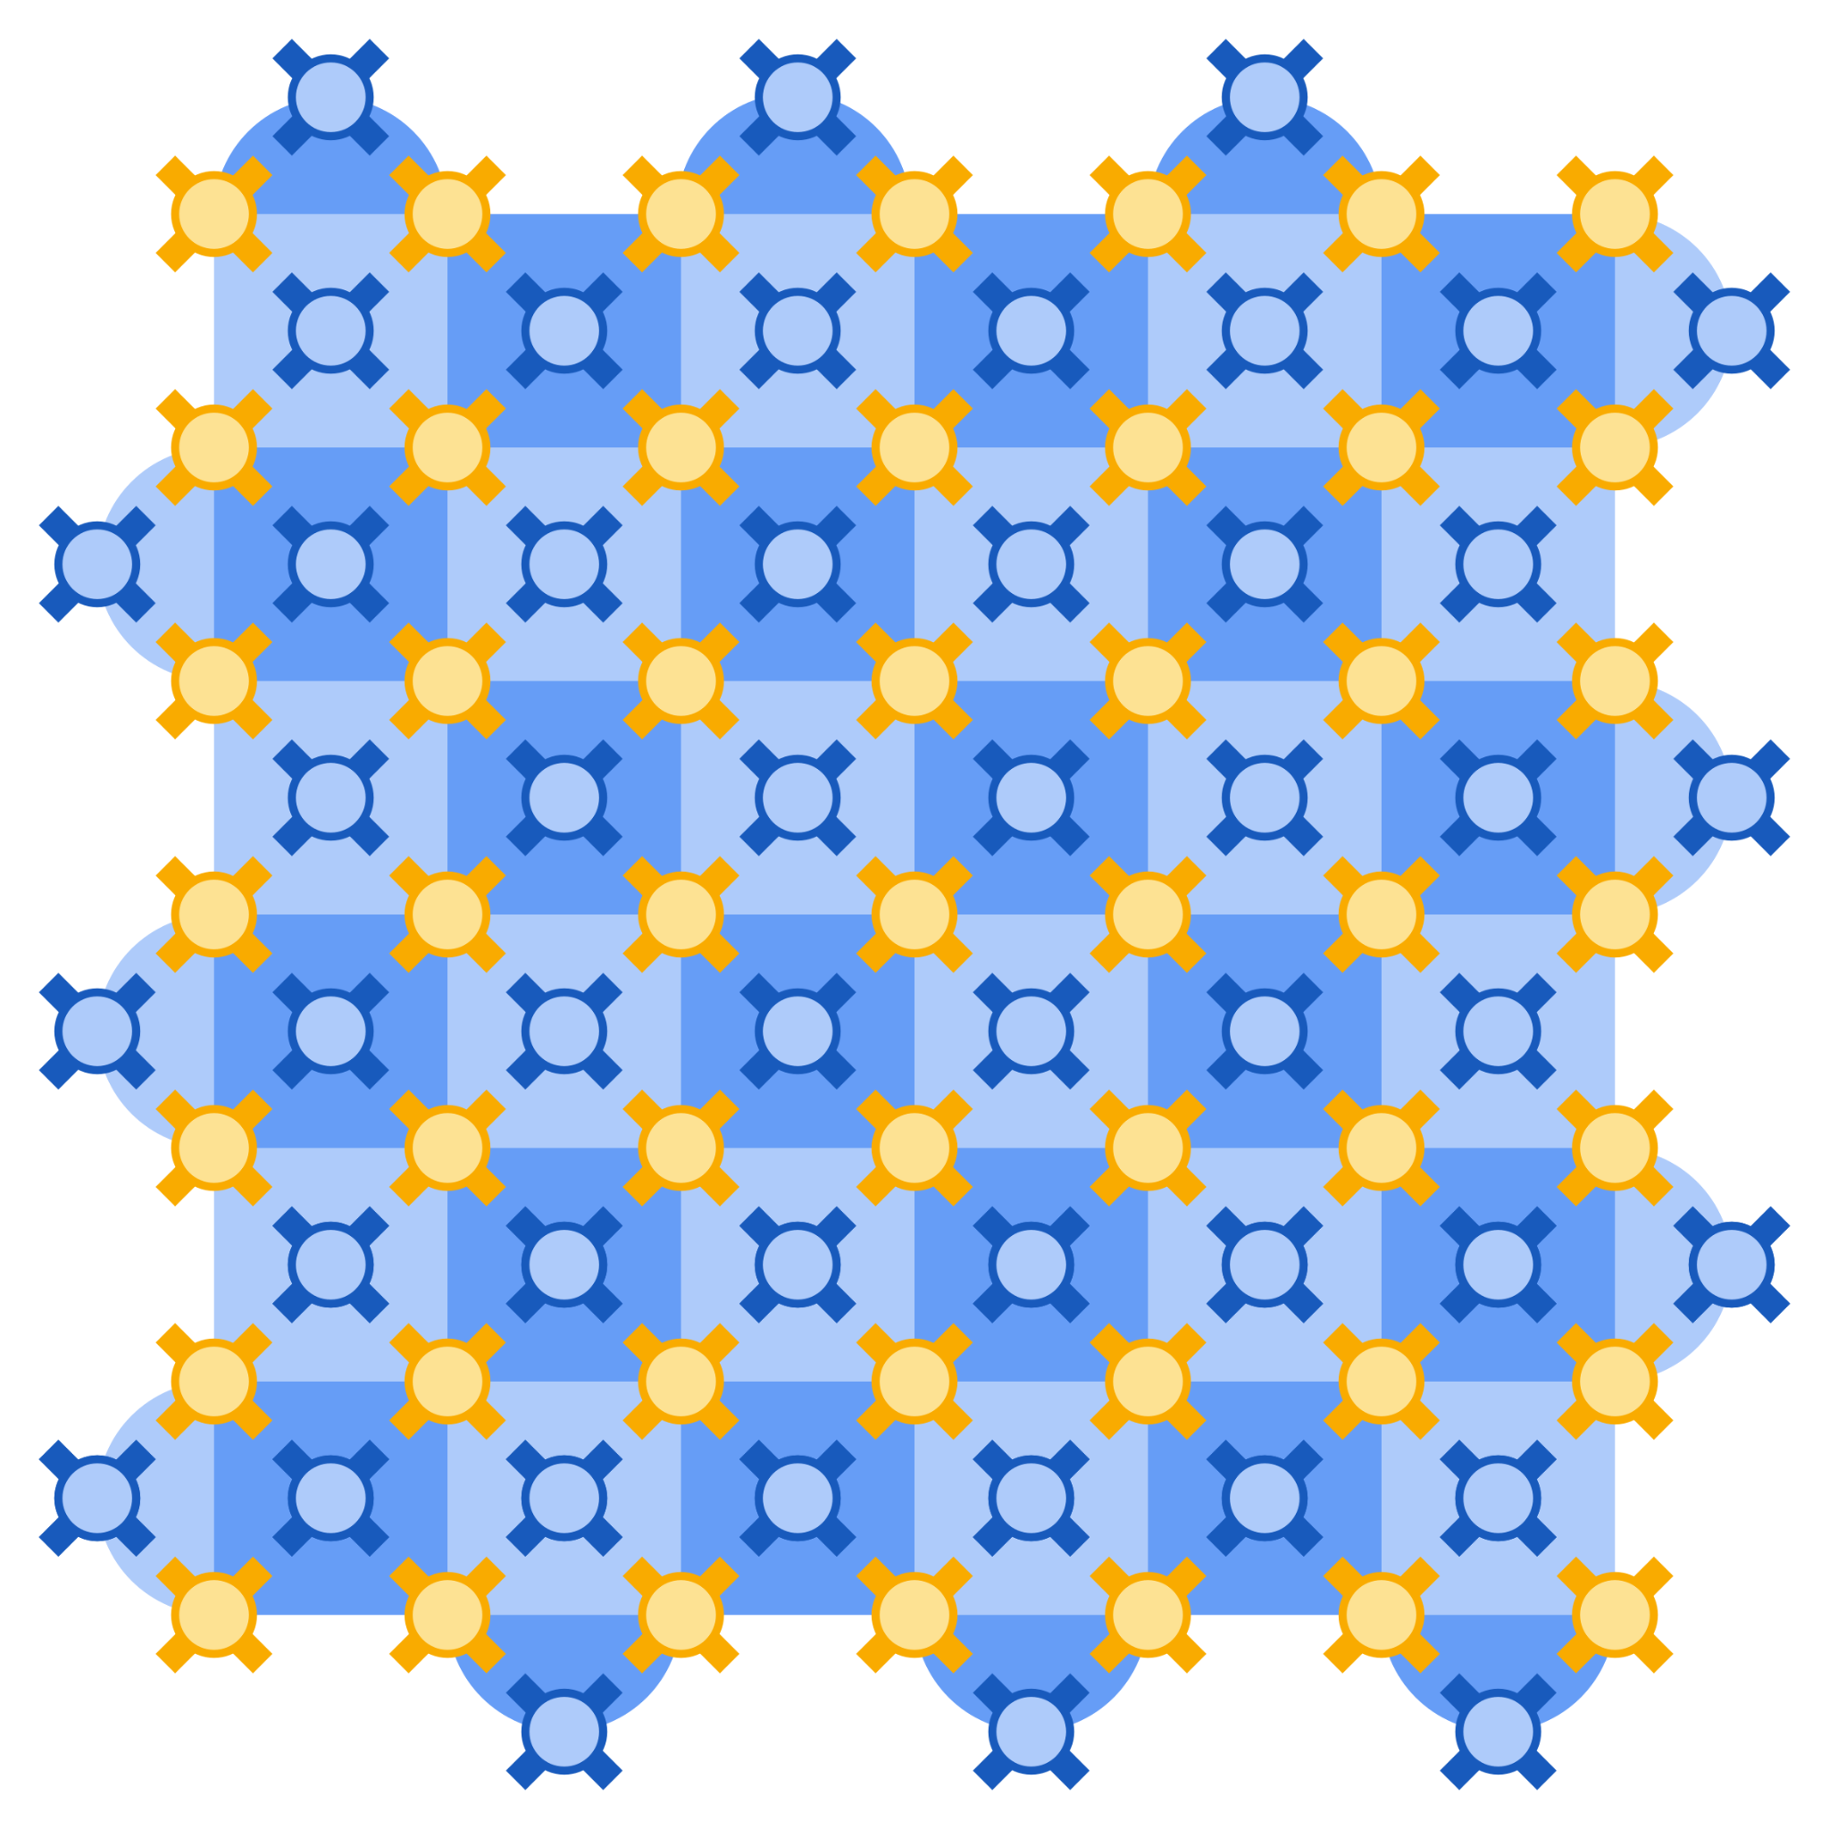
How to make a useful quantum bit?
Quantum error correction:
An excellent logical qubit from faulty physical qubits
=
2

Slide 10
How to make a useful quantum bit?
Quantum error correction:
An excellent logical qubit from faulty physical qubits
=
Surface code
Each step increases the effective T1 by a factor of ≈ 2
[Google Quantum AI (2024)]
2

Slide 11

Quantum error correction 101: the case of the repetition code
|1)
|0)
|111)
|000)
3

Slide 12
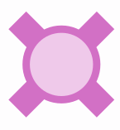
Quantum error correction 101: the case of the repetition code
|1)
|0)
|110)
|001)
3

Slide 13
Quantum error correction 101: the case of the repetition code
|1)
|0)
|110)
|001)
If only one error occurred, majority vote is guaranteed to succeed
3

Slide 14
Quantum error correction 101: the case of the repetition code
|1)
|0)
|100)
|011)
If only one error occurred, majority vote is guaranteed to succeed
Does not protect from two errors
3

Slide 15
Quantum error correction 101: the case of the repetition code
|1)
|0)
|100)
|011)
If only one error occurred, majority vote is guaranteed to succeed
Does not protect from two errors
…protects from two errors
3

Slide 16
Quantum error correction 101: the case of the repetition code
|1)
|0)
|100)
|011)
If only one error occurred, majority vote is guaranteed to succeed
Does not protect from two errors
…protects from two errors
…protects from three errors
3

Slide 17
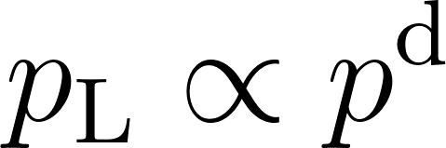
Quantum error correction 101: the case of the repetition code
A logical qubit = 2d - 1 physical qubits
…code with “distance” d = 3
If with probability p, then a logical error occurs with a probability
4

Slide 18
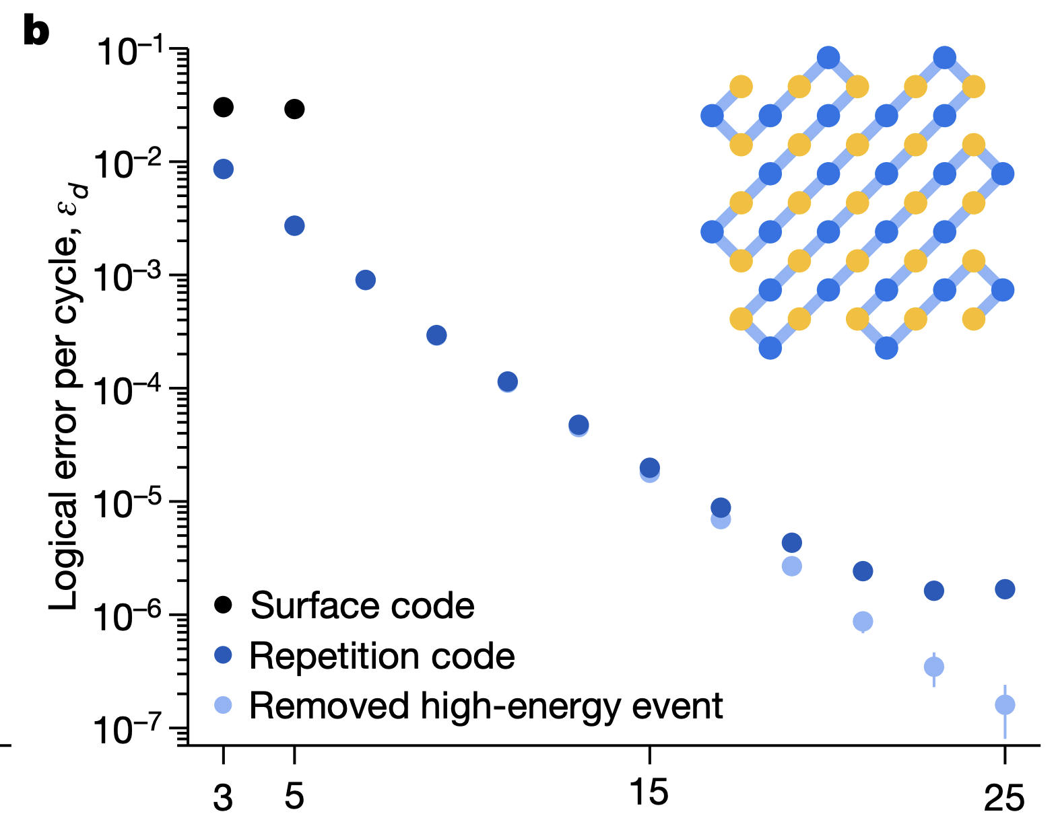
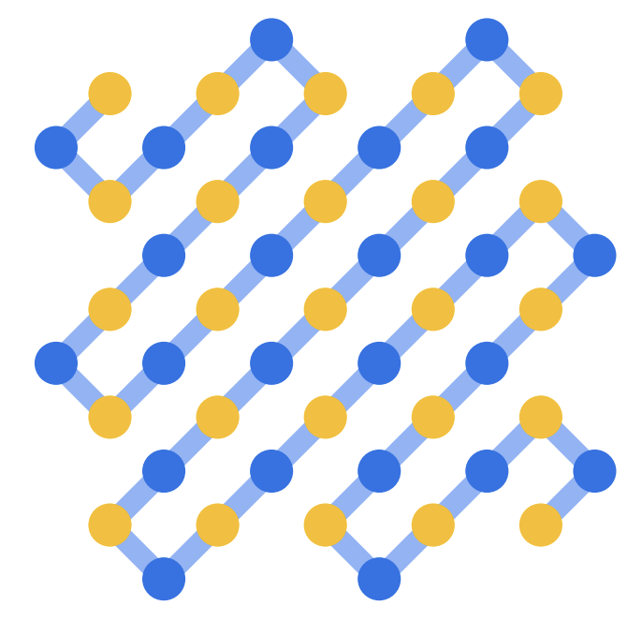

How does this prediction work in practice?
Logical error probability per cycle
code distance d
5

Slide 19
How does this prediction work in practice?
Logical error probability per cycle
code distance d
5

Slide 20
How does this prediction work in practice?
Logical error probability per cycle
Error floor ~ 10⁻⁶
code distance d
5

Slide 21
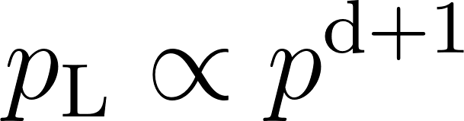
How does this prediction work in practice?
Error floor = catastrophic events on > 1 / 2 of the qubits!
Logical error probability per cycle
Ionizing radiation impacts
Error floor ~ 10⁻⁶
code distance d
5

Slide 22
What happens at the level of individual qubits?
How do we mitigate the problem?

Slide 23

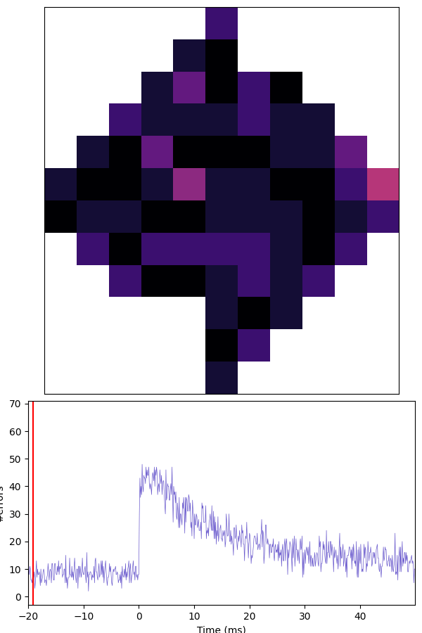
Correlated energy decay errors
time
2022
Feb 2024
Aug 2024
May 2024
X
1 µs
R
Decay errors on qubit qi_j
Number of simultaneous decay events
– Lasts for 10s of ms
– Occur once every 10 s
Index i
Decay errors
6
time [ms]
[M. McEwen et al (2022)]
Index j

Slide 24

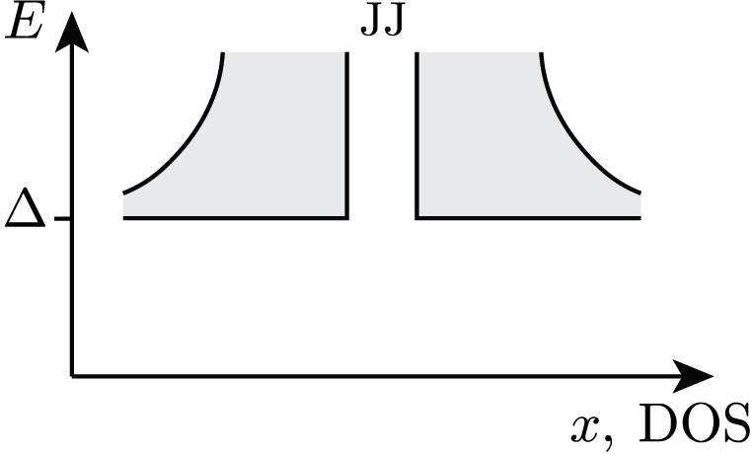
Physical picture: downconversion of ionizing radiation into quasiparticles
substrate
7
[C.D. Wilen et al (2021); M. McEwen et al (2022)]

Slide 25

Physical picture: downconversion of ionizing radiation into quasiparticles
phonons
substrate
7
[C.D. Wilen et al (2021); M. McEwen et al (2022)]

Slide 26
Physical picture: downconversion of ionizing radiation into quasiparticles
quasiparticles
phonons
substrate
7
[C.D. Wilen et al (2021); M. McEwen et al (2022)]

Slide 27
Physical picture: downconversion of ionizing radiation into quasiparticles
quasiparticles
phonons
substrate
7
[C.D. Wilen et al (2021); M. McEwen et al (2022)]

Slide 28
Physical picture: downconversion of ionizing radiation into quasiparticles
quasiparticles
phonons
substrate
This picture suggests a remedy!
7
[C.D. Wilen et al (2021); M. McEwen et al (2022)]

Slide 29

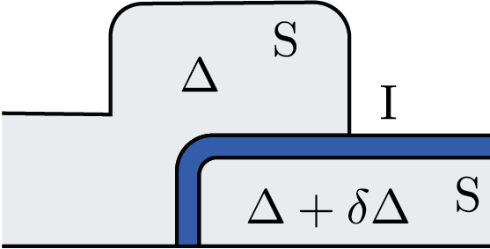
Physical picture: downconversion of ionizing radiation into quasiparticles
quasiparticles
phonons
substrate
Gap engineering
[T. Connolly, P. Kurilovich et al (2024)]
[P. Kamenov et al (2023)]
[C.D. Wilen et al (2021); M. McEwen et al (2022)]

Slide 30
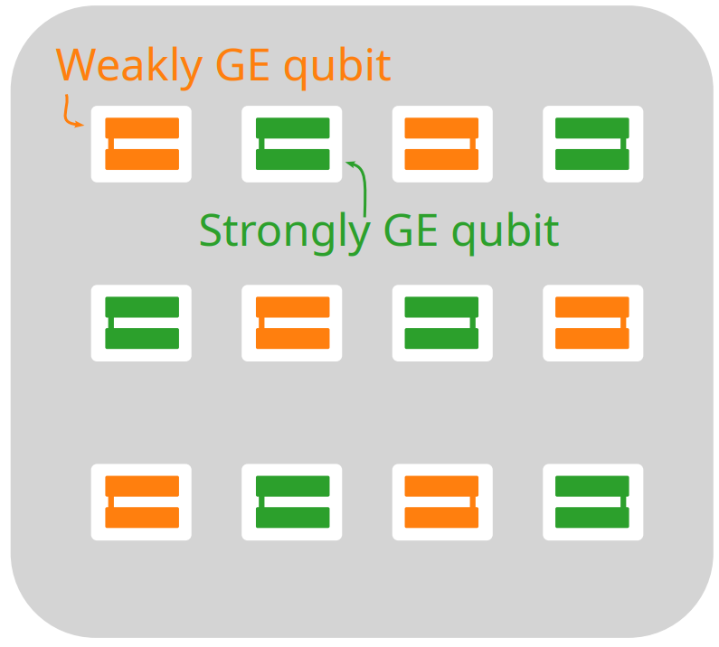
Suppression of correlated error bursts by gap engineering
time
2022
Feb 2024
Aug 2024
May 2024
[M. McEwen, K. Miao et al (2024)]
8

Slide 31
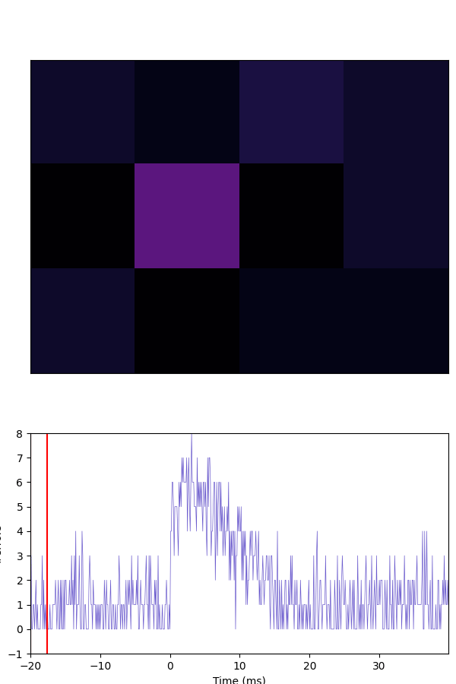
Suppression of correlated error bursts by gap engineering
time
2022
Feb 2024
Aug 2024
May 2024
Number of simultaneous decay events
Decay errors on qubit qi_j
Decay errors
Index i
Index j
time [ms]
9
[M. McEwen, K. Miao et al (2024)]

Slide 32
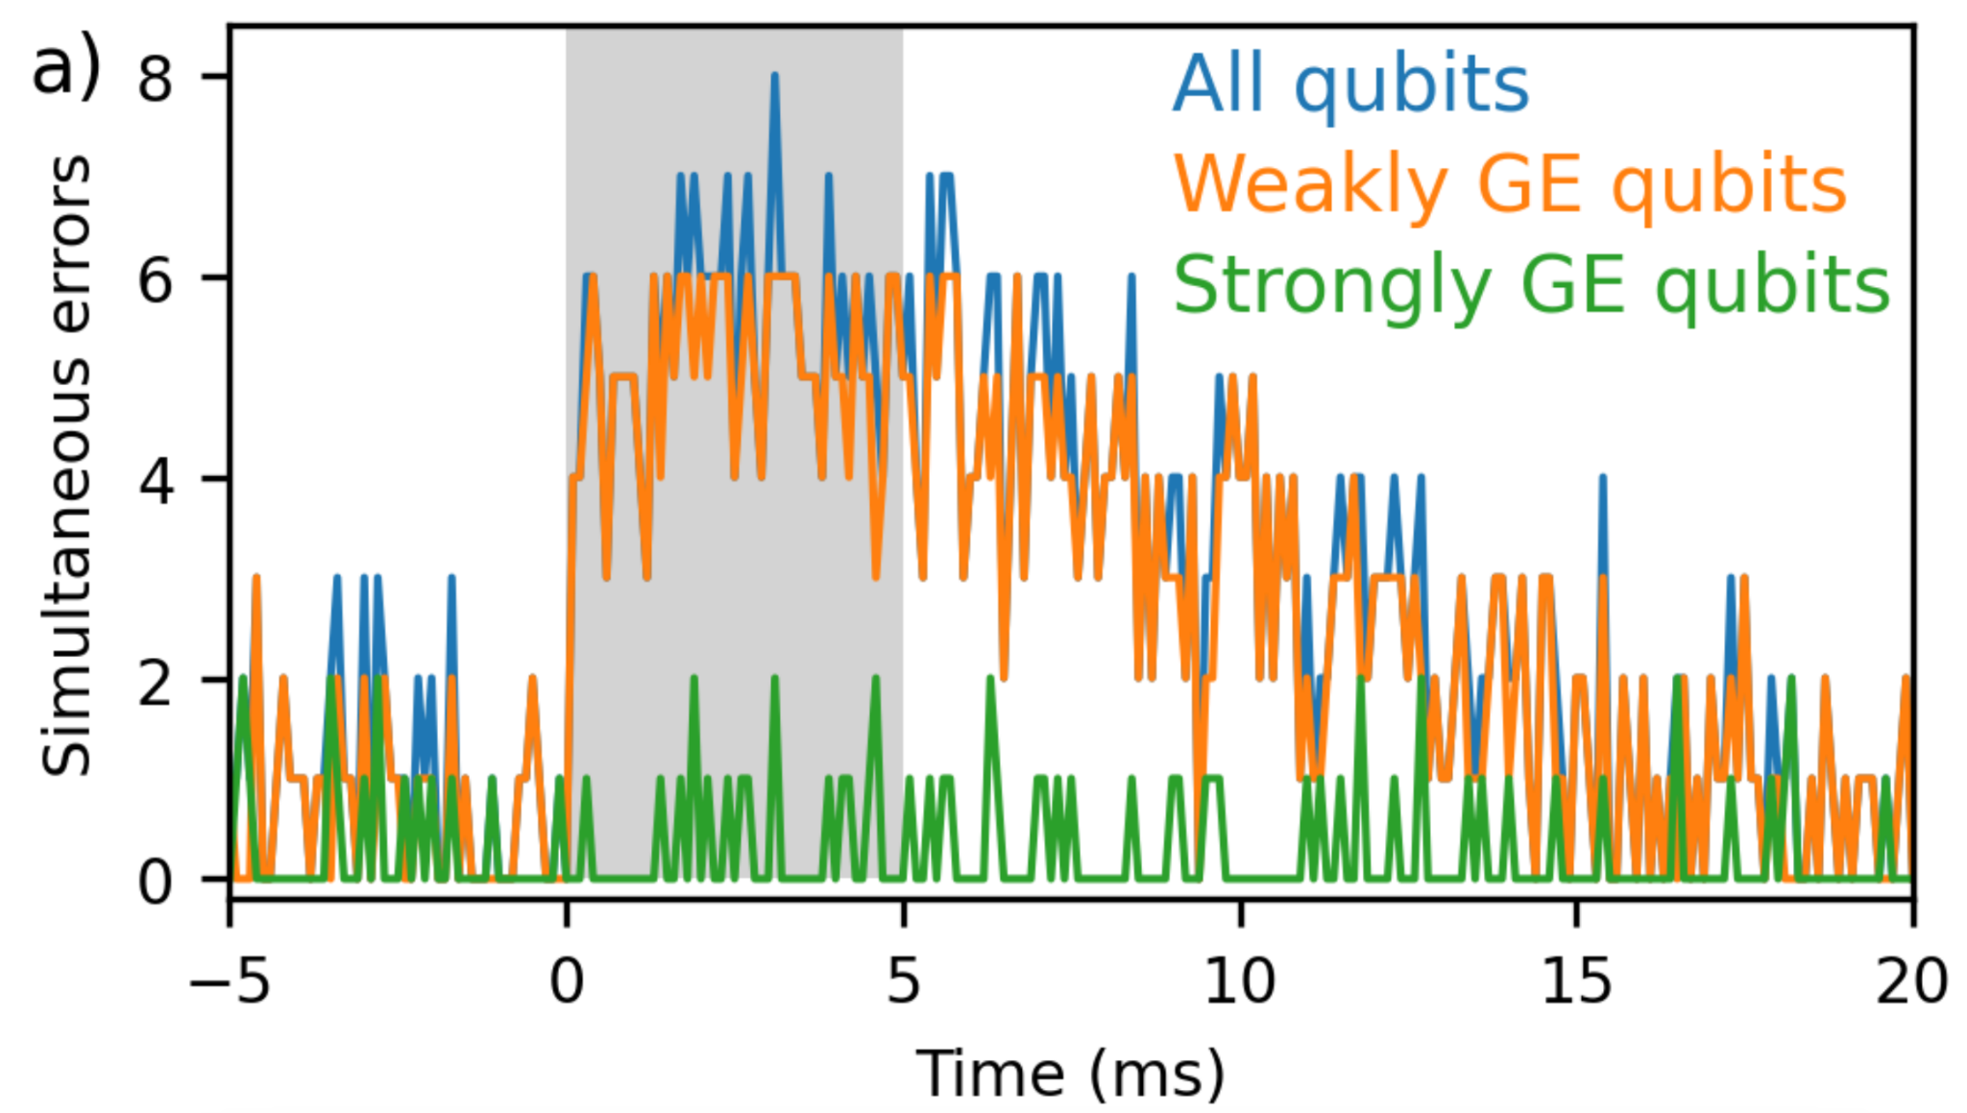
Suppression of correlated error bursts by gap engineering
time
2022
Feb 2024
Aug 2024
May 2024
Number of simultaneous decay events
# of qubit decay errors
9
[M. McEwen, K. Miao et al (2024)]

Slide 33
Suppression of correlated error bursts by gap engineering
time
2022
Feb 2024
Aug 2024
May 2024
Number of simultaneous decay events
# of qubit decay errors
🎉
9
[M. McEwen, K. Miao et al (2024)]

Slide 35
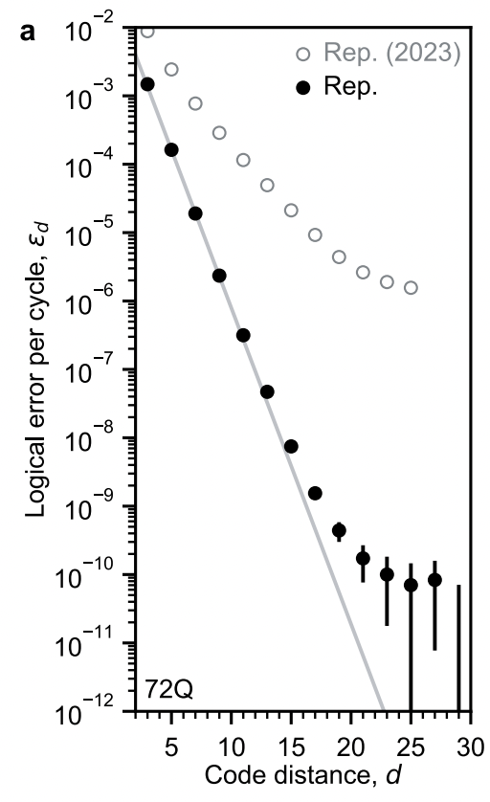
Correlated error bursts strike back
time
Feb 2024
Aug 2024
May 2024
Good news: error floor ~ 10⁻¹⁰
10
[Google Quantum AI (2024)]

Slide 36
Correlated error bursts strike back
time
Feb 2024
Aug 2024
May 2024
Good news: error floor ~ 10⁻¹⁰
Bad news: the floor is still there!
Catastrophic events remain even with gap-engineering!
How can this be?
10
[Google Quantum AI (2024)]

Slide 37
High repetition rate measurements of the qubits coherence
On every qubit on the grid, cycle the coherence characterization sequence:
Ramsey
X/2
τ = 750 ns
X/2
Reset
Echo
X/2
τ / 2
Y
τ / 2
X/2
Reset
5 µs
vs 100 µs previously
Decay
X
τ = 1 µs
Reset
11

Slide 38
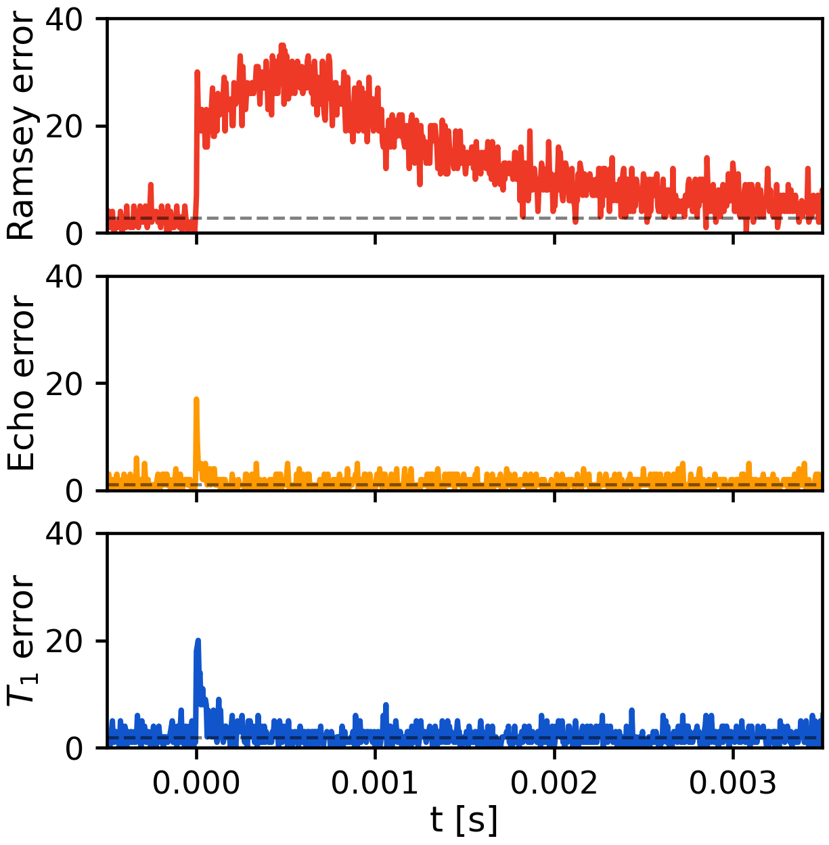
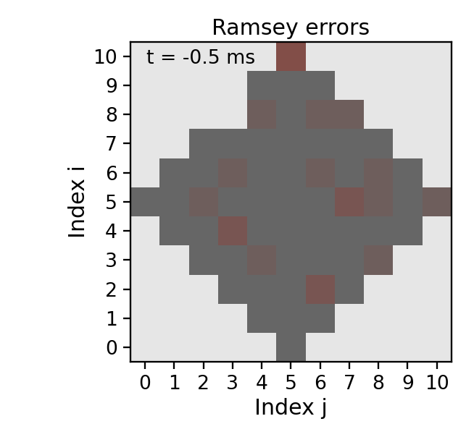
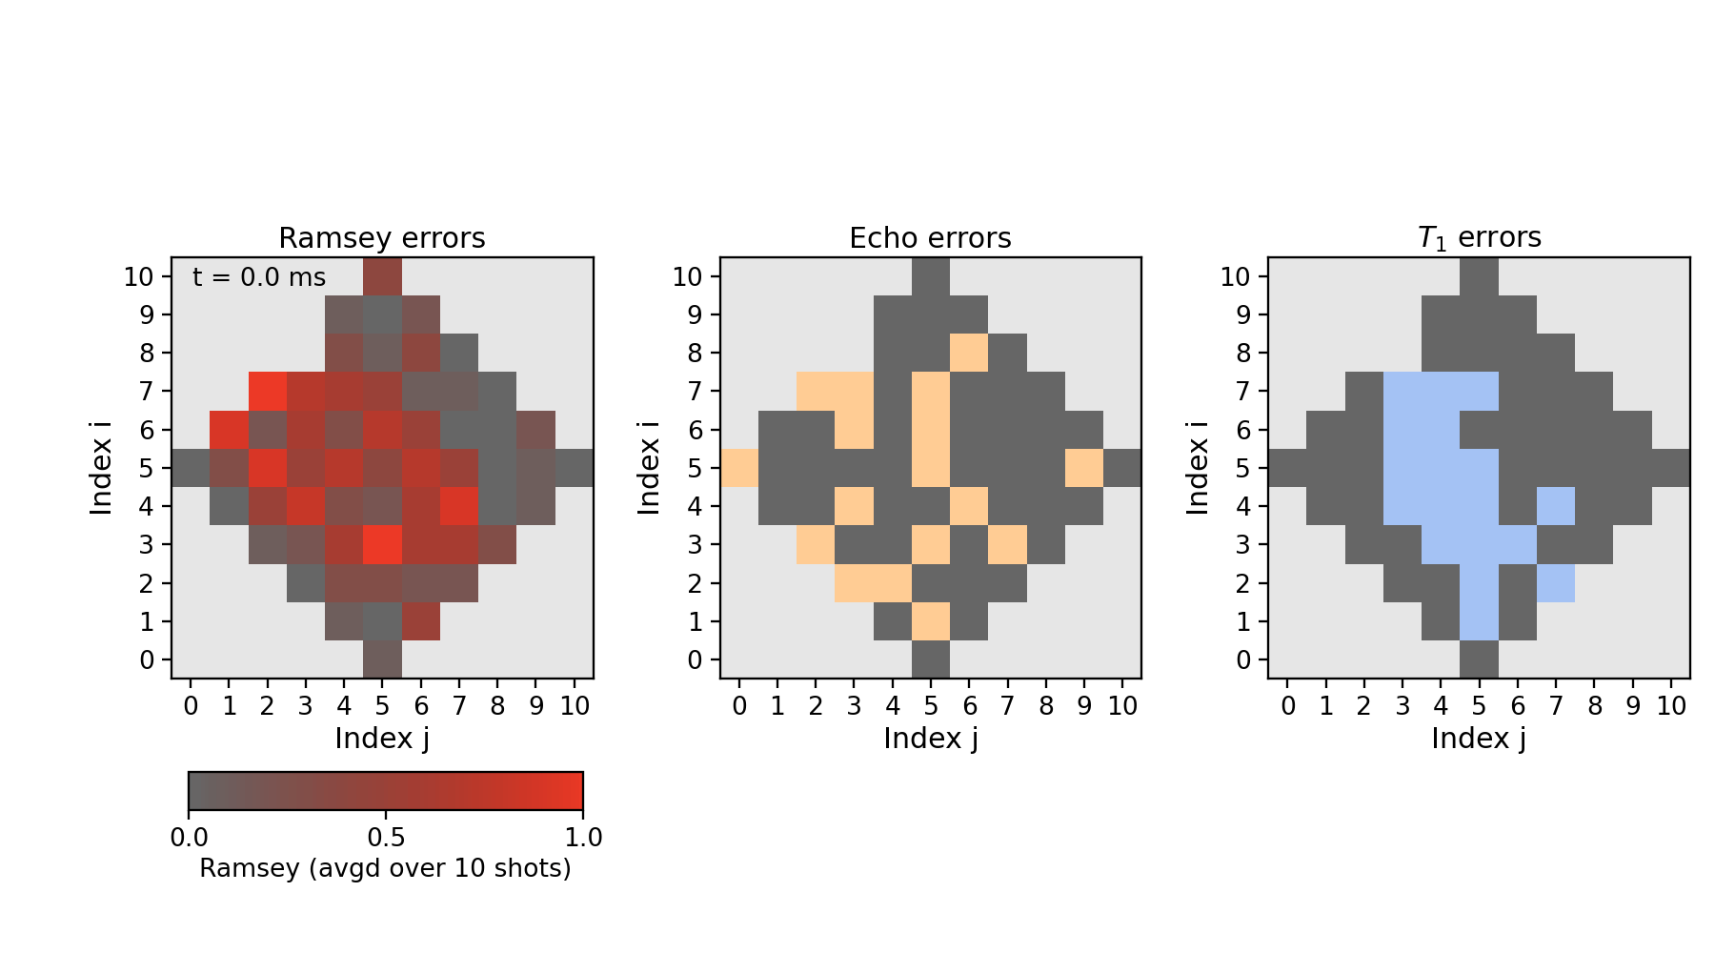
High repetition rate measurements of the qubits coherence
On every qubit on the grid, cycle the coherence characterization sequence:
1 ms
1 ms
12

Slide 39
High repetition rate measurements of the qubits coherence
On every qubit on the grid, cycle the coherence characterization sequence:
1 ms
Main effect with gap engineering:
phase errors
…or, in other words,
qubit frequency shifts

Slide 40
Physical picture
Weakly nonlinear
resonator
Inductance = JJ
Josephson junction
QPs near JJ → Josephson coupling is weaker → inductance is higher
…expect negative frequency shifts
13

Slide 41
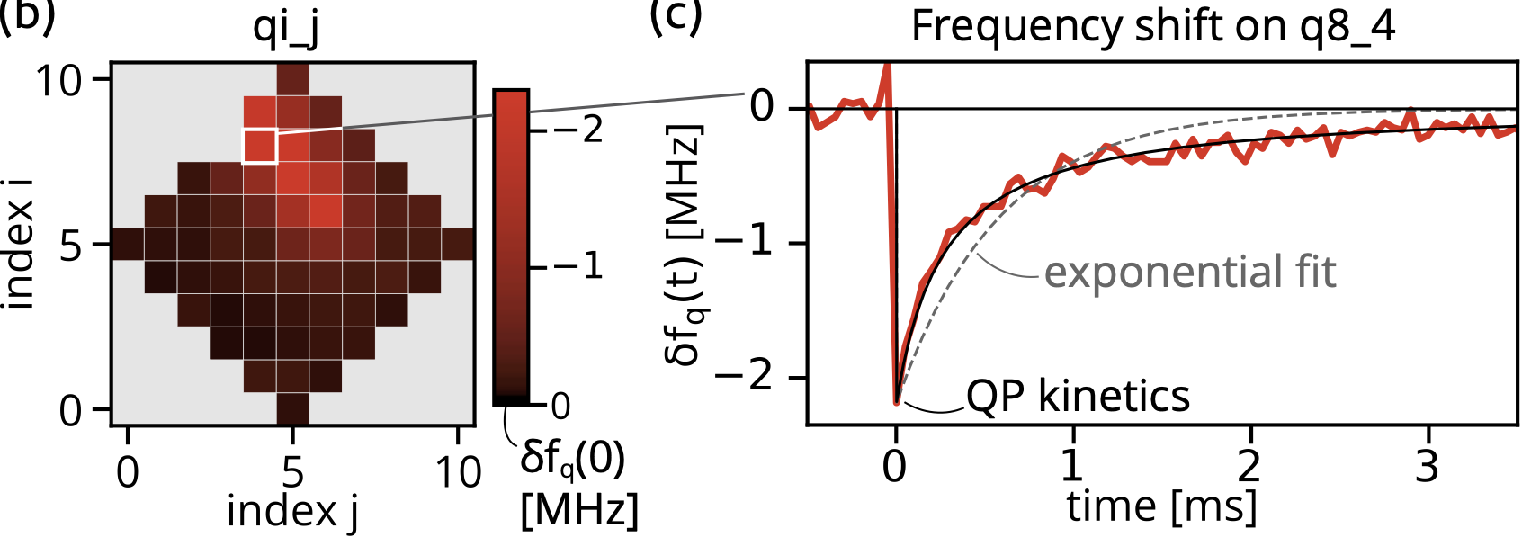
Frequency shift characterization experiment
Quasiparticle kinetics
Negative frequency shifts up to 3 MHz [xqp exceeding 10⁻⁴]
Dynamics is compatible with QP kinetics driven by recombination

Slide 42
Frequency shift characterization experiment
Quasiparticle kinetics
Negative frequency shifts up to 3 MHz [xqp exceeding 10⁻⁴]
Dynamics is compatible with QP kinetics driven by recombination
Characteristic scales of the energy deposition:
100 keV – 1 MeV

Slide 43
Statistics
Before gap engineering
Main type of errors:
Qubit energy decay
Error burst frequency:
1 / (10 sec)
Error burst duration:
~ 10 ms
Repetition code error floor:
10⁻⁶
After gap engineering
Main type of errors:
Frequency shifts
Error burst frequency:
1 / (70 sec)
Error burst duration:
~ 1 ms
Repetition code error floor:
10⁻¹⁰
15

Slide 44
Take home messages
Radiation impacts lead to correlated error bursts in the qubit array
This poses a challenge for the development of a quantum processor
We reduced the problem by four orders of magnitude
  Hardware modification: gap engineering
This doesn’t solve the problem completely
  Qubit errors due to quasiparticle-induced frequency shifts
Outstanding
Time dynamics of the events after the cooldown
Mitigation of frequency shifts on software and hardware levels?

