Slide 1




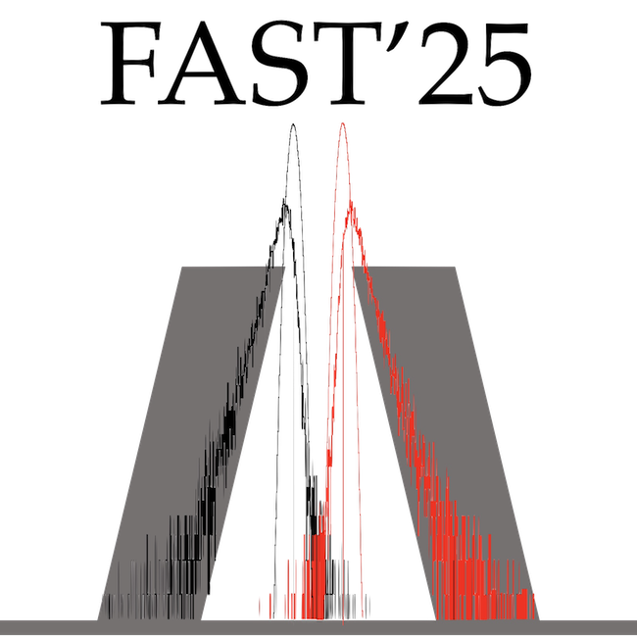



REDSHIFTED CHERENKOV RADIATION FOR FAST-TIMING DETECTORS
C. Fernández-Borreguero¹, L.M. Fraile^{1,2}, J.M. Udías^{1,2}, S. España^{1,3,4}
¹ Grupo de Física Nuclear, EMFTEL & IPARCOS, Universidad Complutense de Madrid, Madrid, Spain
² Instituto de Investigación del Hospital Clínico San Carlos (IdISSC), Ciudad Universitaria, Madrid, Spain
³ Centro Nacional de Investigaciones Cardiovasculares (CNIC), Madrid, Spain
⁴ Instituto de Tecnologías Físicas y de la Información “Leonardo Torres Quevedo” (ITEFI), Consejo Superior de Investigaciones Científicas (CSIC), Madrid, Spain
Notes:
My name is Claudia Fernandez, I belong to the nuclear physic group of Complutense University
and I am going to present our work on redshifted Cherenkov radiation for fast-timing detectors.

Slide 2
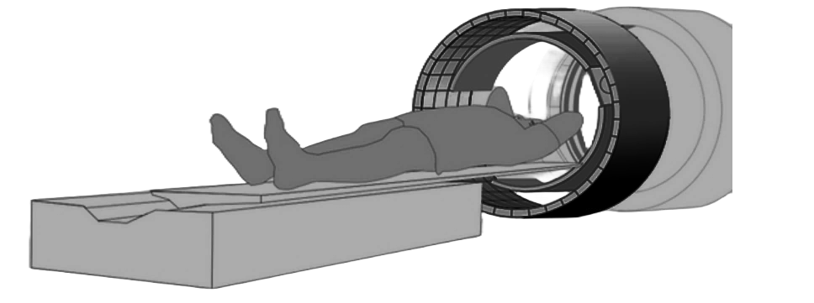
INTRODUCTION
Need for improved time resolution in radiation detectors, essential for Positron emission Tomography (PET) applications.
Focus on Time of Flight (TOF-PET): Enhancing signal-to-noise ratio and detection sensitivity.
Current challenge: Temporal resolution is 200-300 ps, but the goal is 10 ps globally.
Cherenkov light as a strategy: Offers fast-timing properties but produces few photons.
Objective: Increase Cherenkov photon production and
optimize their use to improve time resolution.
Notes:
The motivation behind this work arises from the need to improve the time resolution of radiation detectorswhich is crucial for applications in Positron Emission Tomography (PET).
In particular, our research focuses on Time of Flight Pet (TOF – PET) to improve the signal-to-noise ratio and effective sensitivity.
Currently, the temporal resolution is in the range of 200-300 ps,
however there is a global effort focused on reducing this limit toward 10 ps and our work aligns with this goal.
A prOmising strategy to enhance time resolution is iuRilizing Cherenkov light due to its fast-timing characteristics.
However, its main limitation is the low number of Cherenkov photons generated.
So, our objective is to increase the production of Cherenkov photons and fully exploit their fast-timing properties

Slide 3
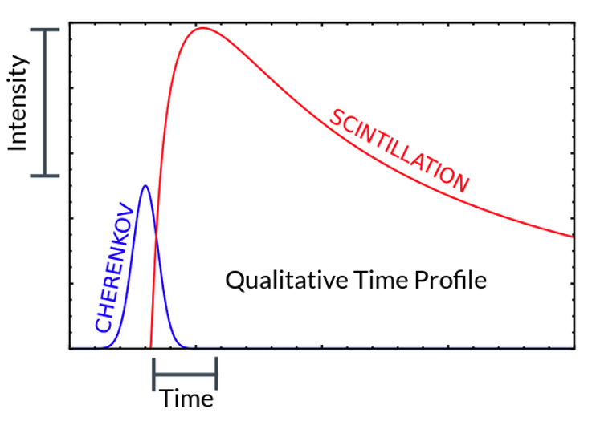

CHERENKOV INTRODUCTION
Notes:
A charged particle traveling through a transparent dielectric material at a phase velocity higher than the phase velocity of light polarizes the medium.
When the medium depolarizes, it emits Cherenkov radiation.
Cherenkov photons have a faster temporal response than scintillation.
Being able to detect pulses incorporating Cherenkov radiation would improve timing performance.

Slide 4
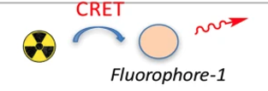
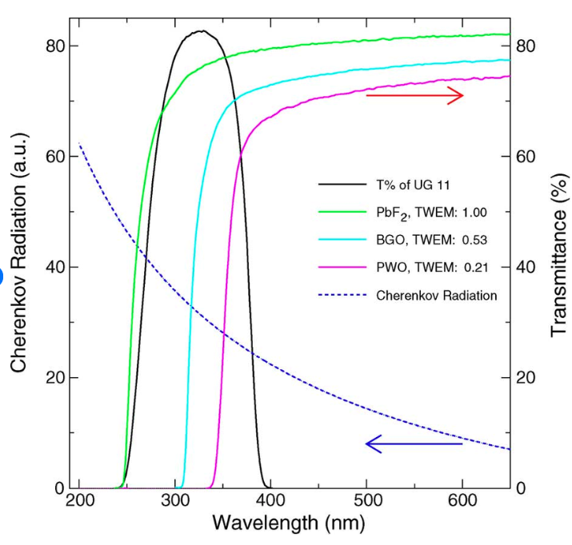

REDSHIFTER CHERENKOV RADIATORS (RCR)
RCR
Cherenkov
BGO
Cherenkov
radiation
Notes:
Cherenkov photons are mainly produced at short wavelengths.
To detect them, we need materials with good transMittance in this range.
Here, you can see the transmittance of one of the most commonly used detectors, BGO, shown in light blue. However, it absorbs all these Cherenkov photons.
We can increase the number of detectable Cherenkov photons by introducing fluorescent Dopants into the detector
and shifting their wavelength.
In this way we prevent absorption and make them visible to photosensors.
The detectors we have named Redshifter Cherenkov Radiators utilize this property.
Por lo que estuvimos estudiando cómo incrementar el índice de refracción global de un plástico añadiendo nanopartículas metálicas a matrices poliméricas, que por un efecto derivado de las resonancias plasmónicas crea un índice de refracción muy alto a determinadas frecuencias.

Slide 5
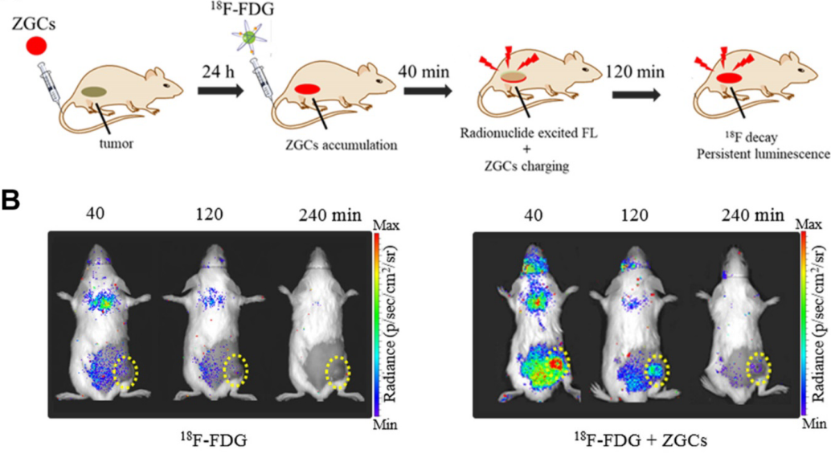

REDSHIFTER CHERENKOV RADIATOR:
BACKGROUND
RCR
Bernhard, Y., Collin, B. & Decréau, R. A. Redshifted Cherenkov Radiation for in vivo Imaging: Coupling Cherenkov Radiation Energy Transfer to multiple Förster Resonance Energy Transfers. Sci. Rep. 7, 45063 (2017).
Notes:
Redshifted Cherenkov imaging has been used to enhance molecular imaging.
Recent advances have demonstrated the ability to shift Cherenkov photons into the near-infrared and even mid-infrared range.
This technique enables deepAH tissue penetration and reduces scattering.

Slide 6
ROADMAP
Cherenkov light and Cherenkov redshift.
Detector Preparation – Materials and configurations used.
Detector Principles – How they work.
Results – Analysis of:
  Light Yield.
  Photon Spread Distribution.
  Coincidence Time Resolution (CTR).
  Conclusions & Future Work – Summary and next steps.
Notes:
Now that I have introduced Cherenkov light and Cherenkov redshift
I am going to explain how we prepared the detectors
And I will describe their working principles
After that, I will present our results, focusing on three key aspects: light yield, photon spread distribution, and coincidence time resolution (CTR).
Finally, we will go over the conclusions and future directions.

Slide 7
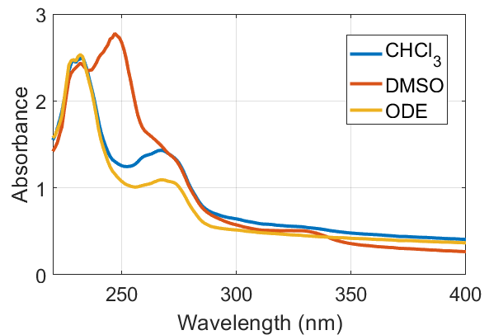
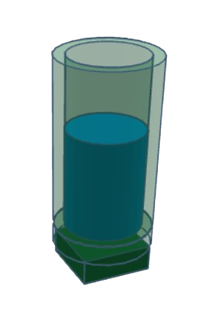
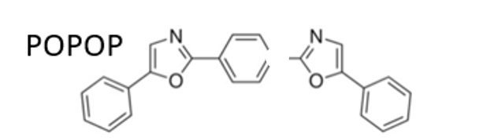

PREPARATION OF RCR
LIQUID DETECTORS!
Different non-aromatic solvents were tested:
Chloroform (CHCl₃)
dimetyl sulfoxide (DMSO)
octadecene (ODE)
NO SCINTILLATION!
RCR
Vial
SiPM
Liquid detector | Solvent | Dopant | Concentration (mg/mL)
CHCl₃-CR | CHCl₃ | - | -
DMSO-CR | DMSO | - | -
ODE-CR | ODE | - | -
CHCl₃-RCR | CHCl₃ | POPOP | 0.1
DMSO-RCR | DMSO | POPOP | 0.1
ODE-RCR | ODE | POPOP | 0.0267
The dopant used to produce the redshift was
1,4-bis(5-phenyloxazol-2-yl) benzene (POPOP)
Notes:
In order to prepare redshifted Cherenkov radiators, we used liquid media to simplify the evaluation of different configurations
Liquid detectors were prepared using transparent, dielectric and non aromatic solvents: cloroform, dimetyl sulfoxide and octadecene
It is important that the solvents do not cantain aromatic rings to avoid the emisión of scintillation light
We measured the absorbance of each solvent and found that octadecene has the highest transmittance at short wavelengths.
To induce the redshift, we used POPOP as the dopant
Pure cherenkov radiators were prepared whiout the dopant as a reference

Slide 8
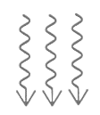
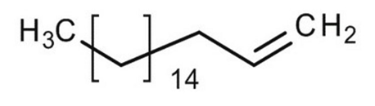
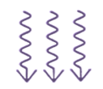
Electrons
POLARITATION
AND
DESPOLARITATION
OCTADECENE
(ODE)
RCR DETECTORS WORKING PRINCIPLES
Deep UV
Cherenkov
photons
CHERENKOV EMISSION
FLUOROPHORE
(POPOP)
FLUORESCENCE
Visible Cherenkov photons
Notes:
Now let’s take a look at how the RCR detectors work
The incident radiation consists of electrons.
These electrons polarize the dielectric medium of the solvent, which upon depolarization produces Cherenkov photons at very short ultraviolet wavelengths.
Our goal is to shift these photons into the visible range by adding POPOP, which re-emits them through fluorescence.

Slide 9

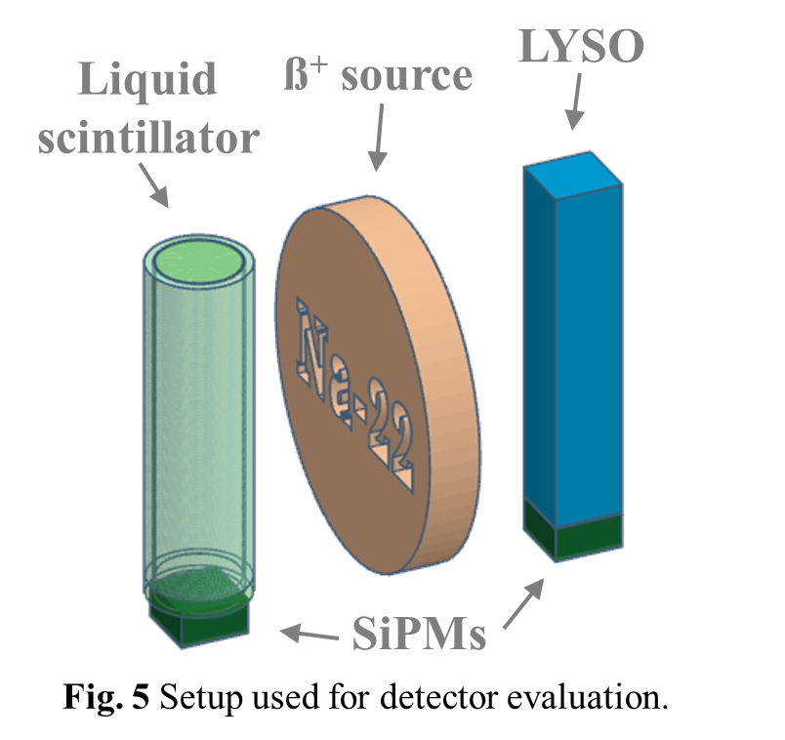
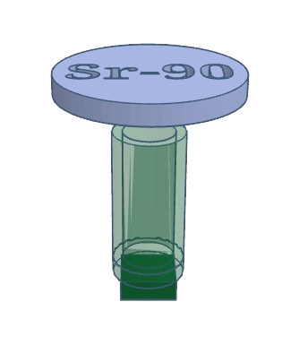
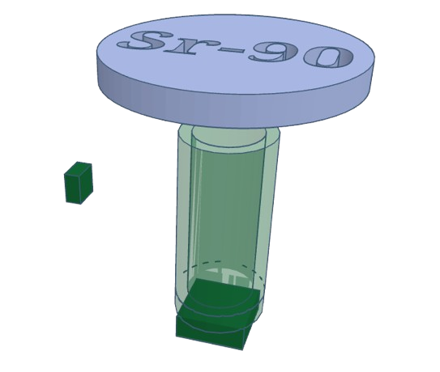


CHARACTERIZATION OF RCR DETECTORS
DETECTED
CHERENKOV YIELD
TIME SPREAD DISTRIBUTION
COINCIDENCE TIME RESOLUTION
LYSO
β⁻ source
β⁻ source
RCR
detector
β⁺ source
RCR
detector
RCR
detector
SiPM
1x1
SiPM
4x4
SiPM
SiPMs
Notes:
To evaluate the performance of the detectors, we will focus on three key measurements:
The first is LIGHT OUTPUT. This tells us how many Cherenkov photons we can detect. We achiV this by placing a strontium-90 source above the liquid detectors and measuring the energy spectra.
Next, we will analyze the TIME SPREAD DISTRIBUTION (TSD). This is done by measuring coincidences between two photosensors placed at different positions on the vial, allowing us to deTermin how the arrival times of detected photons are distributed.
Finally, we will measure the COINCIDENCE TIME RESOLUTION (CTR).
These photons can interact with the medium through different processes, generating electrons in the detector. Fewer photons will be produced compared to strontium, but the result will be proportional, which is why we can apply the light yield results.

Slide 10
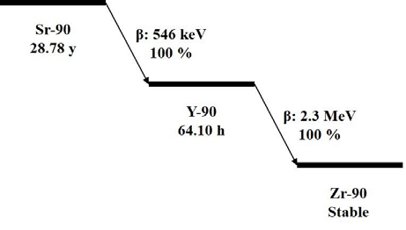
DETECTED CHERENKOV YIELD
β⁻ source
RCR
detector
SiPM
Notes:
To measAH the amount of light emitted by our compounds, we used a strontium-90 Aisotope.
Its decay proDues yttrium-90, whose beta emissions have an endpoint energy of 2.3 MeV. EM I VI
These energetic electrons, in turn, produce Cherenkov photons.

Slide 11
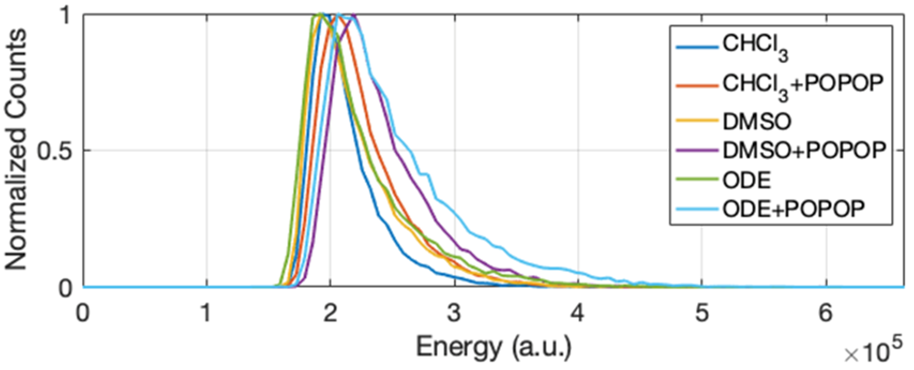
DETECTED CHERENKOV YIELD
β⁻ source
RCR
detector
SiPM
Notes:
The obtained energy spectra are Compton spectra due to the low effective atomic number of the liquid detectors.
In the graF, the energy spectra of all compounds are normalized to the same máximum to easy comparation.
We can observe that the spectrum of chloroform, shown in dark blue, has the lowest light yield
We used this spectrum as a Reference to deTermine the relative photon yield of each detector.

Slide 12
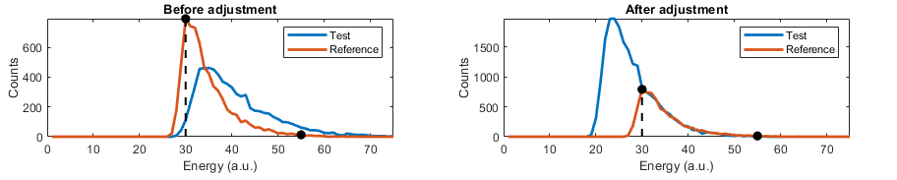
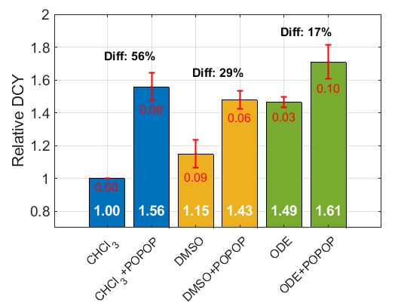
DETECTED CHERENKOV YIELD
Notes:
We assume that the spectra have the same shape and differ only by a sQUEILING factor.
And using lIIst squares miniMAISEISION, the spectra are adjusted both in energy (horizontal) and amplitude (vertical) to match the reference spectrum. This process is applied in a specific rIgion of the Compton spectrum, avoiding low-energy areas where differences are more pronounced.
The bar chart at the bOttom shows the relative detected Cherenkov yield for each detector
The data has been grouped by colors depending on the solvent used.
In each color group, the first bar correspond to the solvent without POPOP and the second bar represents the solvent with the POPOP.
For each solvent, the perCentICH difference between bars has been calculated.
We observed that in all solvents, adding POPOP consistently increases photon detection.
Among the tested solvents, ODE ICXhibited the highest detected Cherenkov yield, both in its pure form and when doped with POPOP
Based on these results and considering that ODE also has the lowest absorbance in the UV range, ODE has been selected as the optimal solvent for the development of RCR detectors.

Slide 13
TIME SPREAD DISTRIBUTION
β⁻ source
RCR detector
SiPM 1x1
STOP
SiPM 4x4
START
Notes:
We measured the Time spread distribution TSD, using an approach of Time-Correlated Single Photon Counting, or TCSPC.
Essentially, we capture two signals:
a START signal placed at the bottom of the vAial registring the first photons produced and
a STOP signal placed a few millimeters away from the side of the vial
These laterally escaping photons
generally arrive after the Erliest detected PHOTONS at the START detctor
as they undergo some internal propagation
before reaching the STOP detector
We measure the time difference between them to characterize how photons propagate in our detector
One important detail is that we avoided using Teflon tape in this experiment. Why? Because we wanted to minimize photon reflections and ensure we directly capture the light escaping from the side of the vial without interference.

Slide 14

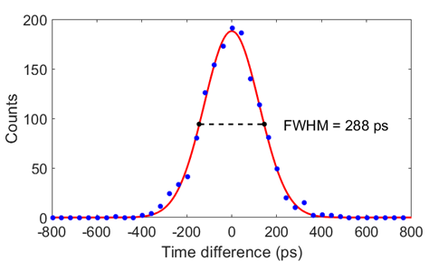
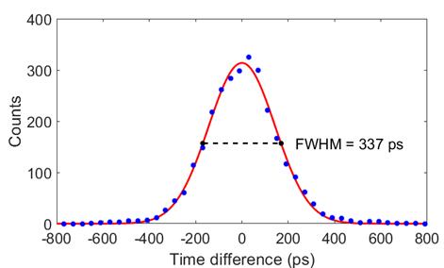

TIME SPREAD DISTRIBUTION
Pure Cherenkov
RCR
ODE
ODE+POPOP
FWHM: 279 ± 10 ps
FWHM: 321 ± 13 ps
Notes:
We have comPEed two liquid detector configurations: the first detects only pure Cherenkov photons, and the second incorporates redshifting
As expected, the RCR detector exhibited a worse time response, but only with a 15% higher
This degradation in the RCR detectors occUHrs because the reemission introduces an additional delay.

Slide 15
COINCIDENCE TIME RESOLUTION
β⁻ source
LYSO
RCR detector
SiPMs
Notes:
This figAh illustreits the coincidence measurement setup with a sodium 22 as a nuclear source

Slide 16
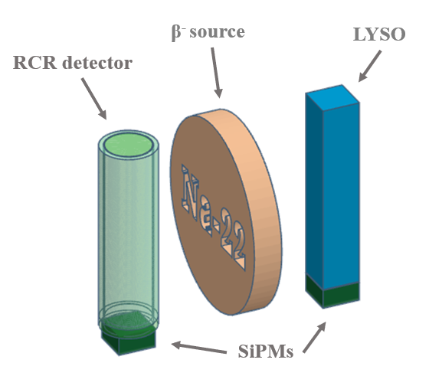
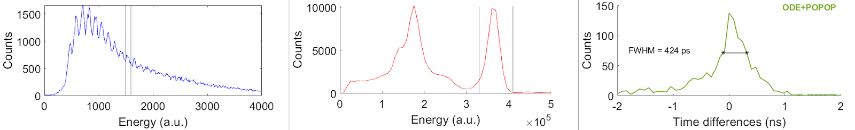
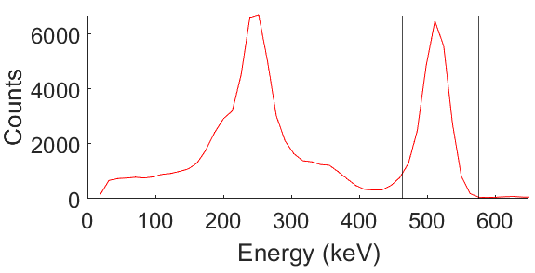
COINCIDENCE TIME RESOLUTION
Notes:
The CTR is obtained by analyzing the time difference between annihilation photons in coincidence
detected in both the liquid RCR detector and the LYSO detector.
Each peak in the energy spectrum of RCR detector correspond to the activated microcells.
Por example here we have one time difference histogram with the CTR calculated as the FWHM

Slide 17
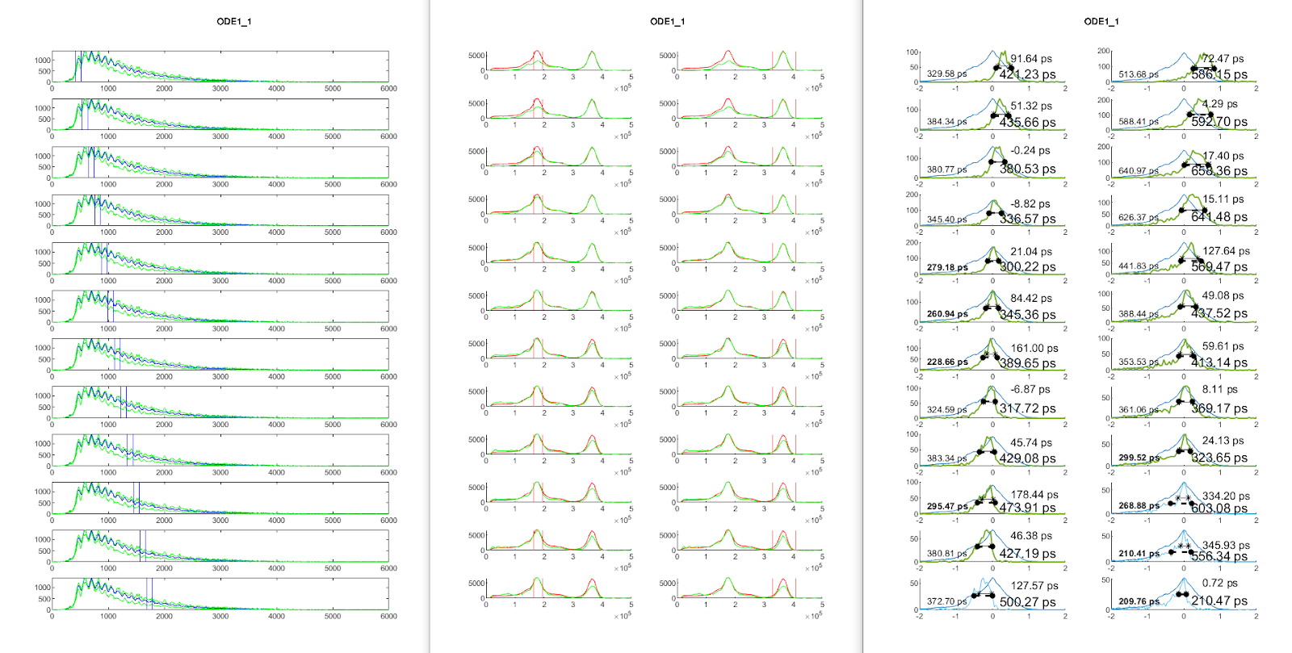
COINCIDENCE TIME RESOLUTION
Notes:
CTRs were generated using events corresponding to
one photocell in the RCR detector
and the photopeak 511keV in the LYSO detector.
By doing this, we ensure that the pulses we analyze have similar amplitudes, minimizing distortions caused by time walk. This approach allows us to avoid the need for time walk correction.

Slide 18
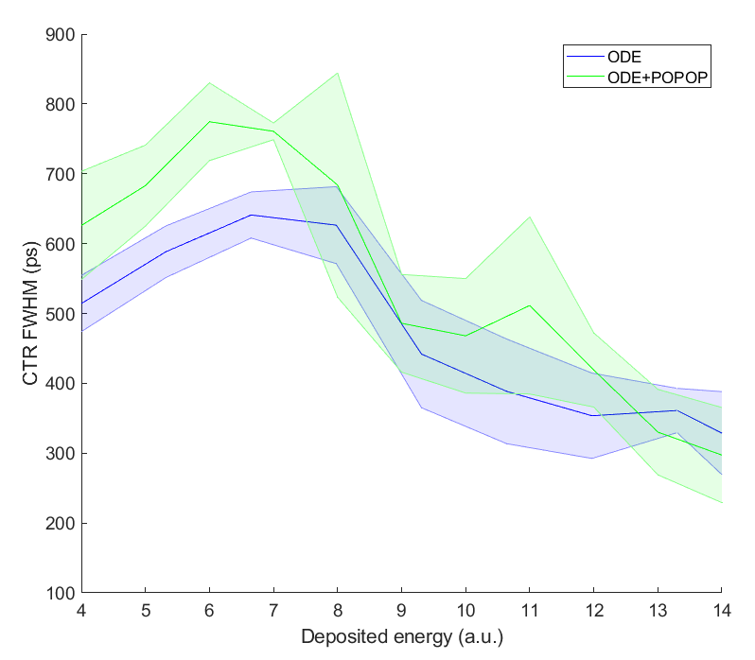
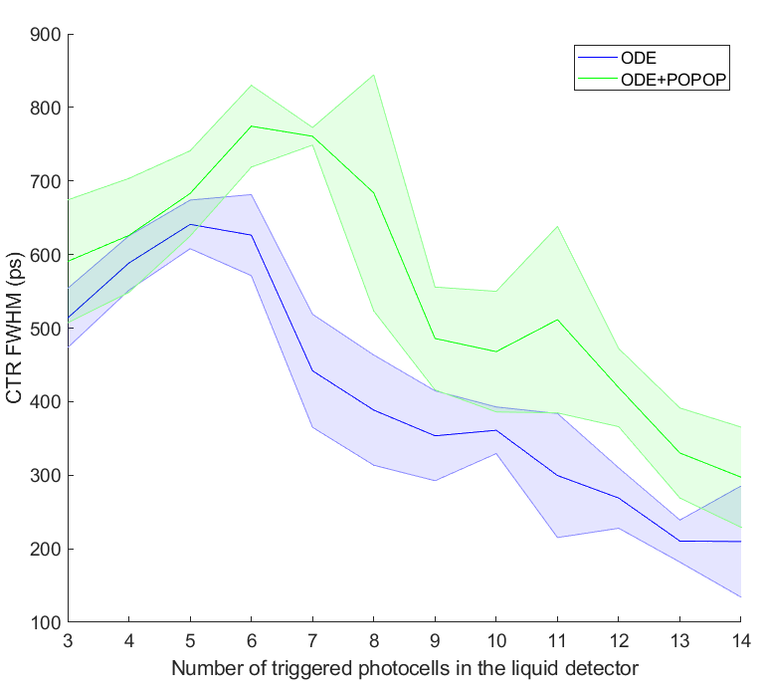
COINCIDENCE TIME RESOLUTION
ODE
ODE + POPOP
Cherenkov
Redshifted
Cherenkov
Notes:
And here we have the CTR vs the active photocells, we have the results of pure Cherenkov in blue and the redshifted Cherenkov in green
the RCR detector have higher CTR values due to the additional time delay from fluorescence reemission. As observed in the TSD results
However, the CTR obtained for RCR was adjusted by scaling the energy windows
for each photocell involved,
to account for the increase in detected photon yield.
-------------------------------------------------------------
By applying this correction, we can now directly compare both detectors under the same deposited energy conditions while considering that more photons are being detected.
As a result, the higher photon yield in the RCR detector helps to balance the timing shift, reduces the CTR differences

Slide 19
CONCLUSIONS
Redshifted Cherenkov Radiation is a promising technique for improving the time resolution of radiation detectors.
Fluorescent dopant POPOP shifts Cherenkov light from UV to visible, increasing photon detection by 17%-56%.
Although the RCR detectors slightly worsed time response than pure cherenkov detectors, the increased photon yield can compensate for this effect.
Notes:
Redshifted Cherenkov Radiation is a promising technique for improving the time resolution of radiation detectors.
Introducing fluorescent dopants (POPOP) into liquid solvents shifts Cherenkov light from UV to visible, increasing photon detection by 17%-56%.
Although the RCR detector exhibited a slightly worse time response, the increased photon yield can compensate for this effect.

Slide 20
FUTURE WORK
Crosstalk correction.
Material optimization.
New dopants and concentrations.
Detector design improvements.
Notes:
Crosstalk correction: Mitigate the impact of possible crosstalk on relative photon yield.
Material optimization: Explore solvents with a higher refractive index and density (e.g., glass or crystals) to enhance Cherenkov light production.
New dopants and concentrations: Investigate alternative fluorescent compounds that could improve photon detection efficiency and timing resolution.
Detector design improvements: Optimize the container geometry and materials to maximize photon collection efficiency.

Slide 21

Thank you for your attention!
CsPbBr₃
CsPbCl₃

