Slide 1
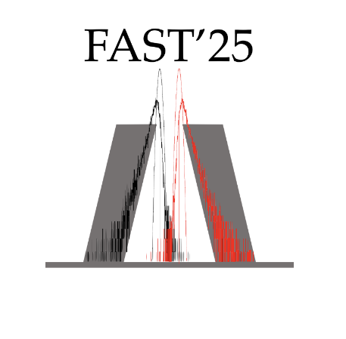
Development of a clover-like LaBr₃(Ce) detector module
Sulagna Dutta
PhD Student
University of the West of Scotland
Fast Timing for Nuclear Structure and Applications
14th March,2025
Notes:
UKNDN

Slide 2
Contents
Introduction
Initial simulations
Detector Construction
Recent Work
Source data, add back and results
Summary
Future applications

Slide 3
Introduction

Slide 4
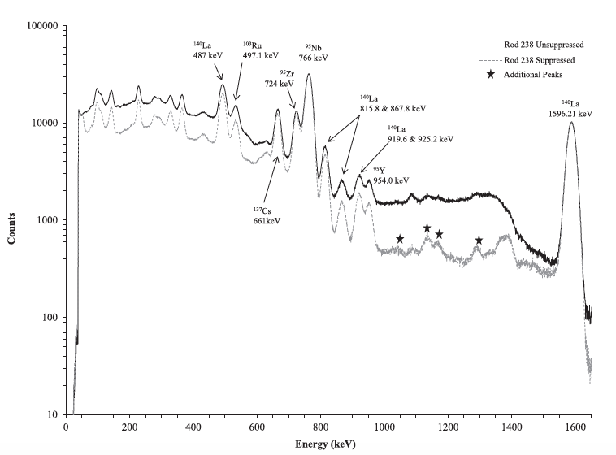
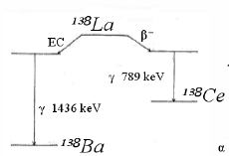
Compton Background from fission products
Measurements with LaBr₃(Ce)
NaI annulus for Compton suppression
Compton continuum due to fission products obscure photo peaks in the gamma-ray spectra of spent nuclear fuel.
To tackle this issue, Compton suppression is employed.
Compton continuum from dominant photo peaks such as ¹⁴⁰La has been suppressed and additional peaks identified
¹⁴⁰La
¹⁴⁰La
¹⁴⁰La
Measurements
Additional peaks
in suppressed spectra
¹³⁸La Self-activity peak is not seen in the spectrum as the source count
rate is much higher
S. Bender et al NIMA (2015)

Slide 5
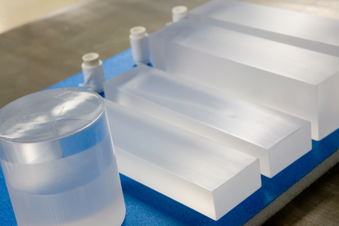
LaBr₃(Ce) crystals coupled to SiPM
High Energy Resolution: at 662 keV peak of 137Cs,
High Light Output: ~63,000 photons/MeV for efficient gamma detection.
Low Afterglow: Ensures clean signals for precise timing.
Temperature Stability: Reliable performance across varying conditions.
Durable: hygroscopic, mechanically robust.
SiPMs offer significant advantages over traditional photomultiplier tubes (PMTs). SiPMs are easy to incorporate into complex detector systems due to their tiny size and lightweight nature.
They can be employed in situations where PMTs may produce interference due to their insensitivity to magnetic fields.
SiPMs have a greater gain, allowing for more effective detection of low light levels.
LaBr3 (Ce) detectors have been shown to be suitable for applications to spent fuel environments.
Room temperature LaBr3 detector with moderate resolution is preferred in many cases over the LN2 cooled germanium detectors

Slide 6
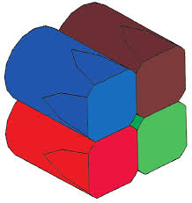
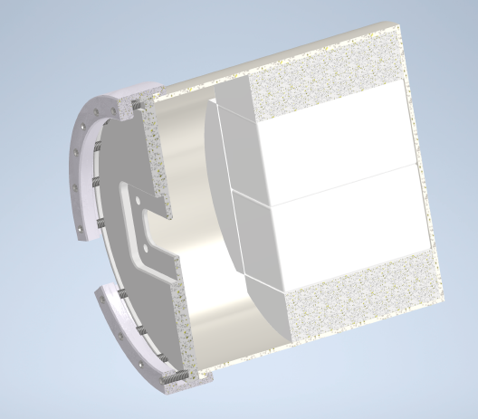
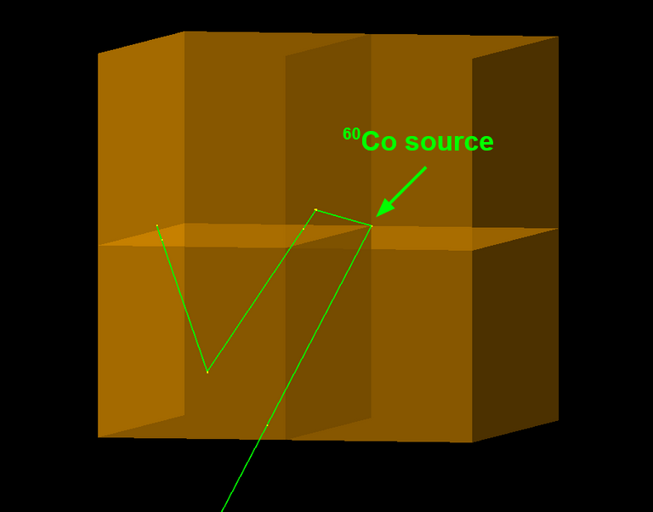
Would Compton addback methods improve energy spectra collected with scintillator detectors?
LaBr3 (Ce) has better intrinsic energy resolution (3.3%) compared to NaI (Tl) (6-7%)
To exploit this property and check the improvement, we considered clover-like geometry

Slide 7
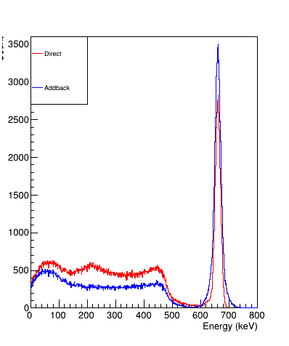
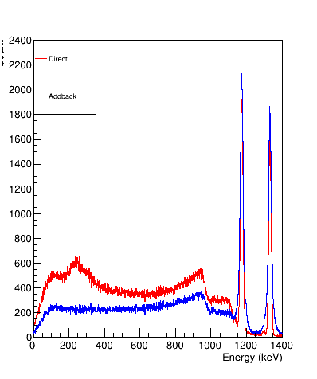
Initial Simulations
Simulation was performed by J. Bordes from University of York
1’’x2’’ cuboids
Simulations by J. Bordes (UoY)
662 keV
1332 keV
1173 keV
1173 keV Direct: : 18.8 (1.6%) Addback: 28.5 (2.4%)
Direct: 23 keV (3.5%) Addback: 31 keV (4.5%)
1332 keV Direct: 16.5 (1.2%) Addback: 26.7 (2%)

Slide 8
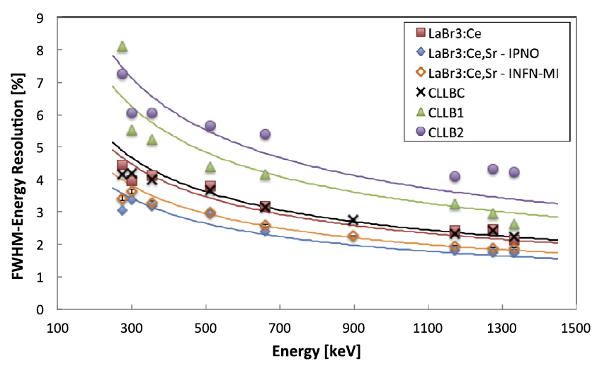
Initial Simulations
Simulations-Direct
by J. Bordes (UoY)
G. Hull et al, NIMA (2019)
Data for 1’’x1’’ LaBr3:Ce crystal

Slide 9
Detector Construction
(prototype)

Slide 10
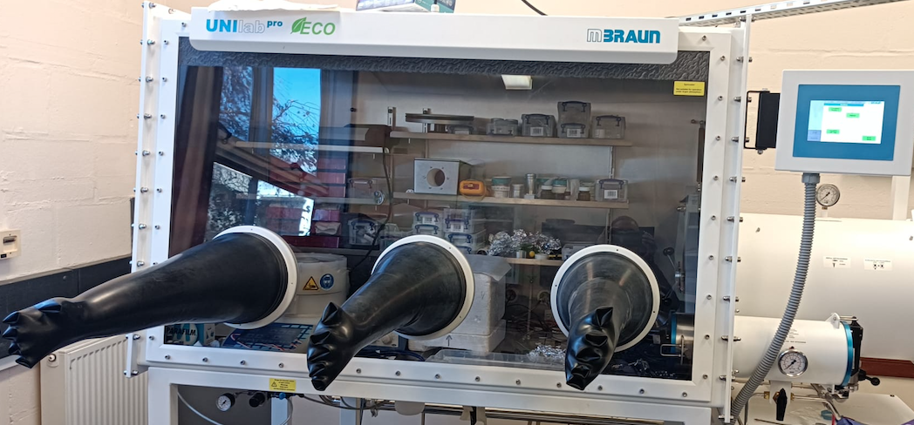
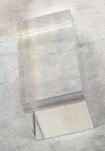
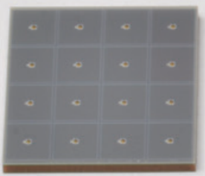
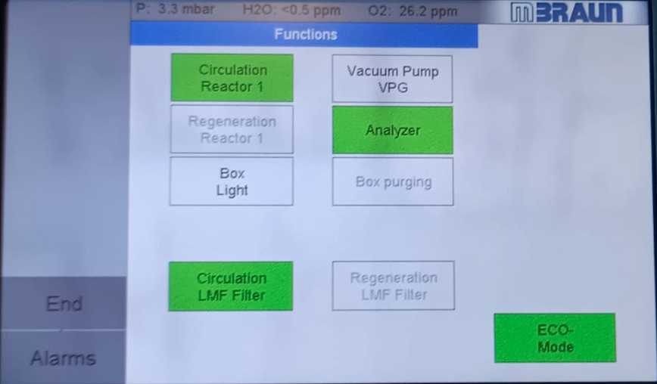
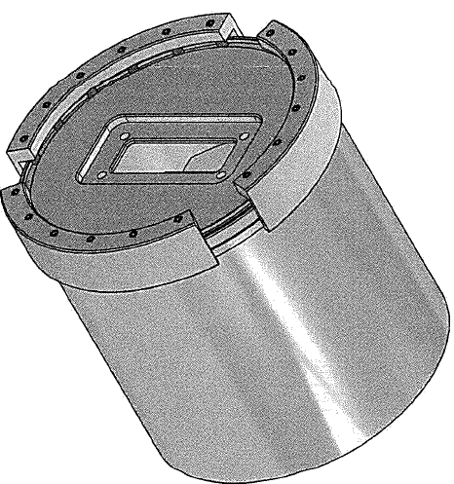
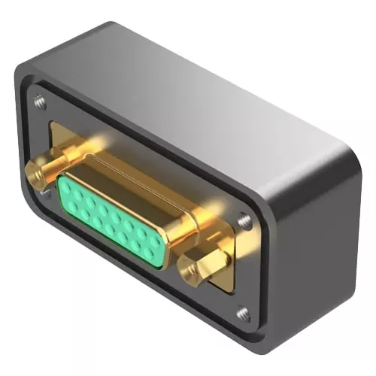
Assembling the detector module
4x4 6mm SiPM-array
15 pin DSub hermetic sealed connector

Slide 11
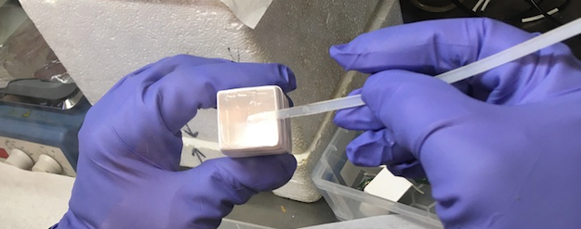
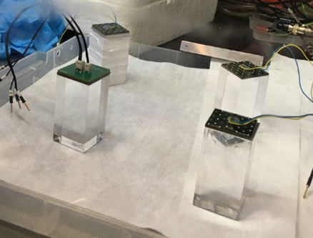
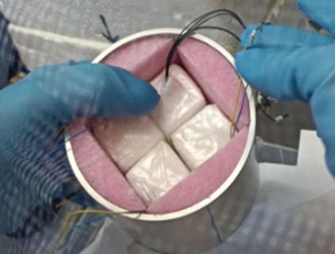
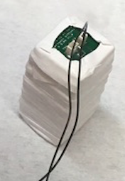
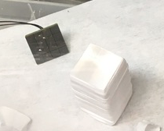
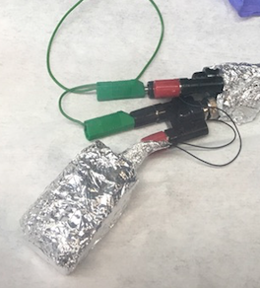
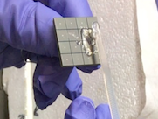

1’’ X 2’’ cuboid + SiPM construction and source tests
P. Joshi
Teflon

Slide 12
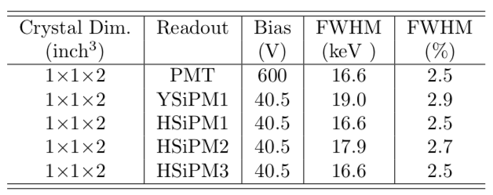
Tests of individual crystals - Preliminary results
Standard construction with PMT FWHM ~ 3.2% at 662 keV
Present construction FWHM ~2.5%

Slide 13
Recent Work
Checking the performance after two years…,
(i) Single crystal FWHM
(ii) Apply add back method and check FWHM and P/T.

Slide 14
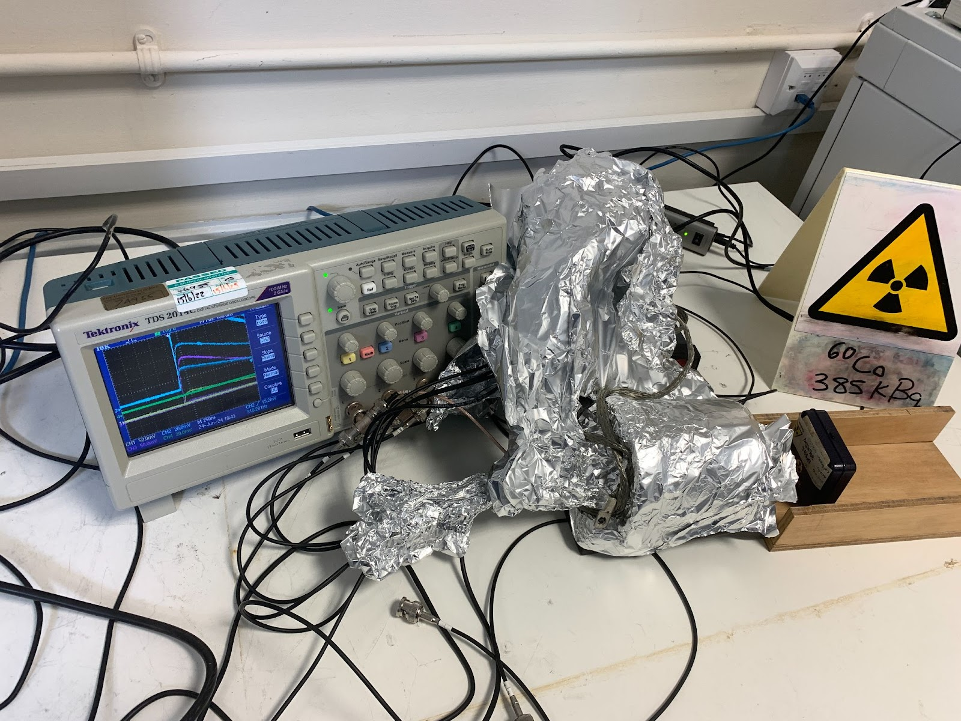
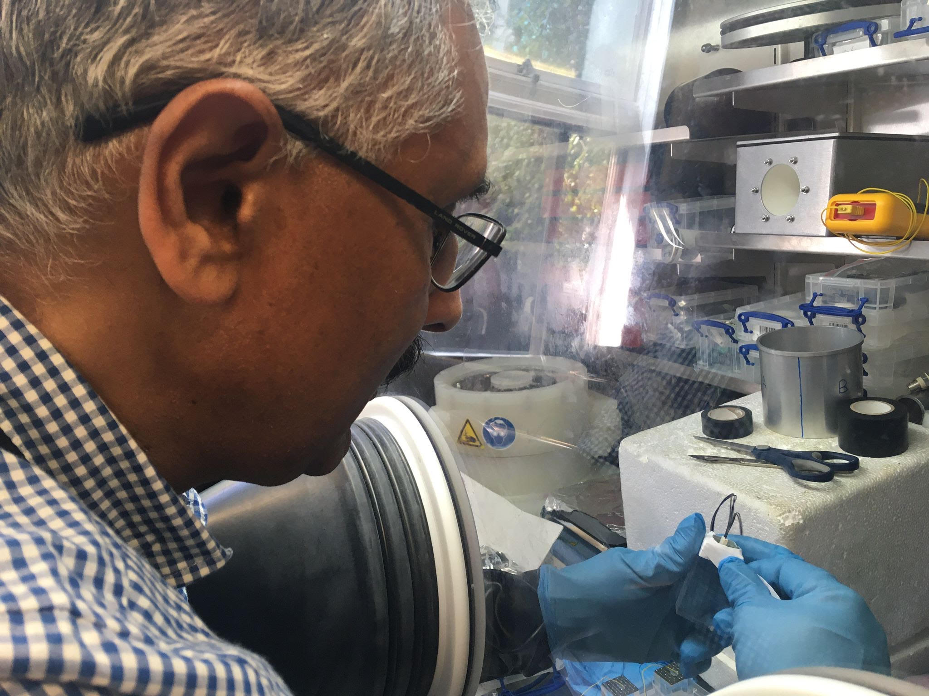
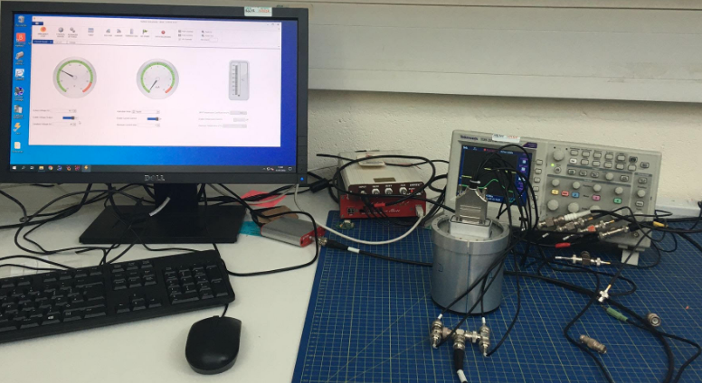
Experimental Setup
Four cuboid-shaped crystals measuring 1"×1"× 2". The crystals are placed in a ~ 3"×3" aluminum container, creating a cloverleaf-like shape for better coverage and detection efficiency.
A 4x4 array was created in-house utilizing Hamamatsu 6x6 mm^2 (S14161-6050HS-04) SiPMs and YSiPMs(Y1) for gamma-ray detection.
Bias voltage was 41.9V, and current 0.05mA
Experiment was carried out with Cs-137, Co-60, Eu-152 sources

Slide 15
Source data & Result

Slide 16
Cs-137 data

Slide 17
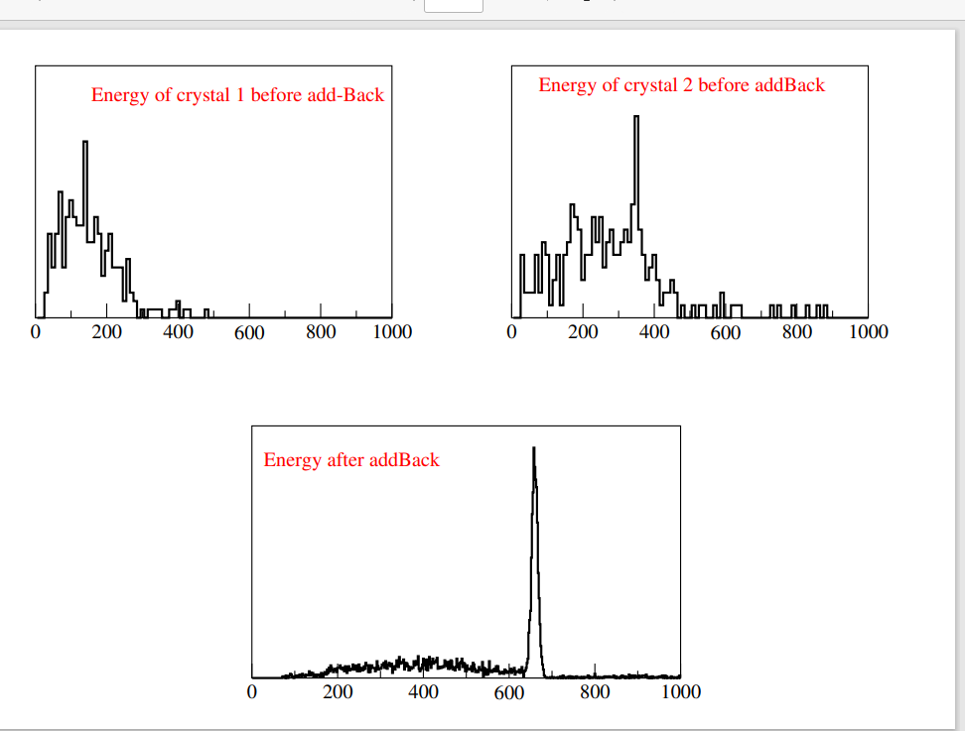
Double hits and Add-Back

Slide 18
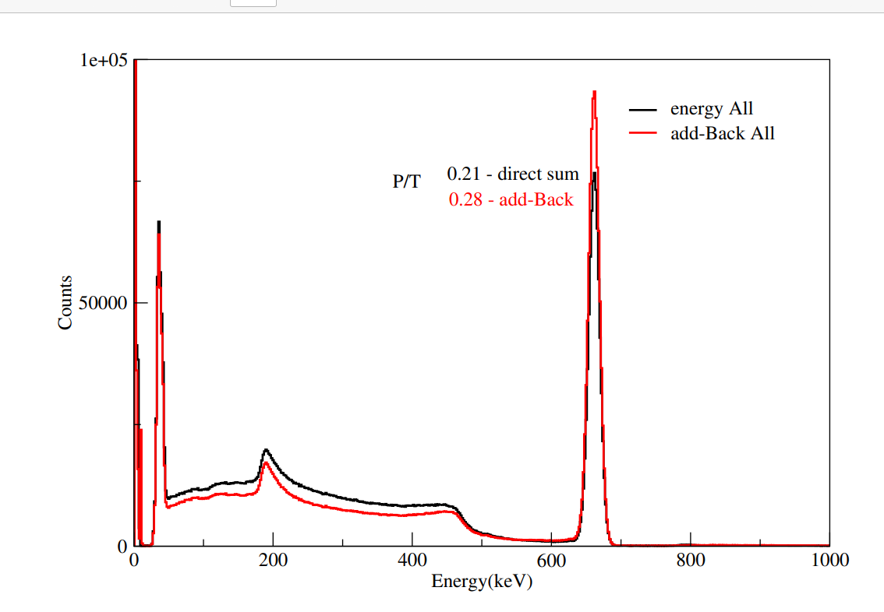
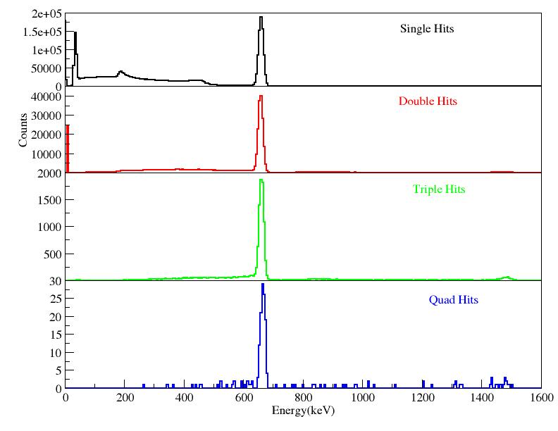
Improving in background
Different crystal hits
P/T improvement from 0.21 to 0.28

Slide 19
Co-60 data

Slide 20
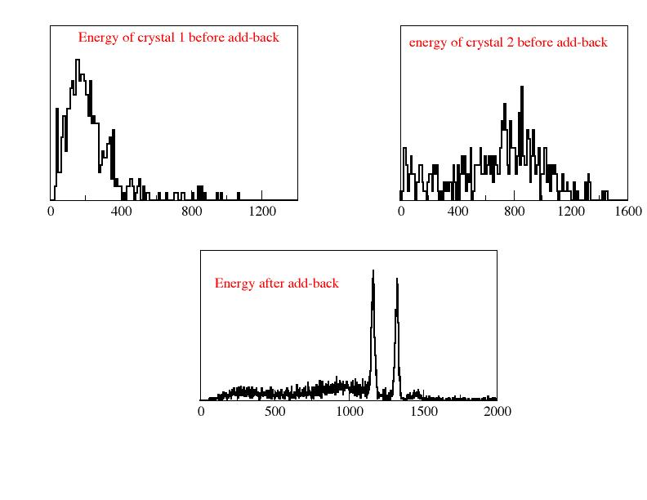
Double hits and add-Back

Slide 21
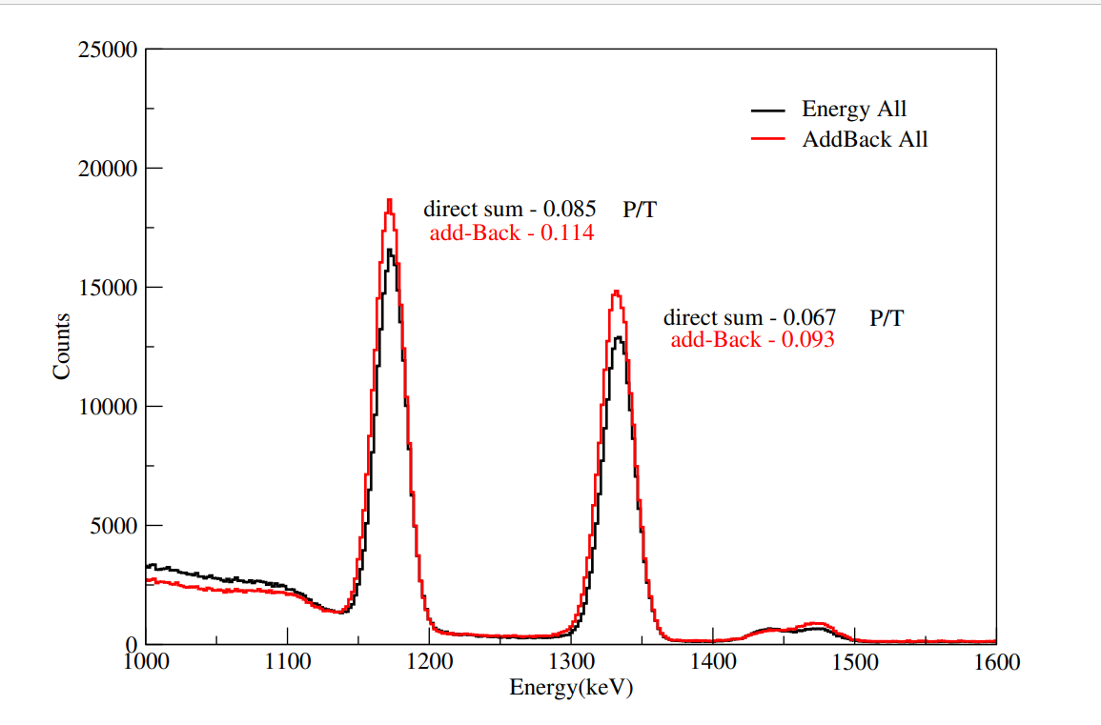
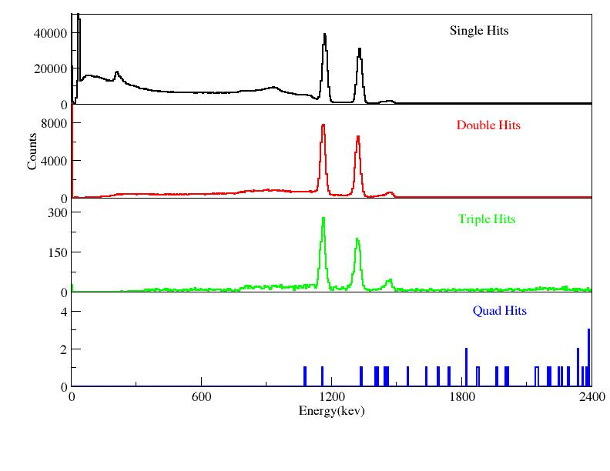
Improving in background
Different crystal hits

Slide 22
Eu-152 data

Slide 23
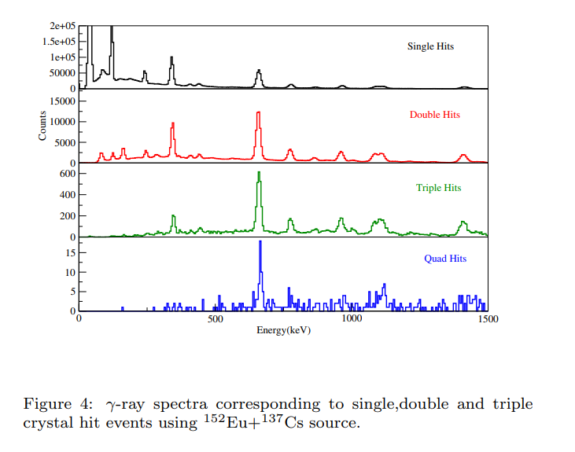
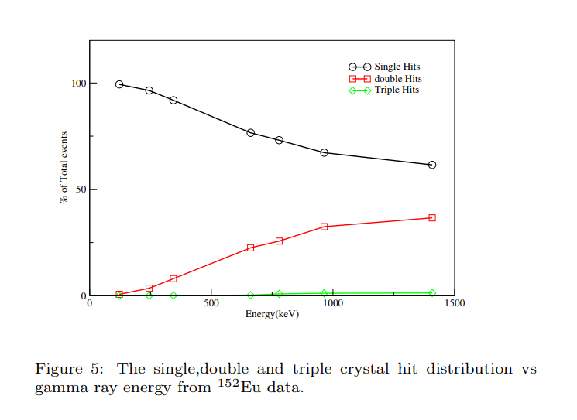
Single, Double, Triple and Quad Hits

Slide 24
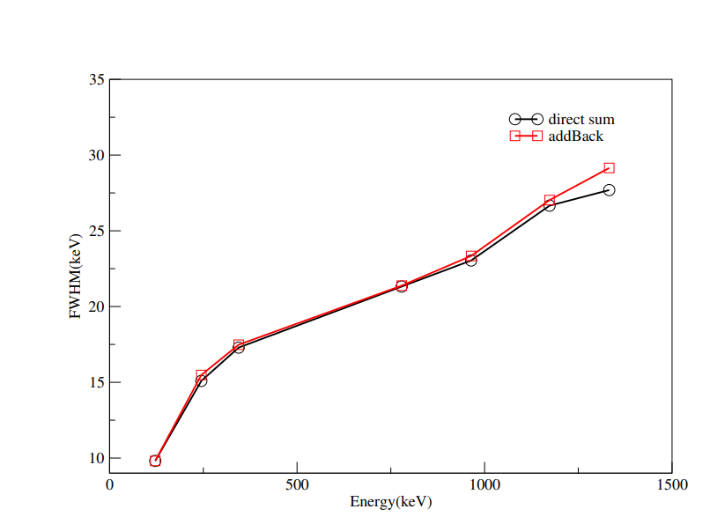
Results
Increase sensitivity and the Peak-to-Total (P/T) ratio.
The results showed that the FWHM values with and without add-back did not differ significantly.
Energy | FWHM without add-Back | FWHM with add-Back
121.7 | 9.8(6) | 9.8(6)
244.6 | 15.1(2) | 15.5(4)
344.2 | 17.3(1) | 17.5(2)
662.6 | 18.9(3) | 18.9(8)
778.9 | 21.3(1) | 21.4(8)
964.1 | 23.0(5) | 23.3(4)
1173.2 | 26.7(6) | 27.0(6)
1332.5 | 27.7(6) | 29.2(6)

Slide 25
Final Result
Energy | R without add-Back | R with add-Back | P/T without add-Back | P/T with add-Back
662.7 | 2.9(1) | 2.9(2) | 0.39 | 0.52
1173.2 | 2.3(2) | 2.3(2) | 0.08 | 0.11
1332.5 | 2.1(2) | 2.2(2) | 0.06 | 0.19

Slide 26
Comparison with previous work
The effectiveness of the LaBr3 clover detector in this investigation was compared to previous research using comparable gamma-ray spectroscopy detection techniques. Using a LaBr3 detector in combination with a PMT, a study by [C Mihai et al.,2020] found an energy resolution of 3.3% at 662 keV. Compared to the 2.9% achieved in this work utilizing the SiPM-based method, this represents a notable improvement

Slide 27
Summary
Use of SiPM based LaBr₃(Ce) clover detector for high resolution gamma spectroscopy.
Achieve energy resolution of ~2.9% at 662 keV after applying the add-Back method.
Improvement of P/T ratio from 0.39% to 0.52% with add-Back, enhancing spectral sensitivity.
Add-Back method effectively recovered energy from multi-hit events, reducing background interface.
The compact and robust SiPM design system suits portable and advanced applications.
The in-house development of our detector module, with a directly coupled SiPM and crystal, allows for easy servicing and maintenance as required.

Slide 28
Work by Cameron Cassells PhD Student CEPS, University of the West of Scotland

Slide 29
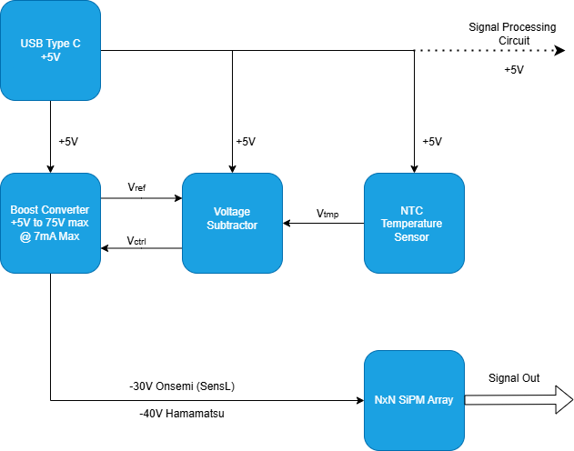
SiPM Array Front-End Electronics

Slide 30
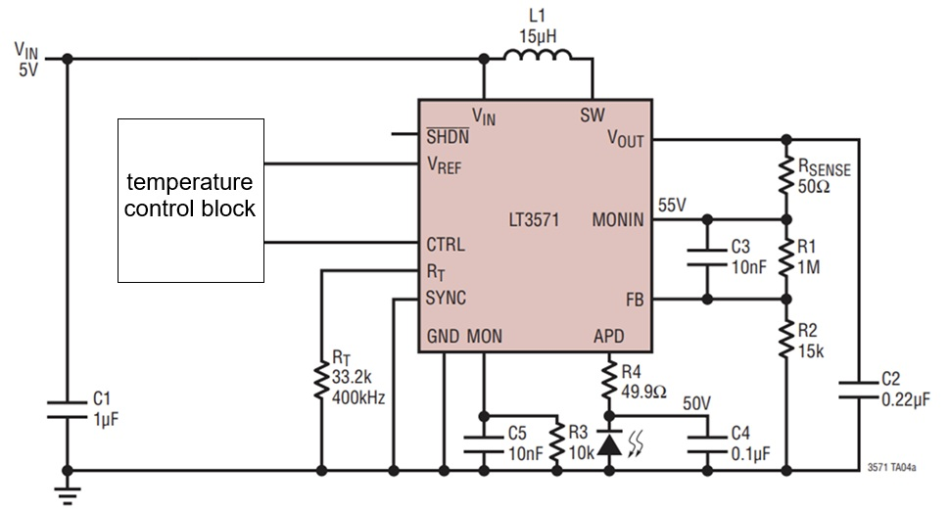
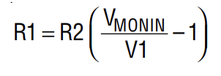
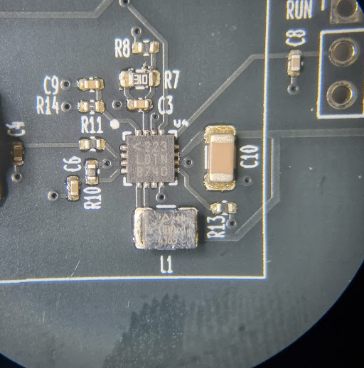
CTRL
DC/DC converter designed to bias avalanche photodiodes with an output voltage up to 75V.
Current Limit set to 7mA max

Slide 31
Temperature Control loop
Analog design, will be digitised in future iterations

Slide 32
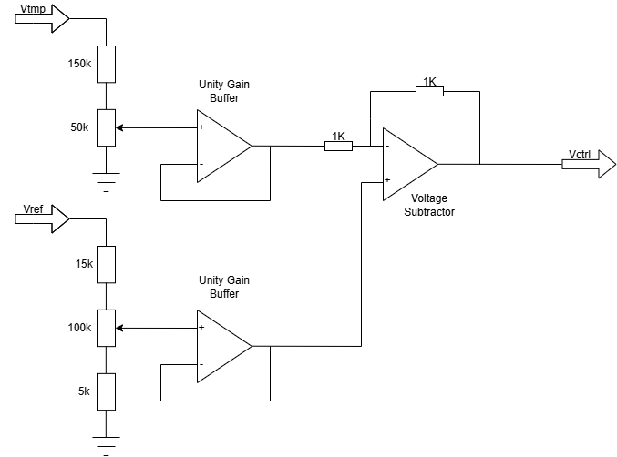
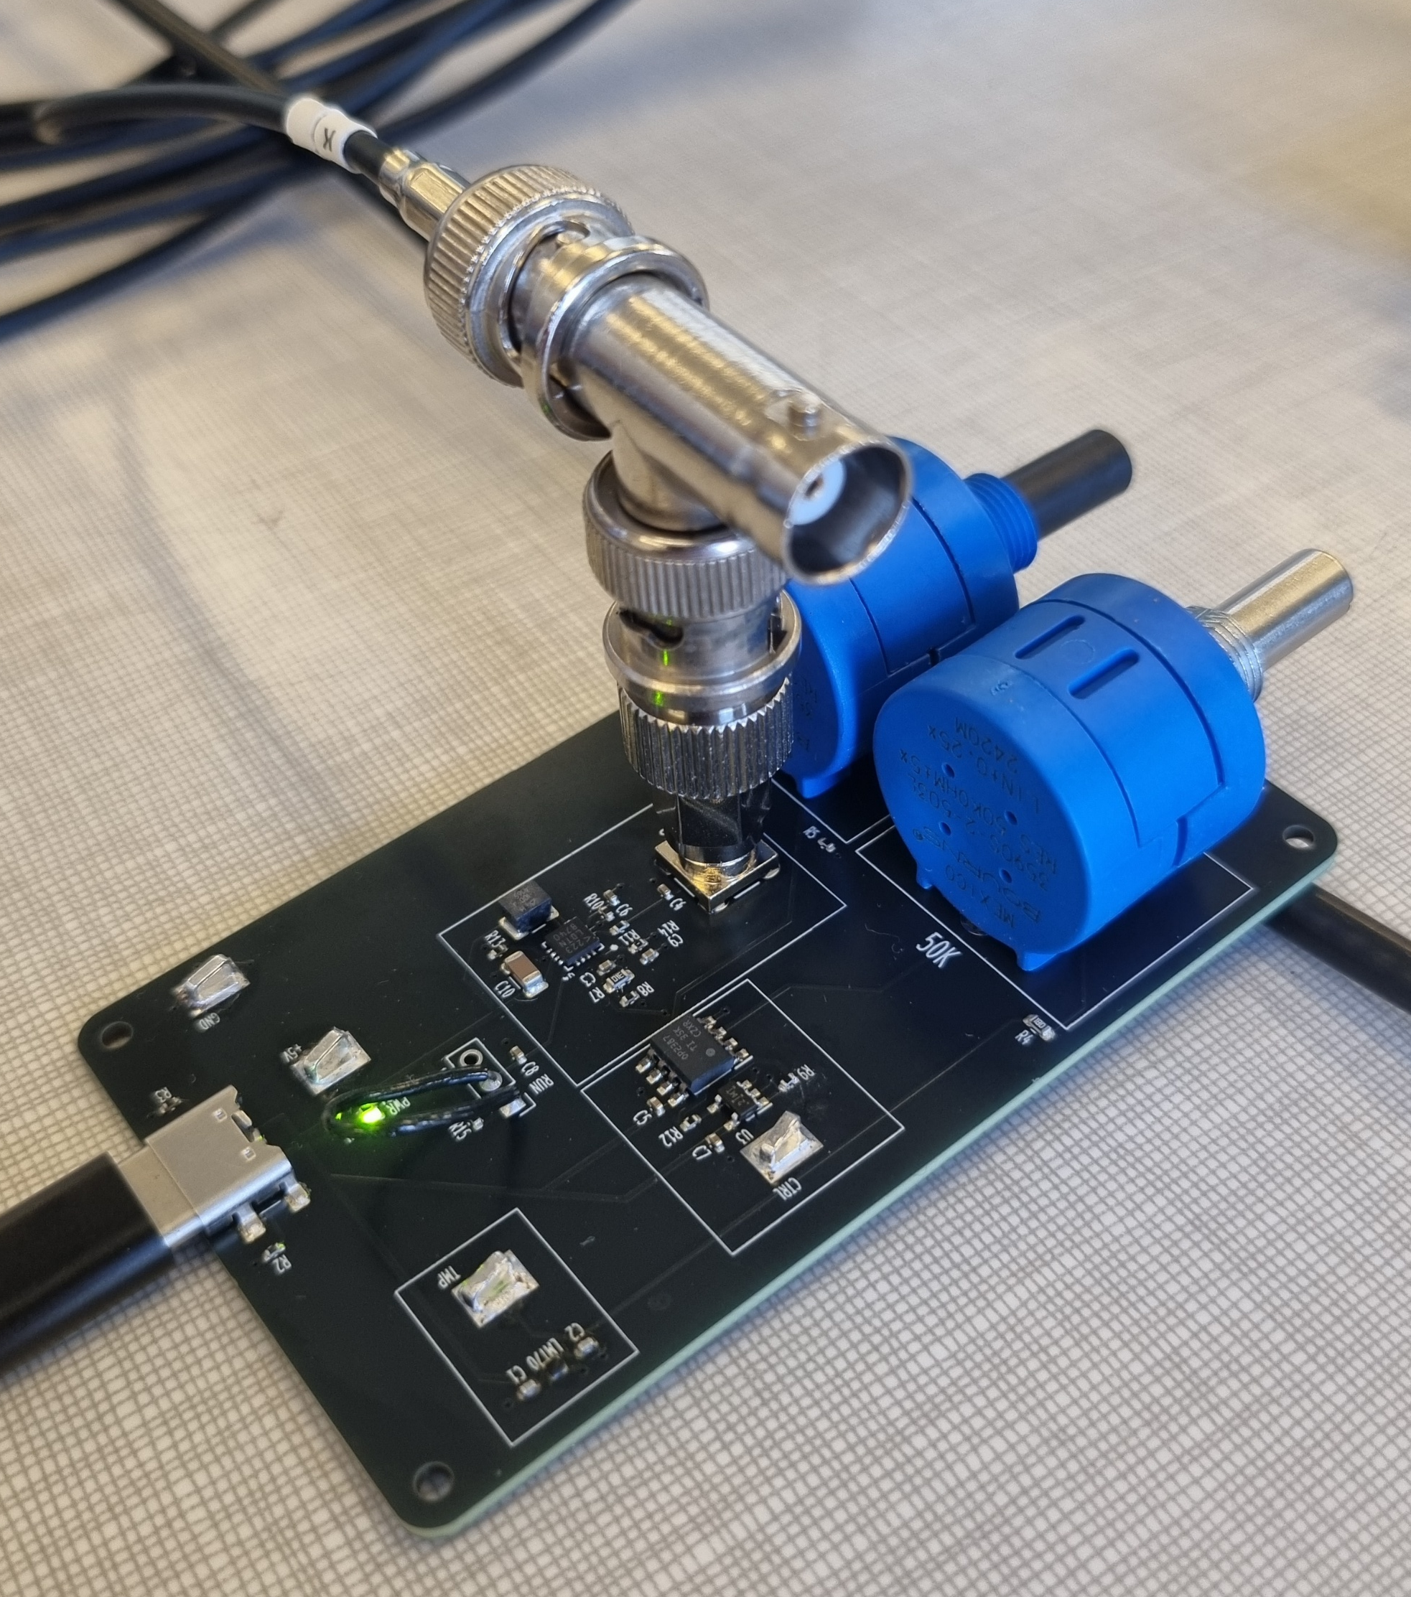



Temperature Control Circuit
$$α$$
$$V_{ctrl}=\frac{R_{f}}{R_{g}}(V_{+}−V_{−})$$
$$β$$
Analog design, will be digitised in future iterations.
Ezgi Şanlı et al NIM A 1055 (2023) 168410

Slide 33
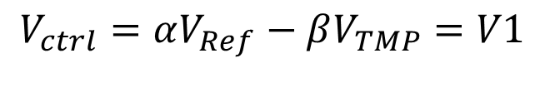
$$V_{ctrl}=αV_{Ref}−βV_{TMP}=V1$$
CTRL
Hamamatsu
Hamamatsu
Onsemi (SensL)

Slide 34
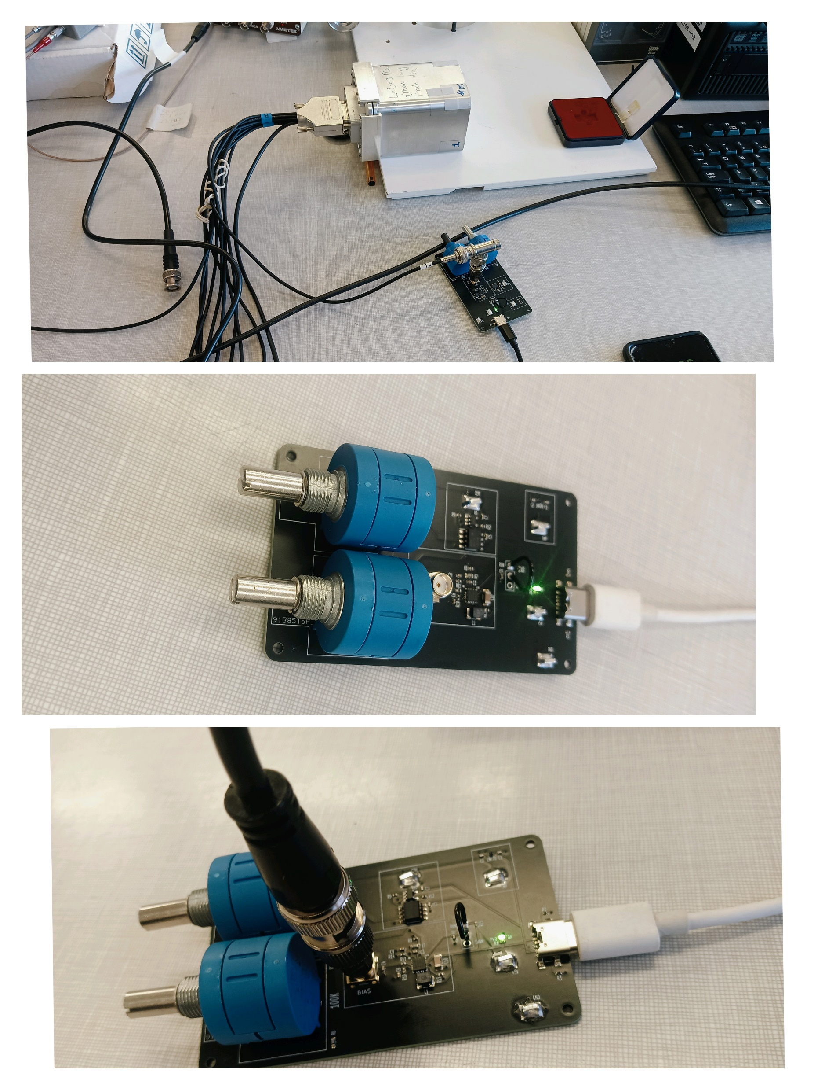
Testing the new bias supply performance

Slide 35
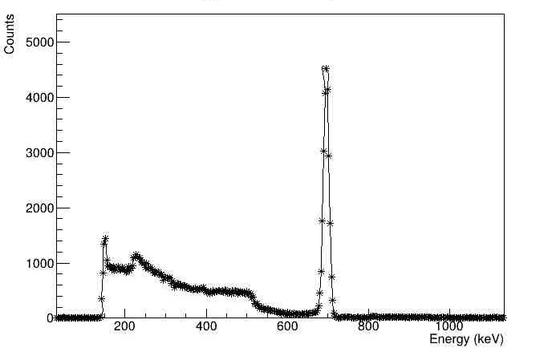
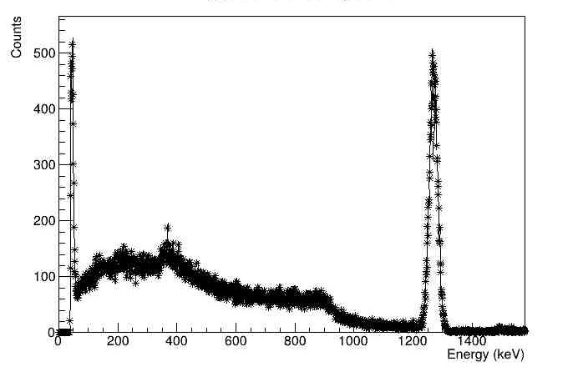
Commercial Bias Supply
UWS Bias Supply
Notes:
I have some doubts regarding this slides

Slide 36
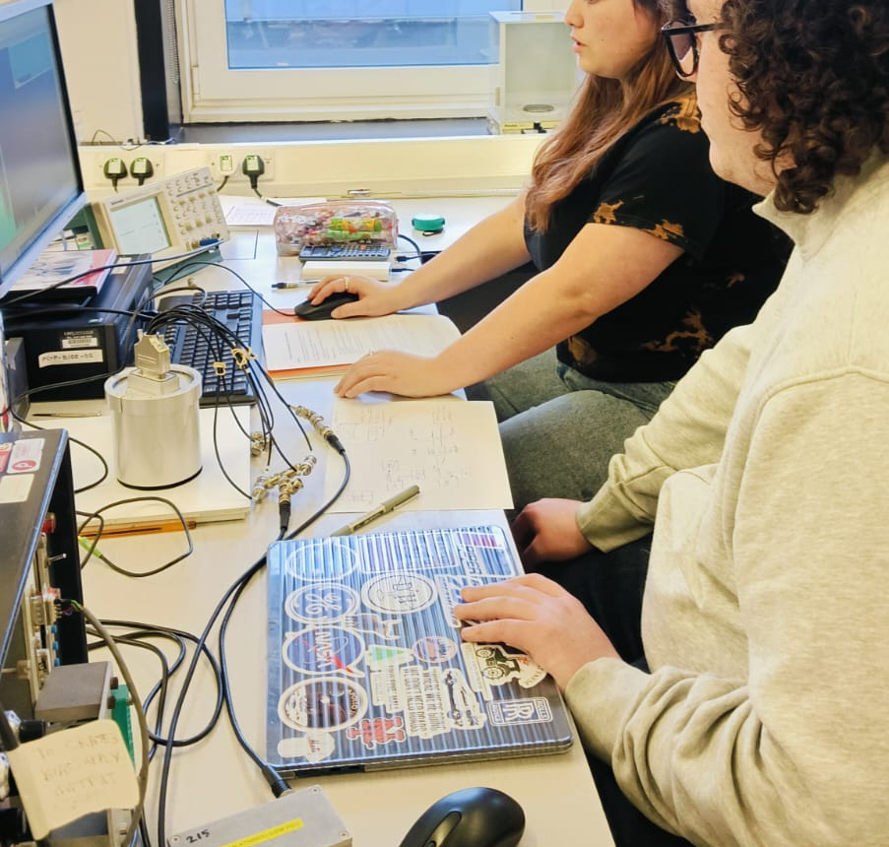
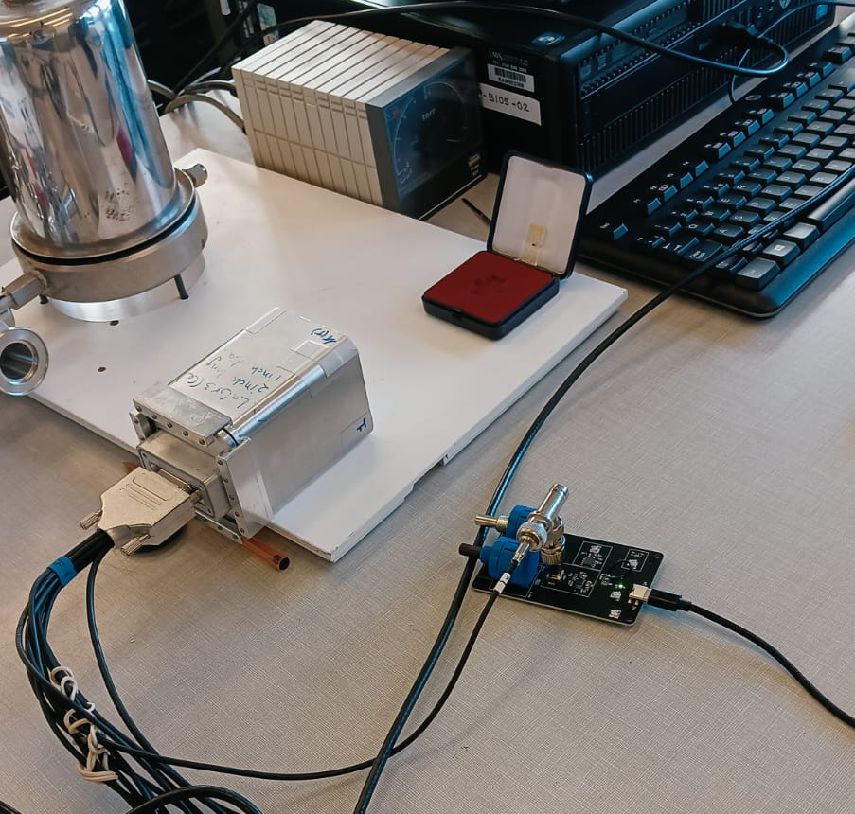
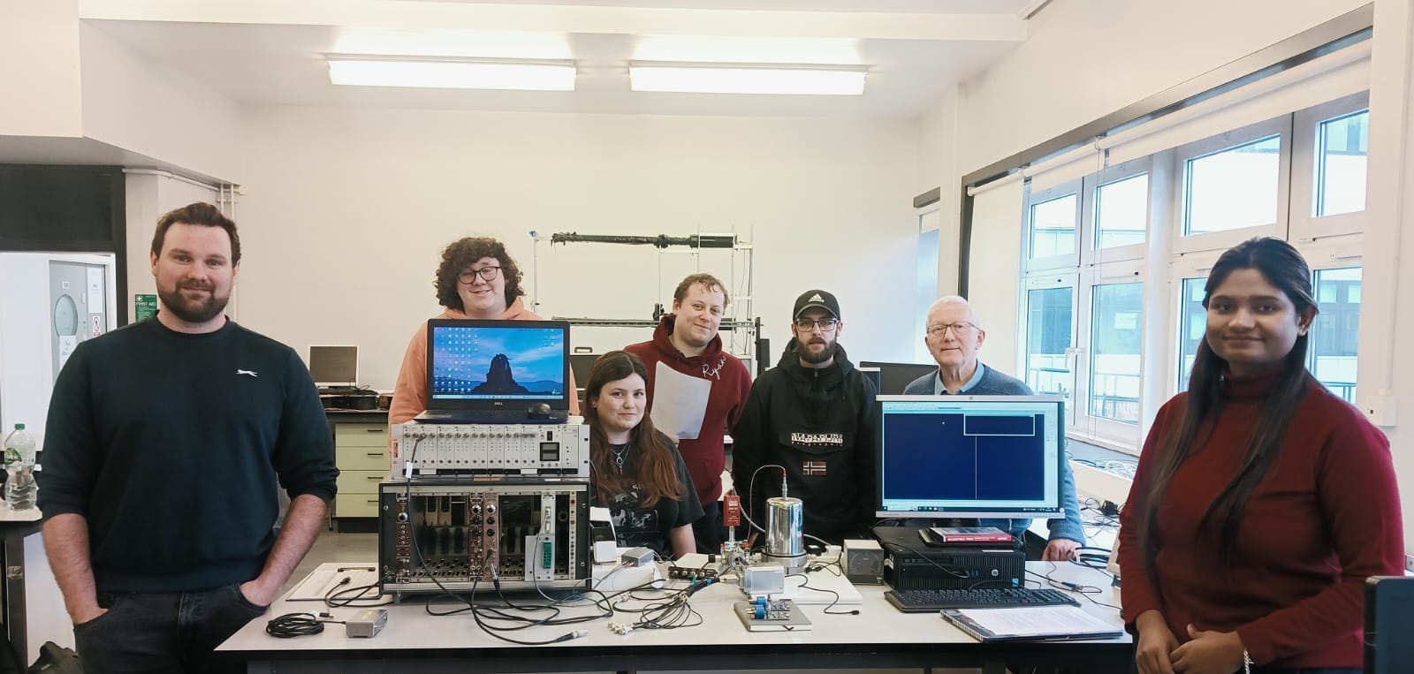
As part of the Year 3 module, Detectors and Nuclear Lab Skills, the novel clover-like LaBr3 (Ce) detector's prototypes have been used in the teaching lab.

Slide 37
Future Applications
At the focal plane or target position of ISRS.
Inside Isolde Solenoidal Separator for Coulex and Plunger techniques.
Nuclear Astrophysical setups detect only a few low—and high-energy gamma rays, which do not require very high resolutions of HPGe. A test will be performed at CMAM.
Fast-timing, e.g., at the focal plane of MARA/RITU separators at Jyvaskyla.

Slide 38
References
B.S. Nara Singh et al., Nucl. Instrum. Methods Phys. Res. A506, (2003) 238.
P.K. Joshi, H.C.Jain, A.S.Medhi, S.Chattopadhyayay, S.Bhattacharya, A.Goswami, Nucl. Instr. and Meth. A 399(1991) 51.
B.S. Nara Singh et al., Nucl. Instrum. Methods Phys. Res. A506, (2003) 238.
C. Mihai et al., Nucl. Instrum. Methods Phys. Res. A953, (2020) 163263.
B.S. Nara Singh et al., presented at IoP 2016 UK.

Slide 39
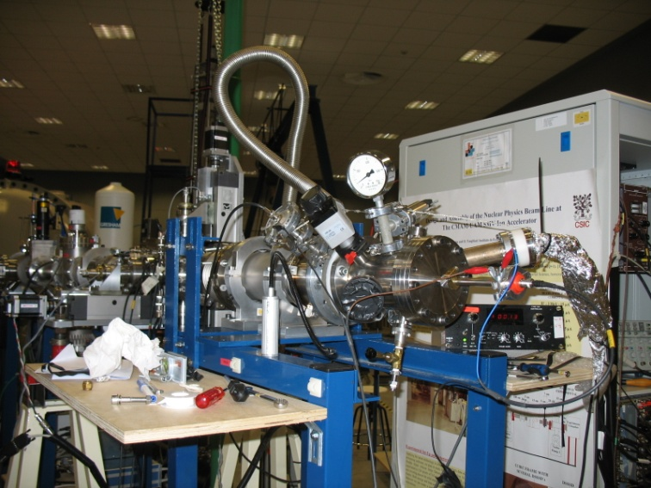


Nuclear Astrophysics to be used in a prompt-gamma experiment at CMAM – Tests next week
RSE Saltire ICA together with CSIC Madrid, March 2021

Slide 40

UWS glovebox

Slide 41





Collaboration
C. Cassells, B.S. Nara Singh, M. Bowry, D. O’Donnell, M. Scheck, J.F. Smith
University of the West of Scotland, UK
P. Joshi, J. Bordes, J.R. Brown, D.G. Jenkins
University of York, UK
O. Tengblad, M.J.G. Borge
Instituto de Estructura de la Materia, CSIC,Spain
Luis M Fraile , J.A.Briz
Universidad Complutense de Madrid, Spain

Slide 42
Thank You

Slide 43
Backup

Slide 44

Non-linearity fitting correction

Slide 45

Physics opportunities
The ISRS allows an application of several reaction mechanisms to produce exotic nuclei in the energy levels of interest, decays of which can be observed by detecting particles or photons with the existing and planned detection systems
Reaction mechanisms
Deep inelastic reactions
Coulomb dissociation
Transfer reactions in inverse kinematics
Multinucleon transfer reactions
Fusion evaporation reactions in inverse kinematics
Transfer, breakup and fusion reactions
Resonant elastic scattering
From Teresa Kurtukian-Nieto

Slide 46

Physics Cases
Inelastic scattering of N~Z (⁷²Kr, ⁸⁰Zr) nuclei (exotic shapes and shape coexistence) and rare earth nuclei (higher order deformations)
Coulex or CNE analysis
Or Plunger measurements

Slide 47




³He(⁴He,γ)⁷Be, Holmgren and Johnston PR 113, 1556, 1959
Rate is 1000 times more than previously thought
The scientific life of John Bahcall:
arXiv:0904.2865v1, 18 Apr 2009, http://www.sns.ias.edu/~jnb/
Standard Model
Standard Solar Model
S₃₄(E) = E σ (E) exp(2πη)
Neutrino Masses
Big Bang
RSE Saltire ICA together with CSIC Madrid, March 2022

Slide 48


Setup to be adopted in December 2024 for prompt gamma-ray detection using the new LaBr3 detector module
https://eprints.ucm.es/id/eprint/27245/1/T35440.pdf (2014)
M. Carmona Gallardo, B.S. Nara Singh et al PRC(2012)
RSE Saltire ICA together with CSIC Madrid, March 2021

Slide 49


Furthermore…
JYFL-Finland – Incorporate the module in the Fast timing array

Slide 50

Furthermore…
Charge state change in recoil ions (e.g. following conversion) – can we identify them using the recoil detector(s) at the end ?
Auger electron
e-
Conversion electron
From K, L or M shell
Auger electrons leave the ions in high charge states
e-
High Charge State
Q₀
Q₀+Q
L
Low Charge State
H

Slide 51



Comparison – LaBr3(Ce) choice
F.G.A. Quarati et al., NIMA (2013)

Slide 52


Gamma detection & ISS
In general, additional information from gamma detection
Gamma detection itself can be crucial in determining final results and physics conclusions.
Taken from the talk by O. Poleshchuk at ISS Workshop 2020

Slide 53



Slide 54


