Slide 1

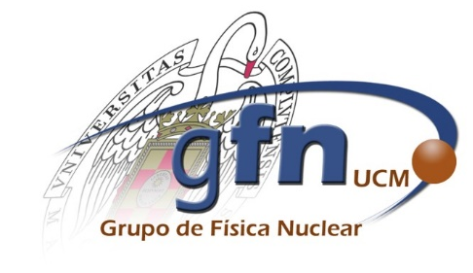

MLTiming:
Using Pairwise Learning for
Improving Timing Resolution in TOF-PET
José A. Avellaneda ¹ , Victor Sánchez-Tembleque¹, Miriam Caballero,
L.M Fraile¹, J. M. Udías^{1, 2} and Joaquín L. Herraiz ^{1, 2}
¹ Grupo de Física Nuclear, Dpto EMFTEL & IPARCOS, Facultad de Ciencias Físicas, Universidad Complutense de Madrid
² Fundación de Investigación Hospital Clínico San Carlos (IdISSC), Madrid, Spain
.

Slide 2
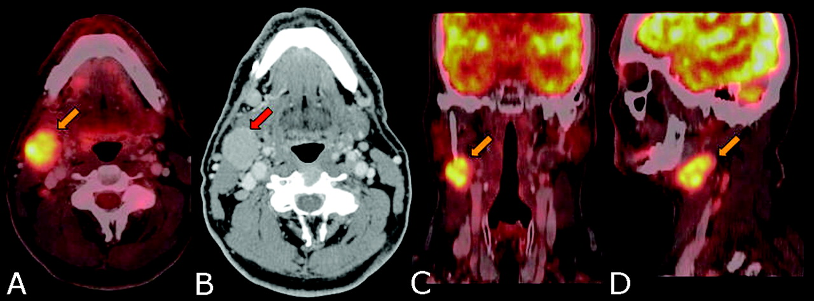
POSITRON EMISSION TOMOGRAPHY (PET)
A functional medical imaging modality

Slide 3
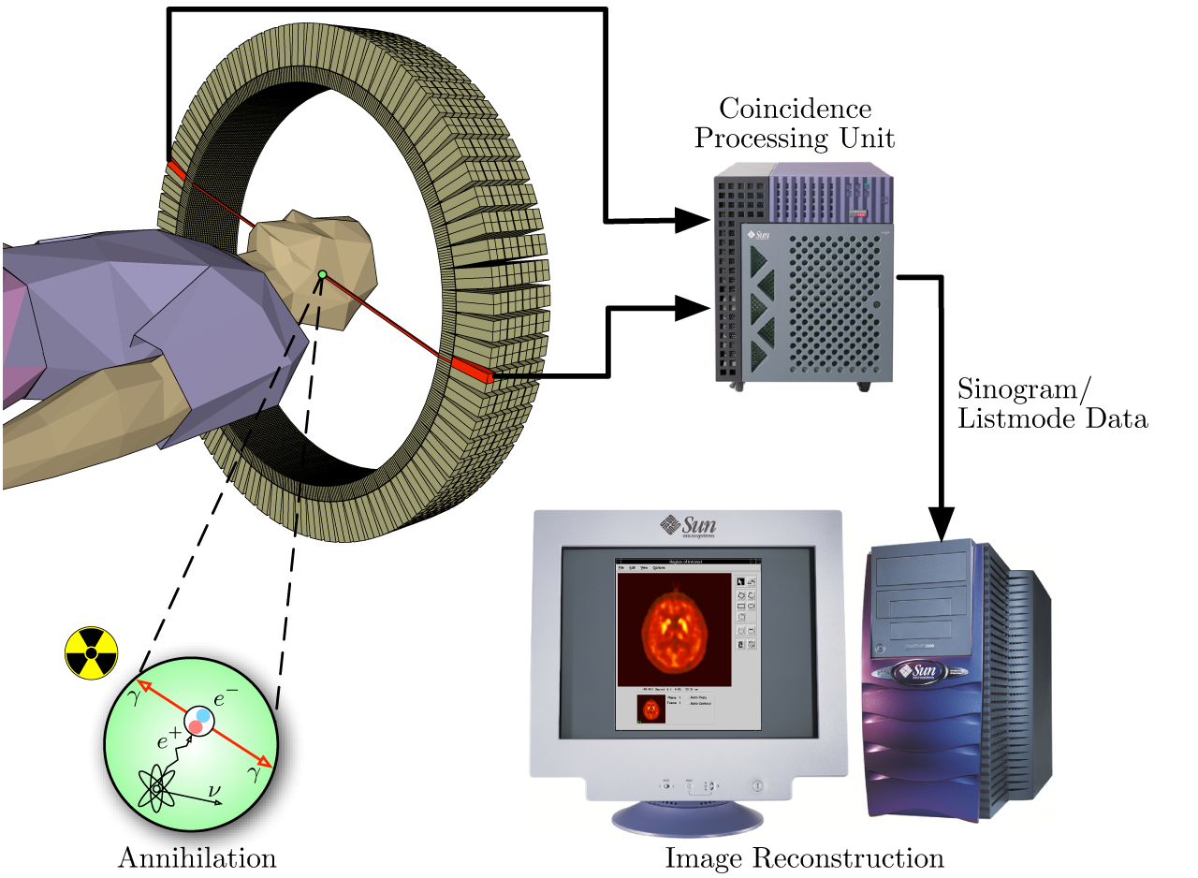
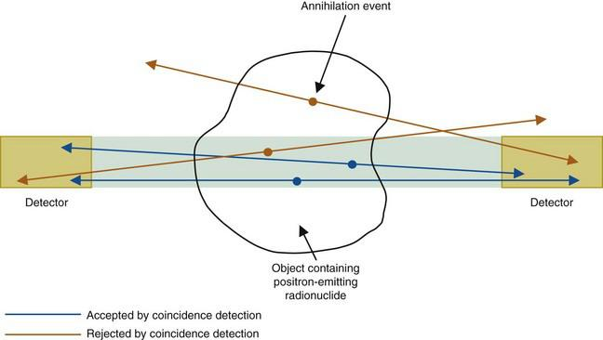
COINCIDENCE DETECTION: The backbone of PET

Slide 4
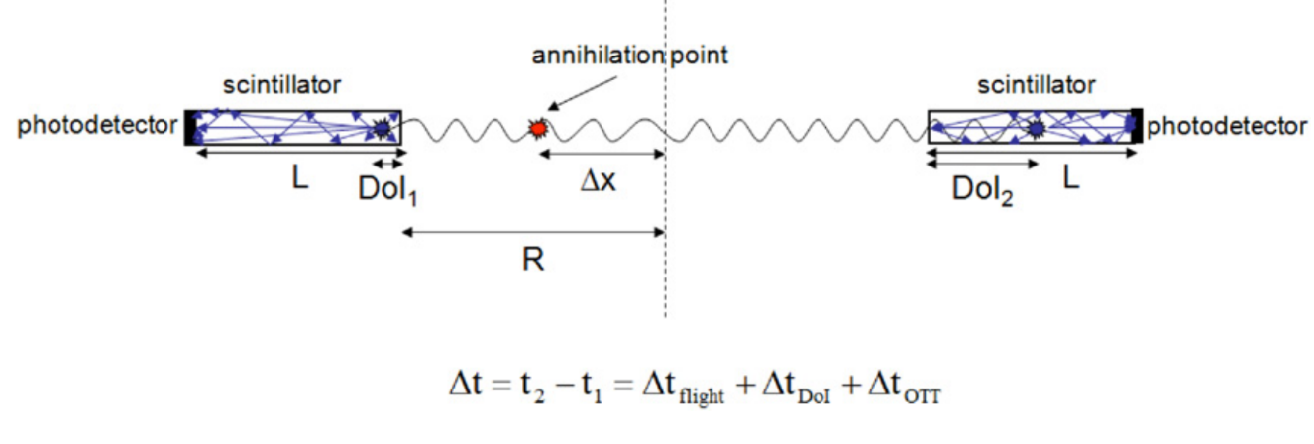
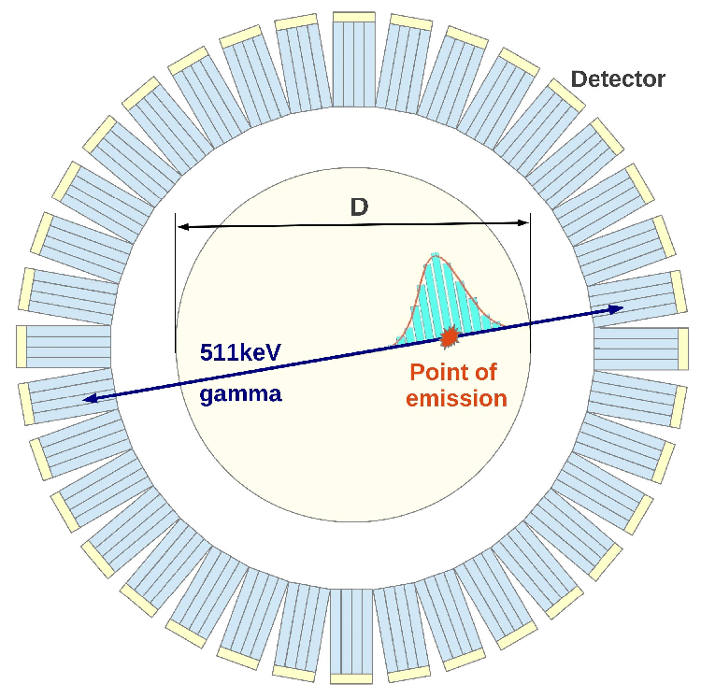

OBJECTIVE: Extract accurate ToA information from the pulses of each detector in order to improve their coincidence time resolution (CTR)
TIME-OF-FLIGHT PET: LEVERAGING TIMING INFORMATION

Slide 5
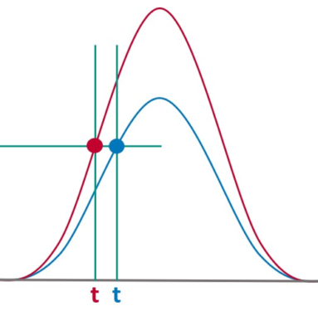
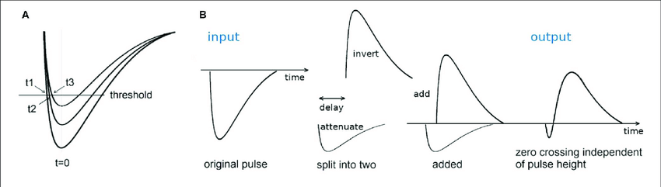
INTRODUCTION: STANDARD TIMING METHODS
A) Leading edge discrimination (LED):
Fixed threshold.
Pulse height dependency.
B) Constant fraction discrimination (CFD):
Relative threshold.
Independent of pulse height.

Slide 6
A STEP BEYOND:
MACHINE LEARNING-BASED TIMING
To train a ML algorithm to give the the time of arrival of a detected gamma-ray, event labelled data are needed, however:
True noiseless ToA cannot be extracted directly from measured data.
Simulations may not be accurate enough.

Slide 7
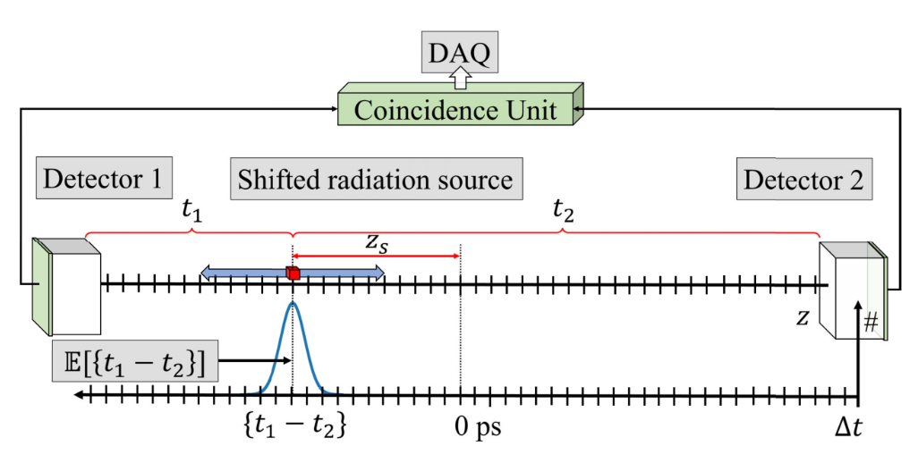
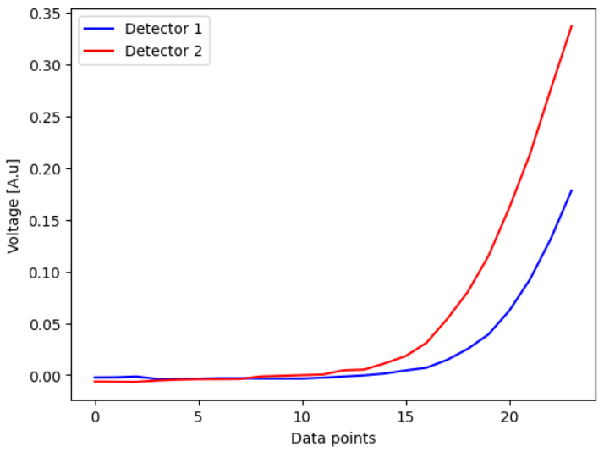
“STANDARD” ML APPROACH:
Measure coincidences in 2 detectors with different source positions.
2. Save waveforms for both detectors for each coincidence event.
Courtesy: Improving the Timing Resolution of Positron Emission Tomography Detectors Using Boosted Learning—A Residual Physics Approach (Naunheim et al. , 2023)
3. Train a Neural Network using both waveforms as inputs and the expected Time-of-Flight as label.

Slide 8
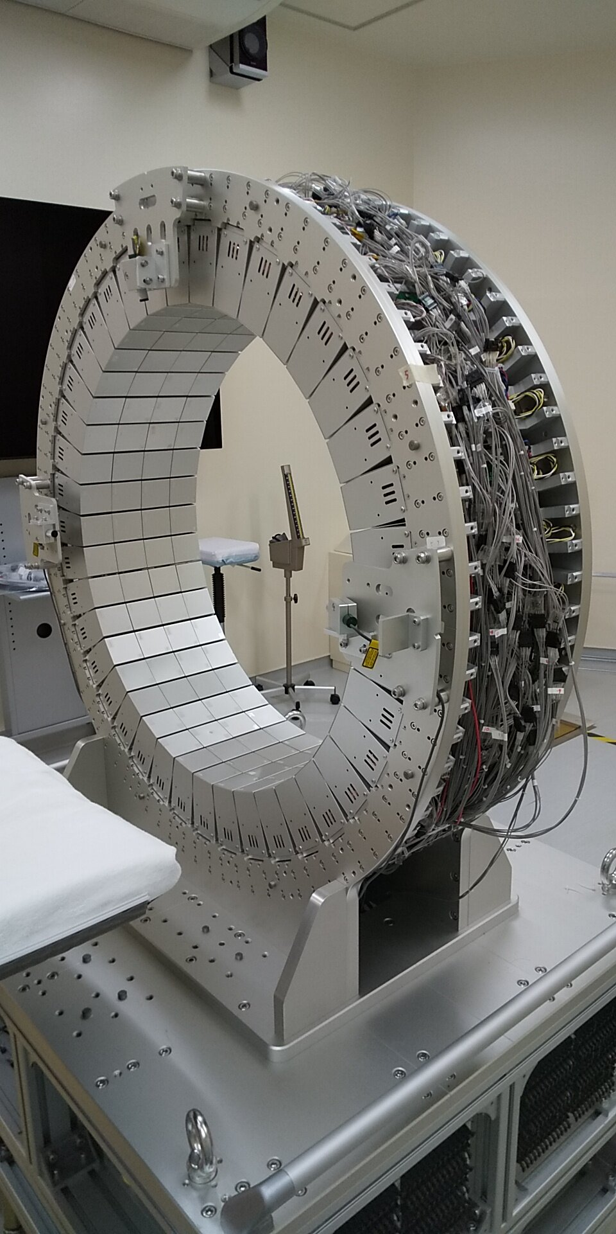
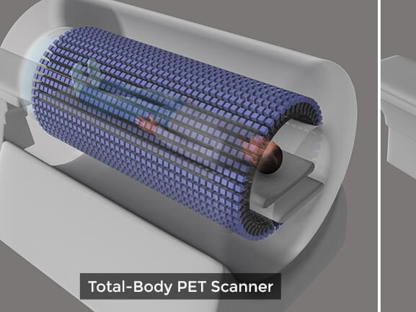
A fully operational PET scanner has thousands of different detector-pair combinations!

Slide 9
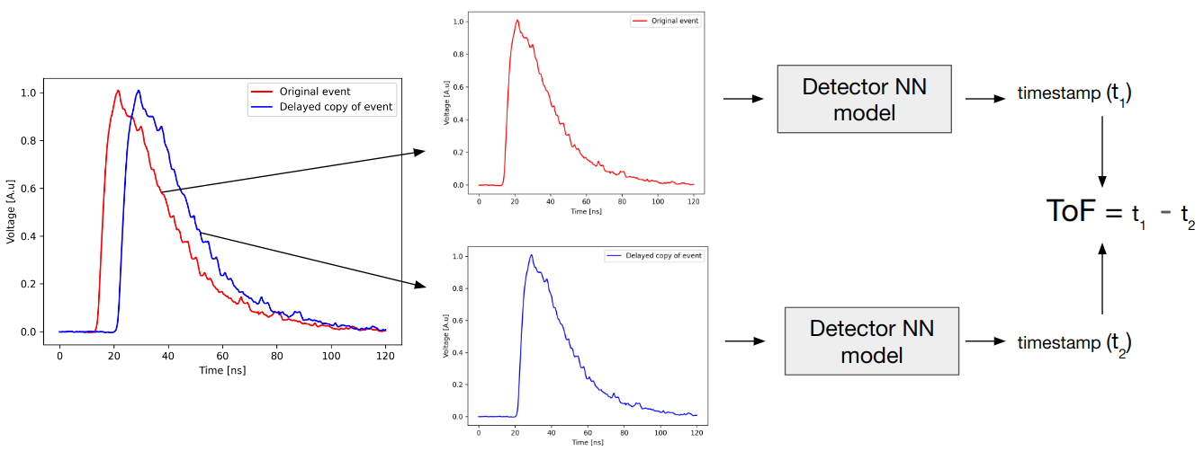
METHODS: HOW TO TRAIN WITH SINGLES
ORIGINAL EVENT
Pairwise
learning
DELAYED EVENT

Slide 10
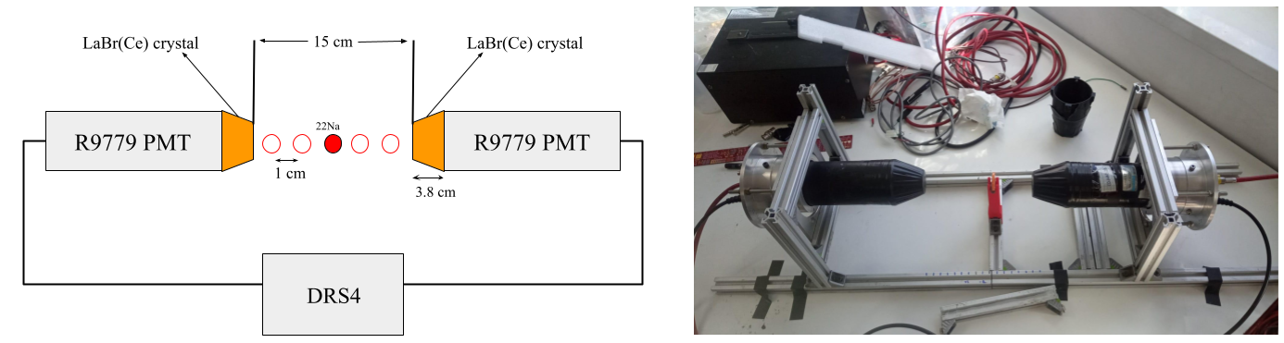
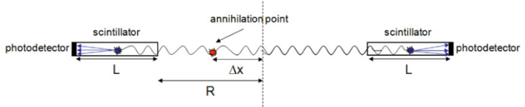
METHODS: EXPERIMENTAL SETUP
Validation data:
Same hardware. Detectors separated 15 cm and source moved in 11 positions (-5 to 5 in steps of 1 cm) along the line of response.
Training data:
Acquired with a 22Na point source with a pair of conic 2” LaBr3(Ce) detectors in coincidence mode connected to Hamamatsu R9779 PMTs sampled at 5 Gs/s.

Slide 11
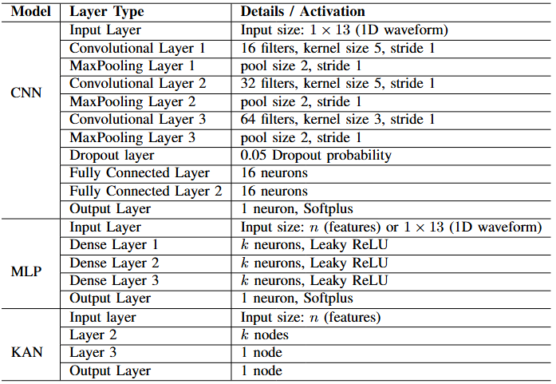
METHODS: Neural Networks Models Considered

Slide 12
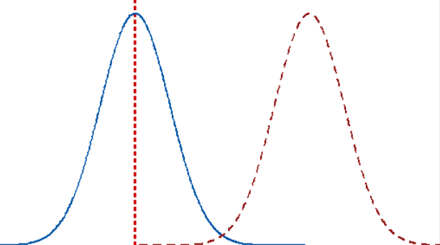
Results: METRICS (Evaluated with Coincidences)
We evaluate performance based on three metrics:
Mean Absolute error (Data science metric)
CTR (FWHM of gaussian fit of TOF distribution) (PET metric)
Bias (Physical metric)
Bias
FWHM
t

Slide 13
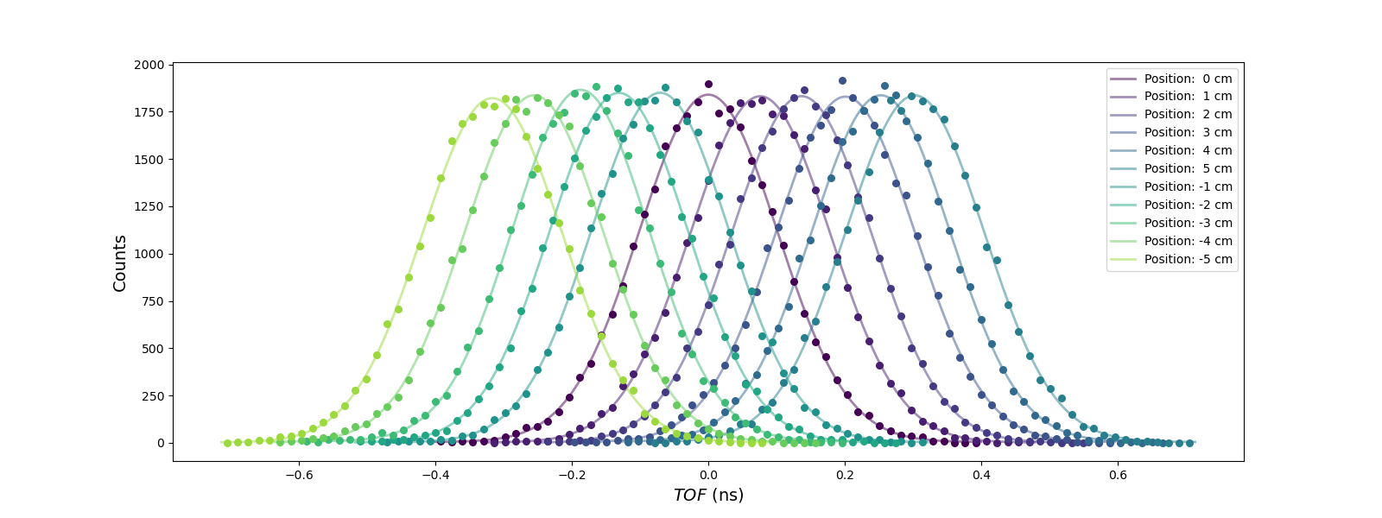
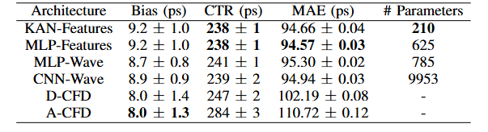
RESULTS:
Trained with ~15000 singles.
Validated with ~330000 coincidences.
1Million pulses processed in ~3 seconds with an NVIDIA GeForce RTX 4090 GPU

Slide 14
CONCLUSIONS:
MLTiming is able to match standard methods in timing tasks using a wide array of different network types.
Our approach could facilitate implementation of ML timing methods in medium and large-sized PET scanners.
KAN networks compete with the other Neural Network methods in key metrics with smaller network size.
Machine learning methods do not constitute a bottleneck for fast pulse processing in high count-rate situations.

Slide 15





Acknowledgements
Prototwin Project (TED2021-130592B-I00) funded by MCIN/AEI/10.13039/501100011033 and by the European Union NextGenerationEU/PRTR.
Fascina Project (PID2021-126998OB-I00) and 3PET Project (PDC2022-133057-I00) funded by MCIN/AEI/10.13039/501100011033 and by the European Union NextGenerationEU/PRTR.
Tartaglia Project (MIA.2021.M02.0005) - Ministerio de Asuntos Económicos y Transformación Digital, financiado con fondos del Plan de Recuperación, Resiliencia y Transformación de la Unión Europea a través de los fondos Next Generation EU. TARTAGLIA está enmarcado dentro del programa Misiones de I+D en Inteligencia Artificial de la agenda España Digital 2025 y de la Estrategia Nacional de Inteligencia Artificial.

Slide 16
Contact: javellan@ucm.es
MLTiming:

