Slide 1




Upgrade of the fast-timing capabilities of the FATIMA array
S. Pascu, A. Stoica, C. Neacsu, A. Bruce, C. Costache, B. Das, M. Gorska,
C. Mihai, M. Mikolajczuk, Zs. Podolyak, P.H. Regan, A.E. Turturica
Fast timing for nuclear structure and applications - FAST'25
12 March 2025

Slide 2
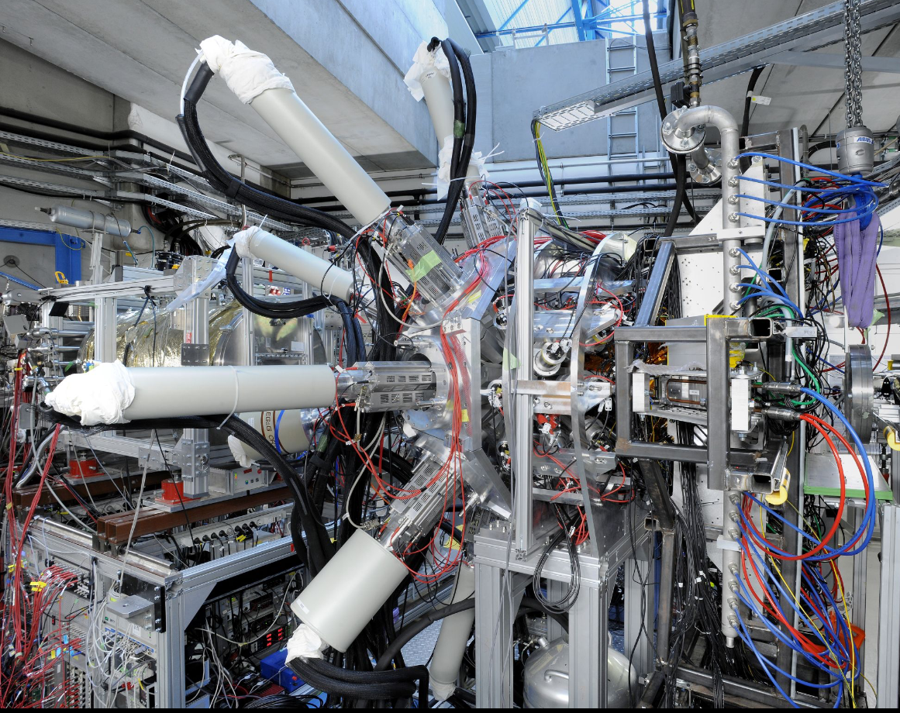
Design of the FATIMA detectors
FATIMA = FAst TIMing Array
DEGAS
FATIMA
FATIMA
DESPEC@FAIR
DESPEC@FAIR

Slide 3
Design of the FATIMA detectors
1”x1”
1.5”x1.5”
Energy performances
Timing performances
1.5” x 2”
1.5” x 1.5” x 2”
hybrid
L.M. Fraile et al., FATIMA TDR (2015)
O.J. Roberts et al., NIM A 748, 91 (2014)

Slide 4
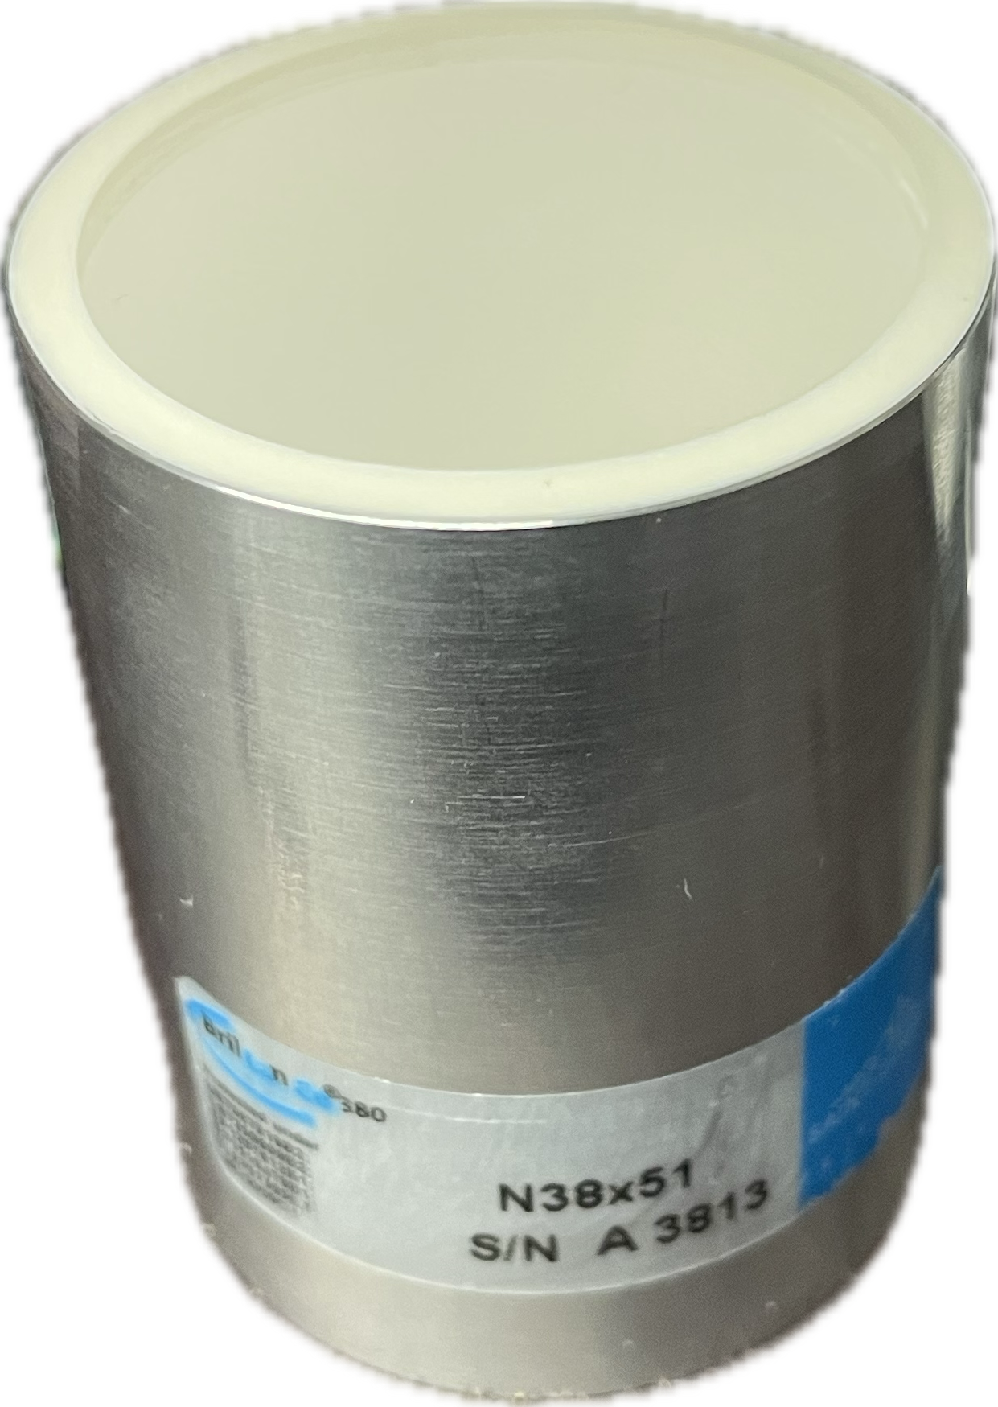
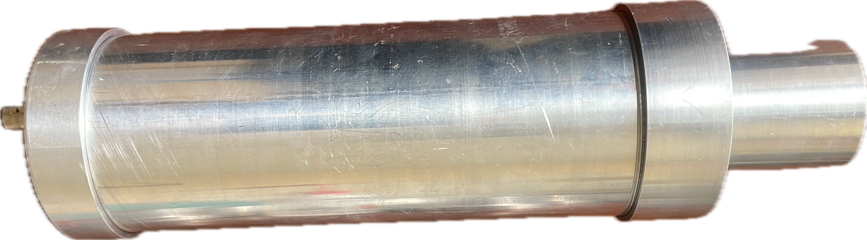
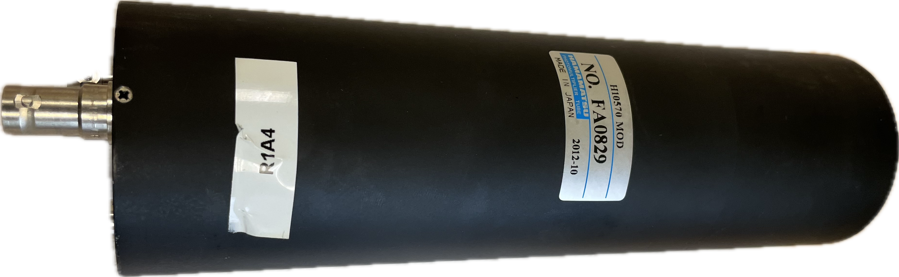
Design of the FATIMA detectors
1.5”x 2” LaBr₃(Ce) crystals
FATIMA = 36 detectors
R9779 PMTs

Slide 5
Characteristics of FATIMA detectors
Energy performances
Timing performances
Internal radioactivity
¹⁵²Eu
M. Rudigier et al., NIM A 969, 163967 (2020)

Slide 6
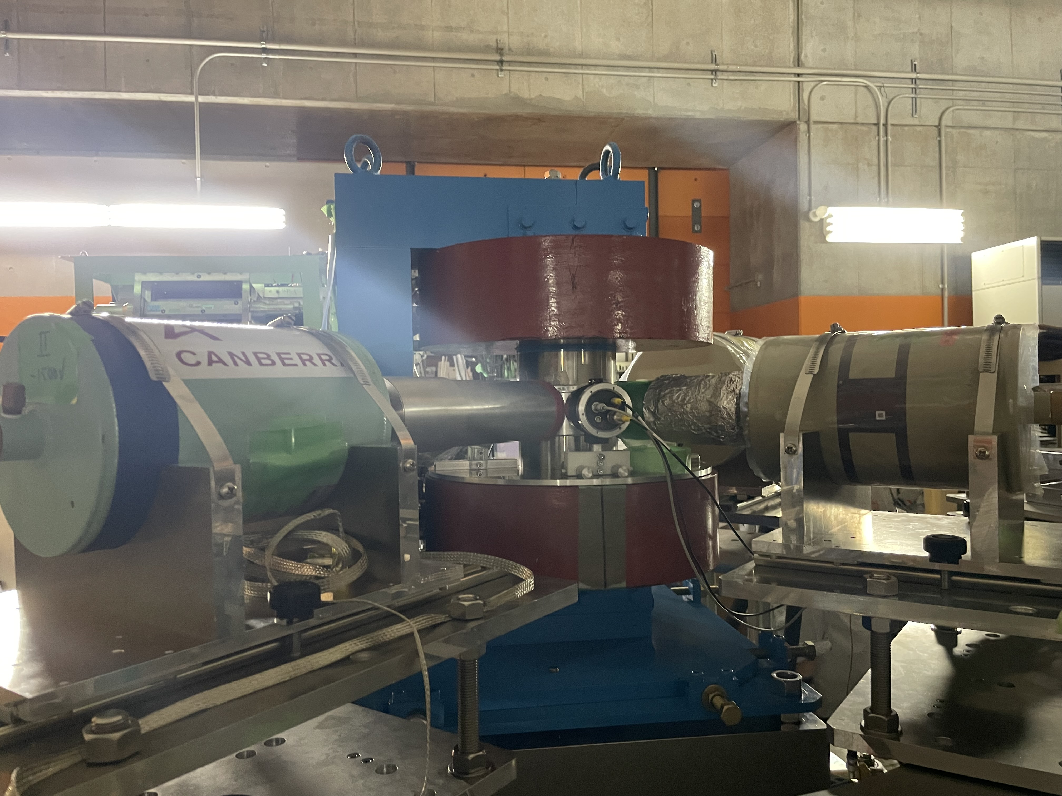
SiPM versus PMT
PMT
SiPM
High voltage (~1 kV)
Bulky size (~10s cm)
Stable with temperature
Sensitive to magnetic fields
Low voltage (~10s V)
Compact size (~few cm)
Sensitive to temperature
Insensitive to magnetic fields
Rel. energy res (%)
M. Rudigier et al., NIM A 969, 163967 (2020)
G. Georgiev, TDPAC @ RIKEN

Slide 7
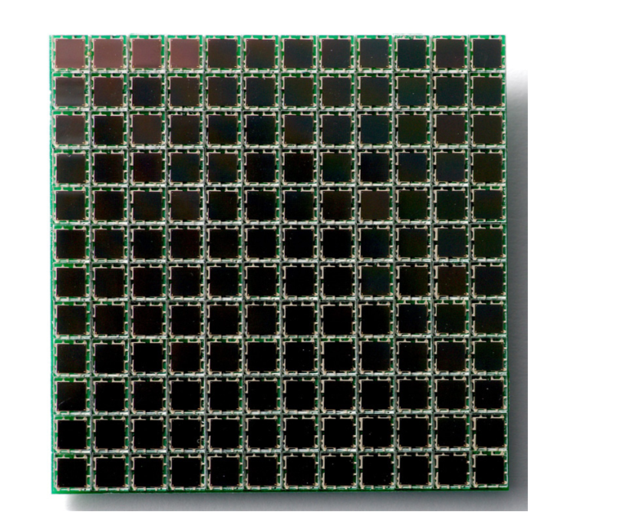
New readout based on SiPM
Readout methods:
Passive – summing the individual SiPM outputs
Individual – use dedicated preamps to readout each SiPM
Active – divide the array into groups with passively summed outputs
  the array is divided into groups of max 8 cells
  The standard signals within a group is summed up
  The fast signal within a group is multiplexed using the Signal Driven Method

Slide 8
FATIMA upgrades
New readout system based on SiPM
Development of a circular array
SiPM J-type 6x6 mm² +3x3 mm²
Multiplexing solution for readout
Temperature compensation circuit
S. Pascu et al., NIM A 1070, 170001 (2025)

Slide 9
SiPM signals
2 outputs: standard and fast

Slide 10
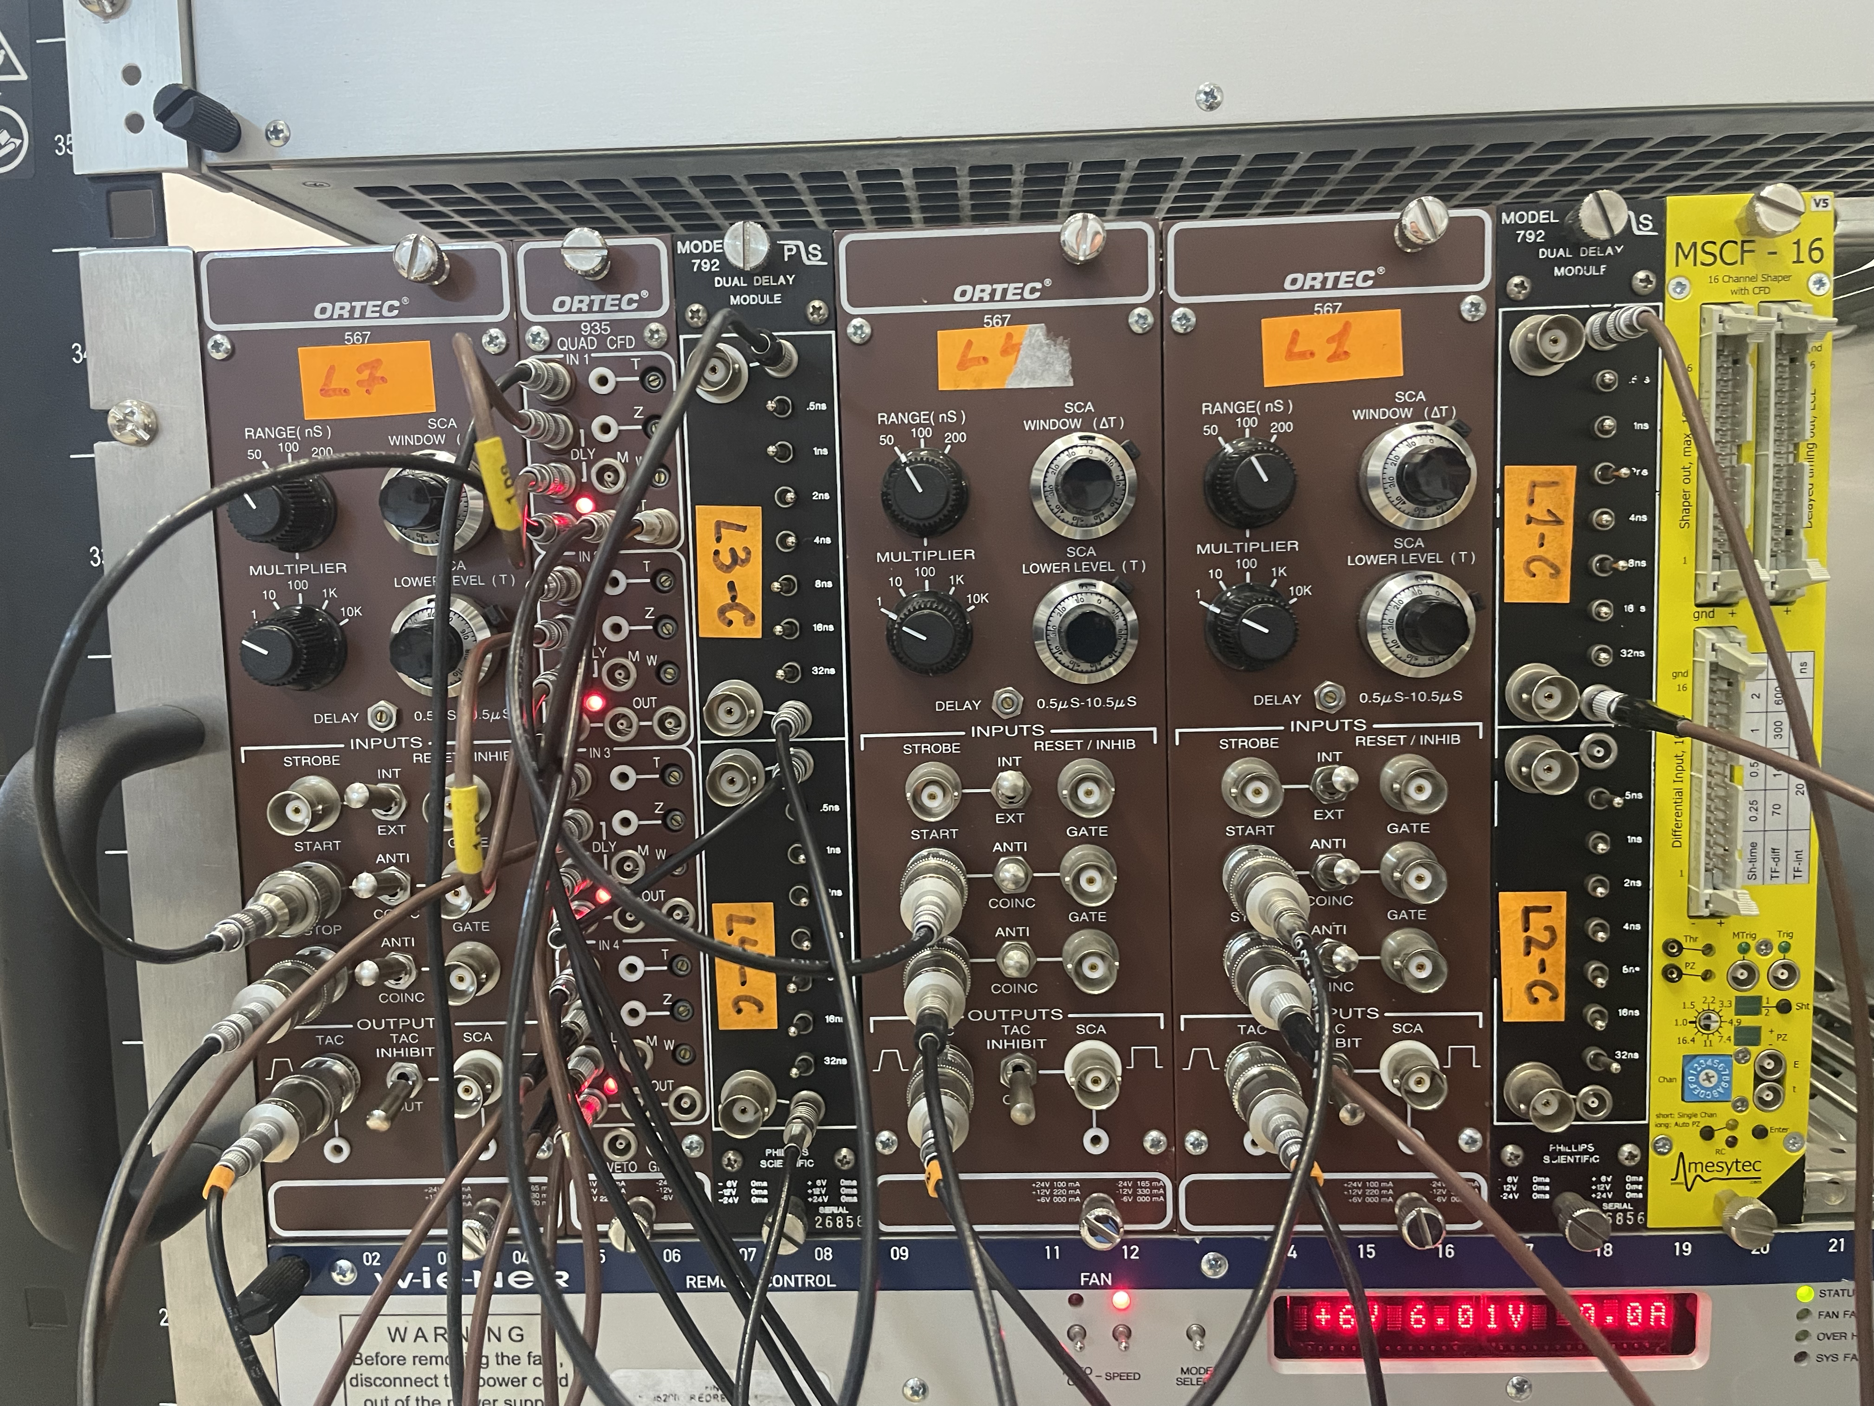
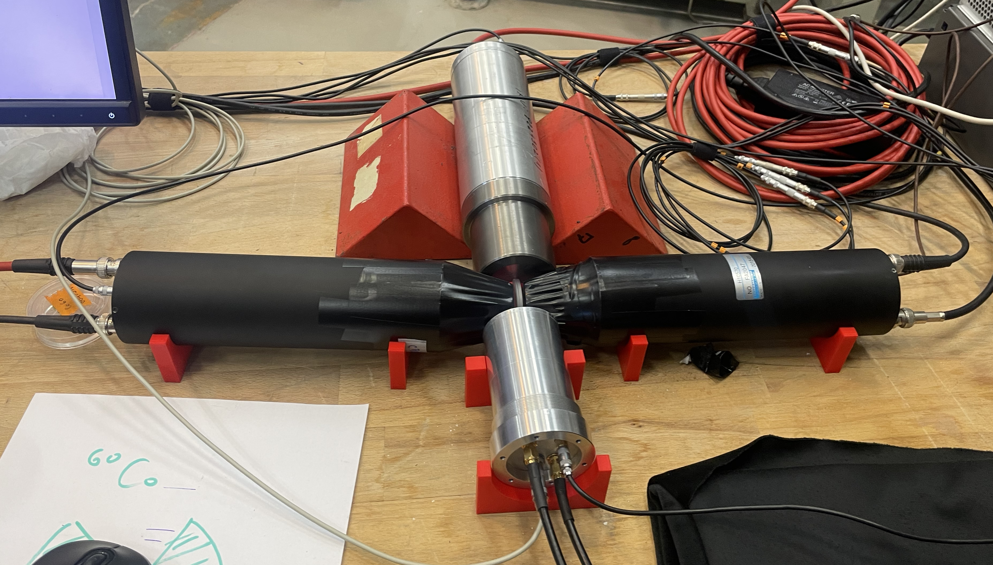
SiPM tests
Analog electronics setup
Detectors setup
FATIMA+PMT
Conical1
Conical2
FATIMA+SiPM

Slide 11
Energy resolution

Slide 12
Time resolution
⁶⁰Co source
S. Pascu et al., NIM A 1070, 170001 (2025)

Slide 13
Temperature compensation circuit
System architecture
S. Pascu et al., NIM A 1070, 170001 (2025)

Slide 14
Conclusions
FATIMA: state-of-the-art array for nuclear spectroscopy
Fast-timing measurements
New readout of the FATIMA detectors
Better energy resolution than with PMT
Similar time resolution
Temperature compensation circuit to correct for the gain drift

