Slide 1
Cooling and ventilation studies
F. Dragoni, N.Zaric/ EN-CV ,
HI-ECN3 WP4 – TARGET COMPLEX – COORDINATION MEETING #8 – 30.01.2025.

Slide 2
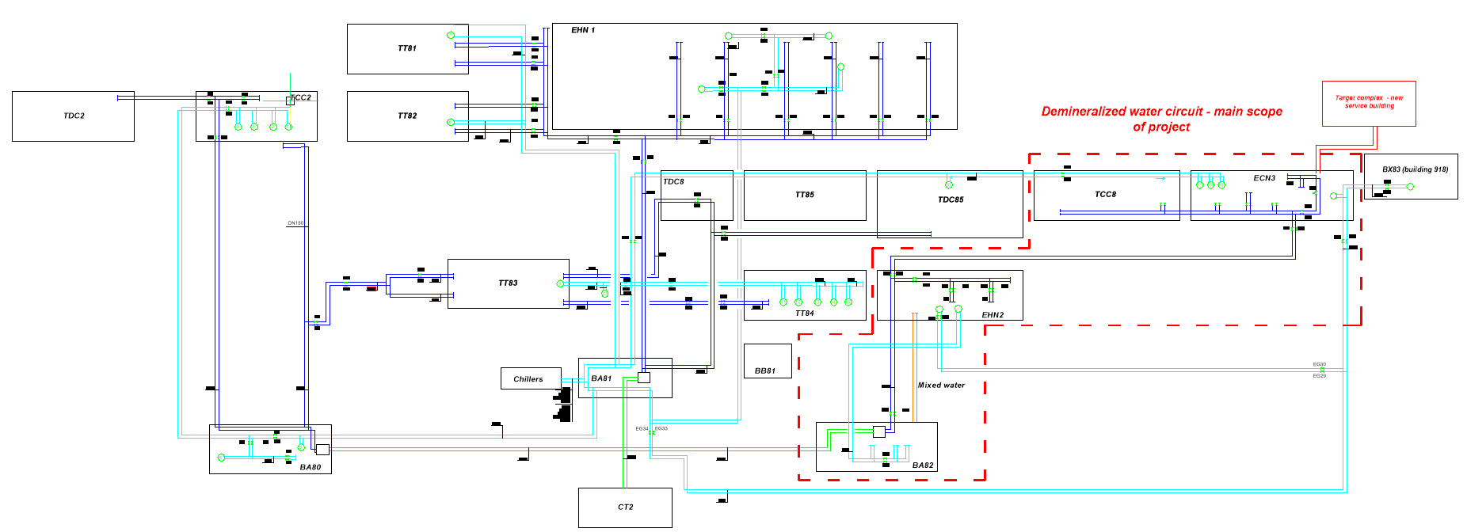
BA82 building: Current cooling station
30/01/2025
F. Dragoni, N.Zaric | Cooling and ventilation studies | Indico 1502683

Slide 3
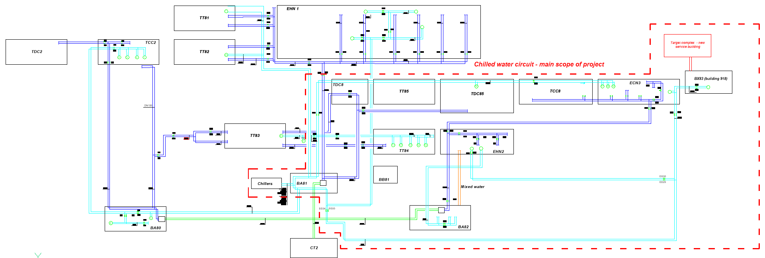
BA82 building: Current cooling station
30/01/2025
F. Dragoni, N.Zaric | Cooling and ventilation studies | Indico 1502683

Slide 4
BA82 building: Current cooling station
Demineralized water – Now, given by Users
30/01/2025
F. Dragoni, N.Zaric | Cooling and ventilation studies | Indico 1502683

Slide 5
BA82 building: Current cooling station
Demineralized water – Future
30/01/2025
F. Dragoni, N.Zaric | Cooling and ventilation studies | Indico 1502683

Slide 6
BA82 building: Current cooling station
Demineralized water – Nominal values
Demineralized water - Future
 | T_{in} | T_{out} | P_{max} | Pressure drop | Total dissipated Power | Total flow | Type of water
 | (°C) | (°C) | (bar) | (bar) | (kW) | (m³/h)
Magnets | 26 | 35-42-46-56 | 30 | 15 | 696.4 | 77.8 | Demineralized
Power converters | 26 | 36 | 16 | 3 | 45 | 2 | Demineralized
Vacuum pumps |  |  |  |  | 4.19 | 0.363 | Demineralized
Water cooled cables |  |  |  |  | 200 | 17.3 | Demineralized
EHN2/Amber facility |  |  |  |  | 4000 | 105 | Demineralized
 |  |  |  | Σ | 4945.59 | 202.46
 |  | T_{in} | T_{out} | P_{max} | Pressure drop | Total dissipated Power | Total flow | Type of water
 |  | (°C) | (°C) | (bar) | (bar) | (kW) | (m³/h)
1st cooling substation | Power converters | 26 | 36 | 16 | 3 | 206 | 18.12 | Demineralized
2nd cooling substation | Vacuum pumps |  |  |  |  | 4.19 | 0.363 | Demineralized
 | SHIP |  |  |  |  | 450 | 35 | Demineralized
 | Water cooled cables |  |  |  |  | 200 | 17.3 | Demineralized
 | EHN2/Amber facility |  |  |  |  | 3300 | 105 | Demineralized
3rd. 4th, 5th cooling substation | Target Proximity shielding Magnetic coil | 27 | 30-33.7-35.6 |  |  | 380 | 65.76 | Demineralized
 |  |  |  |  | Σ | 4540.19 | 241.54
Current measurement:
Cooling capacity: 6.0MW
Flow rate: 290 m3/h
Chilled water – in progress
Mixed water needs – no need so far
30/01/2025
F. Dragoni, N.Zaric | Cooling and ventilation studies | Indico 1502683

Slide 7
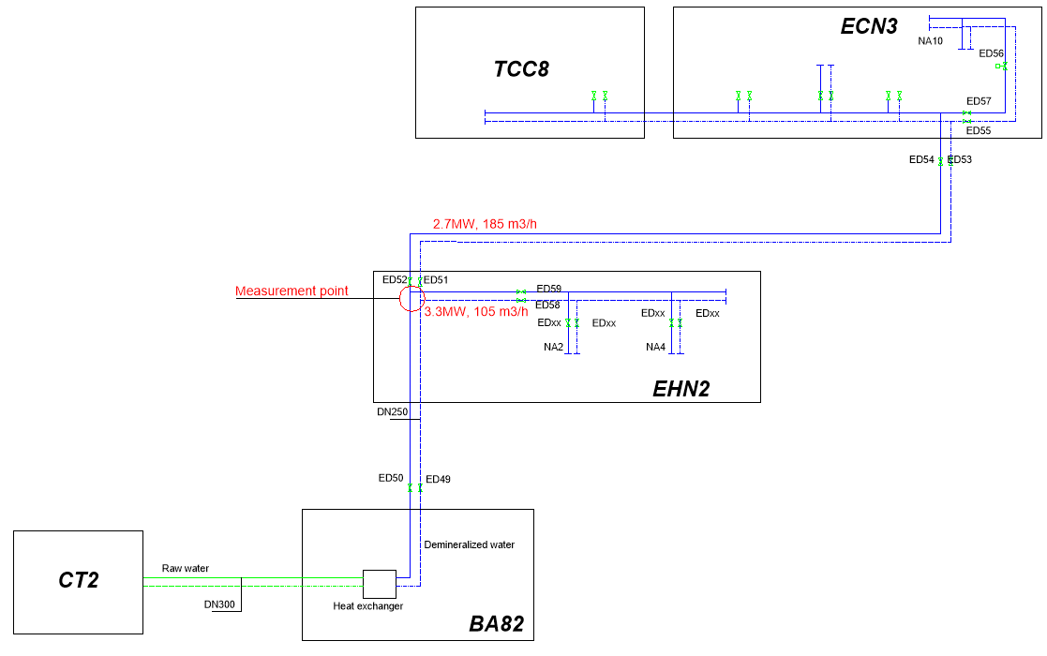
BA82 building: Current cooling station
Demineralized water – measurement results
 | Total cooling Power | Total flow rate | Type of water
 | (kW) | (m³/h)
ECN3, TCC8 branch: Magnets, Power converters, WC cables, vacuum pumps, NA62 experiment | 2700 | 185 | Demineralized
EHN2/Amber facility | 3300 | 105 | Demineralized
Σ | 6000 | 290.00
Current measurement:
Cooling capacity: 6.0MW
Flow rate: 290 m3/h
30/01/2025
F. Dragoni, N.Zaric | Cooling and ventilation studies | Indico 1502683

Slide 8
BA82 building: Current cooling station
Current status:
- Demineralized water: We will have enough power & flow rate in future
- Chilled water: collected data, 4.35MW maximum power, nominal 4.4MW;
Additional chilled water needs in future:
- Berylium facility: 200kW
- New service building: 250kW
- We have to “recover” 450kW from the chilled water loads, NA62 experiment 2 AHUs will be removed, mixed water circuit to be removed, total capacity to be recovered about 150kW
- Maximum capacity (4.35MW) happened only once
- 46 times (hours) we had capacity more than 3.9MW
- Mixed water: no needs so far
Preparing for the TCC on cooling meeting – status for 5th cell of CT2, presenting results of consumption analysis, requests from Users side, strategy for implementation of HI-ECN3
User requirements’ document – in progress
30/01/2025
F. Dragoni, N.Zaric | Cooling and ventilation studies | Indico 1502683

Slide 9
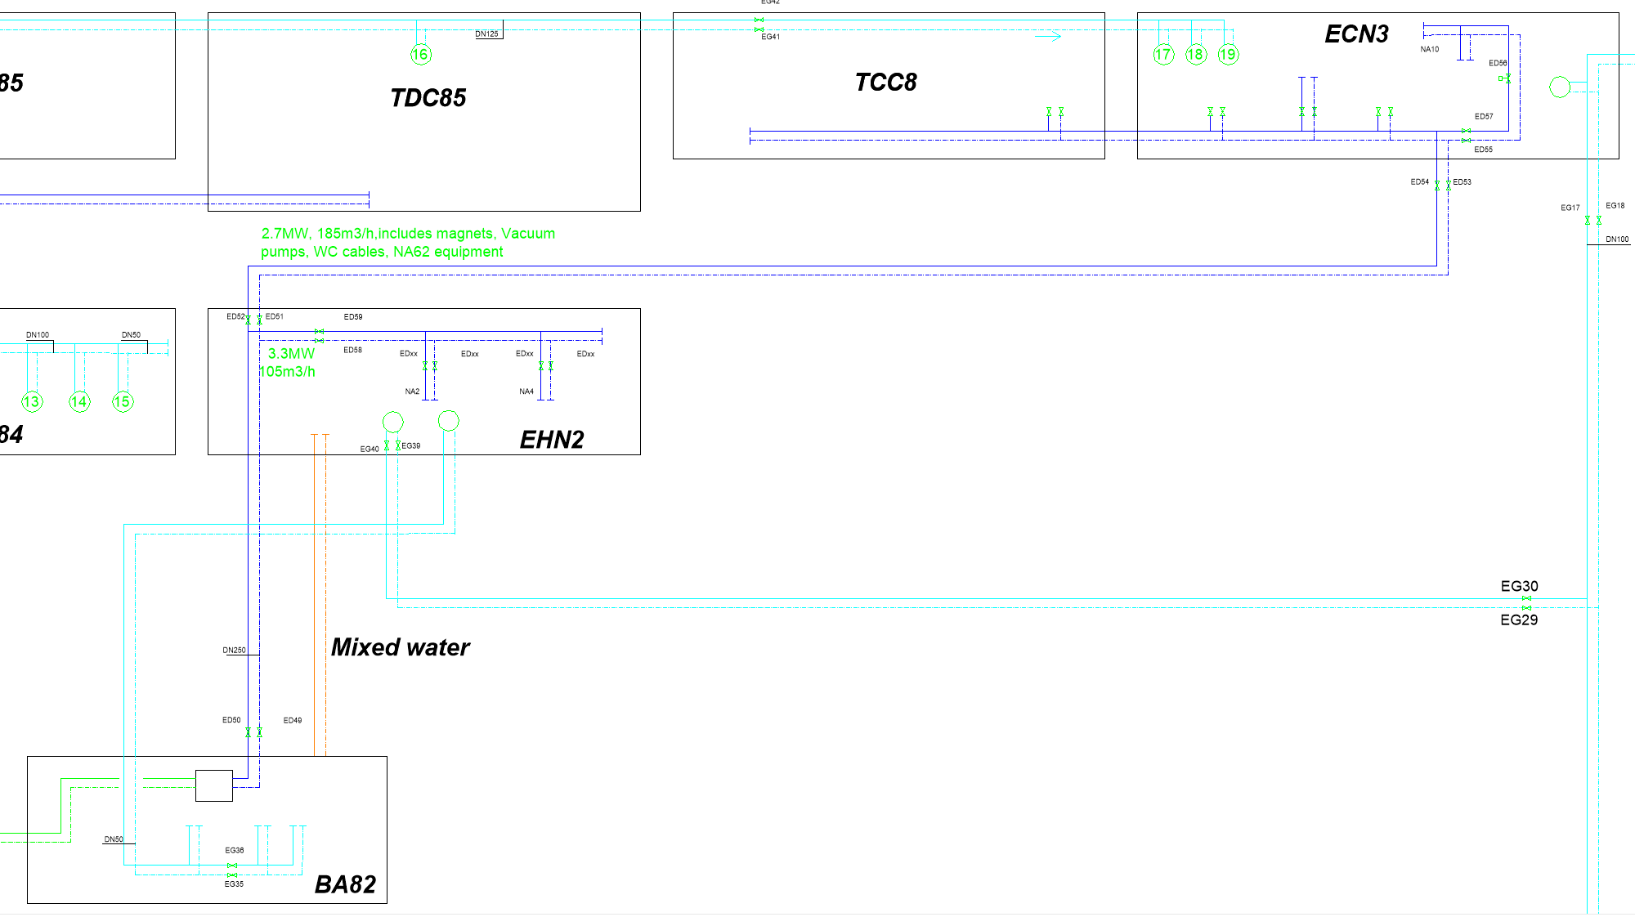
BA82 building: Current cooling station
Demineralized water – Nominal values
Demineralized water - Future
 | Total dissipated Power | Total flow | Type of water
 | (MW) | (m³/h)
ECN3, TCC8 branch: Magnets, Power converters, WC cables, vacuum pumps, NA62 experiment | 2.7 | 185 | Demineralized
EHN2/Amber facility | 3.3 | 105 | Demineralized
Σ | 6 | 290.00
Current measurement:
Cooling capacity: 6.0MW
Flow rate: 290 m3/h
Pending final verification BA82 stations for EHN2, TCC8 and ECN3 have sufficient power and flow rate
30/01/2025
F. Dragoni, N.Zaric | Cooling and ventilation studies | Indico 1502683

Slide 10
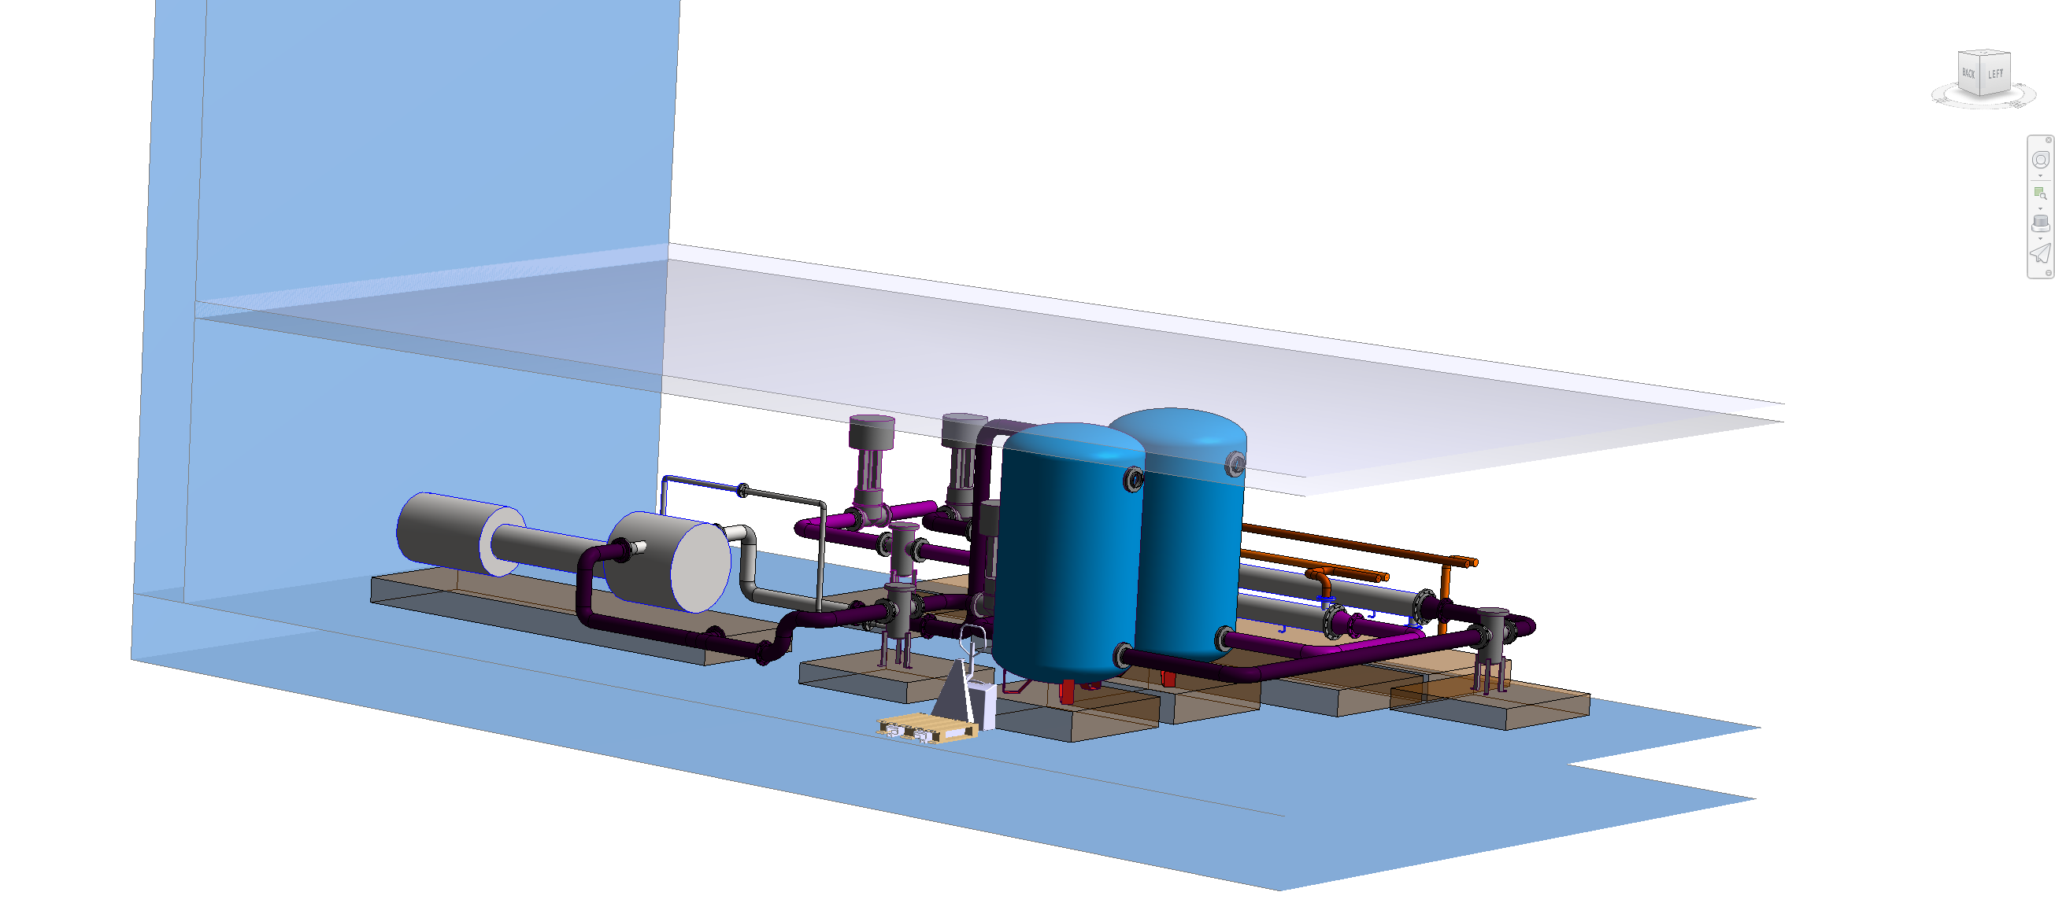
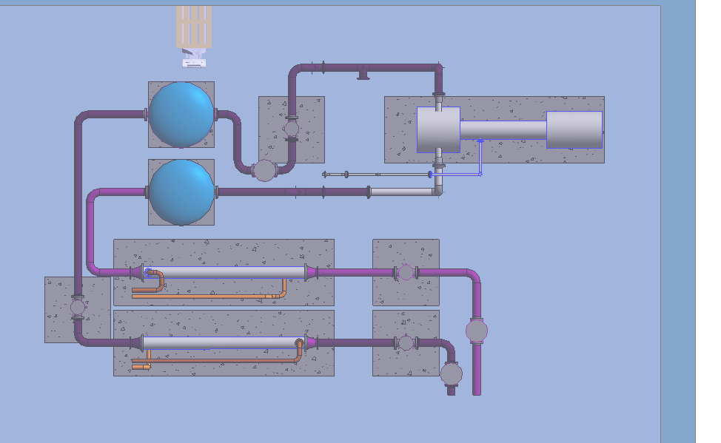
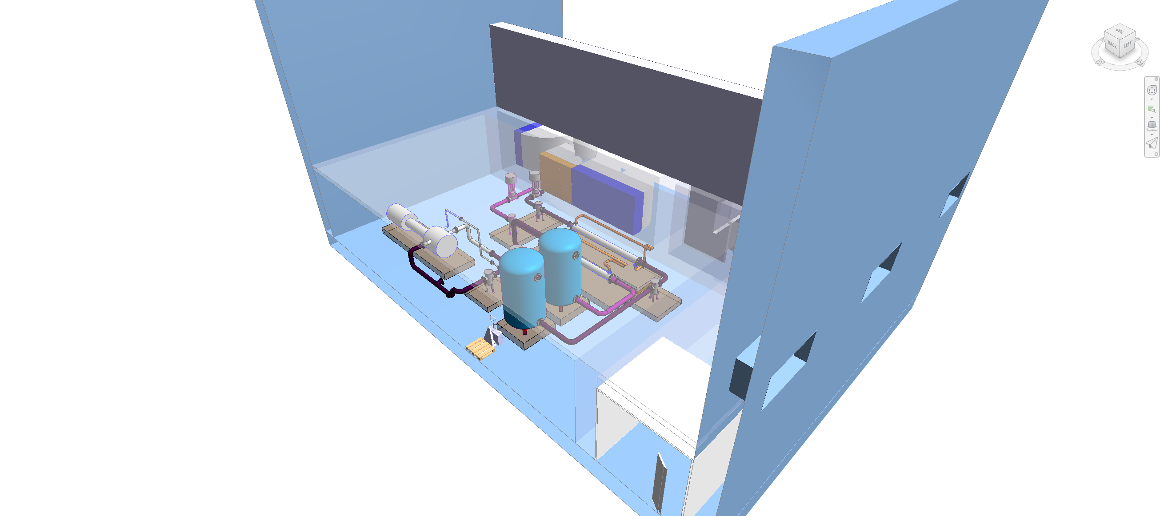
New service building: Integration model
Current status: enough space for all the skids
30/01/2025
F. Dragoni, N.Zaric | Cooling and ventilation studies | Indico 1502683

