Slide 1
Target Station Configuration & Vacuum Vessel Design Study
30.01.2025

Slide 2
Introduction
Vacuum Vessel Design Parameters
Vessel Material and Structure
Vacuum Vessel Technical Specification
Prototype Tests
Technetics
Inputs Required

Slide 3
Rough Design Parameters for Vacuum Vessel
Parameter | Value
Beam Height | 1700mm from ground, 1694mm from vessel base
Volumes (internal & external) | Internal = 28.96m³, External = 38.96m³
External Dimensions (without guide rails) | 6410 x 2050 x 2965mm
Internal Dimensions | 6210 x 1750 x 2665mm
Empty Weight | ~25000kg
Foreseen Internal Load | ~142000kg
Foreseen Kinematics Within Vessel | Internal trolley mounted on rails for extraction of target and shielding

Slide 4
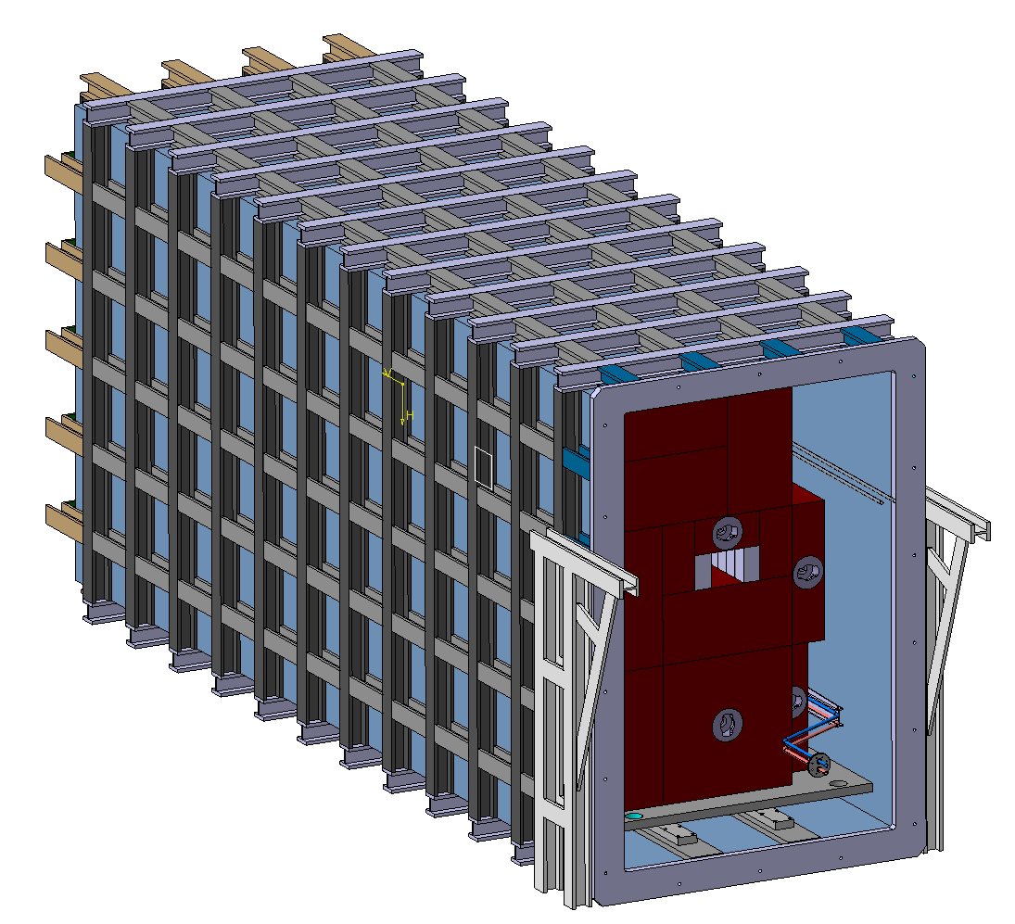
Vessel Guide Rails
Dimension without guide rails: 6410 x 2050 x 2965mm
Dimension with guide rails: 6940 x 2290 x 2965mm
Guide rail dimensions: 1050 x 120 x 2035.5mm
The vessel will be installed without guide rails attached.
(of the 1050mm, only 530mm is protruding from the vessel)

Slide 5
Vacuum Vessel Material
Vessel skin – most likely stainless steel
Vessel structure – currently undecided however a few requirements:
  From an RP perspective:
  No materials with a cobalt content that has a weight percentage of >0.1% - need to bear in mind if choosing a stainless steel.
  Aluminium may be challenging to dispose of as radioactive waste (equally challenging from a construction point of view)
  From SHiP perspective:
    No material which is magnetic.

Slide 6
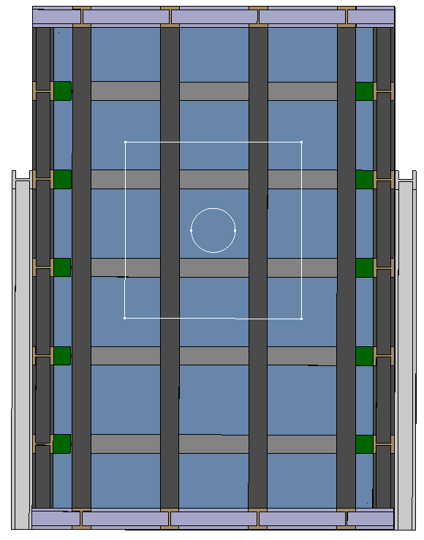
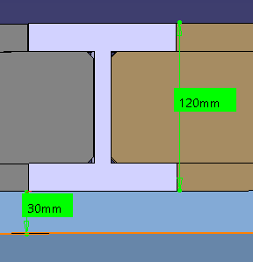
Vessel Structure
Current structure utilises I-Beams 120mm tall paired with 30mm thick skin based upon structural steel for I-Beams
Could change due to new material requirements.
250mm diameter target.
33.5mm clearance from target to lower I beam.
SHiP confirmed Beams behind target doesn’t affect results.

Slide 7
Vacuum Vessel Technical Specification
Deliverables Expected from Design Study: Rough Timeline:
Design report
Prototype recommendations
3D models
2D drawings with detailed explanation
Detailed calculations including structural loads
Assembly and installation recommendations
Factory Acceptance Test recommendations
Cleaning methods required
Inspection procedure requirements
Event | Time to Complete
Definition of Requirements | 2 Months
*Preliminary Design | 4 Months
*Preliminary Calculations | 2 Months
Prototype Production | 6 Months
Prototype Testing | 2 Months
Technical Specification of Final Vessel | 3 Months
Contact Contractor | 2 Months
Detailed Design and Analysis | 6 months
Review of Design | 1 Month
Vessel Production | 6 Months
Factory Acceptance Tests | 1 Month
Delivery of FAT report and CERN acceptance | 1 Month
Authorisation to deliver vessel | 2 Weeks
Delivery of vessel | 3 Weeks
Installation of vessel | 2 Weeks
Conduct testing | 3 Months
Analyse Results | 1 Month
Prototype
Full Vacuum Vessel
* Run in parallel
~3.5 years total

Slide 8
Prototype Tests
Part of the prototype will be required to conduct bellows testing, foreseen tests to be:
Installation of the bellows to the vessel door
Flexibility of the bellows integrating with the connecting coolant pipes
Radiation exposure
Installation and removal of bellow if the event of a radiation leak within the vessel

Slide 9

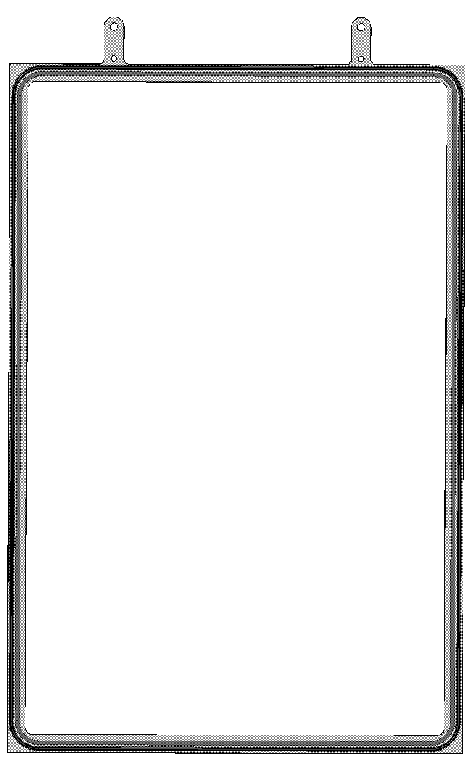
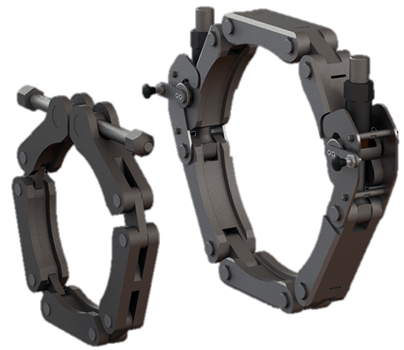
Discussion with Technetics concerning:
Seals for bellows within vacuum vessel door
Seal for connection of door to vessel
Quick disconnect system onwards from helium pipes leaving the bellows out of the vacuum vessel door
Possibility to produce and test the prototype for us

Slide 10
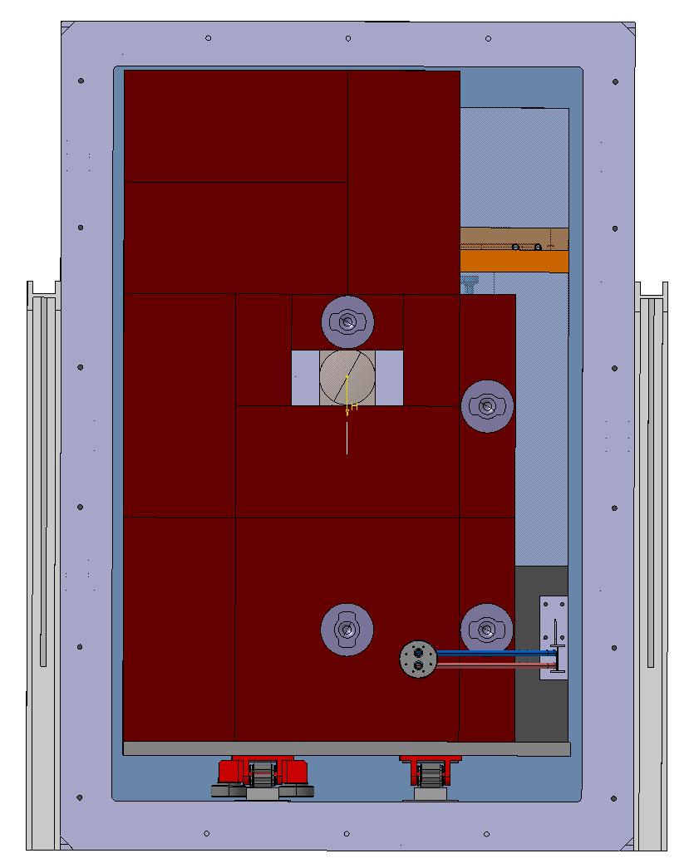
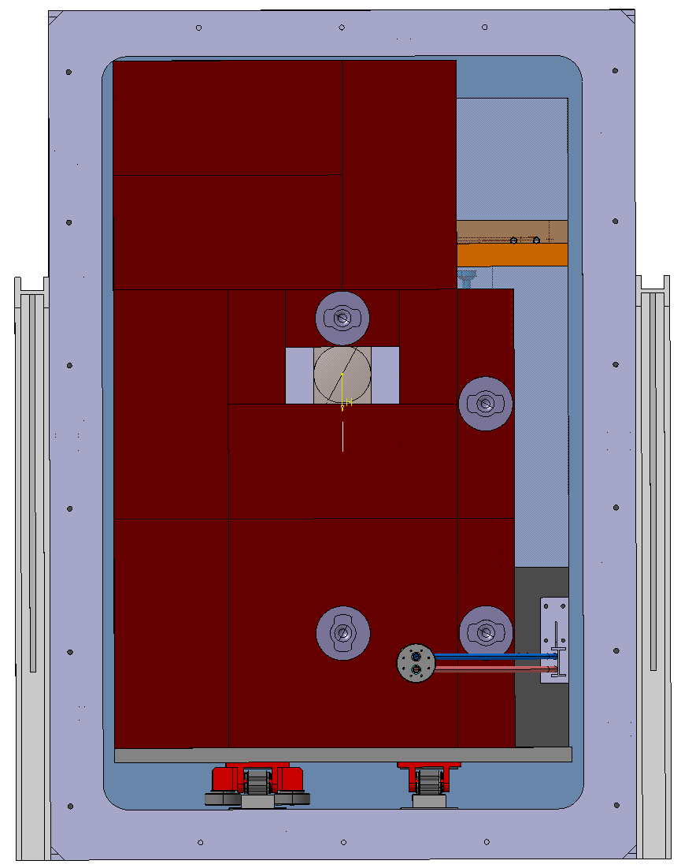
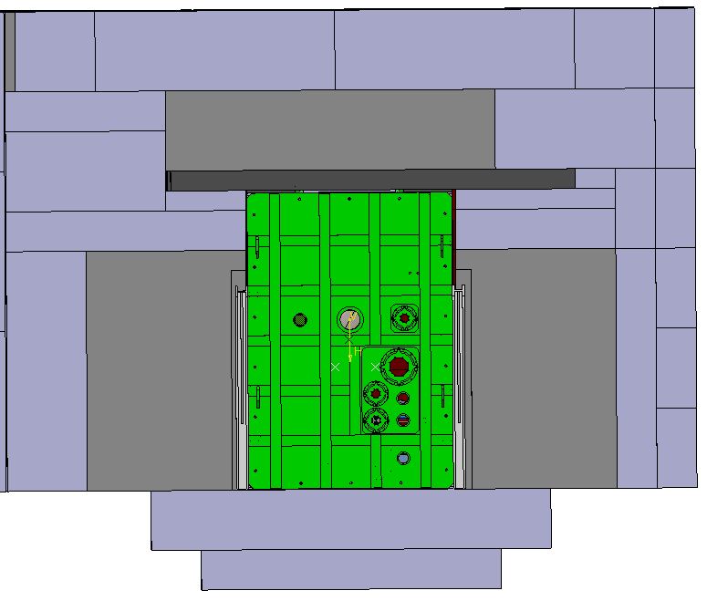
Inputs Required - RP
Assessment of if a pool needs to be built into the ground beneath vacuum vessel and filled with shielding.
20mm Radius Edge Fillet
90mm Radius Edge Fillet
Evaluate what radius/chamfer angle can we have on the vessel door which still allows for enough shielding within the vessel.

Slide 11
Inputs Required – Surveying Team
Potential for ground in TCC8 to be uneven,
problems this could cause:
4.
Potential Problems | Potential Mitigation
Target misaligned with beam line. | Installing a pool within the floor could also aid in levelling the floor.
Shielding blocks not fitting correctly around the vessel due to their standard sizes. | Adjust the thickness of the vessel skin and structure to make the top of the vessel compatible with a certain height of shielding blocks.
Vacuum Vessel
1.
2.
3.
1. | Floor is uneven
2. | Vessel sits on a slope
3. | Shielding installed level
4. | Shielding clashes with vessel
Need to assess the current floor level and if vessel skin thickness would need to be adjusted/floor levelled.

Slide 12
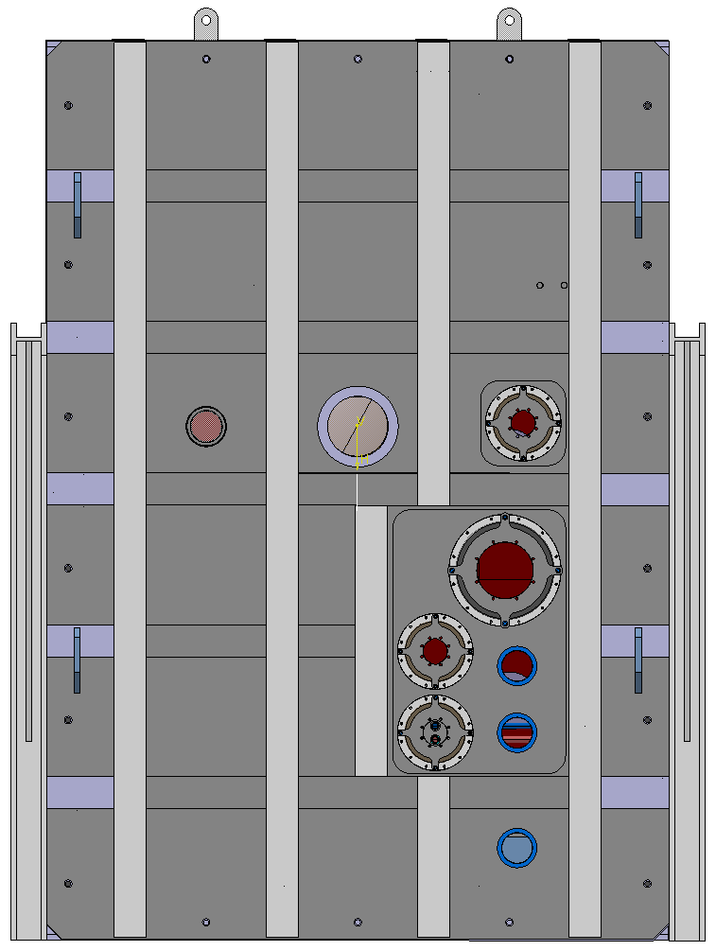
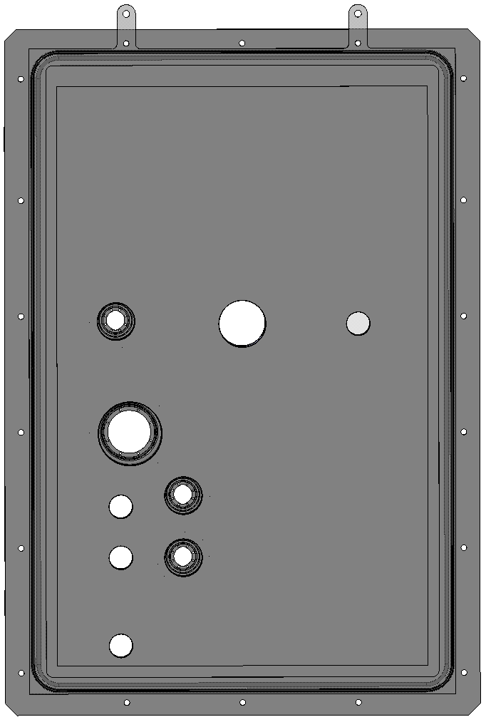
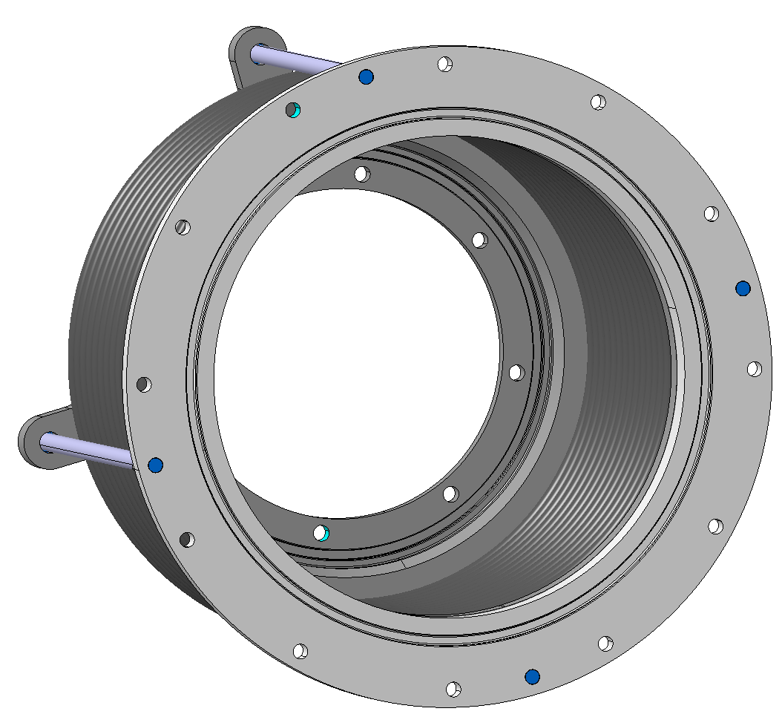
Inputs Required - Robotics
Best method for installing vessel door onto vessel – if a special screw is needed
Method for replacing the gaskets in the bellows and in the vessel door if an unexpected leak occurs within the vessel

